Slide 1
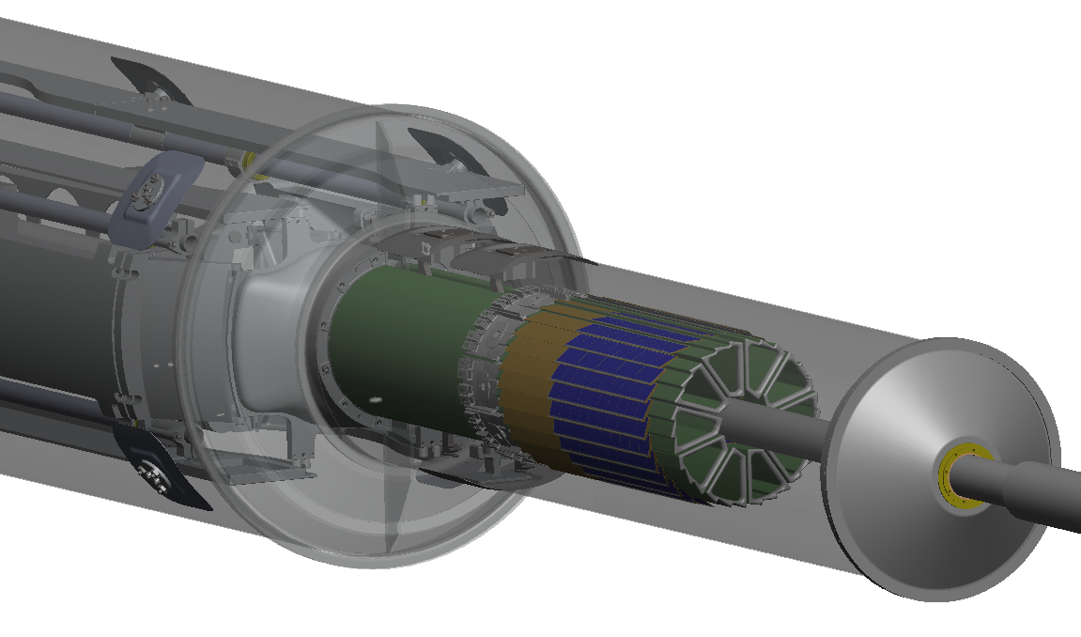
The STAR PXL read-out system
LBNL
Leo Greiner, Eric Anderssen,
Thorsten Stezelberger, Joe Silber, Xiangming Sun, Michal Szelezniak, Chinh Vu,
Howard Wieman
UTA
Jerry Hoffman, Jo Schambach
IPHC Strasburg
Marc Winter CMOS group

Slide 2
Talk Outline
Detector description and basic units
RDO constraints and requirements
Hardware architecture of RDO system
Integrated structure of system with testing needs
Firmware design
Prototyping and system testing
Production system and status
Summary

Slide 3
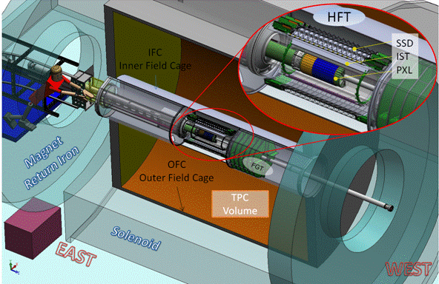
PXL in Inner Detector Upgrades

Slide 4
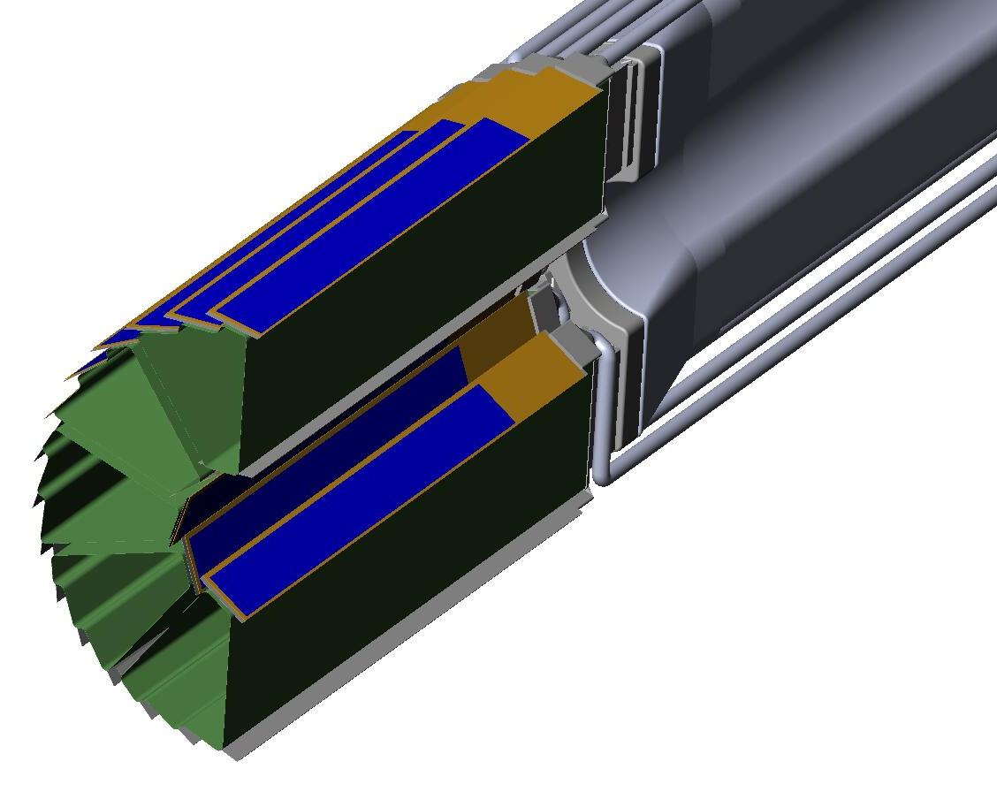
PXL Detector Mechanical Design
Mechanical support with kinematic mounts (insertion side)
carbon fiber sector tubes (~ 200µm thick)
Insertion from one side
2 layers
5 sectors / half (10 sectors total)
4 ladders/sector
Ladder with 10 MAPS sensors (~ 2×2 cm each)
Aluminum conductor Ladder Flex Cable
20 cm

Slide 5
RDO System Considerations
RDO is driven by several considerations
Sensor output – we have some control. RDO places some requirements on the sensor design. Pattern output registers for Xilinx IOdelay, differential outputs, production testability, etc.
STAR DAQ, Trigger, slow controls, etc. – we have less control.
Physical layout of the detector in STAR.
RDO system is an evolution based on final needs, sensor development plan and testing needs.

Slide 6
PXL RDO System Requirements
Interface to the sensors for readout and control. (160 MHz LVDS data, JTAG control, Clock, START, Temp)
Triggered detector system fitting into existing STAR infrastructure (Trigger, DAQ, etc.)
Deliver full frame events to STAR DAQ for event building at approximately the same rate as the TPC (1 kHz for DAQ1000) using the ALICE and now STAR standard DDL fiber interface.
Have live time characteristics such that the Pixel detector is live whenever the TPC is live. (PXL adds ≤ 5% additional dead time)
Reduce the total data rate of the detector to a manageable level (< TPC rate of ~1MB / event).
Reliable, cost effective, etc.
Provide additional functionality for sensor testing including production probe testing (ADCs, USB, SRAM for frame mode data taking)

Slide 7
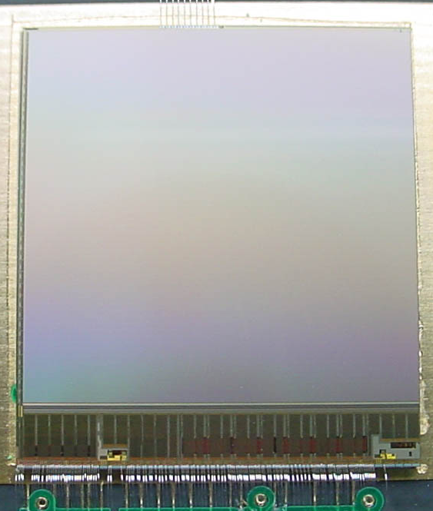
Physical Constraints
Magnetic field + high rad
Main RDO
board
sensors
≤ 8m
Ladder cable
STAR DAQ
RDO PC
DDL Fiber optic
Connection ~50 m
Built events
To HLT and
storage

Slide 8
Sensor generation and RDO attributes
3 generation program with highly coupled sensor and readout development
Complementary detector readout
analog
signals
ADC
digital
CDS
digital signals
Pixel
Sensors
Data
sparsification
readout
to DAQ
CDS
analog
Disc.
1
MimoSTAR sensors 4 ms integration time
2
Phase-1 sensors 640 μs integration time
Production
Readout
3
PXL production sensors (Ultimate) < 200 μs integration time
Sensor and RDO Development Path
Notes:
Start with individual components and put more functionality on the sensor

Slide 9
System Constraints
We need FPGA processing to do zero suppression (Phase-2) and event building. This necessitates moving the processing out of the high radiation area. (SEU)
The constraint of locating the event fast pre-processing hardware ~8m from the sensors (in a lower radiation area) requires a driver/mass termination board located between the sensors and the processing hardware. This is required for mechanical and signal integrity reasons.
This provides additional benefit that the main part of the electronics is in an area that is serviceable during a cave access.
This leads to a 3 main component architecture.

Slide 10
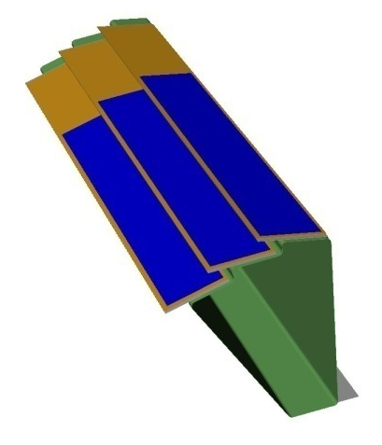
PXL Detector Basic Unit (RDO)
6 m (24 AWG TP)
2 m (42 AWG TP)
Mass Termination Board + latch-up protected power daughter-card
Clk, config, data
Clk, config, data, power
RDO motherboard
w/ Xilinx FPGA
100 m (fiber optic)
RDO PC with DDL link to RDO board
PXL built events
Highly parallel system
4 ladders per sector
1 Mass Termination Board (MTB) per sector
1 sector per RDO board
10 RDO boards in the PXL system
Notes:
The readout design of the PXL system is set mostly be the sensor needs and STAR data acquisition and trigger requirements. Integrating this we come up with the following design.
It is even more parallel than shown in the diagram in that all of the ladder readouts are also a copy of the same firmware and we use 4 copies per sector

Slide 11
PXL RDO Architecture (1 sector)
Ladder x 4
RDO board x 1
fiber
DAQ
RDO PCs
FPGA
SIU
ADC
Unified Development Platform
LU prot. power
USB
Sensor testing
Probe testing
SRAM
i/o
Black – cfg, ctl, clk. path
Blue – data path
Red – power / gnd path
Green – testing path
MTB x 1
Power
Supplies
Control
PCs
Trigger

Slide 12
Functional Data Path – Phase-1
After power-on and configuration, all sensors are run continuously and data is streamed through the RDO path to the RDO motherboards
Highly Parallel FPGA based RDO system
40 sensor outputs/ladder
1 sector / RDO board
Each received trigger enables an event buffer for one frame.
The system is dead-time free up to the hardware buffering limit.
160 independent sensor data chains

Slide 13
Functional Data Path – PXL Sensor
After power-on and configuration, all sensors are run continuously and data is streamed through the RDO path to the RDO motherboards
Highly Parallel FPGA based RDO system
20 sensor outputs/ladder
1 sector / RDO board
Same hardware with reconfigured firmware
Each received trigger enables an event buffer for one frame. Triggered event boundaries are determined by data order.

Slide 14
Firmware Architecture Modules
Phase-2 and Ultimate sensors + testing
Temperature
analog signal
LVDS signal
JTAG
I2C ADC
ADC
IO delay
System control
Frame
fifo
SRAM
fifo
Event
machine
info
machine
DDL
USB
DAQ
Status monitor

Slide 15
Simple Data Rates
PXL System (Production Sensor)
Item | Number
Bits/address | 20
Integration time (µs) | 200
Luminosity (cm⁻²s⁻¹) | 8 × 10²⁷
Hits / frame on Inner sensors (r=2.5 cm) | 246
Hits / frame on Outer sensors (r=8.0 cm) | 24
Final sensors (Inner ladders) | 100
Final sensors (Outer ladders) | 300
Event format overhead | TBD
Average Pixels / Cluster | 2.5
Average Trigger rate | 1 kHz
Data rate to storage = 199 MB/sec (1kHz trigger)
199 kB / event
Notes:
Note: Data rates for hit data only for Au-Au central collisions including peripheral collision electrons and pileup. Sensor noise is not included.
Backup?

Slide 16
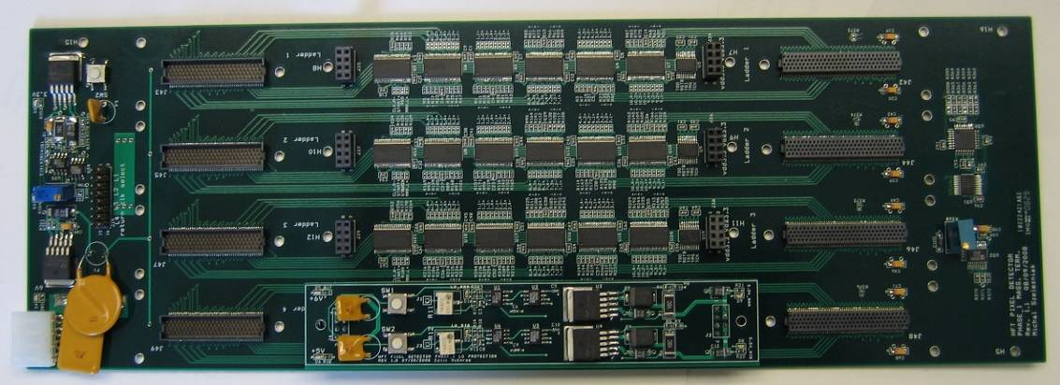
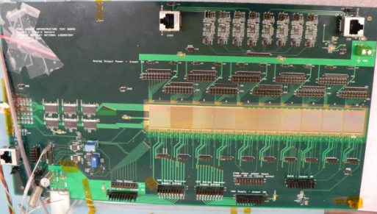
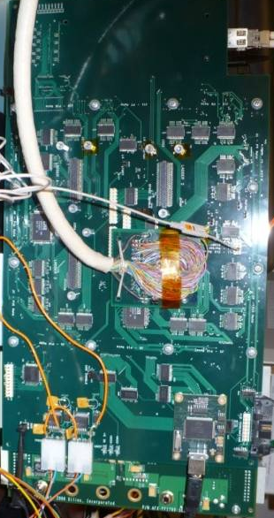
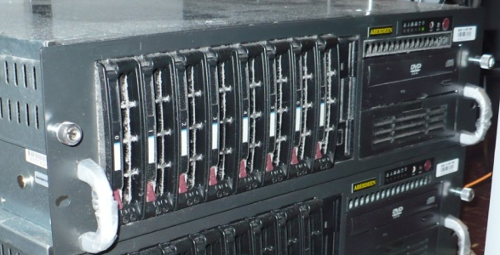
Prototype Ladder Test with Prototype RDO
Architecture verified with LVDS data path test using prototype RDO and fan out based ladder equivalent. Measured BER ~ 10⁻¹⁴
6 m (24 AWG TP)
Clk, config, data
2 m (42 AWG TP)
Clk, cfg, data, pwr
Mass Termination Board + latch-up protected power daughter-card
Infrastructure Test Board
100 m (fiber optic)
PXL built events
RDO PC with DDL link to RDO board
RDO motherboard
Prototype w/ Xilinx
Virtex-5 FPGA
Equivalent to a 1 ladder full system test
Notes:
The readout design of the PXL system is set mostly be the sensor needs and STAR data acquisition and trigger requirements. Integrating this we come up with the following design.
It is even more parallel than shown in the diagram in that all of the ladder readouts are also a copy of the same firmware and we use 4 copies per sector
16

Slide 17
System Testing Results
Data path and architecture are validated.
Interfaces to STAR slow controls, Trigger and DAQ have been tested in a beam test at STAR.
First prototypes have been used to read out ladder prototypes and characterize the operating envelope of sensors in this configuration (more on this in Michal Szelezniak’s talk). The working system is also used for individual sensor testing and characterization, Beam tests, LU and SEU testing, etc.
Prototype hardware, firmware and software are all working well.
This allows for the design of the production system.

Slide 18
Production System Design
We will use the 9U VME physical standard for RDO motherboards. (Not the electrical standard)
1 standard VME crate with P1 backplane for STAR TCD distribution.
Data from sectors arrives via cables plugging into the back of the RDO boards in the P2/P3 locations.
System consists of:
10 double wide 9U VME RDO boards
1 single wide 6U VME TCD board
SIU
SIU
SIU
SIU
SIU
SIU
SIU
SIU
SIU
SIU
STAR TCD
Daughter Card
Daughter Card
Daughter Card
Daughter Card
Daughter Card
Daughter Card
Daughter Card
Daughter Card
Daughter Card
Daughter Card
356 M pixel readout in a single 9U VME crate
USB
USB
USB
USB
USB
USB
USB
USB
USB
USB
JTAG
JTAG
JTAG
JTAG
JTAG
JTAG
JTAG
JTAG
JTAG
JTAG
Standard 21 slot 9U VME crate

Slide 19
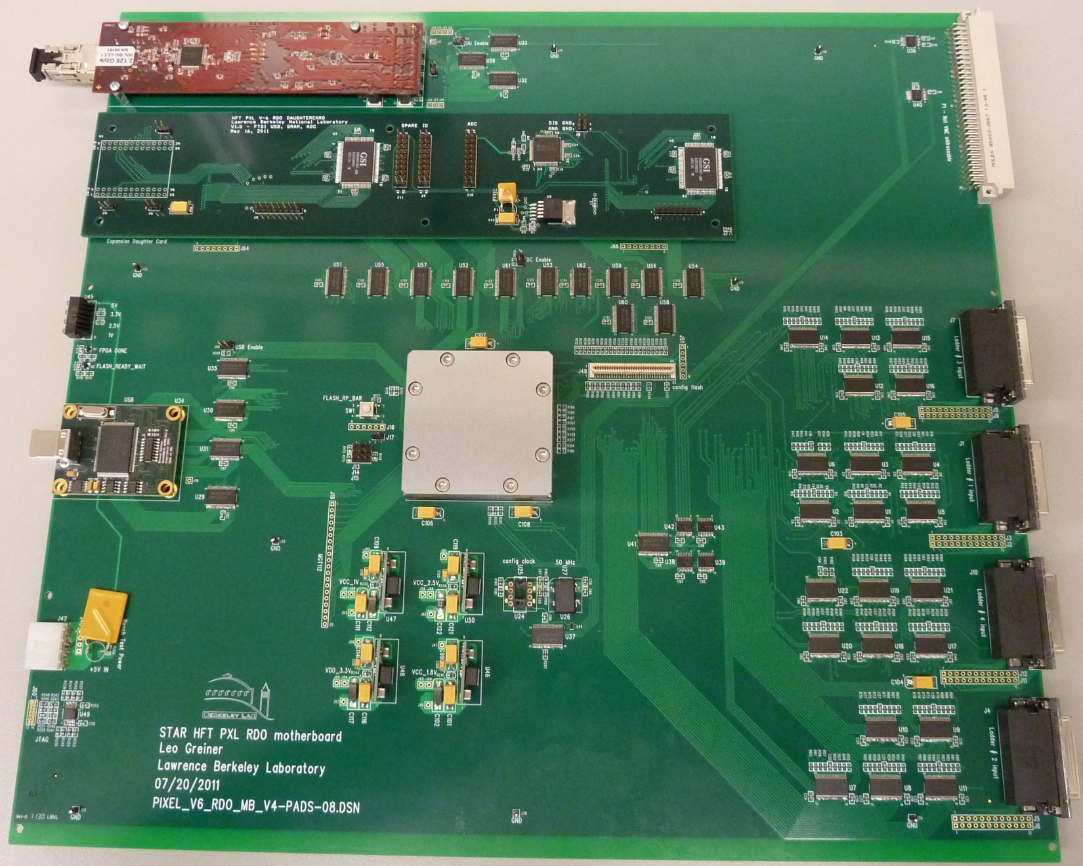
Production Prototype RDO board
SIU
VME P1
Daughter
Card
USB
Ladder
Data
Connectors
(VHDCI)
JTAG
Xilinx Virtex-6 FPGA

Slide 20
Production Prototypes MTB, Cable
The prototype MTB works well and will undergo a re-spin to fit into the existing space in the insertion tube.
The TCD interface 6U VME board has been designed and is currently being fabricated.
The ladder cable is currently being designed based on information gained from the ITB testing. This should be complete in the next few months.
All components used in the MTB or ladder have been tested for SEU and Latch-up.

Slide 21
PXL RDO Summary
The RDO for the STAR HFT PXL system is the culmination 3 generations of sensors and RDO over many years of development.
We have a design that meets the requirements and has been prototyped successfully.
Our design is integrated such that we will use production RDO boards with daughter cards to perform all sensor, probe testing and construction production testing.
The production prototypes are designed, mostly constructed and under test.
The RDO for the full PXL detector will fit into 1 9U VME crate.
We will install a prototype detector using the pre-production RDO in late 2012.

Slide 22
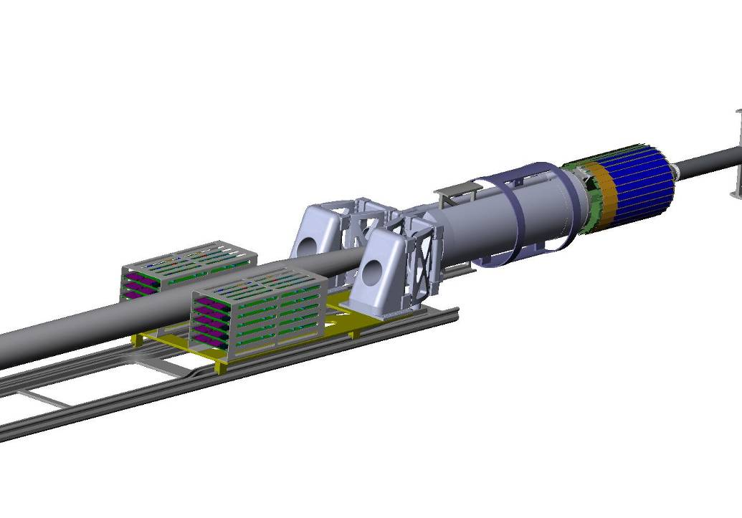
RDO System Design – Physical Layout
Sensors / Ladders / Sectors
(interaction point)
1-2 m
Low mass twisted pair
LU Protected Regulators,
Mass cable termination
Platform
30 m
Power
Supplies
6 m - twisted pair
30 m
RDO Boards
100 m - Fiber optic
Control
PCs
30 m
DAQ Room
DAQ PCs
(Low Rad Area)

Slide 23
PXL Detector Basic Unit (RDO)
6 m (24 AWG TP)
2 m (42 AWG TP)
Clk, config, data
Clk, config, data, power
Mass Termination Board + latch-up protected power daughter-card
100 m (fiber optic)
PXL built events
RDO PC with DDL link to RDO board
Highly parallel system
4 ladders per sector
1 Mass Termination Board (MTB) per sector
1 sector per RDO board
10 RDO boards in the PXL system
RDO motherboard
w/ Xilinx FPGA
Notes:
The readout design of the PXL system is set mostly be the sensor needs and STAR data acquisition and trigger requirements. Integrating this we come up with the following design.
It is even more parallel than shown in the diagram in that all of the ladder readouts are also a copy of the same firmware and we use 4 copies per sector

Slide 24
PXL RDO is 1 x 6U and 10 x 9U RDO board layout
Production RDO Board Concept
TCD
SIU
VME P1
Expansion
board
VME P1
TCD 6U
VME Board
VHDCI X 4
JTAG
x10
USB

