Slide 1
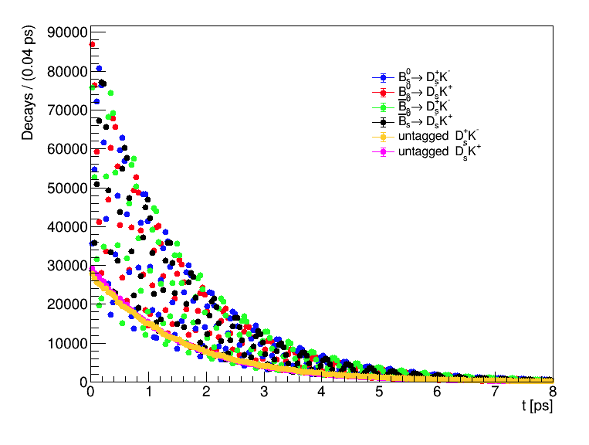
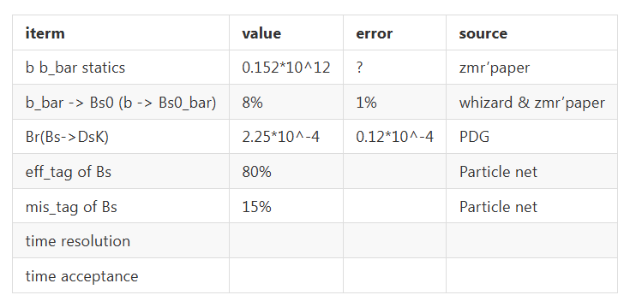
Bs2DsK toyMC

Slide 2
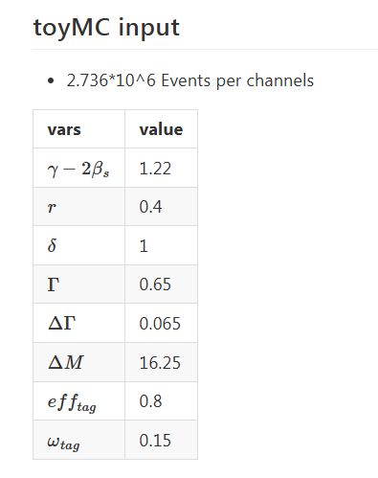
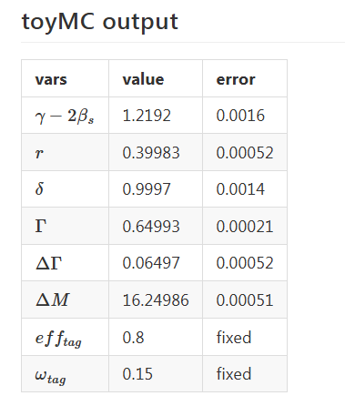
Bs2DsK toyMC
Without detector effects, the uncertainty of γ−2βs is estimated to be 0.0016 (i.e. 0.092°) .

Slide 3
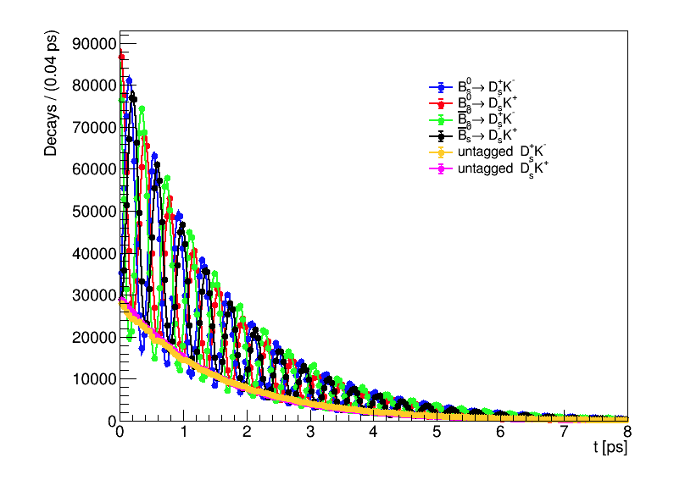
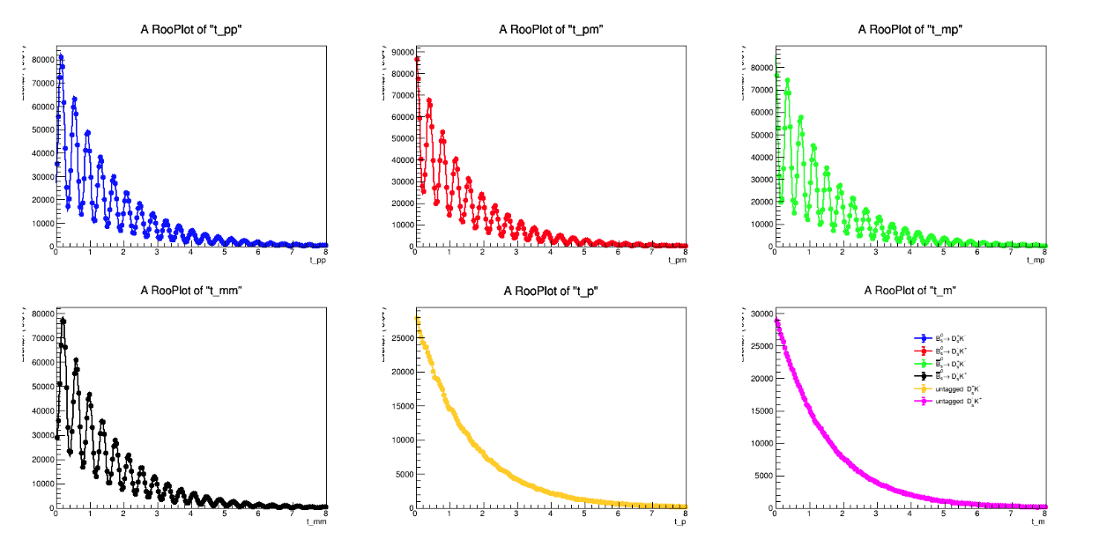
Bs2DsK toyMC

Slide 4
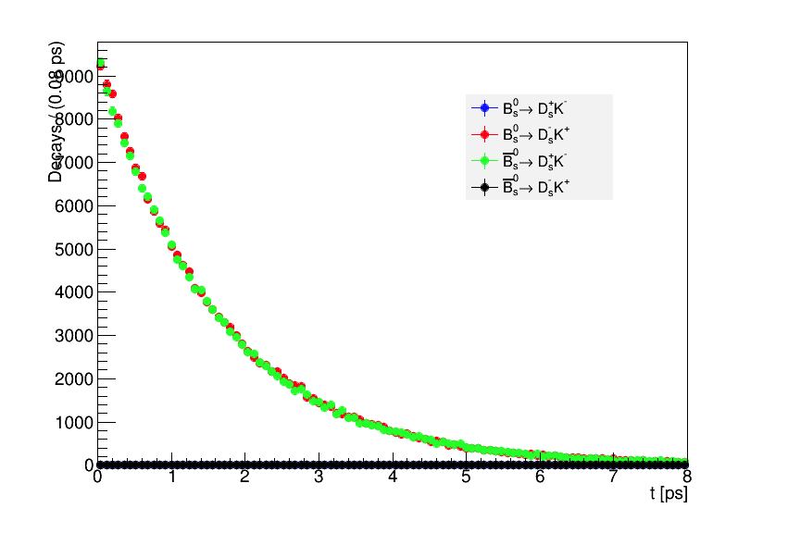
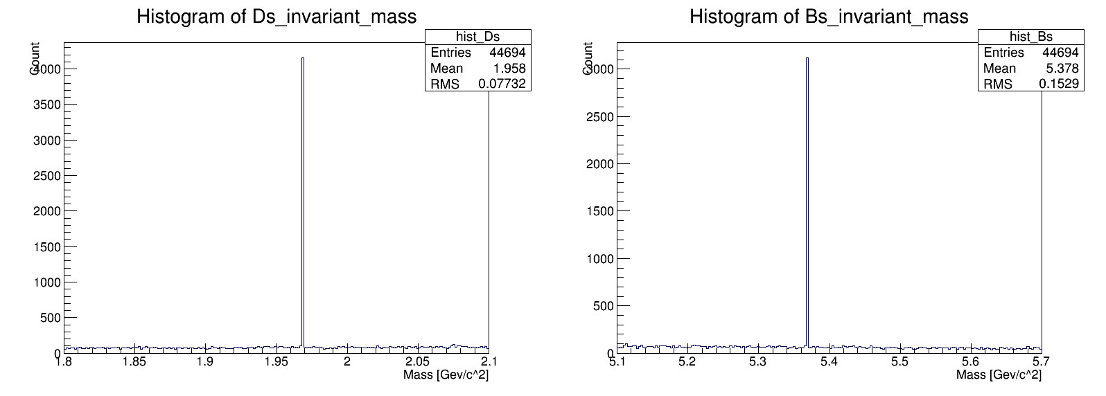
Bs2DsK Reco at Truth Level
/afs/ihep.ac.cn/users/m/mzhao/workdir/BsDsK/GenBsDsK/data
const double BsMass = 5.3693;
const double DsMass = 1.9685;
const double BsMass_tole = BsMass*0.2;
const double DsMass_tole = DsMass*0.2;

Slide 5
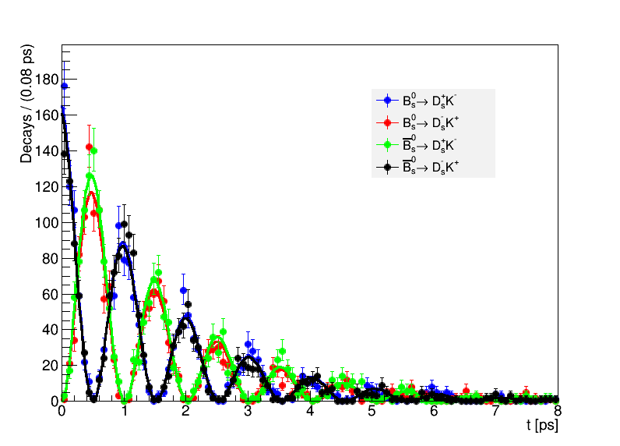
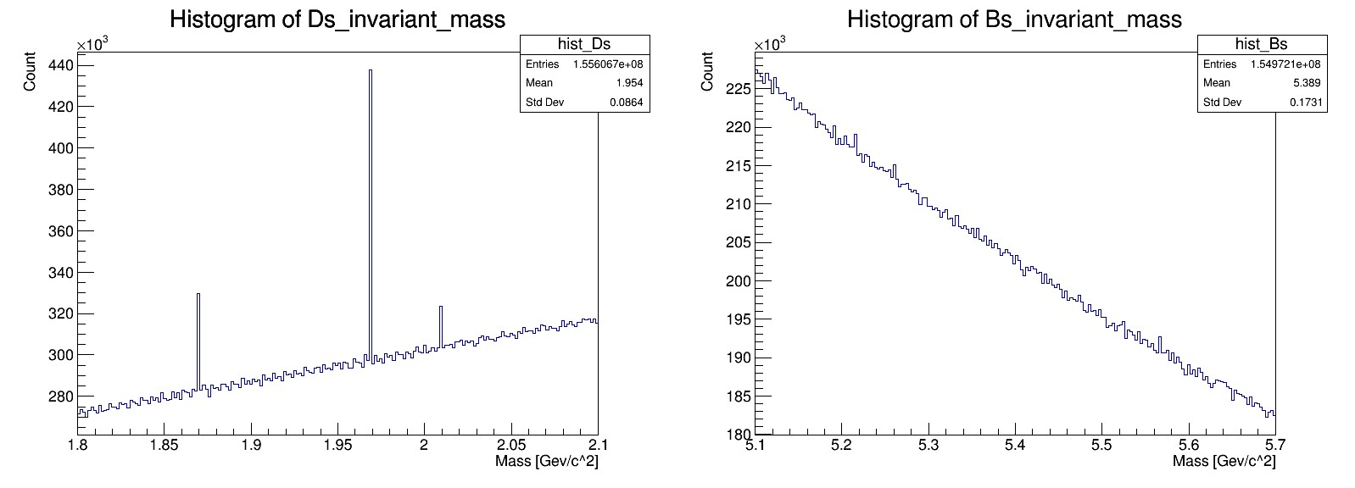
Bs2DsK Reco at Truth Level
/cefs/data/stdhep/CEPC91/2fermions/4ML_GigaZ_2/bb
const double BsMass = 5.3693;
const double DsMass = 1.9685;
const double BsMass_tole = BsMass*0.2;
const double DsMass_tole = DsMass*0.2;

Slide 6
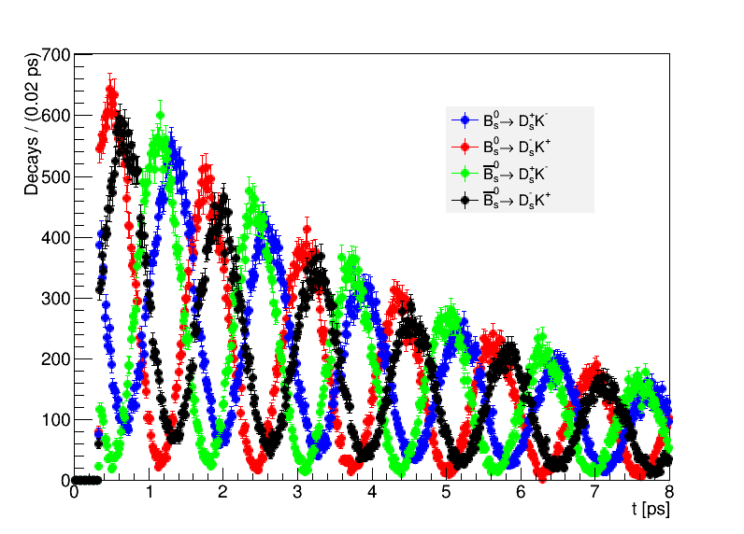
Bs2DsK decay time DIY
/afs/ihep.ac.cn/users/m/mzhao/workdir/BsDsK/ToyBsDsK/data

Slide 7
Back Up

Slide 8
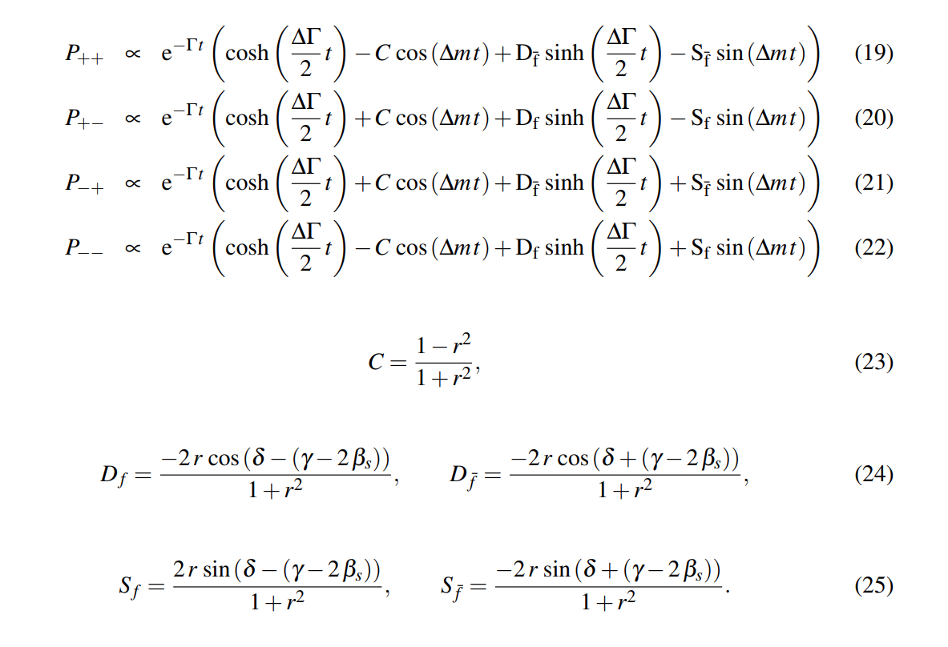
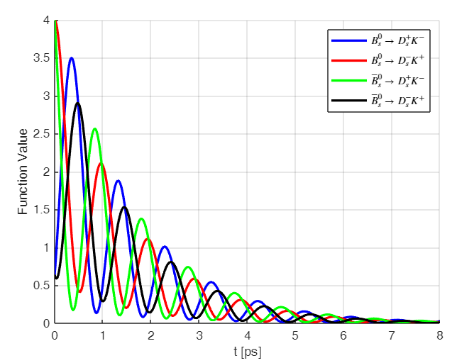
Bs2DsK

Slide 9
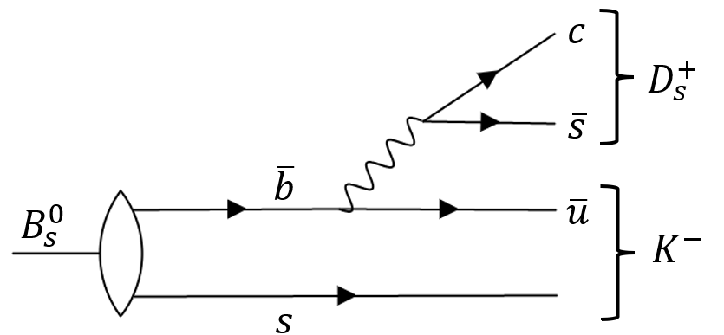
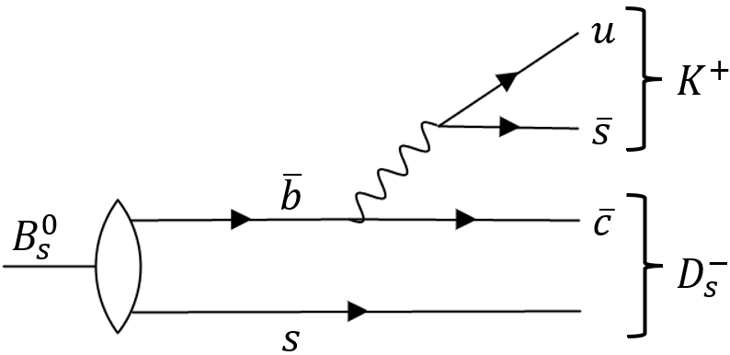
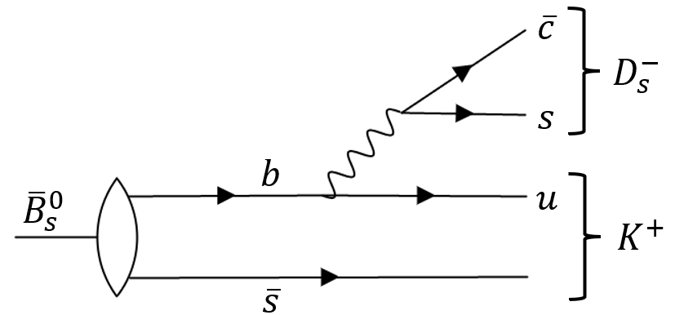
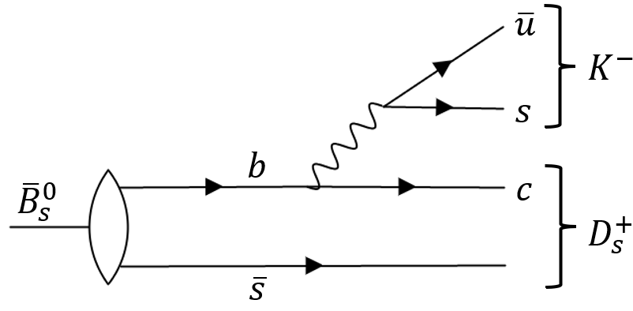
Feynman diagram of Bs2DsK
(2)
(1)
(3)
(4)

