Slide 1
CERN update on measurements
D. Butti, S. Mazzoni
26/07/2024

Slide 2

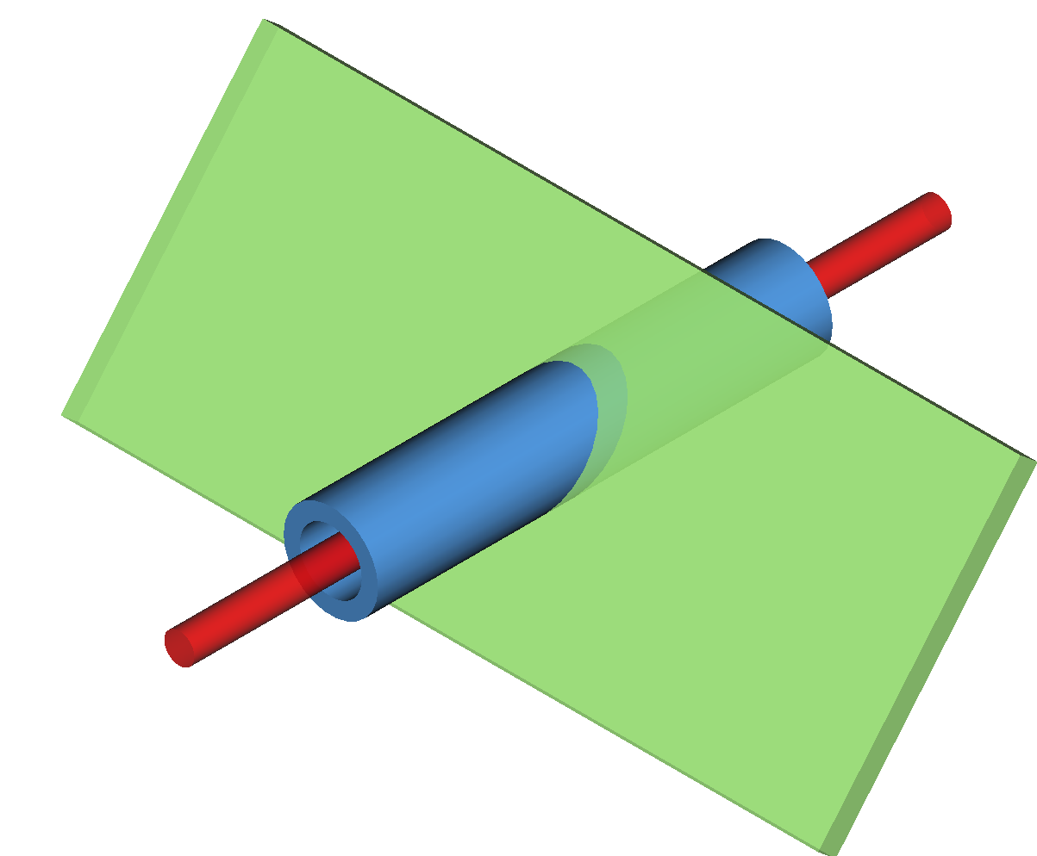

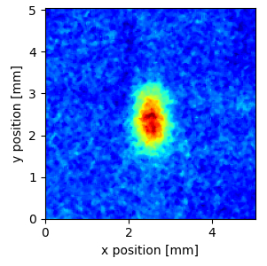


BGC as beam size monitor
Because of the gas jet finite thickness,
the BGC output is different in the two directions
Horizontal projection is unaffected
used as indicator of data quality
Vertical projection includes jet distribution
retrieving accurate beam size is more challenging
detector
fluorescence photons
Example of image with 2 min eff. exposure
$$σ_{V}≡σ_{beam}∗σ_{jet}$$
Top view:
horizontal size coincides with the horizontal beam size whereas the vertical needs to be convolved over the jet thickness.
proton beam
gas jet
$$σ_{H}≡σ_{beam}$$

Slide 3
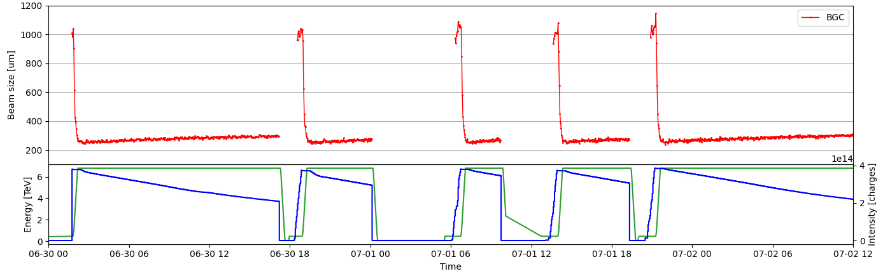
Horizontal measurements over some fills
horizontal size measurement looks qualitatively ok at injection and flat-top
beam size growth resolvable during stable beams (SB)
ramp shows some unexpected behaviour (e.g. spikes at start of ramp)
spikes @ start of ramp

Slide 4

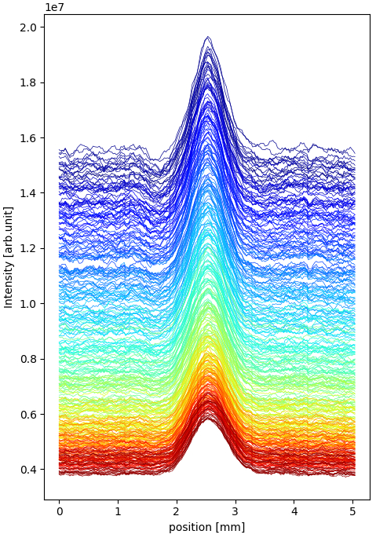
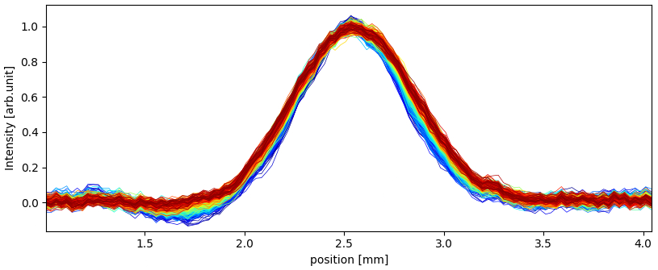
Horizontal measurements of proton beams in SB
0 → time in SB → ~10h
Example of horizontal profiles recorded over a physics fill
peak decrease follows intensity depletion
background decrease follows reduction of losses
(slight) width increase follows emittance growth
Local intensity dip due to photocathode damage, more evident at beginning of SB with higher background
Profile evolution in SB, subtracting constant background and normalizing by fit amplitude
size evolution

Slide 5
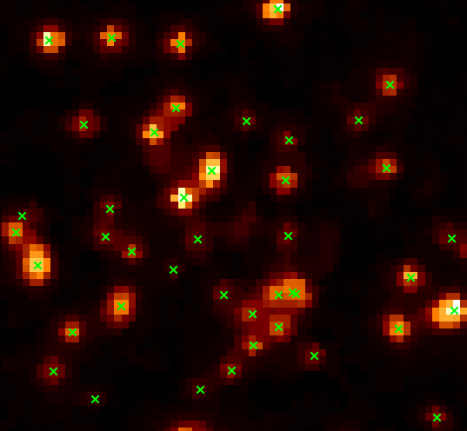
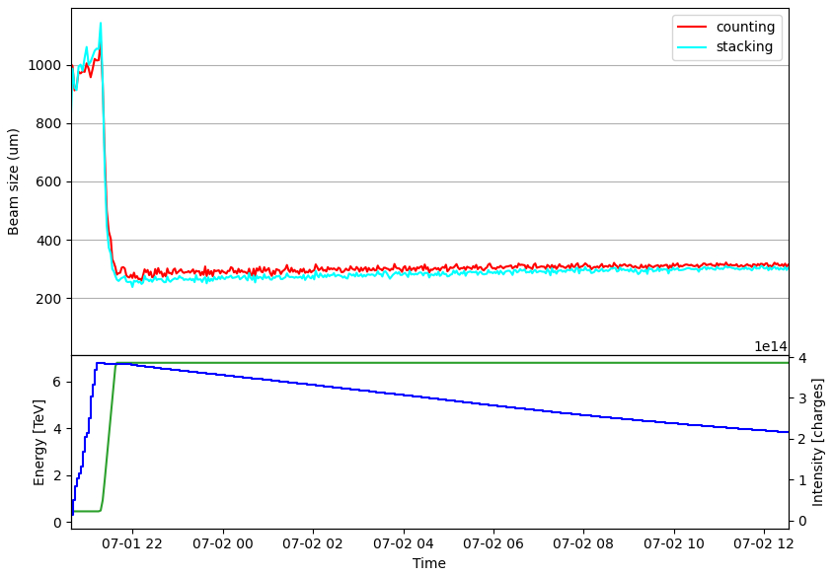
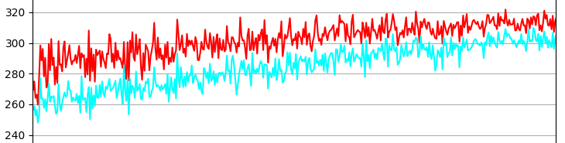


Photon counting vs intensity stacking
0 → time in SB → ~10h
Given the long exposure time required, two possible strategies to create image
photon counting: necessary for fluorescence cross-section measurements and, in principle, less affected by noise
intensity stacking: straightforward implementation but more susceptible to noise
Example of photon detection in a single frame of 50ms exposure
Counting and stacking coincide for large beams
(e.g. at injection energy)
$$Δ\sim 10\%$$
$$Δ\sim 3\%$$
For small beams, counting is systematically larger, and the delta decreases with time at flat-top.
Likely due to a failure of photon counting at high photon density (small beams and beginning of SB with high losses).
frame rate faster than current 20Hz probably needed

Slide 6
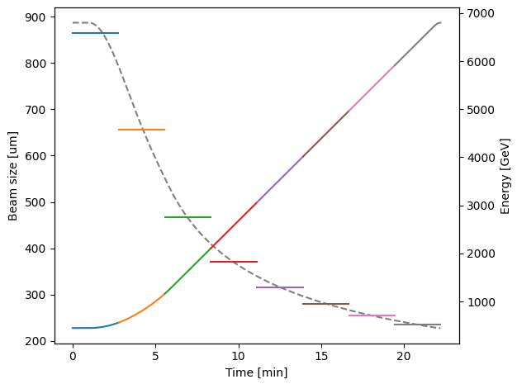
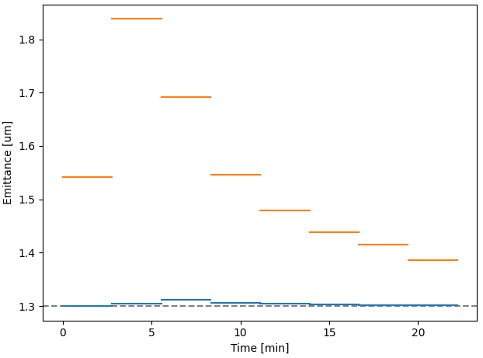
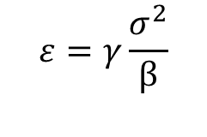
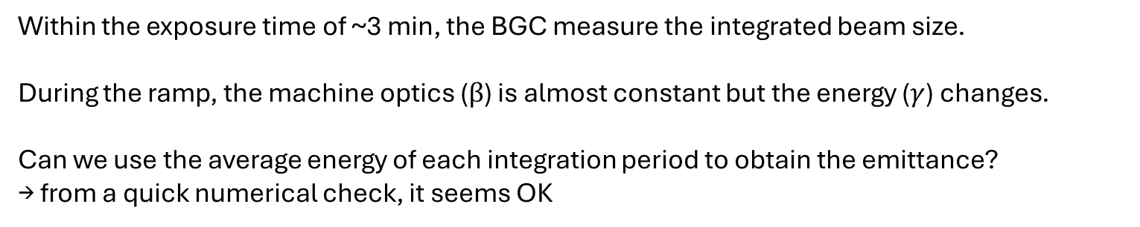
Size and emittance size during ramp
$$ε=γ\frac{σ^{2}}{β}$$
Within the exposure time of ~3 min, the BGC measure the integrated beam size.
During the ramp, the machine optics ($β$) is almost constant but the energy ($γ$) changes.
Can we use the average energy of each integration period to obtain the emittance?
→ from a quick numerical check, it seems OK
Emittance computed using average energy
exposure time
“Raw” emittance computed using energy value at end of exposure

Slide 7
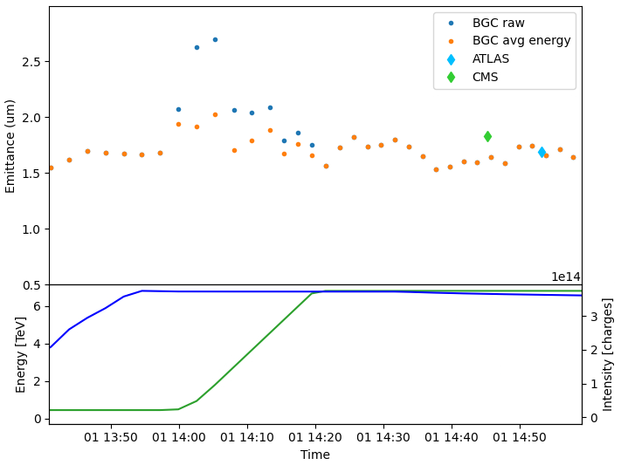
Horizontal emittance during ramp
Using the average energy value on real data, the retrieved emittance during the ramp remains confined within the fluctuation of the BGC measurement
But some jumps still appear at the beginning of the ramp, physical or just a BGC artefact?
RAMP

Slide 8
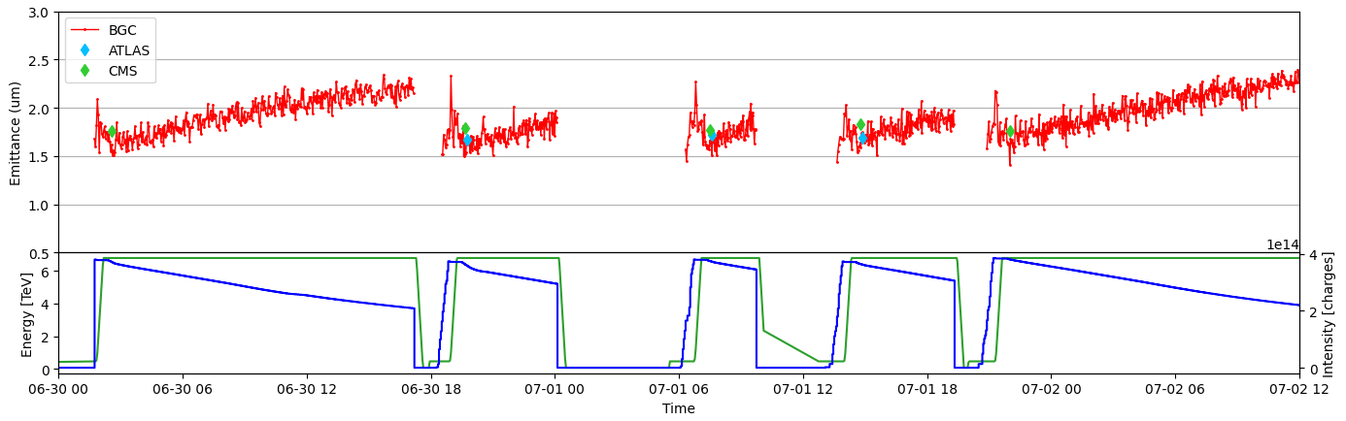
Horizontal emittance over some fills
horizontal emittance is quantitatively ok compared to emittance scans (de facto LHC reference)
emittance growth resolvable during stable beams (SB)
emittance measurement in ramp shows residual spikes. Investigations needed to check if instrumental artefact or physical

Slide 9
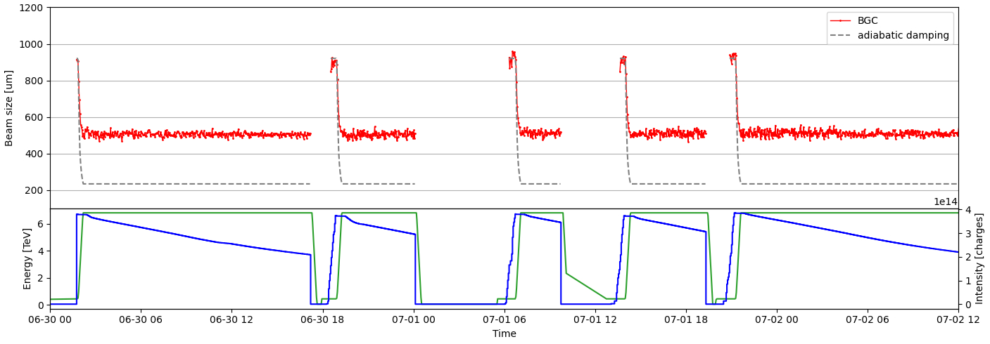
Vertical measurements over some fills
vertical size measurement looks qualitatively ok at injection and start of ramp (no spikes!)
fitted size “saturates” at mid ramp because of jet thickness, with no change detectable

Slide 10
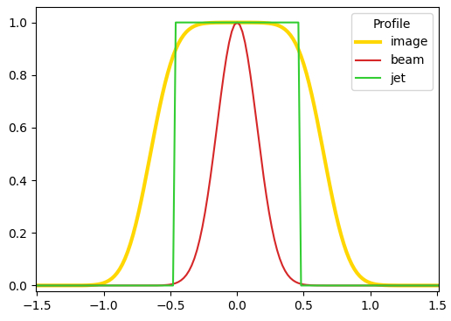
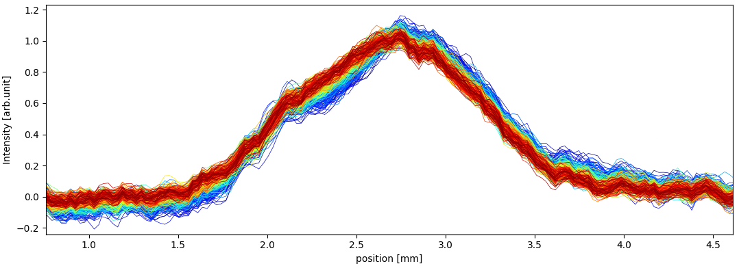
Vertical measurements throughout SB
0 → time in SB → ~10h
Ideally, the vertical profile of the image should have
intensity plateau determined by uniform jet distribution
Gaussian edges determined by beam distribution
the beam size information is only encoded in the edges and a deconvolution should suffice
0 → time in SB → ~10h
In reality, profiles are not as straightforward and no general method to retrieve beam size found so far
Work in progress…
Intensity distortion due to photocathode damage and probably non-uniformity of jet profile

Slide 11
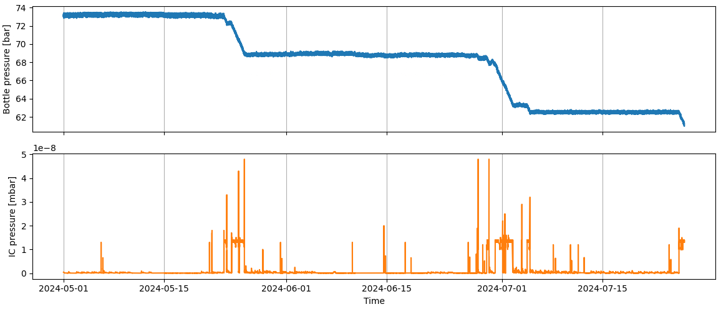
Neon bottle consumption
For reference, as of today 26/07/2024

