Slide 1
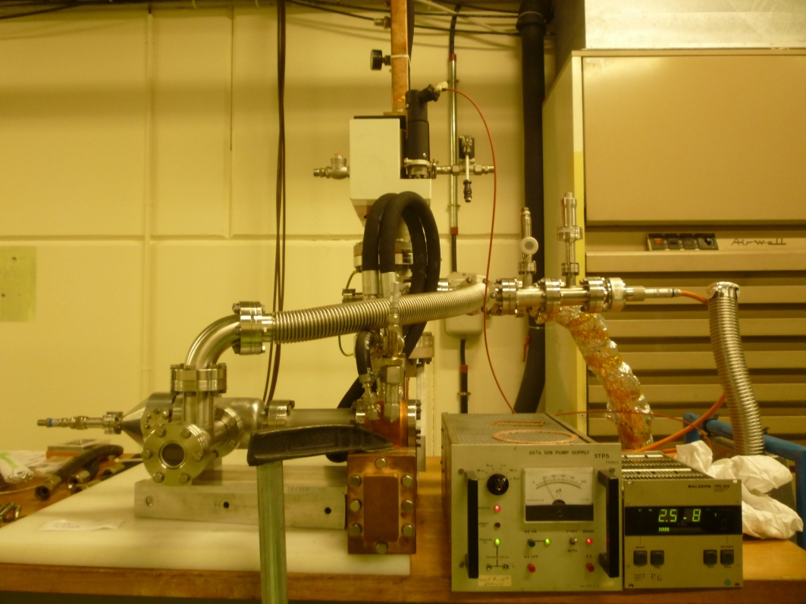
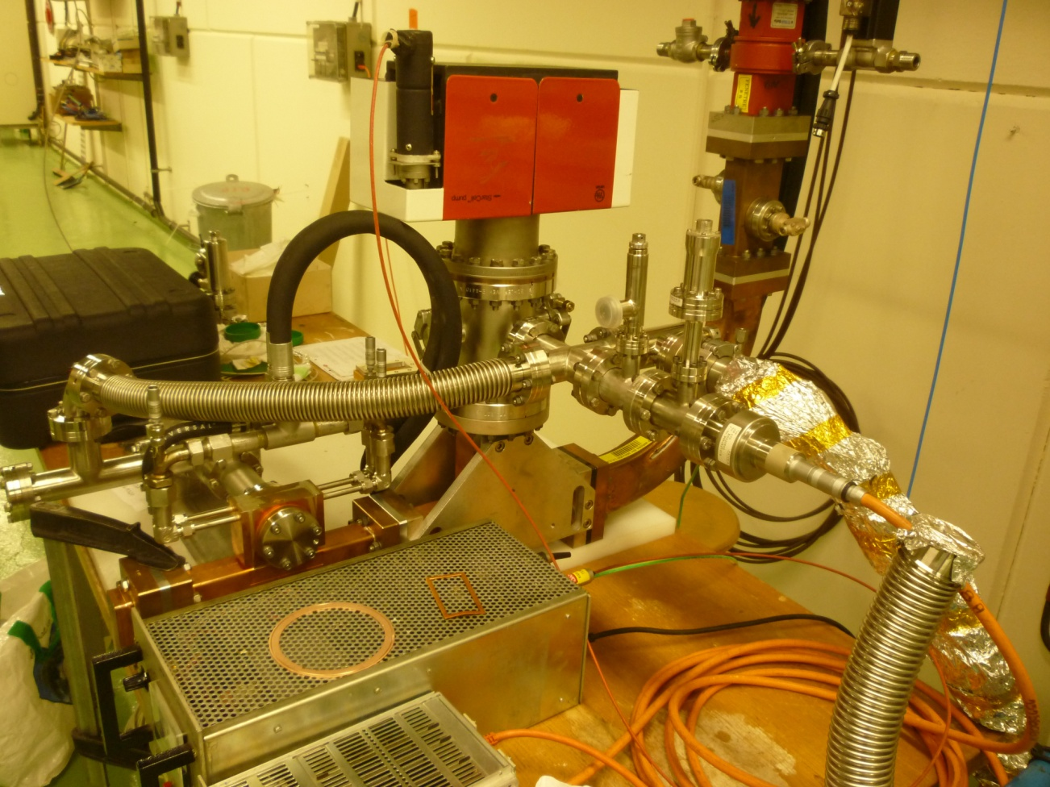
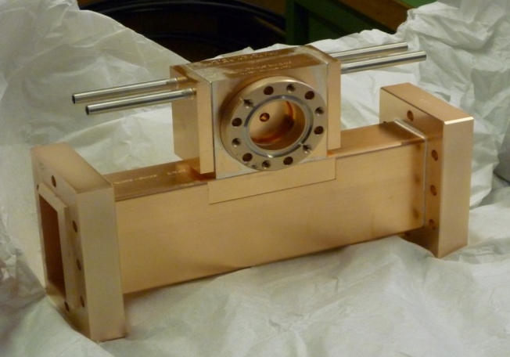
Experiment setup at CTF2 of 3 GHz Single-Cell Cavity
Faraday cup
RF power
Bidirectional coupler
Pumping group
Cavity
Thermistors

Slide 2
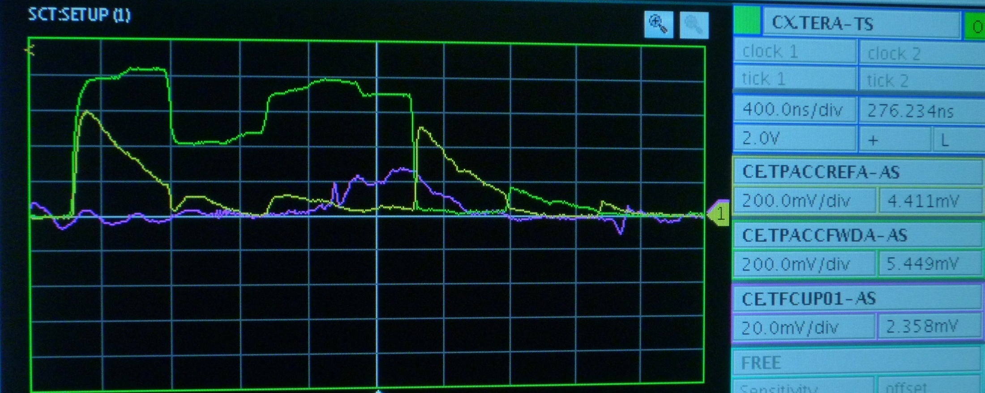
Pulse Shape
Cooling:
Control
We act on PFN voltage.
Interlocks:
on Faraday cup signal (stops RF pulsing) and
On vacuum level (automatically restarts after 15 seconds –time for normal operation vacuum level recovery-).
Notes:
Help to calculate field! Jiaru Shi

Slide 3
Diagnostics & Data Acquisition
- Breakdown definition: reflected power and Faraday cup signal
Phase of reflected is not available yet (but will do soon)*
Cooling:
- Flowmeter reads 5 l/min @ 30°C → designed mass flow
Software for temperature acquisition is debugged and working
HOWEVER we do not expect to detect a temperature increase because:
Average power in cavity is too low ~ 5 W (and cooling system was designed for 350 W and 1 degree inlet-outlet)
Sensor sensitivity: 1 degree
Vacuum:
10-8 mbar during normal operation
* Not so critical as cavity does not detune for so low average power.

Slide 4
History
We
Th
Fr
Sa
Su
Mo
Tu
We
Scope!: increase length of « effective » pulse
Condition for ~1MW pulse of 1 μs @ 5 Hz
Condition for ~1.2 MW pulse of 1 μs @ 5 Hz
Scope!: increase repetition rate to 5 Hz
calibration formulae!
(0.8 MW peak pulse of 0.6 μs @ 0.8 Hz)
Scope!: increase pulse length to 2 μs
power into cavity (hundreds of kW) with 0.6 μs pulse @ 0.8 Hz
Is comparable to what we measured last year?
About 50 MV/m accelerating gradient leads to a BDR of :
(2010) 10^-3 bpp
(2011) 10^-4 bpp
Notes:
(I cannot show plots from software because it took us some tome to understand how software worked) but show plots (conditioning: power and pulse length; breakdown rate) from Monday!

Slide 5
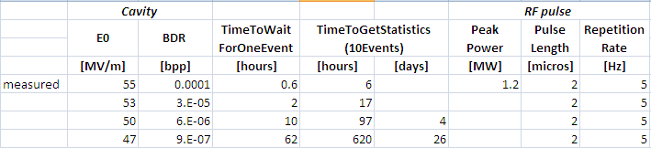
Strategy
How are we conditioning?
- After breakdown event, the power is slightly decreased. If stable operation, power is increased back to the previous value.
Near future:
Give better shape to pulse (if possible)
If cavity is conditioned for highest power level of interest (E0~ 50 MV/m, Es~ 350 MV/m) → BDR measurements start
Scaling law: BDR ~ E^30
1
5
2
4
3
BDR
BDR
or
?
E
E
Notes:
Condition during weekend at desired power level (50 MV/m, we are already quite high)
when BDR is stable (for this we should create plot breakdowns vs time)

