Slide 1
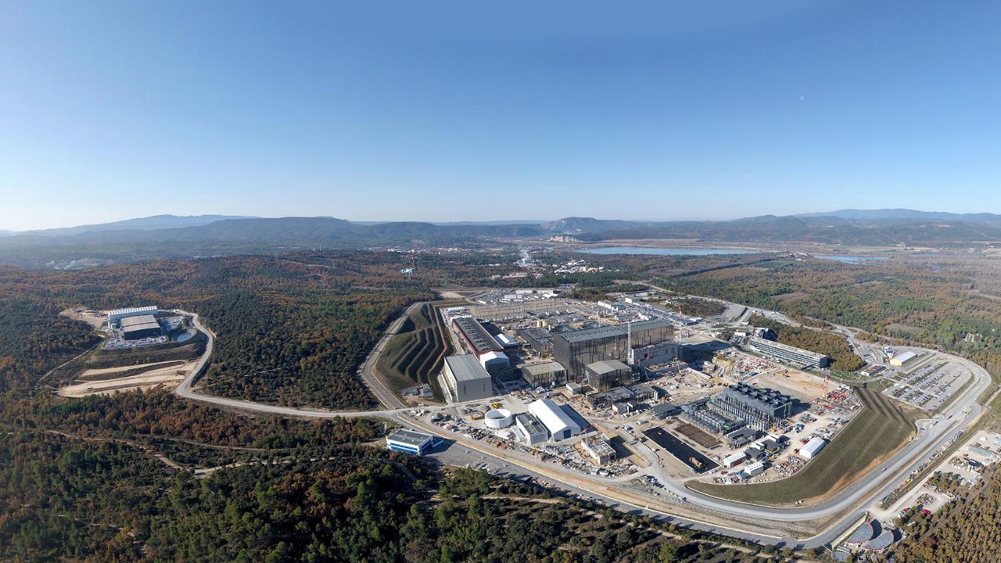
NUCLEAR ENERGY DEVELOPMENTS in ITALY & INTERNATIONAL IMPACTS
Prof. Dr. Eng. Sergio Orlandi

Slide 2
NUCLEAR ENERGY DEVELOPMENTS in ITALY & INTERNATIONAL IMPACTS
Content
Nuclear Energy Scenario – evolution
What has to be finalized to start a new adventure in Nuclear Business
Italian Industrial System capacity in Nuclear Market
International Impact and Italian Industrial System
Conclusion

Slide 3
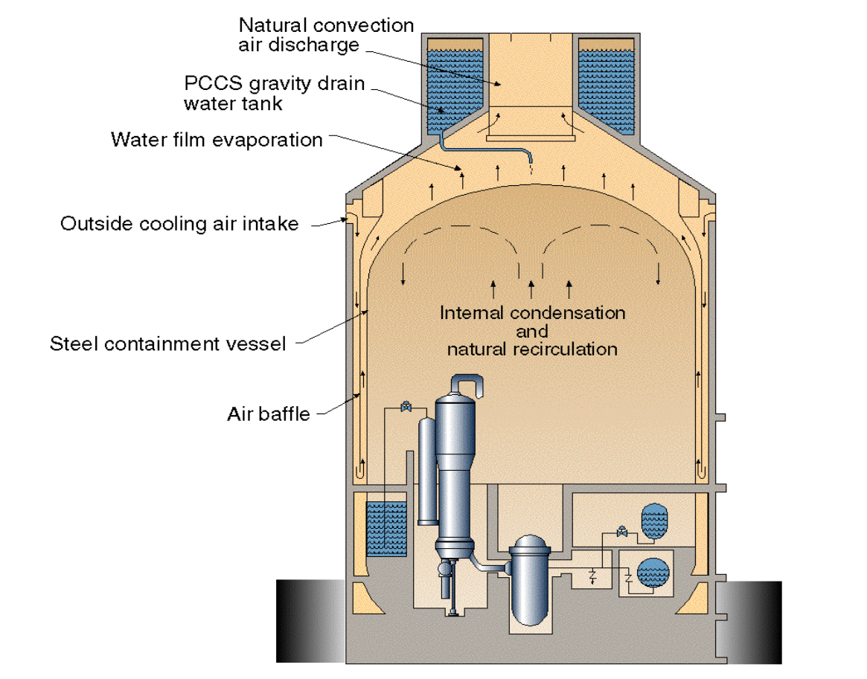
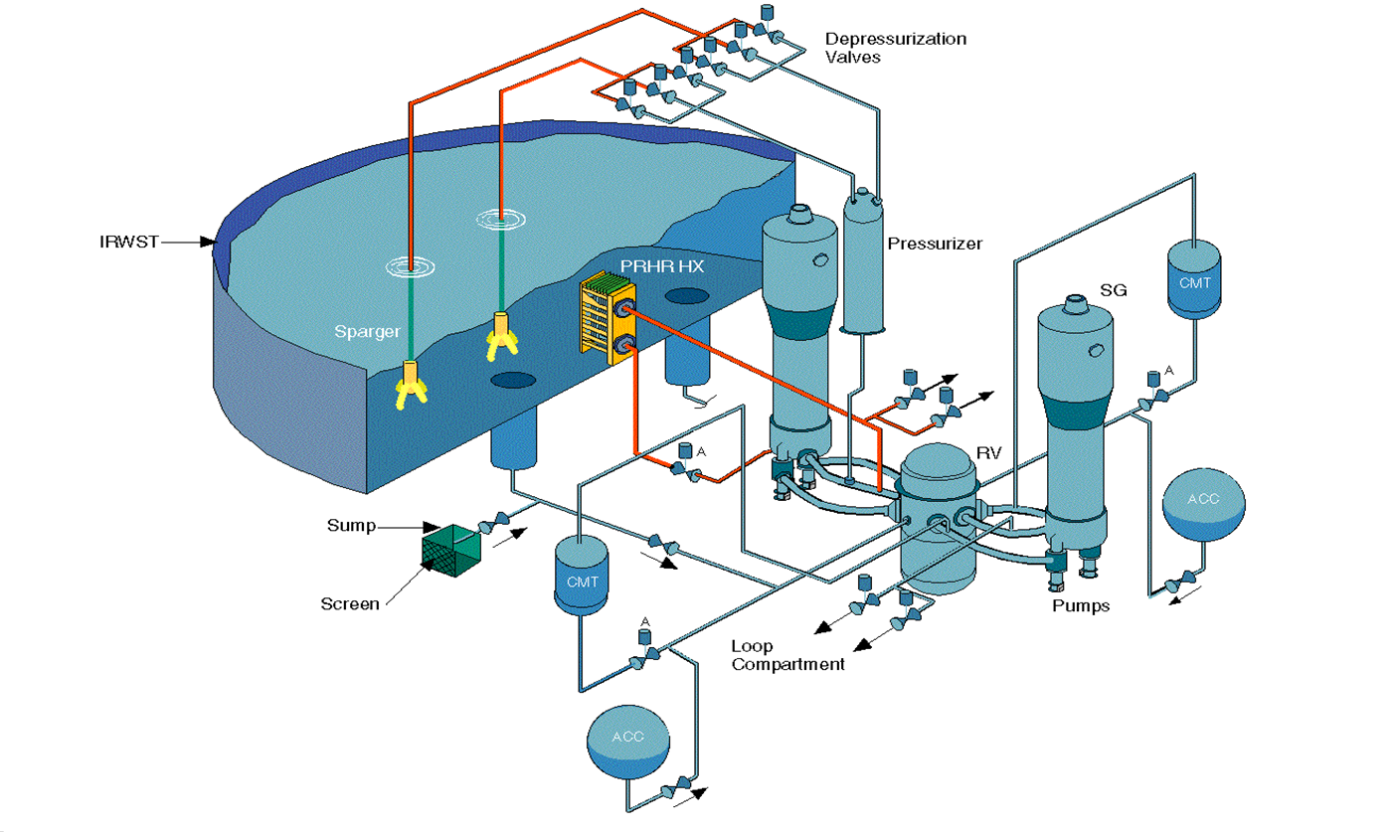
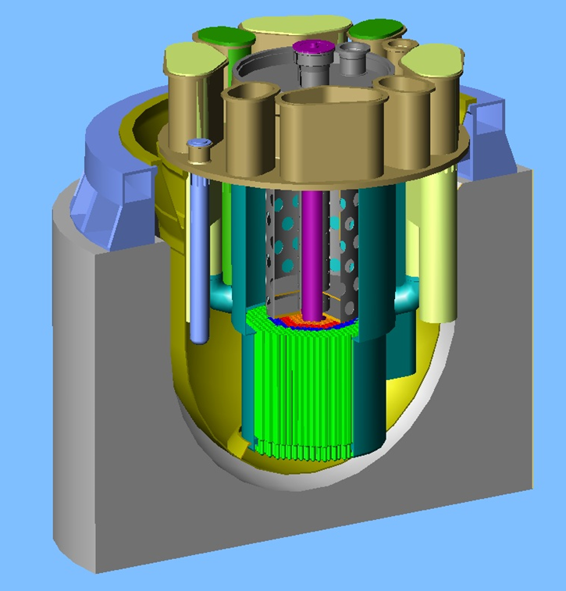
NUCLEAR ENERGY DEVELOPMENTS in ITALY & INTERNATIONAL IMPACTS
Nuclear Energy Scenario – evolution
The nuclear market scenario is offering all over the world:
Standard PWR / BWR / HWR - CANDU
VVER Generation implementing also passive features
Third Generation (EPR) and Third Generation + (AP1000 / AP 600)
Fast Breeder Reactors based on Phoenix / Superphoenix Technology
IVth Generation Nuclear Reactors with different Technologies ( Lead / Sodium Cooled)
Small Modular Reactors
Micro Modular Reactors
Fusion technologies Progress – In Development

Slide 4
NUCLEAR ENERGY DEVELOPMENTS in ITALY & INTERNATIONAL IMPACTS
What has to be finalized to start a new adventure in Nuclear Business
The nuclear market scenario is offering all over the world different valuable products. To be ready to selects the proper required products the following has to be fixed / clarified:
Licensing process finalization for each specific product or necessities. It is not the same if the selection is going toward a standard PWR or to a Micro Modular Reactor. The Country in terms of licensing process must be ready to face the different technical / technological / scientific characteristics of the selected product.
Any authorization process has to be completed before starting the activities on site. This is the only way to keep under control the quality of the product as well as the capital costs investment.
Changes to be implemented following Safety / Performances requests changes will condition heavily the agreed time schedule completion as well as the quality of the effort. Generating uncontrolled costs increasing in the capital cost investment for both reasons: delay in the time schedule and last minute upgrading of the Design configuration.

Slide 5
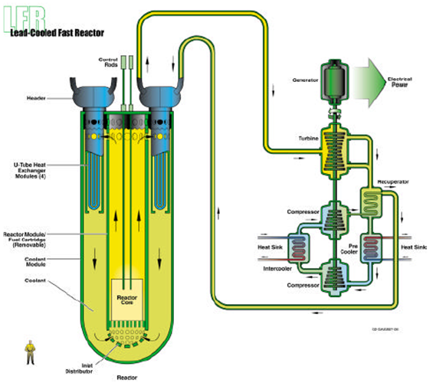
NUCLEAR ENERGY DEVELOPMENTS in ITALY & INTERNATIONAL IMPACTS
What has to be finalized to start a new adventure in Nuclear Business
The nuclear market scenario is offering all over the world different valuable products. To be ready to selects the proper required products the following has to be fixed / clarified:
.

Slide 6
NUCLEAR ENERGY DEVELOPMENTS in ITALY & INTERNATIONAL IMPACTS
What has to be finalized to start a new adventure in Nuclear Business
The nuclear market scenario is offering all over the world different valuable products. To be ready to selects the proper required products the following has to be fixed / clarified:
Development of an ad hoc licensing Process for fusion technology which is driven by different accidental scenarios evolution as well as by different loads identification and combination.
Development of standard acceptance codes specifically valid for Fusion technology as well as classification of Components in Fusion NPP (ESPN / PED). ITER represents the real important Reference. Fusion technical codes and standards (IAEA, ISO, CEN, AFCEN): meeting in November with IAEA
Sites selection
Qualification and characterization of the sites at natural severe events (earthquake, flooding, thunderstorm, fire). It will drive the selection of the design of the basement (in terms of thickness, location on piles or on seismic bearings, rigid anchorage).

Slide 7
NUCLEAR ENERGY DEVELOPMENTS in ITALY & INTERNATIONAL IMPACTS
Italian Industrial System capacity in Nuclear Market
The question might be changed in : Are we ready to supply a NPP?
The answer is complicated .
The ownership of a technology is limited to few Companies in Nuclear Fission like NEWCLEO for Lead Cooled Reactor with new SG / Pump or some patents owned by Ansaldo Nucleare in the frame of Fission technology.
To build an EPR we have to go to EDF , for an AP1000 to Westinghouse , for a Small Modular Reactor we have to select the technology and related Supplier
For Fusion technology the know how is distributed in ENEA, ENI, Ansaldo Nucleare.
But these conclusions do not mean we are not capable to build a Nuclear Power Plant with the surveillance of the Original Designer / Supplier of the Plant.

Slide 8
NUCLEAR ENERGY DEVELOPMENTS in ITALY & INTERNATIONAL IMPACTS
Italian Industrial System capacity in Nuclear Market
The question might be changed in : Are we ready to supply a NPP?
The answer is complicated .
The Italian industrial system has a qualified production capacity demonstrated during design / procurement / assembly and installation / commissioning for Cernavoda NPP, ITER design and Assembly, AP1000 Design and assembly in China, Nuclear Services activities all over the world as well as decommissioning and waste management.
It means the Italian the Italian Industrial System has the capacity to work properly according to quality standard rules, implementing nuclear codes acceptance rules and governing since design up to commissioning the quality control of the product and the design configuration of the Plant.
I can outline the important contribution of Italian industrial system in ITER Project Completion in terms of Plant Installation and Machine Assembly as well as in development and completion of final and execution design.

Slide 9
NUCLEAR ENERGY DEVELOPMENTS in ITALY & INTERNATIONAL IMPACTS
International Impact and Italian Industrial System
The Italian industrial system has been forced to work systematically on foreign Market and many times also out of Europe. It is difficult to survive without an internal backlog which can assure protection and learning curve.
It is important to outline the case of ANSALDO NUCLEARE which has been working in Europe (CERNAVODA Romania, KOZLODUY Bulgaria, NOVOVORONEZH Russia, Chernobyl Ukraine) and out of Europe (China, US).
In ITER Project innovative technologies have been developed and implemented by Italian Companies like ASG superconductors in Toroidal and Poloidal coils, ENEA in Divertor Technology, SIMIC / Ansaldo Nucleare in Sectors repairing and assembly, FINCANTIERI in design / delivery and installation of the Electrical and mechanical systems.
Italian industrial system is ready to face and is facing the challenging effort to move in the nuclear international market without having as protection an Internal Italian Market.

Slide 10
NUCLEAR ENERGY DEVELOPMENTS in ITALY & INTERNATIONAL IMPACTS
CONCLUSION
Necessary to have a qualified Safety Authority in charge of the licensing completion of the different Products available in Nuclear Market.
Necessary to have Rules ad hoc developed for the specific technology; on top required it is required to have dedicated ad hoc Standard Acceptance Code for Fission and fusion technologies.
Necessary to work in order to complete the licensing process before entering on site, not to generate changes of configuration and uncontrolled costs increasing.
Necessary to have at highest level the culture of Quality in the process, in the organization, in the engineering, in the procurement, in the control, in the site surveillance and in the systems commissioning.
Almost Ready. But a lot of integrated work involving all Actors is required.
WE CAN

Slide 11
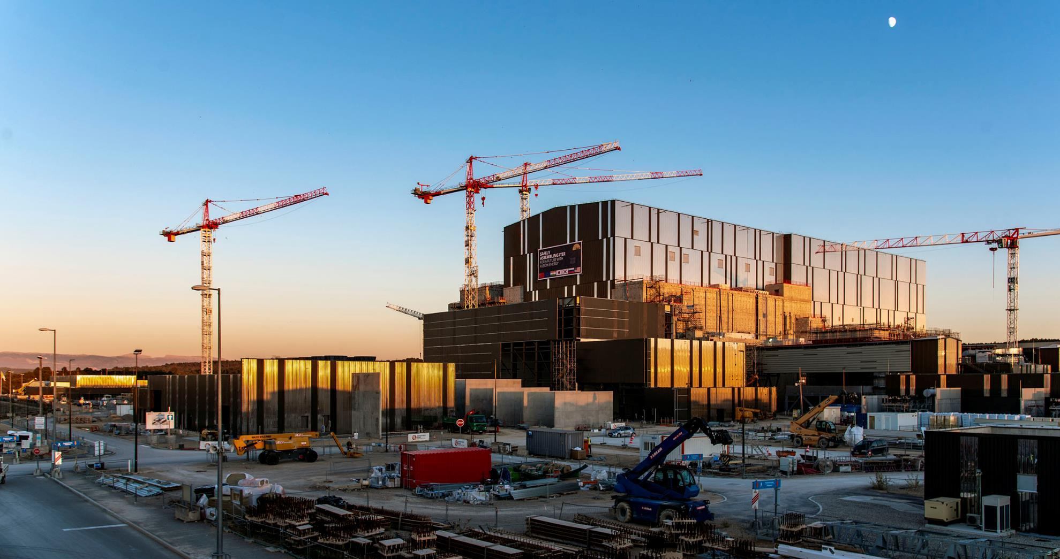


text
text
text
www.iter.org
text

