Slide 1


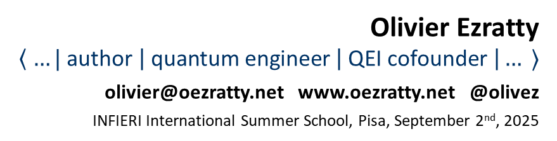
the challenges of quantum computing
science, technology, energetics and economics
Olivier Ezratty
$$\left\langle …| \text{author} \left| \text{quantum} \text{engineer} \right| \text{QEI} \text{cofounder} \right|… ⟩$$
olivier@oezratty.net www.oezratty.net @olivez
INFIERI International Summer School, Pisa, September 2nd, 2025

Slide 2
what is this talk about?
defining quantum technologies and their use cases.
segmenting quantum computing use cases and algorithms.
describing the basics of quantum computing and algorithms.
uncovering hardware scalability challenges.
look at vendor roadmaps, including energetic aspects.
Notes:
looking forward !
- applis avec avantage : chimie, not optim et ML et gros FTQC
- pb de prepa classique et de cout non estimé
- cout de compilation et syndrome detection, fixe vs data
- cout interconnect incontournable
- vitesse portes et temps calcul
- prix machines
- energy acceptability
- qu’elles transversalités ?
- quel est le role de la qei pour regler ces pbs ?
- questions fondamentales : large scale entanglement.
- question alternative : limites de l’analog quantum computing ?
- budgets bruits des qubits , ex d’oxford
- comment impliquer les participants a la conference ? scanner les. les mettre dans les stacks.
- besoin de mieux expliquer pourquoi le nisq n’est pas intéressant. no scale. no biz value. too long computing particularly with vqe.

Slide 3
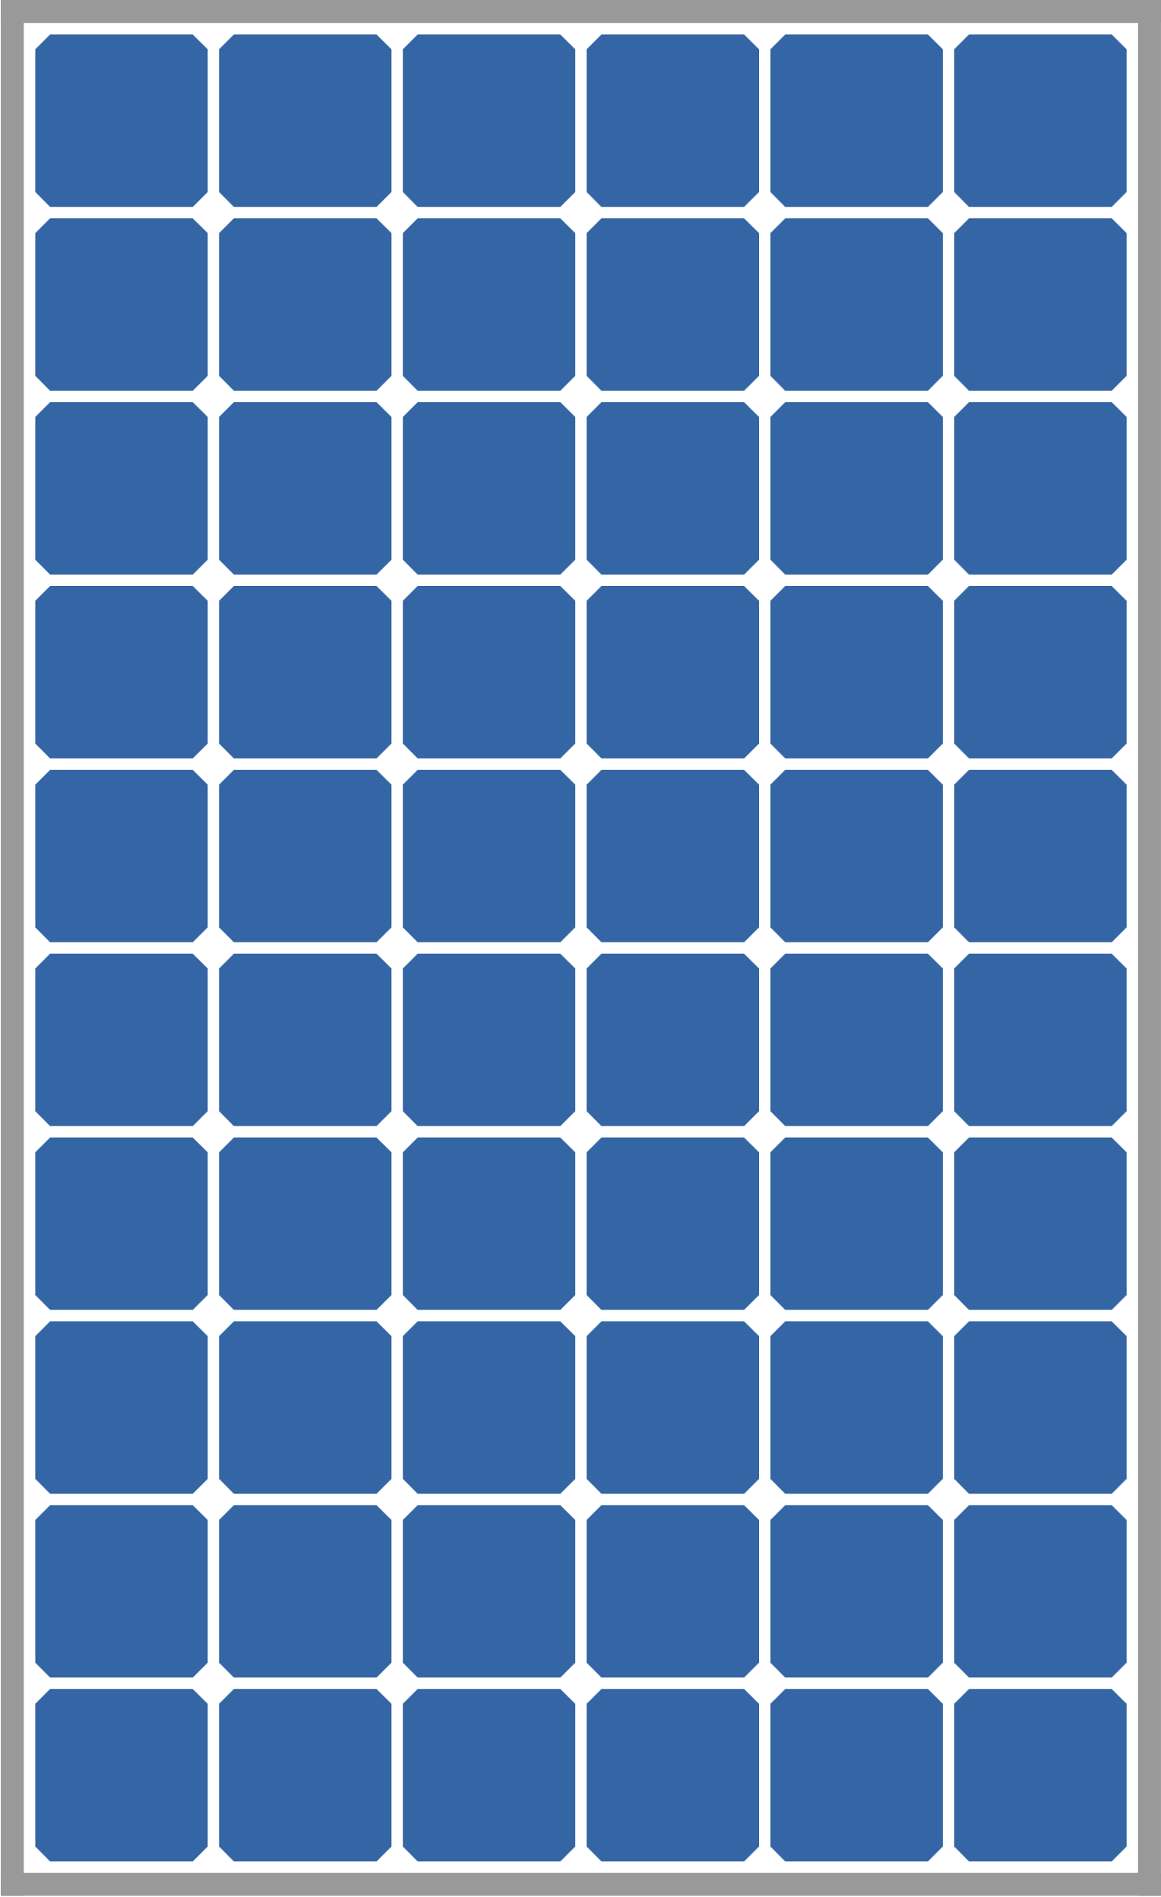
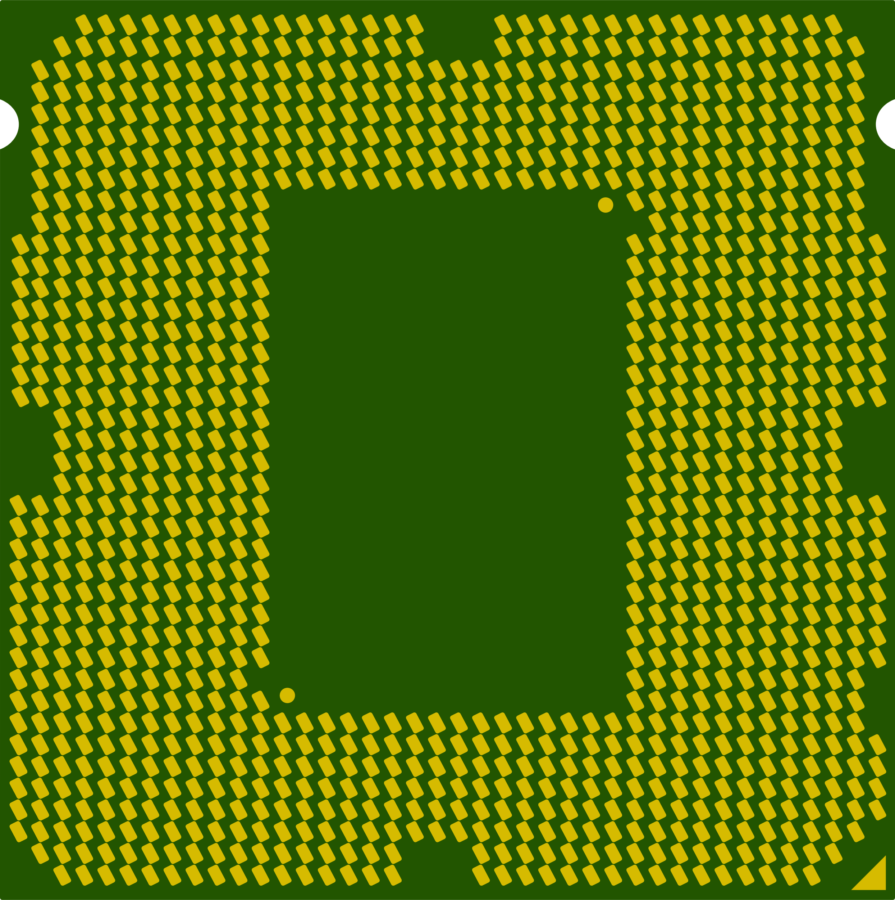

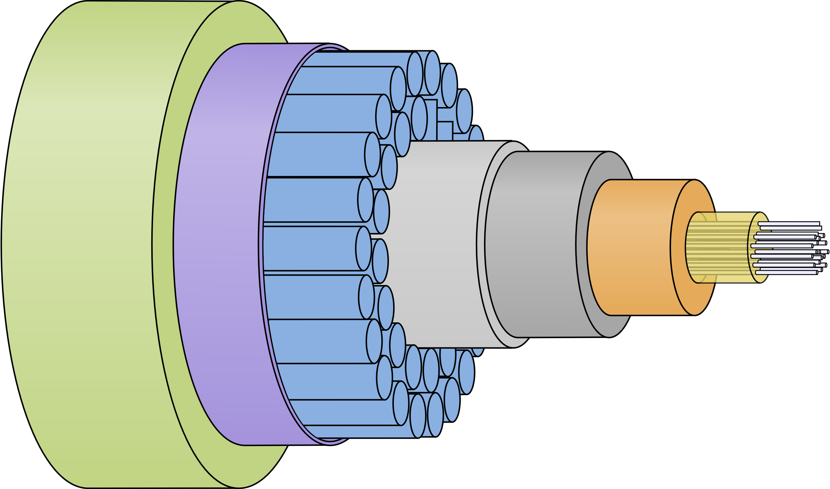
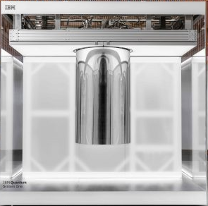
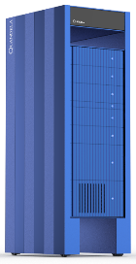
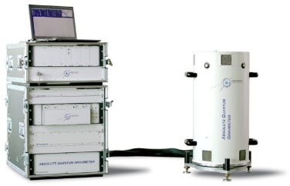
1st and 2nd quantum revolutions
first quantum revolution
second quantum revolution
manipulating groups of quantum particles photons, electrons and atoms interactions
manipulating superposition and entanglement and/or individual particles
quantum information research started hopefully before classical computing reached the peak oil of Moore’s law. scaling issues lead to many research in unconventional computing areas and QC is one of the most promising ones.
(cc) Olivier Ezratty, 2021-2024
transistors, lasers, fiber optics, GPS
photovoltaic cells, atom clocks
medical imaging, digital photography and video
LEDs, LCD TV quantum dots
quantum computing
quantum telecommunications
quantum cryptography
quantum sensing
1947-*
1982-*

Slide 4
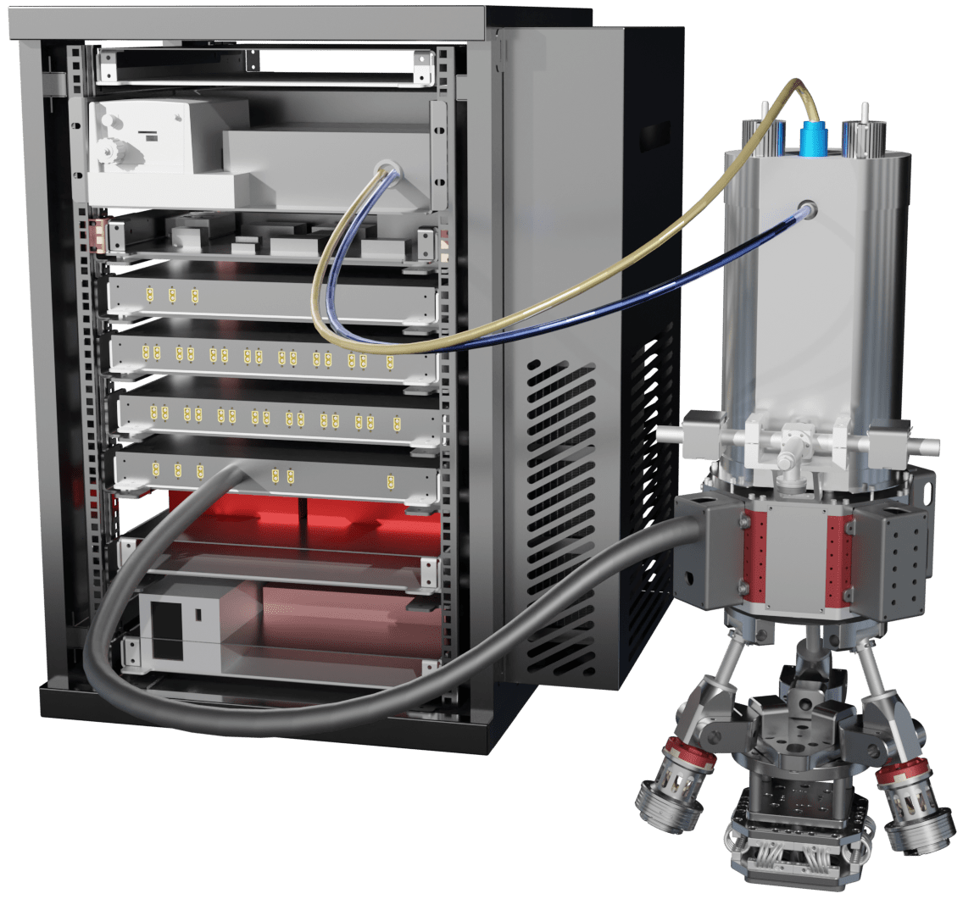
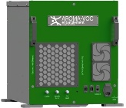
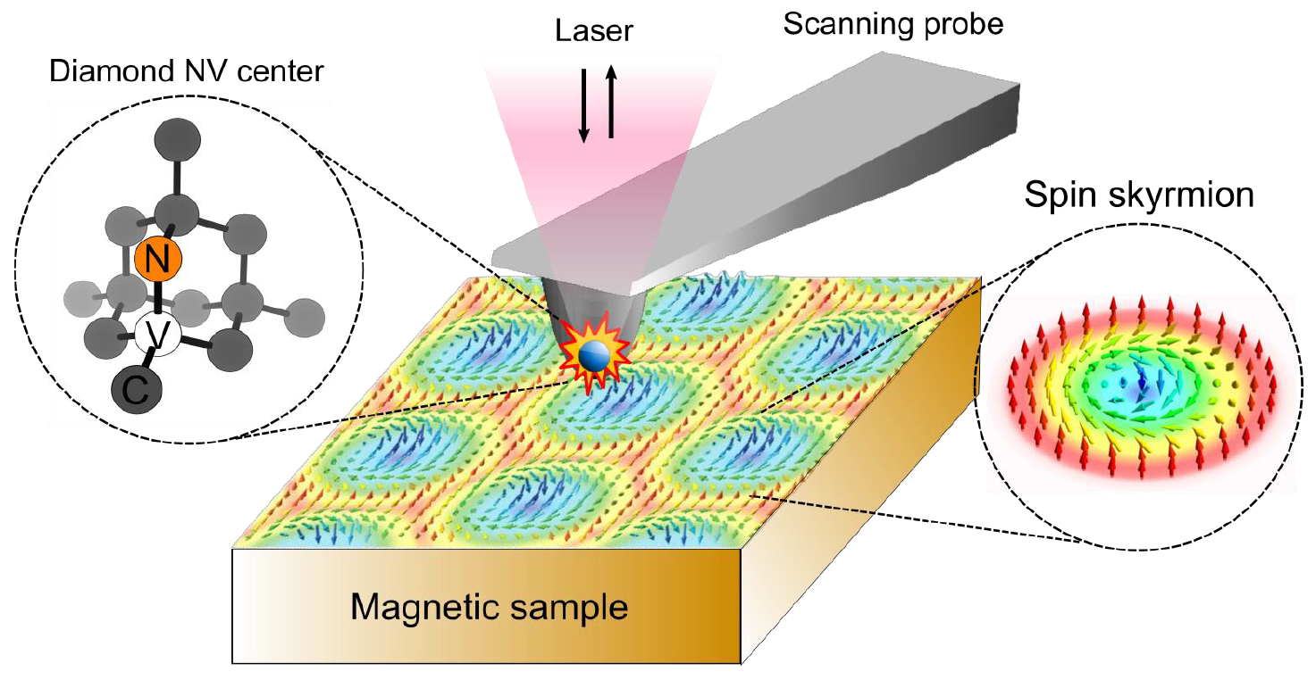
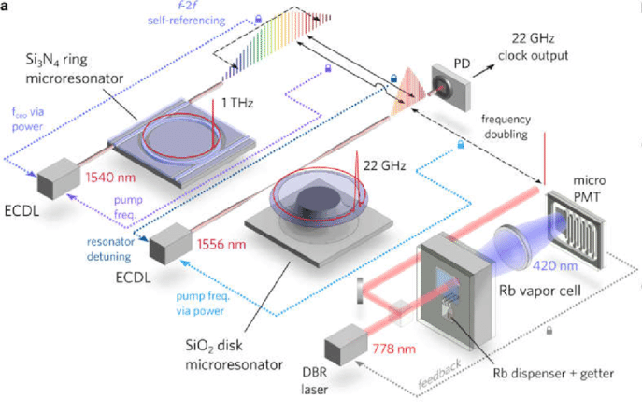
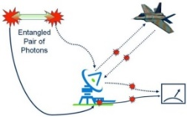
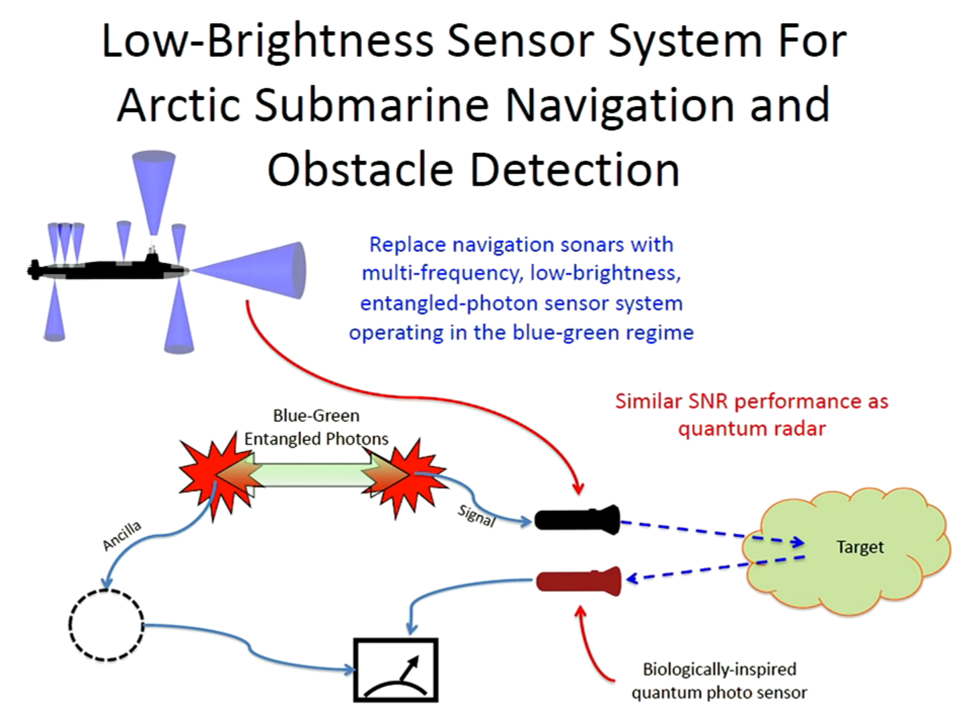
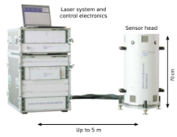
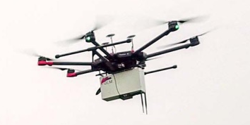
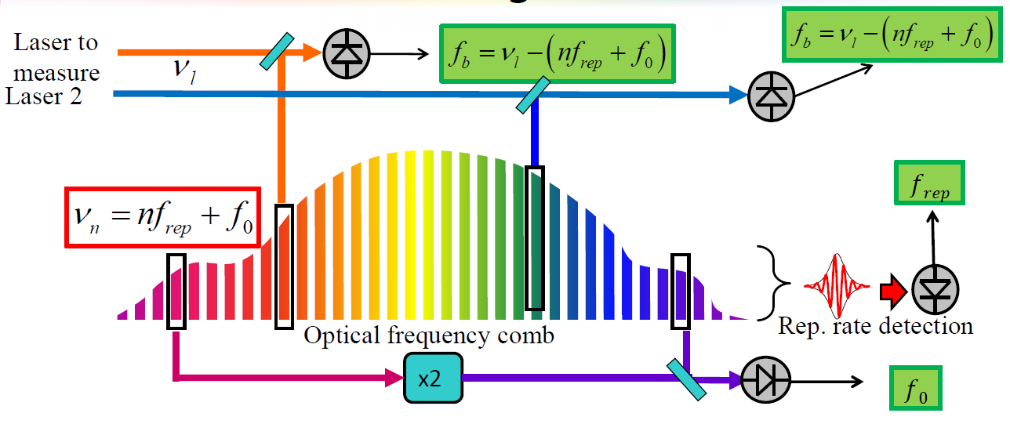
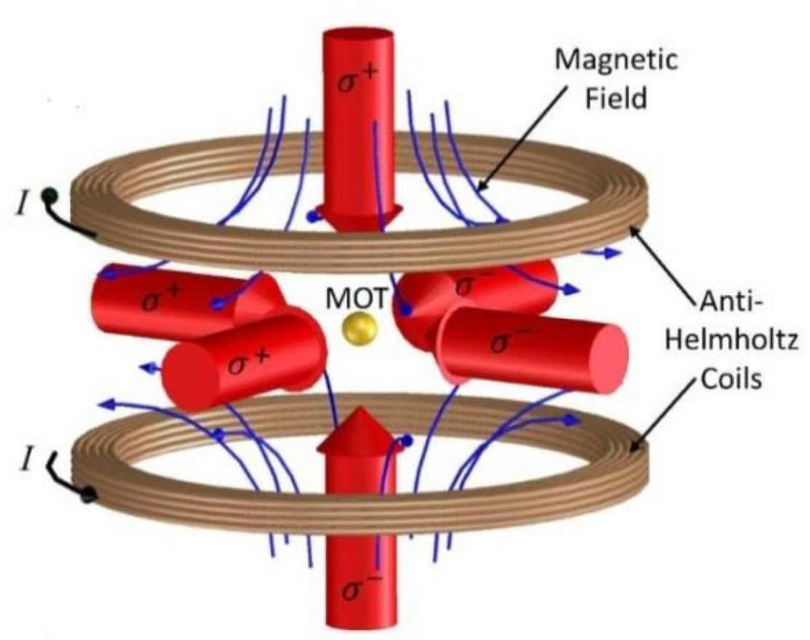
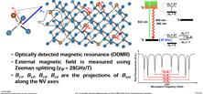
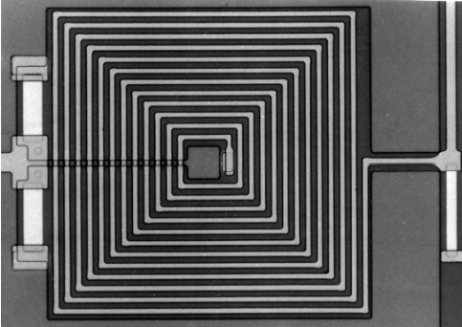
quantum sensing
inertial sensors
gyroscopes
sonars
gas detectors
chemical sensors
thermometers
microscopy medical imaging
large range of quantum sensing applications
can mention what Thales does with NV center magnetometers
the amazing world of quantum radars
also, many medical imaging applications
clocks
spectrographs
ultra-sound mikes
radars
LiDARs
ultra-sensitive
imaging
RF analysis
gravimeters
magnetometers
ODMR
lasers and frequency combs
entangled photons
cold atoms or atoms vapor
SQUIDs
NV centers
ions
(cc) Olivier Ezratty, 2021-2024.
Notes:
https://www.researchgate.net/figure/Schematic-of-photonic-optical-atomic-clock_fig1_328736626

Slide 5
quantum telecommunications
classical technologies
quantum technologies
QRA quantum resistant cryptography
classical cryptography resisting to quantum algorithms
Quantum Key Distribution (QKD)
quantum Internet
V1 first generation, prepare-and measure based, protects public keys sent through optical links, use trusted nodes as repeaters
V2 second generation, entanglement based,
protects public keys sent through optical links, use memory based repeaters
QCKA Quantum Conference Key Agreement
entangled quantum keys shared with more than 2 parties.
distributed quantum computing
connection between quantum computers and sensors, blind quantum computing
symmetric keys
classical cryptography already resistant to quantum algorithms (AES-256, …)
quantum computing cryptography
generated by a quantum computer
QSDC Quantum Secure Direct Communication
quantum data transfer without encryption keys
(cc) Olivier Ezratty, 2023
PQC post-quantum cryptography
new classical asymmetric keys and signatures resisting to quantum algorithms
entanglement distribution
entangled photons distribution to multiple parties
quantum teleportation
teleporting one qubit state to another qubit using entanglement distribution
QRNG
quantum random key generators
ensure the quality of public keys in classical and quantum cryptography
quantum repeaters
with quantum memory, enable entanglement sharing over long distances
Unsafe cryptography classical cryptography based on RSA

Slide 6




















quantum random number generators
photons counting
photons arrival time
vacuum fluctations
phase noise
radioactive decay
qubit Bell-state measurement
self-certified SDI QRNG
other

Slide 7
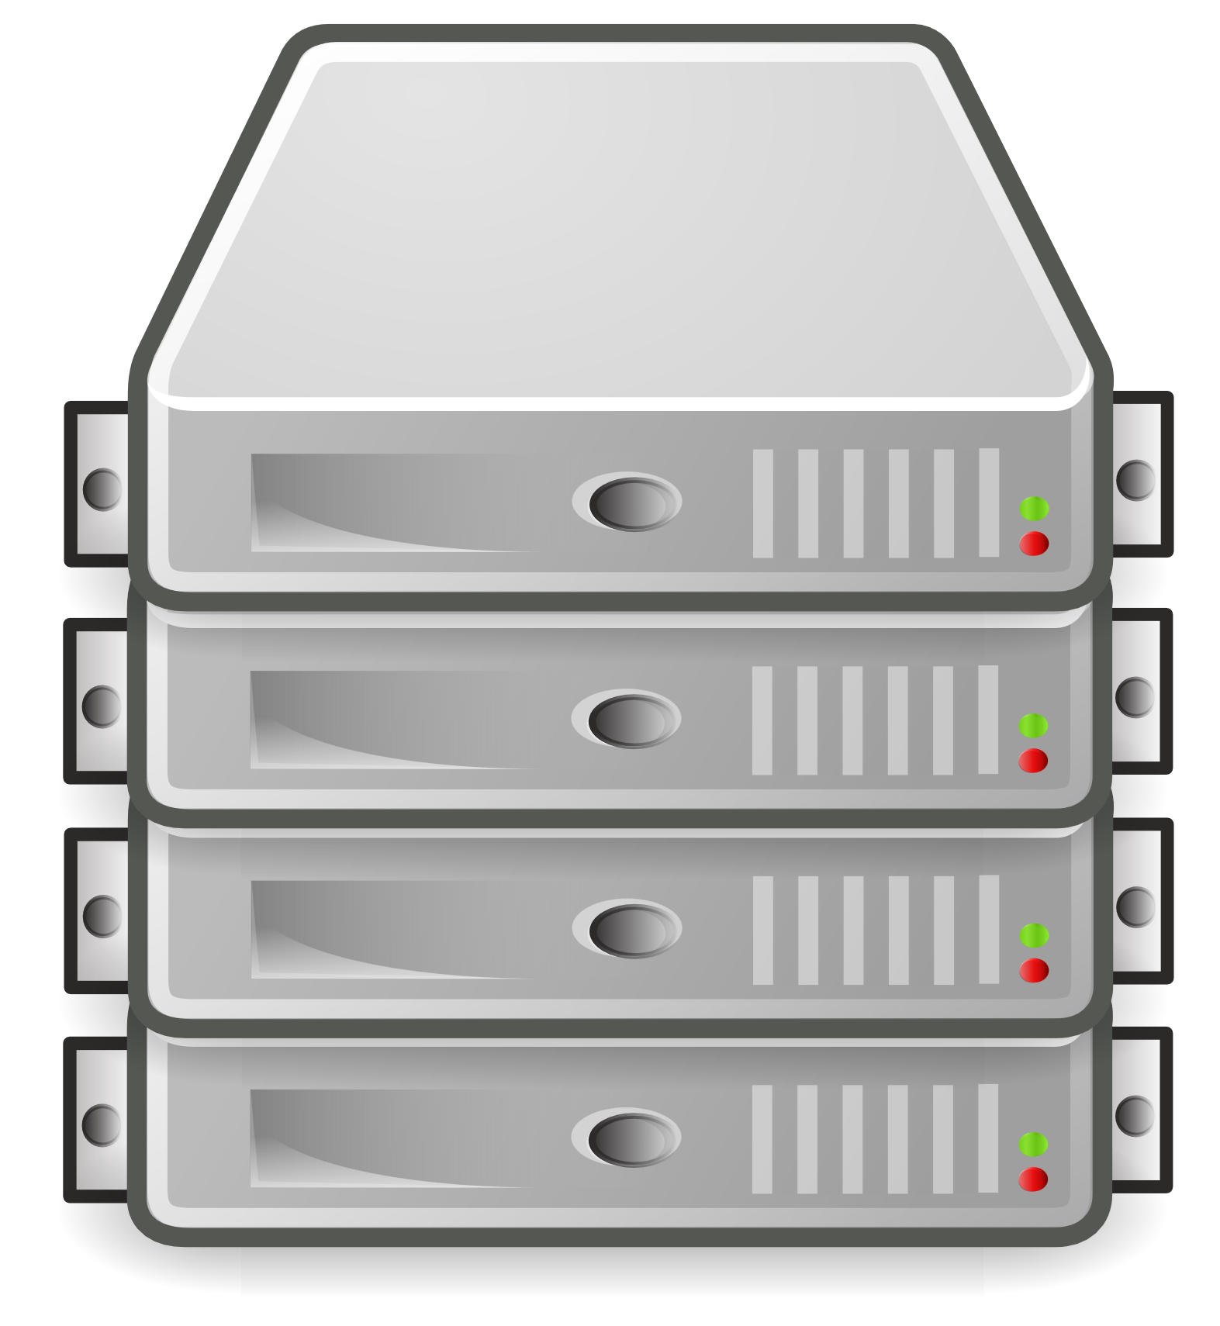

potential quantum computing benefits
computing faster than classical systems.
solving problems inaccessible to classical computers.
reducing required training data, particularly for machine learning tasks.
or
improving results quality: chemical accuracy, better heuristics, etc.
energy advantage (NISQ).
energy acceptability (FTQC).
or
usefulness: which depends on the stakeholder (fundamental research, governments, industry).

Slide 8
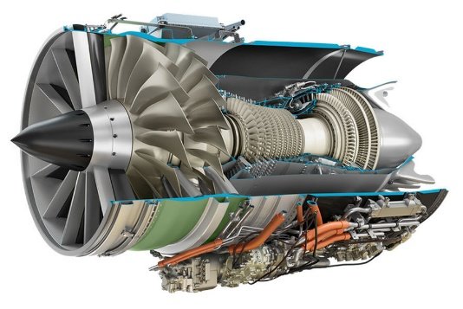
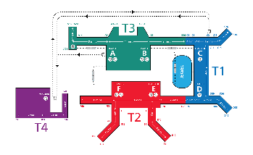
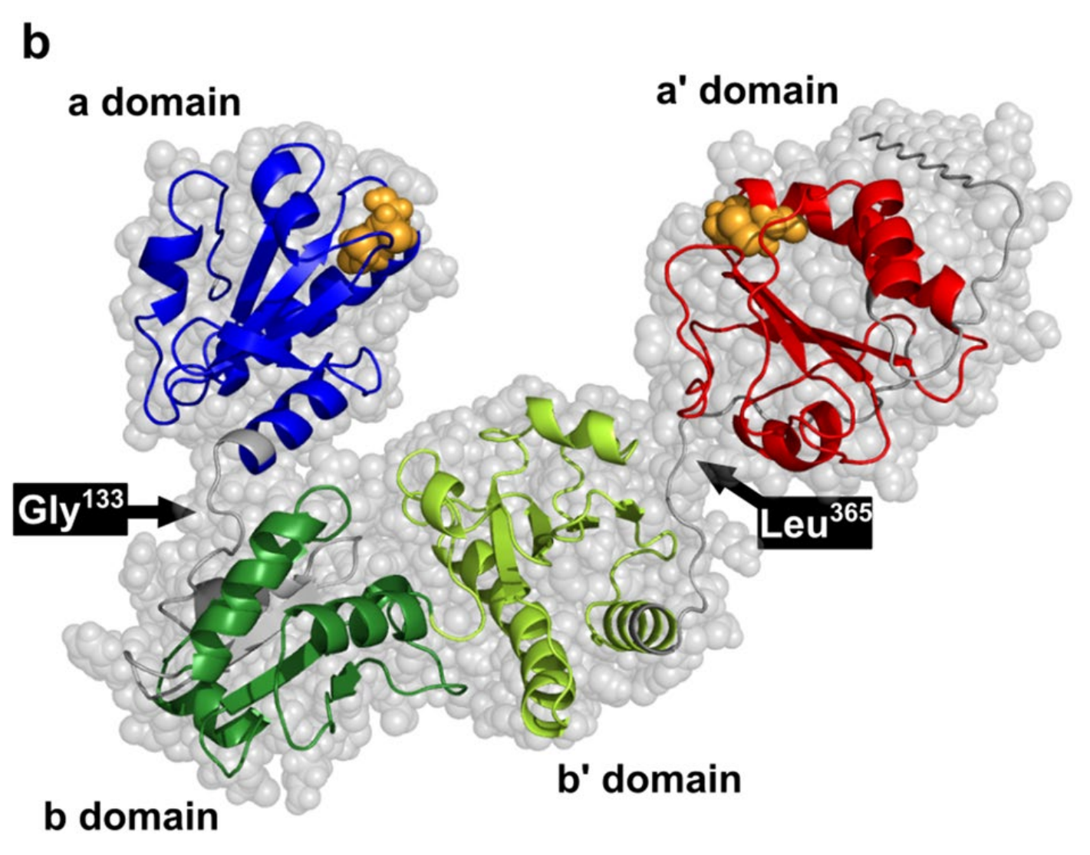
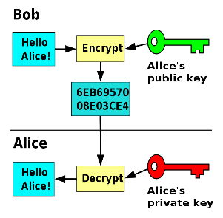
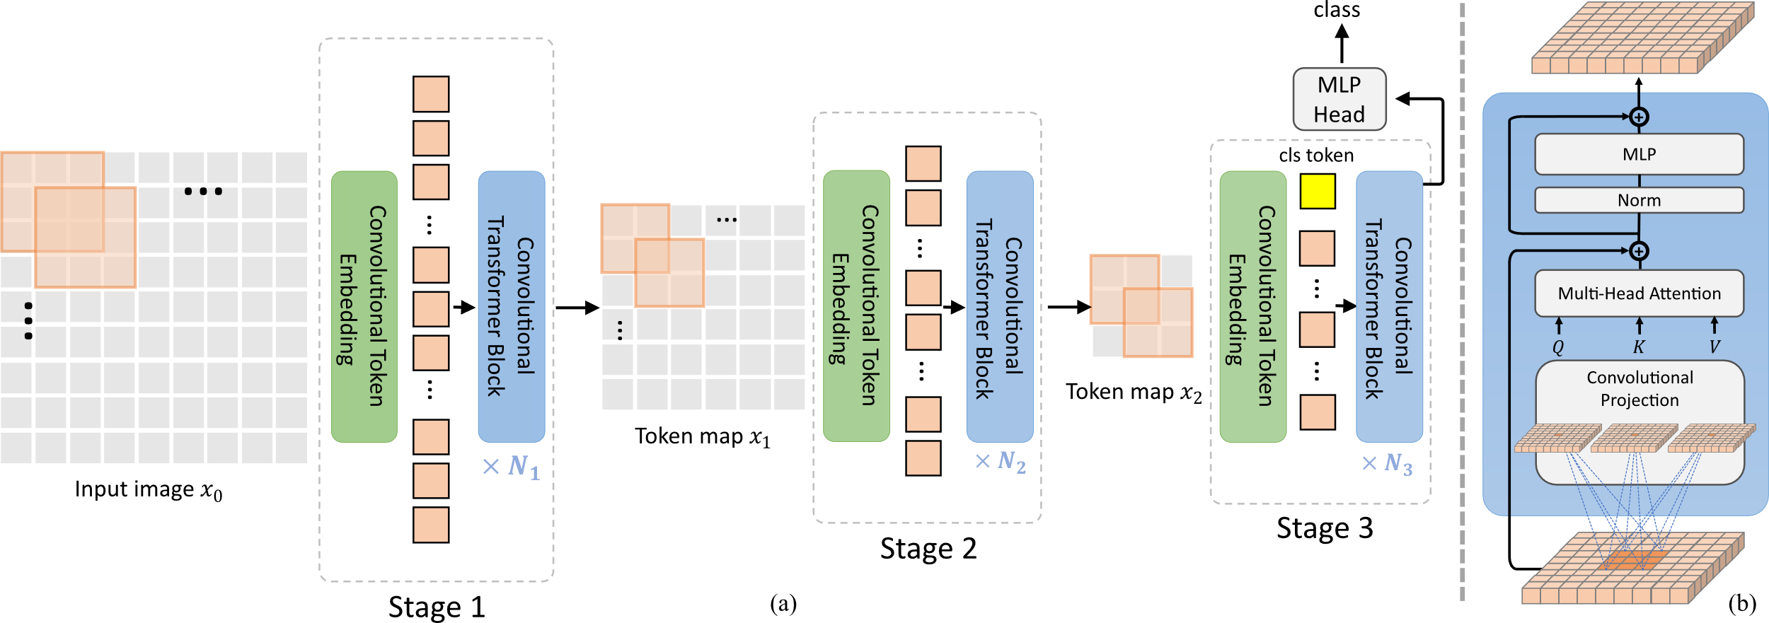
typical difficult problems
combinatorial optimizations
solving partial differential equations
iℏ $\frac{∂Ψ(x, t)}{∂t}$= $−\frac{ℏ^{2} }{2m}$ $\frac{∂2Ψ(x, t)}{∂x2}$ $\text{+} V\left(x\right)Ψ(x, t)$
solving Schrodinger’s wave equation to simulate quantum systems
machine learning and deep learning
breaking asymmetric cryptography keys
Notes:
https://pypi.org/project/cvt-tensorflow/

Slide 9
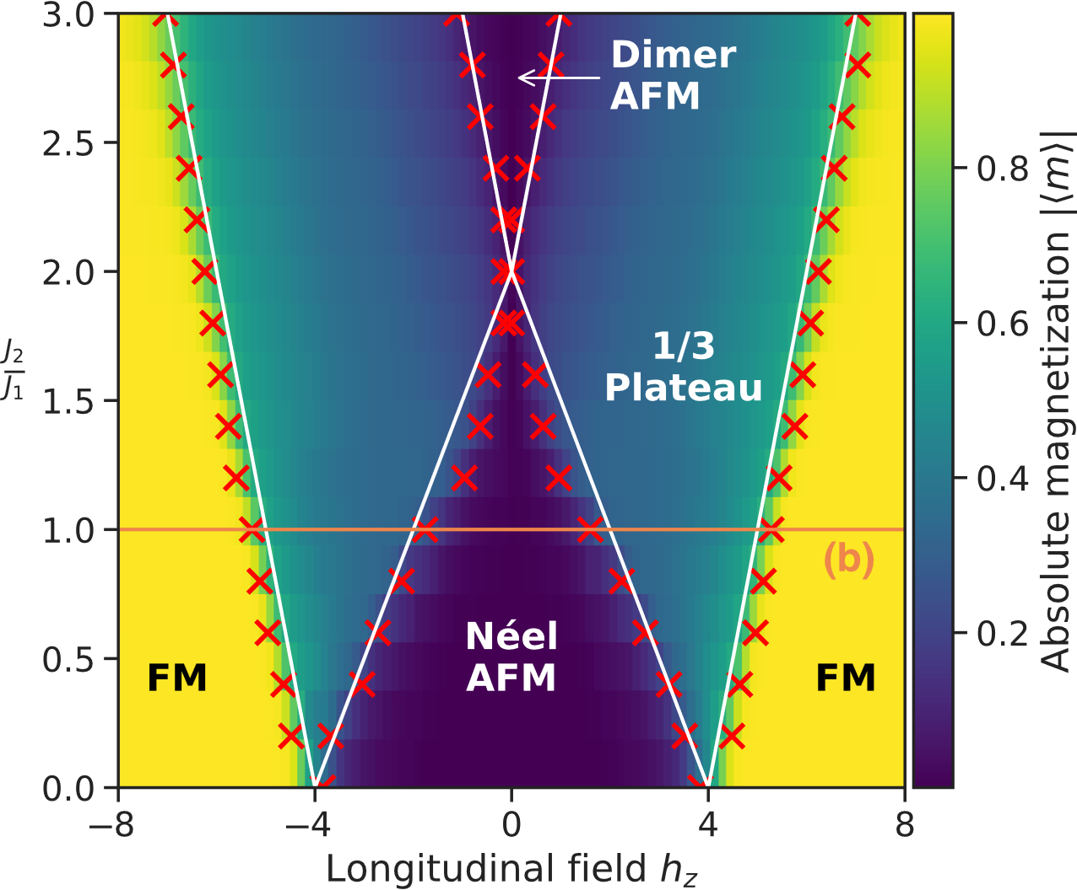
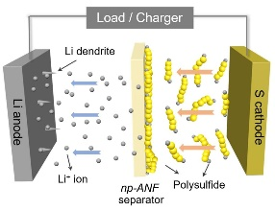
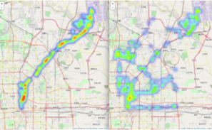
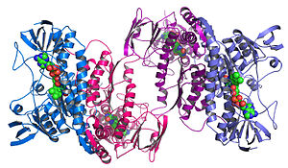
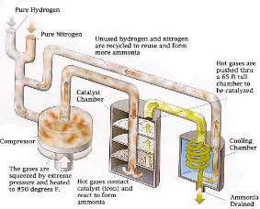
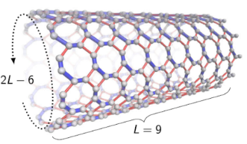
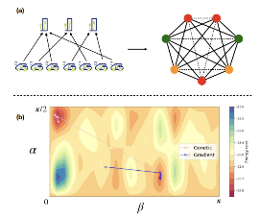
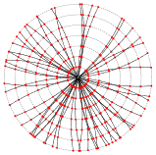

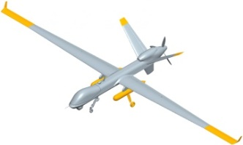
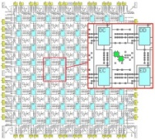
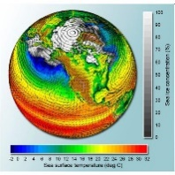
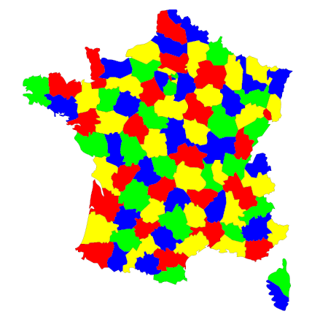
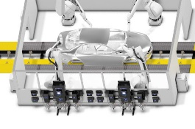
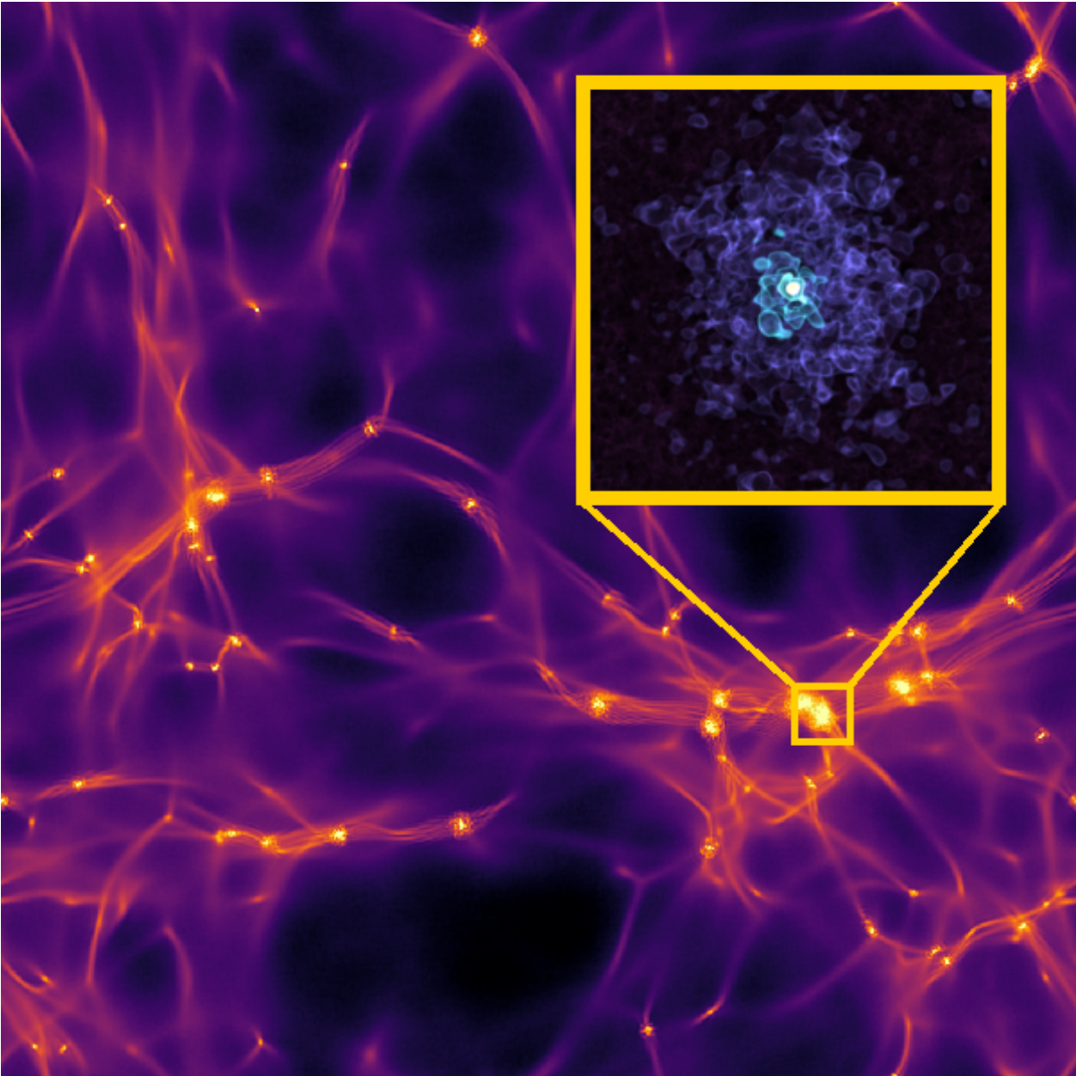
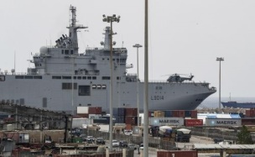
from science to industry applications
fundamental research
applied research
business operations
régalien
condensed matter physics
batteries
drugs
transportation
financial services
logistics and retail
high-energy particle physics
fertilizer production
material design
energy utilities
astrophysics
semiconductors
climate modeling
telecoms
manufacturing
Notes:
Source of High-Energy Particle physics illustration : Quantum Computing for Data Analysis in High-Energy Physics by Andrea Delgado et al, March 2022 (22 pages)
Source of condensed matter physics illustration : Quantum computing enables simulations to unravel mysteries of magnetic materials by Elizabeth Rosenthal, Oak Ridge National Laboratory, February 2021, using a 2000Q D-Wave annealer.
Marketing: https://www.dwavesys.com/media/i2fjhzy2/recruit_case_story_v5.pdf

Slide 10
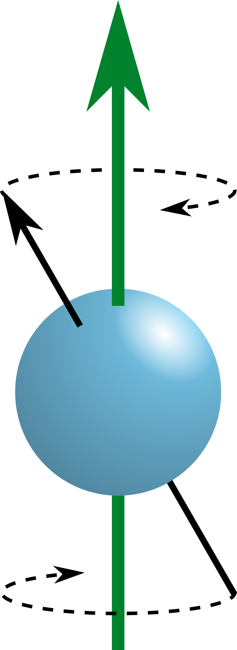
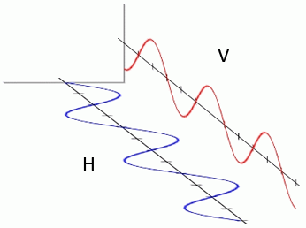
what is a qubit?
complex numbers
amplitudes
basic unit of quantum information
$\left. \right|\left.Ψ\right\rangle =$ $\left.α\right|\left.0\right\rangle +\left.β\right|\left.1\right\rangle$
mathematically
vector in a 2-dimension complex numbers Hilbert space
${|α|}^{2}+{|β|}^{2}$ $=$ 1
probabilities and Born normalization constraint
Bloch sphere representation with amplitude and phase
(cc) Olivier Ezratty, 2023-2024
$$\left. \right|\left.1\right\rangle$$
$$\left. \right|\left.1\right\rangle$$
$$\left. \right|\left.1\right\rangle$$
e-
two-level state controllable quantum object
$$\left. \right|\left.0\right\rangle$$
$$\left. \right|\left.0\right\rangle$$
physically
$$\left. \right|\left.0\right\rangle$$
separable atom energy level
electron or nucleus spin orientation
photon mode (polarization, number, frequency)

Slide 11
qubits mathematical operations
complex amplitudes
combinations of 0s and 1s
CNOT gate
$$\left[\begin{matrix}α_{1} \\ … \\ … \\ … \\ … \\ α_{2^{N}} \end{matrix}\right]$$
$$\left|00…00\right\rangle$$
$$\left|10…01\right\rangle$$
$$\left[\begin{matrix}α_{00} \\ α_{01} \\ α_{10} \\ α_{11}\end{matrix}\right]$$
. $\left[\begin{matrix}1 & 0 & 0 & 0 \\ 0 & 1 & 0 & 0 \\ 0 & 0 & 0 & 1 \\ 0 & 0 & 1 & 0\end{matrix}\right]\text{=}\left[\begin{matrix}α_{00} \\ α_{01} \\ α_{11} \\ α_{10}\end{matrix}\right]$
Bloch sphere
$$\left|11…11\right\rangle$$
two-level quantum object, handling the equivalent of two floating point numbers
N qubits handle the equivalent of 2^{N+1} -1 floating point numbers
entanglement creates links between qubits and brings computing power under certain circumstances

Slide 12
what is a quantum algorithm?
two-qubit gate
single qubit gate
three-qubit gate
quantum algorithm: decomposes a solution to solve some mathematical problem into a quantum circuit.
quantum circuit: series of operations (gates) acting on a quantum memory, on individual qubits (superposition) or with connecting them (entanglement in most cases).
matrix computing: operating on a memory space of dimension 2^{N+1} real numbers.
mecanism: exploit various techniques to yield a value of interest in a series of classical bits.
classical computing: used to prepare the circuit, encore data, and extract useful result from multiple circuit runs.
$$\left|0\right\rangle$$
$$\left|0\right\rangle$$
$$\left|0\right\rangle$$
$$\left|0\right\rangle$$
$$\left|0\right\rangle$$
N qubits
$$\left|0\right\rangle$$
$$\left|0\right\rangle$$
$$\left|0\right\rangle$$
$$\left|0\right\rangle$$
$$\left|0\right\rangle$$
$$\left|0\right\rangle$$
$$\left|0\right\rangle$$
$$\left|0\right\rangle$$
$$\left|0\right\rangle$$
initialization
temps
readout
circuit depth D

Slide 13
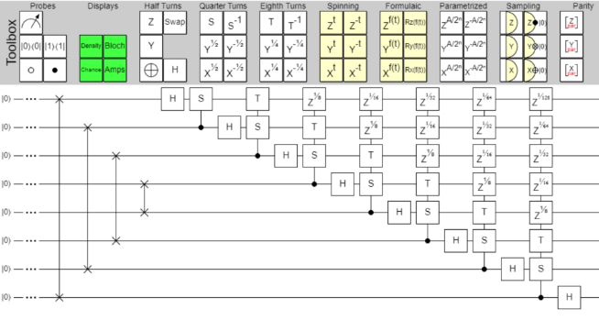
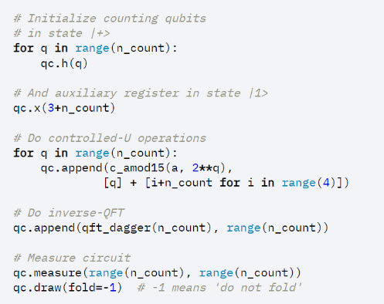

key differences
$$\left|ψ_{1}\right\rangle =\frac{1}{\sqrt{N}}⨂_{j=1}^{n}{\left(\left|0\right\rangle +e^{−2πi\left(\sum_{k=n−j}^{n}{x_{k}2^{−k}}\right)}\left|1\right\rangle \right)}$$
need to (re-)learn linear algebra
visual or Python scripted « circuits » programming
qubit 1 state
qubit 2 state
copy
qubit 1 state
qubit 2 state
entangle
qubit 1 state
qubit 2 state
teleport
uncopiable data, but transferable
probabilistic results, and repeated computing to generate a deterministic outcome

Slide 14
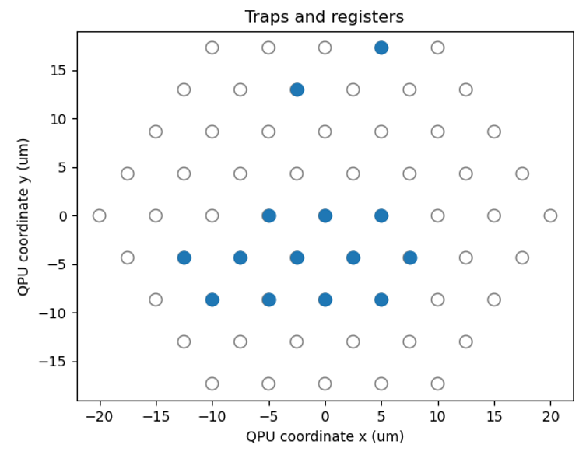
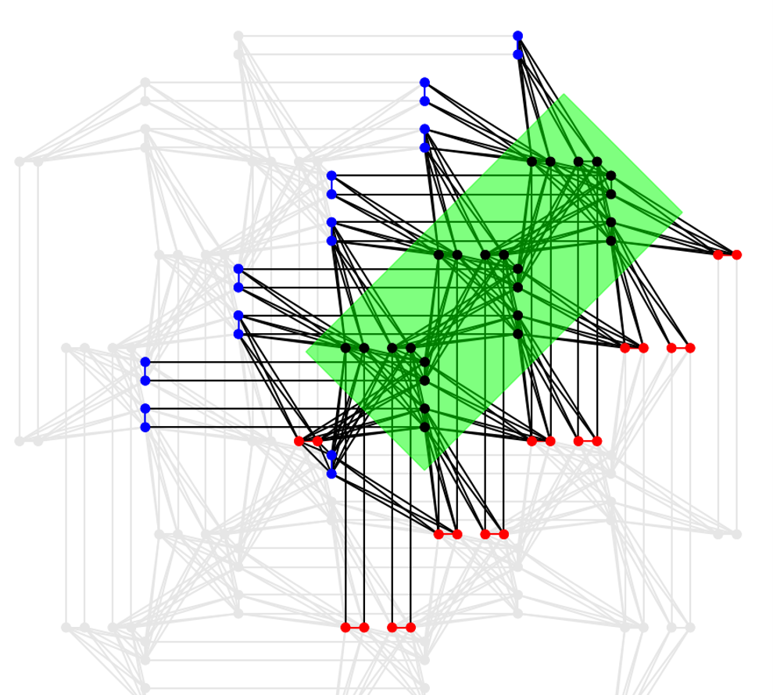

main quantum computing paradigms
gates-based quantum computers
analog quantum simulators
quantum annealers
(cc) Olivier Ezratty, 2022-2025
problem solved with an algorithm containing a series of quantum gates, implementing any unitary transformation
problem embedded in a graph to solve Ising or QUBO problems, using dynamic qubit positioning but no or poor local qubit control
problem embedded in a BQM model to solve Ising or QUBO problems, using static qubit connectivity and local control

Slide 15

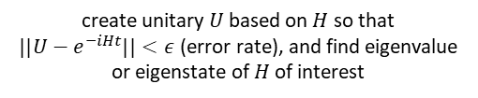
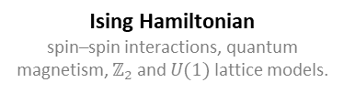

typical target Hamiltonians per paradigm
gates-based quantum computing
analog quantum simulation
quantum annealing
Heisenberg model (VQE)
spin dynamics, quantum magnetism, superconductivity.
XX Ising models
quantum transport, superfluid-Mott insulator transitions, topological phases…
Ising Hamiltonian
spin–spin interactions, quantum magnetism, $ℤ_{2}$ and $U(1)$ lattice models.
electronic structure model (VQE, QPE) encoded into qubit gates using Jordan–Wigner and Bravyi–Kitaev transforms, also applicable with HEP.
XY Ising models
non-trivial topological effects, real-time quench dynamics…
QUBO formulation
optimization problems, graph partitioning, route planning
(cc) Olivier Ezratty, 2025
Fermi-Hubbard model (VQE, QPE)
strongly correlated systems in condensed matter physics, magnetism, Mott insulators, high T_{c} superc.
XXZ Ising models
ferromagnetic, antiferromagnetic, spin-liquid states, U(1) LGT simulations…
MaxCut problems
solving various graph problems.
create unitary $U$ based on $H$ so that $||U−e^{−iHt}||<ε$ (error rate), and find eigenvalue or eigenstate of $H$ of interest
find $σ_{i}^{x},σ_{i}^{y},$and/or $σ_{i}^{z}$ minimizing a cost function that is the minimum eigenvalue of $H$
find $σ_{i}^{z}$ minimizing a cost function that is the minimum eigenvalue of $H$
QAOA (NISQ)
combinatorial optimization (MaxCut, traveling salesman problem, etc.).
Notes:
Fermi Hubbard : For the Fermi–Hubbard model, one typically applies a fermion-to-qubit mapping first—Jordan–Wigner being the most direct example—so the on-site interaction Un^i,↑n^i,↓U \hat{n}_{i,\uparrow} \hat{n}_{i,\downarrow}Un^i,↑​n^i,↓​ and hopping terms t (ai,σ†aj,σ+h.c.)t\,(a_{i,\sigma}^\dagger a_{j,\sigma} + \text{h.c.})t(ai,σ†​aj,σ​+h.c.) become strings of Pauli operators that preserve fermion statistics.
Cold atoms and gauge theory: https://www.nature.com/articles/s41567-024-02721-8
A 2+1D U(1) model is a quantum field theory with two spatial dimensions and one time dimension whose local symmetry group is the abelian U(1) group. In practical terms, it can be viewed as a lower-dimensional analogue of electromagnetism (or other abelian gauge fields) where the gauge field is still governed by Maxwell-like equations, but the reduced dimensionality profoundly alters the nature of confinement, screening, and possible topological effects.
A cold atom analog quantum simulation of an XY Ising model involves preparing ultracold atoms in a specifically arranged lattice or tweezer array, then engineering interactions that mimic the XY Hamiltonian. The XY part of the Hamiltonian typically involves spin-exchange terms σixσjx+σiyσjy\sigma_i^x \sigma_j^x + \sigma_i^y \sigma_j^yσix​σjx​+σiy​σjy​ among neighboring sites, and the Ising label often highlights the possibility of including an external field or longitudinal coupling (though, strictly speaking, “XY” is already an anisotropic spin-1/2 model). In a cold atom setting, each site corresponds to a spatial position in the lattice occupied by an atom whose internal (usually hyperfine) states represent the spin degree of freedom. Laser-induced tunneling and controlled interatomic interactions (via Feshbach resonances in neutral atoms, or Rydberg excitations with van der Waals or dipole–dipole couplings) can be tuned to achieve the pairwise exchange required for the XY interaction. The “input data” in such a simulation are primarily the physical parameters specifying the Hamiltonian to be realized: these include the lattice geometry (one-dimensional chain, two-dimensional square lattice, etc.), the coupling strengths JxJ_xJx​ and JyJ_yJy​, the external fields (if present), and any boundary conditions. Experimentalists translate these Hamiltonian parameters into laser intensities, detunings, magnetic field gradients, and lattice depths that define how strongly atoms tunnel or interact on each bond. Once the system is prepared in a particular initial state—often the ground state of a simpler Hamiltonian or a fully polarized state—and allowed to evolve under the engineered XY Hamiltonian, the resulting “output data” are typically the measured spin configurations, correlation functions, or global observables such as magnetization. Modern quantum gas microscopes permit single-site resolved fluorescence imaging, so one can measure site-by-site spin orientations after a quantum quench or adiabatic ramp. This real-time measurement of local observables and correlation spreads allows direct insight into out-of-equilibrium phenomena, critical dynamics, and entanglement growth that would be challenging to compute via classical methods. Studies of the XY model with cold atoms have demonstrated intriguing effects such as dynamical phase transitions, spin-charge separation (when mapped to fermionic modes), and exotic quantum states of matter.

Slide 16
from Hamiltonian to… values of interest
gate based QPU
unitary approximation.
circuit synthesis.
ground state.
eigenvalues.
eigenstates.
analog QPU
embedding.

Slide 17
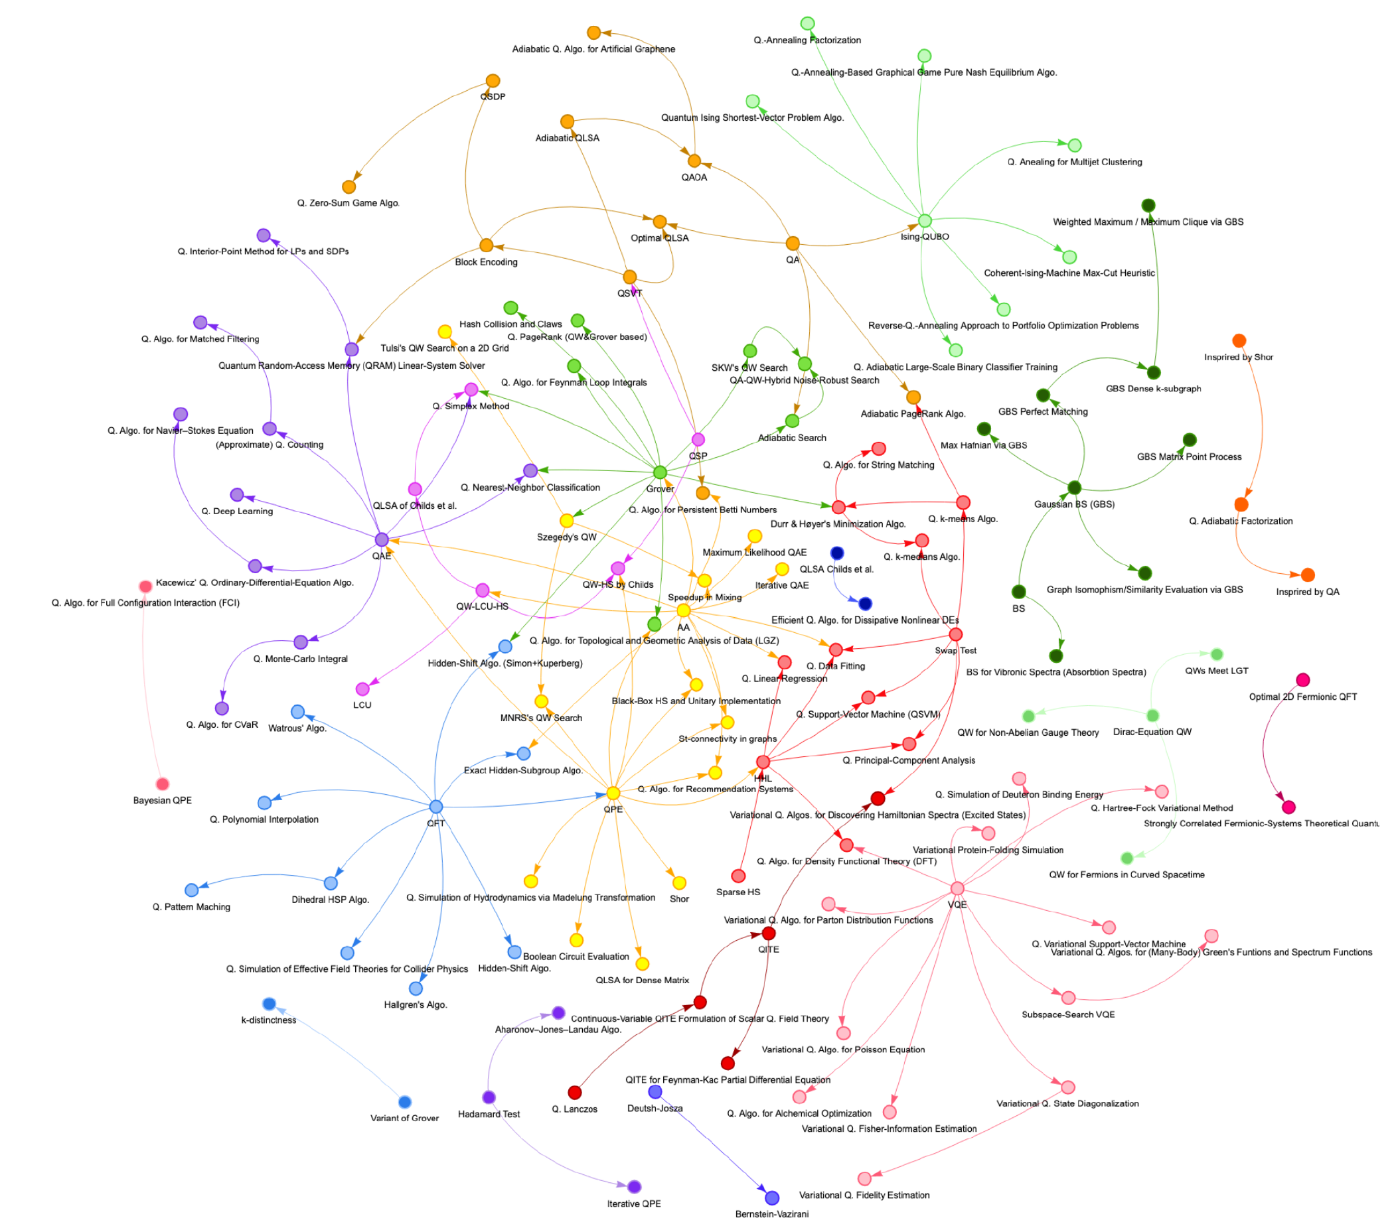
quantum algorithms interdependency clusters
analog QUBO
QAOA
Grover
FTQC QPE & QFT based
QAE
HHL
QFT
QPE
A typology of quantum algorithms by Pablo Arnault, Pablo Arrighi, Steven Herbert, Evi Kasnetsi, and Tianyi Li, Inria, Quantinuum, arXiv, July 2024 (60 pages).
NISQ
VQE
Notes:
https://www.oezratty.net/Files/Conferences/A%20new%20agenda%20proposal%20for%20the%20Quantum%20Energy%20Initiative.pdf

Slide 18
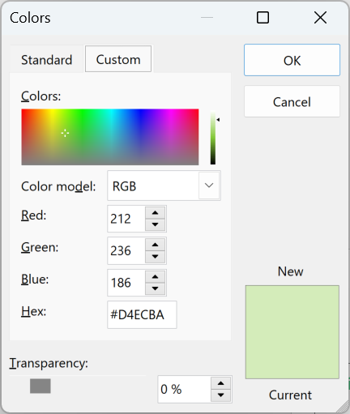






potential quantum speedups
simulations | VQE | amplitude estimation |  | QPE (quantum phase estimate)
searches and combinatorial optimizations | QUBO QAOA | quantum walks | Grover search |  | Deutsche-Jozsa Simon, Bernstein-Vazirani
machine learning | variational QML variants |  | reinforcement learning recommendation supervised clustering ensemble methods Bayesian networks |  | PCA SVM k-means convolutional networks
other | QSVD | Quantum Monte Carlo primality proofs | linear regressions | HHL based linear solvers PDEs QSLA | QFT QSVT, QSP Shor factoring & d-log Gauss sums, Jones polynomials
Ising model and QUBO formulation on analog quantum computers
Understanding Quantum Technologies by Olivier Ezratty, as of November 2024.
speedups
classical reference n = problem size
$$O(f(n))$$
unknown
(heuristics)
polynomial
weakly superpolynomial
exponential
$$O\left(log⁡(f\left(n\right))\right)$$
$$O\left(f{\left(n\right)}^{k}\right)$$
$$0<k<1$$
$$O\left(f{\left(n\right)}^{log log⁡(n)}\right)$$
superpolynomial
quadratic
$$O\left(f{\left(n\right)}^{{\left(\log\left(n\right)\right)}^{k}}\right)$$ $k≥1$
$$O\left(f{\left(n\right)}^{0.5}\right)$$
NISQ or limited quantum advantage
for FTQC QPUs

Slide 19
theoretical vs practical speedups
total computing time, linear scale
total computing time, log scale
classical computing (*)
T_{c}
classical computing
are T_{e} and T_{p}
compatible with the use case constraints?
polynomial speedup
intractable (exponential) problem
quantum computing
T_{p}
exponential or polynomial
theoretical speedup
exponential speedup
T_{e}
“prefactors”
quantum computing
T_{q}
problem size (N)
number of qubits
the typical and naive way to illustrate quantum computing theoretical speedups.
inspired by Opening the Black Box inside Grover's Algorithm by E. Miles Stoudenmire and Xavier Waintal, PRX, November 2024.
(*) for a fair comparison, the classical computer can be as expensive and/or energy hungry as the QPU.

Slide 20






































how variational algorithms work
number of Pauli strings
$O(n^{M}$)
M=4 for electronic structure
M=1 for Heisenberg model
M=1 for QAOA
VQE
unknown number of ansatz iterations
number of L layers
depending on the algorithm
QAOA
n qubits
QML
$$|0⟩$$
$$R_{x}(θ_{1,1}^{1})$$
$$R_{x}(θ_{1,2}^{1})$$
$$R_{x}(θ_{1,1}^{L})$$
$$R_{x}(θ_{1,2}^{L})$$
$$P_{1}^{k}$$
0
number of shots per Pauli strings?
$O(1/{ε^{2}}$)
1 million for VQE and chemical ground state computing
classical initialization with$\left|ψ_{0}\right\rangle$ having energy $E_{0}$
$$|0⟩$$
$$R_{x}(θ_{2,1}^{1})$$
$$R_{z}(θ_{2,2}^{1})$$
$$R_{x}(θ_{2,1}^{L})$$
$$R_{z}(θ_{2,2}^{L})$$
$$P_{2}^{k}$$
1
$\vec{θ_{0}}$
classical optimizer used to compute a new $\vec{θ}$ to minimize cost function $E\vec{(θ})$
$$|0⟩$$
$$R_{x}(θ_{3,1}^{1})$$
$$R_{z}(θ_{3,2}^{1})$$
$$R_{x}(θ_{3,1}^{L})$$
$$R_{z}(θ_{3,2}^{L})$$
$$P_{3}^{k}$$
0
$$⋮$$
$$⋮$$
$$U_{1}(θ)$$
$$W_{1}$$
$$U_{L}(θ)$$
$$W_{L}$$
$$P^{k}$$
$$|ψ⟩$$
$$⋮$$
$$⋯$$
$$⋮$$
$$⋮$$
$$⋮$$
inject new $\vec{θ}$
post-processing computing expectation value
$$|0⟩$$
$$R_{x}(θ_{n,1}^{1})$$
$$R_{z}(θ_{n,2}^{1})$$
$$R_{x}(θ_{n,1}^{L})$$
$$R_{z}(θ_{n,2}^{L})$$
$$P_{n}^{k}$$
0
error mitigation post-processing
exit when $ε$ is stabilized
(cc) Olivier Ezratty, 2023-2025

Slide 21













how oracle based algorithms work
U quantum oracle function flips the sign/phase of found computational state x
Grover diffusion operator series of gates amplifying x and attenuating other states
Grover
creates a superposition of N=2^{n} computational states
index response readout: solution index x with n bits
Simon
Bernstein-Vazirani
$$\left.\left|0\right.\right\rangle$$
$$n$$
$$H^{⊗n}$$
$$H^{⊗n}$$
$$\left.2\left|0^{n}\right.\right\rangle ⟨0^{n}|−I_{n}$$
$$H^{⊗n}$$
$$U_{f}$$
$$\left.\left|0\right.\right\rangle$$
$$X$$
$$H$$
$$H$$
$$\left.\left|1\right.\right\rangle$$
repeated $O\left(\sqrt{N}\right)$ times
oracle sign inversion on one computational base value, x
classical preparation of a quantum circuit
qRAM accessing classical data
example with the Grover algorithm
or

Slide 22









how Quantum Phase Estimation works
N = number of orbitals
n ≈ phase output precision
m ≈ Hamiltonian complexity.
classical pre-processing (HF, FCI, DFT, …) for N orbitals
modular exponentiation
results post-processing
classical computing time scale
$O(N^{3})$ to $O(2^{N})$
n qubits in phase register
state vector encoding circuit
n exponentiations of U
$$O(n/Ω)$$
as close as possible to target ground state
repeated $O\left(\frac{1}{Ω }\right)$ times
$Ω$ decreasing exponentially with molecule size
$O(N^{3})$ to $O(N^{5})$
problem Hamiltonian encoding
$$||U−e^{−iHt}||<ε$$
find U using
Block-encoding.
Trotter-Suzuki decomposition.
QSVT.
Linear Combination of Unitaries (LCU).
$H$= system Hamiltonian
$U$= unitary encoding it
inspired by Quantum chemistry, classical heuristics, and quantum advantage by Garnet Kin-Lic Chan, arXiv, July 2024 & On the feasibility of performing quantum chemistry calculations on quantum computers by Thibaud Louvet, Thomas Ayral, and Xavier Waintal, arXiv, June 2023-October 2024.
Notes:
LCU cost : O(N⁴) for N orbitals. Matrix recomputation scales as O(N⁴) to O(N⁵).

Slide 23
key FTQC quantum algorithms food chain
Quantum Monte Carlo methods
quantum chemistry
quantum machine learning (FTQC)
partial differential equations (PDEs)
computational fluid dynamics
cryptanalysis
QAE
quantum amplitude estimation
HHL
solving linear equations
integer factoring
& dlog
Shor algos
oracle and amplitude amplification
QSVT
QPE quantum phase estimation
modular exponentiation
quantum Fourier transform
Why Haven’t More Quantum Algorithms Been Found? by Peter Shor, 2003 (4 pages).
Quantum algorithms: A survey of applications and end-to-end complexities by Alexander M. Dalzell, Fernando G. S. L. Brandão et al, AWS, RWTH Aachen University, Imperial College London, Caltech, October 2023 (337 pages).

Slide 24

hybrid software architecture
this chart describes not an hybrid classical-quantum algorithm but an hybrid classical-quantum whole architecture, to simulate digitally how niobium-rich refractory alloys could reduce corrosion. Source: Quantum computing for corrosion-resistant materials and anti-corrosive coatings design by Nam Nguyen et al, arXiv, June 2024 (52 pages).

Slide 25

HEP quantum algorithms
typical problems:
low-dimensional lattice gauge theory (LGT).
anomaly detection in collider experiments.
detector operation algorithms.
identification and reconstruction algorithms.
simulation and inference tools.
mix of analog, NISQ and FTQC algorithms.
theoretical physical models
experimental challenges
Quantum Computing for High-Energy Physics: State of the Art and Challenges by Alberto Di Meglio et al., PRX Quantum, July 2023-August 2024 (49 pages) focuses on utility-scale NISQ algorithms.

Slide 26


NISQ cases
GPU-based emulations are faster
A comparison of HPC-based quantum computing simulators using Quantum Volume by Lourens van Niekerk, Christian Boehme et al, arXiv, December 2024.
log times in seconds
for simulating a single quantum volume of the given qubit number for tested emulator on a single classical cluster node
1 s
6
30
https://arxiv.org/abs/2411.13520
11/2024
https://arxiv.org/abs/2412.21177
12/2024
112
6/2024
https://arxiv.org/abs/2401.08044
5/2024
120
https://www.worldscientific.com/doi/full/10.1142/S0217751X24500076
11/2024
https://www.arxiv.org/abs/2411.02486

Slide 27


Stage 1
NISQ
Stage 2
early stage FTQC
Stage 3
utility-scale FTQC
NISQ
FTQC
catalysts for nitrogen fixation
Shor on RSA-2048
corrosion-resistant materials
VQE, QAOA, QML, experiment
VQE, QAOA, QML, QUBO
with potential quantum advantage
pricing derivatives
amyloid beta binding
incompressible CFD
error rate in (power of 10)
-1
-2
-3
-4
-6
-7
-8
-9
-10
-11
-12
-13
-14
-15
-16
-17
-18
-19
-20
-21
-22
-23
-24
10-200
100-128
4,728
“1000s to 100Ks”
vendors roadmaps 2028 - 2033
4K
15K
928
7,925
11K
725K
physical qubits
8,763
logical qubits
# qubits
10
100
100
1,000
10,000
100,000
1M
Notes:
compilation of some resource estimates for key algorithms which have some industry relevance. The top part contains some typical algorithms and their resource estimated ranges in gates, T gates or Toffoli gates. These resource estimates correspond to an error rate for the qubits (physical in NISQ and logical in FTQC) in the purple scale crossed by the dotted lines. Below in orange and red are the related resource estimates in physical (NISQ) and logical (FTQC) qubits, regardless of the implementation. Source: DARPA benchmarks mentioned in the text. Physical qubits and logical qubits are on a similar log scale. What determines the characteristics of logical qubits like the physical per logical qubit count is their target error rate itself dependent on the number of algorithms gates. What the chart shows is that the key vendor’s roadmaps with goals of reaching 100 to 128 logical qubits before 2033 are far off the practical needs of impactful algorithms for the industry related to financial, chemical applications, nitrogen capture and pharmaceutical applications. (cc) Olivier Ezratty, July 2024. Sources: TDA: Towards Quantum Advantage on Noisy Quantum Computers by Ismail Yunus Akhalwaya et al, September 2022, Feasibility of accelerating homogeneous catalyst discovery with fault-tolerant quantum computers by Nicole Bellonzi et al, June 2024, A threshold for quantum advantage in derivative pricing by Shouvanik Chakrabarti et al, Goldman Sachs, IBM and University of Maryland, May 2021 (41 pages). Real Option Pricing using Quantum Computers by Alberto Manzano et al, March 2023, How to factor 2048 bit RSA integers in 8 hours using 20 million noisy qubits by Craig Gidney and Martin Ekerå, 2019, Quantum Resources Required for Binding Affinity Calculations of Amyloid beta by Matthew Otten et al, June 2024, Quantum computing for corrosion-resistant materials and anti-corrosive coatings design by Nam Nguyen et al, June 2024, Feasibility of accelerating homogeneous catalyst discovery with fault-tolerant quantum computers by Nicole Bellonzi et al, June 2024, Feasibility of accelerating incompressible computational fluid dynamics simulations with fault-tolerant quantum computers by John Penuel et al, June 2024.

Slide 28




























>90 QPUs industry vendors!
atoms
electrons controlled spin and microwave cavities
photons
trapped ions
cold atoms
annealing
superconducting
silicon
vacancies
topological
photons
9
1
4
14
12
5
7
10
2
13
15
6
3
16
8
Z-Axis Quantum
11
Notes:
Map of the 90+ industry vendors in quantum computing hardware per qubit type. Some qubit categories are organized in subclasses as follows: (1) for laser driven ions, (2) for microwave driven ions, (3) for ions in Rydberg states, (4) for regular cold atoms, (5) for cold atoms with nuclear spin manifold, (6) for a variant of cold atoms with ionization preparation, (7) for transmon superconducting qubits, (8) for other superconducting qubits like bosonic qubits, dual rail qubits and fluxonium qubits, (9) for silicon spin qubits, (10) for silicon-germanium qubits, (11) for other spin variant qubits like nanosphere and nanotubes, spin on helium and donor spin, (12) for NV centers qubits, (13) for silicon vacancies qubits, (14) for direct variable photon qubits, (15 for continuous variable photon qubits and (15) for coherent Ising model photonics systems.

Slide 29

Notes:
https://globalventuring.com/university/asia/8-quantum-spinouts-breaking-new-ground/

Slide 30


inside a typical quantum computer
computing
servers, network,
software, data
qubits control electronics
microwave generators, readout systems and various electronics
« chandelier » in cryostat
where quantum stuff happens!
cryogenic installation
helium 3 & 4 gas pumps and compressor
helium 4
external compressor
helium 3
vacuum pump
QC in a cryostat but a lot of other components are outside, and always a classical computer driving the QC.
4K
water
compressor
pumps
filters
15mK
liquid nitrogen
gas filter
(cc) Olivier Ezratty, 2023
quantum chipset
for superconducting or electron spin qubits

Slide 31
rough qubit modalities comparison
atoms
electrons controlled spin and microwave cavities
photons
 | cold atoms | trapped ions | superconducting | silicon | NV centers | photons
operations fidelities
gate times | with no shuttling
qubit connectivity | with shuttling
cooling needed | 4K | 4K | 15 mK | ≈500 mK | TBD | 1.8 to 4K
qubit size
scalability |  | with tiled chips
Notes:
Data sources:
Cold atoms: https://arxiv.org/pdf/2006.12326.pdf
In situ equalization of single-atom loading in large-scale optical tweezer arrays by Kai-Niklas Schymik, Florence Nogrette, Antoine Browaeys, Thierry Lahaye et al, PRA, August 2022 and Ultrafast energy exchange between two single Rydberg atoms on a nanosecond timescale by Y. Chew et al, Nature Photonics, 2022 (7 pages).
Trapped ions : https://arxiv.org/pdf/1904.04178.pdf, https://arxiv.org/pdf/2009.00568.pdf, https://www.infineon.com/cms/en/product/promopages/trapped-ions/
Silicon: https://iopscience.iop.org/article/10.1088/1361-6528/abb333/pdf
Superconducting: Google Sycamore and IBM papers
NV centers: https://aip.scitation.org/doi/pdf/10.1063/5.0007444

Slide 32












raw algorithm fidelities requirements
two-qubit gate
single-qubit gate
three-qubit gate
desired error rate $< \frac{1}{N×D}$
$$\left|0\right\rangle$$
$$\left|0\right\rangle$$
$$\left|0\right\rangle$$
$$\left|0\right\rangle$$
$$\left|0\right\rangle$$
N qubits
$$\left|0\right\rangle$$
$$\left|0\right\rangle$$
$$\left|0\right\rangle$$
$$\left|0\right\rangle$$
$$\left|0\right\rangle$$
$$\left|0\right\rangle$$
qubit operations accumulated errors quickly kills algorithms accuracy
possible solutions:
use shallow circuits on a few qubits (NISQ).
quantum error mitigation (NISQ).
quantum error correction (FTQC).
$$\left|0\right\rangle$$
$$\left|0\right\rangle$$
$$\left|0\right\rangle$$
initialization
time
readout
computing depth D

Slide 33

the qubit fidelities challenge
route to FTQC, requiring a large number of quality qubits
quantum error mitigation NISQ utility window
viable NISQ zone in a quantum advantage regime without QEM
(hard to obtain)
bad
good

Slide 34
logical qubits and FTQC
logical qubits
error rate ≈10⁻⁴ to ≈10⁻¹⁸
physical qubit
fault tolerance (FTQC)
error rates ≈0.1%
implement logical gate correction.
avoid error propagation and amplification.
implement a universal gate set.
fault-tolerant results readout.
correct correlated errors.
$$+$$
error correction code
threshold, physical qubits overhead, connectivity requirements, syndrome decoding and scale
tens to thousands physical qubits per logical qubits
Notes:
Source : arxiv 1202.2639

Slide 35



beyond the first breakeven logical qubits
10⁻⁶ logical error rates would require 1,457 physical qubits per logical qubits and a distance-27 surface code with existing qubit fidelities.
physical error rate
logical error rates
Google Willow = 105 qubit chip with a distance-7 single logical qubit
error rate (two-qubit gates)
+
plan for 10K qubits chips
$Λ$ factor slope that may improve over time
QPU interconnect
surface code distance $d$
number $n_{q}$of physical qubits per logical qubit
$$n_{q}=2d^{2}−1$$
Quantum error correction below the surface code threshold by Rajeev Acharya, Frank Arute, Michel Devoret, Edward Farhi, Craig Gidney, William D. Oliver, Pedram Roushan et al, Google, arXiv, August 2024.

Slide 36

multiple QPUs interconnect options
photonic coupling and transduction
photonic coupling and transduction
photonic…
photonic with transduction or shuttling electrons coupling
photonic coupling
photonic coupling
photonic coupling
photonic coupling
multi 10K
single QPU
single chip
single QPU
ions shuttling between ion traps chips
mid-range microwave couplers
microwave couplers
single chip
short range microwave couplers
single chip
single photonic integrated circuit
single chip
single chip
transmon
cat-qubits
transmons
QD spins
trapped ions
trapped ions
cold atoms
photons
single monolithic chip or QPU
interconnect using same qubit modality
short range or mid-range microwave couplers
direct photonic coupling
photonic coupling with transduction
approximate physical qubits # required to reach 100 logical qubits and 10⁻⁶ error rate, the lower being the better.
growing complexity with rough estimates thresholds requiring these techniques

Slide 37
156x7 PQ
200
2000
5K
7.5K
10K
15K
100M
1B
150
300
4-36
60-180
240-720
600-1800
2400-7200
1K
5K
40K
100K
1M
superconductors & spins
16
1K
200
1M
5,000
1G
50K
1T
4
5
100
48
250
2K
1M
100
1000
15
25-45
50-100
180-360
1,400
2-10
64
256
1K
100K
4K
1M
20K
≈1G
120K
≈1T
1M
≈100T
2
20
100
200
box color codes
140
200+
10K
cold atoms
30
100
logical qubits
3K
>10K
(cc) Olivier Ezratty, August 2025.
2
>10
>100
QEC overhead
circuit depth
1.6K
8K
40K
~ 50
~100
~100s
physical qubits
gates / QOPS
96
192
1000s
tapped ions
12
800
1,600
8,000
80,000
logical qubits fidelities
64
256
10K
10M
20,000
200K
1T
2M
1T
100
500
1,000s
10,000s
50
1,000
12,000
40,000
>1M
~100s
photons
1M
10
50K
50s
1M
2025
2026
2027
2028
2029
2030
2031
2032
2033
2034
2035

Slide 38



QPU vs HPC power scale guesstimates
largest WW supercomputers
4K logical qubit QPU estimates
acceptability threshold hypothesis
circuit shots parallelization
IEEE P3329 Quantum Energy Initiative (QEI) Working Group
peak power consumption (log scale)
https://www.youtube.com/watch?v=rUcPLZeZxG0&t=3048s
(cc) Olivier Ezratty, 2025.
estimate base power for various QPUs and actual for existing largest HPCs WW. HPC source: https://www.top500.org/lists/top500/2024/06/.

Slide 39

quantum technologies in astrophysics
dark matter search quantum sensors

Slide 40
industry vendors country + creation year
telecommunications and security
quantum sensing
enabling technologies
number of industry vendors
France, #4 in number of ccmpanies (but not in $ raised).
source : Olivier Ezratty compilation, September 2024
quantum computing
creation year

Slide 41





















QLSI 2
computers
superconducting qubits
trapped ion qubits
trapped ion qubits
silicon qubits
NV centers / SiC qubits
the role of the EU quantum flagship
QLSI lead by Grenoble
Pasqal et Atos in PASQuans
PSL pilote PhoQuS
Thales in Asteriqs, coordonné par Onera
simulators
software
cold atoms
cold atoms and trapped ions
photons
trapped ions (simulation and universal QC)
software applications
telecoms
repeater network, interface with qubits
QKD on photonics, telcos
system on chip
IPC micro-waves
QRNG, CMOS SPADs
photonic
photonic
sensing
NV centers
IRM & NV centers
cold atoms
optical clock
photons

Slide 42










Slide 43


get these slides
(free) 1,554 pages ebook, 7th edition
Notes:
https://www.oezratty.net/Files/Conferences/Olivier%20Ezratty%20Pisa%20Quantum%20Computing%20Sept2025.pdf

