Slide 1
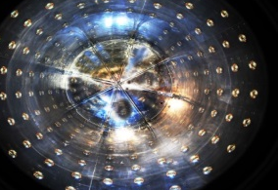
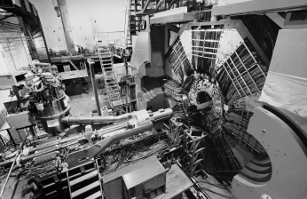
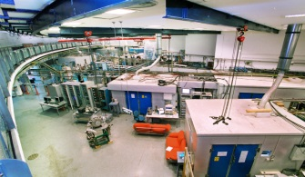
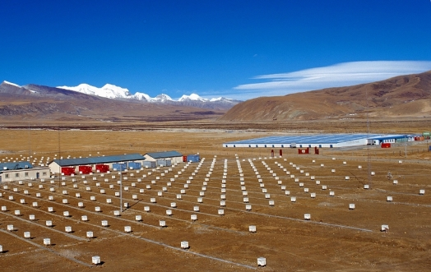
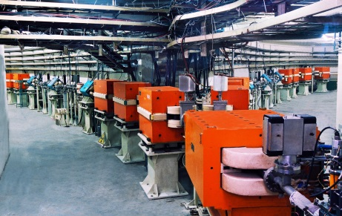
High Energy Physics in China
Yifang Wang
Institute of High Energy Physics, Beijing
Pisa, INFIERI2025, Sep. 4, 2025

Slide 2
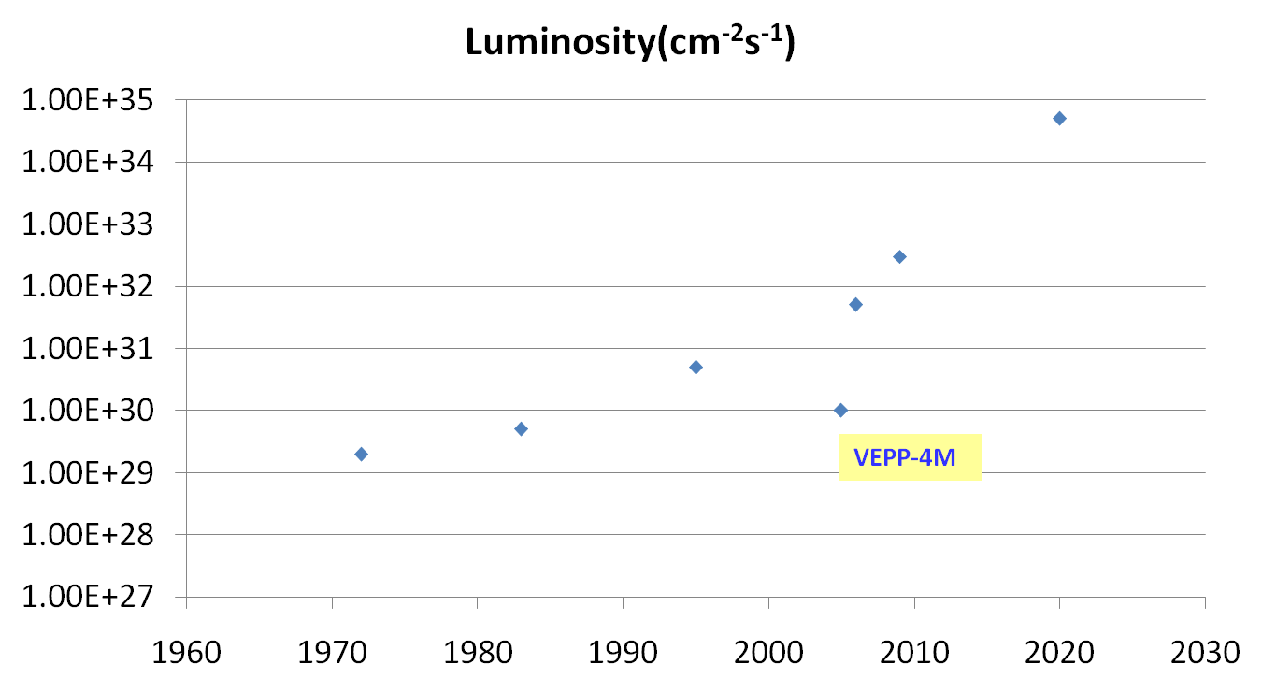




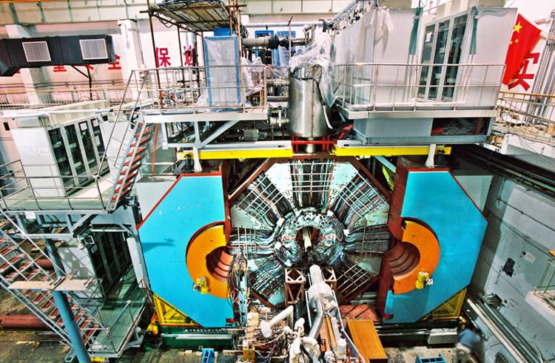

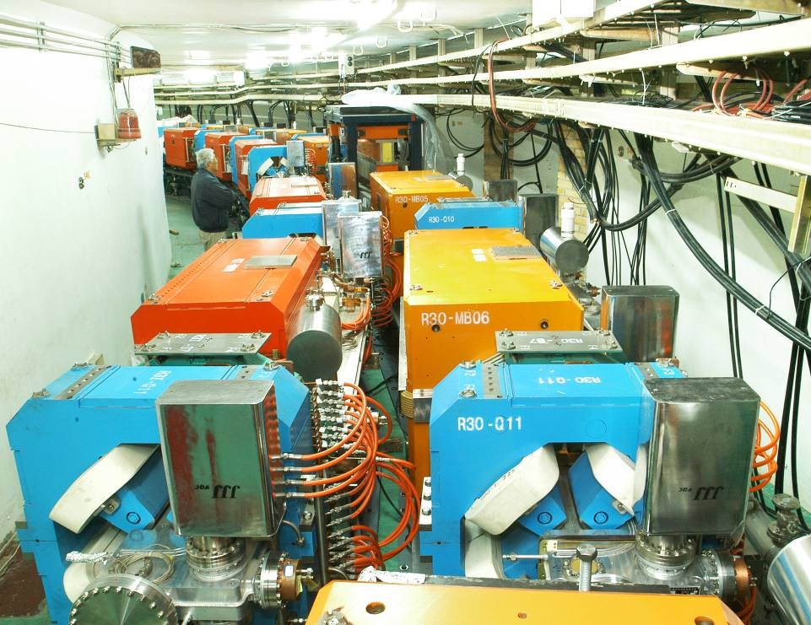
Hadrons：BEPCII/BESIII
Initial construction of BEPC: 1984-1988
Upgrade: 2004-2008, operational since 2009
Reached highest luminosity of 1.1×10³³cm⁻²s⁻¹
A total of ~50 fb⁻¹ collected in 1.84-4.95 GeV COM
Published >660 papers, >125 at PRL
e⁺e⁻ colliders at 2-5 GeV
BEPCII
DORIS I
BEPC
CESRc
SPEAR
ADONE
2

Slide 3
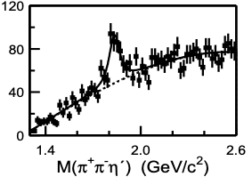
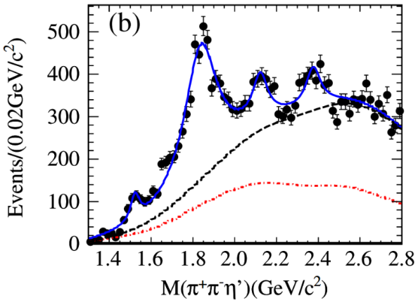
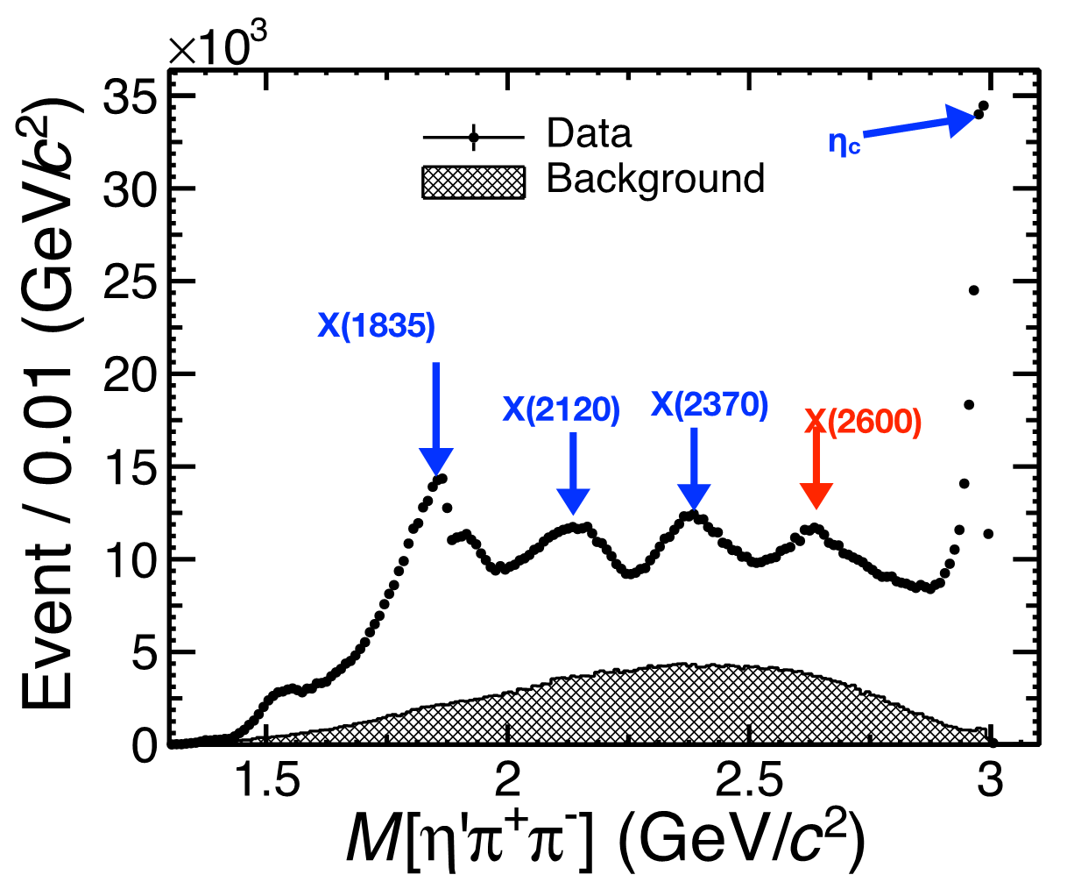
Example 1: Hadron Spectroscopy
X(1835) from J/ψ decays
Great physics results from high statistics and high quality data with low backgrounds:
30 New hadrons discovered at BESIII
58 million J/ψ
Structure
PRL 95(2005) 262001
225 million J/ψ
More structures
PRL106(2011)072002
10 billion J/ψ
Fine structures
PRL129 (2022) 042001

Slide 4
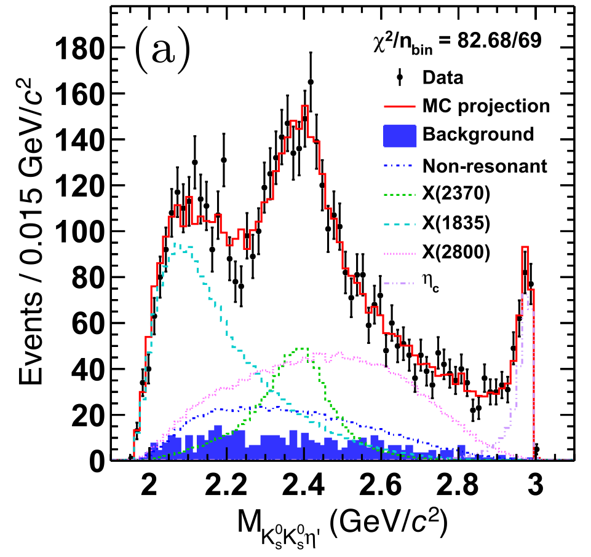
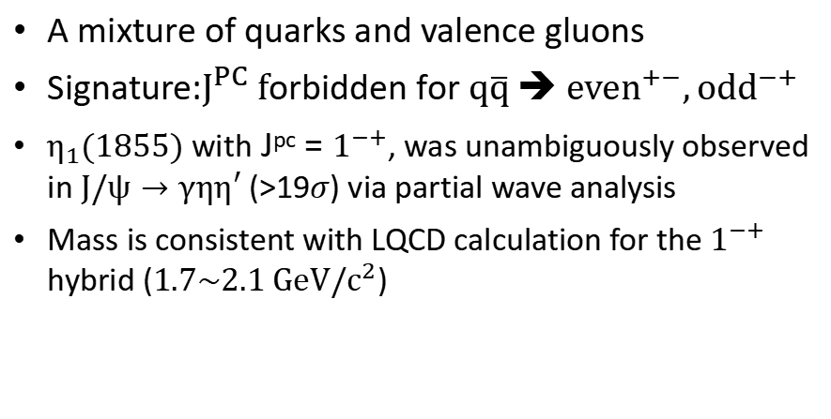
Example 2: Exotic hadrons
Glueball-like Particle X(2370)
Hybrid candidate η₁(1855)
4
PRL 132 (2024)181901
PRL 129 (2022) 192002
A particle made of “force” (gluons)
X(2370) with J^{pc} = 0⁻⁺ as a glueball:
Mass and J^{PC} consistent with LQCD predictions
Produced in a gluon-rich process of J/ψ decays, in consistent with LQCD
Decay: no dominant decay, flavor symmetric, very similar to η_{c} (decay via gluons)
A mixture of quarks and valence gluons
Signature:$J^{PC} f$orbidden for $q\overline{q} \text{➔} {even}^{+−},{odd}^{−+}$
$η_{1}(1855)$ with J^{pc} = $1^{−+}$, was unambiguously observed in $J/ψ→γηη′$ (>19$σ$) via partial wave analysis
Mass is consistent with LQCD calculation for the $1^{−+}$ hybrid ($1.7\sim 2.1 GeV/c^{2}$)

Slide 5
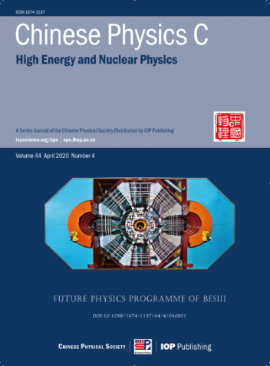
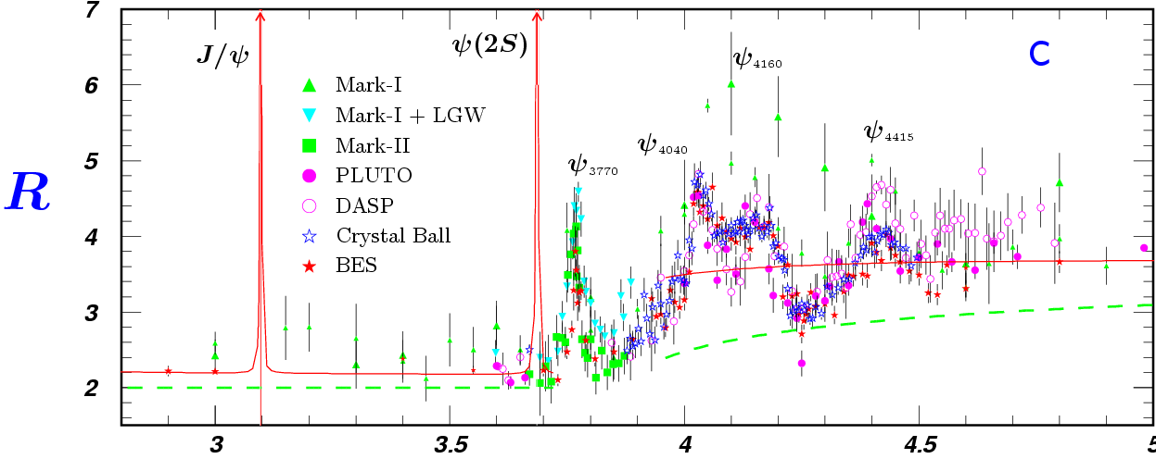
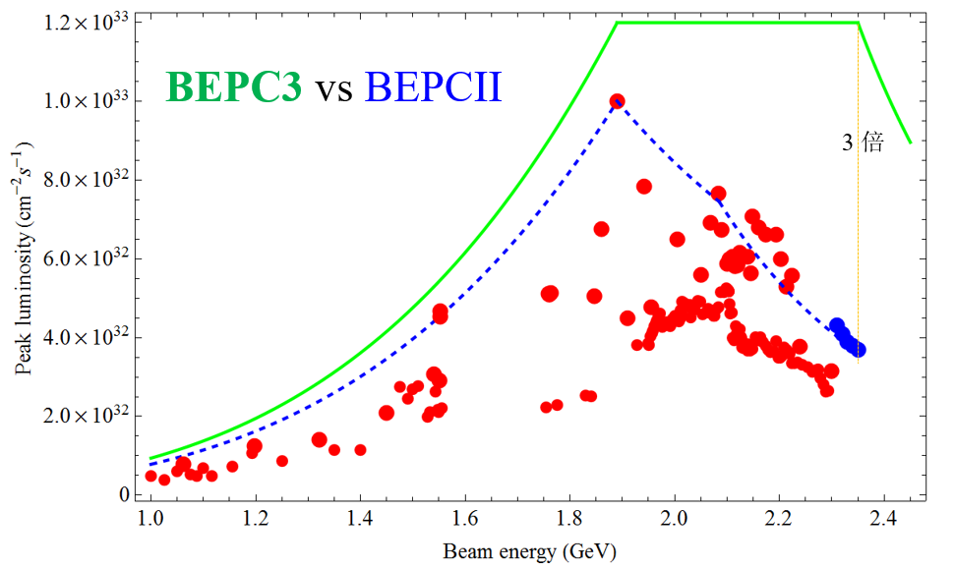
Future Plan of BEPCII/BESIII
Rich physics program requiring > 40 fb⁻¹, corresponding to 15 yrs of data taking at the present luminosity
Upgrade recently completed
The Inner drift chamber replaced by a Cylindrical GEM
Luminosity × ~3 ➔ squeeze the beam size by adding a new RF cavity per beam
Replace the two SC quadrupole magnets near the IP to increase the maximum beam energy from 2.45 to 2.8 GeV
Test of CEPC technologies
Operation will continue until at least 2030
Future physics at BESIII

Slide 6
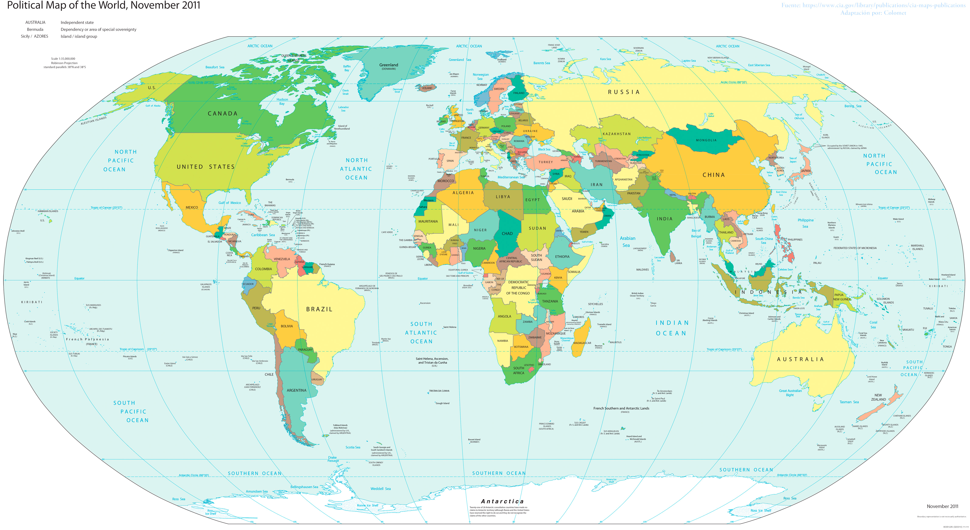
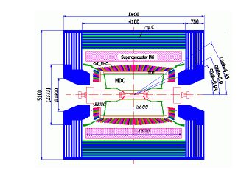


BESIII collaboration
Europe (17/115)
Germany (6): Bochum University,
GSI Darmstadt, Helmholtz Institute Mainz, Johannes Gutenberg University of Mainz, Universitaet Giessen,University of Münster Italy (3): Ferrara University, Frascati, University of Torino Netherlands (1):KVI/University of Groningen
Poland (1)National Centre for Nuclear Research
Russia (2): Budker Institute of Nuclear Physics, JINR
Sweden (1):Uppsala University
Turkey (1):Turkish Accelerator Center Particle Factory Group UK (2): University of Manchester, University of Oxford
Asia (6/10)
Pakistan (2): COMSATS Institute of Information Technology
University of the Punjab, University of Lahore
Mongolia (1): Institute of Physics and Technology
Korea (1): Chung-Ang University
India (1): Indian Institute of Technology madras
Thailand (1): Suranaree University of Technology
USA(4/8) Carnegie Mellon University Indiana University University of Hawaii University of Minnesota
China (58/367)
Institute of High Energy Physics (146), other units(221): Beijing Institute of Petro-chemical Technology, Beihang University,
China Center of Advanced Science and Technology, Fudan University,
Guangxi Normal University, Guangxi University,
Hangzhou Normal University, Henan Normal University,
Henan University of Science and Technology,
Huazhong Normal University, Huangshan College, Hunan University,
Hunan Normal University, Henan University of Technology
Institute of modern physics, Jilin University, Lanzhou University, Liaoning Normal University, Liaoning University, Nanjing Normal University, Nanjing University, Nankai University, North China Electric Power University,
Peking University, Qufu normal university, Shanxi University,
Shanxi Normal University, Sichuan University, Shandong Normal University,
Shandong University, Shanghai Jiaotong Univeristy, Soochow University,
South China Normal University, Southeast University, Sun Yat-sen University,
Tsinghua University, University of Chinese Academy of Sciences, University of Jinan, University of Science and Technology of China,
University of Science and Technology Liaoning,
University of South China, Wuhan University, Xinyang Normal University,
Zhejiang University, Zhengzhou University,YunNan University , China University of Geosciences
South America (1/1) Chile: University of Tarapaca
~600 members
(more than 130 from outside of China)
From 84 institutions in 17 countries
Notes:
The Collaboration is well organized fully following the international practice
for large experiments

Slide 7
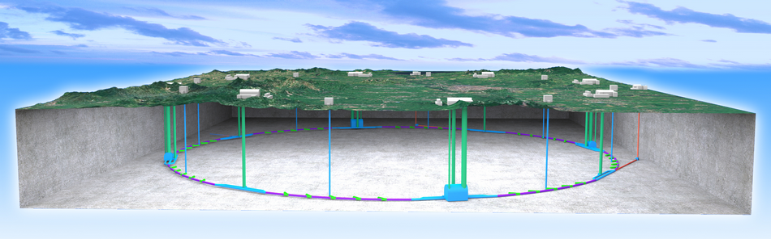
Higgs: CEPC
Since 2005, we were thinking about the next machine after BEPC
After its discovery, we realized that Higgs is the best portal for new physics and for the future of HEP
The idea of a Circular e+e- Collider(CEPC) followed by a possible Super proton-proton collider(SPPC) was proposed in Sep. 2012, and reported in Oct. 2012 at Fermilab during the workshop: “Higgs Factories 2012”
It quickly gained momentum in China and in the world
A natural continuation of BEPC

Slide 8
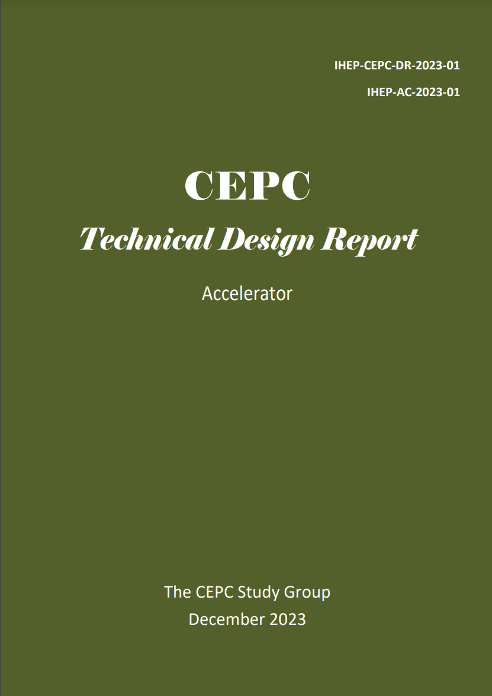
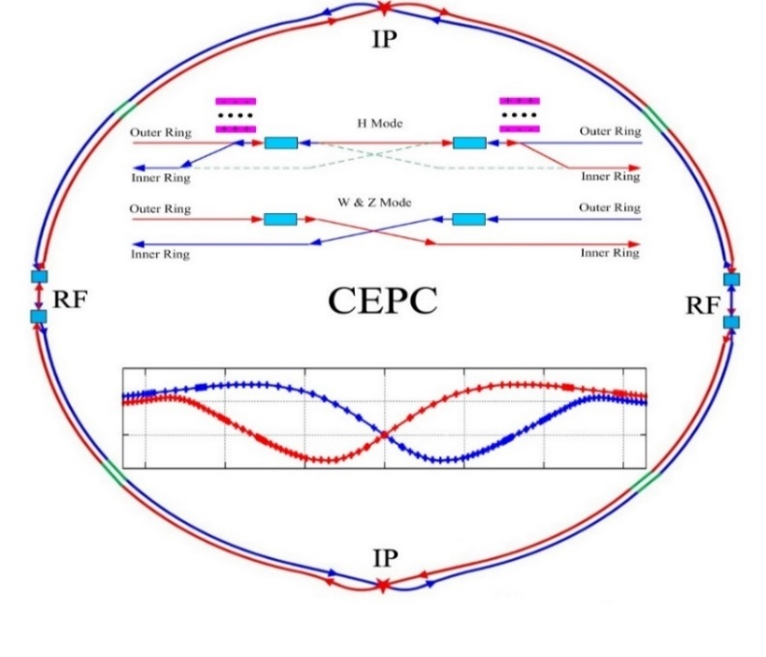
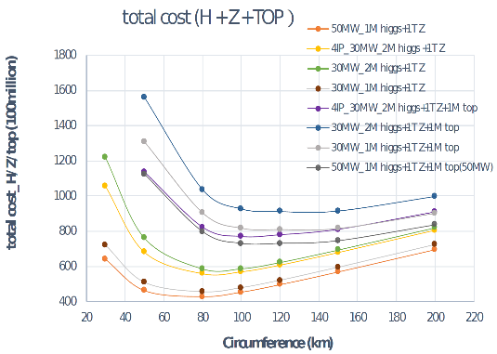
CEPC Accelerator：TDR Published
Baseline: 100 km, 30 MW;
Upgradable to 50 MW, High Lumi Z, ttbar
Shared tunnel: Compatible design for CEPC and SppC
Switchable operation: Higgs, W/Z, top
H/tt
W&Z
arXiv:2312.14363
1114 authors
278 institutions
38 countries
1090 pages
Total cost of 36.4B RMB (~4.6B Euro)
JINST 17, P10018 (2022)

Slide 9
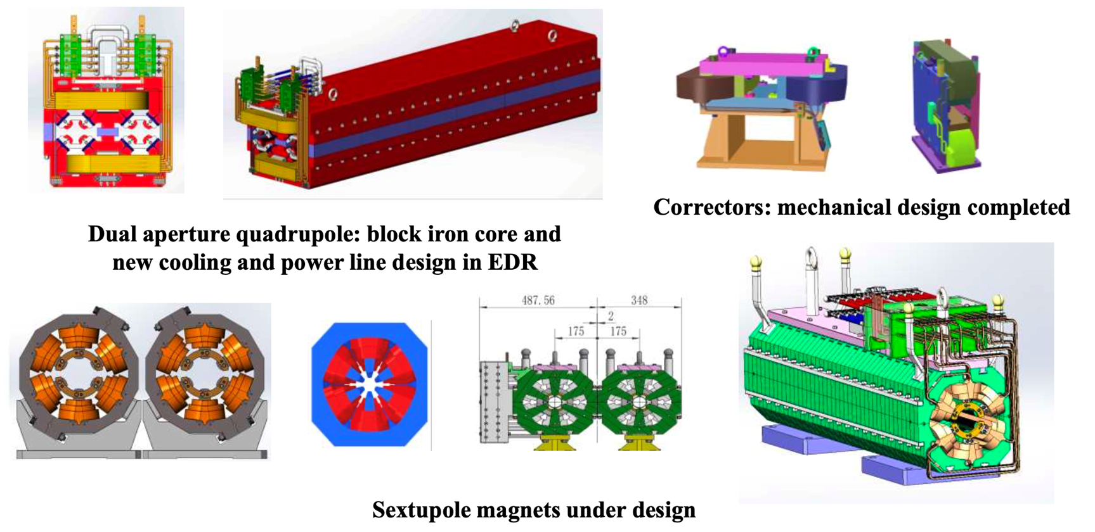
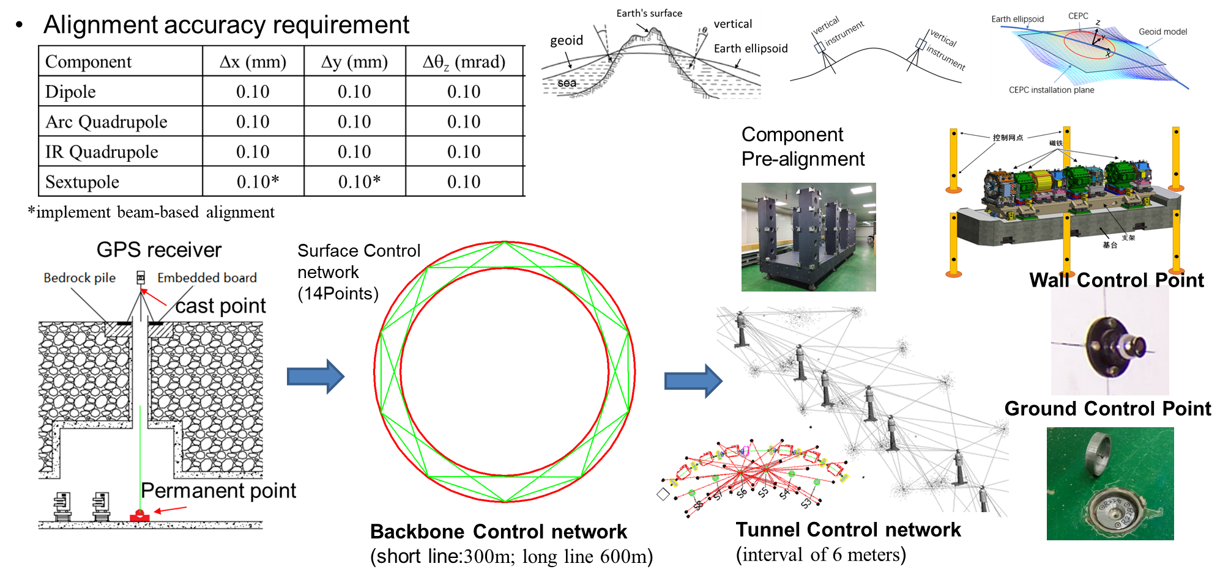
Next Step for the Accelerator：EDR
EDR tasks start with 35 WGs aiming for issues like further R&D of new technologies, mass production, mockup for installation, etc.
A full cryomodule containing six 650 MHz 2-cell cavities
Higher efficiency klystrons
Automatic production for NEG coated vacuum chambers
Automatic production for magnets
More prototypes of magnets
C-band LINAC test band
CCT type SC quadrupole magnet for final focusing
MDI design and background studies
Control and timing
Alignment and installation plan
Mockup for installation
PWFA test facility
….

Slide 10
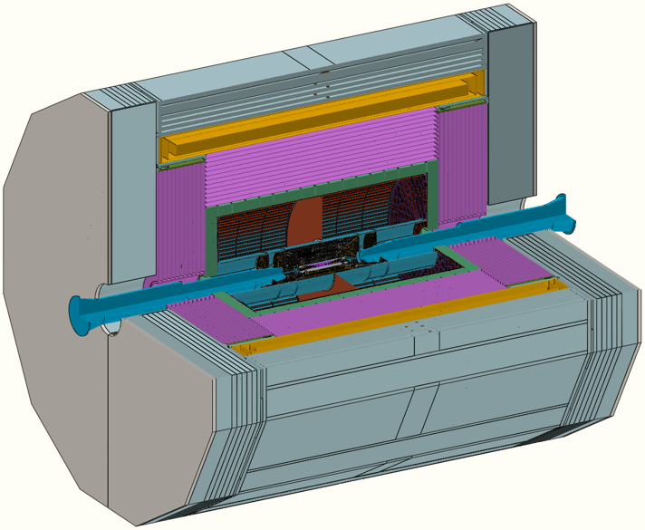
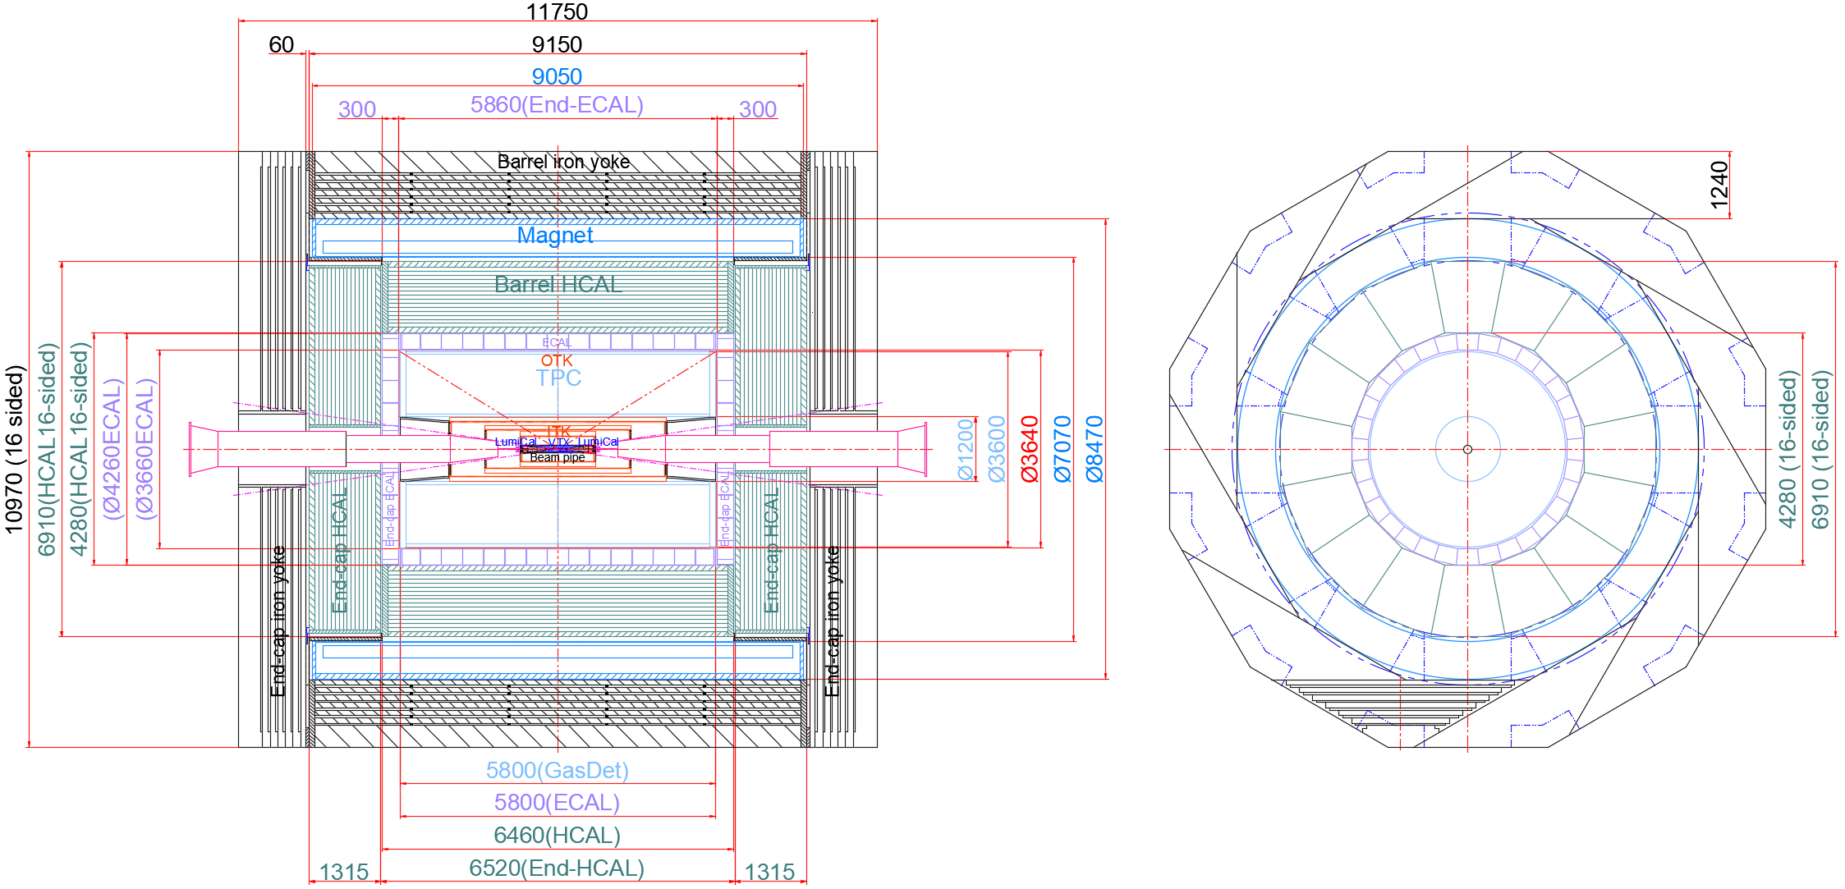
CEPC Detector：Reference Detector TDR
International collaboration may only be established after the CEPC project is approved by the Chinese government
For the approval, a design and budget is needed
Solution: A reference TDR to demonstrate a working design, the feasibility, technologies, budget, etc.
CEPC international advisory committee suggested and approved this plan
A new detector concept was adopted by the Ref-TDR:
Si tracker + TPC for tracking and PID
Crystal EM calorimeter with PFA for good EM/jet resolution
Hadron calorimeter using glass scintillator for better sampling ratio and good hadron/jet resolution
TDR will be released in the mid of this year, after being reviewed by IDRC
York and Muon chamber
(plastic scintillator+SiPM)
Superconducting magnet (3T/2T)
Hadron calorimeter
(Scin. glass~30%/√E)
EM calorimeter (BGO<2%/√E )
tracker+TOF
(AC-LGAD,
~10 um，50 ps)
Si vertex
(Stiching ~3um)
Si tracker(HV-CMOS ~10 um）
TPC
(~100 um，dN/dx ~3%)

Slide 11
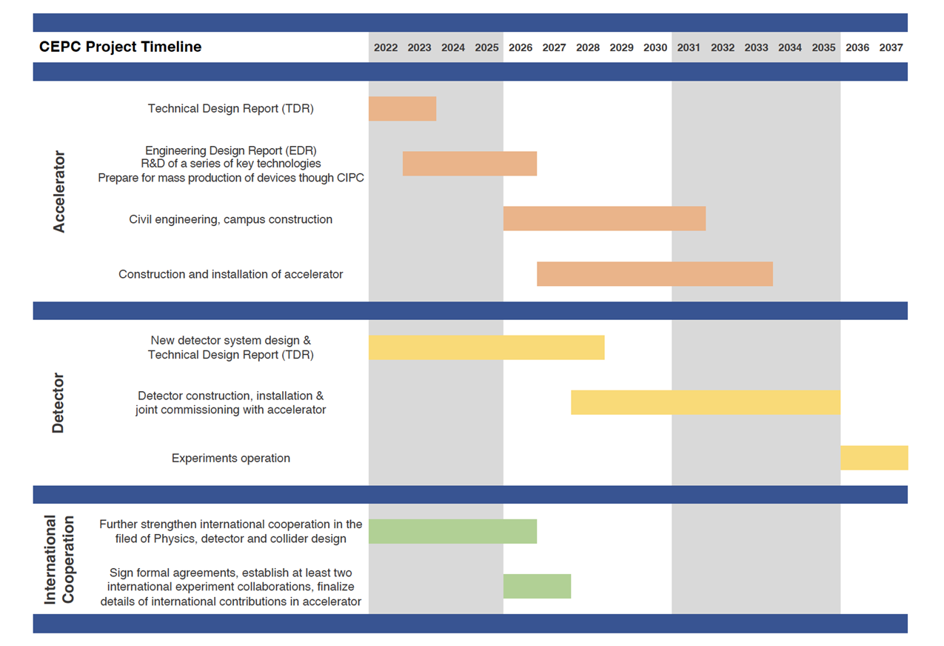
CEPC Planning and Schedule
TDR (2023), EDR(2027), start of construction (~2027)
CEPC plans to submit the proposal to the central government(NDRC) within the “15th five year plan”
CAS organized the 1st review of all proposals at the end of last year. CEPC was the top 2 for Basic Science
Waiting for the 2nd review by CAS in the mid of this year
Waiting for the “call for proposals” by NDRC by the end of this year
Once CEPC is (preliminarily) approved in China, a call for proposal will be released by IHEP
Although the management system is still to be settled, most likely IHEP will be the host lab
15th FY
16th FY

Slide 12
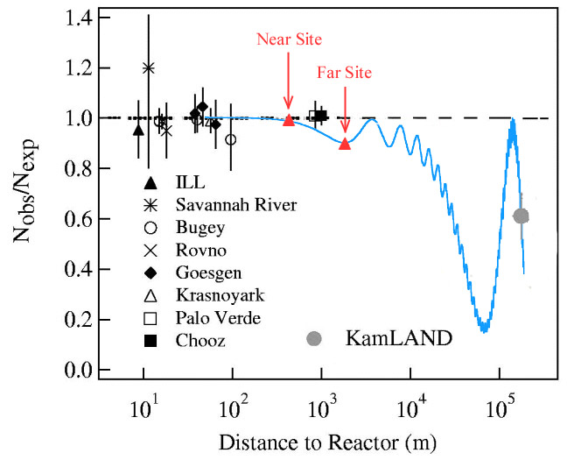
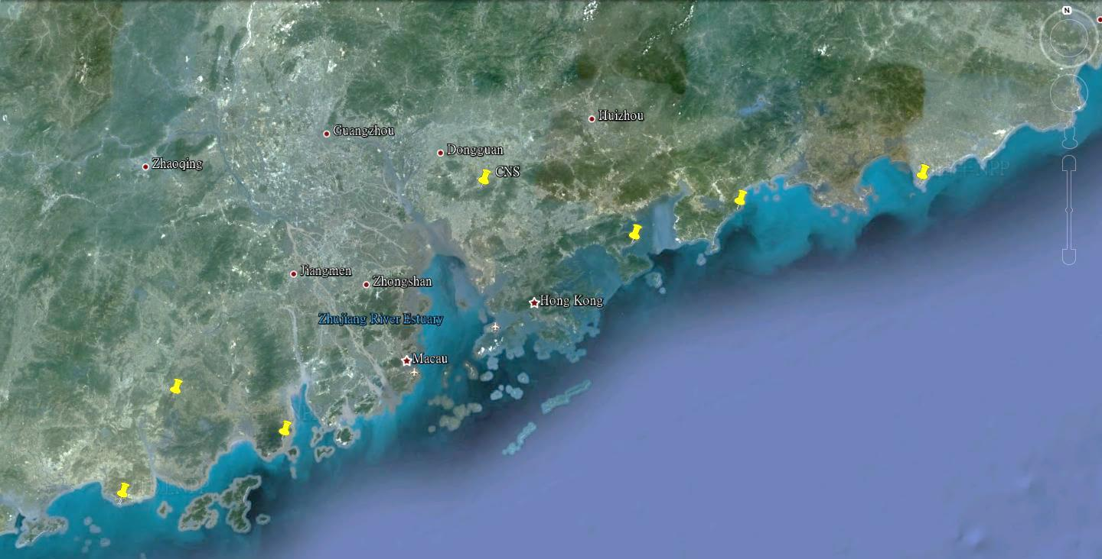

Neutrinos: JUNO Experiment
Continue reactor neutrino experiments using the liquid scintillator: mainly for the neutrino mass hierarchy
Idea since 2008, construction started in 2015, data taking this year
Daya Bay
Overburden ~ 700 m
JUNO
Previous site candidate
Guang Zhou
2.5 h drive
Lufeng NPP
Shen Zhen
Huizhou NPP
Daya Bay NPP
Zhu Hai
Hong Kong
 | Target mass [t] | energy resolution
JUNO | 20,000 | 3% @ 1 MeV
Borexino | 300 | 5% @ 1 MeV
KamLAND | 1,000 | 6% @ 1 MeV
Daya Bay | 20 | 8% @ 1 MeV
53 km
Macau
53 km
Taishan NPP
Yangjiang NPP

Slide 13
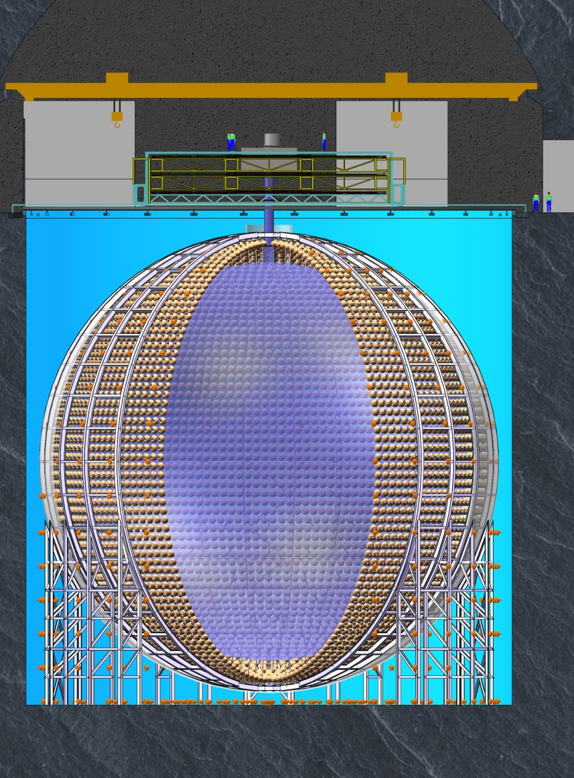
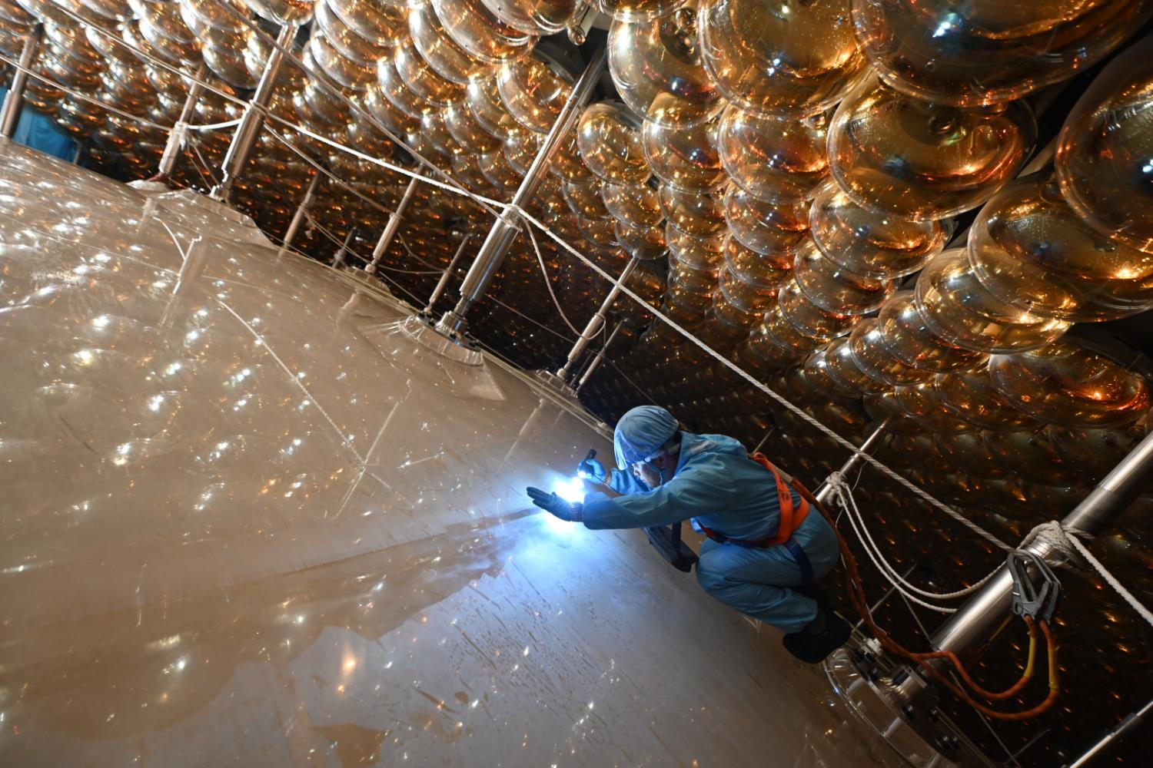
JUNO Detector
Liquid Scintillator detector ➔ 20 kt Linear Alkali Benzene + PPO + Mis-MSB + BHT
Best energy resolution & light yield ➔ >1600 PE/MeV & 20 m attenuation length
44.5m
43.5m

Slide 14
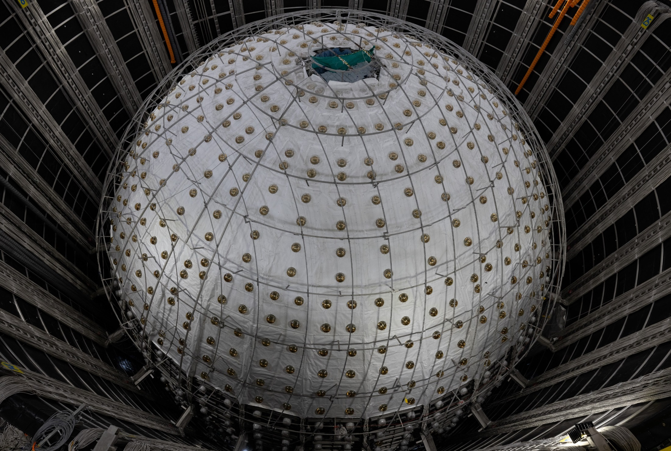
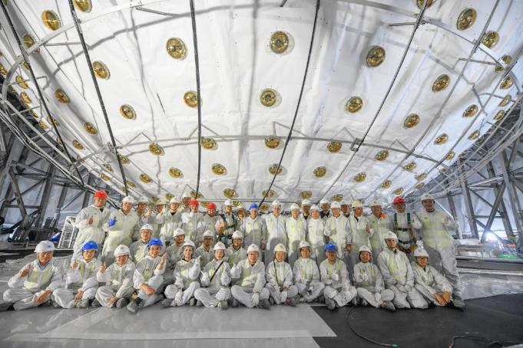
JUNO Detector: Top & Bottom
International Collaboration with ~750 members from 72 institutions in 17 countries/regions
14

Slide 15
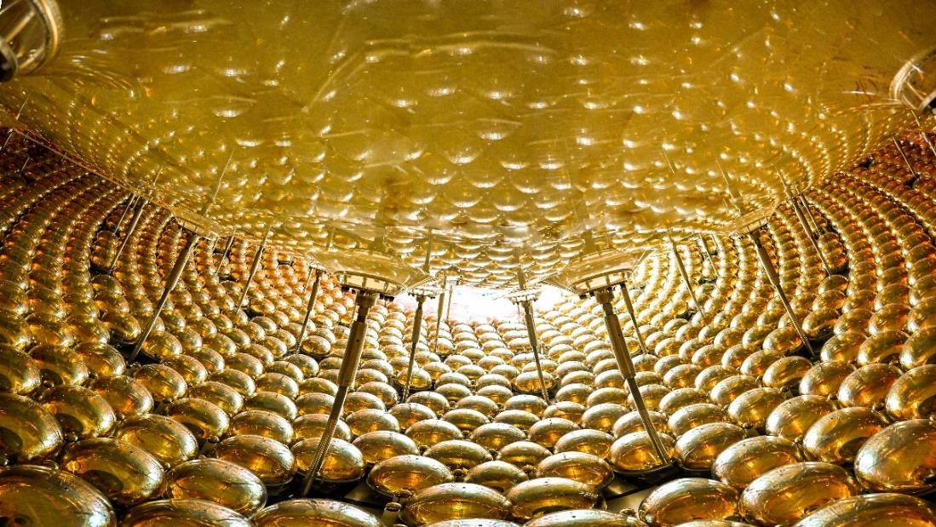
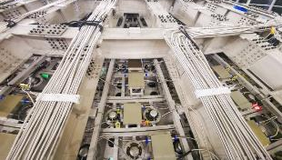
PMT and readout electronics
 | LPMT (20-inch) |  | SPMT (3-inch)
 | Hamamatsu | NNVT | HZC
Quantity | 5000 | 15012 | 25600
Charge Collection | Dynode | MCP | Dynode
Photon Detection Efficiency | 28.5% | 30.1% | 25%
Coverage | 75% |  | 3%
Reference | Eur.Phys.J.C 82 (2022) 12, 1168 |  | NIM.A 1005 (2021) 165347

Slide 16
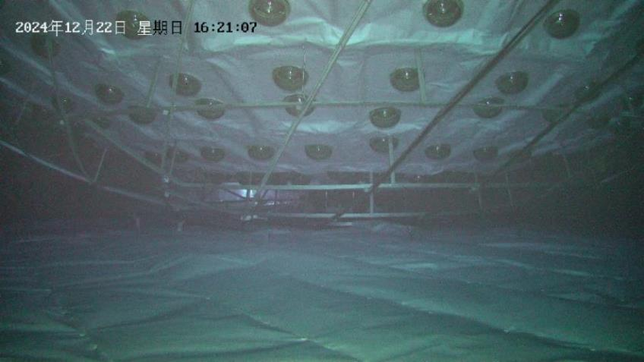
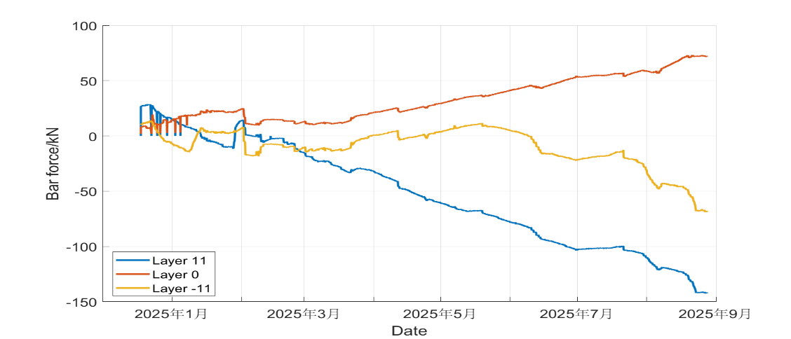
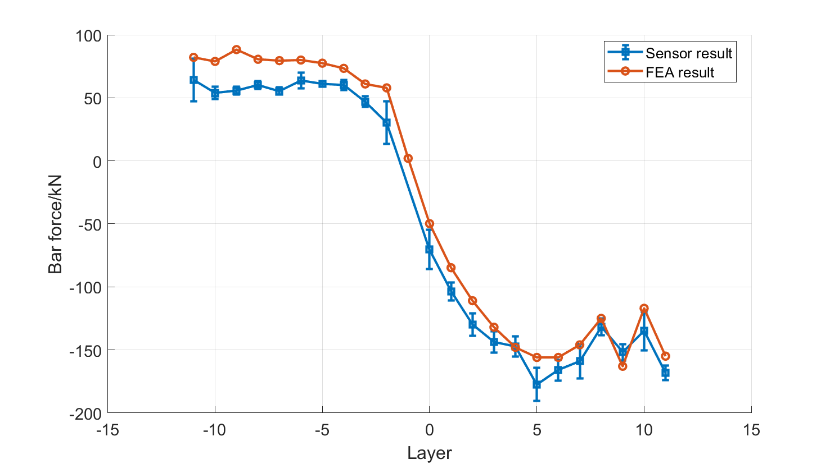
Filling the detector
Liquid and air pressure kept the same between the inside and outside of the acrylic tank
Water pipes and acrylic tank “breath” with N₂
Stress of the detector structure closely monitored, in good agreement with expectations
Evolution of stress during filling
Water filled: 60 kt, 43.7m
Water qualities meet requirements:
Attenuation length: > 60m
Particle counts: ~800/20mL
Resistivity: ~ 4 MΩ*cm
U/Th<10⁻¹⁵ g/g for CD, U/Th<10⁻¹⁴ g/g for VETO
²²²Rn<10 mBq/m³, ²²⁶Ra<1 mBq/m³
temperature 21.1±0.5 ºC
Measured eff. for muons tagged by CD: ~99.98%
Pulling from bottom
Stress from FEA and Measurement
Pushing from top

Slide 17
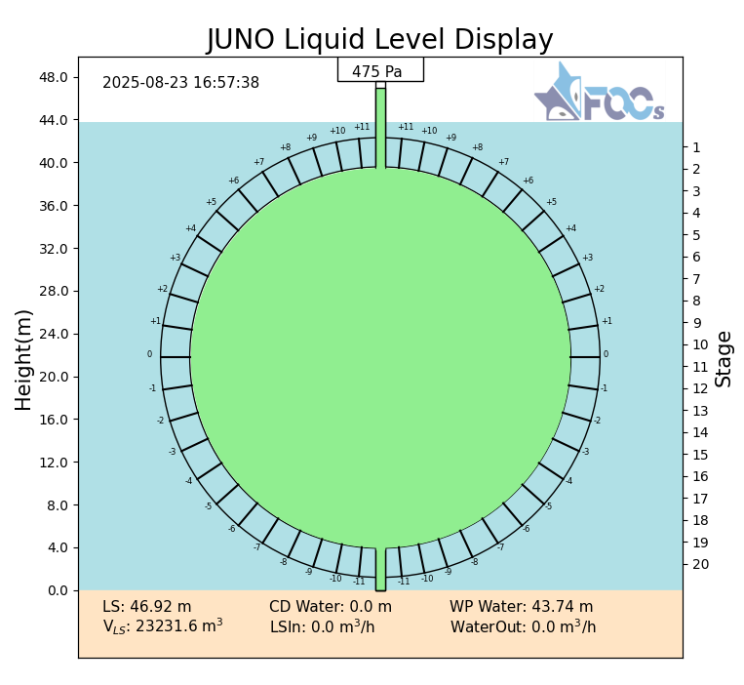
Liquid Filling Completed, Physics Data Taking Started
On August 22 at ~22:12, water in Acrylic tank was fully replaced by LS
~90 t lower quality LS at the bottom were further replaced
Calibration started at 14:00 of Aug. 23
Data taking for physics started on Aug. 26 at 5:30 am (Beijing time)
Total LS in CD: 23231.6 m³
Total water in pool: 41225.1 m³

Slide 18
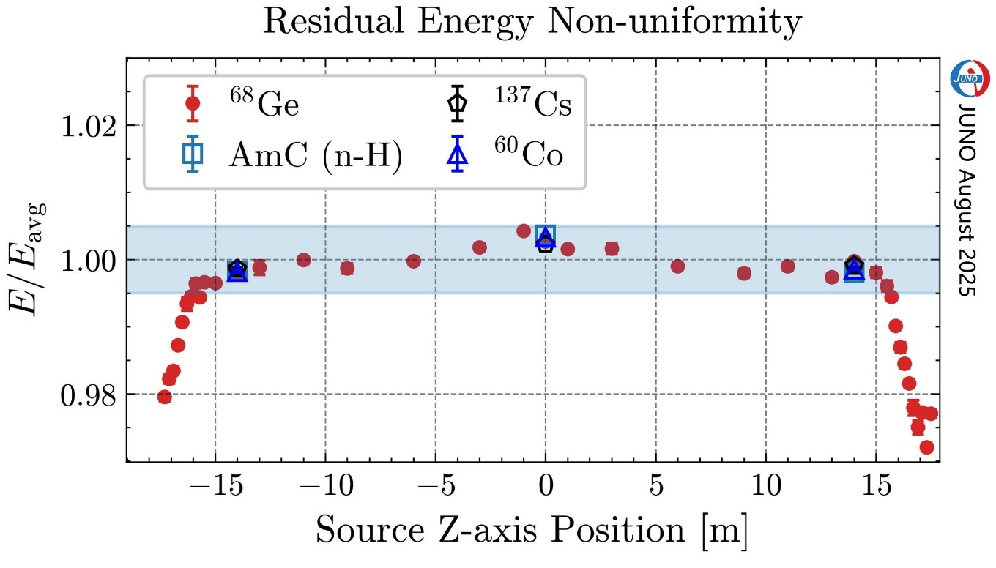
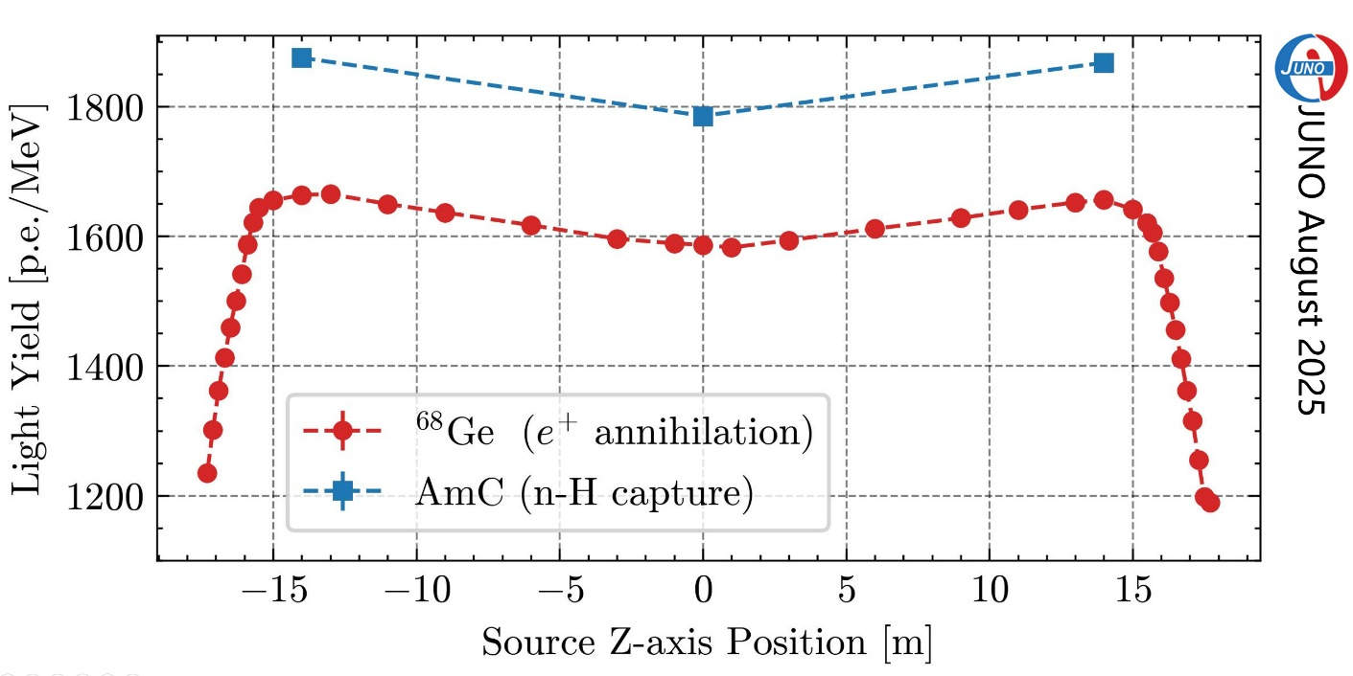
Detector Performance: Uniformity and light yield
For R<16m, residual energy non-uniformity scanned along the Z-axis is <0.5%
Light yield is >1600 PE/MeV for ⁶⁸Ge, >1800 PE/MeV for neutron, better than expectations (difference due to non-linearity, Chinese Phys. C 49 (2025) 013003 )
Edge effects still exist, more calibration data and software work needed
Light yield for ⁶⁸Ge and neutron
Preliminary
Preliminary

Slide 19
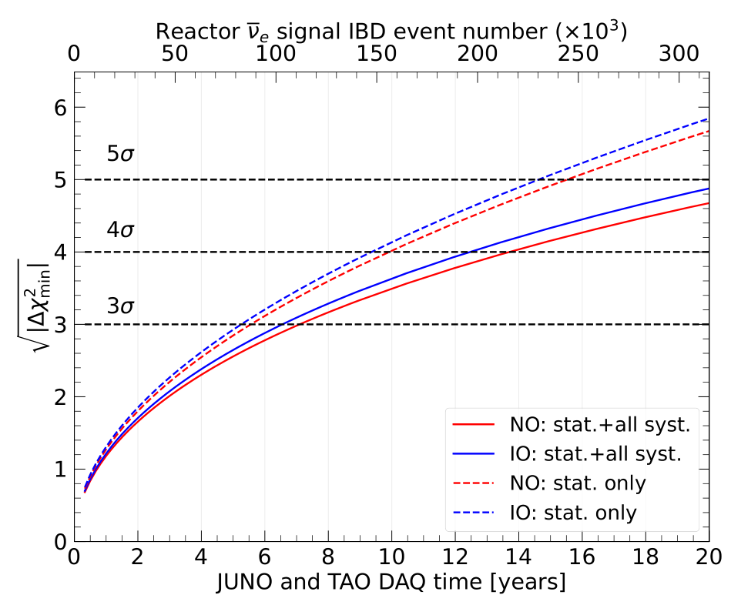
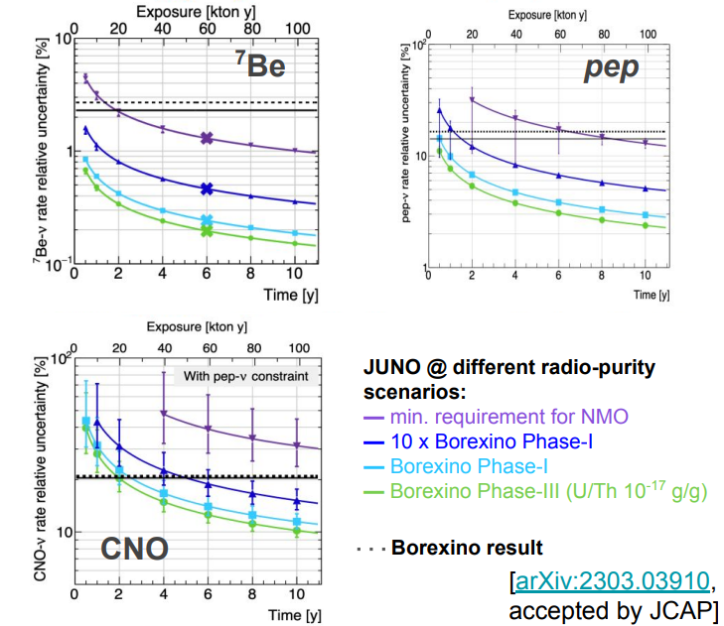
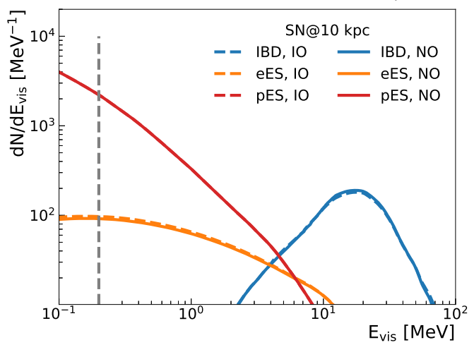
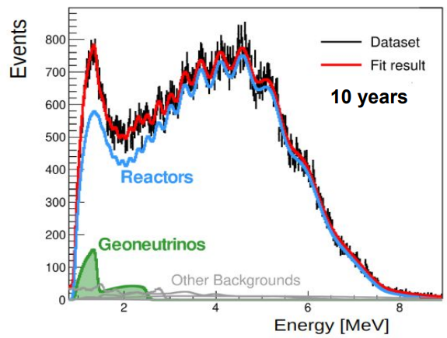
Physics at JUNO
Mass Hierarchy: 4σ in 6 yrs, independent of the CP phase
Neutrino oscillation：measuring parameters to < 1%, and test the unitarity
Burst supernova neutrino events: ~5000 @10 kpc
Discovery of diffused supernova neutrinos if ⟨E⟩ > 15 MeV
Geoneutrinos: determining U/Th ratio in earth
Solar neutrinos: improvements over Borexino
Proton decays
 | Current (PDG2020) | JUNO (100 d) | JUNO (6 y)
Δm²₃₁ Δm²₃₂ | 1.3% | 0.8% | 0.2%
Δm²₂₁ | 2.4% | 1.0% | 0.3%
sin²θ₁₂ | 4.2% | 1.9% | 0.5
sin²θ₁₃ | 3.2% | 47.9% | 12.1%

Slide 20
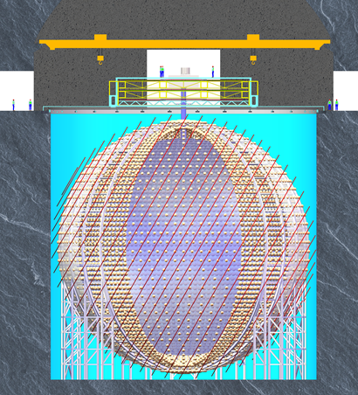
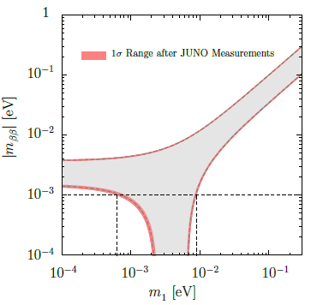
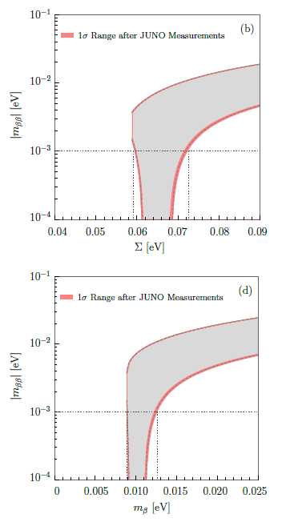
Future Upgrade: JUNO-ββ
In 10 years from now, oscillation will be mostly understood.
0ν ββ decay will be the next focus point:
J. Cao et al., arXiv:1908.08355
 | Isotope | Mass(t) | <m_{ββ}>,meV
SNO+ | ¹³⁰Te | 8 | 19-46
KamLAND2-Zen | ¹³⁶Xe | 1 | ~20
NEXT-HD | ¹³⁶Xe | 1 | 14-40
nEXO | ¹³⁶Xe | 5 | 7-22
Darwin/Panda-nT | ¹³⁶Xe | 3-5 | 7-22
LEGEND-1000/CDEX-1t | ⁷⁶Ge | 1 | 10-40
AMoRE-II | ¹⁰⁰Mo | 0.1 | 12-22
CUPID | ¹⁰⁰Mo | 0.24 | 12-20
CUPID-1T | ¹⁰⁰Mo | 1 | 4-7
JUNO-ββ | ¹³⁶Xe | 50 | 4-10
 | ¹³⁰Te | 100 | 3-14
Insert a balloon filled with ¹³⁶Xe-loaded LS (or ¹³⁰Te) into the JUNO detector
Zhao et al., arXiv: 1610.07143, CPC 41（2017）5

Slide 21
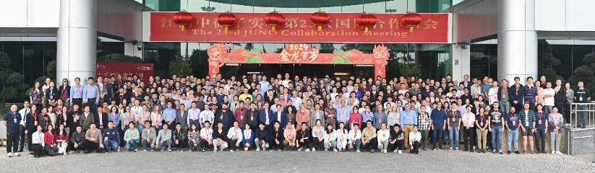
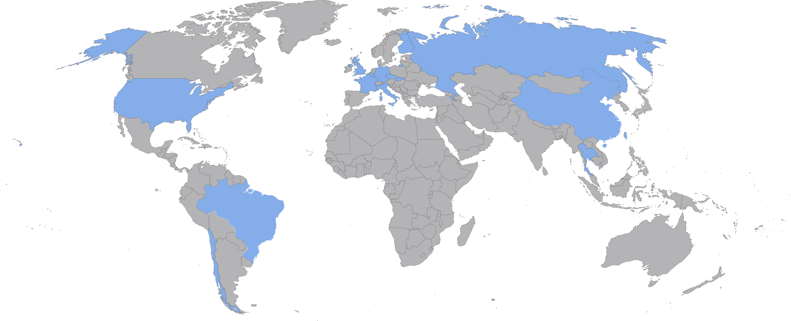
JUNO Project and the collaboration
Project firstly approved in China in 2013 and later in other countries. Civil construction started in 2015
Collaboration mostly established in 2014, now >700 collaborators from 74 institutions in 17 countries/regions
Country | Institute | Country | Institute | Country | Institute
Armenia | Yerevan Physics Institute | China | Wu Yi U. | Italy | INFN di Frascati
Belgium | Universite Libre de Bruxelles | China | Wuhan U. | Italy | INFN-Ferrara
Brazil | PUC | China | Xi'an JT U. | Italy | INFN-Milano
Brazil | UEL | China | Xiamen University | Italy | INFN-Milano Bicocca
Chile | SAPHIR | China | Zhengzhou U. | Italy | INFN-Padova
Chile | UNAB | China | NUDT | Italy | INFN-Perugia
China | BISEE | China | CUG-Beijing | Italy | INFN-Roma 3
China | CAGS | China | ECUT-Nanchang City | Pakistan | PINSTECH (PAEC)
China | ChongQing University | China | CDUT-Chengdu | Russia | INR Moscow
China | DGUT | China | SUSTech-Shenzhen | Russia | JINR
China | Guangxi U. | China | KNRC | Russia | MSU
China | Harbin Institute of Technology | Czech | Charles U. | Slovakia | FMPICU
China | IHEP | Finland | University of Jyvaskyla | Taiwan-China | National Chiao-Tung U.
China | Jinan U. | France | IJCLab Orsay | Taiwan-China | National Taiwan U.
China | Nanjing U. | France | LP2i Bordeaux | Taiwan-China | National United U.
China | Nankai U. | France | CPPM Marseille | Taiwan-China | NKNU
China | NCEPU | France | IPHC Strasbourg | Taiwan-China | NTUT
China | Shandong U. | France | Subatech Nantes | Thailand | NARIT
China | Shanghai JT U. | Germany | RWTH Aachen U. | Thailand | PPRLCU
China | IGG-Beijing | Germany | TUM | Thailand | SUT
China | SYSU | Germany | U. Hamburg | U.K. | U. Liverpool
China | Tsinghua U. | Germany | GSI | U.K. | U. Warwick
China | UCAS | Germany | U. Mainz | USA | UMD-G
China | U. of South China | Germany | U. Tuebingen | USA | UC Irvine
China | IMP | Italy | INFN Catania

Slide 22



AstroPhysics: Cosmic-Rays and γ-astronomy ⎯ Large High Altitude Air Shower Observatory(LHAASO)
World largest air shower array(with e, μ, water Č detectors and Č telescope) for the high energy γ-astronomy and cosmic-ray physics
Construction just completed and interesting results obtained:
Highest γ-rays from the Milky Way： 1.4 PeV
many γ-ray sources up to ~1 PeV identified → PeVatrons in Milky Way
Future
Large Array of Cherenkov Telescopes（LACT）
Under-water neutrino telescope
Sichuan, 4410m above the sea

Slide 23


Future Space Programs
A 3D crystal calorimeter for ×10 acceptance and ×10 higher energy on board of the Chinese Space Station, to be launched in ~2028
dark matter searches
Gamma-ray sky survey
Precise cosmic ray spectrum and composition to calibrate LHAASO
Welcome international collaboration
Enhanced X-ray Timing and Polarimetry satellite for
Neutron stars, black holes, etc. to study extreme gravity, magnetism, density, etc.
With cutting-edge technologies:
Large eff. Area (~3.5 m²@6 keV)
High spectral resolution (<180 eV@6 keV)
Polarimetry
Plan to launch in ~2030
Welcome international collaboration
HERD
eXTP

Slide 24


Dark Matter: JinPin Underground Lab
The deepest underground laboratory in the world with an overburden of 2400 m
Current experiments: dark matter searches and 0νββ searches
Xe-based PandaX-4t (4t LXe)
Ge-based CDEX-300 (300 kg)
Future：
PandaX-xT (~50t LXe)
CDEX-1T (1t ⁷⁶Ge)
Other experiments on 0νββ decays

Slide 25
Summary: Current and Future
 |  | Current | Future
Accelerator-based | Precision frontier | BESIII | ILC, FCC CEPC
 |  | LHCb, Belle II, PANDA, COMET, GlueX,…
 | Energy frontier | CMS、ATLAS
Non-accelerator-based | Underground/underwater | Daya Bay, JUNO | JUNO-ββ
 |  | EXO, Darkside… | nEXO, ARGO
 |  | PANDAx, CDEX | Panda-xT, CDEX-1T
 |  |  | HUNT, Trident
 | Surface | LHASSO | LACT
 | Space | AMS, SVOM | HERD eXTP
 |  | HXMT,Polar, DAMPE

