Slide 1

Introduction
Andrei Nomerotski, Czech TU & FIU

Slide 2
Outline
Principles of QM and logic behind it
Examples of quantum sources of photons and their advantages
  Quantum microscopes & ghost imaging
Examples of quantum interference effects
  HOM & HBT effects
Measurements of photons in Quantum

Slide 3
Quantum Mechanics
Two miracles:
1) wave-particle duality
2) entanglement
They both are dictated by experiment, this is the way the Nature works. They can be reconciled with everything else.

Slide 4
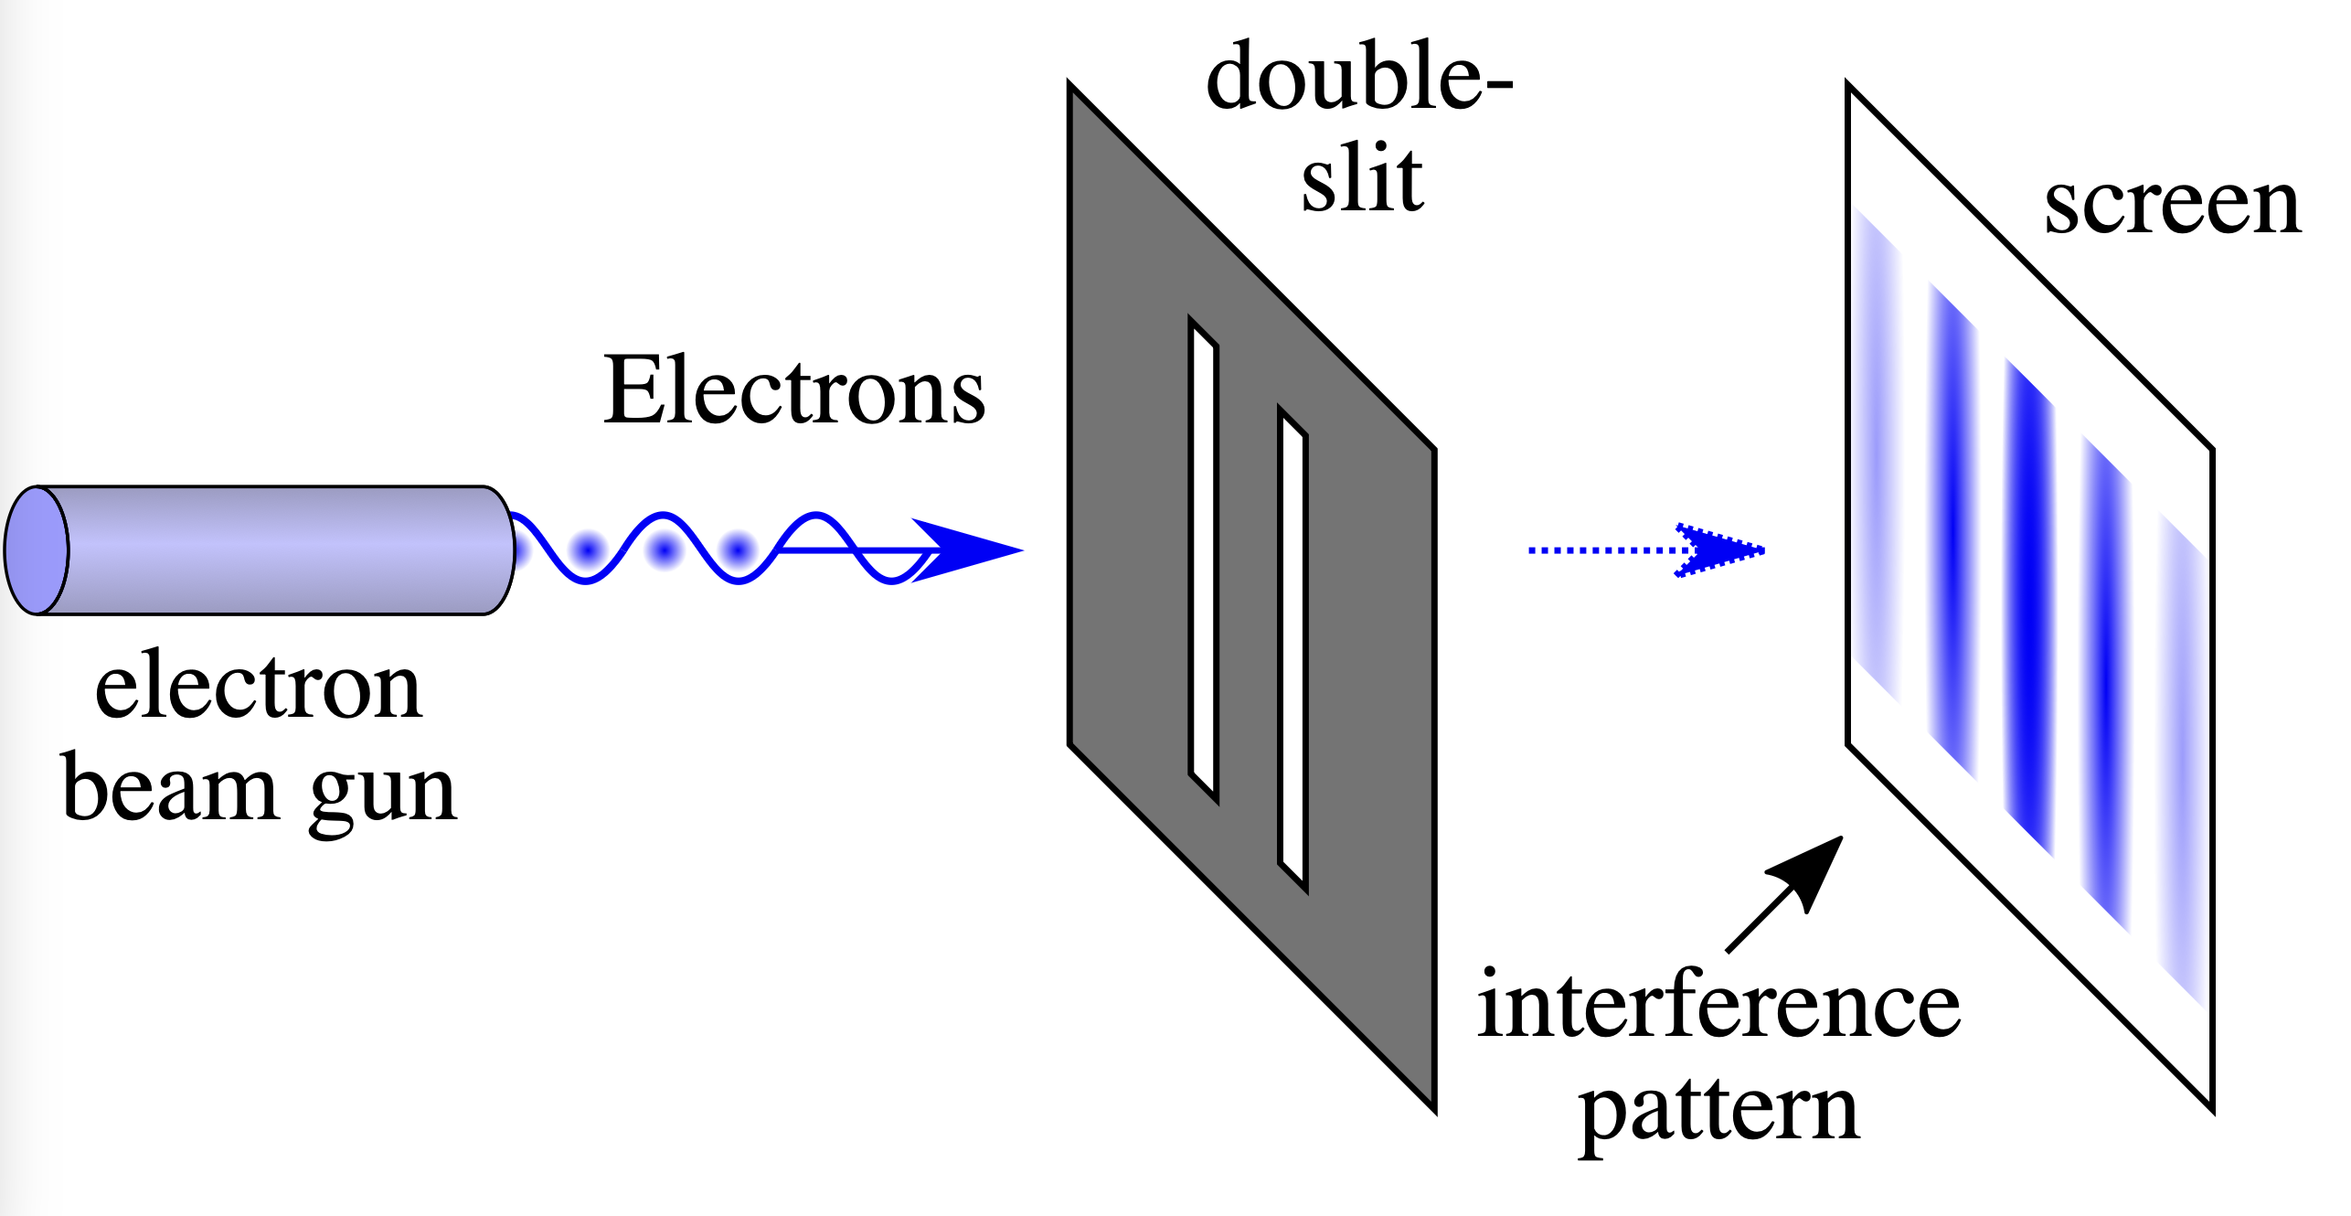
1) Wave - Particle Duality
Applicable to single particles
From Wikipedia
Experiment tells us that particles are similar to waves,
even if you shoot them slowly, one by one
Superposition principle: add amplitudes (of wave function)

Slide 5
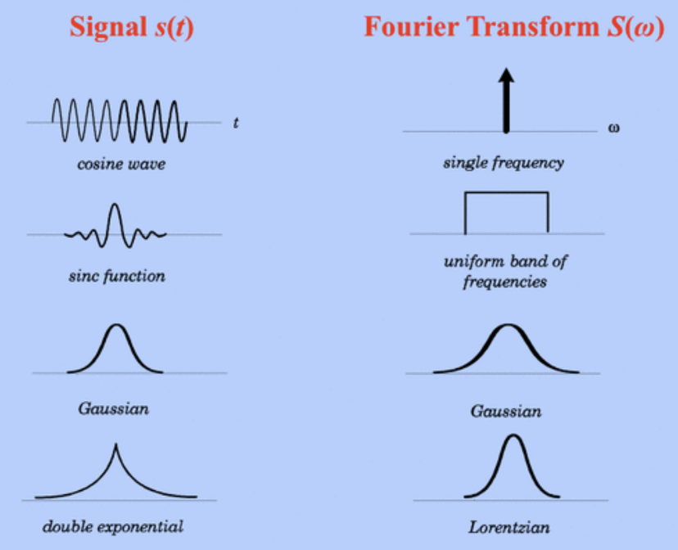


Heisenberg Uncertainty Principle
Similar to Fourier transform limit: infinite sine correspond to a single frequency but finite wave duration will correspond to finite bandwidth
From Wikipedia

Slide 6
Indistinguishability
Cannot label particles and keep track since don’t know where they are
(because of Heisenberg Uncertainty Principle!)
Particles are indistinguishable
Exchange of two indistinguishable particles does not change the system but can change sign of wave function. It can be symmetric or anti-symmetric.
This leads to two types of symmetries: Bose-Einstein & Fermi-Dirac.

Slide 7
2) Entanglement
For two particles with interaction: they can strongly correlate in multiple observables: position, energy, time, polarization etc
“know about each other”, “spooky action” + other murky terminology.
it just means that they are correlated more than allowed classically
In certain situations this is called ‘quantum advantage’

Slide 8
2) Entanglement
For two particles with interaction: they can strongly correlate in multiple observables: position, energy, time, polarization etc
Has non-locality implications $→$ hidden variables (which would allow each particle to have full information about the system)
Bell’s inequalities allowed to prove there are no hidden variables.
Experimental verification lead to Nobel in 2022 (Aspect, Zeilinger, Clauser)

Slide 9
When should we worry about Quantum?
Planck constant sets the scale in Heisenberg Uncertainty Principle
  Probing small distances requires large momentum transfer
  Production of new particles requires energy but does not violate energy conservation law
Quantum physics agrees with its classical limit if large ‘action’ is assumed

Slide 10
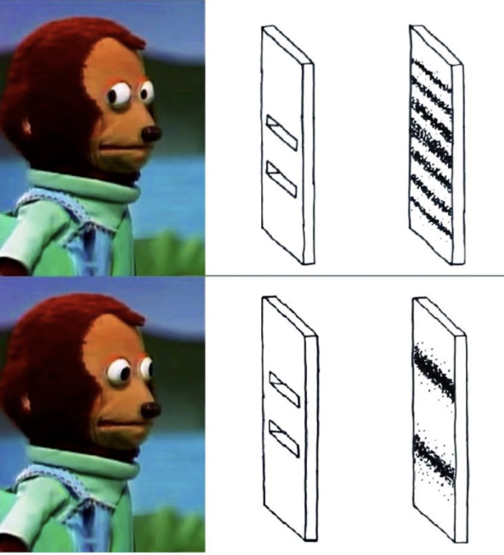
Role of measurement
measuring instruments are classic
measurement ‘collapses’ wave function - good theoretical (and philosophical) topic all the way to many-worlds interpretation (Deutsch et al) and theory of consciousness (Penrose et al)
From Meta

Slide 11
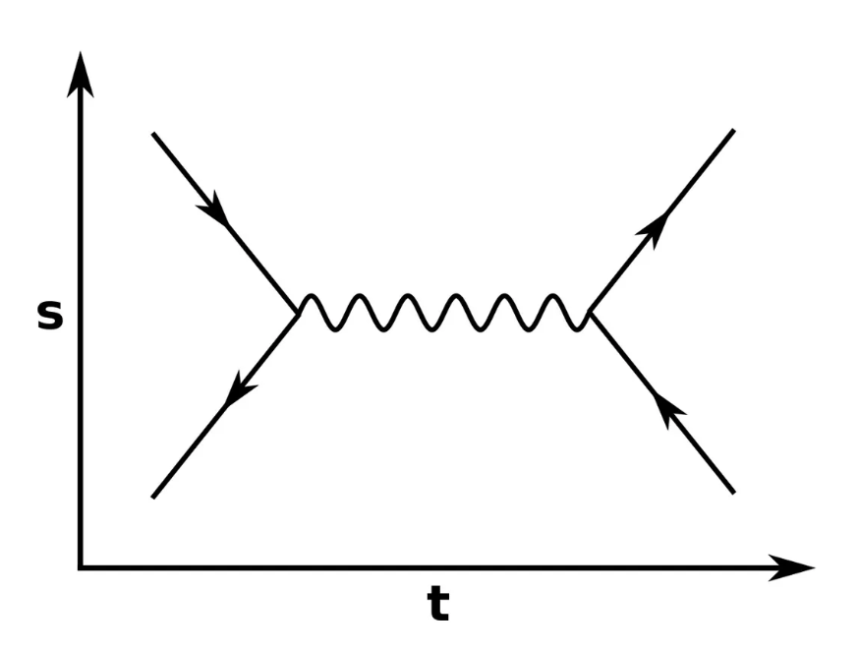
Particle Physics
Deals with elementary particles which are small or even point-like
Needs to be reconciled with relativity since typically in Particle Physics energy >> mass
Quantum Field Theory approaches :
creation and annihilation operators ($→$ quantized field excitations $→$ particles) or
path integrals ($→$ Feynman diagrams)
Recent LHC results -
all way back to entanglement
The ATLAS Collaboration, Observation of quantum entanglement with top quarks at the ATLAS detector. Nature 633, 542–547 (2024)
The CMS Collaboration, Observation of quantum entanglement in top quark pair production in proton–proton collisions at 13 TeV, Rep. Prog. Phys. 87 117801 (2024)

Slide 12
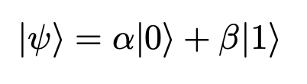
Quantum Computing
Employs entanglement implemented as qubits to do calculations
Qubit is superposition of two bit values: 0 & 1
Requires special algorithms
Lots of progress in qubit technology: multiple candidates using superconductivity, atomic physics, condensed matter physics etc

Slide 13
Quantum sensing
Entanglement for improving measurements - in application to microscopy, telescopy, metrology etc
Most of cases employs OPTICAL PHOTONS

Slide 14
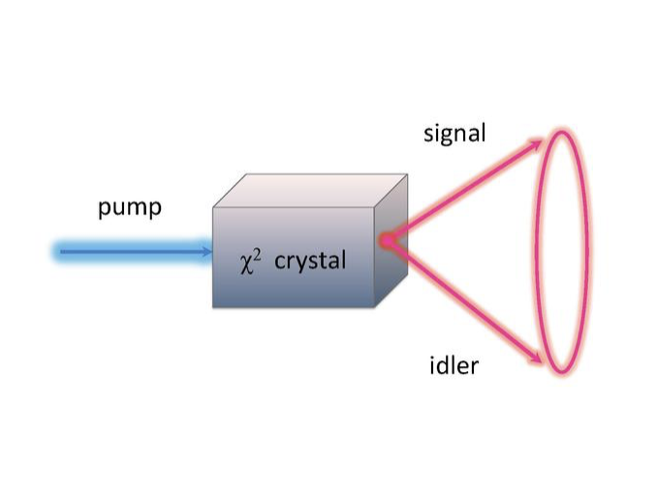
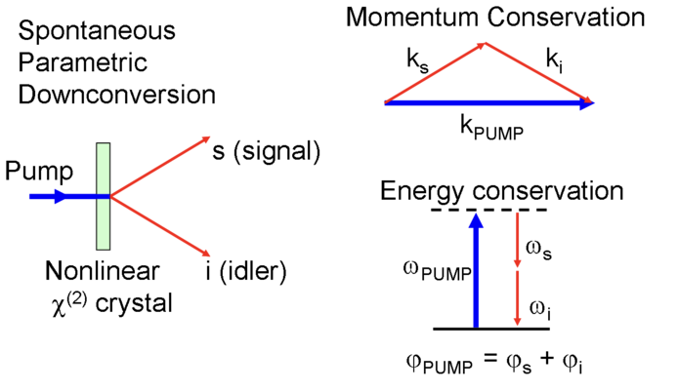
Quantum photon sources -
spontaneous parametric down-conversion (SPDC) sources
From Wikipedia
Produce two photons correlated (sometimes entangled) in
  Time
  Position
  Energy

Slide 15
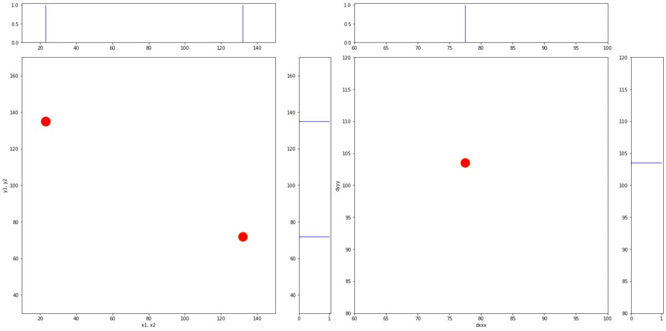
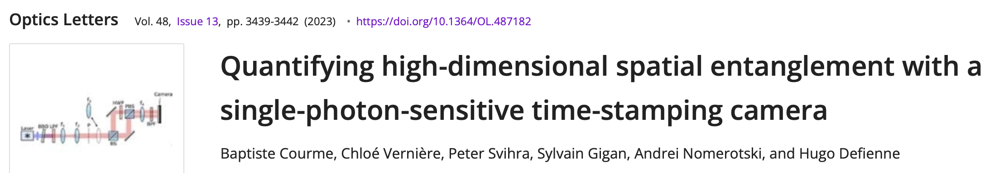
Quantum pair photon source
two photons are correlated in position
Recorded with single photon sensitive fast camera Tpx3Cam

Slide 16
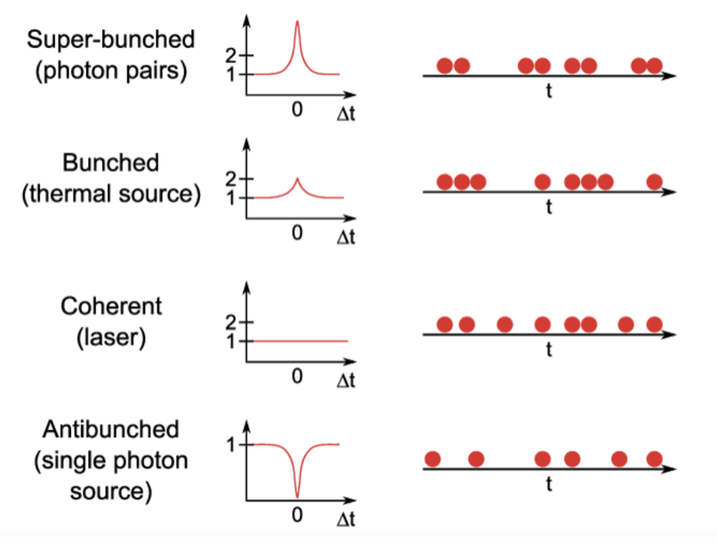
Quantum light sources
  Different types of sources
  Pair photon sources
  Thermal sources
  Lasers (coherent sources)
  Single photon sources
Roy Glauber (Nobel 2005) developed quantum description of single photon detection and of their correlations, based on coherent states (introduced by Schrodinger)

Slide 17
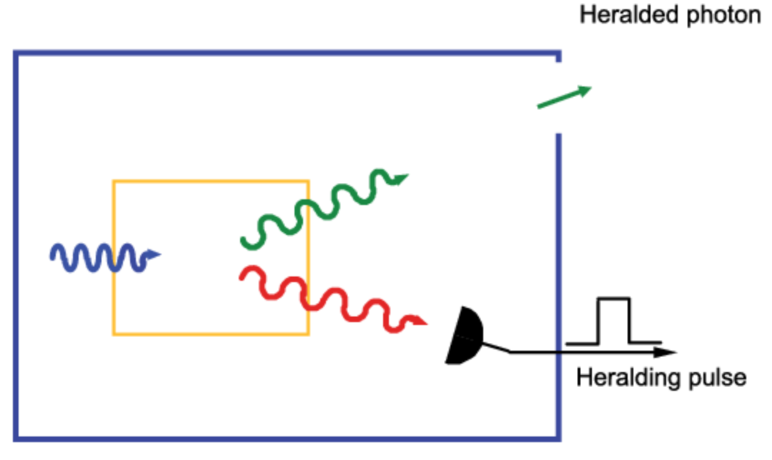
Single photon sources
Thermal photons are bunched so it’s impossible to achieve single photon regime even for very small rates of thermal photons
Use one photon in pair source to ‘herald’ single photon
Credit S.Castelletto, R.Scholten

Slide 18
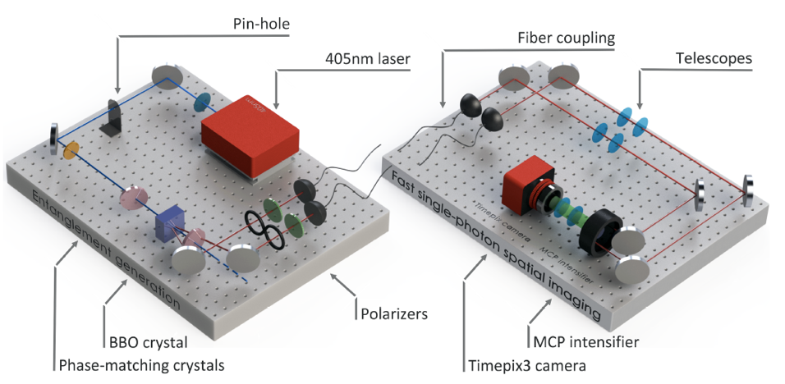

Measuring Entanglement
Figueroa lab
qubit: use H, V photon polarization states

Slide 19
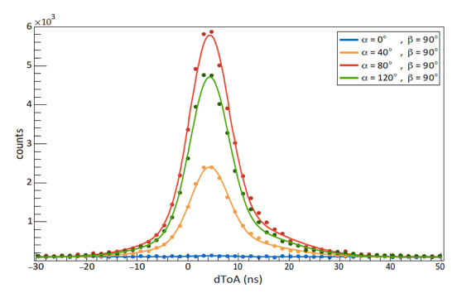
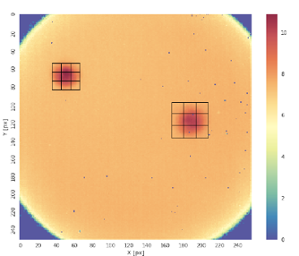
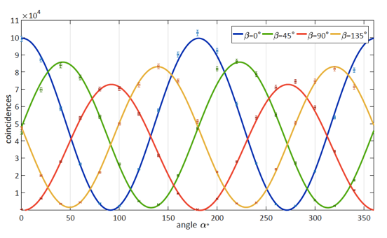
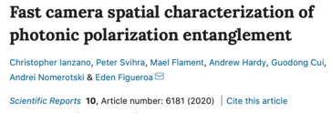
resolution: 4 ns
Time difference between photons
Find coincidences, plot as function of two polarizations
Figure of merit: S-value
  If > 2: photons are entangled
  max value: 2 $\sqrt{2}=2.82$
Measurement:
S-value = 2.72$±$0.02
Clauser-Horne-Shimony-Holt (CHSH) inequality

Slide 20
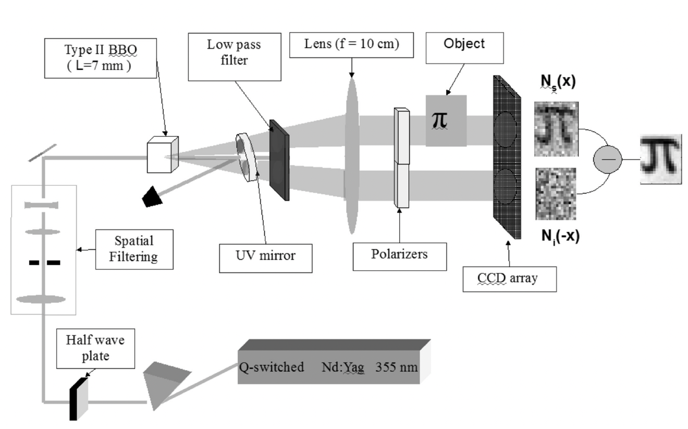
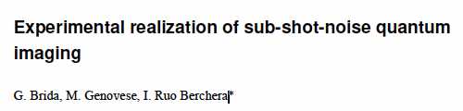
Advantages of quantum sources
Use one beam of the pair as a probe while the other acts as a reference for the shot noise
$$\sqrt{N}$$

Slide 21
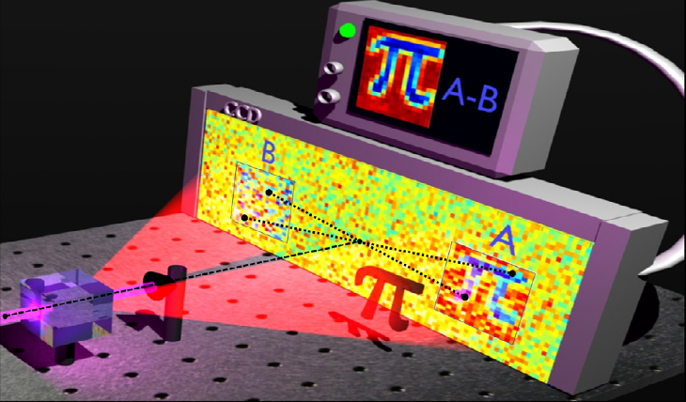
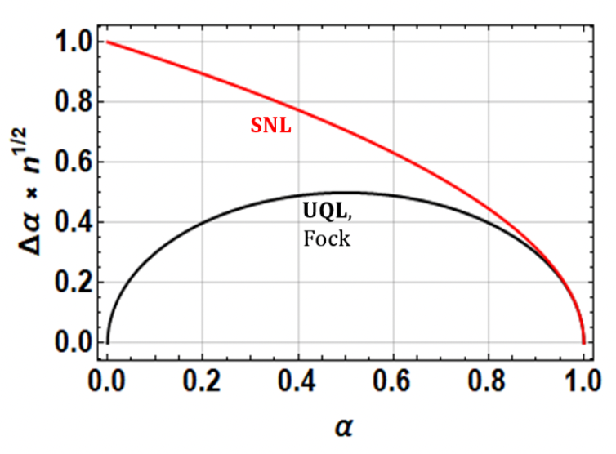
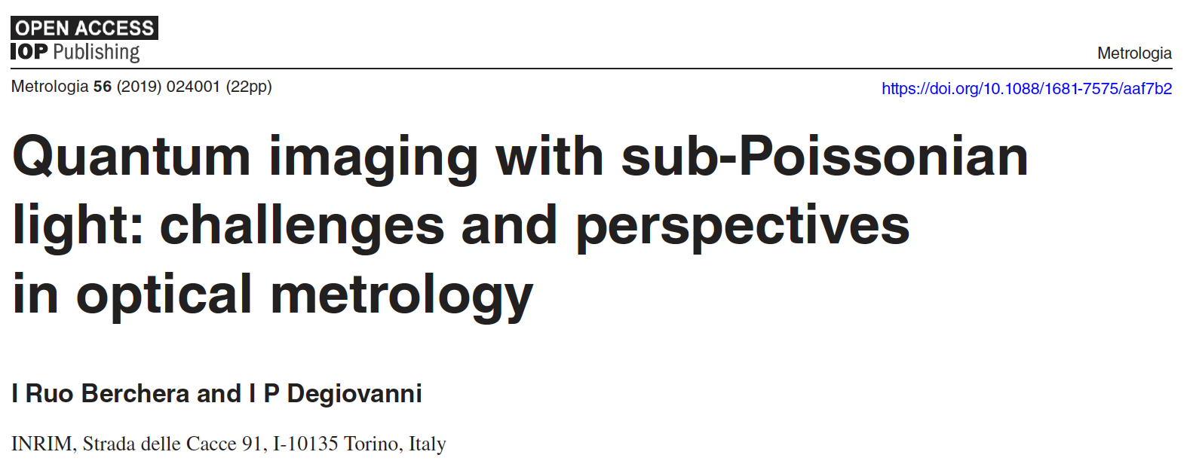
Sub-shot noise quantum imaging
Differential measurement scheme for loss coefficient $α$
Shot noise is the same for two beams and cancels in subtraction assuming same detection efficiency and zero losses
Example of ‘quantum advantage’
shot-noise limit
ultimate quantum limit

Slide 22
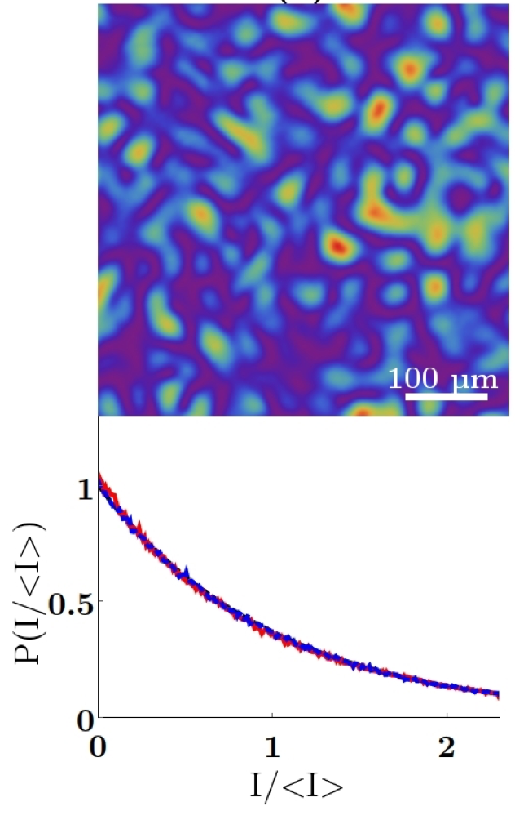
Thermal photons
Rayleigh speckle pattern
Scattering on small particles << $λ$
Results in ‘classical’ correlations similar to quantum correlations but weaker
Also temporal correlations
Of course, sources of thermal photons are much more powerful than quantum sources

Slide 23
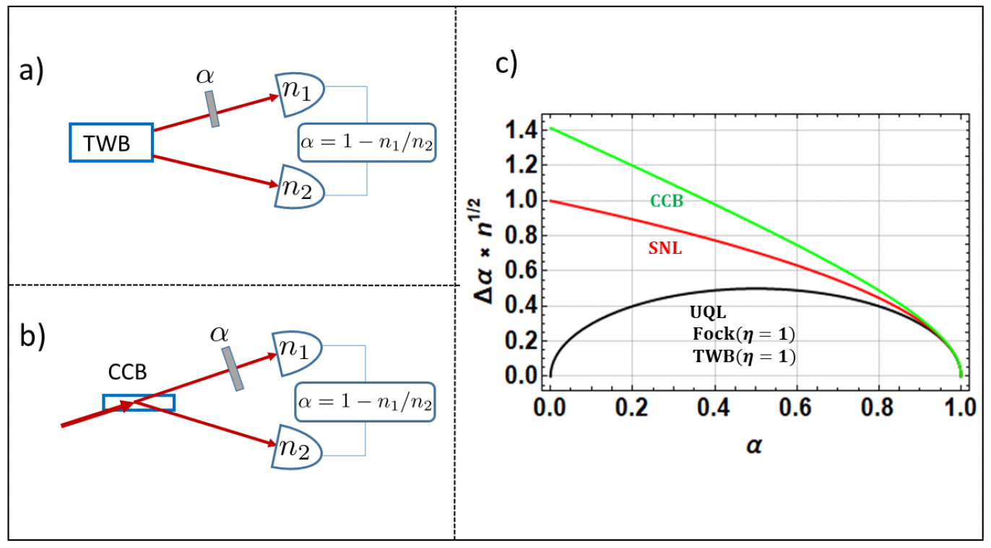
Quantum advantage in imaging
classically correlated beam
twin beam
shot-noise limit
ultimate quantum limit
classically correlated beam
Important caveat!
classical photon sources (so far) are
much more powerful then quantum sources

Slide 24
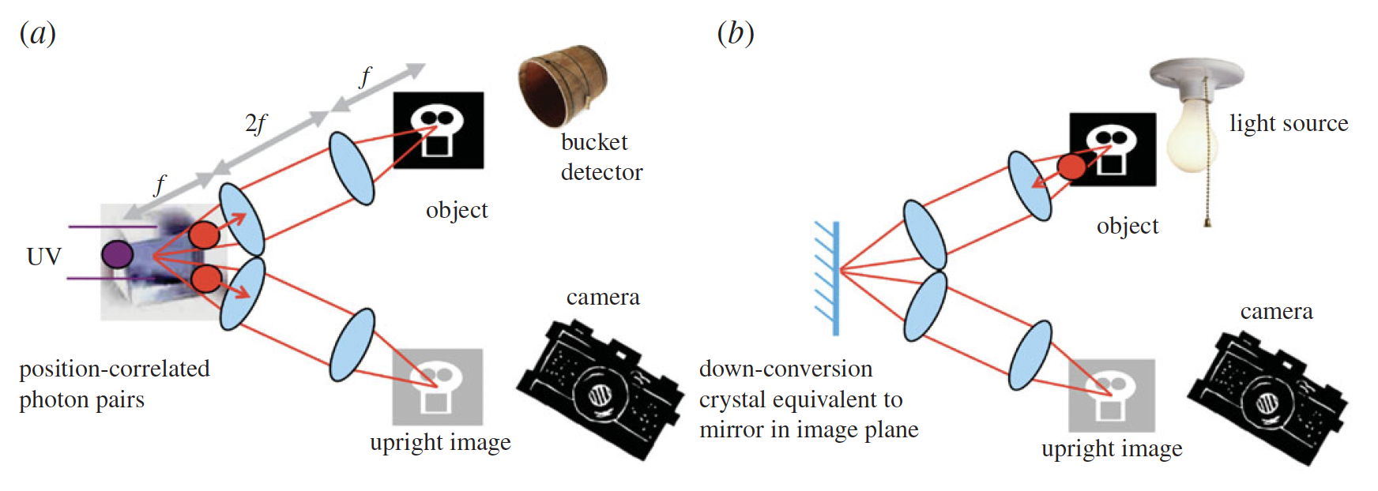
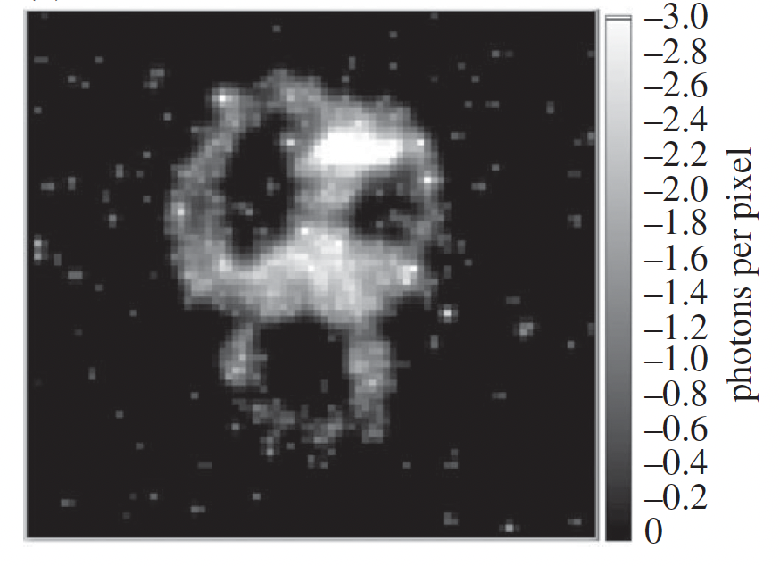
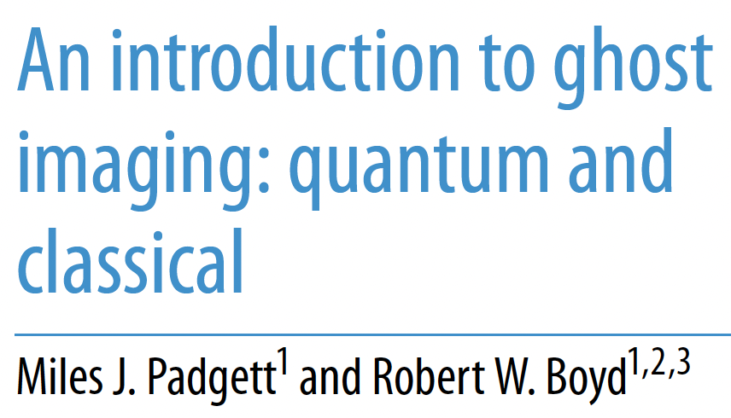
Quantum Ghost Imaging
with quantum pair source
Equivalent to images that could be produced by a classical imaging system
Especially interesting are cases of non-degenerate photon energies:
    visible + IR
    optical + x-ray

Slide 25
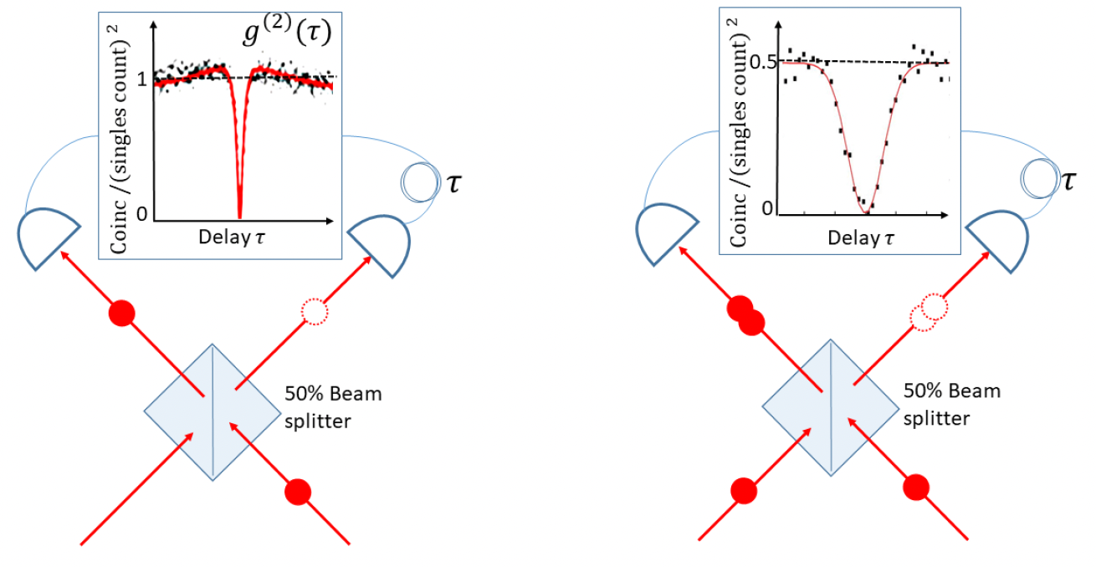
Quantum interference
    to interfere photons must be indistinguishable: similar wavelength and time overlap
Simplest interferometer:
beam splitter = semi-transparent mirror
HOM effect
single photon source
photon pair source

Slide 26
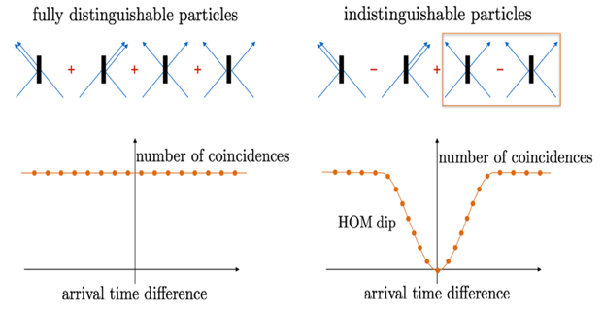
Hong-Ou-Mandel effect
50/50 beam splitter
time
credit: Wikipedia HOM article
HOM dip for coincidences of two outputs

Slide 27
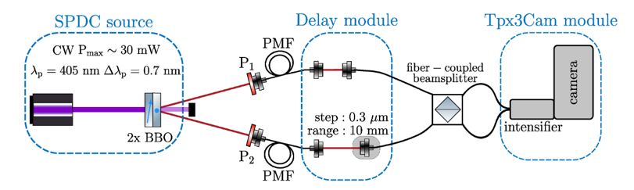
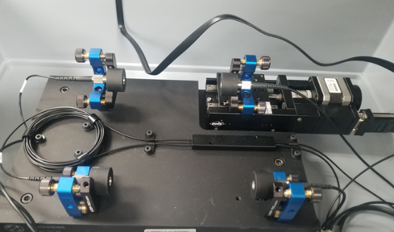

HOM Setup

Slide 28
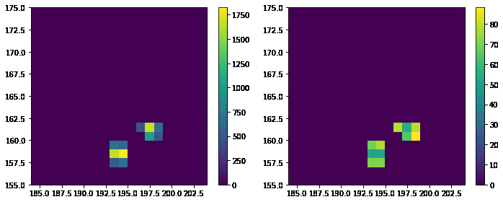
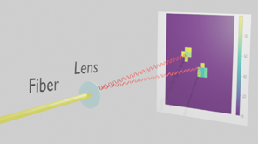
Examples of bunched HOM photons
TOT
TOA

Slide 29
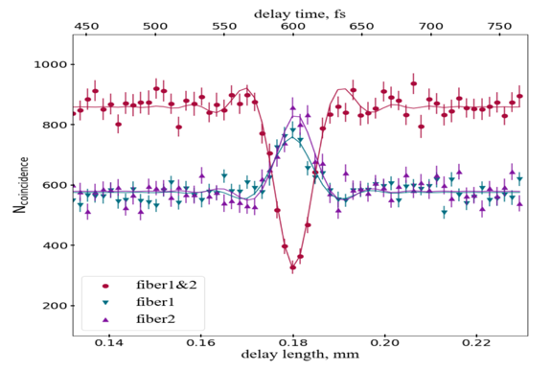
Hong-Ou-Mandel effect
Coincidence of photons in two fibers
Coincidence of photons in single fibers

Slide 30
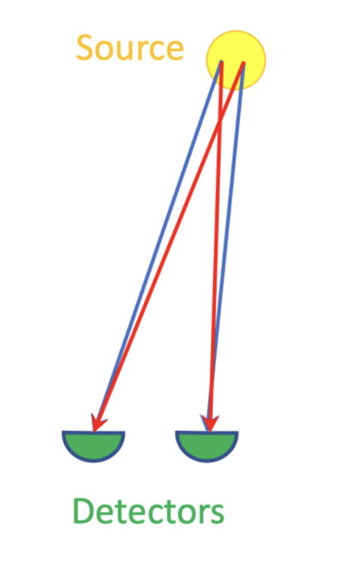
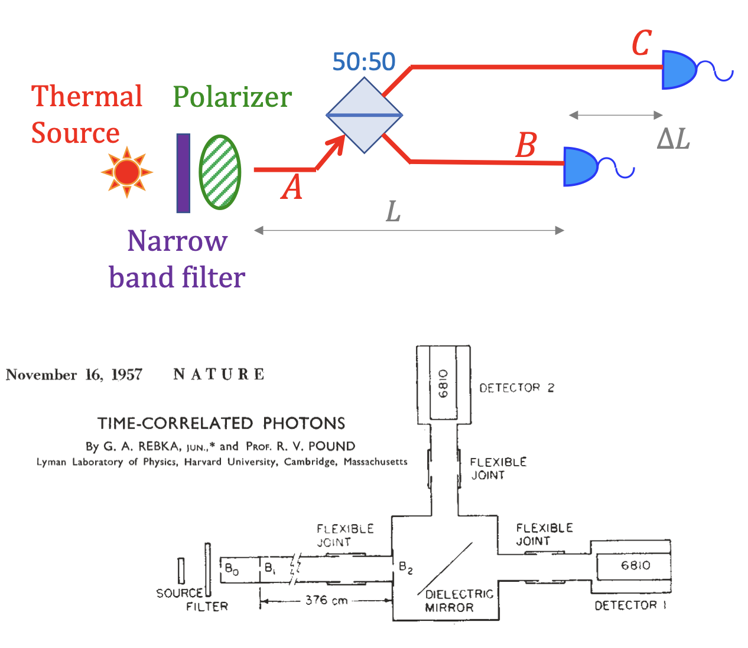
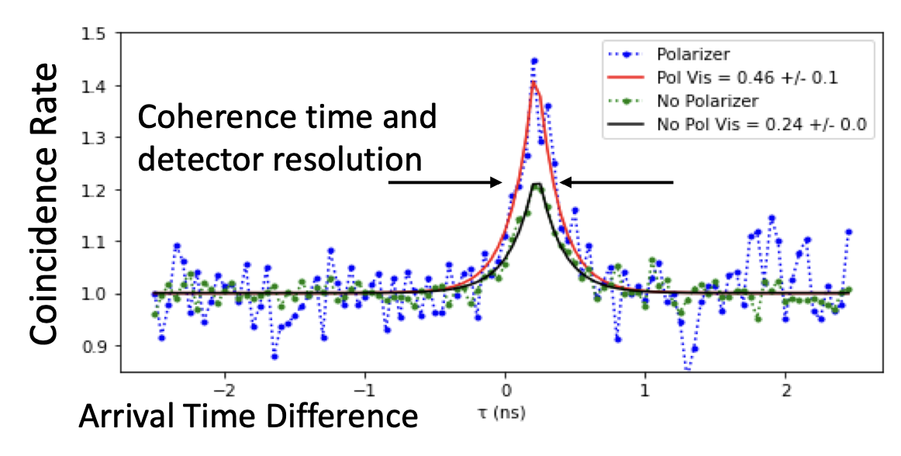
Hanbury Brown - Twiss effect
If points are close enough two options of photons paths are coherent = photon phases not so different and they interfere
Interference produces photon bunching or HBT effect
visibility = S/B = 46%

Slide 31
Requirements to detectors
Will strongly depend on the task!
Single photon sensitivity
    large amplification & low noise
High total detection efficiency
    often use coincidences, rate ~ (efficiency)²
    > 66 % to chase hidden variables loopholes in Bell inequalities
Timing resolution
    mostly to improve S/B
    ~< 20 ps for two-photon interferometry
Imaging capabilities
    for additional degrees of freedom and scalability
Other particles (x-rays, electrons, ions, neutrons, microwaves)?

Slide 32
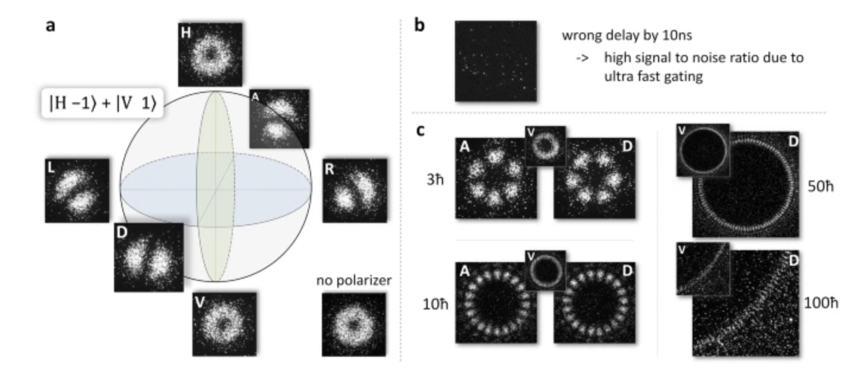
Requirements to detectors: imaging
    additional degrees of freedom in OAM: orbital angular momentum
Spatial structure of the optical (Laguerre-Gauss) modes of photons corresponding to projections of OAM m = [0, …, L]
Fickler, R., Krenn, M., Lapkiewicz, R. et al. Real-Time Imaging of Quantum Entanglement. Sci Rep 3, 1914 (2013)

Slide 33
Comparing detectors for HEP, astro, light sources and quantum?
Quantum:
    Single photon detectors, visible + IR (telecom bands), fast FE, large data rates, imaging; qubits (many candidates, most superconducting)
HEP
    Tracking and calorimetry; ionizing particle and photon detectors in visible; very fast FE, very large data rates, imaging (pixel detectors)
Astronomy
    Low noise, slow FE, high sensitivity; imaging in visible + IR; large data rates (comparing to previous projects)
Light sources
    X-rays, fast FE, large data rates, photon counting

Slide 34
HEP and Quantum
What Quantum can take from HEP for photon detection?
    In HEP: detect particles collision per collision (= fast) then form observables for ‘events’ like transverse momentum, invariant mass etc.
    This influenced modern x-ray detectors which detect x-rays as standalone objects, then count them in each pixel to produce an image (photon counting detectors).
    Same ideas started to propagate in to quantum community - detect optical photons as objects, then correlate them spatially and/or spectrally pair by pair (= fast). Future: higher order correlations for more photons?

Slide 35
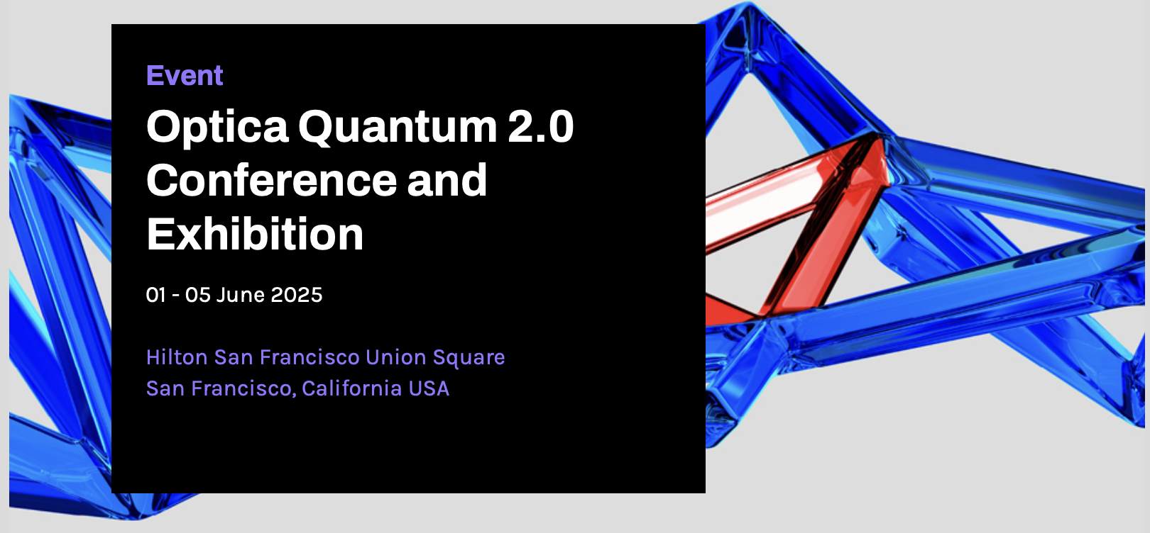
Quantum 2.0
This is about terminology
All in our life is quantum: transistors hence electronics, atoms, molecules, chemistry, biology etc.
However ‘really exciting’ quantum topics now are called Quantum 2.0 - this is about quantum superposition and entanglement in systems.
Examples of such large quantum systems include quantum computers and simulators, quantum communication networks and arrays of quantum sensors.

Slide 36
Recap
Wave-particle duality leads to uncertainty principle, indistinguishability, symmetries
Entanglement leads to correlations beyond classical
Quantum advantage can be realized exploiting correlations in photon pair sources
Similarities in HEP and QIS instrumentation for photons
Disclaimer: I’ve cut corners and hidden several important things under ‘philosophy’ and ‘theory’ labels

Slide 37
“The great advances in science usually result from new tools rather than from new doctrines”
Freeman Dyson (1923-2020)

