Slide 1
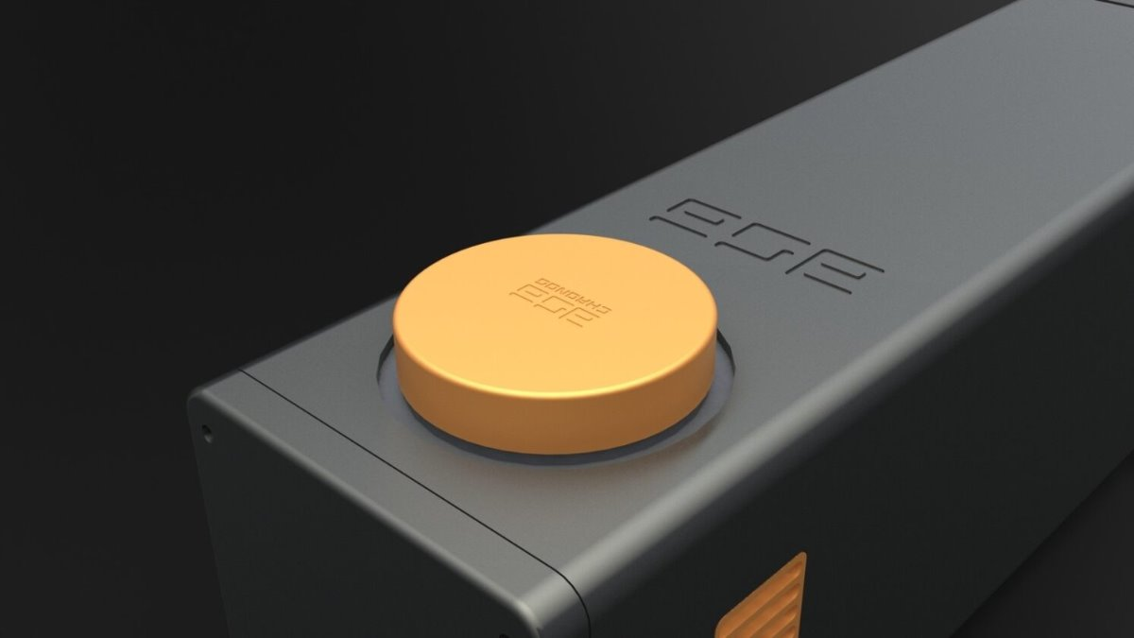


Hybrid Pixel Single Photon Detector for Quantum Applications
Innovative Solutions for Quantum Imaging and Real-Time Feedback
Shazia Farooq
25th January 2025
Notes:
I’ll be talking about the advancements we’ve made at ASI with hybrid pixel single-photon detectors, and how they are opening up new possibilities for quantum imaging and real-time feedback systems
I’ll give you an overview of our technological advancements, discuss some of the challenges we’ve encountered, highlight the current gaps in the field, but before that I will share my perspective as someone working in the industry.

Slide 2
Outline
Perspectives from Academia to Industry
Technological Advancements
Challenges
Current Gaps in the Field

Slide 3
From Lab Coat to Business Suit ☺

Slide 4
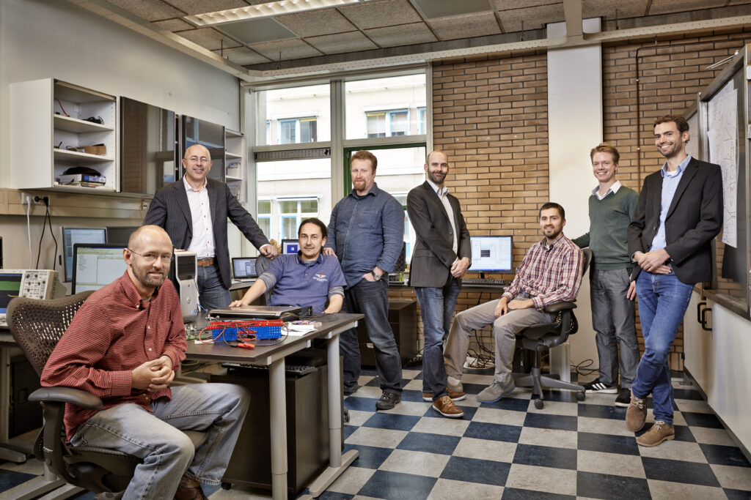
Release of Hyperion
Release of 4D-STEM solutions
2024
Release of CheeTah 1MP
2023
Release of CheeTah M3 and T3 Retractables
Release of Phoebe
2022
Release of LumaCam
2018
2021
2017
2020
Release of TPX3CAM
2013
Commercial Restructuring under new leadership
2011
First deliveries of TPX-1 detectors to synchrotron customers
ASI was found as spin-off from NIKHEF and AMOLF in Amsterdam

Slide 5
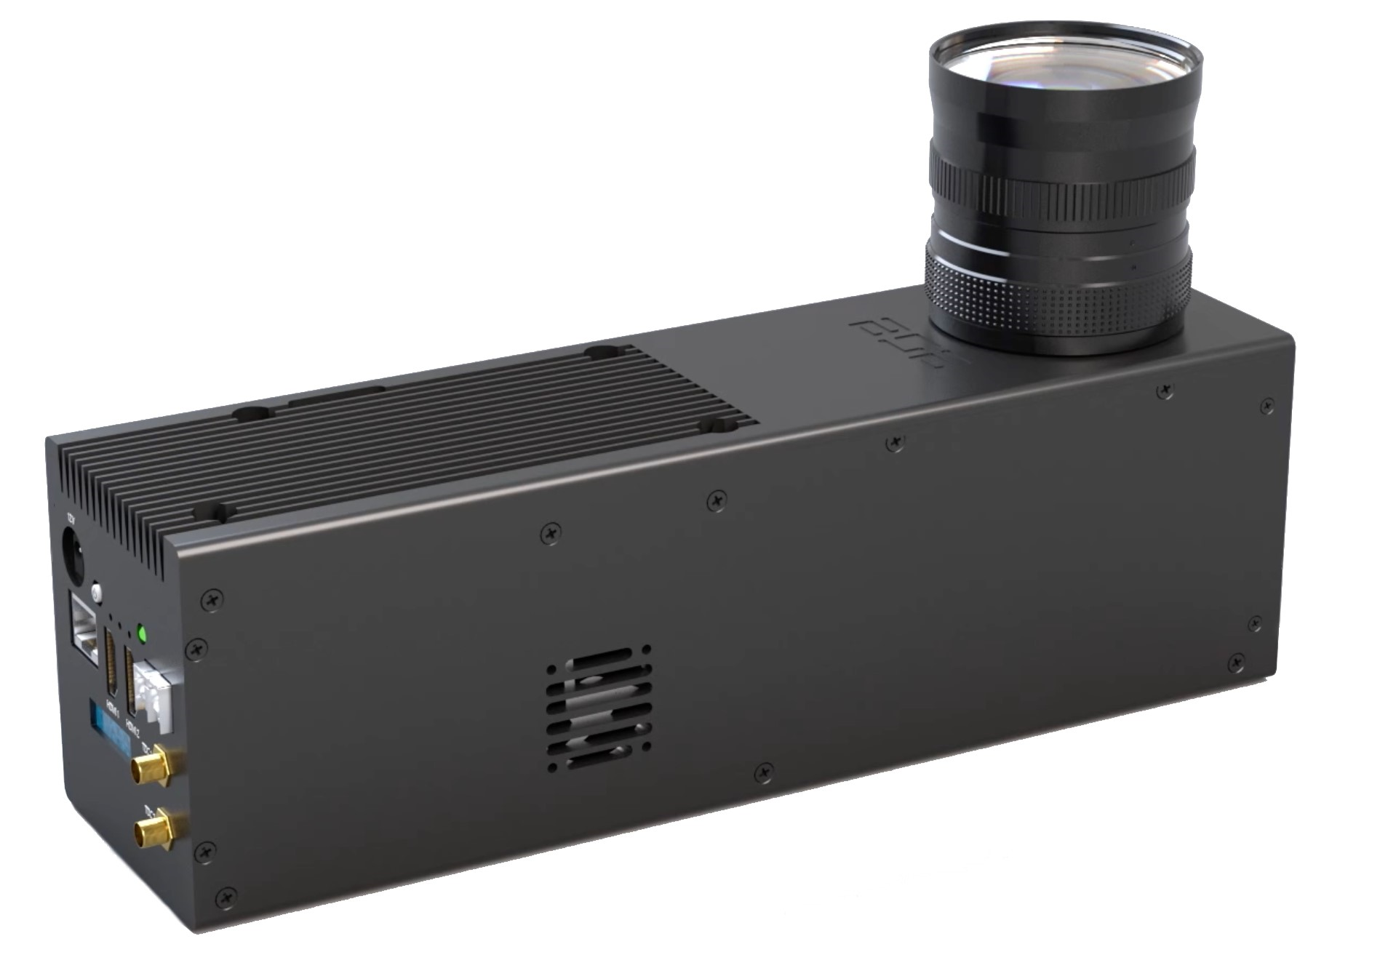
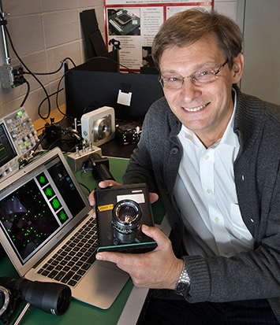
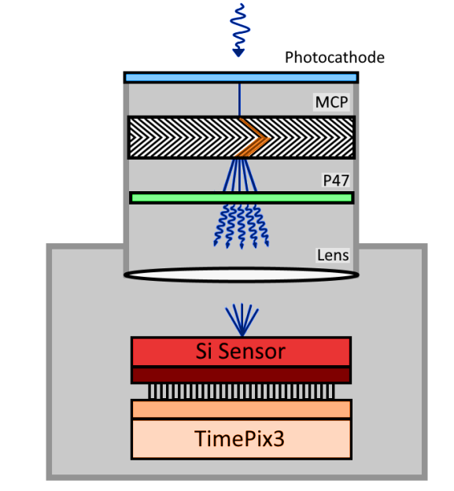
TPX3CAM: Hybrid Pixel Photon Detector
Single-Photon-Sensitive Event-Driven , Tim-Resolved 2D Detector
Detection of optical photons (VIS to UV range) making use of optical photon sensors:
Conventional silicon sensor adapted to optical photons sensing
Electron multipliers (MCP)
Image Intensifiers
Prof. Andrei Nomerotski
(StonyBrook & BNL)

Slide 6
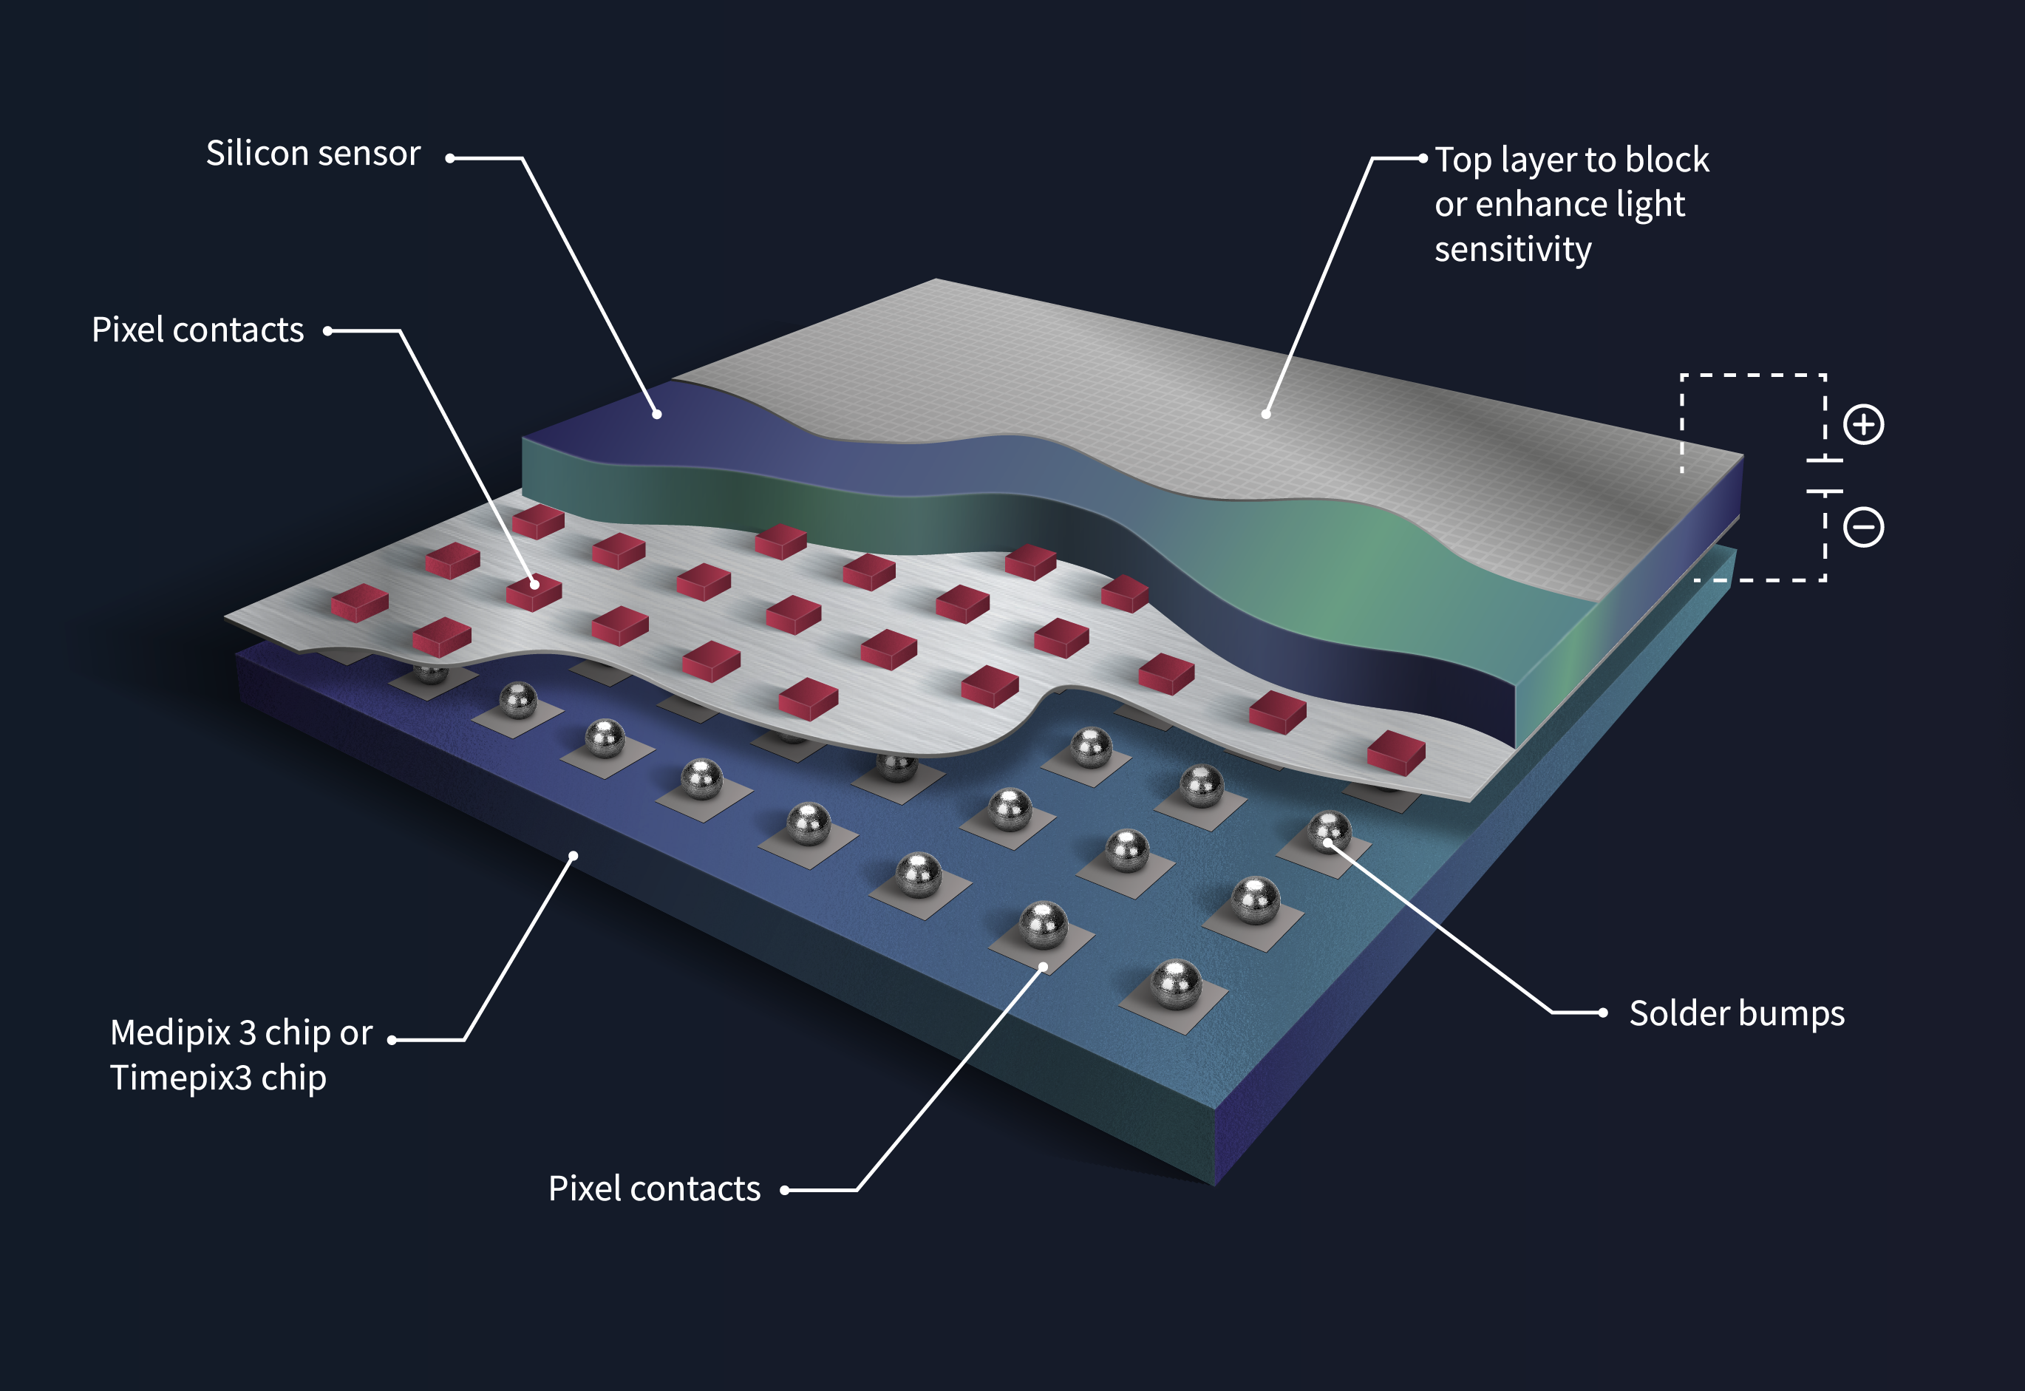
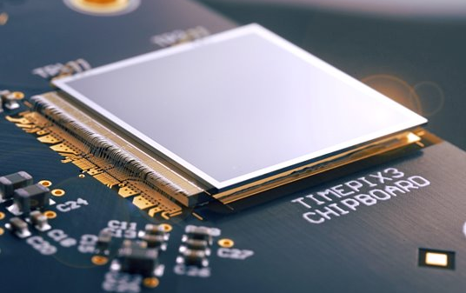
Hybrid Pixel Detectors
Sensor material is separate from electronics this makes Timepix3 very robust.
Noise Free (counting mode, thresholding)​
Ultra-sensitive (high intrinsic amplification)

Slide 7

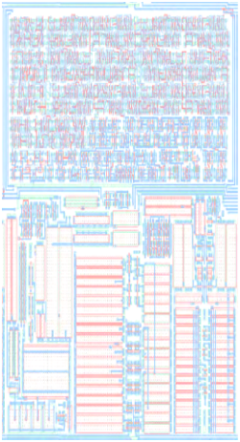
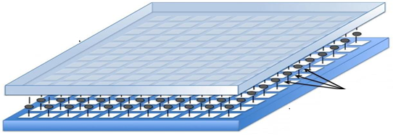


Hybrid Pixel Detector
N+
Working principle
+
Semiconductor
Sensor
(Si, GaAs, CdTe)
P+
Pixel Size: 55 µm
Amplifier
Threshold
level
Bump
Bonds
+ 1 count
Comparator
ASIC Chip
Digital Counter
256 x 256 pixels
Read-out

Slide 8
What does Timepix3 offer/enable: ToA & ToT
Data-driven – direct readout of the hit
Time of Arrival (ToA) of each electron with 1.56 ns time resolution
Very high effective frame rates – 640 MHz
3D information (x,y and time)
Measuring energy deposited (~10 -20% resolution)
Time over Threshold (ToT) of each event with 25 ns resolution
Measuring pile-up (multi hit)
Photon
Si-Sensor
Electron hole pairs
Bias
V
Chip
Signal
Time over Threshold: Energy / Double Hits
Data[X, Y, ToA, ToT]
Threshold
Time
Time of Arrival: 1.56 nanoseconds precision

Slide 9
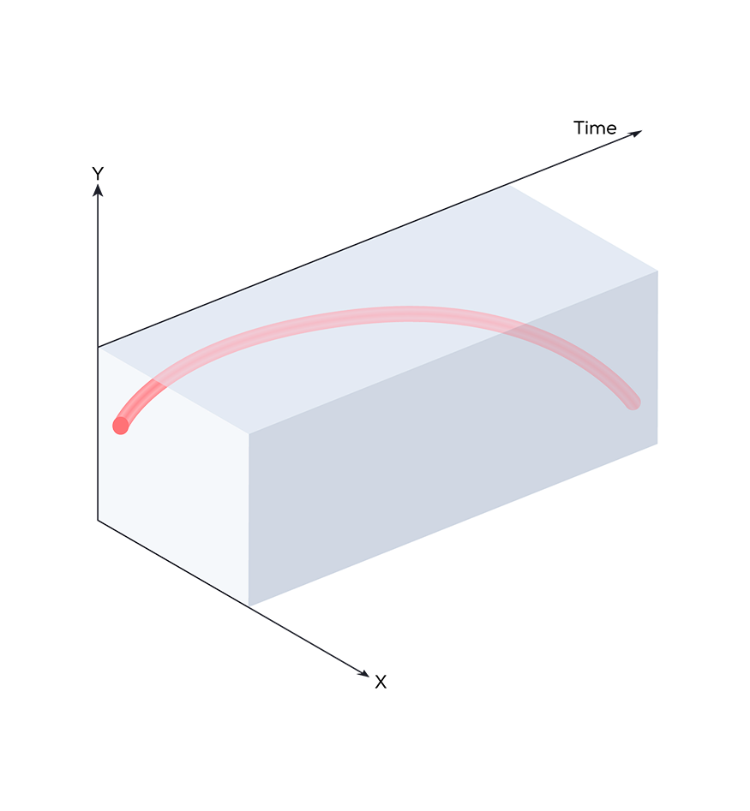
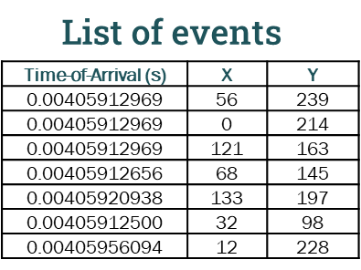
Event-based detection can also create images!
Timepix 3
T = 1 ns
T = 2 ns
T = 4 ns
T = 6 ns
Event-based
Event List
Sum of Events

Slide 10
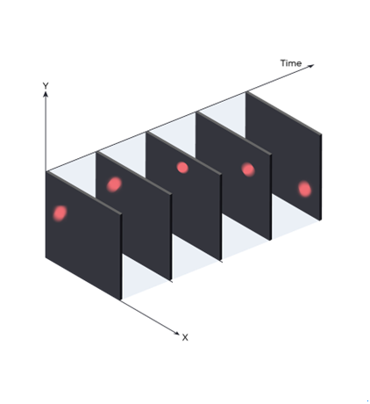
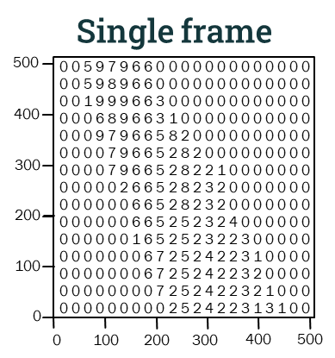
Modes of Operation
Si-Sensor
Chip
Timepix 3
Timepix 3
Frame-based
Event-based

Slide 11
TDC (Time to Digital conversion) input
Electron
ASI Timepix3 Detectors has two external TDC inputs with 260 ps time resolution
These allow synchronization with arbitrary external signals
The inputs are clock synchronized with the Timepix3
They appear as events in the event list output
List of events
 | Time-of-Arrival (s) | X | Y
TPX3 | 0.00405912969 | 56 | 239
TPX3 | 0.00405912969 | 0 | 214
TPX3 | 0.00405912969 | 121 | 163
TPX3 | 0.00405912656 | 68 | 145
TDC | 0.00405912655 | - | -
TPX3 | 0.00405920938 | 133 | 197
TPX3 | 0.00405912500 | 32 | 98
TXP3 | 0.00405956094 | 12 | 228
TDC | 0.00405956096 | - | -
Timepix3 Detectors
Low voltage TTL input on TDC
Source examples:
Pulsed laser sync
Photon counter (e.g.SPAD)
TDC Specifications
Time resolution | 260 ps
Number of inputs | 2
Trigger | Rising or falling edge or both
Maximum rate | 10 MHz

Slide 12
Clock synchronization
Electron
An alternative is to synchronize the clock of the Timepix3 detectors with an external reference
Timepix3 Detectors has a 40MHz input and output
It is even possible to daisy-chain Timepix3 Detectors
Timepix3 Detectors
Timepix3
Detectors
Clock reference 40 MHZ
Source examples:
Function generator
Scan generator
Raspberry Pi

Slide 13
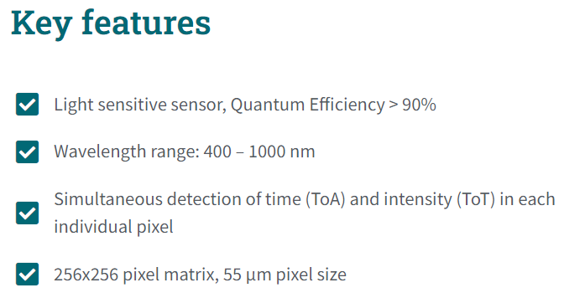
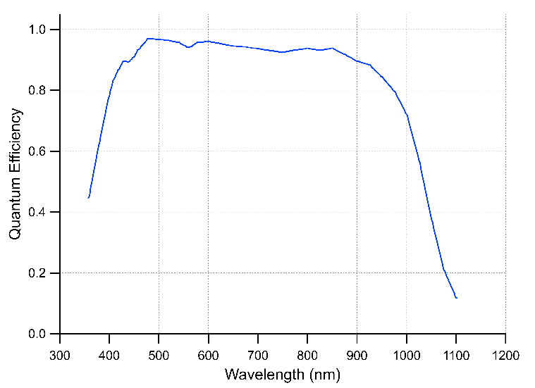
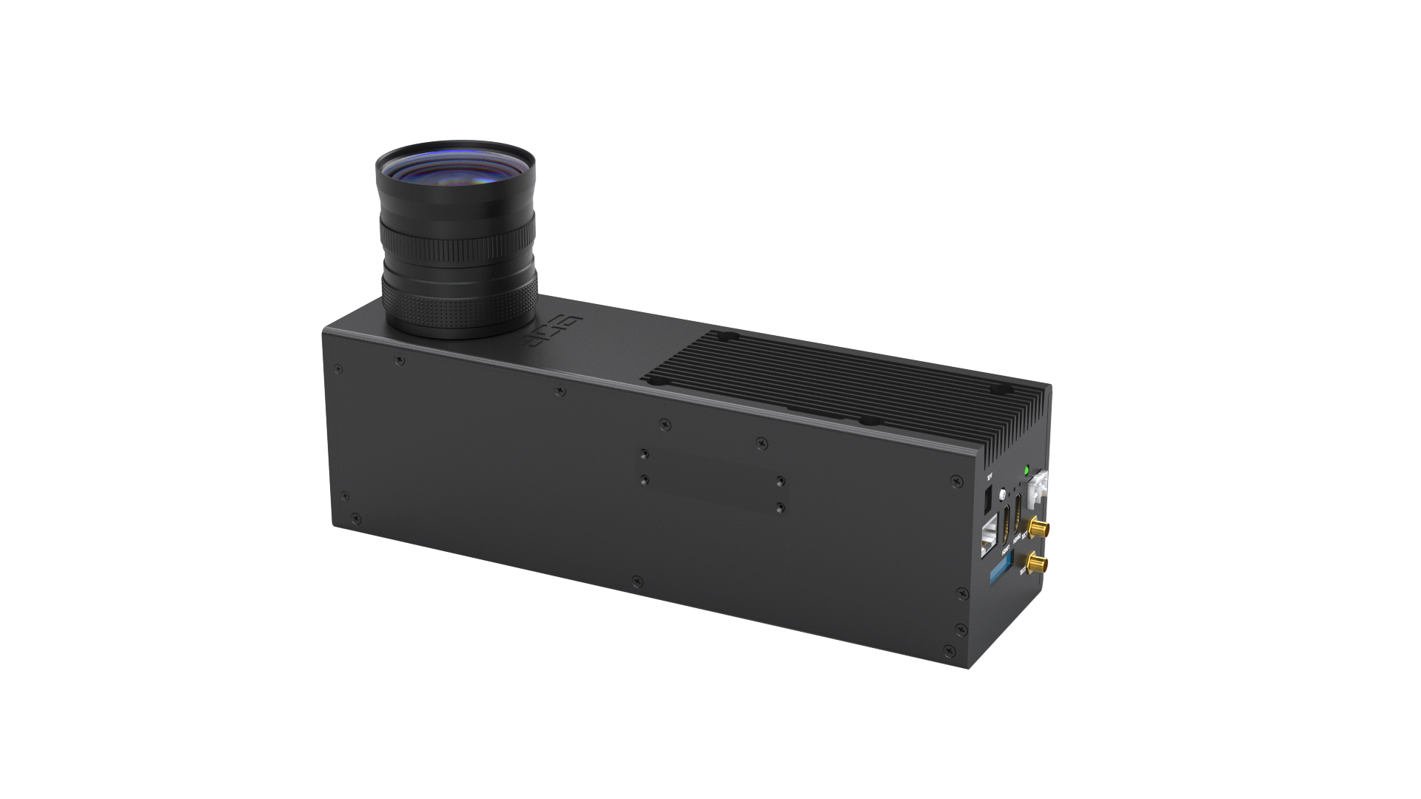
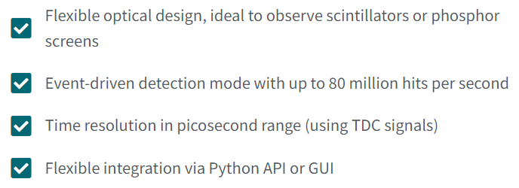
Chronos: The Optical TPX3CAM

Slide 14

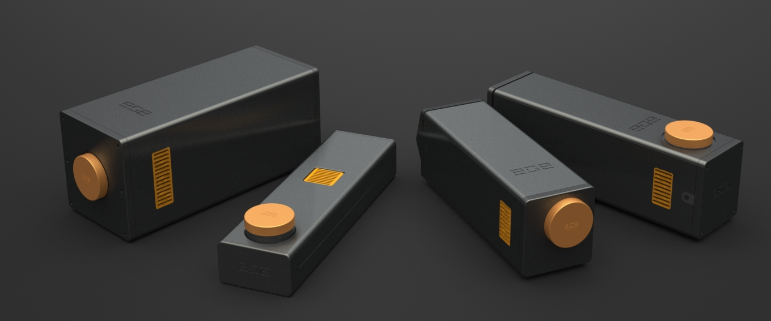
Application Specific Chronos Series
Quantum Science:
Phoebe & Rhea
Neutron Detection:
Telesto
Ion Detecton:
Hyperion
TPX3CAM (legacy)
Notes:
Tpx3cam is adapted for different application and modified for according to its need

Slide 15
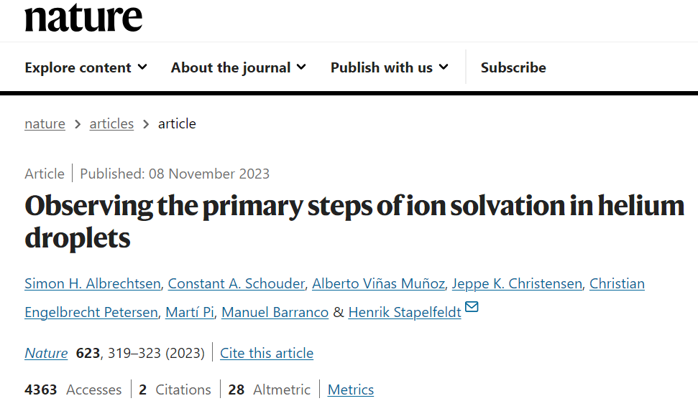

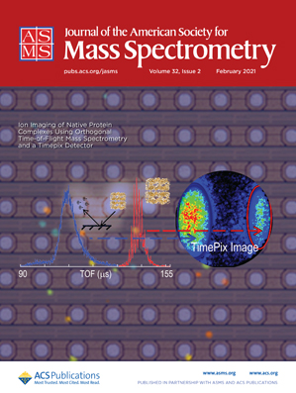
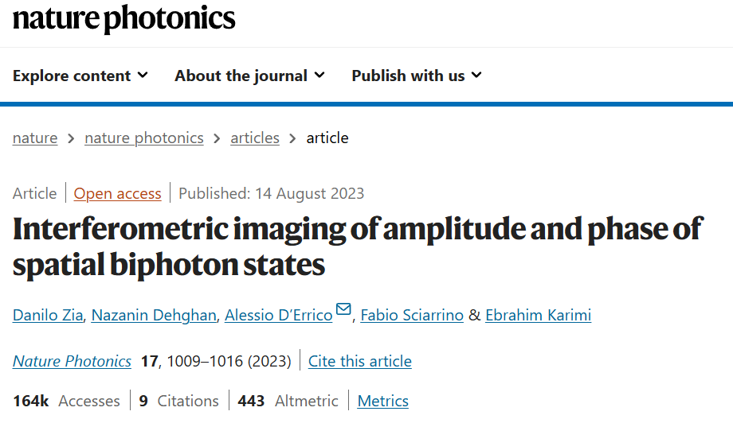
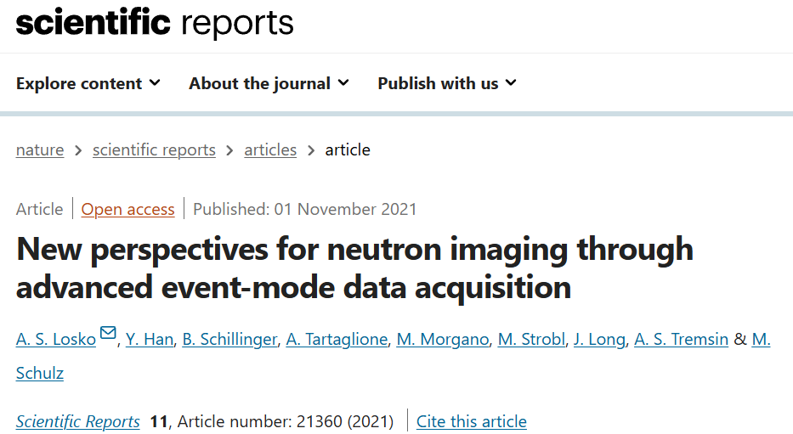
159 publications in past 5 years using TPX3CAM and Chronos
MassSpec
Quantum
VMI
Neutrons

Slide 16

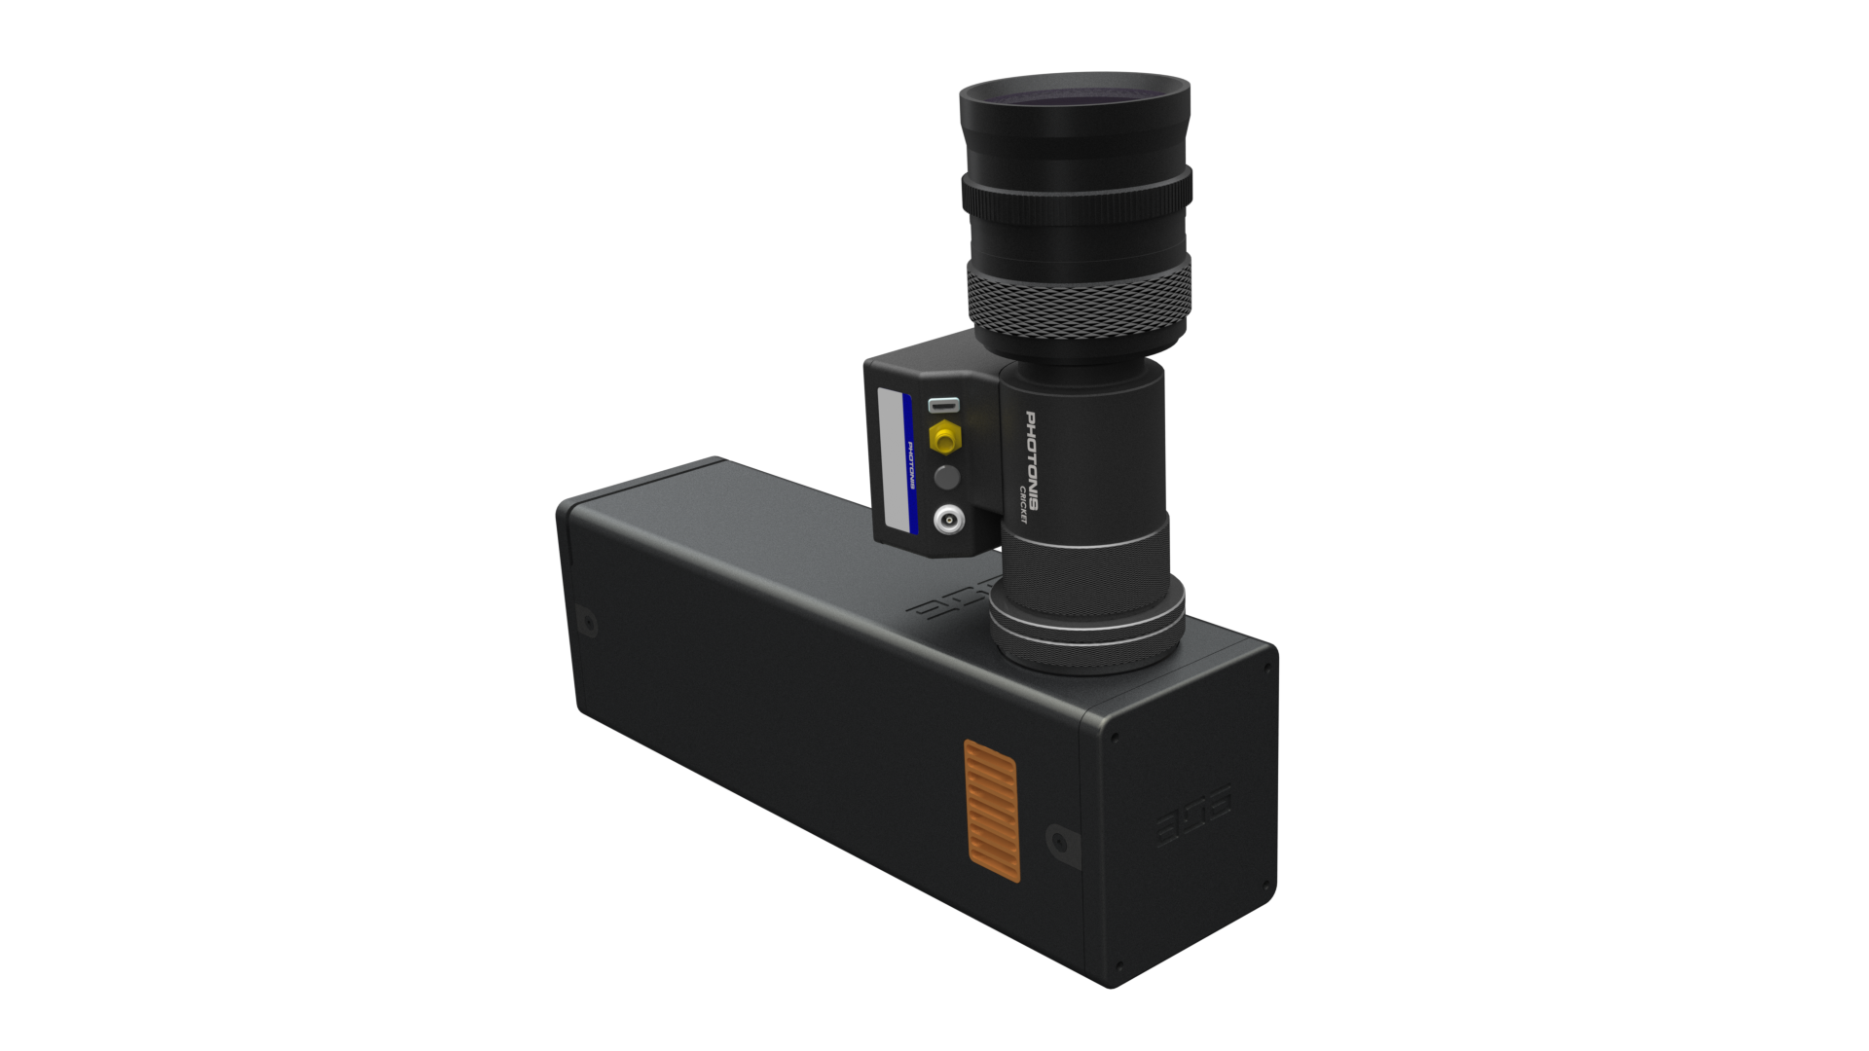
Chronos Series: Quantum Imaging
Phoebe is an intensified hybrid pixel detector based on TPX3CAM especially designed for Quantum Science applications.
Phoebe
the single-photon TPX3CAM

Slide 17
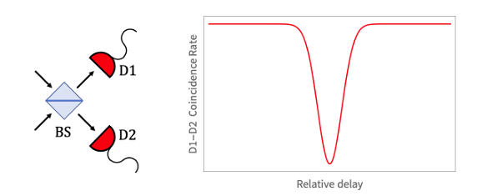
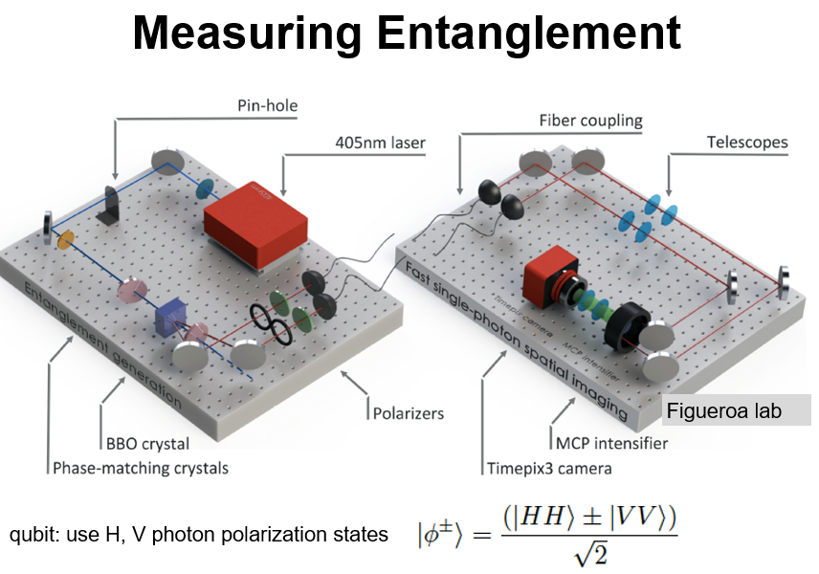

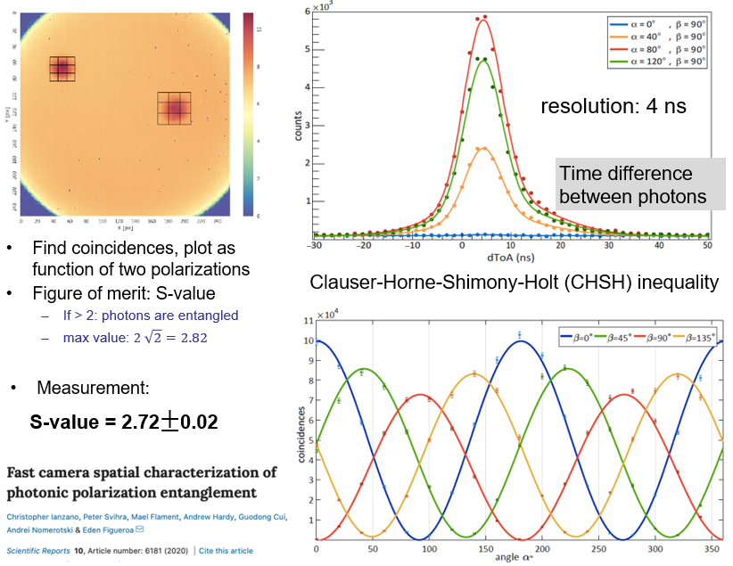
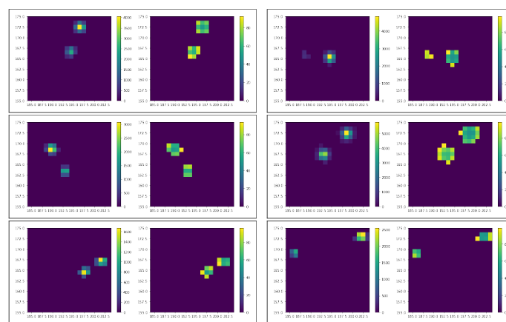
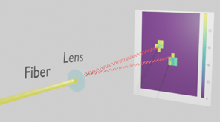
Hong-Ou-Mandel effect
https://doi.org/10.48550/arXiv.2005.07982

Slide 18
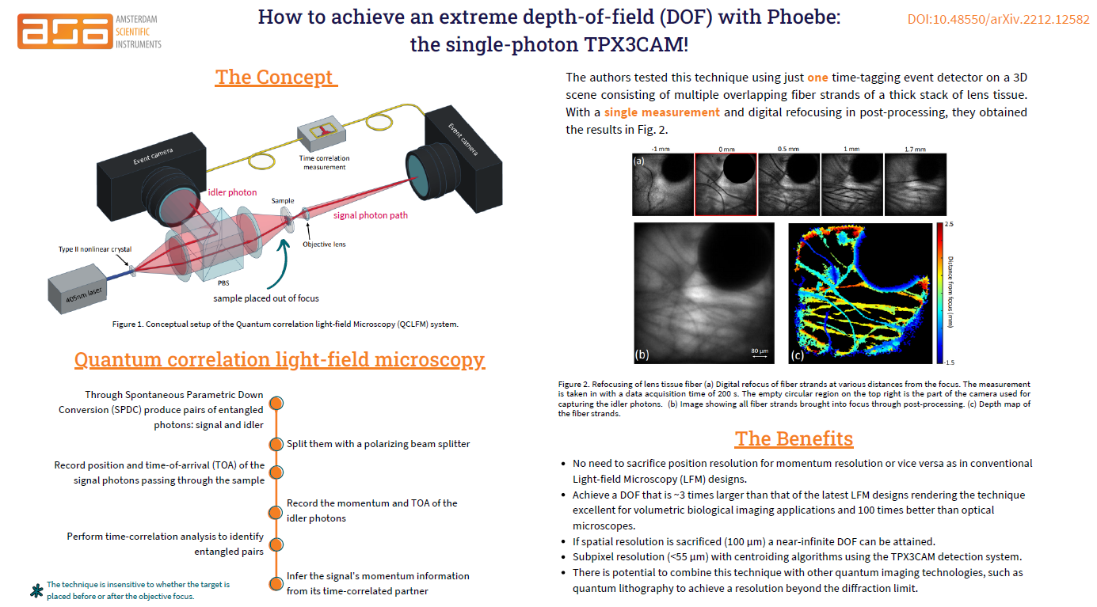
Notes:
​

Slide 19
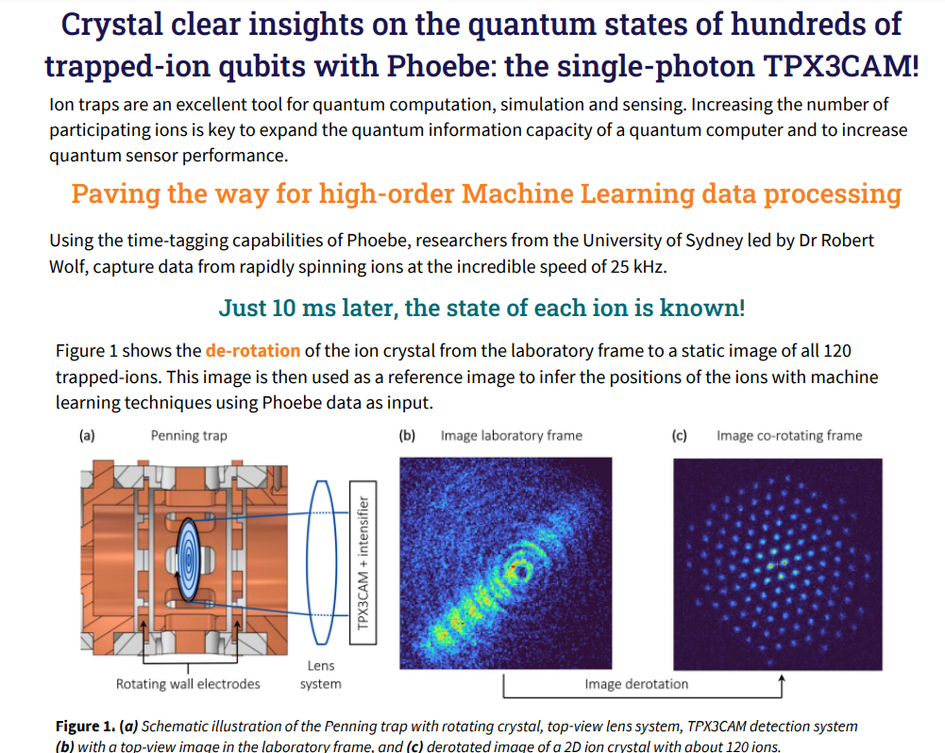
Crystal clear insights on the quantum states of hundreds of trapped-ion qubits with Phoebe: the single-photon TPX3CAM!

Slide 20
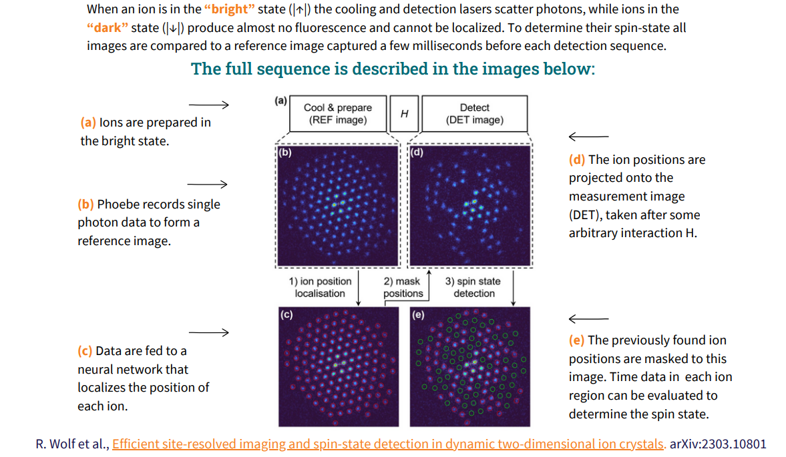

Slide 21
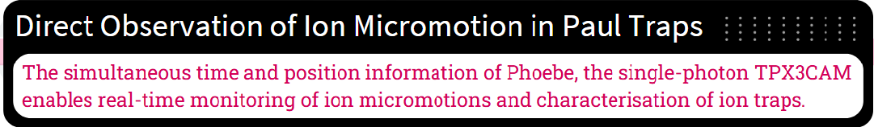
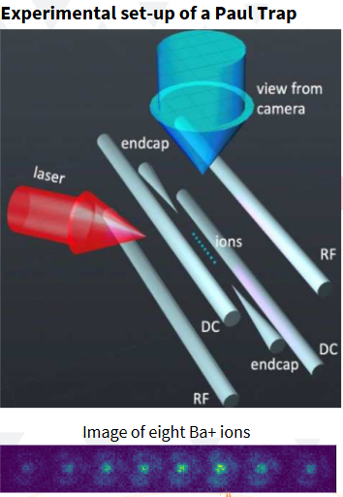
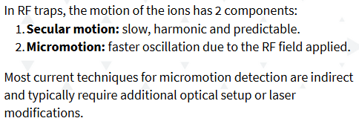
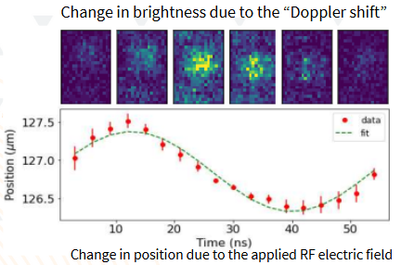
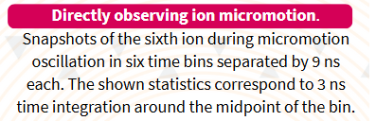

Simultaneous time & position information allows to monitor ion micro-motions
https://doi.org/10.1103/PhysRevA.103.023105
Notes:
FIG. 1. (a) Diagram of the experimental setup with ions in a linear RF trap formed by four rods and two needle end-cap electrodes. dc bias voltages may be applied to any of the four rods to compensate the micromotion. The cooling laser (red arrow) is applied at 45◦ to the trap axis and the ion string is imaged from above. (b) Image of eight Ba+ ions taken with the Tpx3Cam camera over a 20-s integration period. The ion brightness variation is due to the Doppler cooling beam profile. The distance between the middle ions is approximately 5 μm.

Slide 22
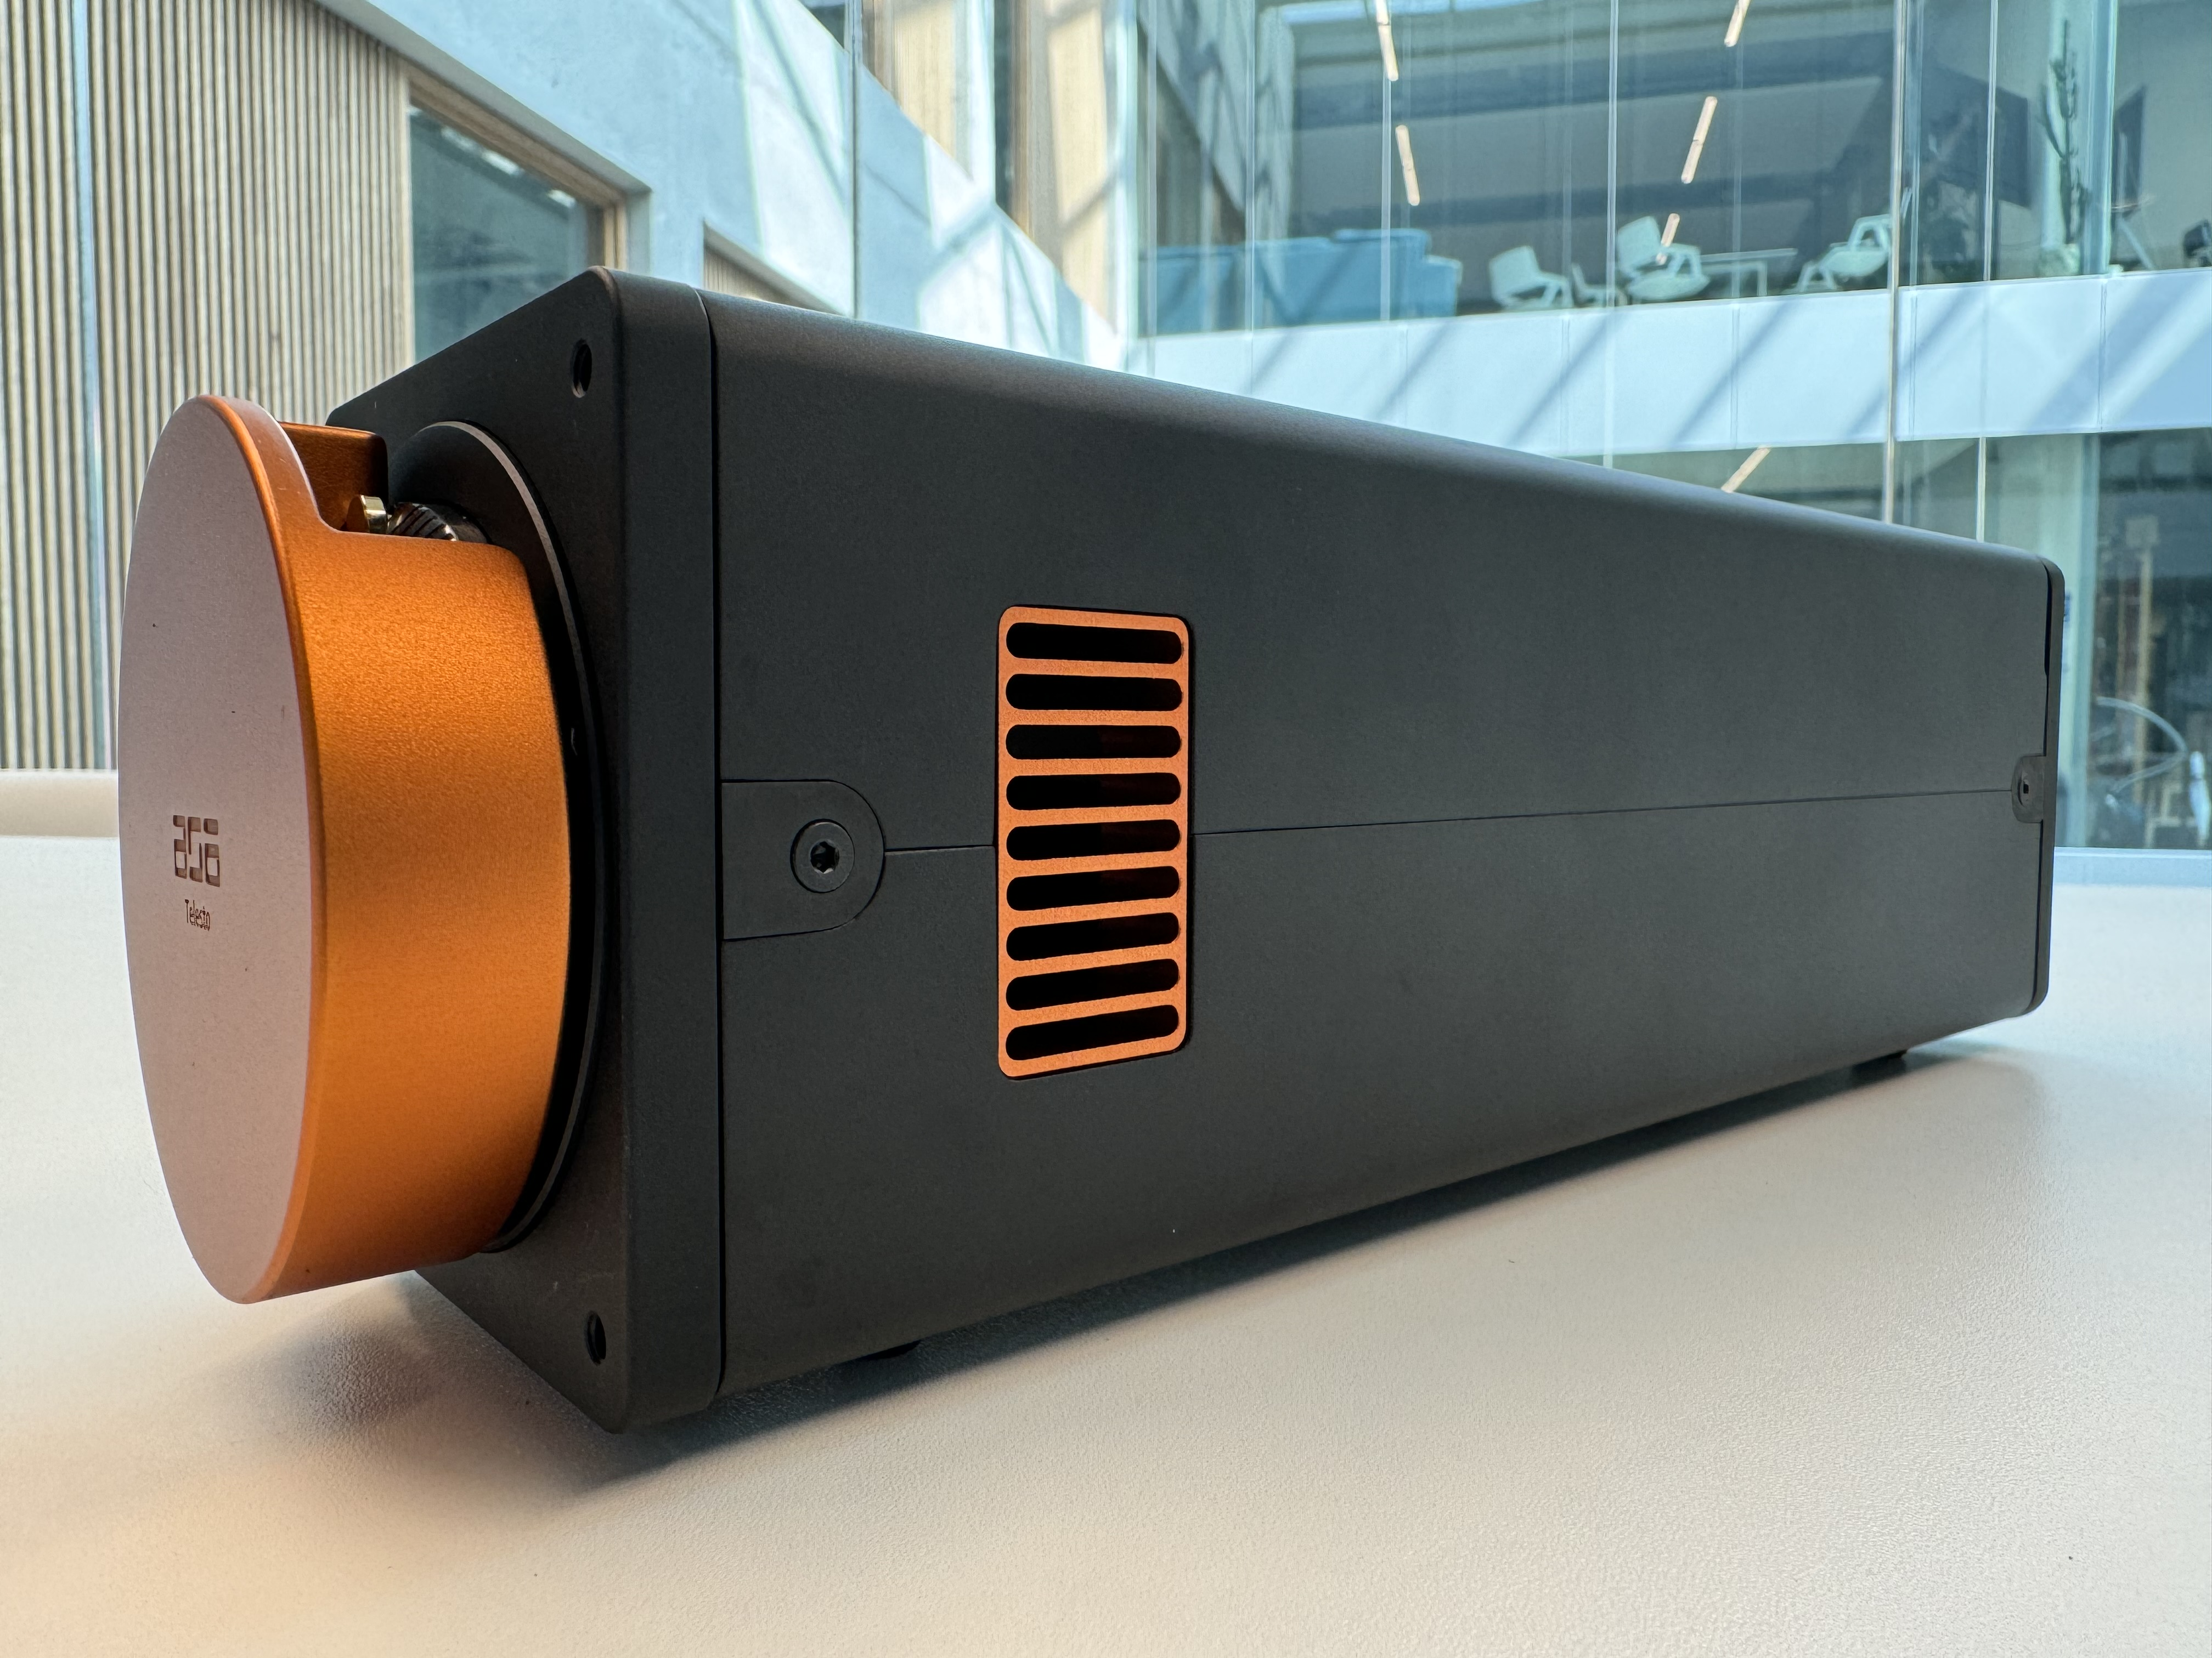
Ongoing Projects: 2025-2026
Chronos
Phoebe
Chronos
Rhea
Chronos
Phoebe T4
Chronos
Phoebe T4 +SPAD
256 x 256 pixels
C-Mount
1.56 ns
80 Mhits/s
TDC: 260 ps
256 x 256 pixels
c-Mount
Latency optimized
TDC: 260 ps
512 x 448 pixels
M-Mount
200 ps
1.2 Ghits/s
512 x 448 pixels
M-Mount
200 ps
1.2 Ghits/s
STANDARD
In Progress
In Progress
Conceptual

Slide 23
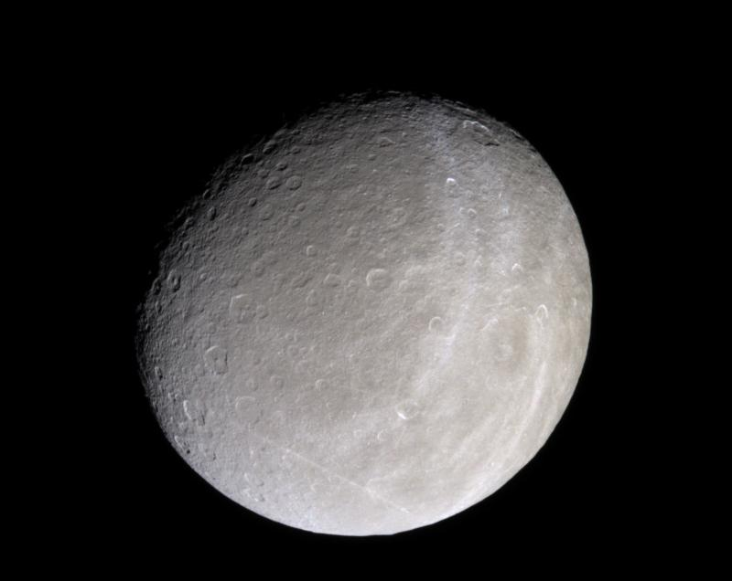
Chronos Series:
Real-Time Feedback
Rhea is an intensified hybrid pixel detector based on TPX3CAM especially designed for real-time feedback control applications. Our development team is currently working on a prototype.
Rhea
the real-time feedback control TPX3CAM

Slide 24
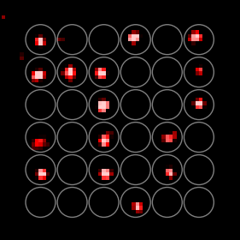
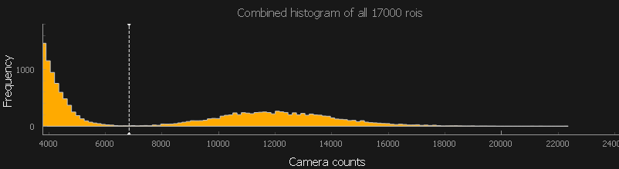
Quantum Computing with Atoms
Quantum computing leverages particles as qubits, and in our case, we focus on atoms.
Atoms function as qubits because they exhibit two distinct states—"dark" (logical 0) and
"bright" (logical 1).
  When exposed to light at a specific wavelength, atoms either reflect or do not reflect light, making their state visible in imaging.
  This property allows us to determine whether they represent a 0 or a 1 by taking pictures and analyzing their brightness.
Application Context
Atoms are held in optical tweezers, and their states
(light or dark) are measured using imaging detectors.
The key requirement in this process:
  Capture an image of the array of atoms.
  Identify the states (light or dark) as quickly as possible to ensure precise feedback.
Typical fluorescence Imaging of single atoms:
Need to collect tens of photons to clear camera noise
Need to have a deep enough trap to tolerate heating
or cool simultaneously
Image durations (exposures): 10-100 ms
  record is 500 us
Notes:
Rhea is a fast real time feedback camera for quantum computing

Slide 25
Why Speed Matters
Fast Feedback is Critical in Quantum Systems
Atoms' states are unstable and decay rapidly (e.g., within ~100 ms).
Delays in feedback, even as little as 10 ms, can result in a 10% loss of quantum states.
Speed is essential to maintain coherence and correct errors in real-time.
Current Workflow Challenges
Standard systems involve these steps:
  Take exposure (open/close shutter).
  Read out data from the detector.
  Transfer data to the control system.
Typical readout involves transferring data from the detector chip to an FPGA, then to a PC for processing.
This can introduce critical latency.

Slide 26

The Innovation of Rhea
What Rhea Does
Rhea accelerates the feedback loop by enabling ultrafast readout and processing of the quantum
system states.
The detector computes the region of interest (ROI) directly on the FPGA:
  Determines whether each region represents a light or dark state.
  Immediately transfers this information to the quantum control system.
Key Innovation
Eliminates the need for data transfer to a PC for processing.
Reduces latency by performing computations directly on the FPGA, ensuring near-instantaneous
feedback.
Light or dark state for atoms in array
Computation happens on FPGA and is fast
Interface to setup needs to be defined
PC
Readout chip
FPGA
Hit/pixel data
High latency
Interaction site information
Correction setup (external)

Slide 27
Challenges and Uncertain Elements
Standardization Challenges
There is no universal standard for transferring data from detectors to quantum control setups.
Different quantum systems (e.g., ion traps, neutral atom processors) require unique configurations.
Latency and Data Rate
Achieving low latency is challenging due to:
  High photon rates overwhelming the system during exposure.
  Balancing data-driven mode and frame-based mode to ensure optimal performance.
Developing physical electronic connections that meet the speed and reliability requirements.
Technical Barriers
The system must manage high data rates while maintaining precision.
Integration with diverse quantum computing setups requires adaptable solutions.

Slide 28
Why Rhea is Needed
Problem Rhea Solves
Traditional systems face delays in transferring and processing data, which slows down real-time
feedback.
These delays lead to errors in quantum computations due to state decay.
Rhea's Solution
Implements low-latency processing directly at the detector level.
Provides immediate feedback to the quantum control system, enhancing error correction and system
reliability.

Slide 29

A little Sneak Peek at our current project

Slide 30
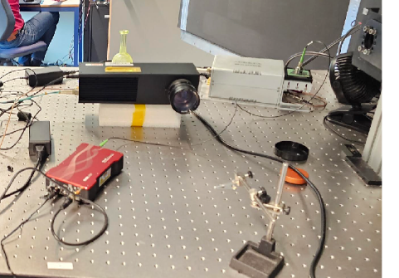
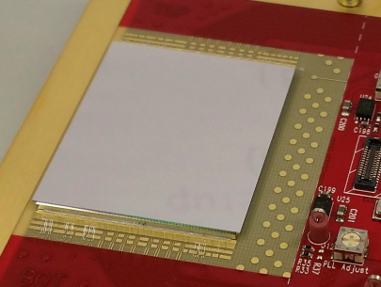
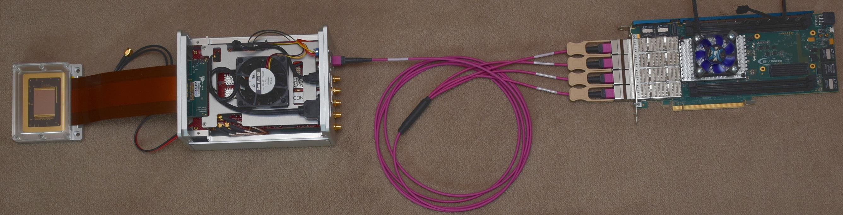
Optical TPX4...(in progress)
First optical TPX4 signals
70 ps pulsed laser
(thanks to Andrei Nomerotski)
The max rate is 1.2 Ghits/s.
195ps time bin
For experiments where High hit rate and large area detection system and much faster time-resolution is required
TPX4 Full rate Data Pipeline
16 GWT links from TPX4 chip (2.56 Gb/s for now, 5.12 Gb/s later)
2 x FireFly → 16 fibers on MPO → 4 x QSFP → BittWare card
16 receivers → packet builders → Wupper interface → memory
Serval: merge streams → sort → split
Notes:
Gigabit Wireline Transmitter. It's the interface Timepix4 uses to offload data which is much faster than Timepix3, maximally at 10.24Gbps (giga bit per second) per link. Currently, it is proven to work reliably at half that rate (5.12 Gbps) using wirebonds. Using TSVs it might be able to work at 10.24Gbps.

Slide 31

Technical Challenges in Development
Higher QE of Intensifiers
Single Photon Sensitive Sensor
Processing Data
Readout Rate
Large Area Intensifier
Fast phosphors
Notes:
Better sensor Single Photon Sensitive Sensor

Slide 32
Non-Technical Challenges in Development
Securing long-term R&D funding.
Aligning R&D expenses with scalability.
Managing academic collaborations alongside industrial schedules. (UvA)
Bridging the talent gap in quantum expertise.
Ensuring access to specialized materials and manufacturing techniques.
Identify companies for integration into the quantum industry sector.
Transitioning from academia-focused sales to targeting the broader industry in the quantum domain.
Identifying what appeals to a larger market in the quantum sector.
Developing strategies for effective networking within the industry.

Slide 33
ASI Effort’s in Quantum Domain
Rhea Project Collaboration
Partnering with the University of Amsterdam (UvA) to advance quantum research.
Quantum Delta NL Grant
Proud recipients of this prestigious grant to support groundbreaking quantum initiatives.
Active Collaborations with QBN
Strengthening ties with the Quantum Business Network to drive innovation and ecosystem development.
Upcoming QBN Event
Hosting the next Quantum Business Network event in Q4 2025.

Slide 34
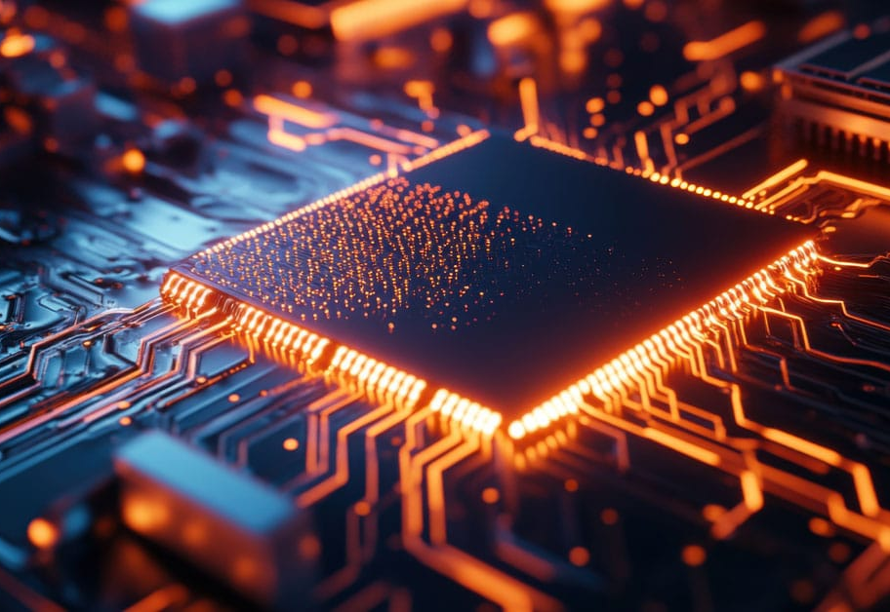
Let’s collaborate to push the boundaries of quantum technology!

