Slide 1

Transition Edge Sensors:
From First Principles to Applications in Particle Detection and Quantum Technologies
José Alejandro Rubiera Gimeno
Postdoctoral researcher at Helmut-Schmidt-Universität (HSU)

Slide 2
Outline
Beginning of Transition Edge Sensors (TES)
TES physics
High energy photon detection
Visible to IR photon detection
Applications in Quantum technologies

Slide 3
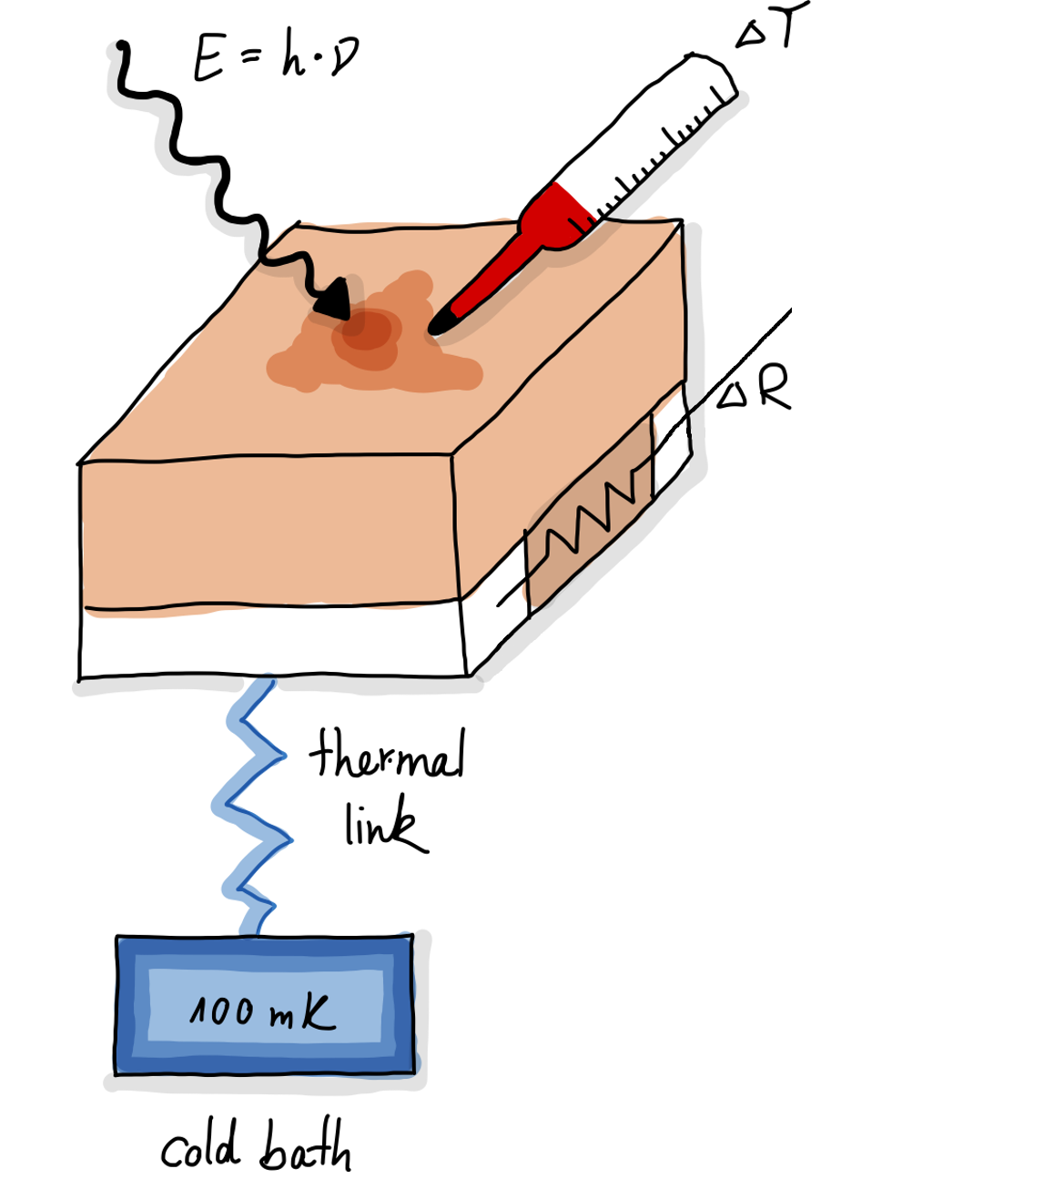
Transition Edge Sensor (TES)
*Courtesy of Katharina-Sophie Isleif
Normal
Conduction
Super-
Conduction
region
Working
point
Cryogenic detector operated at transition region
Connected to a colder thermal bath
Possible definition of the point in the transition
K. Irwin, G. Hilton, Transition-edge sensors, in: Cryogenic Particle Detection, Springer Berlin Heidelberg, Berlin, Heidelberg, 2005, pp. 63–150, http://dx.doi.org/10.1007/10933596_3.

Slide 4
Transition Edge Sensor (TES)
*Courtesy of Katharina-Sophie Isleif
Cryogenic detector operated at transition region
Connected to a colder thermal bath
Possible definition of the point in the transition
Change in resistance produced by energy deposition
Very good energy resolution
K. Irwin, G. Hilton, Transition-edge sensors, in: Cryogenic Particle Detection, Springer Berlin Heidelberg, Berlin, Heidelberg, 2005, pp. 63–150, http://dx.doi.org/10.1007/10933596_3.

Slide 5
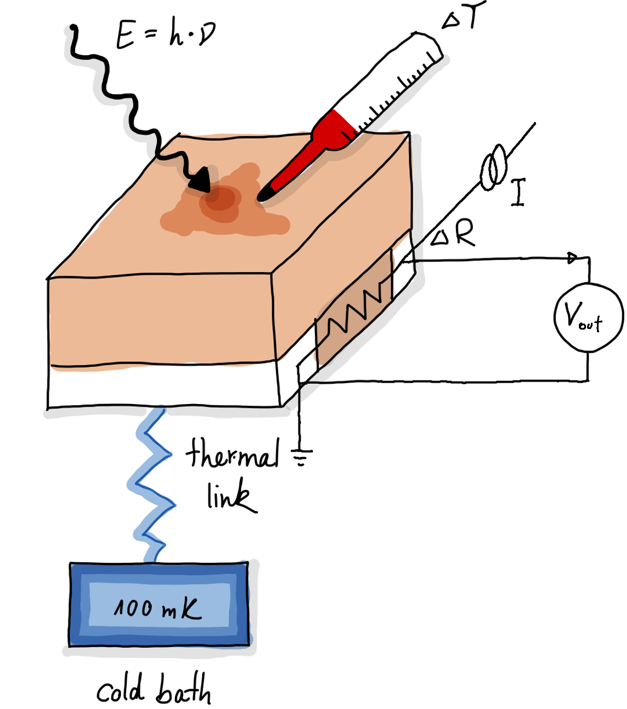
First TESs (‘40s – ‘90s)
*Courtesy of Katharina-Sophie Isleif
Normal
Conduction
Super-
Conduction
region
Working
point
Cryogenic detector operated at transition region
Connected to a colder thermal bath
Possible definition of the point in the transition
  Controlling bath temperature
K. Irwin, G. Hilton, Transition-edge sensors, in: Cryogenic Particle Detection, Springer Berlin Heidelberg, Berlin, Heidelberg, 2005, pp. 63–150, http://dx.doi.org/10.1007/10933596_3.

Slide 6
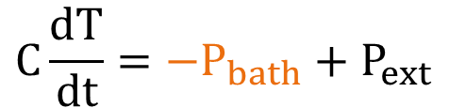


First TESs (‘40s – ‘90s)
$$C\frac{ⅆT}{ⅆt}=−P_{bath}+P_{ext}$$
Thermal circuit
$$P_{bath}=K\left(T^{n}−T_{bath}^{n}\right)$$
Cryogenic detector operated at transition region
Connected to a colder thermal bath
Possible definition of the point in the transition
  Controlling bath temperature

Slide 7
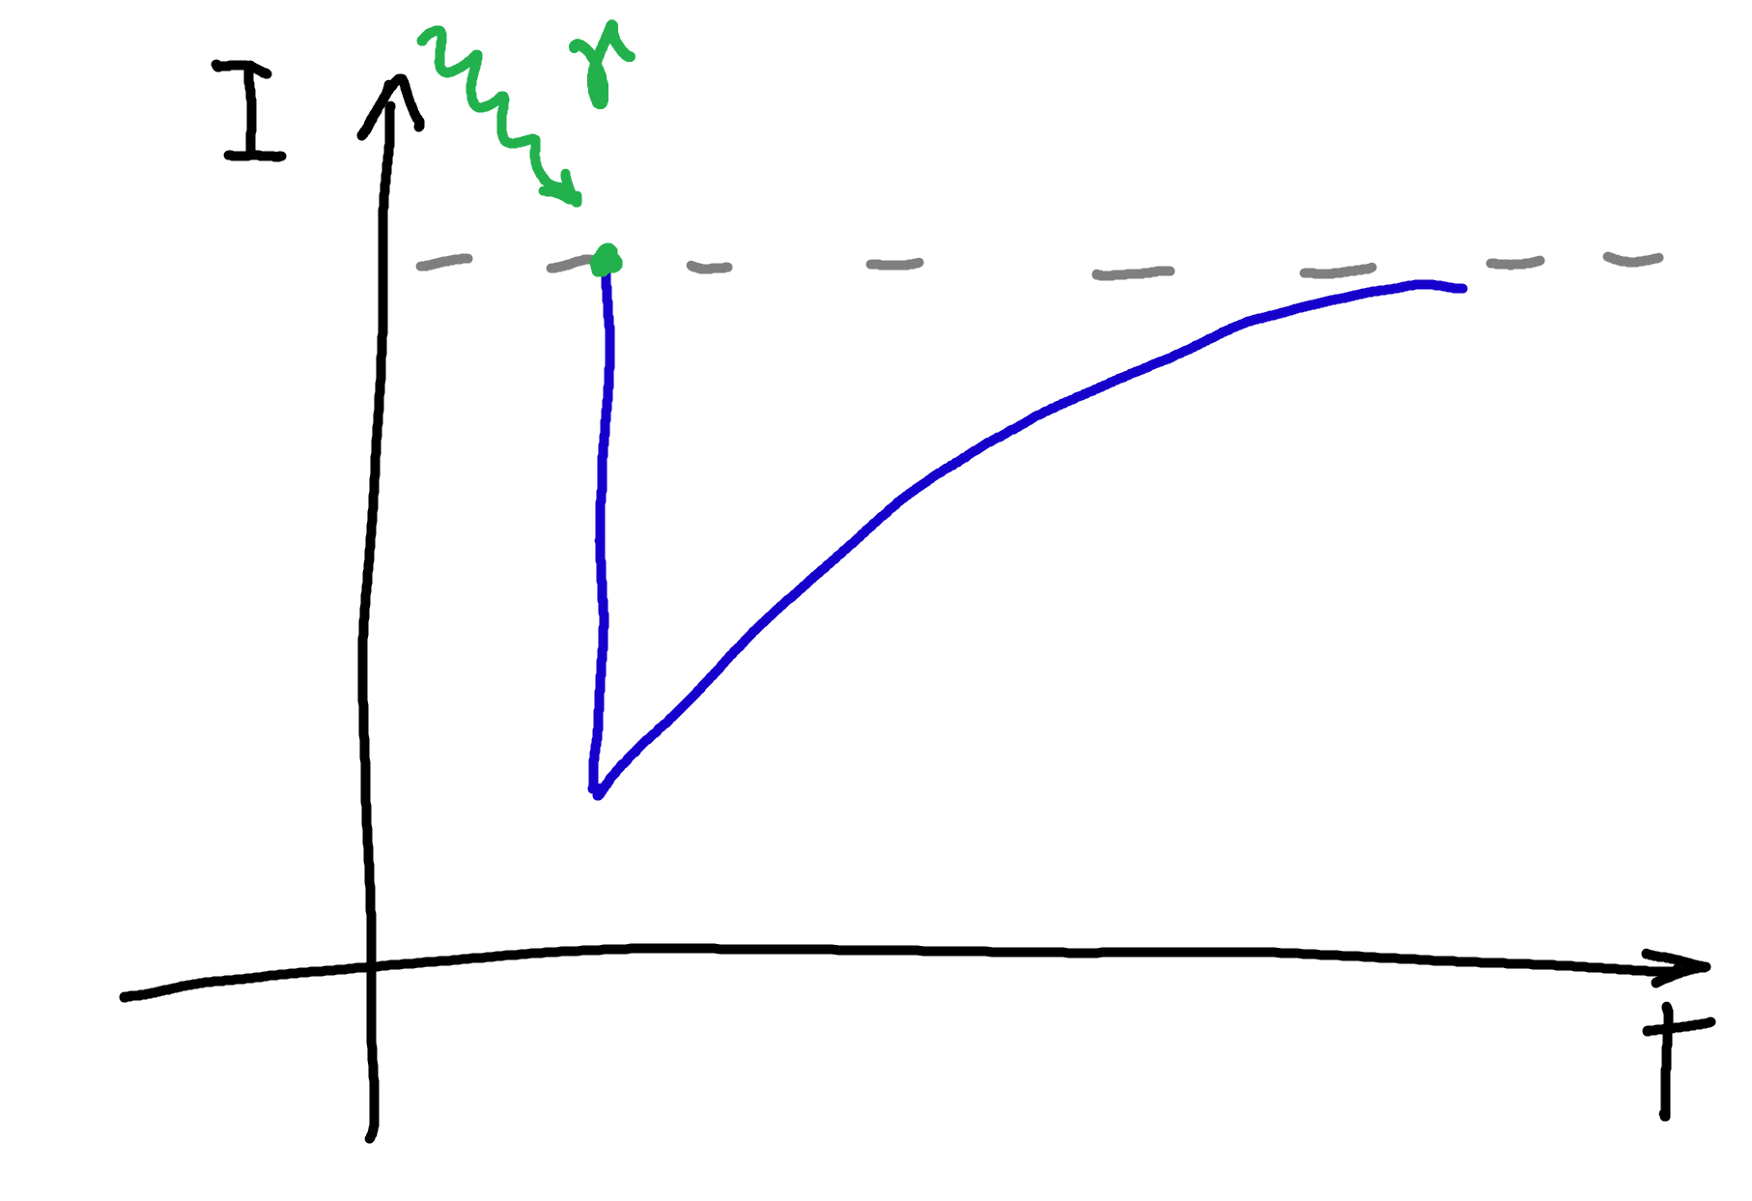




First TESs (‘40s – ‘90s)
$$C\frac{ⅆT}{ⅆt}=−P_{bath}+P_{ext}$$
Thermal circuit
$$P_{bath}=K\left(T^{n}−T_{bath}^{n}\right)$$
$$IR=V_{out}$$
Electrical circuit
$$V_{out}$$
$$τ=\frac{C}{nKT^{n−1}}$$
$$δV=A exp \left\{−\frac{t}{τ}\right\}$$
Cryogenic detector operated at transition region
Connected to a colder thermal bath
Possible definition of the point in the transition
  Controlling bath temperature

Slide 8
First TESs (‘40s – ‘90s)
$$C\frac{ⅆT}{ⅆt}=−P_{bath}+P_{ext}$$
Thermal circuit
$$P_{bath}=K\left(T^{n}−T_{bath}^{n}\right)$$
$$IR=V_{out}$$
Electrical circuit
$$V_{out}$$
$$τ=\frac{C}{nKT^{n−1}}$$
$$δV=A exp \left\{−\frac{t}{τ}\right\}$$
Readout with FET and other solutions
Very noisy ...
Cryogenic detector operated at transition region
Connected to a colder thermal bath
Possible definition of the point in the transition
  Controlling bath temperature

Slide 9
First TESs (‘40s – ‘90s)
*Courtesy of Katharina-Sophie Isleif
Normal
Conduction
Super-
Conduction
region
Working
point
Cryogenic detector operated at transition region
Connected to a colder thermal bath
Possible definition of the point in the transition
  Controlling bath temperature
K. Irwin, G. Hilton, Transition-edge sensors, in: Cryogenic Particle Detection, Springer Berlin Heidelberg, Berlin, Heidelberg, 2005, pp. 63–150, http://dx.doi.org/10.1007/10933596_3.

Slide 10
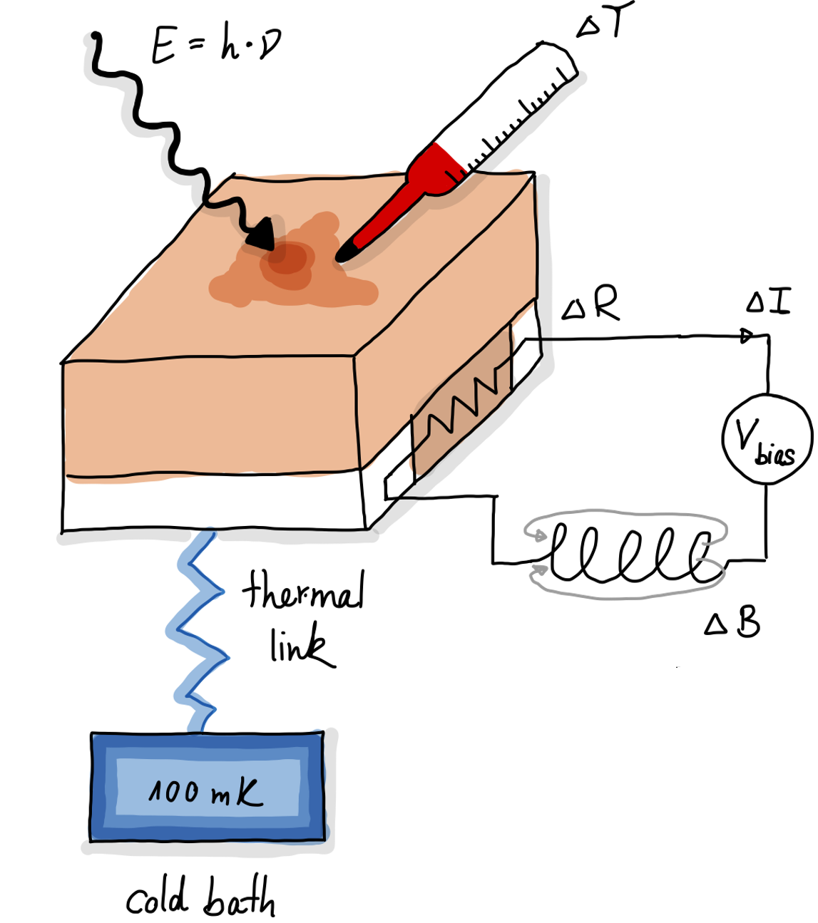
Nowadays TES physics
*Courtesy of Katharina-Sophie Isleif
Normal
Conduction
Super-
Conduction
region
Working
point
Cryogenic detector operated at transition region
Connected to a colder thermal bath
Possible definition of the point in the transition
  Voltage-biased TES
K. Irwin, G. Hilton, Transition-edge sensors, in: Cryogenic Particle Detection, Springer Berlin Heidelberg, Berlin, Heidelberg, 2005, pp. 63–150, http://dx.doi.org/10.1007/10933596_3.

Slide 11

Nowadays TES physics
*Courtesy of Katharina-Sophie Isleif
Normal
Conduction
Super-
Conduction
region
Working
point
Cryogenic detector operated at transition region
Connected to a colder thermal bath
Possible definition of the point in the transition
  Voltage-biased TES
Superconducting Quantum Interference Device (SQUID) readout
K. Irwin, G. Hilton, Transition-edge sensors, in: Cryogenic Particle Detection, Springer Berlin Heidelberg, Berlin, Heidelberg, 2005, pp. 63–150, http://dx.doi.org/10.1007/10933596_3.

Slide 12
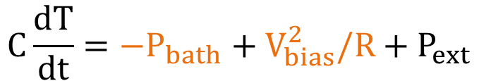

Nowadays TES physics
$$C\frac{ⅆT}{ⅆt}=−P_{bath}+V_{bias}^{2}/R+P_{ext}$$
Thermal circuit
$$P_{bath}=K\left(T^{n}−T_{bath}^{n}\right)$$
TES can be at different temperature than bath
Cryogenic detector operated at transition region
Connected to a colder thermal bath
Possible definition of the point in the transition
  Voltage-biased TES

Slide 13
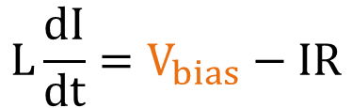
Nowadays TES physics
$$C\frac{ⅆT}{ⅆt}=−P_{bath}+V_{bias}^{2}/R+P_{ext}$$
Thermal circuit
$$P_{bath}=K\left(T^{n}−T_{bath}^{n}\right)$$
$$L\frac{dI}{dt}=V_{bias}−IR$$
Electrical circuit
Cryogenic detector operated at transition region
Connected to a colder thermal bath
Possible definition of the point in the transition
  Voltage-biased TES

Slide 14
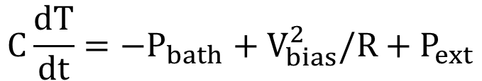
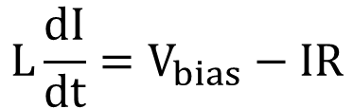
Nowadays TES physics
$$C\frac{ⅆT}{ⅆt}=−P_{bath}+V_{bias}^{2}/R+P_{ext}$$
Thermal circuit
$$P_{bath}=K\left(T^{n}−T_{bath}^{n}\right)$$
$$L\frac{dI}{dt}=V_{bias}−IR$$
Electrical circuit
Non-linear system
Cryogenic detector operated at transition region
Connected to a colder thermal bath
Possible definition of the point in the transition
  Voltage-biased TES

Slide 15
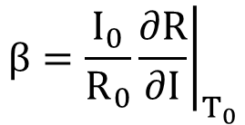

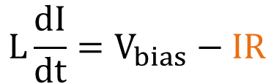
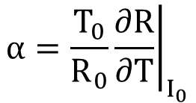
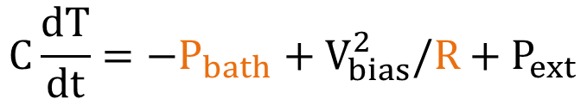

TES Small Signal Theory
$$C\frac{ⅆT}{ⅆt}=−P_{bath}+V_{bias}^{2}/R+P_{ext}$$
Thermal circuit
$$P_{bath}=K\left(T^{n}−T_{bath}^{n}\right)$$
Normal
Conduction
Super-
Conduction
region
$$L\frac{dI}{dt}=V_{bias}−IR$$
Electrical circuit
Linearize with respect to working point for small variations of $T,I$ and $R$
Cryogenic detector operated at transition region
Connected to a colder thermal bath
Possible definition of the point in the transition
  Voltage-biased TES
$$α=\frac{T_{0}}{R_{0}}{\left.\frac{∂R}{∂T}\right|}_{I_{0}}$$
$$β=\frac{I_{0}}{R_{0}}{\left.\frac{∂R}{∂I}\right|}_{T_{0}}$$

Slide 16
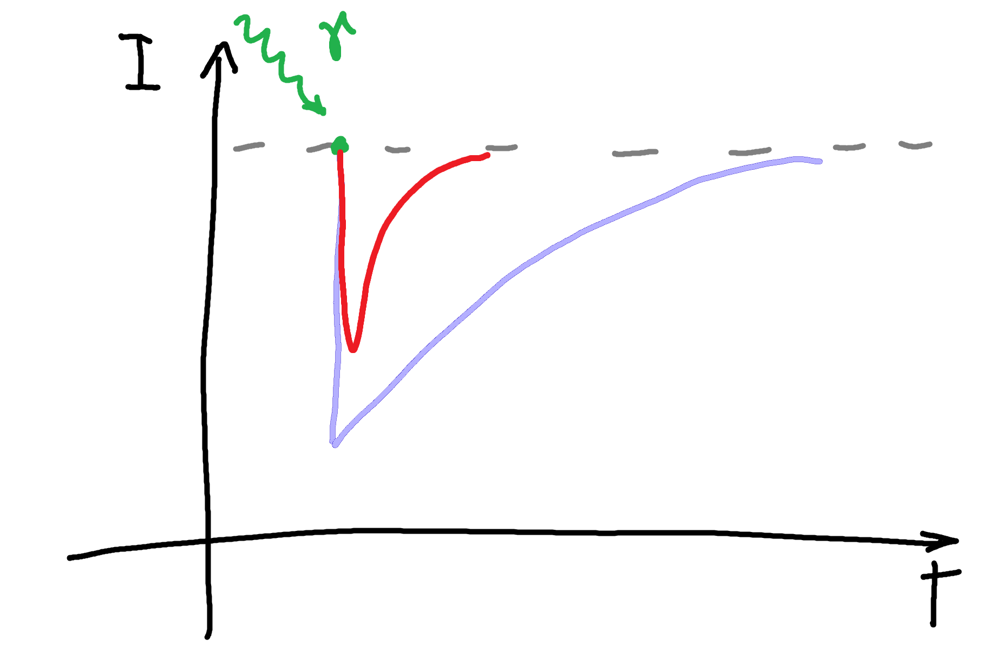
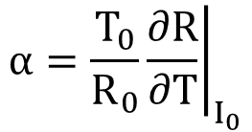
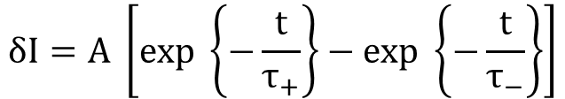
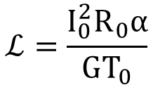
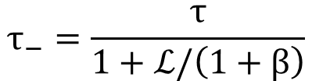
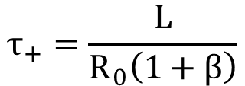

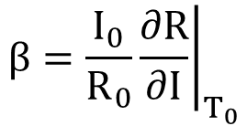
TES Small Signal Theory
$$α=\frac{T_{0}}{R_{0}}{\left.\frac{∂R}{∂T}\right|}_{I_{0}}$$
$$β=\frac{I_{0}}{R_{0}}{\left.\frac{∂R}{∂I}\right|}_{T_{0}}$$
If L is small, so $τ_{+}≪τ_$:
Normal
Conduction
$$τ_{+}=\frac{L}{R_{0}\left(1+β\right)}$$
$$τ_{−}=\frac{τ}{1+ℒ/\left(1+β\right)}$$
$$ℒ=\frac{I_{0}^{2}R_{0}α}{GT_{0}}$$
Super-
Conduction
region
$$δI=A \left[exp \left\{−\frac{t}{τ_{+}}\right\}−exp \left\{−\frac{t}{τ_{−}}\right\}\right]$$
Cryogenic detector operated at transition region
Connected to a colder thermal bath
Possible definition of the point in the transition
  Voltage-biased TES

Slide 17
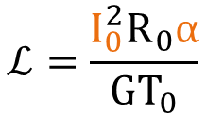

TES Small Signal Theory
$$α=\frac{T_{0}}{R_{0}}{\left.\frac{∂R}{∂T}\right|}_{I_{0}}$$
$$β=\frac{I_{0}}{R_{0}}{\left.\frac{∂R}{∂I}\right|}_{T_{0}}$$
If L is small, so $τ_{+}≪τ_$:
Normal
Conduction
$$τ_{+}=\frac{L}{R_{0}\left(1+β\right)}$$
$$τ_{−}=\frac{τ}{1+ℒ/\left(1+β\right)}$$
$$ℒ=\frac{I_{0}^{2}R_{0}α}{GT_{0}}$$
Super-
Conduction
region
Slower rise time
Faster decay time
$$δI=A \left[exp \left\{−\frac{t}{τ_{+}}\right\}−exp \left\{−\frac{t}{τ_{−}}\right\}\right]$$
$$δI=A \left[exp \left\{−\frac{t}{τ_{+}}\right\}−exp \left\{−\frac{t}{τ_{−}}\right\}\right]$$
Cryogenic detector operated at transition region
Connected to a colder thermal bath
Possible definition of the point in the transition
  Voltage-biased TES

Slide 18
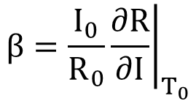
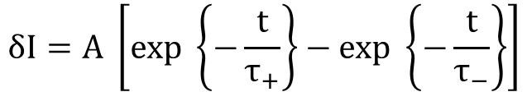
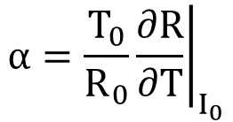
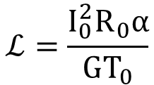
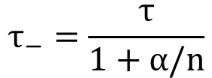
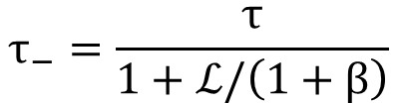

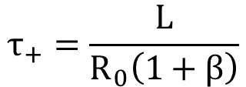

TES Strong ETF
$$α=\frac{T_{0}}{R_{0}}{\left.\frac{∂R}{∂T}\right|}_{I_{0}}$$
$$β=\frac{I_{0}}{R_{0}}{\left.\frac{∂R}{∂I}\right|}_{T_{0}}$$
Strong electrothermal feedback (ETF) if $ℒ≫1$
If L is small, so $τ_{+}≪τ_$:
$$τ_{−}=\frac{τ}{1+α/n}$$
$$τ_{+}=\frac{L}{R_{0}\left(1+β\right)}$$
$$τ_{−}=\frac{τ}{1+ℒ/\left(1+β\right)}$$
$$ℒ=\frac{I_{0}^{2}R_{0}α}{GT_{0}}$$
$$δI=A \left[exp \left\{−\frac{t}{τ_{+}}\right\}−exp \left\{−\frac{t}{τ_{−}}\right\}\right]$$

Slide 19
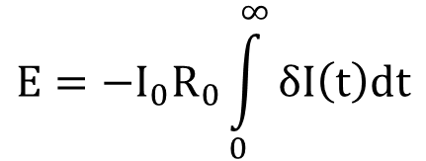

TES Strong ETF
$$α=\frac{T_{0}}{R_{0}}{\left.\frac{∂R}{∂T}\right|}_{I_{0}}$$
$$β=\frac{I_{0}}{R_{0}}{\left.\frac{∂R}{∂I}\right|}_{T_{0}}$$
Strong electrothermal feedback (ETF) if $ℒ≫1$
If L is small, so $τ_{+}≪τ_$:
$$τ_{−}=\frac{τ}{1+α/n}$$
$$τ_{+}=\frac{L}{R_{0}\left(1+β\right)}$$
$$τ_{−}=\frac{τ}{1+ℒ/\left(1+β\right)}$$
$$ℒ=\frac{I_{0}^{2}R_{0}α}{GT_{0}}$$
TES as bolometer:
$$P=−I_{0}R_{0}δI$$
TES as calorimeter:
$$E=−I_{0}R_{0}\int_{0}^{∞}{δI\left(t\right)dt}$$
$$δI=A \left[exp \left\{−\frac{t}{τ_{+}}\right\}−exp \left\{−\frac{t}{τ_{−}}\right\}\right]$$
K. Irwin, G. Hilton, Transition-edge sensors, in: Cryogenic Particle Detection, Springer Berlin Heidelberg, Berlin, Heidelberg, 2005, pp. 63–150, http://dx.doi.org/10.1007/10933596_3.

Slide 20
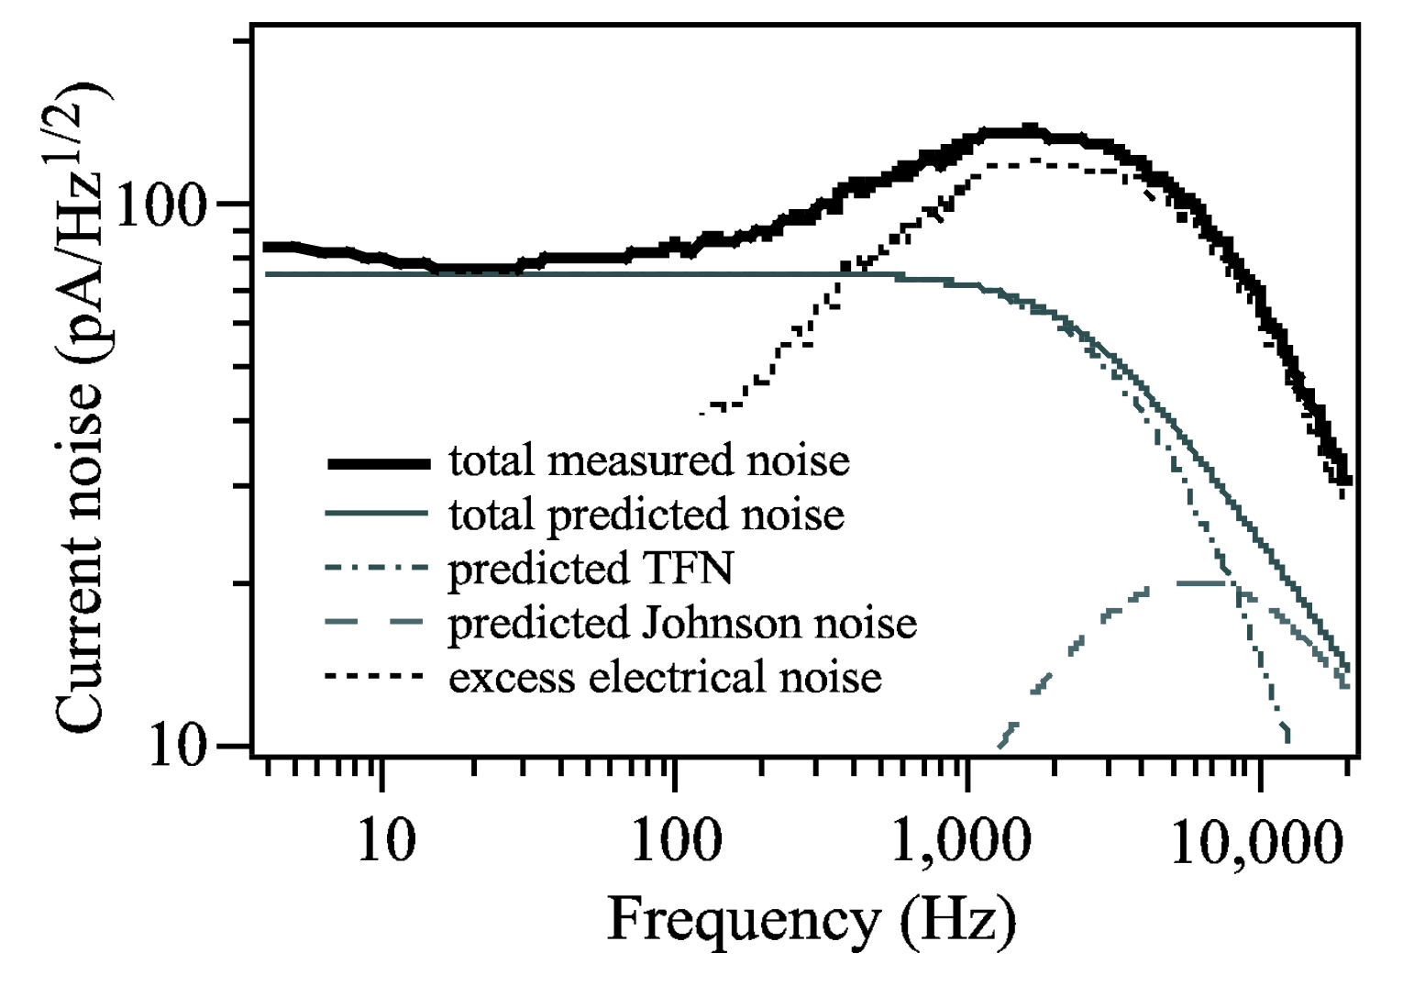

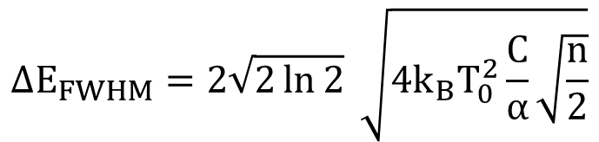

TES noise and energy resolution
Thermal fluctuation noise (TFN)
Thermal noise
Johnson or Nyquist noise
Electronic noise
$$ΔE_{FWHM}=2\sqrt{2\ln{2}} \sqrt{4k_{B}T_{0}^{2}\frac{C}{α}\sqrt{\frac{n}{2}}}$$
K. Irwin, G. Hilton, Transition-edge sensors, in: Cryogenic Particle Detection, Springer Berlin Heidelberg, Berlin, Heidelberg, 2005, pp. 63–150, http://dx.doi.org/10.1007/10933596_3.

Slide 21


TES noise and energy resolution
Thermal fluctuation noise (TFN)
Thermal noise
Johnson or Nyquist noise
Electronic noise
Excess noise
$$ΔE_{FWHM}=2\sqrt{2\ln{2}} \sqrt{4k_{B}T_{0}^{2}\frac{C}{α}\sqrt{\frac{n}{2}}}$$
$$ΔE_{true}>ΔE_{FWHM}$$
K. Irwin, G. Hilton, Transition-edge sensors, in: Cryogenic Particle Detection, Springer Berlin Heidelberg, Berlin, Heidelberg, 2005, pp. 63–150, http://dx.doi.org/10.1007/10933596_3.

Slide 22
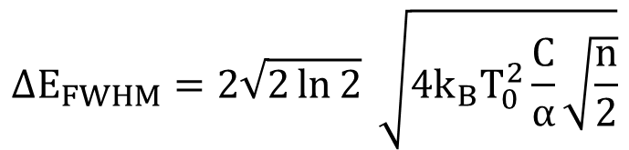
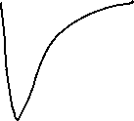

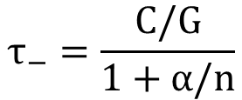
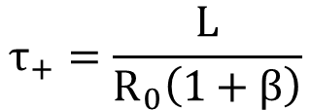

TES physics summary
TES in strong ETF
$$τ_{+}=\frac{L}{R_{0}\left(1+β\right)}$$
Rise time
$$τ_{−}=\frac{C/G}{1+α/n}$$
Decay time
Measured power with TES as bolometer
$$P=−I_{0}R_{0}δI$$
$$E=−I_{0}R_{0}\int_{0}^{∞}{δI\left(t\right)dt}$$
Measured energy of photon with TES as calorimeter
$$ΔE_{FWHM}=2\sqrt{2\ln{2}} \sqrt{4k_{B}T_{0}^{2}\frac{C}{α}\sqrt{\frac{n}{2}}}$$
Theoretical limit for TES energy resolution
*Courtesy of Katharina-Sophie Isleif

Slide 23
TES physics summary
TES in strong ETF
$$τ_{+}=\frac{L}{R_{0}\left(1+β\right)}$$
Rise time
$$τ_{−}=\frac{C/G}{1+α/n}$$
Decay time
Measured power with TES as bolometer
$$P=−I_{0}R_{0}δI$$
$$E=−I_{0}R_{0}\int_{0}^{∞}{δI\left(t\right)dt}$$
Measured energy of photon with TES as calorimeter
$$ΔE_{FWHM}=2\sqrt{2\ln{2}} \sqrt{4k_{B}T_{0}^{2}\frac{C}{α}\sqrt{\frac{n}{2}}}$$
Theoretical limit for TES energy resolution
*Courtesy of Katharina-Sophie Isleif

Slide 24
High energy photon detection

Slide 25



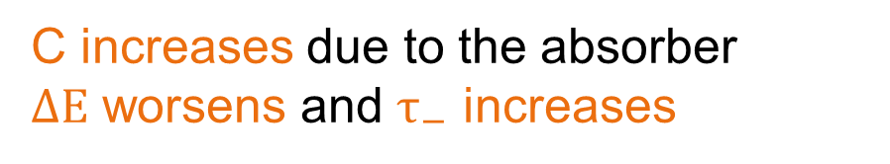



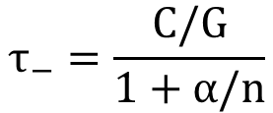

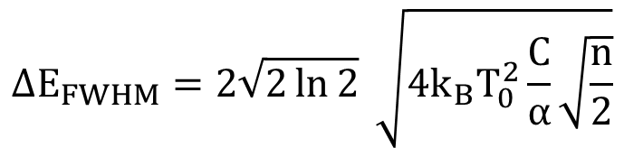
X-ray and gamma TES detectors
Absorber big enough to increase probability of X-ray and gamma interaction
$$τ_{−}=\frac{C/G}{1+α/n}$$
Decay time
$$ΔE_{FWHM}=2\sqrt{2\ln{2}} \sqrt{4k_{B}T_{0}^{2}\frac{C}{α}\sqrt{\frac{n}{2}}}$$
Theoretical limit for TES energy resolution
C increases due to the absorber
$ΔE$ worsens and $τ_{−}$ increases

Slide 26
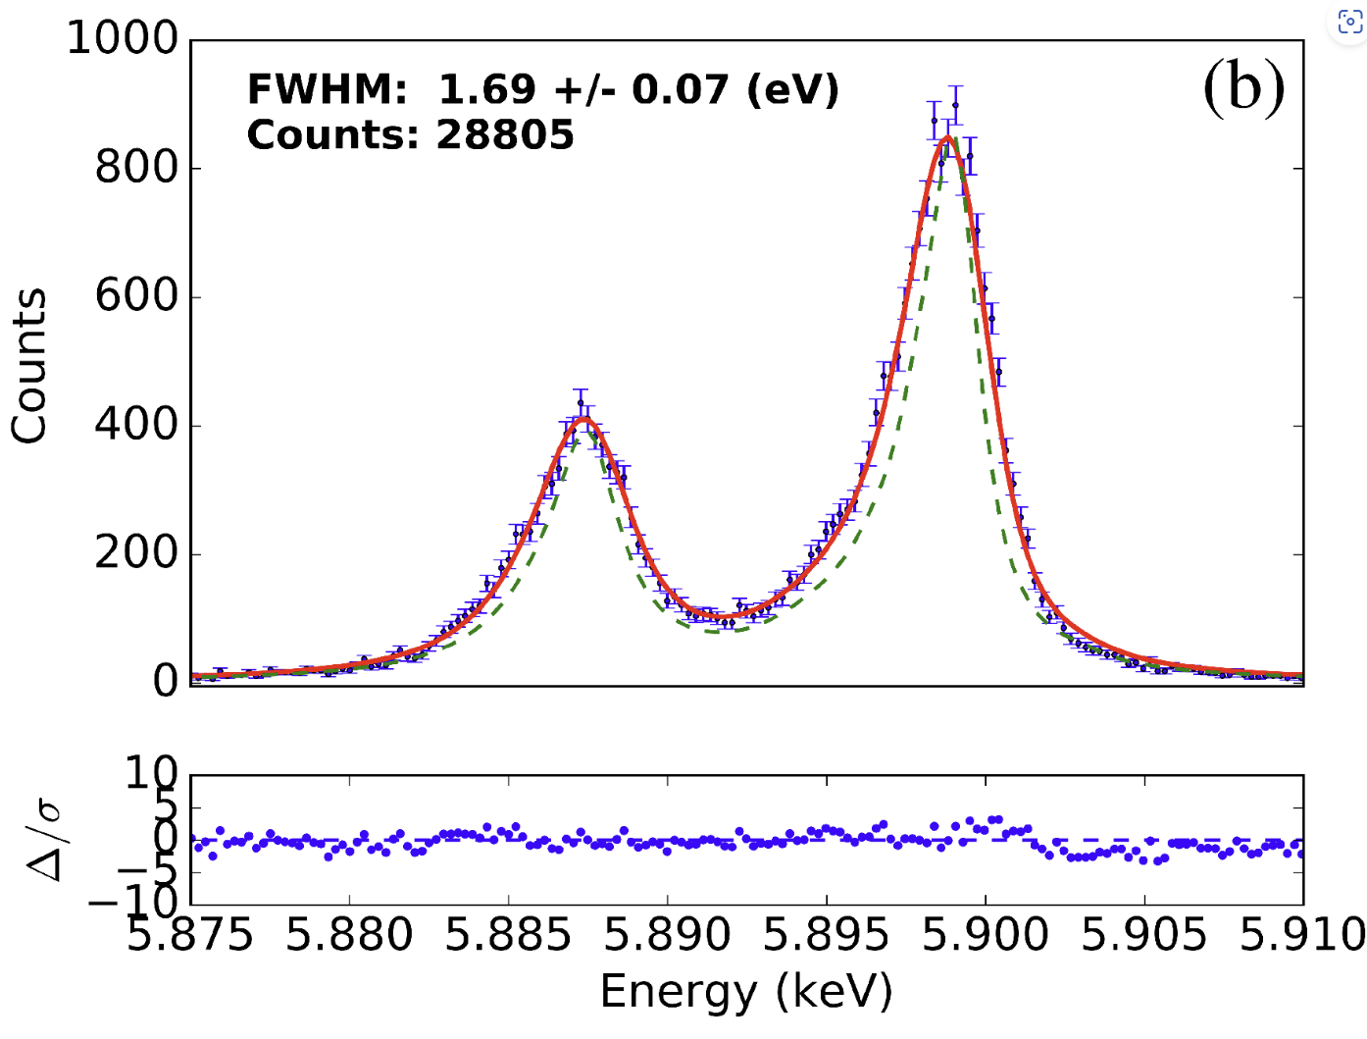
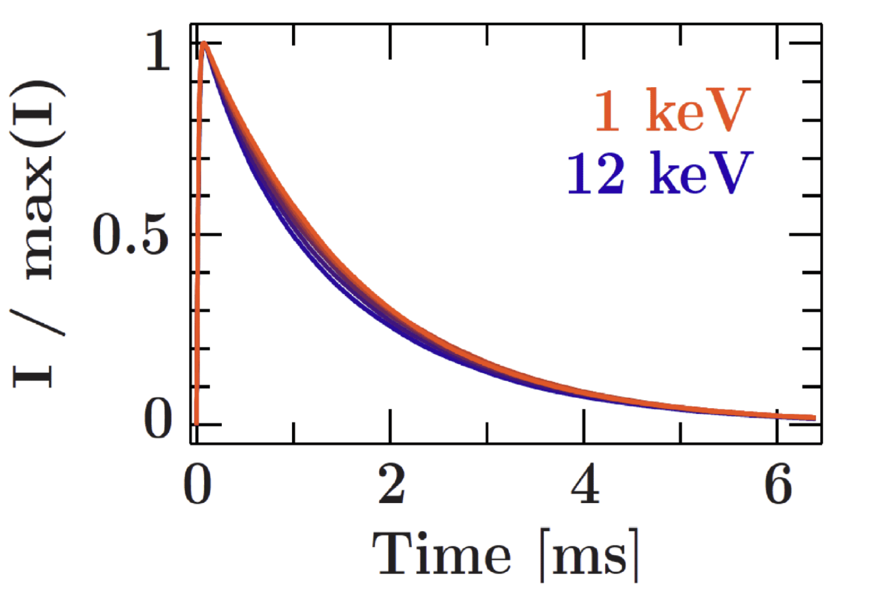
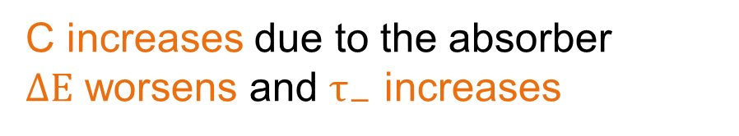
X-ray and gamma TES detectors
C increases due to the absorber
$ΔE$ worsens and $τ_{−}$ increases
Very high S-to-N ratio
Excellent energy resolution of ~0.01%
A Review of X-ray Microcalorimeters Based on Superconducting Transition Edge Sensors for Astrophysics and Particle Physics. Applied Sciences, 11(9), 3793. https://doi.org/10.3390/app11093793

Slide 27
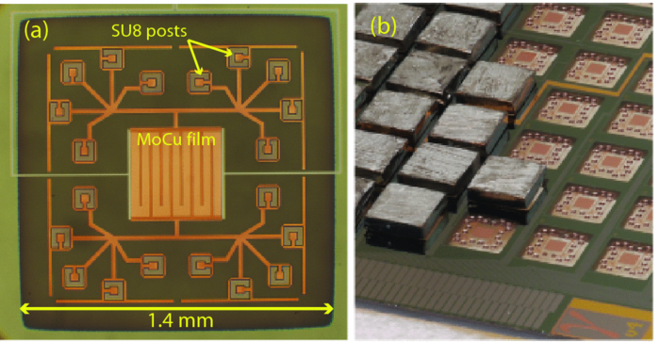
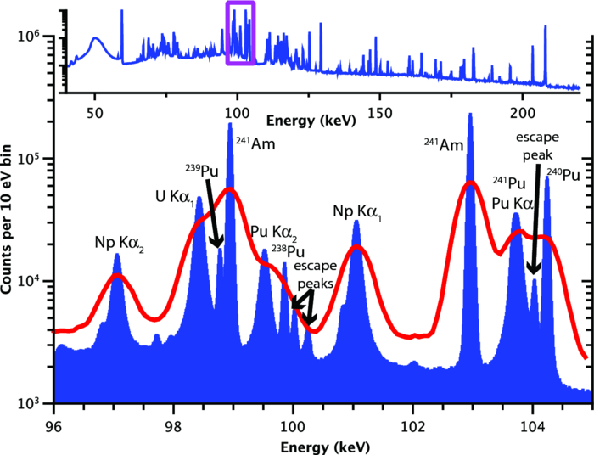
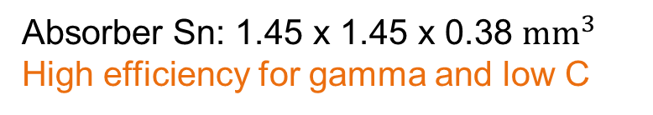

Extending the range to ~100 keV
Absorber Sn: 1.45 x 1.45 x 0.38 $mm^{3}$
High efficiency for gamma and low C
High purity Germanium detector
$ΔE=25 eV @ 100 keV$
TES
Rev. Sci. Instrum.. 2012;83(9). doi:10.1063/1.4754630

Slide 28
Extending the range to ~100 keV
SQUID multiplexing
Absorber Sn: 1.45 x 1.45 x 0.38 $mm^{3}$
High efficiency for gamma and low C
High purity Germanium detector
$ΔE=25 eV @ 100 keV$
TES
Rev. Sci. Instrum.. 2012;83(9). doi:10.1063/1.4754630

Slide 29
X-ray astrophysics
X-rays emitted by ionized atoms and energetic electrons near active objects
Energies of discrete X-ray lines reveal elements
Doppler shift of lines indicate dynamic conditions of elements
Presence of several ionization lines
Requires excellent energy resolution

Slide 30
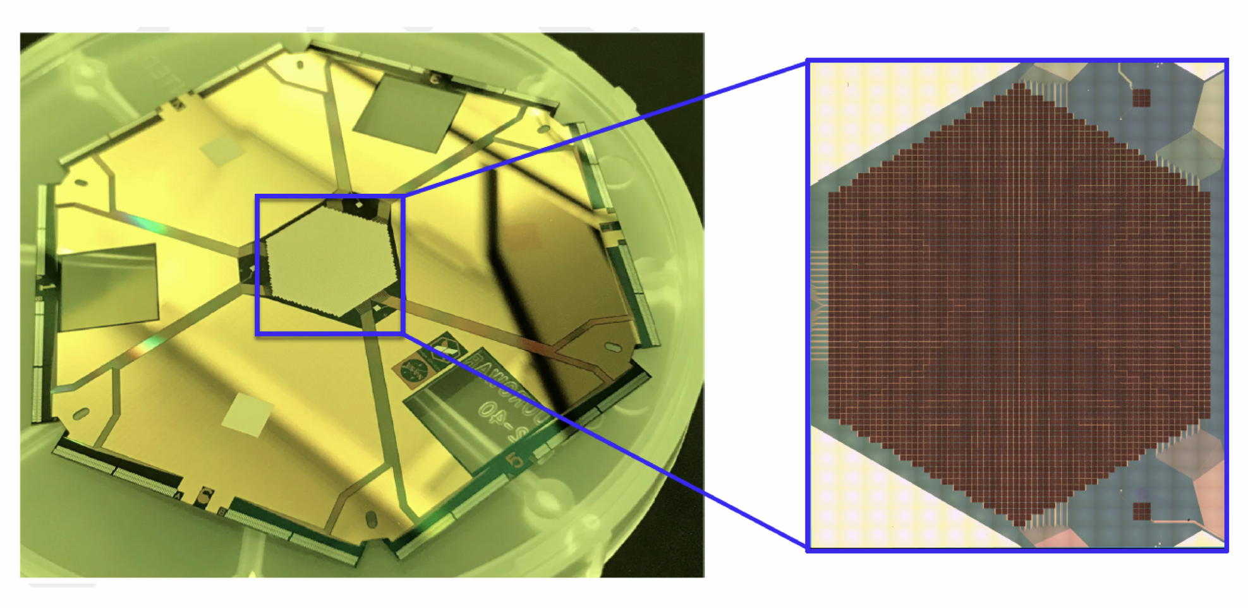
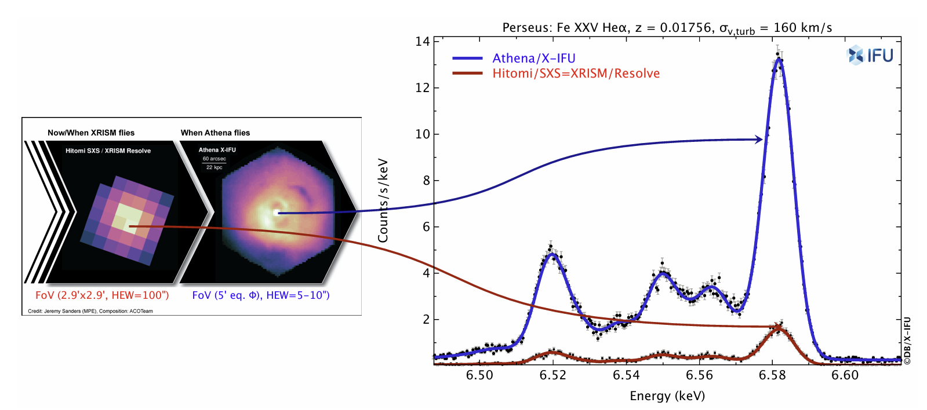
X-ray astrophysics
X-rays emitted by ionized atoms and energetic electrons near active objects
Energies of discrete X-ray lines reveal elements
Doppler shift of lines indicate dynamic conditions of elements
Presence of several ionization lines
Athena/X-IFU to be launched with more than 3000 pixels
Requires excellent energy resolution
doi:10.1007/s10686-022-09880-7

Slide 31
Visible to IR photon detection

Slide 32
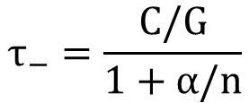

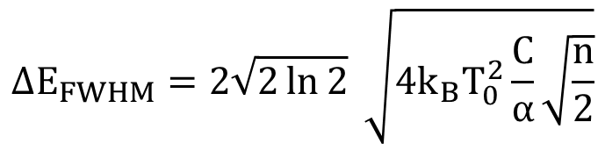
Visible to IR photon TES detectors
The TES is the absorber $→$ C lower
$ΔE$ is lower and $τ_{−}$ also lower
$$τ_{−}=\frac{C/G}{1+α/n}$$
Decay time
Theoretical limit for TES energy resolution
$$ΔE_{FWHM}=2\sqrt{2\ln{2}} \sqrt{4k_{B}T_{0}^{2}\frac{C}{α}\sqrt{\frac{n}{2}}}$$

Slide 33






Visible to IR photon TES detectors
The TES is the absorber $→$ C lower
$ΔE$ is lower and $τ_{−}$ also lower
$$ΔE=0.14 eV$$
1064nm pulse
$$E=1.165 eV$$
$ΔE \sim 0.1 eV$ and much faster $τ_{−}\sim 1 μs$
doi:10.3204/PUBDB-2024-07357

Slide 34






Propagating photons to the detector
Use of an optical fiber to transmit photons to the TES
A tungsten microchip ($25 μm×25 μm×20 nm$) provided by NIST and SQUID and packaging PTB stabilized in the transition region (~ 140 mK)
Optimized for $1064 nm$ photon $E≈1.2 eV$ with an optical stack
* TES setup at DESY

Slide 35
Propagating photons to the detector
Use of an optical fiber to transmit photons to the TES
TES at DESY for the ALPS II experiment
doi:10.22323/1.449.0567
A tungsten microchip ($25 μm×25 μm×20 nm$) provided by NIST and SQUID and packaging PTB stabilized in the transition region (~ 140 mK)
Optimized for $1064 nm$ photon $E≈1.2 eV$ with an optical stack
* TES setup at DESY

Slide 36


Background in the TES
[1] doi:10.22323/1.398.0801
[2] doi:10.3204/PUBDB-2024-07357
Fiber disconnected from the TES.
The recorded rate of events in the order is usually below ${10}^{−1} cps$ (depends on the trigger)
Origin associated to radioactivity and cosmic rays.
TES response different than photon pulses. Allows pulse shape discrimination and machine learning
e.g. [1] ${<10}^{−5} cps @ 1064nm$
Schematic adapted from Katharina-Sophie Isleif.

Slide 37


Background in the TES
[1] doi:10.22323/1.398.0801
[2] doi:10.3204/PUBDB-2024-07357
Fiber disconnected from the TES.
The recorded rate of events in the order is usually below ${10}^{−1} cps$ (depends on the trigger)
Origin associated to radioactivity and cosmic rays.
TES response different than photon pulses. Allows pulse shape discrimination and machine learning
e.g. [1] ${<10}^{−5} cps @ 1064nm$
Fiber connected from the TES and other end in the dark.
The recorded rate of events in the order can be up to ${10}^{1} cps$ (depends on the trigger)
Mainly Black Body Radiation coupling to the optical fiber.
TES energy resolution allows background discrimination [2] ${<10}^{−4} cps @ 1064nm$
Very low background requires other strategies.
Schematic adapted from Katharina-Sophie Isleif.

Slide 38



Multicolor measurement with TES
Use in energy dispersive spectroscopy for bioanalysis research and industry.
Sensitive to different wavelengths
CMOS
TES
Conditions:
100x brightness
10x exposure
Exposure 8 min
doi:10.3204/PUBDB-2024-07357
doi:10.1038/srep45660

Slide 39


Photon Number resolution
Near unity quantum efficiency
Very good photon number resolution
  Number of photons of same wavelength arriving at a given time.
Maximum repetition rate depending on decay time of TES pulses
doi:10.1117/12.852221

Slide 40

Quantum Metrology with TESs
TES allow direct access to photon statistics from light sources.
Possibility to study entangled and squeezed states.
Analysis and exploration of solid-state-based quantum light sources for applications in quantum information, quantum-enhanced sensing and quantum metrology
doi:10.1103/PhysRevA.82.031802

Slide 41



TES in quantum computing
Combining TES with a superconducting qubit on a shared silicon substrate.
Idea of detecting correlated disturbances induced by the radiation.
TES as a veto to reject the calculations that could be potentially incorrect due to an environmental disturbance.
Monitoring with a TES has been demonstrated.
doi:10.1103/PhysRevApplied.16.024025

Slide 42
Towards future TESs
doi:10.1117/12.852221
High detection efficiency > 95%, up to 99.8% @ 1550nm
Faster TESs
Better energy resolution
Improve in readout complexity
Lower background level

Slide 43





Towards future TESs
doi:10.1117/12.852221
High detection efficiency > 95%
Faster TESs
Better energy resolution
Improve in readout complexity
Lower background level
ER = 0.062 eV

Slide 44
Thank you!

Slide 45
References
Transition-edge sensors, in: Cryogenic Particle Detection. http://dx.doi.org/10.1007/10933596_3
A Review of X-ray Microcalorimeters Based on Superconducting Transition Edge Sensors for Astrophysics and Particle Physics. https://doi.org/10.3390/app11093793
A high-resolution gamma-ray spectrometer based on superconducting microcalorimeters. https://doi.org/10.1063/1.4754630
The Athena X-ray Integral Field Unit: a consolidated design for the system requirement review of the preliminary definition phase. https://doi.org/10.1007/s10686-022-09880-7
Optimizing a Transition Edge Sensor detector system for low flux infrared photon measurements at the ALPS II experiment. https://doi.org/10.3204/PUBDB-2024-07357
A TES system for ALPS II - Status and Prospects. https://doi.org/10.22323/1.449.0567
Superconducting transition-edge sensors optimized for high-efficiency photon-number resolving detectors. https://doi.org/10.1117/12.852221
Generation of optical coherent-state superpositions by number-resolved photon subtraction from the squeezed vacuum. https://doi.org/10.1103/PhysRevA.82.031802
Sensor-Assisted Fault Mitigation in Quantum Computation. https://doi.org/10.1103/PhysRevApplied.16.024025
Fast transition-edge sensors suitable for photonic quantum computing. https://doi.org/10.1063/5.0149478
An optical transition-edge sensor with high energy resolution. https://doi.org/10.1088/1361-6668/ac7e7b
Kinetic inductance current sensor for visible to near-infrared wavelength transition-edge sensor readout. https://doi.org/10.1038/s44172-024-00308-y

Slide 46
Backup

Slide 47

SQUID multiplexing
Also, microwave KID
And microwave SQUID

Slide 48
Any Light Particle Search II (ALPS II)
$$p_{γ→ a →γ}=8∙{10}^{−26} \frac{β_{PC}}{5000} \frac{β_{RC}}{16000}{\left(\frac{g_{aγγ}}{{0.2⋅10}^{−10} GeV^{−1}}\frac{B}{5.3 T}\frac{L_{B}}{106 m}\right)}^{4}$$
Enhancement by optical cavities
Motivated by astrophysics
Schematic adapted from Todd Kozlowski

Slide 49

Transition Edge Sensor in ALPS II
Requirements for ALPS II:
Sensitivity to very low rates (1-2 photons a day)
Low energy photon detection (1064nm equivalent to 1.16eV)
Long term stability ($\sim 20$ days)
High system detection efficiency [1]
Low background rate: $<7.7∙{10}^{−6}cps \sim$ 1 photon (1064nm−like) every 2 days
  Intrinsics [2]
  Extrinsics
  Good energy resolution (for background rejection) [1]
[1] J. A. Rubiera Gimeno, F. Januschek, K.-S. Isleif, A. Lindner, M. Meyer, G. Othman, C. Schwemmbauer, R. Shah, “A TES system for ALPS II - Status and Prospects”, PoS EPS-HEP2023 (2023) 567. https://doi.org/10.22323/1.449.0567
[2] Rikhav Shah, Katharina-Sophie Isleif, Friederike Januschek, Axel Lindner and Matthias Schott, “TES Detector for ALPS II”, Proceedings of The European Physical Society Conference on High Energy Physics, Volume 398, Page 801, (2022); https://doi.org/10.22323/1.398.0801

Slide 50

Extrinsics background
doi:10.3204/PUBDB-2024-07357
Additional curling uncertainty
in simulation
Good agreement with data in region not dependent on curling
Remnant intrinsic background

