Slide 1
Q-CMOS : Image sensors with single photon capabilities
Ljiljana Durdevic, Sebastian Beer
Hamamatsu Photonics
24/01/2025

Slide 2
Contents
Nomenclature
Historical Perspective
Current Implementations
Applications

Slide 3
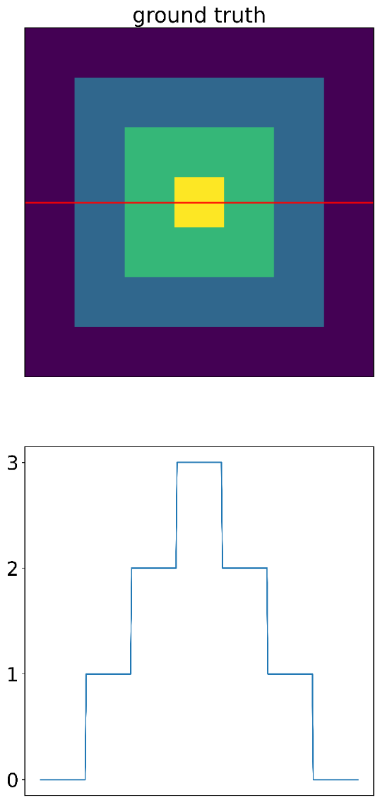
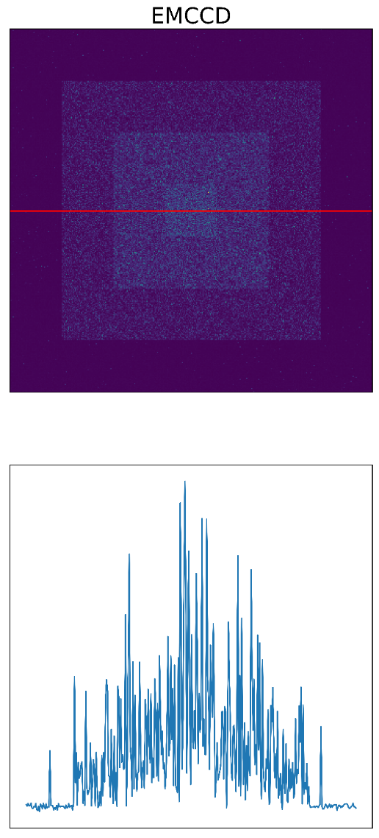
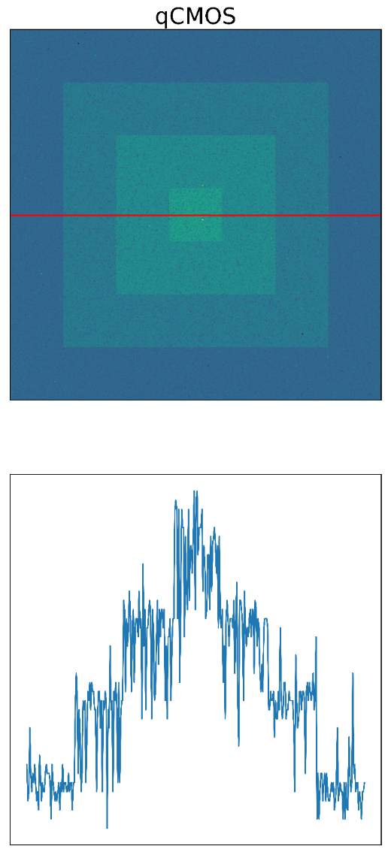
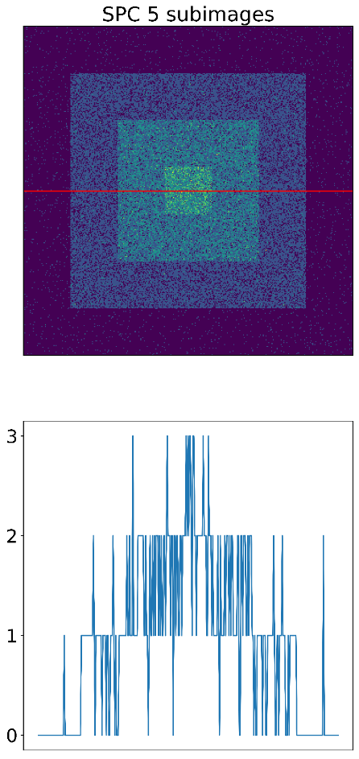
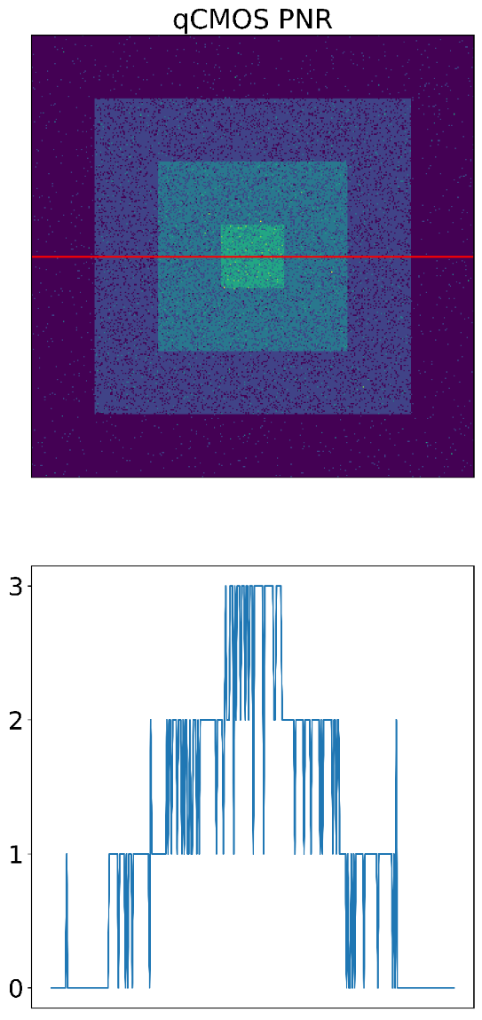
Motivation

Slide 4
Nomenclature

Slide 5
What is a single-photon detector (SPD)?
N ph
+
AU
2
1
0
Photodetector unable to detect a single photon
t
t
+
N ph
AU
2
1
0
Photodetector able to detect a single photon
t
t
A single photon detector creates a signal from a single photon above the noise level

Slide 6
What is a photon number resolving (PNR) detector?
N ph
Photodetector able to detect a single photon
But unable to resolve photon numbers
AU
2
1
0
t
t
N ph
N
2
1
0
Photodetector able to resolve photon numbers
2
1
0
t
t

Slide 7
Counting photons?
The absorbtion efficiency, that triggers the response (called quantum efficiency, QE) is never perfect

Slide 8
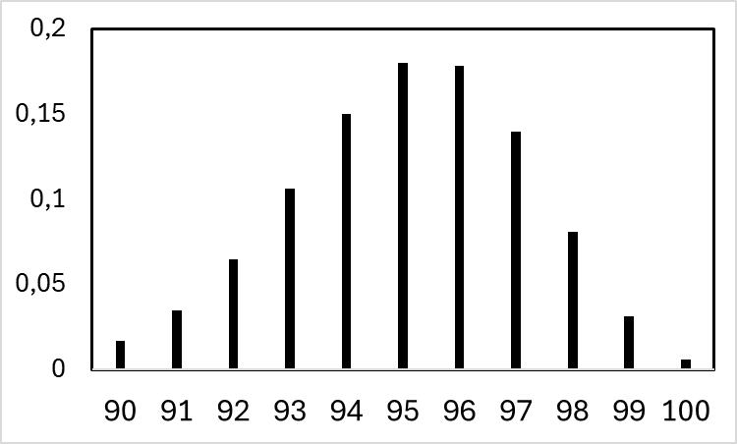
Counting photons?
N ph
P
100
0
Perfect Photodetector able to resolve photon numbers
1
0
t
100
N Ph
N ph
Photodetector able to resolve photon numbers,
QE = 95%
P
100
0
1
0
?
t
95
N Ph
N ph
Photodetector able to resolve photon numbers,
QE = 95%
P
100
0
t
N Ph

Slide 9
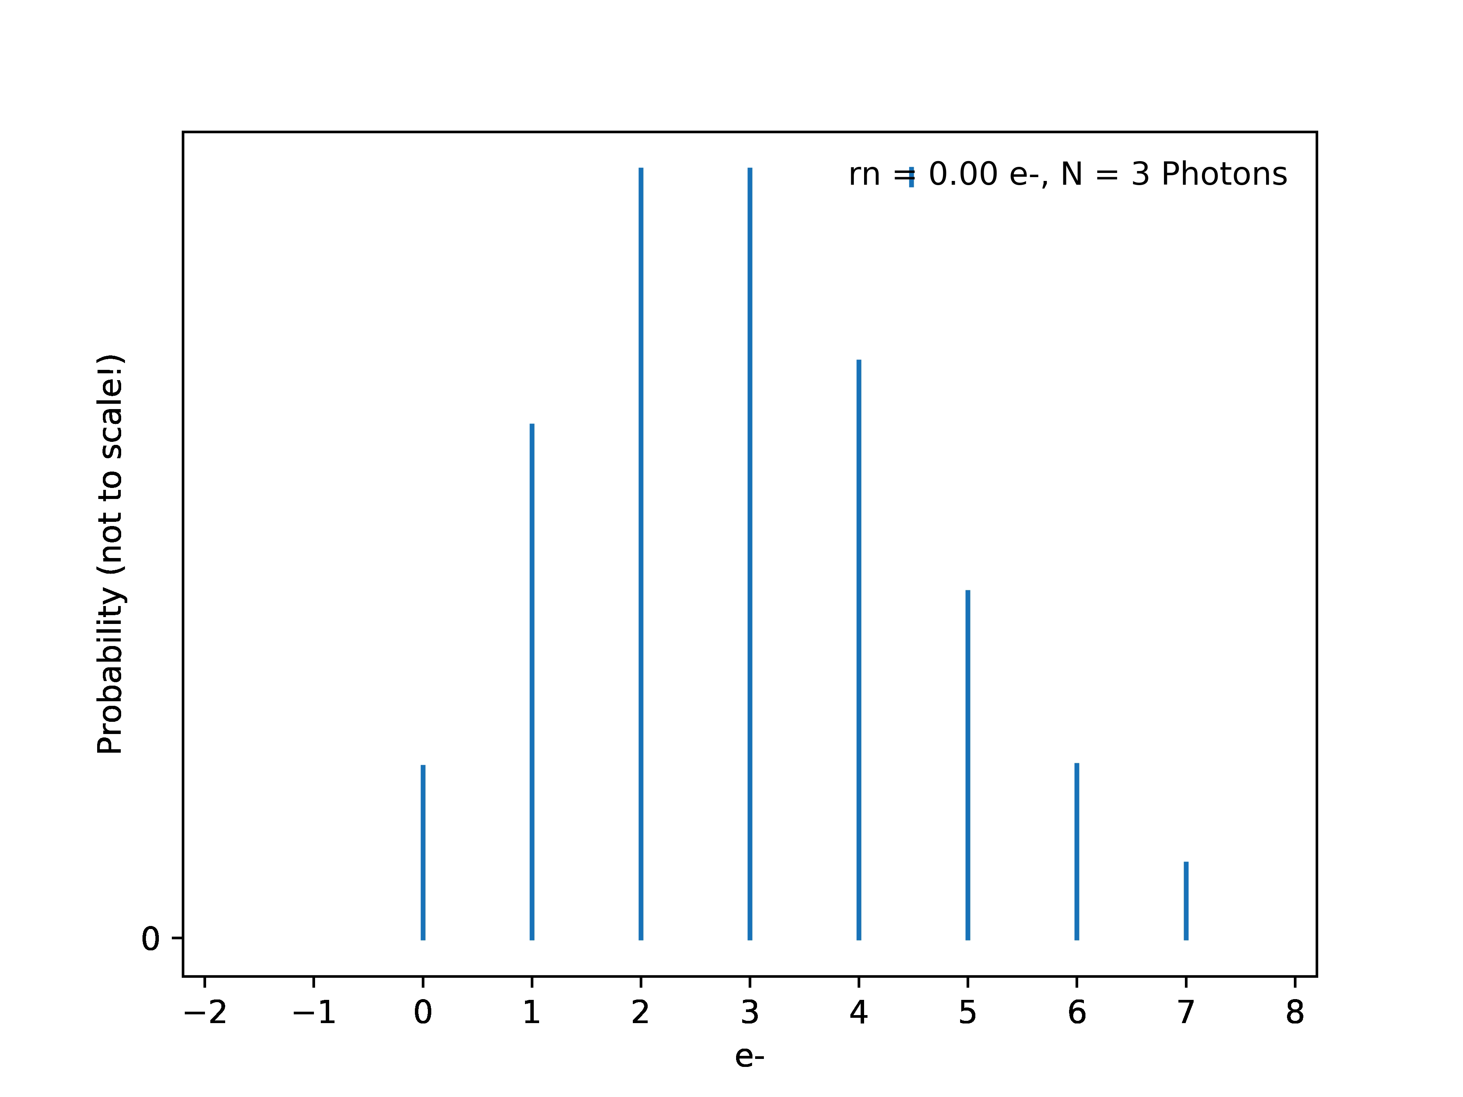
Noise Performance

Slide 10
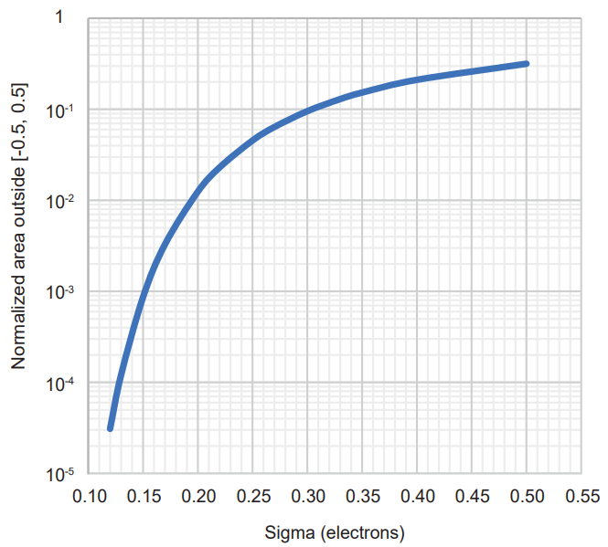
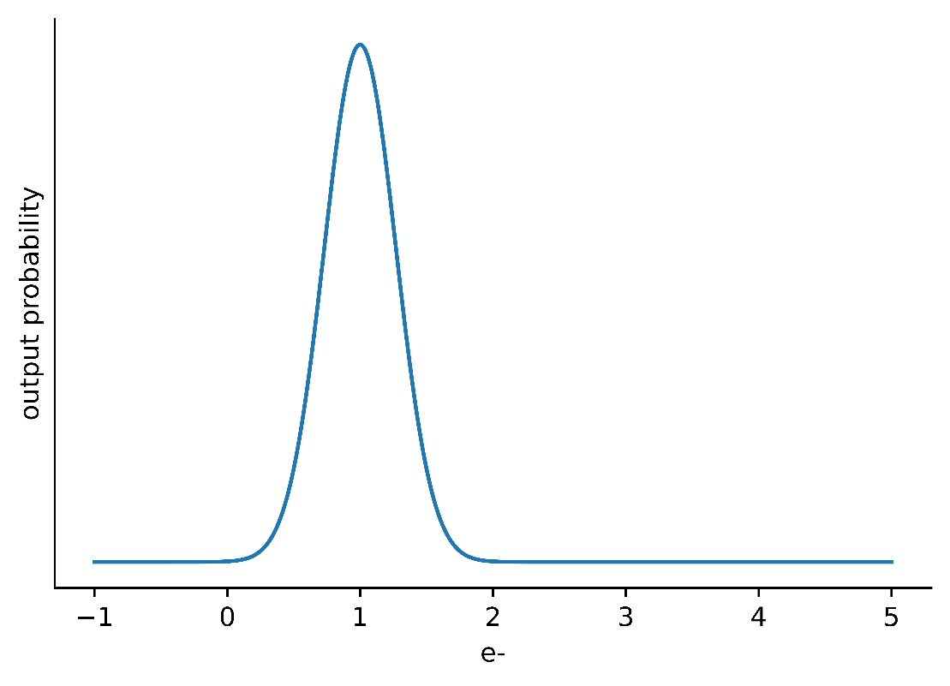
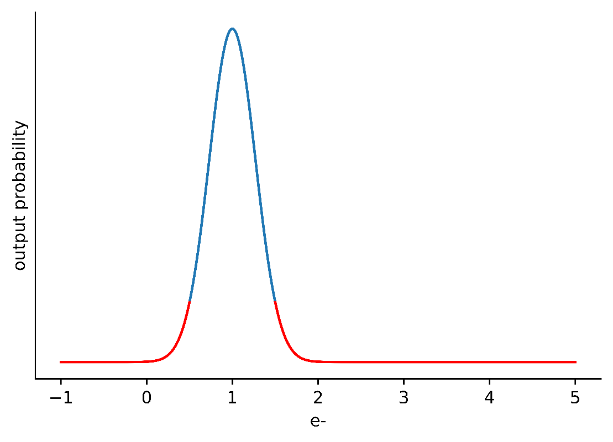
Photon Number Resolving Performance

Slide 11
Historical Perspective

Slide 12
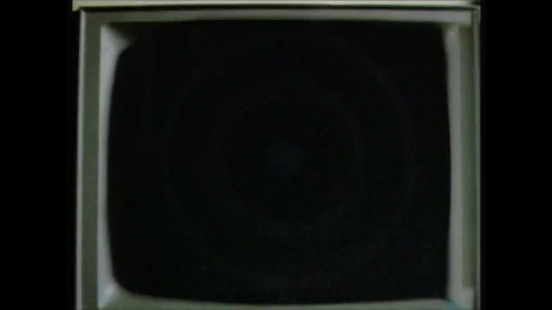
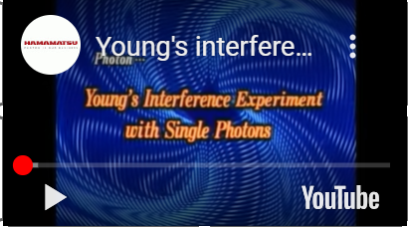
Historical Perspective
Major focus: readout noise reduction
Instead of reducing readout noise, amplify the signal before readout
Image Intensifier
  Limit to photocathode materials (max QE ~45%)

Slide 13
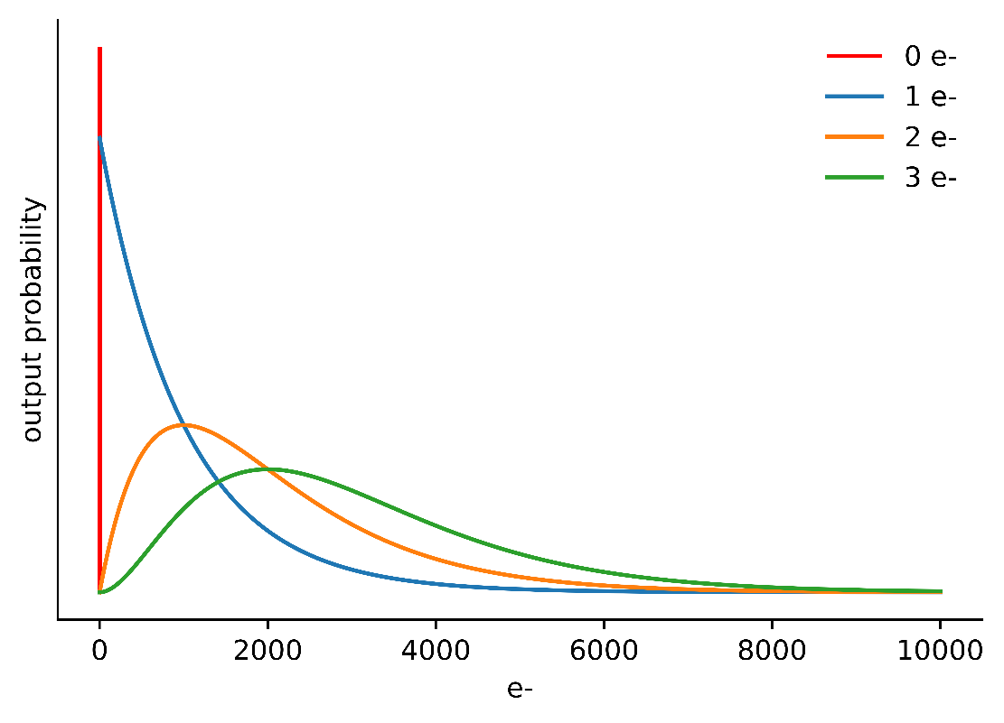
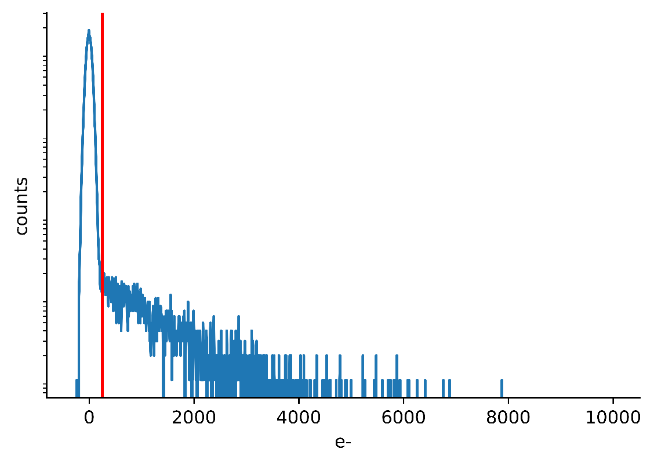
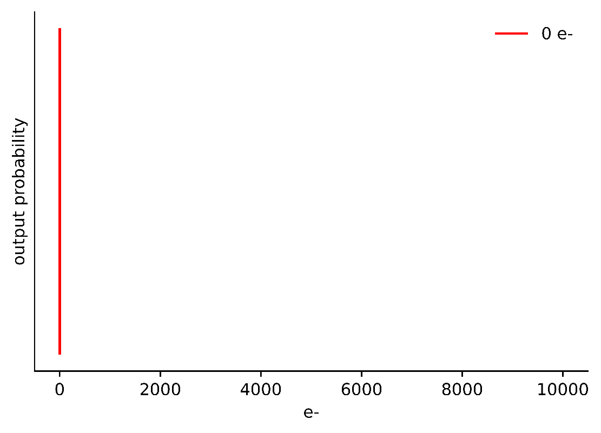
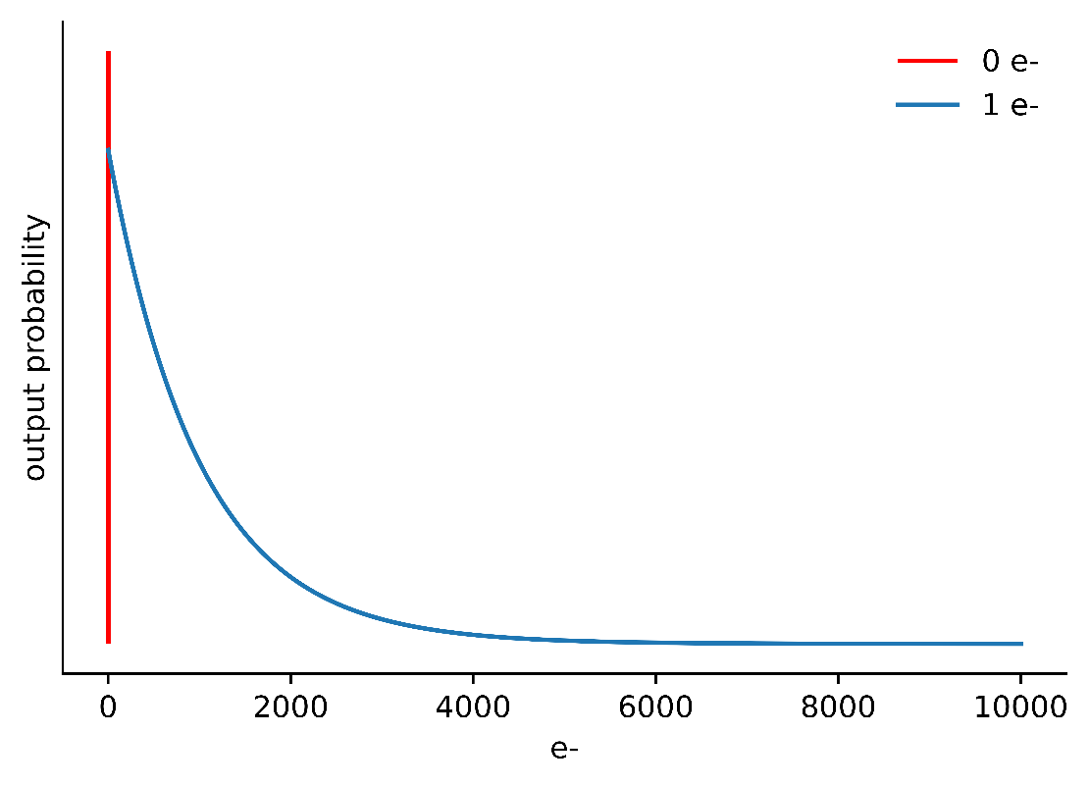
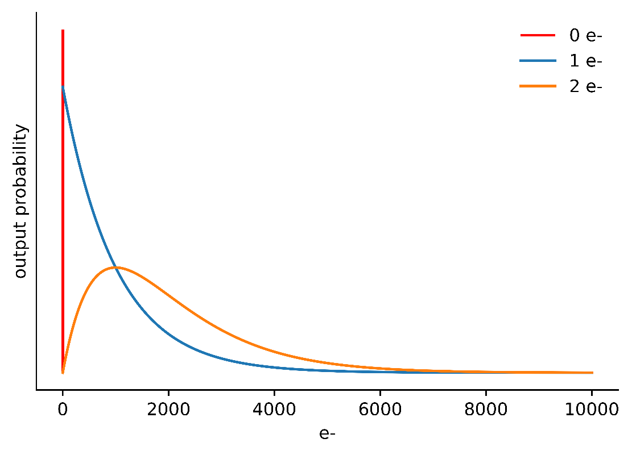
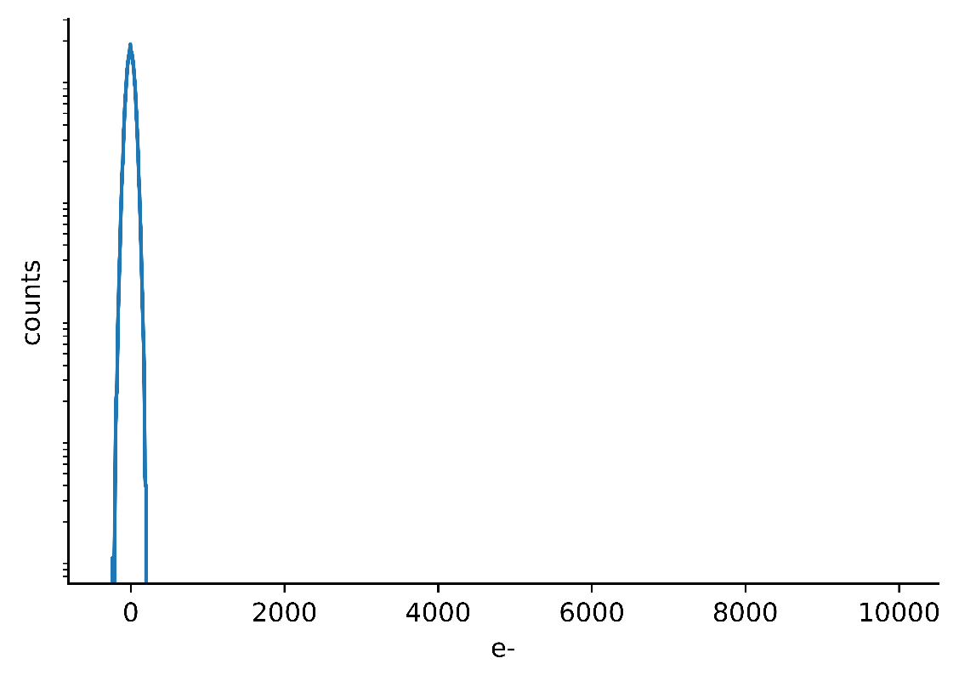
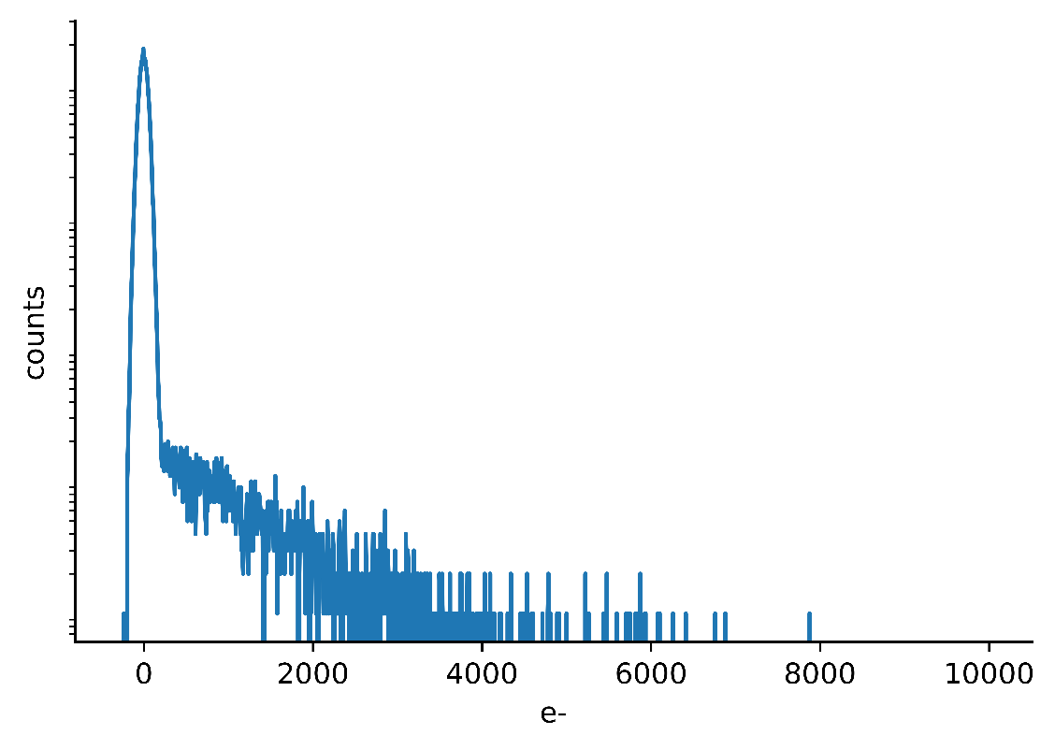
Historical Perspective
Since 2001 EMCCDs (Peak QE 95%)
Downside: gain fluctuations

Slide 14
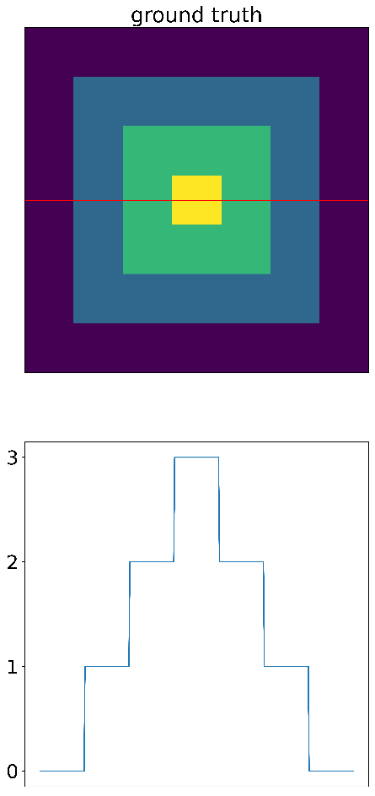
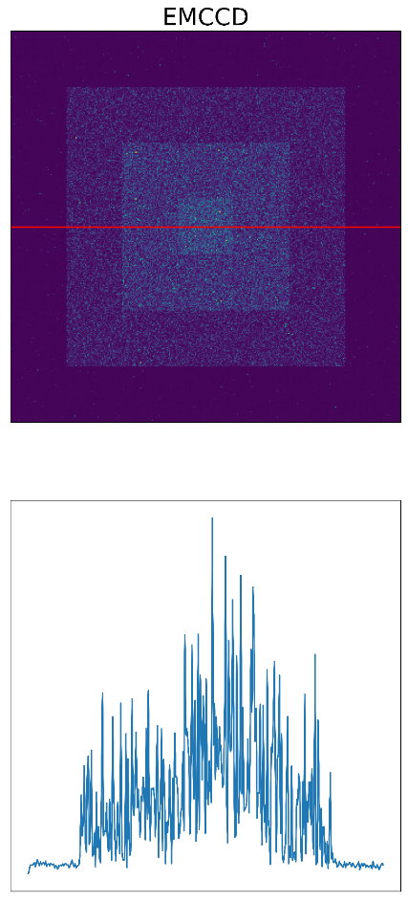
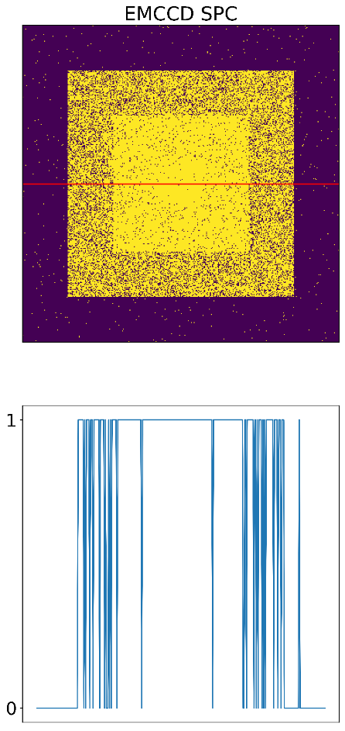
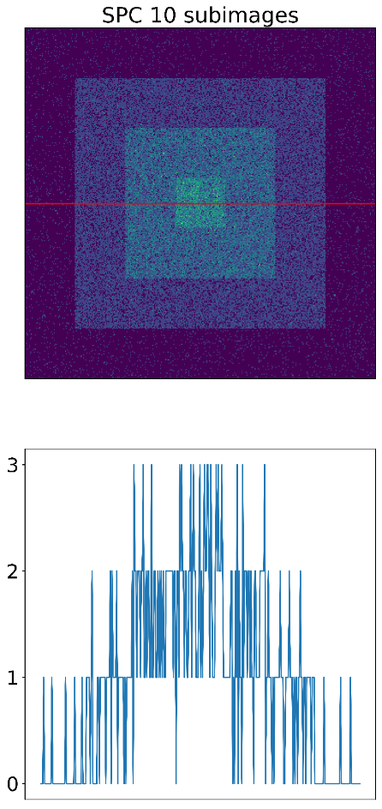
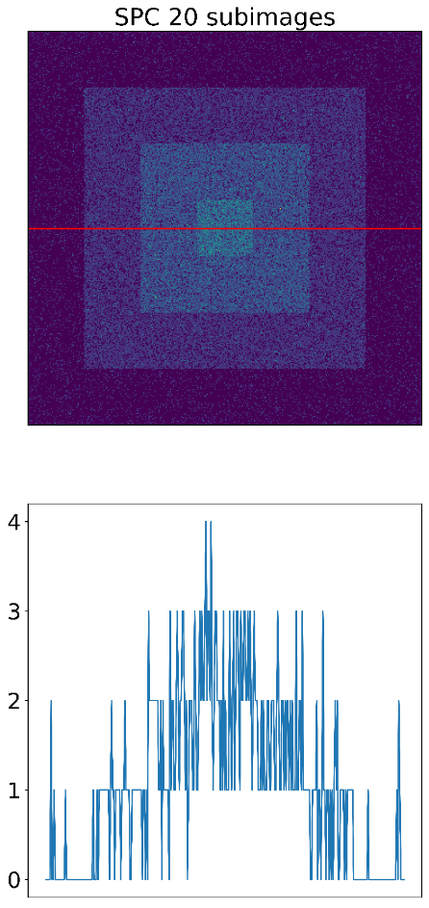
Historical Perspective
Binary Image
Solution: temporal subsampling

Slide 15
Historical perspective – Status Quo
Single photon counting image sensors available
Photon number resolving detectors postulated:
  Janesick et al 1990: Skipper CCD / Quantum CCD
  Fossum 2005: Quanta Image Sensor
Janesick, James R., et al. "New advancements in charge-coupled device technology: subelectron noise and 4096 x 4096 pixel CCDs." Charge-Coupled Devices and Solid State Optical Sensors. Vol. 1242. SPIE, 1990.
Fossum, Eric R. "11 Some Thoughts on Future Digital Still Cameras." IMAGE SENSORS and SIGNAL PROCESSING for DIGITAL (2006): 305.

Slide 16
Historical perspective – Status Quo
Skipper CCD / Quantum CCD
  Technical roadmap for noise reduction
  General idea: reduce noise by averaging nondestructive readouts
Quanta Image Sensor
  Postulates the universal camera:
  Pixel pitches well below diffraction limit
  Readout noise below 0.15 e- (practically irrelevant)
  High speed readout
  Potentially single bit pixels
  „lossless“ spatial and temporal binning

Slide 17
Current Implementations

Slide 18
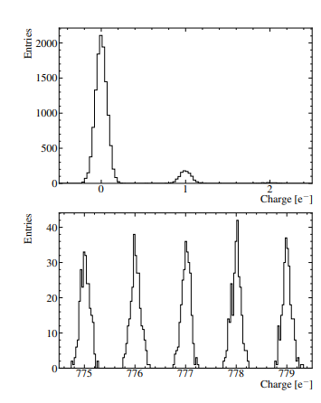
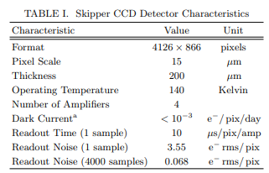
Current Implementations – Skipper CCD / Quantum CCD
Implemented in 2017
Academic project
Single frame readout:
  3h
Tiffenberg, Javier, et al. "Single-electron and single-photon sensitivity with a silicon Skipper CCD." Physical review letters 119.13 (2017): 131802.

Slide 19
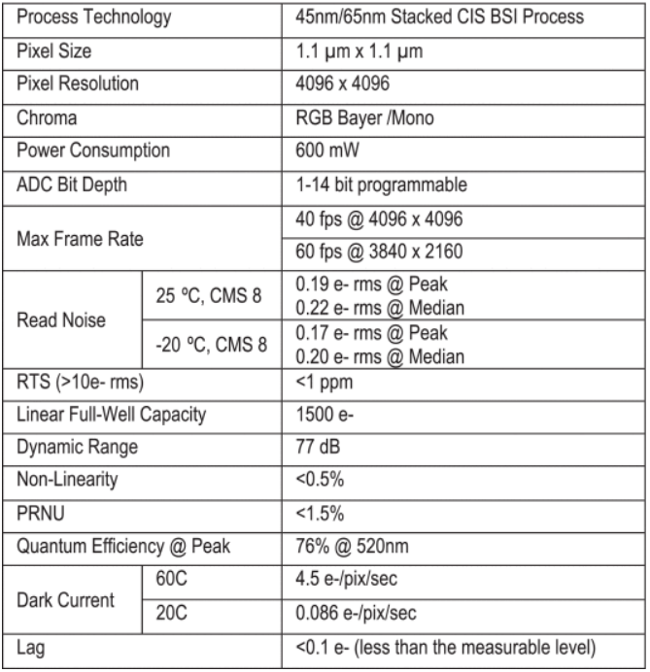
Current Implementations – Quanta Image Sensors
Manufactured by Gigajot
Spin Off of Dartmouth College (Eric Fossoms group)
Disappeared from the market in 2022
Ma, Jiaju, et al. "A 0.19 e-rms read noise 16.7 Mpixel stacked quanta image sensor with 1.1 μm-pitch backside illuminated pixels." IEEE electron device letters 42.6 (2021): 891-894.

Slide 20
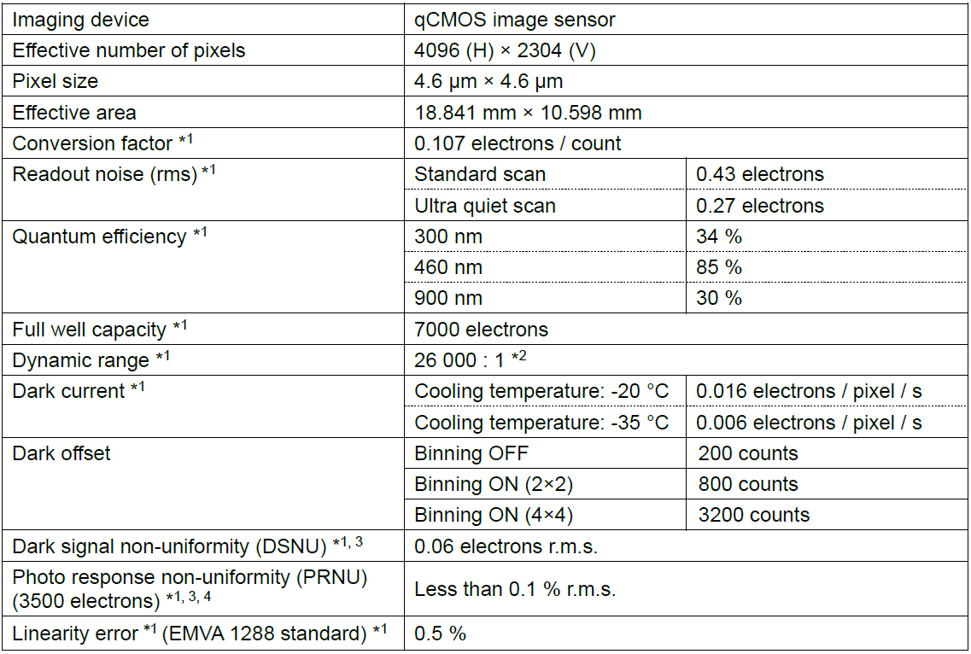
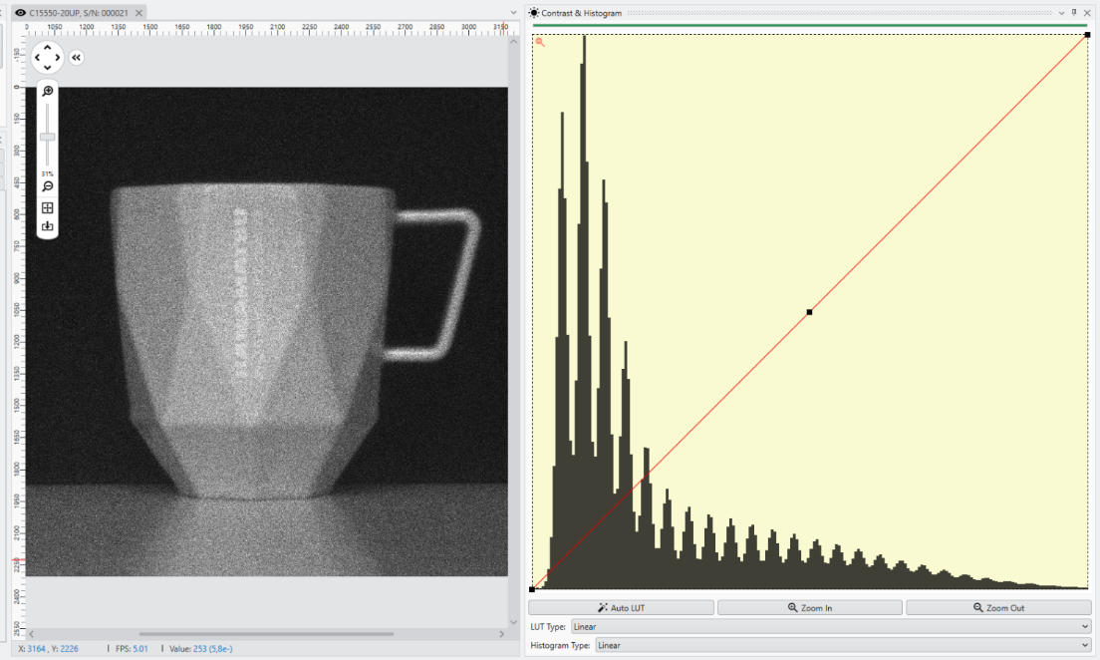
Current Implementations – quantitative CMOS
Implemented by Hamamatsu
Available since 2021

Slide 21
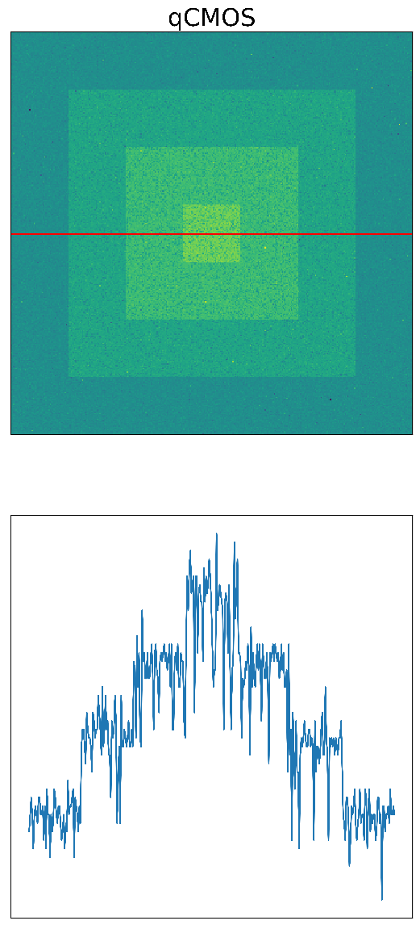
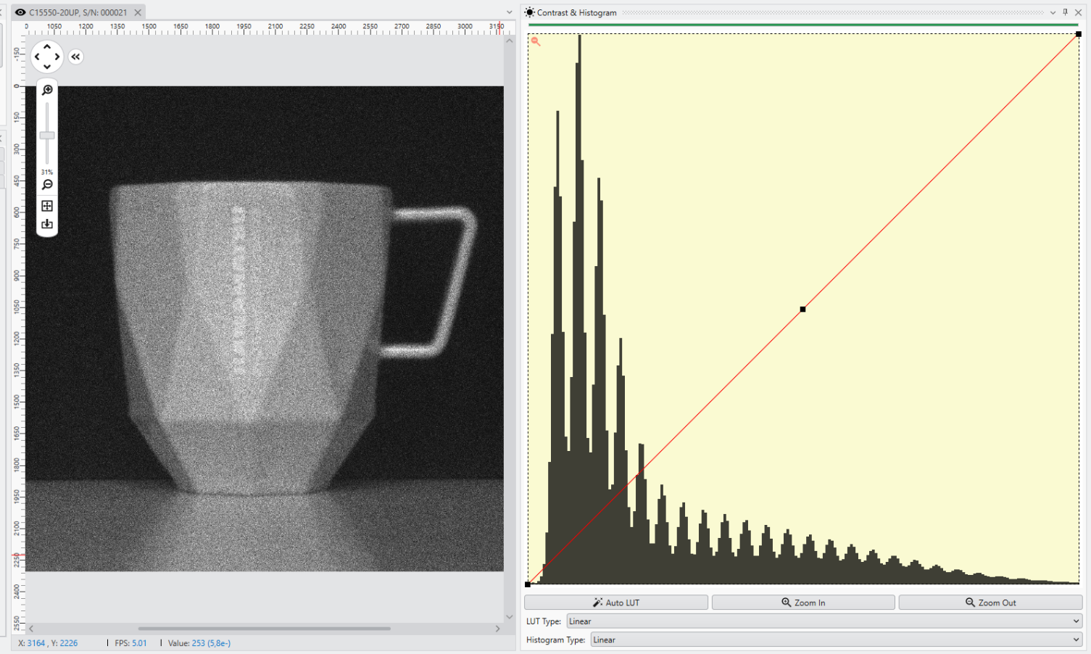
Current Implementations – Photon Number Resolving Operation

Slide 22
Current status
Skipper CCD
15μm pixel pitch
0.068 e- RON
0.3 fph ~ 7.2 fpd
qCMOS
4.6μm pixel pitch
~0.3 e- RON
5 – 25 fps
Quanta Image Sensor
1.1μm pixel pitch
0.2 – 0.3 e- RON
5 – 40 fps

Slide 23
Applications

Slide 24
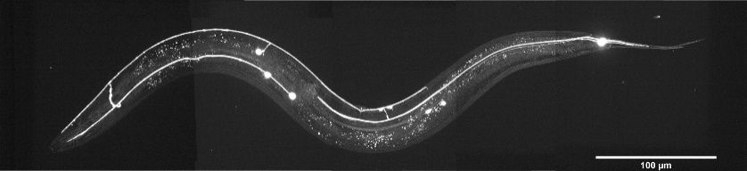
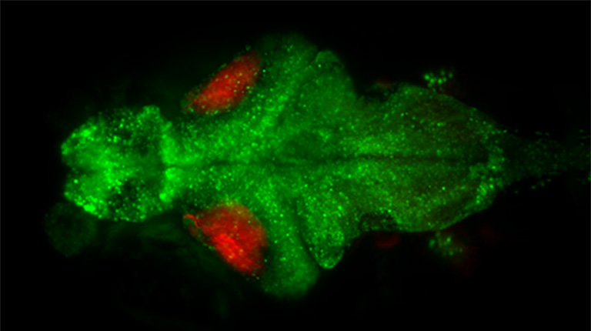
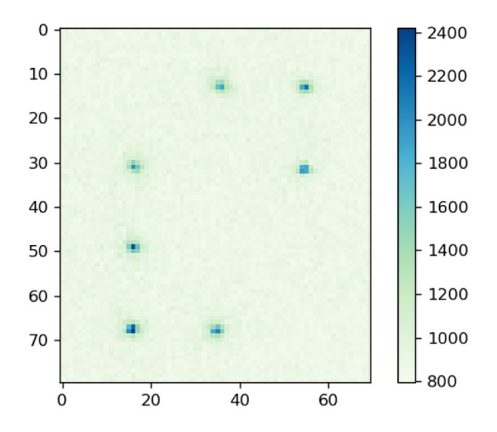
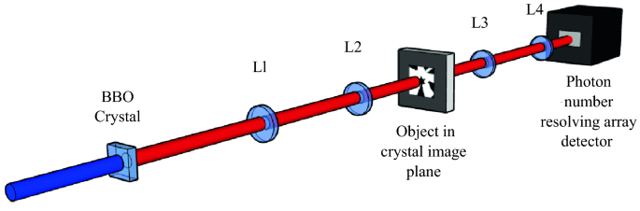
Applications
Low light imaging
Quantum Imaging
Quantum Computing

Slide 25
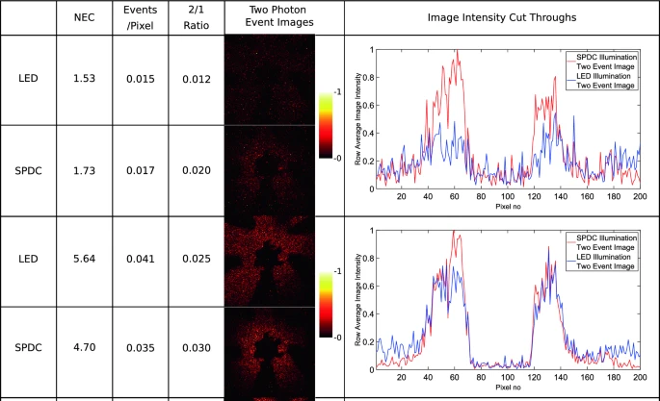
Applications
Quantum
Imaging
qCMOS
By detecting entangled photon pair(s):
  Accurate measurements of quantum states
Osian Wolley et al. "Quantum imaging with a photon counting camera." Scientific Reports (2022)

Slide 26
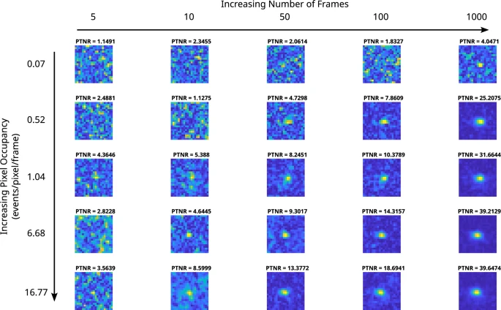
Applications
Quantum
Imaging
By detecting entangled photon pair(s):
  Accurate measurements of quantum states
  Characterization of entangled photons
Correlation Peak Array for the qCMOS camera
K. Roberts et al.‘’ A comparison between the measurement of quantum spatial correlations using qCMOS photon-number resolving and electron multiplying CCD camera technologies’’ Scientific Reports (2024)
.

Slide 27
Applications
Quantum Computing
Uses quantum mechanics principles to process information, based on fundamental units; qubits
Qubits leverage entanglement, superposition, interference

Slide 28
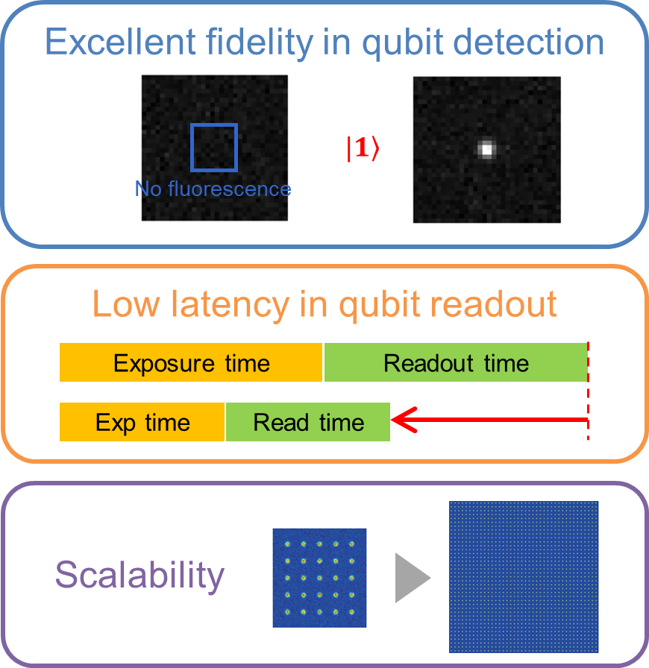
Applications
Quantum Computing
Uses quantum mechanics principles to process information, based on fundamental units; qubits
Qubits leverage entanglement, superposition, interference
qCMOS helps with error rates,
scalability
and supports quantum gates

Slide 29
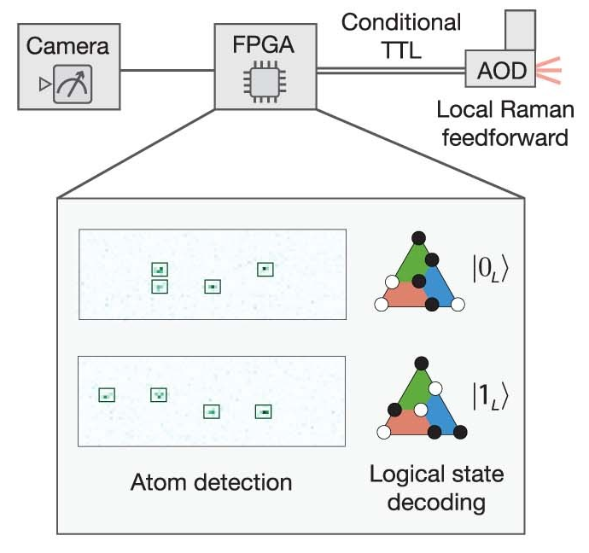
Applications
Quantum Computing
Most commonly qCMOS are used for mid-circuit measurements in quantum controls
Bluvstein, D., Evered, S.J., Geim, A.A. et al. Logical quantum processor based on reconfigurable atom arrays. Nature 626, 58–65 (2024)

Slide 30
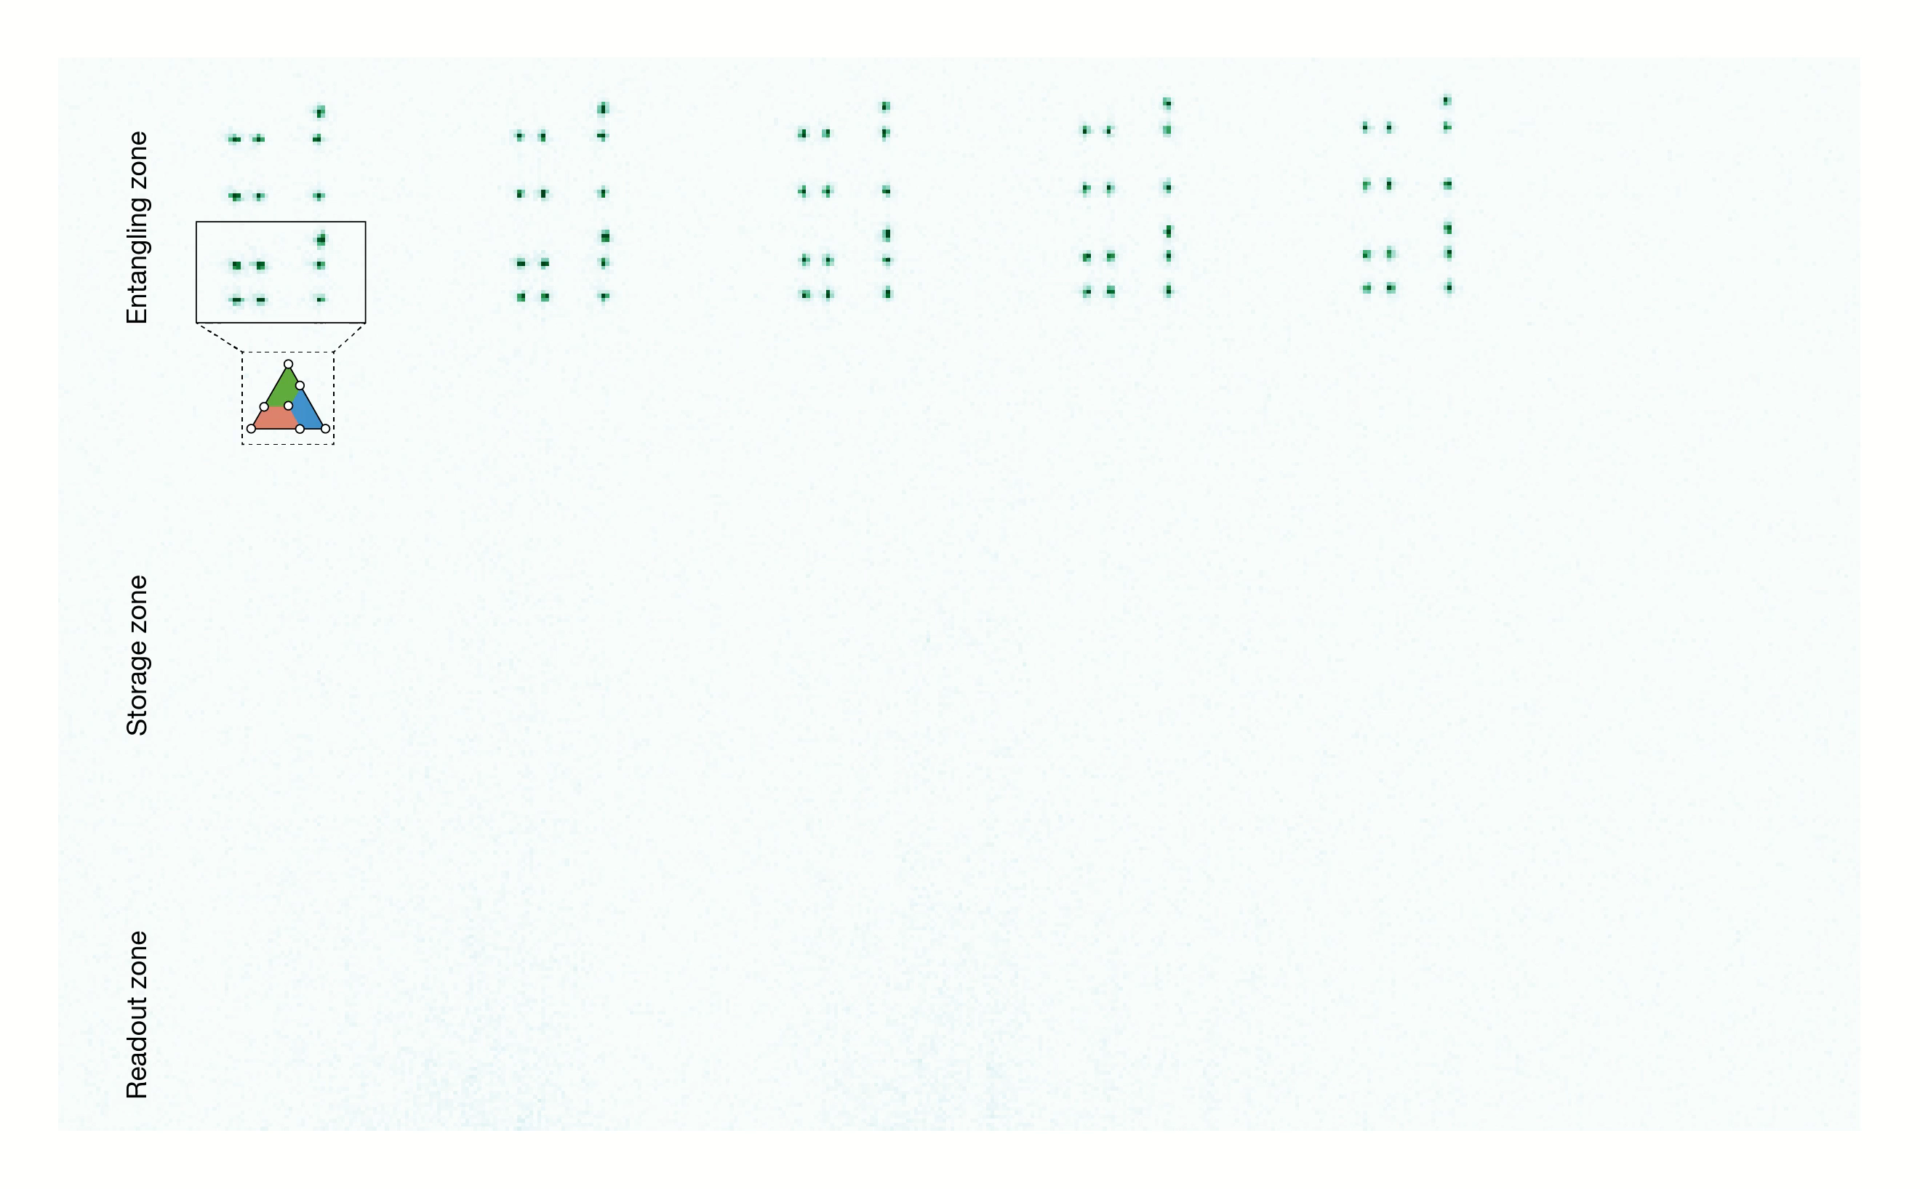
Applications
Quantum Computing
Most commonly qCMOS are used for mid-circuit measurements in quantum controls
Bluvstein, D., Evered, S.J., Geim, A.A. et al. Logical quantum processor based on reconfigurable atom arrays. Nature 626, 58–65 (2024)

Slide 31

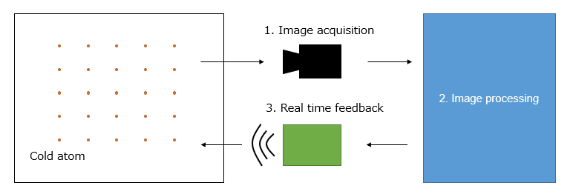
Applications
Quantum Computing
Most commonly qCMOS are used for mid-circuit measurements in quantum controls
QPU

Slide 32
Conclusion
PNR sensors available below 0.3 e- RON
3 major implementations exist, only one commercial
Applications mostly in scientific low light applications and quantum systems
 | Skipper CCD | qCMOS | QIS
Max QE | ? | 85% | 76%
Speed | fpd | fps | fps
Dark current | Very low | low | low
Pixel count | + | ++ | +++
Pixel pitch | 15 | 4.6 | 1.1

Slide 33
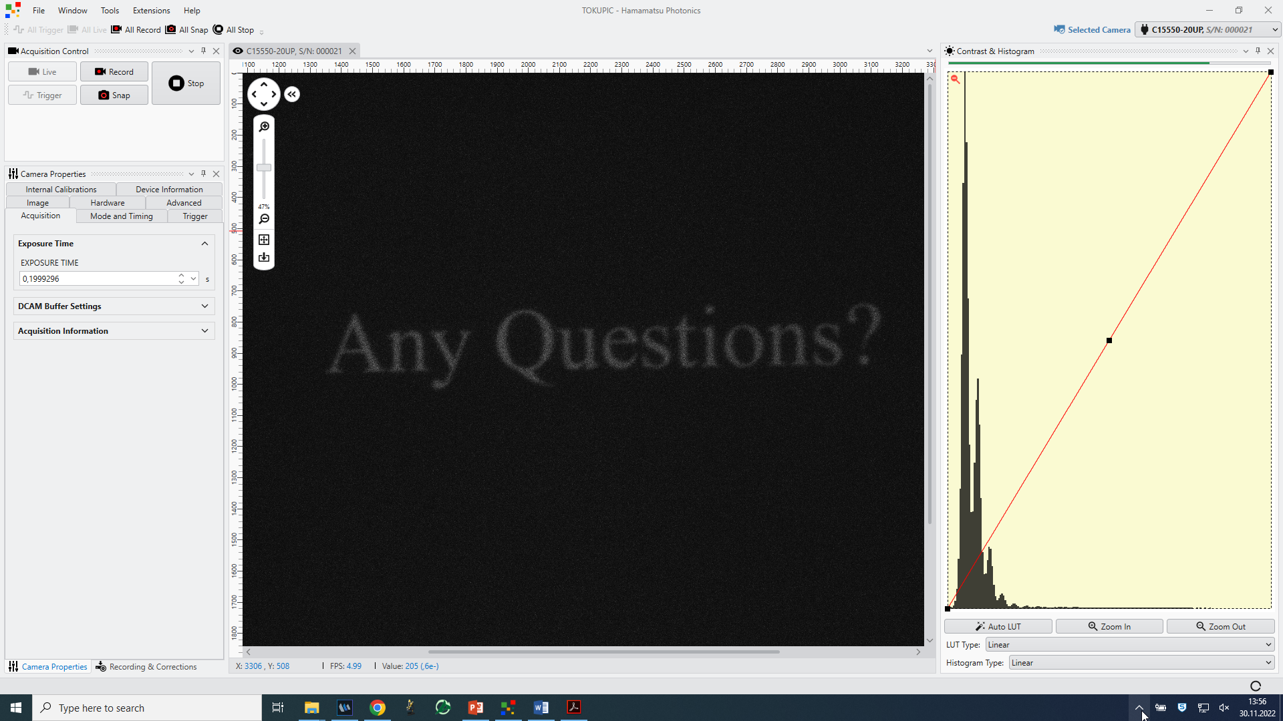

Slide 34
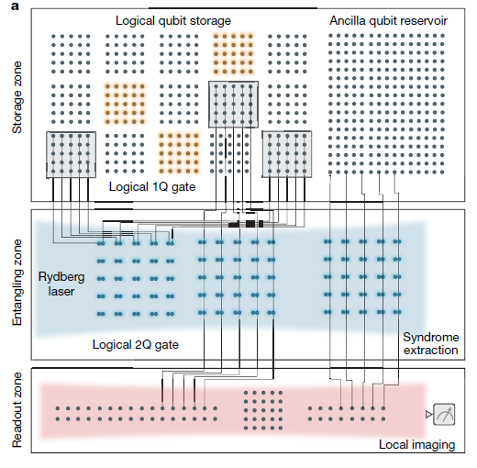
Applications
Quantum Computing
Most commonly qCMOS are used for mid-circuit measurements in quantum controls
Bluvstein, D., Evered, S.J., Geim, A.A. et al. Logical quantum processor based on reconfigurable atom arrays. Nature 626, 58–65 (2024)
Besides quantum imaging, quan

Slide 35
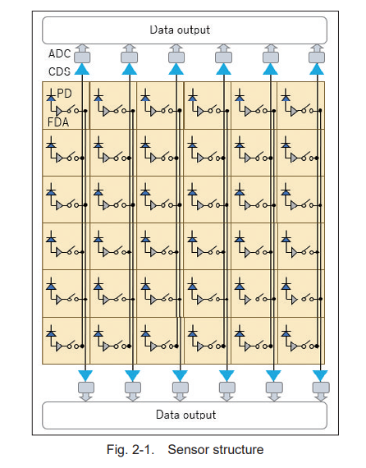
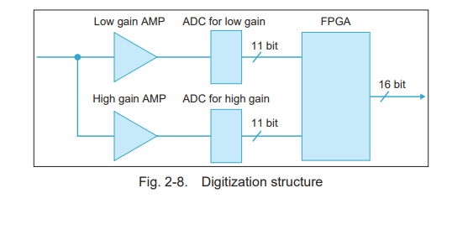

Slide 36
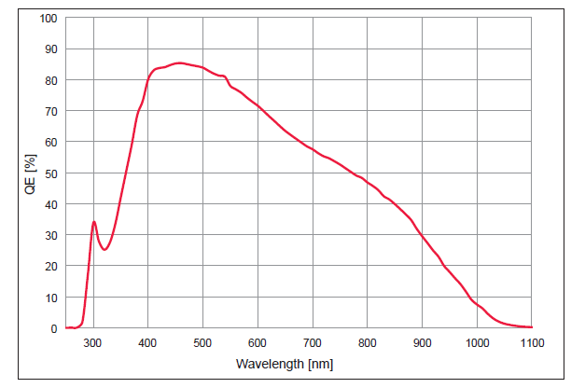
QE

