Slide 1


Efficiency and time resolution of a thin gap Resistive Cylindrical Chamber
Rocchi, B. Liberti, M. Sessa
3rd DRD1 Collaboration Meeting

Slide 2
What is a Resistive Cylindrical Chamber (RCC)
The RCC detector is a new gaseous detector introduced by R. Cardarelli in 2020 - 2022.
[R. Cardarelli, A. Rocchi et al, The Resistive Cylindrical Chamber. NIM Section A. Volume 1058,2024,168822-ISSN 0168-9002]
https://doi.org/10.1016/j.nima.2023.168822
It consists of two cylindrical concentric electrodes of resistive material which define a gas gap.
Like RPC, HV is distributed on the electrode surface (not facing the gas) through a graphite coating.
Pillars are replaced by end-cap spacers or spiraled fishing line.
Pick-up readout could be placed both in the internal cavity or on the outer surface.

Slide 3

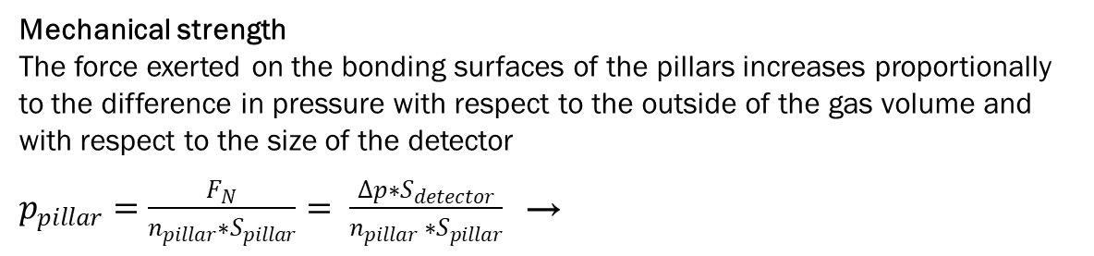
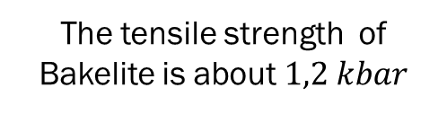
Why a Resistive Cylindrical Chamber
Mechanical strength
The force exerted on the bonding surfaces of the pillars increases proportionally to the difference in pressure with respect to the outside of the gas volume and with respect to the size of the detector
$p_{pillar}=\frac{F_{N}}{n_{pillar}∗S_{pillar}}= \frac{Δp∗S_{detector}}{n_{pillar} ∗S_{pillar}}$→
F_{N}
$$Δp=2 bar ; S_{detector}=10 kcm^{2} ;$$
$$S_{pillar}=0,2 cm^{2} ;$$
↓
$p_{pillar}=\frac{ {10}^{2}}{n_{pillar} } kbar$
The planar geometry is not suitable to be pressurized unless significantly increasing the density of pillars or building a complex mechanical structure that counterbalances internal forces
F_{N}
The tensile strength of Bakelite is about $1,2 kbar$
Geometry
  empty cavity for the insertion and integration of other devices such as detectors, sources or beam pipes…
  redundancy of the active area and readout with respect to secant tracks, increased active area for tangent tracks → self tracking capabilities
  Electric field gradient drive the avalanche discharge depending on detector structure and polarization
It is feasible using low-cost components found in commercial catalogue

Slide 4
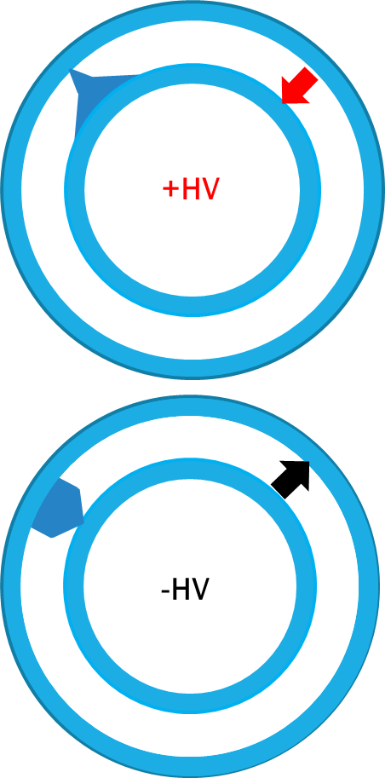

RCC at work
$E\left(r\right)=\frac{V}{r ln\frac{R_{o}}{R_{i}}}\sim \frac{V}{R_{i}ln\frac{R_{o}}{R_{i}}}− \frac{V}{R_{i}ln\frac{R_{o}}{R_{i}}}\frac{r−R_{i}}{R_{i}}$
$$R_{o}−R_{i}≪R_{i}$$
The field gradient inside the gas gap can be exploited in both polarities.
For the detector design described below the following configurations will be studied:
Positive polarity (applied on the inner cylinder)
  Electrons produced far from the inner electrode are accelerated by a less intense electric field in the first part of the path. With a crude approximation we can describe it as process of drift followed by multiplication. High probability that these electrons produce a detectable signal due to the long path.
  Electrons produced near the internal electrode can cover a small path in the gas gap. The more intense electric field produces a greater gain in this region, increasing the gap effective.
Negative polarity (applied on the inner cylinder)
  Electrons produced near the inner electrode are accelerated by a more intense electric field in the first part of the path. With a crude approximation we can describe it as a multiplication followed by a drift. Very High probability that these electrons produce a detectable signal due to the long path and high gain.
  Electrons produced near the external electrode can cover a small path in the gap: furthermore, the field in this region is less intense, so the probability of producing detectable signals is small reducing the effective gap.

Slide 5
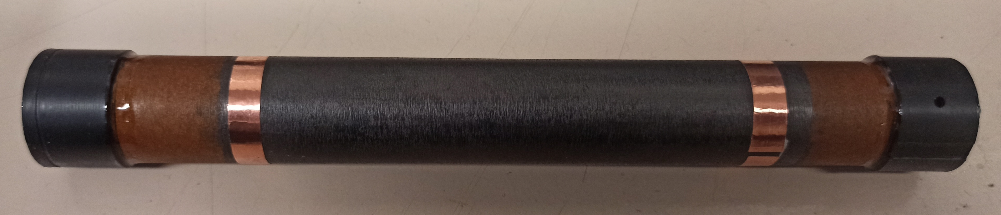
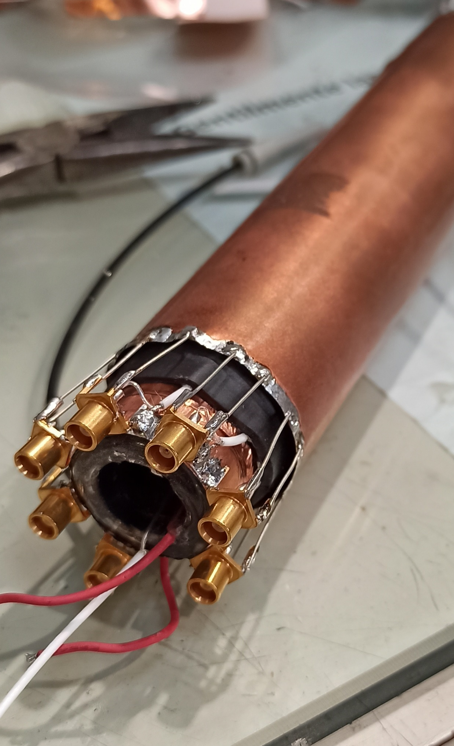
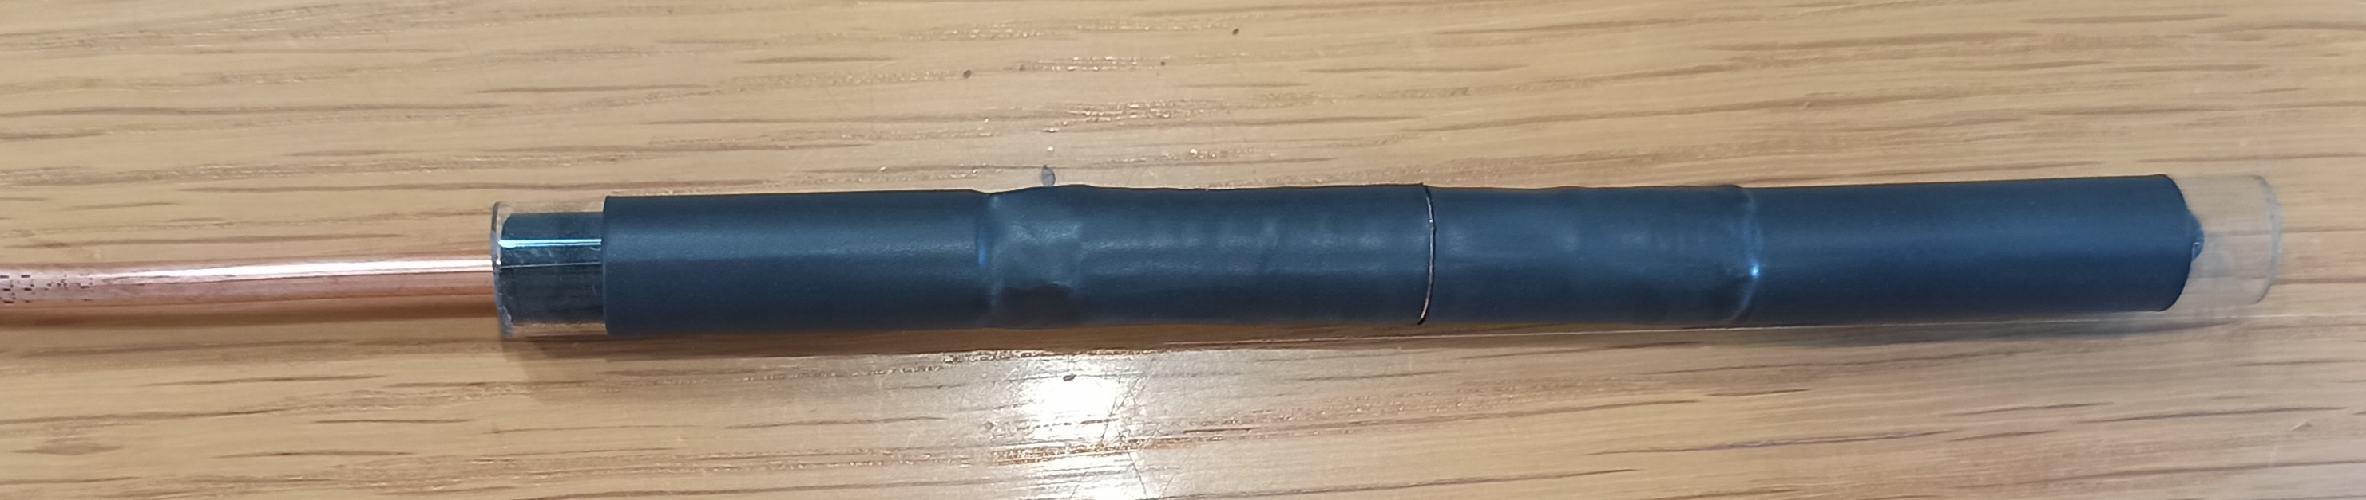
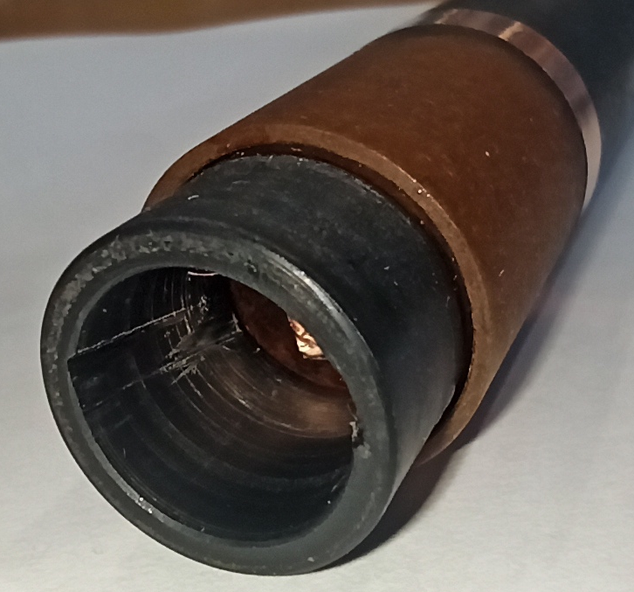
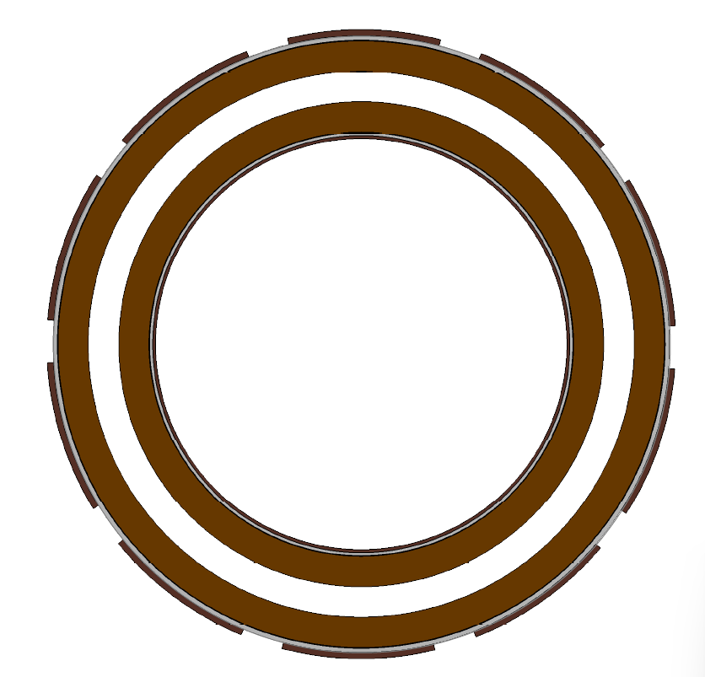
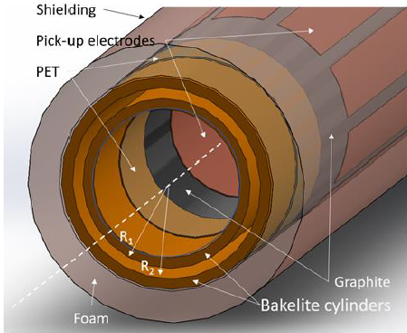
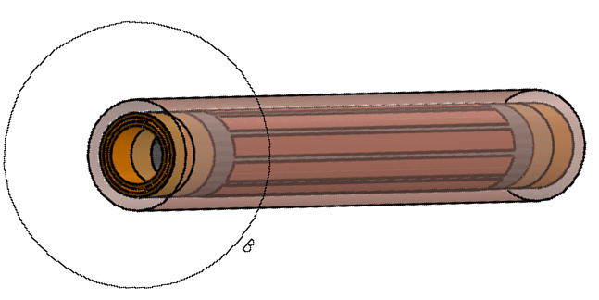
Detector Design
Features:
Two concentric bakelite tubes: 15 cm long
Graphite layer not calibrated in resistivity sprayed on external surfaces (GRAPHIT 33 Spray)
7 Strips pick up on the outer surface: 0.8 mm, 1 cm pitch
1 Pad pick-up on the inner surface
Scintillator detector inside the RCC cavity, readout: SIPM Hamamatsu MPPC S14160 series + INFN FE-E board (Tanks to A. Paoloni and G. Felici )
0.3 mm gas gap
Rated up to 6 bar
Weak points:
Shielding end-caps not ready for the tests
SIPM power cable inside the cavity.
Insulator
Bakelite
Shielding
SIPM+
Scintillator
Graphite
Gas gap
Strips
Shielding

Slide 6
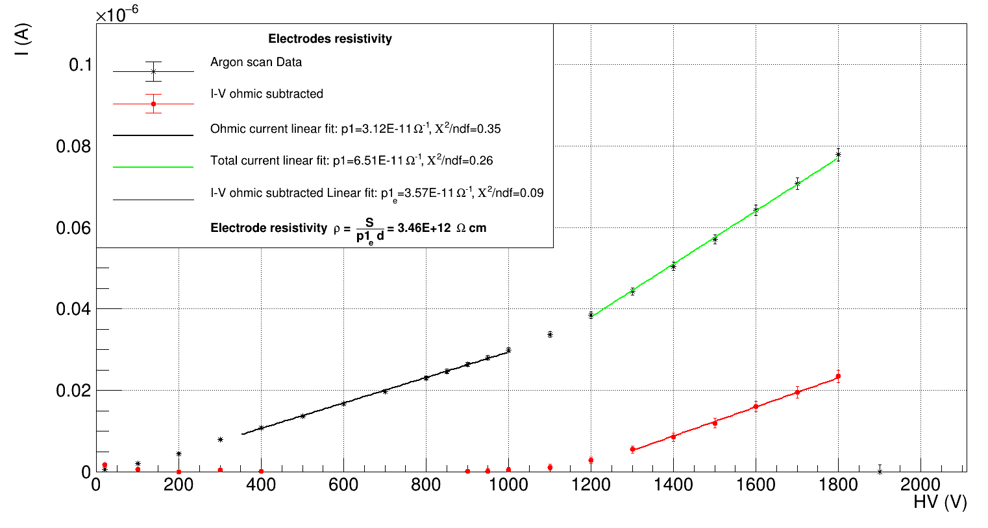
Bakelite tubes electrodes
Bakelite tubes are widely used in the electrotechnical industry, for insulation and insulation. This makes them easy to find and economical (cost around €25/m). They are rarely sold with selected resistivity.
Tubes used in this test were purchased from the CERN store, where different formats are available.
The internal and external surfaces have different properties: the inside is polished, the external is rough.
To obtain the desired gas-gap thickness, the internal tube was machined. The residual surface roughness was smoothed and treated with linseed oil. Macroscopic difference in the quality of the two surfaces.
Inner tube:
  Thickness 0.77 mm
  External diameter 17.4 mm
Outer tube
  Thickness 1 mm
  Internal diameter 18 mm
The resistivity of the electrodes was measured with an Argon scan
The Ohmic current is almost comparable to the current in the gas

Slide 7
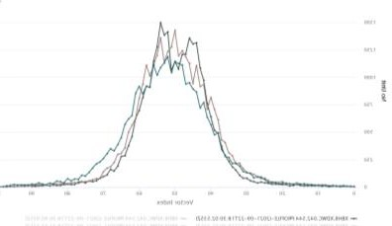
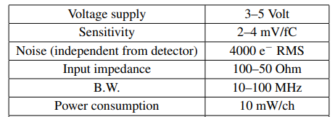
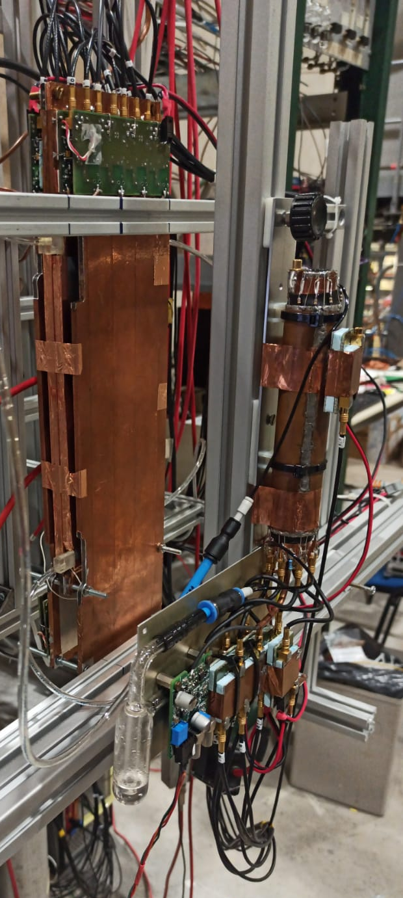
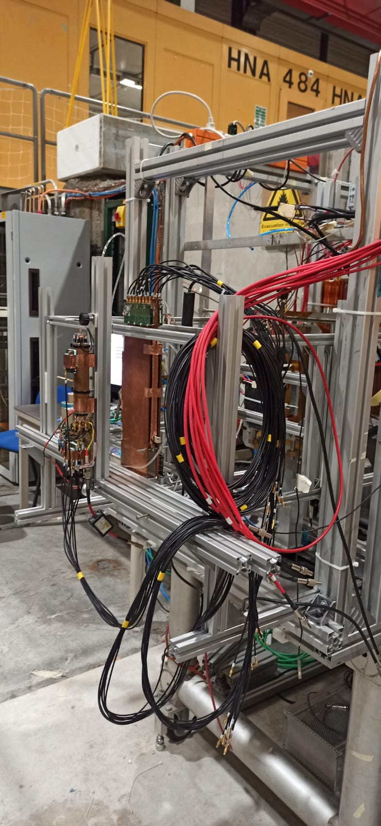
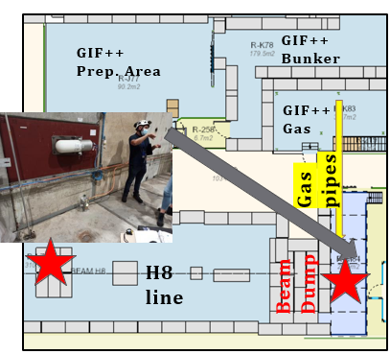
Experimental area and setup
2013 JINST 8 P01003
H8 line:
180 GeV/c muons beam;
The test was carried out in two positions:
Platform PPE168, behind the beam dump platform.
Two beam configurations:
Primary muon beam (23 mm x 23 mm RMS),
Dumped pions beam (spread).
Beam profile
From wire chambers
Gas lines:
94.7% TFE + 5% iC4H10+0.3%SF6
CO2 gas line from H8 gas rack
DAQ System:
CAEN V1718 USB Bridge
CAEN V1742 32 Ch Digitizer
Trigger System:
Logic & between RD51
Protov 4 x 2 cm2 Cerenkov
detector

Slide 8
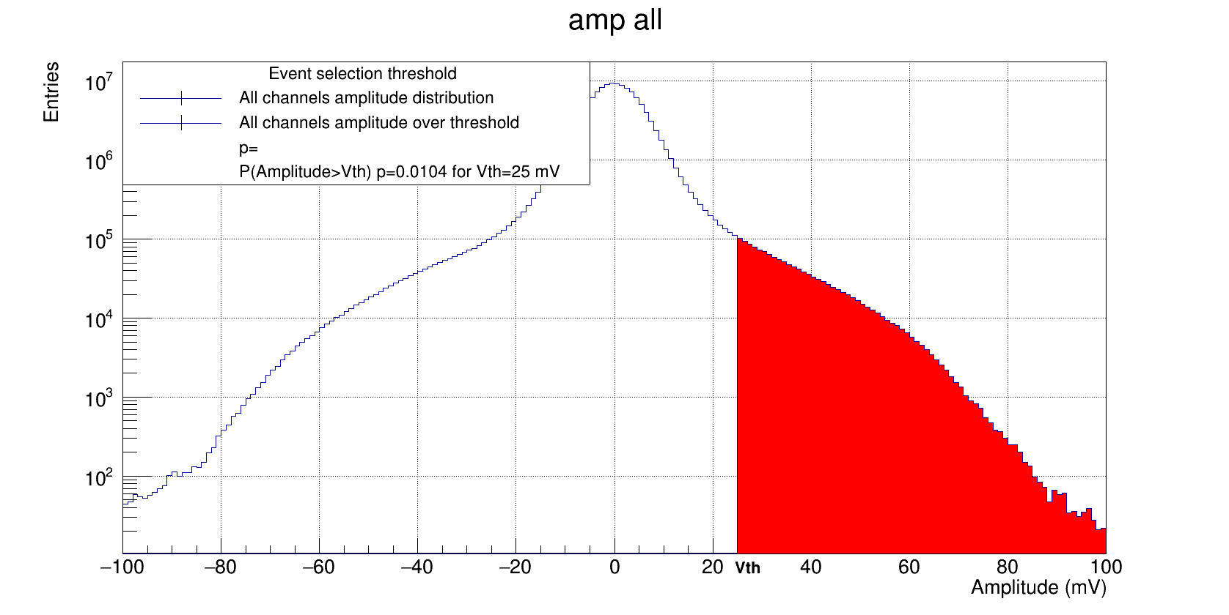
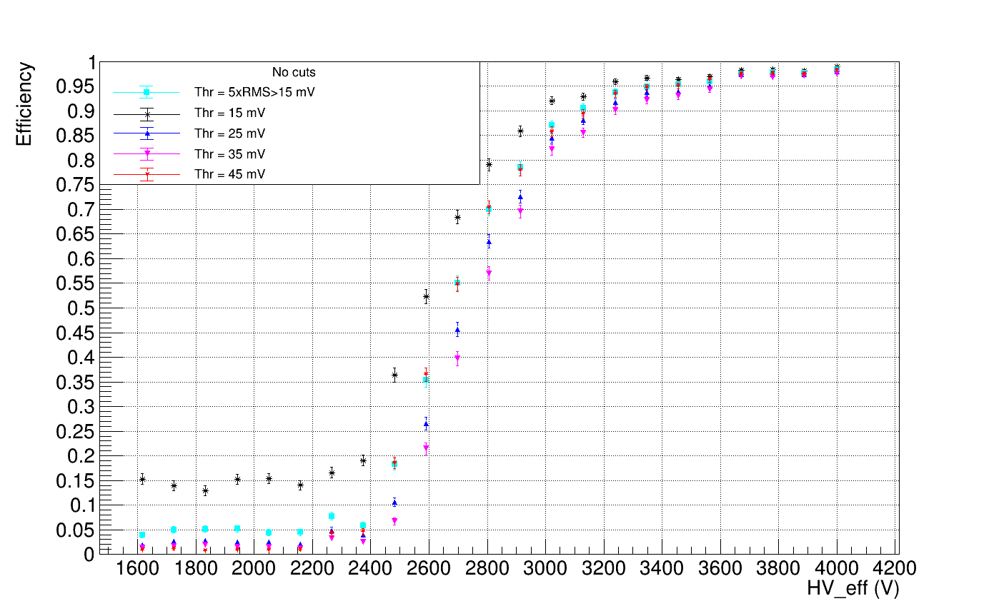
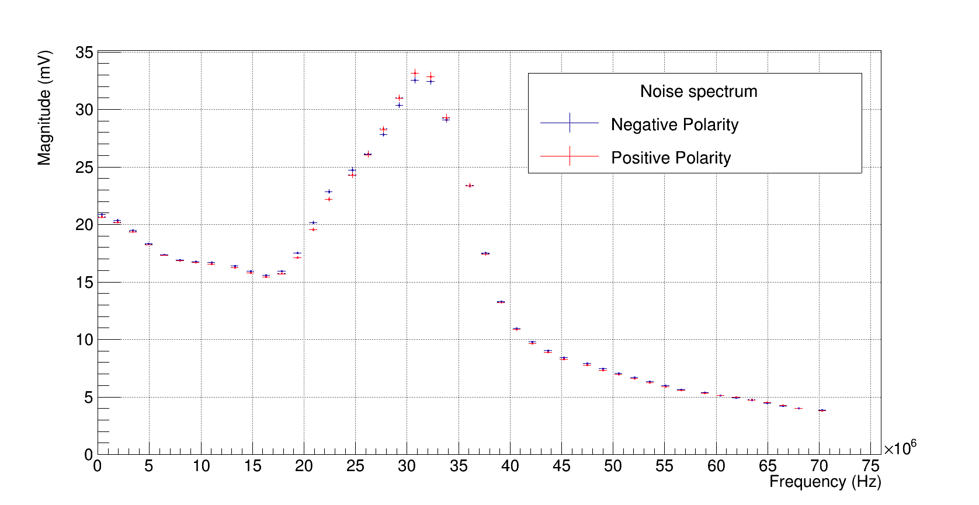
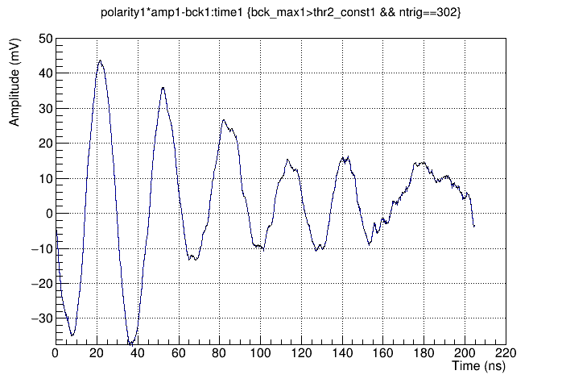
Data rejection
Pedestal window = 220 ns
Search window = 50 ns
P_{50ns}(n>1,0.026)=0.025
Pedestal amplitude distribution shows long tails up to 100 mV
Amplitude spectrum profile highlight the pick centered at 30 MHz
Cause of the problem seems to be the SIPM power cable entering the RCC cavity.
No refined algorithm for noise suppression are applied, signals are
not filtered,
Threshold set to balance fake probability in the search window and event
rejection
Events where signal crosses the threshold before the search window are
discarded
Typical noise oscillation

Slide 9
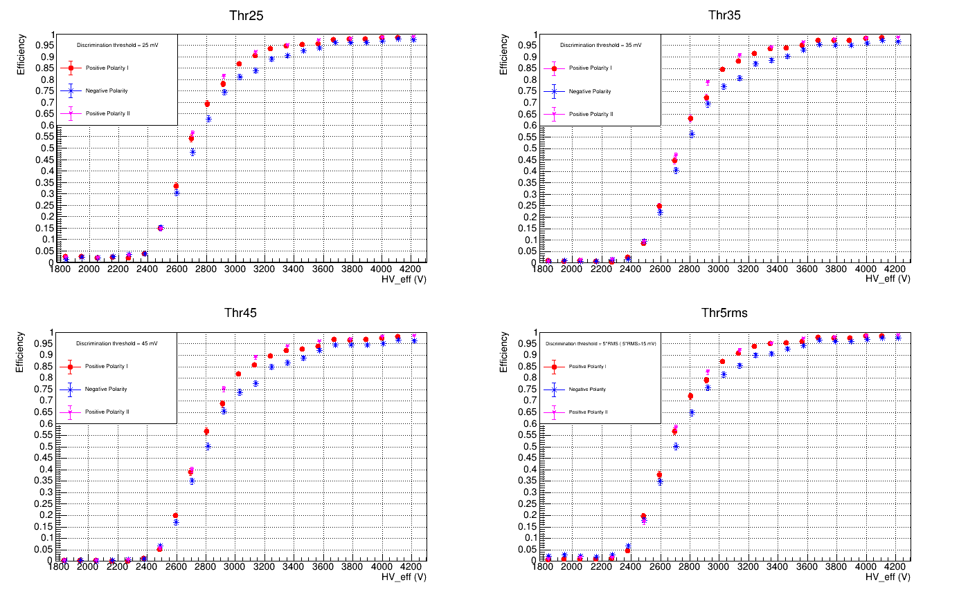
Efficiency for different polarization
Efficiency measured at different fixed thresholds for both polarities.
Positive polarity: avalanche discharge moves towards the internal electrode encountering more intense field in the final steps
Negative Polarity: avalanche discharge moves towards the external electrode encountering less intense field in the final steps
Efficiency scan have been performed three times switching polarity to evaluate hysteresis effects. First and second curves in positive polarities are perfectly consistent.

Slide 10
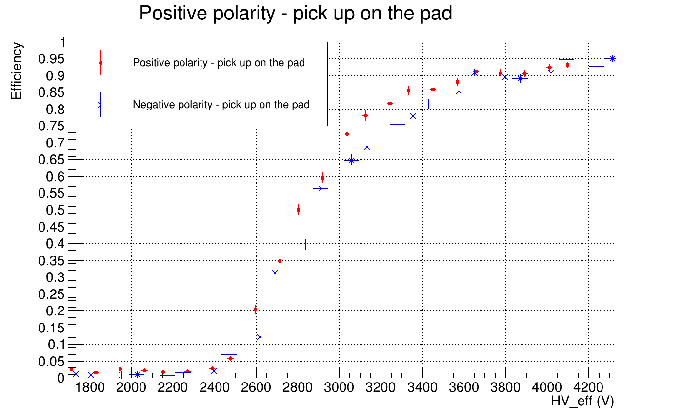
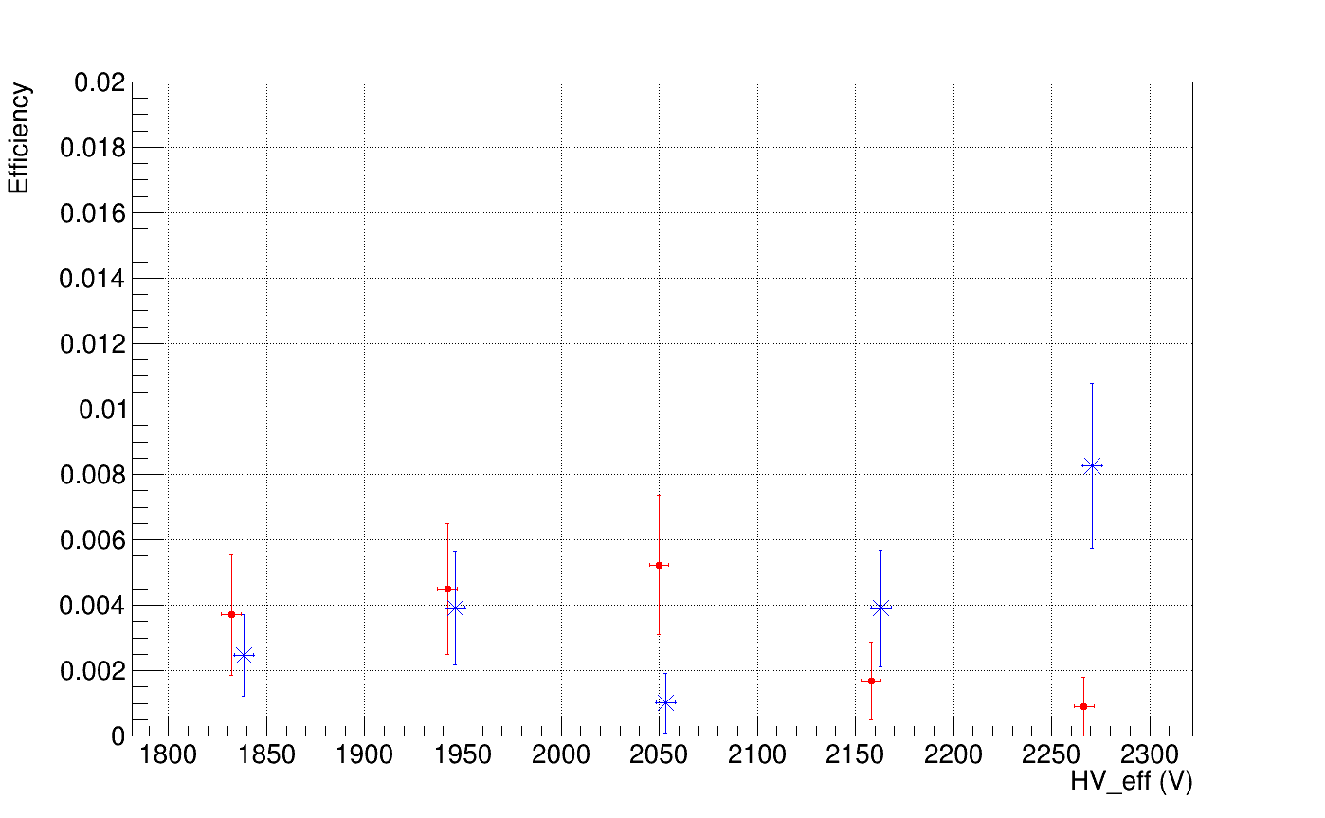
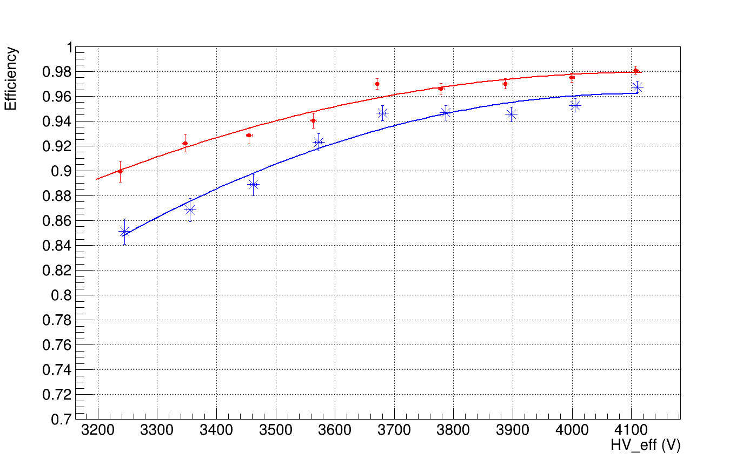
More on efficiency
Negative polarity is systematically less efficient. Discrepancy is observed regardless of the discrimination threshold .
The FE electronics have asymmetric dynamics: the observation could be traced back to a systematic effect due to a lower sensitivity in negative polarity.
Signals on the external strips and on the internal pick up are of opposite polarity for any polarization → The efficiency measurement on the internal pick-up confirms the trend observed with the external strips. Inefficiency does not depend on the response asymmetry of the FE.
The probability of random events, after applying the cuts, is less than 0.01, well below the observed excess efficiency!
Random count probability
Plateau region on the

Slide 11
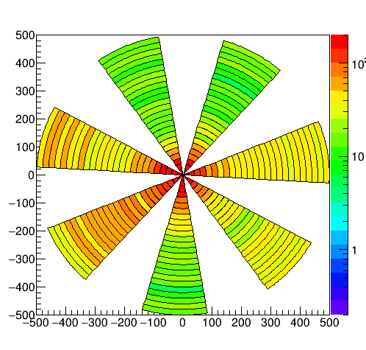
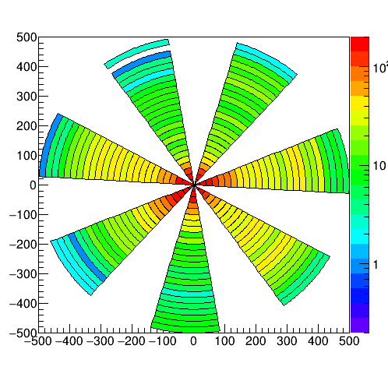
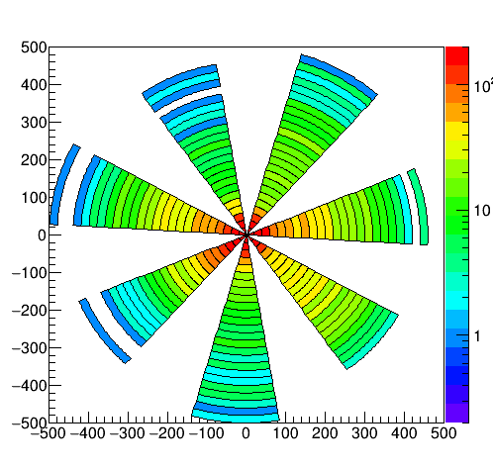
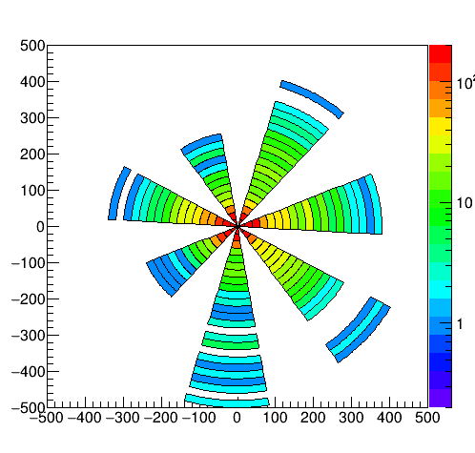
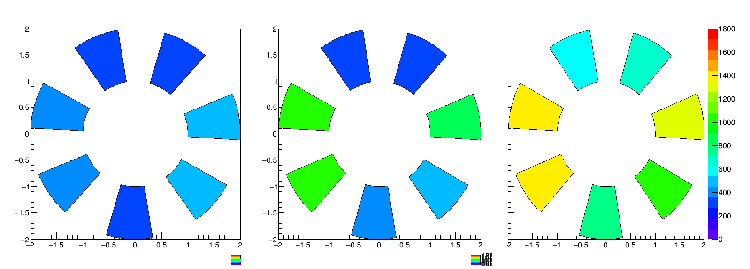
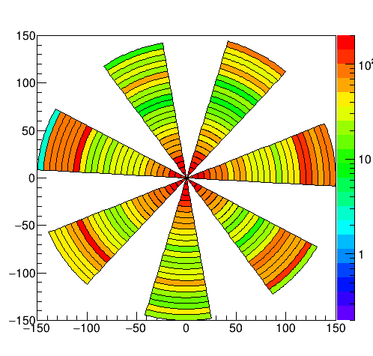
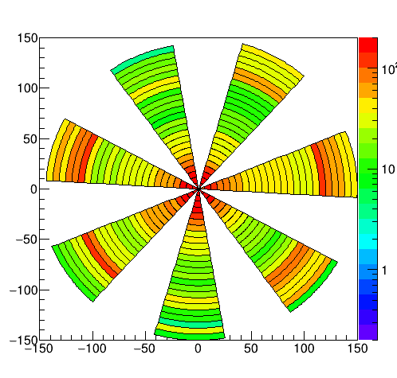
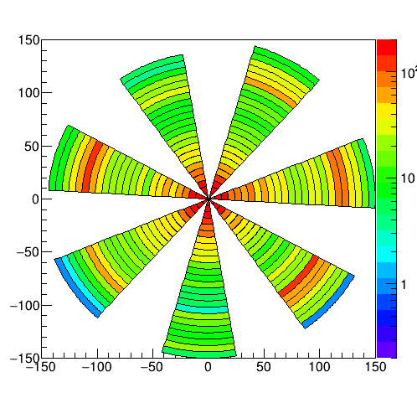
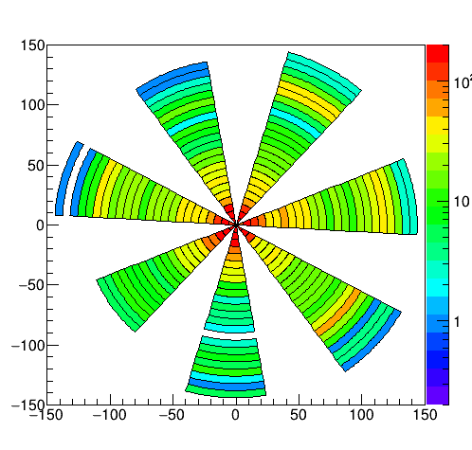
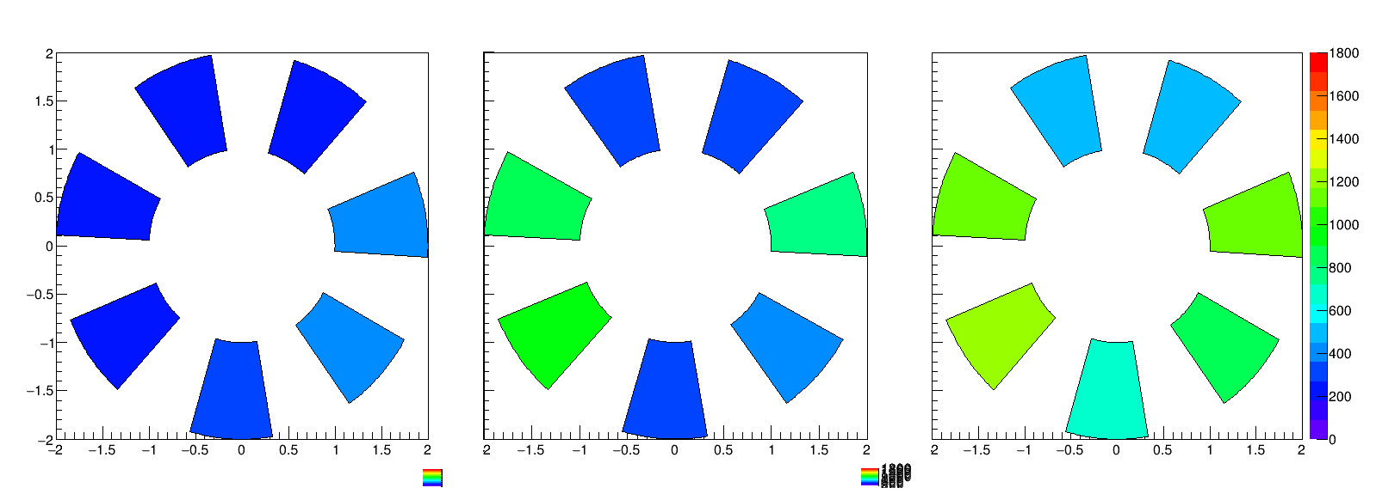
Amplitude distribution and efficiency map
The cylindrical geometry can be optimized to identify the direction of the incident particle.
The internal scintillator selects only the particles that pass through the cavity. Three cases can be observed: a cluster upstream, a cluster downstream, two clusters. Cluster position is expected to be diametrically opposite along the beam direction.
The asymmetric dynamics of FE electronics is clearly observed in the amplitude distributions. Positive signals saturate above 450 mV, negative signals saturate below 130 mV.
here, in addition to the saturation of the electronics the negative polarity produces a fraction of saturated events already at low efficiency (streamers?).
Amplitude (mV)
Efficiency
3400 V
3000 V
2800 V
2600 V
1 Cluster/Event
2 Cluster/Event
All cases
Amplitude (mV)
Efficiency

Slide 12
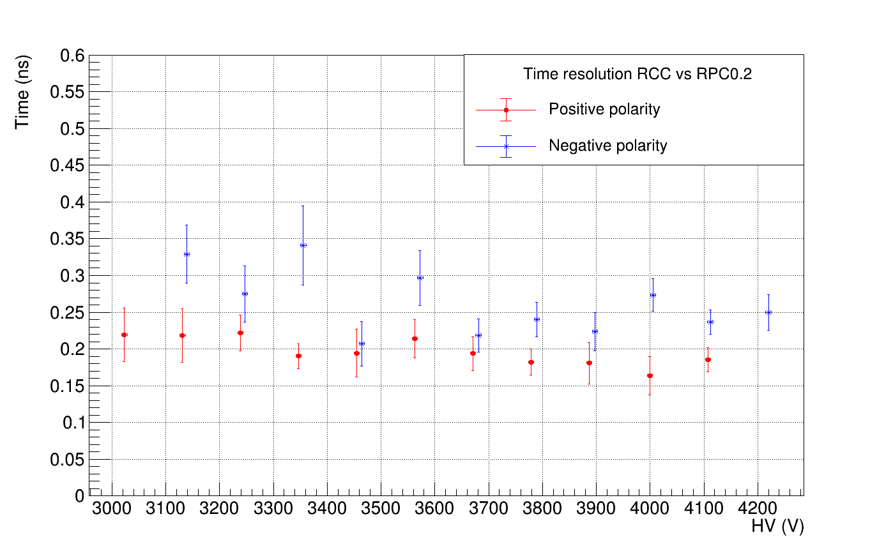
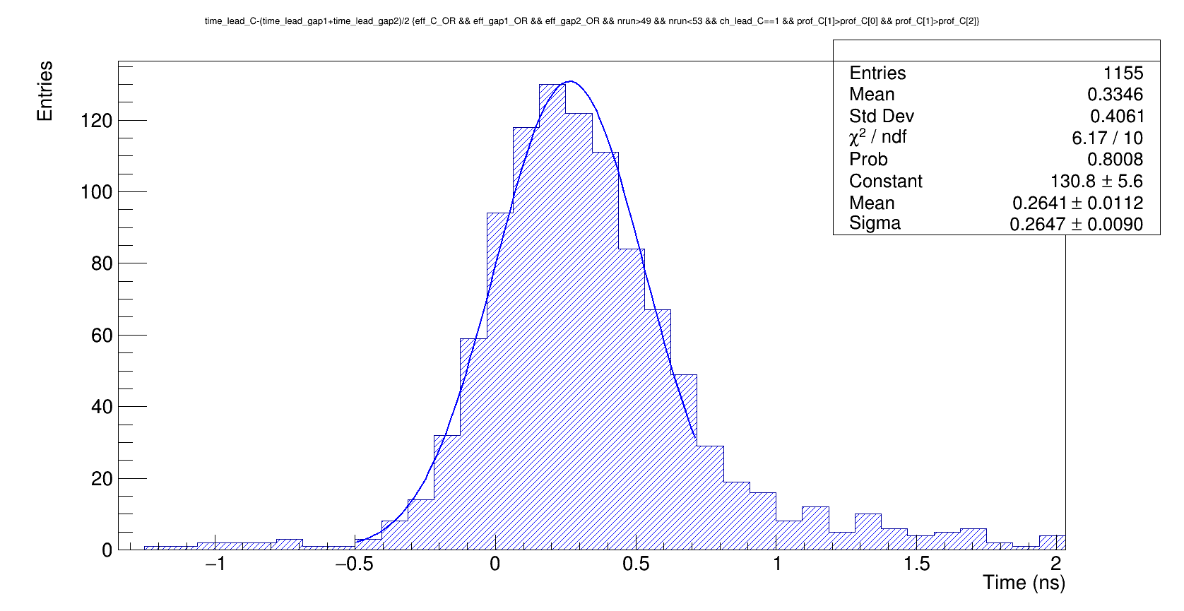
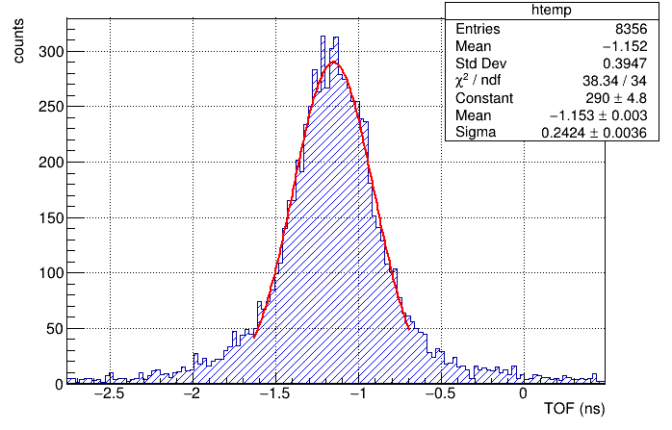
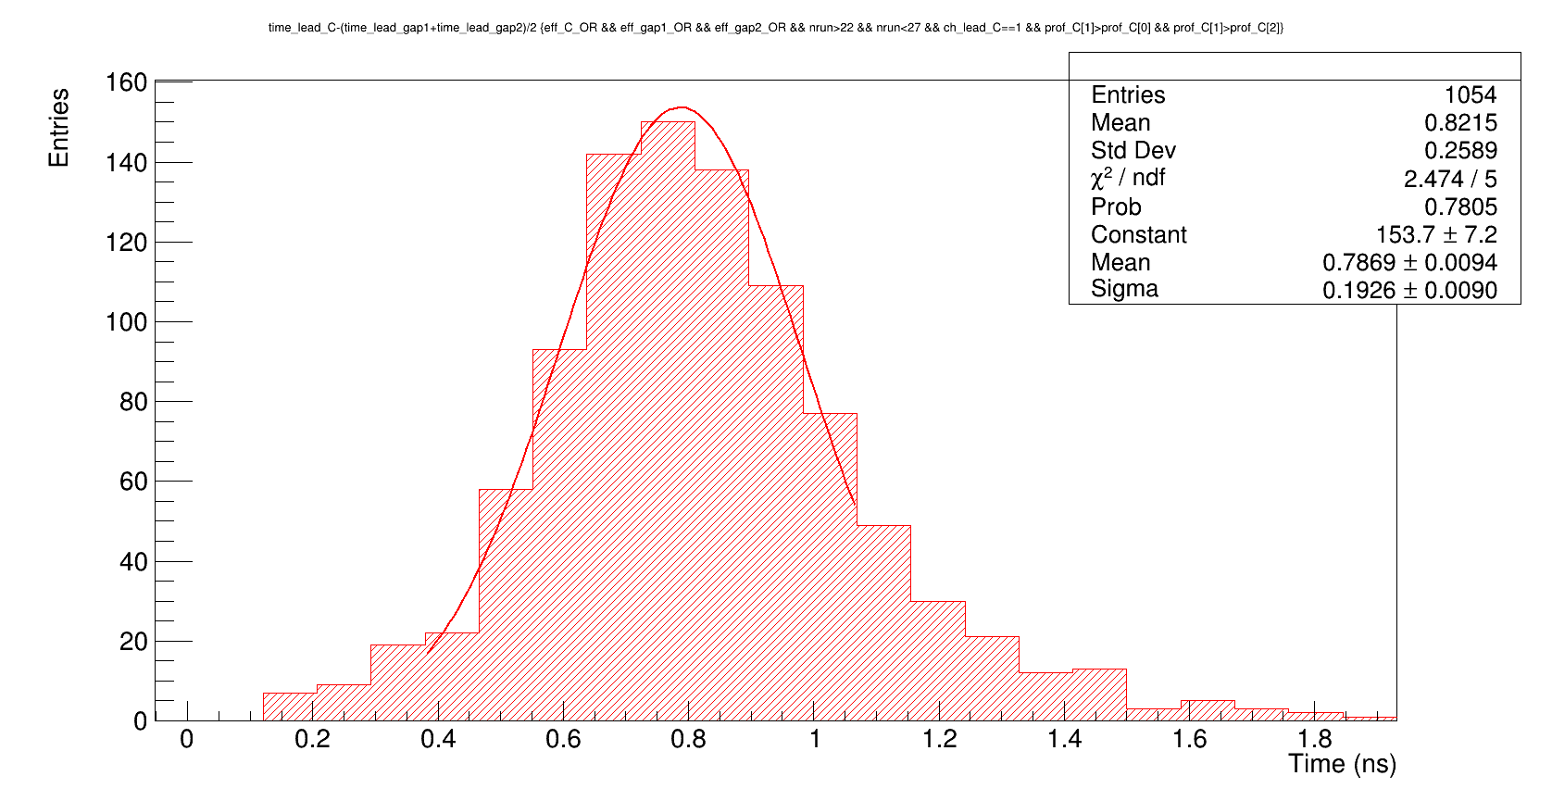
Time resolution
Time resolution was estimated through time-of-flight measurement with respect to external reference.
As a reference, the times above the threshold at 10% of the maximum Amplitude signals of two 0.2 mm RPC detectors have been averaged.
Crossing time of threshold set at10% of maximum amplitude has been measured
Time of the leading channel in the cluster was selected, requiring that all the selected clusters were on the same side with respect to the direction of the beam
Time jitter has an almost constant trend on the plateau for both polarities.
The observed value is comparable with the jitter of the time-of-flight measured between the two reference detectors. Probably the experimental setup (readout system, reading pick-up, skew...) does not allow better results to be obtained
Reference Detector RPC 0.2 mm

Slide 13
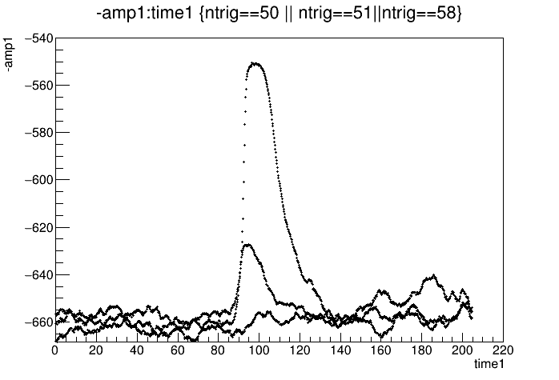
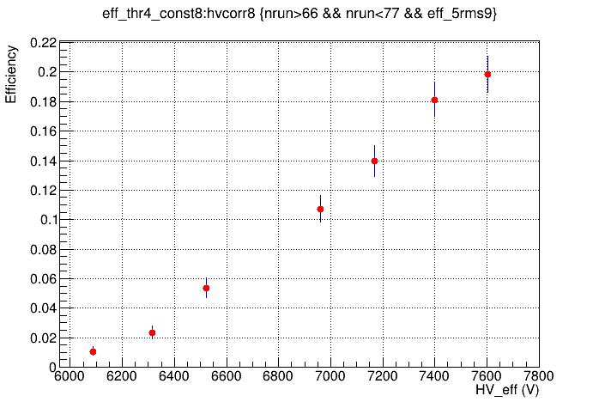
Some trials with Pure CO2
RPCs work at atmospheric pressure with a non pressurizable gas mixture; given the lack of mixers we connected the safest and easy gas to find and safe.
Pure CO2 was flushed at a pressure of +3Bar
The high leackage current together with the increase in voltage and the increase in charge produced in the gas made the detector unstable, as expected.
This did not prevent us from revealing coincidences and sketching an efficiency curve.
This is the first step to transition to a new pressurized mixture, hopefully eco-friendly.
Time (ns)

Slide 14
Conclusions
In the last 4 years the RCC was introduced, and the functionality of the detector has been demonstrated with prototypes of different design (1 mm gas-gap, 0.3 mm gas-gap…)
Today we present a high-performance device with multi-channel read-out, capable of being pressurized.
In addition to being a valid tool to study the dynamics of the discharge in this operating regime and in the different polarities, the proposed detector has established solid performances:
  Efficiency up to 98%
  Time resolution well below 200 ps
  Tracking capability
despite the thin gap, the electric field gradient, of about 4% appears to produce a detectable asymmetry. This presents a great opportunity to study the physics of the device.
Further studies will be conducted by removing the electronics of FE-E, and a measurement of the streamer avalanche ratio will be conducted
Soon the device will be updated, removing the SIPM from the cavity, and inserting a light guide. This will allow noise to be suppressed and shielding end caps to be inserted

Slide 15
Thanks for your attention

Slide 16
Backup-slides

Slide 17
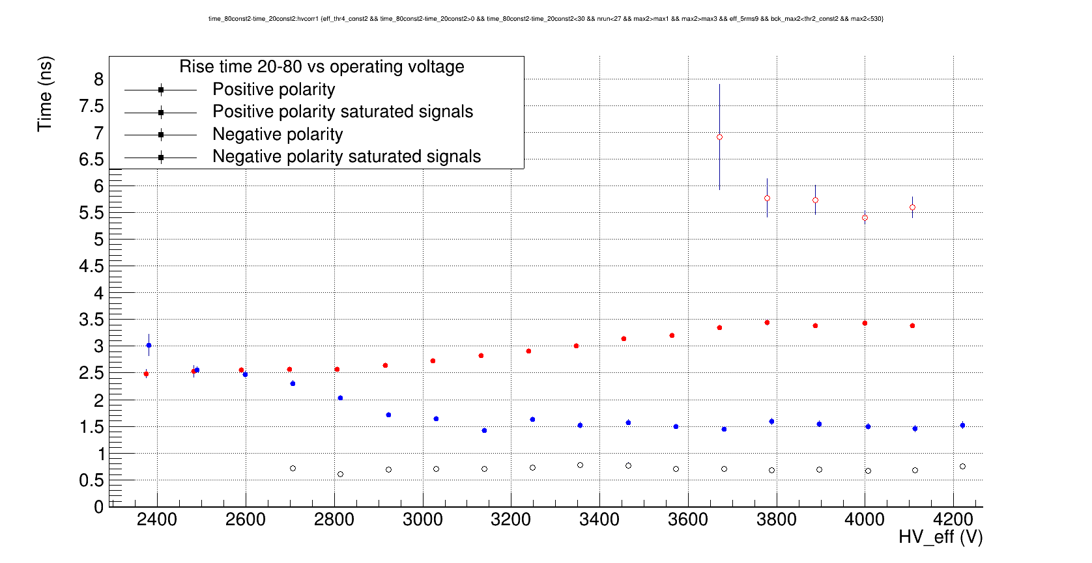
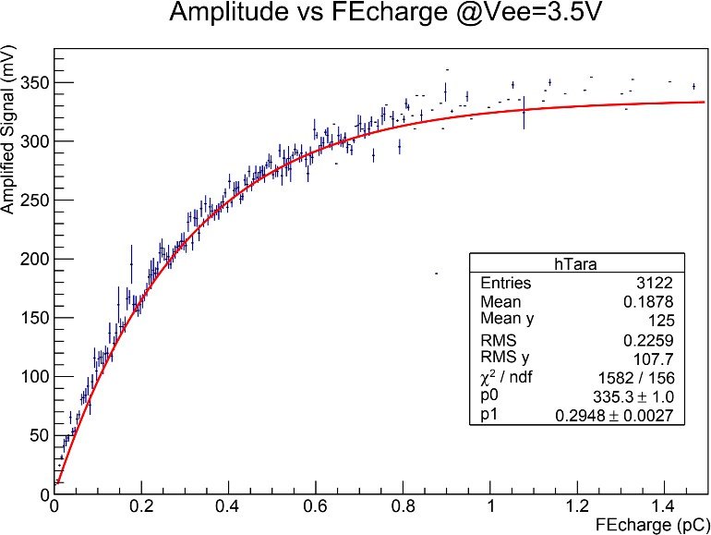
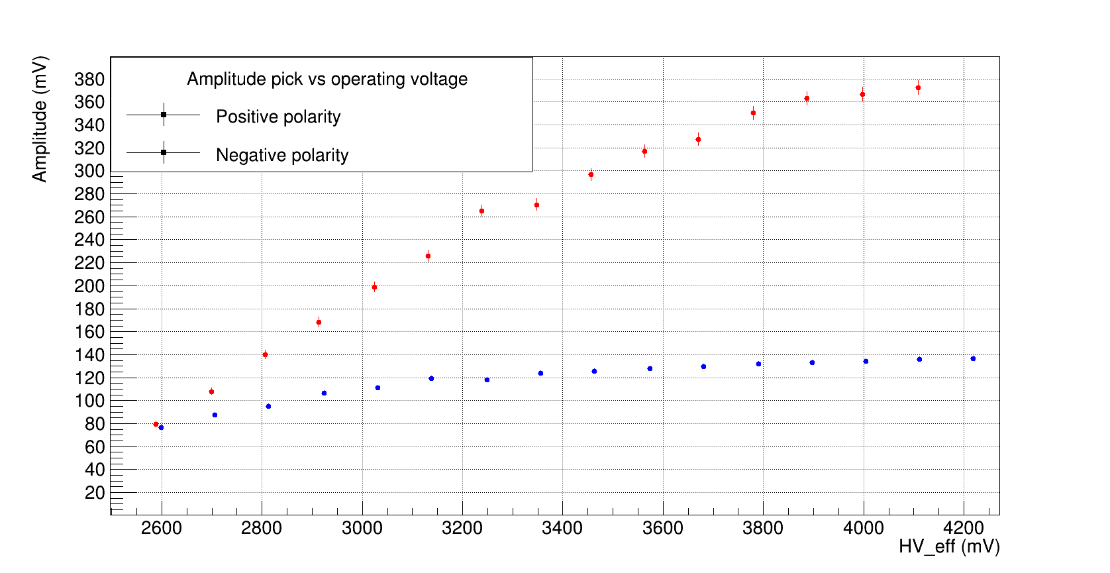
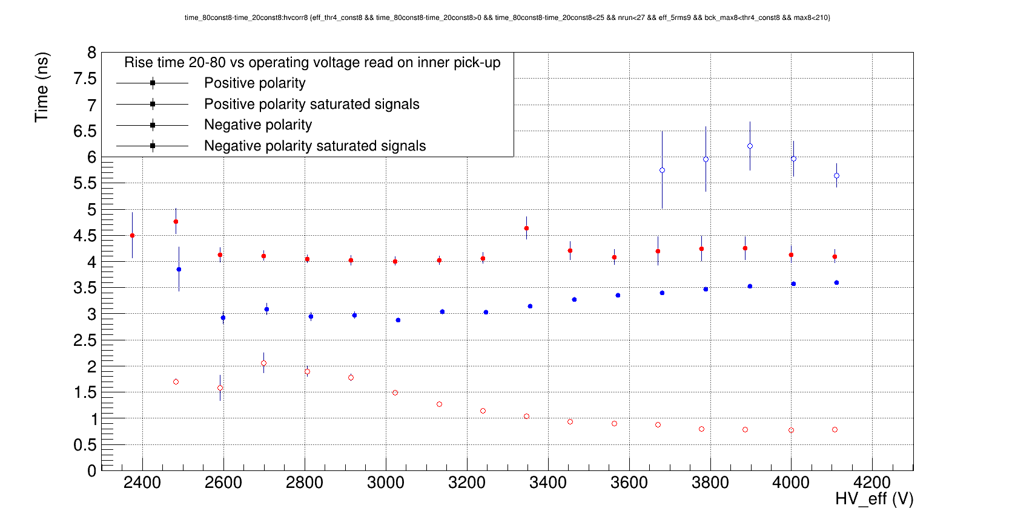
Signals Shape

Slide 18
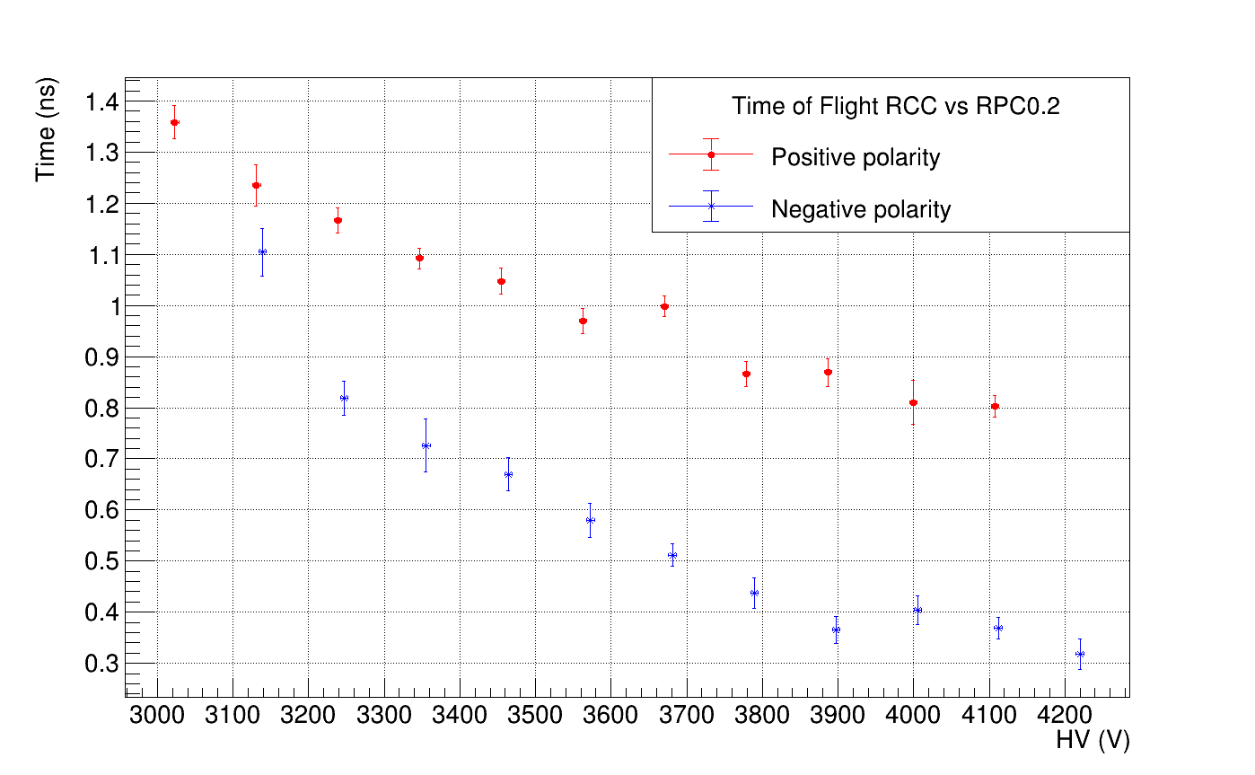
Time Delay

