Slide 1
WP Endorsement procedure
(Draft for discussion)
F. Tessarotto, E. Oliveri. M. Titov, P. Gasik
DRD1 Collaboration Meeting, 09-13.12.2024, CERN

Slide 2
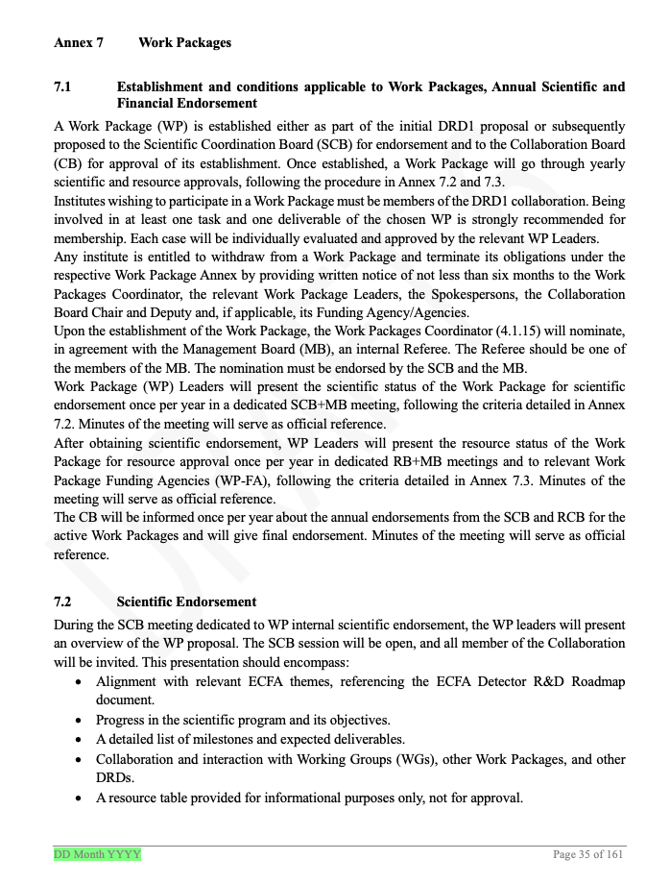
MoU annex 7 – current status
Current nine WPs established at the time of the DRD1 proposal endorsement
Annexes on WPs are updated

Slide 3
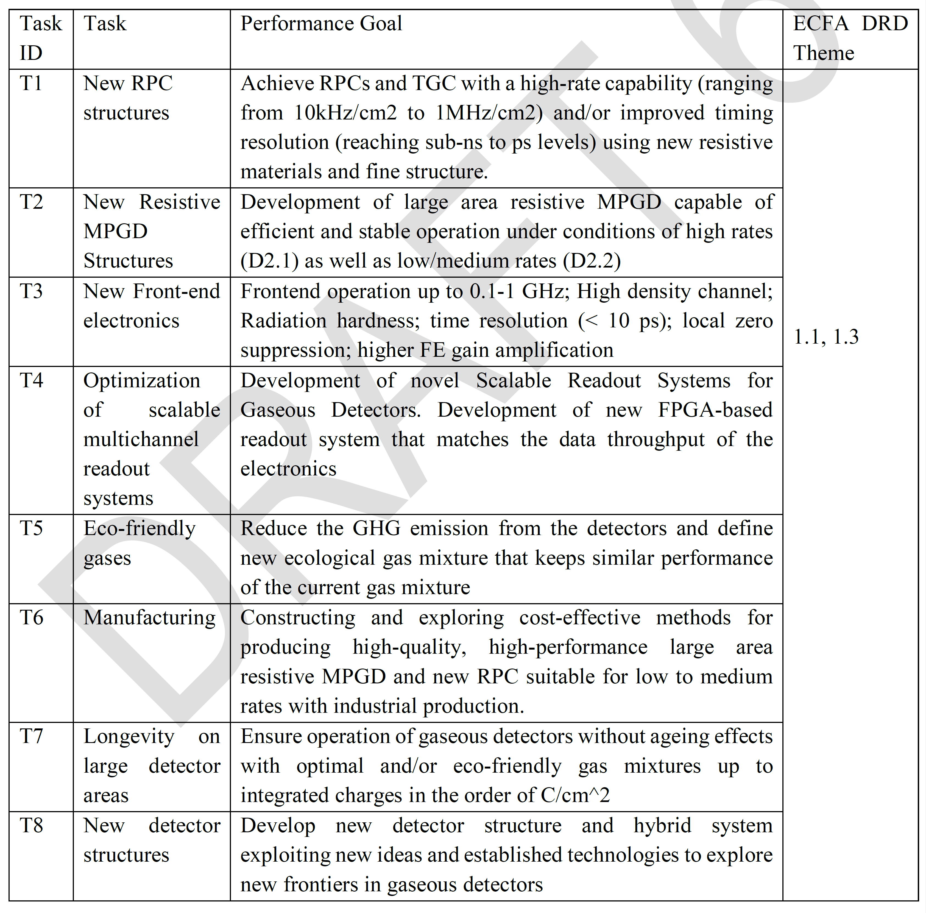
2024: MoU Annex 7 – Work Packages
Tasks
Deliverables / Milestones
Institutes
Resources
Resources and List of FA’s to be complemented only after DRD1 MoU signature & WP endorsement process

Slide 4
Scientific endorsement in the MoU Annex 7
Alignment with relevant ECFA themes, referencing the ECFA Detector R&D Roadmap document.
Progress in the scientific program and its objectives.
A detailed list of milestones and expected deliverables.
Collaboration and interaction with Working Groups (WGs), other Work Packages, and other DRDs.
A resource table provided for informational purposes only, not for approval.
Baseline for the procedure

Slide 5
Resource endorsement in the MoU Annex 7
During the RCB meeting dedicated to WP internal resource approval, the WP Leaders will present the WP resources. MB will be invited. All relevant WP Funding Agencies (WP-FA) listed in the Work Package Annexes (6.4.x) will be invited. The presentations will focus specifically on resource requirements and allocation.
To facilitate informed discussion, all relevant information for the presentation will be provided to the relevant WP-FA and RCB members at least one month in advance of the meeting, with the best effort.
Before the RCB meeting, WP Leaders are responsible, irrespective of the nature of the feedback received, for organizing the timely collection and presentation of confirmations from the WP-FA to ensure that the proposed resource table accurately reflects their allocated funding and support.
The method by which the proposed resource table will be acknowledged is left to each WP-FA, with the unique requirement that the acknowledgement is clear and unambiguous.
Baseline for the procedure

Slide 6
WP Endorsement

Slide 7
WP endorsement procedure drafting timeline
Drafting by the committee
The draft circulated within SCB on 15.11.2024
  Zoom slot to explain the details of the draft will be available
Discussion in the SCB on 22.11.2024
  WP Leaders are encouraged to get feedback from the WP Institutes (WP-FAs) and discuss
Discussion in the MB on 29.11.2024
  Draft with additional comments from SCB; expected endorsement from the MB
DRD1 Collaboration Meeting, WP session on Monday 09.12.2024 - procedure presentation.
  Open discussion within the Collaboration
Presented to CB on 12.12.2024
  Expected endorsement from the CB

Slide 8
Key aspects of the procedure
Define a clear time flow
Avoid duplicating work. Clear list or required documentation without overlapping or duplication. Proposed list of documents needed for the endorsement:
  MoU Annex 7 (updated with all tables)
  Work Package Executive Summary for Internal DRD1 Scientific and Resource Endorsement
  WP Leader Presentations for SCB
  WP Leader Presentations for RCB
Simplify the collection of the required information for the endorsement process. Using common templates – see documents attached.

Slide 9
WP Internal Referee
From MoU Annex 7: Upon the establishment of the Work Package, the Work Packages Coordinator (4.1.15) will nominate, in agreement with the Management Board (MB), an internal Referee. The Referee should be one of the members of the MB. The nomination must be endorsed by the SCB and the MB. Comments:
    Internal referee from the institute which does not participate in the WP
    Being a member of the MB assures that the person is up to date with DRD1 and WP activities
    Nominated MB members may ask an expert from outside MB for support
Referee(s) work together with WPLs (see also next slides). (S)he is not a single person to decide on the endorsement, but preparing the background for discussion in the SCB
The goal of the procedure is an endorsement. We don’t judge the quality of work.
  Research line compatible with ECFA, synergies within collab and other DRDs, etc. Status of Milestones and Deliverables.
The referee is preparing a report, following the template
  Findings, comments, and recommendations
  The report helps in the Scientific Endorsement, it serves as a baseline for minutes.
SCB and MB shall establish the list of referees by the end of 2024, after the procedure gets approved.

Slide 10

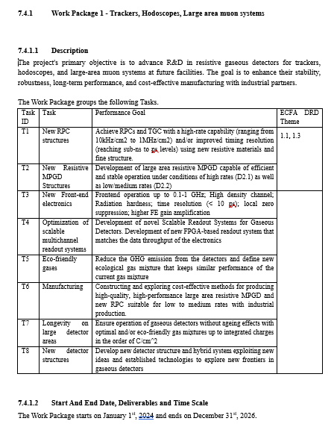
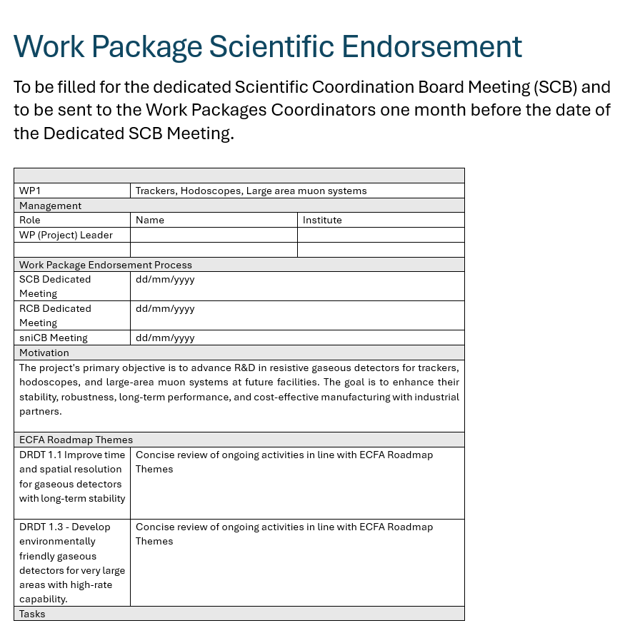
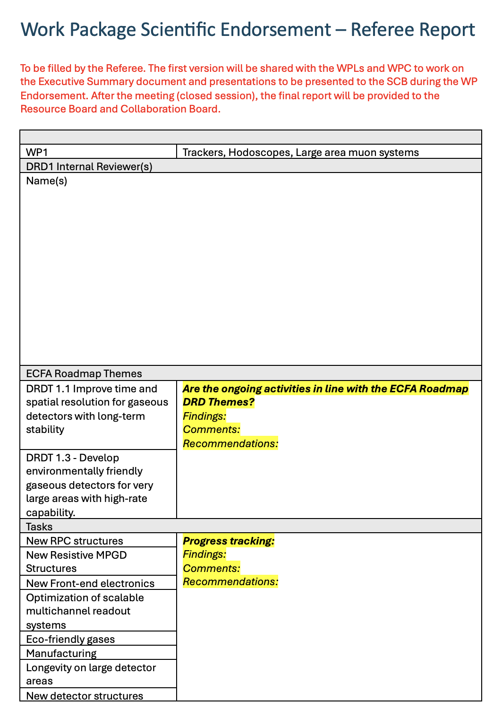

Endorsement: Required Documentation
Please check the attachments
Please check the attachments
Please check the attachments
20’ minutes presentation for the Scientific Coordination Board (reflecting the review)
Updated version of MoU Annex 7
Please check the attachments
WP Executive Summary
A concise review of the status of the WP activities.
(It will include a section – not for endorsement – presenting long-term plans and additional requests for funds)
Please check the attachments
Referee report, following the WP Executive Summary document layout. Findings, Comments , and Recommendations for each part
10’ minutes presentation for the Resource Coordination Board

Slide 11
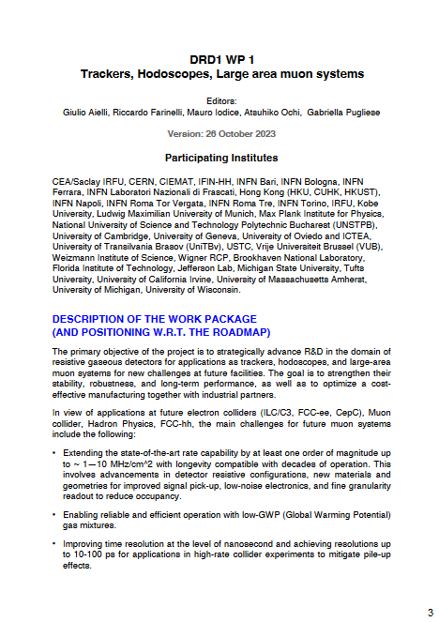
Additional Documentation – Detailed Proposals
Detailed Description of Work Package Activities as Required by the WP-FA for Participating Institutes
Not required for internal DRD1 endorsement.
Each Work Package is strongly encouraged to prepare (and keep it updated) a detailed document describing its activities, in line with the DRD1 proposal submission.
This document should support the funding request with a more detailed description of the planned activities. It will not be reviewed by the DRDC and will not be part of the WP Endorsement but can be used by all institutes in discussions with their corresponding funding agencies.

Slide 12
GENERAL TIMELINE
Latest time |  | -5 week |  | -3 week | -2 week | -1 week | CB Date
SCIENTIFIC ENDORSEMENT | Requirement | Updated Annex 7 with all tables WP Executive Summary |  | Updated WP Executive Summary Referee report Annex 7 | All documents and presentations ready Summary of WP-FA acknowledgements 1h Dedicated SCB/MB Meeting for the WP Scientific Review |  | Scientific endorsement Financial endorsement Recommendations to CB
 | Action | All documents sent to Work Packages Coordinator, Resource Coordinator and the WP Internal Referee Referee report is prepared within 2 week time period. The Referee works together with WPLs to “improve” the WP Executive Summary. |  | Documents sent to SCB and MB by WPs Coordinator | 1) Open session (30’) - WPL or WPPL present with all WP members present. Open to all collaboration. 2) Closed session (30’) - Internal referee presents their report; SCB and MB members may ask questions. WPLs, WPPLs and WP-Members present |  | Final WP Endorsement
 | Outcome |  | WPs Coordinator and Resources Coordinator receive the referee report and updated WP Executive Summary | Any major concerns identified by the respective board members shall be communicated before the dedicated SCB meeting | Scientific endorsement (Final referee report and SCB minutes)
RESOURCES ENDORSEMENT | Requirement | Updated Annex 7 with all tables |  | 75% of acknowledgements expected (otherwise, needs to be discussed in the SCB endorsement) |  | Scientific approval 30’ Dedicated RCB/MB Meeting 30’ per WP project
 | Action | The annex is distributed to relevant WP-FA and requests for acknowledgement in 2 weeks |  | Summary of WP-FA acknowledgements of existing Resources are sent to SCB, RCB and MB |  | 1) Closed session (30’) - WPL presents a summary of SCB approval,resource tables and a list of acknowledgements (100% expected) | Recommendation and minutes ready for CB
 | Outcome |  |  |  |  | Financial endorsement

Slide 13
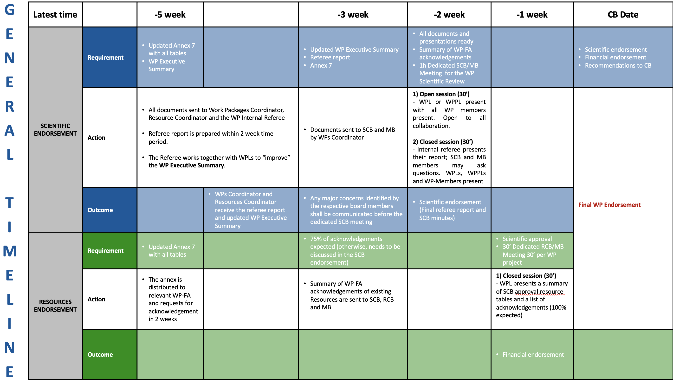
WP endorsements
After establishment and first endorsement, a WP shall undergo an endorsement procedure once per year.
WP endorsement can be initiated before each CB meeting
This way, we can accommodate (especially in the initial phase) different levels of preparations of various WPs
The proposed timeline shows an example where the endorsement documents are sent at the latest five weeks before the corresponding CB meeting.
  Earlier initialisation of the procedure is encouraged

Slide 14
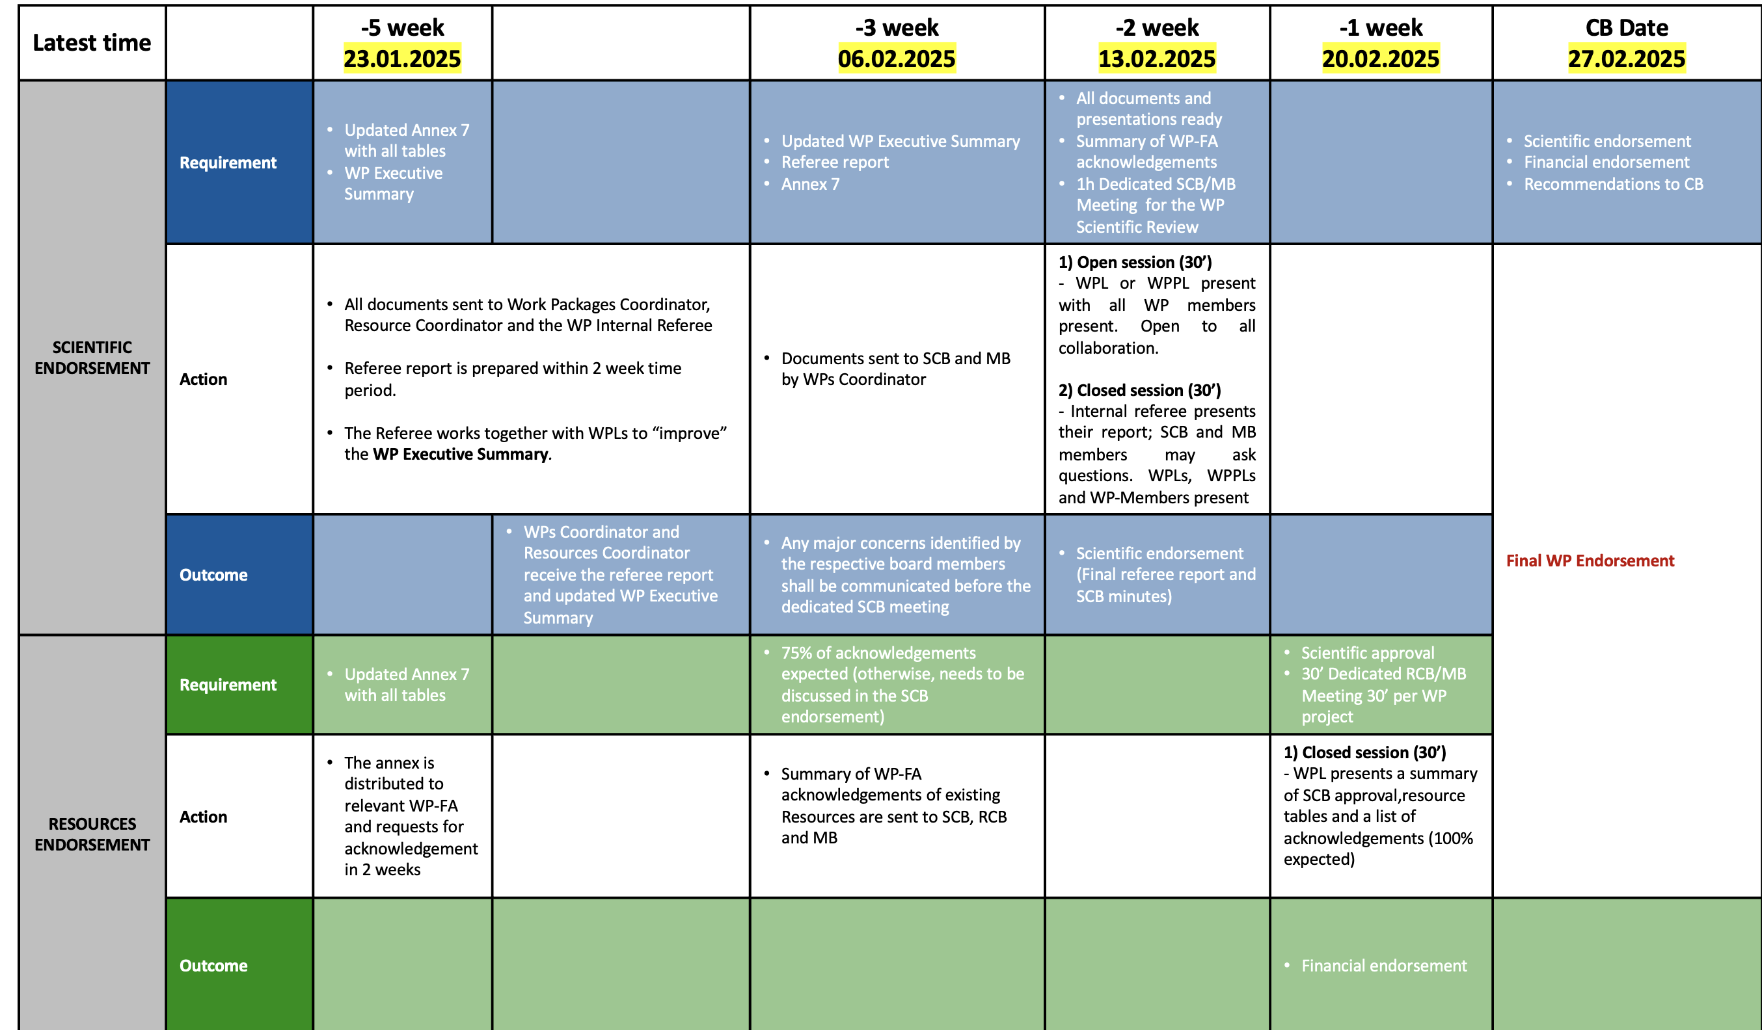
Example – next CB on 27.02.2025
For the most advanced WPs, we can prepare the endorsement in the first CB meeting of 2025 already
Influence of the MoU signing process to be clarified.
The resulting timeline, based on the discussion before, would consider the following dates as the final deadlines

Slide 15
Latest time |  | -5 week 23.01.2025 |  | -3 week 06.02.2025 | -2 week 13.02.2025 | -1 week 20.02.2025 | CB Date 27.02.2025
SCIENTIFIC ENDORSEMENT | Requirement | Updated Annex 7 with all tables WP Executive Summary |  | Updated WP Executive Summary Referee report Annex 7 | All documents and presentations ready Summary of WP-FA acknowledgements 1h Dedicated SCB/MB Meeting for the WP Scientific Review |  | Scientific endorsement Financial endorsement Recommendations to CB
 | Action | All documents sent to Work Packages Coordinator, Resource Coordinator and the WP Internal Referee Referee report is prepared within 2 week time period. The Referee works together with WPLs to “improve” the WP Executive Summary. |  | Documents sent to SCB and MB by WPs Coordinator | 1) Open session (30’) - WPL or WPPL present with all WP members present. Open to all collaboration. 2) Closed session (30’) - Internal referee presents their report; SCB and MB members may ask questions. WPLs, WPPLs and WP-Members present |  | Final WP Endorsement
 | Outcome |  | WPs Coordinator and Resources Coordinator receive the referee report and updated WP Executive Summary | Any major concerns identified by the respective board members shall be communicated before the dedicated SCB meeting | Scientific endorsement (Final referee report and SCB minutes)
RESOURCES ENDORSEMENT | Requirement | Updated Annex 7 with all tables |  | 75% of acknowledgements expected (otherwise, needs to be discussed in the SCB endorsement) |  | Scientific approval 30’ Dedicated RCB/MB Meeting 30’ per WP project
 | Action | The annex is distributed to relevant WP-FA and requests for acknowledgement in 2 weeks |  | Summary of WP-FA acknowledgements of existing Resources are sent to SCB, RCB and MB |  | 1) Closed session (30’) - WPL presents a summary of SCB approval,resource tables and a list of acknowledgements (100% expected) | Recommendation and minutes ready for CB
 | Outcome |  |  |  |  | Financial endorsement

