Slide 1
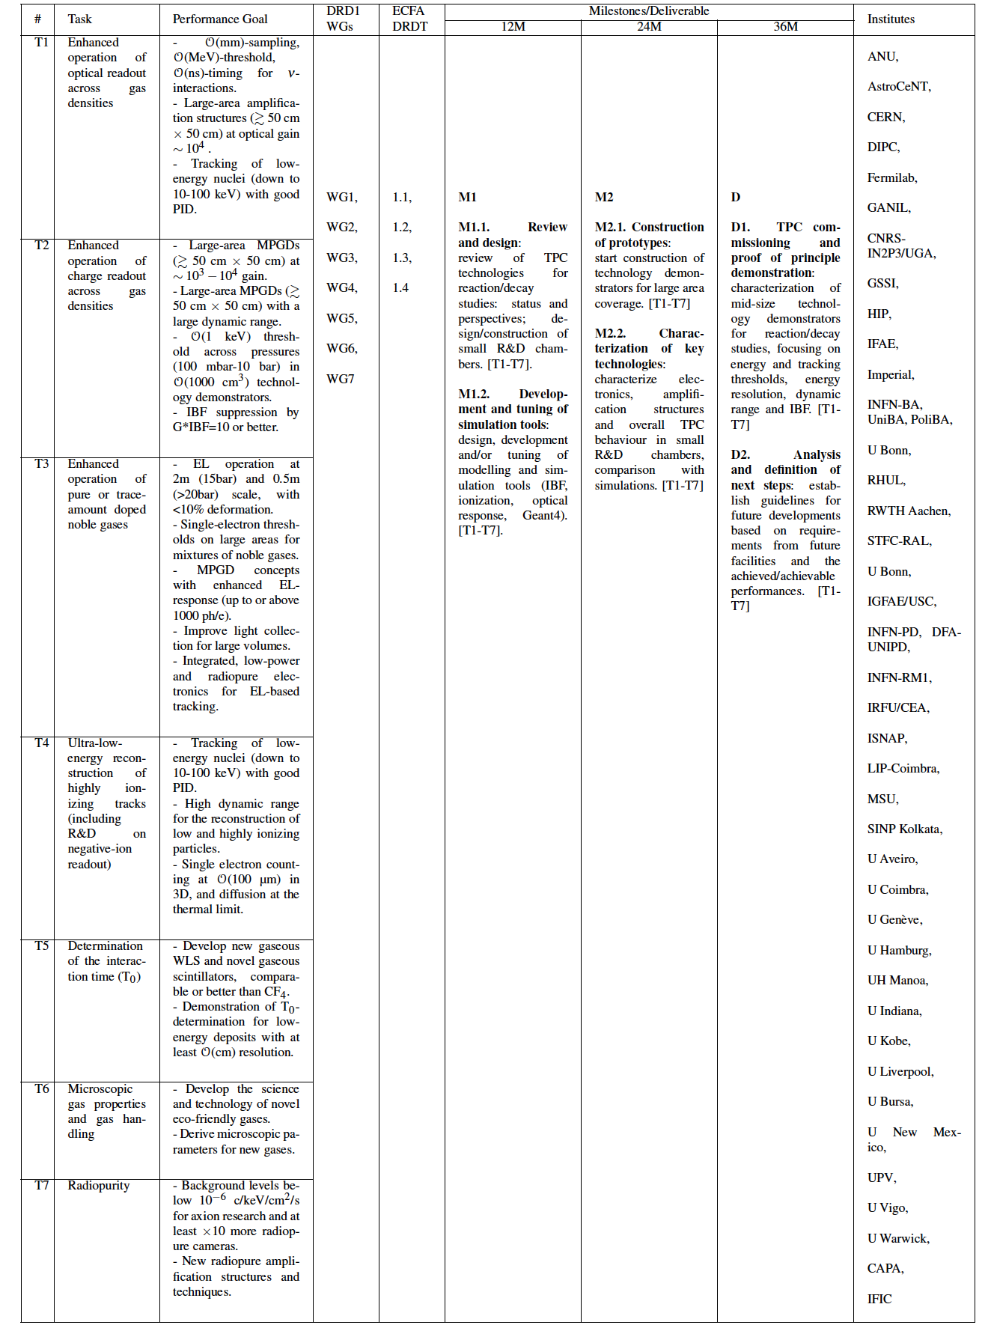
WP8 (towards endorsement)
summary as of January
How the WP covers the topics in the ECFA roadmap:
DRDTs: 1.1, 1.2, 1.3, 1.4 (specifically 1.4)
Fundamental challenges (as on DRD1 proposal):
Achieving track-reconstruction of low-energy nuclei and electrons, at granularities going from few mm down to potentially tens of um and close to the thermal diffusion limit. ECFA 1,2,3,6; task T1, T2, T4.
Operating in a broad range of pressures going from few tens of mbar to tens of bar, with energy-reconstruction performing generally down to ~1keV threshold if not less. ECFA 5,7; task T2, T3.
Achieving high and uniform amplification in nearly pure or weakly-doped noble gases. ECFA 4,5; task T3.
Increasing optical throughput (primary and secondary). ECFA 6; tasks T1, T4, T5, T6.
Developing more suitably scintillating and/or eco-friendly gas mixtures as well as recuperation systems ECFA 6,7; task T1, T5, T6
Enhancing the radiopurity of the amplification structure and of the TPC as a whole. ECFA 8; task T7
(1)
(2)
(3)
(4)
(5)
(6)
DRDT 1.4
(7)
(8)

Slide 2
WP8 (towards endorsement)
summary as of January
Projects
High Pressure TPCs for precision studies of neutrino interactions. (Alan Bross)
TPCs for low-energy nuclear physics. (Marco Cortesi)
Electroluminescence-based TPCs for Rare-Event Searches and other R&D on pure noble-gas amplification. (Francesc Monrabal)
Radiopure TPCs for precise track imaging and/or calorimetry with avalanche-based readouts. (Giorgio Dho)
Milestones and deliverables (as on DRD1 proposal)
M1.1. Review and design: review of TPC technologies for reaction/decay studies: status and perspectives; design/construction of small R&D chambers. [T1-T7]
M1.2. Development and tuning of simulation tools: design, development and/or tuning of modelling and simulation tools. [T1-T7]
M2.1. Construction of prototypes: start construction of technology demonstrators for large area coverage. [T1-T7]
M2.2. Characterization of key technologies: characterize electronics, amplification structures and TPC behaviour in small R&D chambers, comparison with simulations. [T1-T7]
D1. TPC commissioning and proof of principle demonstration: characterization of mid-size technology demonstrators for reaction/decay studies, focusing on energy and tracking thresholds, energy resolution, dynamic range and IBF. [T1-T7]
D2. Analysis and definition of next steps: establish guidelines for future developments based on requirements from future facilities and achieved/achievable performances. [T1-T7]

Slide 3
WP8 (towards endorsement)
A. High Pressure TPCs for precision studies of neutrino interactions. (A. Bross)
B. TPCs for low-energy nuclear physics. (M. Cortesi)
Kickoff meeting (June 3, 2024). 👍
Good progress with groups’ response & project implementation. 👍
Current Project version not too different from original one.
No plans for endorsement yet.
Contributions to 1st DRD1 meeting: I
Contributions to 2nd DRD1 meeting: -
Contributions to 3rd DRD1 meeting: -
Kickoff meeting (April 30, 2024) + at least another meeting. 👍
Good progress with groups’ response & project implementation. 👍
Current Project version has strong feedback based on recent meetings. 👍
No plans for endorsement yet.
Contributions to 1st DRD1 meeting: I
Contributions to 2nd DRD1 meeting: -
Contributions to 3rd DRD1 meeting: I
C. Electroluminescence-based TPCs for Rare-Event Searches and other R&D on pure noble-gas amplification. (F. Monrabal)
D. Radiopure TPCs for precise track imaging and/or calorimetry with avalanche-based readouts. (G. Dho)
Kickoff meeting (June 3, 2024). 👍
Good progress with groups’ response & project implementation. 👍
Current Project version not too different from original one.
No plans for endorsement yet.
Contributions to 1st DRD1 meeting: -
Contributions to 2nd DRD1 meeting: -
Contributions to 3rd DRD1 meeting: I
Kickoff meeting (May 3, 2024) + at least another meeting . 👍
Good progress with groups’ response & project implementation. 👍
Current Project version has strong feedback based on recent meetings. 👍
Aiming at endorsement by mid-2025. 👍
Issue on how many deliverables/milestones we want to go on with.
Contributions to 1st DRD1 meeting: I
Contributions to 2nd DRD1 meeting: I
Contributions to 3rd DRD1 meeting: -

Slide 4
Appendix

Slide 5
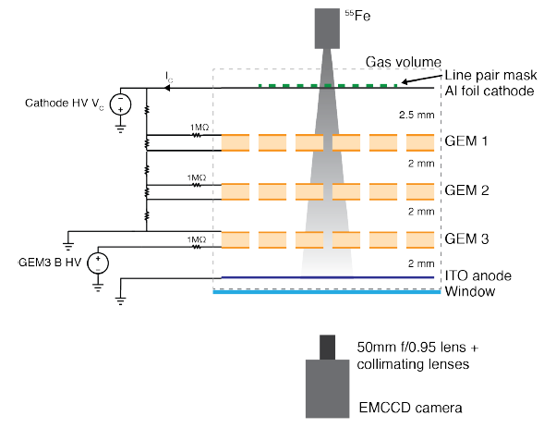
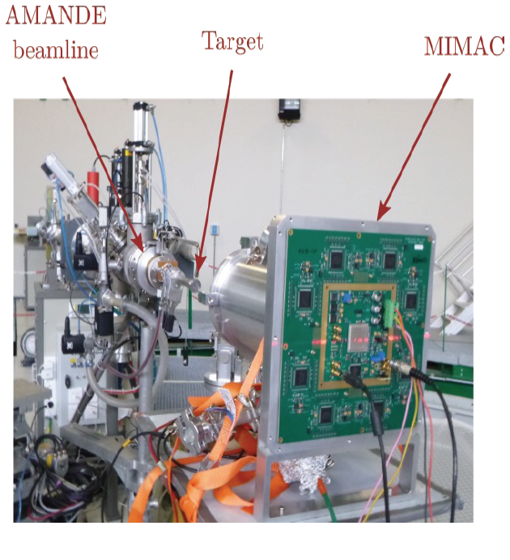
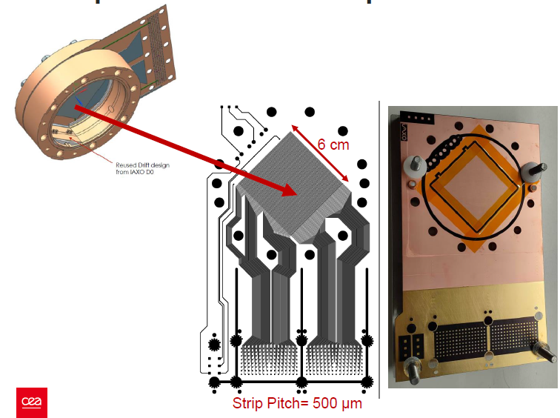
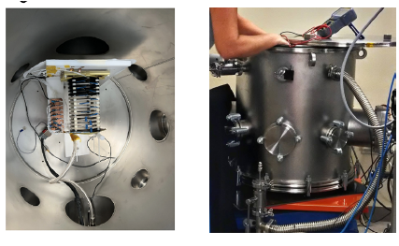
WP8 Project D:
Radiopure and/or low-energy TPCs for precise track imaging and/or calorimetry with avalanche-based readouts
Focus on TPCs aimed to:
Reconstruction of keV recoils
Enhanced operation of charge and optical readout
Understanding of noble and scintillating gases and negative ion operation
Radiopurity of materials for TPCs for rare event searches
Images taken from kick-off meeting presentation

Slide 6
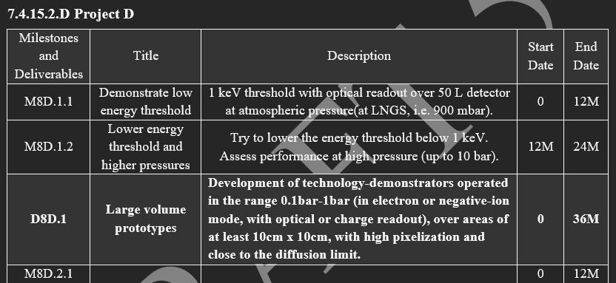
WP8 Project D:
Radiopure and/or low-energy TPCs for precise track imaging and/or calorimetry with avalanche-based readouts
Kick-off meeting held on 3rd May 2024:
    10 out of 15 institution which initially expressed interest participated
Different WG interaction possible within this project
Milestones and FA organisation under discussion
More meetings and activity expected with new year
Endorsement procedure should probably be aimed for mid next year

