Slide 1


WG4 - 3rd DRD1 Collaboration Mitting, December 2024. , Geneva, Switzerland
WG4 – How the different cathodic metals perturb
the CF₃⁺ potential energy curves
People involved : Nebojša Begović (nebojsa.begovic@cern.ch)
Jelena Jovanović (jelena.dragoslav.jovanovic@cern.ch)

Slide 2
WG4 - 3rd DRD1 Collaboration Mitting, December 2024. , Geneva, Switzerland
Activities
To be able to cope with a problem of electrode aging we want to use quantum-chemical calculation to get deeper insight into the processes on electrodes
In regard to that we constructed Potential Energy Surface (PES) in vicinity of boundary phase of cathode composed of different metals for CF₃⁺ ion which appear in plasma during gaseous detector use.
Using quantum chemical calculations, DFT method and appropriate basis set
we construct PES
We optimize structures for minimum energy for CF₃⁺ ion for chosen distance from electrode – cathode with different metal surface and record their energies
We simulated Cu, Ag, Au and Al electrode for CF₃⁺ ion, which we previously optimized and hold fixed during simulations

Slide 3
WG4 - 3rd DRD1 Collaboration Mitting, December 2024. , Geneva, Switzerland
Motivation
In spite we have knowledge about reaction in bulk, i.e. plasma,
electrodes can on different way perturb energetic levels of our investigated ion
so we need to enlarge out knowledge in way in which electrodes perturb
bonds in our ion which lead to stabilization or destabilization

Slide 4
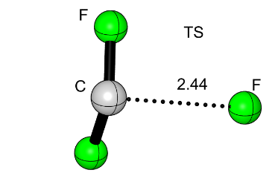
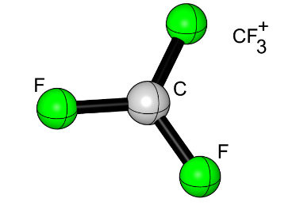
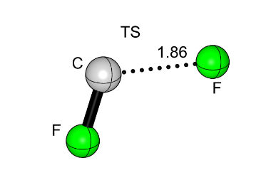
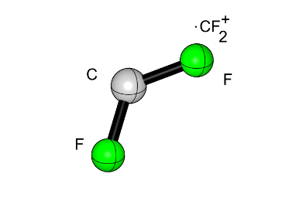
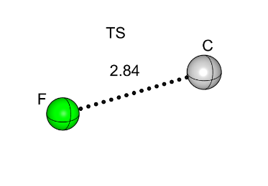
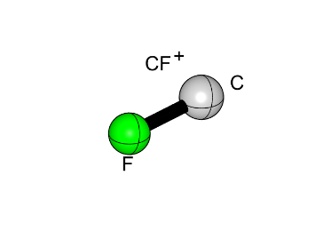
WG4 - 3rd DRD1 Collaboration Mitting, December 2024. , Geneva, Switzerland
Degradation pathway of CF₃⁺ in bulk, in plasma
CF₃⁺ → .CF₂⁺ + . F (R1)
E_{a}=7.11 eV
. CF₂⁺ → CF⁺ + . F (R2)
E_{a}=3.63 eV
CF⁺ → . C⁺ + .F (R3)
E_{a}=9.36 eV
Ground state
Transition state

Slide 5
WG4 - 3rd DRD1 Collaboration Mitting, December 2024. , Geneva, Switzerland
Reaction
perturbation
transition
state
ground
E_{a}
state
Near the electrode surface energy levels of ion can be stabilized or destabilize in ground and also in transition state

Slide 6
WG4 - 3rd DRD1 Collaboration Mitting, December 2024. , Geneva, Switzerland
In order to investigate perturbation we calculate Potential Energy Surface for CF₃⁺ ion approaching electrode of different metals:
Au
Ag
Cu
Al
Quantum chemical calculation were performed with ORCA and gaussian package at different theoretical level and appropriate basis set

Slide 7
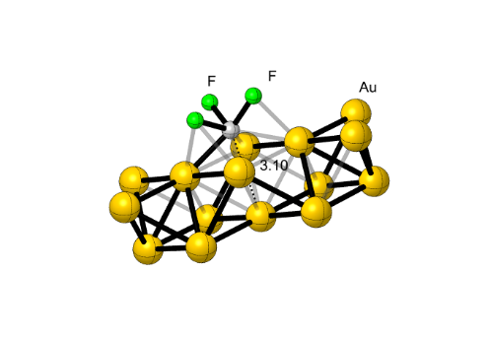
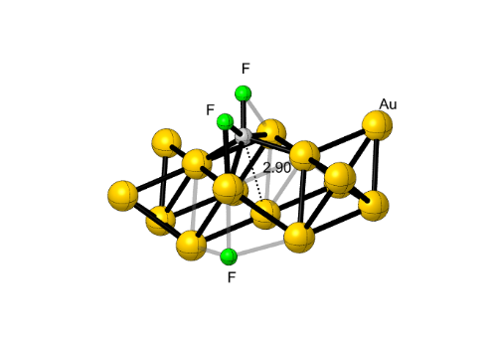
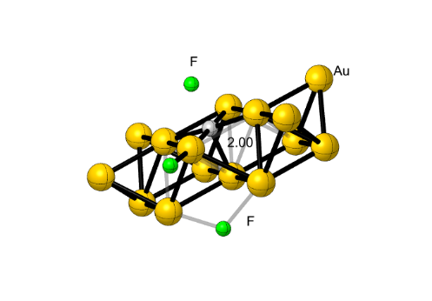
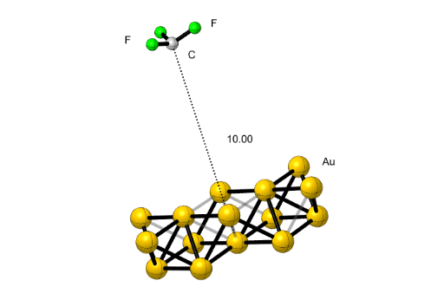
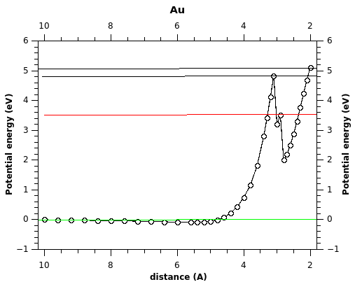
WG4 - 3rd DRD1 Collaboration Mitting, December 2024. , Geneva, Switzerland
R3
R1
Au
electrode
R2

Slide 8
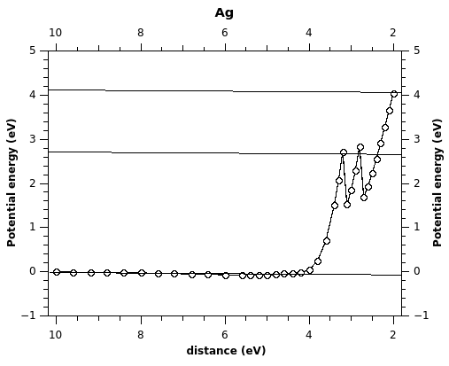
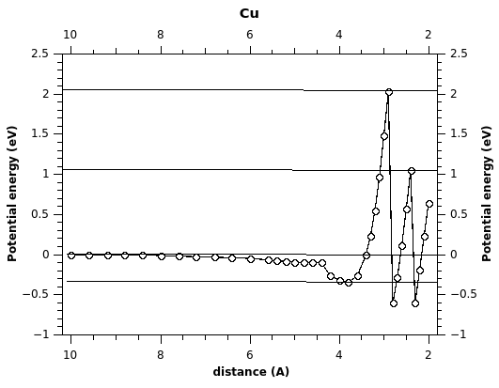
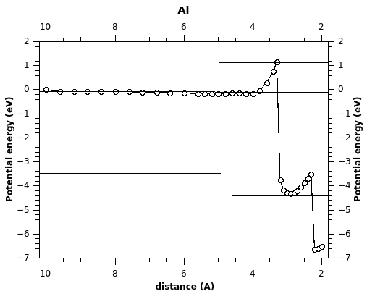
WG4 - 3rd DRD1 Collaboration Mitting, December 2024. , Geneva, Switzerland
PES for Au electrode
PES for Ag electrode
PES for Cu electrode
PES for Al electrode

Slide 9
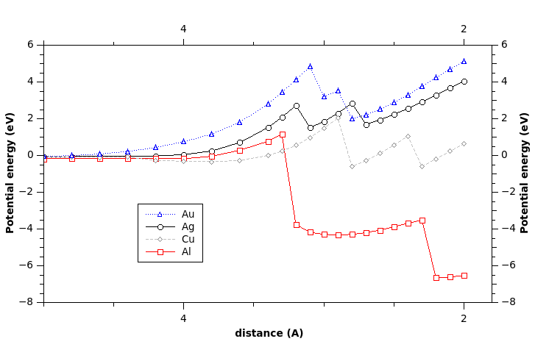
WG4 - 3rd DRD1 Collaboration Mitting, December 2024. , Geneva, Switzerland
Comparison of PES for different electrode metals

Slide 10
WG4 - 3rd DRD1 Collaboration Mitting, December 2024. , Geneva, Switzerland
Conclusion
To the best of our knowledge this is the first time of such investigation.
PES for different electrodes metal show different behavior.
DRD1 Future Plans
Longevity and aging
Construction of Potential energy surface (PES) in vicinity of boundary phase for both electrodes b y using quantum chemical calculations for eco-friendly gases
Construction of Potential energy surface (PES) in vicinity of boundary phase for both electrodes by using quantum chemical calculations for eco-friendly gases with different electrodes materials

