Slide 1


New RPC facilities
Paolo Camarri (University of Roma «Tor Vergata» and INFN Roma Tor Vergata
3rd DRD1 Collaboration Meeting

Slide 2

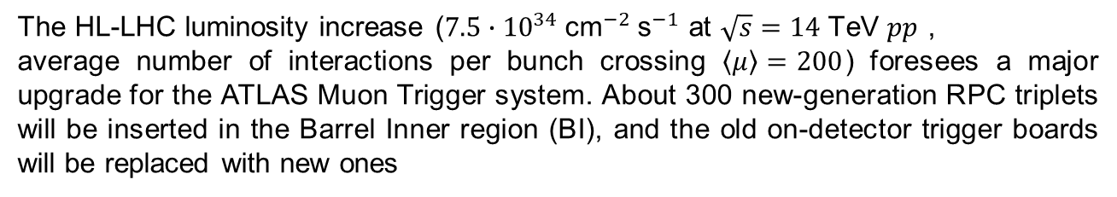
The ATLAS RPC upgrade for Phase II
The HL-LHC luminosity increase (${7.5∙10}^{34} {\text{cm}}^{−2} {\text{s}}^{−1}$ at $\sqrt{s}=14 \text{TeV} pp$ ,
average number of interactions per bunch crossing $\left\langle μ\right\rangle =200$) foresees a major upgrade for the ATLAS Muon Trigger system. About 300 new-generation RPC triplets will be inserted in the Barrel Inner region (BI), and the old on-detector trigger boards will be replaced with new ones
BO
BM
BI
Improved trigger redundancy (from 6 to 9 layers)
Increased trigger acceptance (from 78% to 92%, and to 96% by requiring BI-BO coincidence, see Table 3.2 of the Phase II Muon TDR: https://cds.cern.ch/record/2285580/files/ATLAS-TDR-026.pdf)
Improved time resolution for time-of-flight measurements: new thin-gap RPCs (1 mm) and new read-out electronics (0.4 ns for BI RPCs, from 2 ns to 1.1 ns for legacy RPCs)
BI RPC detector surface: 472 ${\text{m}}^{2}$
306 BI RPC triplets
8262 new front-end boards

Slide 3
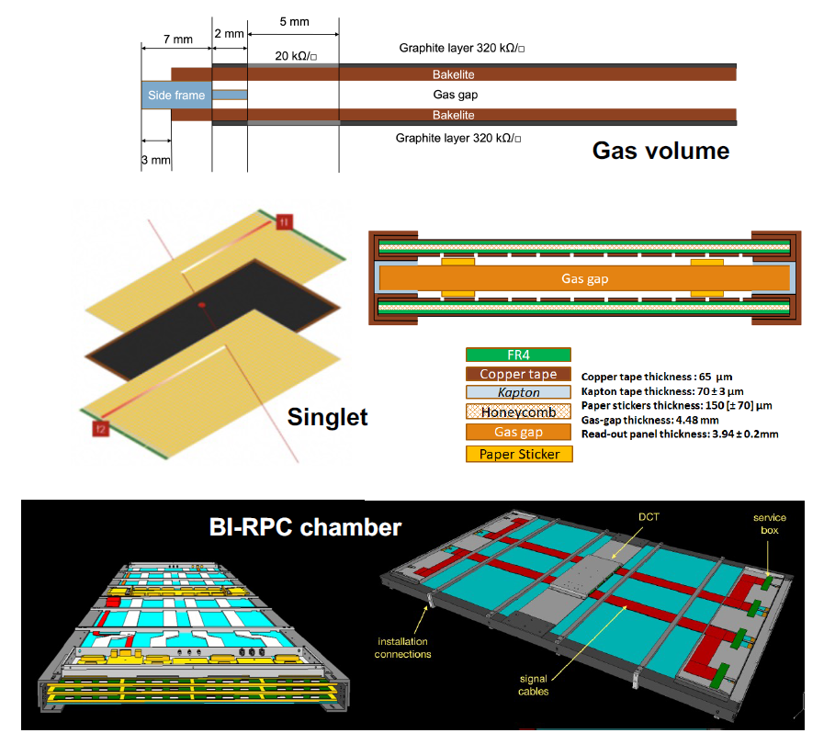
BI-RPC: gas volumes, singlets and chambers
Gas volume: a gas volume is composed of a gas gap enclosed between two High-Pressure Laminate (HPL) plates. A graphite layer is deposited on the external face of each HPL plate. Total gas-volume thickness: about 4.5 mm
Singlet: the gas volume is enclosed between two read-out panels with η-oriented strips (parallel to the long side of the chamber), forming a «singlet». The gas volume with the read-out panels is enclosed in a Faraday cage consisting of the outer faces (copper) with their edges connected by conductive copper tape. Singlet thickness: about 13 mm
BI chamber: three singlets (a «triplet») are inserted within a suitable mechanical structure to form a BI chamber. BIL-RPCs will be inserted in the Large sectors, while BIS-RPCs will be inserted in the Small sectors. BI chamber thickness: about 65 mm

Slide 4
New gas volumes
A new design for the gas volumes has been used, with several changes with respect to the ATLAS legacy RPC detectors:
Gas-gap thickness: reduced from 2 mm to 1 mm
The gas distribution was re-designed, with 4 inlets for connecting the gas pipes on the corners of the gas volume, drilled in the profile
New HV-cable connection on the the gas-volume side
The 6 mm diameter gas pipes were replaced with 3 mm diameter gas pipes
The graphite-layer resistivity was reduced from 500 kΩ/□ to 320 kΩ/□ and the footprint was redesigned to reduce the risk of possible current leaks
Electrode thickness: reduced from 1.8 mm to 1.4 mm
The production of the gas volumes in Italy has started in 2023 and is expected to end in 2025, carried out by General Tecnica Engineering (GTE).
Two new possible production centers are undergoing a qualification process: Munich (Max Planck Institute, MPI) and Hefei (University of Science and Technology of China, USTC)

Slide 5
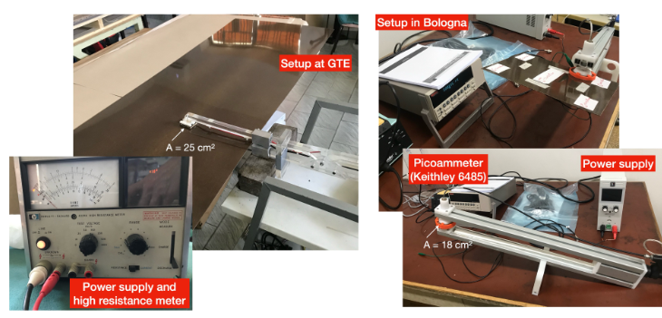
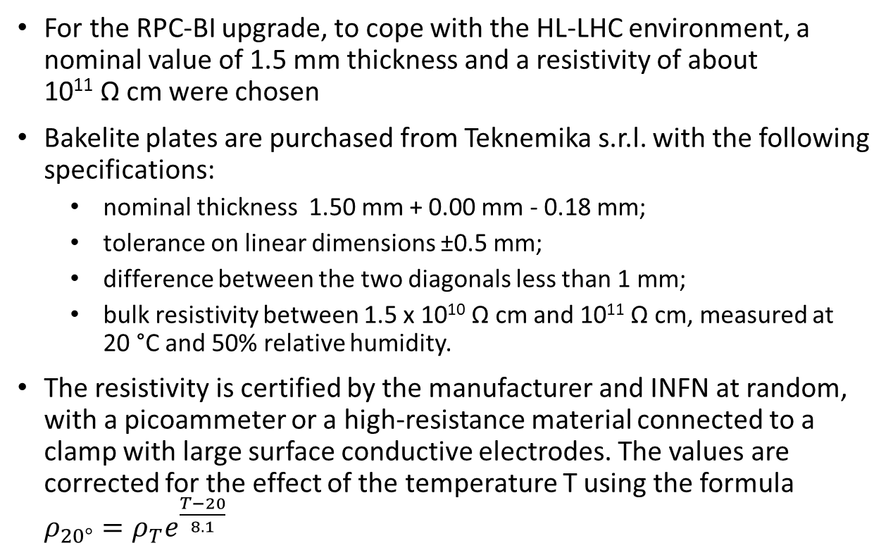
Bakelite plates (Italian facility)
By A. Pelosi
BIL680
For the RPC-BI upgrade, to cope with the HL-LHC environment, a nominal value of 1.5 mm thickness and a resistivity of about 10¹¹ Ω cm were chosen
Bakelite plates are purchased from Teknemika s.r.l. ​​with the following specifications:
  nominal thickness 1.50 mm + 0.00 mm - 0.18 mm;
  tolerance on linear dimensions ±0.5 mm;
  difference between the two diagonals less than 1 mm;
  bulk resistivity between 1.5 x 10¹⁰ Ω cm and 10¹¹ Ω cm, measured at 20 °C and 50% relative humidity.
The resistivity is certified by the manufacturer and INFN at random, with a picoammeter or a high-resistance material connected to a clamp with large surface conductive electrodes. The values ​​are corrected for the effect of the temperature T using the formula $ρ_{20°}=ρ_{T}e^{\frac{T−20}{8.1}}$

Slide 6
FAT and production of gas volumes (1/2)
By A. Pelosi
Factory Acceptance Tests (Italian facility)
Spacer gluing must resist to a traction force of 30 N;
Bakelite oiling: scratch test on dummy gas volume;
Graphite layer: to check surface resistivity (350±100 kΩ/□);
Gas tightness: p_{start}= 3 mbar, ∆p < 0.1 mbar after 3 min;
Envelope dimensions
Mechanical rigidity: injected air 1% of gas volume, after 1 min Δp > 2 mbar
Current leakage: measured with both electrodes at 7 kV on long sides. I_{leak} < 0.2 for BIS and I_{leak} < 0.3 μA for BIL
Visual inspection: absence of bubbles larger than 2-3 mm² and absence of scratches
Quality-control tests under the CERN-INFN responsibility:
  Gas-tightness test (Δp < 0.1 mbar after 3 minutes @ 3mbar overpressure);
  I-V characterization;
  Conditioning at GIF++ working at 4800 V in position D4.
BIL680

Slide 7
FAT and production of gas volumes (2/2)
By A. Pelosi
Production (Italian facility)
About 700 gas-volume are being produced over 2 years 2023-2025 by General Tecnica Engineering (GTE).
206 gas volume produced and tested of BIL A-B and BIS A-B type so far.
BIL680

Slide 8
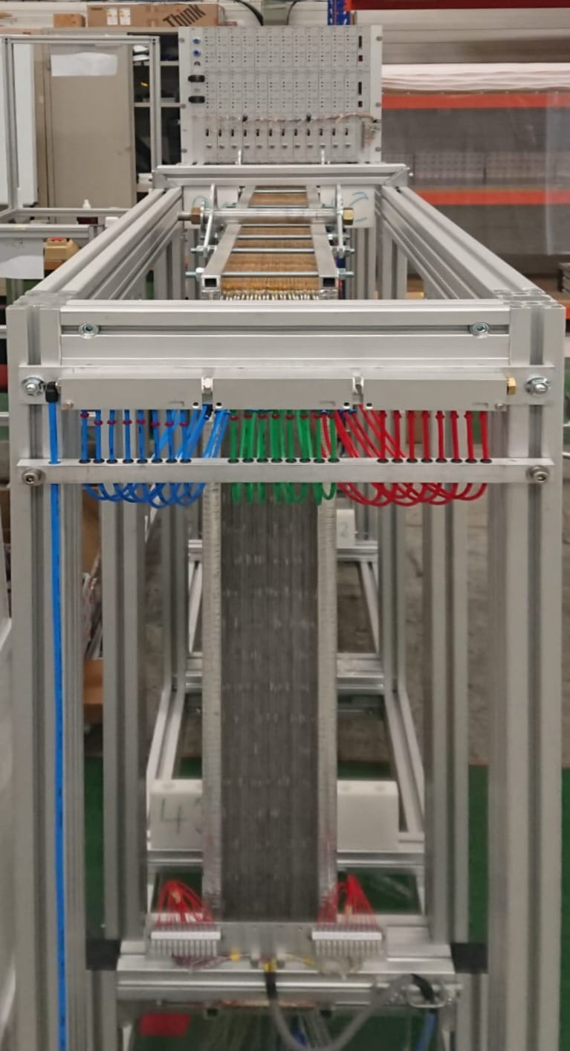
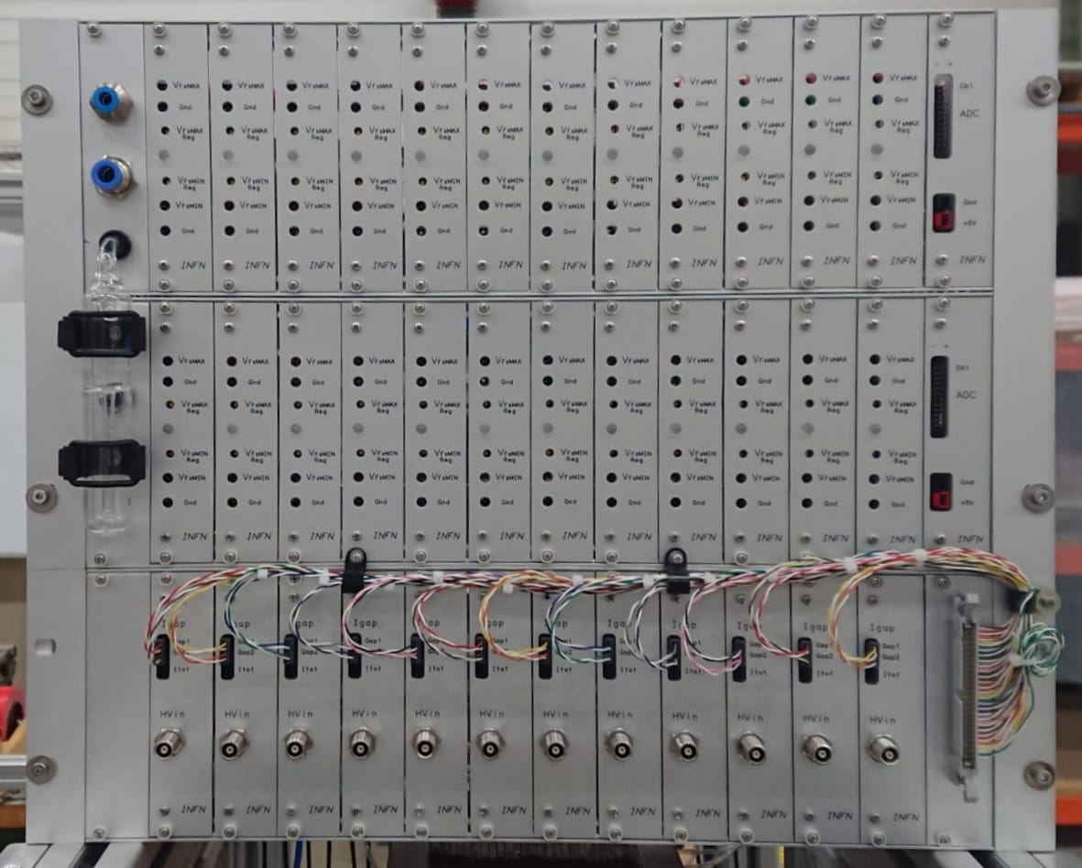
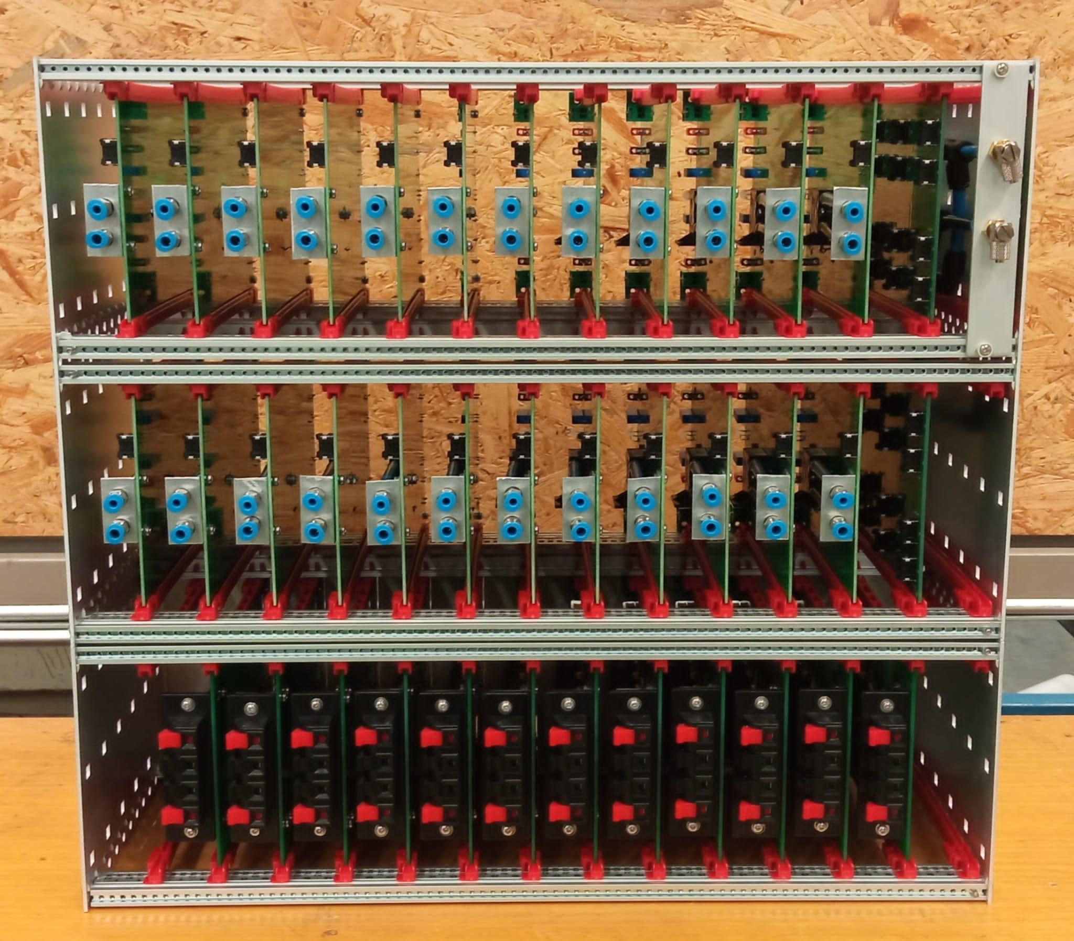
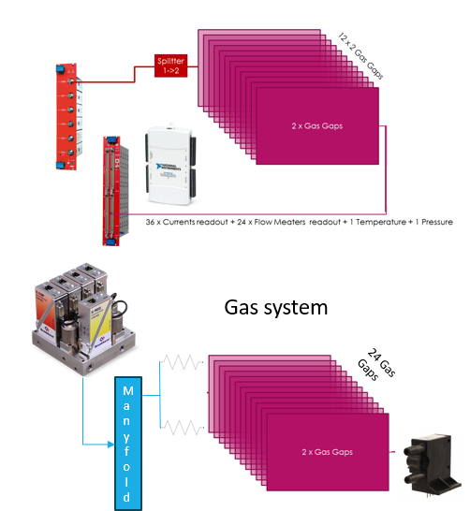
Infrastructures for gas volume certification
By A. Pelosi
Crate
Custom device for gas and high voltage distribution, and monitoring sensors to test 24 gas volumes simultaneously:
12 HV splitters with 24 100 kΩ shunt resistors;
24 gas sensor boards equipped with Omron D6FP0010A and signaling LED with two adjustable threshold;
2 mainboards providing for sensors power supply and signal concentrator.
5 crates have been produced from INFN in collaboration with Max Planck Institute and USTC
BIL680
Front

Slide 9
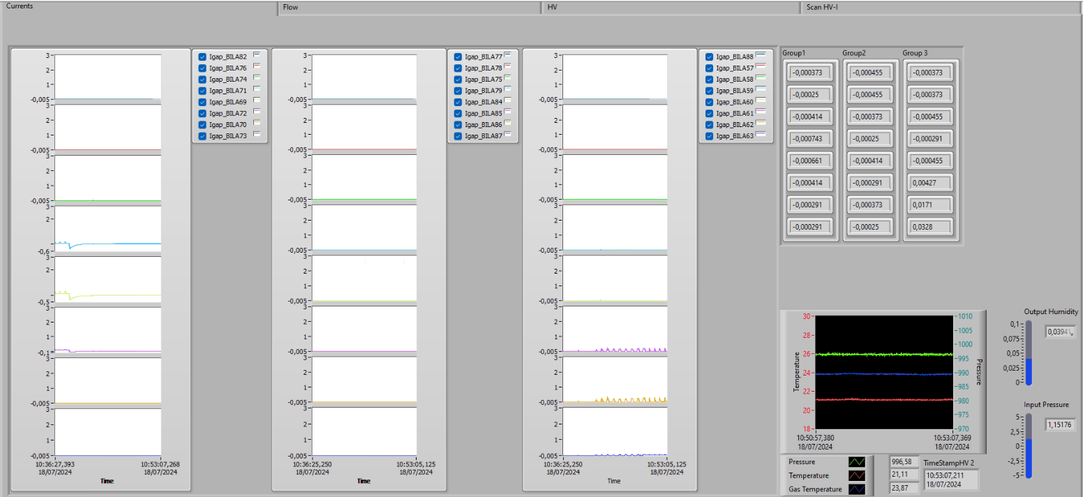
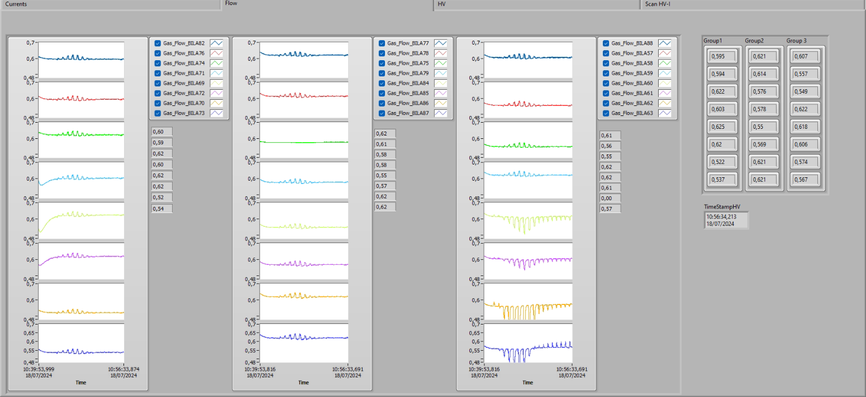
Gas-volume qualification DCS monitor
By A. Pelosi
A data control system monitors and performs I-V characterization of gas volume.
Two National Instruments USB-6218 ADC boards are used for the I-V curves (data are saved at 0.03 Hz).
Different parameters are monitored:
Gas-volume absorbed current (2 nA sensitivity)
Gas flux out of each gas volume (0.08 l/h margin error without calibration)
Gas temperature and pressure at the manifold input
Environmental parameters
BIL680
Front

Slide 10
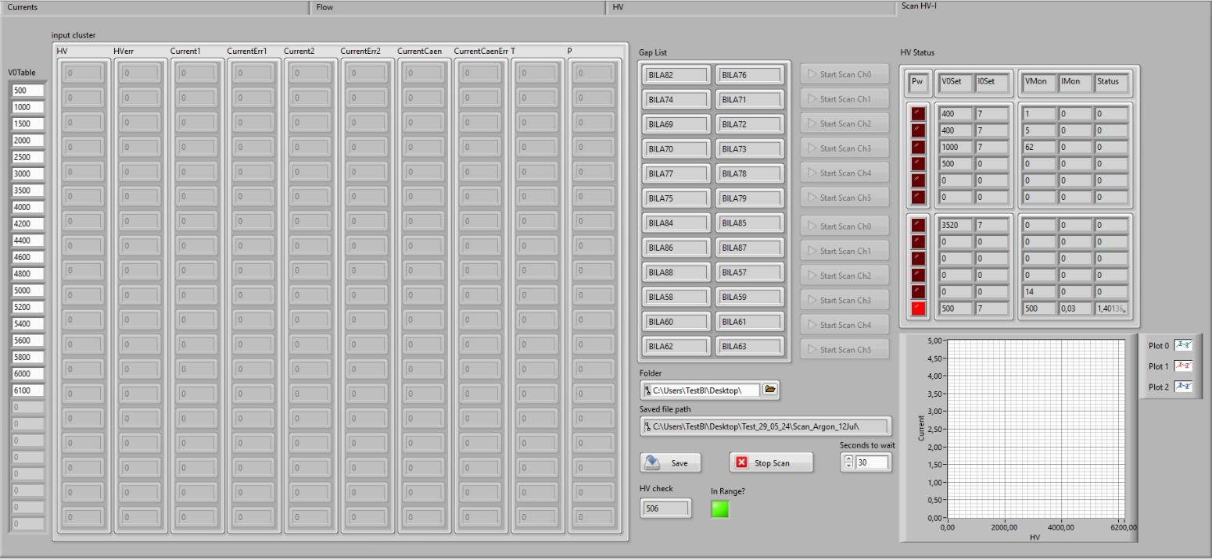
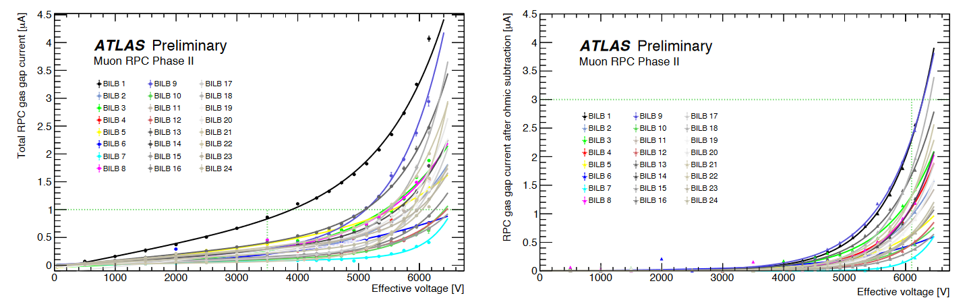
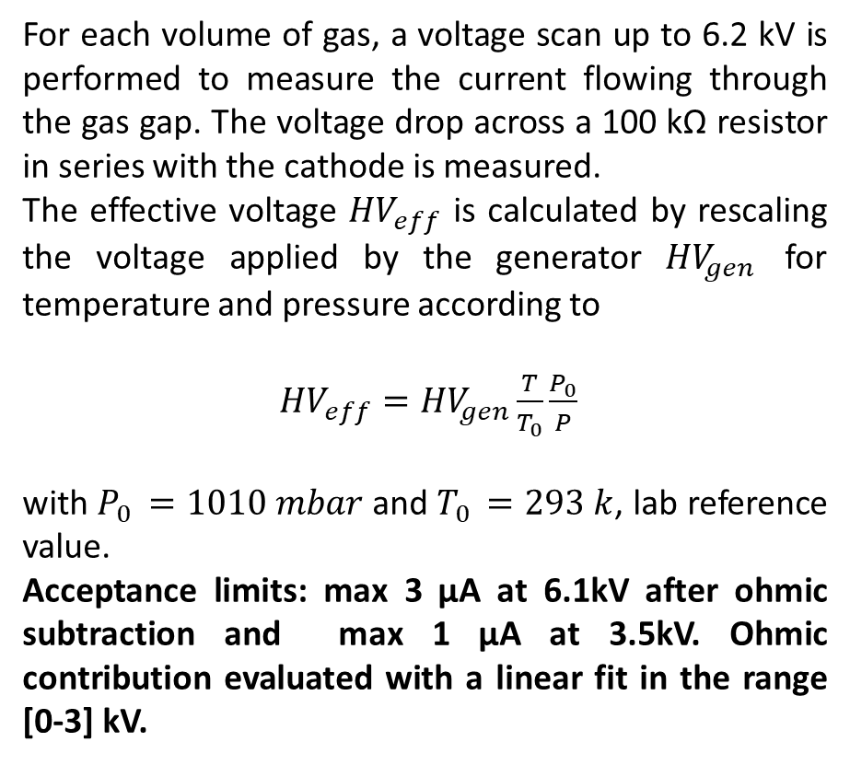
I-V Characterization
By A. Pelosi
For each volume of gas, a voltage scan up to 6.2 kV is performed to measure the current flowing through the gas gap. The voltage drop across a 100 kΩ resistor in series with the cathode is measured.
The effective voltage ${HV}_{eff}$ is calculated by rescaling the voltage applied by the generator ${HV}_{gen}$ for temperature and pressure according to
${HV}_{eff}={HV}_{gen}\frac{T}{T_{0}}\frac{P_{0}}{P}$
with $P_{0 }=1010 mbar$ and $T_{0 }=293 k$, lab reference value.
Acceptance limits: max 3 µA at 6.1kV after ohmic subtraction and max 1 µA at 3.5kV. Ohmic contribution evaluated with a linear fit in the range [0-3] kV.
BIL680
Front

Slide 11
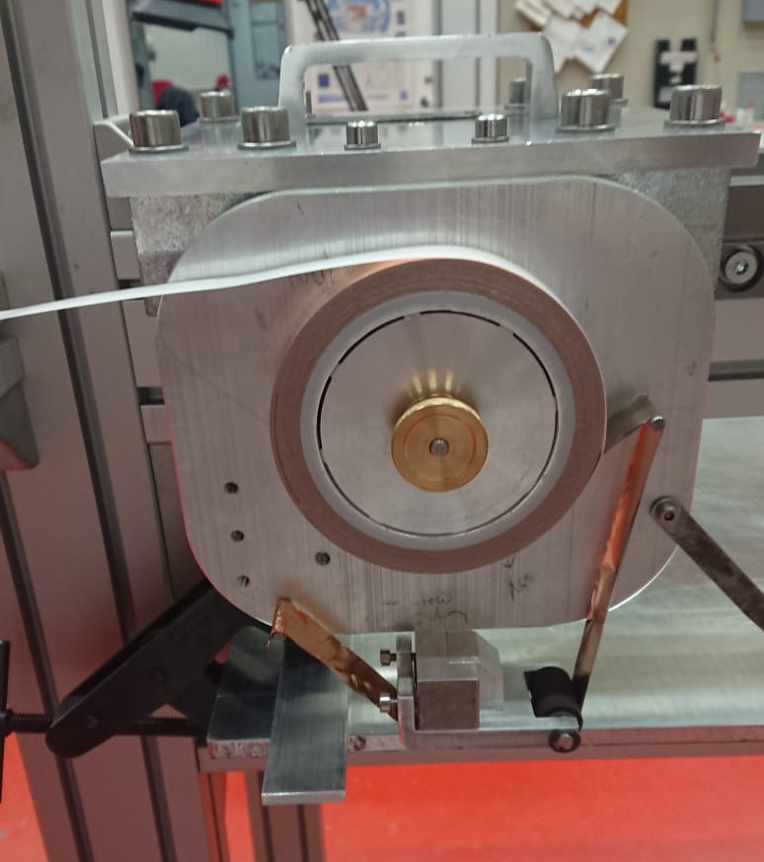
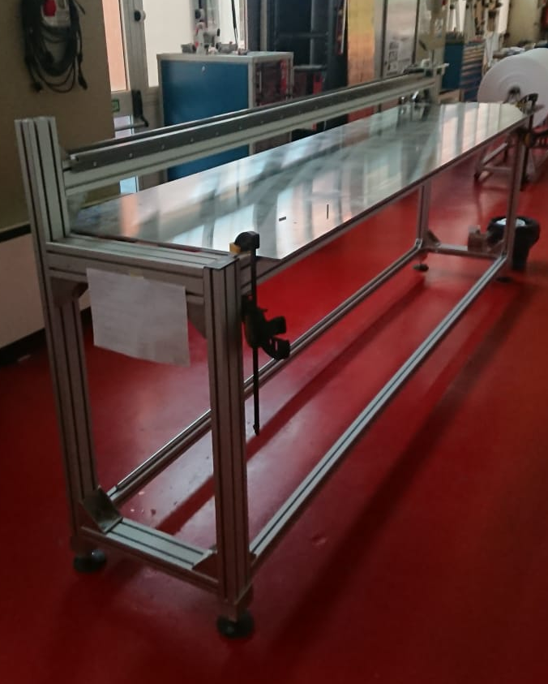
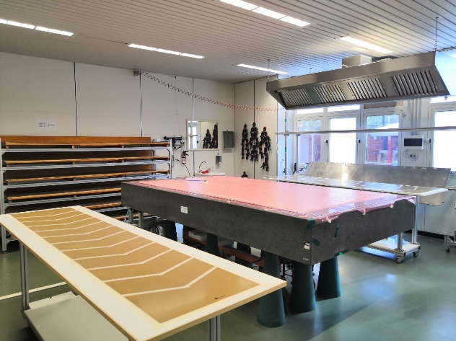
Read-out panels production
By A. Pelosi
The read-out panels consist of a 3 mm thick honeycomb aramid paper sheet sandwiched between two 0.4 mm thick halogen-free copper-coated FR4 plates. On one of the two plates the strip pattern is obtained by photoengraving process
Cosenza site is producing about 1000 readout panels using the vacuum bag technique on a granite table → maximum daily production rate = 4 BIL or 2 BOM panels.
Production chain:
Single side copper clad halogen free FR4 plates produced by MDT srl (Milan, IT);
Single side copper clad FR4 photo-incision by Eltos (Arezzo, IT)
Paper honeycomb impregnated with phenolic resin produced by IMATEC srl (Milan, IT).
Panels assembly and QC tests in dep. of Physics of UNICAL
Dedicated transport from Cosenza to CERN in batch of 90 strip panels about every 2 months.
Production status: 400 BIL strip panels corresponding to 60% of the BIL has been produced. Transferred to CERN 95%.
Front

Slide 12
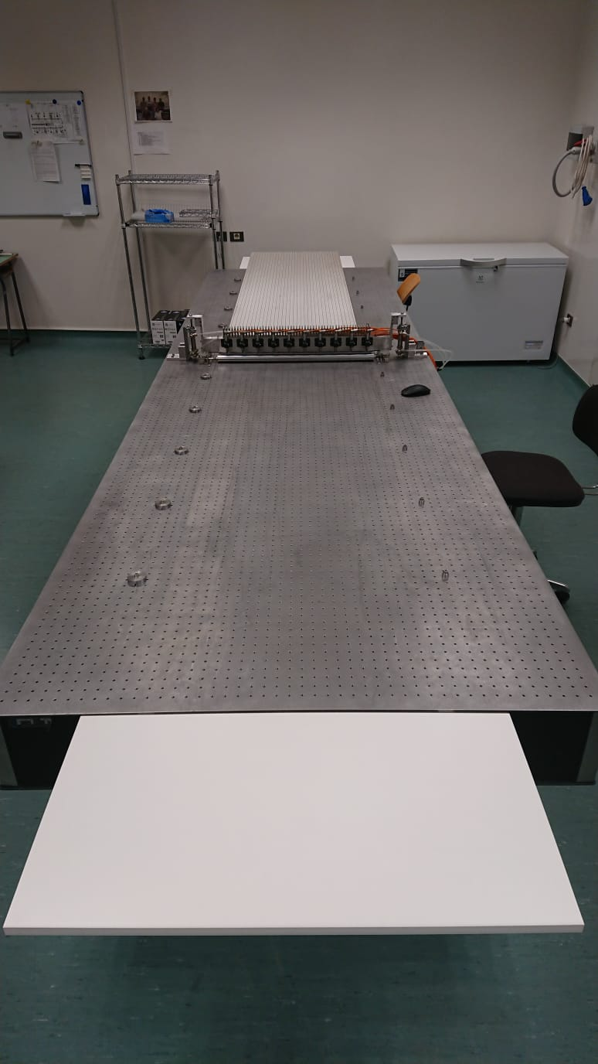
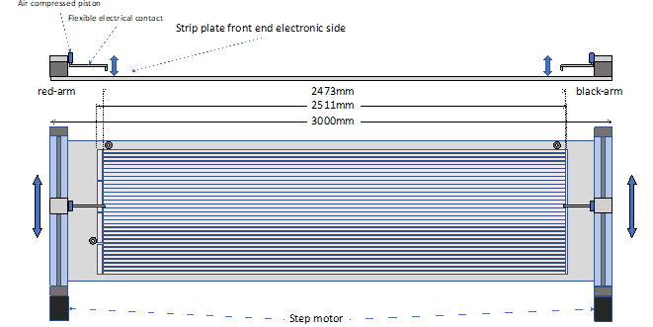
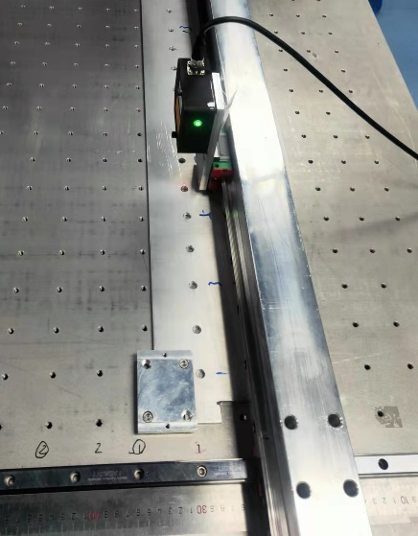
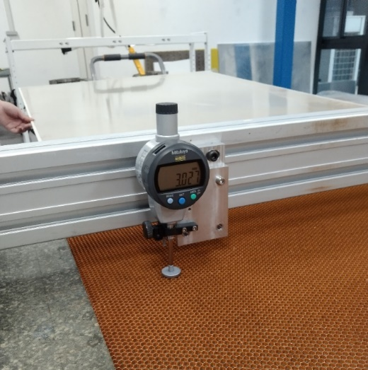
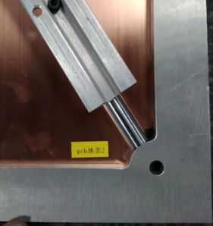
Read-out panels qualification
Produced panels and components are qualified with test on
Aramide paper thickness with gauge comparator;
FR4 single side copper clad and assembled panel thickness:
  Cosenza with gauge comparators sampling the surface on a 7 cm x 7 cm pitch matrix;
Dimensional measurements between 2 points by means of a digital micrometer which measures the deviation from stainless-steel reference bars.
Tolerance on length and width of the FR4 plates are 0.5 mm and 0.3 mm, respectively, while those of the strip
panel is 2.0 mm and 1.0 mm respectively. Tolerance on thickness is 0.16 mm.
SMD matching resistors are soldered to the ends of each strip and each decoupling wire. To verify the value of the
resistors, a 17-channel test board was developed and produced
Front

Slide 13
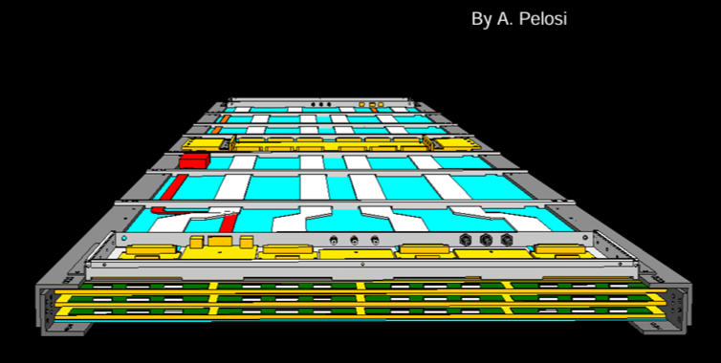
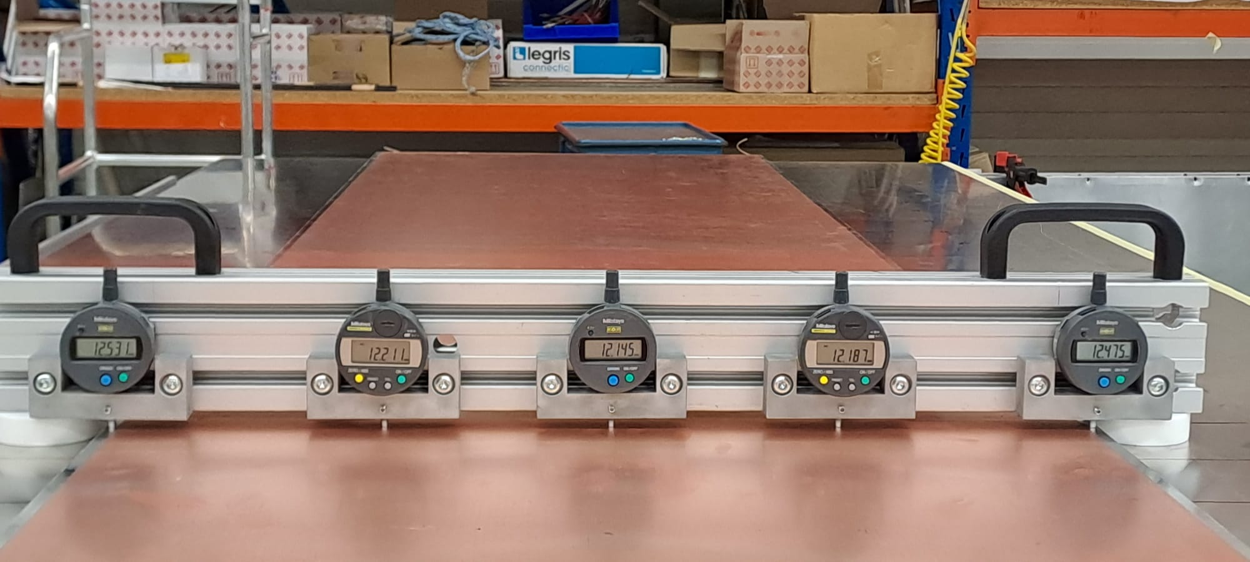
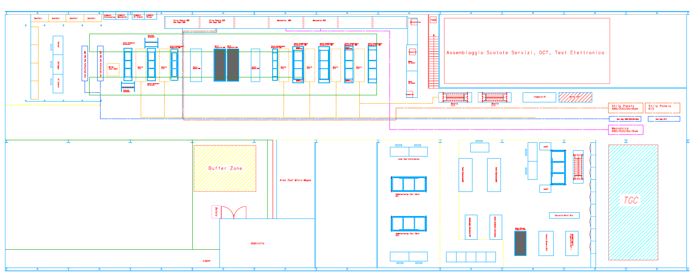
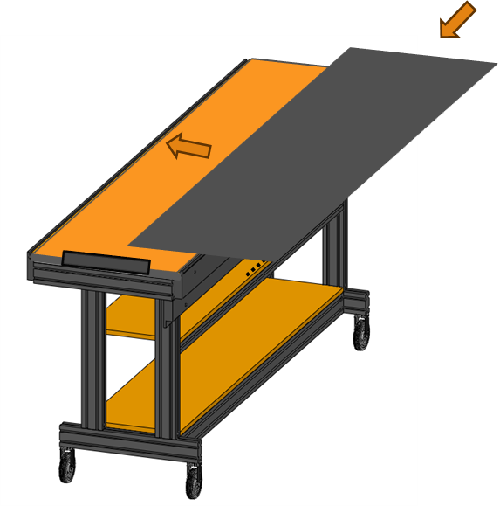
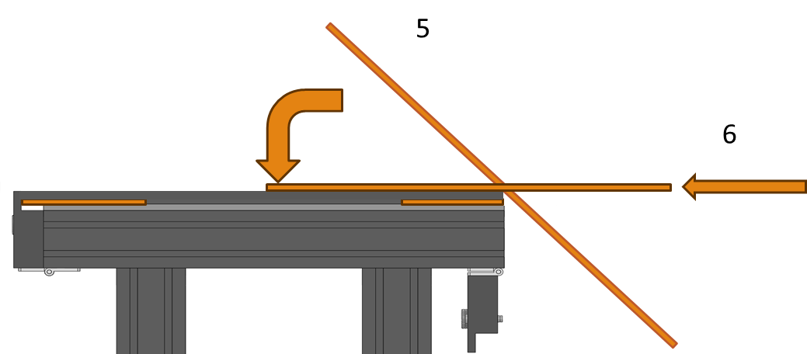
Singlets and Chambers production
RPC-BI chamber
The ATLAS RPC-BI chamber consists of 3 independent singlets sharing the same mechanics and services. Singlets and chambers will be assembled in different production sites:
INFN will assemble and tests all BIL singlets and chambers excluding 7 chambers of the sector 7 and 50% BOM/BOR in the CERN-BB5 site;
MPI will assemble and test all BIS chambers in Munich;
USTC will assemble the BIS singlets, BIS singlets are delivered to Munich for chambers production. The 7 chambers BIL sector 7 and the 8 chambers BIS1 will be assembled in CERN-BB5;
Hong Kong University: 25% BOR/BOM chambers in CERN-BB5;
Istinye University, Turkey: 25% BOR/BOM chambers in their institute.
INFN production line is ready. Tables and tools are ready for singlet assembly and test.
Singlets are tested for envelop dimension with micrometric gauge comparators and for current leak @ 7kV before FE-boards welding.
A cosmic-ray test station is working. It was designed to perform QC tests on BI singlets and chambers.
Test stands are in preparation also in other institutes for BIS certification.
Front

Slide 14
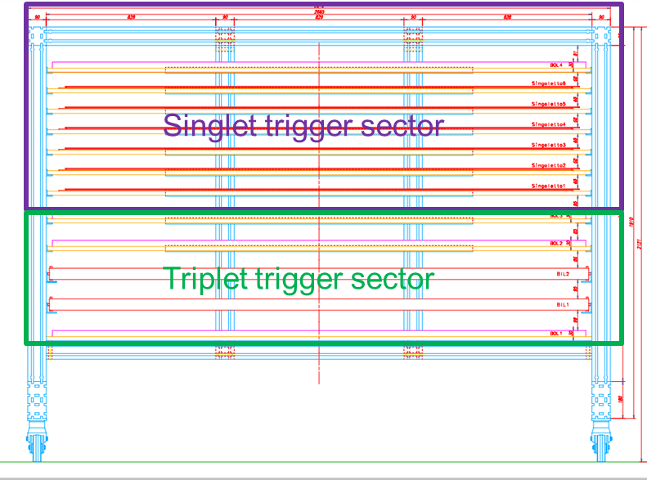
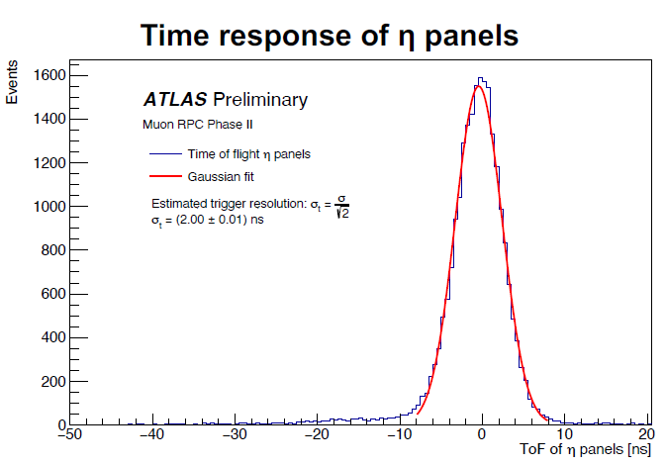
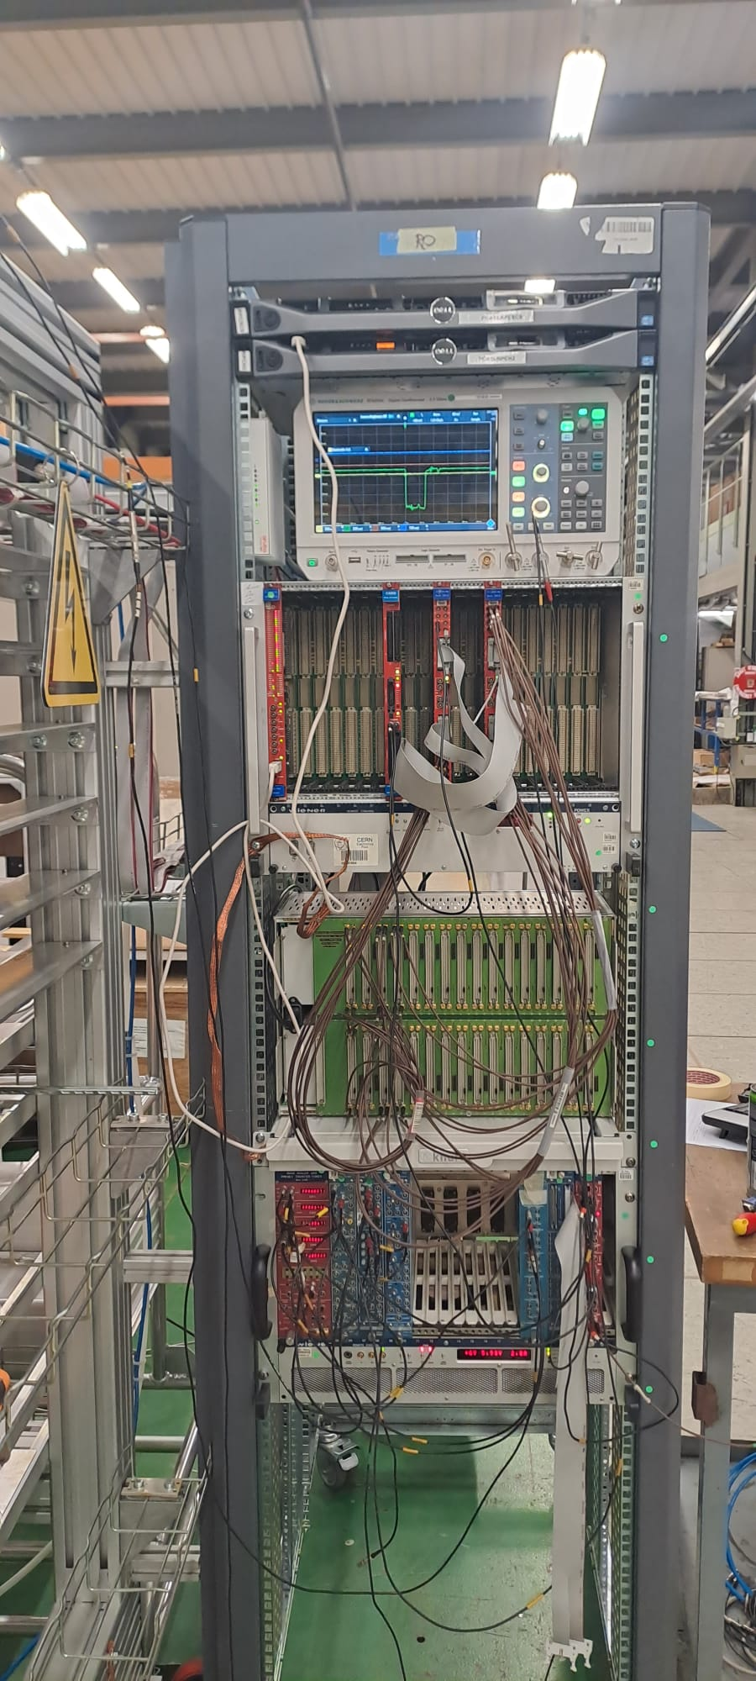
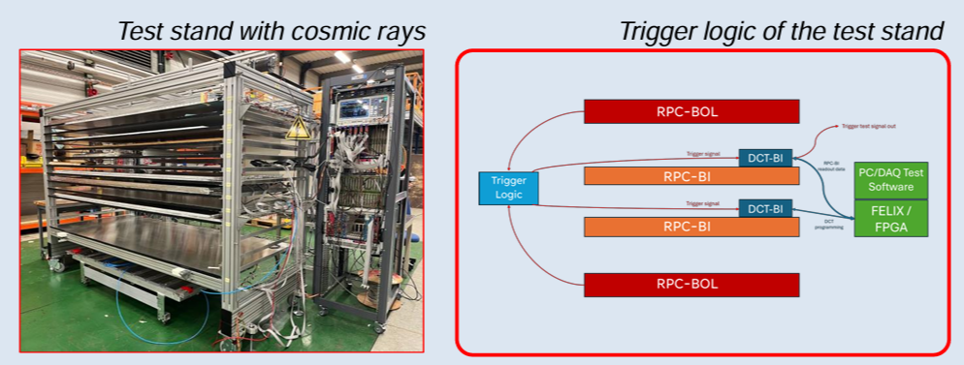
Cosmic-ray test stand
A cosmic-ray test stand has been completed on the INFN BIL production line at CERN-BB5. The infrastructure will certify all BIL-RPC singlets and chambers produced by the Italian community: 120 BIL chambers and 360 singlets, plus 40 BOR/BOM chambers.
Trigger detectors are 4 x BOL-RPC Atlas Singlets (2 mm RPC detectors) with active area of 2430 x 1010 mm² each and a total of 448 Channels. This solution allows to perform integration tests of new BMBO-DCT on ATLAS Legacy detectors.
Trigger chambers read-out system is based on TTL translator with NIM fast-OR for each FE board (Granularity 1x1 Chs → 8 x 8 Chs )
Trigger Logic: implemented on FPGA CAEN V2495 Altera Cyclon V Translator/Logic Unit
All trigger tyles have been installed and acquired. Trigger has been implemented on 2/4 Trigger tiles and tested for timing performance, a firmware using all trigger tyles for RoIs definition under development.
Front

Slide 15
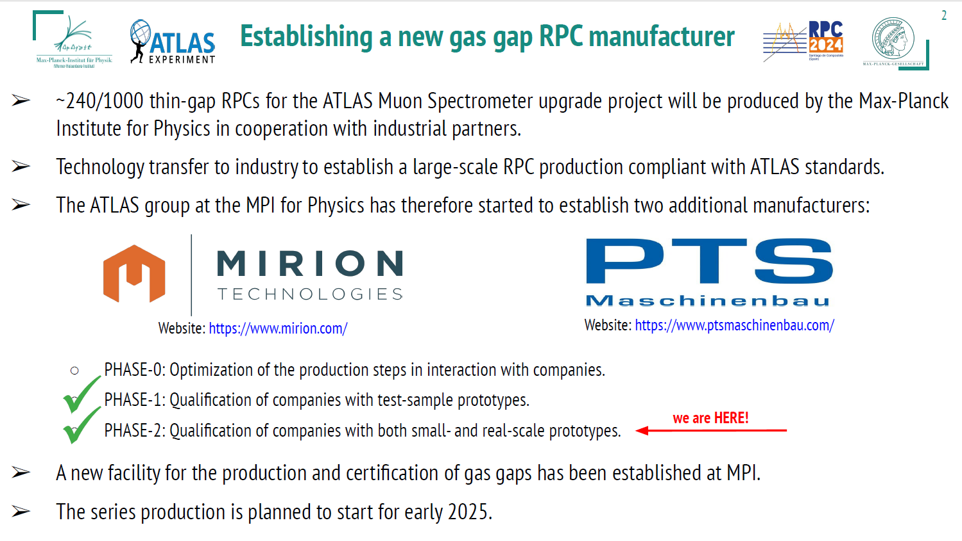

Slide 16
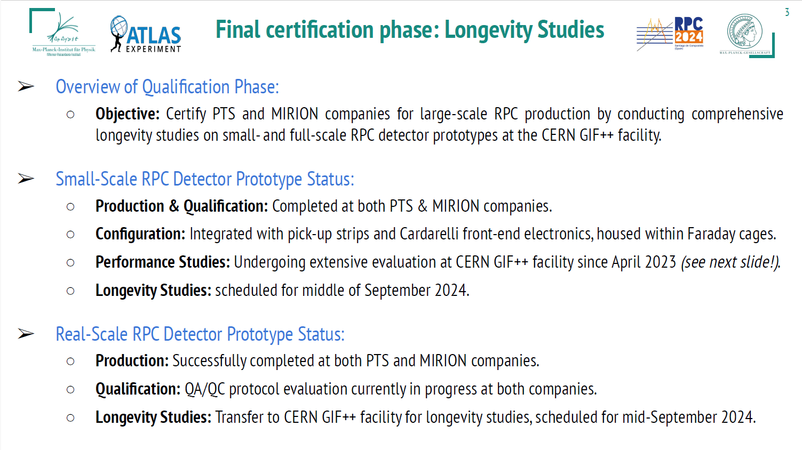

Slide 17
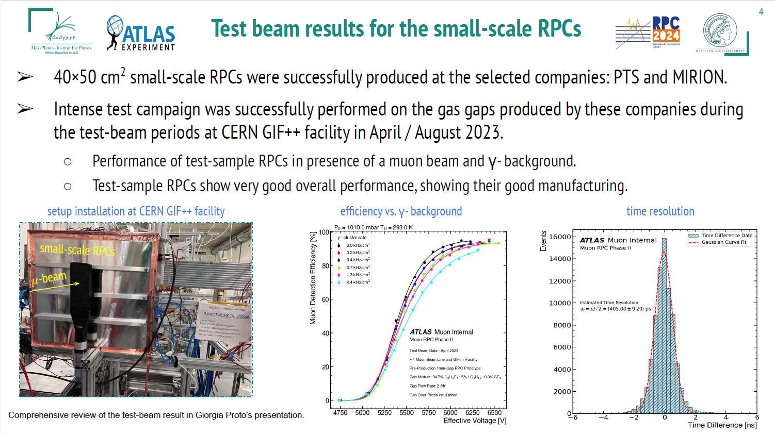

Slide 18
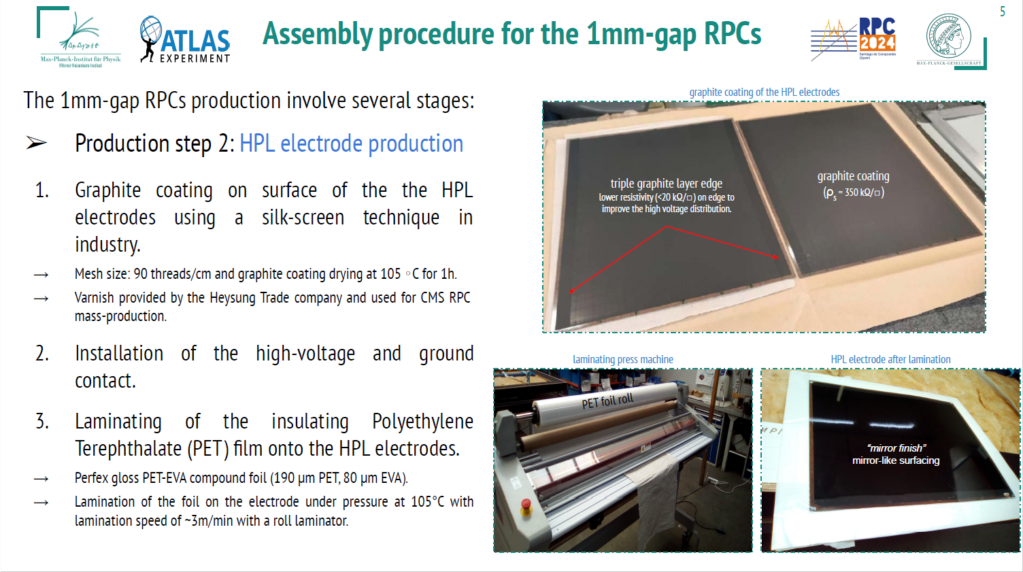

Slide 19
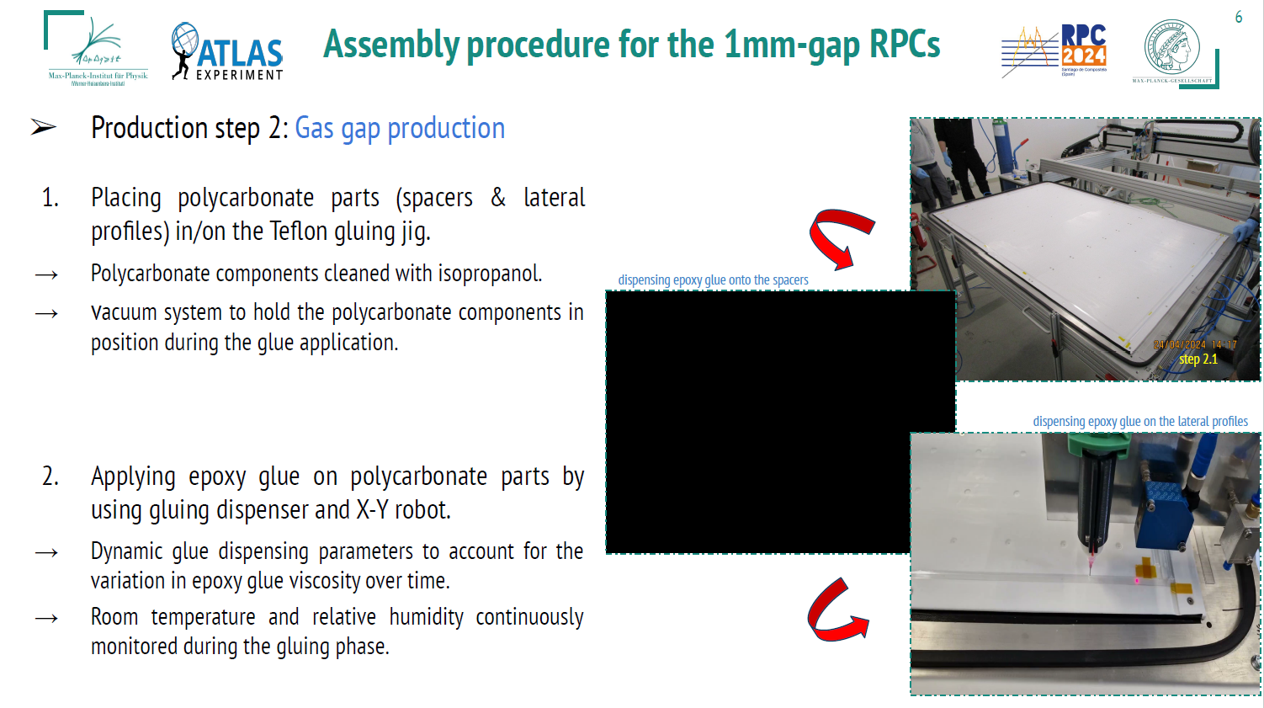

Slide 20
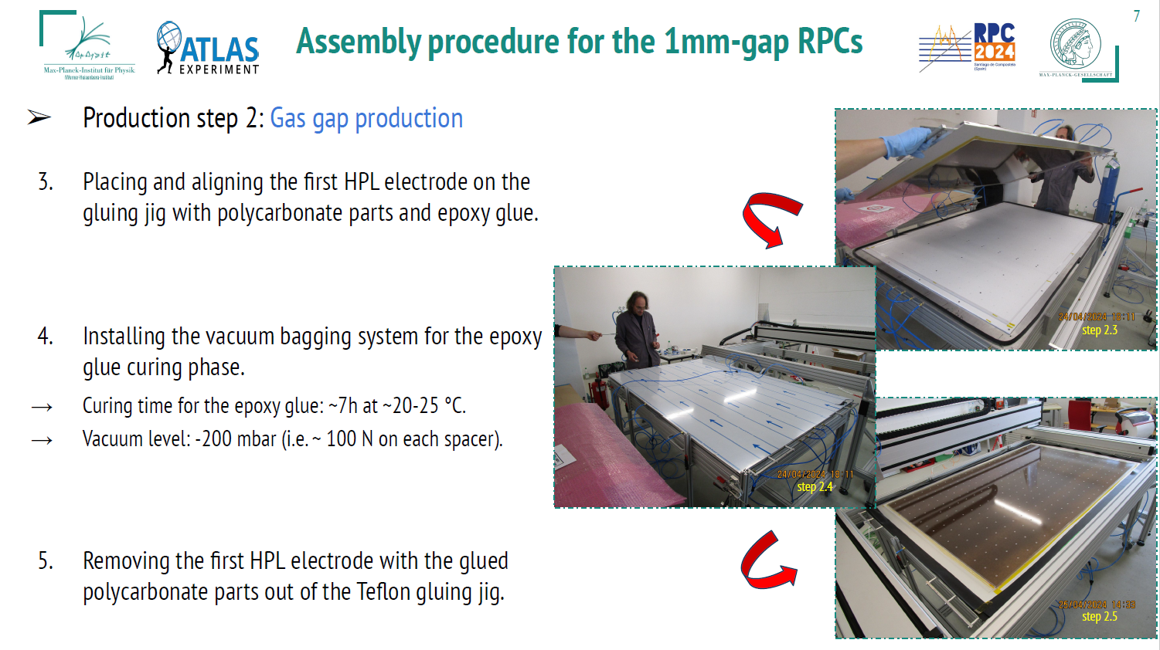

Slide 21
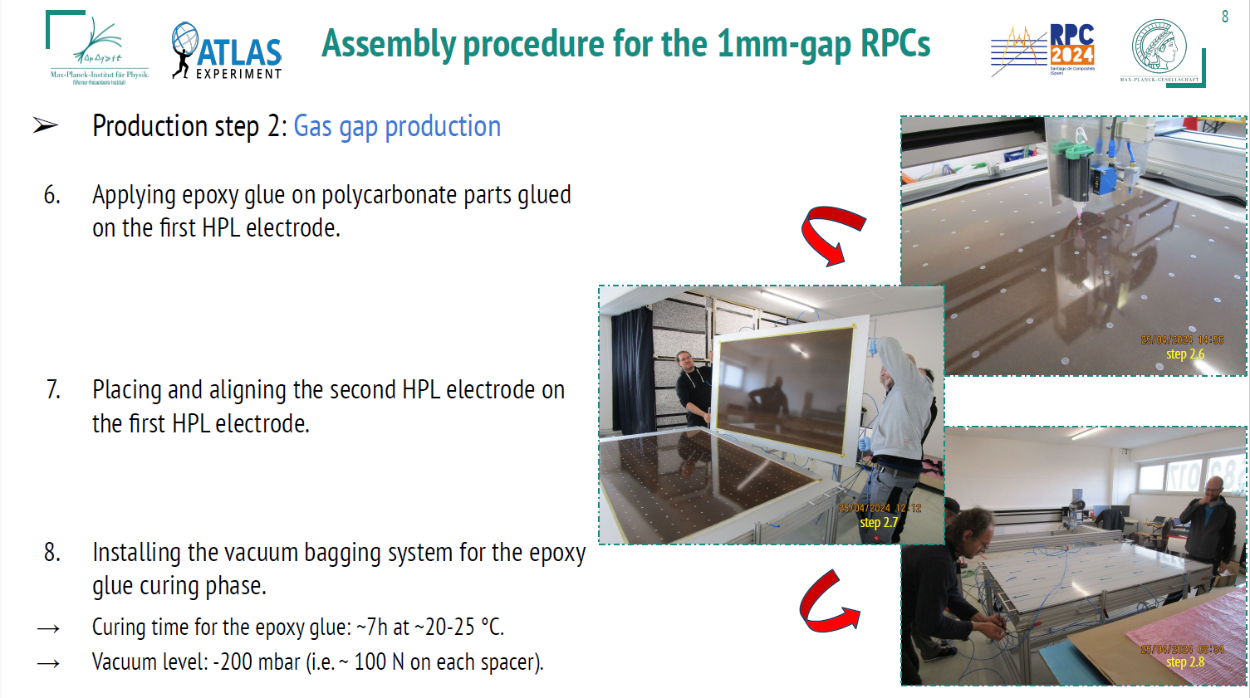

Slide 22
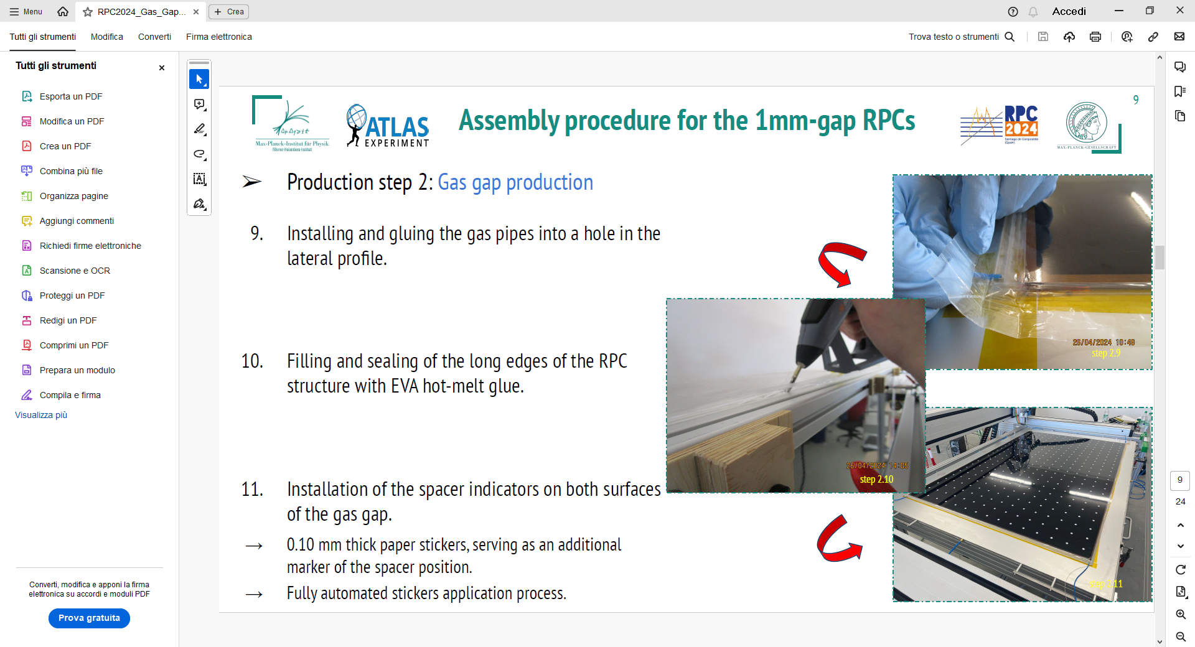

Slide 24
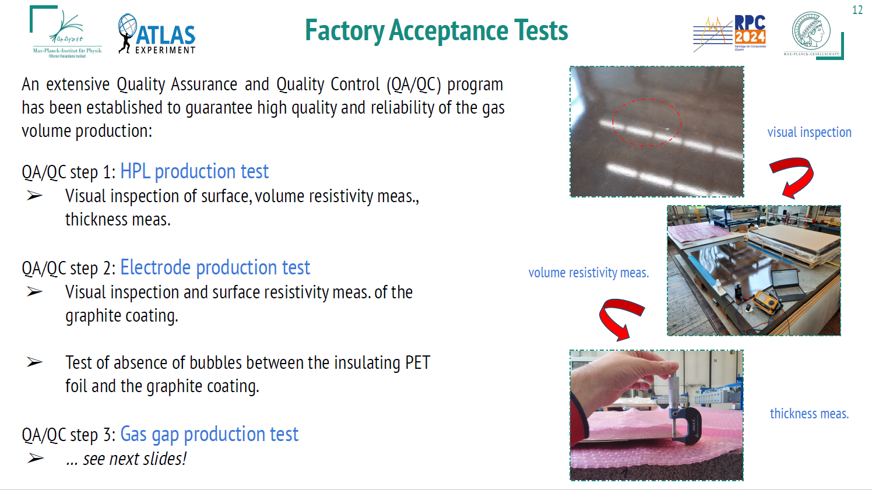

Slide 25
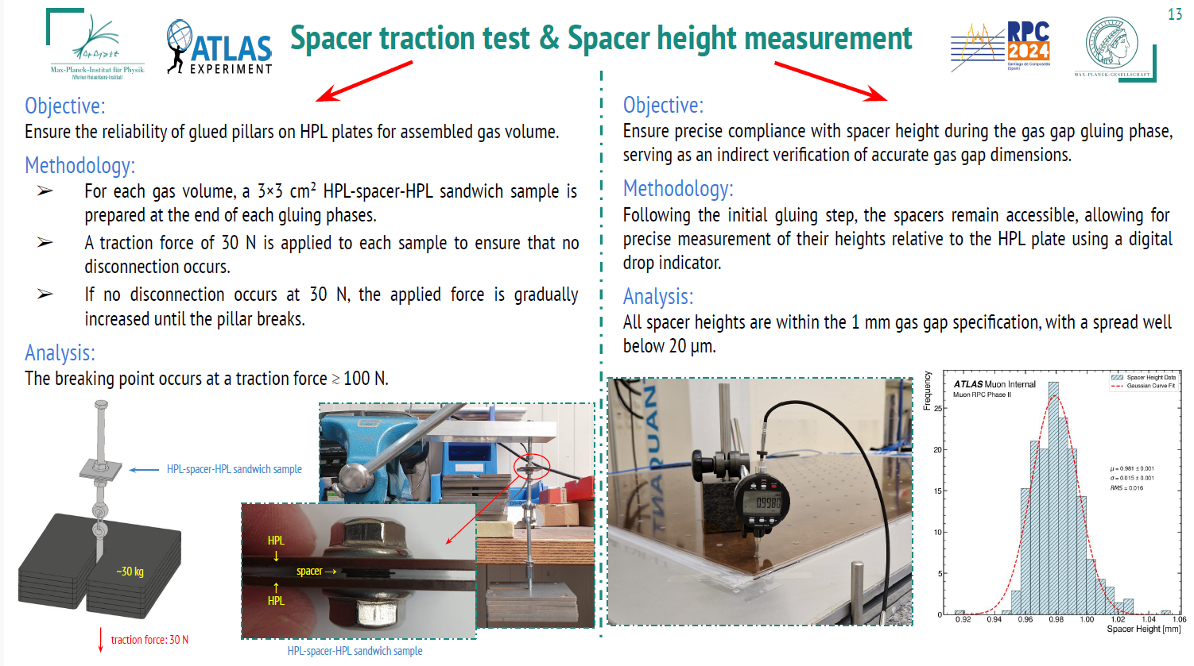

Slide 26
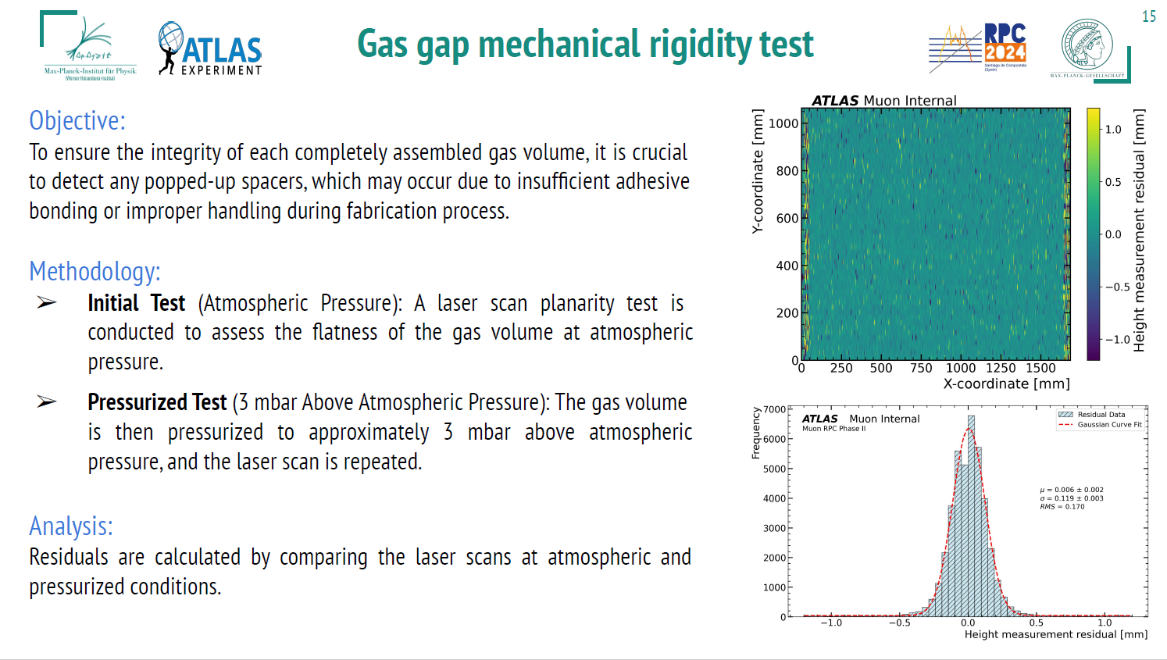

Slide 27
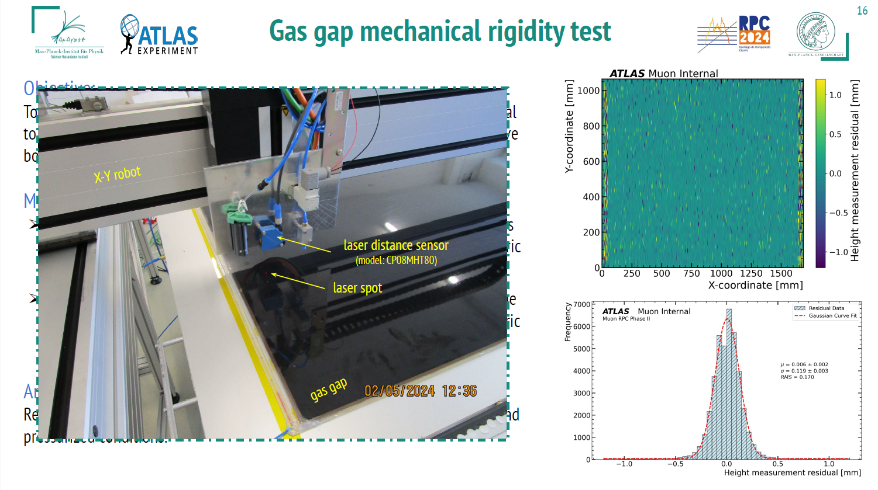

Slide 28
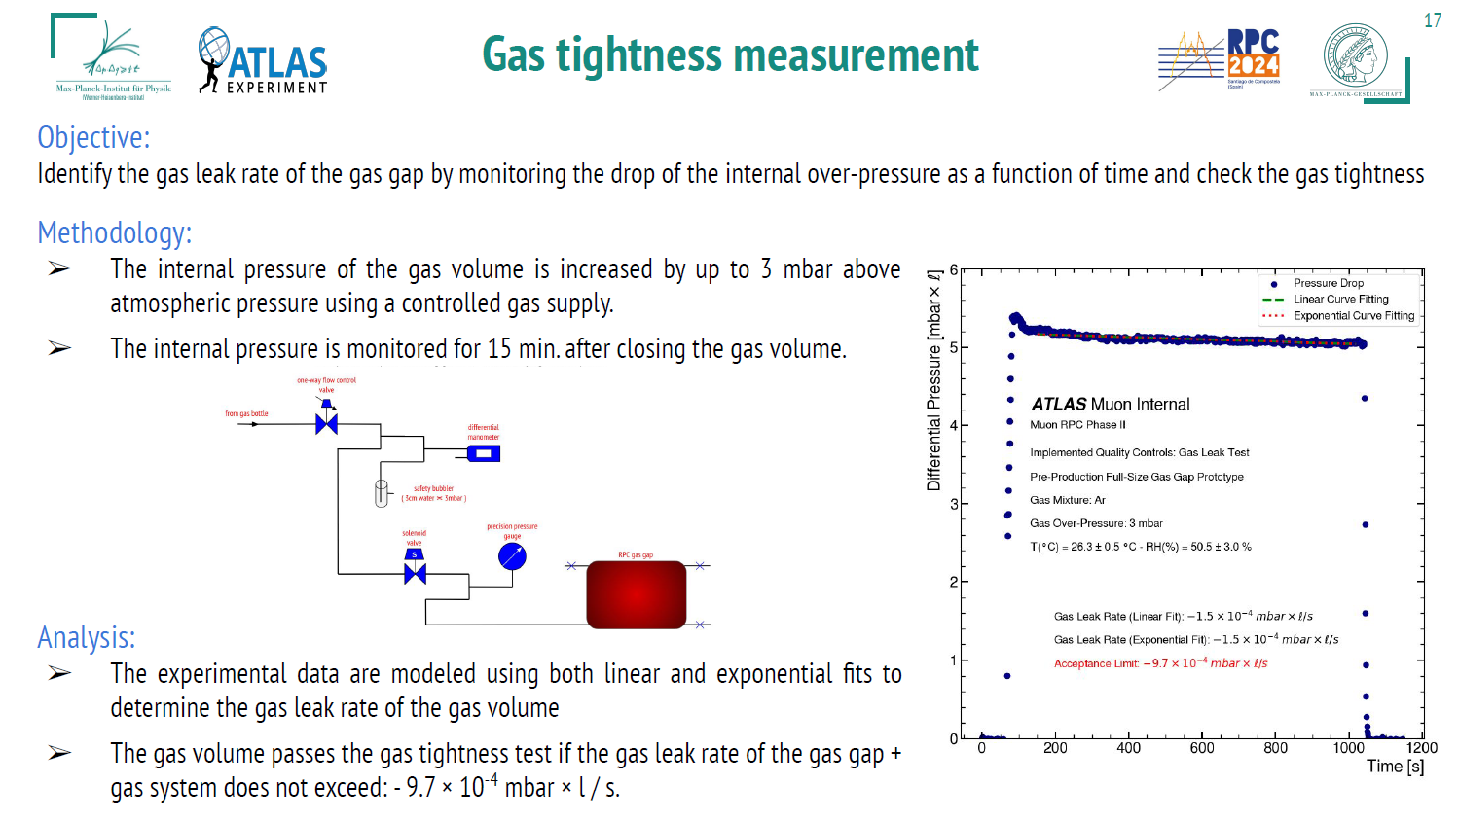

Slide 29
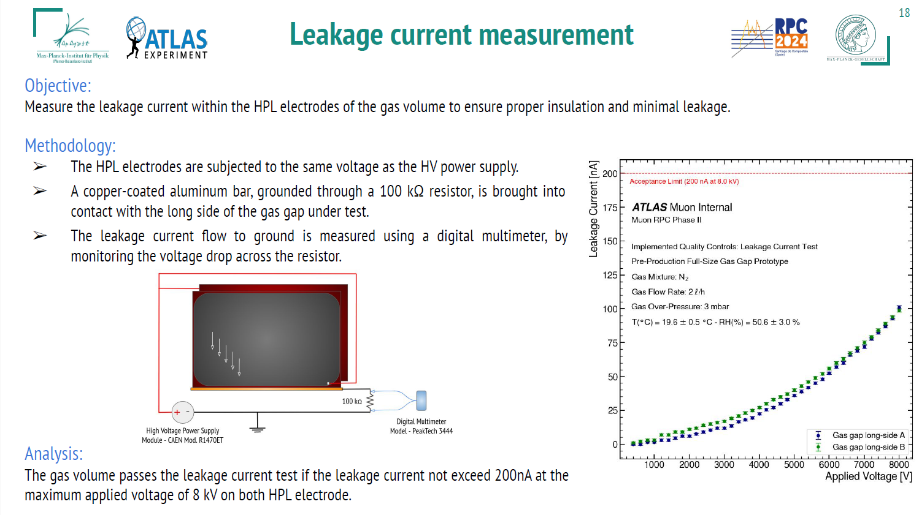

Slide 30
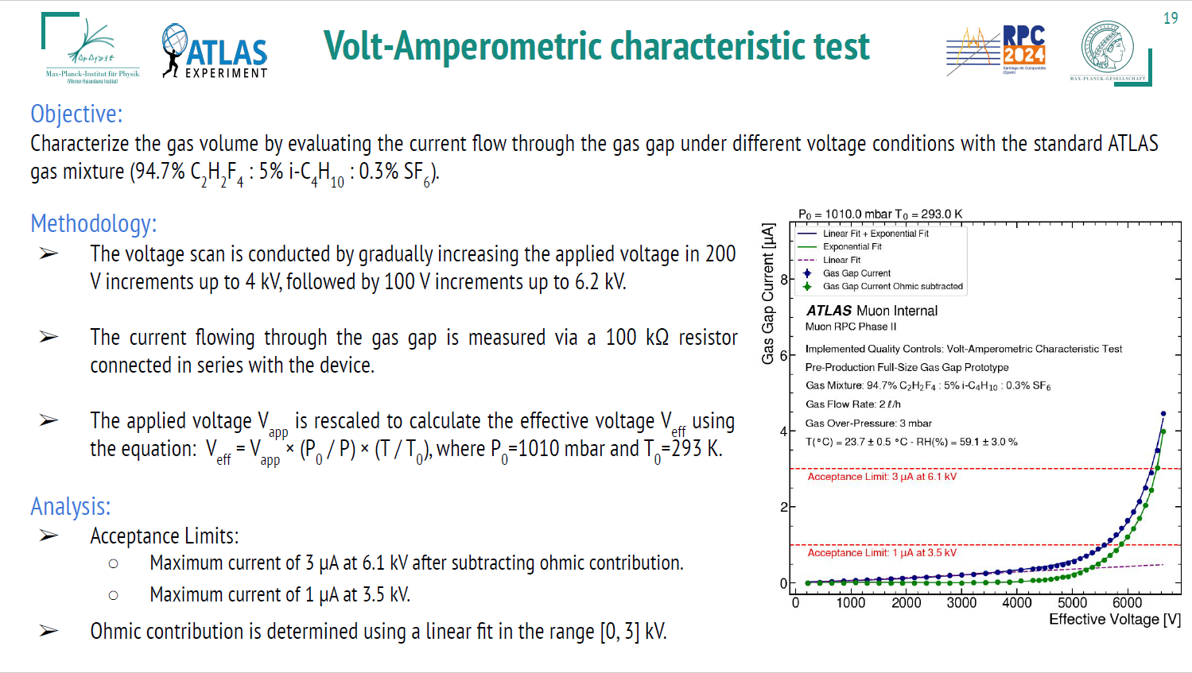

Slide 31
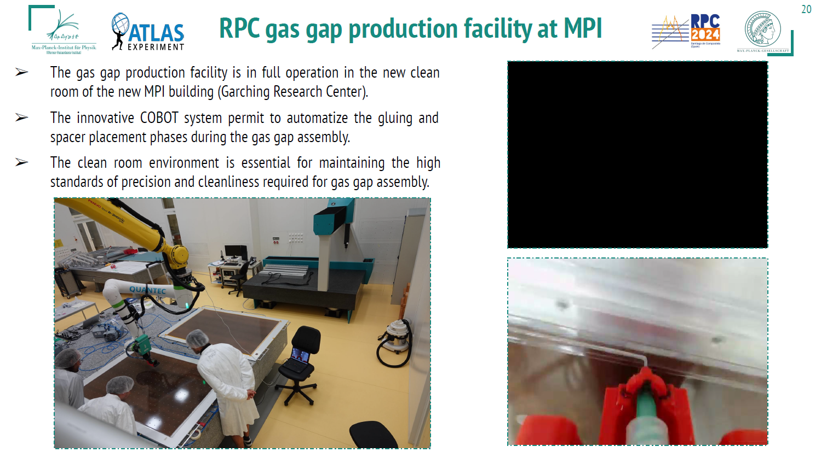

Slide 32
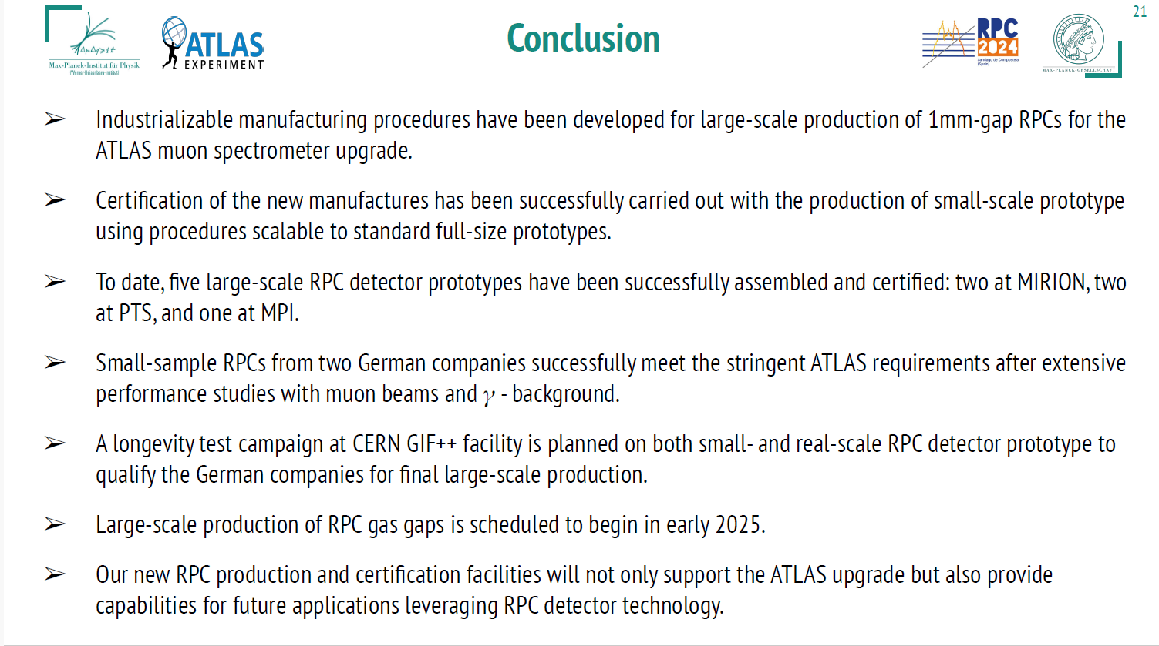

Slide 33
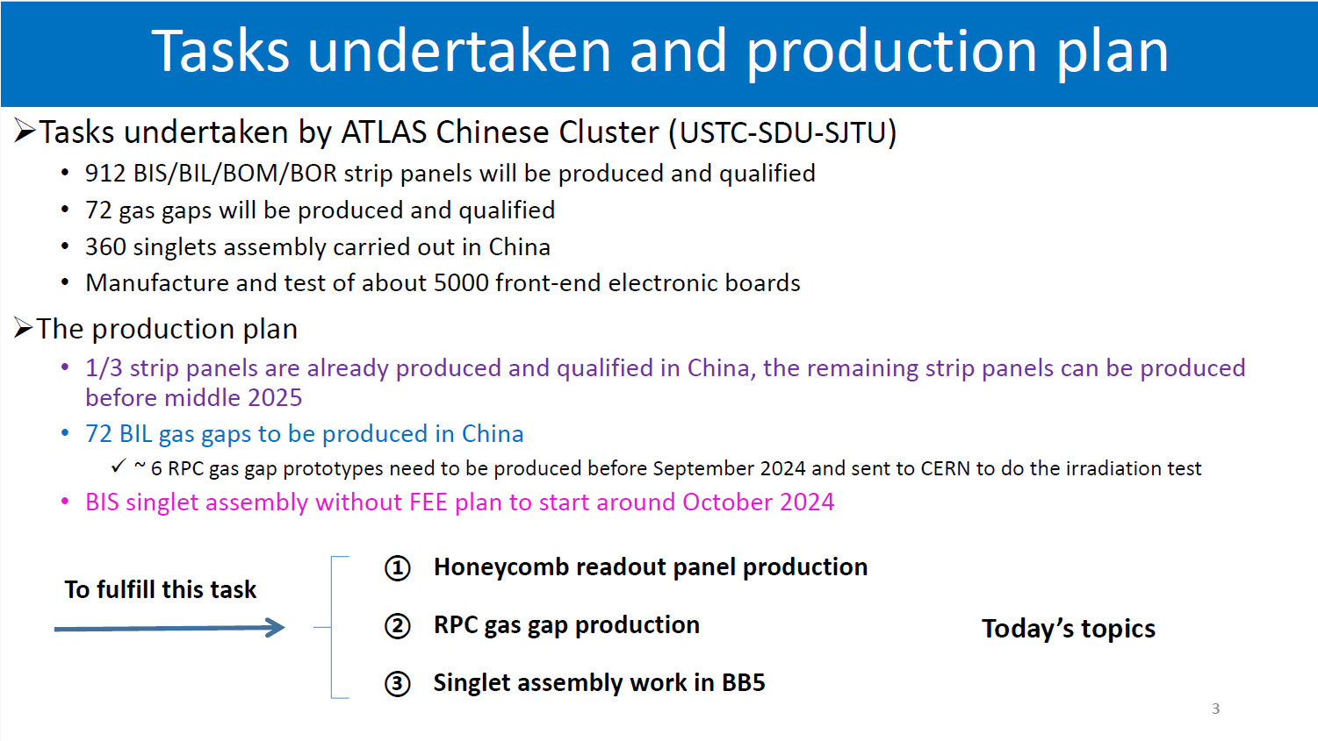

Slide 34
Summary
General Tecnica Engineering firm (Italy) is constructing a big fraction of the BI RPC gas volumes for the Phase-II upgrade of the ATLAS muon-trigger system
General Tecnica Engineering (former General Tecnica) is the first firm which has been contructing RPC gas volumes since the RPC technology was invented about 43 years ago
Qualification is under way for firms which can construct RPC gas volumes in Germany and China after careful technology transfer
Over 400 BOR-BOM RPC gas volumes are foreseen to be constructed in Germany
Very good results reported by the MPI of Munchën (Germany)
Expecting further developments from the USTC research group (China) very soon
About 50 BIL RPC gas volumes are foreseen to be constructed in China.

