Slide 1

Dario Stocco
Riccardo Farinelli

Slide 2
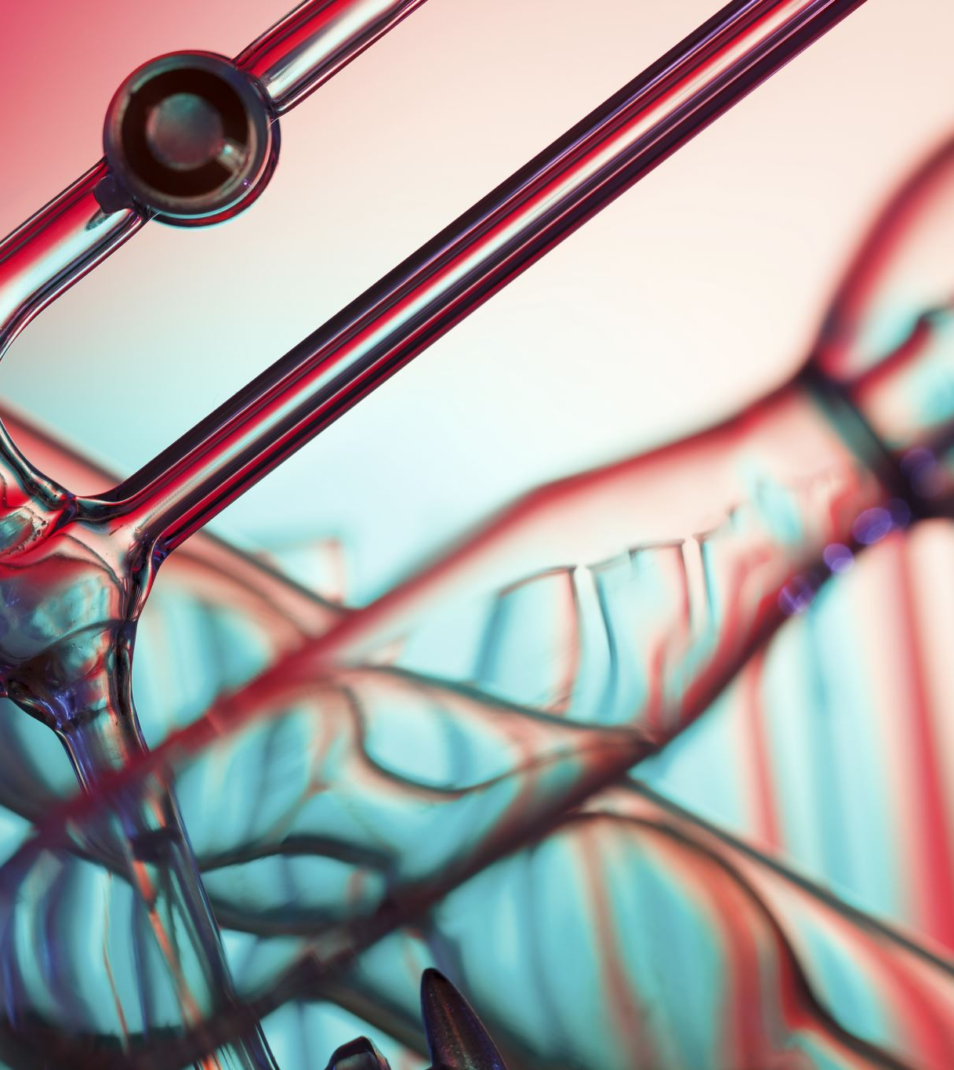
Introduction to simulations
Simulations play a crucial role in the design, optimization, and analysis of devices and physical phenomena across multiple disciplines.
Design and Configuration
Physical Prediction
Validation of Experimental Results
In the case of particle detectors, they enable the prediction and study of interactions between particles and materials without relying solely on expensive or challenging experiments.

Slide 3
Garfield++
Toolkit designed specifically to model and analyze the behavior of ionization detectors, both gaseous and semiconductor-based. it is widely used in particle physics research to study complex processes, from the initial particle interaction to the final detected signal.
Core Applications
Event Detection:
  Simulation of electron avalanches to study efficiency and time resolution in detectors like RPCs (Resistive Plate Chambers).
  Optimization of design and operating parameters for Micromegas and other detectors.
Visualization and Analysis:
  Graphical representation of geometries, electric fields, and particle trajectories.
  Detailed analysis of induced signal shapes and timing.
Integration with Additional Tools:
  Integration with Magboltz for gas transport calculations.
  Use of Python and ROOT for extended analysis capabilities.

Slide 4
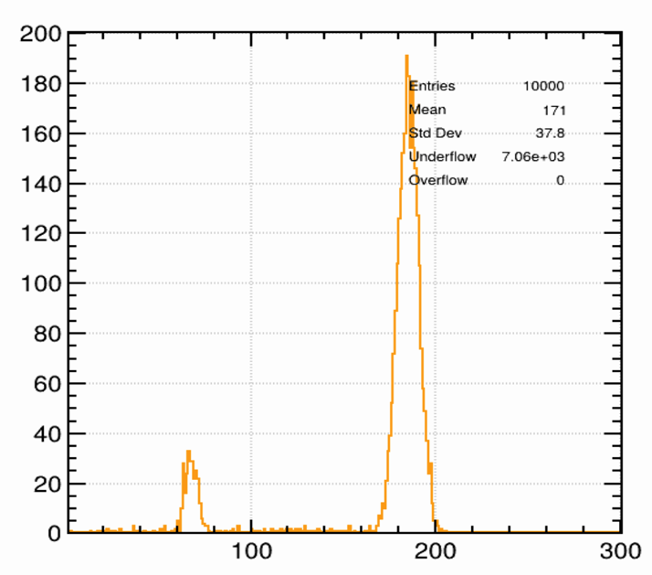
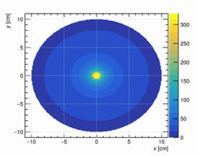
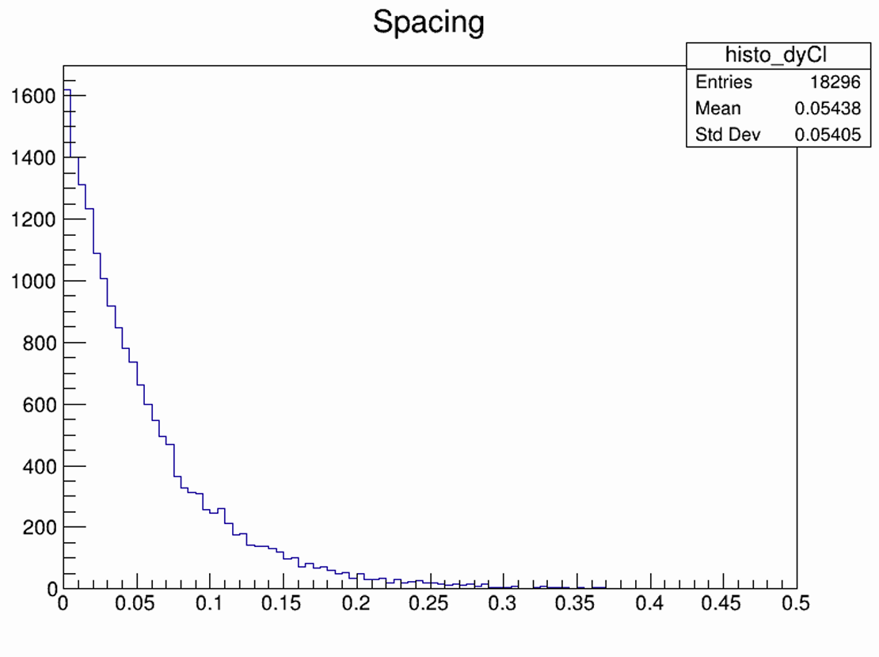
Garfield++ Basics
Electric Field Configurations
  Simulations of parallel plate chambers, wire chambers, and GEMs.
  Gas setup (Argon/CO2) and electric field visualization.
  Generation of potential and electric field line plots
Gas Ionization
  Study of primary ionization caused by charged particles.
  Simulation of spatial distributions of primary and secondary clusters.
  Statistical analysis of deposited energy and generated electrons.
X-Ray Conversion
  Simulation of photon absorption from Fe55 in a gas volume.
  Analysis of primary electrons produced and comparison with experimental data.
Electron Drift and Diffusion
  Investigation of electron drift velocity and diffusion in different gases.
  Comparison of deterministic (Runge-Kutta) and probabilistic methods.

Slide 5
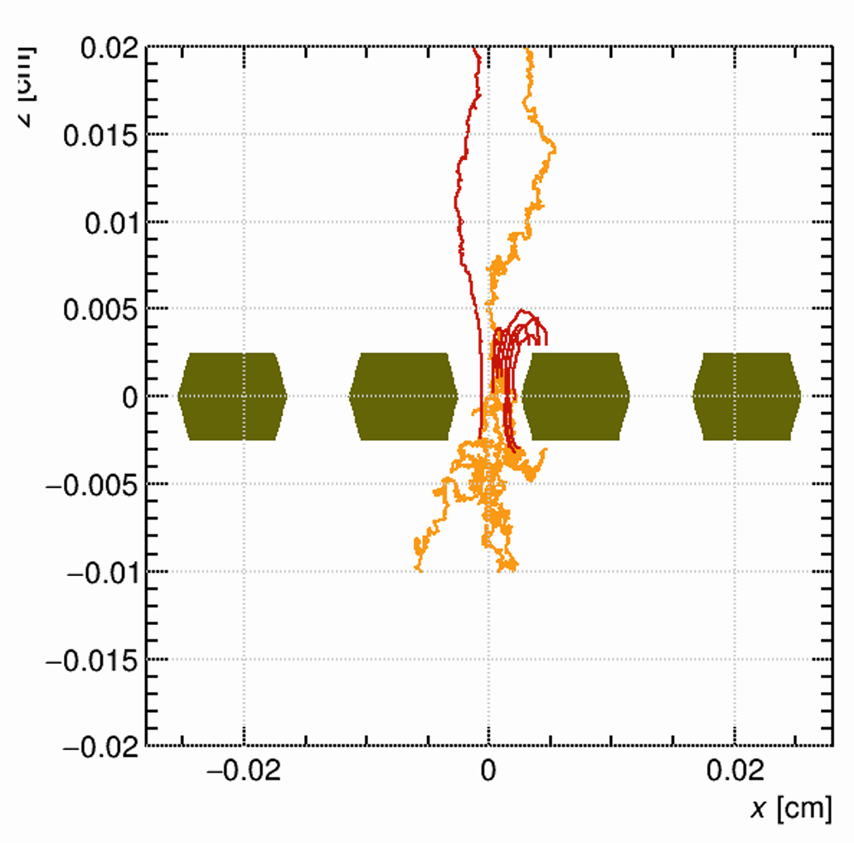
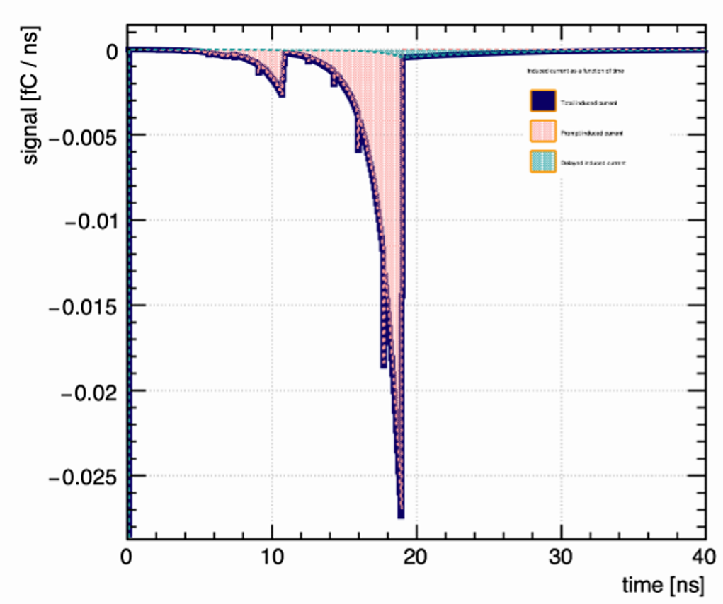
Advanced Processes and Results
Electron and Ion Drift
  Simulation of particle drift in an ionization chamber.
  Analysis of how gas properties affect diffusion.
Electron Amplification
  Simulation of electron avalanches in a resistive plate chamber (RPC).
  Evaluation of detector gain as a function of applied voltage.
Signal Induction
  Study of current induction on a readout electrode by moving electrons.
  Simulation of electronic response using a transfer function.

Slide 6
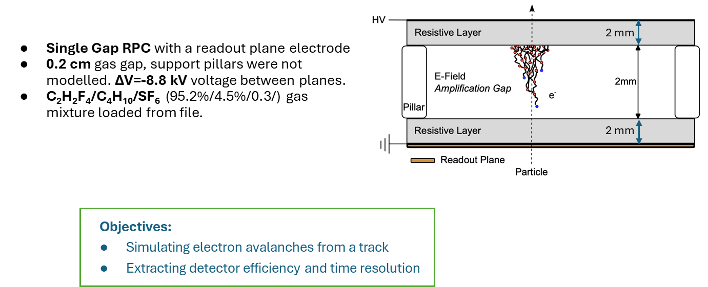


Slide 7
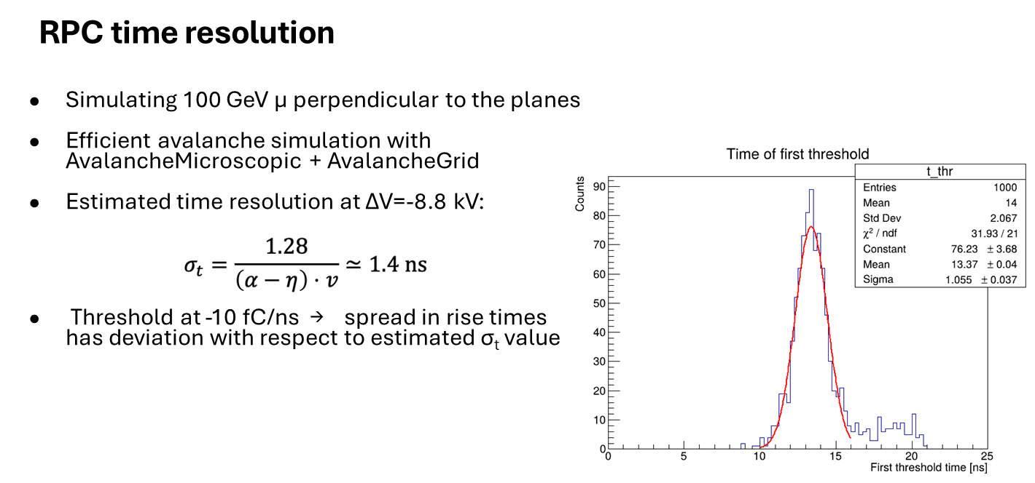

Slide 8
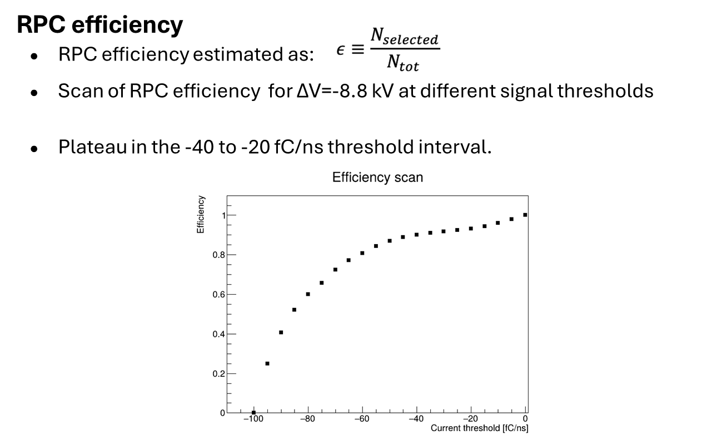

Slide 9
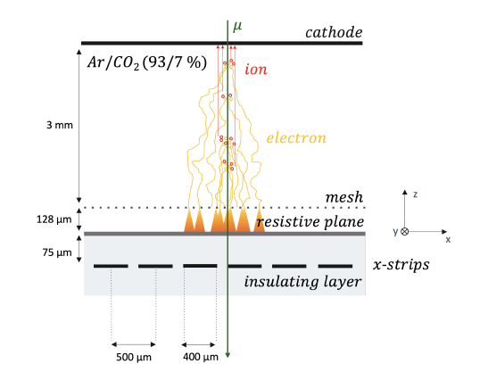
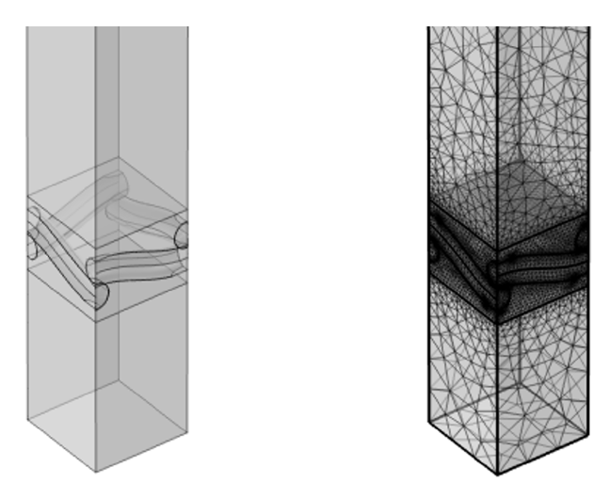
Micromegas: setup
Schematic representation of a Micromegas with an infinite expanding resistive plane and strip readout
Woven mesh
Electric field calculation using the Finite Element Method (COMSOL)

Slide 10
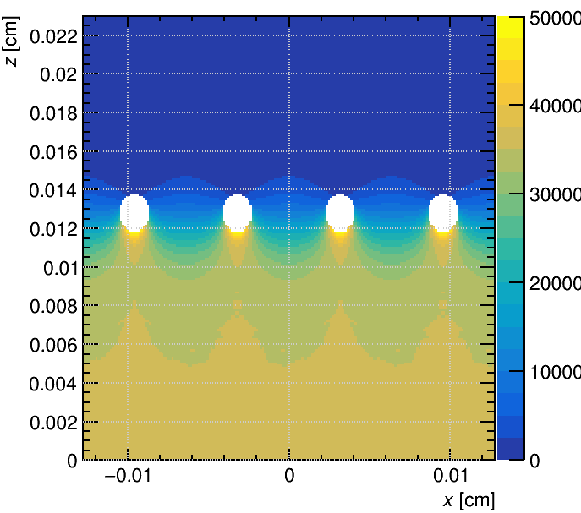
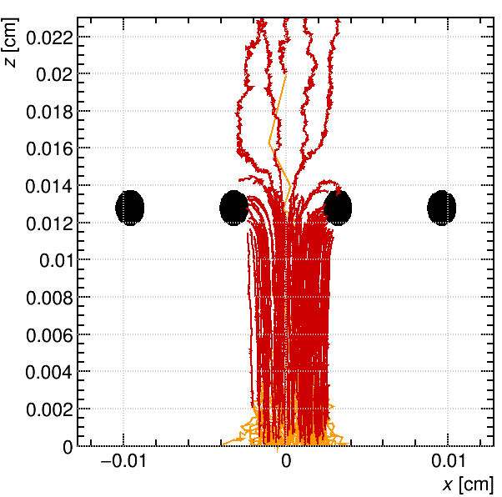
Micromegas: electric field and gain
Representation of the electric field inside the Micromegas
Use of AvalancheMicroscopic to simulate the gain of the detector

Slide 11
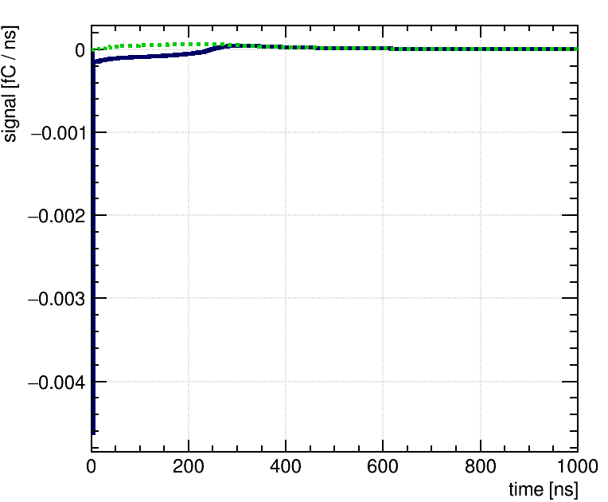
Micromegas: signal induction
FEM solutions of time-dependent weighting potentials to calculate the induced signals on the readout strips
The simulated signal exhibits the characteristic features of a Micromegas signal: a sharp electron peak followed by a long ion tail.

Slide 12
Conclusions
Explored the features of Garfield++ for the simulation of gas detector physics:
Made use of multiple field solvers: analytical fields, ANSYS and COMSOL field maps, etc.
Extracted relevant distributions for the ionization processes
Single Gap RPC: studied the time resolution and efficiency behaviour
Micromegas geometry from COMSOL: studied the signal production with a time-dependent weighting potential.
GARFIELD++ is a reliable tools for studying the detector features and efficiency.

Slide 13
Acknowledgements
DRD1 Gaseous Detector school organizers, tutors, and collaboration

