Slide 1
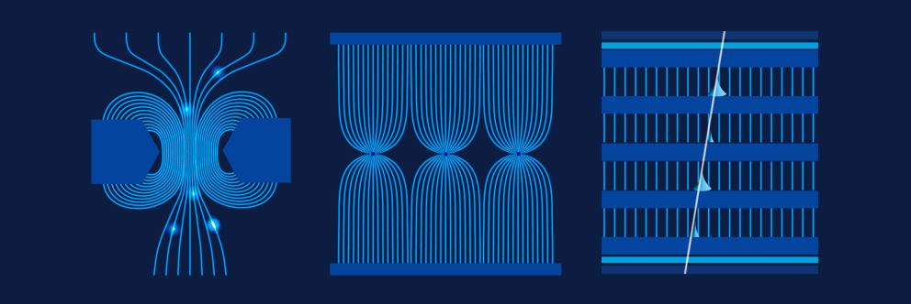
RPC Characterization
DRD1 school 2024
Group 8:
Felice Nenna, Jinxian Zhang, Ioannis Karakoulias, Mattia Verzeroli

Slide 2
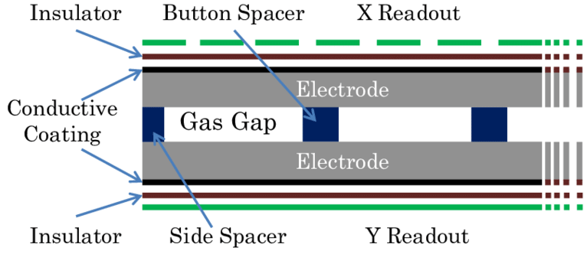
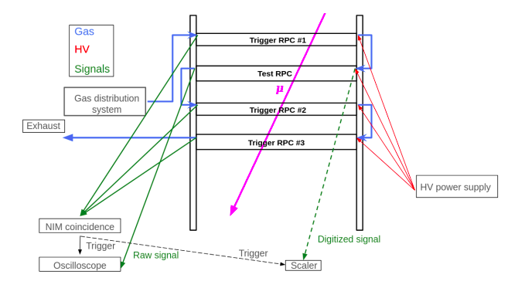
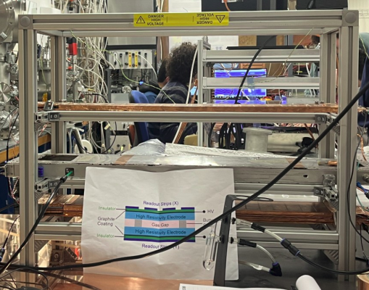
Experimental setup
Main instrumentation:
3 RPCs with 1 mm gas gap used as trigger chambers
1 RPC with 1 mm gas gap used as test chamber
Gas mixture (94.7% C₂H₂F₄ , 5% i-C₄H₁₀ , 0.3% SF₆)
Further instrumentation: oscilloscope, high voltage power supply, NIM modules, gas supply
DRD1 Collaboration Meeting - 13/12/2024

Slide 3
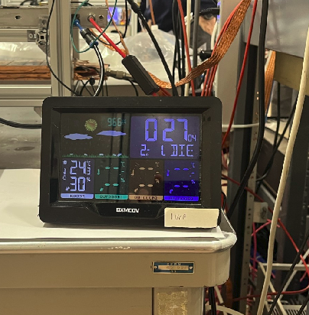

Experimental setup
The coincidence of the 3 trigger chambers selects events from cosmic muons.
Sensors measuring temperature, pressure and humidity were employed in order to monitor the working condition of the detector
The properties of the gas molecules depend on its pressure and temperature → affect the HV working point:
Pressure | 966 mbar
Temperature | 24.4 Cº
P₀ | 1010 mbar
T₀ | 20 Cº
E.g., in our laboratory condition for an applied voltage of 5800V, the effective HV is 6064V
DRD1 Collaboration Meeting - 13/12/2024

Slide 4
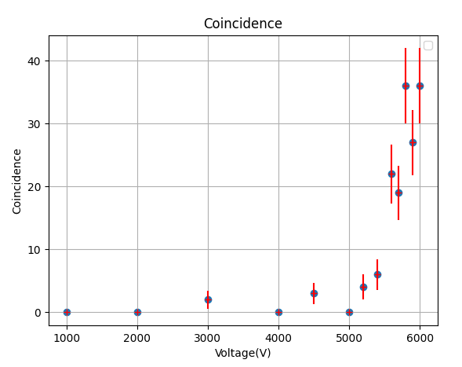
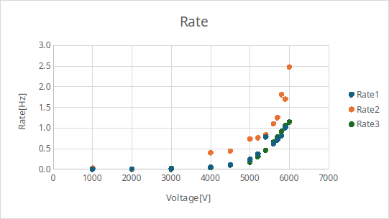
Characterization of an RPC
The working point is defined as the high voltage at which the number of coincidences plateaus, ensuring maximum efficiency and stable operation without excessive noise or discharge.
Number of coincidence events for different voltages in 100 seconds
Number of each trigger chamber for different voltages in 100 sec.
The HV of working point is 5800V
DRD1 Collaboration Meeting - 13/12/2024

Slide 5
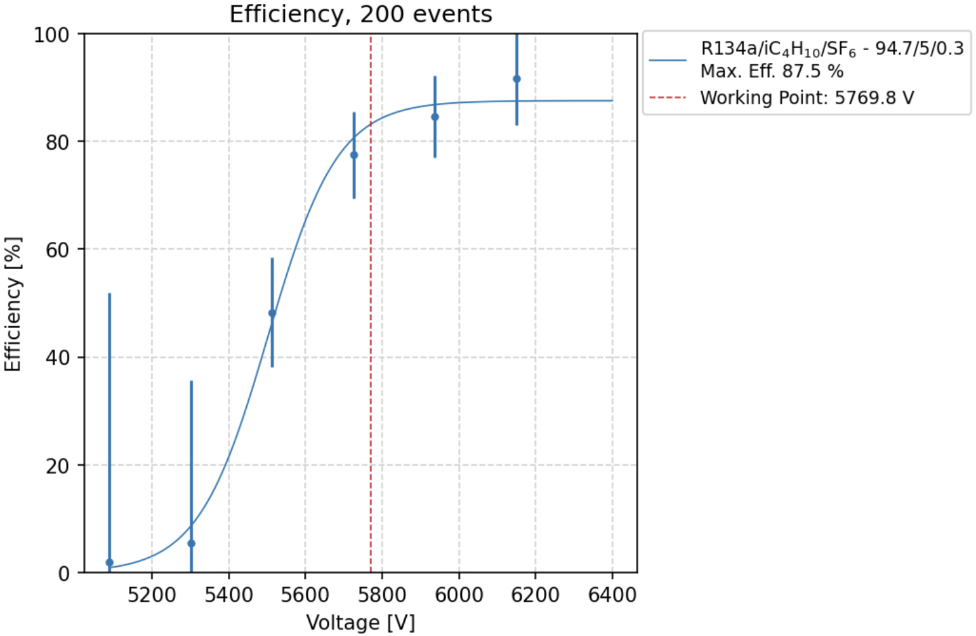
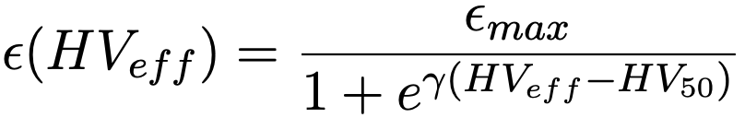
Efficiency curve
Sigmoid fit:
Where:
HV_{eff}: Applied voltage corrected by T/P
ε_{max}: Maximum efficiency
HV₅₀: Voltage where efficiency = 50%
Working point: voltage for which efficiency reach 95% of ε_{max}, plus 150 V.
The single point are obtained as:
Efficiency = N. signal / N. trigger
with the Standard poissonian errors.
DRD1 Collaboration Meeting - 13/12/2024

Slide 6
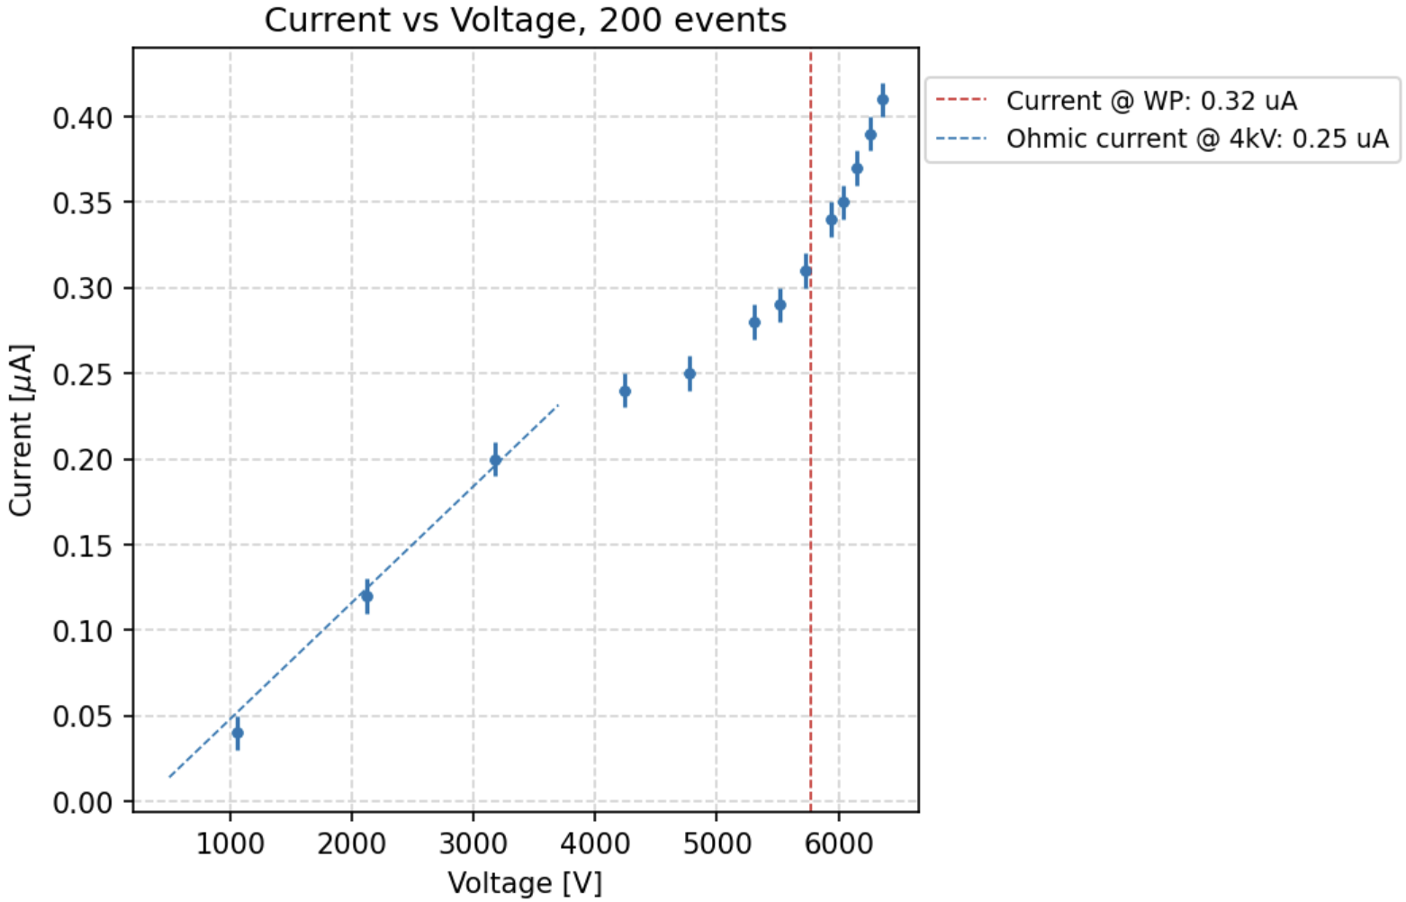
Current curve
Two different trends:
Ohmic linear contribution up to 4 kV:
This take in account all the possible
ohmic current due to detector’s
imperfection;
Physics exponential contribution after 4 kV:
This is the contribution of the ionization inside the gas gap, and it shows an exponential increase.
2
1
DRD1 Collaboration Meeting - 13/12/2024

Slide 7
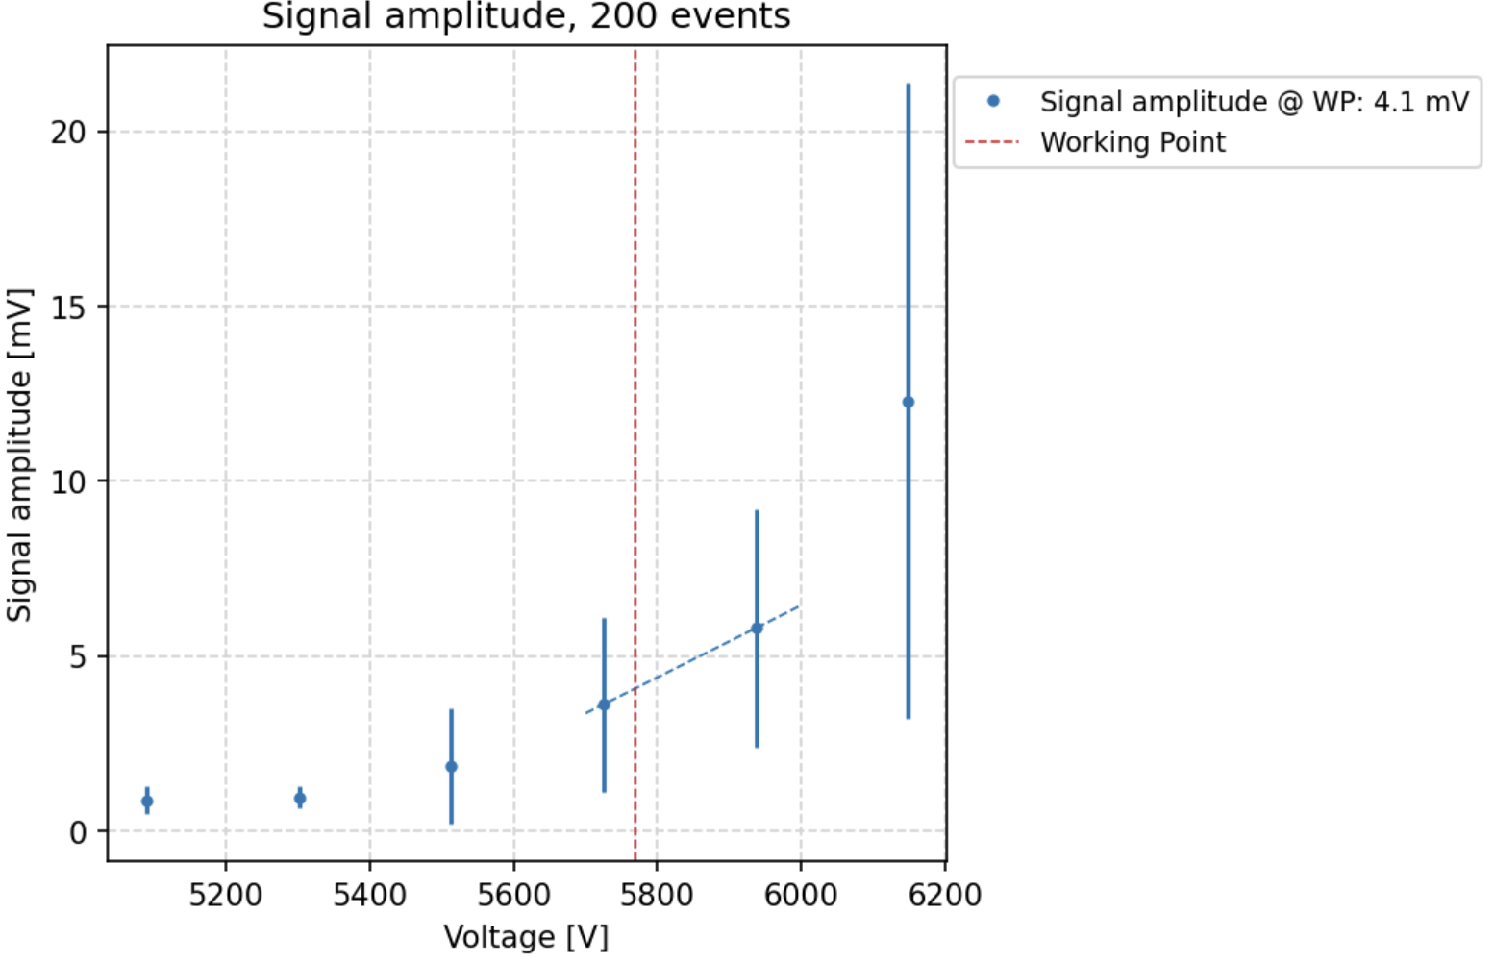
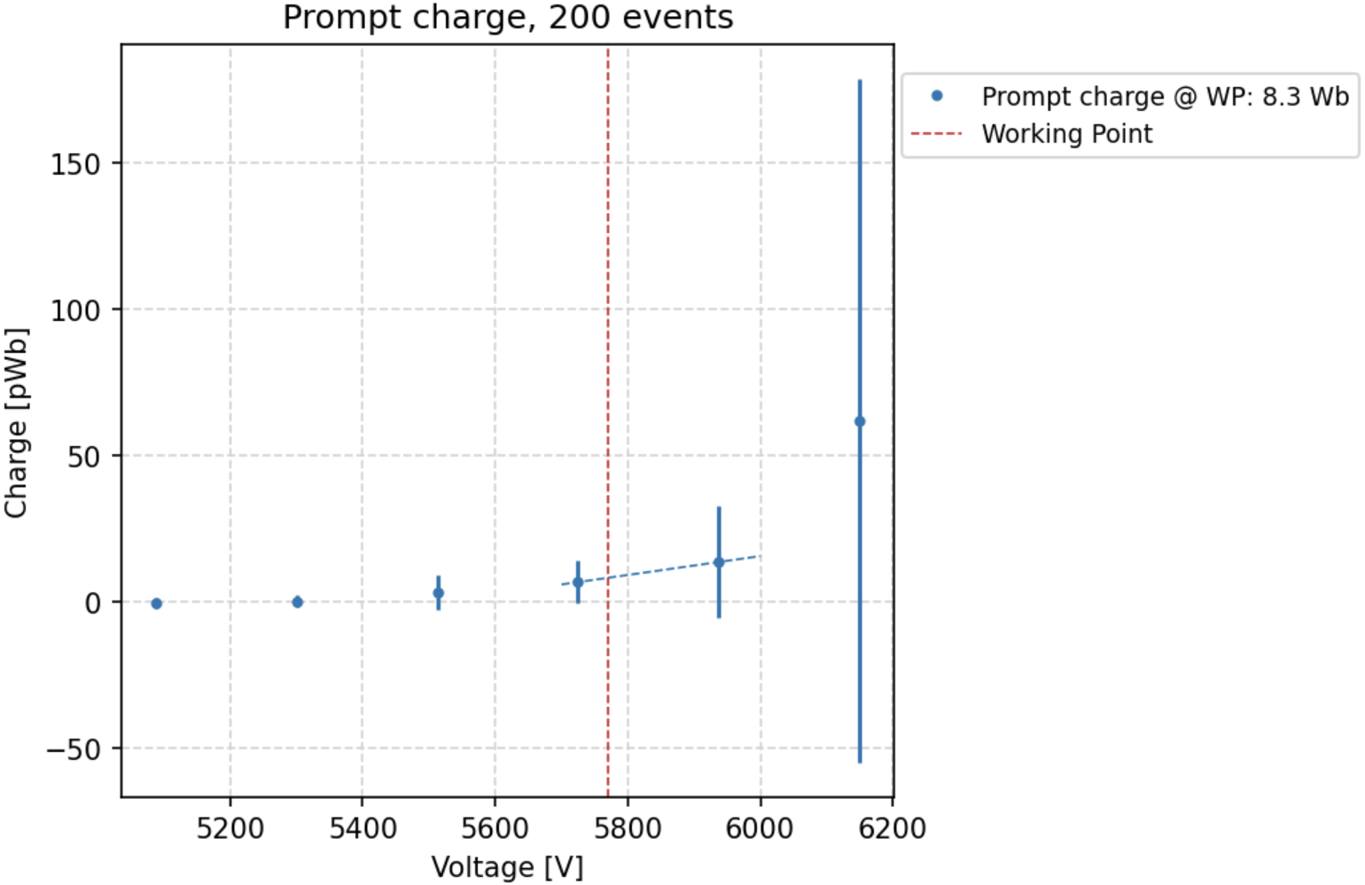
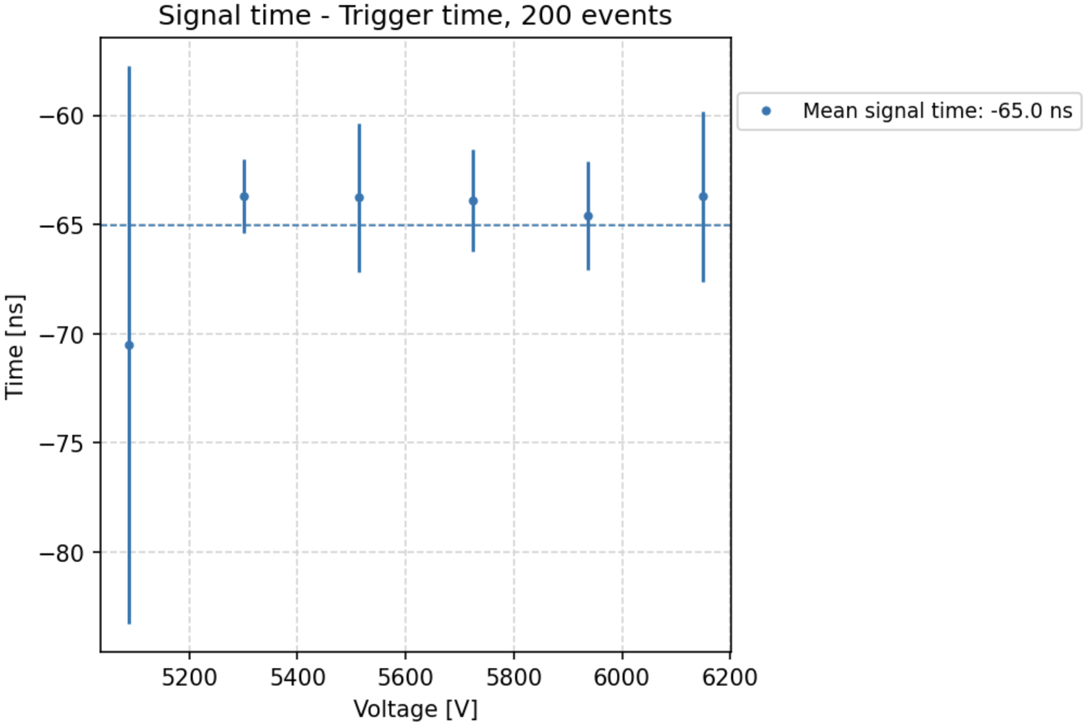
Other relevant parameters
The time difference between the signal and the trigger remain constant over the Voltage applied.
Increase as the Voltage increases;
Similar trend to the increase of the prompt charge:
  The charge is the integral of the signal in mV
DRD1 Collaboration Meeting - 13/12/2024

Slide 8
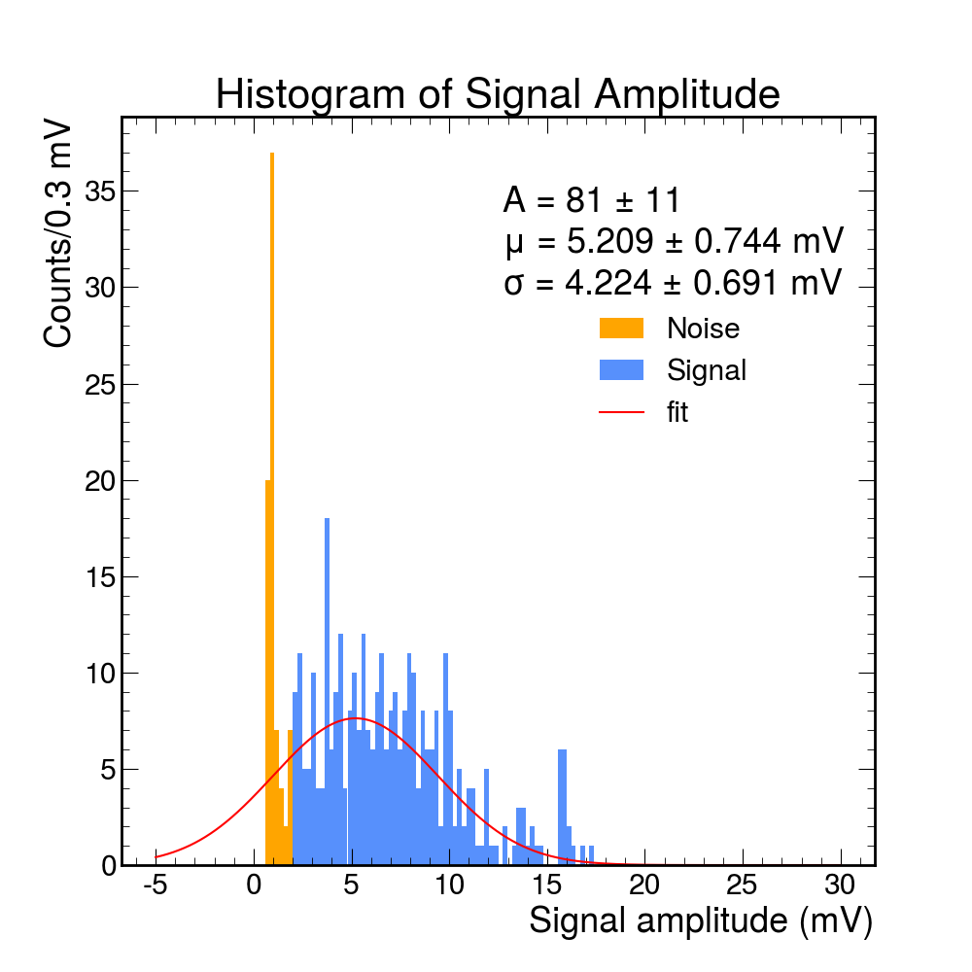
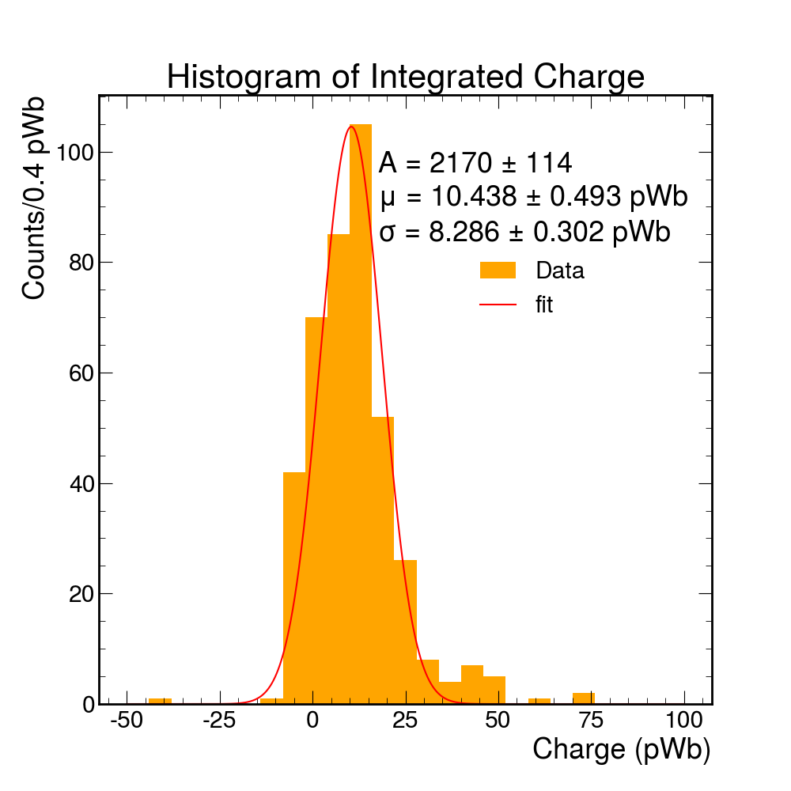
High statistics run at the Working Point
Integrating the signals
At the working point (5800 V) → higher statistics run:
low signal amplitude (<2 mV): noise
intermediate signal amplitude (<15 mV): signals generated by avalanches
high signal amplitude (>15 mV): signals generated by streamers
DRD1 Collaboration Meeting - 13/12/2024

Slide 9
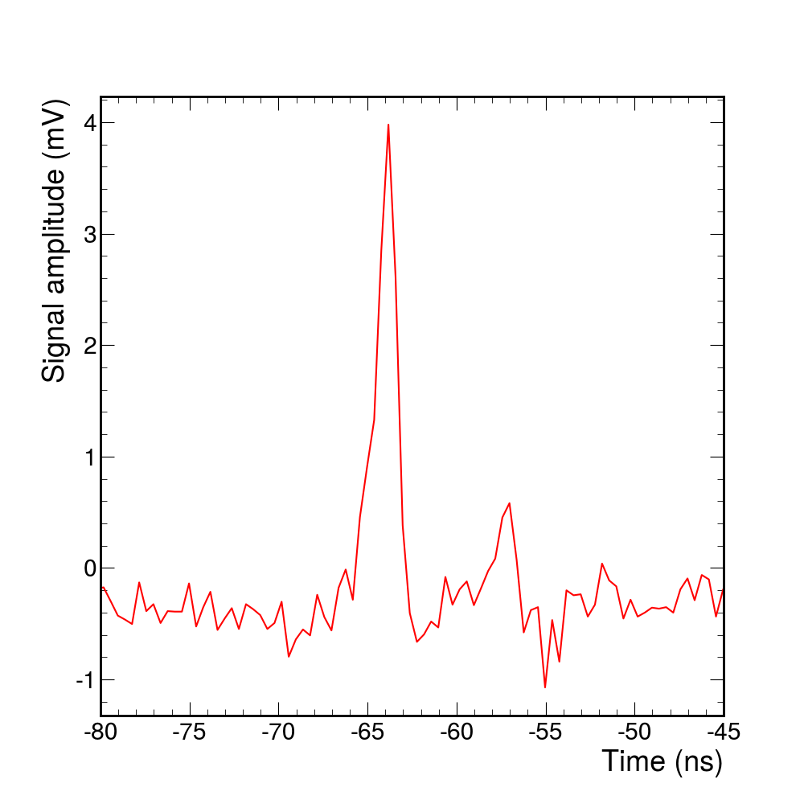
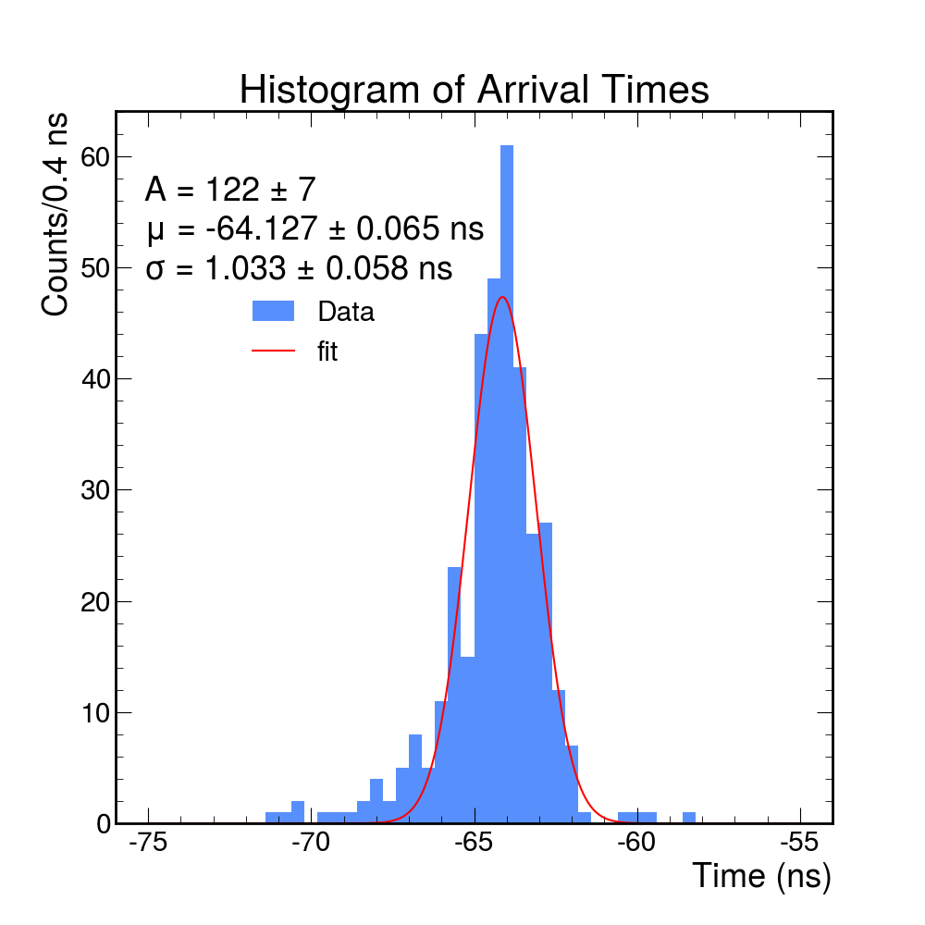
Time resolution
Rising time of the signal: ~2 ns
Delayed signal probably due to an afterpulse generated by photon induced avalanche
From the peaking time distribution, performing the gaussian fit
→ time resolution of ~1 ns
DRD1 Collaboration Meeting - 13/12/2024

Slide 10
Conclusions
We operated RPC chambers and measured some relevant parameters:
With a trigger made of 3 RPCs in coincidence aligned with one RPC under test
A maximum efficiency of ~90% was reached at a working point of 5800V
The average signal amplitude (and integrated charge) increases as the voltage increases, as expected
The signal time resolution of the chamber was 1 ns at the working point
DRD1 Collaboration Meeting - 13/12/2024

Slide 11
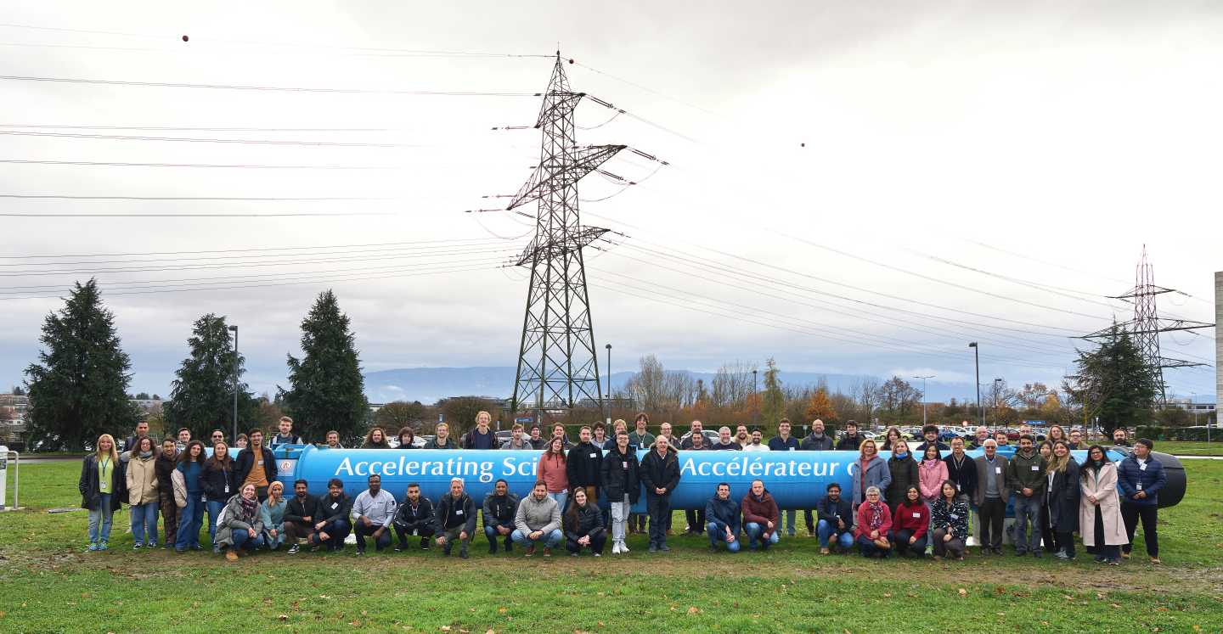
Thank you for your attention!

