Slide 1

Bulletins, Seminars, & Communications
3rd DRD1 Collaboration Meeting - CERN
9-13 December 2024
Working Group 8 - Knowledge Transfer, Training, Career Promotion
Elisabetta Baracchini (GSSI)
Florian Brunbauer (CERN)
Mauro Iodice (INFN)
Raheema Hafeji (IFIC)

Slide 2
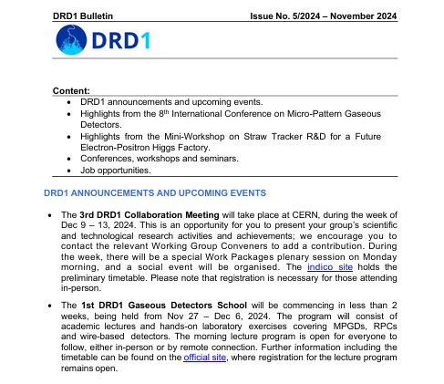
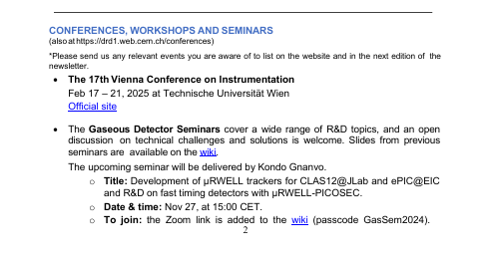
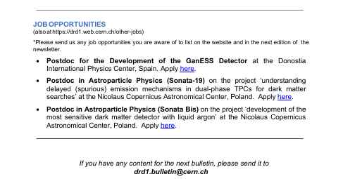
DRD1 bulletin
Monthly bulletin → emailed out to DRD1-all@cern.ch mailing list.
Content includes:
DRD1 announcements and upcoming events.*
News from work packages and working groups.
Training and schools.*
Conferences, workshops and seminars.*
Job opportunities.*
(*also updated on the website drd1.web.cern.ch)
If you have some relevant news or updates that you would like added to the bulletin, send it at anytime to drd1.bulletin@cern.ch.
Comments + suggestions are also very welcome.

Slide 3
Seminar series
2024 Seminars
Kondo Gnanvo Jlab - Virginia | ‘Development of µRWELL trackers for CLAS12@JLab and ePIC@EIC and R&D on fast timing detectors with µRWELL-PICOSEC’
Soham Chakraborty TRIUMF - Canada | ‘𝜇-RWELL in TACTIC: TRIUMF Annular Chamber’
Thomas K Hemmick Stony Brook - New York | ‘SPhenix TPC, from assembly to running’
Pawel Majewski RAL - UK | ‘Commissioning of the MIGDAL experiment using fast neutrons from a D-D generator’
Seminars to be held the first Wednesday of the month – remotely.
Cover a wide range of R&D topics; open discussions on technical challenges are encouraged.
Details shared in advance via the bulletin, with a reminder a few days beforehand sent to mailing lists.
Initiated by and co-organised with Gabriel Charles.
Do you want to give a seminar?
Let us know!
Gabriel Charles gabriel.charles@ijclab.in2p3.fr
Raheema Hafeji DRD1-WG8-convenors@cern.ch
…next seminar planned for February 2025.

Slide 4
Mailing lists
All important communications, bulletins and updates are sent to DRD1-all@cern.ch.
Prompt reminders and communications will be sent to a new mailing list: drd1-communications@cern.ch. If you were subscribed to DRD1-all, you will have been added to this new mailing list.
If you do not wish to receive frequent reminders, you can unsubscribe from DRD1-communications and you will still receive the important updates via DRD1-all as before.
(You can unsubscribe here: https://e-groups.cern.ch/e-groups/EgroupsSubscription.do?egroupName=drd1-communications)

Slide 5
Stay updated
Subscribe to participate in the WG8 meetings and follow the activities:
https://e-groups.cern.ch/e-groups/EgroupsSubscription.do?egroupName=drd1-wg8
- Subscribe to other working groups by following the relevant webpages here: https://drd1.web.cern.ch/working-groups
To get in touch, share any suggestions or comments etc. with WG8:
DRD1-WG8-convenors@cern.ch
- Contact other WG convenors by emailing:
DRD1-WGx-convenors@cern.ch

