Slide 1
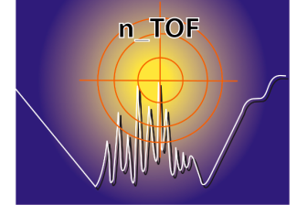

Status of the n_TOF experiment and New Experimental Area
E.Chiaveri
(EN-STI-EET)
On behalf of n_TOF collaboration

Slide 2


ITEMS
Experimental campaign 2011
EAR2 (experimental Area 2)
Impact of long shut-down on n_TOF experiment
Summary

Slide 3
Experimental campaign 2011: HIGHLIGHTS
Successful measurements of ⁵⁴Fe σ(n,γ)
Successful measurements of 63Niσ(n.γ)
First measurement at n_TOF for measuring (n,α) with diamond (xCVD) detectors
Start measurements with ²⁴⁰Pu,²⁴²Pu and ²³⁶U

Slide 4
Experimental campaign 2011: PLANS
The campaign 2011 will provide finally a total of 1.55 e19 protons/year, which will allow to advance in most of the approved proposals.
Some innovations:
First use of MGAS for measuring ³³S σ(n,α): isotope for possible medical appliction
First use of a large area pCVD diamond for σ(n,α) below the MeV frontier
First use of MGAS for measuring σ(n,f) at high energy: ^{240,242}Pu
First ever measurement of the radioactive ⁶³Ni σ(n,γ)
The challenges will mainly come from:
the use of new (or combinations) of detection systems
the unprecedented aimed accuracy for the ²³⁸U(n,γ) measurement:
  2-3% overall accuracy between thermal and 1 MeV!!

Slide 6
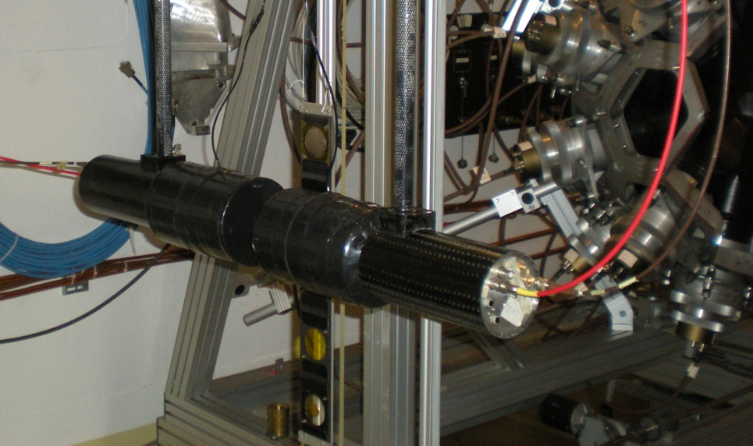
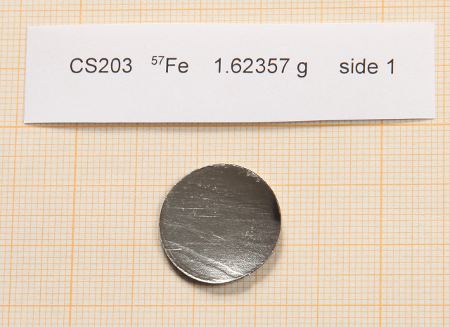
CERN-INTC-2006-012 (INTC/P-208)
The role of Fe and Ni for s-process nucleosynthesis in the early Universe and for innovative nuclear technologies
Continuation of the Fe and Ni campaign:
^{54,56}Fe and ⁶²Ni have been measured in 2010
Sample characteristics
Mass | 1.62357 g
Diameter | 19.95 mm
Thickness | 0.64 mm
Isotopic composition
⁵⁴Fe | 0.01%
⁵⁶Fe | 0.62%
⁵⁷Fe | 96.06%
⁵⁸Fe | 3.36%

Slide 7
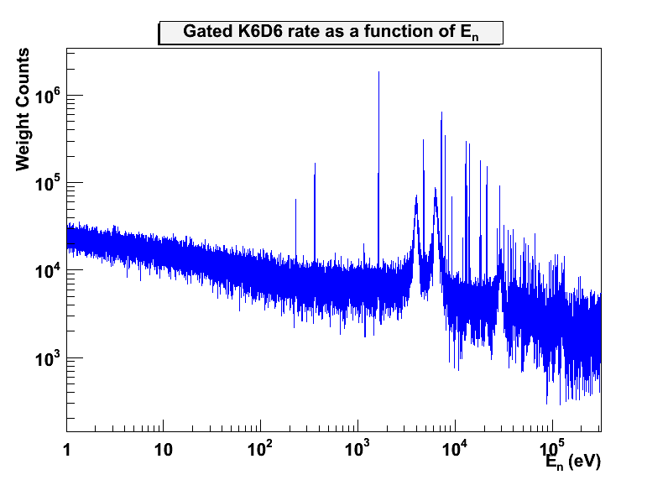
CERN-INTC-2006-012 (INTC/P-208)
The role of Fe and Ni for s-process nucleosynthesis in the early Universe and for innovative nuclear technologies
The measurement has revealed a large number of s- and p-wave resonances, many of them only observed in measurement of ^{nat}Fe samples, and many of them never observed before!

Slide 8

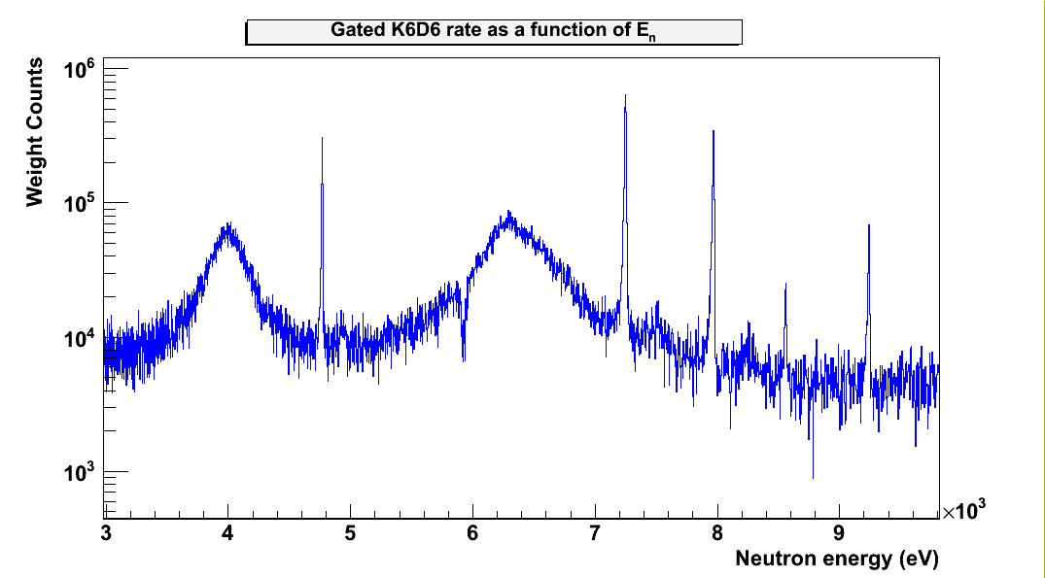
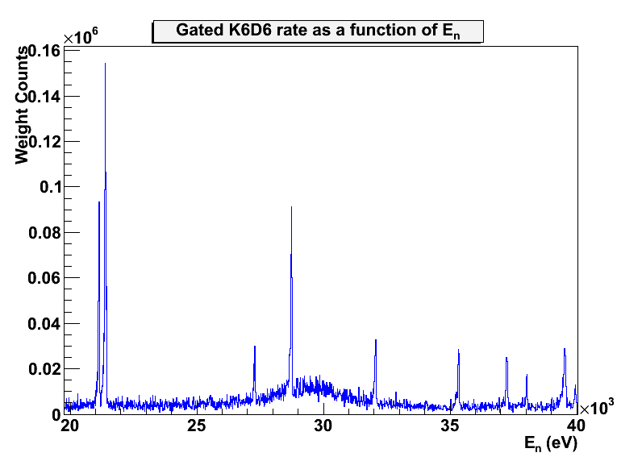
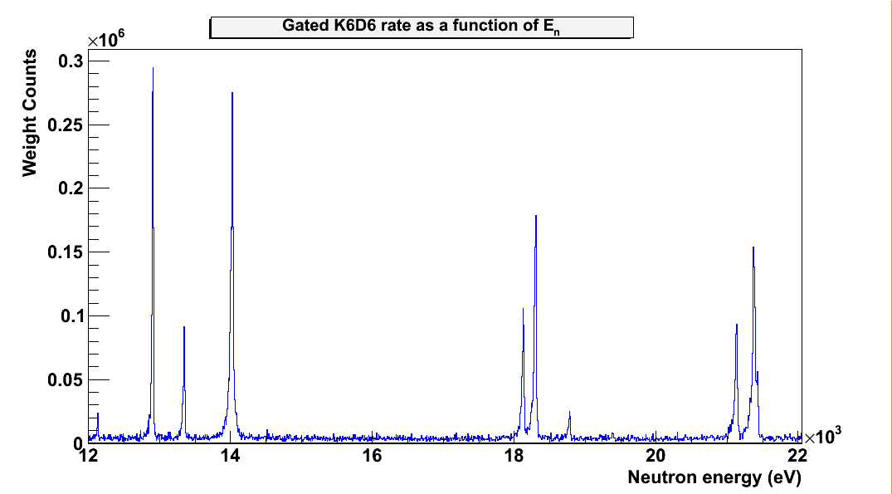
CERN-INTC-2006-012 (INTC/P-208)
The role of Fe and Ni for s-process nucleosynthesis in the early Universe and for innovative nuclear technologies
The range around 30 keV, of astrophysical interest, is dominated by a broad s-wave resonance, but several narrow p-wave resonance have been found to contribute significantly to the MACS @ 30 keV.

Slide 9
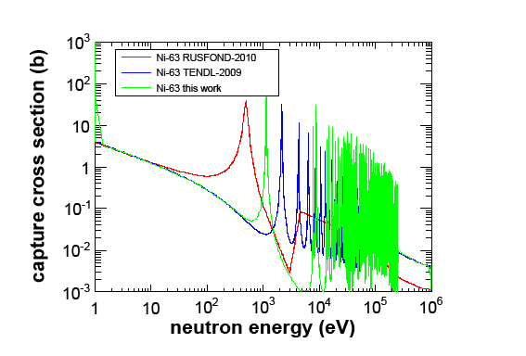
CERN-INTC-2010-067 (INTC/P-283)
The neutron capture cross section of the s-process branch point isotope 63Ni
The unstable isotope ⁶³Ni is of particular interest because it represents the first branching point in the reaction path of the s-process, BUT:
- Measurements exist ONLY at thermal energies
- MACS are based on extrapolation from thermal point
→ theoretical assumptions may be affected by large uncertainties
Indeed, MACS at 30 keV:
Maxwellian-Averaged Cross Sections
KADoNiS: 31± 6 mb
Karlsruhe Astrophysical Database of Nucleosynthesis in Stars
TENDL(2009): 68.9 mb
TALYS-based Evaluated Nuclear Data Library
nTOF (predict.): 90.8 mb
Unique possibility to measure ⁶³Ni(n,γ) with highly pure sample containing only ⁶²Ni and ⁶³Ni.
Collaboration with FZK, PSI,TU Munich

Slide 10
CERN-INTC-2010-067 (INTC/P-283)
The neutron capture cross section of the s-process branch point isotope 63Ni
First measurement of ⁶³Ni(n,γ) at the energy of interest of astrophysical
Chemical form | NiO
Mechanical form | Pressed powder encapsulated in a PEEK container.
⁶³Ni enrichment | 11.2%
Spot diameter | 20 mm
Activity | 200 GBq (pure β) [Q_{β} =67 keV max.] @ 10.03.2011
Dose rates | Dose rate at contact 50 micro-Sv/h Dose rate at 10 cm 1.5 micro-Sv/h

Slide 11
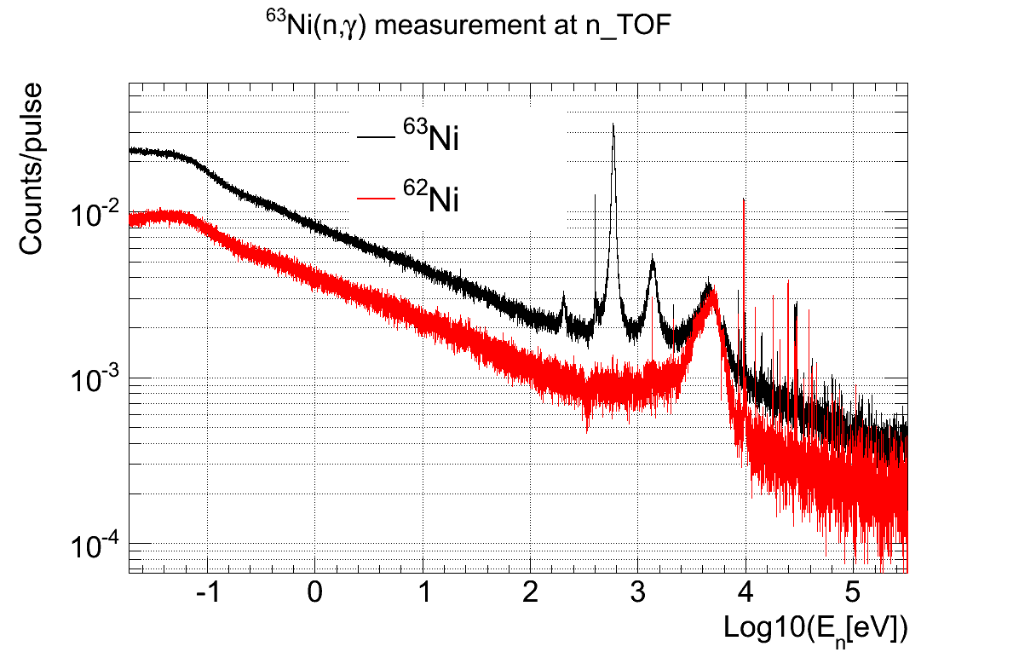
CERN-INTC-2010-067 (INTC/P-283)
The neutron capture cross section of the s-process branch point isotope 63Ni
The measurement have been completed in April-May 2011 and has provided high-statistics high-resolution data of both ⁶³Ni and ⁶²Ni (only contaminant→ main background)
The measurement covers the range:
from thermal: allows to compare to previous experiments
to ~300 keV: allow to determine directly the MACS @30 keV and @90 keV

Slide 12
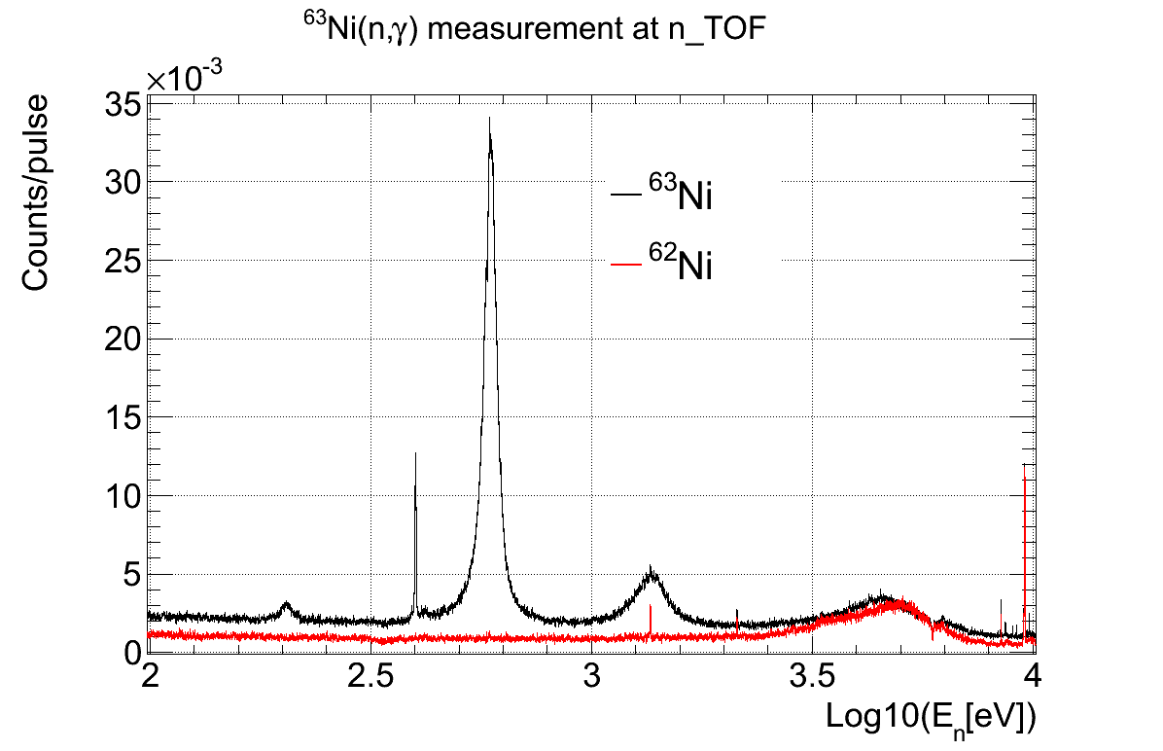
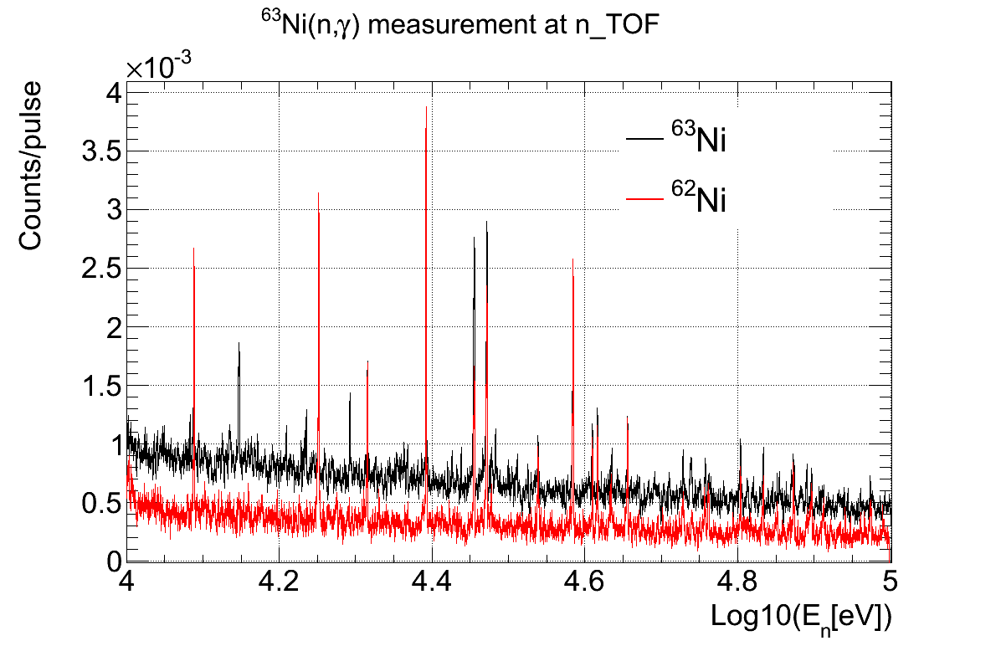
CERN-INTC-2010-067 (INTC/P-283)
The neutron capture cross section of the s-process branch point isotope ⁶³Ni
The measurement have been completed in April-May 2011 and has provided high-resolution data with good statistics for both ⁶³Ni and ⁶²Ni (only contaminant→ main background)
The measurement covers the range:
from thermal: allows to compare to previous experiments
to ~300 keV: allow to determine directly the MACS @30 keV and @90 keV

Slide 13
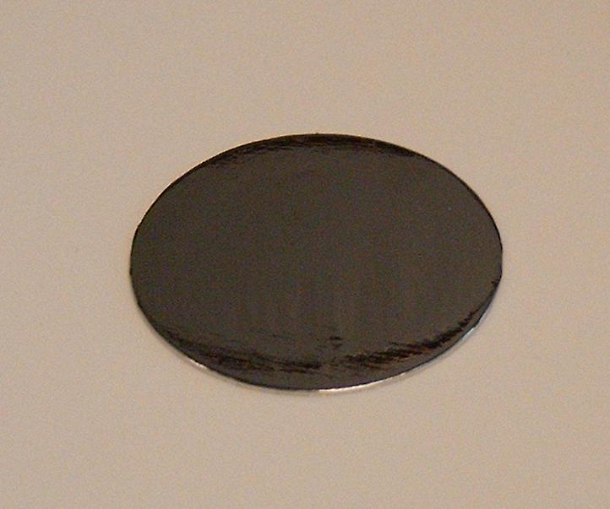
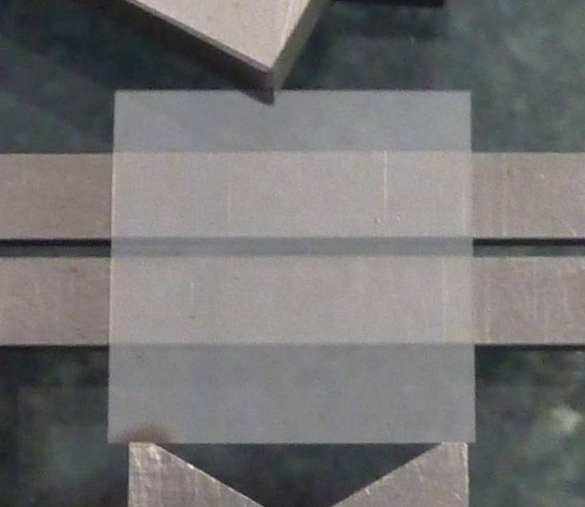
CERN-INTC-2010-061(INTC/I-125)
Reference measurement of the high energy (n,α) cross section of ¹⁰B with a CVD diamond detector for the prospect of future applications
    OBJECTIVES OF THE TEST MEASUREMENT (16/6/11-29/6/11):
    First time measurement of (n,α) reaction with diamond detectors at n_TOF
    Investigate the background level in the region of interest
    Investigate the detection efficiency for the (n,α) reaction
    Identify aspects to be improved for the future detector
Detector:
    20 x 20 mm² pCVD diamond detector
    Al metallization in coll. with CEA Saclay
    Subdivided in 4 pads
Sample:
    1.1 μm thick ¹⁰B₄C (W. Vollenberg)
PCB:
    Ceramics with Al deposition (A. Teixeira)
20 mm
20 mm

Slide 14
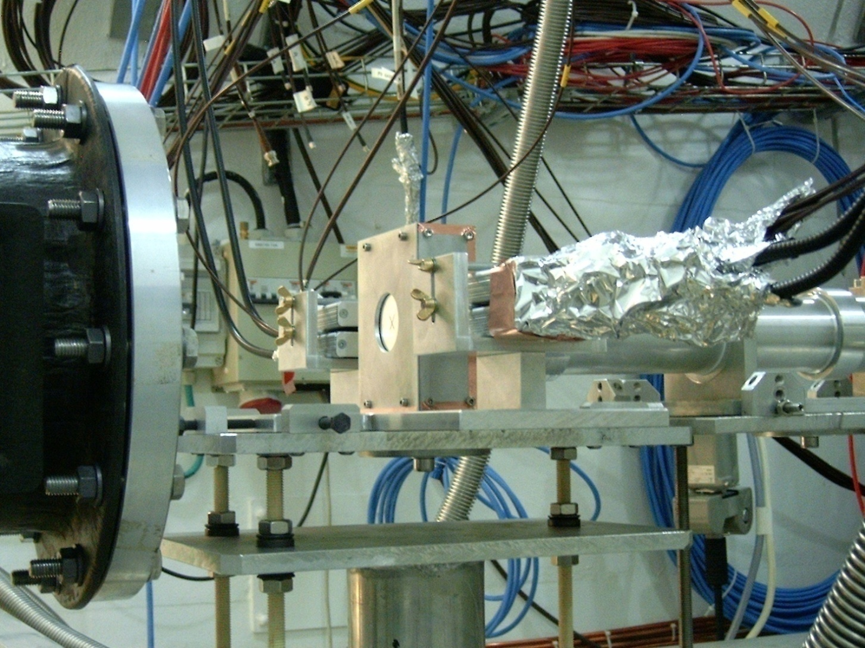
^{Experimental setup at n_TOF}
CERN-INTC-2010-061(INTC/I-125)
Reference measurement of the high energy (n,α) cross section of ¹⁰B with a CVD diamond detector for the prospect of future applications
Detector box with
Sample inside
Preamplifiers
Neutrons
    Preamplifiers:
    80 MHz charge amplifier
    (CIVIDEC Instrumentation GmbH)

Slide 15
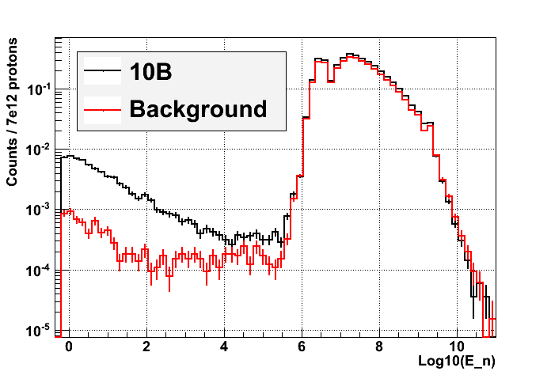
CERN-INTC-2010-061(INTC/I-125)
Reference measurement of the high energy (n,α) cross section of ¹⁰B with a CVD diamond detector for the prospect of future applications
    The test measurement finished a few days ago.
    The results look very promising and will be analyzed in order to answer the questions:
    What is the background level? Can it be improved?
    What is the detection efficiency? Is it as expected? Can it be improved?
    What should be the characteristics of a future detector intended for (n, α) measurements of relevence in astrophysics?
Contribution from (n,α) reactions occurring in ¹⁰B
Threshold for
¹²C(n,cp) reactions

Slide 16
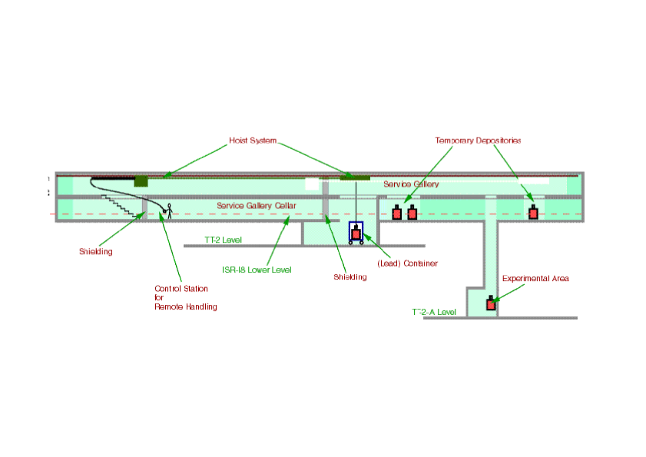
EAR-2
New
Experimental
Area (EAR-2)
~ 20 m
10 m
n_TOF target
EAR-1
(at 185 m)
Flight-path length : ~20 m
at 90° respect to p-beam direction
expected neutron flux enhancement
drastic reduction of the t₀ flash

Slide 17
EAR-2 Experiments
Experiments in EAR-2 can be performed :
on very small samples
(important to reduce mass of unstable samples
and in cases where sample material is limited)
on isotopes with very small cross sections
(where signal/background ratio is crucial)
in much shorter time
(measurements can be eventualy repeated to reduce
systematic uncertainties)
Measurements of neutron-induced cross sections at high energies (E_{n}>10-100 MeV), which are not possible in the existing EAR-1, will benefit from largely reduced the γ-flash.

Slide 18
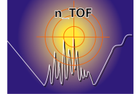
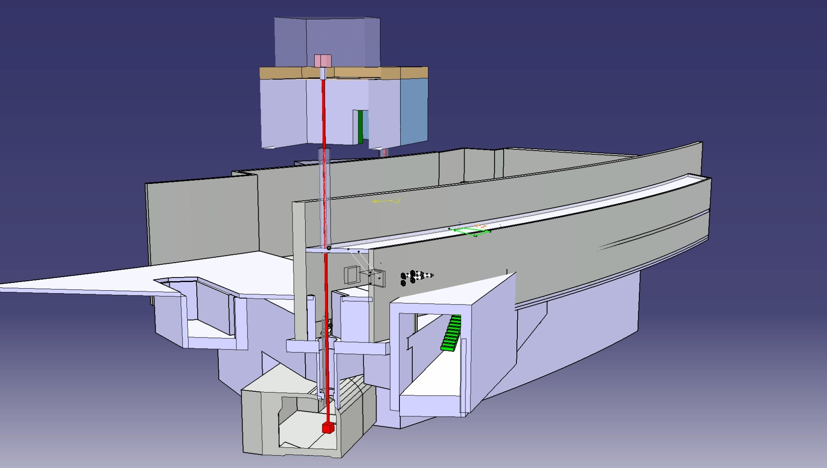
Overview of the n_TOF spallation target area
EAR2 (@20 m from pit, above ground)
To be built
ISR
Technical gallery (@10 m from pit)
Existing hole
n_TOF target pit

Slide 19
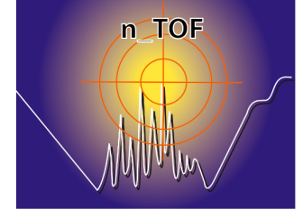
Overview of the n_TOF EAR2

Slide 20
Comparison Neutron Fluence EAR1/EAR2

Slide 21
Neutron Fluence EAR1/EAR2

Slide 22
EAR-2 Nuclear Transmutation
From the transmutation projects (or future generation nuclear energy systems), the EAR2 would allow to measure the fission cross-section of Pu isotopes and minor actinides with half lives of a few tens of years.
Although short lived, it may be convenient to burn those actinides in future systems (either ADS or Gen IV fast reactors), together with their neighboring long-lived isotopes.
Important Candidates:
Fission Cross Section :238Pu (87.7 y)/241Pu (14.1 y) 244Cm(18.1 y)
Capture Cross Section : 242Am (141 y)/ 243Cm (29.1 y) and
231Pa(32400 y)

Slide 23
EAR-2: Nuclear Astrophysics
Nucleosynthesis by the slow neutron capture process
represents a unique tool for studying the related abundances through the tight correlation with the experimental (n, γ) cross sections.
The EAR-2 options for measurements of so far
inaccessible reaction rates will provide a boost for our
understanding of neutron capture nucleosynthesis during the
He burning phases of stellar evolution, which played a crucial
role in the history of the Universe, because they contributed half of the abundances between Fe and Bi.
important candidates for EAR-2:
⁷⁹Se, ⁹⁰Sr, ⁹³Zr, ¹⁰⁷Pd, ¹³⁵Cs, ¹⁴⁷Pm, ¹⁶³Ho,¹⁷¹Tm, ¹⁸²Hf, ²⁰⁴Tl

Slide 24
EAR-2 Experiments follow-up
Detailed studies continue (RP, CE, Planning and budget)
Final document will be presented to Collaboration Board (Dec2011) for approval
February 2012 will be presented to INTC
With INTC approval will be presented to Research Board

Slide 26
Measurement | Detector | # Prot. (e18) [proposal] | Dates | Comments
Start Up | Varii | 0.5 | 17/3 - 23/3 | Completed
⁵⁷Fe(n,g) | C6D6 | 2 | 23/3 - 26/4 | Completed
⁶³Ni(n,g) | C6D6 | 5 | 27/4 – 12/6 | Completed
¹⁰B(n,a) | Diamond (pCVD) | 0.5 | 16/6 – 29/6 | Completed
²³⁶U(n,g) | C6D6 | 1.5 | 1/7 – 25/7 | Ongoing
^{240,242}Pu(n,f) | MGAS (fission) | 8 (parallel) | 1/7 – …….. | Parallel with C6D6
²³⁸U(n,g) | C6D6 | 3 | 26/7 - 14/9 | Planned
²³⁸U(n,g) | TAC | 2 | 14/9 – 8/10 | Planned
²³⁶U(n,g) | TAC | 1.5 | 8/10 – 2/11 | Planned
⁸⁸Sr(n,g) | TAC | 2* (if prot. avail.) |  | If prot. available
Ang. Distr. FF.FF. | PPAC | 0.5 | 12/11 - 22/11 | Planned
³³S(n,a) | MGAS | 0.5 (parallel) | 12/11 - 22/11 | Parallel with PPAC
Total |  | 16.5 (18.5*) | 17/3 - 22/11

Slide 27
Impact of long shut-down on n_TOF experiment
Construction of EAR2
Update the Data Acquisition System
Update all the Detectors
Improvement on Moderator circuit

Slide 28
n_TOF Facility Summary
Operation of a borated water moderation system
  Successfully done
2011 experimental campaign
According to scheduled program
EAR-2 (Experimental Area 2)
Working document presented to INTC

