Slide 1




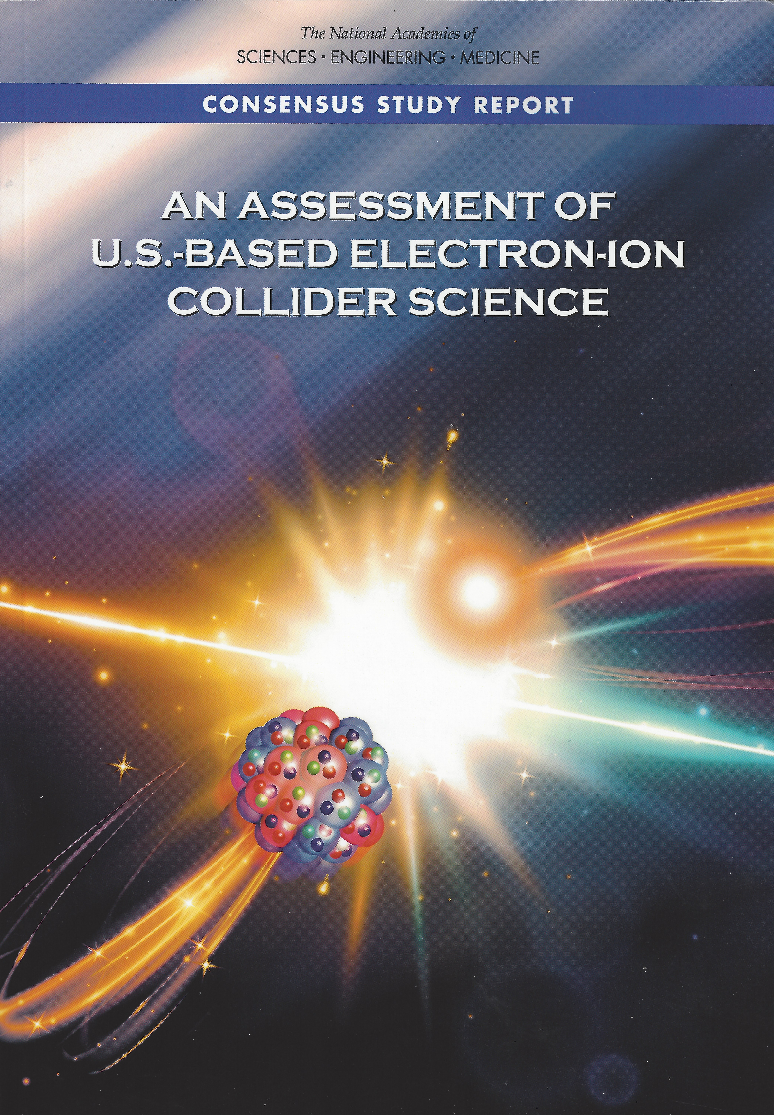
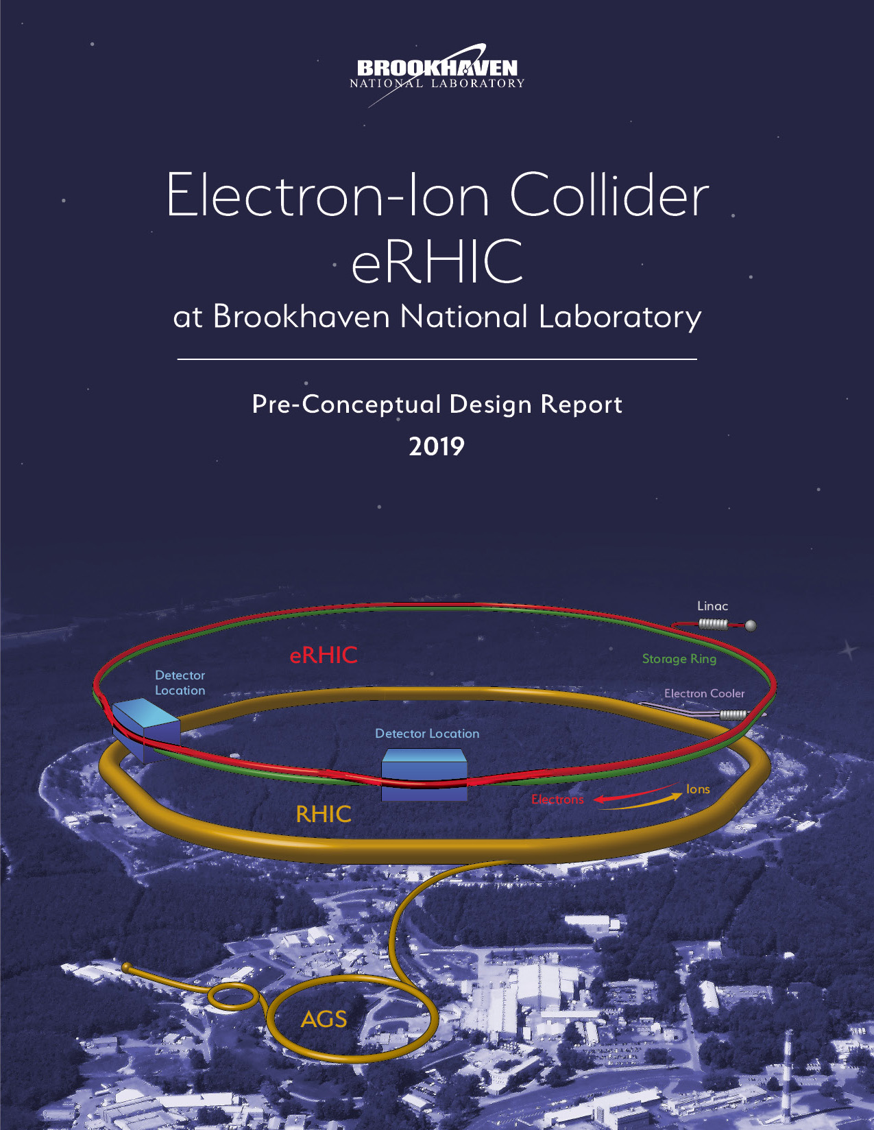
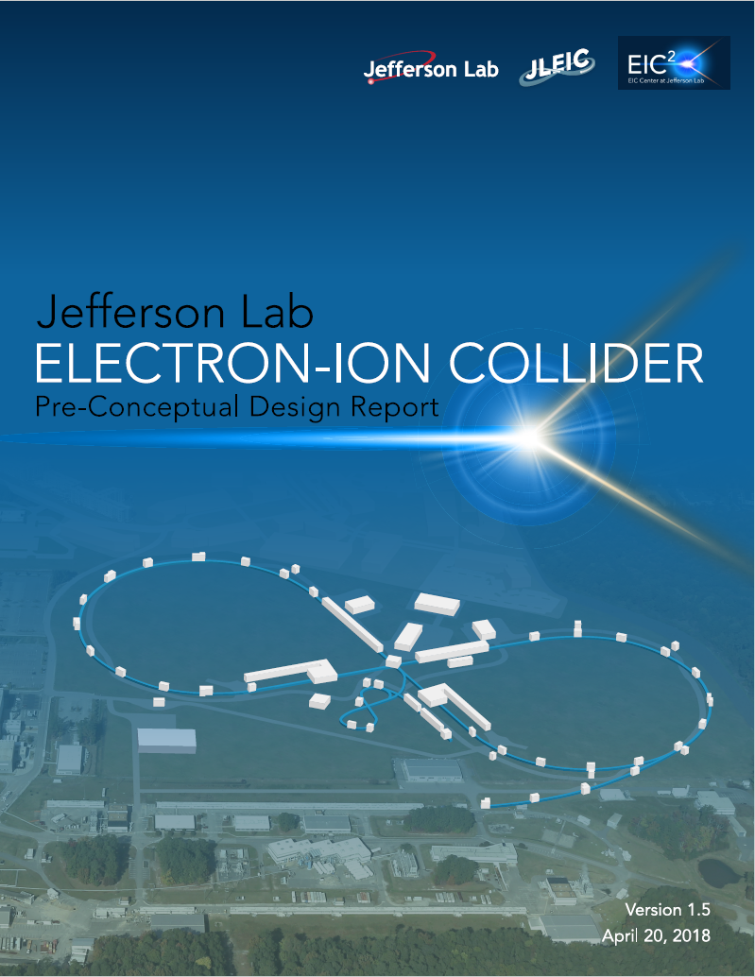
Electron Ion Collider (EIC):
BCVSPIN 2024: Particle Physics in the Himalayas
Kathmandu, Nepal – December 13, 2024
2019-present
2015
2016
2018
2019
machine
detector
Physics of EIC
Evaluation
Realization

Slide 2
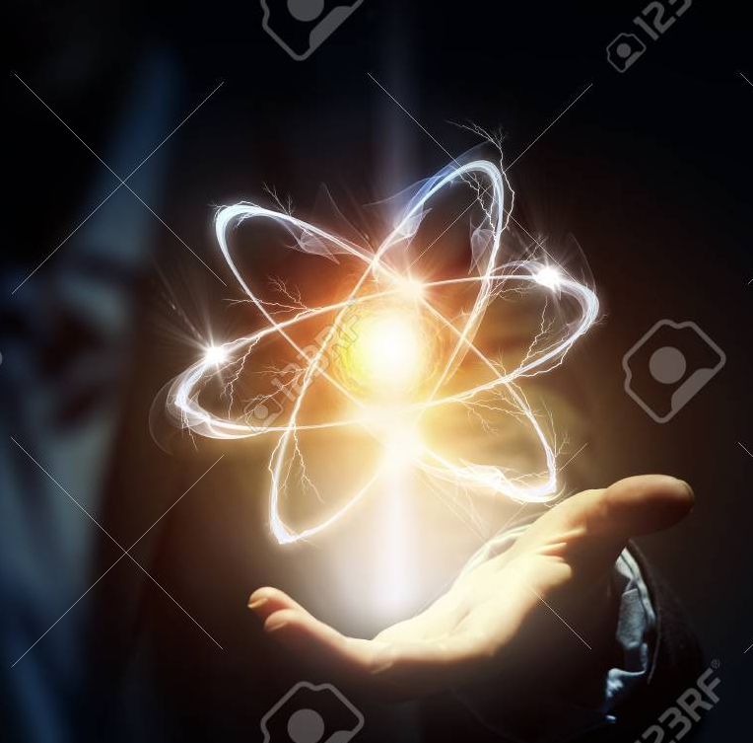
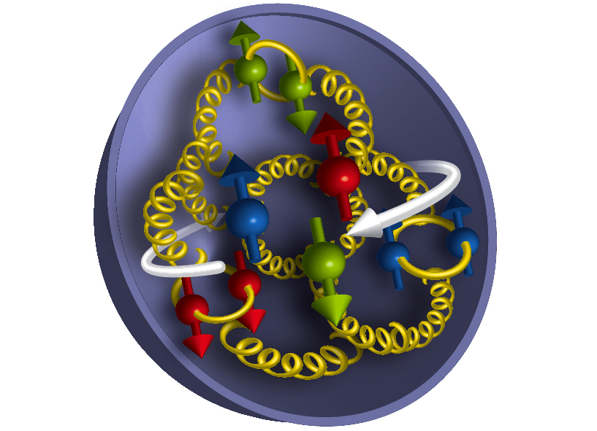
About 100 years after the discovery of the atom and the proton
We know atomic structure so well, that we define “time” using electronic transitions:
Current accuracy
~1 sec in 220 Million years
However, the internal structure of the proton is
known to only about 20-30%
~20 minutes in an hour…!
WHY?
Because of the gluons

Slide 3




Quantum Chromodynamics (QCD)
1974: QCD Asymptotic Freedom
Nobel Prize in Physics 2004
David J. Gross,
H. David Politzer,
Frank Wilczek
"for the discovery of asymptotic freedom in the theory of the strong interaction".
Theory of strong interactions includes color confinement, asymptotic freedom
2004 Nobel Prize for explaining asymptotic freedom
Confinement observed, but not quite understood….. Many facets to it…

Slide 4
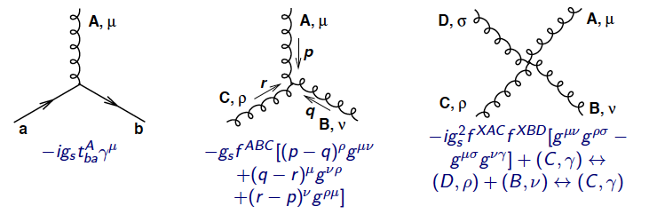
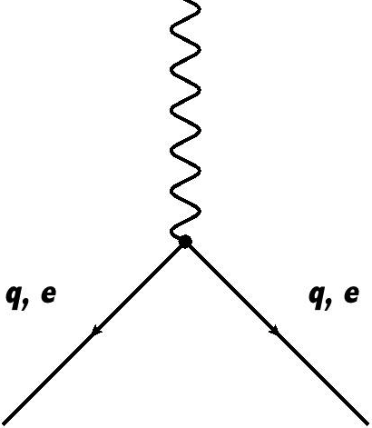
What distinguishes QCD from QED?
QED is mediated by photons (γ) which are charge-less (and couple to charged particles)
QCD is mediated by gluons (g), also charge-less but are colored! → can interact with themselves, and colored quarks
In QCD &
g → γ in QED
Only in QCD
Nonlinear growth in g-g interactions…
Bring richness and complexity to QCD
Experimental guidance always needed

Slide 5

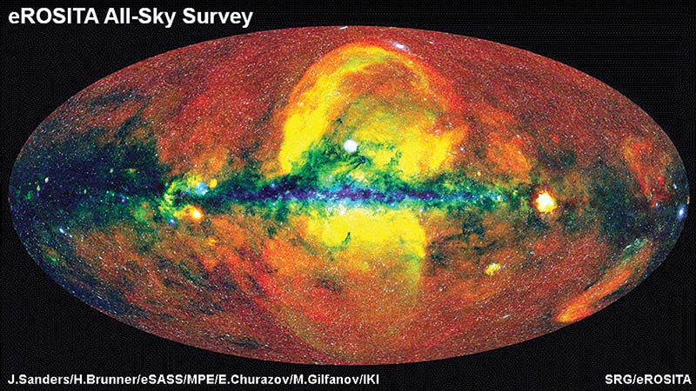
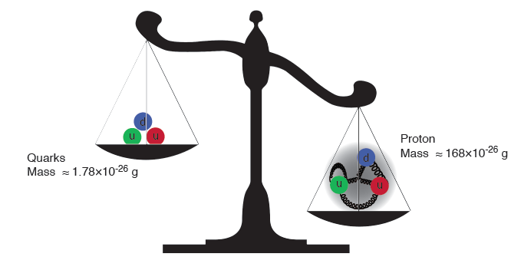
Proton mass puzzle
Nobel 2013 With
Francois Englert
“Higgs Boson” that gives mass to quarks, electrons,….
Add the masses of the quarks (HIGGS mechanism) together 1.78 x 10⁻²⁶ grams
But the proton’s mass is 168 x 10⁻²⁶ grams
only 1% of the mass of the protons (neutrons)
Where does the rest of the mass come from?
➔ Hence the Universe

Slide 6
Non-linear Dynamics of QCD has Fundamental Consequences
Emergence of spin, mass & confinement, gluon fields
Quark (Color) confinement:
  Unique property of the strong interaction
  Consequence of nonlinear gluon self-interactions
Strong Quark-Gluon Interactions:
  Confined motion of quarks and gluons – Transverse Momentum Dependent Parton Distributions (TMDs)
  Confined spatial correlations of quark and gluon distributions -- Generalized Parton Distributions (GPDs)
  Deeply connected to emergence of mass and spin of observed building blocks of nature
Ultra-dense color (gluon) fields in all nucleons and nuclei?
  Runaway growth in gluon number: Is it tamed by existing mechanisms in QCD?
  Is there a universal many-body structure due to ultra-dense color fields?
  Happens in all hadrons and nuclei? ➔ Universal?
A-A, p-A, e-A, p-p, e/μ-p/A and e-e collisions are all essential for fully understanding of QCD

Slide 7

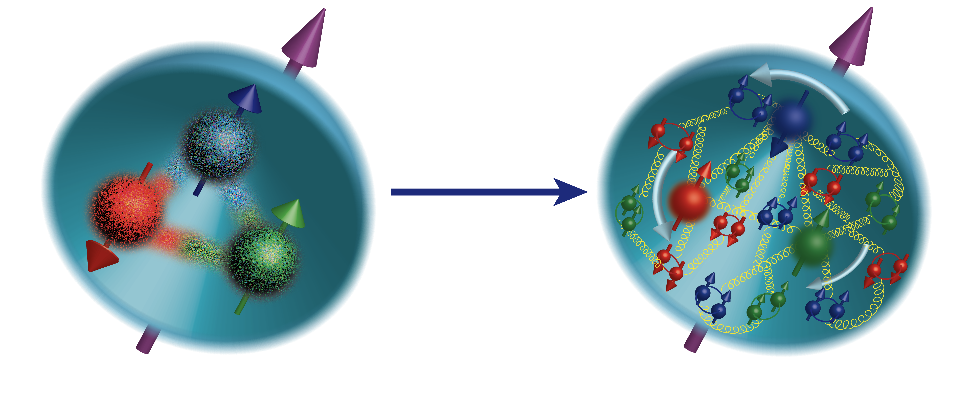
Spin “Crisis” → Spin Puzzle
Discovered by EMC experiment at CERN
25%
25%
?
?
Transverse motion and finite size of the proton must create the orbital motion.
Connected to the mass?

Slide 8
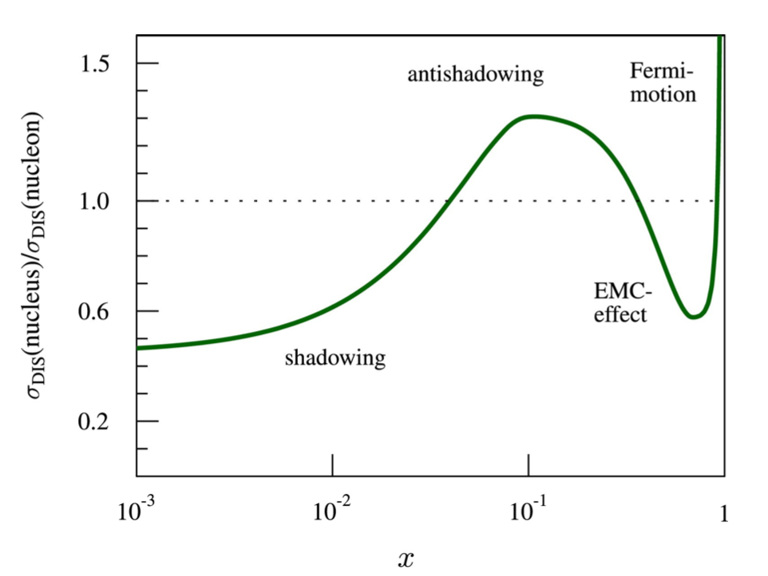
Nuclear Puzzle
Discovered by EMC experiment at CERN
Nuclear EMC effect
Parton distributions are different in protons and nuclei
Exactly how do they get modified?
What happens in regions x < 0.001?
Not quite known, and not predictable
However, low-x dynamics in protons and nuclei is of great interest, need to measure experimentally

Slide 9
Deep Inelastic Scattering (DIS)
The best technique to understand the internal structure of protons, neutrons and the nuclei.

Slide 10
We can ask : What is in there, but not how they are built or how they work!

Slide 11
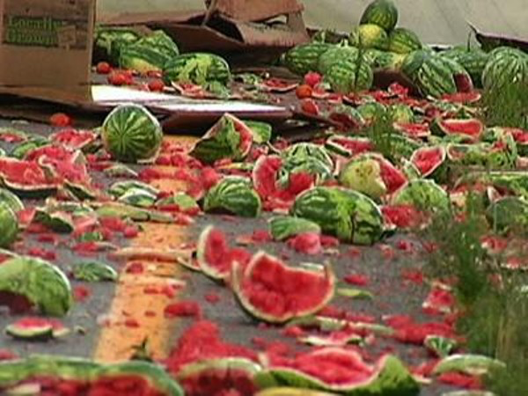


Study of internal structure of a watermelon:
A-A (RHIC/LHC)
1) Violent collision of melons
2) Cutting the watermelon with a knife
Violent DIS e-A (EIC)

Slide 12

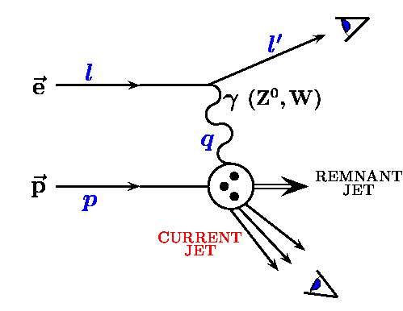
Deep Inelastic Scattering
λ = (h/2π)(1/Q²)
h = constant
λ = wavelength
Q² = momentum
transferred
Q
λ
Deep Inelastic: (λ << Proton Size)

Slide 13
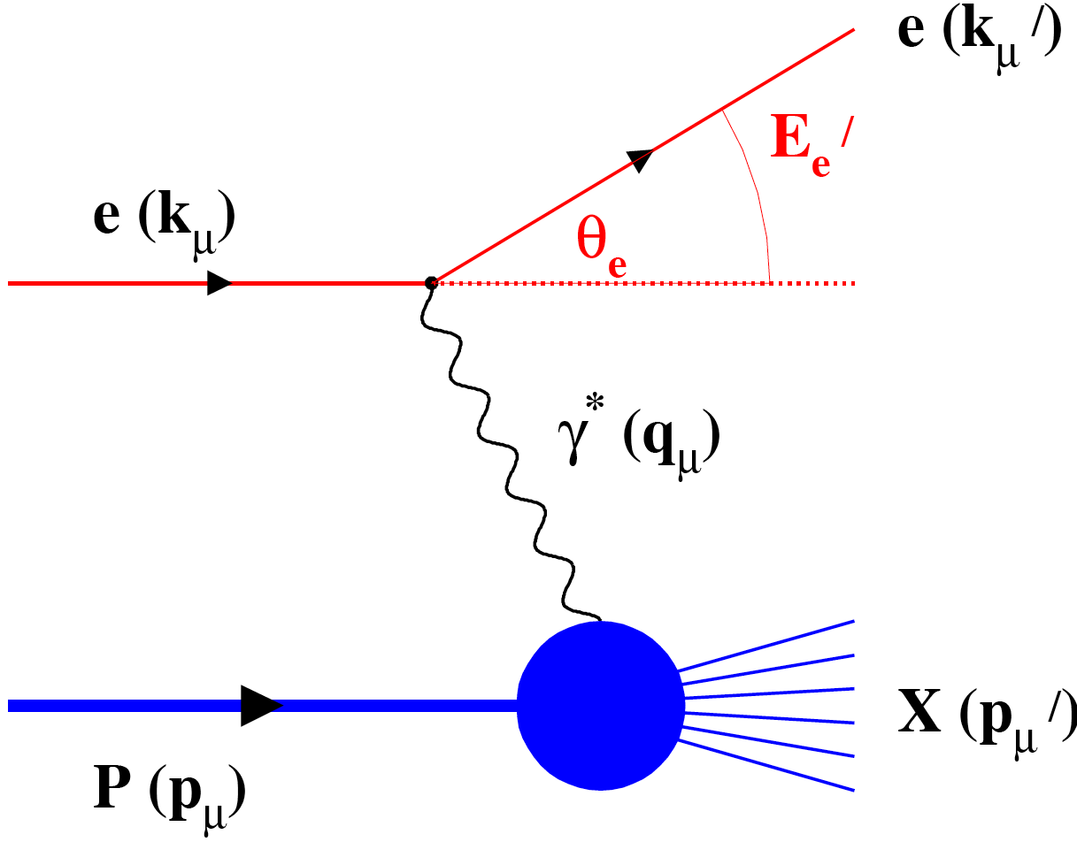
Deep Inelastic Scattering: Precision and control
Kinematics:
Measure of resolution power
Measure of inelasticity
Measure of momentum fraction of struck quark
High lumi & acceptance
Exclusive DIS
  detect & identify everything e+p/A → e’+h(π,K,p,jet)+…
Semi-inclusive events:
  e+p/A → e’+h(π,K,p,jet)+X
  detect the scattered lepton in coincidence with identified hadrons/jets
Inclusive events:
  e+p/A → e’+X
  detect only the scattered lepton in the detector
with respect to γ∗
s = 4 E_{h} E_{e}
Low lumi & acceptance

Slide 14
The x-Q² plane…
Resolution
y = 0.95
y = 0.01
x = Momentum fraction

Slide 15
Physics of EIC

Slide 16
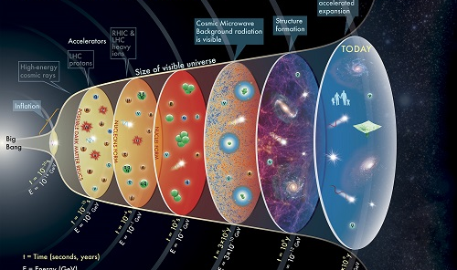
Electron Ion Collider

Slide 17
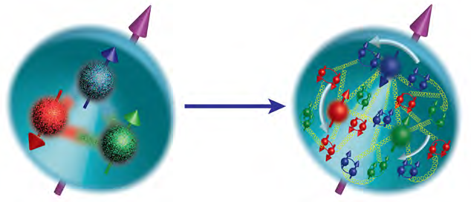
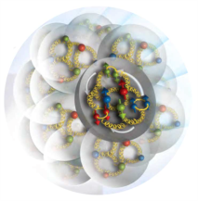
EIC Physics at-a-Glance
How are the sea quarks and gluons, and their spins, distributed in space and momentum inside the nucleon?
How do the nucleon properties (mass & spin) emerge from their interactions?
How do color-charged quarks and gluons, and colorless jets, interact with a nuclear medium?
How do the confined hadronic states emerge from these quarks and gluons?
How do the quark-gluon interactions create nuclear binding?
How does a dense nuclear environment affect the quarks and gluons, their correlations, and their interactions?
What happens to the gluon density in nuclei? Does it saturate at high energy, giving rise to a gluonic matter with universal properties in all nuclei, even the proton?
gluon
emission
gluon recombination
?
=

Slide 18
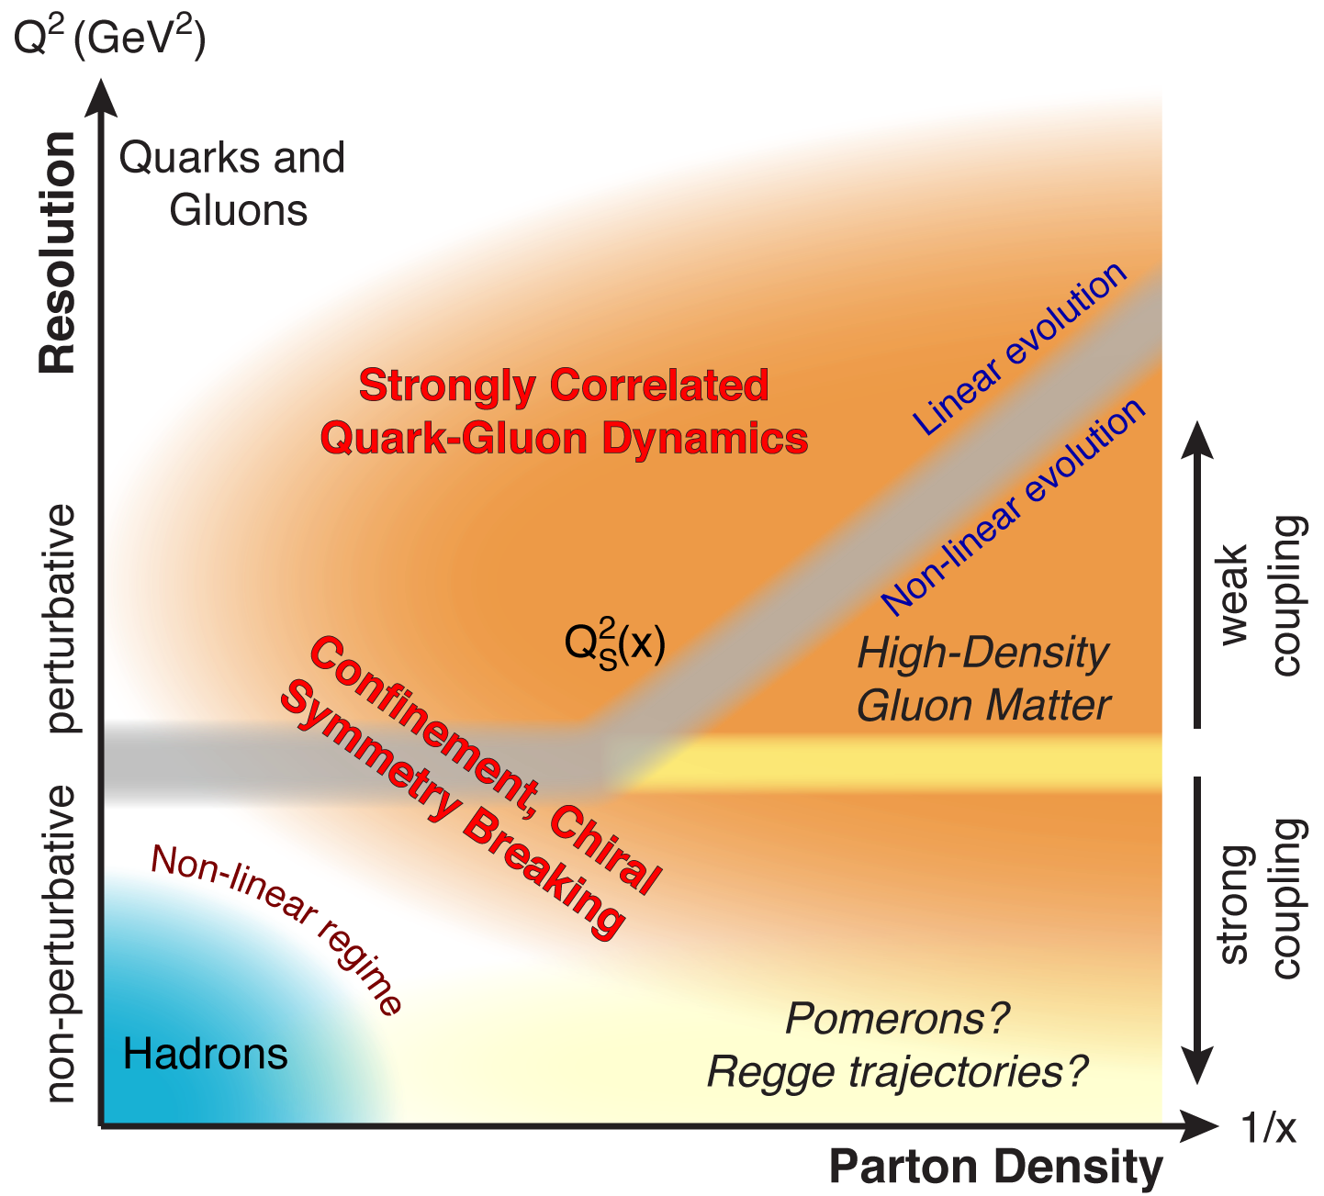
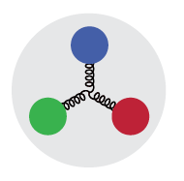
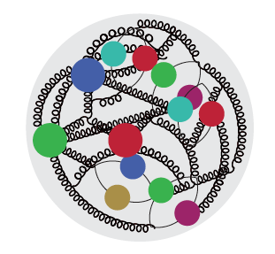

QCD Landscape to be explored by a new future facility
QCD at high resolution (Q²) —weakly correlated quarks and gluons are well-described
Strong QCD dynamics creates many-body correlations between quarks and gluons
→ hadron structure emerges
Systematically explore correlations in this region.
arXiv: 1708.01527
An exciting opportunity: Observation of a new regime in QCD of weakly coupled high-density matter
Need Precision and Control

Slide 19
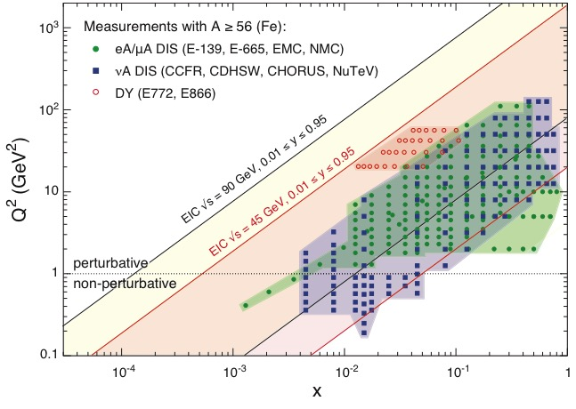
EIC: NEW Kinematic reach & properties
Resolution ➔
For e-N collisions at the EIC:
Polarized beams: e, p, d/³He
Variable center of mass energy
Wide Q² range → evolution
Wide x range → spanning valence to low-x physics
Momentum fraction
Resolution ➔
For e-A collisions at the EIC:
Wide range in nuclei
Luminosity per nucleon same as e-p
Variable center of mass energy
Wide x range (evolution)
Wide x region (reach high gluon densities)
Momentum fraction
Notes:
Minimize words, keep and enhance the figures….

Slide 20
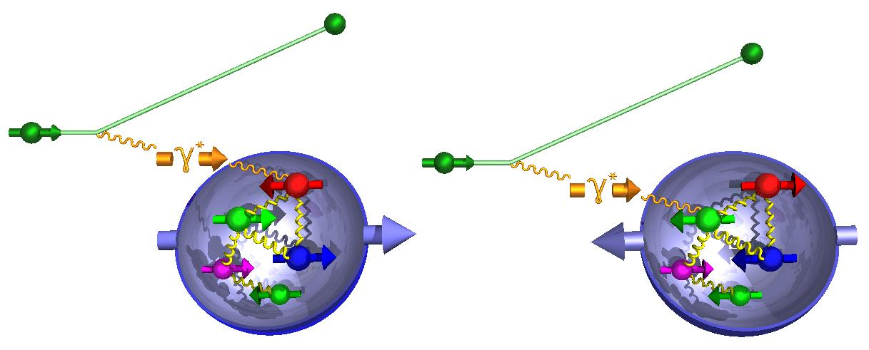
Nucleon Spin: Precision with EIC
g₁ ~
-
ΔΣ/2 = Quark contribution to Proton Spin
Δg = Gluon contribution to Proton Spin
L_{Q} = Quark Orbital Ang. Mom
L_{G} = Gluon Orbital Ang. Mom
Spin structure function g₁ needs to be measured over a large range in x-Q²
Precision in ΔΣ and Δg ➔ A clear idea
Of the magnitude of L_{Q}+L_{G} = L
Lattice Calculations : comparison
SIDIS: strange and charm quark spin contributions
Notes:
Make the connection from measured x to unmeasured x very clear.
Figure on the right bottom: replace by the EIC money plot. Drop

Slide 21
Courtesy: Alssandro Bacchetta

Slide 22
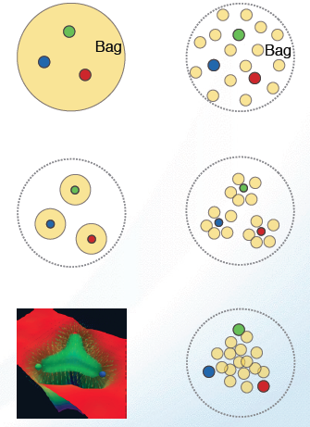
What does a proton look like in “transverse” dimension?
Static Boosted
Bag Model: Gluon field distribution is wider than the fast moving quarks. Color (Gluon) radius > Charge (quark) Radius
Constituent Quark Model: Gluons and sea quarks hide inside massive quarks. Color (Gluon) radius ~ Charge (quark) Radius
Lattice Gauge theory (with slow moving quarks), gluons more concentrated inside the quarks: Color (Gluon) radius < Charge (quark) Radius
Need transverse images of the quarks and gluons in protons

Slide 23
2+1-Dimensional Imaging Quarks and Gluons
Wigner functions W(x,b_{T},k_{T})
offer unprecedented insight into confinement and chiral symmetry breaking.
W(x,b_{T},k_{T})
∫d²b_{T}
∫ d²k_{T}
Momentum
space
Coordinate
space
Near future promise of direct
Comparison with lattice QCD
f(x,k_{T})
f(x,b_{T})
Spin-dependent 3D momentum space
images from semi-inclusive scattering
→ Transverse Momentum Distribution
Spin-dependent 2D coordinate space (transverse) + 1D (longitudinal momentum)
images from exclusive scattering (Deeply virtual Compton scattering and meson production)
→ Generalized Parton Distributions
momentum and position distributions → Orbital motion of quarks and gluons
Possible direct access to gluon Wigner function through diffractive di-jet measurements at an EIC: Y. Hatta et al. PRL 16, 022301 (2016
Notes:
added why wigner fcts. are important. and added reference statement that diffraction allows access to gluon wigner functions
Y. Hatta, Bo-Wen Xiao & F. Yuan, PRL 116, 022301 (2016)
10.1103/PhysRevLett.116.202301
Angular correlation between the nucleon’s recoil momentum and the di-jet transverse momentum carry non-trivial information about the phase space of the Wigner distribution.

Slide 24
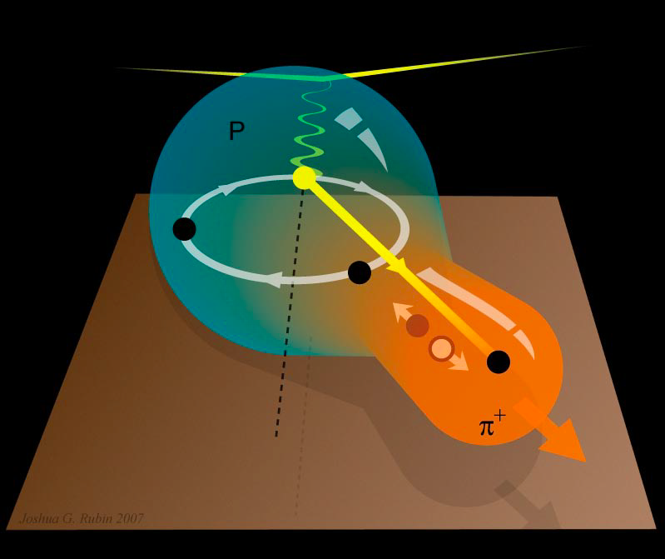
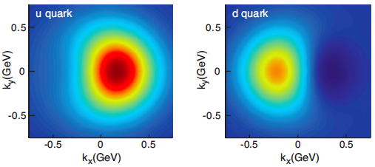
2+1 D partonic image of the proton with the EIC
Spin-dependent (2+1)D momentum space images from semi-inclusive scattering (SIDS)
Spin-dependent 2D coordinate space (transverse) + 1D (longitudinal momentum) images from exclusive scattering
Transverse Momentum Distributions
Transverse Position Distributions
Quarks
Motion
Gluons:
Only @
Collider
Deeply Virtual Compton Scattering
Measure all three final states
e + p → e’+ p’+ γ
Fourier transform of momentum transferred=(p-p’) → Spatial distribution
Quark’s 2D momentum distribution
Sea quark’s 2D position distribution
unpolarized polarized

Slide 25
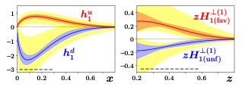
Transversity and family
Transversity PDFs
Favored & unfavored Collins FFs
Lattice QCD Calculations are already playing a very significant role in fully understanding and interpretation of data
Tensor charge
Lin et al., arXiv:1710.09858; Lattice Augmented transversity fits by JAM
Pavia 18: Radici & Bacchetta, PRL 120 (19) 2018) 192001
[1] C. Alexandrou et al., PRD102 (5) 2020 054517
[2] T. Haris et al., PRD 100 (3) 2019 034513
[3] N. Hasan et al., PRD 99 (11) 2019 114505
[4] N. Yamanaka et al., PRD 98 (5) 2018 054516
[5] R. Gupta et al., PRD98 (2018) 034503
[6] C. Alexandrou et al., PRD95 (11) (2017) 114514
[7] G.S. Bali et al., PRD91 (5) 2015 054501
[8] J.R.Green et al., PRD86 (2012) 114509
Isovector tensor charge

Slide 26
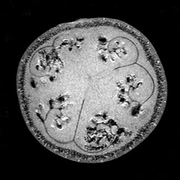
Study of internal structure of a watermelon:
A-A (RHIC, LHC)
1) Violent collision of melons
2) Cutting the watermelon with a knife
Violent DIS e-A (EIC)
3) MRI of a watermelon
Non-Violent e-A (EIC)

Slide 27
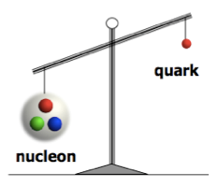
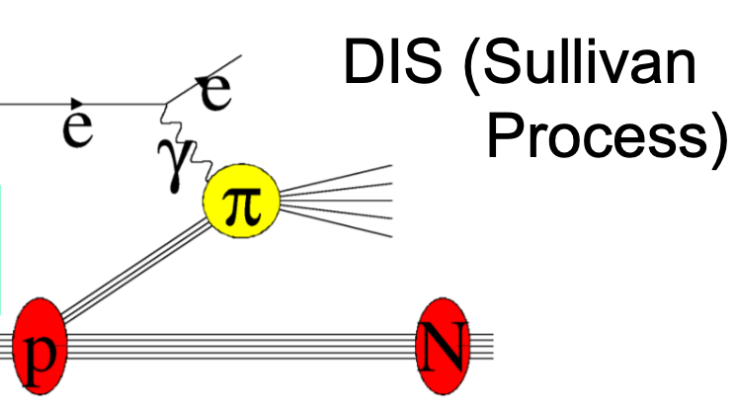
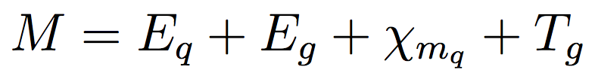
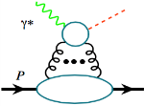




Mass of the Nucleon (Pion & Kaon)
“The mass is the result of the equilibrium reached through dynamical processes.” X. Ji
“… The vast majority of the nucleon’s mass is due to quantum fluctuations of quark-antiquark pairs, the gluons, and the energy associated with quarks moving around at close to the speed of light. …”
-- The 2015 Long Range Plan for Nuclear Science
Chiral
Symmetry
Breaking
Quantum
Fluctuations
Relativistic Motion
X. Ji, PRL 74 1071 (1995)
Quark Energy
Gluon Energy
Quark Mass
Trace Anomaly
(pion/Kaon) PDFs: P. C. Barry et al. PRL 127, 232001 (2021)
Criticisms: not scale-invariant, decompositions: Lorentz invariant vs. rest frame
Recent interest (workshops) planned to settle: how to determine the different contributions
Lattice QCD providing estimates
Trace anomaly:
Upsilon production
near threshold:
SoLID@JLab & EIC
J/Ψ, Υ, …
~30%
~40%
~10%
~ 25%
arXiv: 1710.09011

Slide 28
Consequence of gluon self interactions
Particularly at high energy (low-x)

Slide 29
How does a Proton look at low and very high energy?
Time →
Low energy: High x
Regime of fixed target exp.
High energy: Low- x
Regime of a Collider
Cartoon of boosted proton
At high energy:
Wee partons fluctuations are time dilated in strong interaction time scales
Long lived gluons radiate smaller x gluons ➔ which in turn radiate more… a chain reaction leading to a runaway growth?
Gluon splitting

Slide 30
Gluon and the consequences of its interesting properties:
Gluons carry color charge ➔ Can interact with other gluons!
“…The result is a self catalyzing enhancement that leads to a runaway growth.
A small color charge in isolation builds up a big color thundercloud….”
F. Wilczek, in “Origin of Mass”
Nobel Prize, 2004
? Infinity?
No!
Notes:
Significant modification and simplification of this slide… may convert in to two….

Slide 31
Gluon and the consequences of its interesting properties:
Gluons carry color charge ➔ Can interact with other gluons!
“…The result is a self catalyzing enhancement that leads to a runaway growth.
A small color charge in isolation builds up a big color thundercloud….”
F. Wilczek, in “Origin of Mass”
Nobel Prize, 2004
gluon
emission
gluon recombination
=
Saturation State of Gluons reached
Notes:
Significant modification and simplification of this slide… may convert in to two….

Slide 32
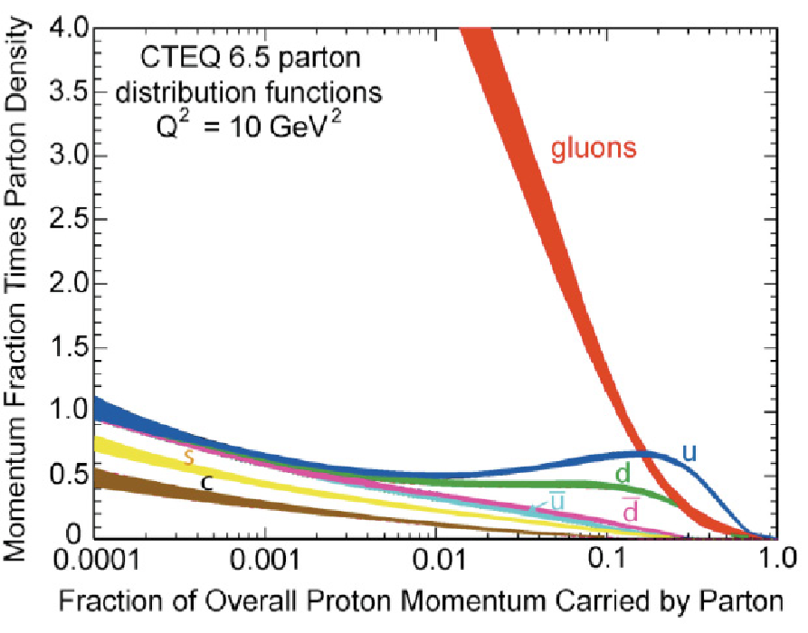
In search of a new state of matter!
?
What could tame the low-x rise?
Can EIC access this region?
QCD inherently has the needed mechanism for this taming but we don’t know when it gets triggered.
gluon
emission
gluon recombination
=
At Q_{S}
Observation of gluon recombination effects
➔Is there such new state of matter?
“Color Glass Condensate”
50-100 times higher energy density than the core of the neutron star
Experimental evidence needed
Notes:
Color Glass Condensate mentioned for the first time here!

Slide 33
Low x physics with nuclei
Accessible range of saturation scale Q_{s} ² at the EIC with e+A collisions.
arXiv:1708.01527
gluon
emission
gluon recombination
300 GeV
=
At Q_{S}

Slide 34
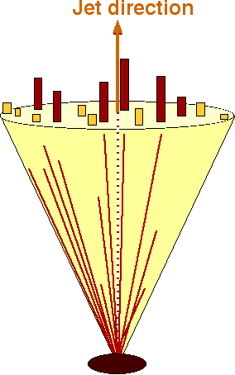
Can EIC discover a new state of matter?
EIC provides an absolutely unique opportunity
to have very high gluon densities
→ electron – lead collisions
combined with an unambiguous observable
counting experiment of
Di-jets in ep and eA
Saturation:
Disappearance of backward jet in eA
EIC will allow to unambiguously
map the transition from a non-saturated to saturated regime
e
p
e
A
#backward jets in eA / ep
increased √s → increased suppression

Slide 35
Emergence of Hadrons from Partons
Nucleus as a Femtometer sized filter
Unprecedented ν, the virtual photon energy range @ EIC : precision & control
Energy loss by light vs. heavy quarks:
Study in light quarks
vs.
heavy quarks
Control of ν by selecting kinematics;
Also under control the nuclear size.
(colored) Quark passing through cold QCD matter emerges as color-neutral hadron ➔
Clues to color-confinement?
Identify π vs. D^{0 (charm)} mesons in e-A collisions:
Understand energy loss of light vs. heavy quarks traversing the cold nuclear matter:
Connect to energy loss in Hot QCD
Need the collider energy of EIC and its control on parton kinematics
Notes:
Large nu measurements, Q2 large, so Shadowing effects are absent

Slide 36
National Academy’s Assessment
Physics of EIC
Emergence of Spin
Emergence of Mass
Physics of high-density gluon fields
Machine Design Parameters:
High luminosity: up to 10³³-10³⁴ cm⁻²sec⁻¹
  a factor ~100-1000 times HERA
Broad range in center-of-mass energy: ~20-140 GeV
Polarized beams e-, p, and light ion beams with flexible spin patterns/orientation
Broad range in hadron species: protons…. Uranium
Up to two detectors well-integrated detector(s) into the machine lattice
EIC science:
compelling, fundamental
and timely

Slide 37

EIC moved forward…. A major step!
Site selection & anticipated timeline
DOE announced: January 9, 2020
  CD0 December 19, 2019
  Site of EIC: Brookhaven National Laboratory
BNL and JLab realize EIC as partners
  A formal EIC project is now setup at BNL
  BNL+Jlab management & scientists
CD1 June 28, 2021

Slide 38
EIC moved forward…. A major step!
Site selection & anticipated timeline
DOE announced: January 9, 2020
  CD0 December 19, 2019
  Site of EIC: Brookhaven National Laboratory
BNL and JLab realize EIC as partners
  A formal EIC project is now setup at BNL
  BNL+Jlab management & scientists
CD1 June 28, 2021
CD2 Approval 3rd Quarter FY2023
CD3 1st Quarter FY2024 (start construction)
EIC CD4A Early Finish 4thQ FY2029
EIC CD4B 3rdQ FY 2032

Slide 39
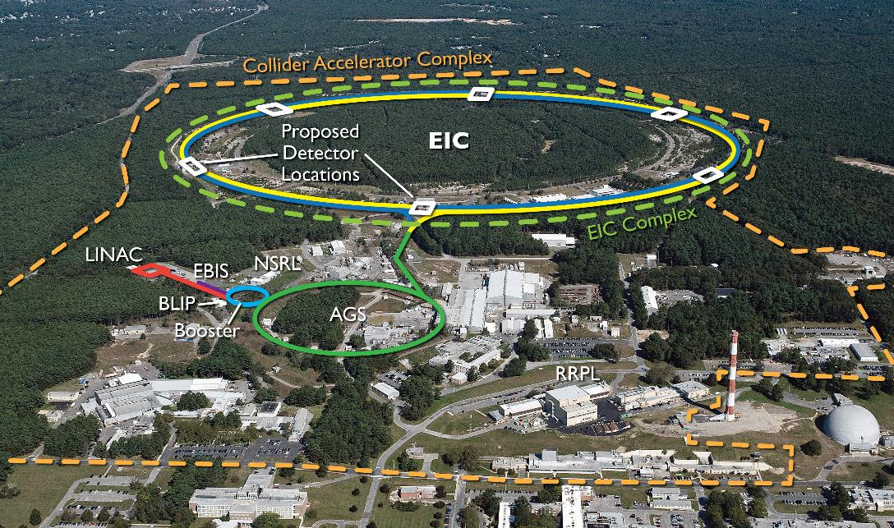
EIC benefits from $B class investments at BNL and the highly successful RHIC program.
RHIC will conclude operations in 2025. EIC installation will begin after RHIC ops concludes.

Slide 40
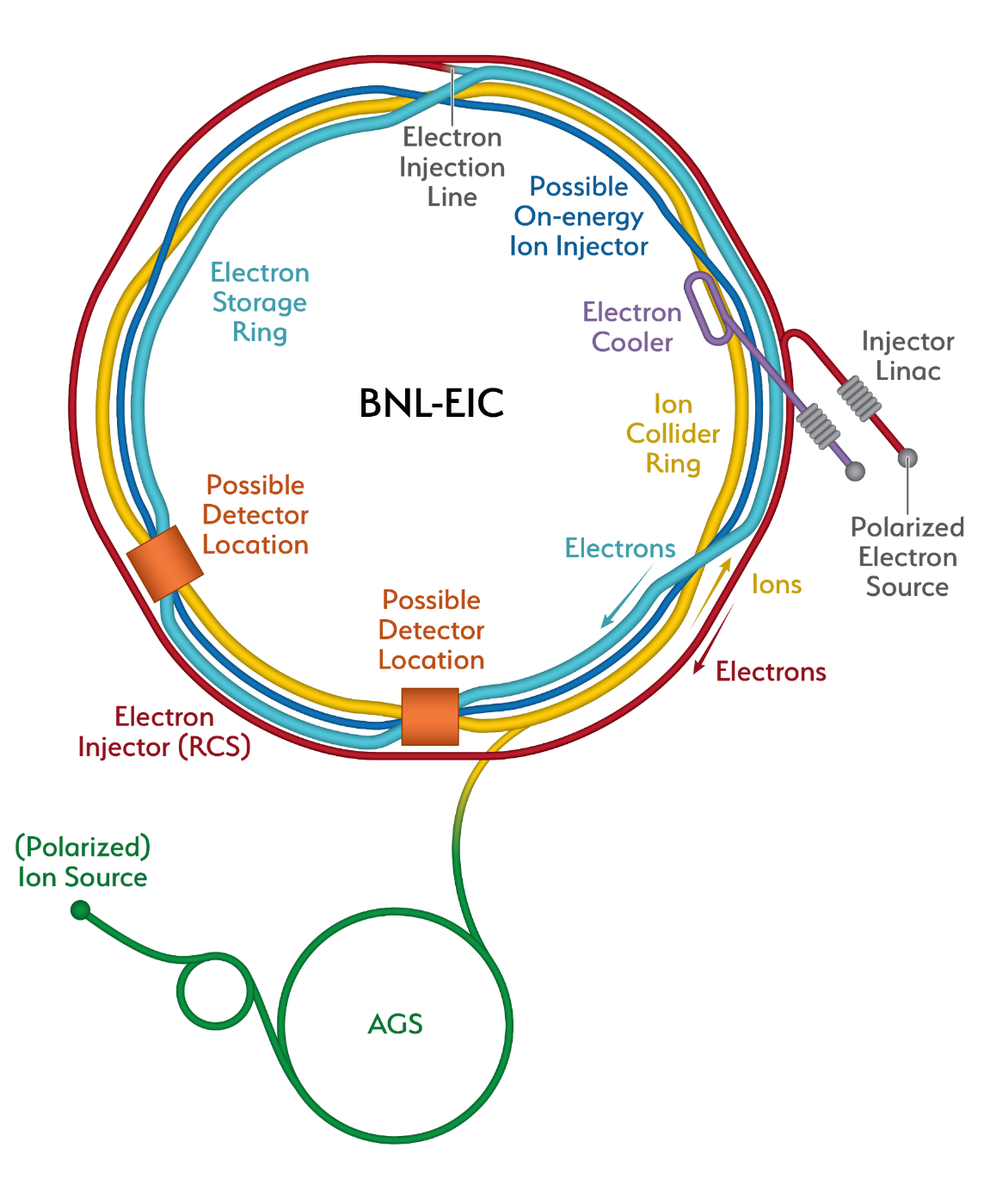
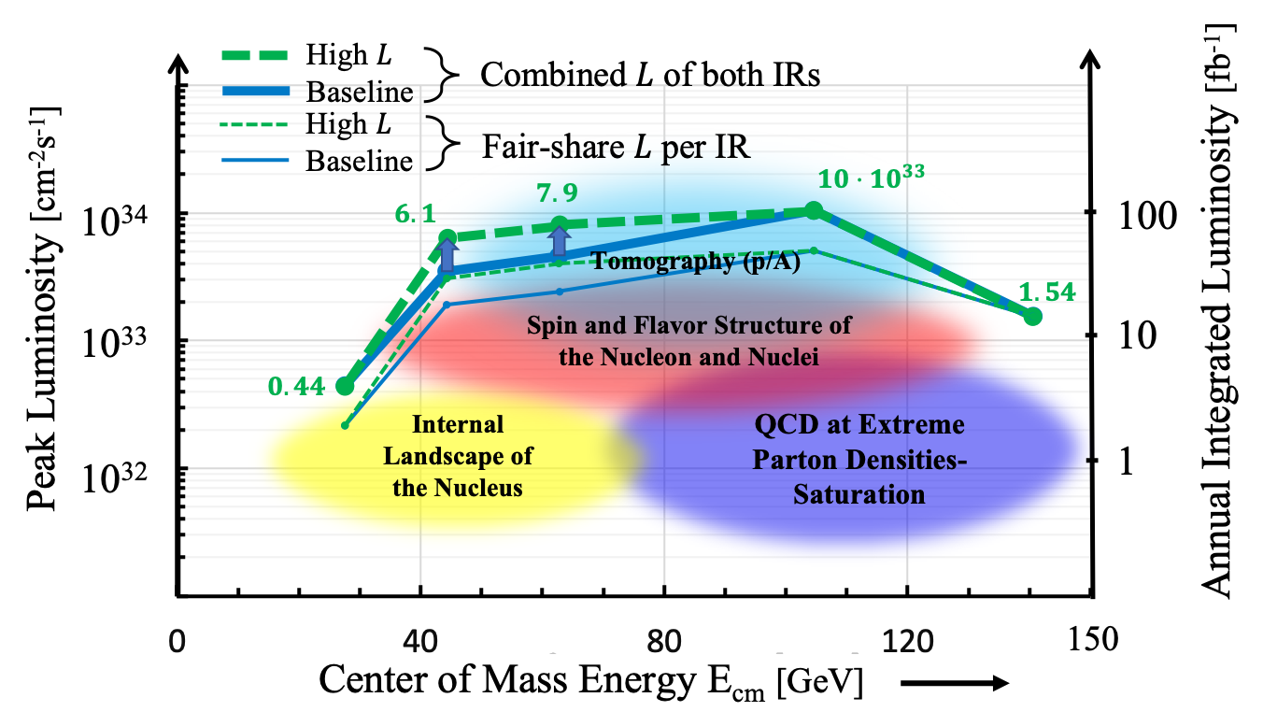
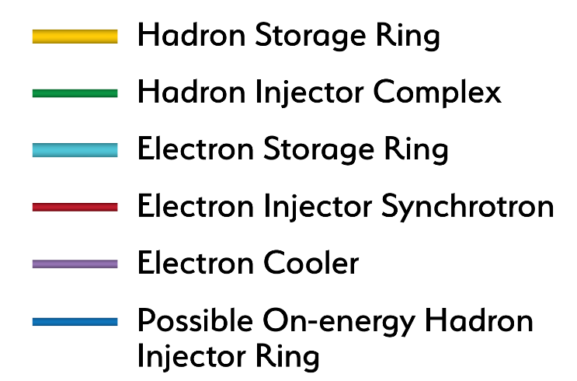
EIC Accelerator Design
Center of Mass Energies: | 20GeV - 140GeV
Luminosity: | 10³³ ⁻ 10³⁴ cm⁻²s⁻¹ / 10-100fb⁻¹ / year
Highly Polarized Beams: | 70%
Large Ion Species Range: | p to U
Number of Interaction Regions: | Up to 2!

Slide 41
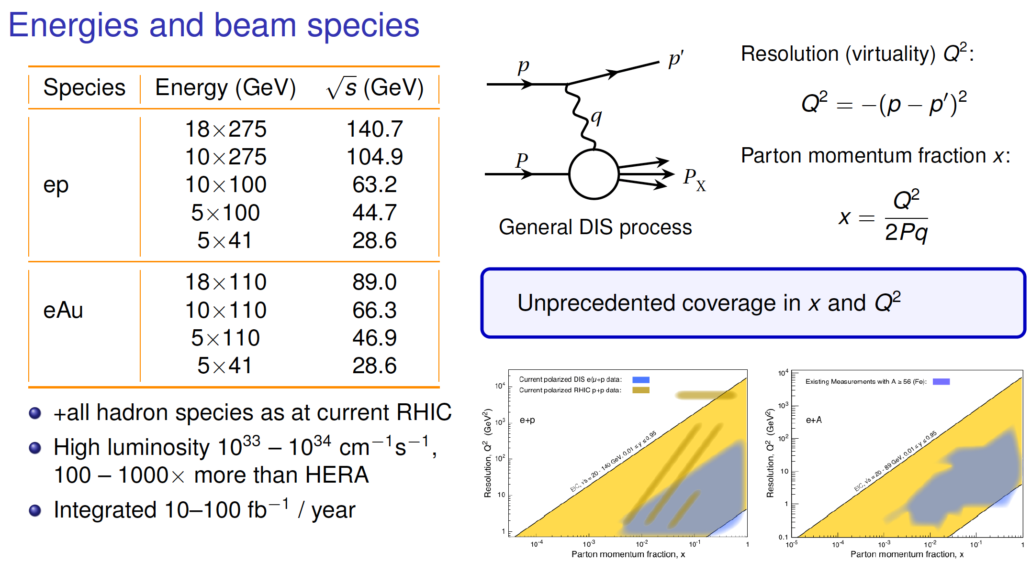

Slide 42
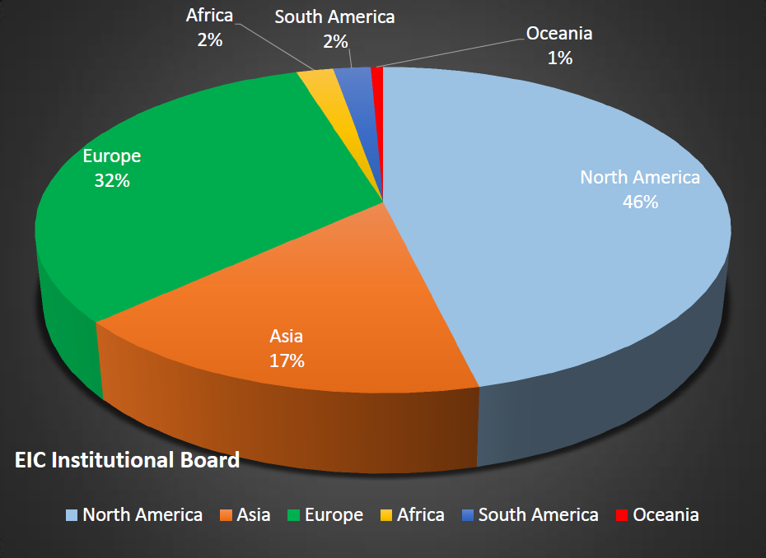
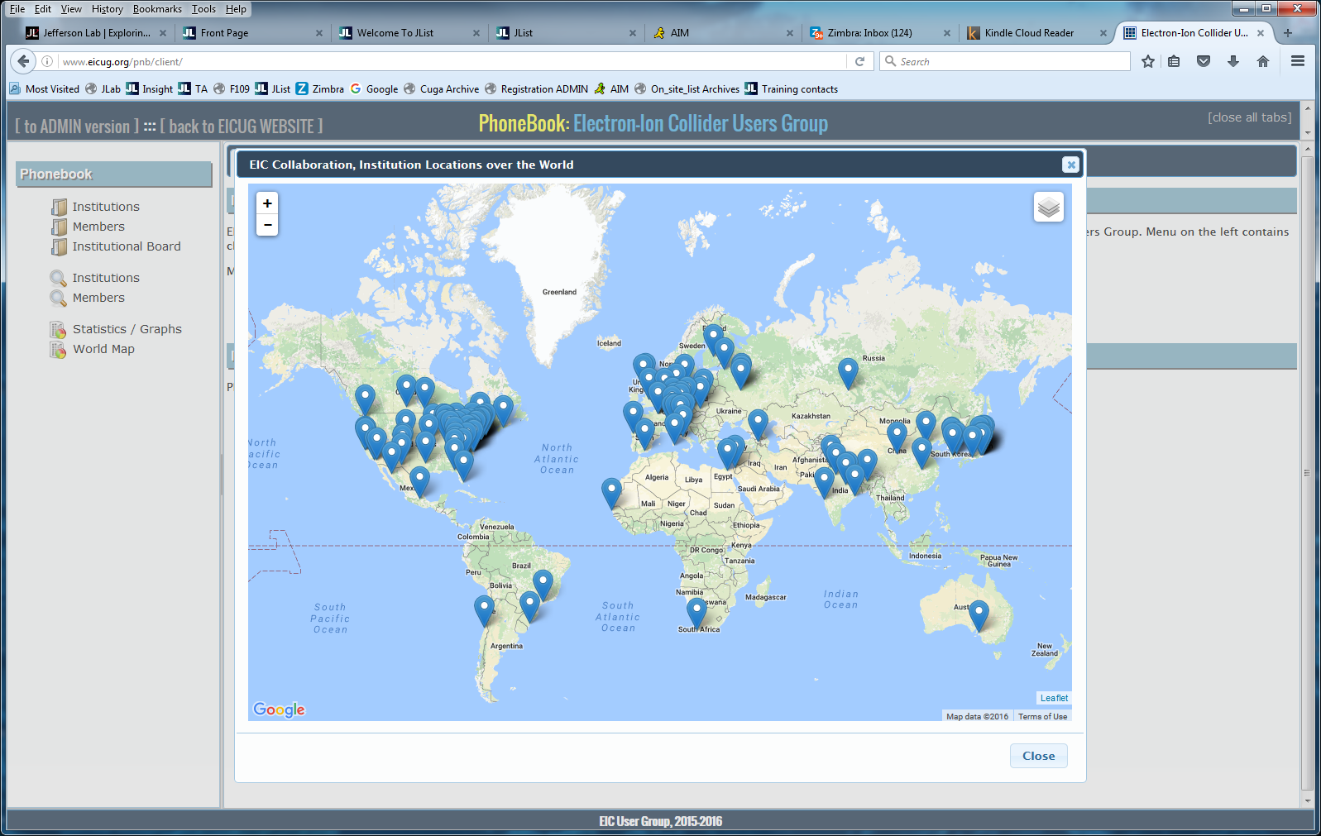

The EIC Users Group: EICUG.ORG
Formally established in 2016, now we have:
~over 1000s Ph.D. Members from over 30 countries
New members welcome
Map of institution’s locations
EICUG Structures in place and active:
EIC UG Steering Committee, Institutional Board, Speaker’s Committee, Election & Nominations Committee
New:
Center for Frontiers in Nuclear Science (at Stony Brook/BNL)
EIC² at Jefferson Laboratory

Slide 43
Physics @ the US EIC beyond the EIC’s core science
Of HEP/LHC-HI interest to Snowmass 2021 (EF 05, 06, and 07 and possibly also EF 04)
Perhaps other intersections with LQCD?
New Studies with proton or neutron target:
Impact of precision measurements of unpolarized PDFs at high x/Q², on LHC-Upgrade results(?)
What role would TMDs in e-p play in W-Production at LHC? Gluon TMDs at low-x!
Heavy quark and quarkonia (c, b quarks) studies with 100-1000 times lumi of HERA
Does polarization of play a role (in all or many of these?)
Physics with nucleons and nuclear targets:
Quark Exotica: 4,5,6 quark systems…? Much interest after recent LHCb led results.
Physic of and with jets with EIC as a precision QCD machine:
  Internal structure of jets : novel new observables, energy variability, polarization, beam species
  Entanglement, entropy, connections to fragmentation, hadronization and confinement
  Studies with jets: Jet propagation in nuclei… energy loss in cold QCD medium
Connection to p-A, d-A, A-A at RHIC and LHC
Polarized light nuclei in the EIC
Precision electroweak and BSM physics:
Electroweak physics & searches beyond the SM: Parity, charge symmetry, lepton flavor violation

Slide 44
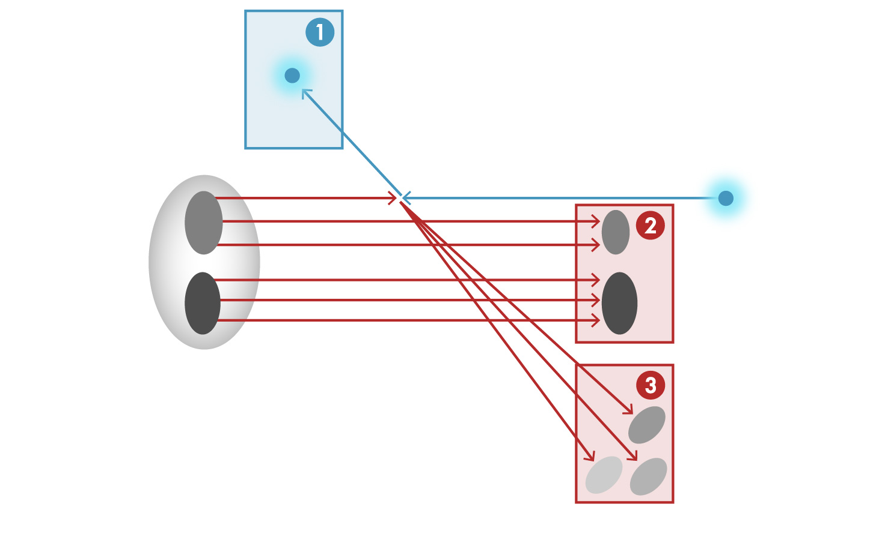


Detector Challenge of the EIC
e
e’, $ν$
Aim of EIC is 3D nucleon and nuclear structure beyond the longitudinal description.
This makes the requirements for the machine and detector different from all previous colliders.
$γ,$Z,W
p/A
q
p remnant
“Statistics”=Luminosity × Acceptance
e’
e
EIC Physics demands ~100% acceptance for all final state particles (including particles associated with initial ion)
p/A
Ion remnant is particularly challenging
not a usual concern at colliders
at EIC integrated from the start with a highly integrated (and complex) detector and interaction region scheme.
Scattered electron
Particle associated with initial Ion
Particle associated with struck quark (or associated gluon)
Aschenauer/Ent

Slide 45
December 2019 – March 2021
EICUG Yellow Report
Led by EICUG Steering Committee, UG-wide effort towards a detailed detector design effort with a detailed document.
Kick off meeting at MIT in December 2019 followed by 4 more meetings in 2020 all remote: Philadelphia, Pavia, Miami, Washington DC, Berkeley
902 pages
415 authors
151 institutions
120 MB
arXiv:2103.05419

Slide 46
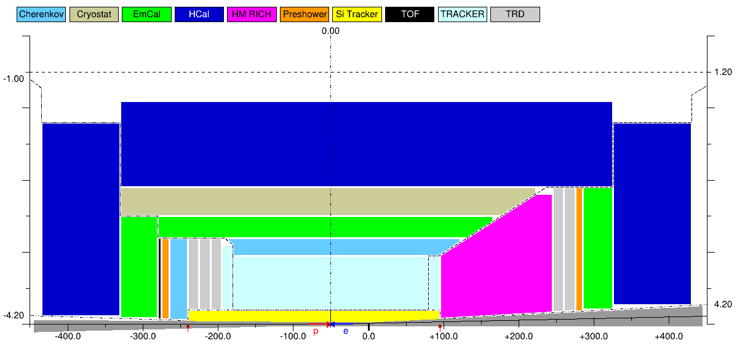
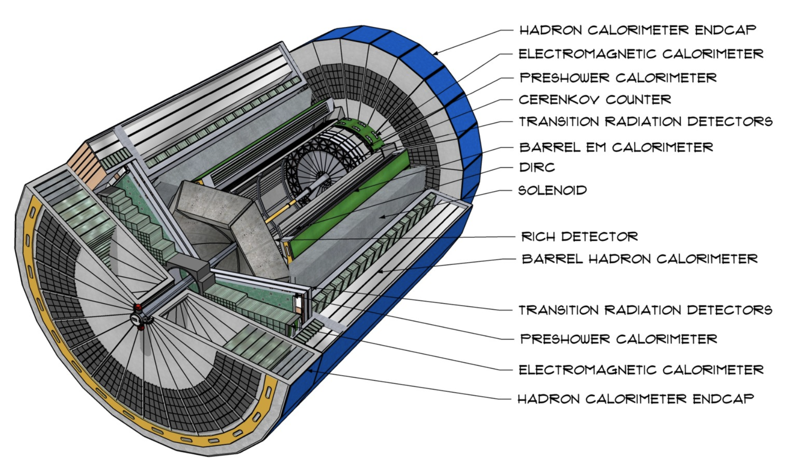
Concept DETECTOR
This detector concept was included in the EIC CDR prepared for the CD1 Review
HCal
HCal
HCal
ECal
PID
TRD
ECal
ECal
PID
TPC
Gaseous RICH
TRD
Si trackers

Slide 47
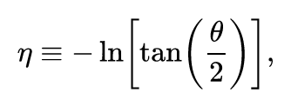
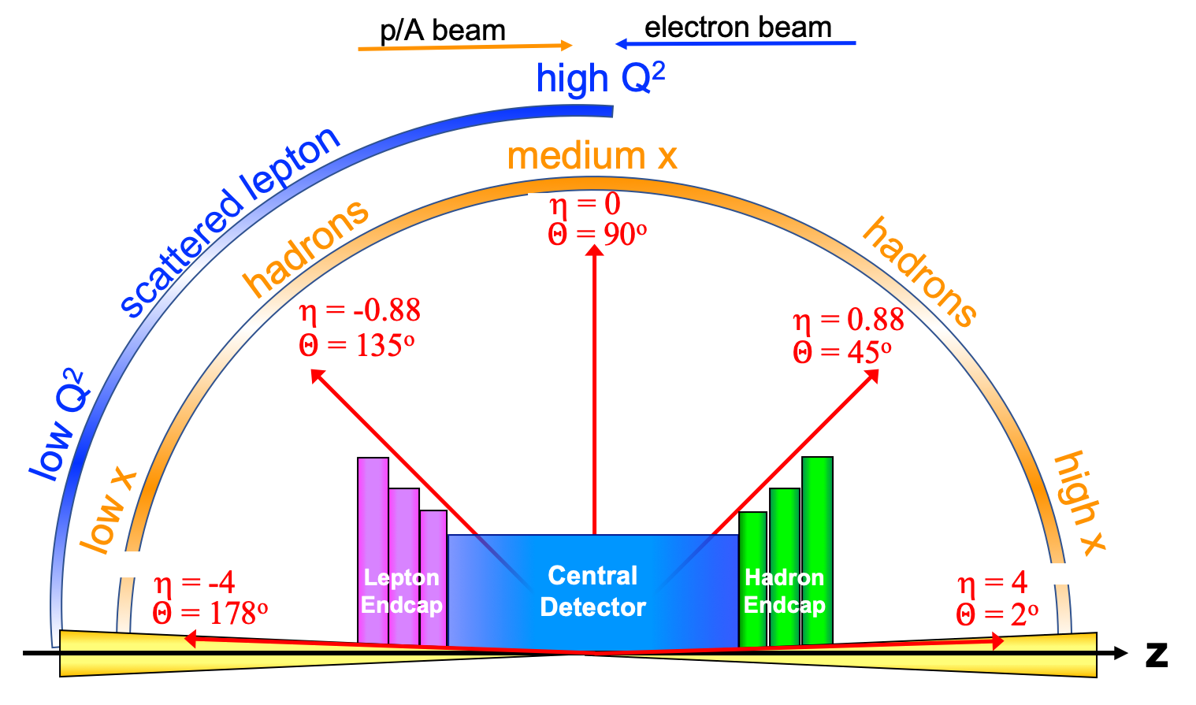
Detector polar angle / pseudo-rapidity coverage

Slide 48
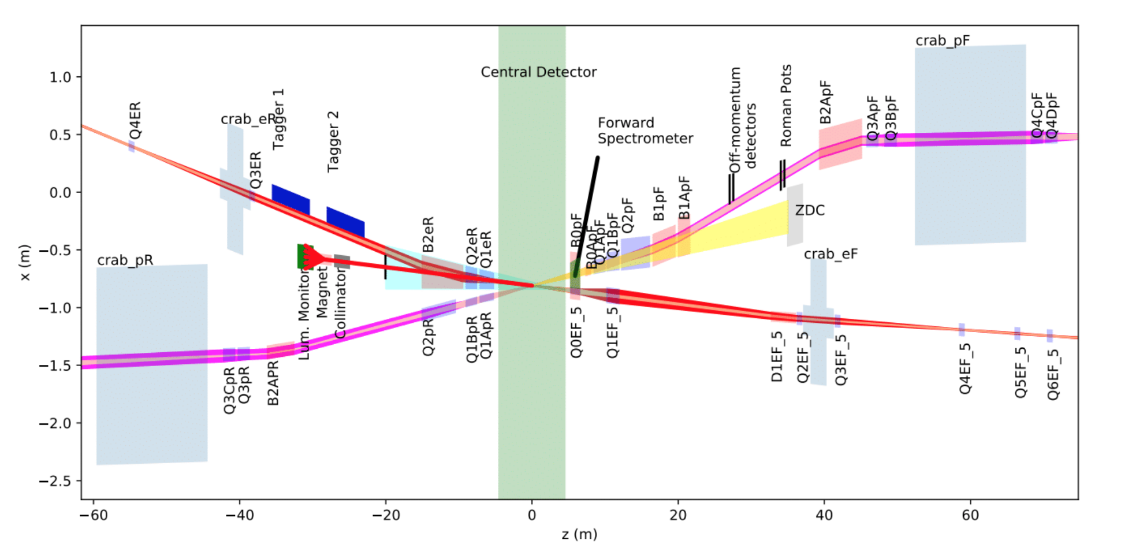
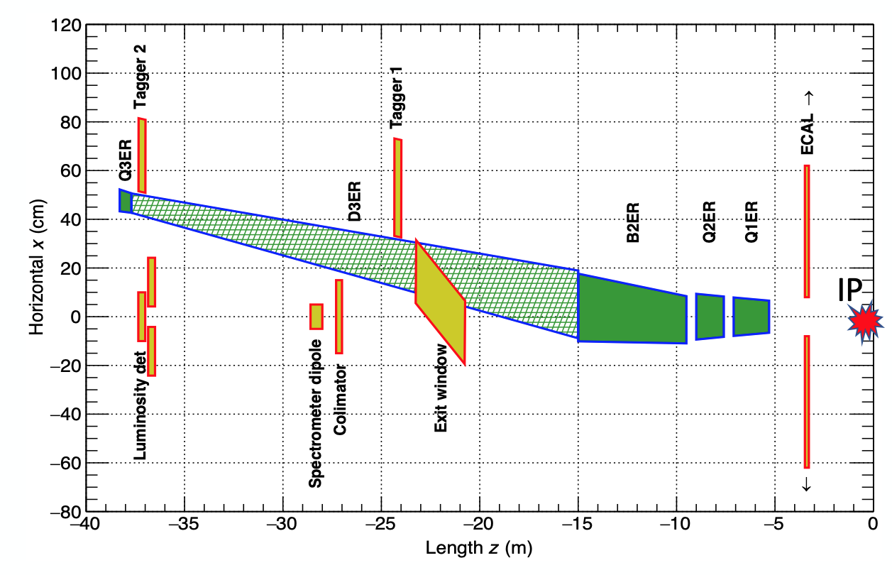
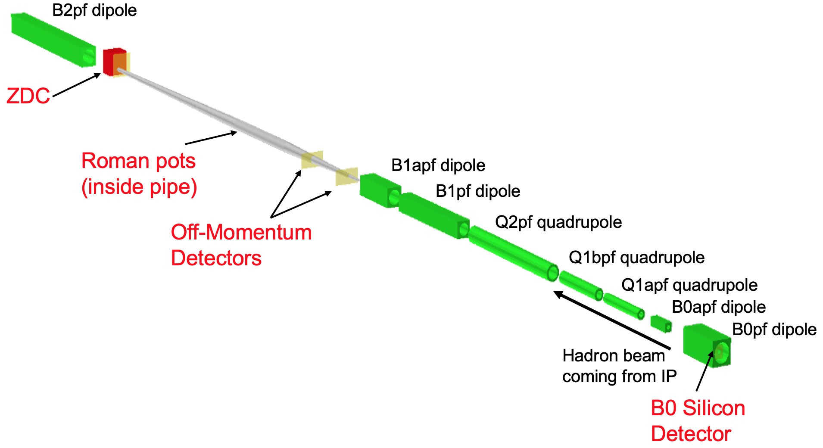
Reference Detector – Backward/Forward Detectors
far-backward detectors
far-forward detectors
Extensive integration of forward and backward detector elements into the accelerator lattice

Slide 49
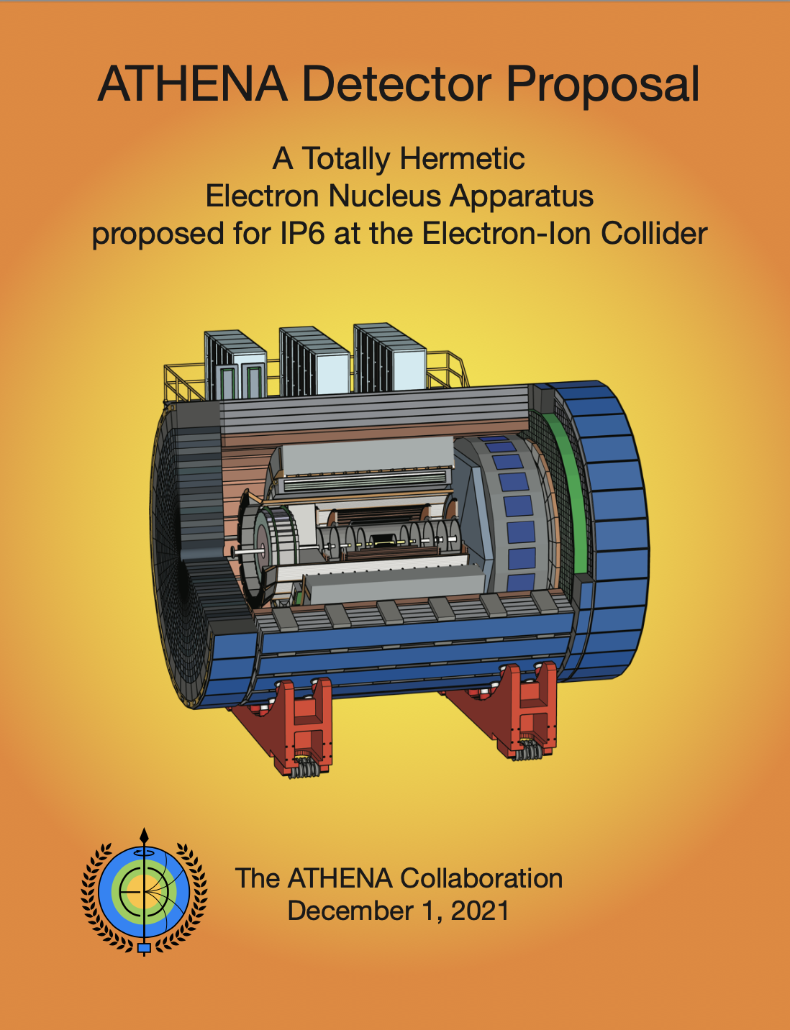
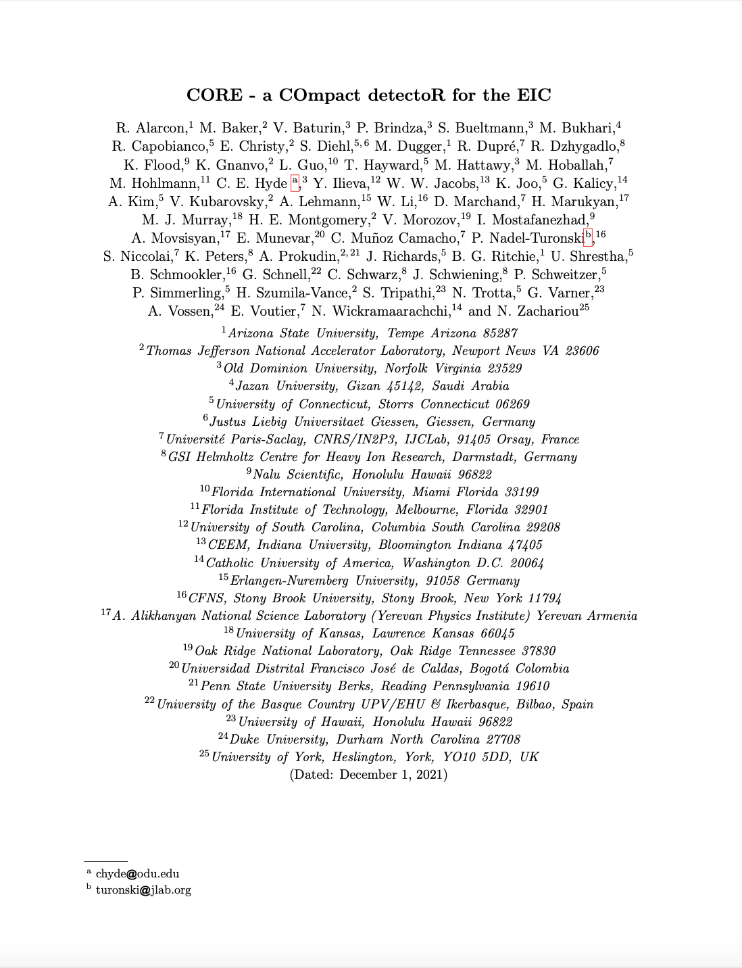


The three proposals + White Paper: 2nd IR Physics
CFNS helped all three & the 2nd IR White Paper
EIC Advisory Panel’s recommendation on April 8, 2022

Slide 50


Slide 51


Slide 52


Slide 53


Slide 54

Highest priority for facility construction

Slide 55

Reference Schedule
J. Yeck, EICUG Meeting

Slide 56


Slide 57
Summary & Outlook
Electron Ion Collider, a high-energy high-luminosity polarized e-p, e-A collider, funded by the DOE will be built in this decade and operate in 2030’s.
  Will address some of the most profound question yet unanswered in the Standard Model of Strong Interactions (and beyond)
Up to two hermetic full acceptance detectors under consideration, currently EIC project has funds for 1 detector, cost of a second detector from non-DOE sources
  Experimental collaboration: ePIC formed
  EIC project assumes an aggressive timeline : engineering collisions around 2030s, physics collisions within 2-years of that.
High interest in having international partners both on detector and accelerator
For all early career scientists, graduate and undergraduate students: This machine is for you! Ample opportunity to contribute to machine, detector & physics of a new project.

Slide 58
Thanks to Abhay Deshpande for sharing his slides and for discussions

Slide 59


R. Ent, T. Ullrich, R. Venugopalan
Scientific American (2015)
Translated into multiple languages
Deshpande
& R. Yoshida
June 2019
Translated in to
multiple languages
E. Aschenauer
R. Ent
October 2018

Slide 60

EIC Physics and the machine parameters
CM vs. Luminosity vs. Integrated luminosity
EIC
The US EIC with a wide range in $√s$, polarized electron, proton and light nuclear beams and luminosity
makes it a unique machine in the world.

