Slide 1


Open Digitizers
Ferdinando Giordano (CAEN) –
2024 Isolde workshop and user meeting

Slide 2
Summary
Intro to the new digitizers (vs FERS)
OpenFPGA concept
2740/45 – 2730 – 2751
Conclusions

Slide 3
Introduction
Two different approaches to the detector readout chain
New physics experiments and medical imaging applications are using detectors with higher density, lower cost per channel and faster signal outputs.
The most representative example is the transition from PMT to SiPM.
Readout electronics must follow this transformation: CAEN has developed two complementary product lines to meet the increasing demands for channel count, scalability, and data throughput.
Waveform Digitizer: full digital readout chain (Flash ADC + FPGA) with the possibility to develop and upload user-defined algorithms for the digital pulse processing. Maximum flexibility in customizing the hardware for a wide range of detectors and applications.
FERS: all-in-one readout chain based of dedicated ASIC chips directly connected to the detectors. The system is composed of multiple distributed cards, all controlled and synchronized by a single data concentrator via an optical link, ensuring maximum scalability starting from low-cost single units.

Slide 4




Waveform Digitizer vs FERS (ASIC readout)
Waveform Digitizer
= High Throughput
External
FPGA
Waveform
HV
Digital PP
+
TRG Logic
+
Data Format
Readout Interface
FADC
Time, Ampl, PSD
PA
Sync, ExtTrg
D-I/O
Off-line Waveform Processor
FERS
HV
20-80V for SiPM
FPGA
ASIC
ADC
Ampl
TRG Logic
+
Data Format
Preamp
+
Analog PP
+
Discr
Time, Ampl, PSD^{(*)}
Readout Interface
SelfTrgs
TDC
Time, ToT
Sync, ExtTrg
D-I/O

Slide 5
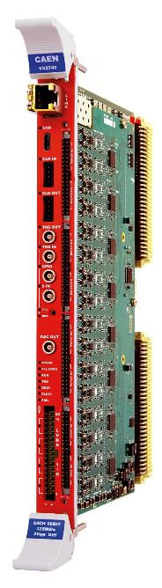
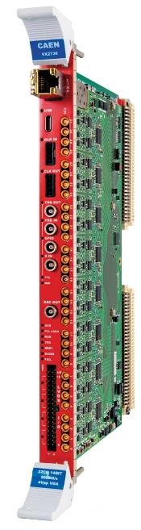
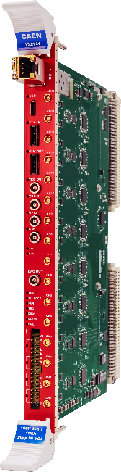
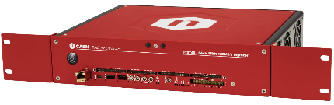
Digitizers 2.0 : key features
High channel density
Variable Gain Amplifier (VGA) to adapt the input dynamic range
up to 5 GB on-board memory (e.g. 84 ms record length at 500 MS/s)
OpenFPGA with SciCompiler: design and upload a custom pulse processor
DPP off-the-shelf: PHA, QDC, PSD, CFD, ZLE, DAW
Readout: 1/10 GbE, USB 3.0, Optical link. (tested up to ~800 MB/s with UDP)
easy scalability and synchronization

Slide 6
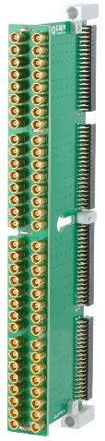
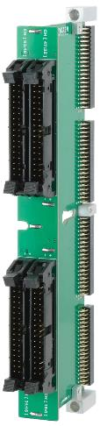
2740/2745 : 64 channel, 125 MS/s, 16 bit
Cable Adapters
A372M
A372F
Inputs:
  Single ended or Differential (factory setting)
  Connector: four 20x2 pin, 2 mm pitch headers.
  Adapters to MCX and 2.54 mm, 17x2 headers (for ribbon cables)
  Dynamic Range:
    V2740: 2 Vpp fixed
    V2745: 40 mVpp ÷ 4 Vpp (Gain from x1 to x100)
Max waveform length: ~84 ms @ 125 MS/s (2 buffers).
Extension up to 84 s by decimation (divide by 2N, with N=1÷10)
Baseline Noise: 3.9 LSB (≃ 120 µV) @ 2 Vpp
ENOB = 11.7 (typ.)
  Spectroscopy with segmented Si and HPGe
  Dark Matter and Neutrino Esperiments
  PMT with slow scintillators (e.g. NaI)
  SiPM readout (need preamp)

Slide 7
2730 : 32 channel, 500 MS/s, 14 bit
Inputs:
  Single ended, 50 Ω
  Connector: MCX
  Dynamic Range: 200 mVpp ÷ 4 Vpp (Gain from x1 to x20)
Max waveform length: ~84 ms @ 125 MS/s (2 buffers).
Baseline Noise: 2.8 LSB (≃ 340 µV) @ 2 Vpp
ENOB = 10.5 (typ.)
Applications:
  Pulse Shape Discrimination with organic and plastic scintillators (n/γ discr)
  High Resolution Timing
  Fast detector readout (PMTs, SiPMs, etc…)
  Multi parametric acquisition (Energy + Time + PSD)

Slide 8
2751 : 16 channel, 1 GS/s, 14 bit
Inputs:
  Single ended, 50 Ω
  Connector: MCX
  Dynamic Range: 200 mVpp ÷ 2 Vpp (Gain from x1 to x10)
Max waveform length: ~84 ms @ 125 MS/s (2 buffers).
Baseline Noise: 3.2 LSB (≃ 390 µV) @ 2 Vpp
ENOB = 10.0 (typ.)
Applications: same as VX2730, with a better timing performance

Slide 9
Open FPGA
Open
Limited access
Locked
main custom
activity is here
data format:
partially imposed
but flexible
no user access to DDR management
(it’s just a buffer)
ADC data stream
Pulse
Processor
Output
Data
DDR
Memory
Readout
Interface
ADC
PA
SCLK
Trigger Logic
+
Time Stamping
Sync
Synchronization: dedicated front panel digital I/Os. Synch through the readout protocol is under study
Digital I/Os

Slide 10
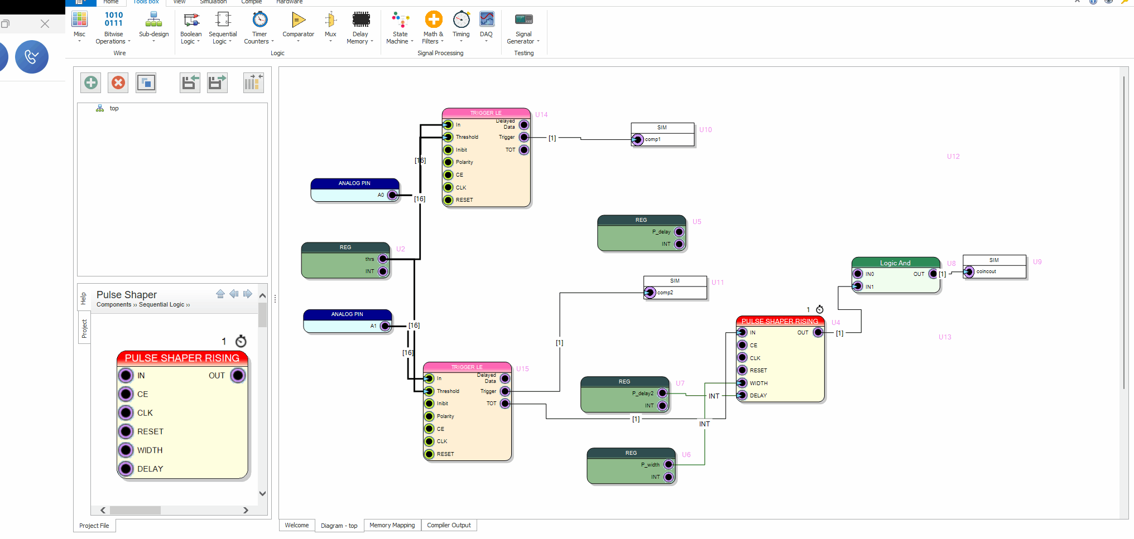
SciCompiler: a graphical tool for FPGA programming
Block diagram
Define the functionalities of the firmware
Function blocks
Build the diagram relying on a wide library of blocks for physics and nuclear engineering
Firmware
Automatic generation of VHDL and bitstream. No coding expertise required
Testing
Easy-to-use embedded tools for debugging

Slide 11
NUMEN
(Nuclear Matrix Elements for Neutrinoless Double Beta Decay)
53 digitiziers 2745 are being used by the NUMEN experiment across various detectors:
600 channels for the Tracker (Gem Detector): 10 VX2745/A1429
1200 channels for the PID (SiC Detector): 20 VX2745/A1429
1200 channels for the PID (Cesium Iodide Detector): 20 VX2745/A1429
140 channels for the Calorimeter (Lanthanum Bromide Detector, read by PMT):
3 VX2745/A1429.
Each digitizer is supplied with a license (DPP-SUP 2.0) that allows the installation and use of CAEN Digital Pulse Processing Firmware.

Slide 12
DarkSide
Total production:
1 DT5742 - 16+1 Channel 12 bit 5 GS/s Switched Capacitor Digitizer
13 VX2740 - 64 Channel 16 bit 125 MS/s Digitizer
12 VX2745 - 64 Channel 16 bit 125 MS/s Digitizer with Programmable Input Gain
DarkSide is meant to detect dark matter particles using a liquid Argon TPC, read by SiPM.
The 2740/5 offer great capabilities to acquire waveforms from SiPM, plus the flexibility of the OpenFGPA that is being exploited to build veto and detection algorithms.

Slide 13
Conclusion
We have presented a new family of digitizers with OpenFPGA capabilities.
These includes a broad frequency range (form 125 MS/s to 1 GS/s) and different channel densities.
The OpenFPGA comes with two different declinations, the VHDL intensive FDK and the friendly SciCompiler.
Few applications have been shown but more will be coming. Let us know if you publish results with our electronics!

Slide 14

Thank you for your attention
Any question/curiosity? Please write to Ferdinando.Giordano@caen.it

Slide 15

Backup slides

