Slide 1
1
Non collider science opportunities at FCC-ee
Frank Zimmermann
Non collider science opportunities at FCC-ee | kickoff brainstorm,
23 August 2024

Slide 2
Past studies
brainstorming in July 2020
  Michael Benedikt, Sara Casalbuoni (EU-XFEL), Michael Doser, Frank Zimmermann
1. Photon science
1.1 FCC-LS : The world’s most powerful light source for very hard X-rays
1.2 FCC-CBS: 3-5 orders of magnitude more flux and higher photon energy than ELI-NP
2. Other applications
2.1 Positron source for material research
2.2 Testbed for LEMMA muon collider
2.3 Plasma acceleration of positrons
2.4 Non-perturbative QED Experiments – proving the boiling of the QED vacuum
2.5 Positronium-based GeV photon source – a speculative proposal
Documented in M. Benedikt, F. Zimmermann, M. Doser, S. Casalbuoni, 10.5281/zenodo.7675663

Slide 3
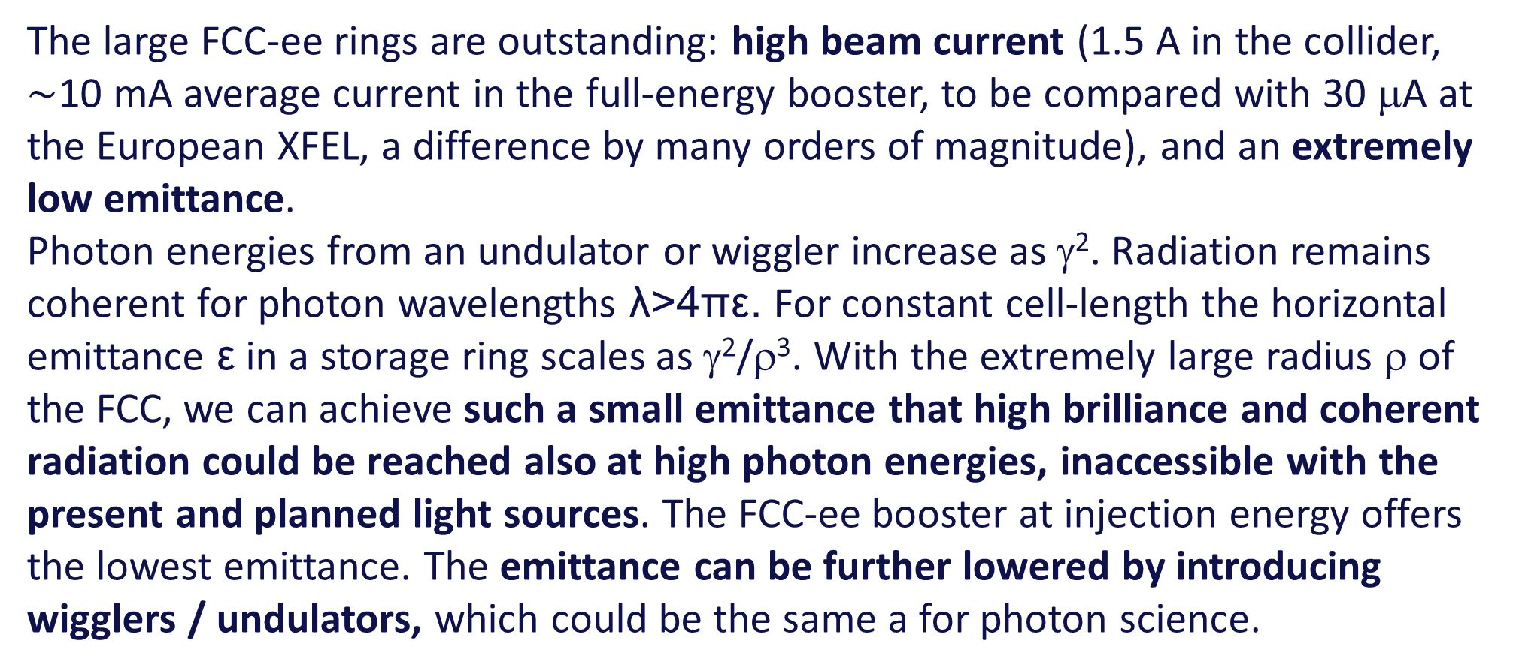
Photon Science: FCC-LS – motivation
The large FCC-ee rings are outstanding: high beam current (1.5 A in the collider, $\sim$10 mA average current in the full-energy booster, to be compared with 30 μA at the European XFEL, a difference by many orders of magnitude), and an extremely low emittance.
Photon energies from an undulator or wiggler increase as γ². Radiation remains coherent for photon wavelengths λ>4πε. For constant cell-length the horizontal emittance ε in a storage ring scales as γ²/ρ³. With the extremely large radius ρ of the FCC, we can achieve such a small emittance that high brilliance and coherent radiation could be reached also at high photon energies, inaccessible with the present and planned light sources. The FCC-ee booster at injection energy offers the lowest emittance. The emittance can be further lowered by introducing wigglers / undulators, which could be the same a for photon science.

Slide 4
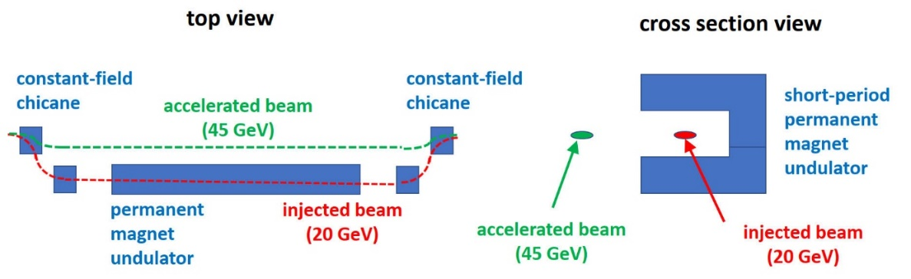

Photon Science: FCC-LS - Powerful light source for very hard X-rays
ultimate photon source at $\sim$100 keV energies
Sketch of permanent-magnet undulator and fixed-field chicane for the FCC-ee booster
update by Sara !
The peak and average brilliance can be roughly 1000 times higher than at the proposed future storage ring light source PETRA IV in the very hard X ray regime, and coherent wavelengths down by a factor 100, opening up new areas of science.
FCC-ee booster at injection with 28 (40) mm period undulator (wiggler) offers highest average brilliance at E_{γ}>30 keV

Slide 5
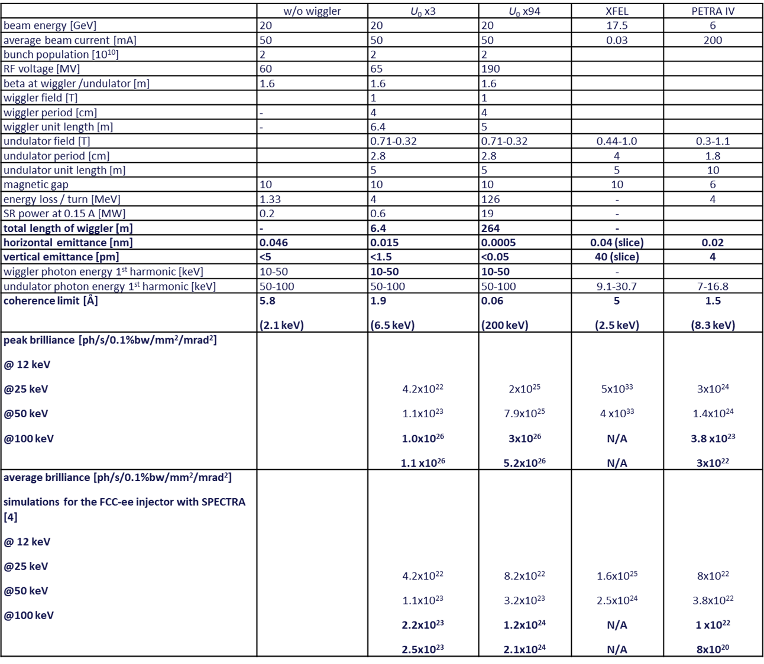
Photon Science: FCC-LS – Parameter comparison
Parameters for the FCC-ee booster as light source (FCC-LS), compared with the European XFEL [1,2] and the proposed PETRA IV facility [3]. At present, the European XFEL cannot reach photon energies above 30 keV.
update by Sara !

Slide 6
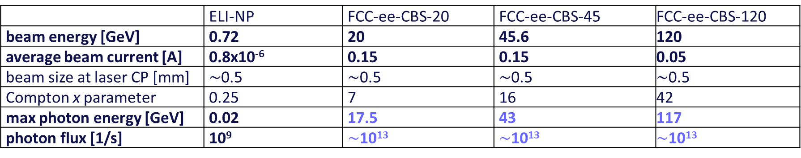
FCC-CBS: 1000-100000x more flux & higher energy than ELI-NP
Comparison of ELI-NP and FCC-ee Compton Backscattering Source (FCC-ee-CBS), assuming Yb:YAG laser (2.3 eV)
 | ELI-NP | FCC-ee-CBS-20 | FCC-ee-CBS-45 | FCC-ee-CBS-120
beam energy [GeV] | 0.72 | 20 | 45.6 | 120
average beam current [A] | 0.8x10⁻⁶ | 0.15 | 0.15 | 0.05
beam size at laser CP [mm] | $\sim$0.5 | $\sim$0.5 | $\sim$0.5 | $\sim$0.5
Compton x parameter | 0.25 | 7 | 16 | 42
max photon energy [GeV] | 0.02 | 17.5 | 43 | 117
photon flux [1/s] | 10⁹ | $\sim$10¹³ | $\sim$10¹³ | $\sim$10¹³
The photon energies are 1000 times higher, the photon flux exceed ELI-NP’s by about a factor 10,000. To achieve this rate the laser beam recirculator system of ELI-NP would need to be modified or, possibly, be replaced by an optical cavity, suitable for cw operation.

Slide 7
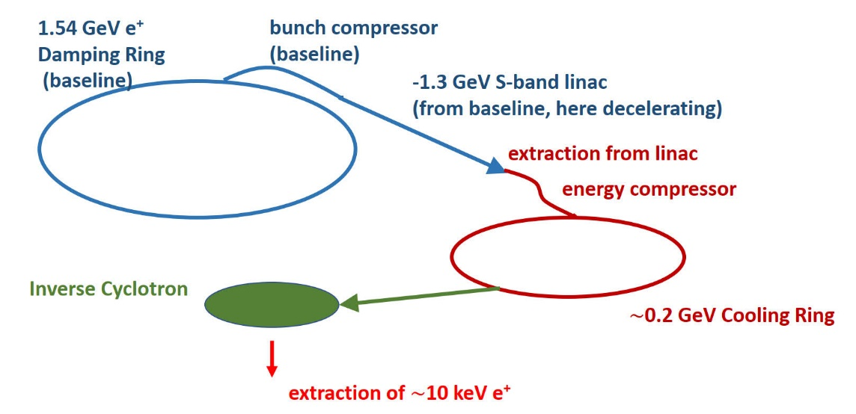
Positron source for material research
The availability of one of the world’s most powerful positron sources, delivering high-flux positrons a of a few 10¹² e+/second, in an energy range from a few 100 MeV to 20 GeV, could offer numerous other applications.
Layout of high-intensity cold positron source fed from the FCC-ee e⁺ damping ring, passing through the bunch compressor and part of the baseline S-band linac. After extraction from the linac, and energy-spread compression. low-energy cooling ring and a small (1 metre) inverse cyclotron are added to provide a high-flux low-energy low-emittance positron beam.
e.g. C. Hugenschmidt, Positrons in Surface Physics, https://arxiv.org/pdf/1611.04430

Slide 8
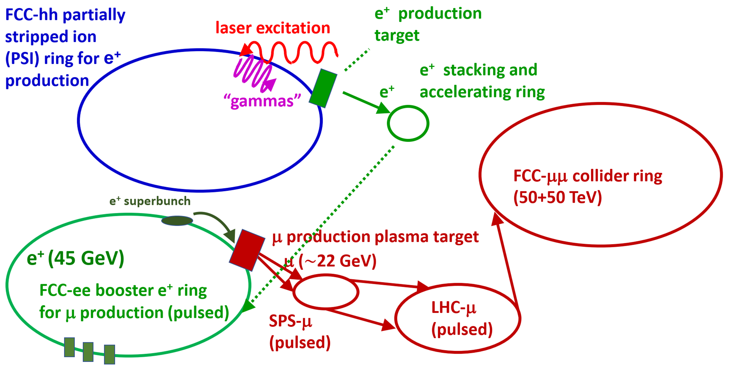
Testbed for LEMMA muon collider
FCC-ee would allow many important proof-of-principle tests for the LEMMM based muon collider. For example, 45 GeV positrons extracted from the booster would be by far the best conceivable platform for carrying out demonstration experiments and beam tests for the LEMMA low-emittance muon-beam production scheme. Various targets and accumulation schemes could be studied. The emittance of the generated muons could be characterized.
Farmer et al., Muon Collider based on Gamma Factory, FCC-ee and Plasma Target, IPAC’22

Slide 9
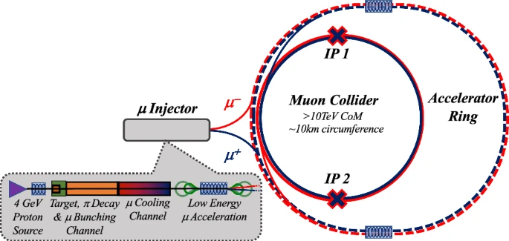
FCC as muon accelerator ring to feed muon collider in LHC tunnel
FCC-ee tunnel
hosts muon accelerator
ring
LHC tunnel hosts
~30 TeV CoM muon collider
C. Accettura et al.
EPJC, vol 83, 864 (2023)

Slide 10
Plasma acceleration of positrons
Plasma acceleration of positron is not yet a fully solved problem. The positrons from the FCC injector complex could be used for acceleration-tests in AWAKE-like experiments or for tests with positrons for other novel acceleration schemes, e.g. acceleration of positrons in crystals.
e.g.
Gevy J. Cao, et al., Phys. Rev. Accel. Beams 27, 034801 (2024)

Slide 11
Non-perturbative QED Experiments – boiling the QED vacuum
The FCC-ee injector complex can generate high rates of high-energy photons either by sending bunches from the linac against a target via bremsstrahlung, as in the proposed LUXE experiment [5], or, via laser Compton backscattering off bunches in the booster. These high-energy photons are then collided with low energy photons from a laser and pairs of electrons and positrons are created via the Schwinger process. The intensity of the laser is varied, e.g., between 5 × 10¹⁸ W/cm² and 1 × 10²⁰ W/cm² (parameters from LUXE) and the rate of electron/positron pairs is measured as function of this intensity, The rate should be proportional to E² e (−E_{S}/E) where E is the electric field of the laser.
Comparison of FCC-ee QED explorer configurations and the European XFEL’s LUXE proposal.
 | LUXE [5] | FCC-ee linac | FCC-ee booster
Beam energy [GeV] | 14 (17) | 20 | 20 or 45.6
Conversion | bremsstrahlung | bremsstrahlung | laser Compton (See Table 2)
Bunch charge [nC] | 0.25 (1) | 3 | 3 (only fraction converted to γ)
Number of bunches | 1 | 2 or 4 | up to 16,000
Repetition rate [Hz] | 1 (10) | 200 | 3,000
Rms spot size [μm] | 5 | 3 (1 cm β) | 30

Slide 12
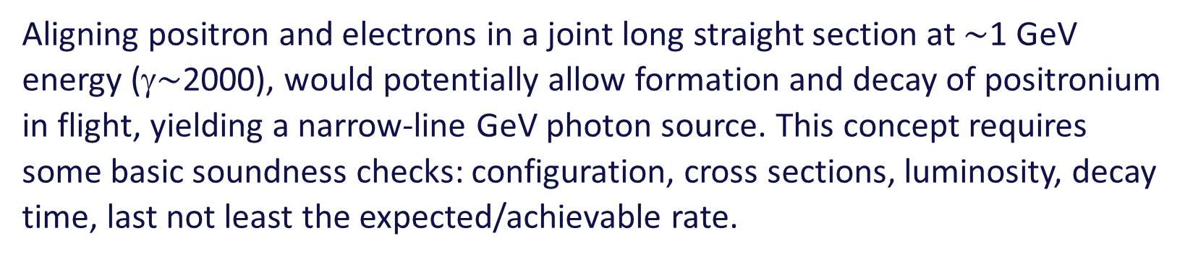
Positronium-based GeV photon source – a speculative proposal
Aligning positron and electrons in a joint long straight section at $\sim$1 GeV energy (γ$\sim$2000), would potentially allow formation and decay of positronium in flight, yielding a narrow-line GeV photon source. This concept requires some basic soundness checks: configuration, cross sections, luminosity, decay time, last not least the expected/achievable rate.

Slide 13
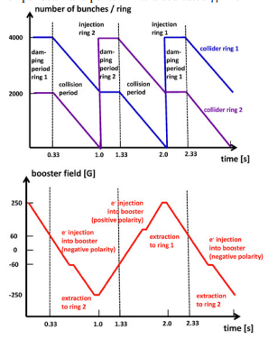
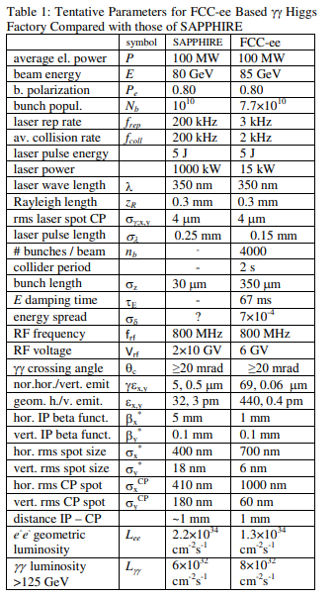
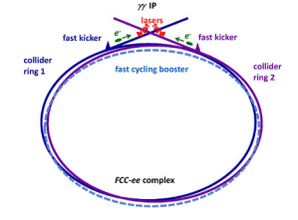
γγ collider based on FCC-ee
Schematic γγ collider based on filling the two FCC-ee collider rings with e⁻ bunches and extracting one bunch per beam and per turn into a dedicated γγ line.
R. Aleksan, A. Apyan, Y. Papaphilippou,
F. Zimmermann, IPAC2015
Cycle pattern for two collider rings (top) and for the booster (bottom).

Slide 14
References
M. Altarelli et al. (Eds.), XFEL: The European X-Ray Free-Electron Laser.Technical Design Report, Preprint DESY 2006-097, DESY, Hamburg, 2006 (see also http://xfel.desy.de).
E.A. Schneidmiller and M.V. Yurkov,”Photon Beam Properties at the European XFEL”, DESY-11-152; TESLA-FEL 2011-01
C. G. Schroer et al., PETRA IV Conceptual Design Report, https://bib-pubdb1.desy.de/record/426140/files/DESY-PETRAIV-Conceptual-Design-Report.pdf
T. Tanaka and H. Kitamura, “SPECTRA: a synchrotron radiation calculation code”, Journal of Synchrotron Radiation 8, 1221 (2001)
F. Burkart et al., “LUXE — A QED Experiment at the European XFEL,” 10th Int. Particle Accelerator Conf. IPAC2019, Melbourne, Australia JACoW Publishing ISBN: 978-3-95450-208-0 doi:10.18429/JACoW-IPAC2019-TUPRB008
C. Hugenschmidt, Positrons in Surface Physics (2016), https://arxiv.org/pdf/1611.04430
M. Benedikt, S. Casalbuoni, M. Doser, F. Zimmermann, First thoughts on the synergetic use of the FCC-ee collider and its injector complex for photon science and other applications, 10.5281/zenodo.7675663.
S. Casalbuoni and F. Zimmermann, FCC-ee booster as ultimate storage ring photon source, FCC Week 2021
R. Aleksan, A. Apyan, Y. Papaphilippou, F. Zimmermann, Scenarios for Circular Gamma-Gamma Higgs Factories, Proc. IPAC2015, Richmond (2015) 2156

Slide 15
Possible work plan
need to update all to new parameters (booster intensity, DR energy)
on FCC side focus on light source and Compton source applications,
perhaps also e+ for material research
PBC looking after QED vacuum boiling & also positronium scheme?
Other science applications?

