Slide 1
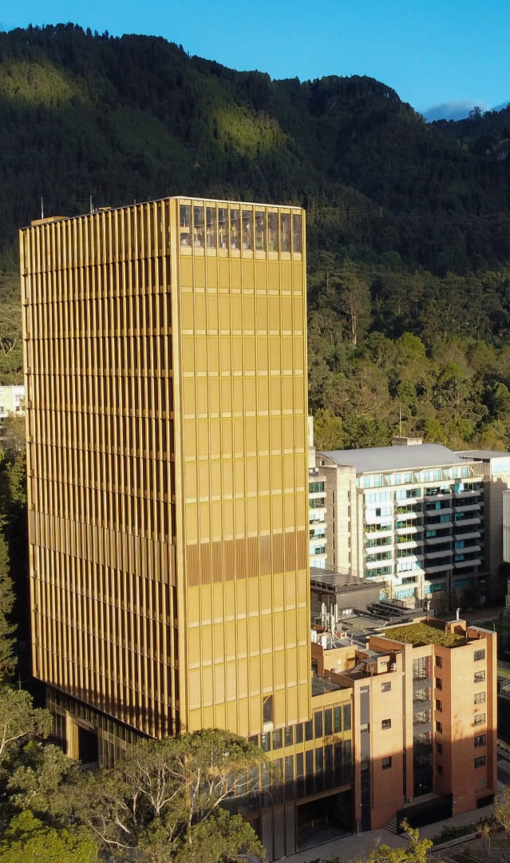



Magnetic Field Tests
Diego Alejandro Vera Ortega
28/08/2024

Slide 2
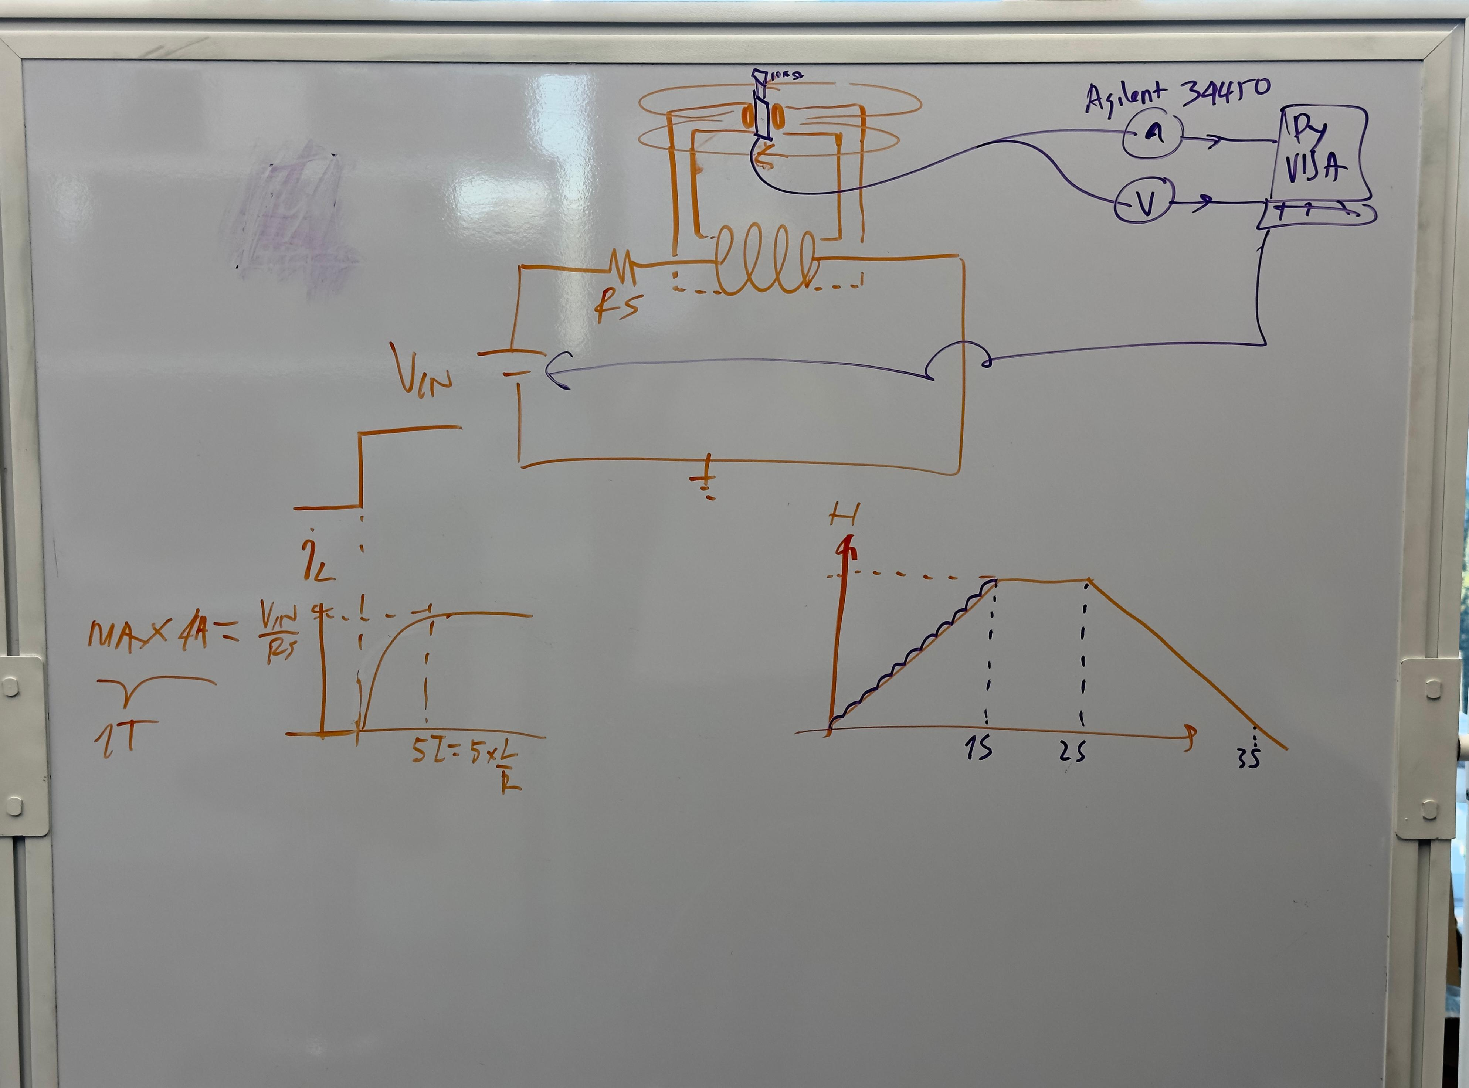
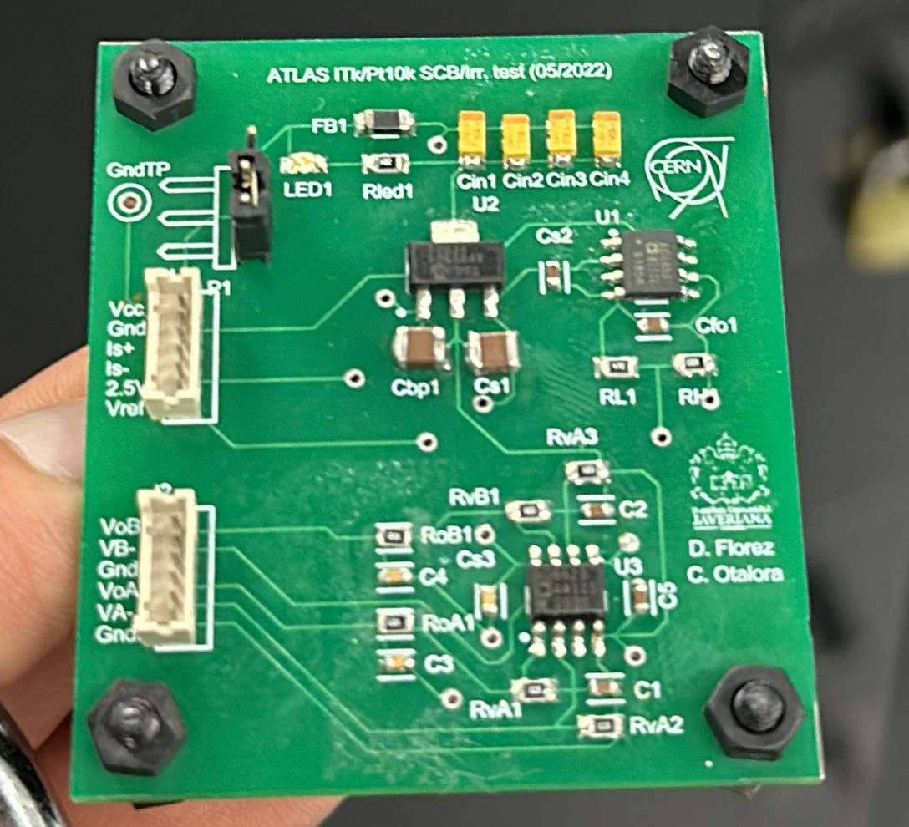
15/08/2024
Vmin= 0V@0T@0A
Vmax=26,7V @609mT@5A

Slide 3
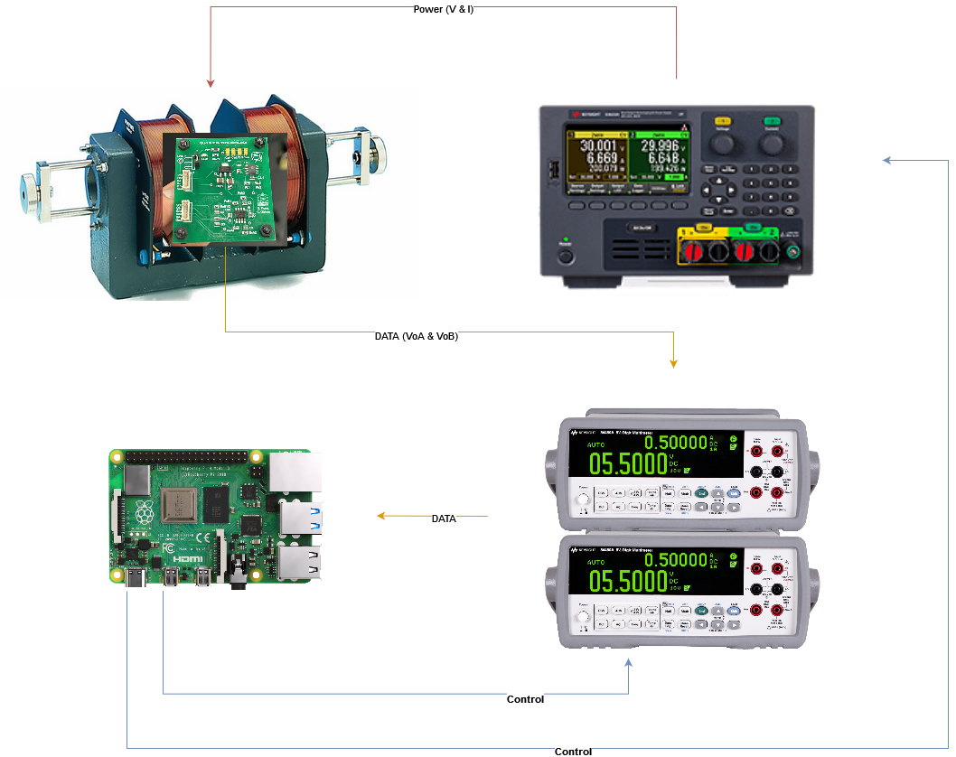

Slide 4
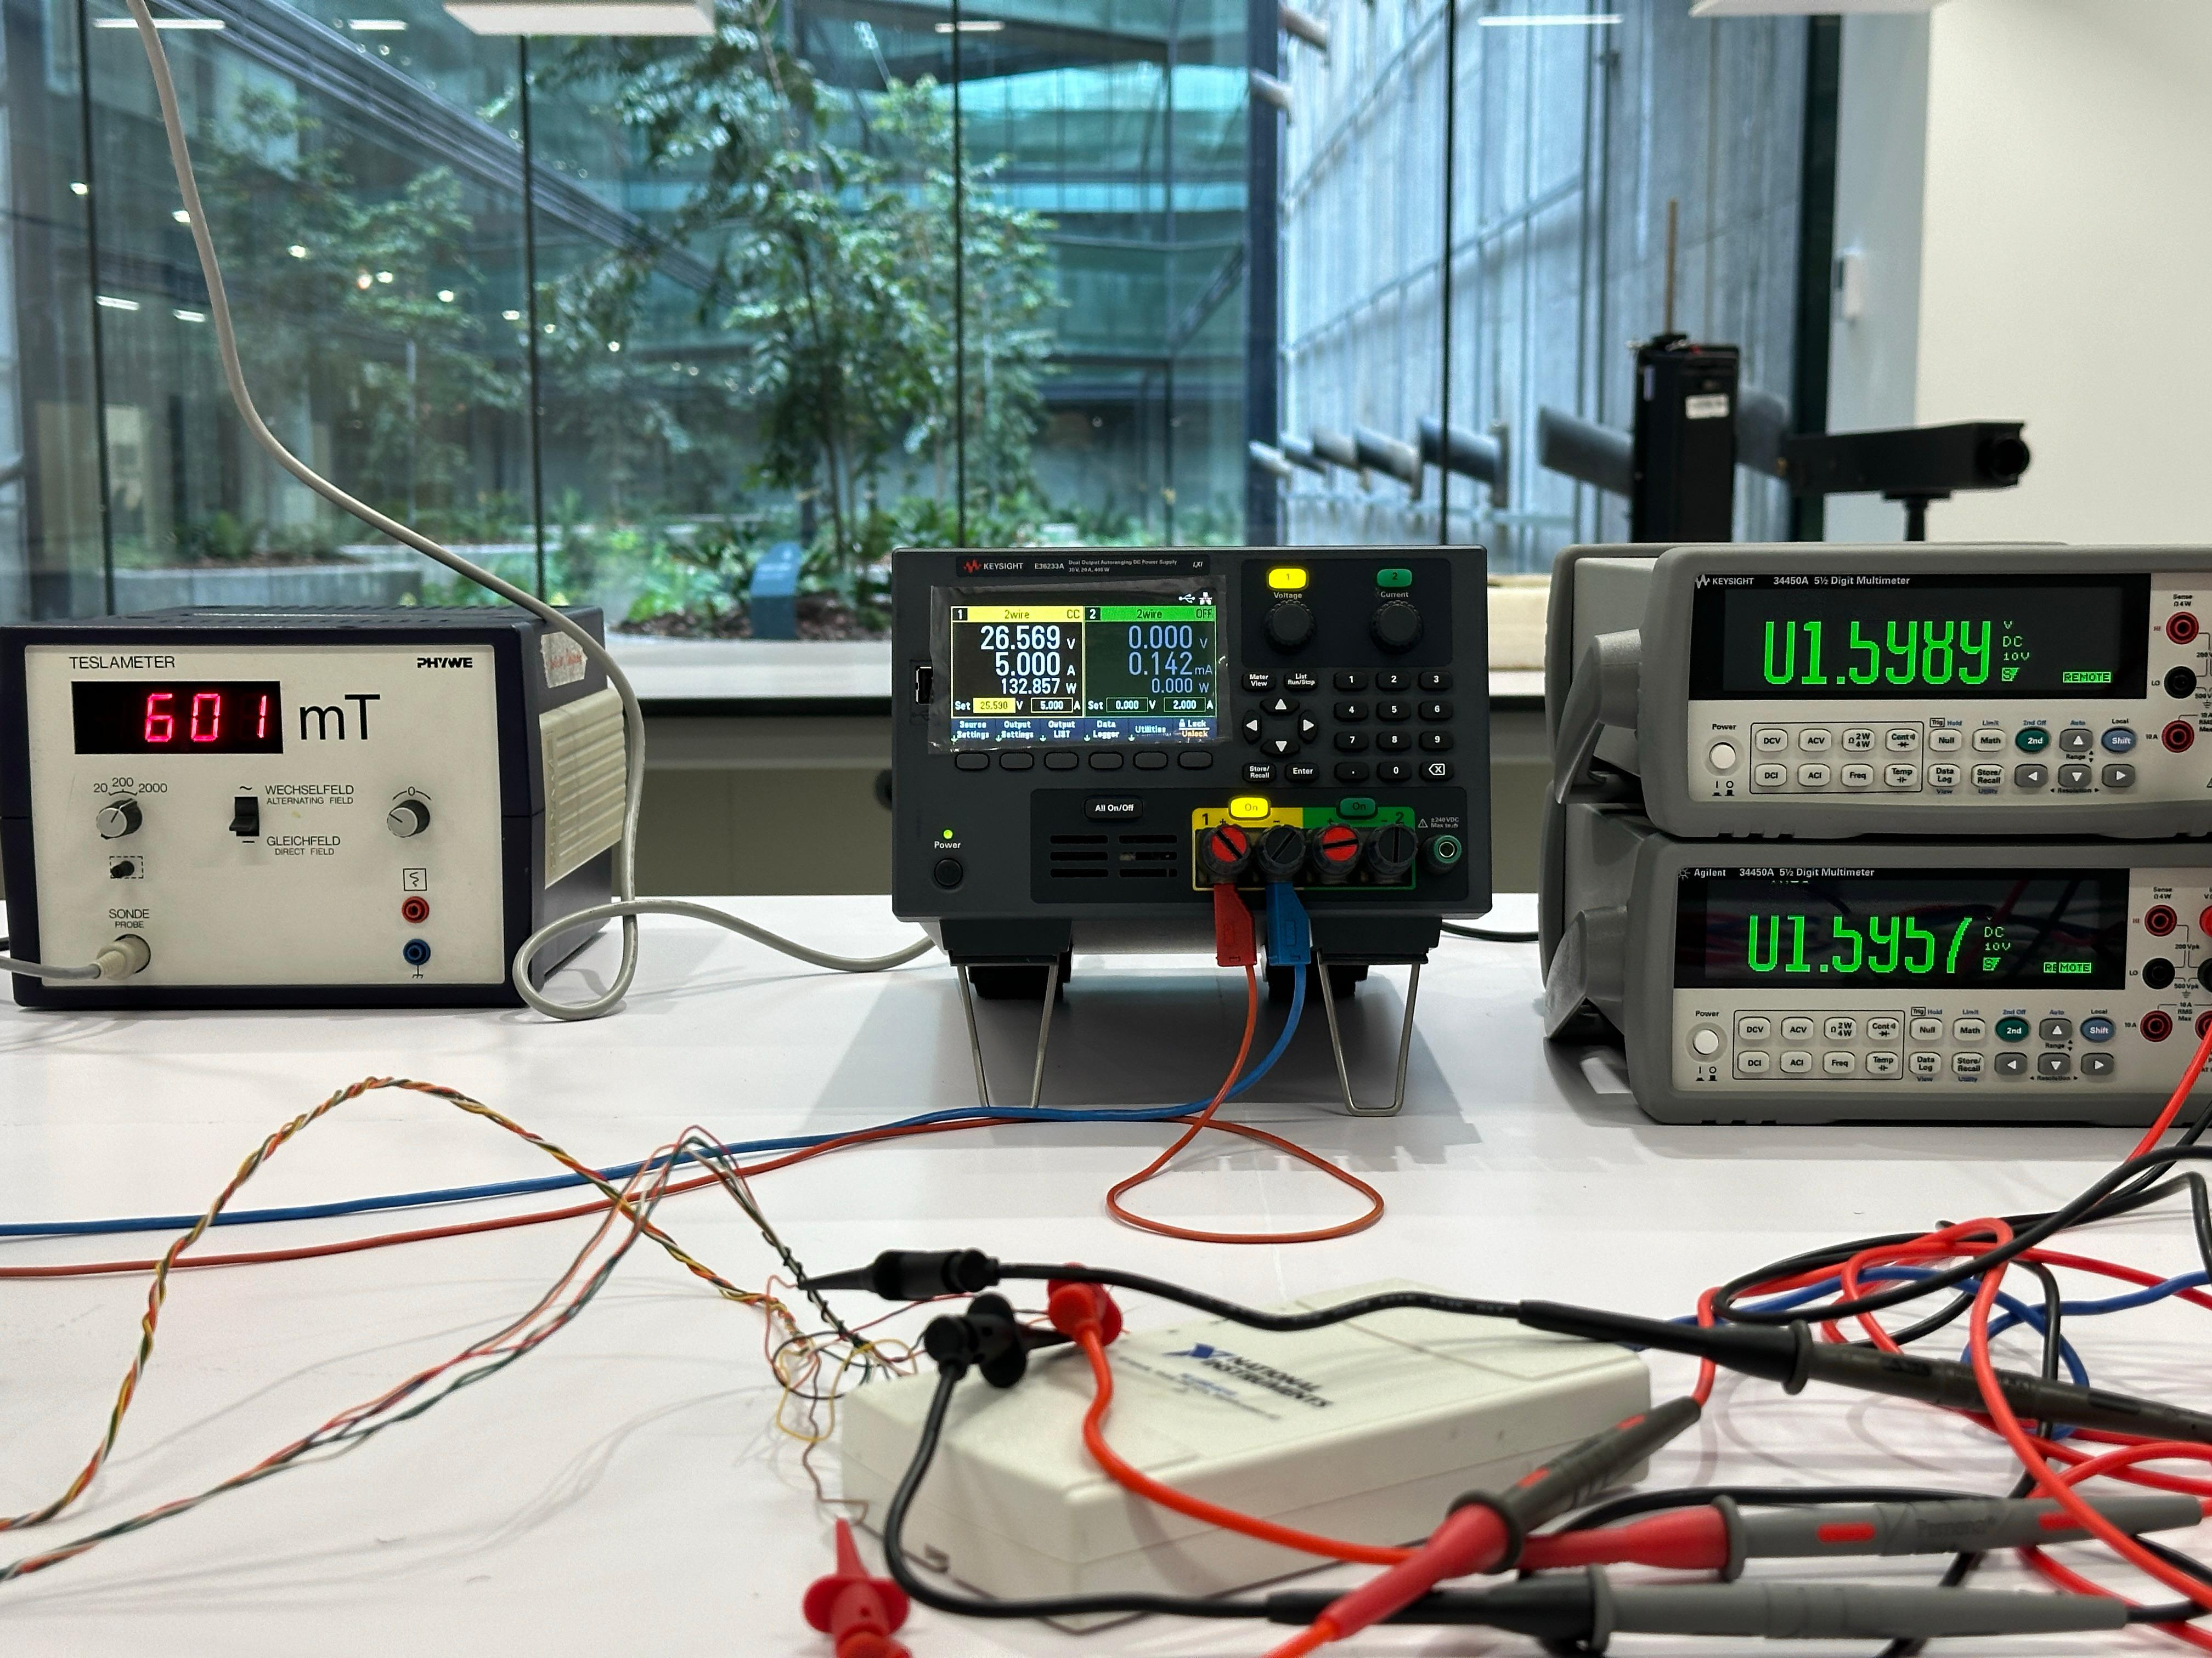

Slide 5
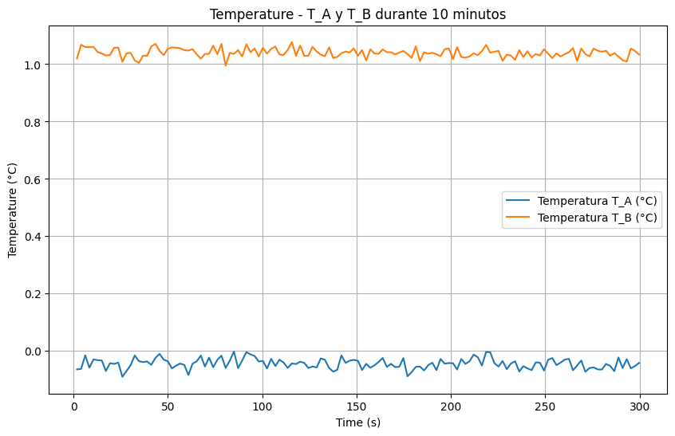
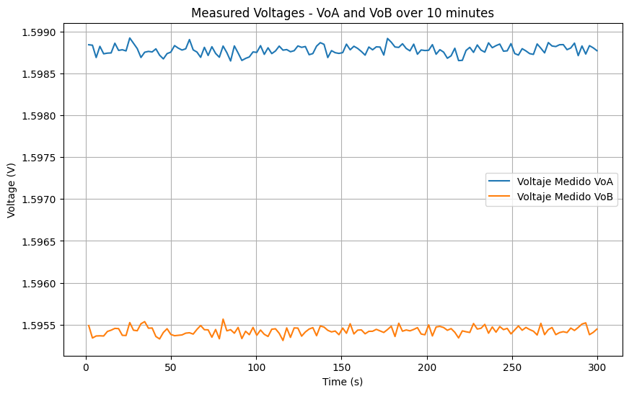
Reference

Slide 6
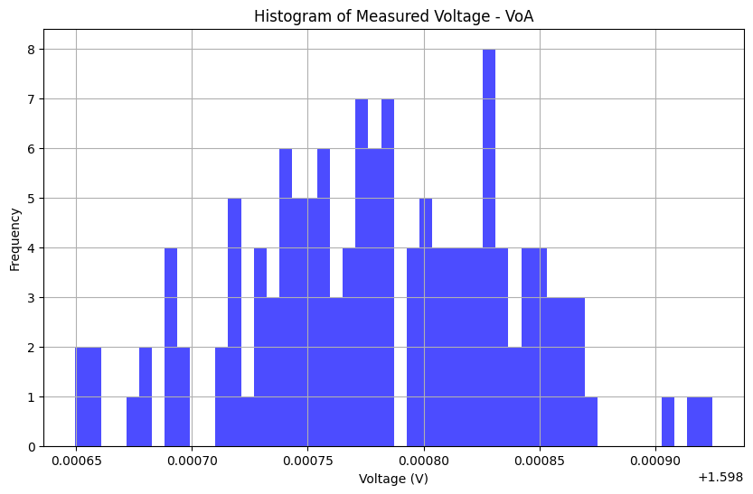
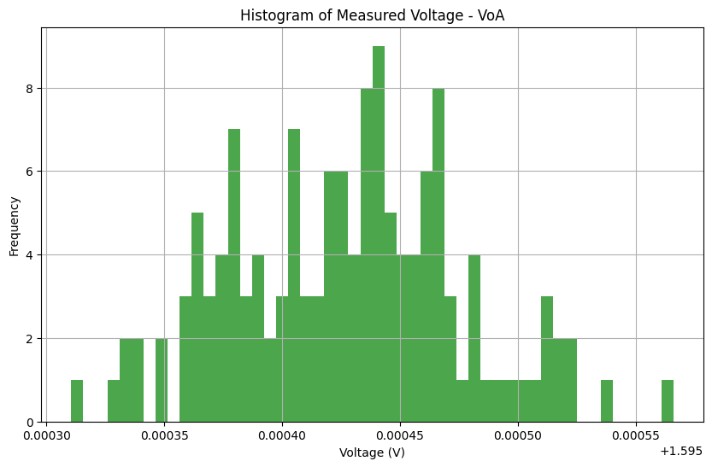

Slide 7
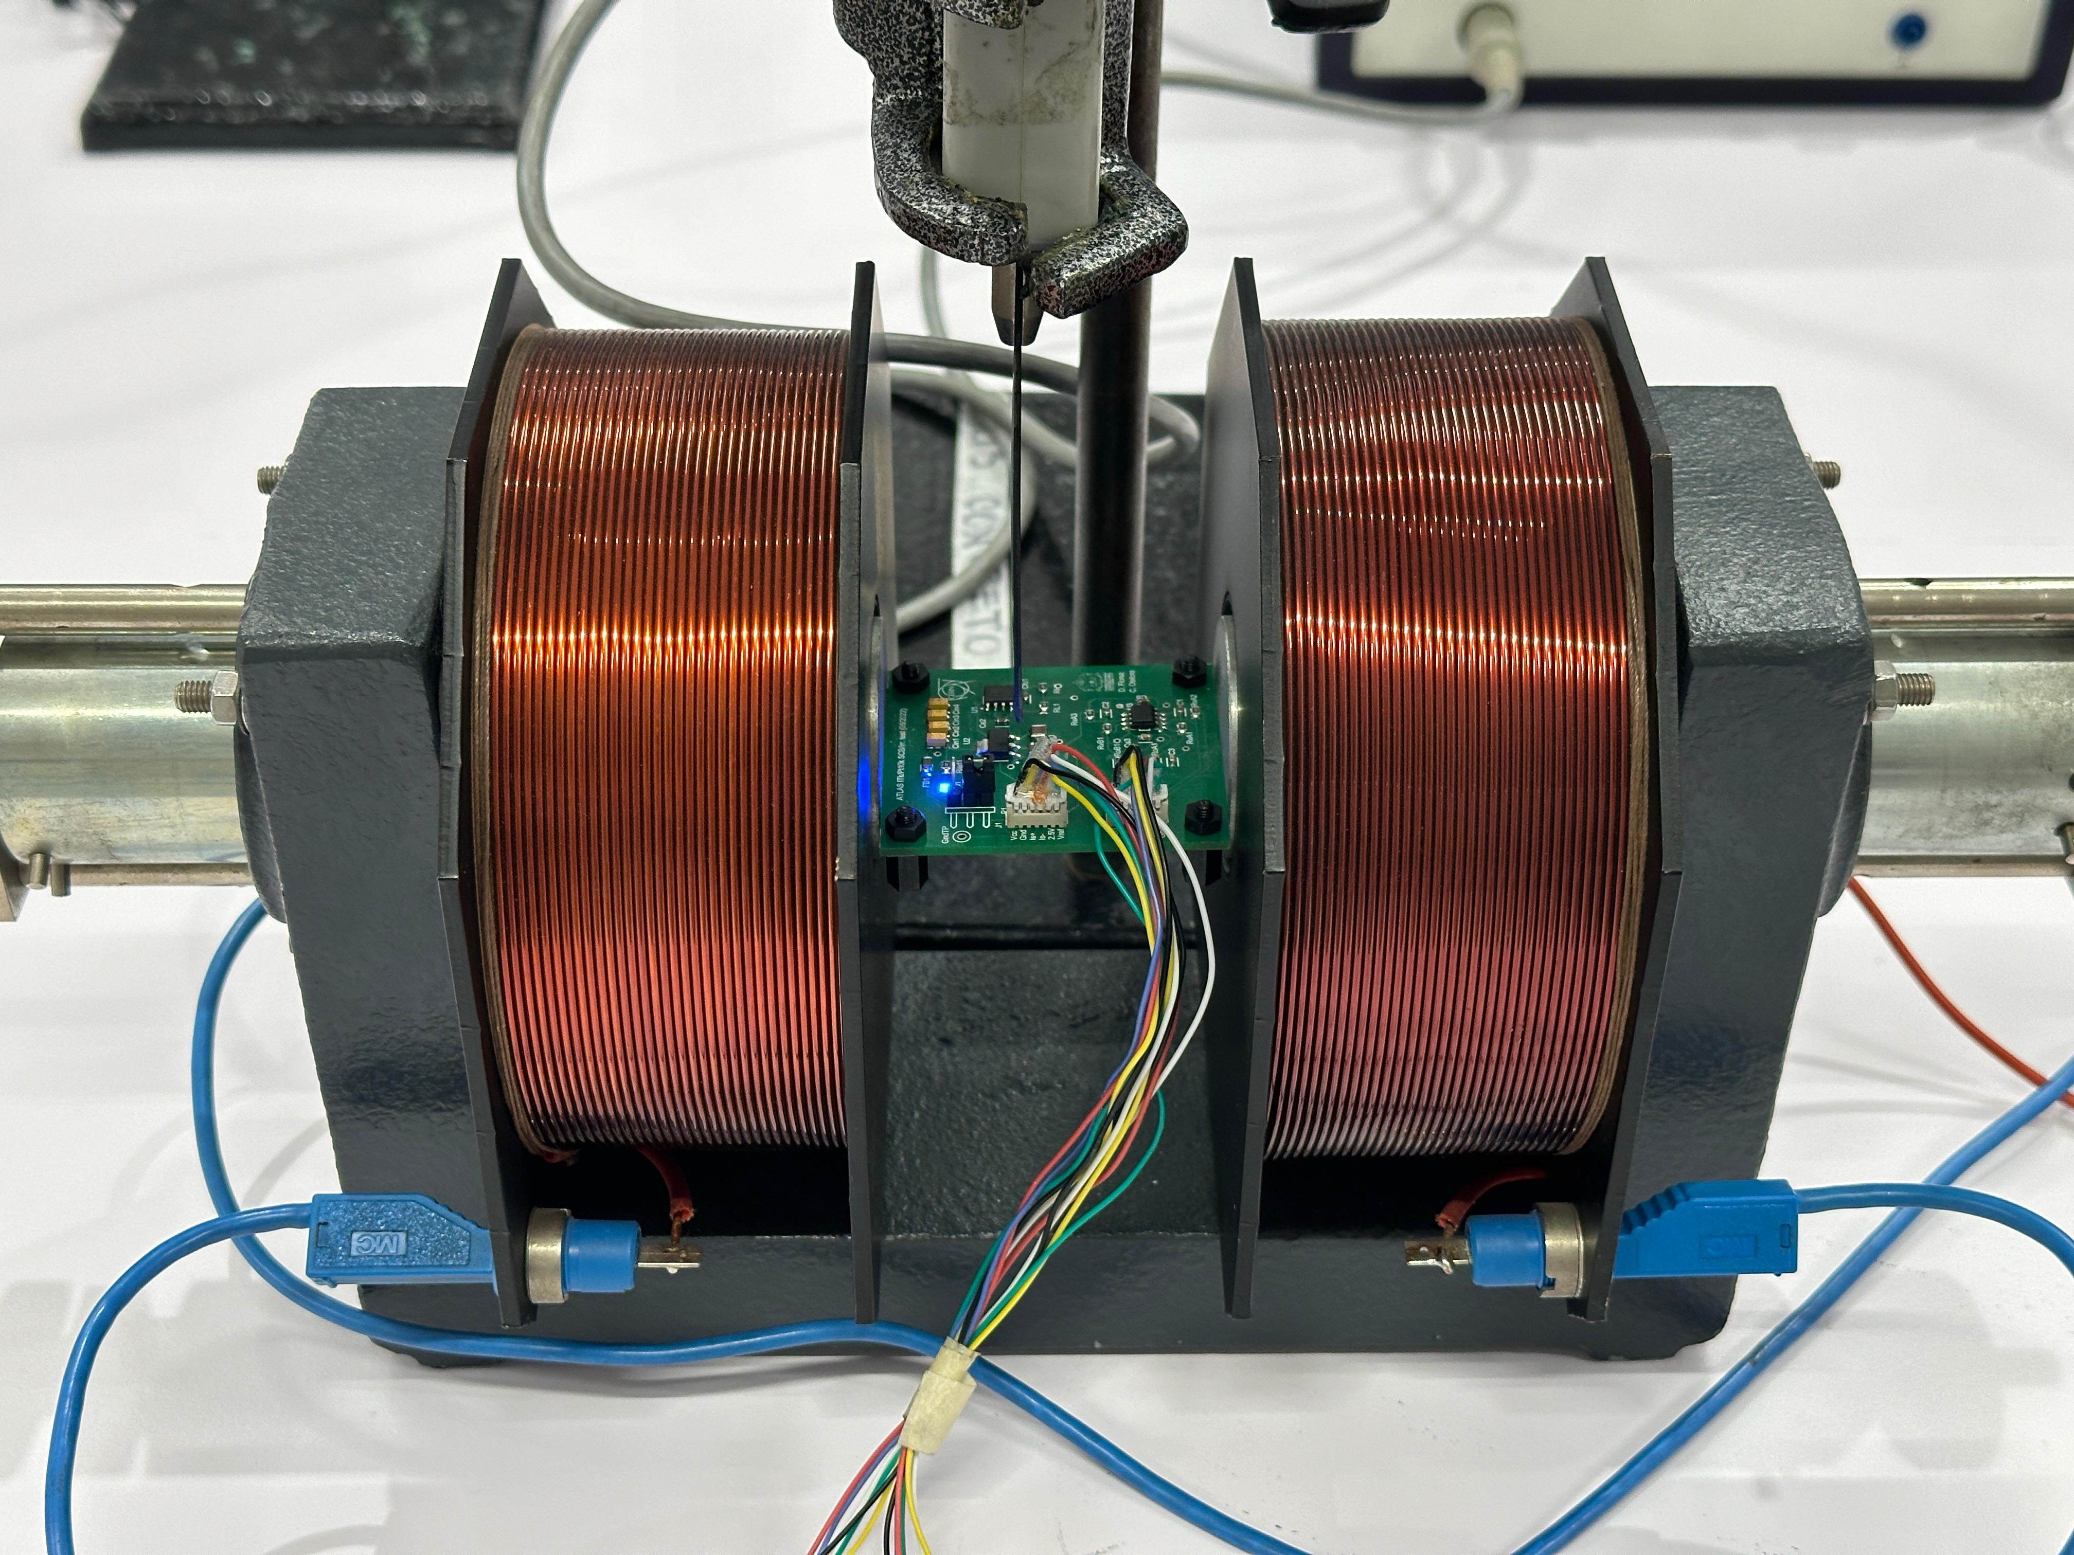

Slide 8
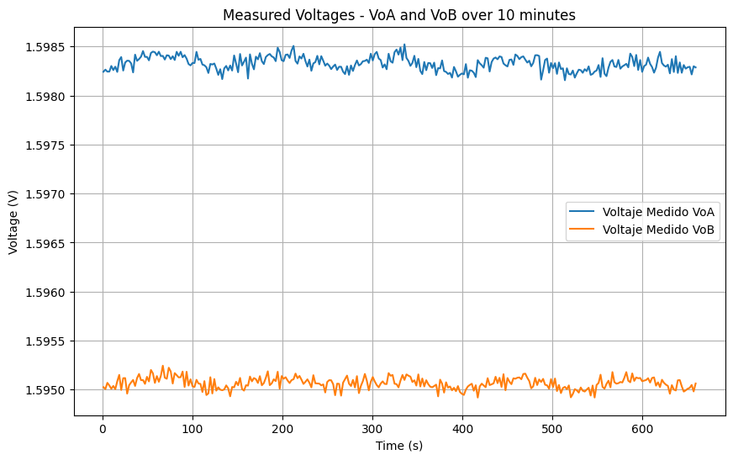
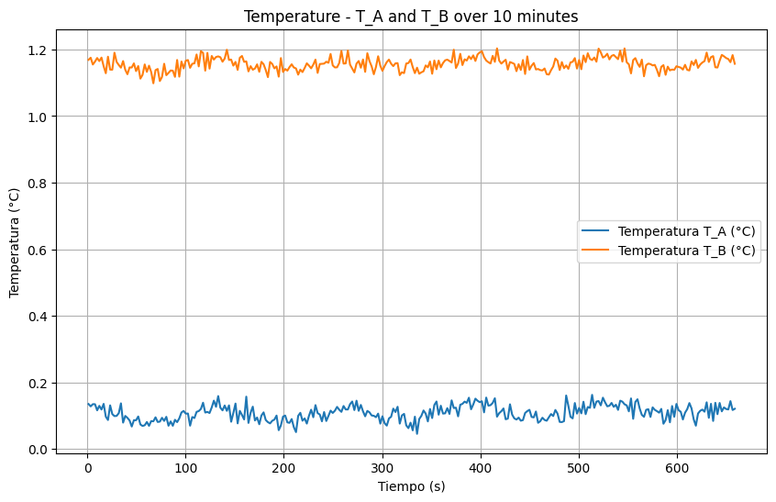
Metric | VoA Voltage (V) | VoB Voltage (V) | Temperature T_A (°C) | Temperature T_B (°C)
Total Samples | 300 | 300 | 300 | 300
Mean | 1,598324676 | 1,595066062 | 0,108258916 | 1,156024204
Variance | 5,19E-09 | 3,59E-09 | 0,000532384 | 0,00037444

Slide 9
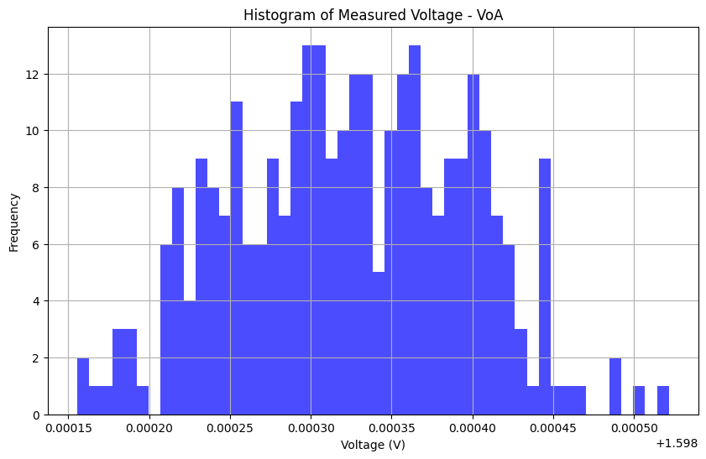
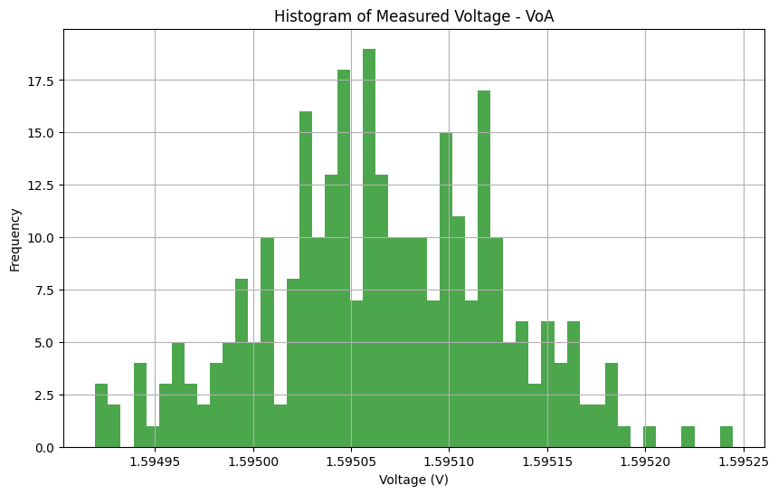

Slide 10
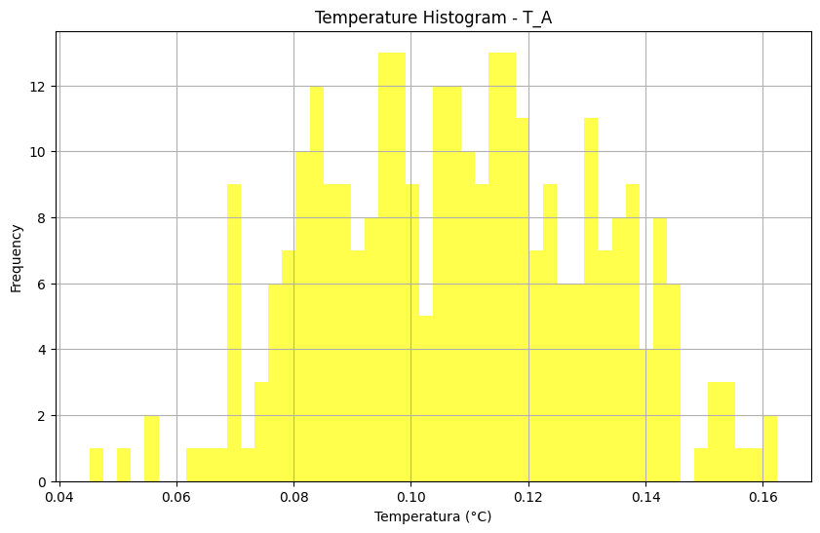
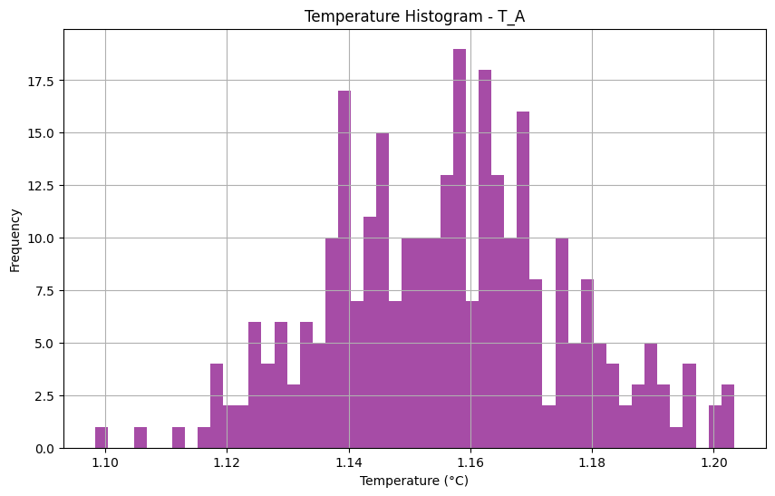

Slide 11
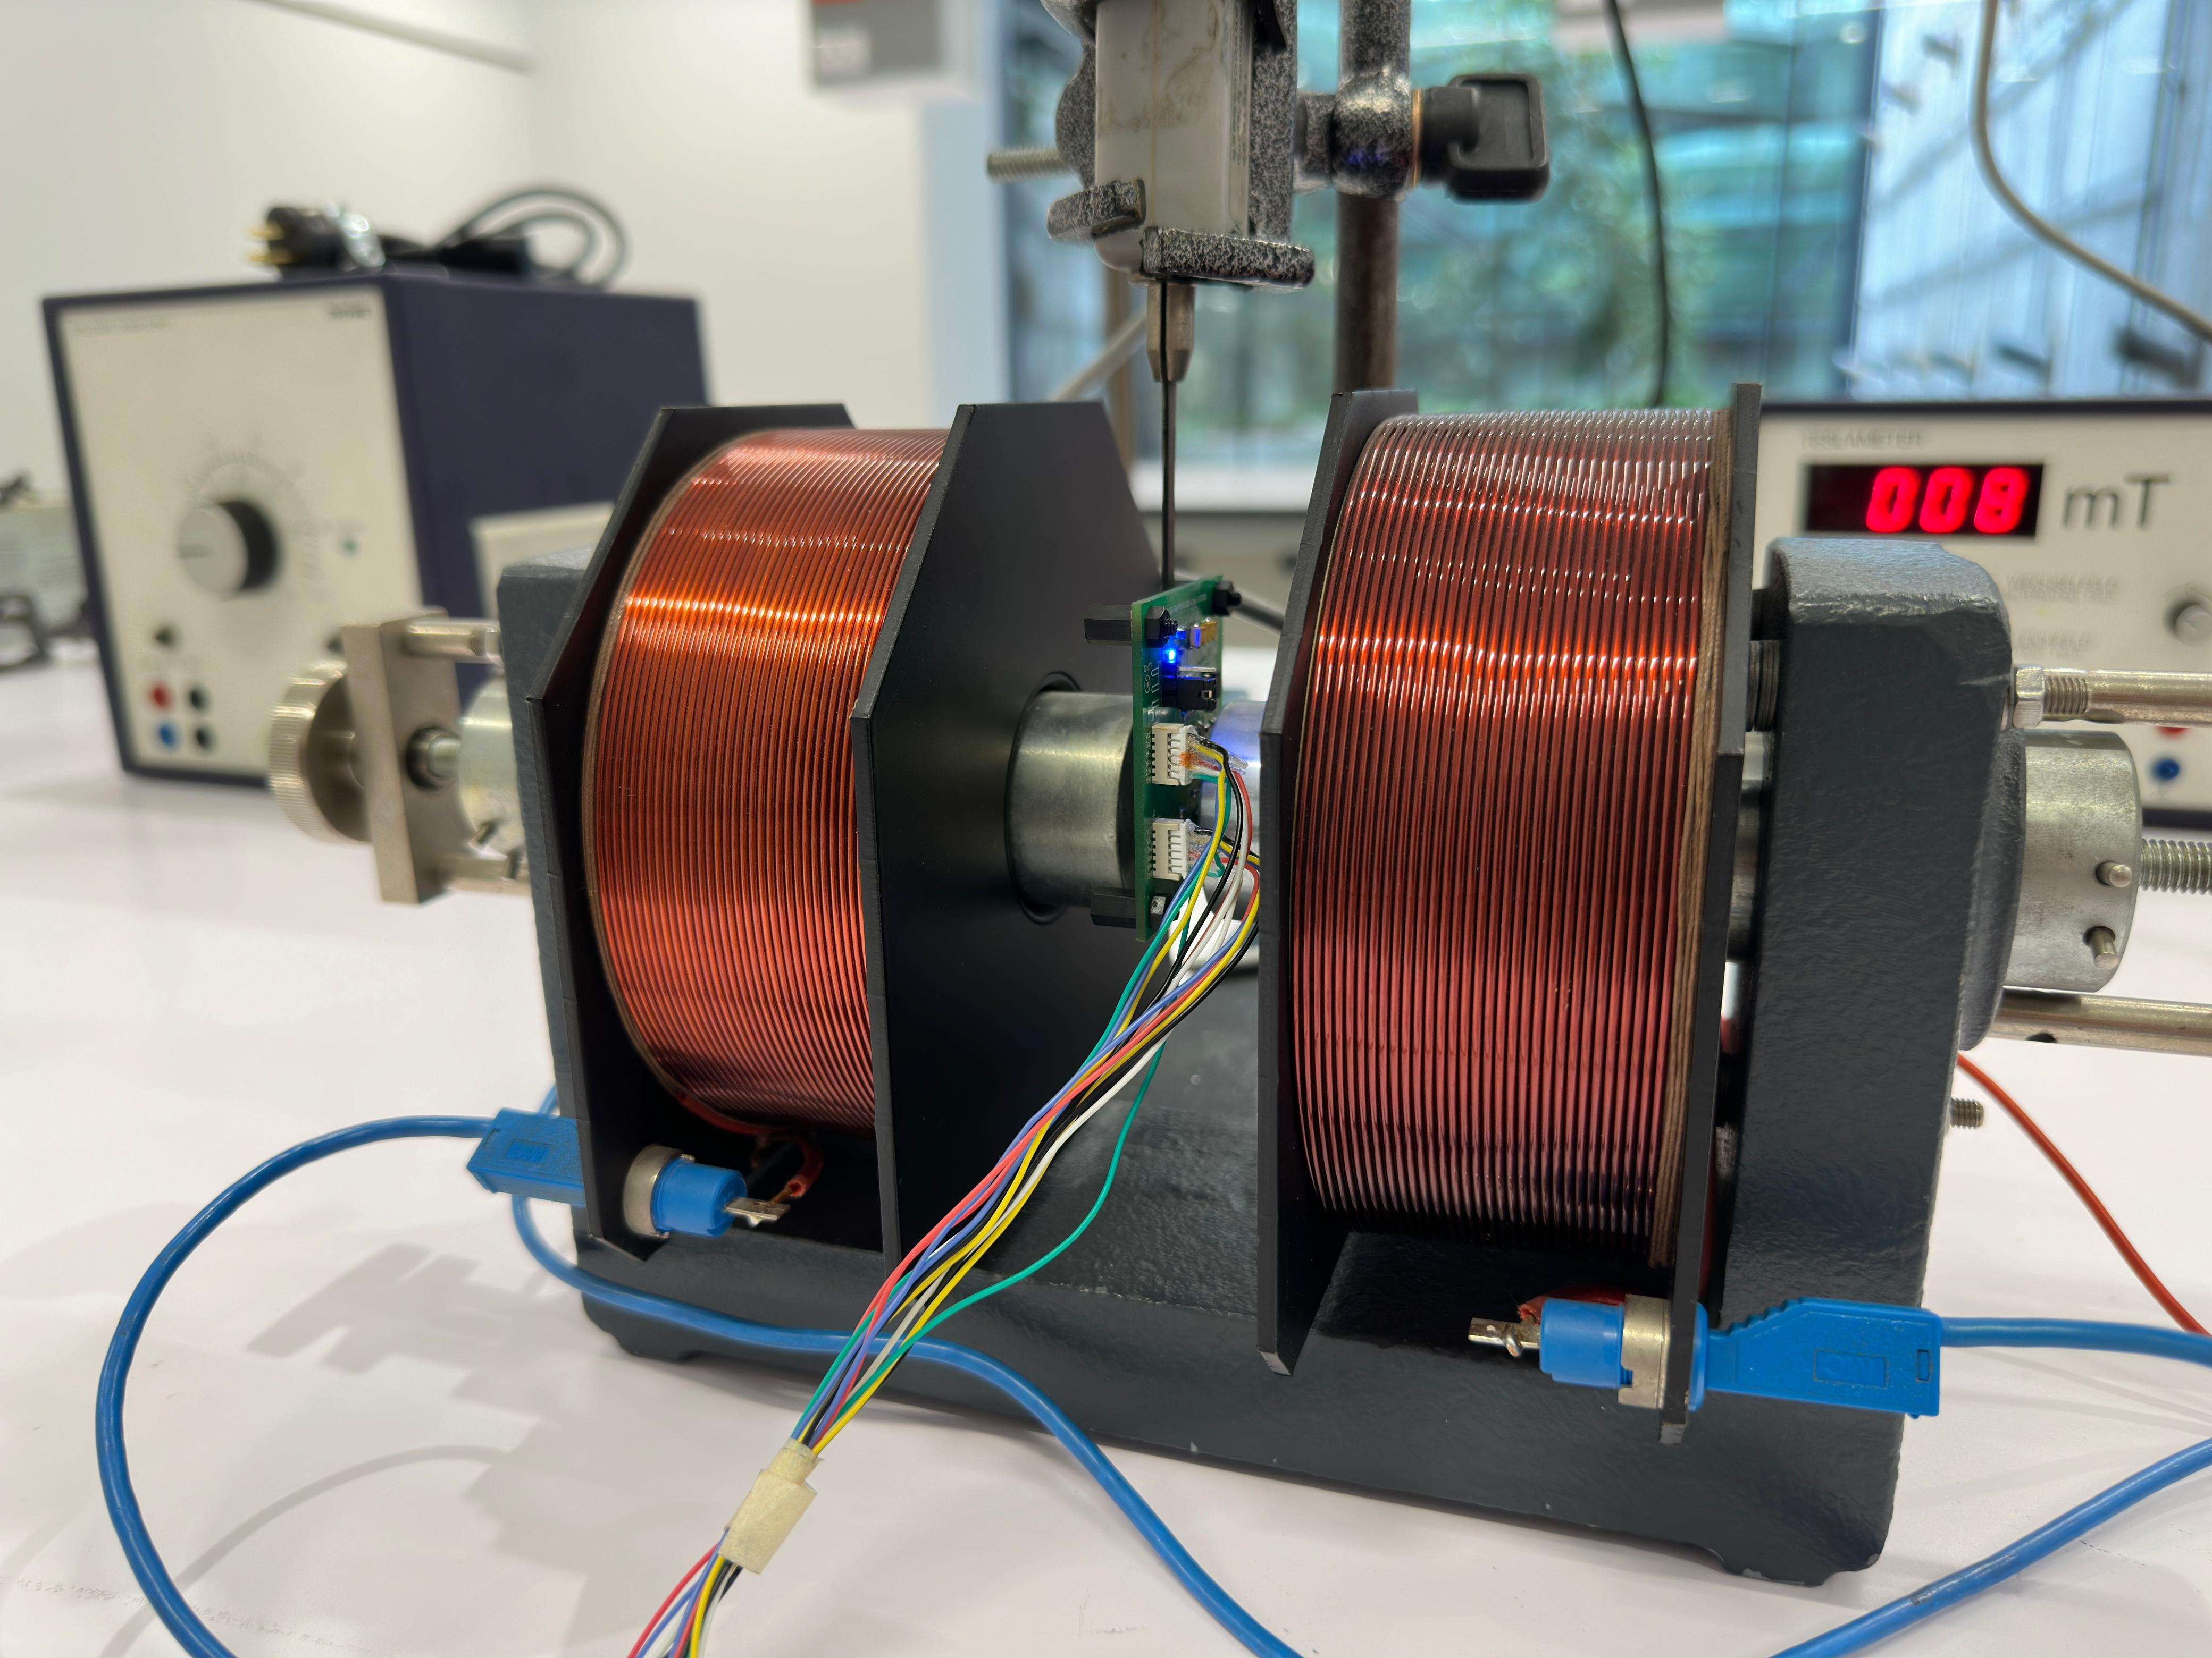

Slide 12
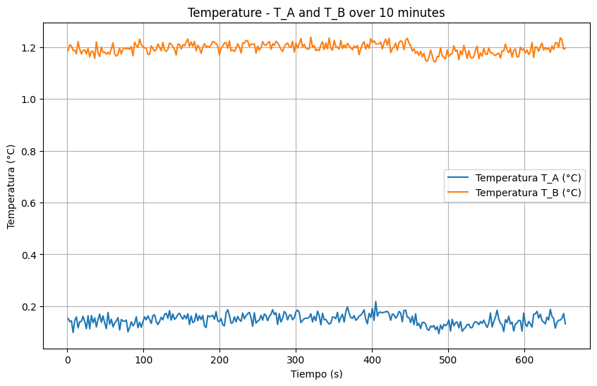
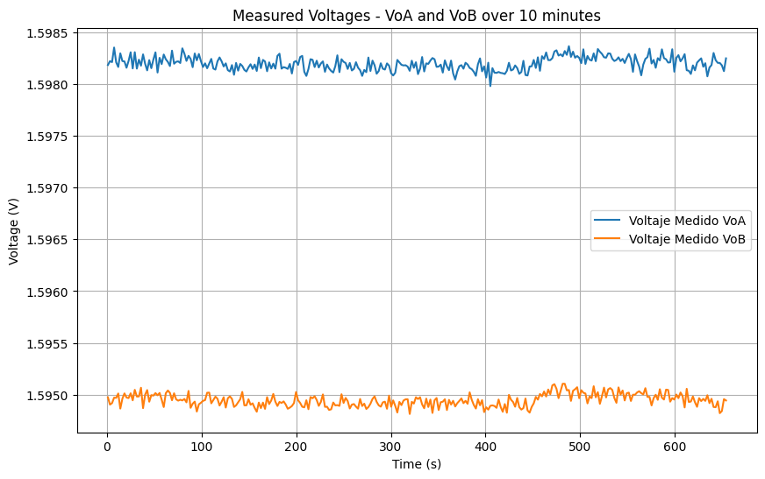
Metric | VoA Voltage (V) | VoB Voltage (V) | Temperature T_A (°C) | Temperature T_B (°C)
Total Samples | 300 | 300 | 300 | 300
Mean | 1,598199469 | 1,594946022 | 0,148353 | 1,194792276
Variance | 4,29E-09 | 3,72E-09 | 0,000439681 | 0,00038762

Slide 13
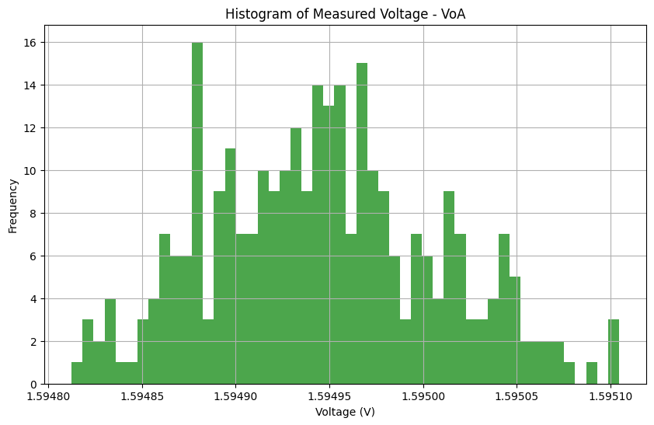
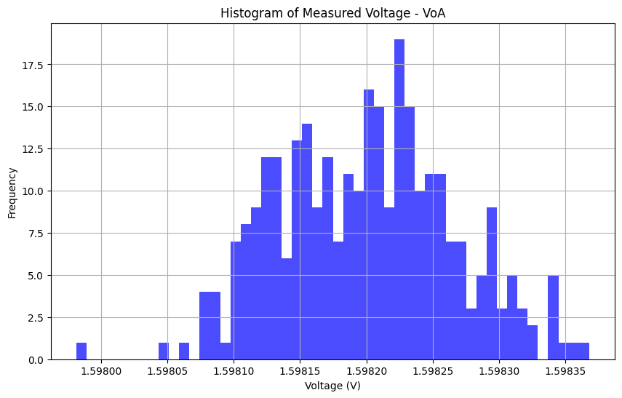

Slide 14
