Slide 1
Project management and training within UNDARK
Overview of the Activities to be done

Slide 2
UNDARK
UNDARK’s main objective is to transform the IAC into a world-class institution in astroparticle physics.
Four specific objectives
  Strategic partnership. The main goal is to establish a new and robust consortium across the EU under the umbrella of EuCAPT , with the Widening coordinator (IAC) at the helm, uniting top class partners and ensuring continuity beyond the conclusion of this action.
  Scientific capacity. The main goal is to generate a major build-up of the IAC’s research capacity and creativity in the fields of astroparticle physics and dark matter exploration, of excellence and sustainable after the end of UNDARK.
  Scientific visibility. The goal is to increase the scientific profile of the IAC in the international and EU R&I system and to expand its influence and dissemination of knowledge to the society at large.
  Management capacity. The main goal is to produce a structural increase in the management capacity and skills of the IAC research and administrative staff.

Slide 3
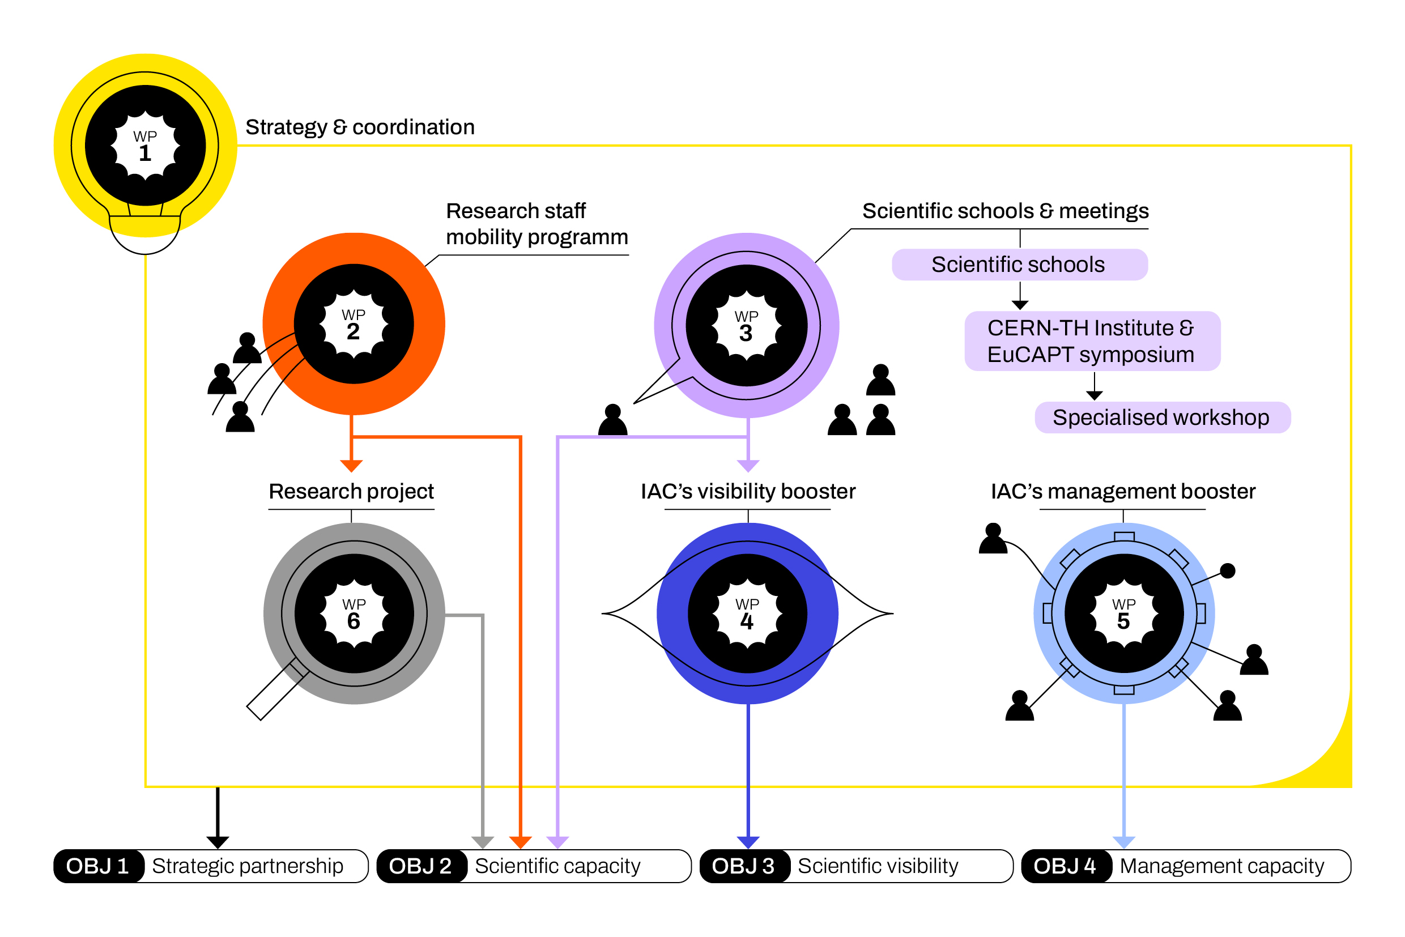
UNDARK Overview

Slide 4
IAC’s Management Booster -.Objective
Exchange of research management best practices from top partners to the IAC for their implementation.
Boost the elaboration of HE proposals.
Raise the efficiency of HE Project Management.
Improve existing processes in IAC’s research Management.

Slide 5
Wp5 IAC’s Management Booster
Improve IAC Research Management skills and competence through short visits
HE Proposal ElaborationWorkshops
Tutoring on HE proposal elaboration for researchers and managers.
Tutoring on HE proposal management for researchers and managers.
Boost IPR & Technology Transfer in IAC

Slide 6

Improve IAC Research Management skills and competence through short visits.
Within this task, short term visits of IAC administrative staff to internationally leading partners will be prepared and delivered

Slide 7
HE Proposal ElaborationWorkshops
3 Specific Workshops to prepare the researchers of IAC for submitting proposals for different HE schemes.
  More specifically, this includes the European Research Grants Marie Sklodowska-Curie Actions and Research and Innovation Actions.
  These workshops will be in-person at the IAC and streamed online, will have a duration of 1 day and will be open to the researchers from the partners
    The first one to be organized in the first months of 2025

Slide 8
Tutoring on HE proposal elaboration for researchers and managers.
Continuous mentoring
  To identify topics
  Brainstorms to select the proposals to be done
  After we decide to go forward to a proposal
    Plan until deadline
    Weekly meeting to revise progress
    Solve doubts
    Review proposal and propose improvement
  At least 6 researchers will be mentored during the project duration

Slide 9

Tutoring on HE proposal elaboration for researchers and managers.
Tomorrow (15:00-16:00) : Meeting to probe interests on coaching/training on EU projects at the IAC

Slide 10
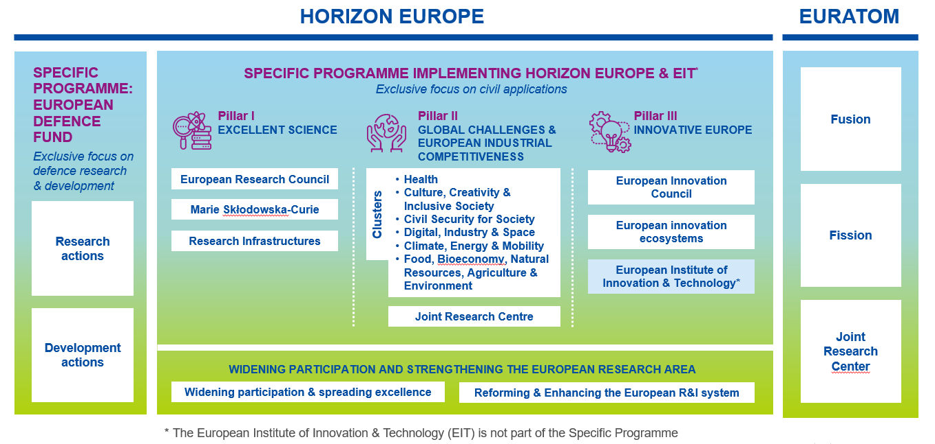
About Horizon Europe
Horizon Europe supports research and innovation through Work Programmes, which set out funding opportunities for research and innovation activities.

Slide 11
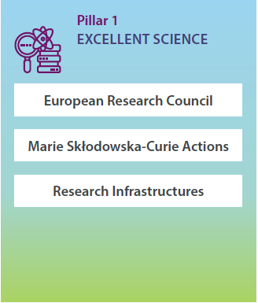
Pilar 1 Overview

Slide 12
ERC GRANTS

Slide 13
MSCA ACTIONS

Slide 14
Pilar 2 Overview

Slide 15
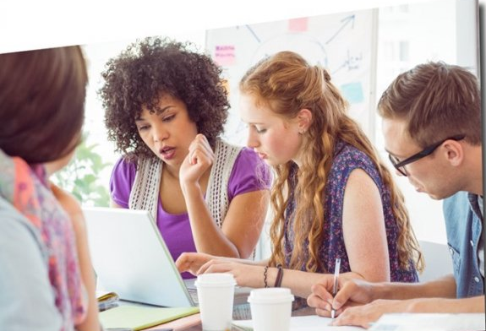
Tutoring on HE proposal management for researchers and managers.
1 workshop, with a duration of 1 day, will be organized by SAT at the IAC. It will be conducted in person and simultaneously streamed online, allowing participation from all partner institutions.
Continuous mentoring will be done by SAT to IAC management and administrative staff during the project to train on the challenges of managing HE projects.
  Identify bottlenecks and challenges
  Solve doubts
  Propose possible alternatives to gain efficiency
Meeting during the KoM to discuss the current challenges

Slide 16
Boost IPR & Technology Transfer in IAC
To encourage the exploitation of the use of the research results.
1 workshop will be organized it will be conducted in person and simultaneously streamed online, allowing participation from all partner institutions.
Also, support will be provided by SAT to the IAC in technology transfer methods to enlarge the impact of the research done in the institution.

Slide 17
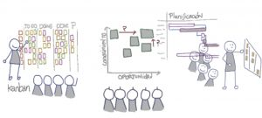
Who we are?
SATURNTECH has extensive experience in enhancing organizations' abilities to develop successful EU proposals and improve their participation in European projects.
Saturntech has taken the lead in delivering training courses on European project management and proposal writing,
Our expertise spans a wide range of services, including EU proposal coaching, intellectual property rights (IPR) management and technology transfer capabilities, ensuring that innovations are effectively protected and brought to market.

Slide 18
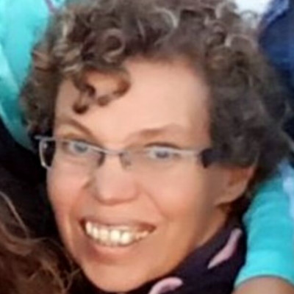

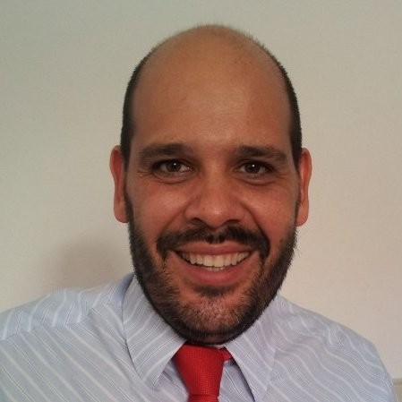
Our Team involved in UNDARK
Ana Branco
Technological Physical Engineer, with more than 20 years of experience in European projects management and European Proposal Elaboration.
Intellectual Property training from the WIPO and from EPO, and in Gender issues from ONUWomen
Blanca Araujo
Industrial Engineer with more than 15 years experience in building new proposals and projects,
Innovation and agile consultant, project management and EU business management
Jorge Bayon
Telecomunnication Engineer with more than 2O years of experience in Technology Transfer and international project management
Support innovative and new technology project

Slide 19
Next steps
Tomorrow 15:00-16:00 :Meeting to probe interests on coaching/training on EU projects at the IAC
First workshop - date to be defined but in the first months of 2025
Feel free to contact us for any doubt/assistance concerning Horizon Europe proposals elabporation or project management
  Talk with me during the coffee/lunch breaks

Slide 20
Thank you for attention
And if you have any doubts, please fell free to contact me :
Ana.branco@Saturntech.eu
(0034) 654399166

