Slide 1
EESD
Structural analysis of the vacuum vessel
D. Ramos, xx/xx/2024

Slide 2
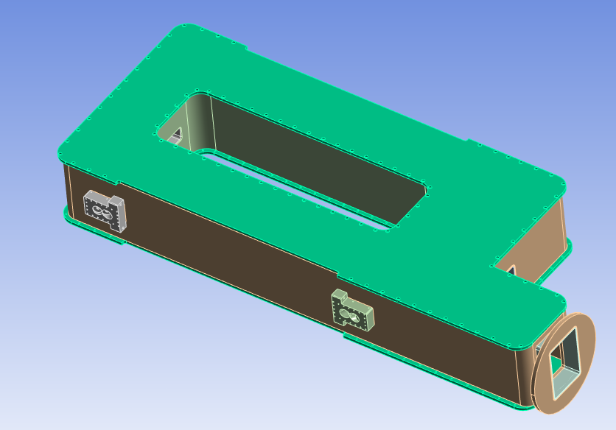
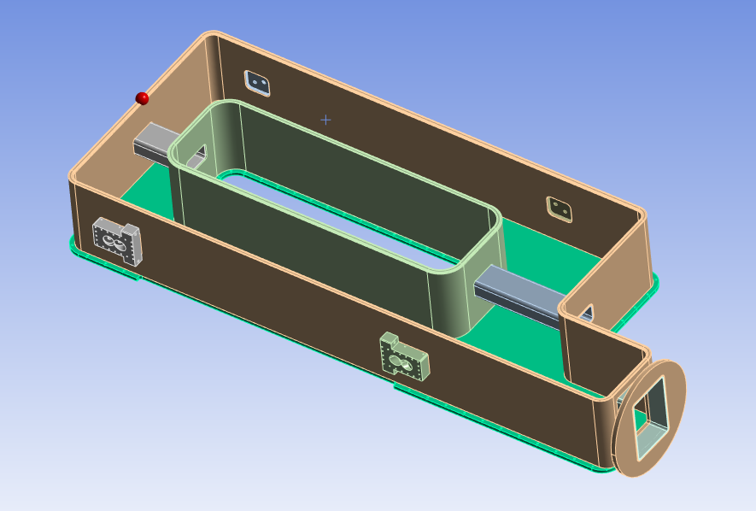
Vacuum vessel
Core structure includes the interfaces for the cold mass suspension rods
Top and bottom covers close the assembly once the cold mass is already aligned
Sealing with elastomer O-ring
Covers and core structure are assembled in “sandwich” with threaded rods and nuts, compressing the seals. The pressure will help compressing the seal on the regions where there is no space for bolts
Step interface between covers and the core walls prevents the core walls from bending inwards

Slide 3
Loads
Atmospheric pressure
No significant inner pressure thanks to safety valve
  To be checked: Where is the safety valve located and what’s the opening pressure?
Suspension rod preload up to 13 kN assuming a 10 mm cross section in Invar or stainless steel. Calculations are done applying a safety factor of 1.5, i.e. 20 kN per rod.

Slide 4
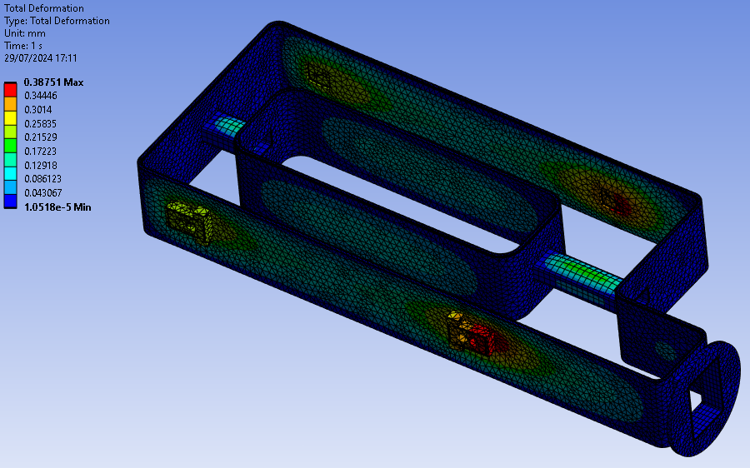
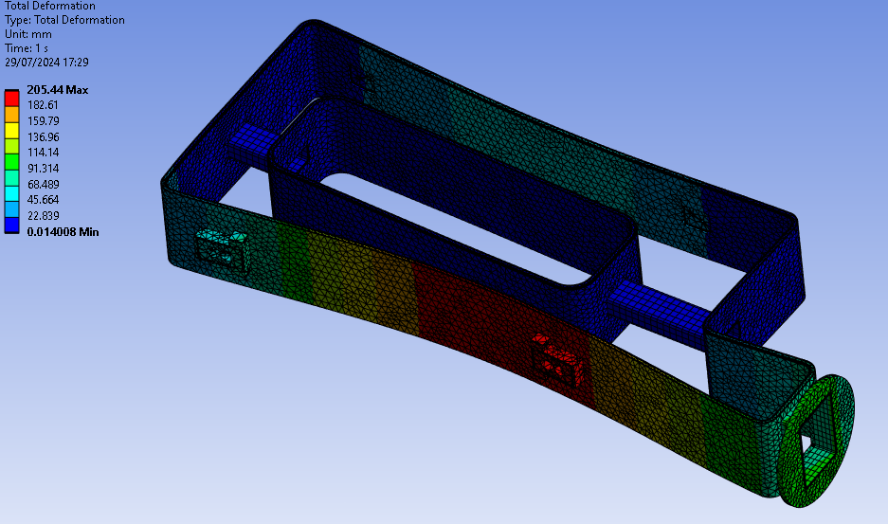
Displacements
With the locking effect given by the covers, the maximum displacement is 0.4 mm at the suspension rod interfaces
Without the supporting effect from the covers, the core structure would not be able to sustain the pressure

Slide 5
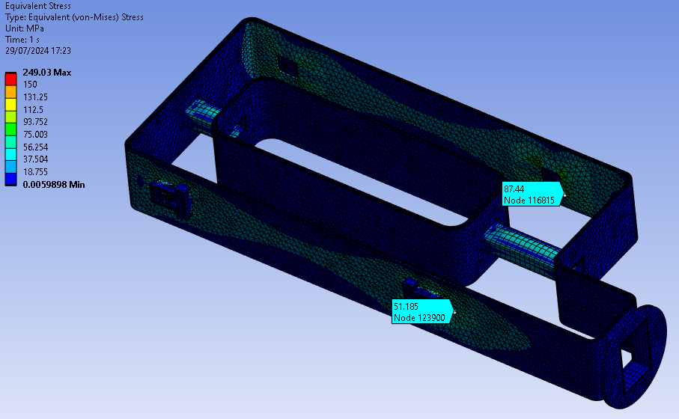
Stresses
As usual with vacuum vessels, the main design constraint is displacement
Stresses are low
Local Von-Mises stress below 90 MPa
Overall stress in the order of 50 MPa

Slide 6
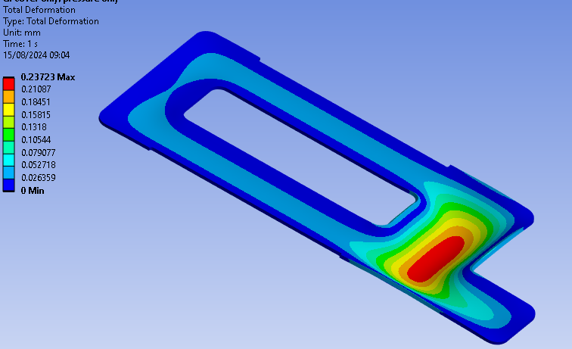
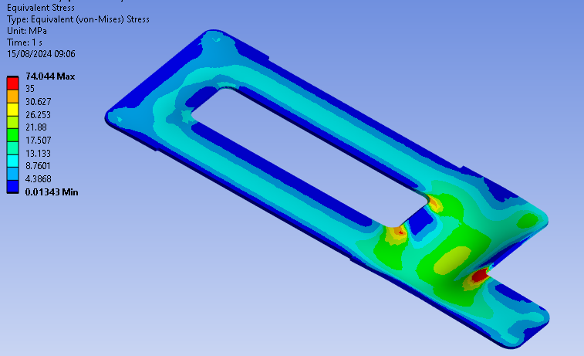
Covers
0.2 mm max deformation
Low stresses

