Slide 1
PID/ Instrumentation
EESD phase 3
25/07/2024

Slide 2
Questions
Shall we keep the option or using N2, supplied by a Dewar in the thermal shield cooling circuit, see slide 5.(Issues on helium purity, risk of error)
When sensors (TT1,TT2, TT4) are redundant with CRG CFB setup should we keep them into the cryostat?
How many voltage taps are available at the busbar location? (see with Jerome)
Should we add PCB sensors?
Strain gauges on Tirod for cold mass support: how many wires? Half or full bridge?
Ambiguity numeration of CFB connections on CRNLSQLJ0006, see slides 6. Be sure to use the proper connection for the mechanical integration.

Slide 3

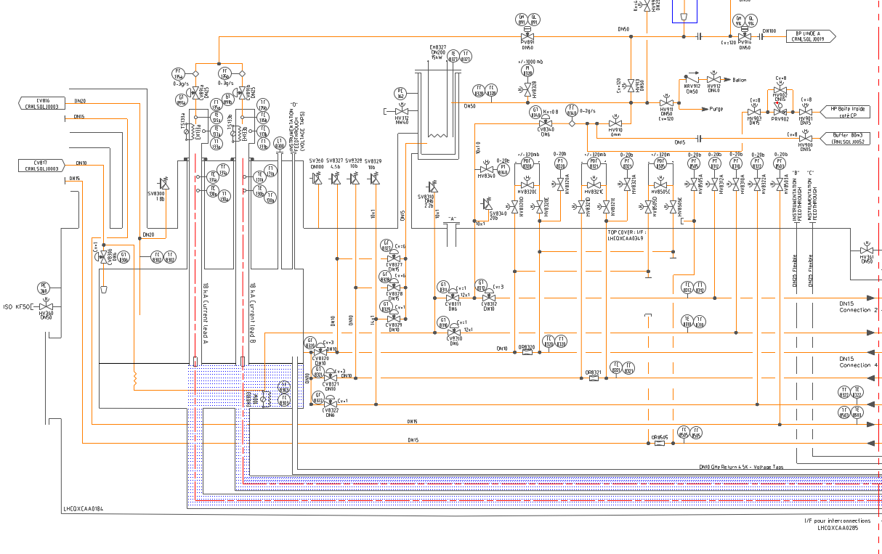
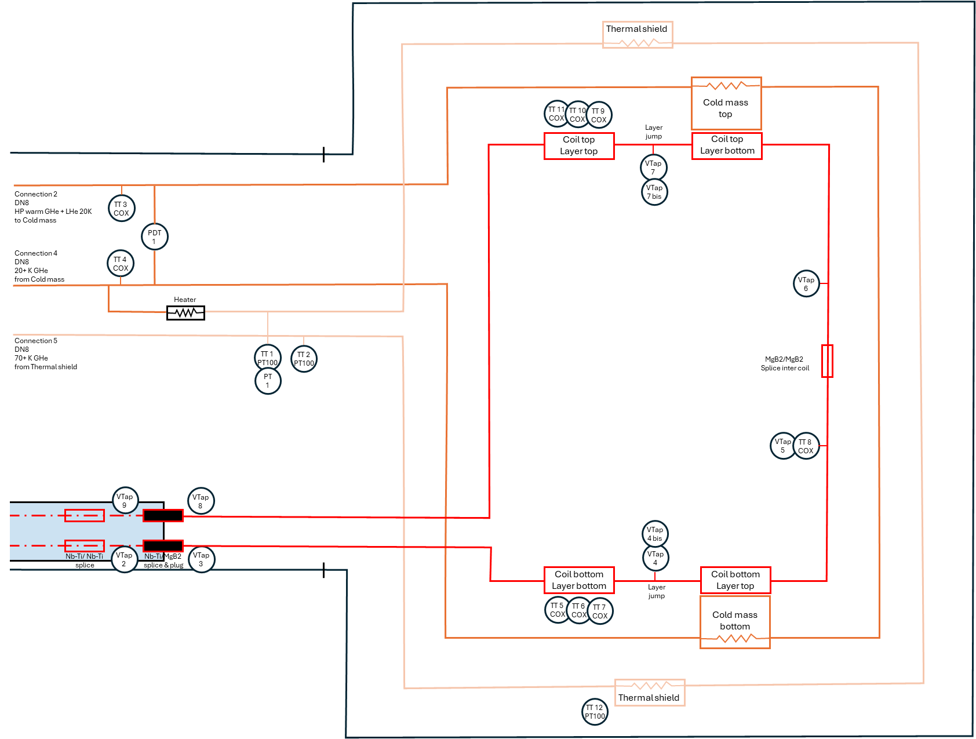
PID CFB and EESD phase 3
Connection 2
Connection 1
Connection 4
Connection 5
Connection 6
Connection 7
Connection 8
Instrumentation
From CRNLSQLJ0006: https://edms.cern.ch/ui/file/1337211/AF/crnlsqlj0006-v.AF.pdf

Slide 4
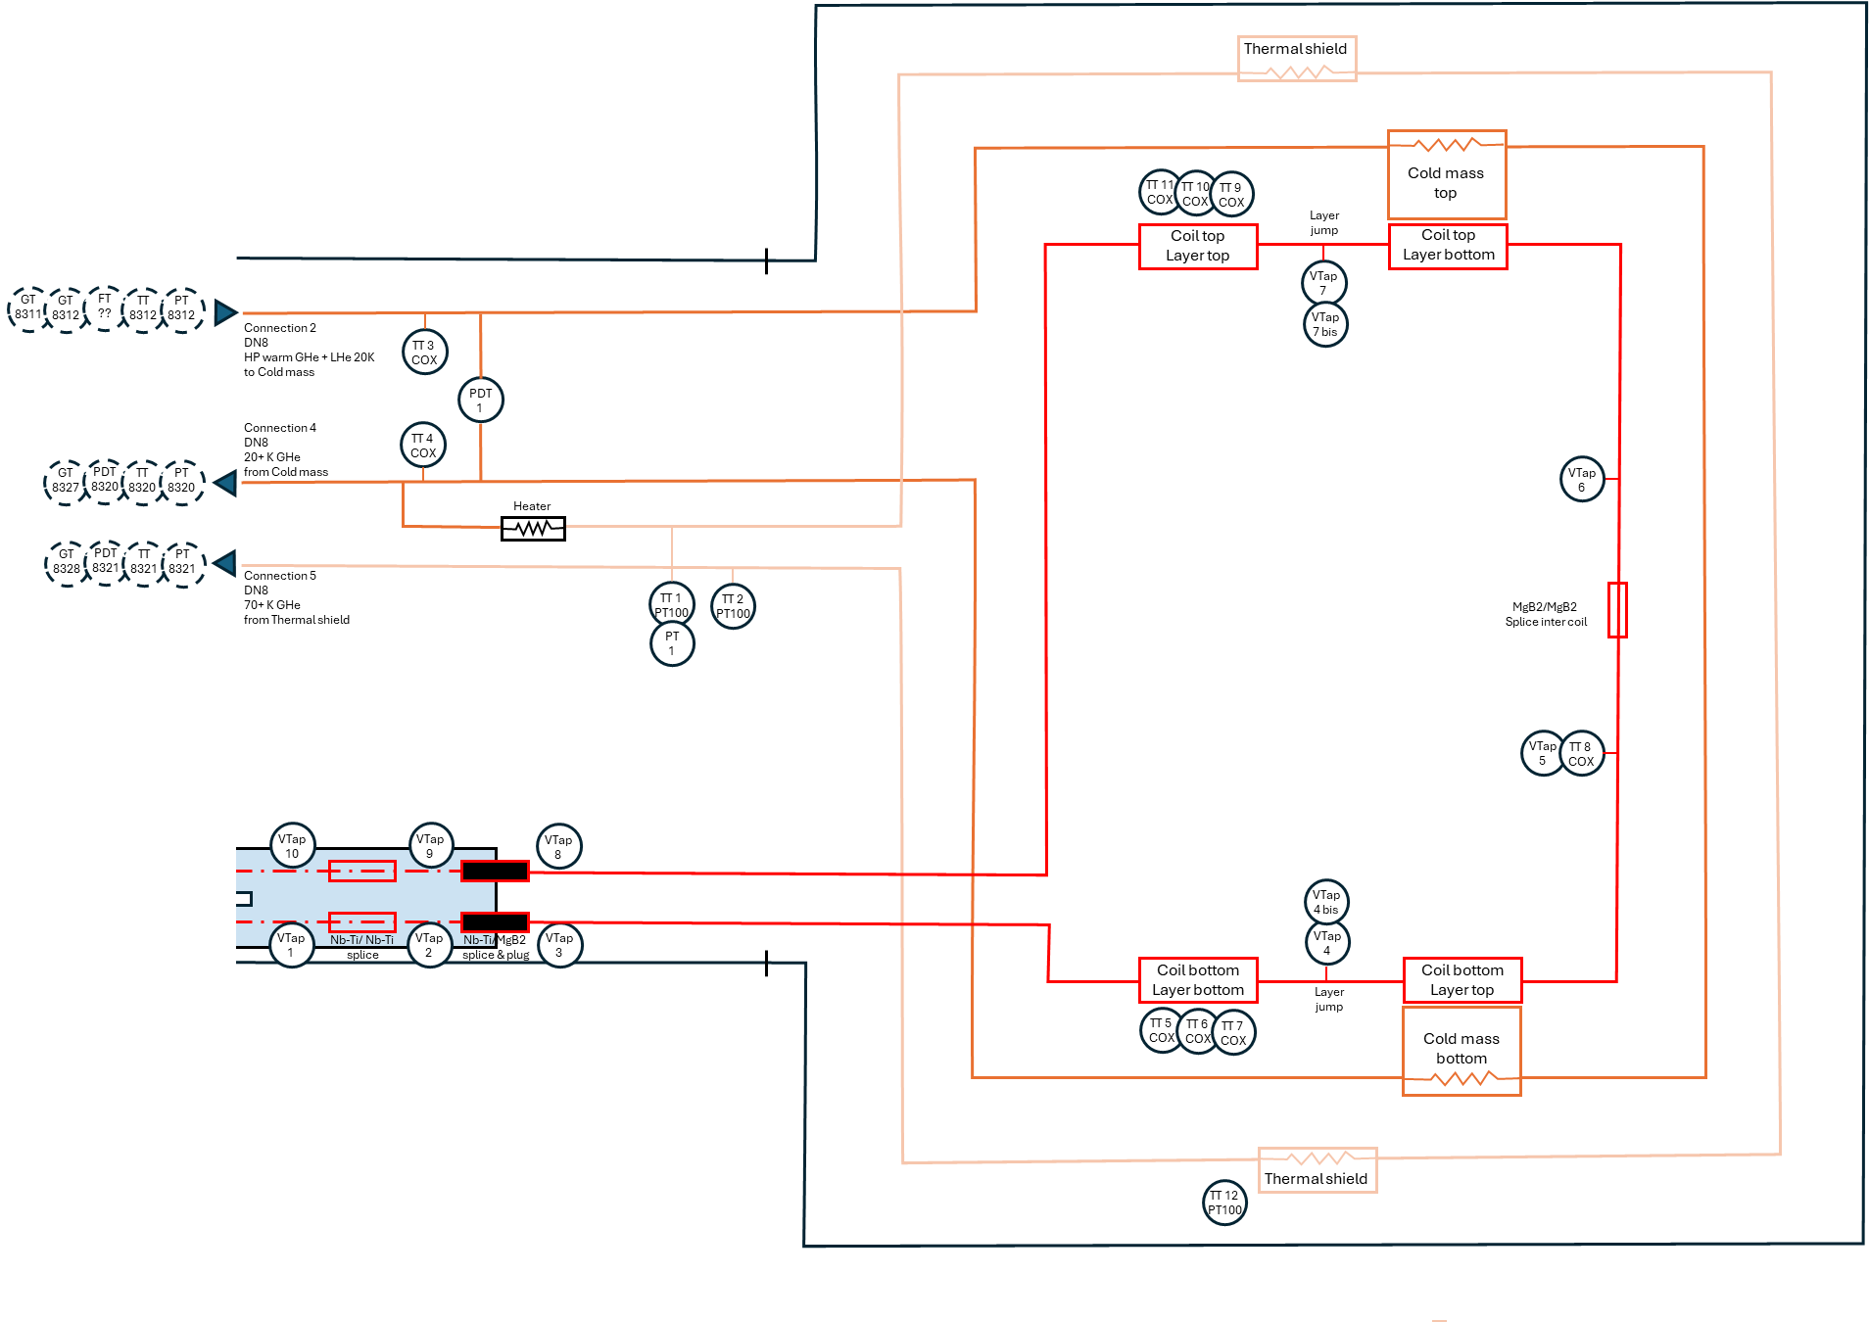
PID EESD phase 3 & Instrumentation list
 | Sensor ID Number | Type of sensor | Name | Nb of cables to extract from cryostat | Redundant sensor in CFB
0 | - |  | Heater | 2
1 | Vtap 1 |  | Voltage Tap Lead A CFB | 0
2 | Vtap 2 |  | Voltage Tap Lead A Nb-Ti splice | 0
3 | Vtap 3 |  | Voltage Tap Lead A MgB2 splice | 1
4 | Vtap 4 |  | Voltage Tap Coil bottom layer jump | 1
5 | Vtap 4 bis |  | Voltage Tap Coil bottom layer jump (redundance) | 1
6 | Vtap 5 |  | Voltage Tap Slice Intercoil top | 1
7 | Vtap 6 |  | Voltage Tap Slice Intercoil bottom | 1
8 | Vtap 7 |  | Voltage Tap Coil top layer jump | 1
9 | Vtap 7 bis |  | Voltage Tap Coil top layer jump (redundance) | 1
10 | Vtap 8 |  | Voltage Tap Lead B MgB2 splice | 1
11 | Vtap 9 |  | Voltage Tap Lead B Nb-Ti splice | 0
12 | Vtap 10 |  | Voltage Tap Lead B CFB | 0
13 | TT1 | PT100 Pipe element | N2 Inlet Temperature | 4 | None
14 | TT2 | PT100 Pipe element | N2 Outlet Temperature | 4 | TT 8321
15 | TT3 | CERNOX Pipe element | GHe Inlet Temperature | 4 | TT 8312
16 | TT4 | CERNOX Pipe element | GHe Outlet Temperature | 4 | TT 8320
17 | TT5 | CERNOX | Coil Former Temperature Bot 1 | 4 | None
18 | TT6 | CERNOX | Coil Former Temperature Bot 2 | 4 | None
19 | TT7 | CERNOX | Coil Former Temperature Bot 3 | 4 | None
20 | TT8 | CERNOX | Splice intercoil | 4 | None
21 | TT9 | CERNOX | Coil Former Temperature Top 1 | 4 | None
22 | TT10 | CERNOX | Coil Former Temperature Top 2 | 4 | None
23 | TT11 | CERNOX | Coil Former Temperature Top 3 | 4 | None
24 | TT12 | PT100 | Thermal Screen Temperature (Evaluate the hotest point of the Themal screen ) | 4 | None
25 | PT1 |  | N2 Inlet Absolute pressure | 2 ?
26 | PDT | 0-600 mbar | Inlet/return GHe differential pressure | 2 ?
27 | SG1 |  | TiRod Coldmass 1 | 4
28 | SG2 |  | TiRod Coldmass 2 | 4
29 | SG3 |  | TiRod Coldmass 3 | 4
30 | SG4 |  | TiRod Coldmass 4 | 4
31 | SG5 |  | TiRod Coldmass 5 | 4
32 | SG6 |  | TiRod Coldmass 6 | 4
33 | SG7 |  | TiRod Coldmass 7 | 4
34 | SG8 |  | TiRod Coldmass 8 | 4

Slide 5
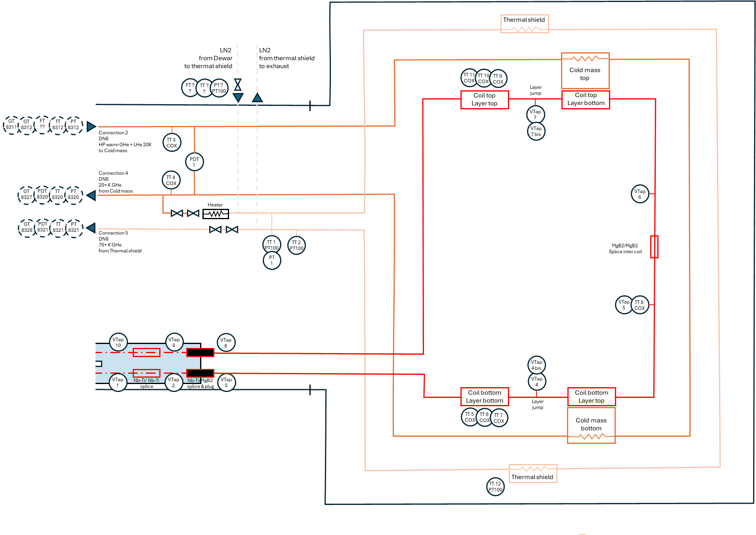
PIS EESD phase 3
With option of supplying N2 for thermal shield cooling circuit

Slide 6
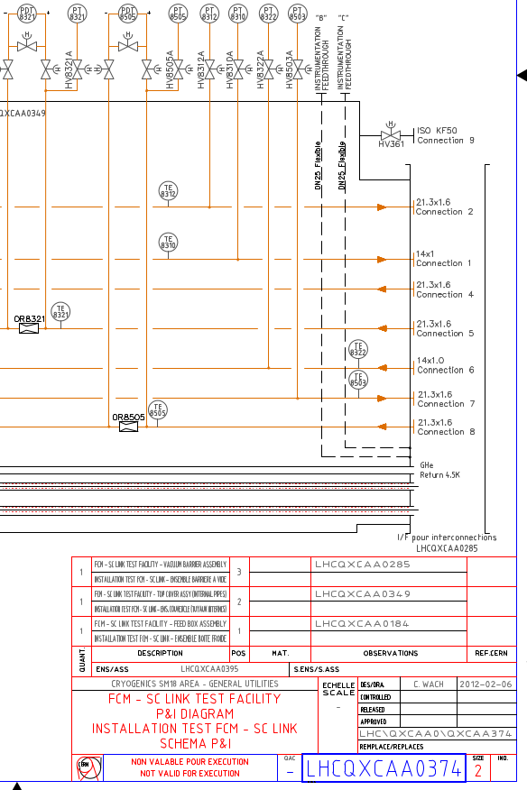
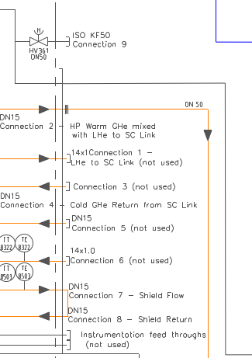
Ambiguity numeration of CFB connections on CRNLSQLJ0006
From CRNLSQLJ0006: https://edms.cern.ch/ui/file/1337211/AF/crnlsqlj0006-v.AF.pdf

Slide 7
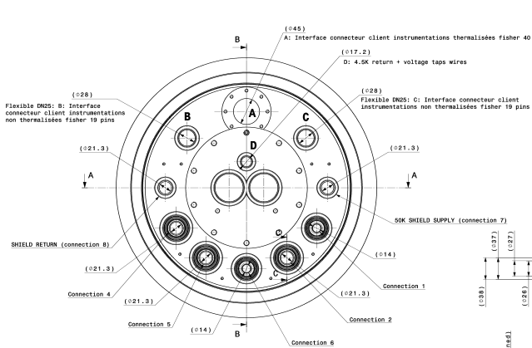
Mechanical integration on CFB vacuum barrier
Connection 4
DN8
20+ K GHe
from Cold mass
Connection 5
DN8
70+ K GHe
from Thermal shield
Connection 2
DN8
20 K GHe
to Cold mass
From CRNLSQLJ0006: https://edms.cern.ch/ui/file/1337211/AF/crnlsqlj0006-v.AF.pdf
From LHCQXCAA0285

Slide 8
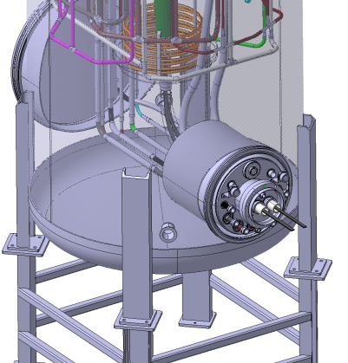
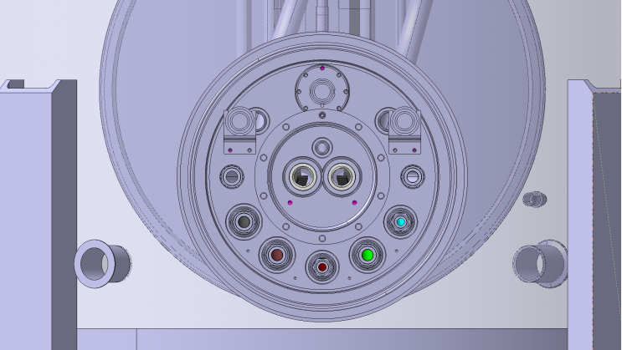
Mechanical integration on CFB vacuum barrier
Connection 4
DN8
20+ K GHe
from Cold mass
Connection 5
DN8
70+ K GHe
from Thermal shield
Connection 2
DN8
20 K GHe
to Cold mass

Slide 9
Figures

Slide 10
Thermal shield
LN2
from Dewar
to thermal shield
LN2
from thermal shield
to exhaust
TT 11
COX
TT 10
COX
TT 9
COX
Cold mass
top
FT ?
?
TT ?
?
PT ?
PT100
Layer jump
Coil top
Layer top
Coil top
Layer bottom
VTap
7
GT
8311
GT
8312
FT
??
TT
8312
PT
8312
VTap
7 bis
Connection 2
DN8
HP warm GHe + LHe 20K
to Cold mass
TT 3
COX
PDT
1
Connection 4
DN8
20+ K GHe
from Cold mass
TT 4
COX
GT
8327
PDT
8320
TT
8320
PT
8320
VTap
6
Heater
GT
8328
PDT
8321
TT
8321
PT
8321
Connection 5
DN8
70+ K GHe
from Thermal shield
TT 1
PT100
TT 2
PT100
MgB2/MgB2
Splice inter coil
PT
1
VTap
5
TT 8
COX
VTap
10
VTap
9
VTap
8
VTap
4 bis
VTap
1
Nb-Ti/ Nb-Ti
splice
VTap
2
Nb-Ti/MgB2
splice & plug
VTap
3
VTap
4
Coil bottom
Layer bottom
Coil bottom
Layer top
Layer jump
TT 5
COX
TT 6
COX
TT 7
COX
Cold mass
bottom
TT 12
PT100
Thermal shield

Slide 11
Thermal shield
TT 11
COX
TT 10
COX
TT 9
COX
Cold mass
top
Coil top
Layer top
Layer jump
Coil top
Layer bottom
VTap
7
GT
8311
GT
8312
FT
??
TT
8312
PT
8312
VTap
7 bis
Connection 2
DN8
HP warm GHe + LHe 20K
to Cold mass
TT 3
COX
PDT
1
Connection 4
DN8
20+ K GHe
from Cold mass
TT 4
COX
GT
8327
PDT
8320
TT
8320
PT
8320
VTap
6
Heater
GT
8328
PDT
8321
TT
8321
PT
8321
Connection 5
DN8
70+ K GHe
from Thermal shield
TT 1
PT100
TT 2
PT100
MgB2/MgB2
Splice inter coil
PT
1
VTap
5
TT 8
COX
VTap
10
VTap
9
VTap
8
VTap
4 bis
VTap
1
Nb-Ti/ Nb-Ti
splice
VTap
2
Nb-Ti/MgB2
splice & plug
VTap
3
VTap
4
Coil bottom
Layer bottom
Coil bottom
Layer top
Layer jump
TT 5
COX
TT 6
COX
TT 7
COX
Cold mass
bottom
TT 12
PT100
Thermal shield

