Slide 1
POLAB at ICEC/ICMC
R.Piccin
Polymer Lab Weekly Meeting
01/08/2024

Slide 2

Themes:
Materials for cryogenic applications (mostly metallic but including polymers!)
Large Cryogenic Systems (e.g. LHC, fusion machines)
Industrial applications (e.g. Energy, Transport)
Cryocoolers, Cryostats, and other components
From the indico page of the event you can download the presentations: https://indico.cern.ch/event/1296489/timetable/?view=standard

Slide 3
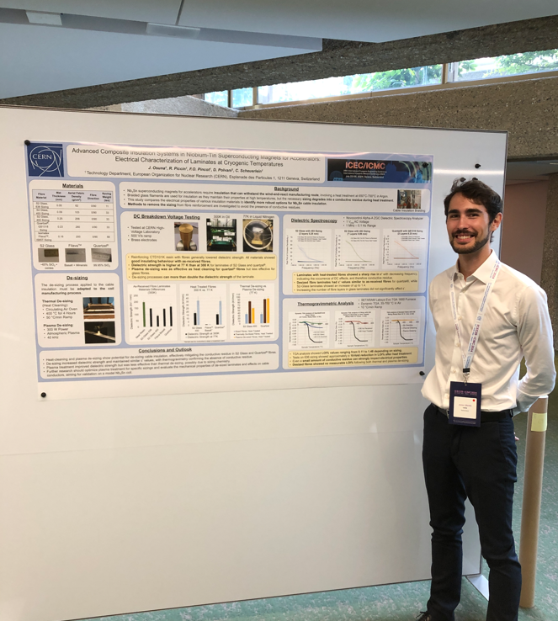
POLAB at ICEC/ICMC
5 contributions from polymer lab team!!!
Add your poster here:
https://edms.cern.ch/ui/#!master/navigator/project?P:1816443886:101509855:subDocs
Bertsch J. et al. | Thermomechanical properties of epoxy and wax matrix composites for superconducting magnets
Osuna J. et al. | Advanced Composite Insulation Systems in Niobium-Tin Superconducting Magnets for Accelerators [...]
Scheuerlein C. et al. | Dielectric, thermal and mechanical properties of insulation systems for quench heaters for the protection of superconducting magnets
Verma B. et al. | Adhesion analysis of epoxy resin impregnation systems for Nb3Sn superconducting magnets
Scheuerlein C. et al. | Thermomechanical properties and irradiation induced aging of SLA and FDM 3D printed high performance polymers

Slide 4
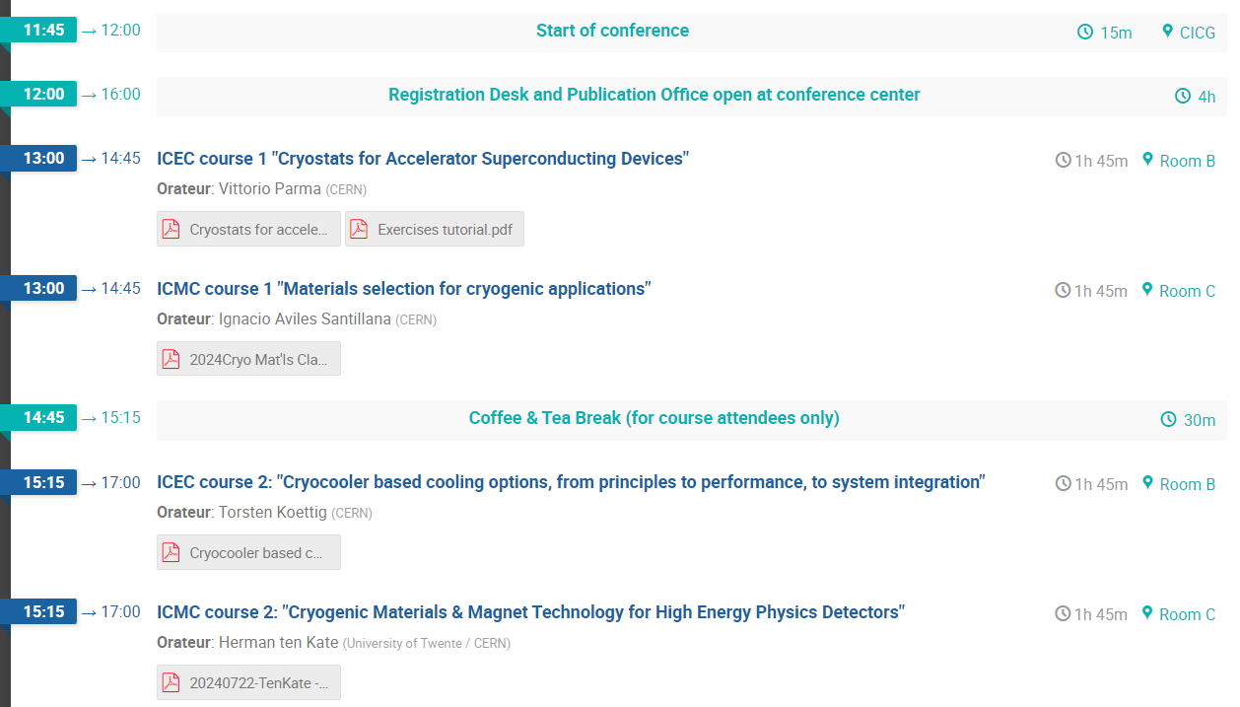
Courses

Slide 5
A list of some Plenary Talks
Accelerator technologies:
Low temperature technologies for accelerators and detectors at CERN (M. Jimenez)
Advancing Superconductor Technology for High Field Applications: Current State and Emerging Trends (C. Senatore)
Other industrial applications:
Electrification of Aviation Propulsion – Cryogenic Technologies that enable the Next Generation of Propulsion Systems
Cryogenics for power and energy: a winning ticket?
Cryogenics for future Hydrogen Infrastructure

Slide 6
Oral Presentations
Onset of mechanical degradation due to transverse compressive stress in Nb3Sn Rutherford cables as a function of heat treatment and impregnation (K. Puthran)
Can Stainless Steel Meet the Challenges of Future Cryogenic Engineering Systems? (I. A. Santillana)

