Slide 1


CM05 Magnetic Separation Center Non Conformity
Sandor Feher – HL-LHC AUP L2 manager, Fermilab
CERN meeting – August 2nd, 2024

Slide 2
Magnetic Center Separation Requirement
We have decided that this requirement needs a modification since during CA01 assembly we have observed that the measured Magnetic Center Separation (MCS) of the two magnets at room temperature was different:
  It was 4792 mm (14 mm shorter)
Ezio contacted CERN’s accelerator experts and according to them this is not an issue since the beam optics can be adjusted
We have created an NCR and we have decided that we will wait to have a few more CMs built and measured before we will pick the new target value for the MCS (Ezio’s request) and then we will update the FRS and the acceptance criteria

Slide 3
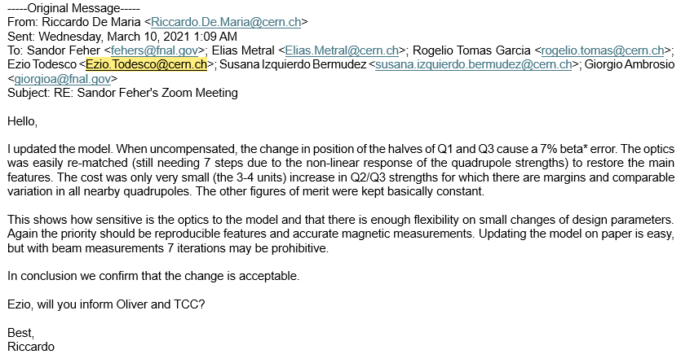

Slide 4
Magnetic Center Separation Measurements
Magnetic Center Separation (MCS) for 5 CMs have been measured so far
The average separation of the magnetic centers for the first 4 CMs is 4.792
CM05 magnetic center separation is 8.1 mm shorter than the average for 4 CMs
Measured distances between magnets of each cold mass
 | initial (no shell) | before weld (shell tacked) | after weld | cold (rotatingCoil)
CM01 | 4.7915 | 4.7898 | 4.7895 | 4.7721
CM02 | 4.7913 | 4.7947 | 4.7930
CM03 | 4.7942 | 4.7934 | 4.7932
CM04 | 4.7928
CM05 | 4.7843
8.1 mm
10 mm
Average for the first 4 CMs

Slide 5
MCS adjustment
There is a possibility to move CM05 magnets further apart by 3 mm
3.5 mm
4.1 mm
7 mm
3.5 mm
With the new target MCS value the CMS values for all magnets would be
within ± 5 mm

Slide 6
MQXFA16
It turns out that MCS for MQXFA16 is 6 mm longer
Adjusting the distance by 3 mm at FNAL means that the tolerance will be within the requirement using the new target value for MCS
Even if would use for the target value of MCS the average value of the 6 CMs we would be within the ± 5 mm tolerance values (+ 2.4 mm – 4.5 mm)

