Slide 1
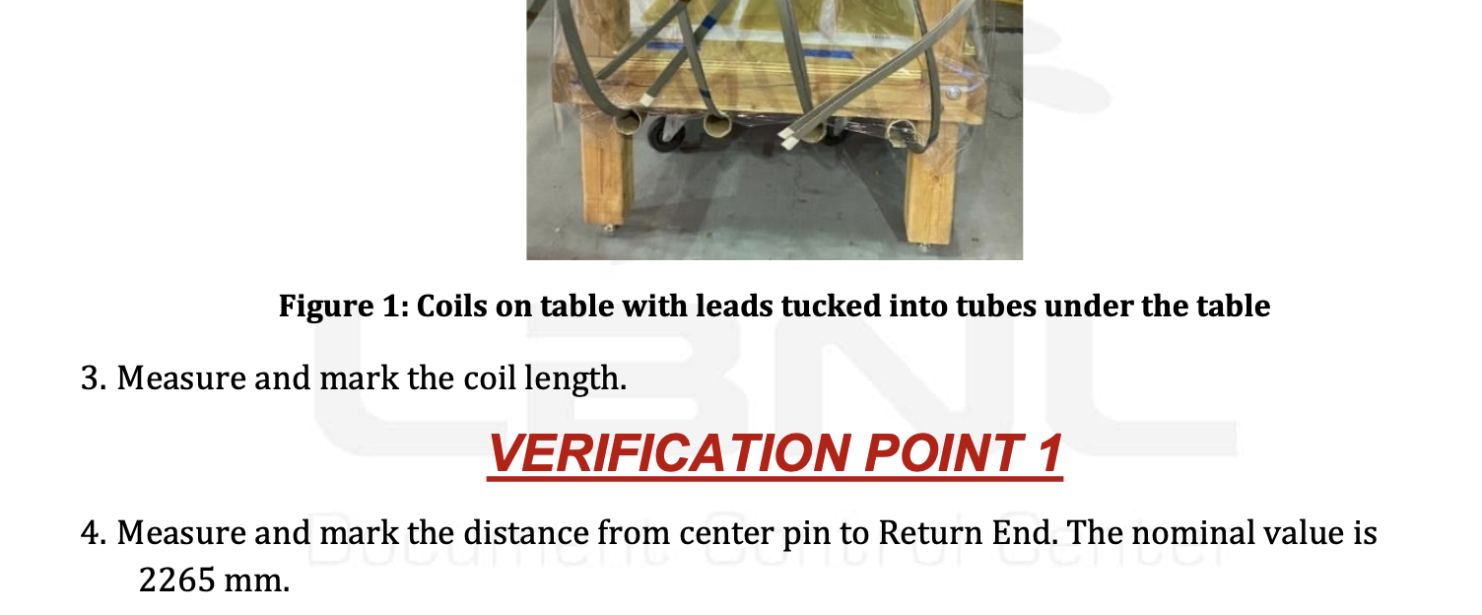
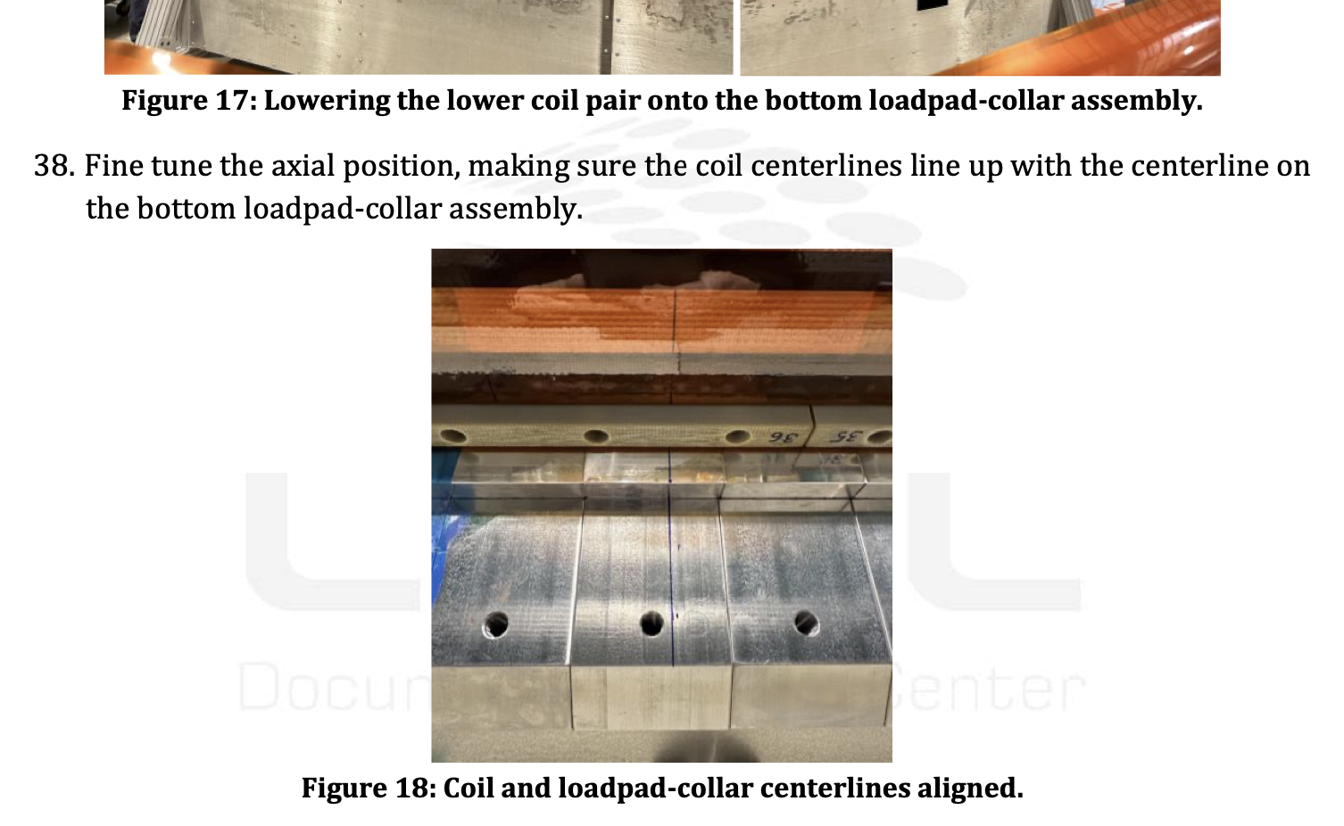
Coil Longitudinal Centering
Dressed Coil Operation (each individual coil)
  Centerline is marked pin, nominal 2265 mm
At Coil Pack assembly
  Each coil’s centerlines are matched when pairing
  Centerlines are placed on centerlines of Pad/Collar assembly (lower coils)
  However, no Verification point is listed at this point to measure LE/RE setbacks and/or adjust
WI will be revised to include this check/adjustment

Slide 2
Additional slides

