Slide 1
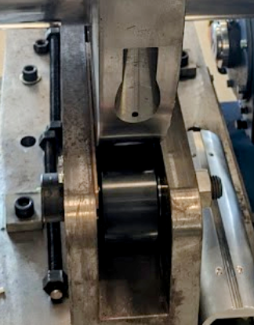
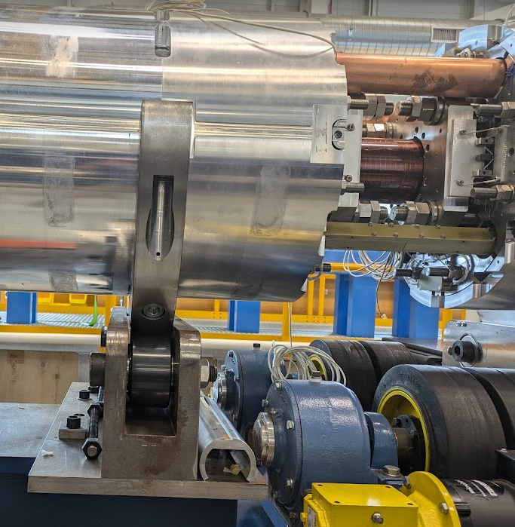
MQXF07b
3.3 mm shim
MQXF07b
MQXF15

Slide 2
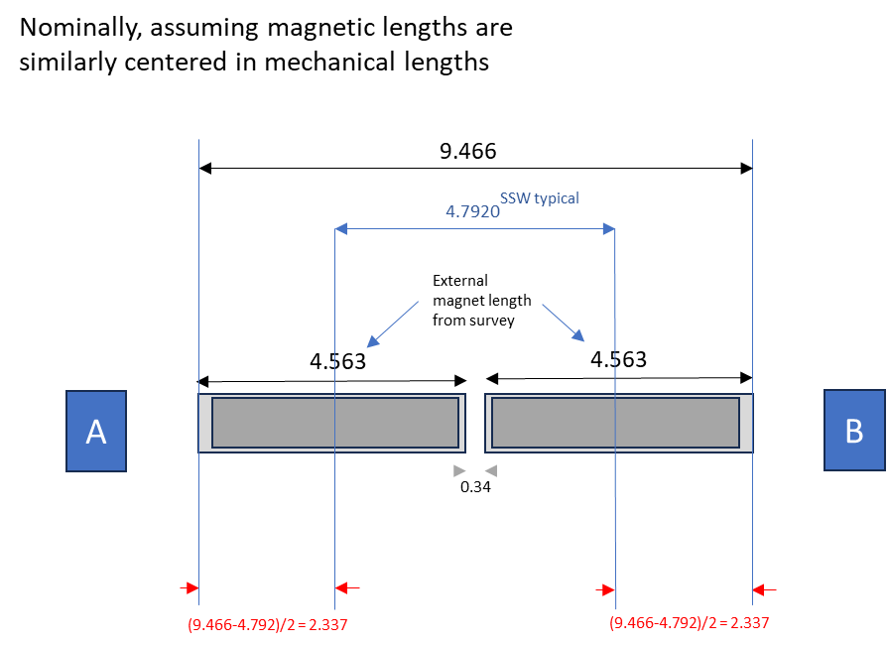
Ref. J. DiMarco, SSW_Zcenter_CM05_magnetPositionCompare_30Jul2024.pptx, July 30, 2024

Slide 3
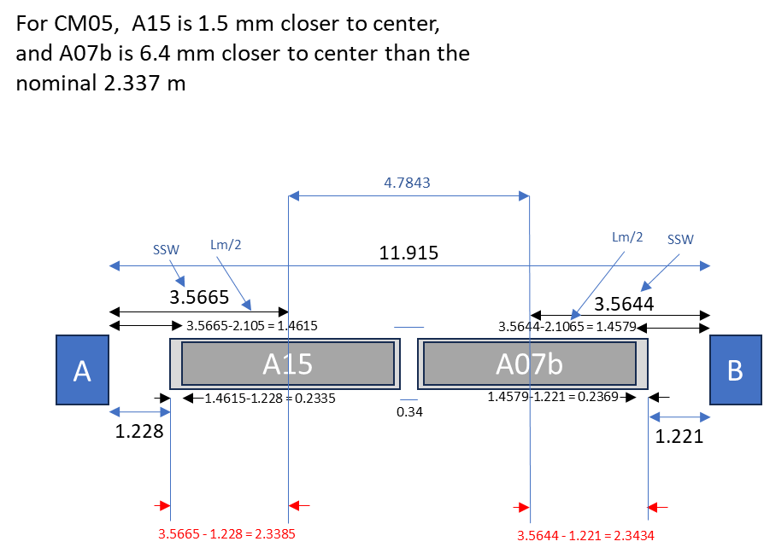
Ref. J. DiMarco, SSW_Zcenter_CM05_magnetPositionCompare_30Jul2024.pptx, July 30, 2024

