Slide 1
MBRD – Status of the quench protection scheme effectiveness
F. Levi
A. Bersani, B. Caiffi, S. Farinon, A. Pampaloni - INFN Genova

Slide 2
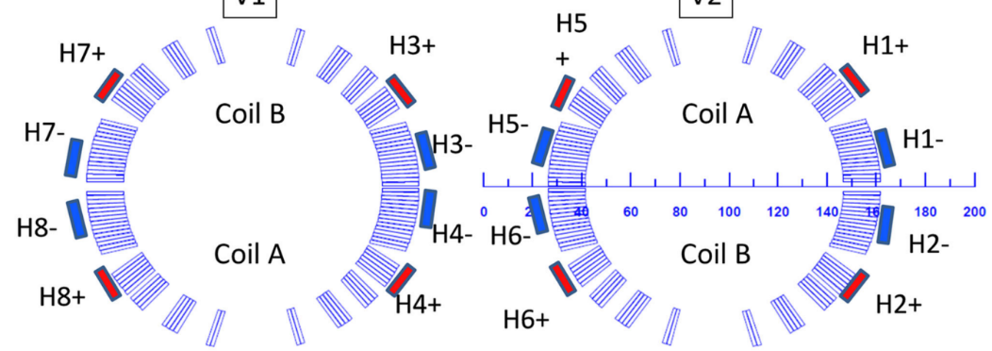
Quench protection baseline performance
AP01
AP02
34.7 MA²s
300 K
Current [A] | N of QH firing | MIIts from Q [MA²s] | Adiab HS T [K] | V peak to ground [V]
6000 | 8 | 20.3 | 80 | 9
8000 | 8 | 24.3 | 112 | 15
10000 | 8 | 27.3 | 151 | 33
12330 | 8 | 30.8 | 211 | 54
13357 | 8 | 32.4 | 243 | 72

Slide 3
Complete failure analysis at nominal current
Case | N of QH firing | MIIts from Q [MA²s] | Adiab HS T [K] | V peak to ground [V]
1 | 8 | 30.8 | 211 | 54
2 | 7 | 31.5 | 222 | 140
3 | 7 | 31.4 | 222 | 134
4 | 7 | 31.5 | 223 | 168
5 | 7 | 31.4 | 222 | 158
6 | 7 | 31.5 | 222 | 142
7 | 7 | 31.4 | 221 | 124
8 | 7 | 31.5 | 222 | 100
9 | 7 | 31.4 | 222 | 94
10 | 6 | 32.7 | 241 | 277
11 | 6 | 32.7 | 241 | 374
12 | 6 | 32.6 | 240 | 341
13 | 6 | 32.7 | 240 | 229
14 | 5 | 33.8 | 260 | 430
15 | 5 | 33.7 | 258 | 418
16 | 5 | 33.7 | 260 | 429
17 | 5 | 33.7 | 259 | 419
18 | 5 | 33.7 | 259 | 369
19 | 5 | 33.6 | 258 | 359
20 | 5 | 33.7 | 260 | 374
21 | 5 | 33.6 | 257 | 354
22 | 4 | 35.4 | 292 | 700
23 | 4 | 35.3 | 290 | 622
STD
1 BROKEN QH
2 BROKEN QH
3 BROKEN QH
4 BROKEN QH

Slide 4
Complete failure analysis at nominal current
In graphs:

Slide 5
Sensitivity analysis of QH insulation thickness
I [A] | th ins [um] | case | MIITS from Q [MA2/s] | Adiab HS T [K] | Δ MIITS [MA2/s] | Δ Adiab HS T [K]
12330 | 100 | std | 30.8 | 211 | 0.68 | 10
12330 | 125 | std | 31.5 | 221
13557 | 100 | std | 32.4 | 243 | 0.76 | 14
13557 | 125 | std | 33.2 | 257
12330 | 100 | fail 3 | 32.7 | 240 | 0.68 | 12
12330 | 125 | fail 3 | 33.4 | 252

Slide 6
MBRD – Status of the quench protection scheme effectiveness
F. Levi
A. Bersani, B. Caiffi, S. Farinon, A. Pampaloni - INFN Genova

Slide 7
Sensitivity analysis of QH insulation thickness

