Slide 1



ATLAS RPC FOAM TECHNIQUE
R&D STUDIES
Report
presenter: Ahmet Renklİoğlu
On behalf of atlas rpc R&D team
26.08.2024

Slide 2
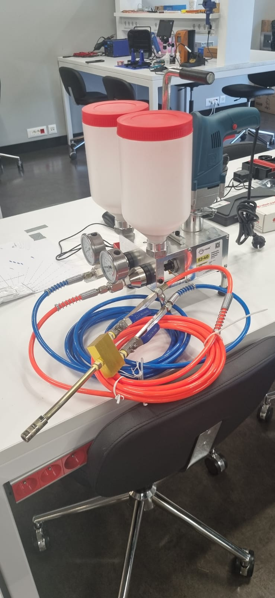
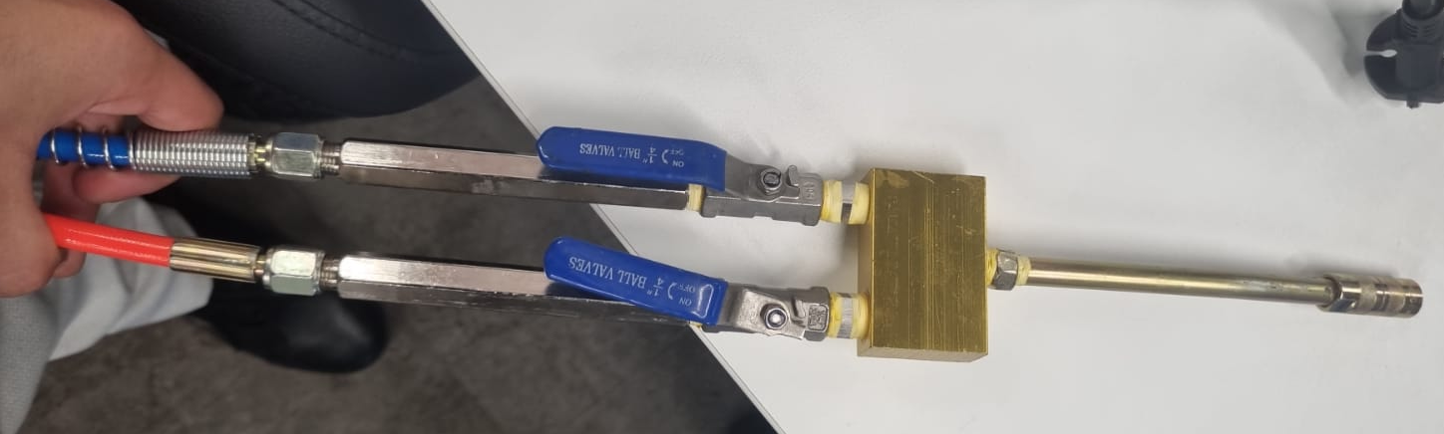
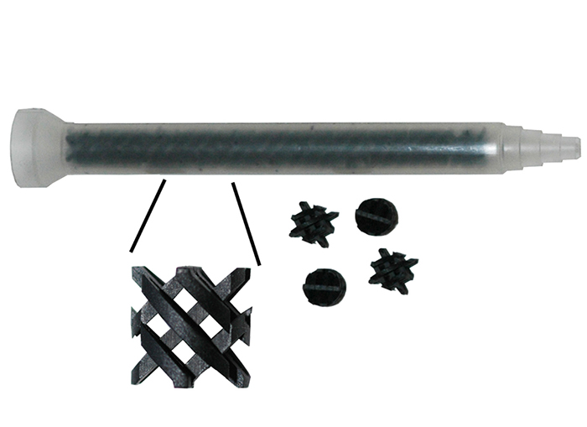

New Machıne tested wıth aktıf-foam2
EJ-40 was carefully tested.
The first tests were promising.
We focused on optimizing the operation of the EJ-40 at a pressure that would not damage the connectors inside the service box, as initially feared.
The injection pressure can be increased step by step using the drill trigger.
In this process, the maximum pressure that would not harm the connectors was determined and noted.
Note: We removed some of the connectors at the end of the machine to allow the foam to exit through a larger cross-section, which helped further reduce the pressure.
26.08.2024

Slide 3
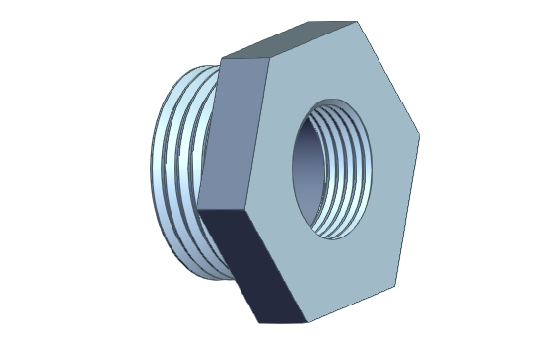
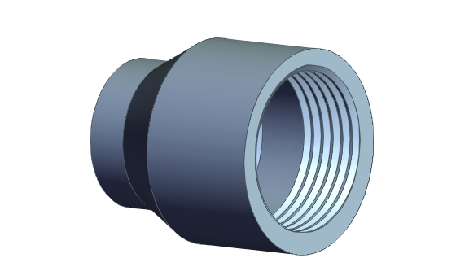
What are the planned activities for the upcoming week?
Green –> Completed
Yellow -> Following weeks
New Application Gun:
  Tested with water and acetone.
  Testing EJ-40 with our foam.
  Cleaning and Sustainability tests for serial applications. (Testing Acetone for cleaning).
  Connecter design and production between EJ-40 and static mixers.
  Testing the Stamixco Mixers with EJ-40 machine. -> Failed due to 3d printed connector between EJ-40’s tip and the mixer
    We have decided to manufacture the connection component from aluminum.
    The order has been placed with the manufacturing company.
    The connection component will be in our hands by the end of this week or the beginning of next week, and we will be able to conduct our test more precisely.
  Designing static mixers that will fit to EJ-40 (If extra tests are necessary until Stamixco delivers the mixers).
26.08.2024

Slide 4
ATLAS RPC FOAM TECHNIQUE
R&D STUDIES UNTIL NEXT YETS24/25
Thank You
ATLAS RPC Gas Repair Meeting
26.08.2024

