Slide 1
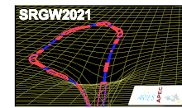
Response of a storage-ring beam to a gravitational wave
Feb. 10, 2025 @SRGW2025
K. Oide (UNIGE/CERN/KEK)
Many thanks to G. Franchetti and F. Zimmermann.
These are basically copying my previous presentation at SRGW2021:
https://indico.cern.ch/event/982987/contributions/4199474/attachments/2182082/3687703/Beam_response_Oide_210203.pdf
https://arxiv.org/abs/2105.00992

Slide 2
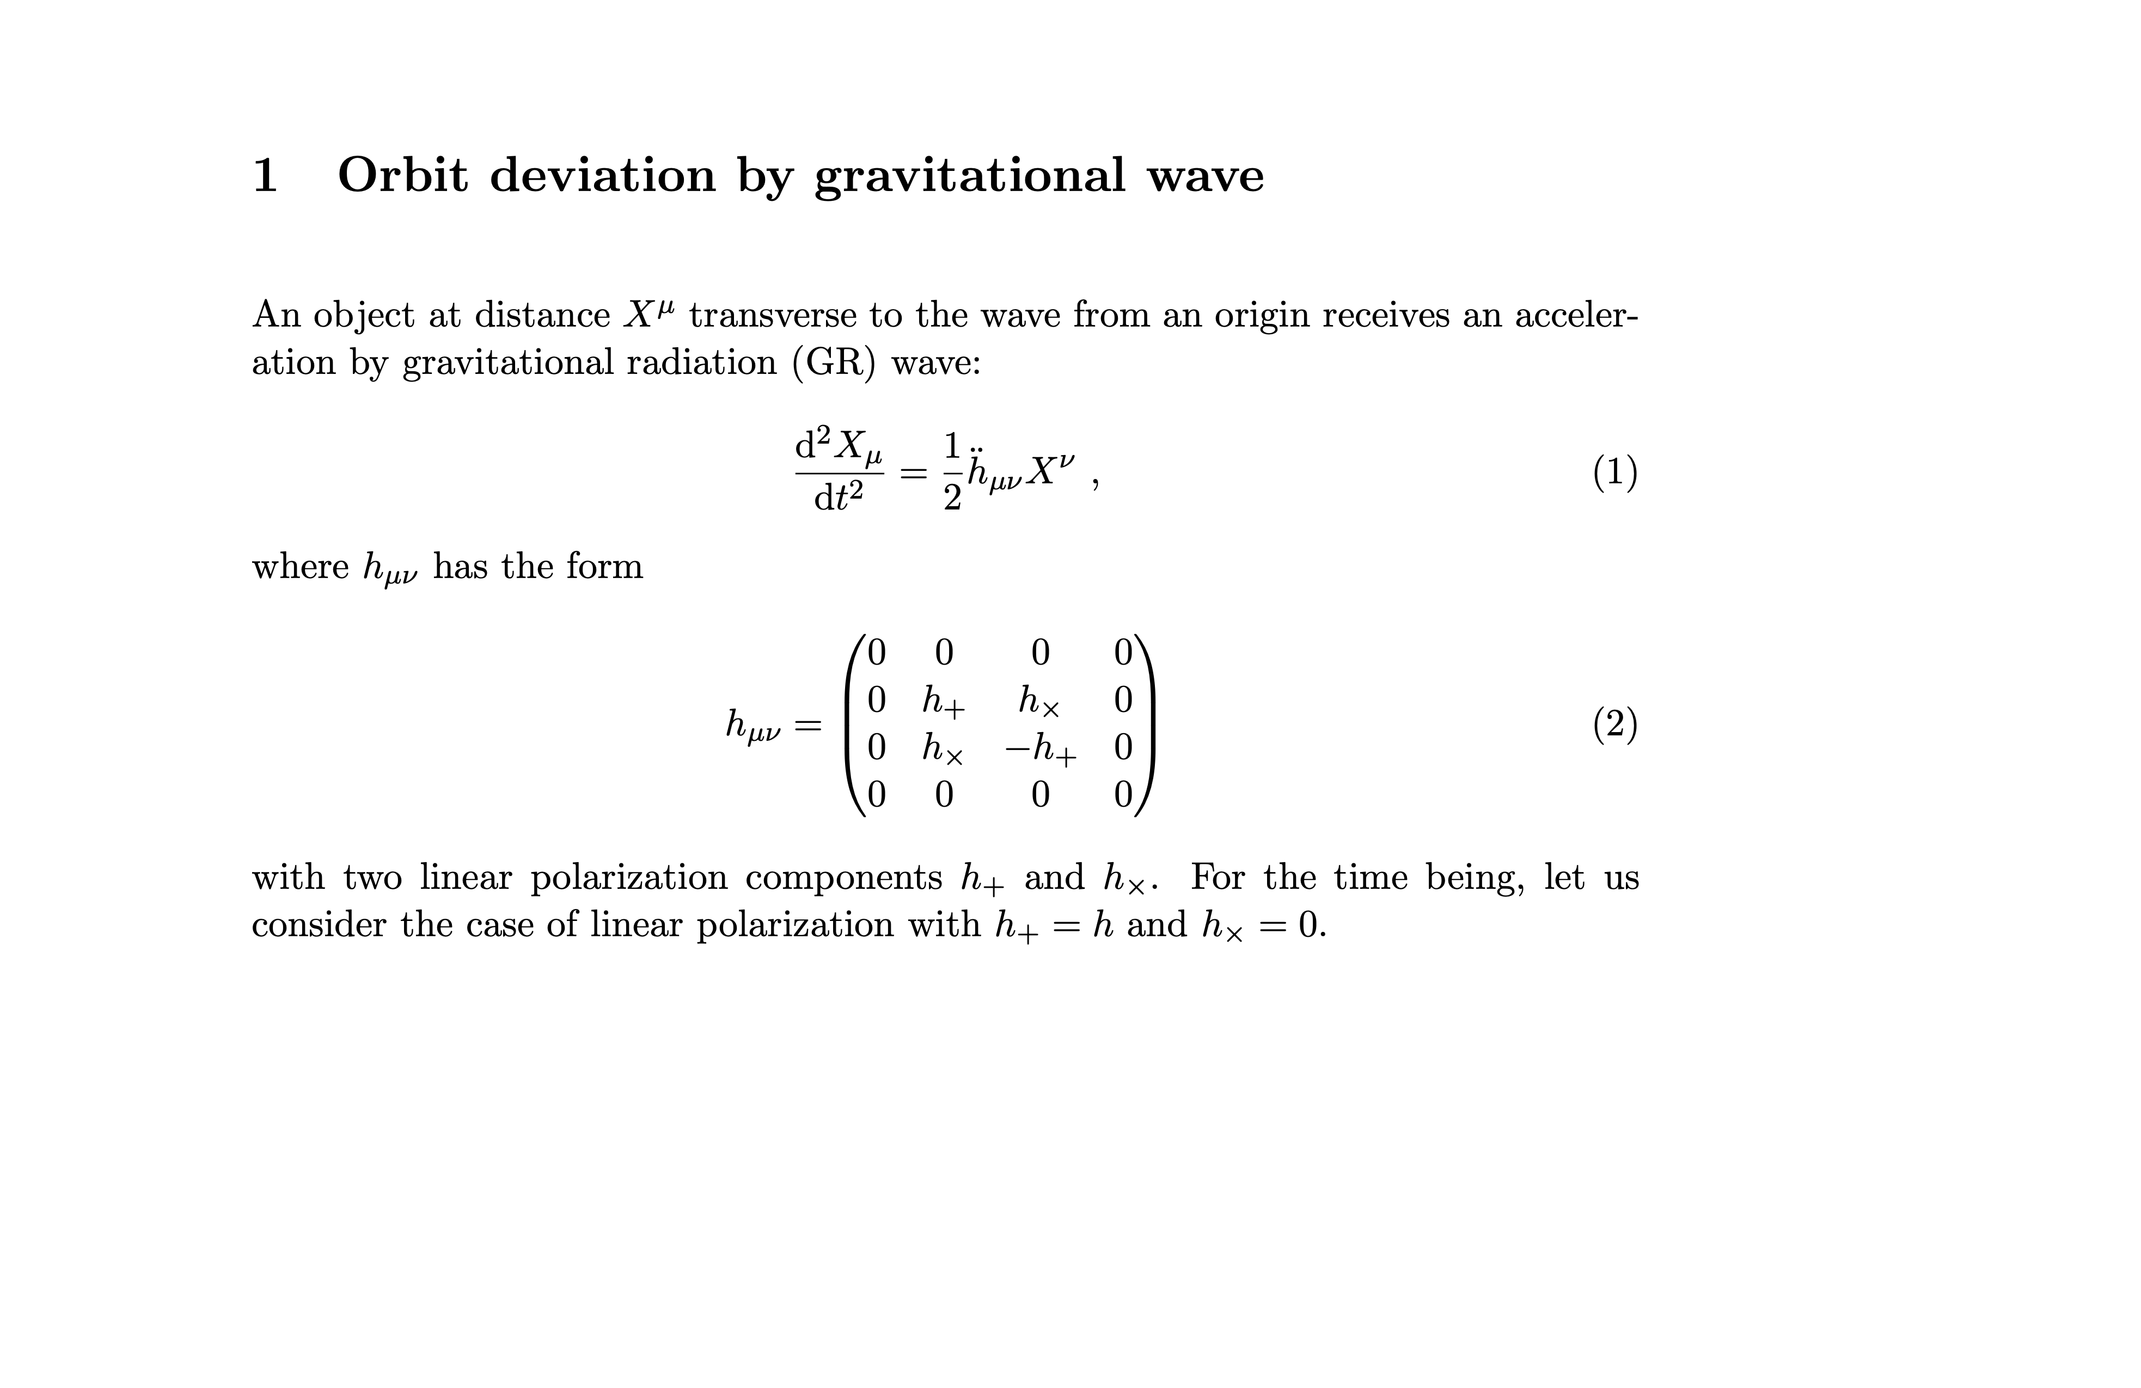

Slide 3
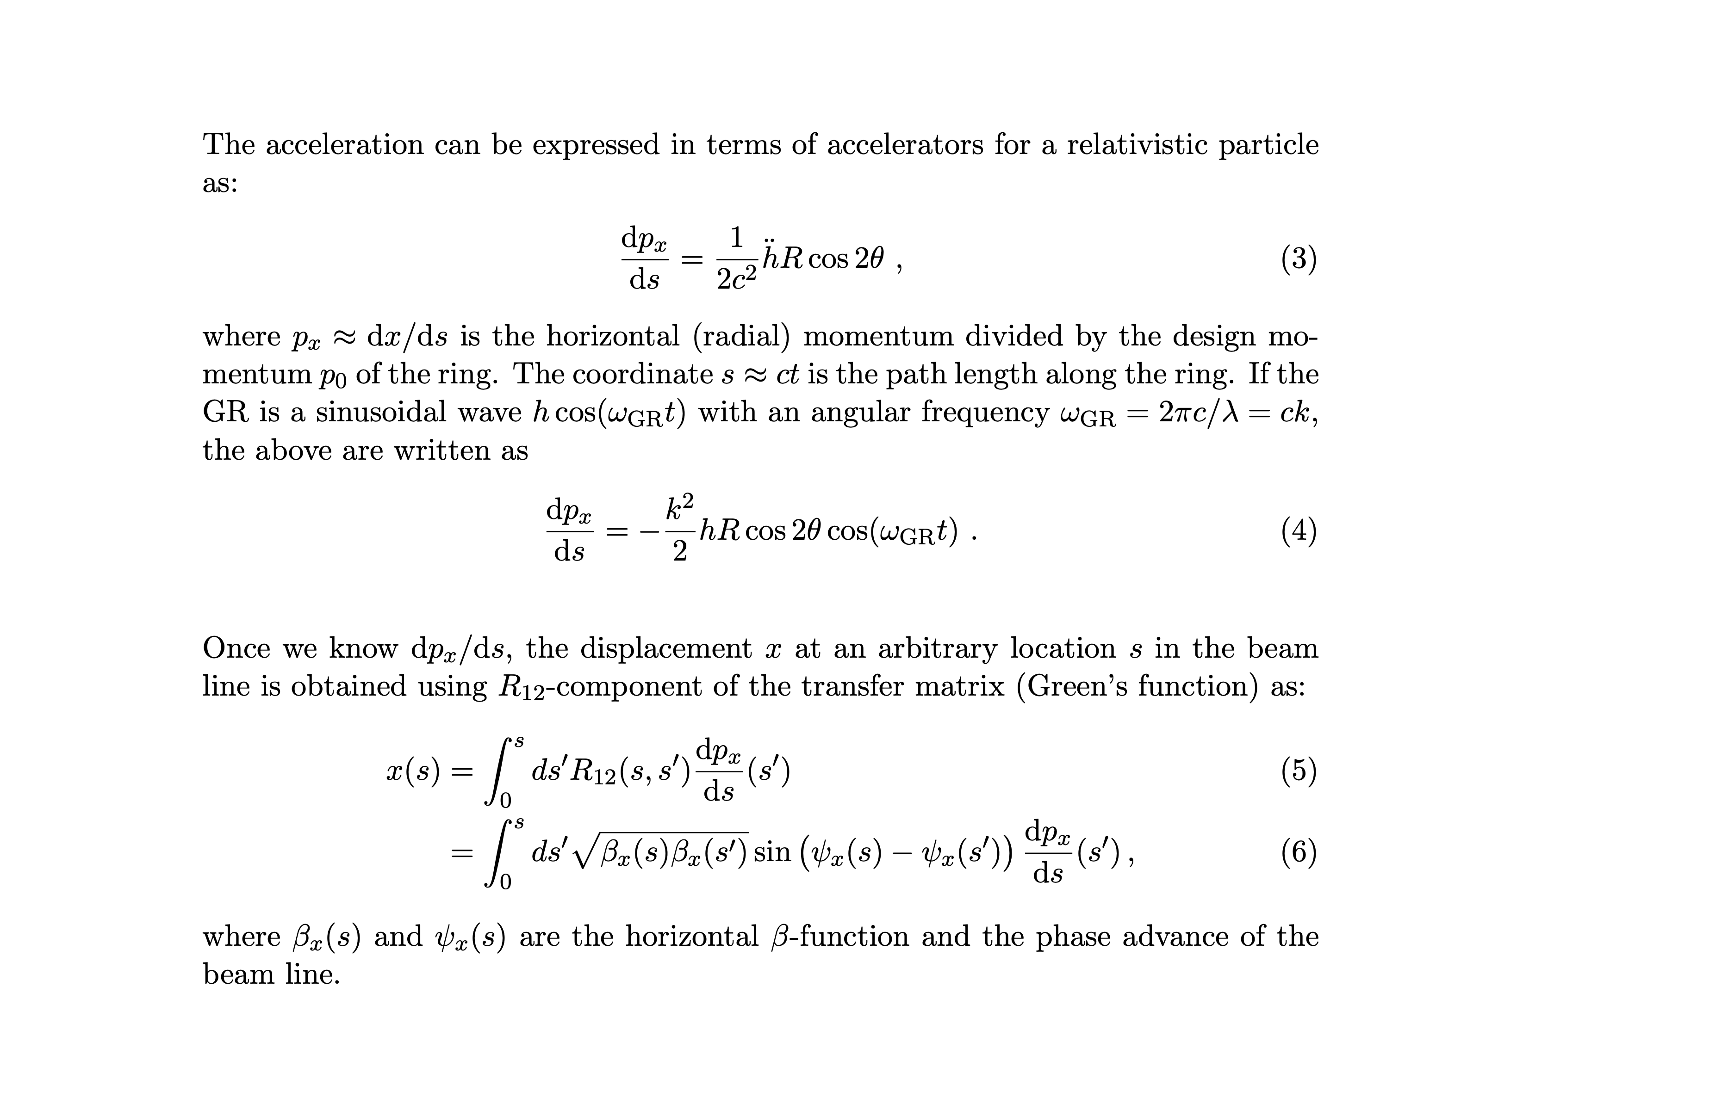

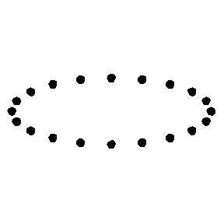




horizontal displacement of the beam particle
https://en.wikipedia.org/wiki/Gravitational_wave

Slide 4
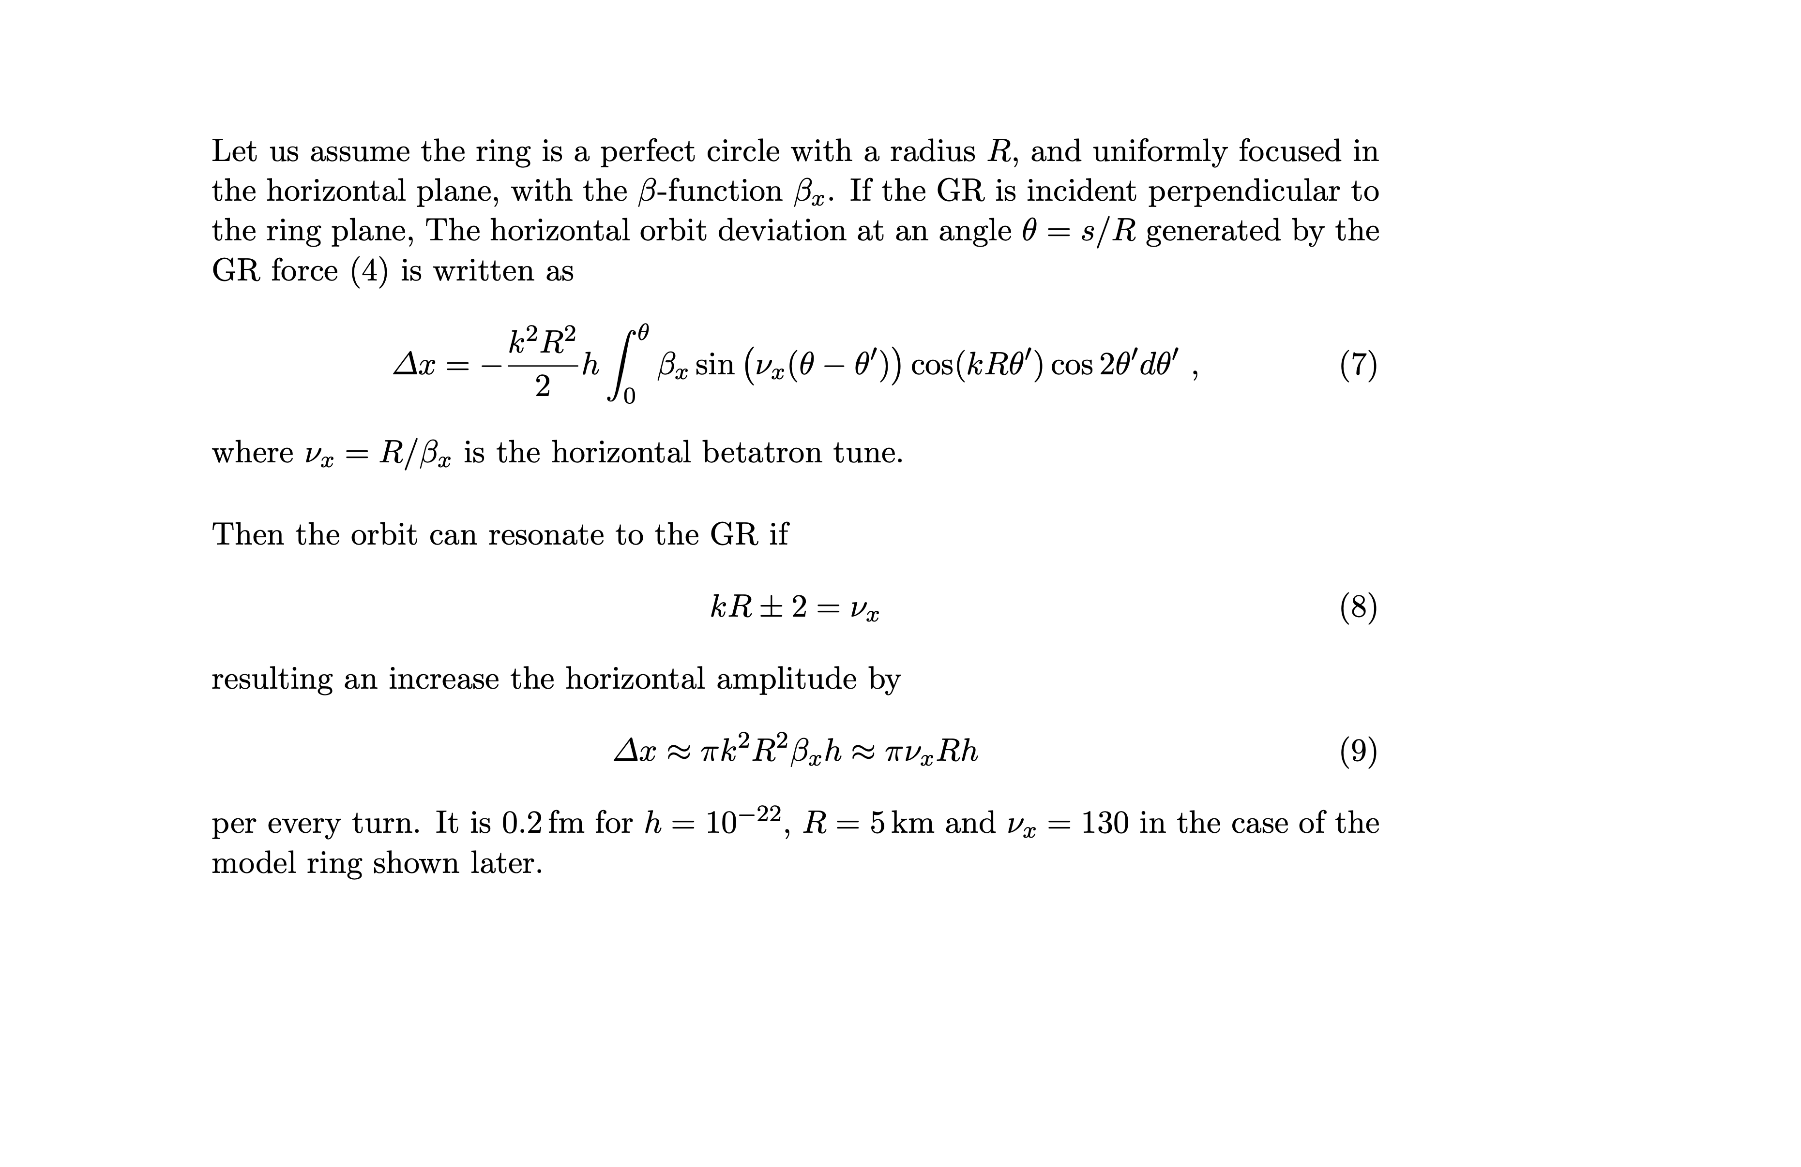
Resonance

Slide 5
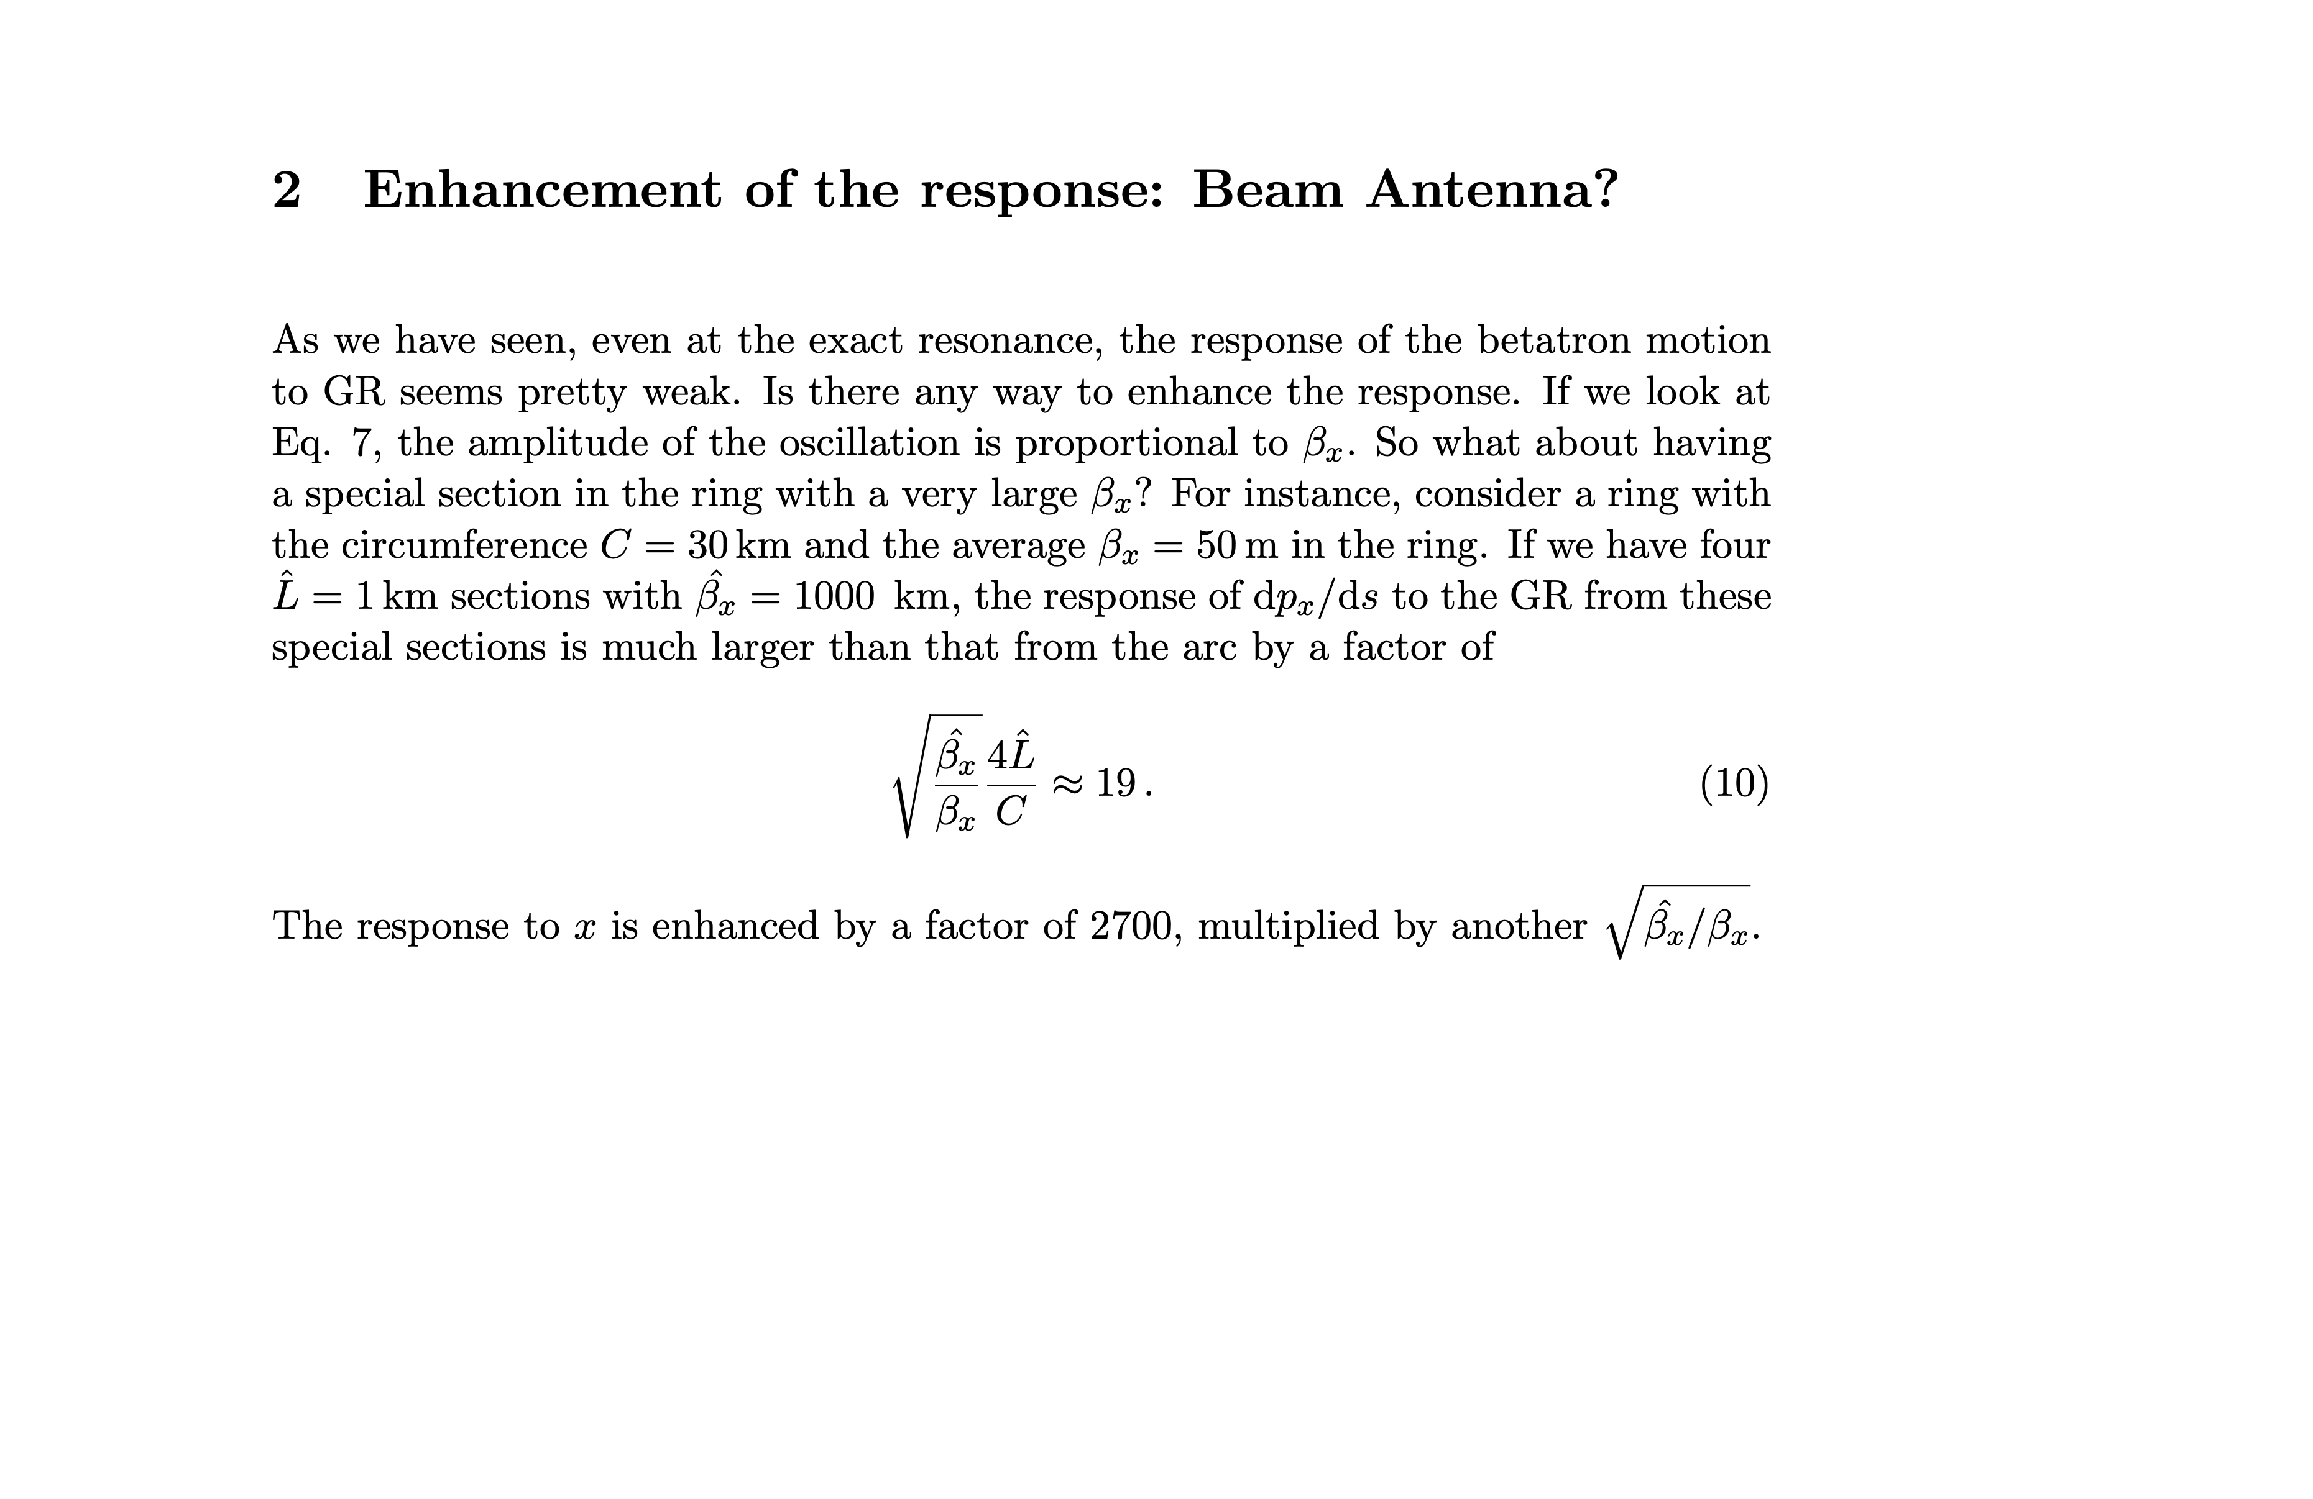

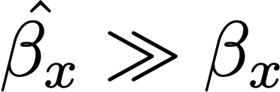

https://en.wikipedia.org/wiki/Gravitational_wave

Slide 6

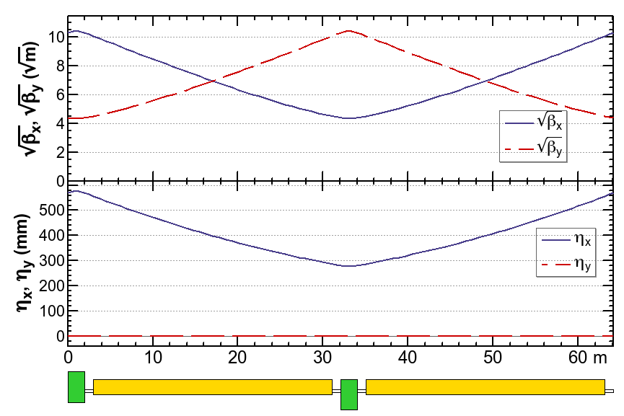
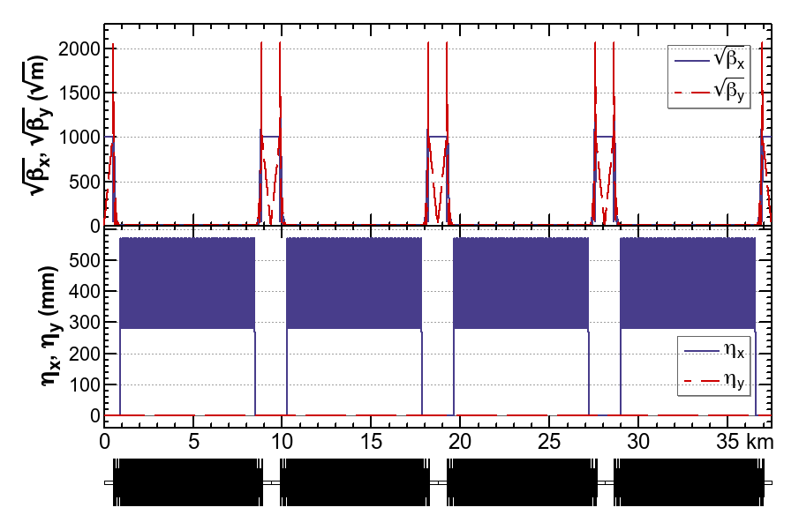


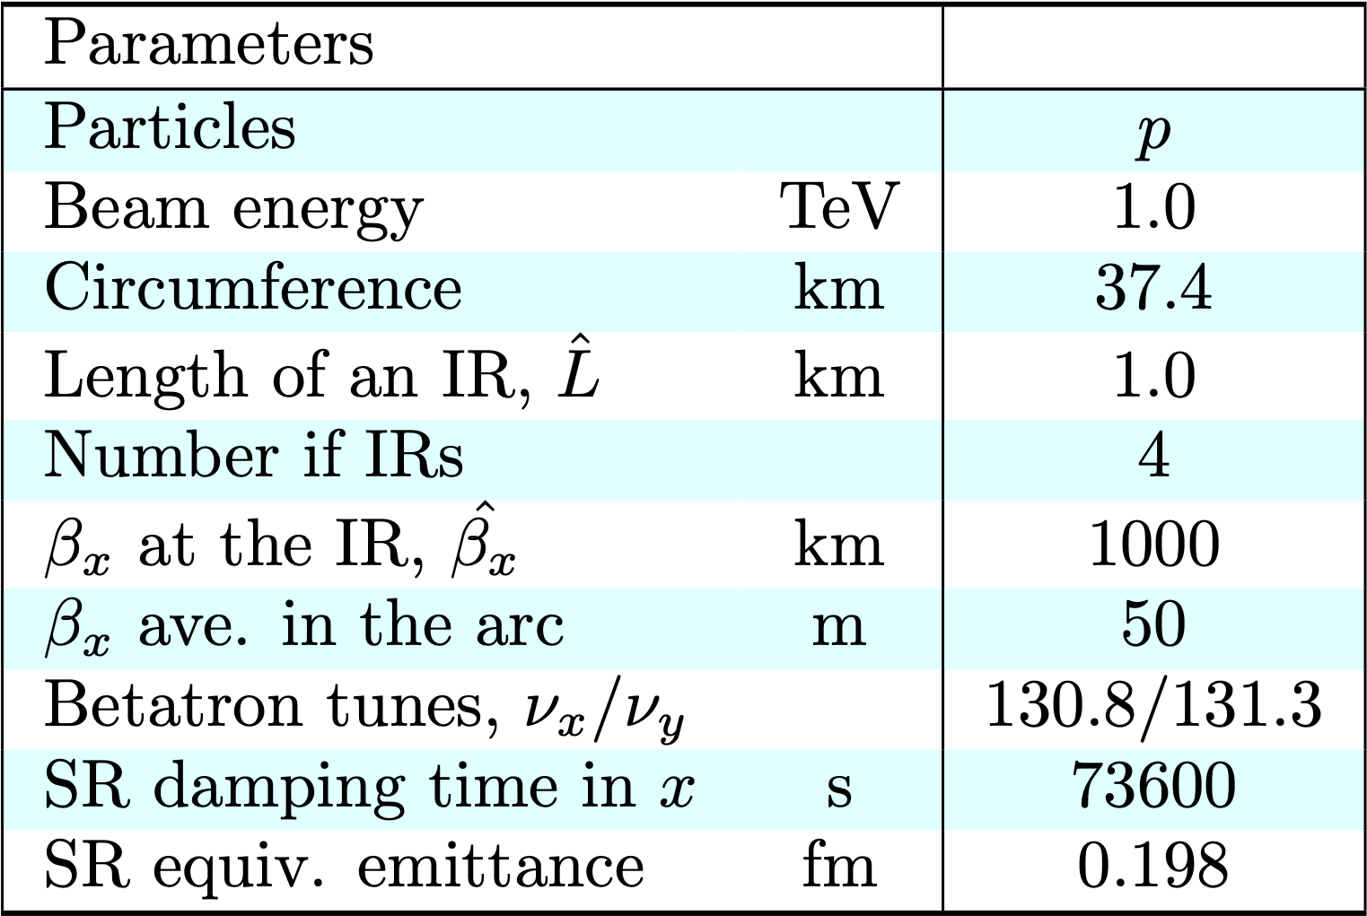
An example ring optics for a GR antenna

Slide 7
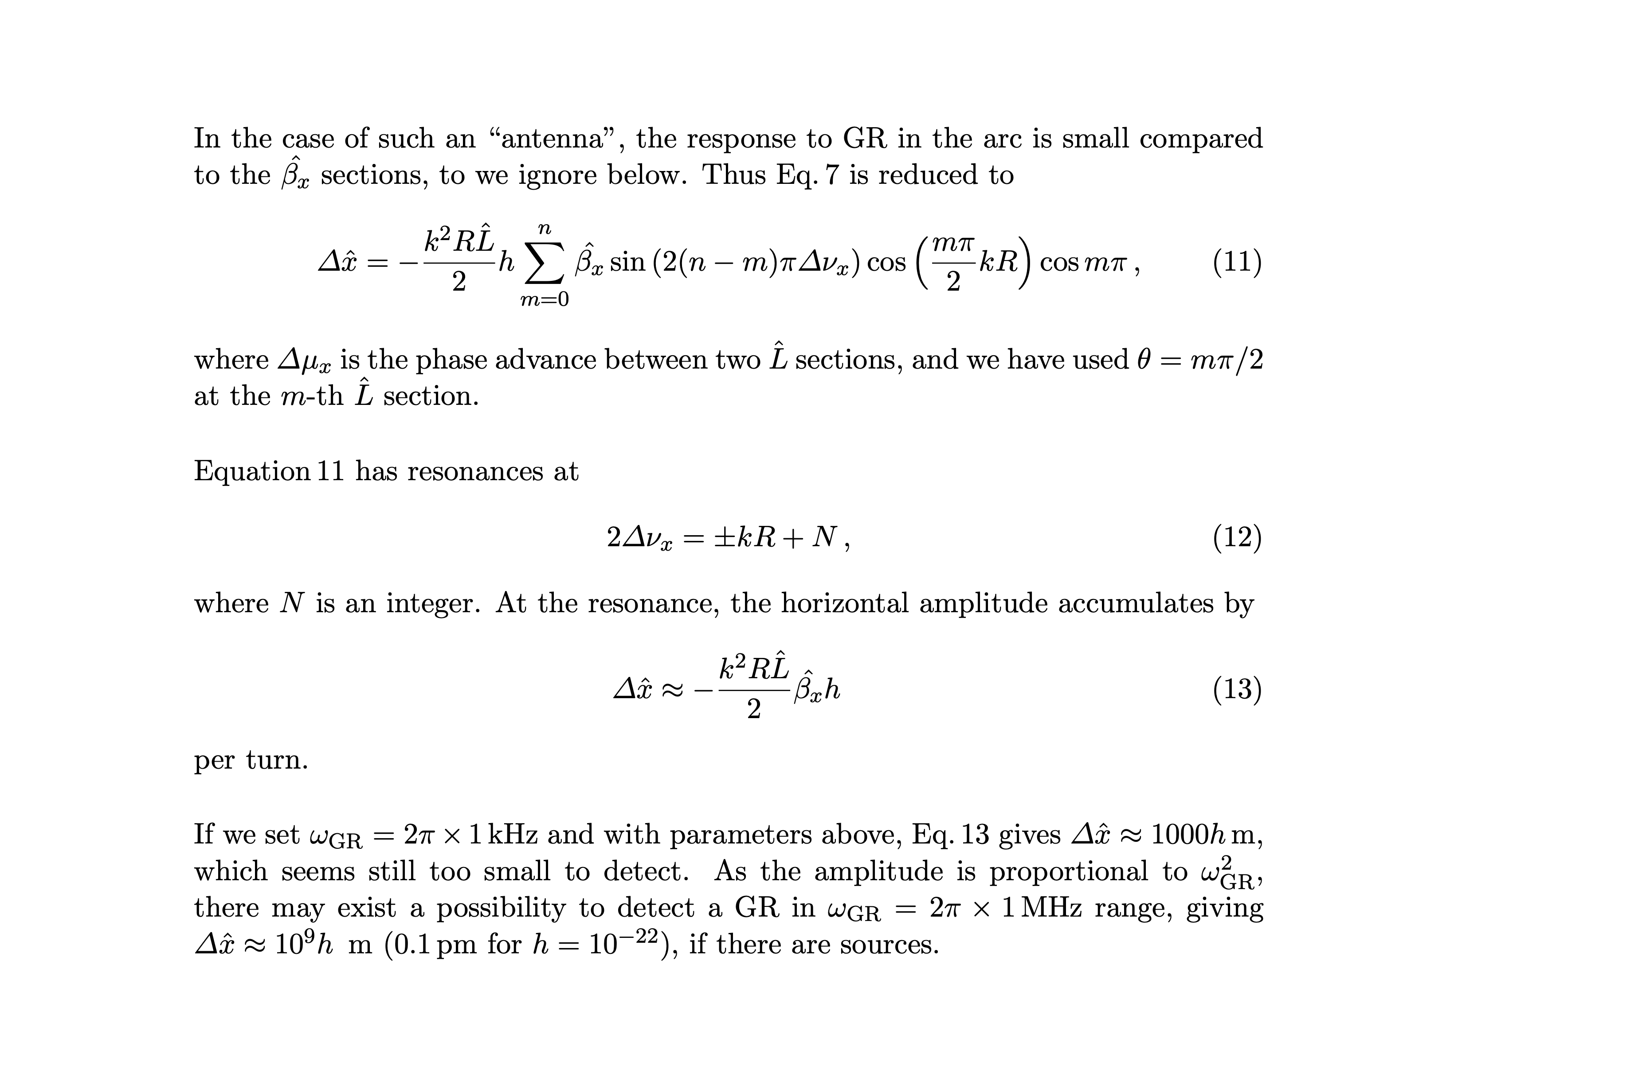
Response of “antenna”

Slide 8
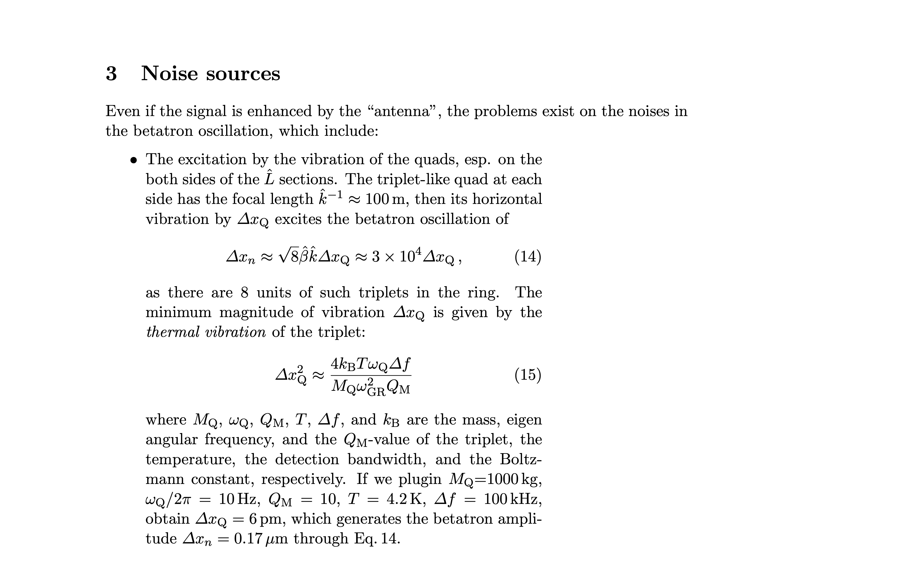
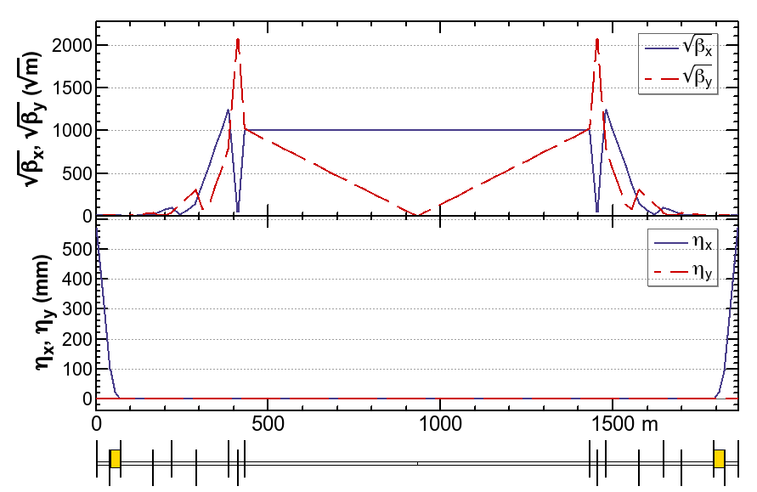



Slide 9
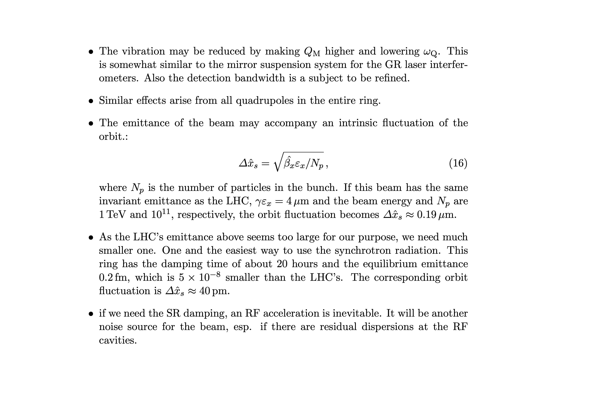
More noise sources

Slide 10
