Slide 1
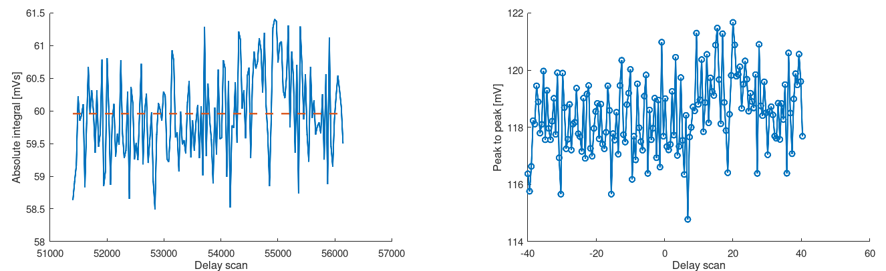
Example delay scan

Slide 2
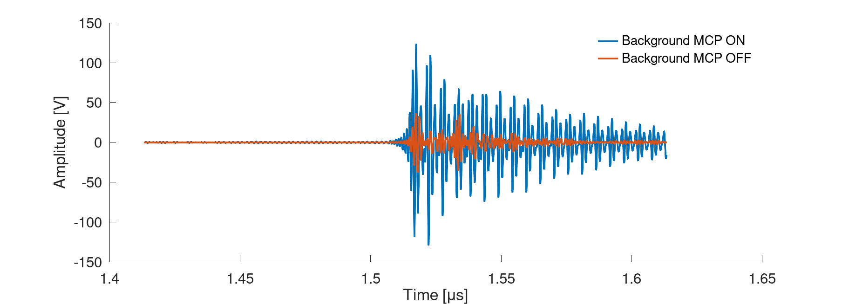
Background signal (2500 V for MCP ON)

Slide 3
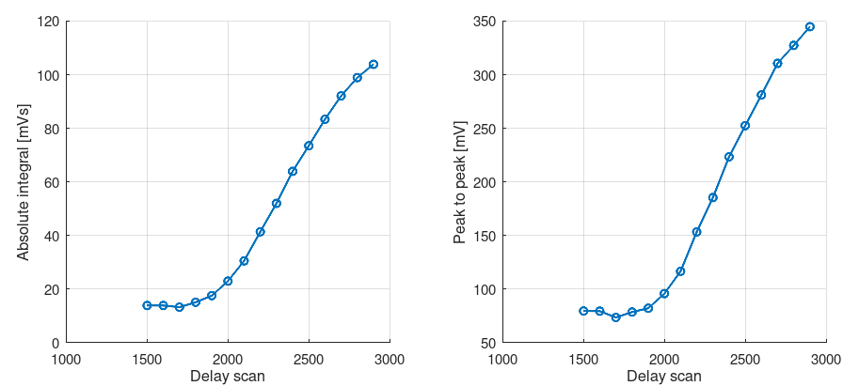
Scan of the MCP gain

Slide 4
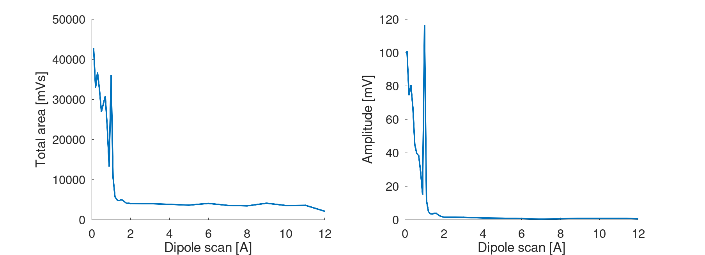
Dipole scan (2 pC bunch charge)

Slide 5
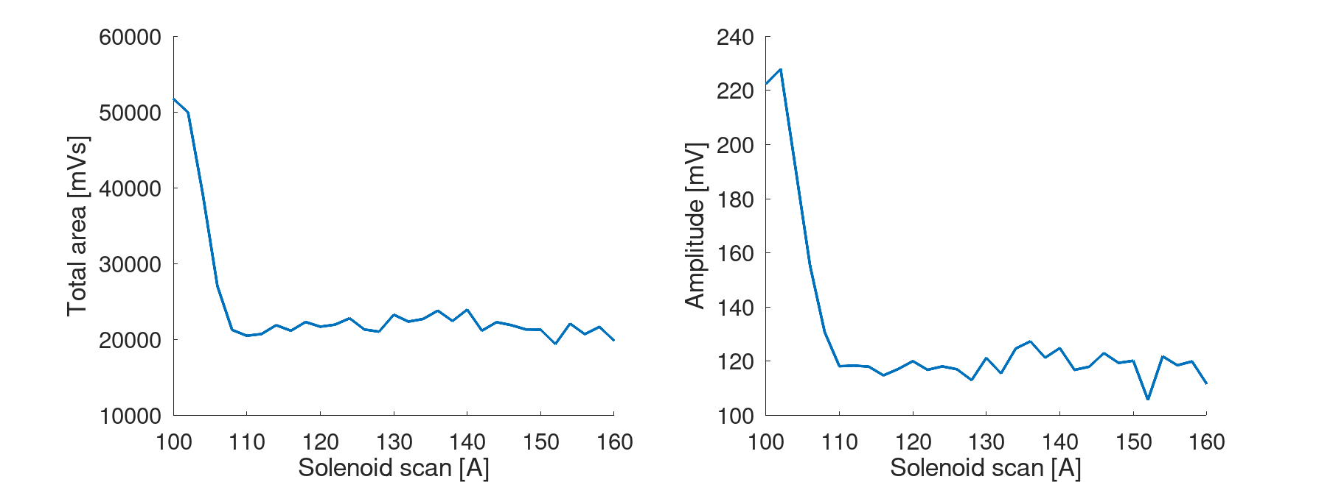
Solenoid scan (2 pC bunch charge)

