Slide 1
Practical Info
FLUKA Beginner course – December 2024 – CERN
Notes:
In the introduction talk by Francesco we saw a first glimpse into the scope of FLUKA, as well as various applications, from accelerator problems to medical physics applications.
The aim of this talk is to put the wide variety of applications on a common basis.
We will discuss the generalities of the radiation transport problem, what equation governs it, how one can solve it, and we will make sure to stress not only the advantages of the method, but also its limitations

Slide 2
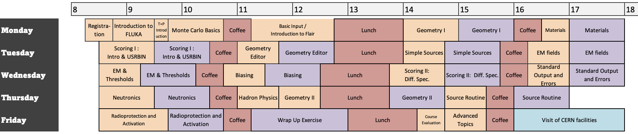
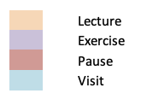
Timetable
Beginner programme : varied topics useful for people picking up the software
Start at 8.30 -> End at 6.00pm
Door to the room closes → During lecture leave it against the doorframe, don’t close
During breaks : Room will be (de facto) locked when no one is inside, you can leave your belongings

Slide 3
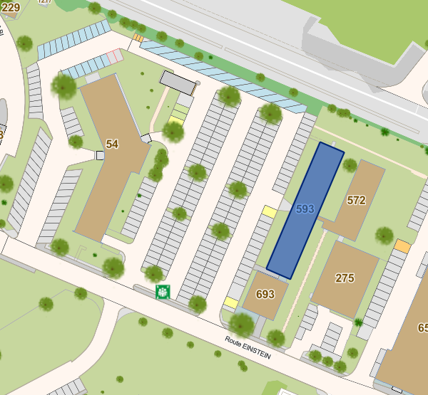
Coffee Breaks
Taken in Blg. 54 (across the parking) groud floor, in/around Novae cafeteria

Slide 4
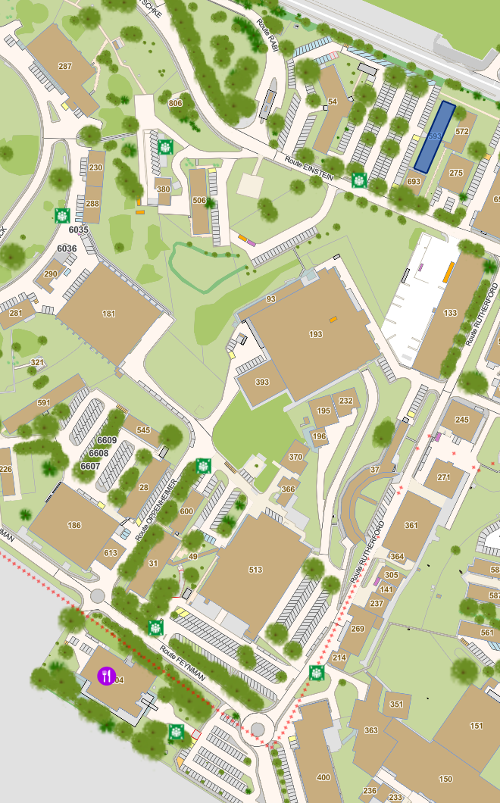
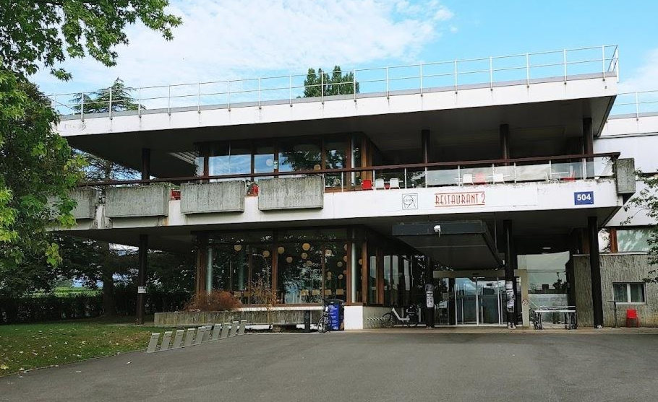
Lunch Breaks
Taken at CERN Restaurant 2
10 mins walking distance
Use your vouchers, and ask for coffee with your meal

Slide 5

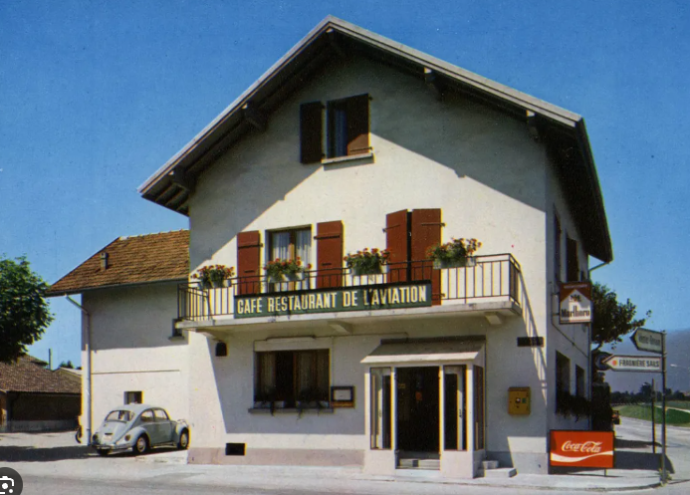
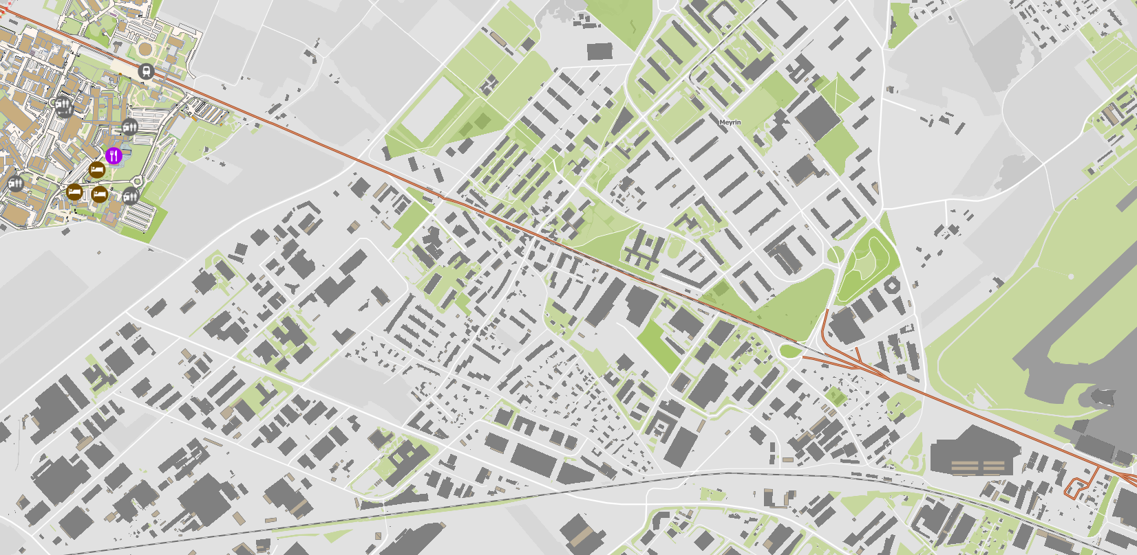
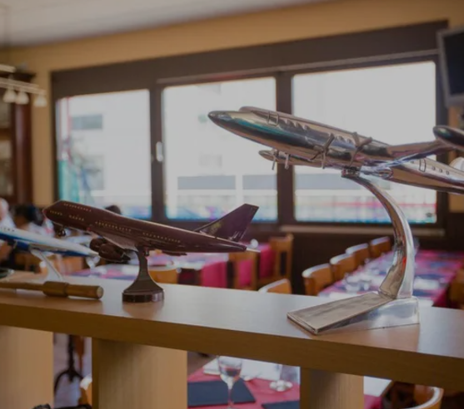
Social Dinner
On Wednesday, 7.30 pm
Easily accessible by tram 18 from CERN (Blandonnet stop)
  2 menus : Beefsteak or ricotta/spinach panzerotti
  Based on your veggie choice in your registration form!
  Please check!!!
B
*

