Slide 1
DRD8.WP2 Status and Proposed Projects
Adam Lowe & Sushrut Karmarkar on behalf of DRD8.WP2
25 Sept 2024
DRD8 Community Meeting for Proposal Preparation

Slide 2
Contents
Initially selected DRD8.WP2 Projects
  ‘Project 1’
    Initial definition,
    Intended output/delivery,
    Issues with definition,
  ‘Project 2’
    Initial definition,
    Intended output/delivery,
    Issues with definition,
Proposed Definitions and Timelines
  Project 1
    Proposed Definition
    Proposed Timeline
  Project 2
    Proposed Definition
    Proposed Timeline

Slide 3
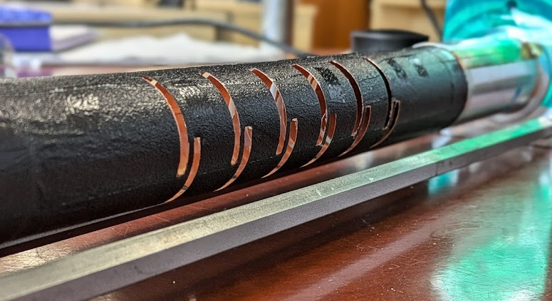
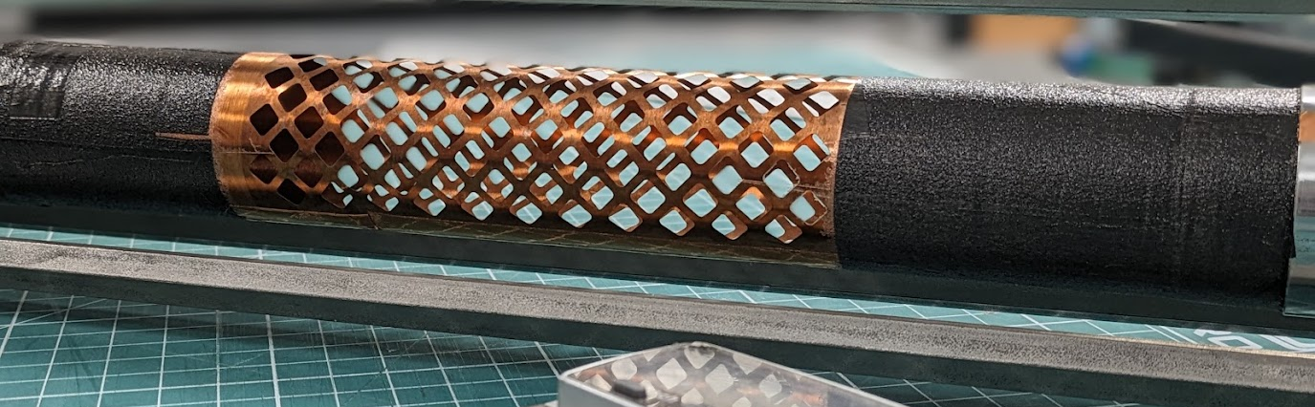
The 2 initially selected projects for within DRD8.WP2
Project 1
  Initially coarsely defined as;
    3-dimensional tracker structures: Non-planar structures and sensors, spaceframes, curved and lattice composite structures, structures optimized in tensile stress direction, individual modules in space-frame etc. Development of design and optimization approaches and tools. Integration of services (co-cured cooling channels, electrical services, fibres, structural power busses, etc.).
  Desired output;
    A more blue-skies design process that would hopefully output any potential fundamentally different approached to detector design in the future this may include;
      Idealised geometry and material reduction based on the use of orthotropic materials,
      Non-standard use of novel materials such as tow-spread composites,
      Analytical and design tools required to carry out such work,
      Increased understanding of the importance of material properties for novel materials,
      Novel manufacturing techniques and it’s effect on achievable geometry,
      NDT procedures and other test procedures for confirmation of quality and mapping this back to standardised testing and material property investigation (project 2),

Slide 4
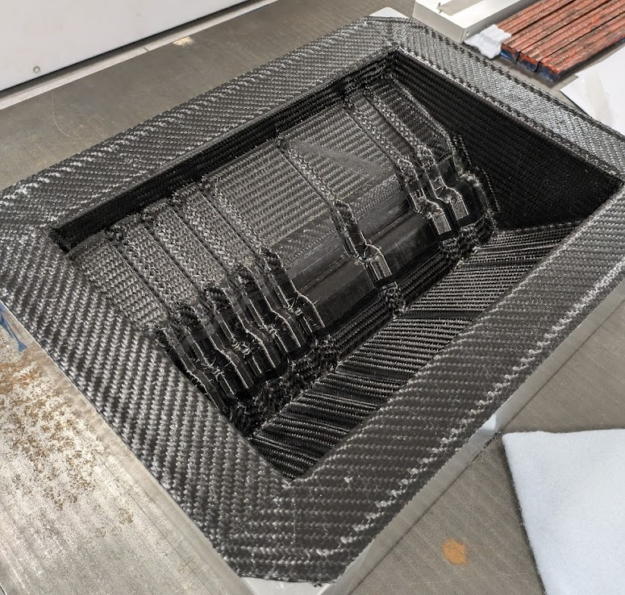
The 2 initially selected projects for within DRD8.WP2
Project 1
  Initially coarsely defined as;
    3-dimensional tracker structures: Non-planar structures and sensors, spaceframes, curved and lattice composite structures, structures optimized in tensile stress direction, individual modules in space-frame etc. Development of design and optimization approaches and tools. Integration of services (co-cured cooling channels, electrical services, fibres, structural power busses, etc.).
  Issues with project definition
    The desired blue-sky nature of this project makes it tricky to define measurable and quantifiable output;
      For a geometry, material, manufacturing technique etc to be deemed relevant, it must be guided by some requirements,
      Do we use existing detector requirements and re-design and analyse an existing detector as an exercise? Comparing project performance against a baseline?
      Do we take a stab at some informed detector requirements for the next generation, this could be what would inform the ‘demonstrator’ outputs we’ve previously spoken about.
        I’m not sure if the latter is feasible in time for our proposal submission in October.
      It’s important the community feeds in to this, to ensure output is as relevant as possible.

Slide 5
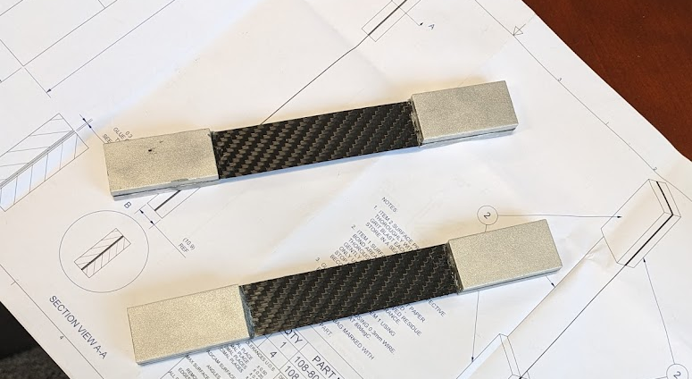

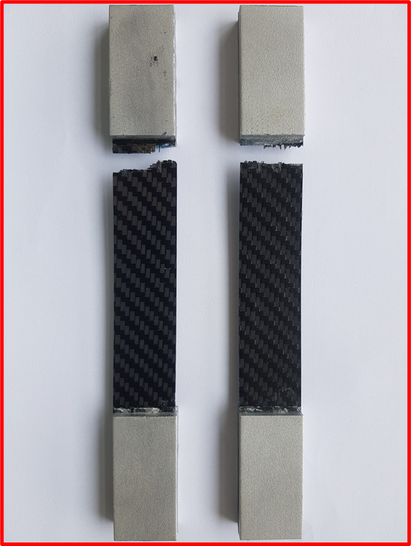

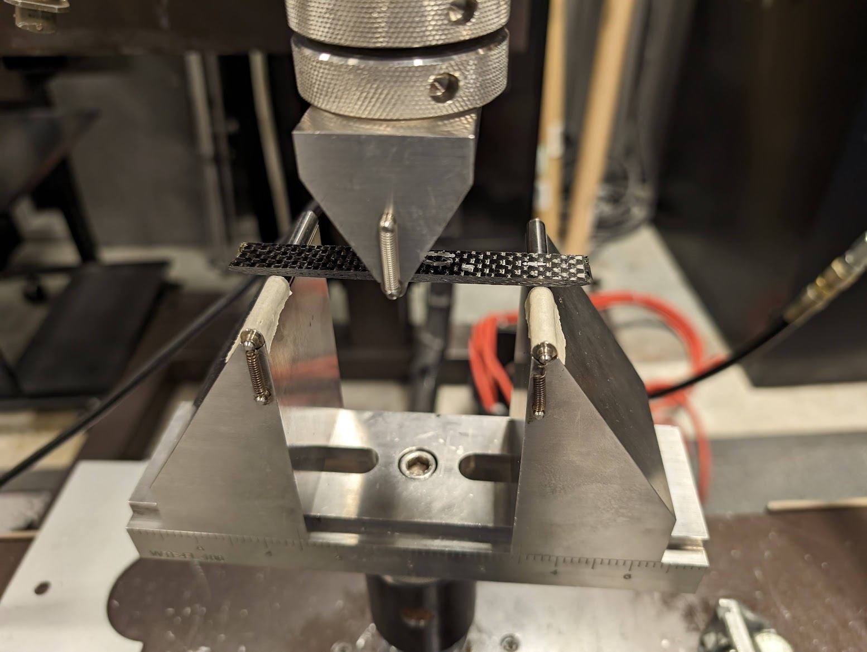

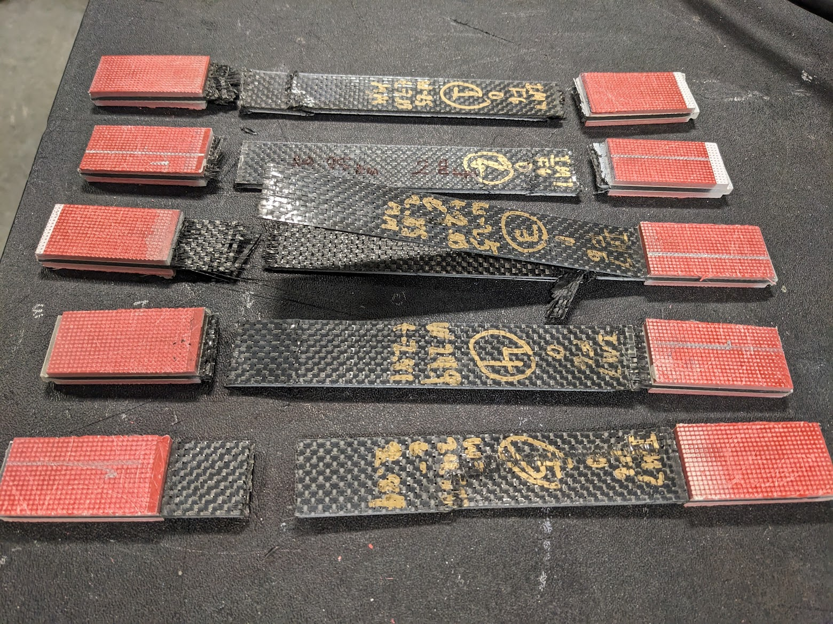

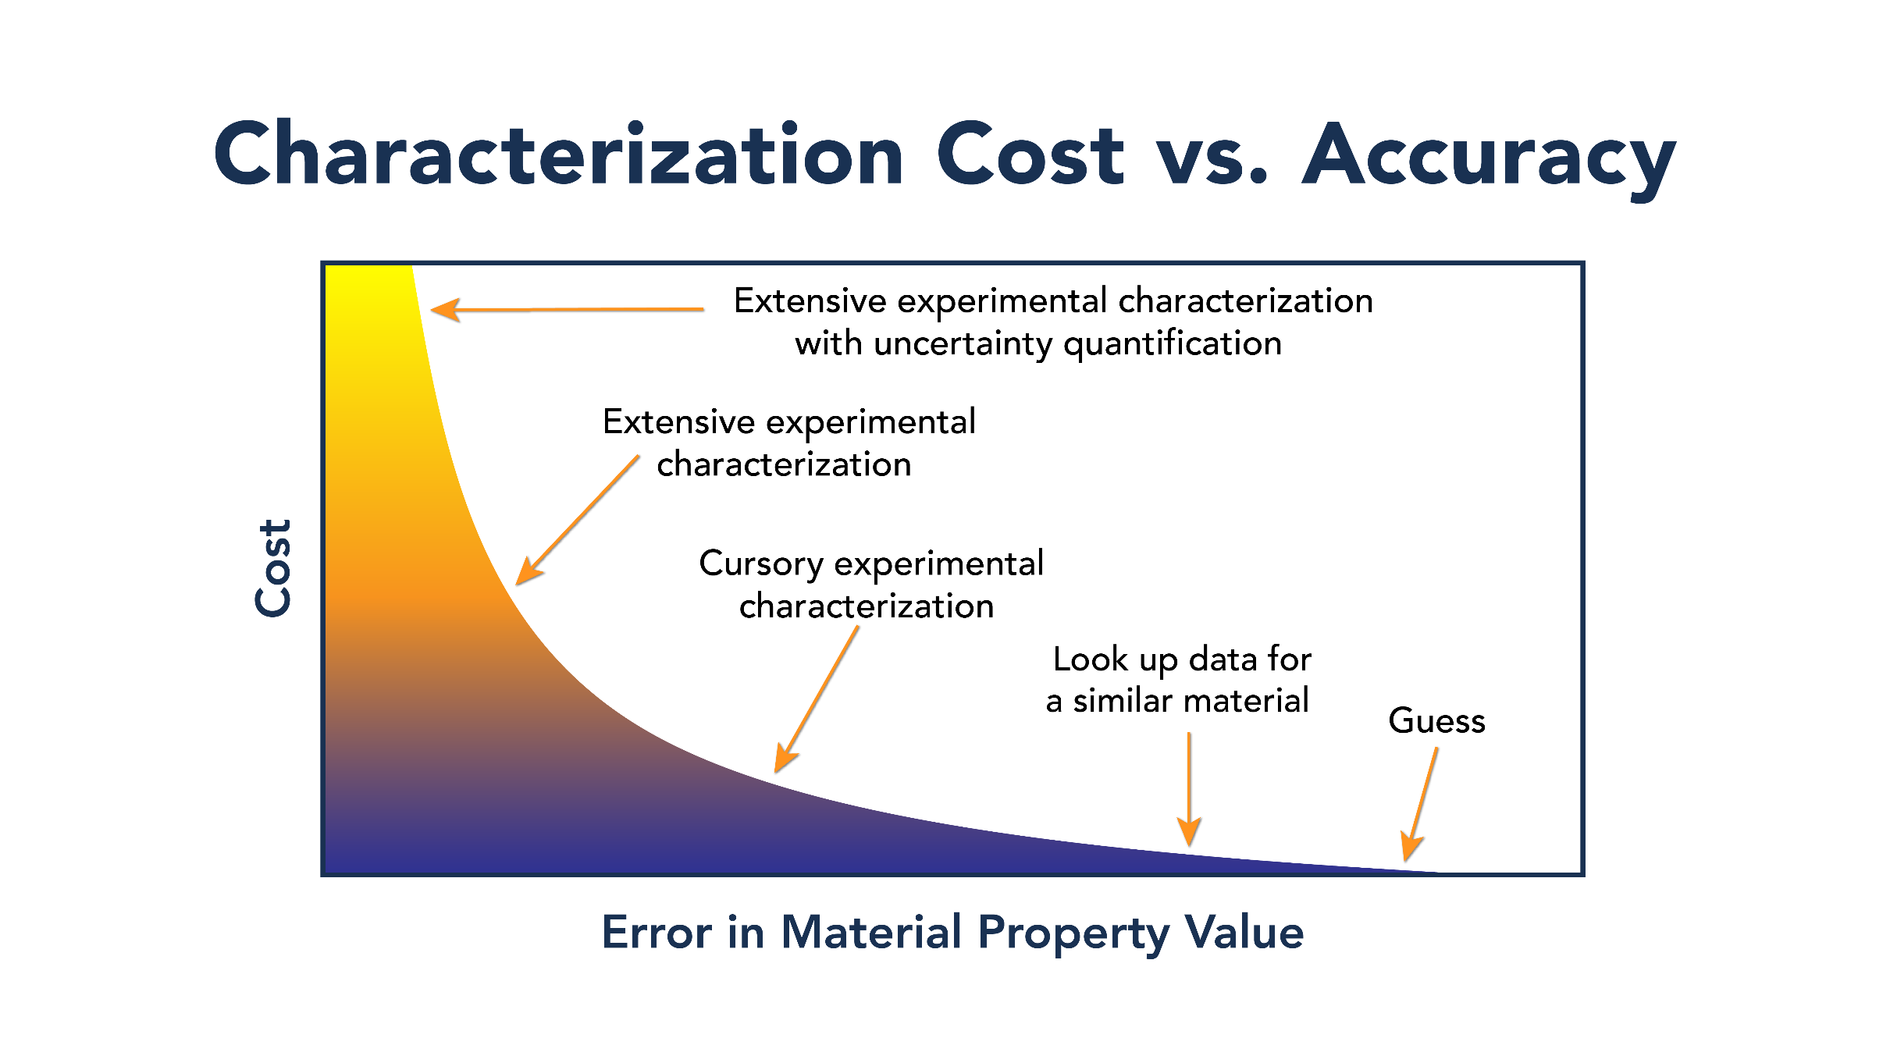
The 2 initially selected projects for within DRD8.WP2
Project 2
  Initially coarsely defined as;
    Materials database. Starting from the proposed X0 measurements and database, but also pulling together all HEP-relevant material data (structural performance, heat conductivity and CTE/CME, radiation hardness, health & safety relevant properties, flammability etc.)
  Desired output;
    A more easily defined tangible output. A functioning materials database containing HEP relevant data. This could go further, however and include;
      Identify critical material properties (tie-in to project 1),
      Develop unified testing protocol for aforementioned material properties, including, environmental control, standardised equipment etc.
      Through round-robin testing ensure test results are repeatable across different labs,
      Create frame work of inter-lab test facilities, proposed streamlined processes utilising multiple labs,
      Development of models for simulation packages (tie-in to project 1),
      Certification of lab-technicians to ensure on-going uniform material testing.

Slide 6
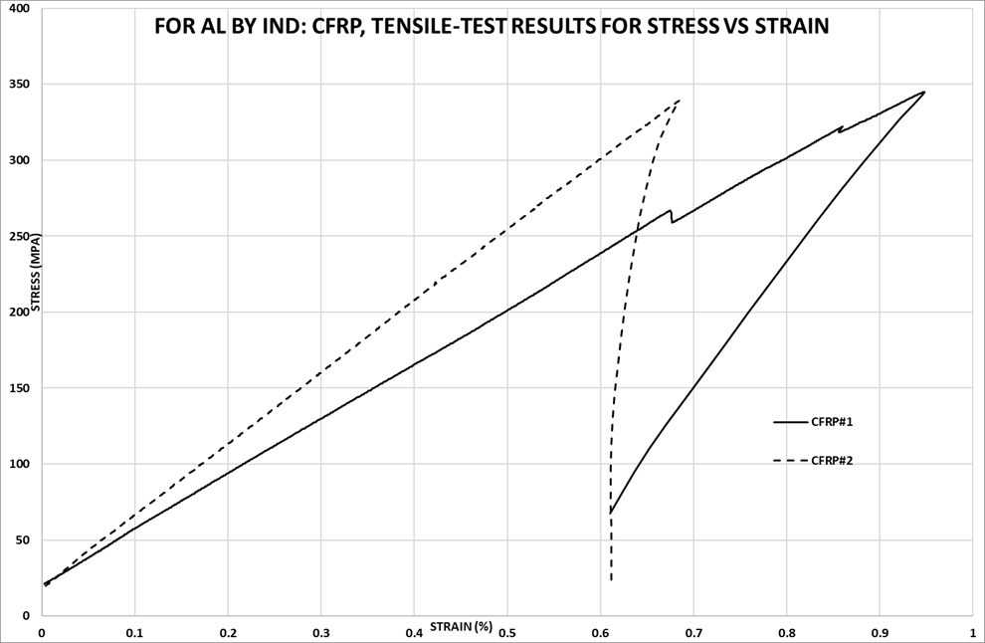
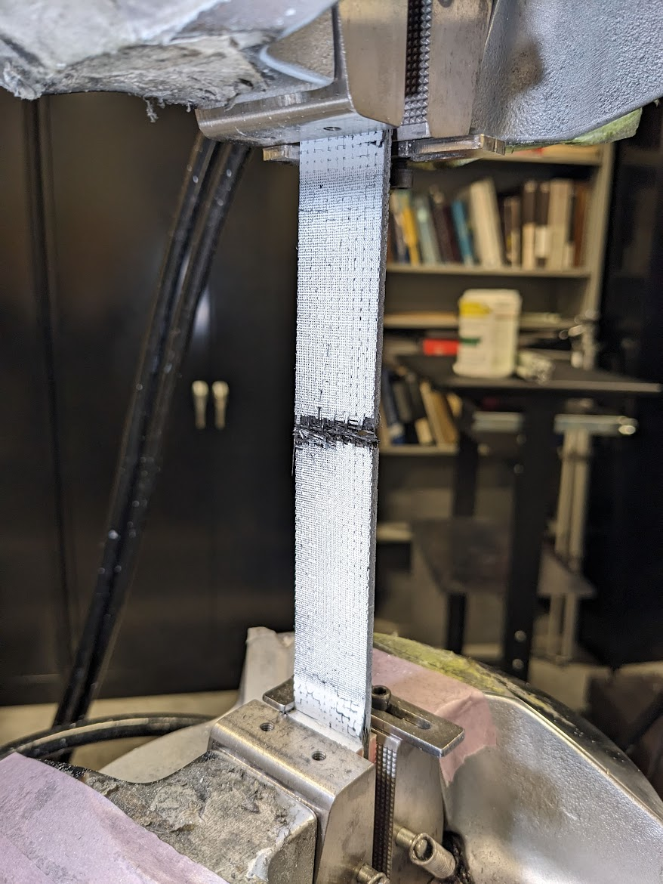
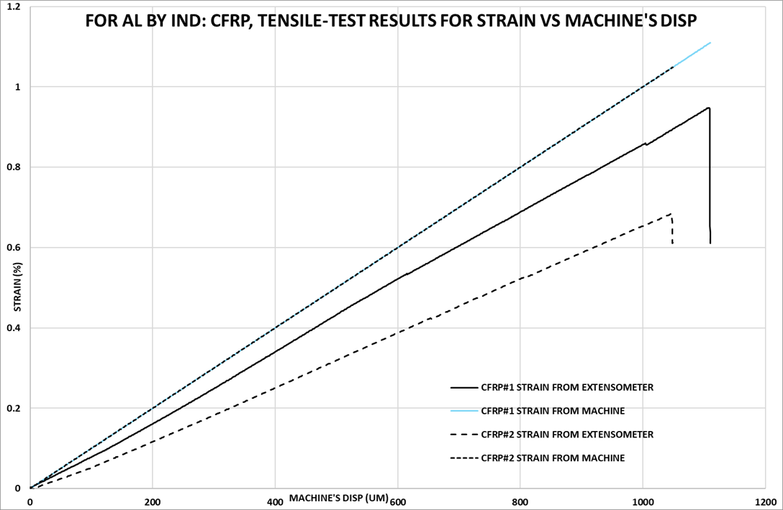
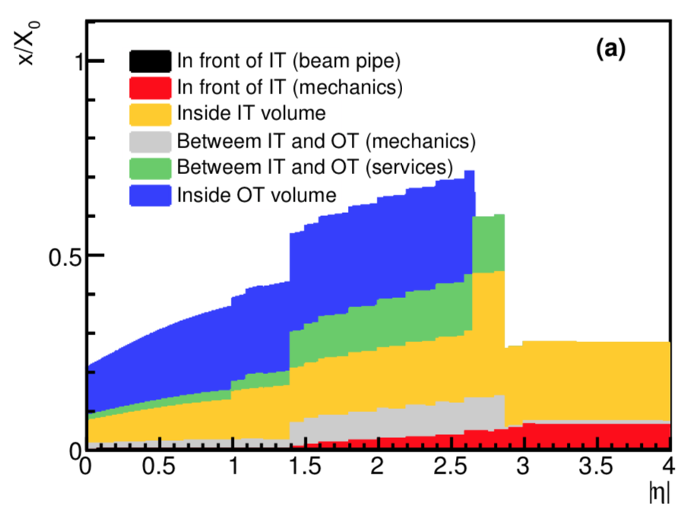
The 2 initially selected projects for within DRD8.WP2
Project 2
  Initially coarsely defined as;
    Materials database. Starting from the proposed X0 measurements and database, but also pulling together all HEP-relevant material data (structural performance, heat conductivity and CTE/CME, radiation hardness, health & safety relevant properties, flammability etc.)
  Issues with project definition
    This is a much easier to define project based on the nature of the quantifiable output. In it’s rawest sense; a material database containing HEP relevant data. However somethings to consider during definition;
      “HEP relevant data” must be defined by both existing knowledge but also the blue-sky thinking of project 1,
      Before material data is collected, testing standards and controls must be agreed upon, and repeatability proven out across multiple labs,

Slide 7
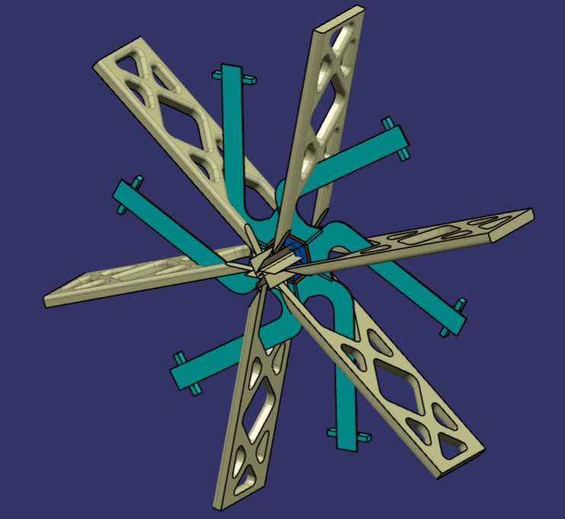
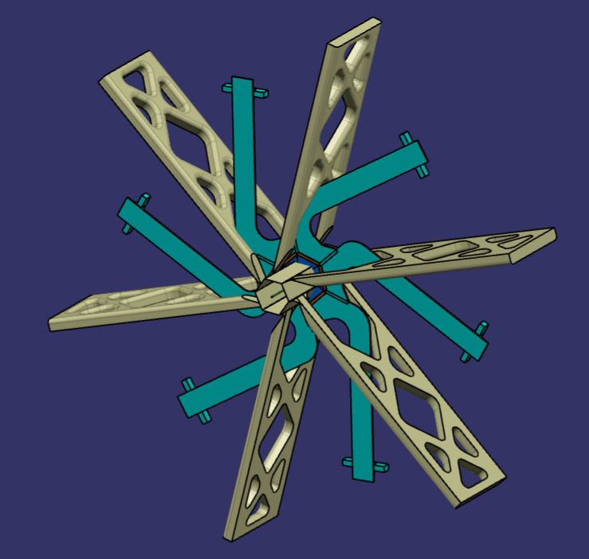
Project 1 Proposed Definition
…[see overleaf document for full definition. The goal of this project is to facilitate the conceptual design of particle physics tracking detectors to be re-visited at the most fundamental level. The traditional, standard approach of simplistic, planar geometry and homogeneous, isotropic materials should be revisited. Working from simple design parameters that must be respected, this project will aim to investigate how detector structures can be improved when embracing advances in materials, manufacturing techniques and resultingly the design and analysis that should accompany this. Splitting design, analysis and testing tasks across the work package, this project will aim to holistically address the following potentially large improvements in tracking detector mechanics;
  Orthotropic materials and exploitation of optimised mechanical and thermal performance in each direction whilst minimising material budget,
  Non-planar structures utilising geometry for stiffness rather than increased material budget,
  Complex (non-traditionally manufacturable) geometry utilising advanced manufacturing techniques,
  Integration of services into mechanical structures to reduce overall material budget and increase mechanical performance,
  Development, where appropriate, of design and analysis tools to help facilitate this direction of design for future detectors,
  NDT testing and other forms of QA/QC that will guarantee quality of non-traditional, homogenous or isotropic structures.
  Potential tie-in with (especially DRD4) other DRDs should be investigated, to help inform the design work.

Slide 8
Project 1 Proposed Milestone Timeline – Year 1
Year | Milestone Designation | Description
Y1 | Y1.M1-3 | Document design, analysis and testing capabilities of all participating institutions and availability and turn around time for design, analysis and testing tasks.
Y1 | Y1.M1-4 | Work on a clear, but simple specification for a tracking detector. Guidance should come from the DRD8 steering committee who will inform where specifications should be guided by current generation detectors and where new, theoretical specifications are appropriate.
Y1 | Y1.M2-6 | Agree on the distribution of design, analysis and testing tasks based on the evolving specifications being produced. Produce a simple project plan to depict timeline and task owners clearly.
Y1 | Y1.M6-11 | Embark on design and analysis campaign targeting an informal, internal pre-CDR (pre-Conceptual Design Review) level of maturity. Evaluating detector performance gains against
Y1 | Y1.M9-10 | Fully define scope, definition and terms of reference for the internal “Pre-CDR”
Y1 | Y1.M11-12 | Conduct an internal design review, evaluating proposed performance of the concept or individual concepts, against a benchmark of current generation performance. Clearly document advised next steps from internal review panel.

Slide 9
Project 1 Proposed Milestone Timeline – Year 2
Year | Milestone Designation | Description
Y2 | Y2.M1-2 | Reconvene after Y1.M11-12 and plan Y2 tasks and tasks owners, updating the simple project plan so all are aware of timelines.
Y2 | Y2.M2-11 | Continue design and analysis work based on “pre-CDR” feedback. Evolving design or designs to a CDR (Conceptual Design Review) level of maturity.
Y2 | Y2.M2-12 | Feed material testing requirements based on maturing work into ‘project 2’
Y2 | Y2.M5-11 | Propose and begin to develop NDT and QC procedures for the bespoke structures. These techniques will be reviewed at CDR.
Y2 | Y2.M10-11 | Fully define scope, definition and terms of reference for the internal CDR
Y2 | Y2.M11-12 | Conduct an internal CDR, evaluating proposed performance of the concept or individual concepts, against a benchmark of current generation performance.
Y2 | Y2.M12 | As a part of the outcome of the CDR, the review panel will decided which demonstrator prototype parts could be manufactured and tested in year 3.

Slide 10
Project 1 Proposed Milestone Timeline – Year 3
Year | Milestone Designation | Description
Y3 | Y3.M1-2 | Reconvene after Y2.M11-12 and plan Y3 tasks and tasks owners, updating the simple project plan so all are aware of timelines.
Y3 | Y3.M2-5 | Final design and analysis of proposed parts and sub-systems for manufacture.
Y3 | Y3.M4-5 | Feed material testing requirements based on maturing work into ‘project 2’
Y3 | Y3.M2-6 | Begin manufacture of relevant prototypes for testing and designs mature.
Y3 | Y3.M3-9 | Final proposal and development of NDT and QC techniques for prototype based on maturing designs and analysis
Y3 | Y3.M10-11 | Fully define scope, definition and terms of reference for the internal CrDR (Critical Design Review)
Y3 | Y3.M11-12 | Conduct an internal CrDR, evaluating the close off of suggestions from the CrDR as well as realised testing and performance of the prototypes manufactured and effectivity of the material qualification, NDT test and thermal and structural testing

Slide 11

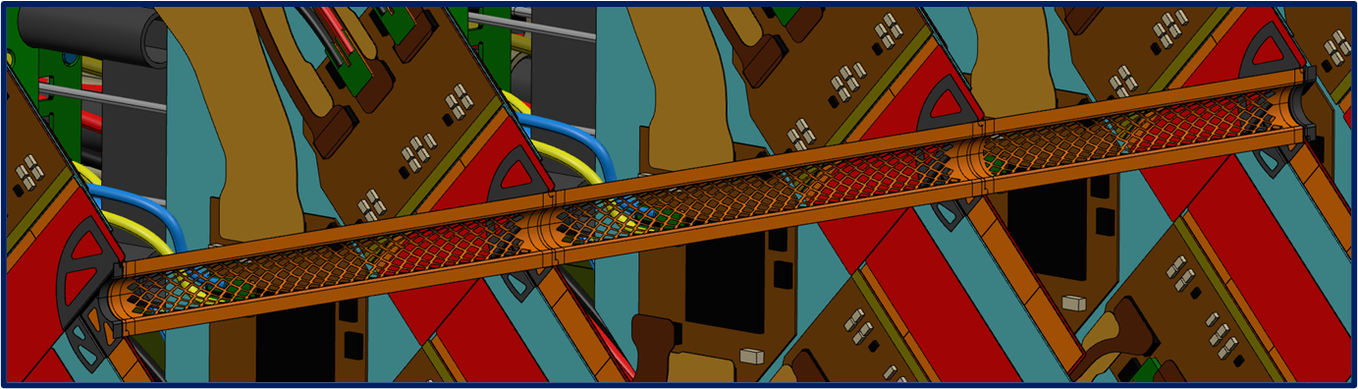

Project 1 – Immediate Next Steps
Project 1 – Immediate Next Steps – October to December 2024
1. Agree on exact definition of the project for submission into the DRD8 proposal document (required prior to proposal submission – 28th October.
Document and publish design, analysis and QC testing capabilities across the collaboration that are appropriate to project 1.
Begin work on appropriate specification/design brief for project 1, including clear definition of any tie-ins with other DRDs.
An email will be sent out immediately after this meeting to DRD8.WP2 requesting feedback and discussion around the specification shown here.
In early October a call email will be sent out for indications of interest in the various parts of project 1.
By January 2025 a timeline and plan will be distributed outlining scope of individual tasks, owners and required timeline for completion.

Slide 12
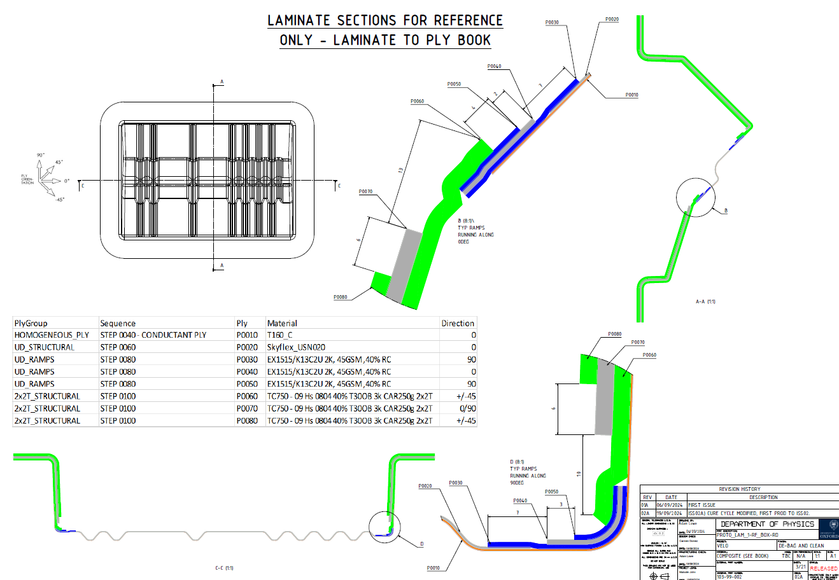
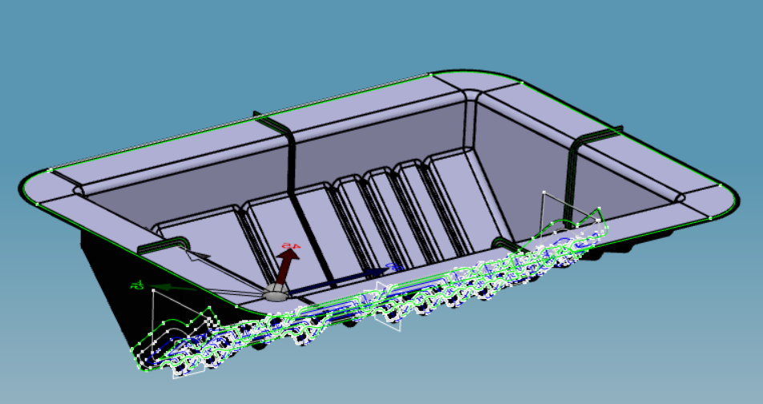
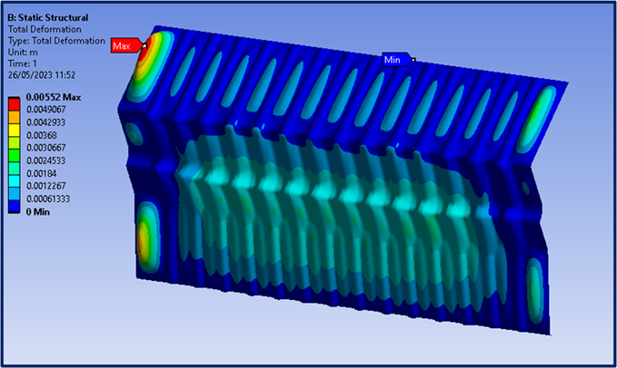
Project 1 – Medium Term Next Steps
Project 1 – Medium Term Next Steps – January 2025 Onwards
Finalise specifications and design brief of project 1,
Begin allocation of immediate tasks within project 1,
Start conceptual design work (Feb/March onwards)
Effort in the immediate short term will be concentrated on the information required for the proposal documentation.
Following proposal submission effort will be concentrated on establishing logical tasks and exact deliverables based on infrastructure and personnel within the work package.
Once tasks, timelines and owners are understood – design work can begin.

Slide 13
Project 2 Proposed Definition
…[see overleaf document for full definition] The goal of this project is to create a collaborative community for material characterization across countries and institutions. It is crucial to establish standardized procedures for testing and reporting material properties. Standardizing material testing for thermal and mechanical properties requires establishing clear protocols and guidelines that ensure consistency, reproducibility, and accuracy across different laboratories and institutions. This project will pursue a structured approach that could help achieve standardization:
  Develop Unified Testing Protocols - Define Material Categories: Classify materials (e.g., adhesives, TIMs, polymers, composites) based on their specific thermal and mechanical properties to create tailored testing methods. Establish test procedures for each material category, document step-by-step testing procedures, including specimen preparation, testing equipment, environmental conditions, and measurement techniques that can be recreated across the labs in the HEP collaborations.
  Standardize Environmental Conditions – Controlled/known temperature & humidity for both thermal and mechanical test campaigns. For radiation dependent material properties, cataloguing baseline as well as irradiated material properties to build degradation models using available irradiation facilities in EU and USA.
  Use Standardized Test Equipment and Instruments or calibrate and prove repeatability in custom built test equipment – having a calibration certificate is encouraged but not needed as long as calibration can be proven.
  Identifying Critical Material Parameters & Testing Standards
    Thermal properties – Exact material properties still being discussed,
    Mechanical Properties – Exact material properties still being discussed,

Slide 14
Project 2 Proposed Milestone Timeline – Year 1
Year | Milestone Designation | Description
Y1 | Y1.M1-3 | Document testing capabilities of all participating institutions and availability and turn around time for a test series.
Y1 | Y1.M2-9 | Conduct round-robin or inter-laboratory testing to verify the reproducibility of test results and provide cross-validation for TWO selected thermal and mechanical test materials of interest to the collaboration.
Y1 | Y1.M1-10 | Implement Material Data Management • Centralized Database: Create a globally accessible material property database where participating institutions upload their test results. All data entries should follow a standardized format that includes test conditions, specimen details, equipment used, and results. Need to explore expanding the currently established CERN / UK databases, IT policies and making the database open source. • Data Verification: Establish a peer-review process for validating and approving the data before it is added to the centralized database to ensure reliability and consistency.
Y1 | Y1.M11-12 | Float + Reconvene to finalize the database and start implementing changes and features requested by users to the database GUI. Analyze results produced with round robin testing and set out what the documentation guidelines can be.

Slide 15
Project 2 Proposed Milestone Timeline – Year 2
Year | Milestone Designation | Description
Y2 | Y2.M1-3 | Set Reporting and Documentation Guidelines • Comprehensive Reporting: Require standardized reporting formats for all test results, which should include test methods, equipment details, calibration status, test conditions (temperature, humidity, load, etc.), and observed outcomes. • Data Units: Ensure all measurements are reported using internationally accepted SI units to avoid discrepancies in data interpretation.
Y2 | Y2.M1-10 | Expand round robin testing / targeted testing to multiple materials and explore irradiation of samples and pre- & post- radiation studies for material properties.
Y2 | Y2.M6-10 | Create framework for inter-laboratory material testing facilities (who has what capabilities and who to contact for what test).
Y2 | Y2.M1-11 | Database GUI and backend development.
Y2 | Y2.M12 | Float + Beta version of Database released for users. Exploring capabilities to add new tests and standards.

Slide 16
Project 2 Proposed Milestone Timeline – Year 3
Year | Milestone Designation | Description
Y3 | Y3.M1-4 | Development of material models for simulation packages.
Y3 | Y3.M4-6 | Implementation of materials models and validation of the same with collaborative projects within DRD8. WG2. Project 1 or other DRD collaborations.
Y3 | Y3.M9 | Review and Updates • Update Testing Standards: Periodically review and update the standard procedures to incorporate advancements in testing technology and techniques. • Feedback from Users: Collect feedback from institutions performing tests to refine procedures and ensure they meet the needs of evolving materials and applications.
Y3 | Y3.M10 | Training and Certification for Personnel • Standardized Training Programs: Develop a training program for laboratory personnel to ensure they are proficient in the standardized testing protocols. • Certification of Technicians: Provide guidelines for technicians to ensure that material testing is conducted consistently and correctly across institutions.
Y3 | Y3.M11-12 | Float + Public Release of material database and simulation models. Decision on a central authority responsible on the upkeep of the database and the collaboration efforts for the future.

Slide 17
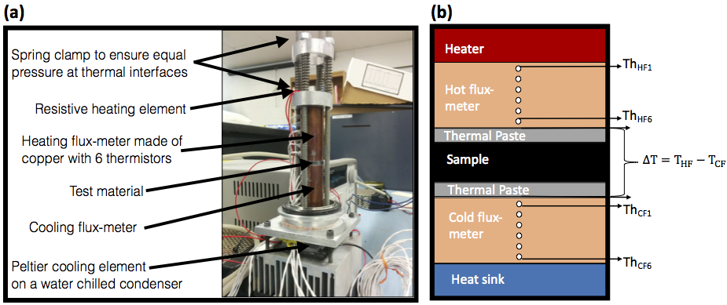
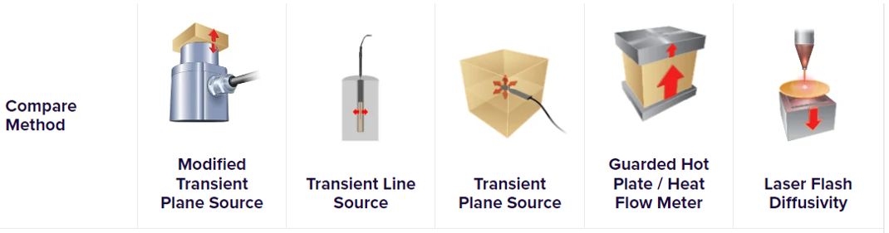
Project 2 – Immediate Next Steps – October to December 2024
Select control sample material – Proposed material –
  Patz F6 / IM7 plain weave – (cyanante ester). Purdue can supply materials and samples in required dimensions to all participating institutes ( Contact – Sushrut Karmarkar )
  Skyflex USN020 – K51 resin system, Pryofil TR50S (cyanante ester). Oxford can suppy material and samples in required dimensions to all participating institutes ( Contact – Adam Lowe )
Collect specimen dimensions and number of specimen for thermal conductivity and tensile modulus measurements.
Will send out email for the call for participating in first round-robin test campaign for calibration of measurements in early October 2024.

Slide 18
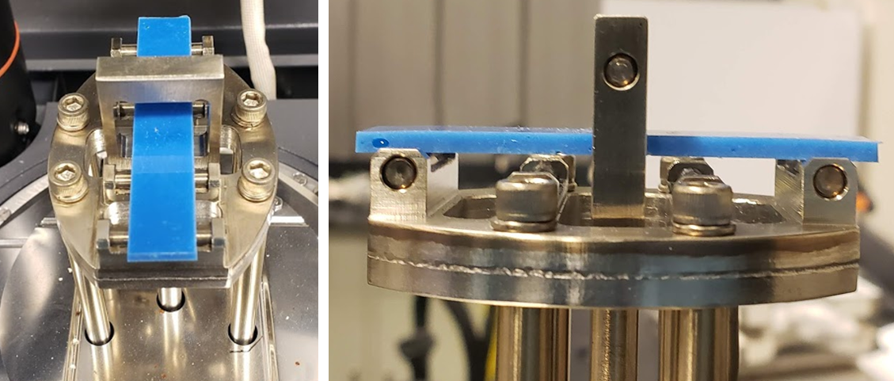
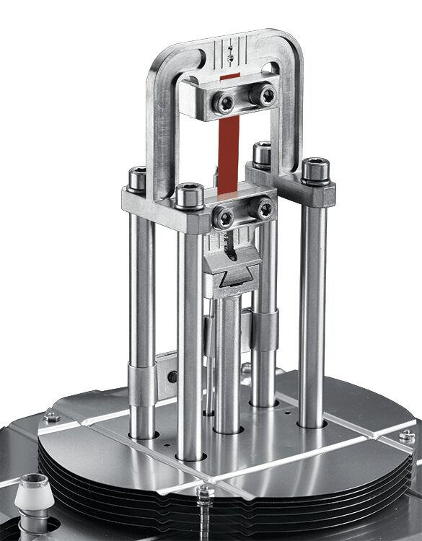
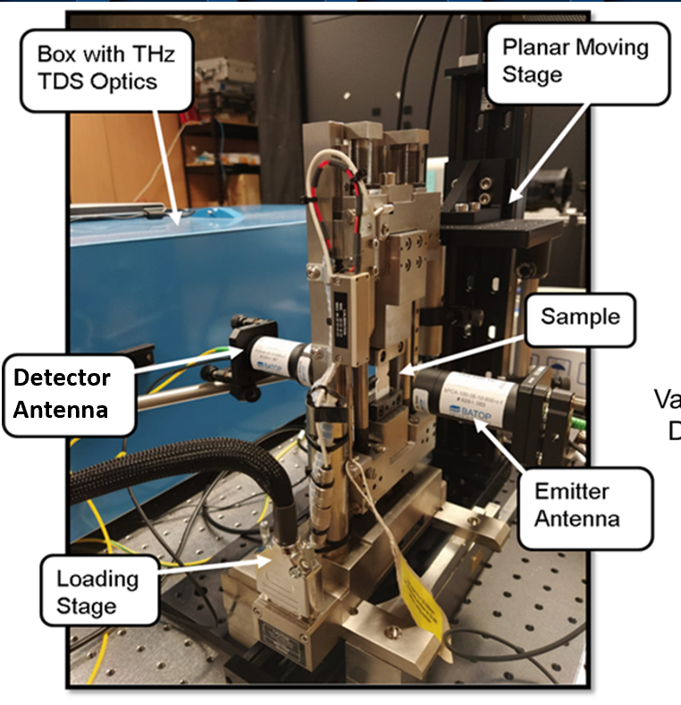
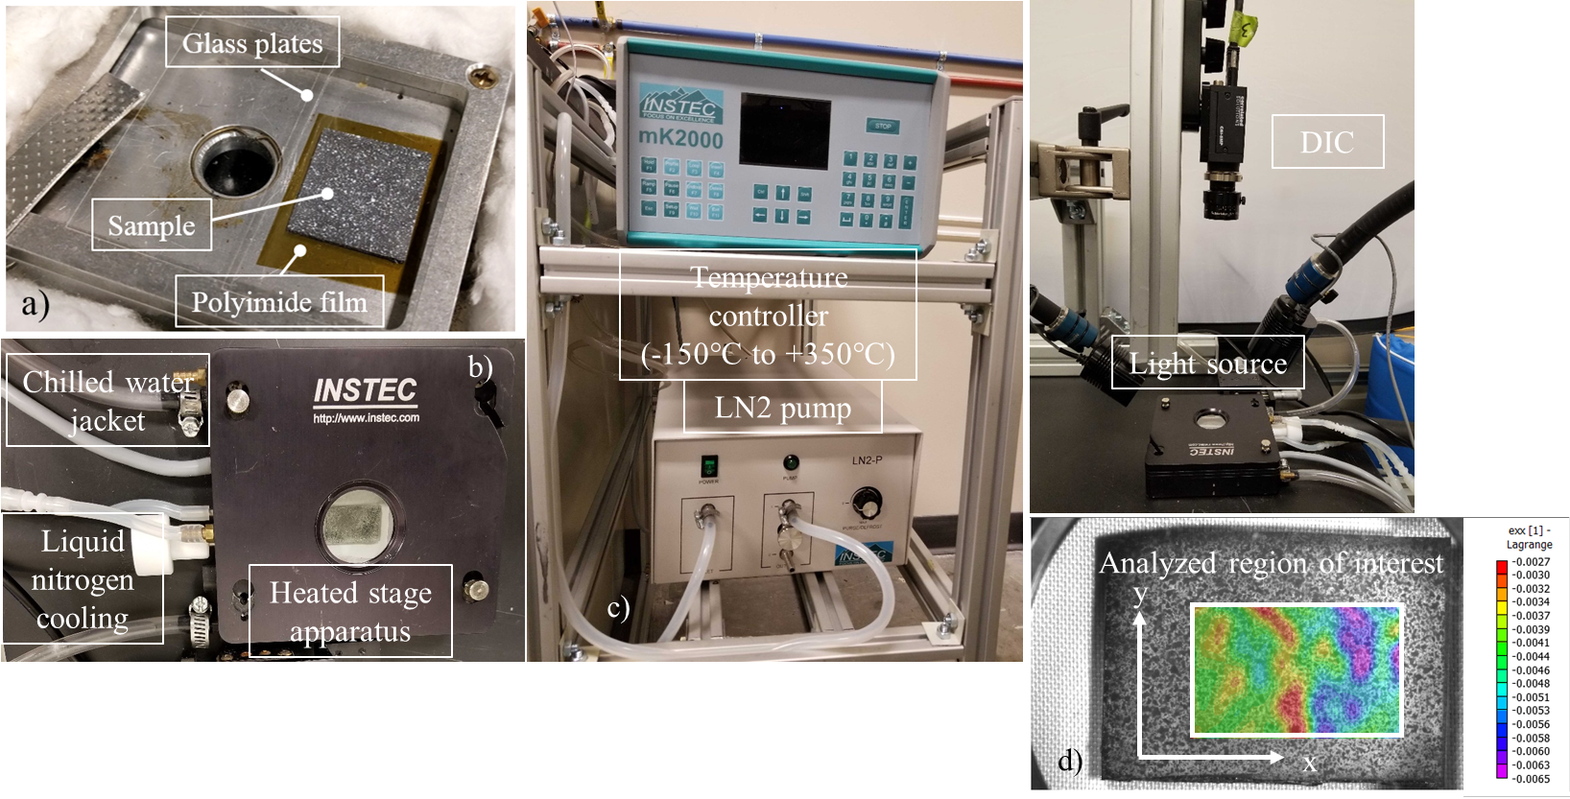
Project 2 – Immediate Next Steps – October to December 2024
Document and publish available test capabilities of all labs and participating institutes including point of contact; test costs/timelines (if available) and create a pathway for easy access to such tests within collaboration.
Expect emails for this early October 2024 (Sushrut)

Slide 19
DRD8.WP2
DRD8.WP2’s goal is to deliver a meaningful technical step forward in low mass mechanics and integrated thermal management – it is believed that the combination of these two harmonious and complimentary projects will deliver that.
Thank you for your time.

