Slide 1

DRD8 Proposal Preparation:
WP4 – Design & Qualification Tools
J. Batista Lopes; D. Alvarez
CERN, 25th September 2024

Slide 2

Introduction
WP4 aims to develop new tools and approaches to improve how we design and build detectors
Enhance the entire design cycle for detectors, from the early conceptual phase to the final installation, maintenance and decommissioning
Five potential activities initially identified in the LoI (see link):
  Connection of CAD tools to physics simulation software
  Open-source software & parallel computing
  Machine learning-driven topology optimisation
  Virtual/augmented reality aided design
  3D Design of complex geometries (e.g. services)
Proposal to focus on two activities for the next 3 years:
  Extended Reality (XR) Development for Detector Design
  Connection of Engineering Design Tools with Physics Simulation Software

Slide 3
Project 4.1: Extended Reality Development Programme
Objective: Investigate the adoption of Extended Reality (XR) technologies for the design, construction and interaction with detectors
Detector design, and particularly activities in experimental areas (e.g. installation, maintenance, decommissioning) could benefit greatly of Augmented Reality (AR), Virtual reality (VR) and Mixed Reality (MR) technologies (potential synergies with Project 1.2)
Project organised in 2 phases:
  Phase 1: Research and evaluation of current XR technologies
    Evaluation of off-the-shelf XR solutions/platforms
    Procurement of initial software & hardware and training
  Phase 2: Implementation of XR technologies for in detector application
    Initial evaluation in lab environment
    Application of XR technologies in an ongoing project at one of CERN’s experimental areas, including the necessary digital content to build a demonstrator

Slide 4
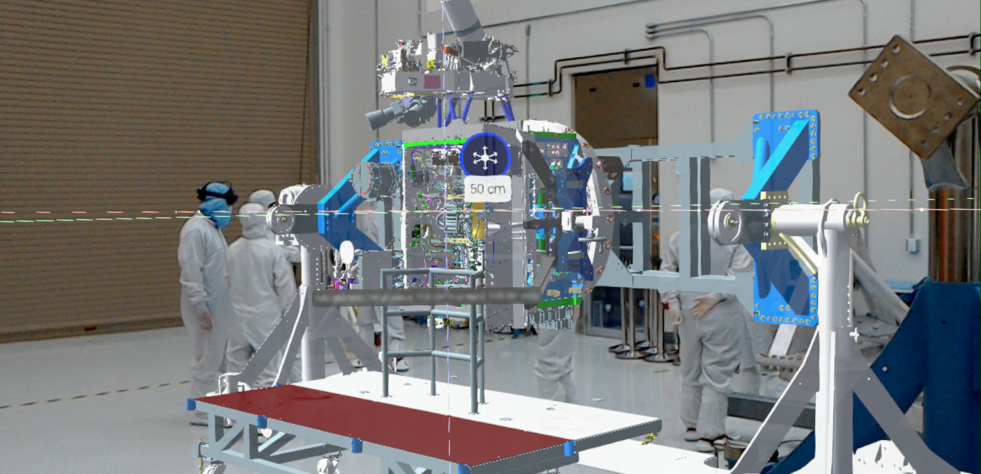
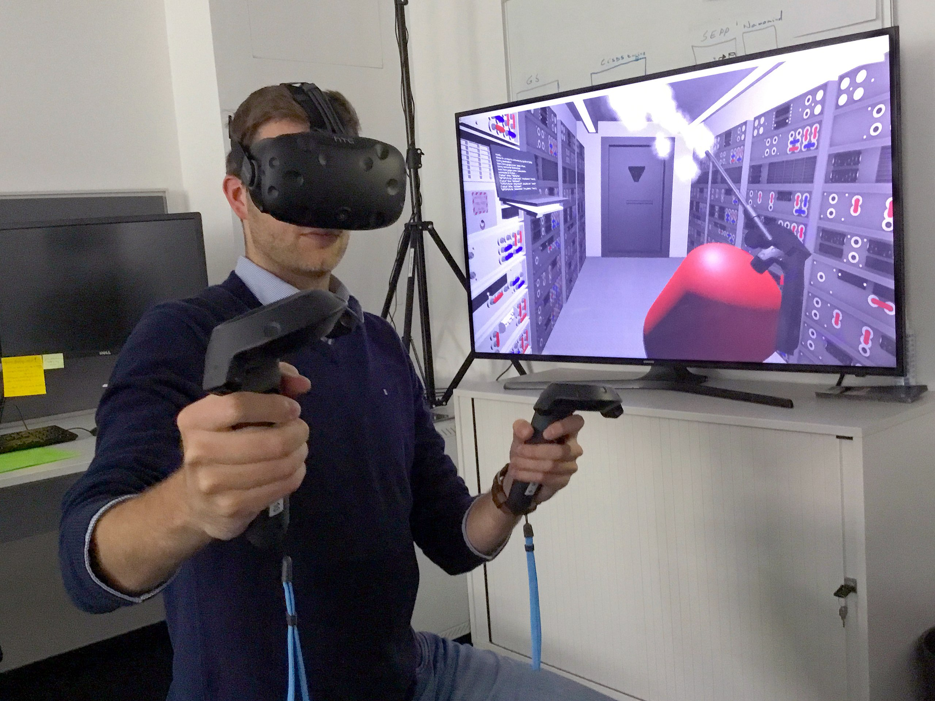
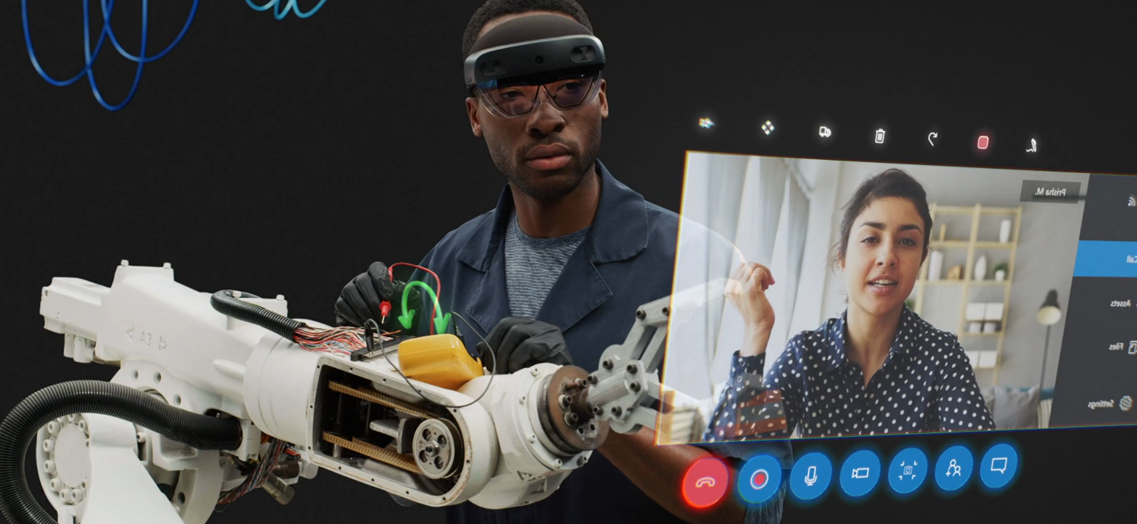
Europa Clipper engineers using mixed reality headsets to examine Europa Clipper’s avionics module assembly. Source: NASA/JPL-Caltech
Researchers at ESA, Darmstadt, using a VR headset & motion controllers to train to extinguish a fire inside a lunar habitat. Source: ESA
Collaboration from anywhere - Microsoft HoloLens 2. Source: Microsoft

Slide 5
Project 4.2:
Connection between Engineering Tools & Physics Simulation Software
Objective: Automatise data transfer between CAD design tools and physics simulation software (e.g. GEANT4, FLUKA)
Eliminating the need to introduce manually the detector geometry and material information in physics software will shorten the design times, minimise errors and allow for more realistic detector descriptions
Project organised in 2 phases:
  Phase 1: Requirement definition
    Interface with designers and physicists to define needs and identify input/output formats of both the engineering tools and physics simulation software
  Phase 2: Development software tools to extract and transfer relevant data (e.g. geometry, material) between applications

Slide 6
Final Comments
Relatively modest funding would be needed to launch Project 4.1 (dedicated primarily to the acquisition of XR systems), while no significant hardware costs are anticipated for Project 4.2
Person power will have to be secured for both activities!
Please, get in touch if you are interested in collaborating in any of these projects!!!

Slide 7
Questions?

