Slide 1





IMCC
D. Schulte
On behalf of the International Muon Collider Collaboration
Funded by the European Union (EU). Views and opinions expressed are however those of the author(s) only and do not necessarily reflect those of the EU or European Research Executive Agency (REA). Neither the EU nor the REA can be held responsible for them.
FNAL, August, 2024

Slide 2
IMCC Goals
Motivation to develop high-energy muon collider as option for particle physics:
Muon collider promises sustainable approach to the energy frontier
  limited power consumption, cost and land use
Technology and design advances in past years
Reviews in Europe and US found no unsurmountable obstacle
Accelerator R&D Roadmap identifies the required work
Has been developed with the global community
Goals are
Assess and develop the muon collider concept for a O(10 TeV) facility
Identify potential sites to implement the collider
Develop an initial muon collider stage that can start operation around 2050
Develop an R&D roadmap toward the collider
IMCC is based on MoC, current host lab is CERN but can be changed later
2

Slide 3
MoC and MuCol Partners
IT | INFN
 | INFN, Univ., Polit. Torino
 | INFN, Univ. Milano
 | INFN, Univ. Padova
 | INFN, Univ. Pavia
 | INFN, Univ. Bologna
 | INFN Trieste
 | INFN, Univ. Bari
 | INFN, Univ. Roma 1
 | ENEA
 | INFN Frascati
 | INFN, Univ. Ferrara
 | INFN, Univ. Roma 3
 | INFN Legnaro
 | INFN, Univ. Milano Bicocca
 | INFN Genova
 | INFN Laboratori del Sud
 | INFN Napoli
Mal | Univ. of Malta
EST | Tartu University
SE | ESS
 | University of Uppsala
PT | LIP
NL | University of Twente
FI | Tampere University
LAT | Riga Technical University
CH | PSI
 | University of Geneva
 | EPFL
BE | Univ. Louvain
AU | HEPHY
 | TU Wien
ES | I3M
 | CIEMAT
 | ICMAB
China | Sun Yat-sen University
 | IHEP
 | Peking University
KO | KEU
 | Yonsei University
IEIO | CERN
FR | CEA-IRFU
 | CNRS-LNCMI
DE | DESY
 | Technical University of Darmstadt
 | University of Rostock
 | KIT
UK | RAL
 | UK Research and Innovation
 | University of Lancaster
 | University of Southampton
 | University of Strathclyde
 | University of Sussex
 | Imperial College London
 | Royal Holloway
 | University of Huddersfield
 | University of Oxford
 | University of Warwick
 | University of Durham
US | Iowa State University
 | University of Iowa
 | Wisconsin-Madison
 | Pittsburg University
 | Old Dominion
 | Chicago University
 | Florida State University
 | RICE University
 | Tennessee University
 | MIT Plasma science center
 | Pittsburgh PAC
India | CHEP
US | FNAL
 | LBL
 | JLAB
 | BNL
3

Slide 4
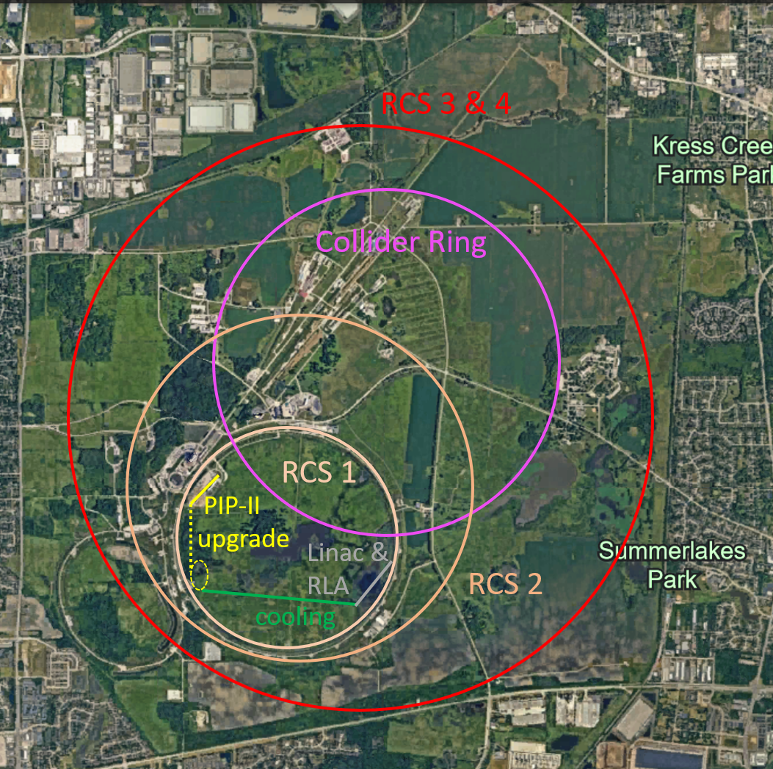
US P5: The Muon Shot
US has been instrumental in advancing the muon collider during Snowmass process
See the contributions even increase after the process
Particle Physics Project Prioritisation Panel (P5) supports US ambition to host a 10 TeV parton-parton collider
Endorses muon collider R&D: ”This is our muon shot”
Recommend joining the IMCC and consider FNAL as a host candidate
Warmly welcome the US
Informal discussion with DoE (Regina Rameika, Abid Patwa):
DoE wants to maintain IMCC as a global collaboration
Addendum to CERN-DoE-NSF agreement should be in preparation
IMCC prepares options for Europe and for the US in parallel
4

Slide 5
US P5: The Muon Shot
It is great news that the P5 report makes so clear and prominent recommendations concerning muon collider R&D, participation in the International Muon Collider Collaboration (IMCC), and taking a leading role in the muon collider design process. This is the fruit of your excellent work during the Snowmass process.
Several US institutes are already members of the IMCC and members of the US community are already engaged in important roles.
The US expertise in the different fields, including physics, detectors, accelerators, technologies and project leadership will be instrumental to the progress of the muon collider design. In particular, the ambition of the US to host such a facility is excellent news and strengthens the motivation for R&D and demonstrator planning at a fast pace.
As already planed, we will revise the distribution of R&D efforts and the organisation with your help in 2024, reflecting the US efforts and resources. This will enable us to move forward in the most efficient way possible, with a much stronger collaboration, towards a muon collider design and hopefully implementation.
Welcome,
Daniel, Nadia and Steinar.
US has been instrumental in advancing the muon collider during Snowmass process
See the contributions even increase after the process
Particle Physics Project Prioritisation Panel (P5) supports US ambition to host a 10 TeV parton-parton collider
Endorses muon collider R&D: ”This is our muon shot”
Recommend joining the IMCC and consider FNAL as a host candidate
Warmly welcome the US
Informal discussion with DoE (Regina Rameika, Abid Patwa):
DoE wants to maintain IMCC as a global collaboration
Addendum to CERN-DoE-NSF agreement should be in preparation
IMCC prepares options for Europe and for the US in parallel
5

Slide 6
US P5: The Muon Shot
US has been instrumental in advancing the muon collider during Snowmass process
See the contributions even increase after the process
Particle Physics Project Prioritisation Panel (P5) supports US ambition to host a 10 TeV parton-parton collider
Endorses muon collider R&D: ”This is our muon shot”
Recommend joining the IMCC and consider FNAL as a host candidate
Warmly welcome the US
Informal discussion with DoE (Regina Rameika, Abid Patwa):
DoE wants to maintain IMCC as a global collaboration
Addendum to CERN-DoE-NSF agreement should be in preparation
IMCC prepares options for Europe and for the US in parallel
6

Slide 7
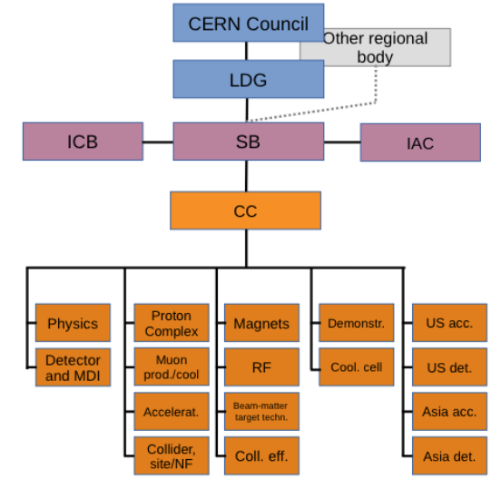
IMCC Organisation
Collaboration Board (ICB)
Elected chair: Nadia Pastrone
50 full members, 60+ total
DOE
Steering Board (ISB)
Chair Steinar Stapnes
Members: Mike Lamont (CERN), Gianluigi Arduini (CERN), Dave Newbold (STFC), Mats Lindroos (ESS), Pierre Vedrine (CEA), N. Pastrone (INFN), Beate Heinemann (DESY)
Study members: SL and deputies
US contact experts: Mark Palmer, Sergo Jindariani, Diktys Stratakis, Sridhara Rao Dasu
Advisory Committee
Coordination committee (CC)
Study Leader: Daniel Schulte
Deputies: Andrea Wulzer, Donatella Lucchesi, Chris Rogers
Will integrated the US also in the leadership
In particular the CC

Slide 8
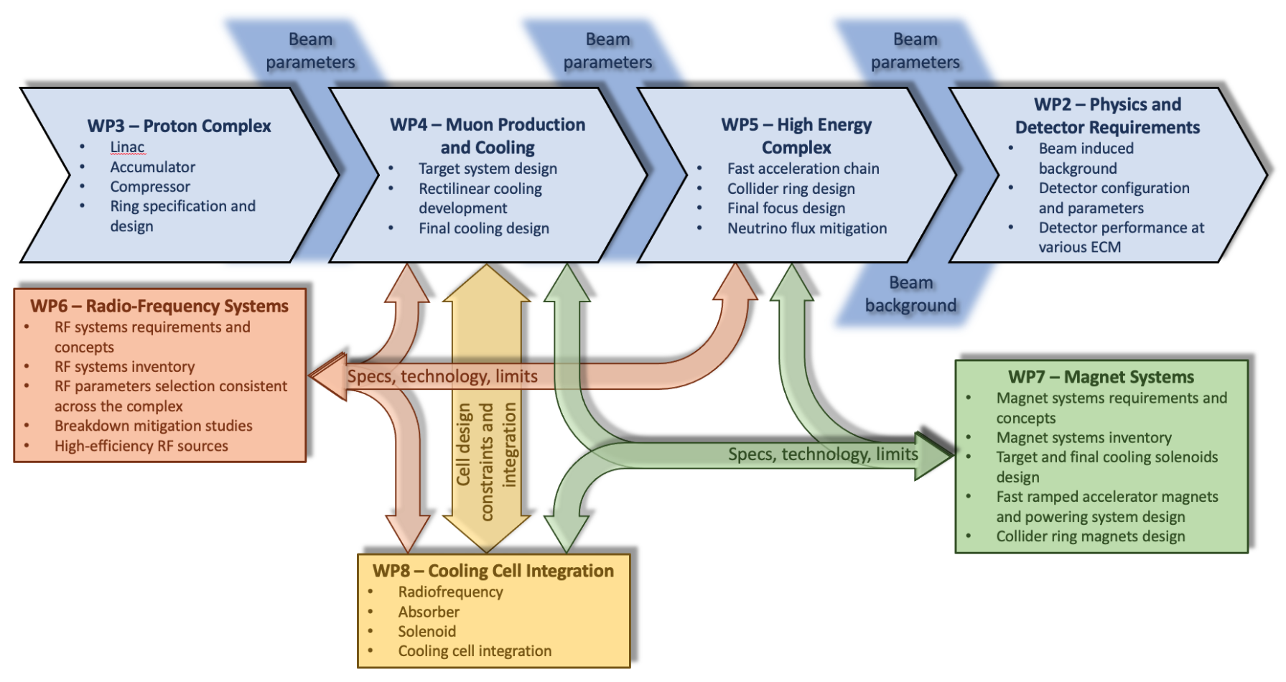
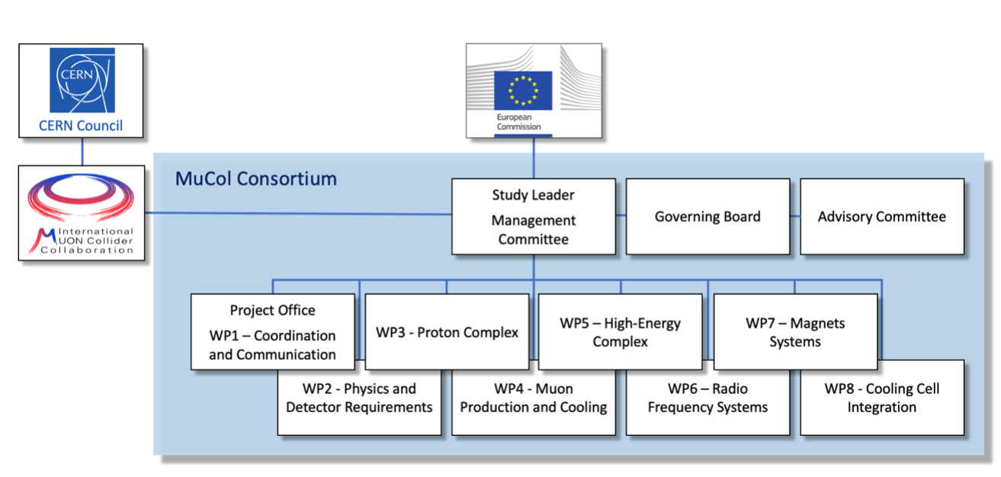
MuCol
3 MEUR from the EU, the UK and Switzerland, about 4 MEUR from the partners
The backbone of the study in Europe
30 partners
Strongly interweaved
  Share most meeting
  Similar management structure
Instrumental to kick off collaboration
Motivated partners to commit
Added resources
Motivated CERN to commit more
Management similar to IMCC
Deputy: Chris Rogers

Slide 9
MuCol Integration
MuCol promises the IMCC Evalution and R&D Plan reports as its main deliverables
MuCol contributes some part of it, the rest comes from the other collaboration
The IMCC Collaboration Board handles most decisions
MuCol Governing Board is attending these meetings (even those that did not sign MoC)
MuCol GB decides sperately on issues related to the EU contract
The IMCC Coordination Committee is a superset of MuCol Management committee
E.g. Gender Advisor of MuCol (who is from the US, by the way)
MuCol endorses IMCC Advisory Committee as it own Advisory Committee
Publications of IMCC and MuCol are handled by the same team
IMCC publication rules take into account interest of sub-projects
MuCol partners put the logo on their talks, like any other logo from your funding agency, lab, …

Slide 10
Coordination Committee Members
Physics | Andrea Wulzer
Detector and MDI | Donatella Lucchesi
US (detector) | Sergo Jindariani
US (accelerator) | Mark Palmer
US (accelerator) | Diktys Stratakis
Asia (China) | Jingyu Tang
Asia (Japan) | tbd
Protons | Natalia Milas
Muon production and cooling | Chris Rogers
Muon acceleration | Antoine Chance
Collider | Christian Carli
Cost | Carlo Rossi
Publications | Elias Metral
Gender Advisor | Ej Bahng
Magnets | Luca Bottura
RF | Alexej Grudiev, Dario Giove
Beam-matter int. target systems | Anton Lechner
Collective effects | Elias Metral
Collaboration Board Chair | Nadia Pastrone
Steering Board Chair | Steinar Stapnes
Cooling cell design | Lucio Rossi
Demonstrator | Roberto Losito

Slide 11
Coordination Committee Members
Physics | Andrea Wulzer
Detector and MDI | Donatella Lucchesi
Demonstrator CERN
Demonstrator FNAL
Site study CERN
Site study FNAL
Potential other site
Protons | Natalia Milas
Muon production and cooling | Chris Rogers
Muon acceleration | Antoine Chance
Collider | Christian Carli
Additional US coordinators
Cost | Carlo Rossi
Publications | Elias Metral
Gender Advisor | Ej Bahng
Other package (e.g. computing?)
Additional US coordinators
Magnets | Luca Bottura
RF | Alexej Grudiev, Dario Giove
Beam-matter int. target systems | Anton Lechner
Collective effects | Elias Metral
Cooling cell design | Lucio Rossi
Collaboration Board Chair | Nadia Pastrone
Steering Board Chair | Steinar Stapnes

Slide 12
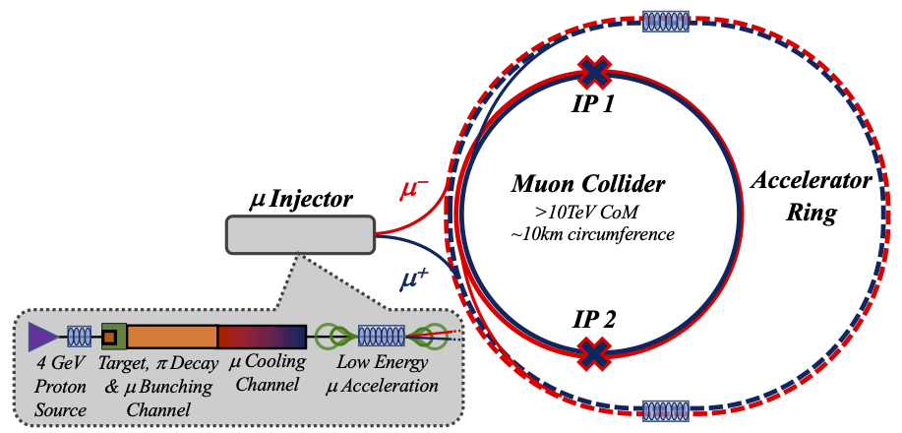
Key Challenges
0) Physics case
4) Drives the beam quality
MAP put much effort in design
optimise as much as possible
2) Beam-induced background
1) Dense neutrino flux
mitigated by mover system and site selection
3) Cost and power consumption limit energy reach
e.g. 35 km accelerator for 10 TeV, 10 km collider ring
Also impacts beam quality
12

Slide 13
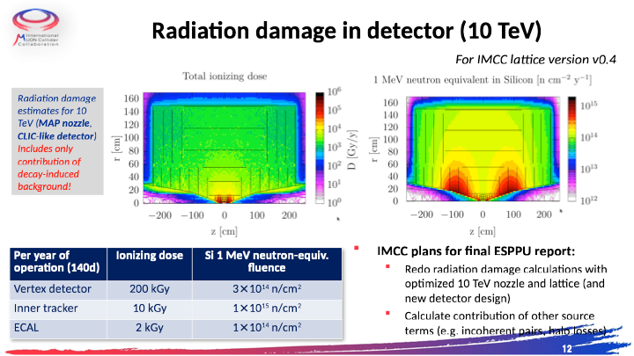
Important technical progress
But cannot cover it here
Technical progress

Slide 14
Technical progress

Slide 15
Technical progress

Slide 16
Technical progress

Slide 17
Technical progress

Slide 18
Technical progress

Slide 19
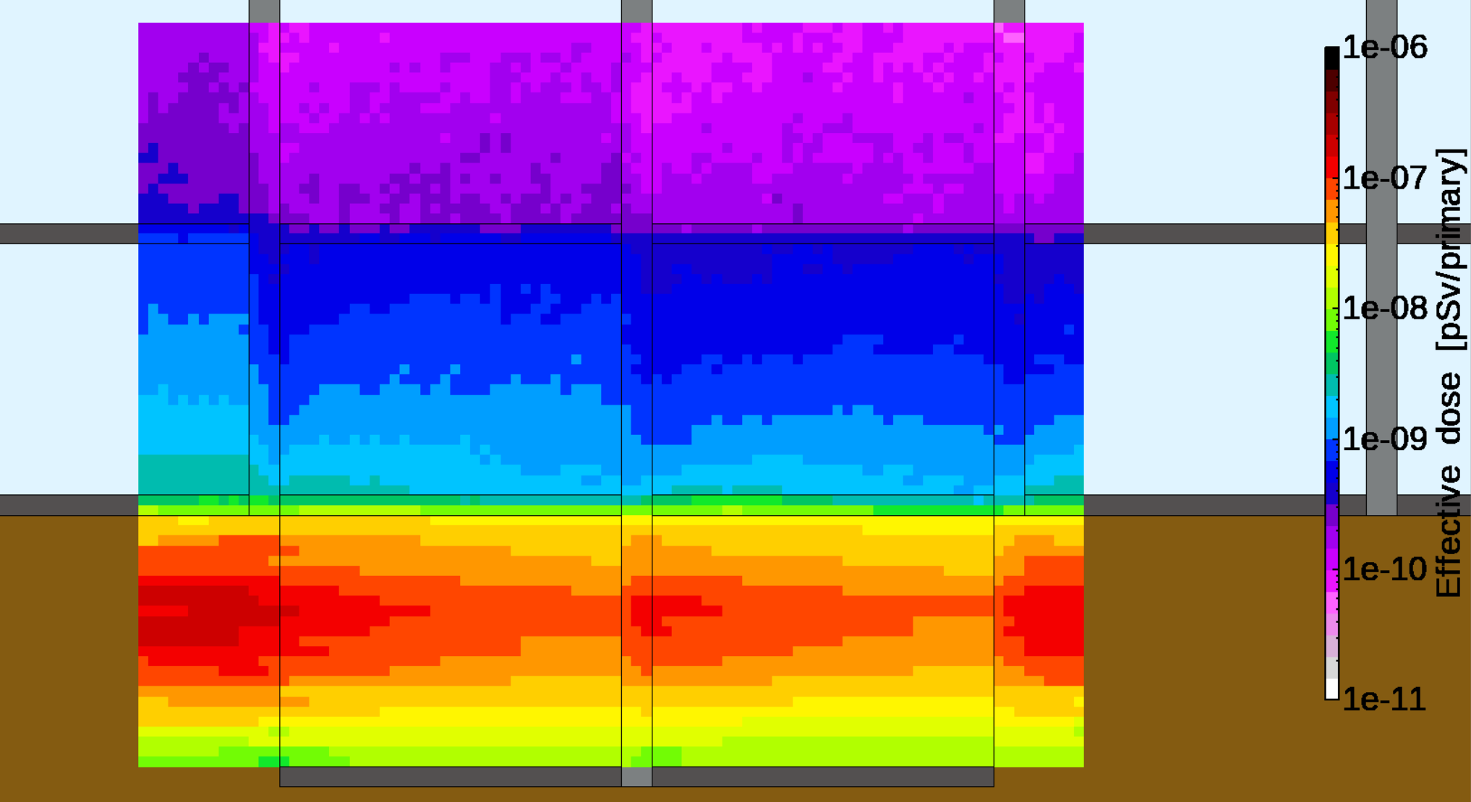
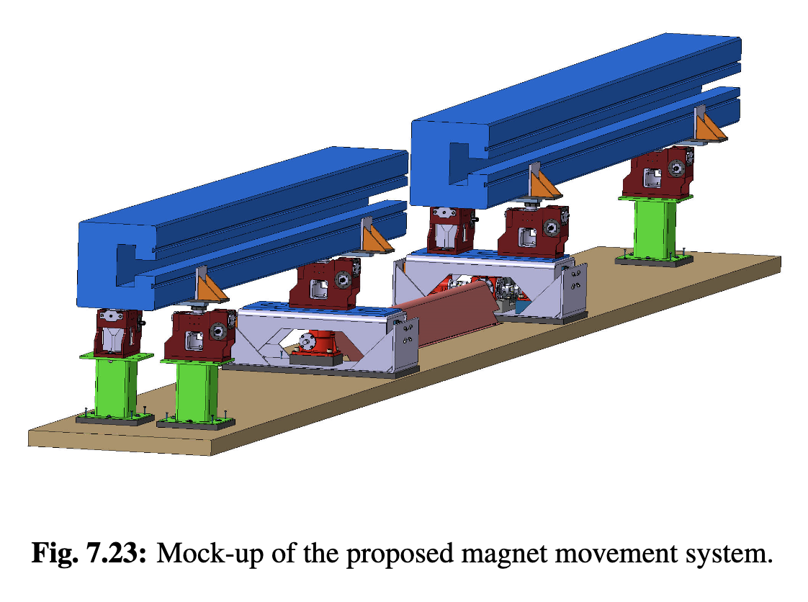
Muon Decay and Neutrino Flux
Muon decays in collider ring
Impact on detector
Have to avoid dense neutrino flux
Detailed studies by RP and FLUKA experts
Impact on surface
Considering buildings
Aim for negligible impact from arcs
Similar impact as LHC
At 10 TeV go from acceptable to negligible with mover system
  Mockup of mover system planned
  Impact on beam to be checked
Impact of experimental insertions
3 TeV design acceptable with no further work
But better acquire land in direction of straights, also for 10 TeV
Detailed studies identified first location and orientation close to CERN
  Poiint to uninhabited area in Jura and Mediterranian sea

Slide 20
Technology Maturity
Important timeline drivers:
Magnets
  HTS technology available for solenoids (expect mature for production in 15 years)
  Nb₃Sn available for collider ring, maybe lower performance HTS (expect in 15 years)
  High performance HTS available for collider ring (may take more than 15 years)
Muon cooling technology and demonstrator (expect demonstrator operational in <10 years, with enough resources, allows to perform final optimization of cooling technology)
Detector technologies and design (expect in 15 years)
Other technologies are also instrumental for performance, cost, power consumption and risk mitigation
but believe that sufficient funding can accelerate their development sufficiently
Other important considerations for the timeline are
Civil engineering
Decision making
Administrative procedures

Slide 21
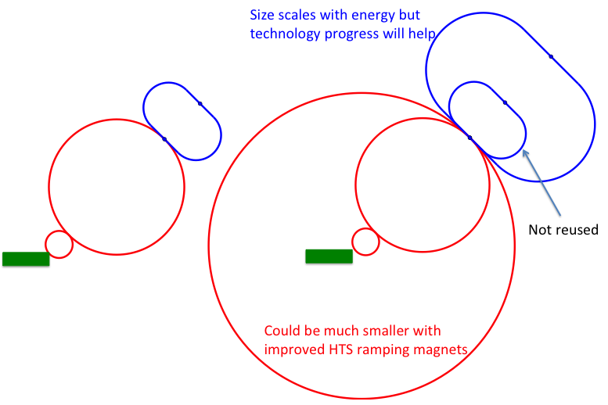
Staging
Energy staging
Start at lower energy
Current 3 TeV, design takes lower performance into account
Splits cost, little increase in integrated cost
Luminosity staging
Start at with full energy, but lower luminosity
Main luminosity loss sources are arcs and interaction region
  Can later upgrade interaction region (as in HL-LHC)
Start considering reuse of existing infrastructures
But maintain green field

Slide 22
Tentative Timeline (Fast-track 10 TeV)
Only a basis to start the discussion, will review this year
Need at least two years of demonstrator operation (better more)
Need RF test stand before
Decision starting in 2036
Estimated10 TeV construction/installation
Different initial estimates for detector
seem to be fast enough
Buit need to develop robust timeline

Slide 23
Timeline with Magnets
Only a basis to start the discussion, will review this year
First magnets in time for demonstrator
14-16 T Magnets in time for collider
But only 11 T for decision

Slide 24
IMCC Plans
IMCC is a world-wide collaboration
Provide input to all regional processes
Roadmap has been developed with global community
We want a muon collider
Where it will be hosted will be in the hands of funding agencies
One lesson to take from ILC
Medium-term plans:
For the ESPPU (March 2025), will deliver planned reports to ensure support in Europe
Will fulfill EU contract (February 2027)
  Final deliverable is report on all R&D
Will provide the required input to the process in the US that follows the ESPPU according to P5 recommendations (2027?)
  Likely requires Reference Design
Will provide input to any other processes

Slide 25
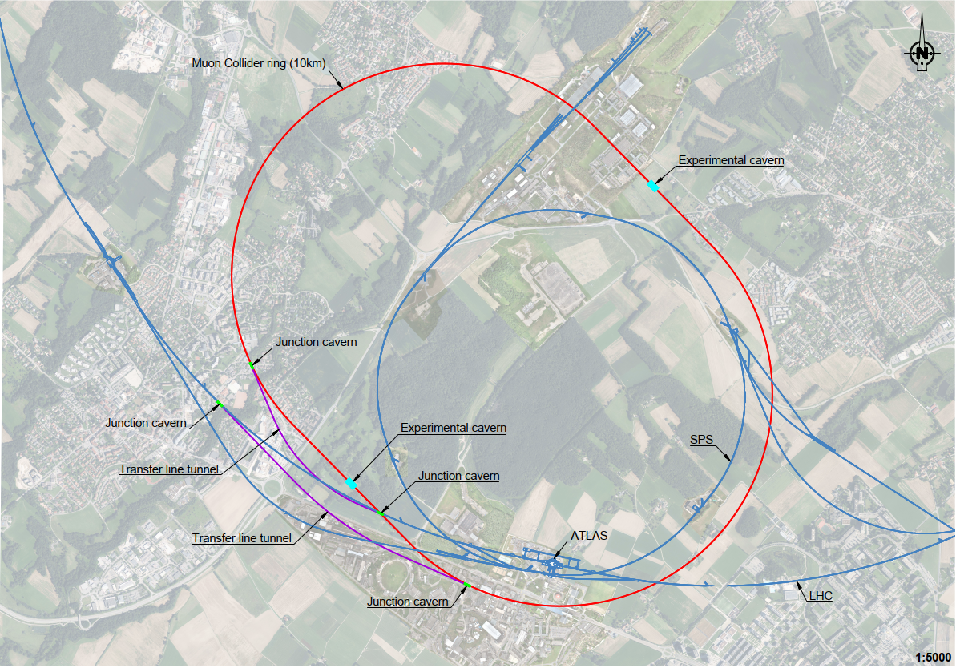
Plan for ESPPU
March 2025 deliver promised ESPPU reports
Evaluation report, including tentative cost and power consumption scale
R&D plan, including scenarios and timelines
This requires to push as hard as possible with existing resources
Continue to perform studies on green field designs
International collaboration
Parameters, lattice designs, component designs, beam dynamics, cost, …
Perform example civil engineering studies
CERN (collider and demonstrator)
The US started doing similar studies for FNAL
Provide parameters tables for the implementation at existing sites (FNAL, CERN, …)
Scaled from green field design
Do not have the resources and time to make detailed designs for CERN and FNAL for ESPPU
25

Slide 26
R&D Plan
Plan is to submit an R&D plan to ESPPU
Allows to maintain momentum during and after the process
Should be a global programme
A common plan with the US
Defining the scope of the R&D is critical
Need to have realistic scope
Address what is important
But do not include non-essential items
Each work areas should propose the scope for that field
Followed by an arbitration on a higher level
Identify the required resources and potential distribution of work
Based on the estimates of the different work areas
26

Slide 27
Schedule
Important to establish that technically a timescale consistent with young peoples’ careers can be envisaged
Ideally have a common technically limited timeline
Needs to critically review proposed tentative timeline
Critical to agree on common technically limited timeline
Implementation considerations may later change the implementation in the US and in Europe
E.g. political developments, budgets, other projects, strategy decisions, …
Main technical areas to be considered for the timeline
The muon cooling technology and the demonstrator
The magnet technology
The detector
Start-to-end model of the collider
Other technologies
Site specific studies
27

Slide 28
Organisation
Longer run: Full merging of US effort with IMCC
Short-time: Fast contributions to the ESPPU
Physics case
Make a common schedule and R&D plan
  In particular specific items
    Demonstrator development
    Magnet development
    Detector design
    Other areas
Potential organisation:
Appoint a European and a US coordinator for each area of the R&D report
A small task force reviews and updates the current schedule
The R&D plan coordinators review the schedule in more depth
28

Slide 29
Conclusion
Muon collider has a compelling physics case
R&D progress is increasing confidence that the collider is a unique, sustainable path to the future
Now integrate the US at eye level
Urgent key issues is preparation of ESPPU
Then preparation of US process
Many thanks to the collaboration for all the work
To join contact muon.collider.secretariat@cern.ch

Slide 30
Reserve

Slide 31
R&D Plan Considerations
I do not think that we have the resources to make a full plan until the implementation of the project
Focus on the next few years, a little less detailed for the longer term
Include the items that technically drive the timeline
Or that are important for the decision process
R&D reduces the risk of a project
Will have diverging opinions about the importance of some items
I expect that we need to define risk classes
Some key questions:
What does the demonstrator really need to demonstrate?
Do we need a demonstration of a hybrid synchrotron or is a demonstration of a cell sufficient?
Which alternatives should be included?
What is the path toward the magnets?
31

Slide 32
32

Slide 33
33

Slide 34
34

Slide 35
Areas of US Contribution
Need a start-to-end model of the muon collider
More accelerator physicists
Need contributions to the key technology lines
Muon cooling technology and demonstrator
Magnets
Need contributions to the full range of accelerator technologies
Neutrino flux mitigation, target, instrumentation, vacuum, …
Need to increase the effort on at least two detector designs
Also considering the technologies
Site specific studies (demonstrator and collider)
35

Slide 36
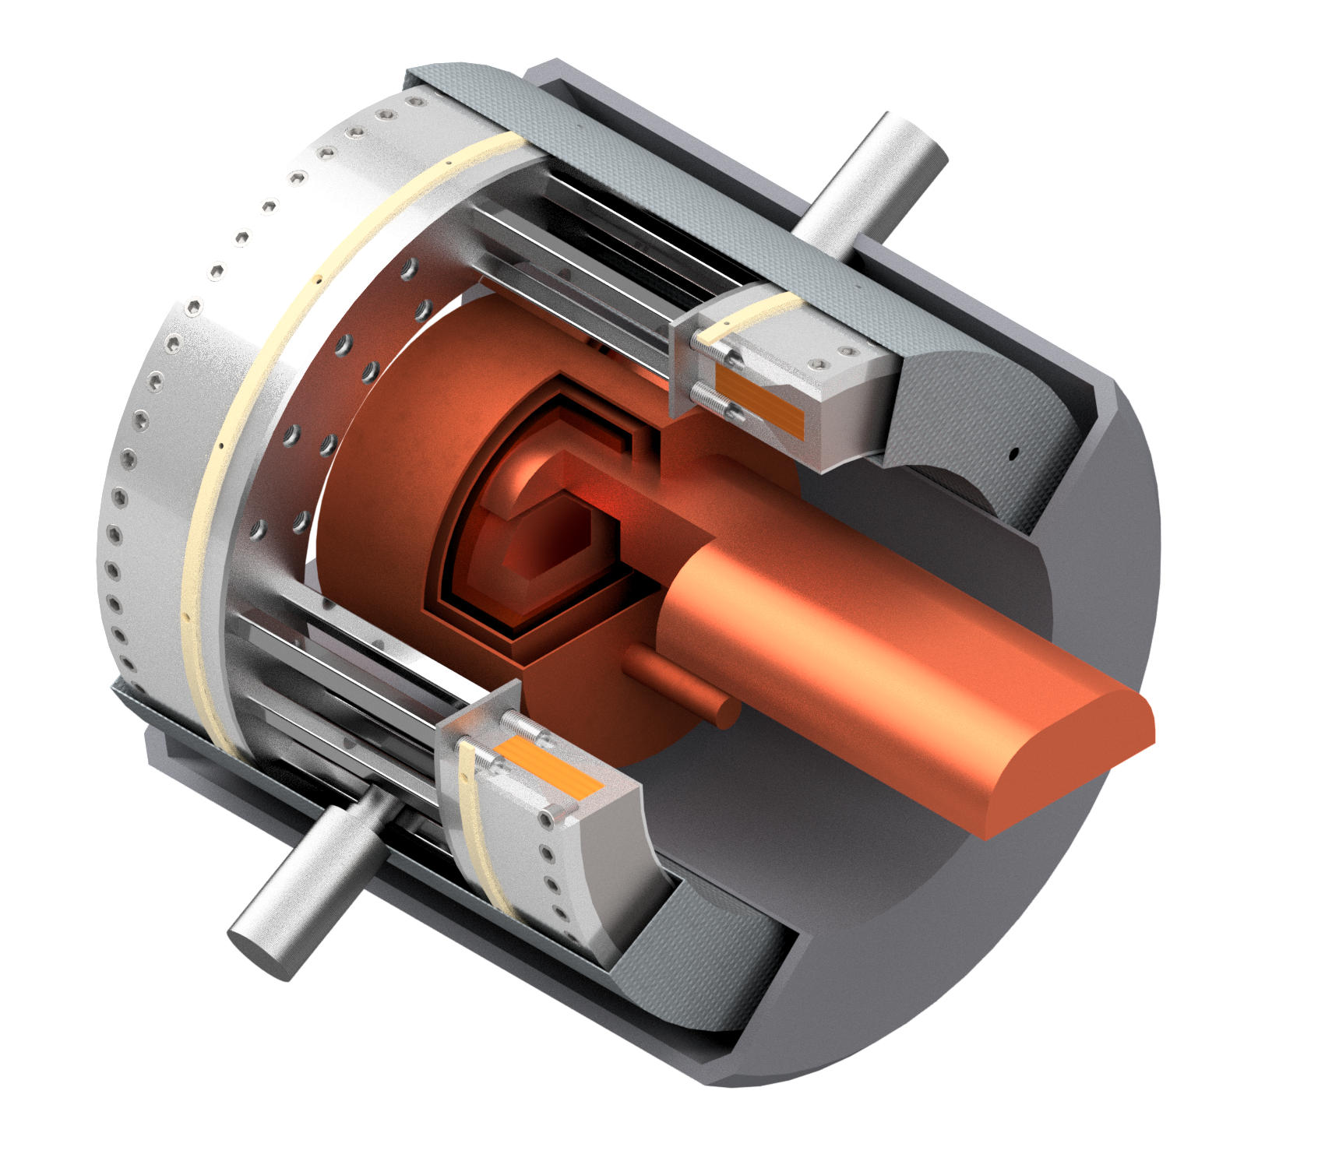
R&D Programme
Broad R&D programme can be distributed world-wide
Muon cooling technology
RF test stand to test cavities in magnetic field
Muon cooling cell test infrastructure
Demonstrator
  At CERN, FNAL, ESS, JPARC, …
  Workshop in October at FNAL
Magnet technology
HTS solenoids
Collider ring magnets with Nb3Sn or HTS
Detector technology and design
Can do the important physics with near-term technology
But available time will allow to improve further and exploit AI, MI and new technologies
Many other technologies are equally important now to support that the muon collider can be done and perform
Training of young people
Strong synergy with HFM Roadmap and RF efforts

Slide 37
Tentative Staged Target Parameters
Parameter | Unit | 3 TeV | 10 TeV | 10 TeV | 10 TeV
L | 10³⁴ cm⁻²s⁻¹ | 1.8 | 20 | tbd | 13
N | 10¹² | 2.2 | 1.8 | 1.8 | 1.8
f_{r} | Hz | 5 | 5 | 5 | 5
P_{beam} | MW | 5.3 | 14.4 | 14.4 | 14.4
C | km | 4.5 | 10 | 15 | 15
<B> | T | 7 | 10.5 | 7 | 7
ε_{L} | MeV m | 7.5 | 7.5 | 7.5 | 7.5
σ_{E} / E | % | 0.1 | 0.1 | tbd | 0.1
σ_{z} | mm | 5 | 1.5 | tbd | 1.5
β | mm | 5 | 1.5 | tbd | 1.5
ε | μm | 25 | 25 | 25 | 25
σ_{x,y} | μm | 3.0 | 0.9 | 1.3 | 0.9
Target integrated luminosities
Need to spell out scenarios
Need to integrate potential performance limitations for technical risk, cost, power, …
Example as discussion basis
numbers will change
37

Slide 38
Organisation Form
USMCC appears to focus on finding resources and monitor their use
Would like to have US participate to the leadership
Almost everyone prefers to have the project in their region
But better to have the project in a different region that not at all
Site will be will decided by funding agencies of the different regions
  A strong effort in other regions will help to convince funding agencies
  Actually, a competition between funding agencies is best for everybody
Best setup is one coherent collaboration
Addresses all challenges of the muon collider
Establish its benefits for science and society
Promote it toward society and funding agencies
Only a sub-part should focus on local implementation
Not two project studies that collaborate but a collaboration that considers two or more sites

Slide 39
Very Short-term Plan
Just finished Interim Report
Design
Challenges
Plan until 2026
IAC has been formed and reviewed interim report as a first task
IAC regular members:
Ursula Bassler (IN2P3, interim Chair), Mauro Mezzetto (INFN)
Hongwei Zhao (Inst. of Modern Physics, IMP), Akira Yamamoto (KEK), Maurizio Vretenar (CERN), Stewart Boogert (Cockcroft), Sarah Demers (Yale), Giorgio Apollinari (FNAL)
Experts for Interim Report review
Marica Biagini (INFN), Luis Tabarez (CIEMAT), Giovanni Bisoffi (INFN), Jenny List (DESY), Halina Abramowicz (Tel Aviv), Lyn Evans (CERN)
Will focus on advanced ESPPU:
March 2025, deliver promised ESPPU reports
  Evaluation report, including tentative cost and power consumption scale estimate
  R&D plan, including some scenarios and timelines
This requires to push as hard as possible with existing resources

Slide 40
Synergies and Outreach
Training of young people
Novel concept is particularly challenging and motivating for them
Technologies
Muon collider needs HTS, in particular solenoids
Fusion reactors
Power generators
Nuclear Magnetic Resonance (NMR)
Magnetic Resonance Imaging (MRI)
Magnets for other uses (neutron spectroscopy, detector solenoids, hadron collider magnets)
Target is synergetic with neutron spallation sources, in particular liquid metal target (also FCC-ee)
High-efficiency RF power sources and power converter
RF in magnetic field can be relevant for some fusion reactors
High-power proton facility
Facilities such as NuStorm, mu2e, COMET, highly polarized low-energy muon beams
Detector technologies
AI and ML
Physics
40

Slide 41
Role of Higgs Factory
The community wants a higgs factory as a first step
Will explore important questions and may point to new physics
A higgs factory is currently considered in Japan (ILC), China (CEPC) and Europe (FCC-ee, LC at CERN)
Need additional budget for CEPC, ILC and FCC, but probably not for linear collider at CERN
The highest-energy facility would have to come after the higgs factory if it where in the same region
Note: I think that Europe will strive to maintain CERN as a leading laboratory with continued or increased budget
Catch:
Higgs factory results are unlikely available when a decision for 10 TeV has to be taken
Aggressive lead time 15 years if sufficient preparation has been done
Earliest potential higgs factory is CEPC approved 2025, ready 2035, results 2040
Consideration:
We should strive to move toward the highest-energy facility with the largest discovery potential

Slide 42
Recent Results: Interim Report
IAC regular members:
Ursula Bassler (IN2P3, interim Chair)
Mauro Mezzetto (INFN)
Hongwei Zhao (Inst. of Modern Physics, IMP)
Akira Yamamoto (KEK)
Maurizio Vretenar (CERN)
Stewart Boogert (Cockcroft)
Sarah Demers (Yale)
Giorgio Apollinari (FNAL)
Experts for this review
Marica Biagini (INFN)
Luis Tabarez (CIEMAT)
Giovanni Bisoffi (INFN)
Jenny List (DESY)
Halina Abramowicz (Tel Aviv)
Lyn Evans (CERN)
The IAC reviewed the Interim Report and prepared an excellent report on their findings

Slide 43

Proposal: EuMAHTS
Luca Botture et al.
Submitted to INFRA-2024-TECH-01-01
Short name | Country | Status
CERN | IERO | B
EMFL | Belgium | B
TAU | Finland | B
CEA | France | B
ESRF | France | B
EUXFEL | Germany | B
GSI | Germany | B
KIT | Germany | B
INFN | Italy | B
UMIL | Italy | B
UTWENTE | Netherlands | B
IFJ-PAN | Poland | B
PK | Poland | B
CIEMAT | Spain | B
CSIC | Spain | B
PSI | Switzerland | A
TERA-CARE | Switzerland | A
UNIGE | Switzerland | A
CNRS | France | A
HZDR | Germany | A
RU-NWO | Netherlands | A
Focus on HTS development
O(10 Meur) request
WP9 – Test Infrastructures
(G. Willering, E. Beneduce)
WP6 – 40T-class all-HTS solenoid
(B. Bordini, P. Vedrine)
WP5 – Materials and Technologies
(D. Bocjan, A. Bersani)
WP2 – Strategic Roadmap
(A. Ballarino, L. Rossi)
WP1 - Coordination and Communication
(L. Bottura, P. Vedrine)
WP4 – HTS Magnets Applications Studies
(P. Vedrine, M. Statera)
WP3 – Industry Co-innovation
(J.M. Perez, S. Leray)
WP7 – 10T/10MJ-class all-HTS solenoid
(S. Sorti, C. Santini)
WP8 – K=2 all-HTS undulator
(S. Casalbuoni, M. Calvi)
Strategy and context
Material and technology
Three core components (6 MEUR)
40 T solenoid, 50 mm bore
10 T/10 MJ/300 mm solenoid
HTS undulator
Test infrastructure

Slide 44
Magnet Roadmap
Assume: Need prototype of magnets by decision process
Consensus of experts (review panel):
Anticipate technology to be mature in O(15 years):
  HTS solenoids in muon production target, 6D cooling and final cooling
    HTS tape can be applied more easily in solenoids
    Strong synergy with society, e.g. fusion reactors
  Nb₃Sn 11 T magnets for collider ring (or HTS if available): 150mm aperture, 4K
This corresponds to 3 TeV design
Could build 10 TeV with reduced luminosity performance
  Can recover some but not all luminosity later
Operation start
2036+2037 decision process
Still under discussion:
Timescale for 10 TeV HTS/hybrid collider ring magnets
For second stage can use HTS or hybrid collider ring magnets
Strategy:
HTS solenoids
Nb₃Sn accelerator magnets
HTS accelerator magnets
Seems technically good for any future project

Slide 45
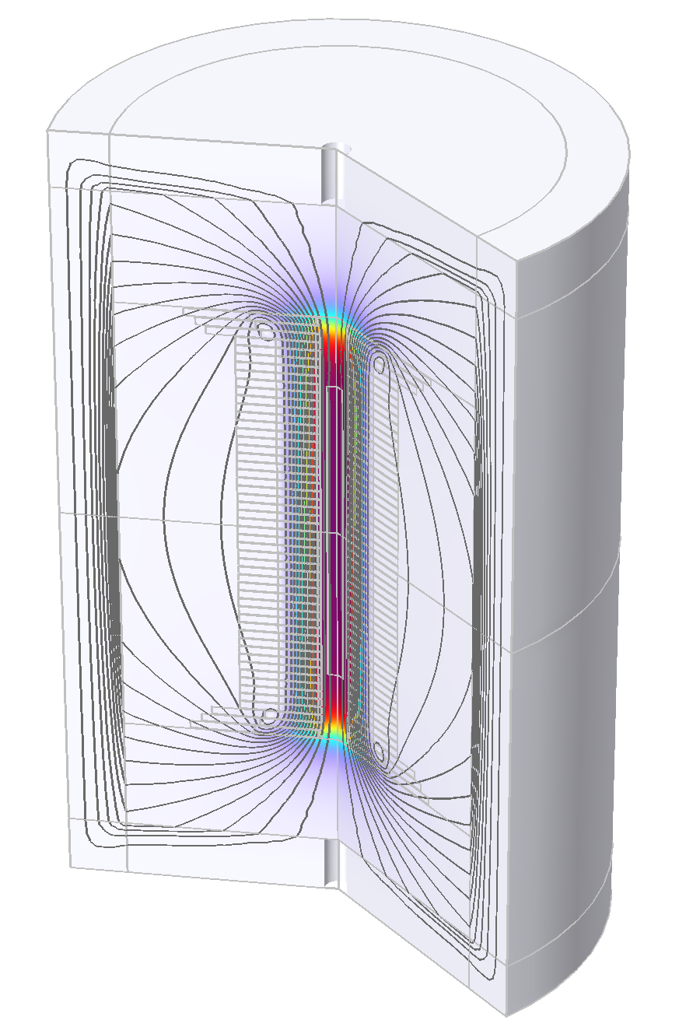
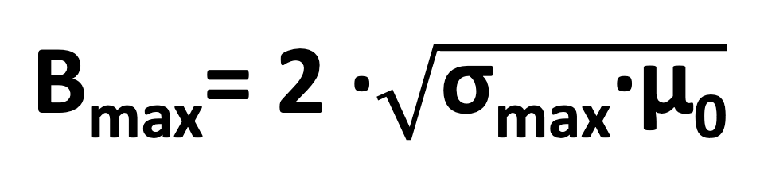
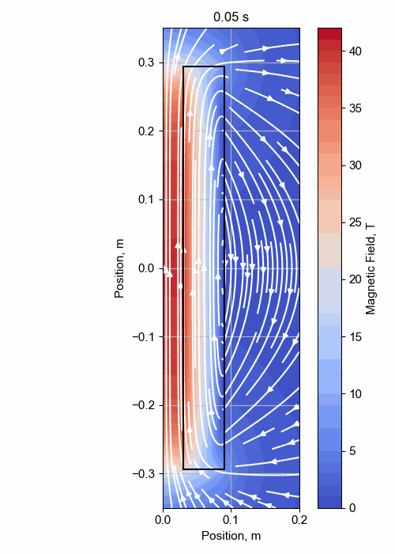

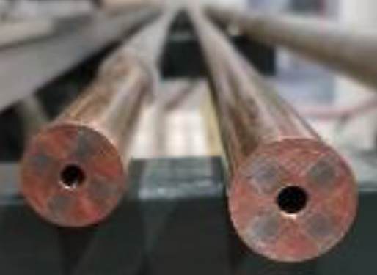
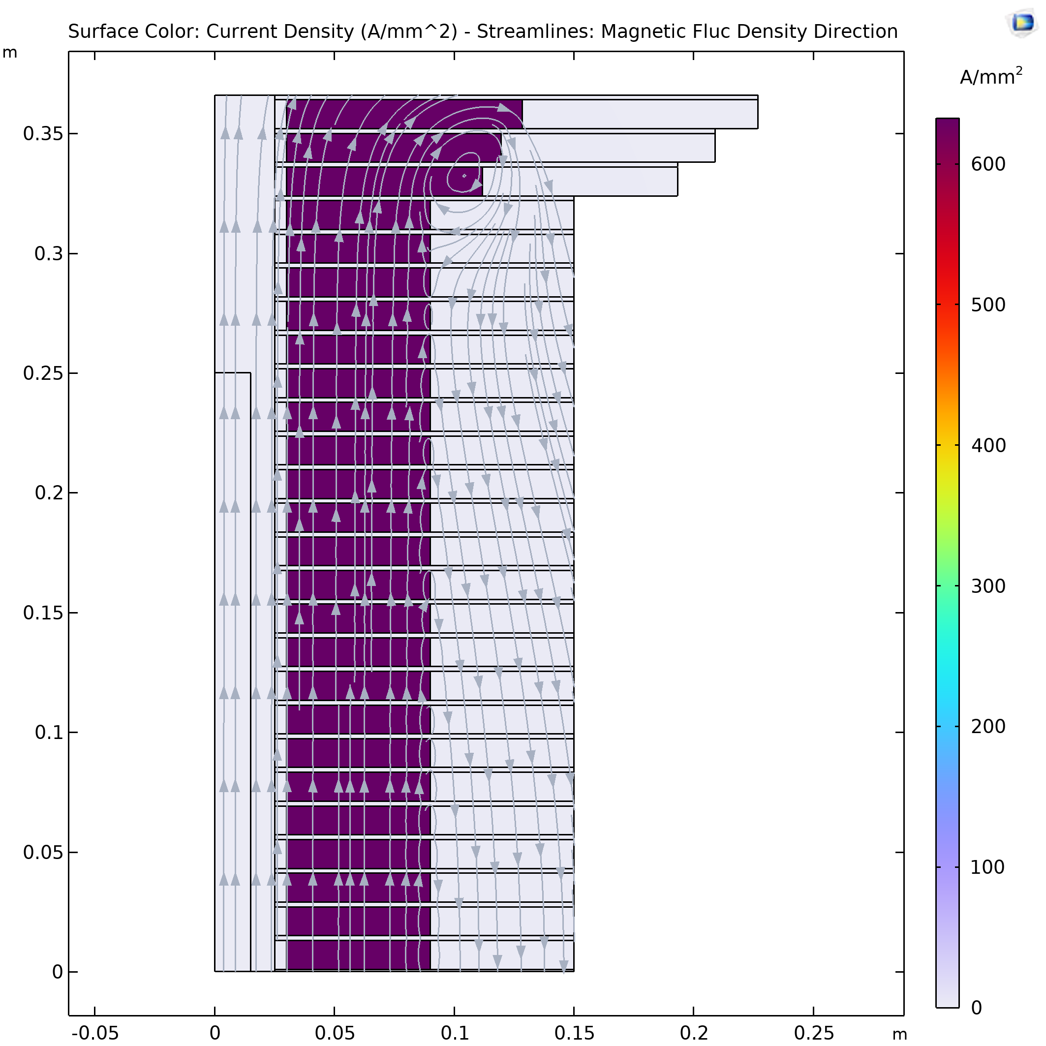
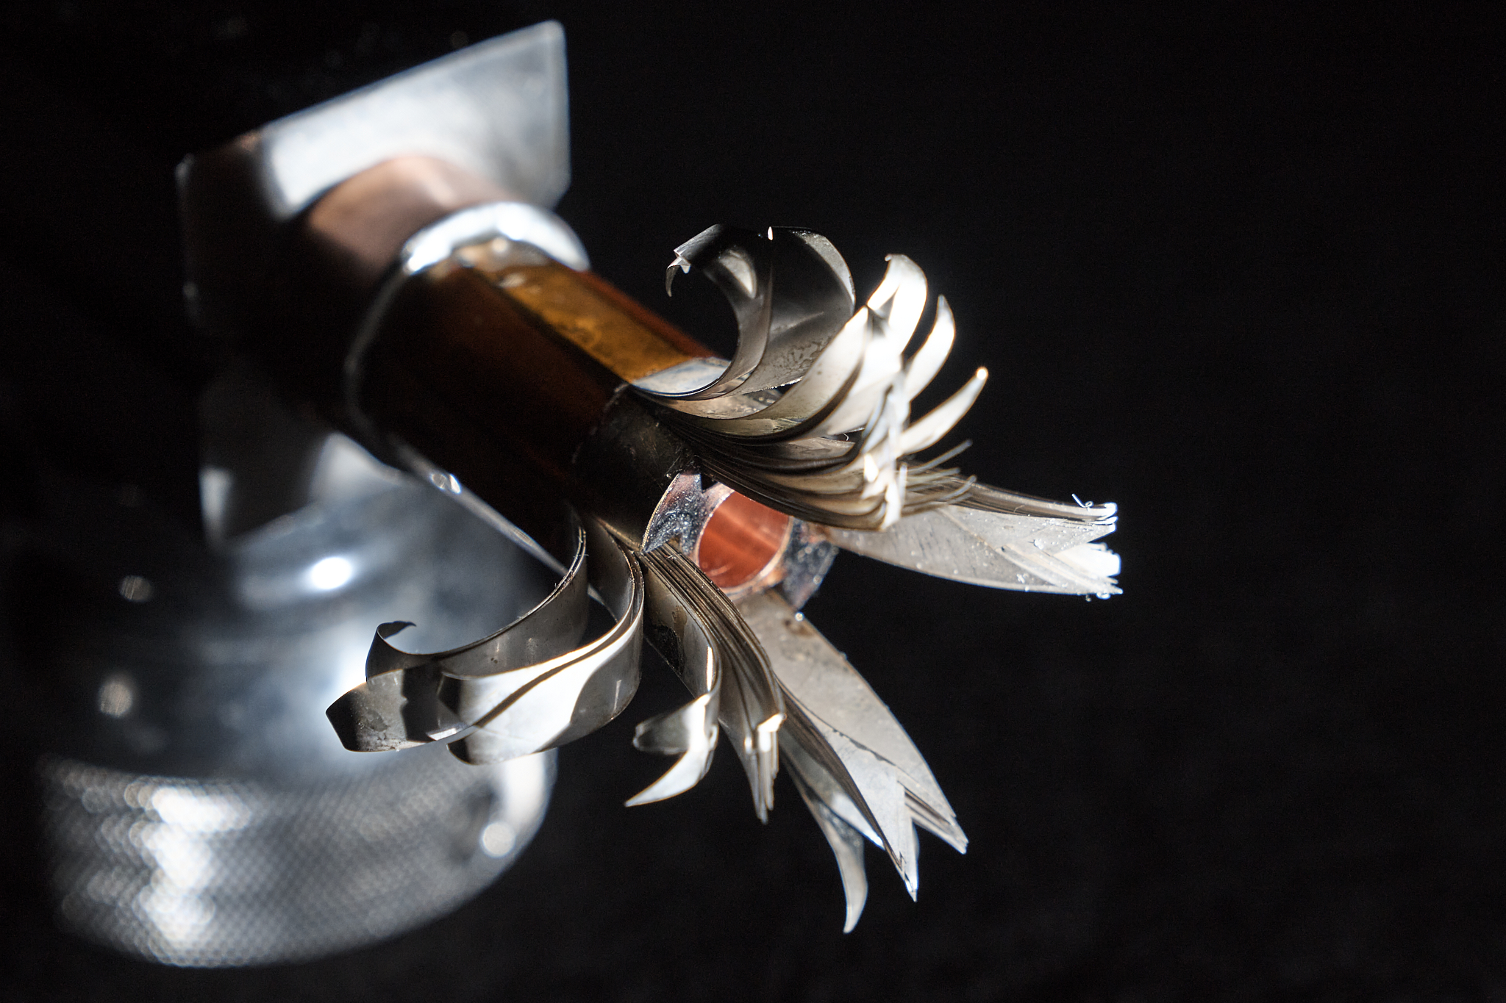
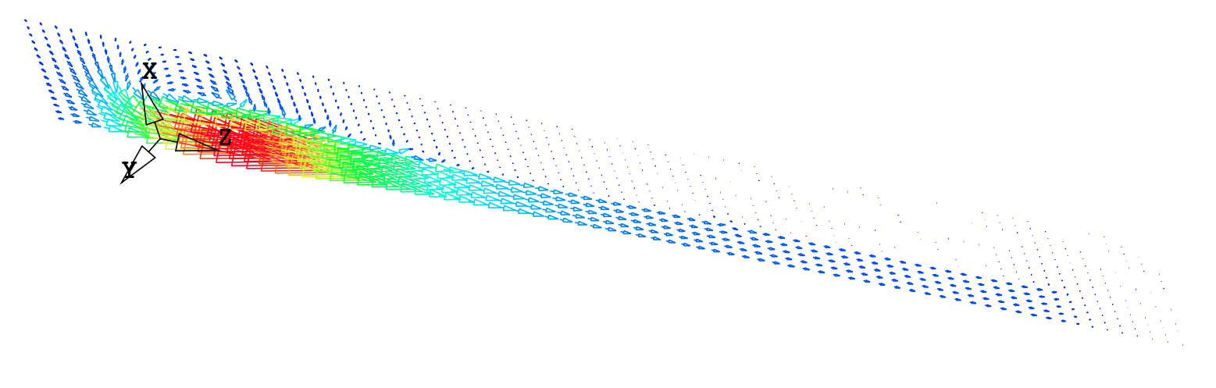
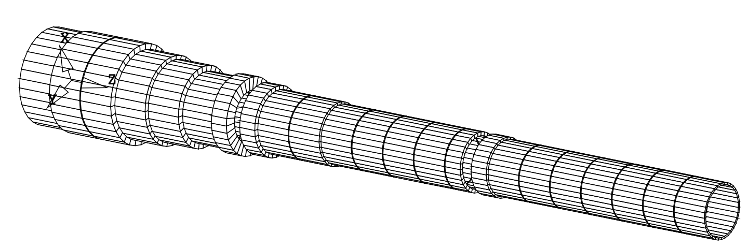
Solenoid R&D
Final Cooling solenoid
Started HTS solenoid development for high fields
Synergies with fusion reactors, NRI, power generators for windmills, …
A Portone, P. Testoni, J. Lorenzo Gomez, F4E
σ_{max} = 600 MPa
32 T LTS/HTS solenoid demonstrated
A. Dudarev, B. Bordini, T. Mulder, S. Fabbri
MIT “VIPER” conductor
Inner Ring
‘Correction’ Coil
Outer Ring
Bore
NHFML
32 T solenoid with HTS
‘Modular’ Coil
MuCol HTS conductor
Operating current: 61 kA
Target solenoid, 20 T, 20 K
1 % Field Homogeneity
Support Plate

Slide 46
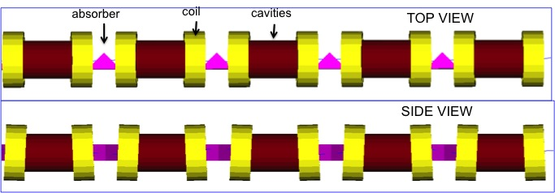
Muon Cooling Principle
High-gradient normal-conducting cavities
C. Rogers, B. Stechauner, E. Fol et al. (RAL, CERN)
Robust absorbers
High-field, superconducting solenoid
Principle has been demonstrated in MICE
Nature vol. 578, p. 53-59 (2020)

Slide 47
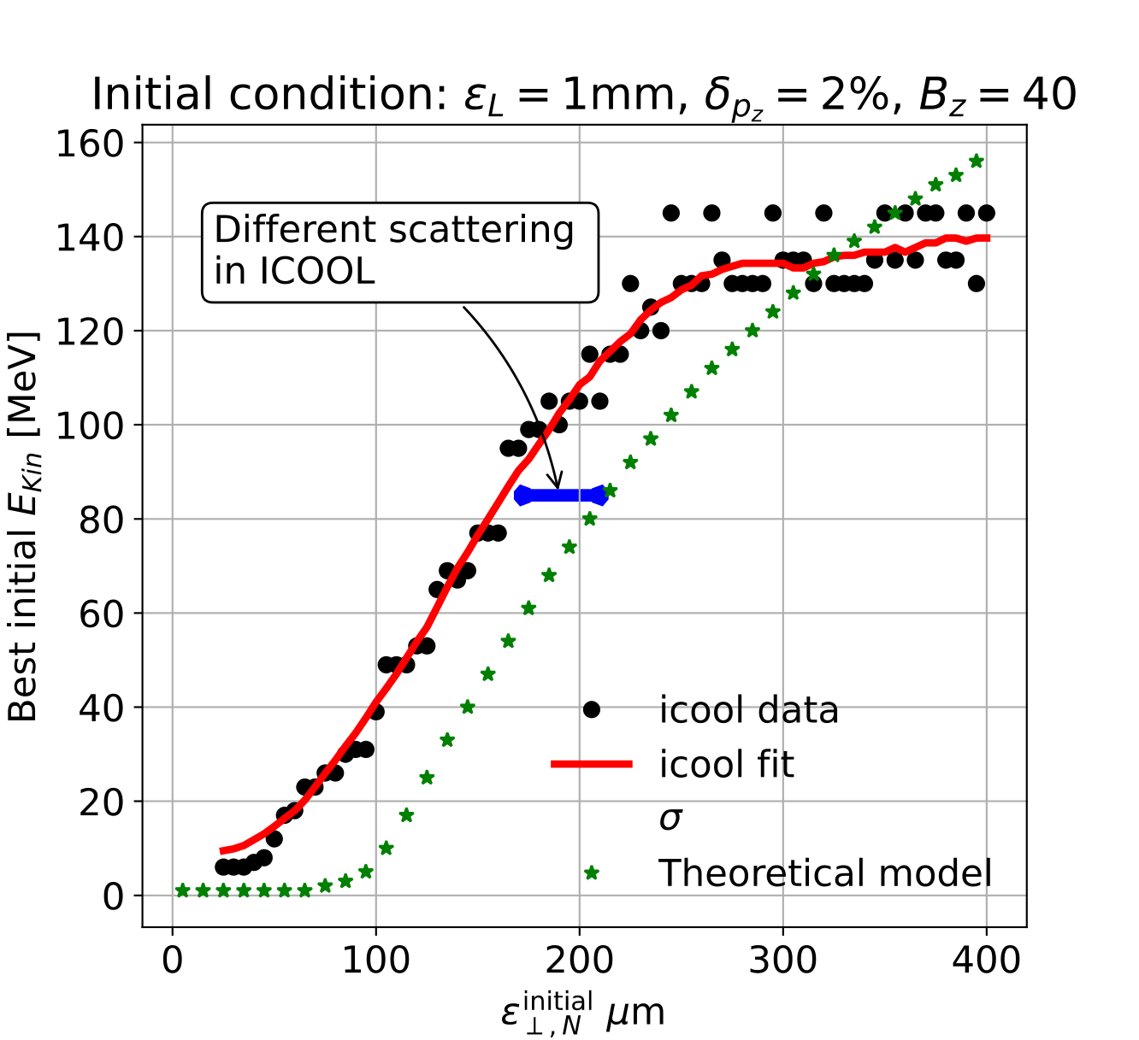
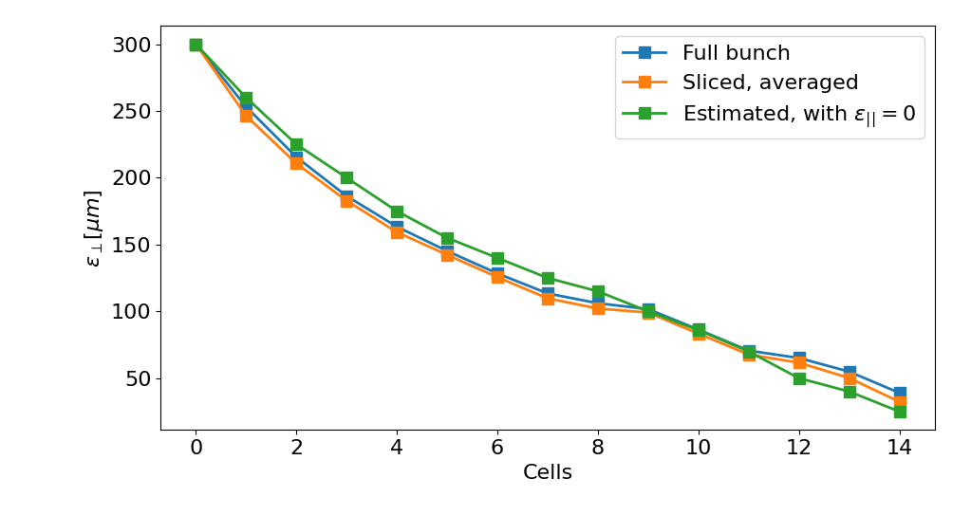
Muon Cooling Performance
MAP design achieved 55 um based on achieved fields
Can expect better hardware
Integrating physics into RFTRACK, a CERN simulation code with single-particle tracking, collective effects, …
A. Latina, E. Fol, B. Stechauner at al.
Working on improved, systematic design, also using better magnets and RF
Currently improved from 55 um to 33 um,
25 um is the goal
Ch. Rogers, Zhu Ruihu, R. Taylor, B. Stechauner, E. Vol et al.

Slide 48
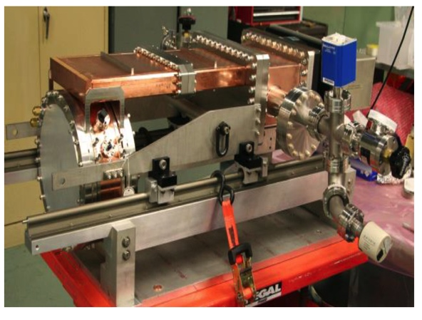
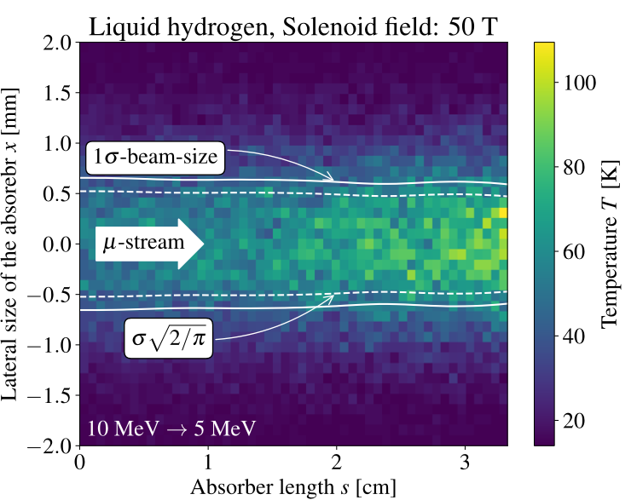
Cooling Cell Technologies
Most complex example 12 T
Are developing example cooling cell with integration
tight constraints
additional technologies (absorbers, instrumentation,…)
early preparation of demonstrator facility
Marco
HTS solenoids
Ultimate field for final cooling
Also consider cost
Windows and absorbers
High-density muon beam
Pressure rise mitigated by vacuum density
First tests in HiRadMat
L. Rossi et al. (INFN, Milano, STFC, CERN),
J. Ferreira Somoza et al.
RF cavities in magnetic field
Gradients above goal demonstrated by MAP
New test stand is important
Optimise and develop the RF
Different options are being explored
Need funding
MuCool demonstrated >50 MV/m in 5 T
H2-filled copper
Be end caps
Dario
D. Giove, C. Marchand, Alexej Grudiev et al. (Milano, CEA, CERN, Tartu)
48

Slide 49
International Muon Collider Collaboration (IMCC)
IMCC was founded in 2021
Reports to CERN Council
Anticipate it will also report to DoE and other funding agencies
50 full members, a few additional contributors
IMCC goals
10 TeV high-luminosity collider
  Higher energies to be explored later
Develop initial stage to start operation by 2050
  Lower energy or luminosity
Identify potential sites
Implementing workplan following priorities from Roadmap
49
http://arxiv.org/abs/2201.07895

Slide 50
MuCol (EU co-funded)
Started March 2023, lasts until early 2027
3 MEUR from the EU, the UK and Switzerland, about 4 MEUR from the partners, CERN leads and contributes
Final deliverable is a report on the full IMCC R&D results
EU officer will come on 19th June.

Slide 51
Staging
Important timeline drivers:
Magnets:
In O(15 years):
  HTS technology available for solenoids
  Nb₃Sn available for collider ring, maybe lower performance HTS
In O(25 years):
  HTS available for collider ring
Muon cooling technologies and integration
Expect to be able with enough resources
Detector technologies and design
Can do the important physics with near-term technology
Energy staging
Start at lower energy (e.g. 3 TeV)
Build additional accelerator and collider ring later
3 TeV design takes lower performance into account
Luminosity staging
Start at with full energy, but less luminosity collider ring magnets
Main luminosity loss sources are arcs and interaction region
  Can later upgrade interaction region (as in HL-LHC)

Slide 52
Muon Collider Overview
Would be easy if the muons did not decay
Lifetime is τ = γ x 2.2 μs
Short, intense proton bunch
Ionisation cooling of muon in matter
Acceleration to collision energy
Collision
Protons produce pions which decay into muons
muons are captured
52

Slide 53
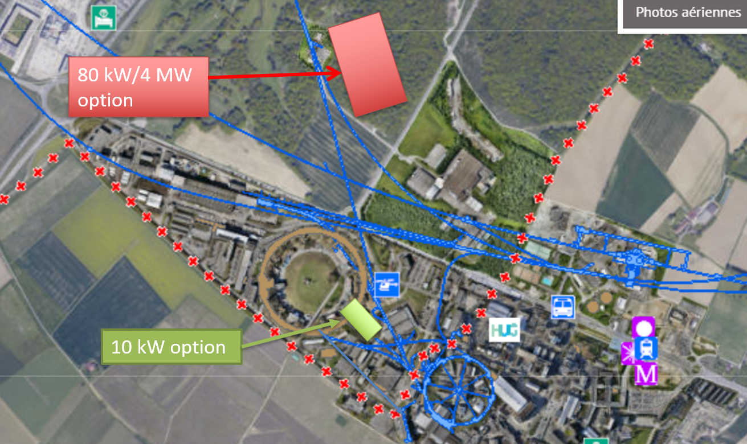
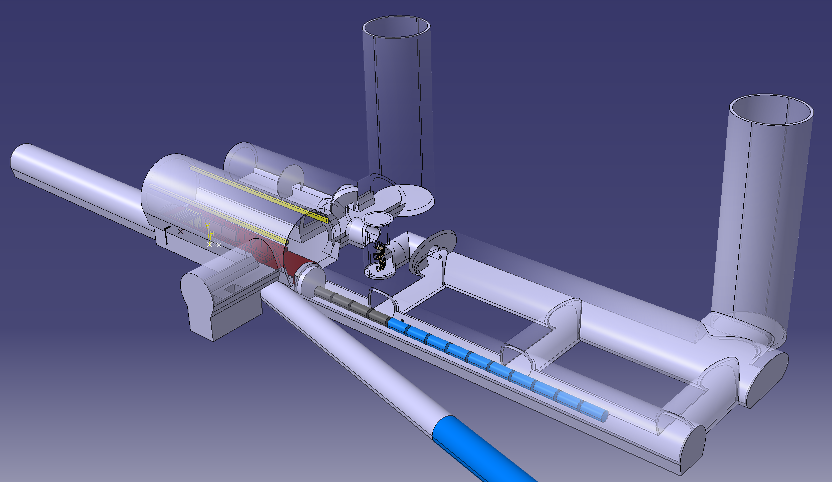
CDR Phase, R&D and Demonstrator Facility
M. Calviani, R. Losito, J. Osborn et al.
Broad R&D programme can be distributed world-wide
Models and prototypes
  Magnets, Target, RF systems, Absorbers, …
CDR development
Integrated tests, also with beam
Cooling demonstrator is a key facility
look for an existing proton beam with significant power
Different sites are being considered
CERN, FNAL, ESS …
Two site options at CERN
Muon cooling module test is important
INFN is driving the work
Could test it at CERN with proton beam
Two stage cryocooler
With cryostat
Thermal shield
Coil support structure
Tie rods for repulsion and compression forces
SC HTS coils

Slide 54
Time-critical Developments
Identified three main technologies that can limit the timeline
Muon cooling technology
RF test stand to test cavities in magnetic field
Muon cooling cell test infrastructure
Demonstrator
  Muon beam production and cooling in several cells
Magnet technology
HTS solenoids
Collider ring magnets with Nb3Sn or HTS
Detector technology and design
Can do the important physics with near-term technology
But available time will allow to improve further and exploit AI, MI and new technologies
Other technologies can be accelerated with sufficient funding
But they are equally important now to support that the muon collider can be done and perform

Slide 55
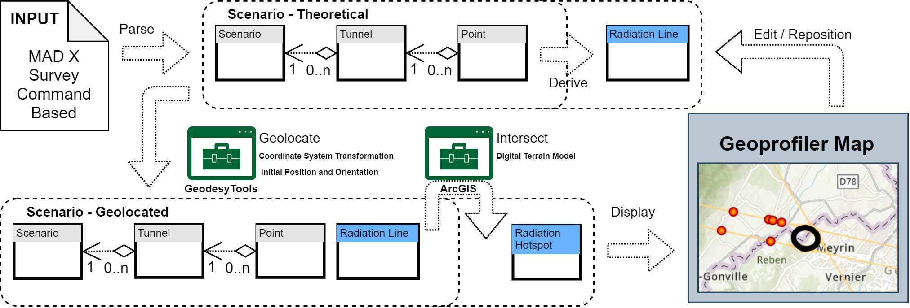
Site Studies
Candidate sites CERN, FNAL, potentially others (ESS, JPARC, … )
Study is mostly site independent
Main benefit is existing infrastructure
Want to avoid time consuming detailed studies and keep collaborative spirit
Will do more later
Some considerations are important
Neutrino flux mitigation at CERN
Accelerator ring fitting on FNAL site
Potential site next to CERN identified
Mitigates neutrino flux
  Points toward mediterranean and uninhabited area in Jura
Detailed studies required (280 m deep)

