Slide 1


Quality-Control measurements for the LGAD silicon sensors of the ATLAS High-Granularity Timing Detector
Moritz Vogt, Supervisors: Xiao Yang, Theodoros Manoussos
27.08.2024, EP-DT Summer Student Seminar
Notes:
I did measurements and analysis in the Context of this Quality Control as my summer students project

Slide 2


Personal overview
Student at University of Mainz (Master’s in Physics)
Bachelor Thesis on “Trigger Algorithm with Neural Networks & realisation on FPGA for ATLAS first level Trigger”
Skills: neural networks, FPGA programming with hls4ml, python and libraries (Keras, numpy, pyroot)
Hobbies: Piano, Badminton
https://jl-netzwerk-rlp.de/standorte-projekte/mainz/uni-mainz/
Notes:
A bit about me I am currently studying…
For my Bachelor‘s thesis I worked with ATLAS data figuring out the possibility of including neural networks for the first level trigger of electrons in the forward region

Slide 3
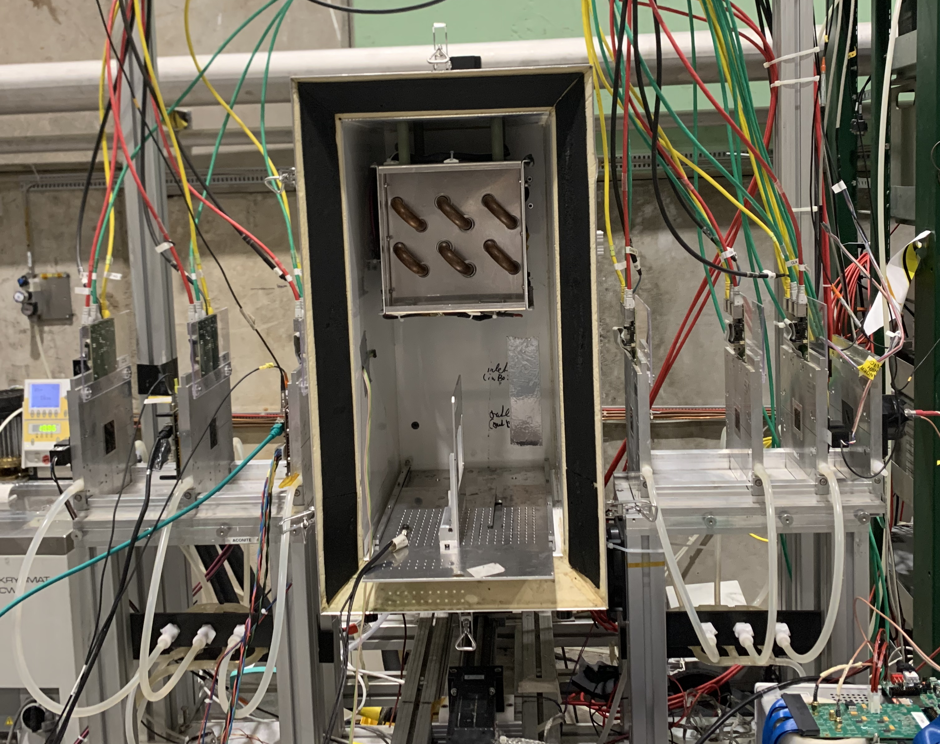
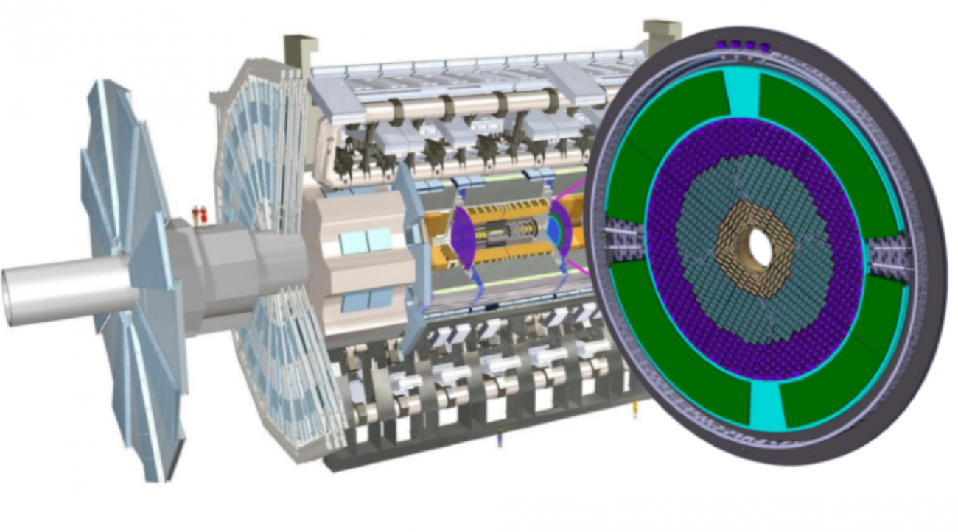
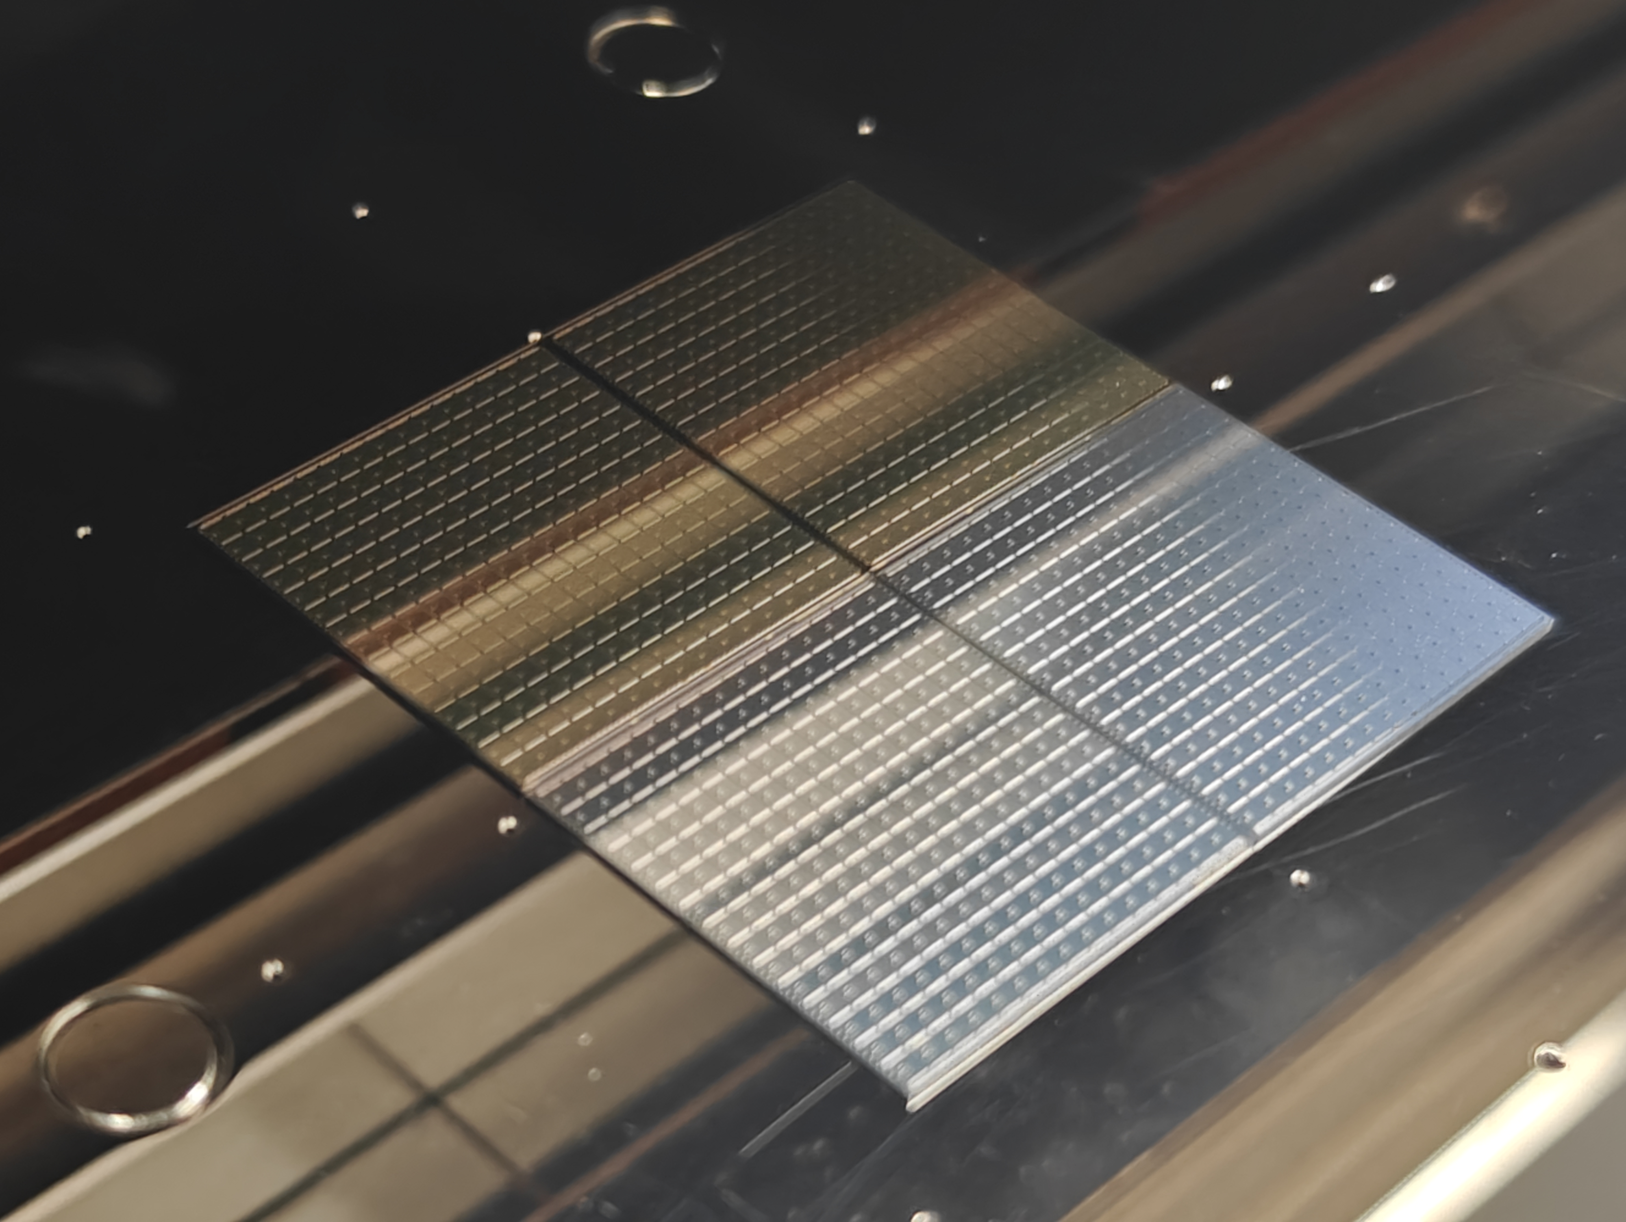

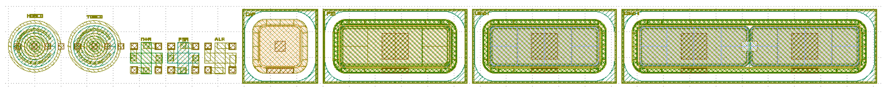
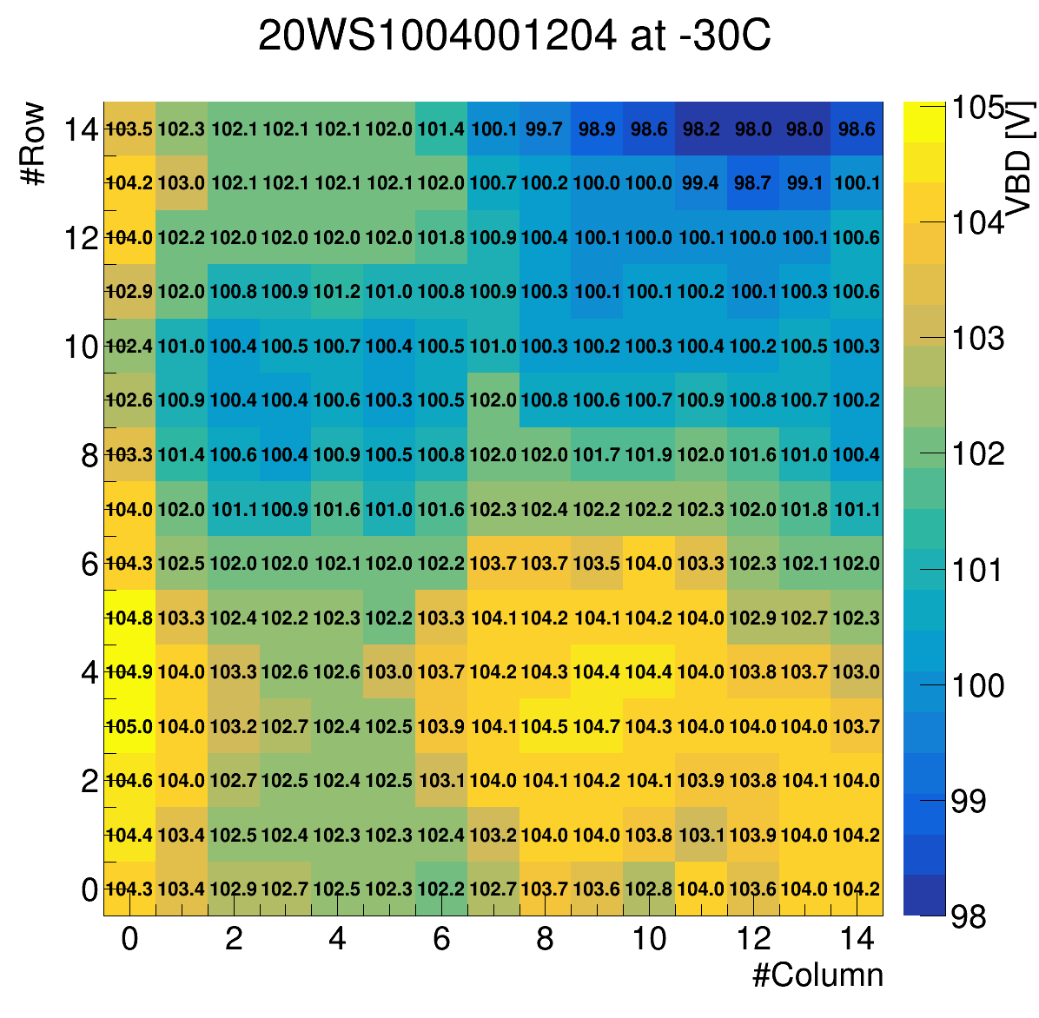
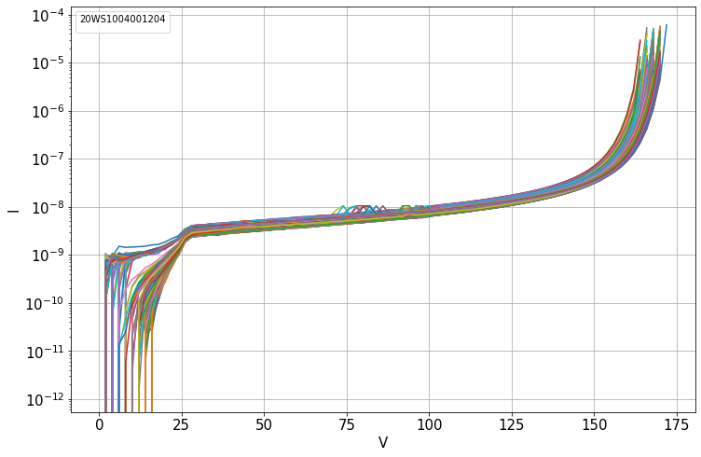
Quality Control
Inter-pad resistance
Sensor QC
Testbeam
ATLAS HGTD
Testbeam setup
ATLAS detector
Sensors
Test structure
Sensor IV curve
Sensor breakdown voltage map
Notes:
Just a quick glance at the outline of my talk
Introduction on ATLAS HGTD and LGAD sensors
Continue with remark on quality control in context of these sensors
Look at actual measurements and quality control tests…

Slide 4
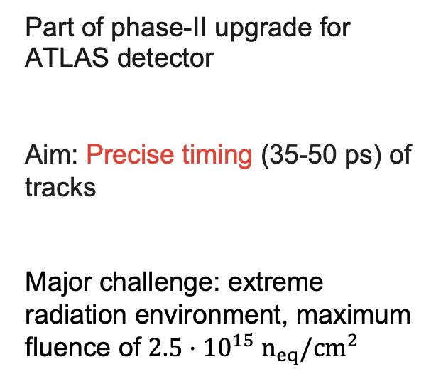
What is HGTD for ATLAS? And why do we need it?
ATLAS HGTD
High Granularity Timing Detector
Part of phase-II upgrade for ATLAS detector
Aim: Precise timing (35-50 ps) of tracks
Major challenge: extreme radiation environment, maximum fluence of $2.5⋅{10}^{15}{ n}_{eq}/{cm}^{2}$
ATLAS HGGTD Technical Design Report, 2020
Coverage: 2.4 < |η| < 4.0
3.5 m from interaction point
Notes:
Part of ATLAS detector Phase-II Upgrade
Placed between the updated Inner Tracker (ITk) and the Liquid Argon Calorimeter, one wheel for each side
extreme conditions in terms of radiation so close to the beam line (not next to interaction point)
As the name suggests, the detector is meant to time tracks, why is that useful?
(Plot that shows simulation of radiation)
(range of timing resolution: changes during the lifetime -> maybe this will come as a question)
Different for particle hits: 50-70 ps (worse than for the tracks!)

Slide 5
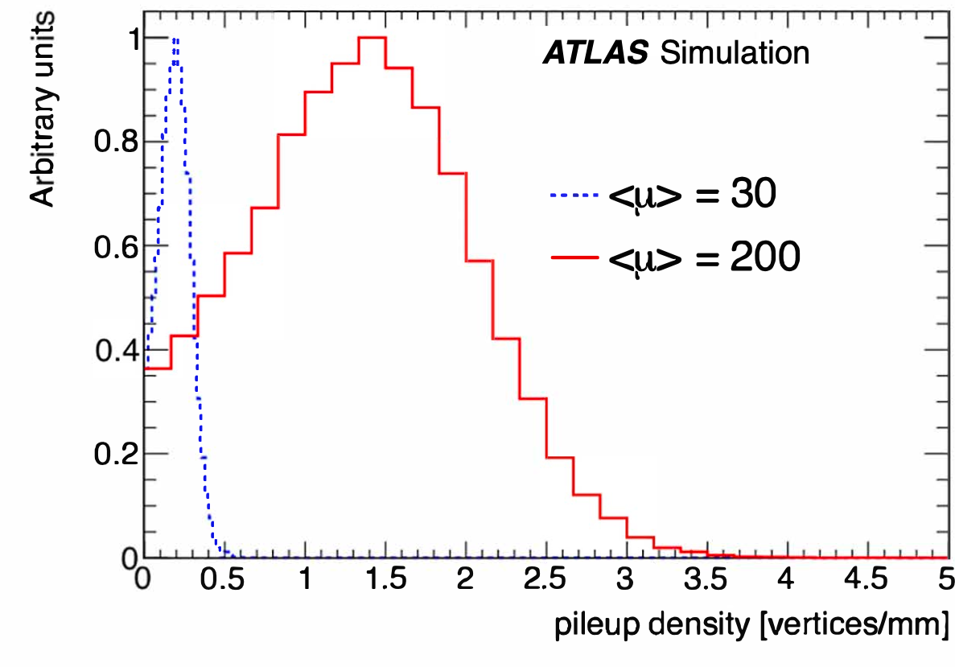
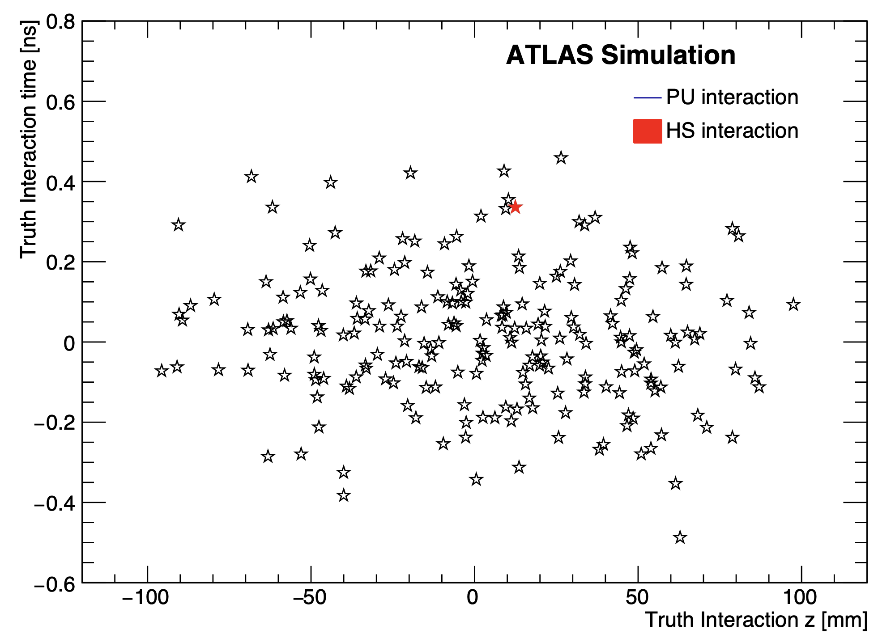
Why are we interested in the timing of particles?
ATLAS HGTD
Nominal HGTD resolution
HGTD Technical Desing Report (2020)
Nominal ITk resolution
Increased interactions per bunch crossing at High Luminosity-LHC:
Challenge: Correctly assign tracks to vertices
With HGTD: Improvement in pile-up rejection
Improvement: Jet & lepton performance in forward region
→ Forward-backward asymmetry & vector boson fusion/scattering
Notes:
define pile-up: collision from different number of simultaneous
The ATLAS Phase-II upgrade is like an „answer“ to the High luminosity LHC Upgrade
Left plot
HGTD aims to improve spatial and temporal resolution for reconstruction -> reduce background & enhance precision of measurements
Right Plot
Forward region to measure for example A_FB
Let‘s look into the more technical details, more precisely the sensors of this new detector module
(Maybe Include physics object performance plots from TDR (ITK + HGTD vs ITK))

Slide 6
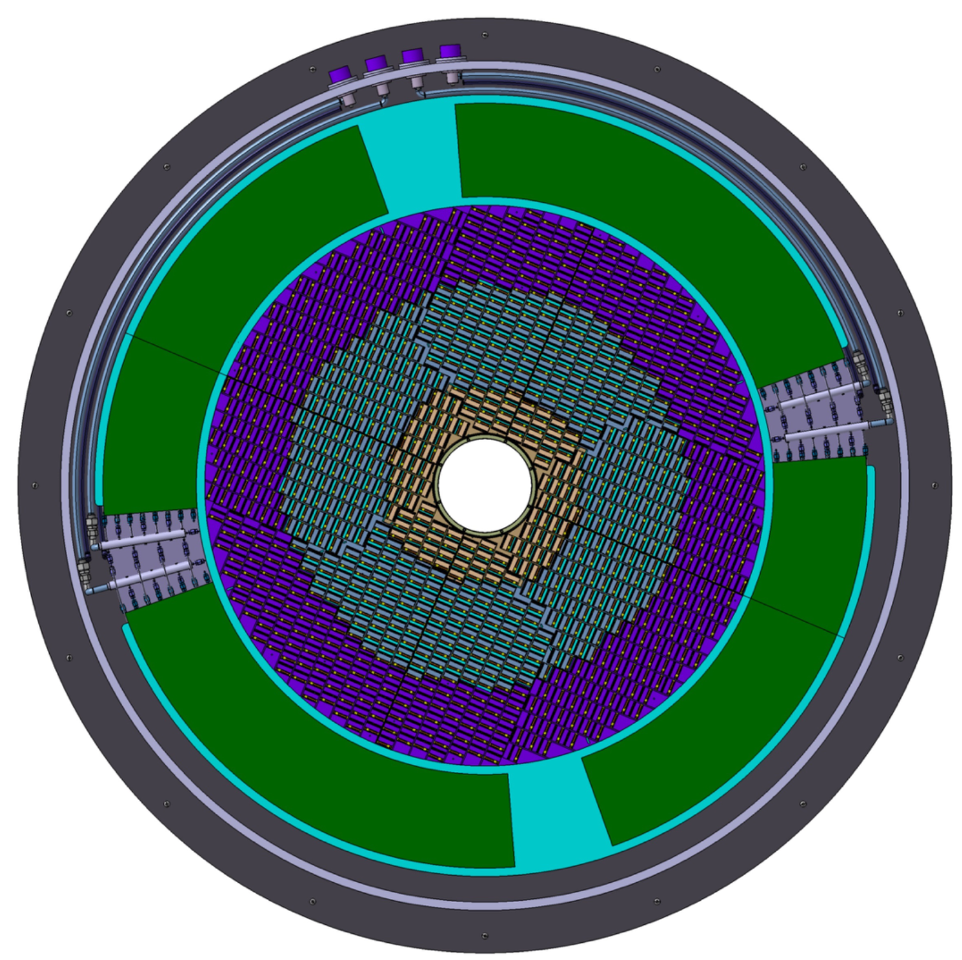
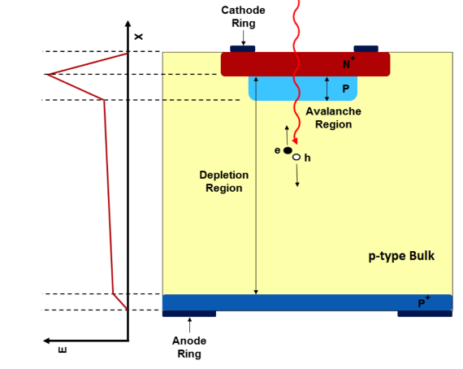
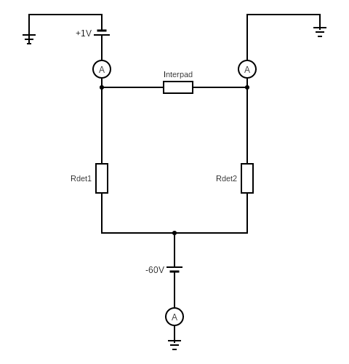
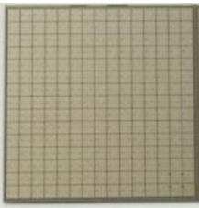
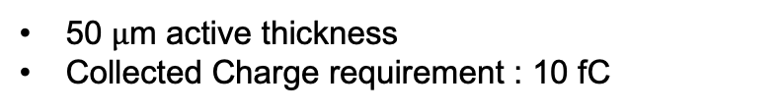
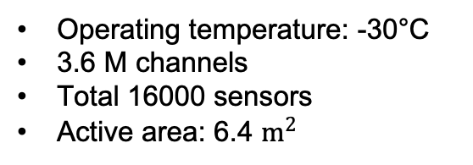
LGAD: The tool of your choice for precise timing
ATLAS HGTD
Low Gain Avalanche Diode: narrow gain layer
→ Large signal with fast rise time & large sig./noise ratio
15x15 pixels
https://cds.cern.ch/record/2741363/plots
~ 2 cm
(Pixel size
1.3mm x 1.3mm)
Operating temperature: -30°C
3.6 M channels
Total 16000 sensors
Active area: 6.4 $m^{2}$
E
HV
50 $μ$m active thickness
Collected Charge requirement : 10 fC
Notes:
N-in-P diode structure with extra p-type gain layer
Moderate gain: 10 – 20
Extra gain layer: Fast rise time and larger signal-to-noise ratio → Excellent time resolution
Sensor: Array of LGADs
Describe the wheel: active region, peripheral electronics, cooling
Collected charge requirement -> adequate signal
before /after irradiation: acceptor removal process

Slide 7

Quality Control
Inter-pad resistance
Sensor QC
Testbeam
ATLAS HGTD
Testbeam setup
ATLAS detector
Sensors
Test structure
Sensor IV curve
Sensor breakdown voltage map
Notes:
Maybe put HGTD in middle and other 4 sections on the outside
Quality Control split into three major parts:
Do a distinguishment between the two quality control schemes
Sensor: large LGAD array
Short caption for plots

Slide 8
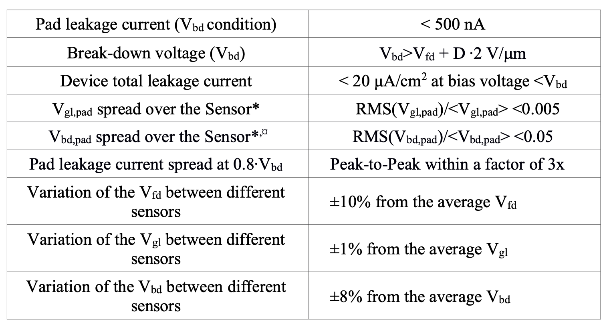
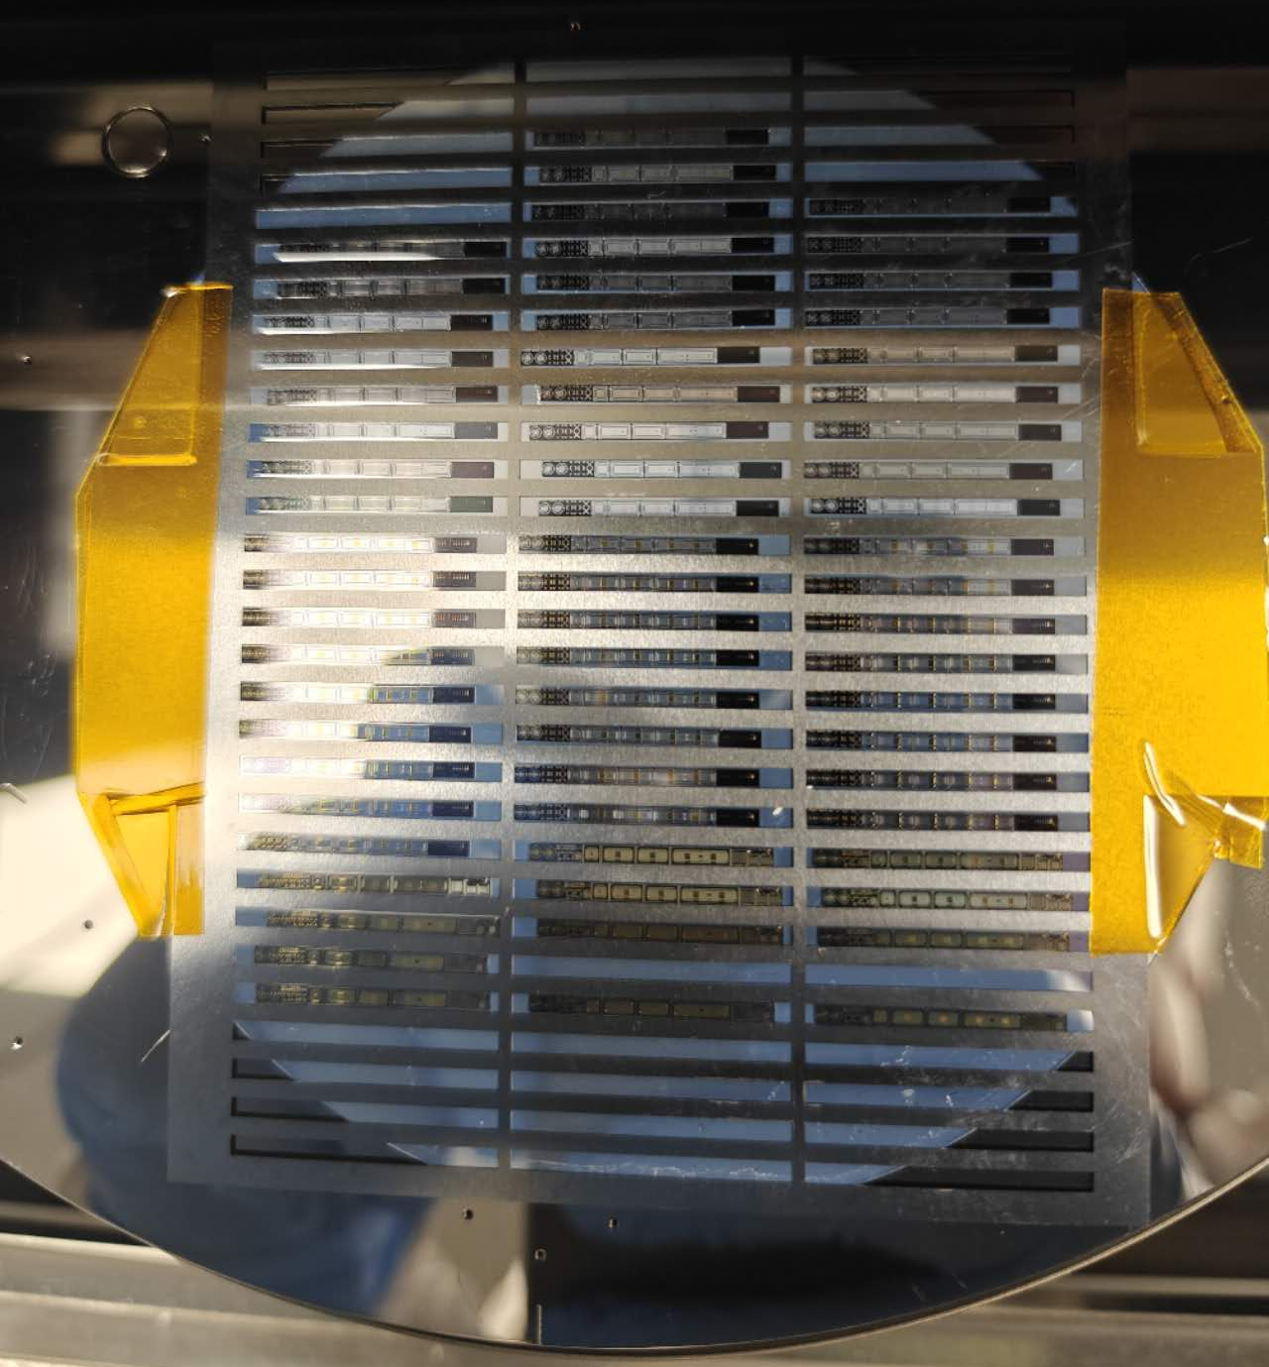

What is Quality Control (QC)?
Peak leakage current (V_BD cond.) | < 500 nA
Breakdown voltage | V_BD > V_fd + D * 2 V/m
V_BD,lgad spread over Sensor | RMS(V_BD)/ <V_BD> < 0.05
Quality Control
Establish quality benchmark
Check product quality
Contact with vendor
Divided into 3 parts: CQC: Company QC (vendor) SQC: Sensor QC (HGTD) PQC: Process QC (HGTD)
Strict requirements for LGAD sensors
Sensors
Quality Control Test Structures
Notes:
In general: want to detect manufacturing details but also ensure Long-term reliability
Final performance (HGTD) is governed by specifications
Product quality check: first 2 for sensor, last one on test structures, (produced at same time and next to the sensor)
In general I would like to focus on checking the product quality, which consists of variety of tests on different setups
But lets take the time and quickly talk over a few of the benchmarks in the context of the LGAD sensors

Slide 9
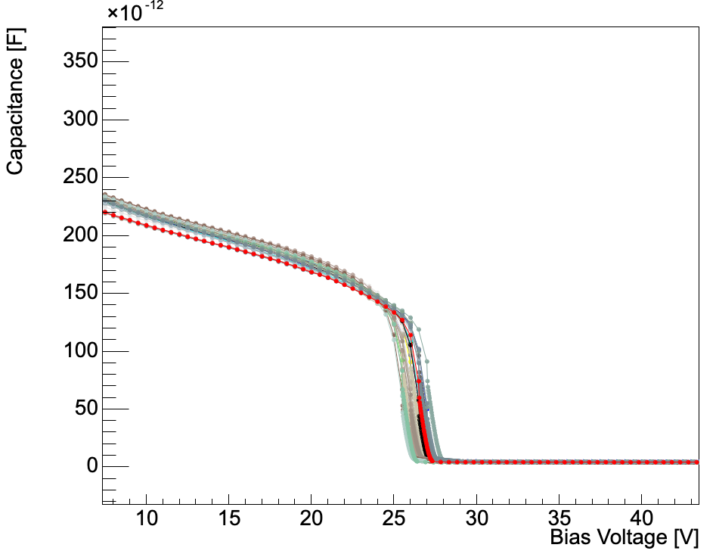
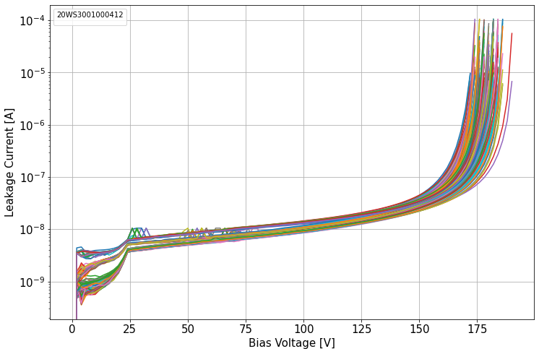

Electrical characterisation for LGAD sensors
Quality Control
Current/Voltage (I/V) characteristics, find V_BD: Breakdown voltage (diode conducting in reverse bias)
Capacitance/Voltage curve, find V_fd: full depletion voltage
500 nA
Specifications:
V_BD
V_fd
Breakdown voltage | V_BD > V_fd + 50$μ$m * 2 V/$μ$m
Target operating voltage: 0.8 * V_BD
Notes:
Quantities tied to performance
characteristics of LGAD changes with respect to bias voltage
In I-V (tracking leakage current while varying bias voltage)
Breakdown: sensor conducting -> agreed on limit of 500nA in specifications
In C-V
Full depletion voltage: sensor fully depleted
Mention Specifications: relation of full depletion and thickness to breakdown (why?)
IV and CV measurement, reference textbook (which textbook??)

Slide 10
Quality Control
Inter-pad resistance
Sensor QC
Testbeam
ATLAS HGTD
Testbeam setup
ATLAS detector
Sensors
Test structure
Sensor IV curve
Sensor breakdown voltage map
Notes:
Continue with a measurement in the context of Process QC using test structures: probing resistance of the interpad region

Slide 11
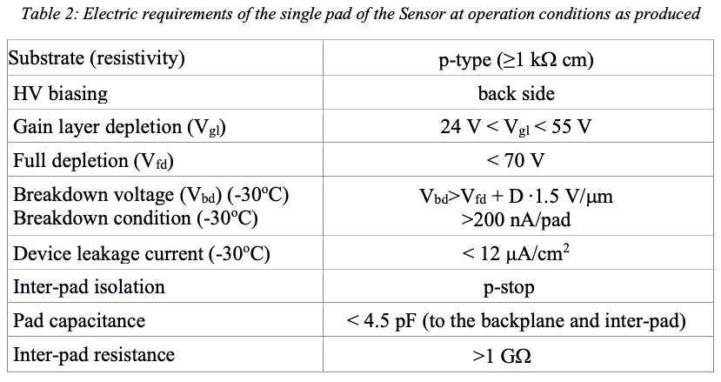
What are QC-TS (Quality Control Test Structure)?
Inter-pad resistance
Dedicated test structure placed adjacent to every sensor on the wafer
Measurement of technological parameters not accesible directly on sensors
Gated diodes
VdP
MOS
PIN
LGAD
1x2 LGAD
Technical drawing of QC-TS
HGTD Technical Desing Report (2020)
Notes:
Importance of inter-pad resistance: in general, mitigate influence of adjacent pixels on one another
test structure components and why: (maybe only name a few)
a PIN diode (same as single pad LGAD without gain layer) to check the bulk properties of the active layer (full depletion voltage and leakage current);
MOS capacitor to check the flat band voltage, oxide thickness and charge
Gated diodes to check the surface current;
Van der Pau structures to check sheet resistance of the implants (n+,p+) and aluminium lines
Put plots of the statistics of parameters of the QC-TS (I don’t think there’s enough time)

Slide 12
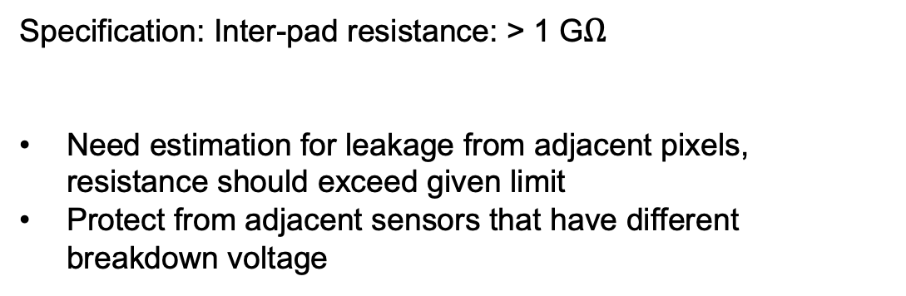
Why is the Inter-pad resistance important?
Inter-pad resistance
Specification: Inter-pad resistance: > 1 G$Ω$
Need estimation for leakage from adjacent pixels, resistance should exceed given limit
Protect from adjacent sensors that have different breakdown voltage
Gated diodes
VdP
MOS
PIN
LGAD
1x2 LGAD
Technical drawing of QC-TS
HGTD Technical Desing Report (2020)
Notes:
Importance of inter-pad resistance: in general, mitigate influence of adjacent pixels on one another
test structure components and why: (maybe only name a few)
a PIN diode (same as single pad LGAD without gain layer) to check the bulk properties of the active layer (full depletion voltage and leakage current);
MOS capacitor to check the flat band voltage, oxide thickness and charge
Gated diodes to check the surface current;
Van der Pau structures to check sheet resistance of the implants (n+,p+) and aluminium lines
Put plots of the statistics of parameters of the QC-TS (I don’t think there’s enough time)

Slide 13
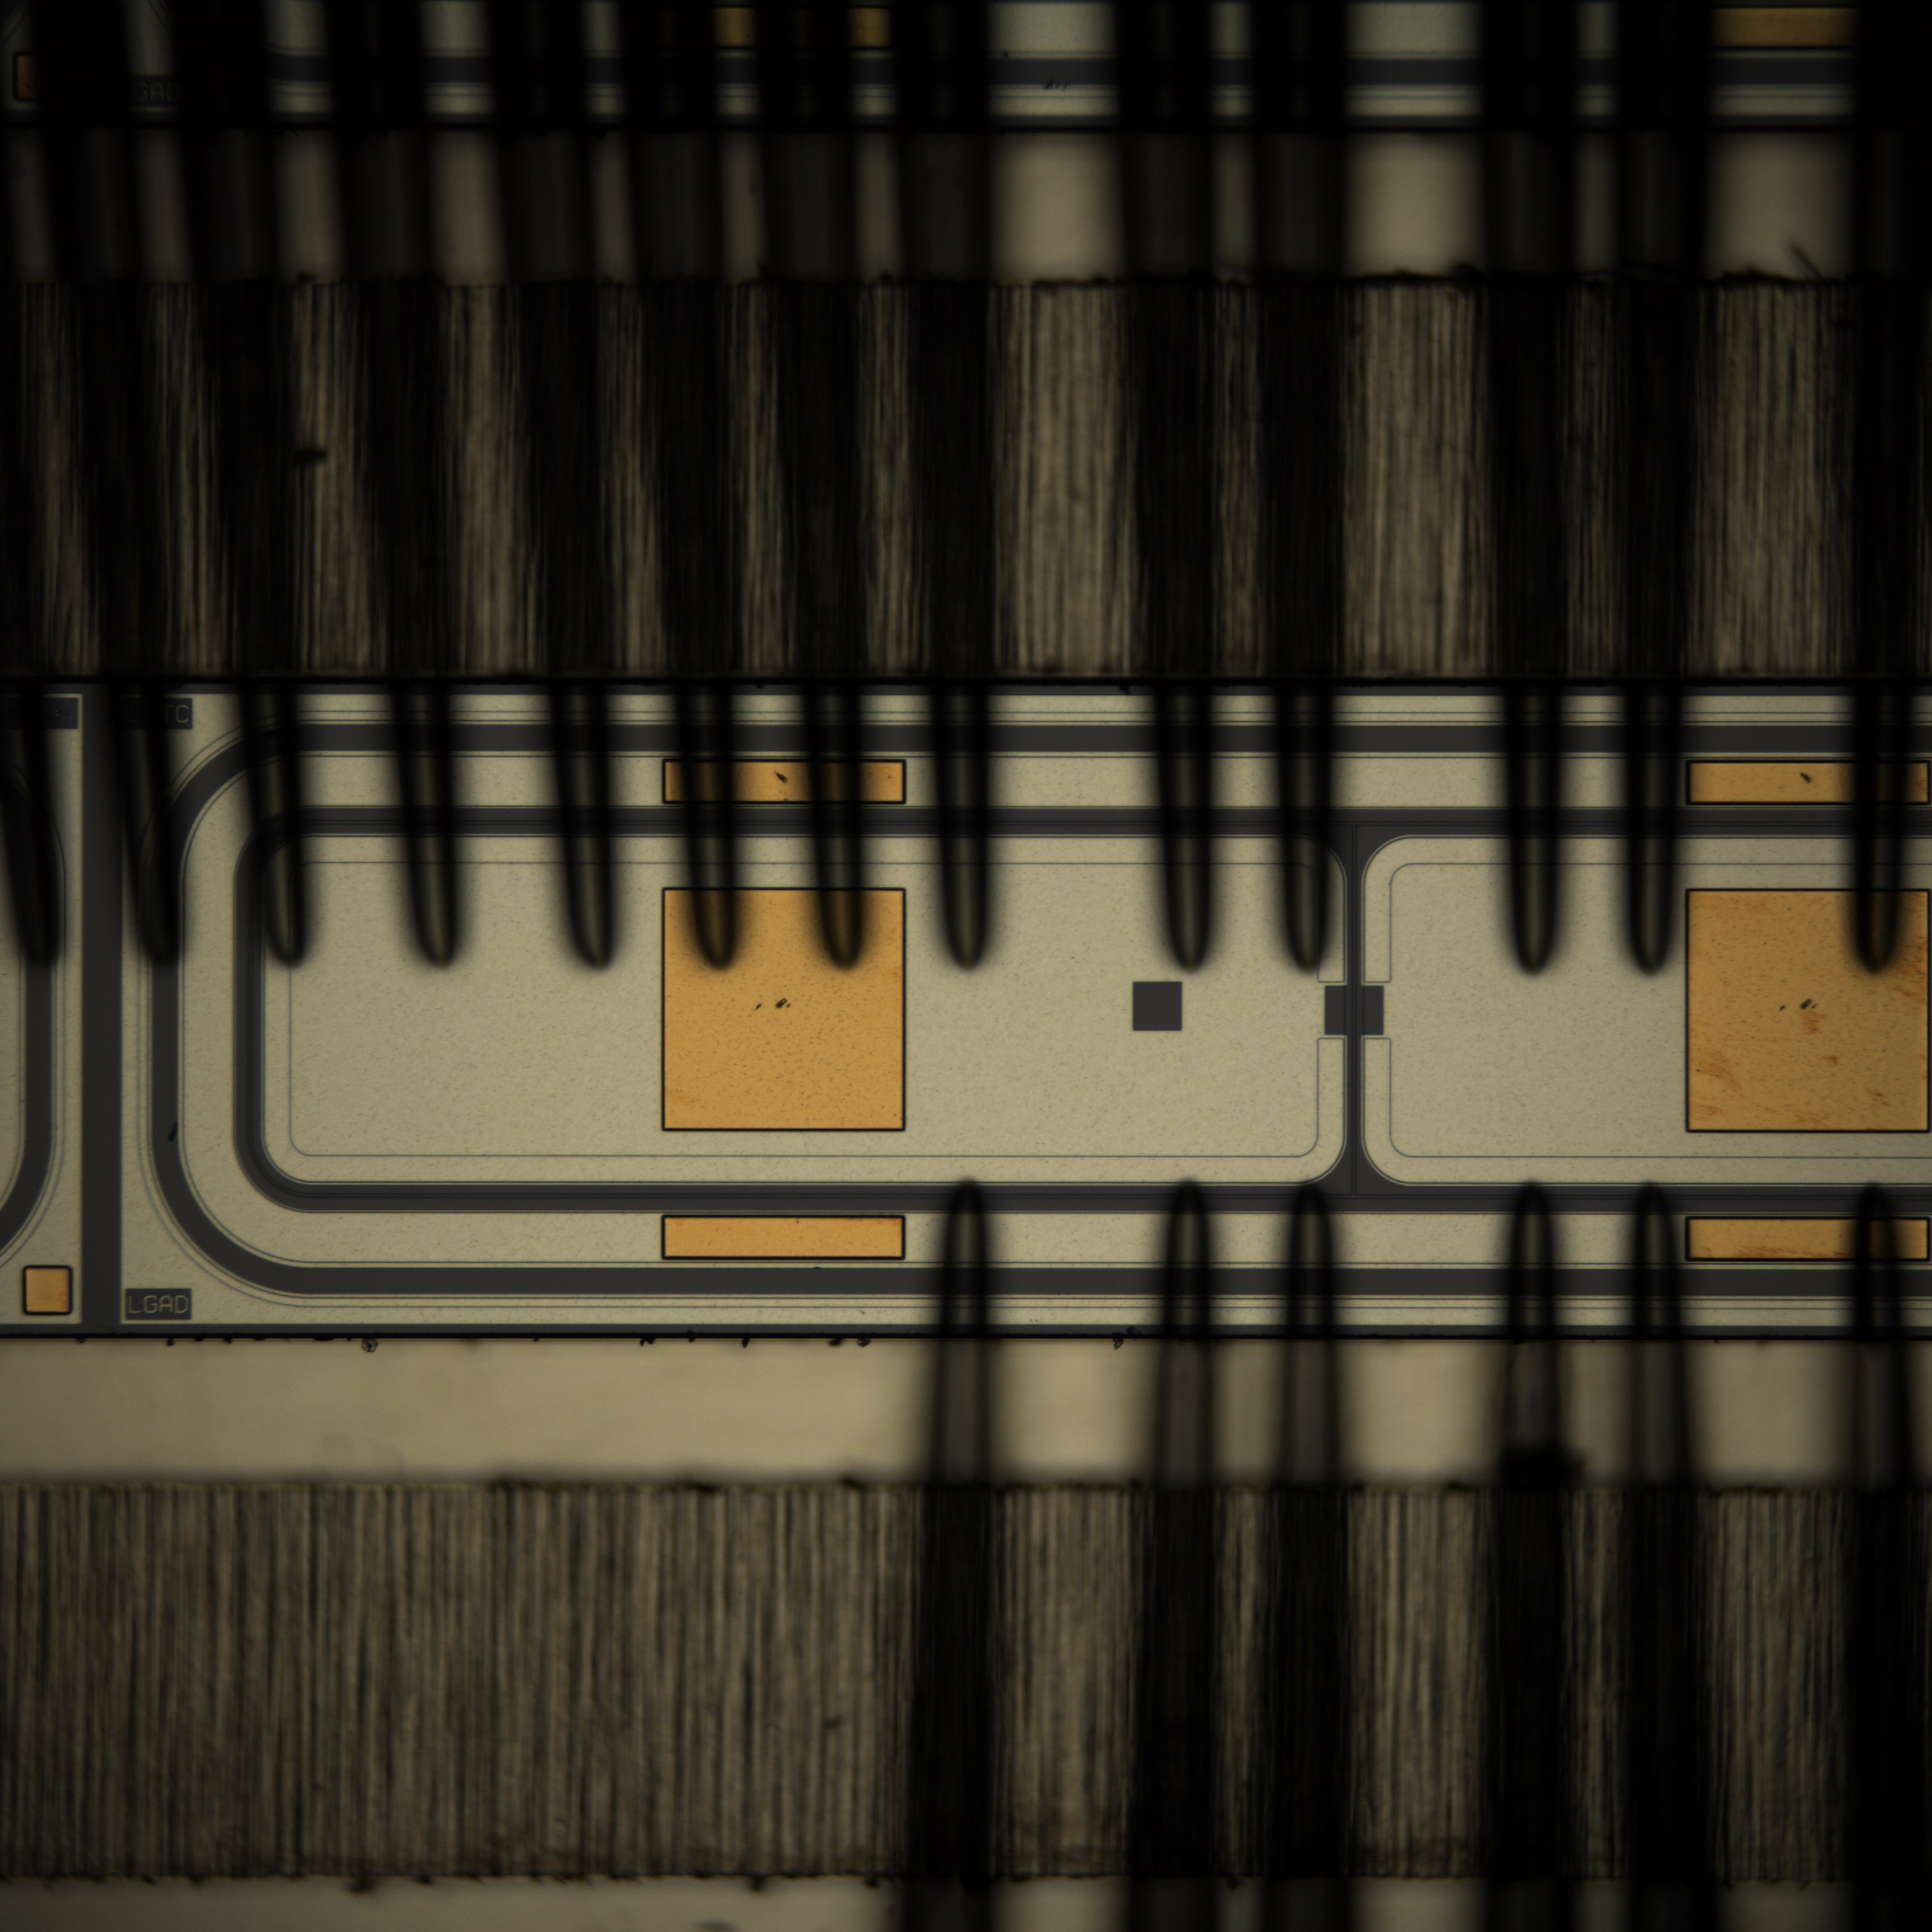
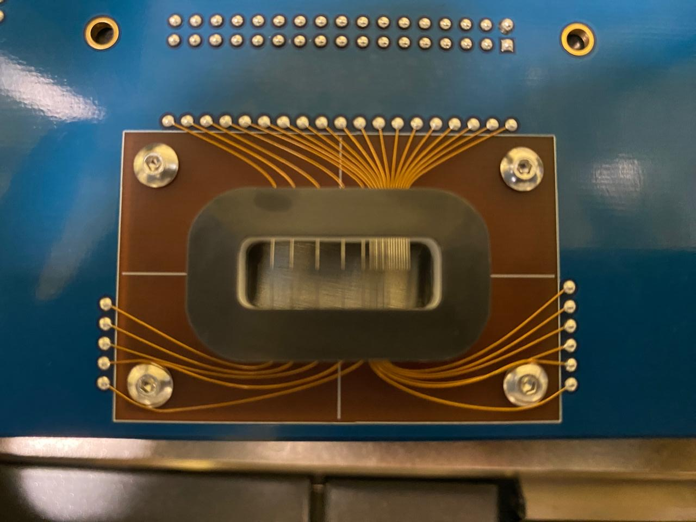
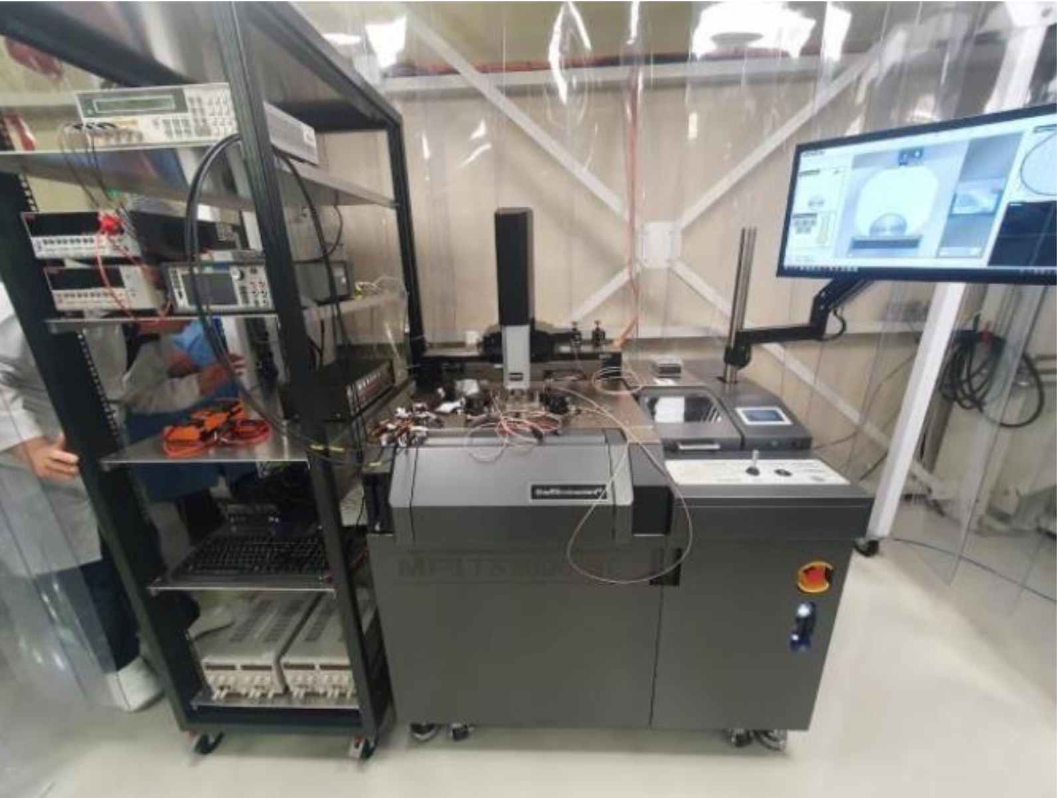
Measurement of Test Structures (QC-TS)
Inter-pad resistance
Probecard, customized needles to match contacts of QC-TS
Stencil with QC-TS loaded into probestation
1x2 LGAD of QC-TS under microscope with probecard needles (not aligned)
Setup in HGTD integration hall (ISO 7 clean room) in hall 180

Slide 14
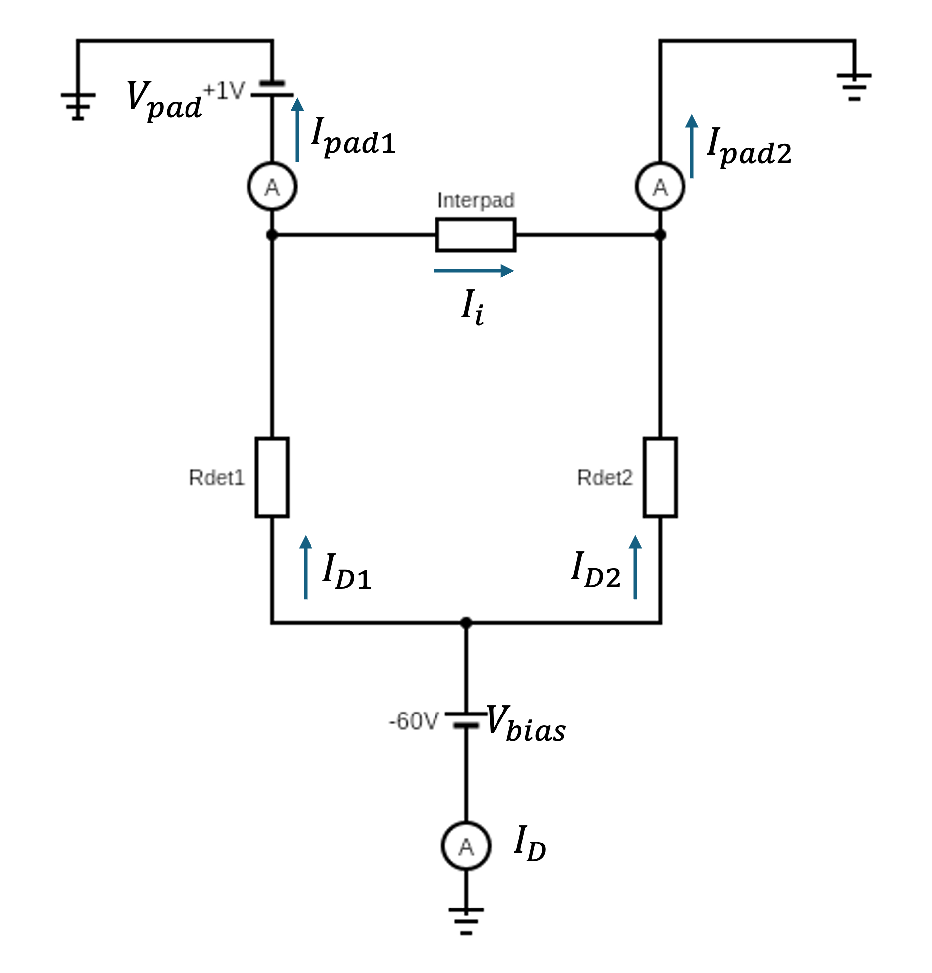
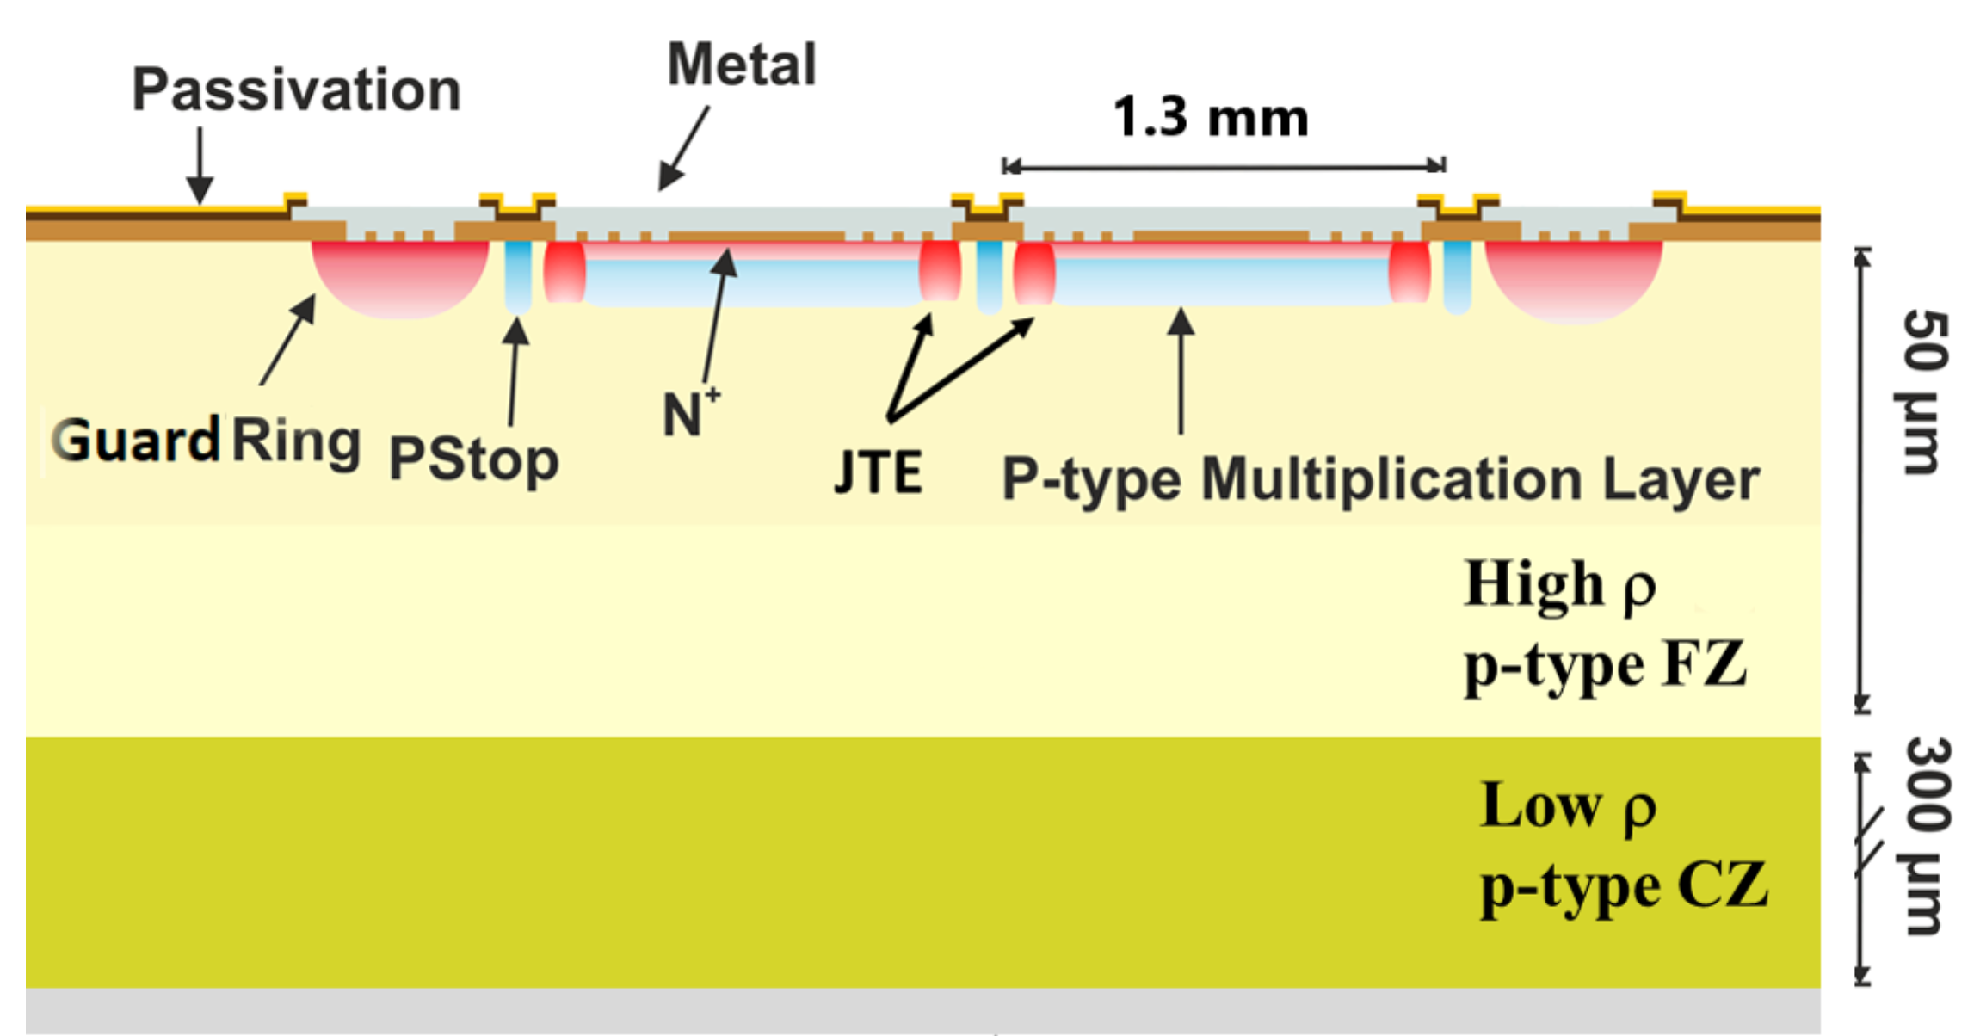
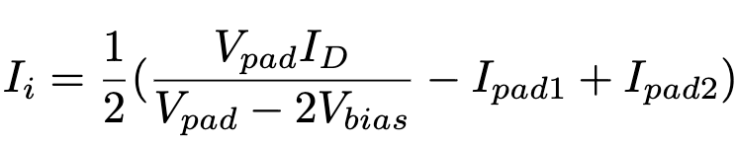


Measurement of resistance
Inter-pad resistance
Sweep voltage
$$I_{i}$$
Cross section of 1x2 LGAD
Approximating sensors as resistors
Assuming guard ring contributions are negligible
Find current along this region
$$I_{i}$$
Notes:
Structure of the 1x2 LGAD
JTE: Junction Termination Extension: avoid early breakdown, of course also less efficiency
Explain measurement: 3 source meters, set one bias voltage & sweep with second SMU while measuring current
Equivalent circuit diagram
Mentioning approximations
Calculating the current using Kirchhoff rules --> formula Inter-pad current
(Look at Gregor’s slides and take note of his introduction)

Slide 15
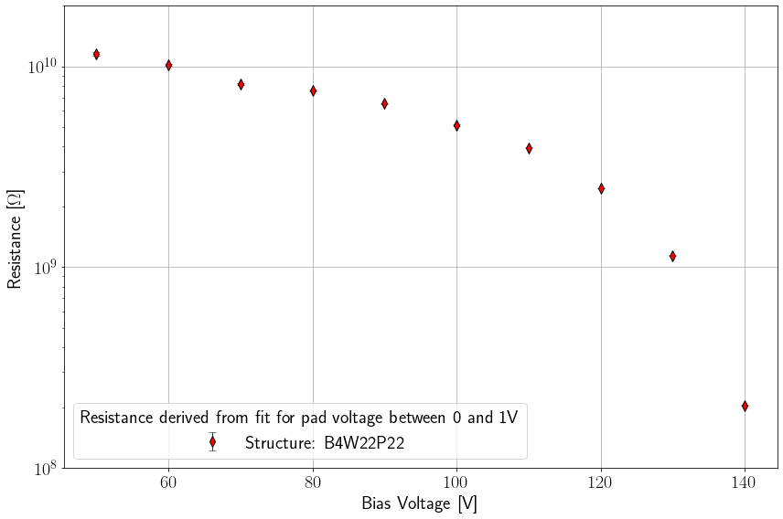
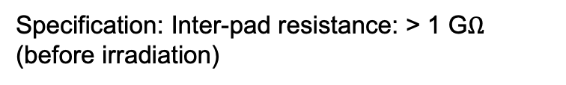
Results
Drop not fully understood
Inter-pad resistance
Linear fits for different bias voltages:
Specification: Inter-pad resistance: > 1 G$Ω$ (before irradiation)
50 V
60 V
70 V
80 V
90 V
100 V
110 V
120 V
130 V
140 V
Conservative estimation, approximations valid?
Notes:
Left plot:
Visible linear correlation between voltage and inter-pad current -> fit for each different
bias voltage to find resistance
Right plot:
V bias above 50: full depletion of sensor, not constant over different bias voltages, especially dropping when nearing breakdown voltage
Conclusion:

Slide 16
Quality Control
Inter-pad resistance
Sensor QC
Testbeam
ATLAS HGTD
Testbeam setup
ATLAS detector
Sensors
Test structure
Sensor IV curve
Sensor breakdown voltage map
Notes:
Now moving from Process QC to Sensor QC, which is the testing of the actual sensors

Slide 17
Why is Sensor QC important?
Sensor QC
Test uniformity of sensors: consistent detector response
All 225 cells of one sensor biased in parallel → sensor performance limited by lowest breakdown pad!
V_BD shifts with temperature
Specifications:
Peak leakage current (V_BD cond.) | < 500 nA (< 200 nA @-30°C)
Breakdown voltage | V_BD > V_fd + D * 2 V/m
V_BD,lgad spread over Sensor | RMS(V_BD)/ <V_BD> < 0.05
4 sensors loaded into Probestation
I-V Measurement performed pad by pad (single needle)
Notes:
Sensors determine the performance of HGTD in the end
Concrete example I cover here:
Test breakdown voltage with I-V curve
LGAD bias is limited by the lowest breakdown pad -> performance will not be adequate for most sensors
Uniformity and spread benchmarks
Test for different temperatures especially at the foreseen operating temperature

Slide 18
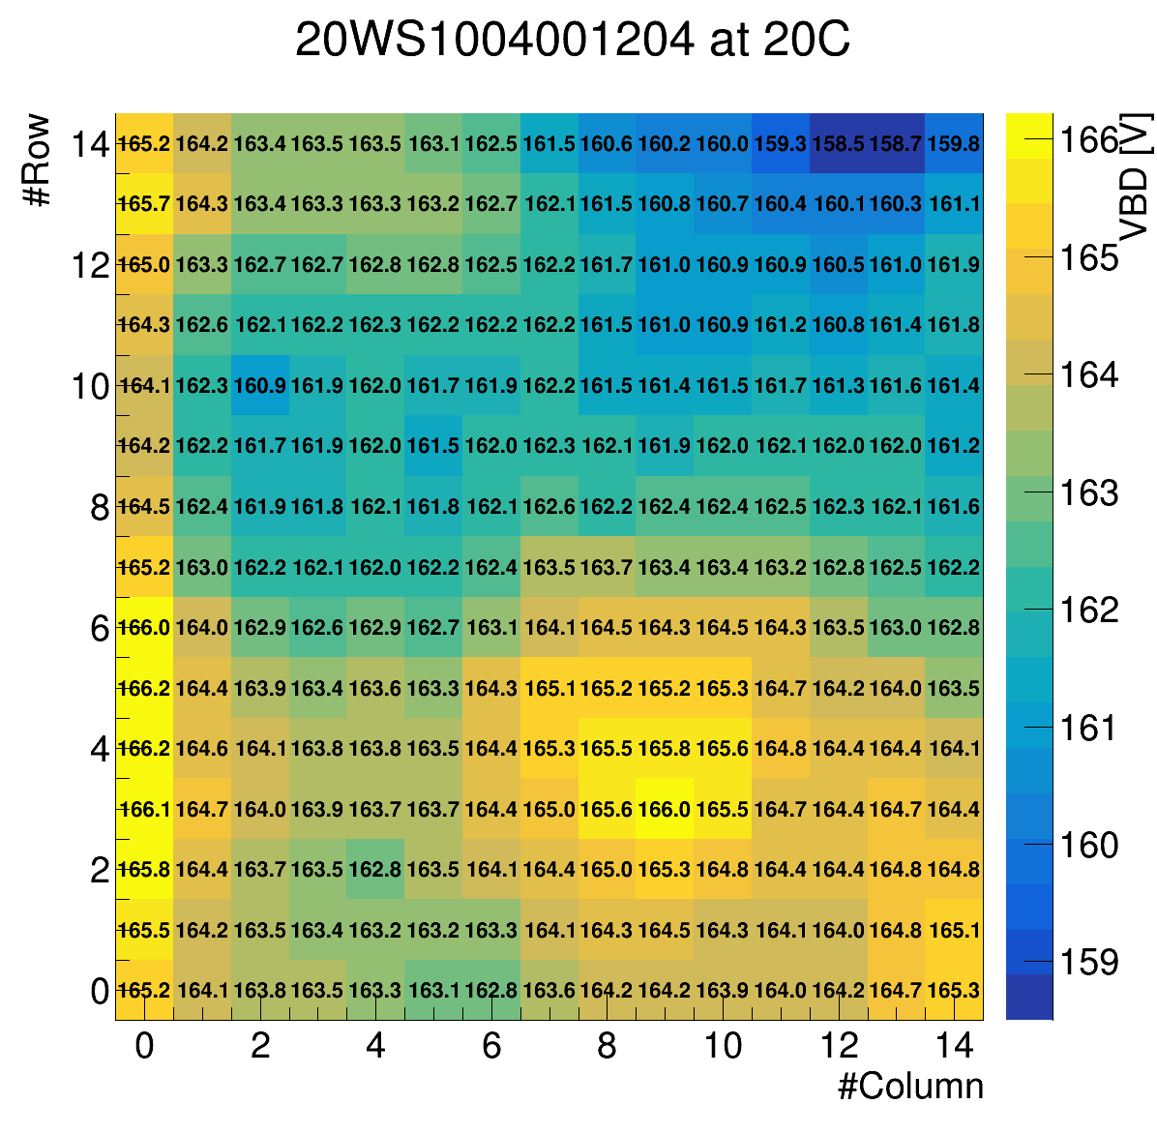
Breakdown Voltage at different temperatures
Sensor QC
CERN measurement at 20°C
CERN measurement at -30°C
Minimum requirement
Serial number: 20WS1004001204
RMS(V_BD)/<V_BD> = 0.012 %
Notes:
Sensor, 15x15 pads
What is the difference of the plots? -> temperature -> still, similar shape of the breakdown voltage
Conclusion:
On average 60V decrease between the two temperatures
Sensor does not meet requirement of breakdown voltage, does meet requirement of uniformity though

Slide 19
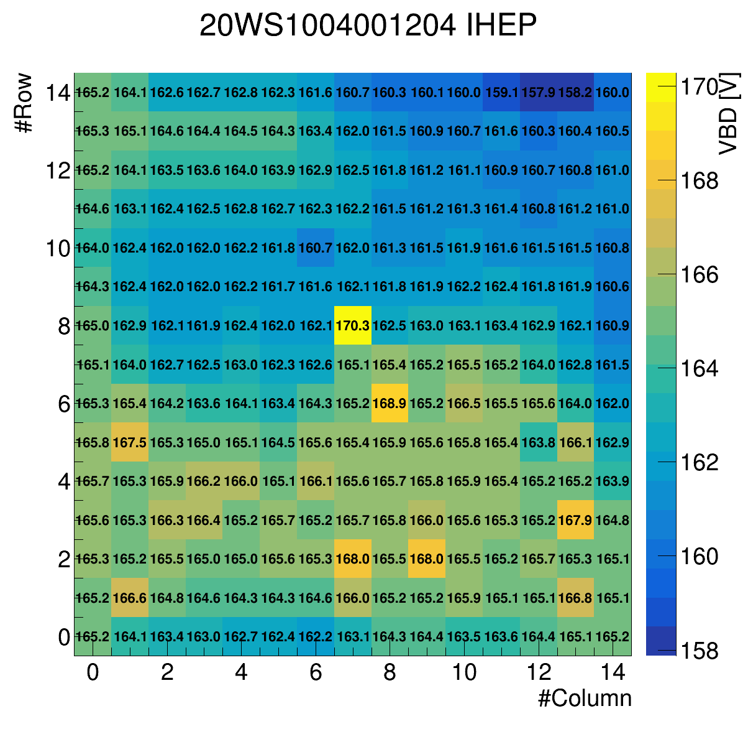
Comparison: Vendor and CERN
Sensor QC
CERN measurement at 20°C
Vendor measurement ??°C
Notes:
Conclusion:
On average, they agree well
Temperature during IV scan from vendor not with controlled temperature
-> try to estimate it with own temperature controlled measurement at different temperatures
And also look at the difference more closely!

Slide 20
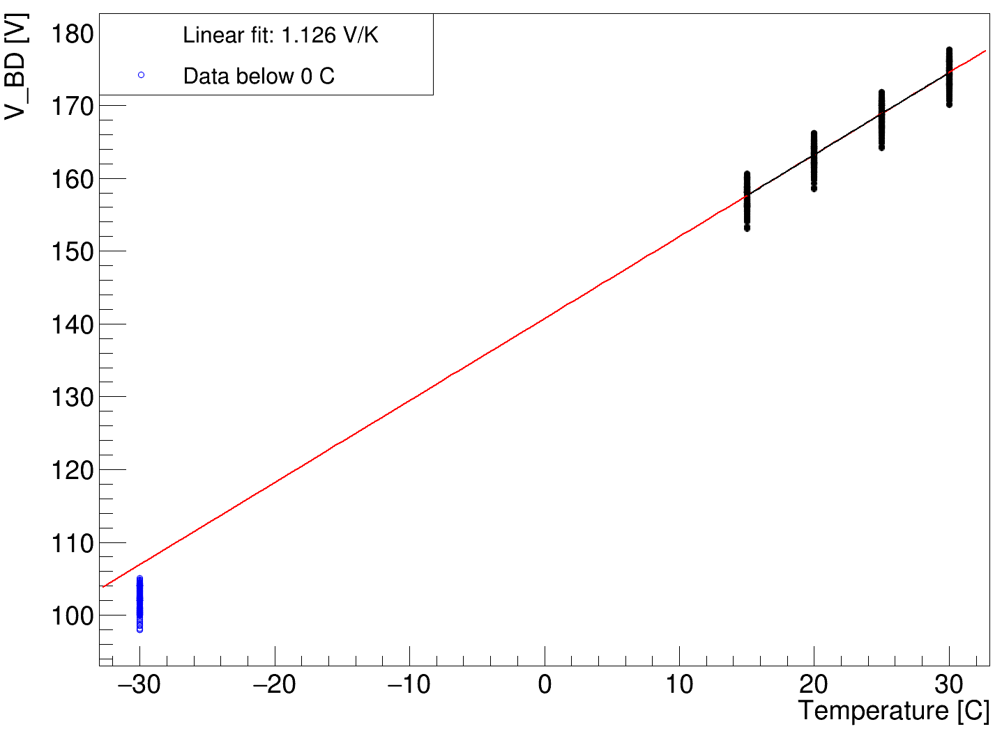
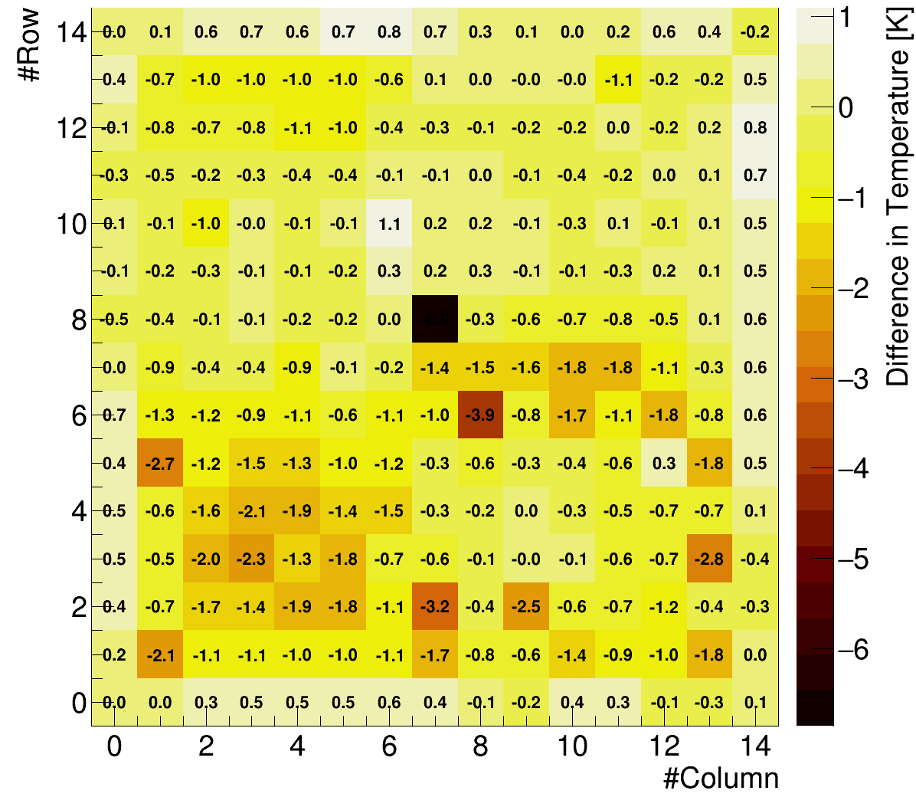

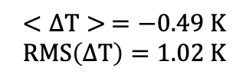
Sensor IV scan at different temperatures
Sensor QC
Linear fit: (1.13 $±$ 0.01) V/K
Non-linear
Estimate unknown temperature during vendor’s measurement
$$<ΔT> =−0.49 K$$
$$RMS\left(ΔT\right)=1.02 K$$
Notes:
Highlight the slope + fitting error
-> In general they agree, with an average difference of 0.5 K
-> Seems for some pixels the measurement was inaccurate

Slide 21
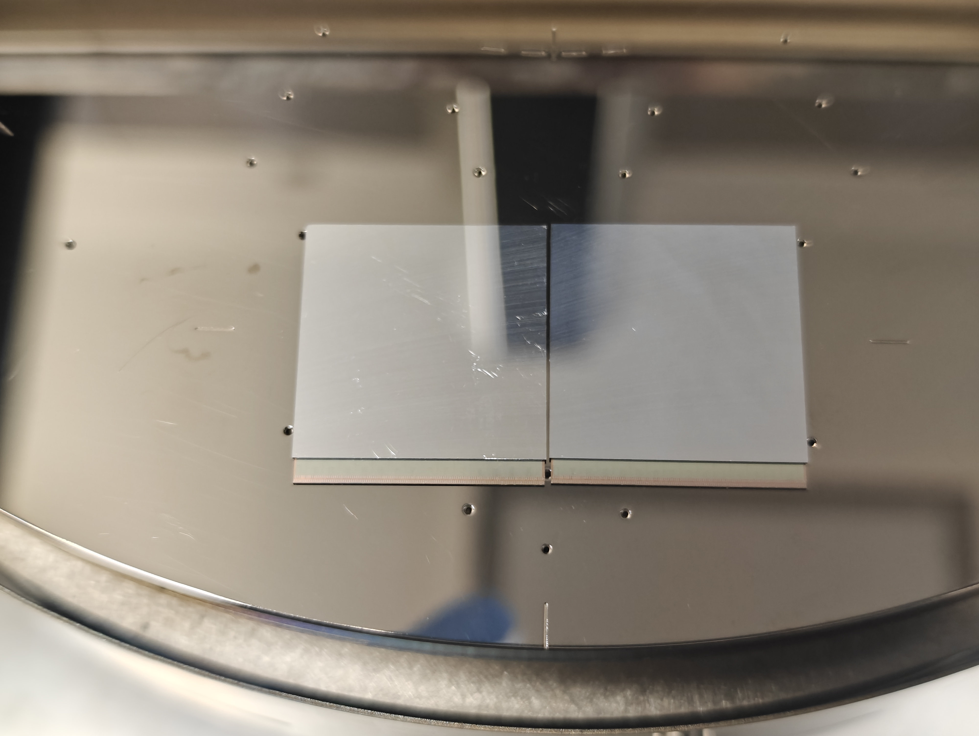
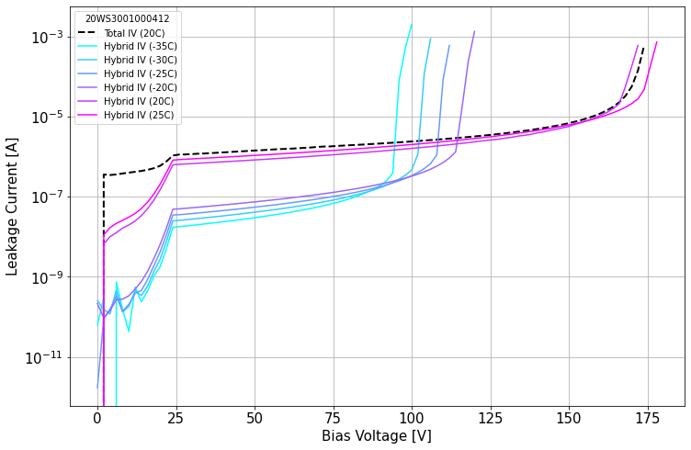
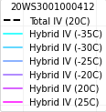
IV Scan: Hybrid vs. Sensor
Sensor QC
Hybrid = ASIC + Sensor
bump-bonded
Total IV: Summed up current of each pad before hybridisation
Good agreement between sensor & hybrid measurement
Notes:
Conclusion: They agree precicesly before and after hybridization -> would expect it

Slide 22
Quality Control
Inter-pad resistance
Sensor QC
Testbeam
ATLAS HGTD
Testbeam setup
ATLAS detector
Sensors
Test structure
Sensor IV curve
Sensor breakdown voltage map
Notes:
Another major part in Sensor testing: Testbeam
Actual testing of timing of the detector

Slide 23
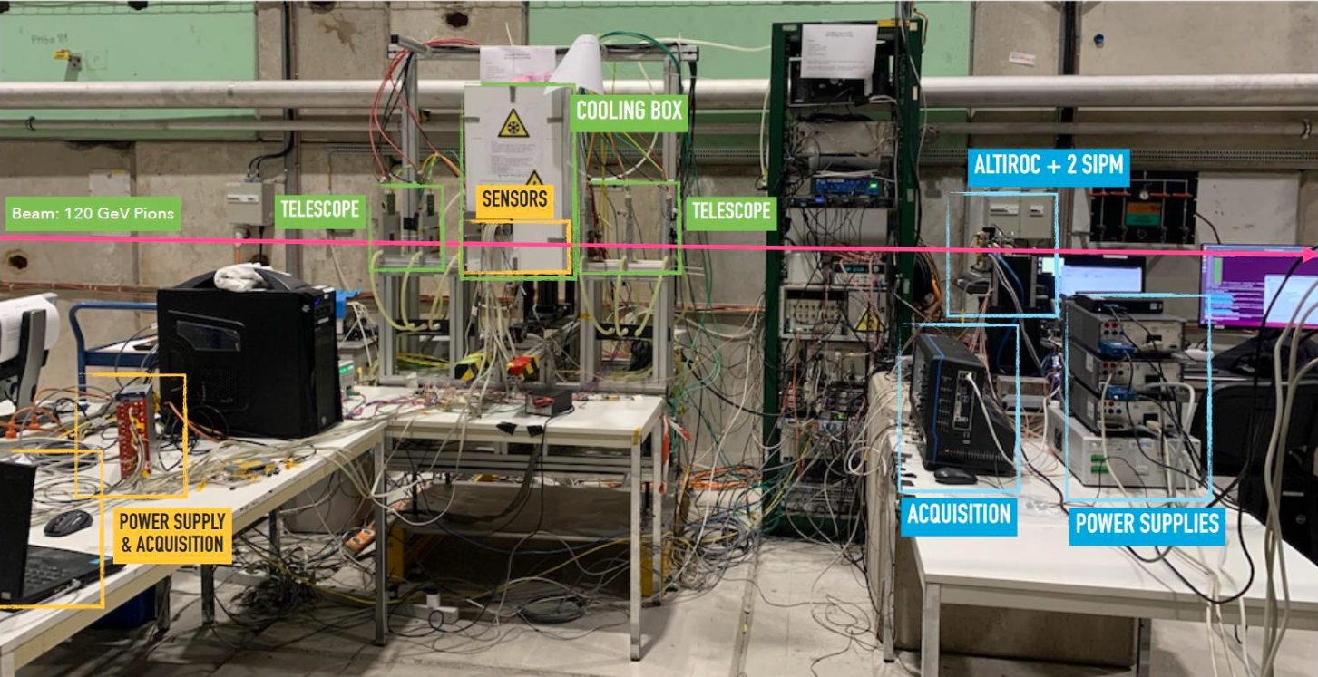

Setup at CERN (SPS)
Testbeam
Cooling box
Device under Test
120 GeV $π$
Telescope (Tracking)
MCP (Timing Reference)
Readout
Notes:
Cooling box with Hybrids on testboard inside
Telescope for tracking, SIPM for timing reference, by now MCU
Reference for details in conference talk (which one/ who to reference?)

Slide 24
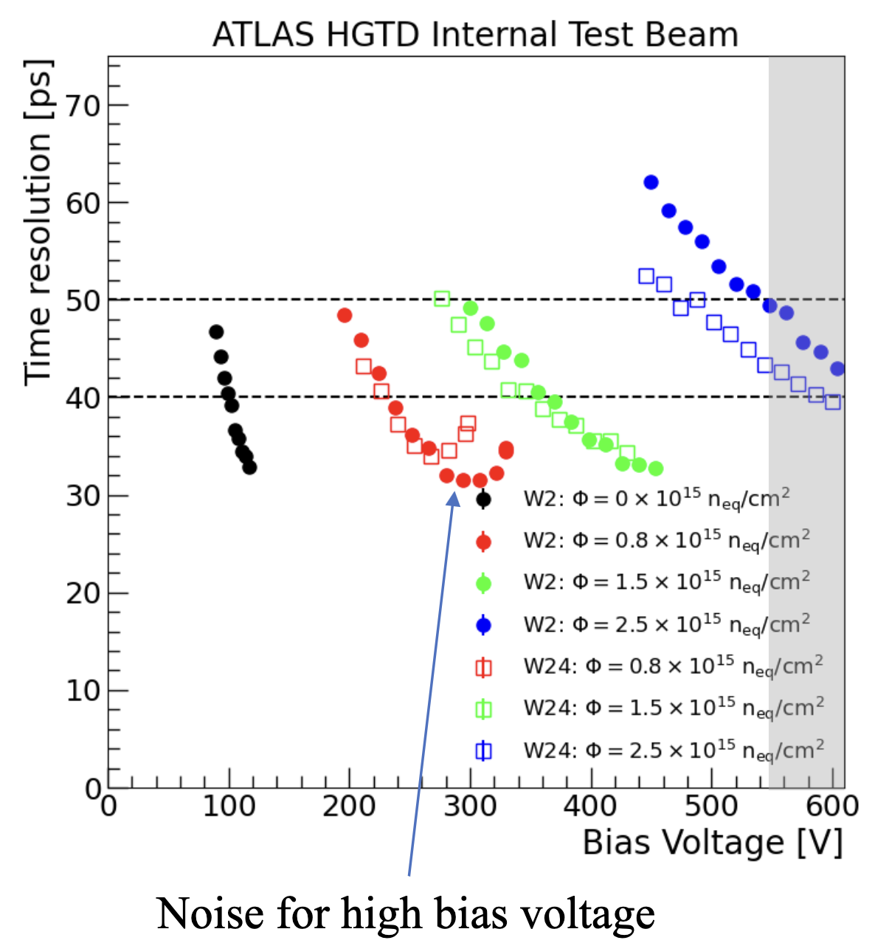
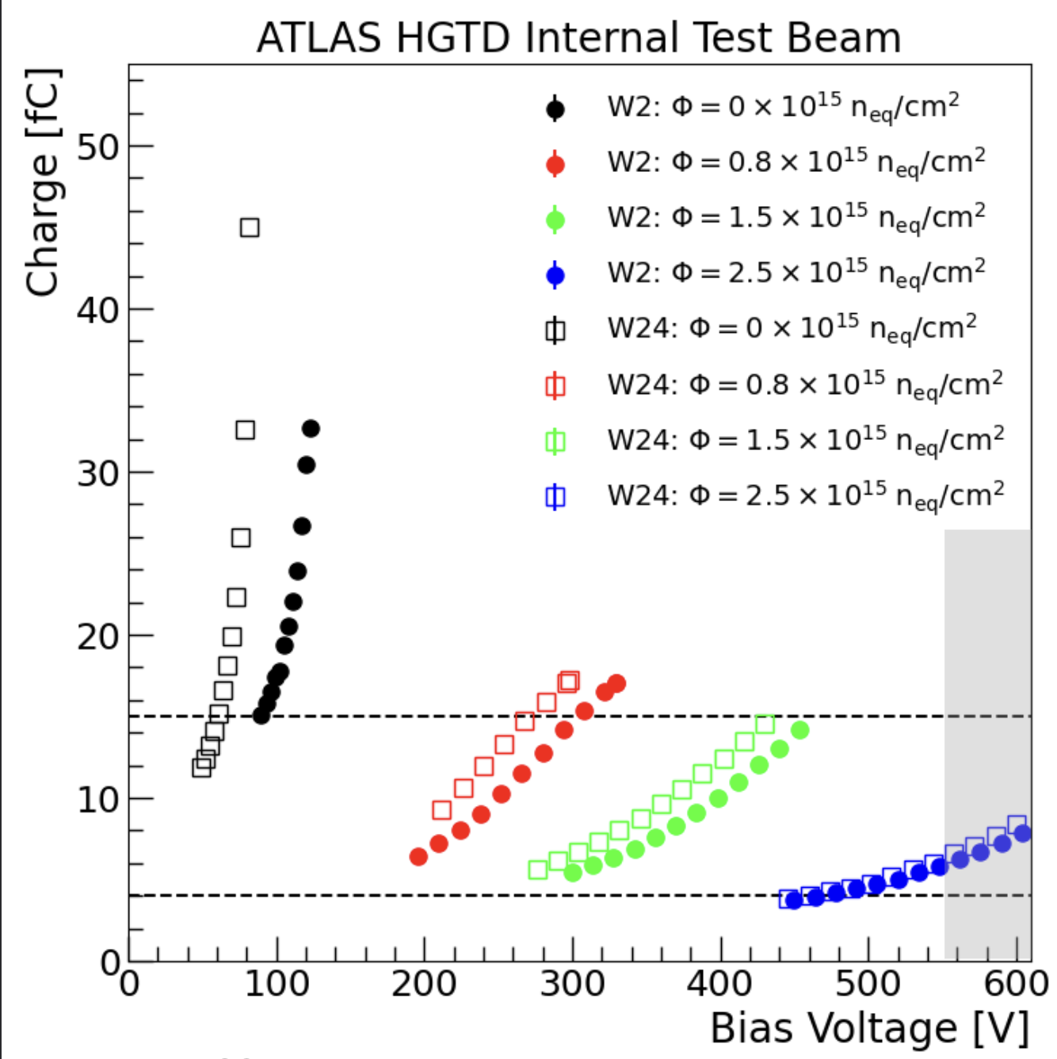
Results (August 23)
Testbeam
W24 is more carbonated (lower bias voltage to reach the required performance)
Preproduction sensor test beam: Summary, Giulia Di Gregorio
All sensors meet specifications (< 50 ps and >4fC for irradiated)
Notes:
Left: y axis timing and x-axis bias voltage -> different data for different irradiation degrees, sensors from two different wafers tested
Can see that more bias voltage is needed for higher irradiation
Right: similar plot, this time with collected charge in both cases the specifications are marked with dotted lines

Slide 25
Quality Control
Inter-pad resistance
Sensor QC
Testbeam
ATLAS HGTD
Testbeam setup
ATLAS detector
Sensors
Test structure
Sensor IV curve
Sensor breakdown voltage map

Slide 26
Summary
HGTD will improve pile-up rejection for ATLAS in HL-LHC conditions
QC plays critical role in HGTD construction
              Preliminary results for electrical characterisations show sensor performance within specifications
              Ongoing test-beam on sensor performance: agreement with expectations
Quality Control
Inter-pad resistance
Sensor QC
Testbeam
ATLAS HGTD

Slide 27
Acknowledgements
Thanks to Xiao Yang, Theodoros Manoussos and Dominik Dannheim for the supervision!

Slide 28
Backup
Notes:
Put logo of university & logo of atlas

Slide 29
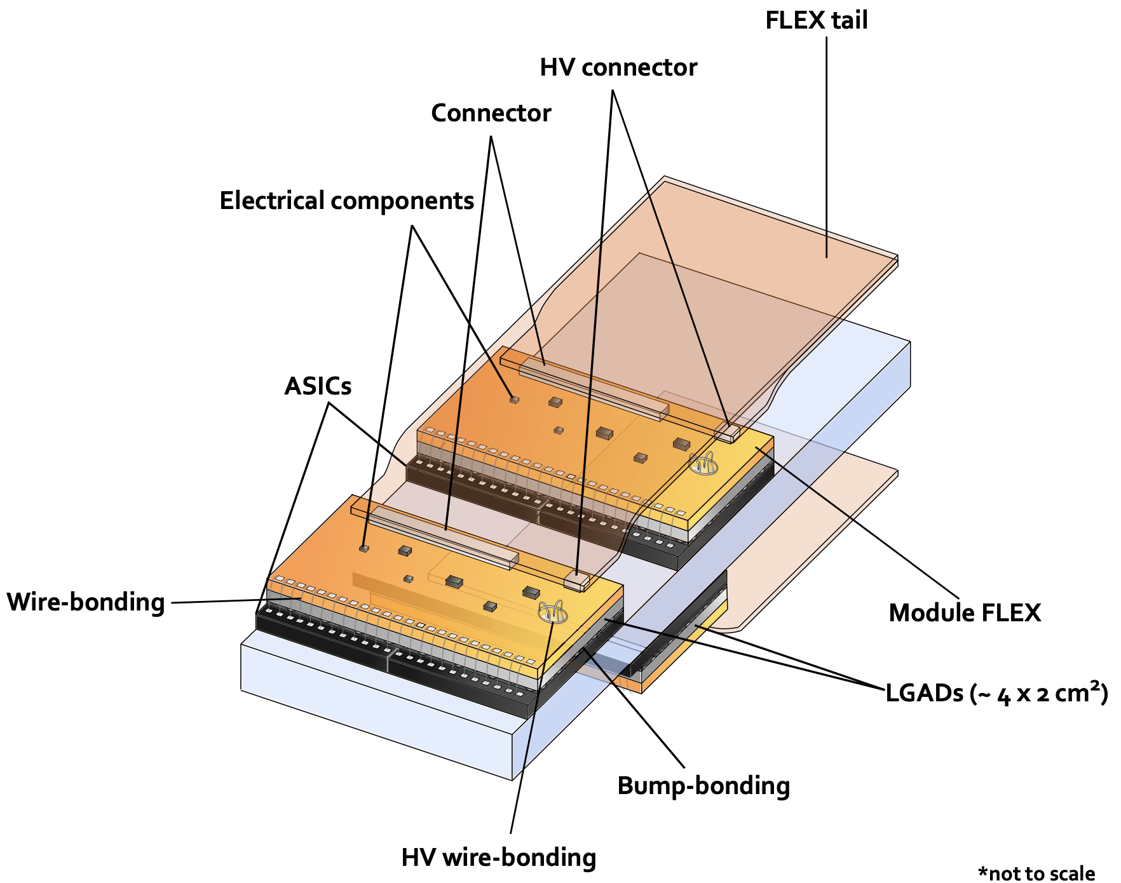
Sensor infrastructure
ATLAS HGTD
HGTD Technical Desing Report (2020)
LGADs
Notes:
Infrastructure around the Sensor, together form a module
ASIC: frontend readout electronic & logic, bump bonded onto the sensor
Module flex: readout & High voltage
Electrical connection via wire bonding
-30°C (${CO}_{2}$ dual phase) to mitigate high radiation effects
replacements of the inner (every 1000 fb-1) and middle rings (every 2000 fb-1)
With technical details covered, move on to quality control

Slide 30
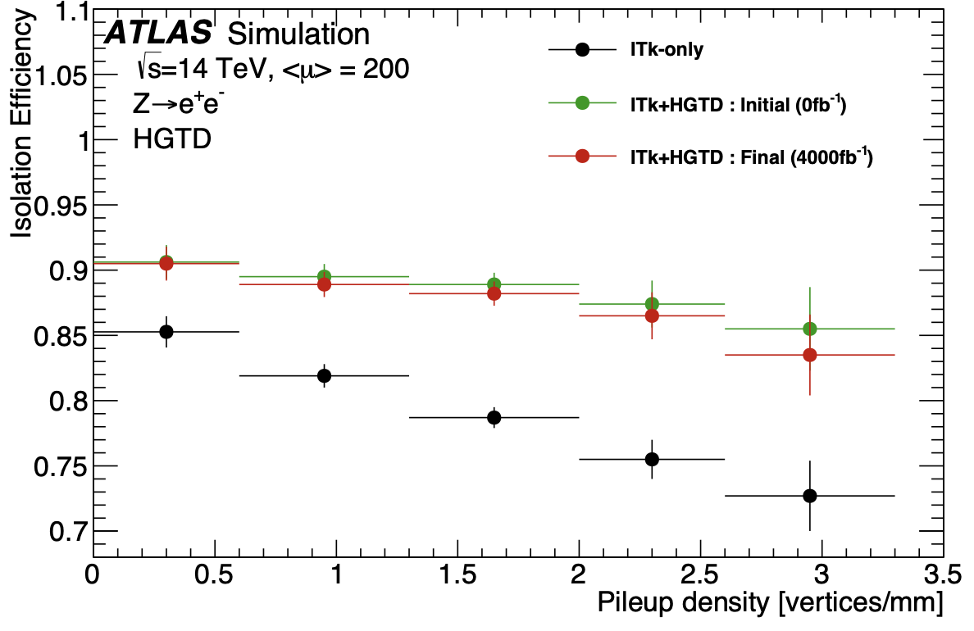
Physics Processes for which HGTD will provide better precision
Improvement on jets and forward leptons
Jets: vector boson fusion (VBF) & vector boson scattering (VBS)

Slide 31
Quality Control for different sensors
Sensor | Lowest Breakdown voltage @ -30°C | Specifications
20WS1004000708 | 101.0 | 102.6
20WS1004001204 | 98.0 | 102.6
20WS3001000312 | 110.4 | 99.9
20WS3001000412 | 107.0 | 99.9
Notes:
20WS1004000708 at 20: min_vbd = 162.08, spread (%) = 0.0058
20WS1004000708 at -30: min_vbd = 101.01, spread (%) = 0.0141
20WS1004000708 at nan: min_vbd = 170.23, spread (%) = 0.0057
20WS1004001204 at 20: min_vbd = 158.5, spread (%) = 0.0043
20WS1004001204 at -30: min_vbd = 98.0, spread (%) = 0.0118
20WS1004001204 at nan: min_vbd = 157.87, spread (%) = 0.0075
20WS1004001204 at 30: min_vbd = 170.07, spread (%) = 0.0039
20WS1004001204 at 25: min_vbd = 164.19, spread (%) = 0.004
20WS1004001204 at 15: min_vbd = 153.08, spread (%) = 0.0047
20WS3001000312 at 20: min_vbd = 170.04, spread (%) = 0.0144
20WS3001000312 at -30: min_vbd = 110.39, spread (%) = 0.0318
20WS3001000312 at nan: min_vbd = 180.56, spread (%) = 0.0131
20WS3001000412 at 20: min_vbd = 166.6, spread (%) = 0.0201
20WS3001000412 at -30: min_vbd = 107.03, spread (%) = 0.0438
20WS3001000412 at nan: min_vbd = 175.79, spread (%) = 0.0145

Slide 32
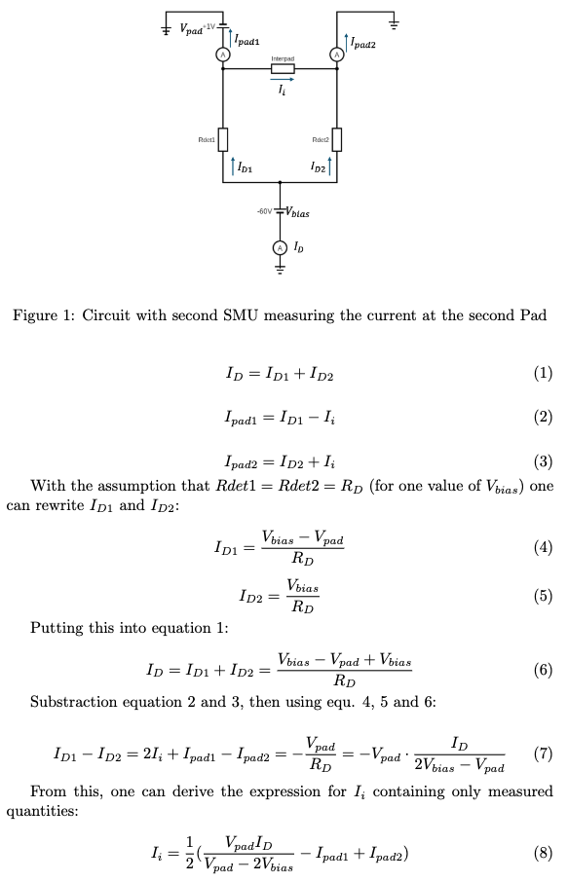
Derivation: Inter-pad current

Slide 33
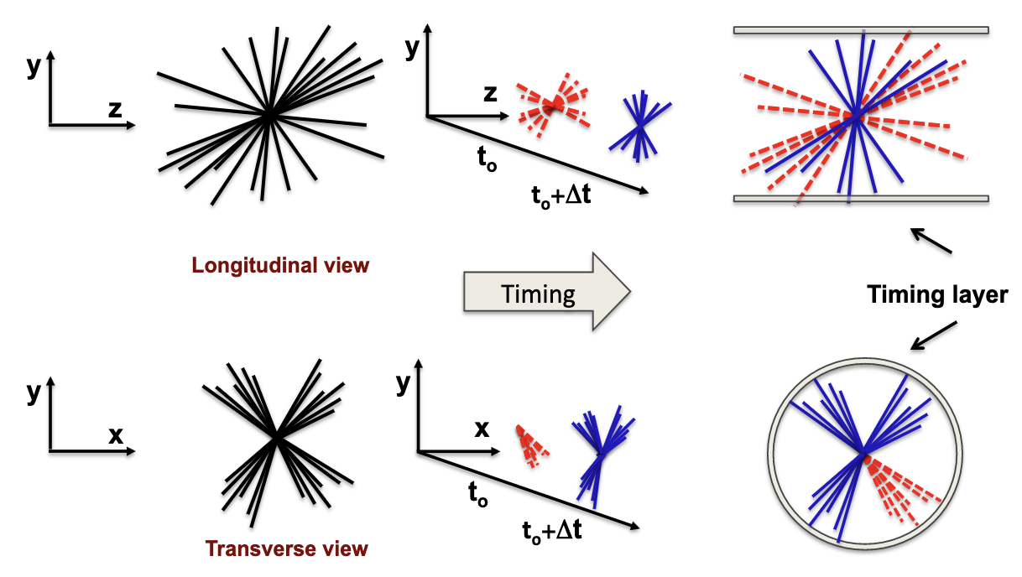
Importance of 4D resolution
https://arxiv.org/ftp/arxiv/papers/1704/1704.08666.pdf

