Slide 1
Comparison
BBSrc and OMC3

Slide 2
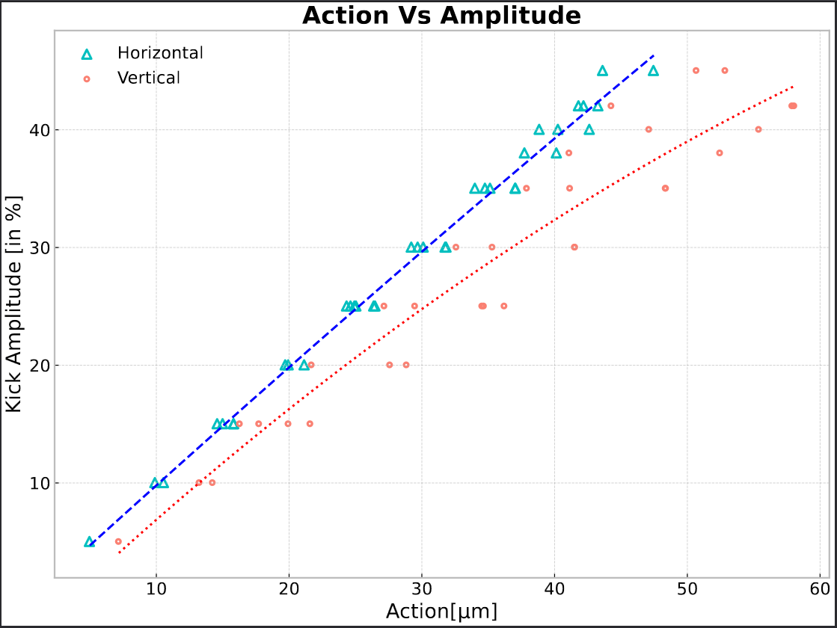
Amplitude and Action
Amplitude of kick is not always linear to Action (especially in the Vertical Plane).
Vertical Action consistently has higher Action values than Horizontal Action for any given kick amplitude.
Function:
Horizontal: y = 9.77 x + 0.193
  Vertical: y = 10.7x - 4.56x² - 3.444

Slide 3
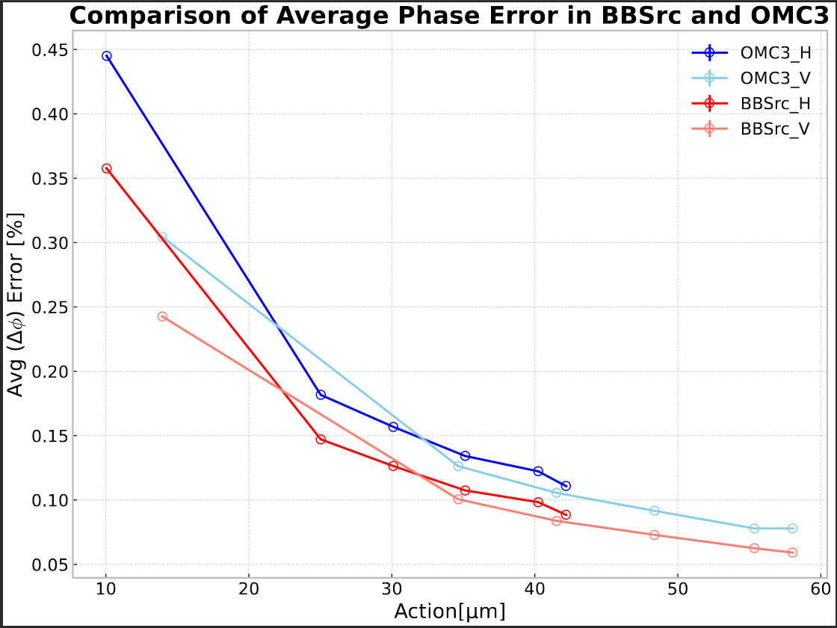
Comparison of Phase Error in BBSrc and OMC3
Average Phase Error is smaller in BBSrc than in OMC.
Beam 1 - 30cm
Fill No. = 9403
Model:
  BBSrc: B1_30cm_22-03-2024
  OMC3: B1_30cm_for_global_corrections_with_knobs

Slide 4
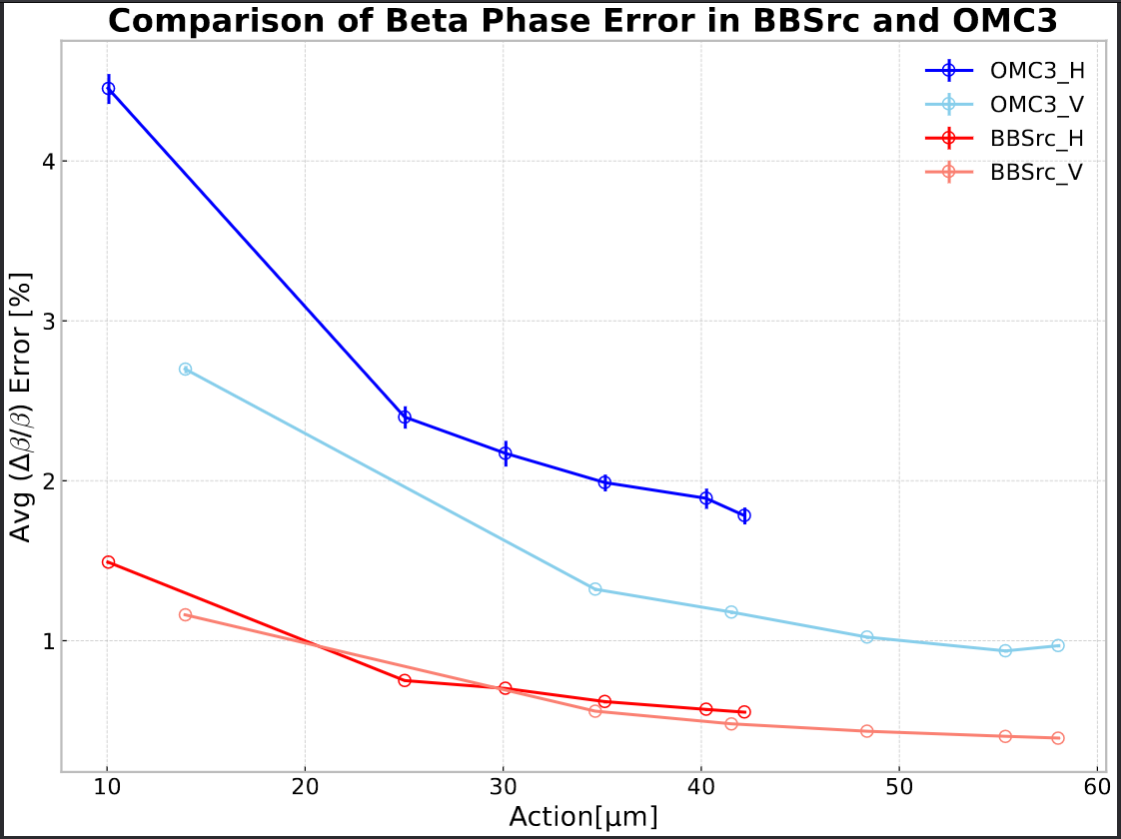
Comparison of BetaPhase Error in BBSrc and OMC3
Errorbars are smaller in BBSrc than in OMC.
Error is smaller in BBSrc in both horizontal and vertical
–> difference of approx. 2x.
Beam 1 - 30cm
Fill No. = 9403
Model:
  BBSrc: B1_30cm_22-03-2024
  OMC3: B1_30cm_for_global_corrections_with_knobs

Slide 5
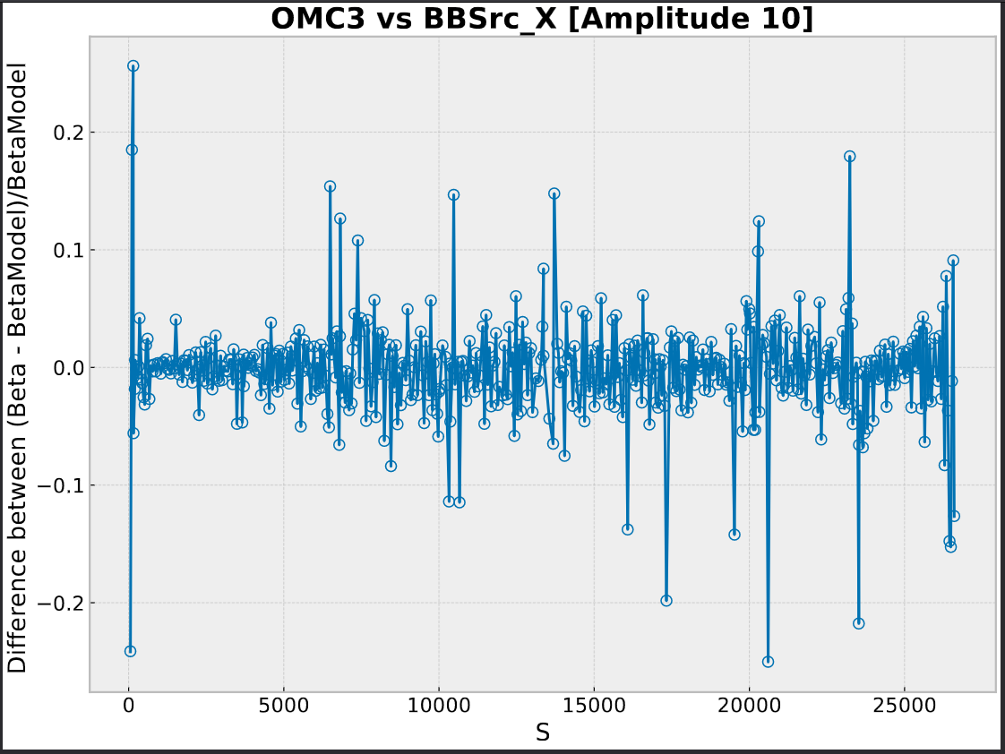
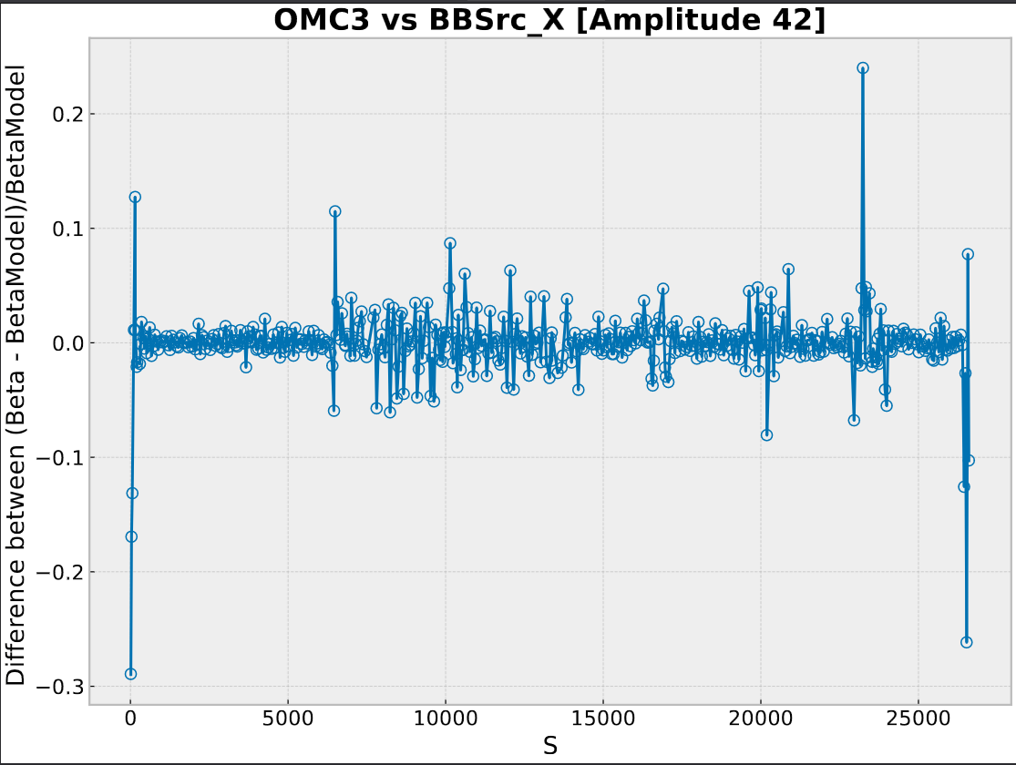
Difference in Horizontal
Beam 1
Fill No. = 9403​

Slide 6
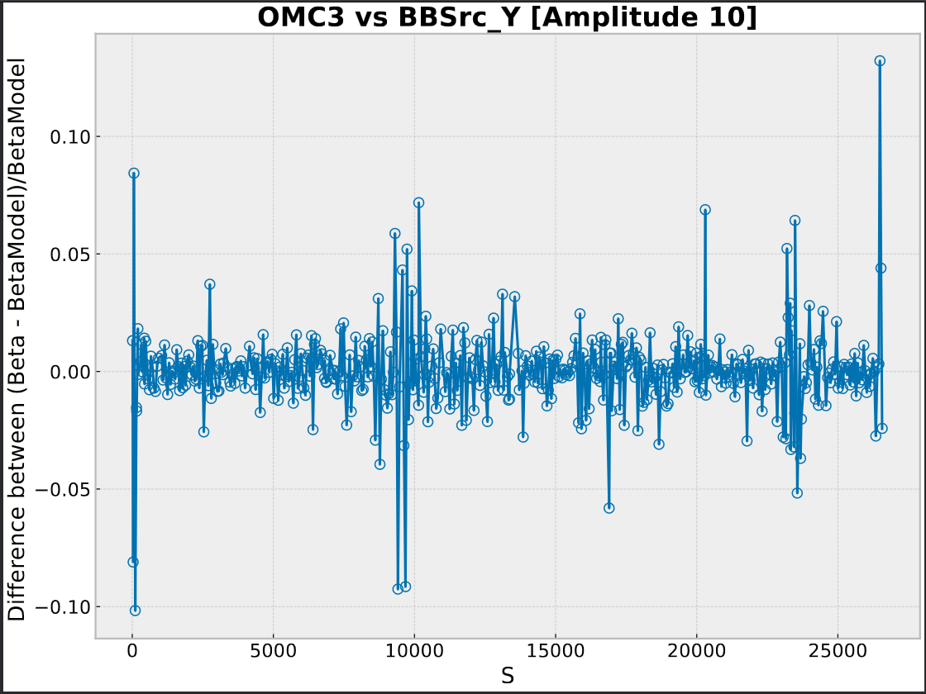
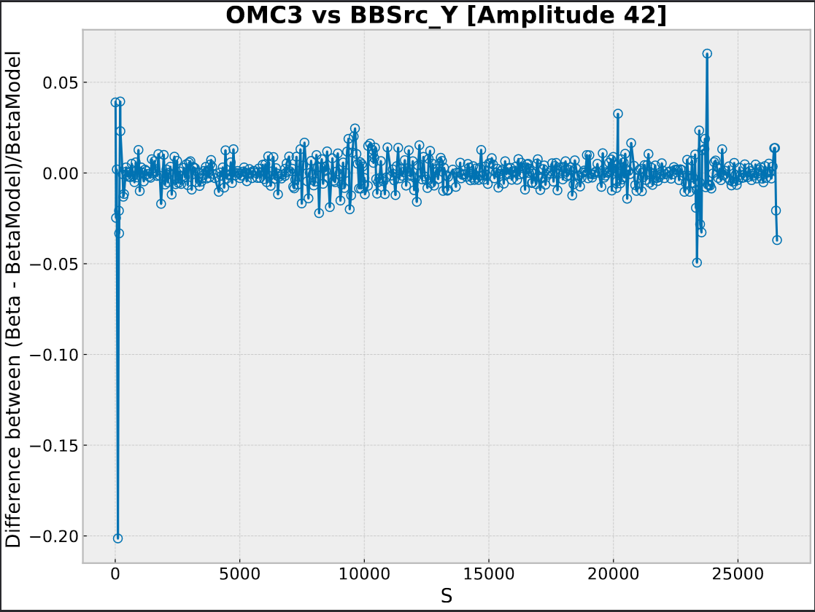
Difference in Vertical ​
Beam 1
Fill No. = 9403​

Slide 7
Conclusion
For same fill, BBSrc consistently has lower errors compared to OMC3 across the range of actions, with the difference becoming less pronounced at higher actions..
Amplitude has a more non-linear relationship to the Action in the vertical.
[Can be considered when taking readings/kicking in both planes.]

Slide 8
Extras

Slide 9
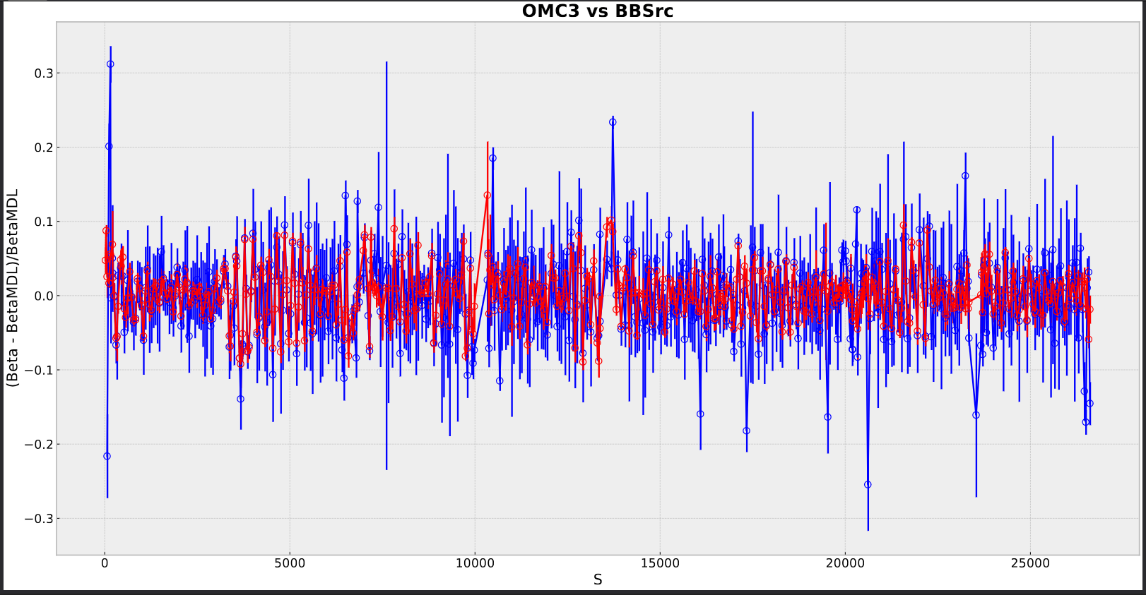
10_X

Slide 10
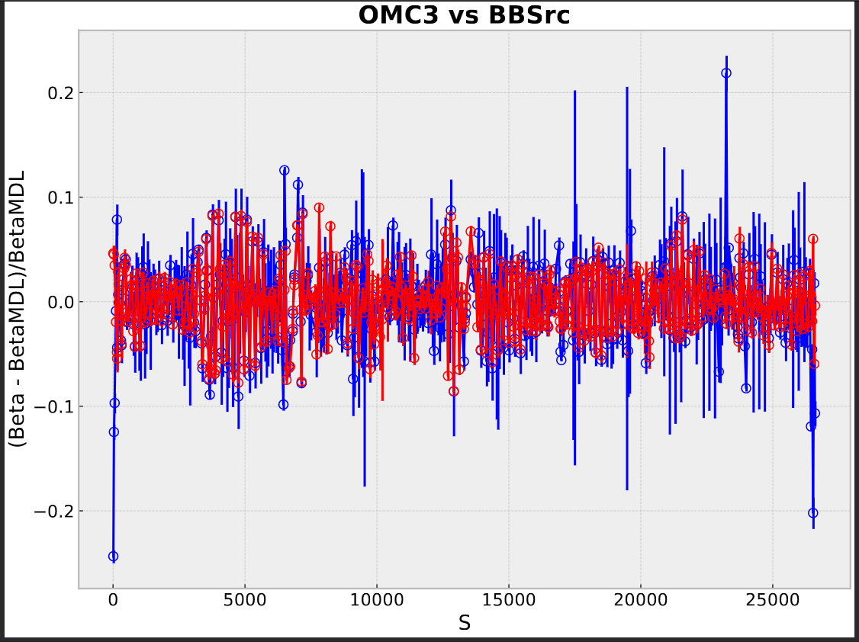
42_X

Slide 11
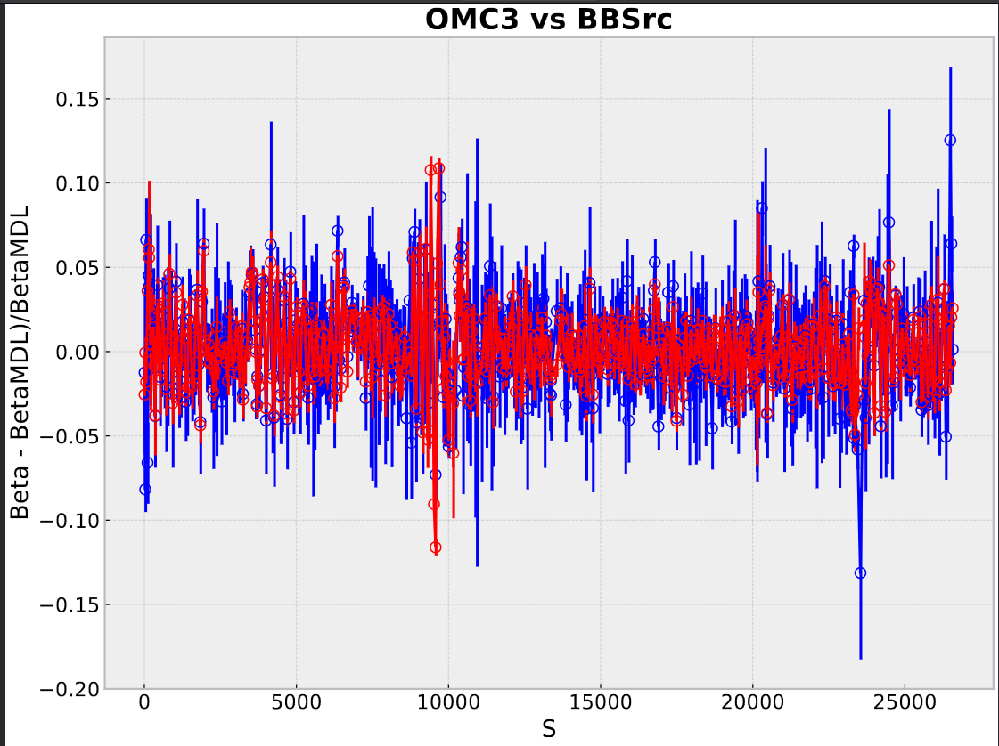
10_Y

Slide 12
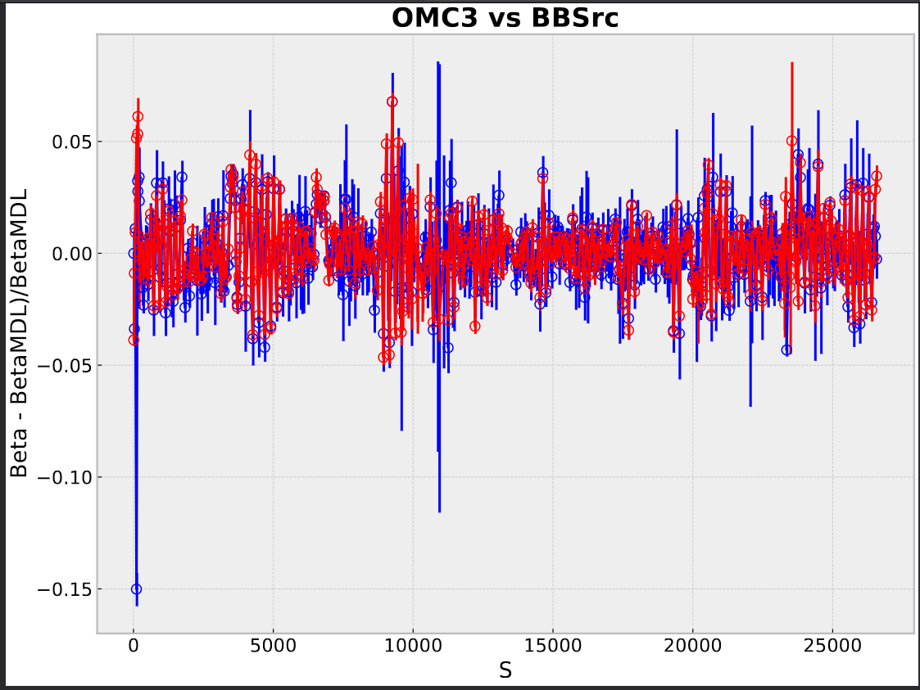
42_Y

Slide 13
Amplitude Vs Action

Slide 14
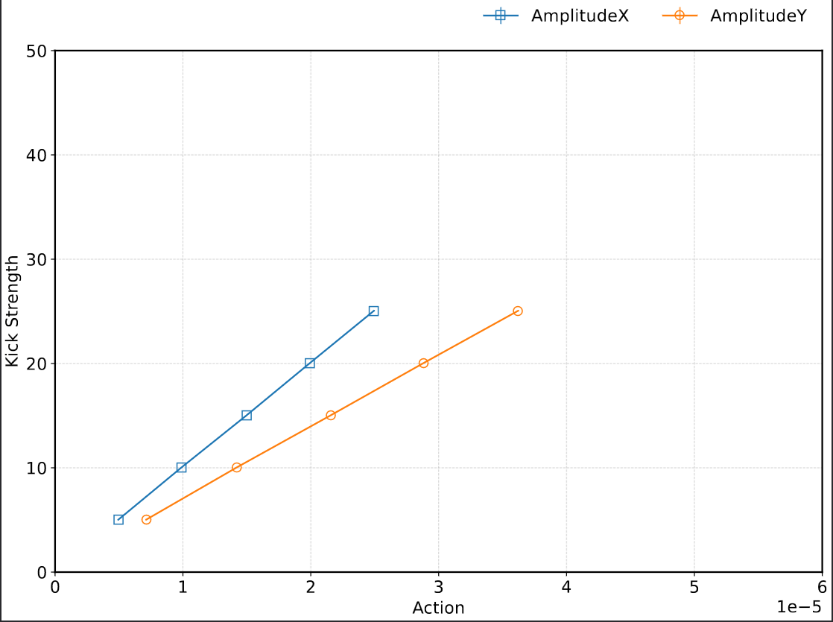
Observations:
Fill 8521– Beam1 - 30cm

Slide 15
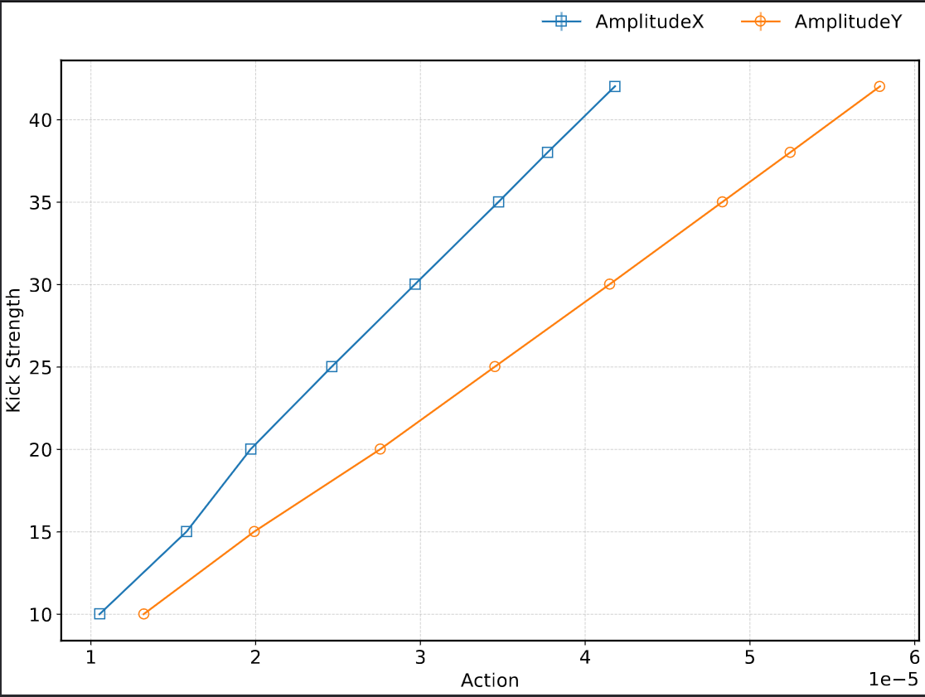
Observations:
Fill 8521 – Beam1 - 60cm

Slide 16
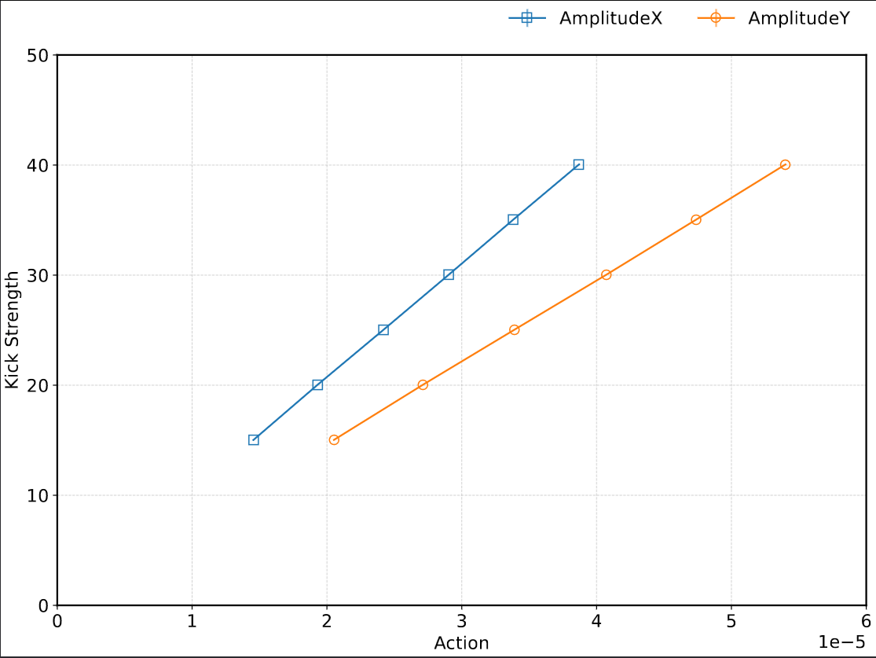
Observations:
Fill 8521– Beam1 - 120cm

Slide 17
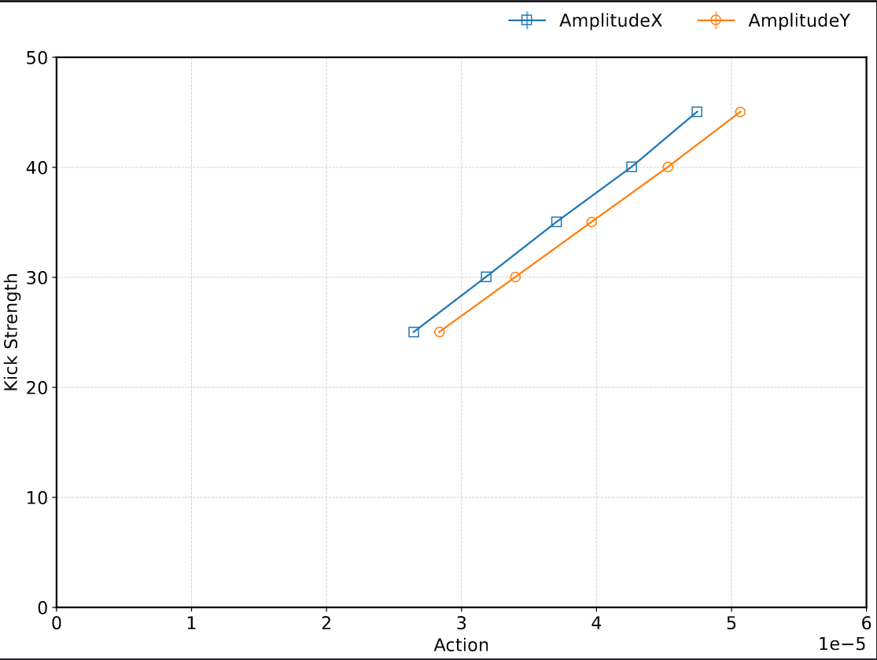
Observations:
Fill 8521– Beam2 - 30cm

Slide 18
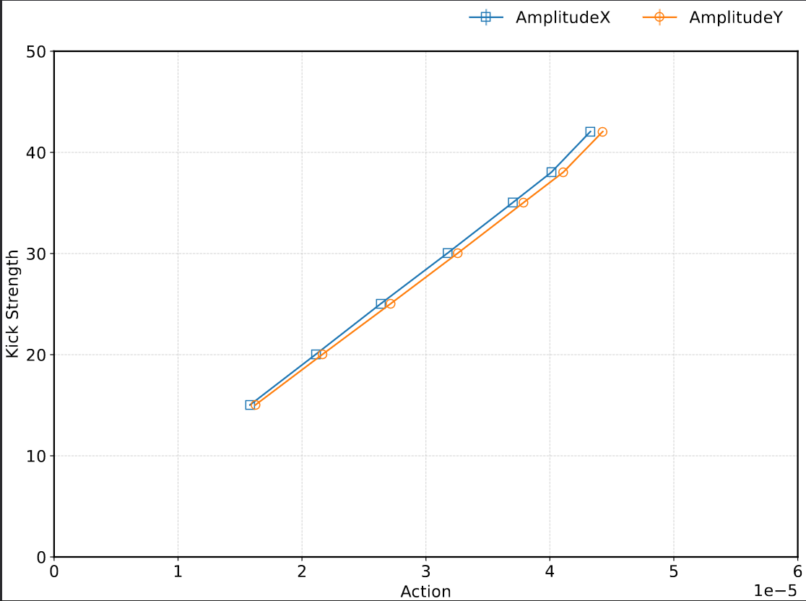
Observations:
Fill 9403– Beam2 - 60cm

Slide 19
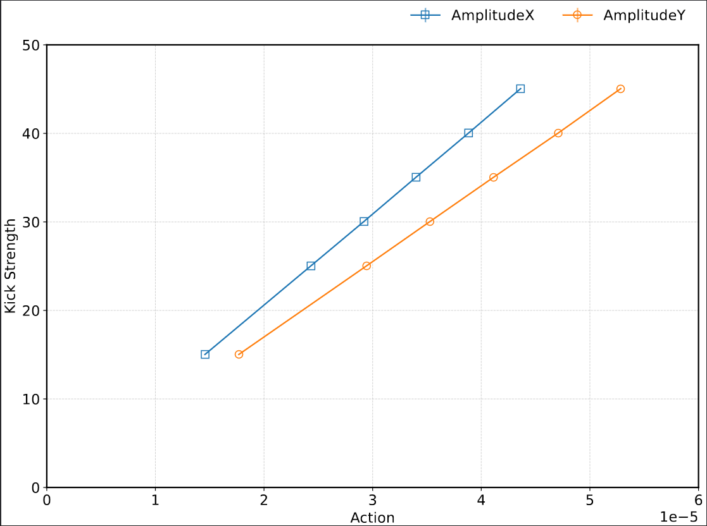
Observations:
Fill 8521– Beam2 - 120cm

Slide 20
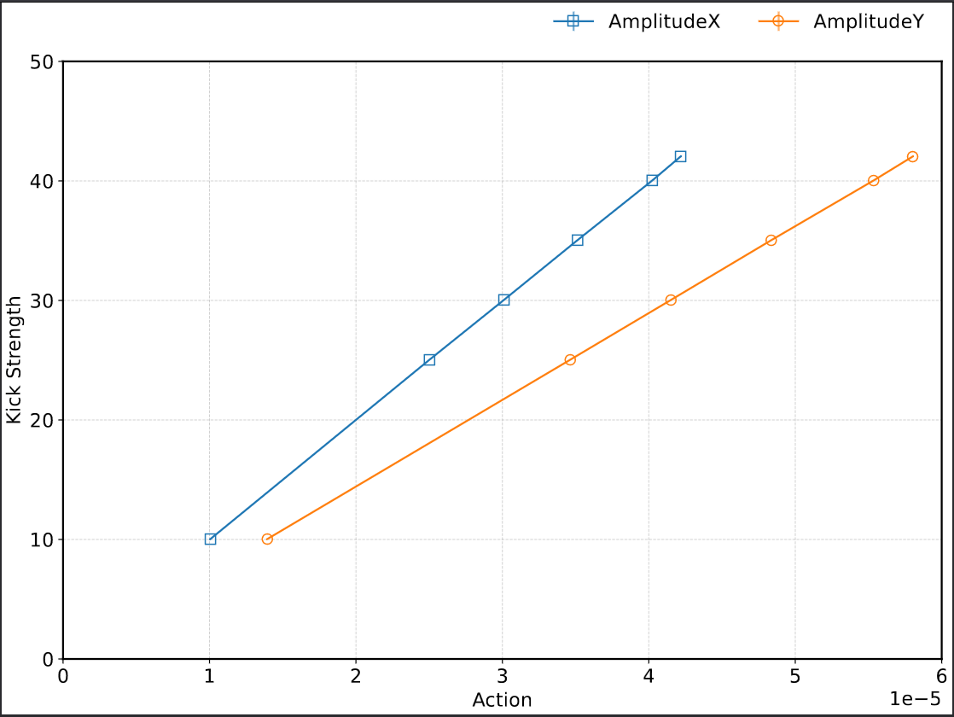
Observations:
Fill 9403– Beam1 - 30cm

