Slide 1

R&D meeting
Recovery systems
Maria Cristina Arena
08/08/2024

Slide 2
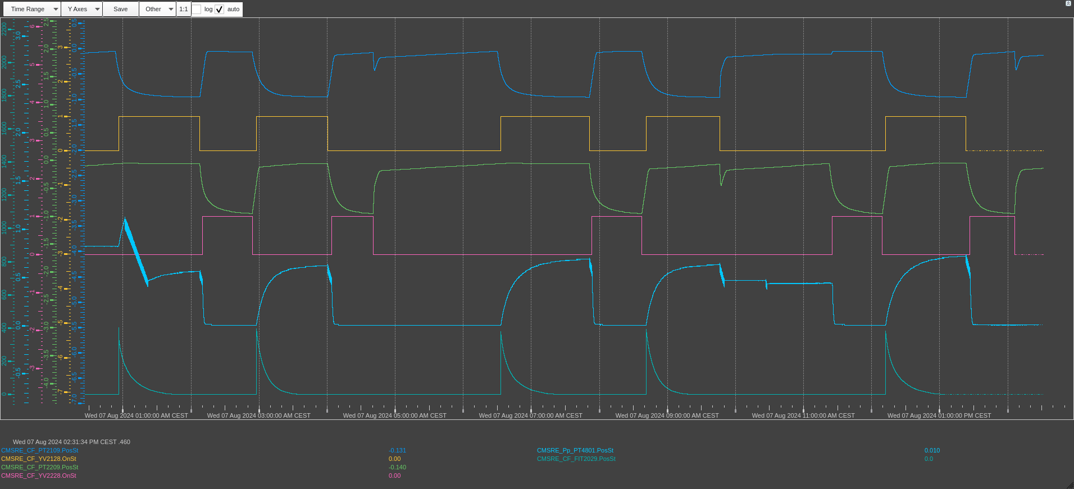
CMS CSC CF4 Recovery
Problem found on the YV2228 → this morning it was replaced with a new one, check ongoing

Slide 3
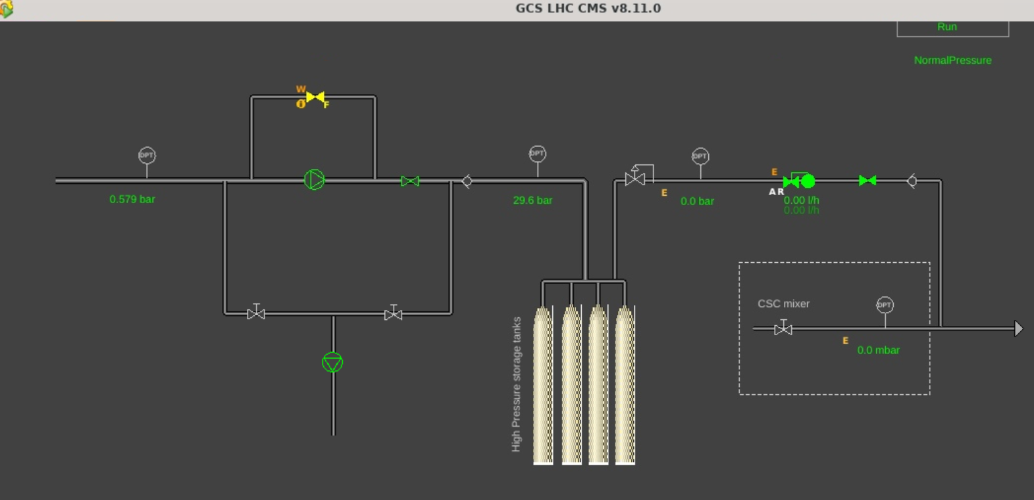


CMS CSC CF4 Recovery – Pump module

Slide 4
CMS RPC R134a Recovery
This week the efficiency was affected by Pump 1 → it reached around 400 working hours that it too much for the working conditions of the recovery system
Pump 1 disabled and efficiency back to 83% today!
Still 15 days for the pump 2 then it must be repaired → no repair kit and no spare compressor → System must be stopped (?)

