Slide 1
DA studies with Xsuite
K. André
189th FCC-ee Accelerator Design Meeting – July 25th, 2024
Thanks to K. Oide

Slide 2
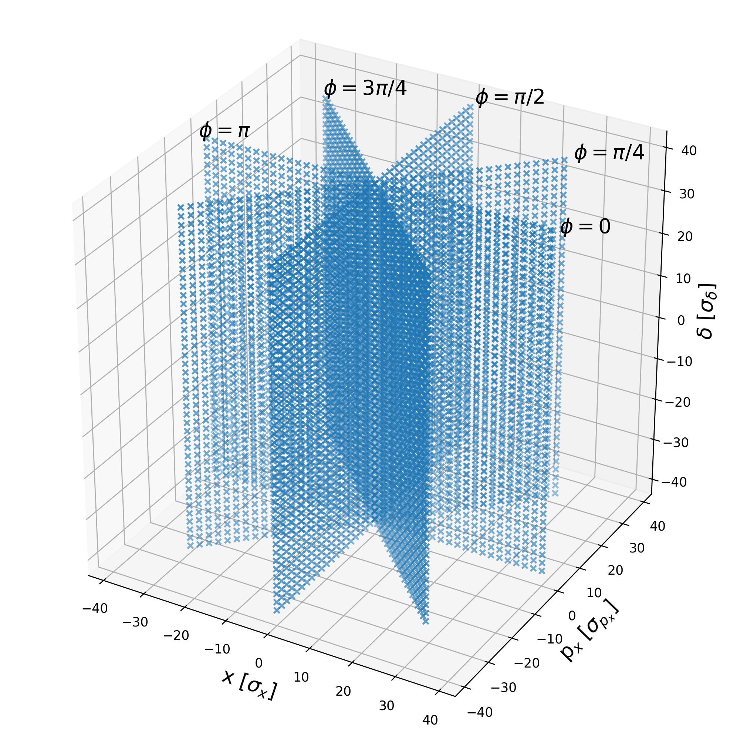
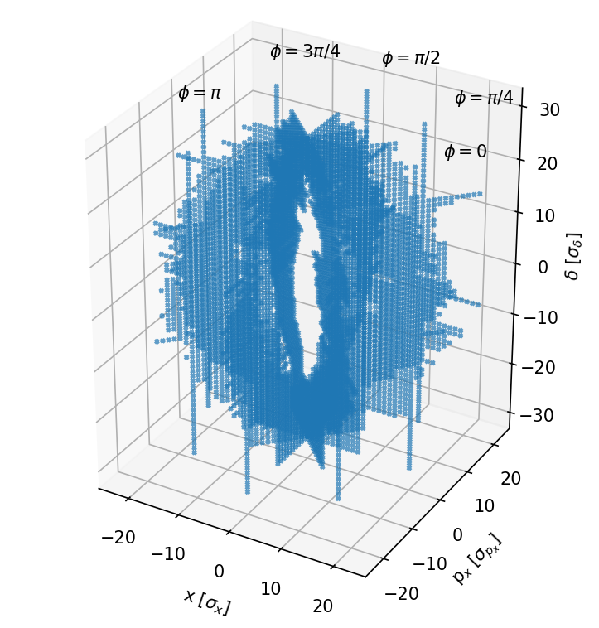
Oide’s DA - Macroparticle grid
‘Brute force’ grid
Grid resulting from bisection

Slide 3
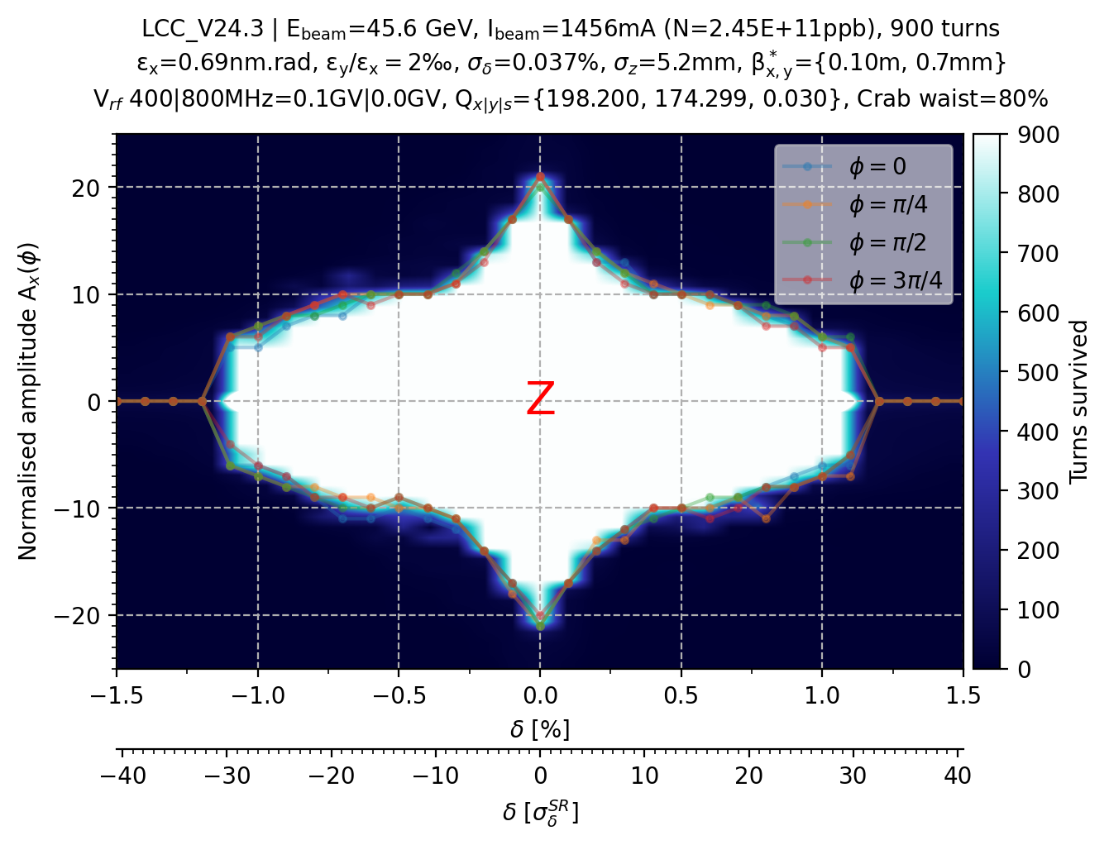
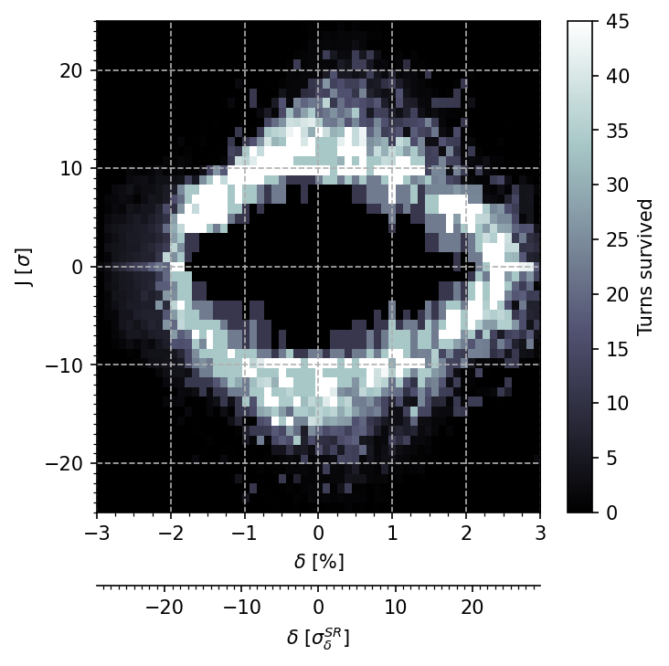
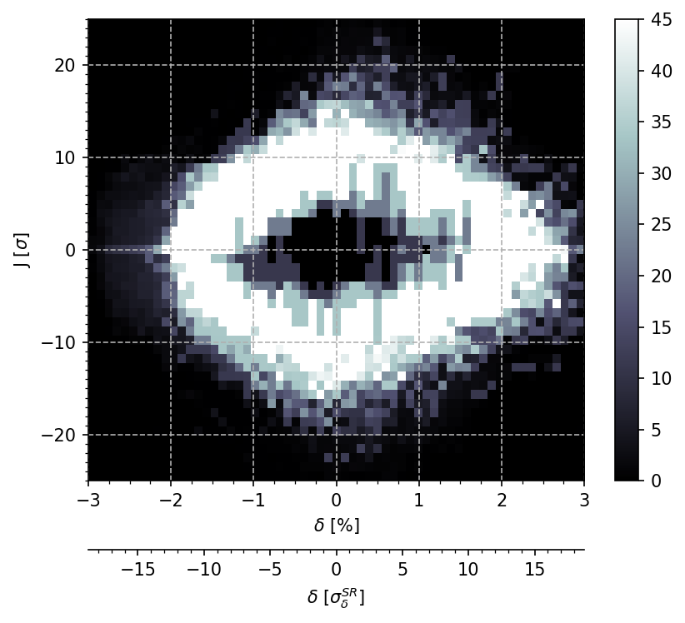
Resulting DA
As you increase the ‘depth’ of tracked macroparticle in action J, the central area becomes increasingly whiter, proving the particles survived.
Some parts of the central region appear less white because of the average between phase planes because some planes have no data at this (δ,J) position.

Slide 4
Reduction to one RF section
From 4 RF cavities at 400MHz evenly distributed in the ring (one in each straight section) to 1 RF section including 400 MHz RF cavities and 800 MHz RF cavities.

Slide 5
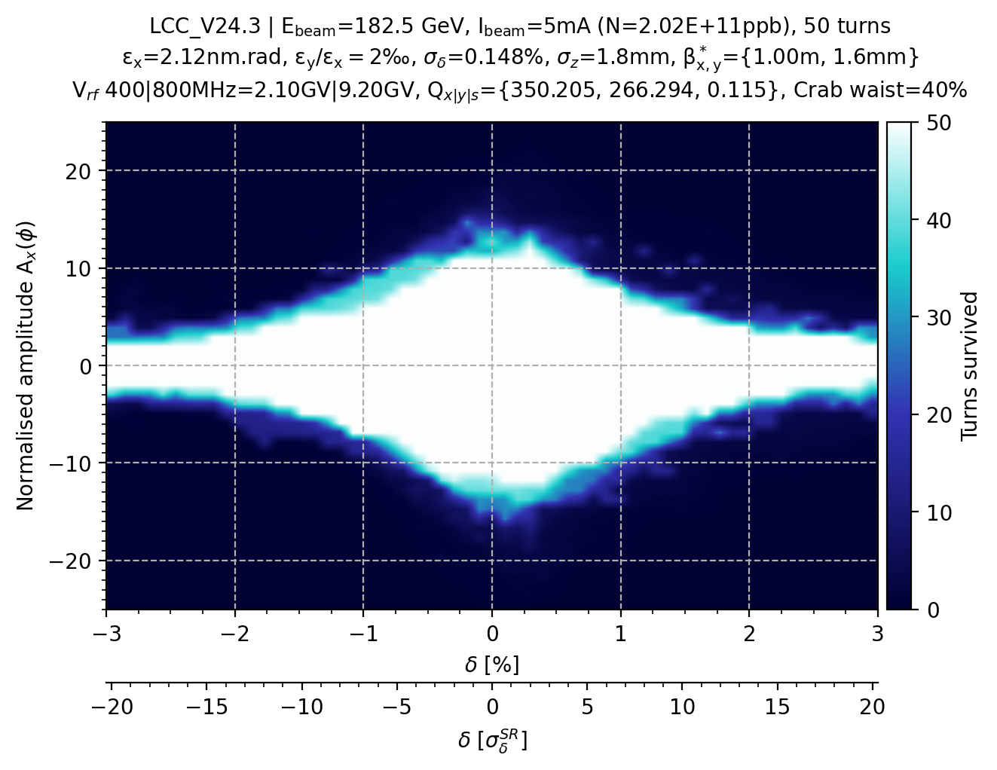
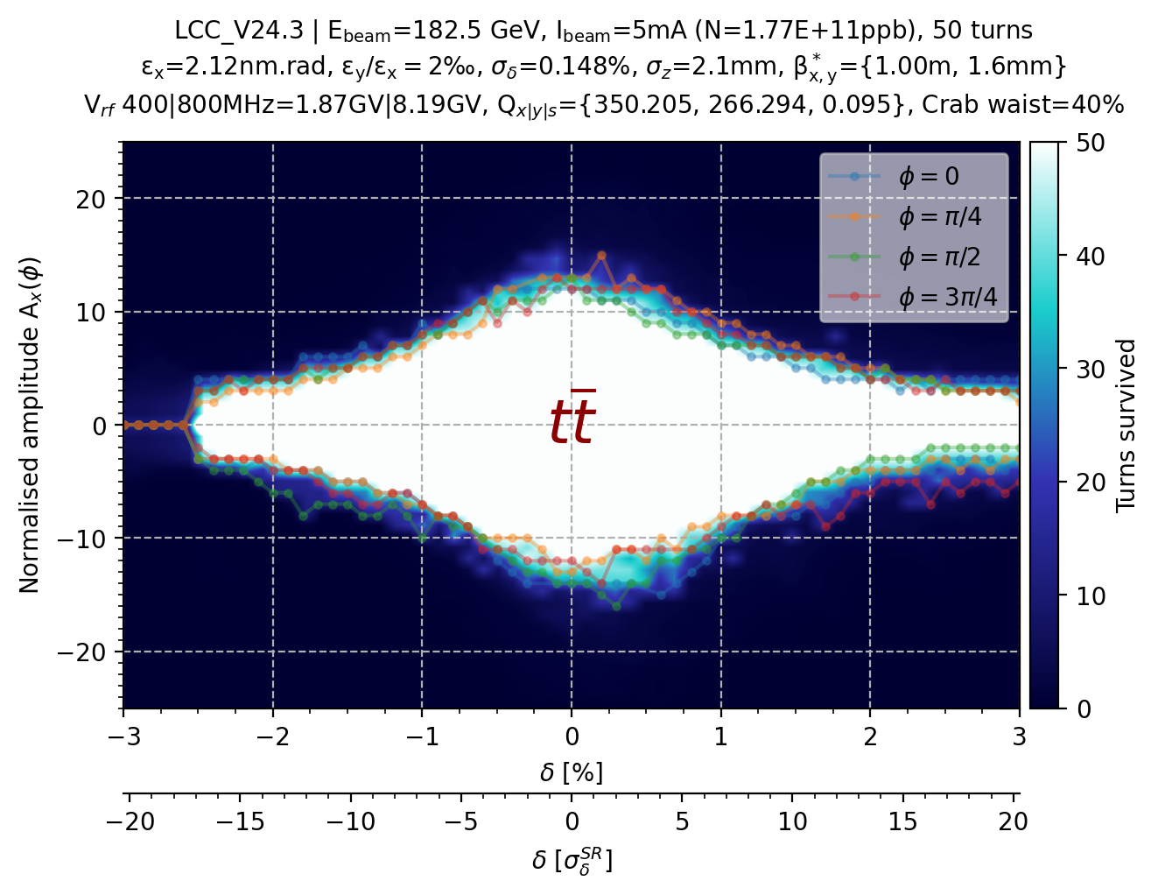
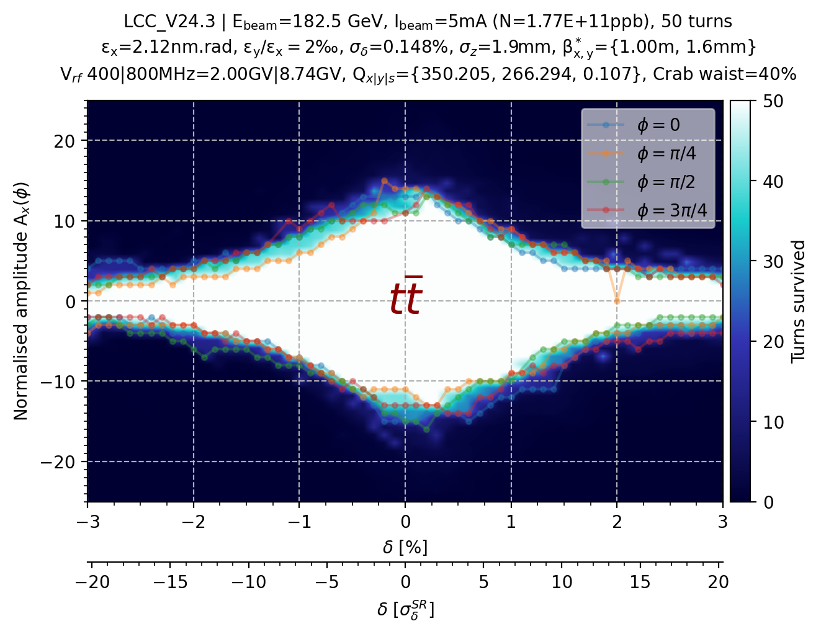
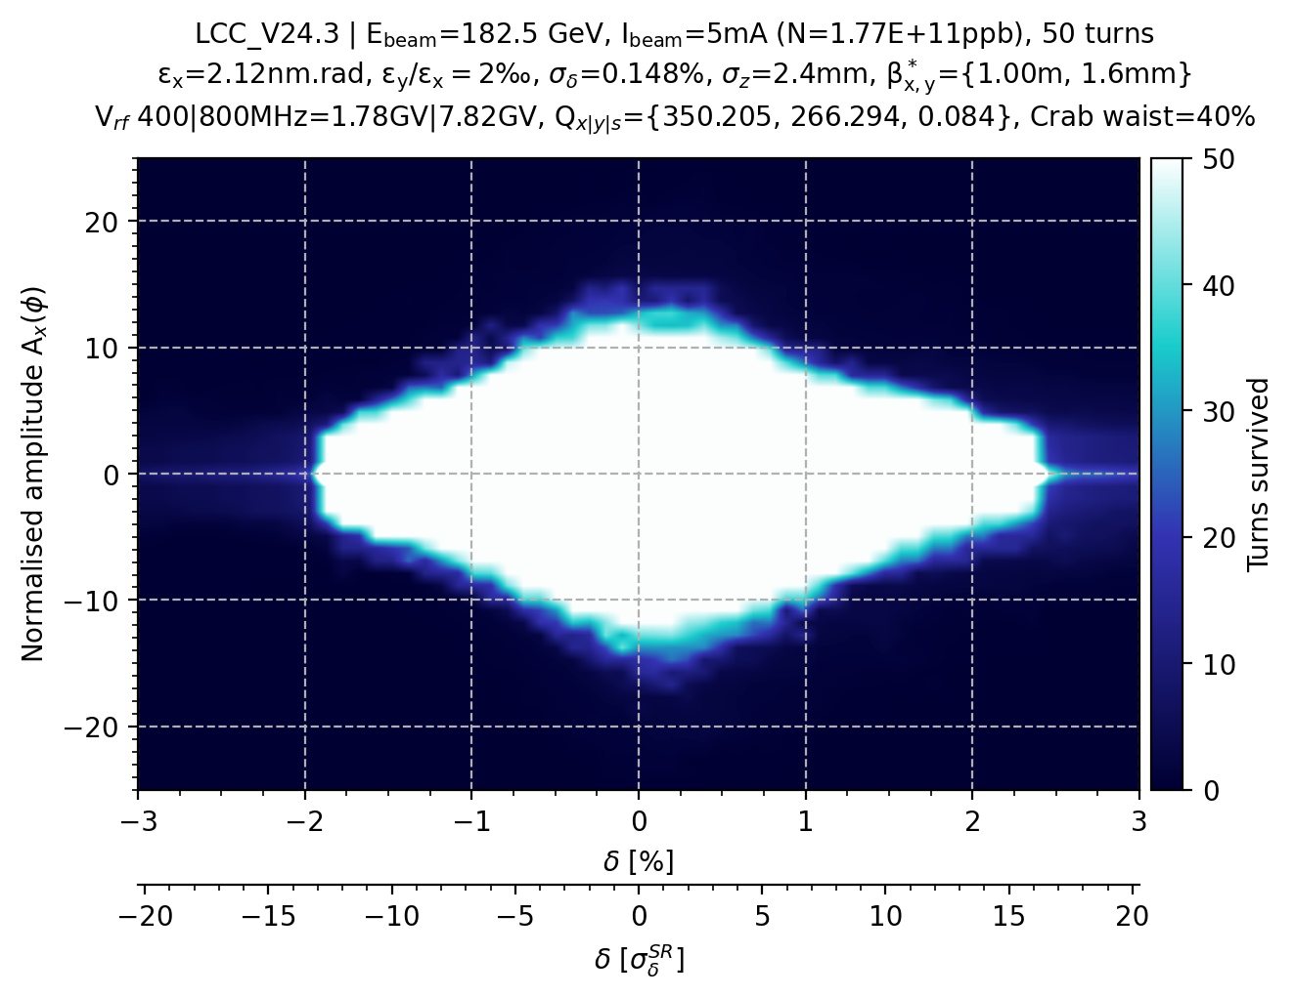
Single RF section for the LCC lattice (nominal)
Attempt to get the same synchrotron tune as GHC lattice (Q_{s}=0.089).
The energy loss per turn is smaller for LCC by 10-12%,
but the momentum compaction factor is larger α_{GHC}=7.5e-6 and α_{LCC}= 8.8e-6
Is it important to get to Q_{s}=0.089 with the LCC lattice ?
Single RF section same total RF voltage
Single RF section 90% total RF voltage
Single RF section 95% total RF voltage
Single RF section 85% total RF voltage

Slide 6
MA comparison between SAD & Xsuite for the GHC lattice and against LCC lattice

Slide 7
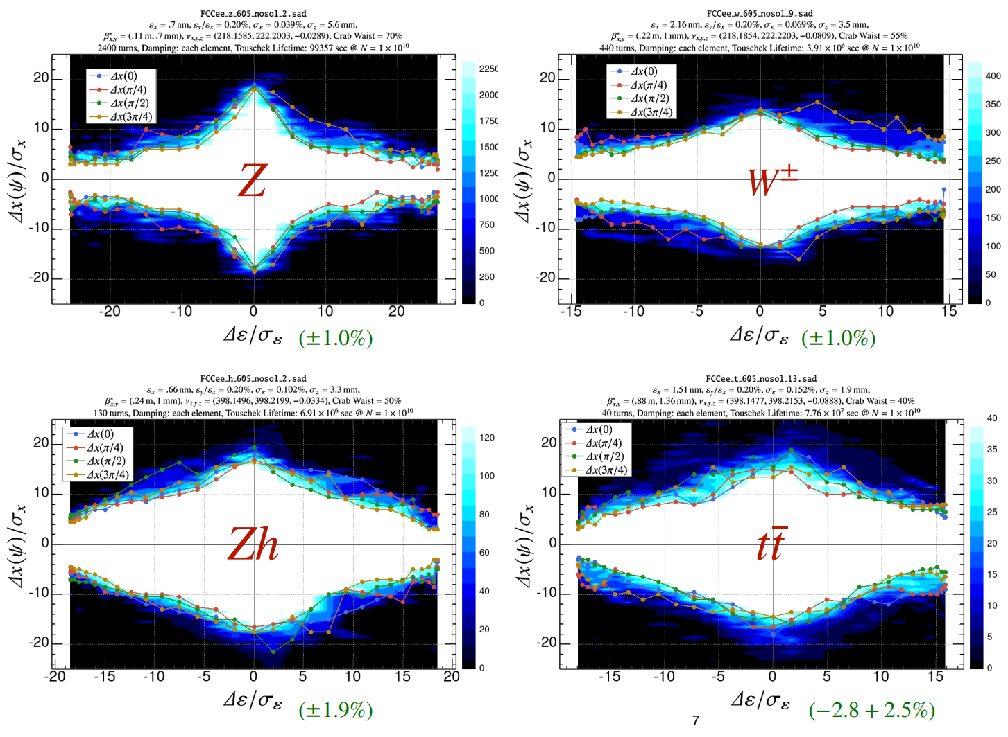
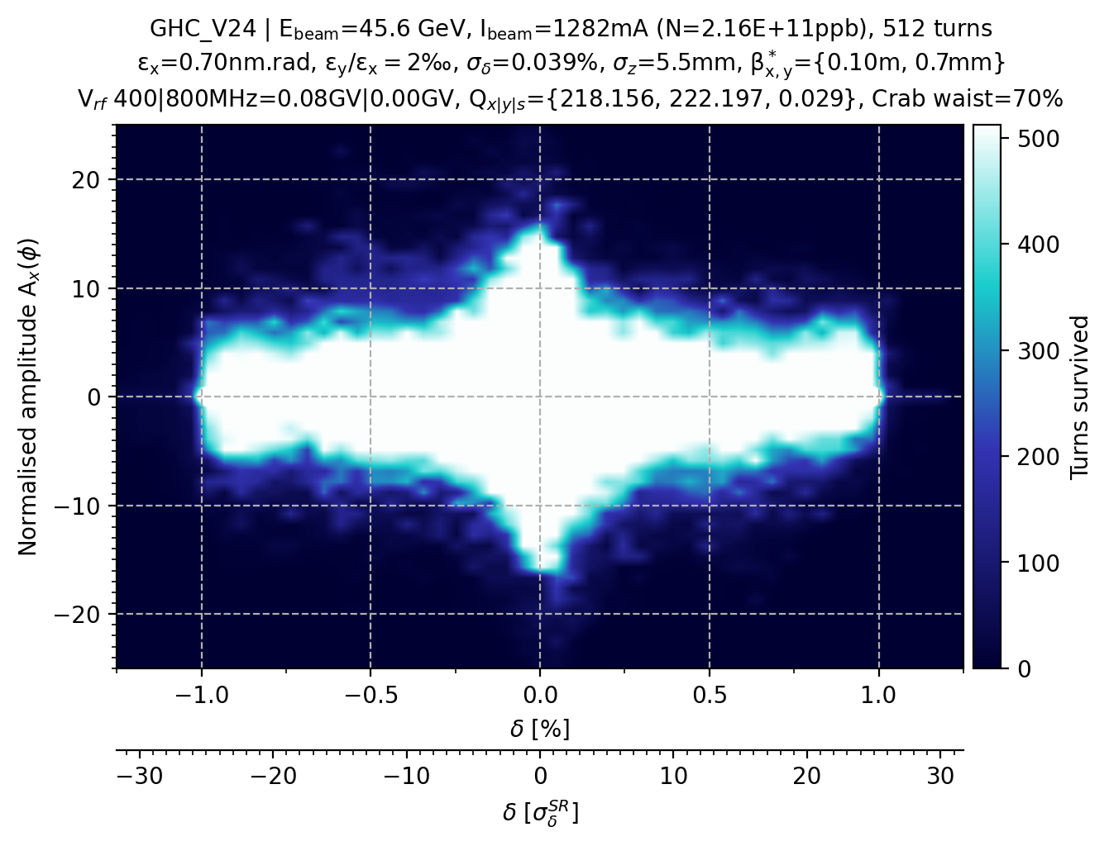
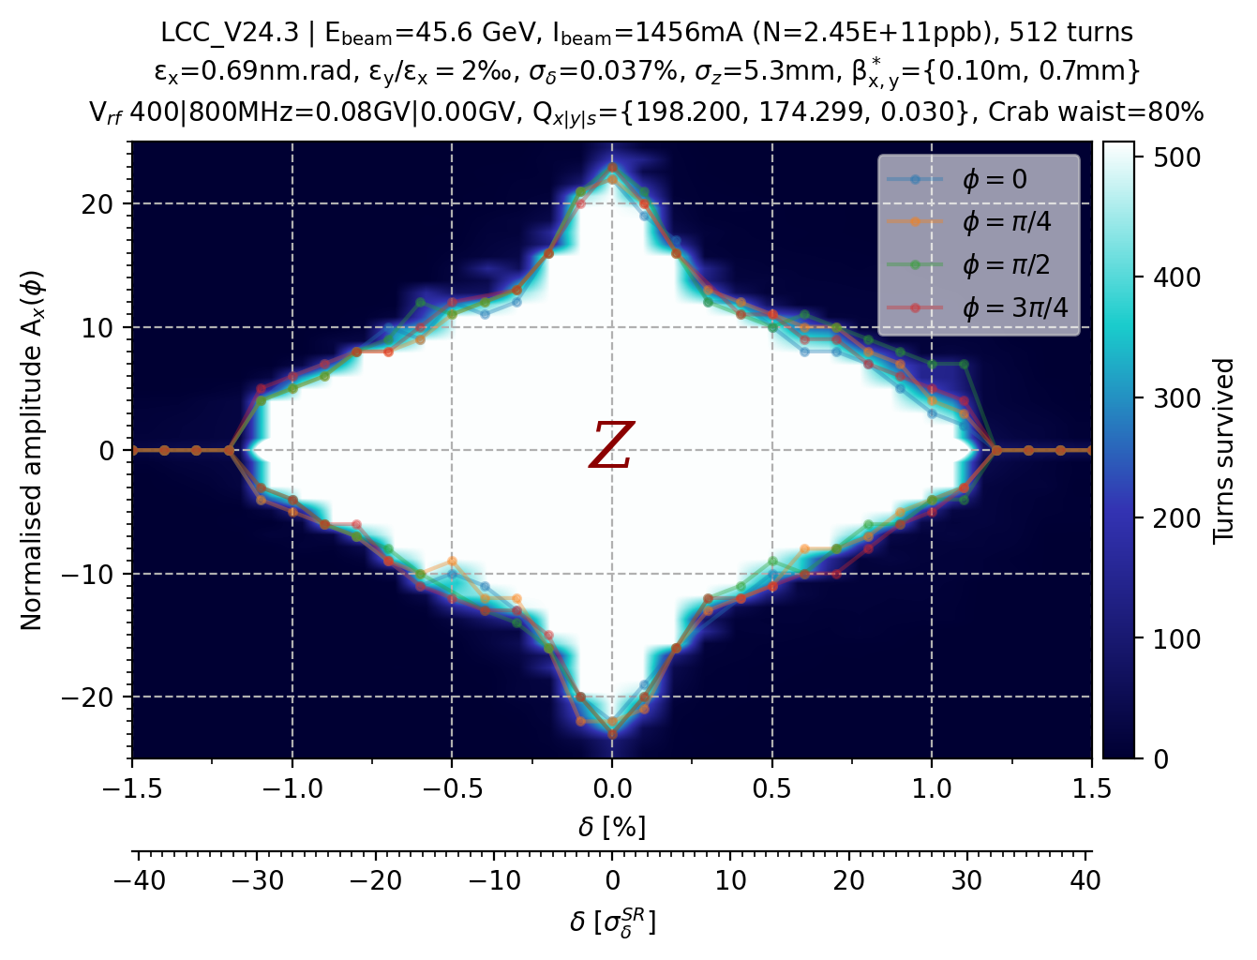
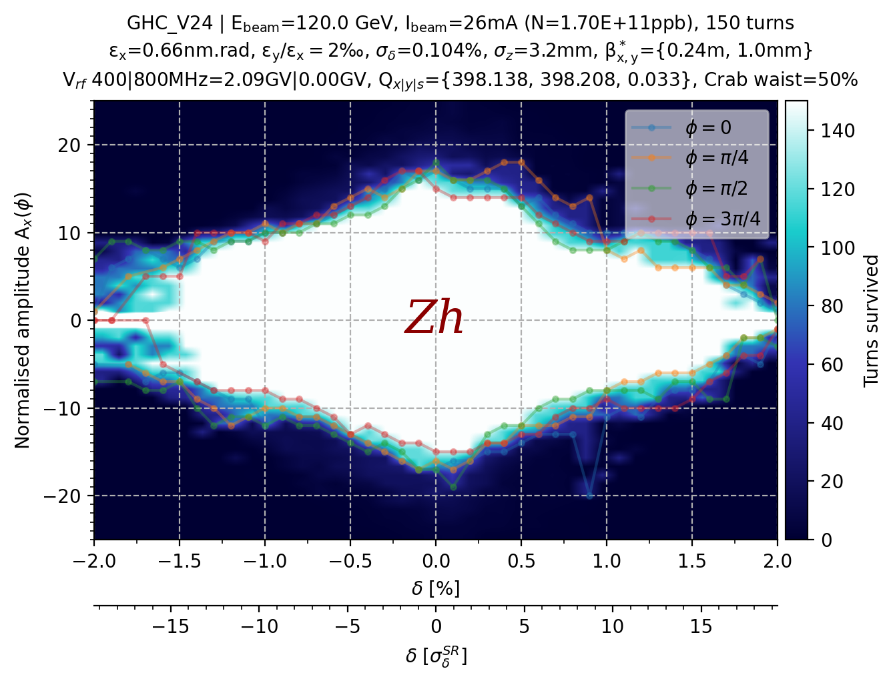

Slide 8

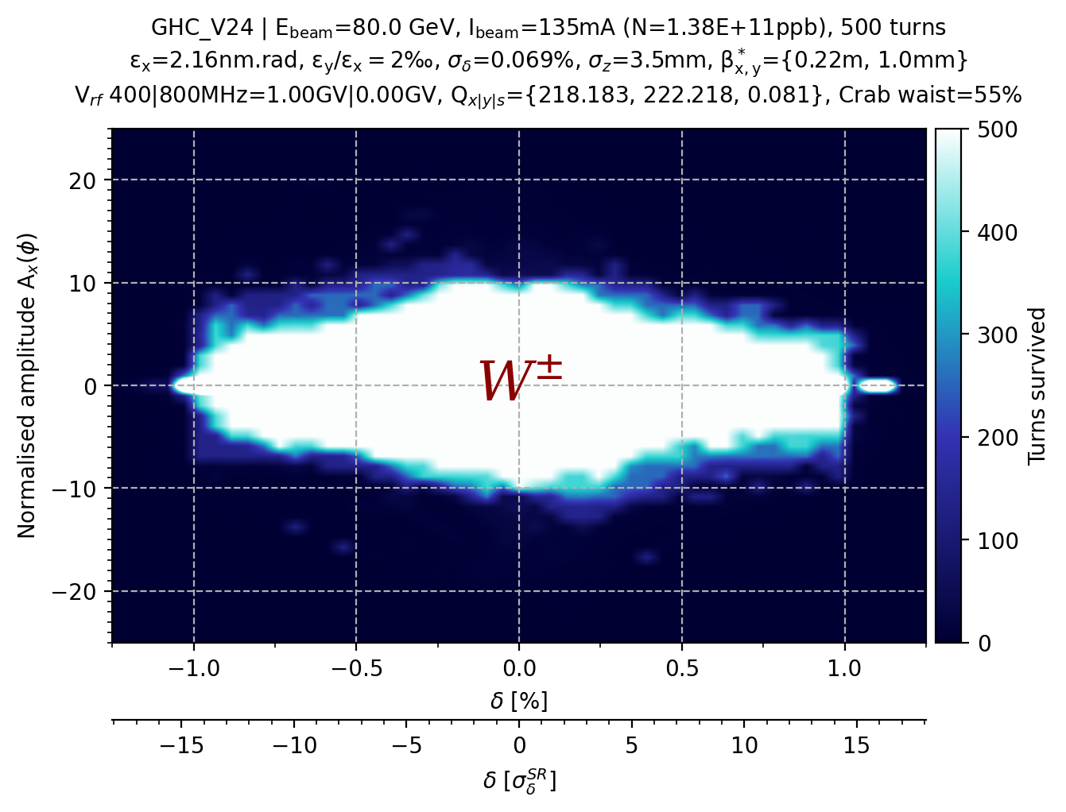
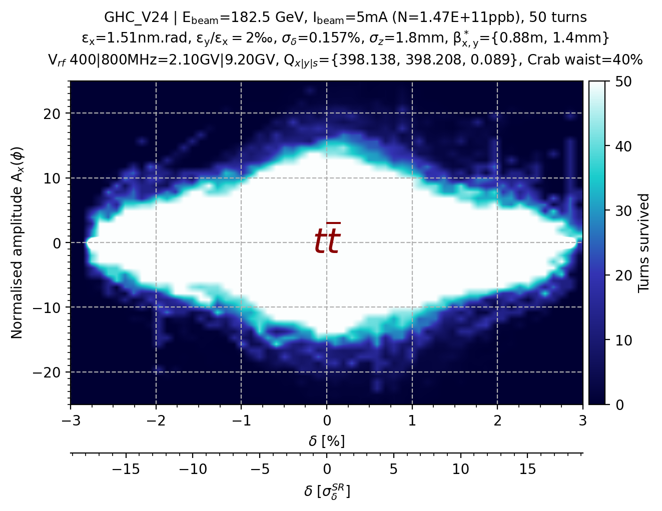

Slide 9
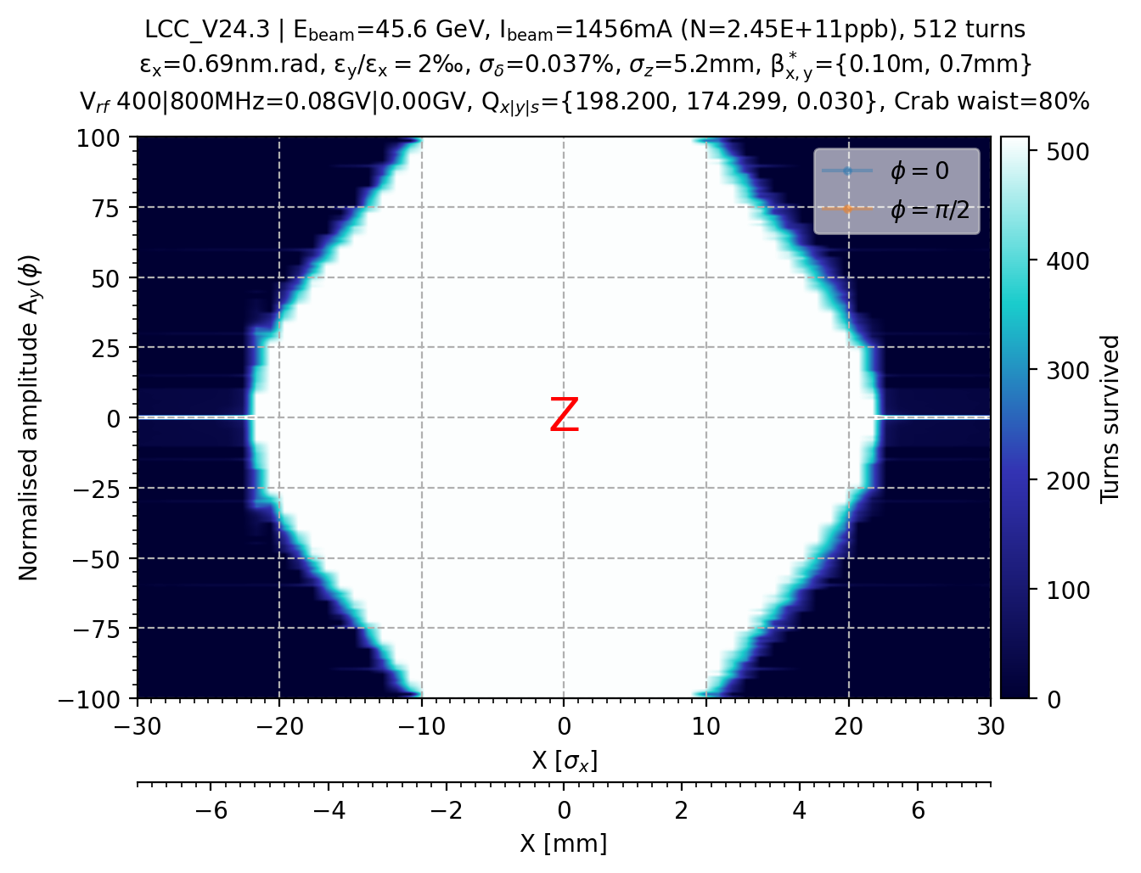
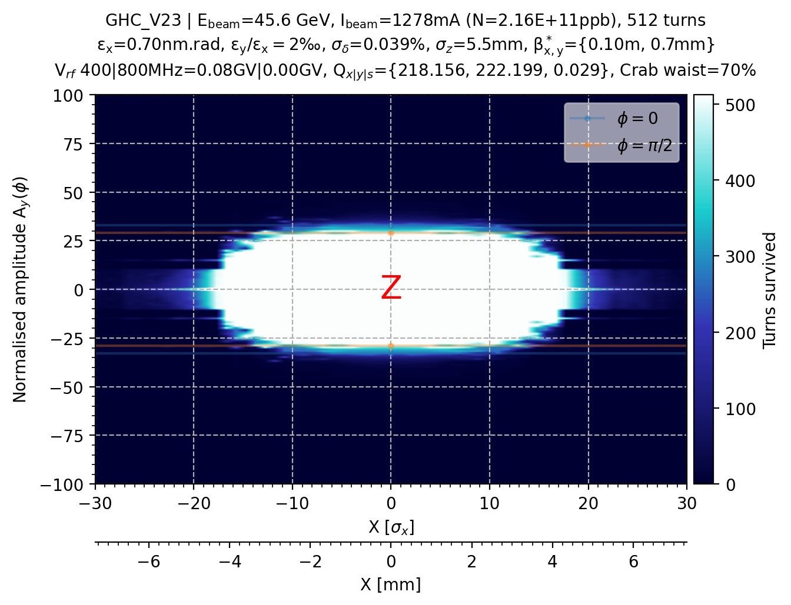
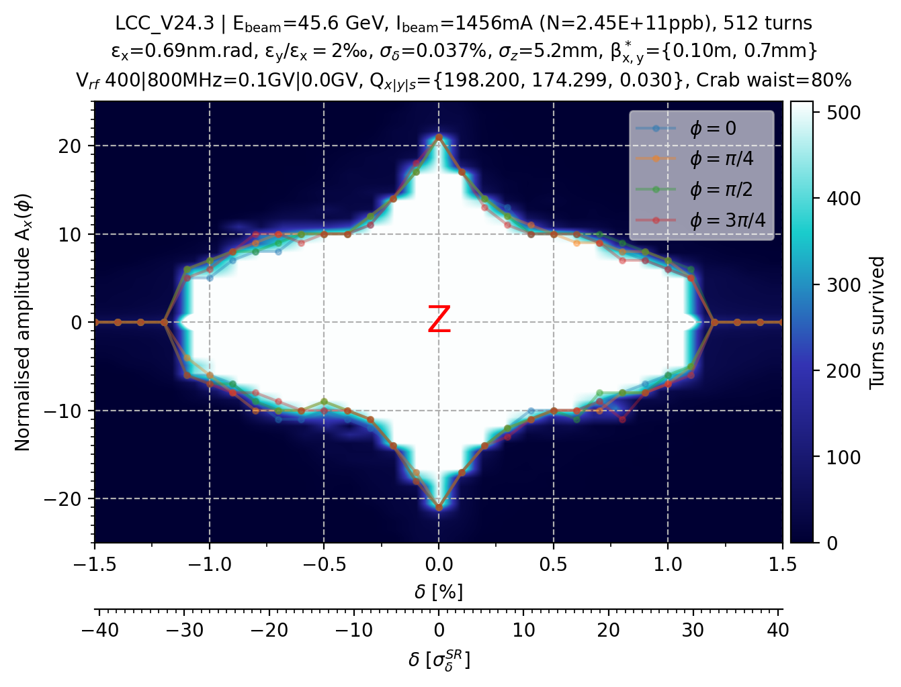
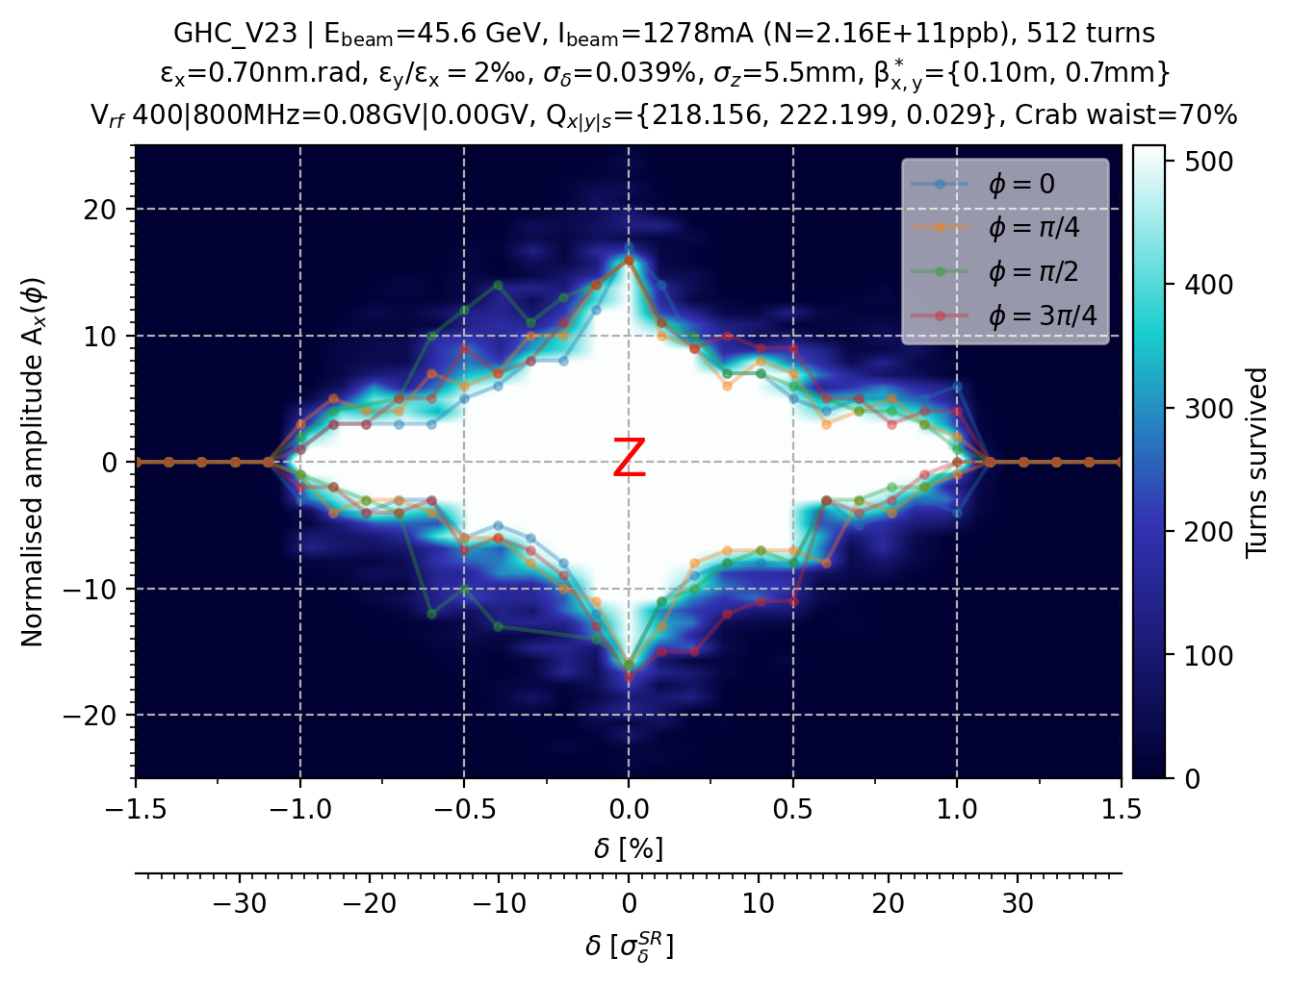
Comparison GHC vs. LCC @ Z energy
Nominal magnet strengths (v92a)

Slide 10
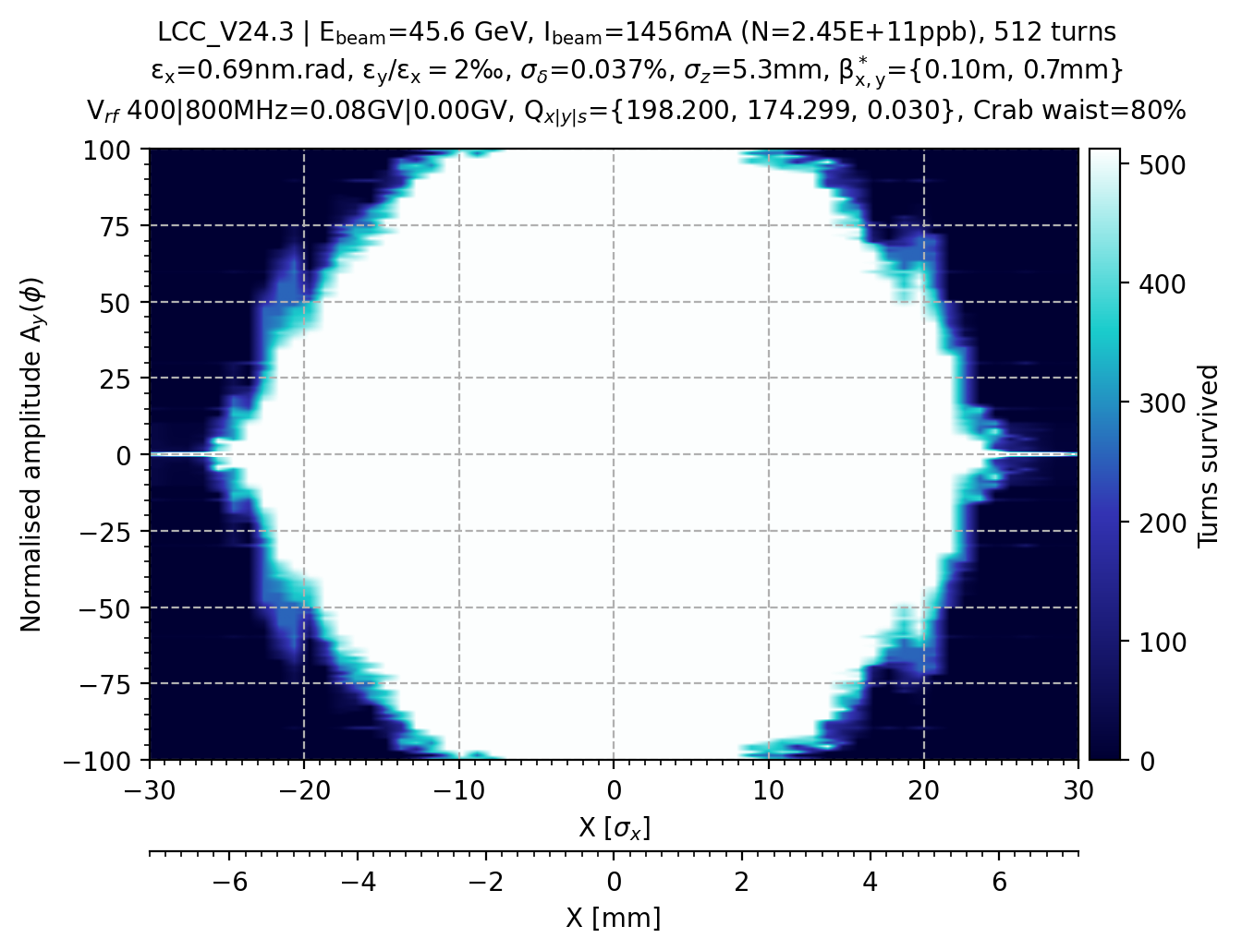
Comparison GHC vs. LCC (opti) @ Z energy
Optimized magnet strengths (v92a)

Slide 11
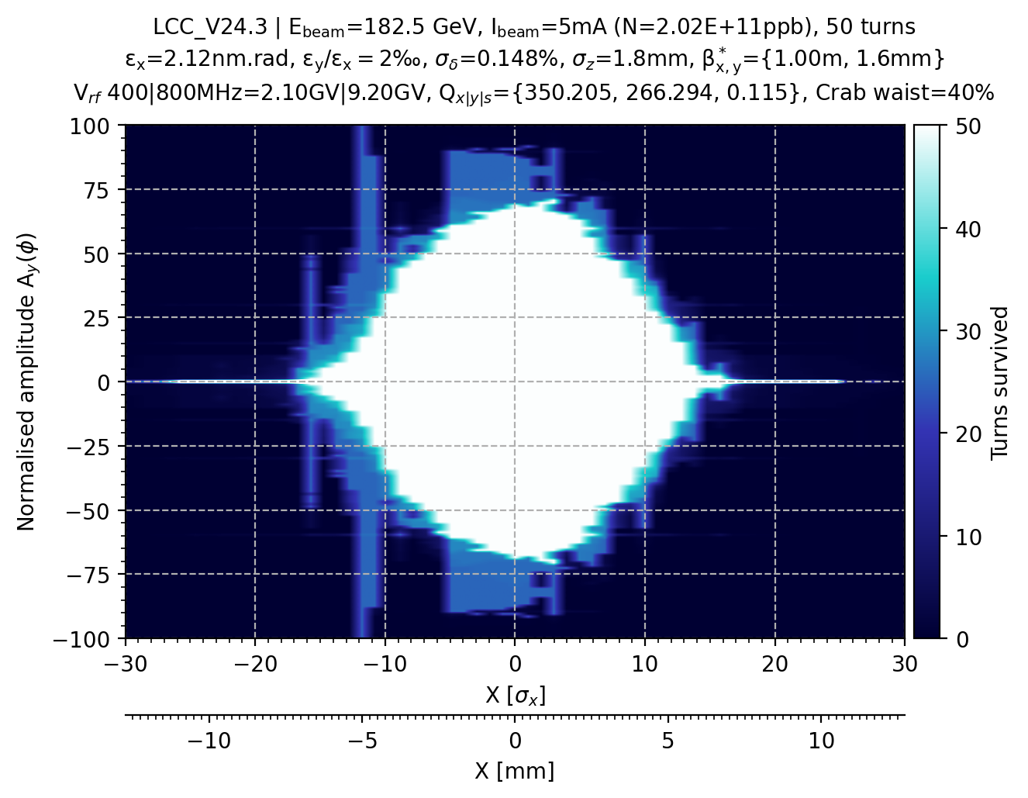
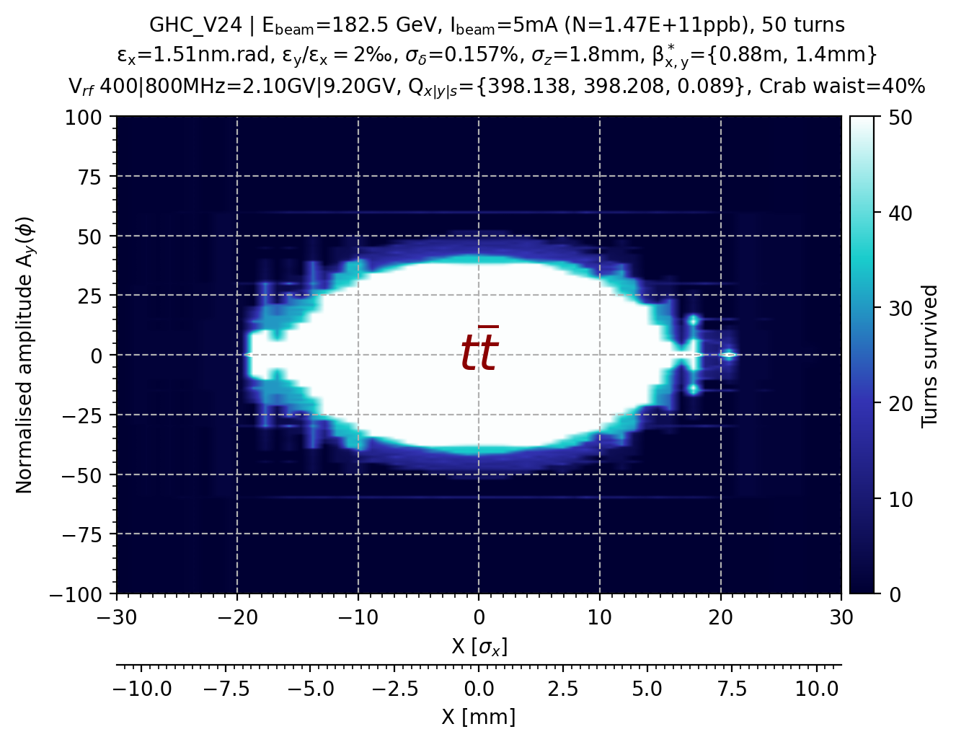
Comparison GHC vs. LCC @ tt̄ energy
DA
MA

Slide 12
MA comparison between SAD and Xsuite for the LCC lattice

Slide 13
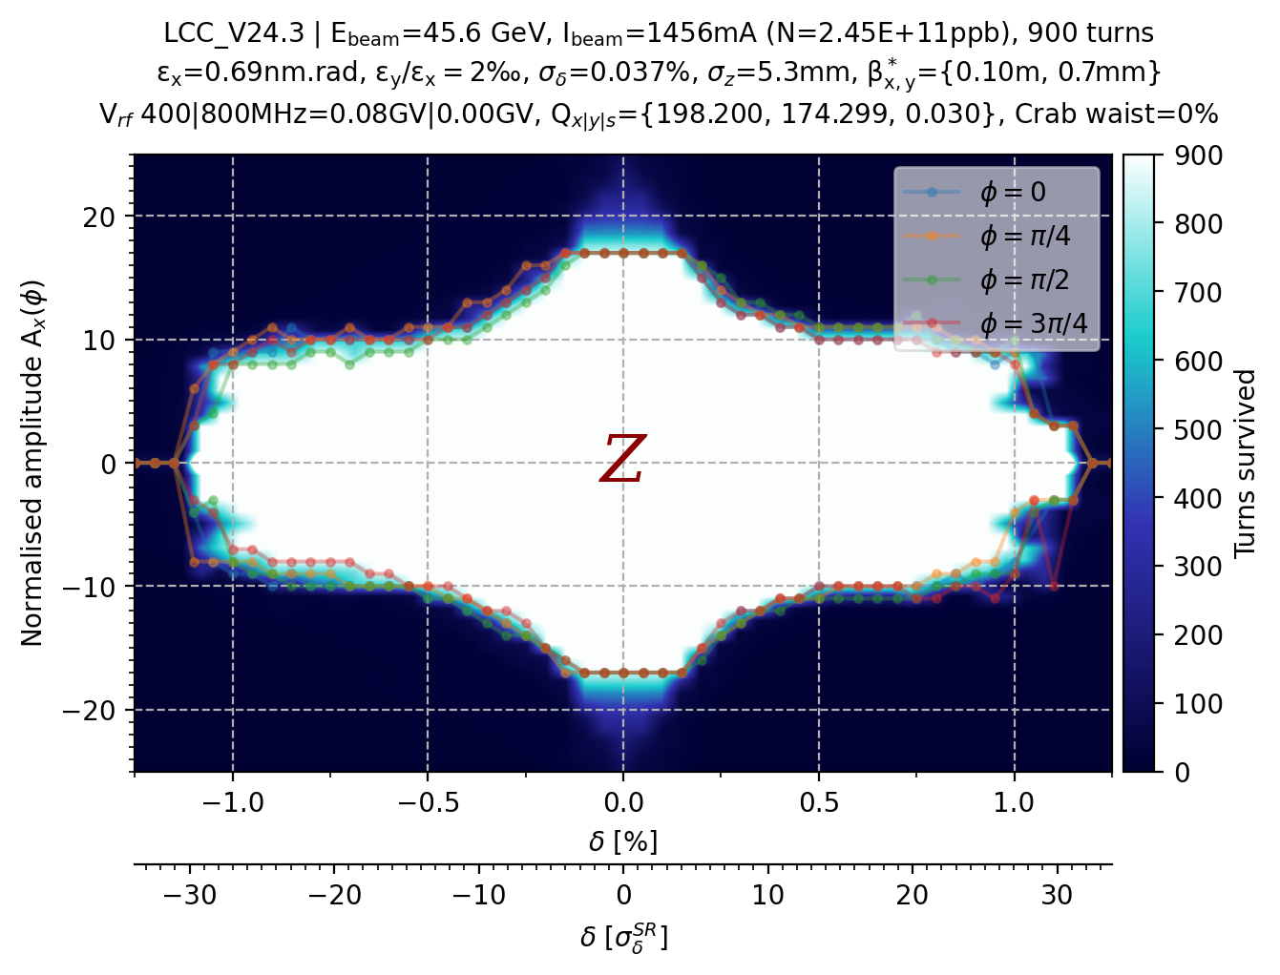
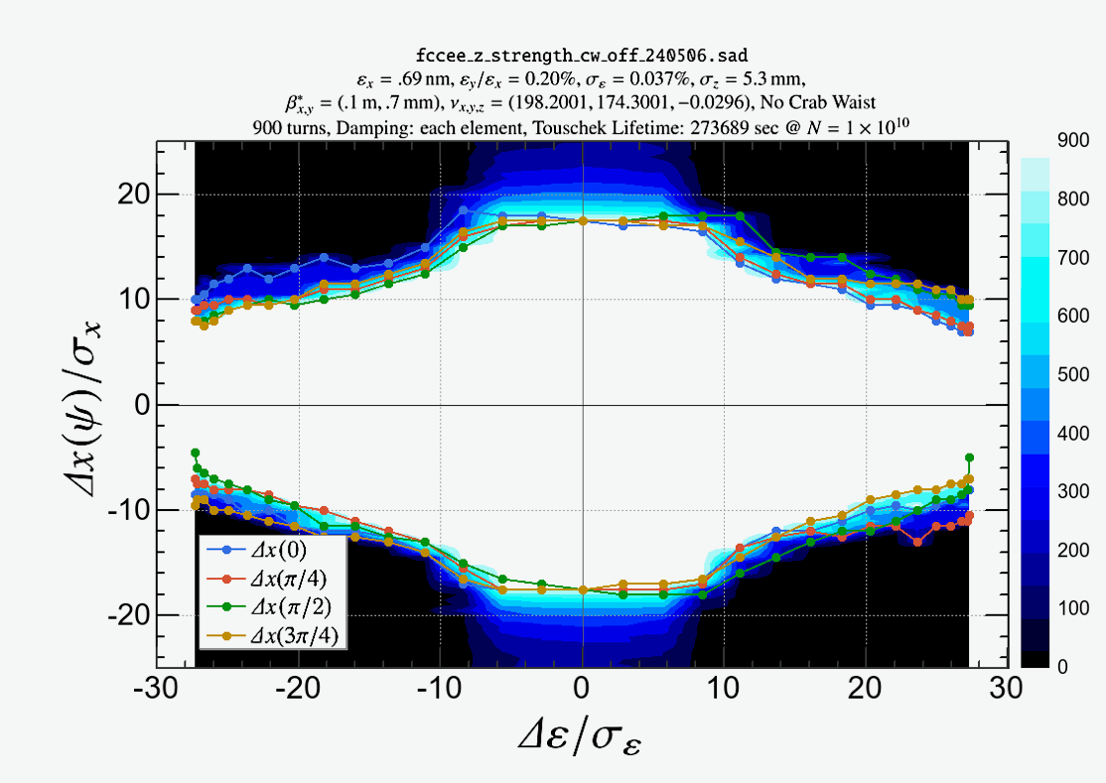
Differences between Xsuite and SAD (CW=0%)
I spotted differences (in the converted MADX file, Oide-san sent me) in which the variable cs_comp is not used and the decapoles not defined.
It could explain the differences observed with and without crab waist as the decapoles are turned on also without crab waist.

Slide 14
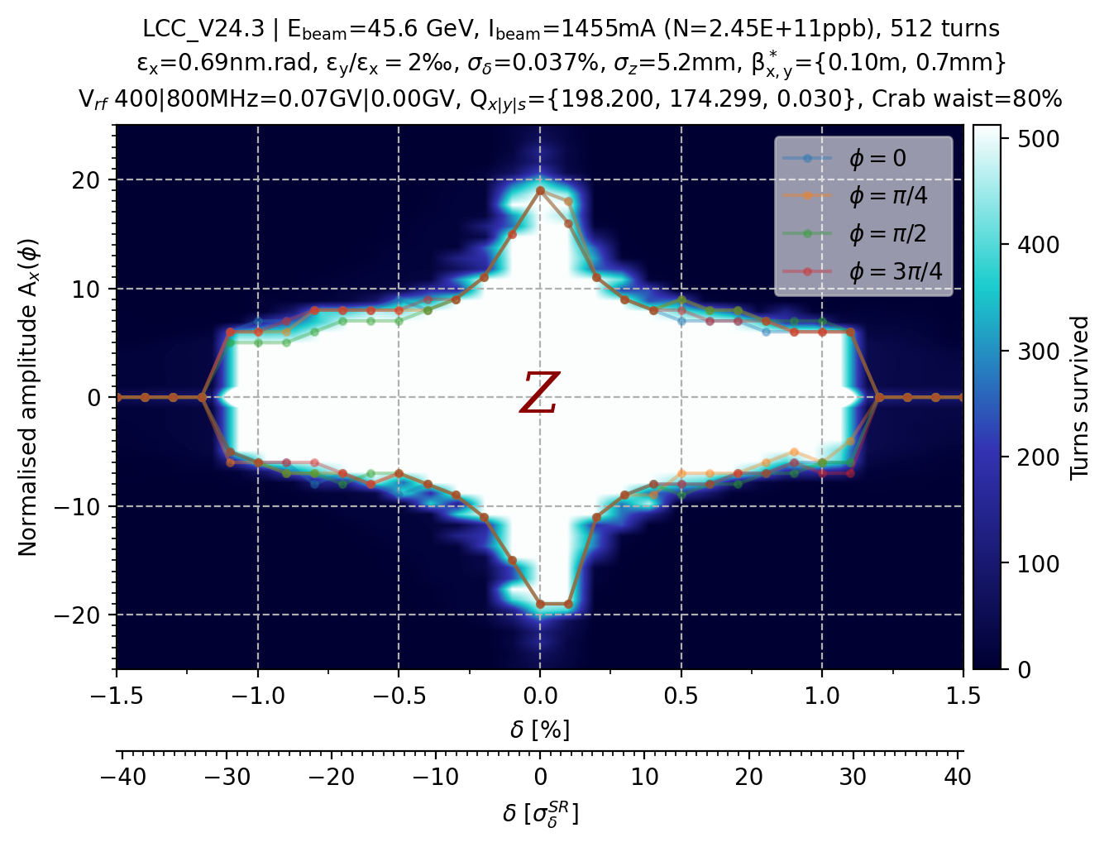
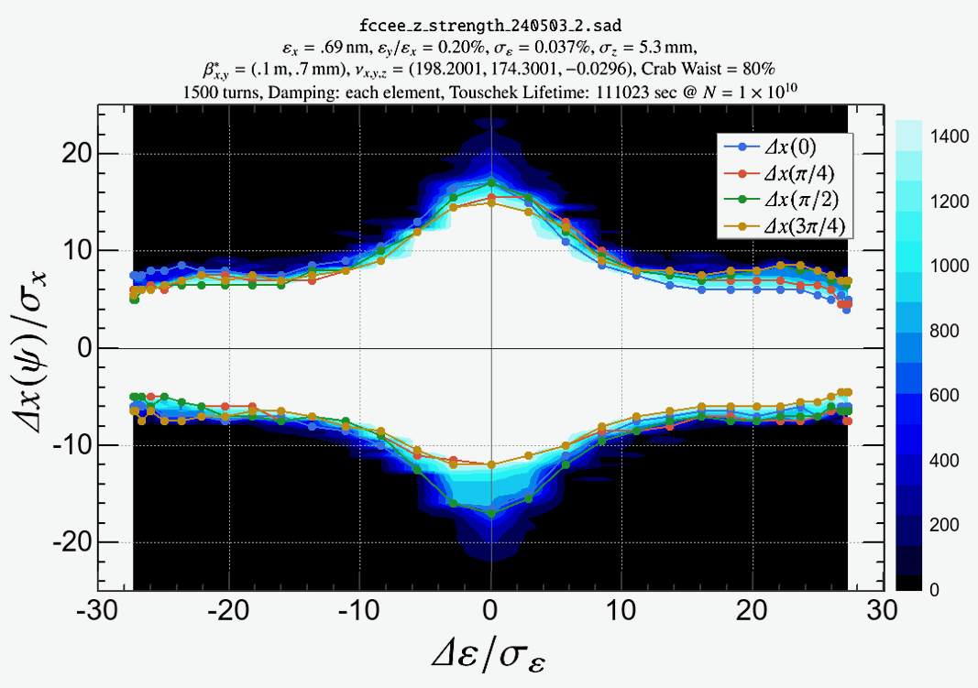
Differences between Xsuite and SAD (CW=80%)
I spotted differences (in the converted MADX file, Oide-san sent me) in which the variable cs_comp is not used and the decapoles not defined.
It could explain the differences observed with and without crab waist as the decapoles are turned on also without crab waist.

Slide 15
MA study comparison between relaxed vs. nominal optics
-- GHC lattice detuned to ϐ*_{x}= 0.33m & ϐ*_{y}=7 mm
-- LCC lattice detuned to ϐ*_{x}= 0.30m & ϐ*_{y}=7 mm

Slide 16
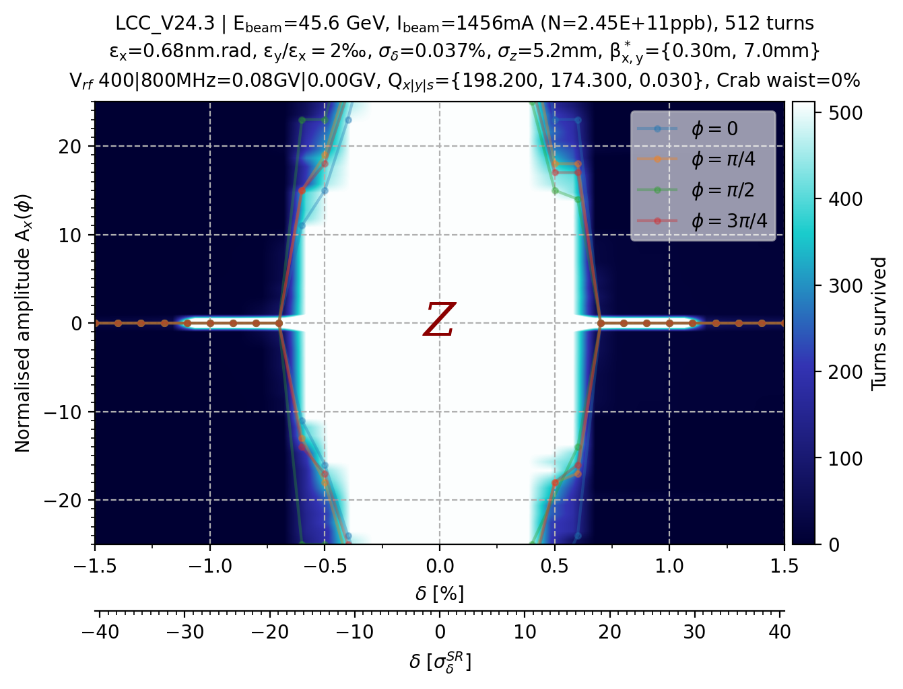
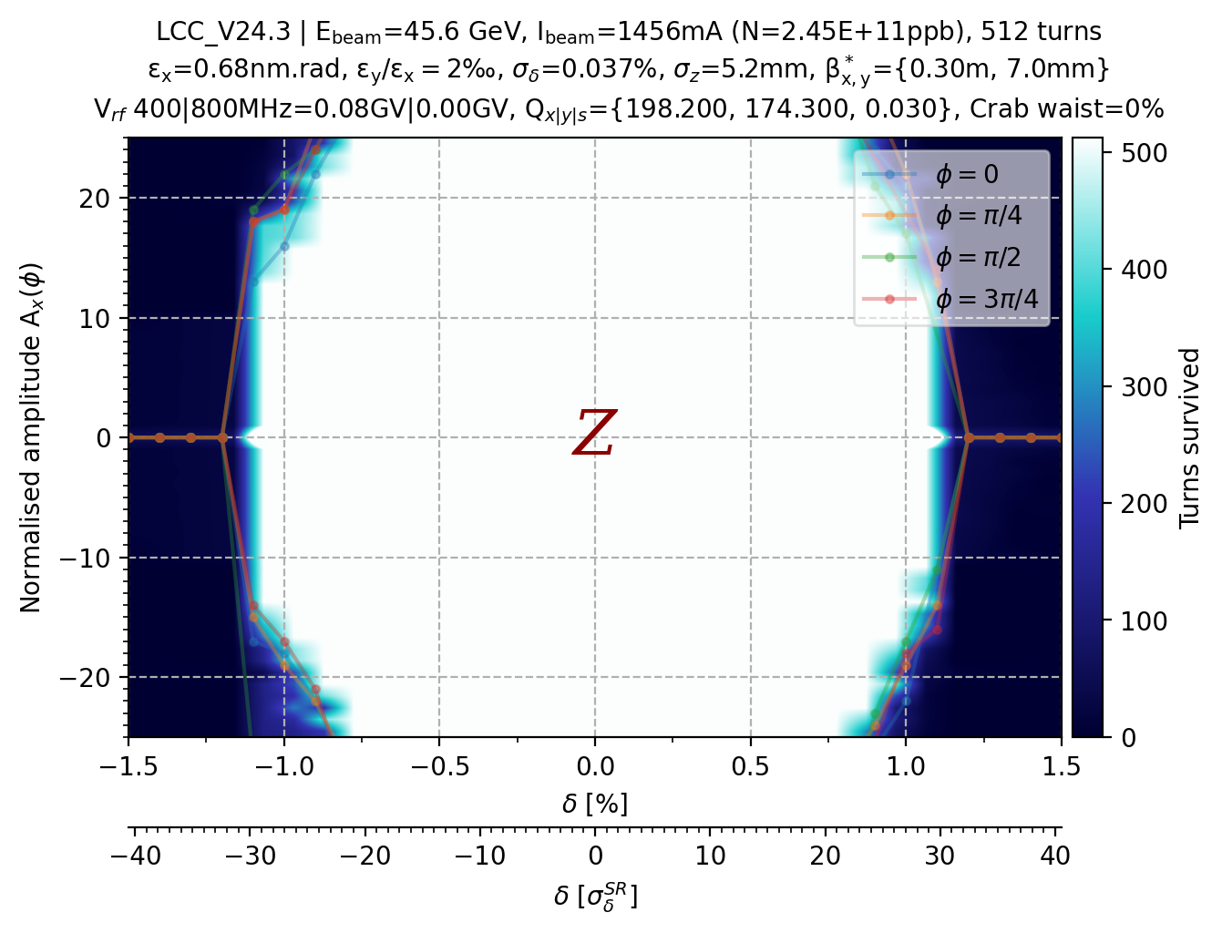
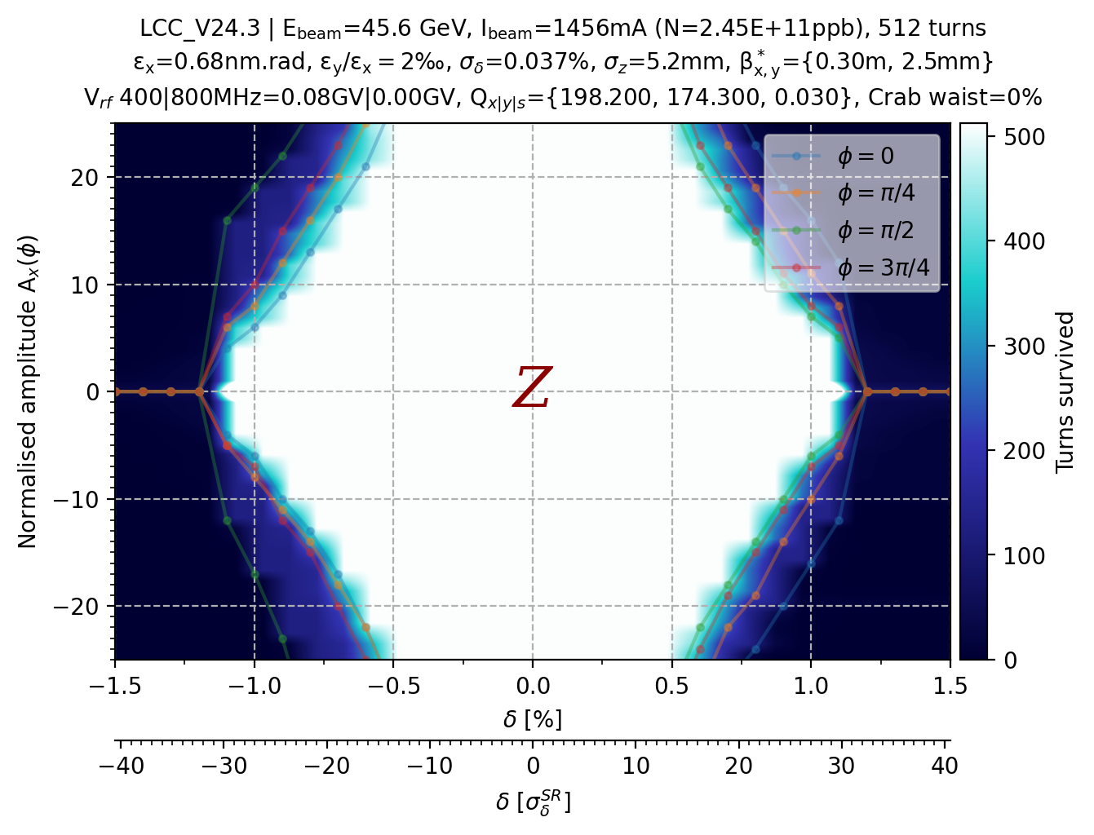
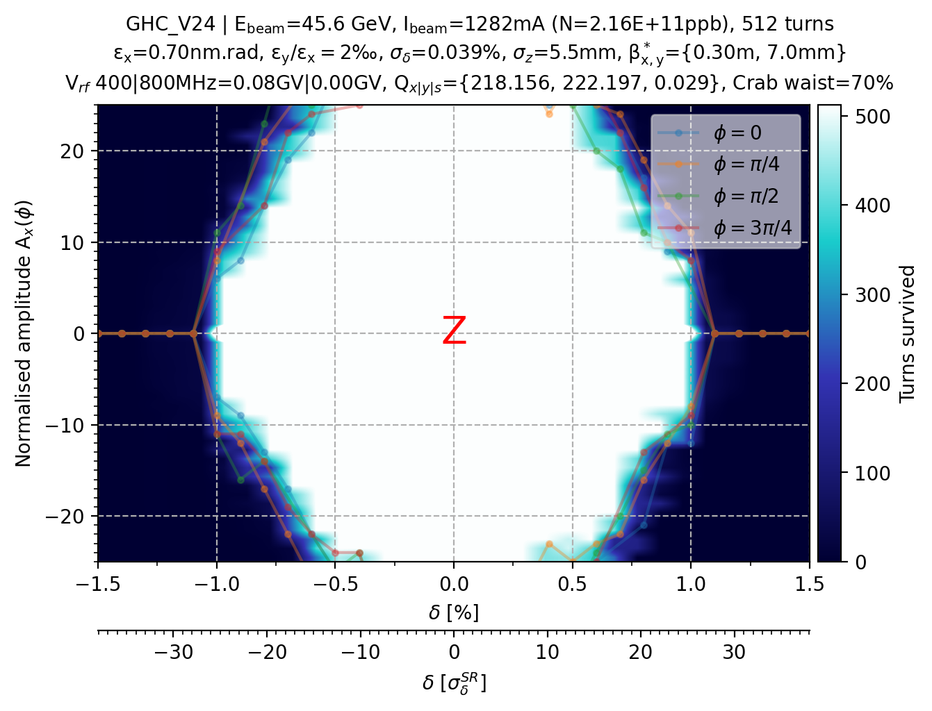
Momentum Acceptance of the relaxed optics
Nominal
Nominal
LCC
GHC

Slide 17
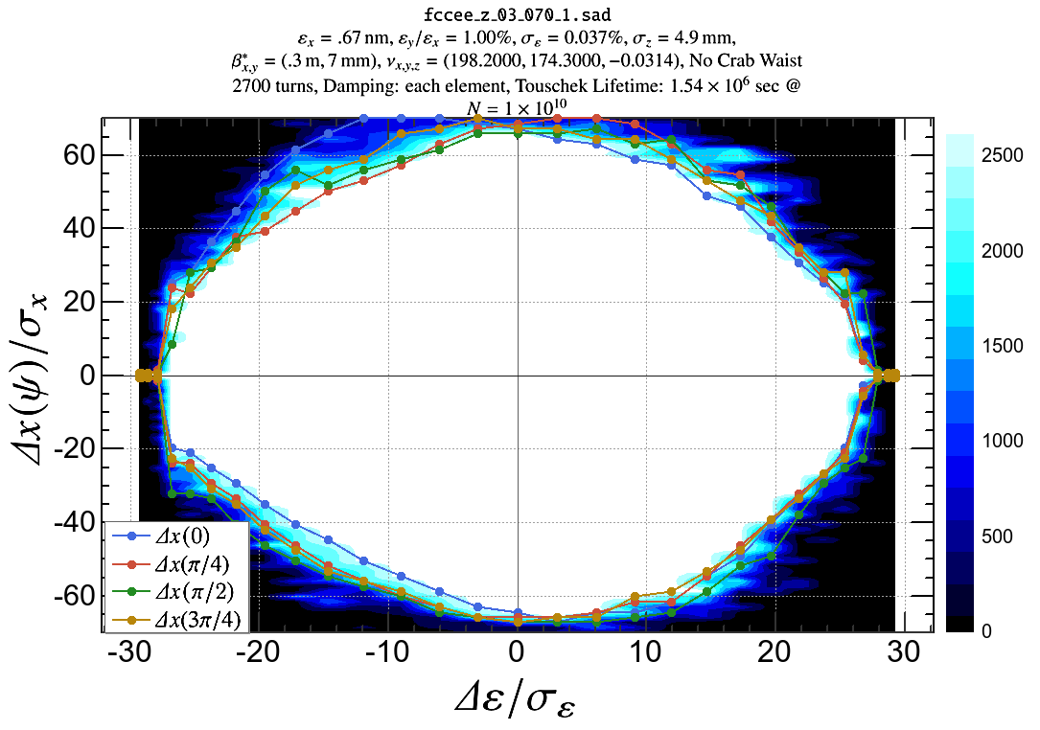
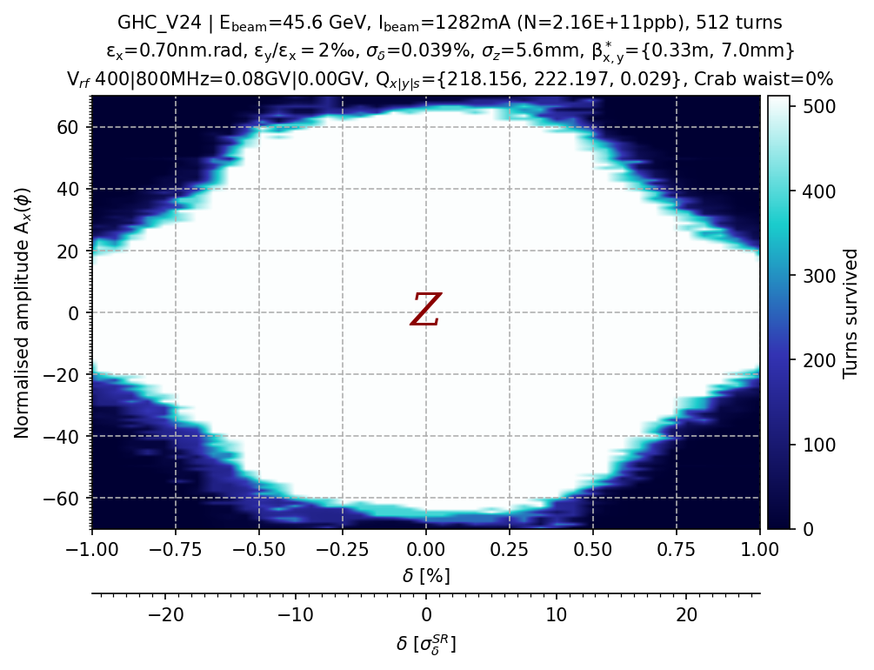
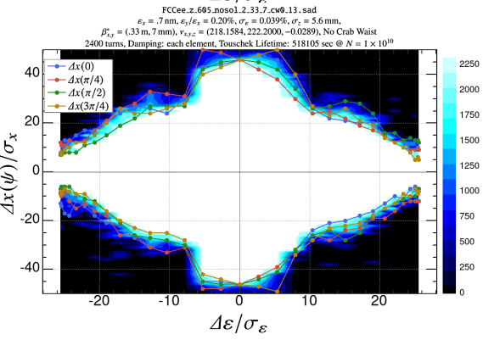
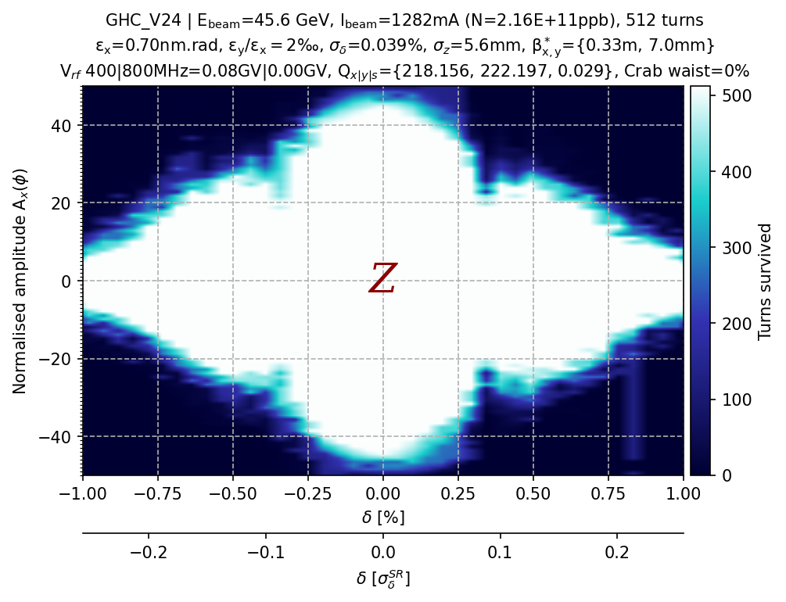
Momentum Acceptance of the relaxed optics
Nominal
LCC
Detuned
From link
Nominal
GHC
Detuned

Slide 18
Summary and outlook
One RF section: Decreasing by about 5% the total RF voltage of LCC at tt energy still result in ±3% MA and Q_{s}=0.107. 10% is too much though.
Xsuite/SAD MA comparison: The MA results for the GHC lattice agree well with CW. The MA results for the LCC lattice agree well without CW.
Detuned optics: The MA of the GHC detuned optics goes beyond 40σ_{x} on-energy and 10σ_{x} at ±1%, whereas LCC detuned optics goes beyond 60σ_{x} on-energy and 20σ_{x} at ±1%.
_{Outlook:}
- Implement the DA/MA with Xsuite as a test in the Gitlab lattice repository, along with SAD?
- Compare Xsuite/SAD MA results for the LCC lattice including decapoles (and cs_comp with CW).
- Implement the optimum magnet strengths for the LCC lattice at ttbar energy.

