Slide 1
Developing a Zenodo Jupyter Lab Extension
Link to CDS record
Michael Zengel. - Supervisors: Enrique Garcia and Giovanni Guerrieri
09/08/2024

Slide 2
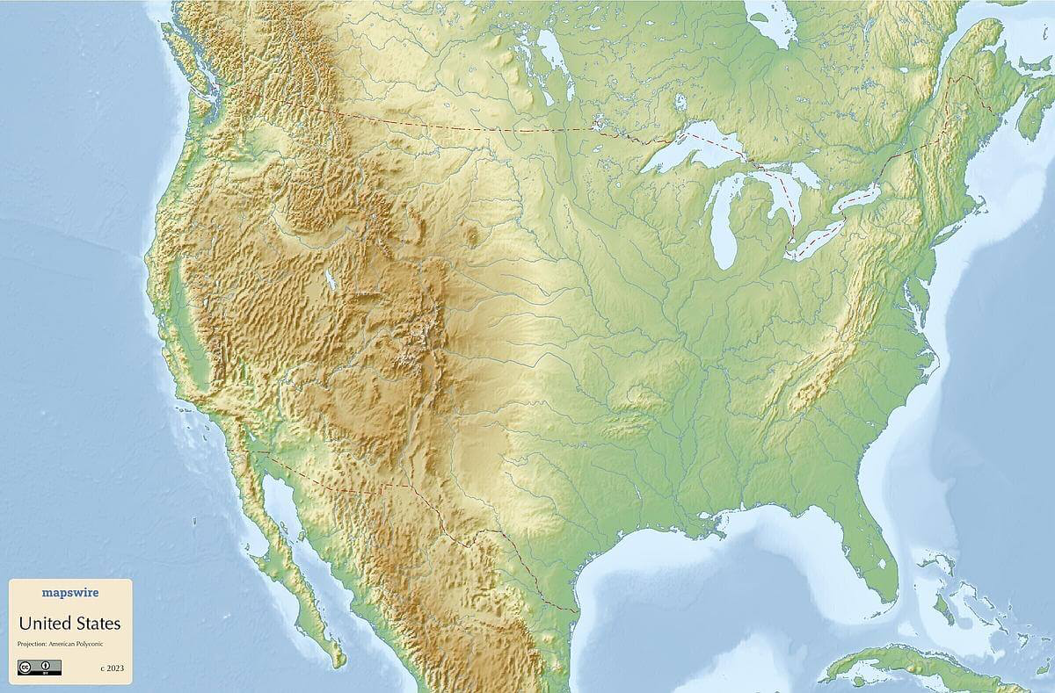
Who am I
Michael Zengel
Originally from New Orleans
Rising 4th year Physics and Math Major at the University of Alabama
Participating in Summer Student Programme via the University of Michigan CERN Research Experience for Undergraduates (REU) program

Slide 3
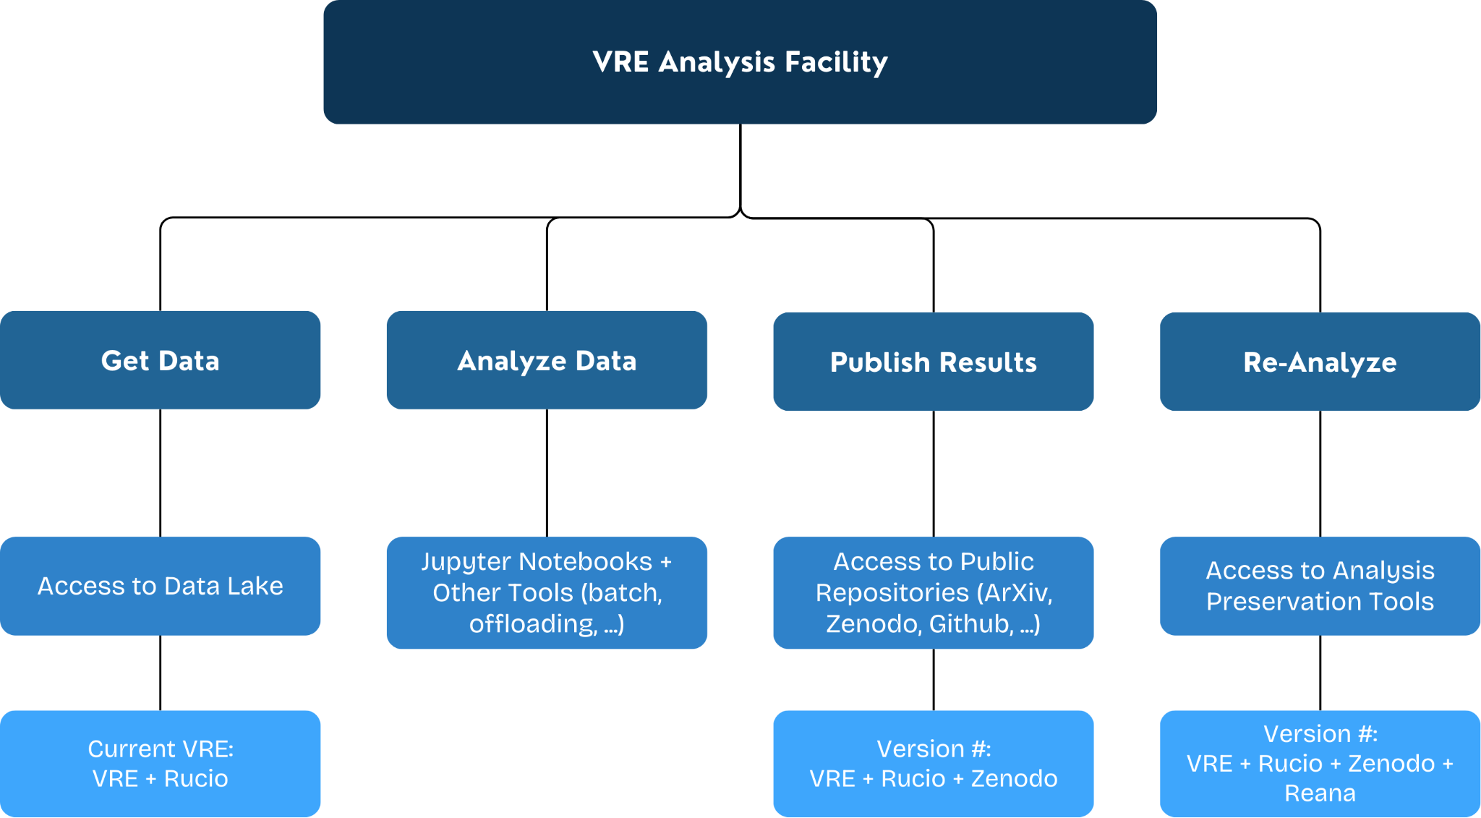
The Virtual Research Environment (VRE)
Grand Purpose of VRE
  An analysis facility based on the Jupyter framework
  Simplify life for physicists by aggregating software and infrastructure
  Developed by the ESCAPE collaboration
  Goal: End-to-end Scientific Analysis Workflow in a Cloud-Based Environment

Slide 4


This project: Context
Zenodo: Open-source database software for sharing results/code
  Goal: Incorporate into VRE via Jupyter Lab, widely used interactive framework
    Increases speed and ease of downloading and uploading data
    Removes the need for local storage interaction; fully cloud-based
    Exploits command line interface (CLI) in a visual way
    Incorporates the “Publishing Results” step of the VRE end goal
      https://github.com/vre-hub/zenodo-jupyterlab-extension
+

Slide 5
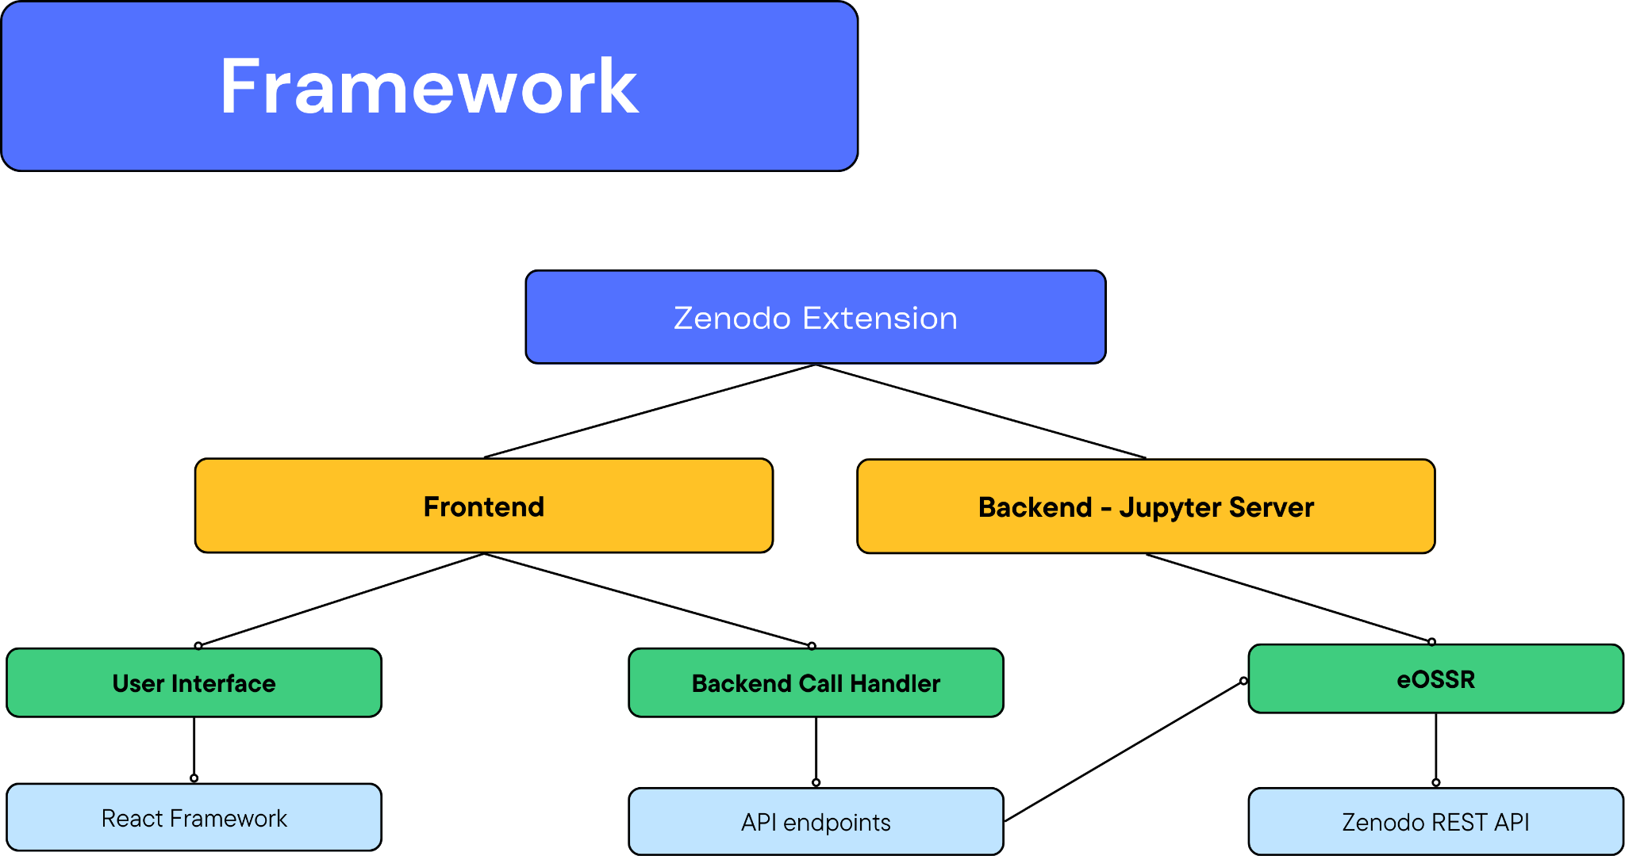
General Framework

Slide 6
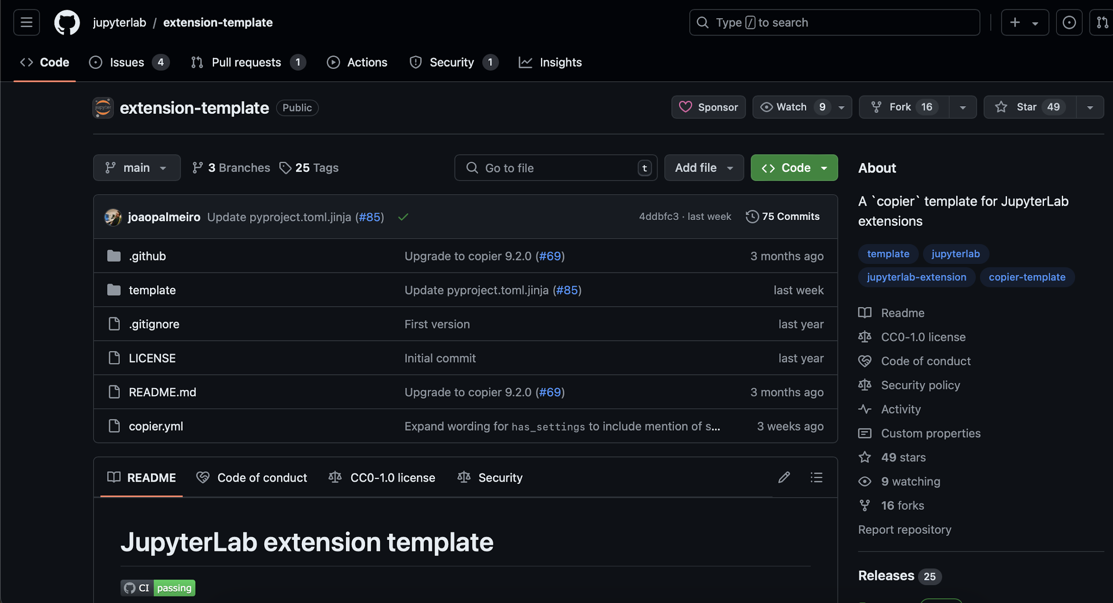
General Framework
Frontend Design
Built off of copier extension template
Developed via Nodejs 20 and React
Rendered as a Sidebar Widget
Extends JupyterFrontEnd app

Slide 7
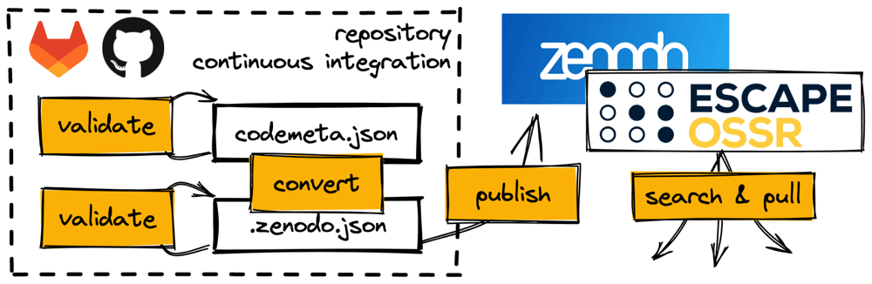
General Framework
Backend Design
Jupyter Server Extension (separate from Frontend Extension)
Hosts API calls
Runs eOSSR scripts for searching, logging in, and uploading data
    eOSSR is a python library developed as a part of the ESCAPE Project

Slide 8
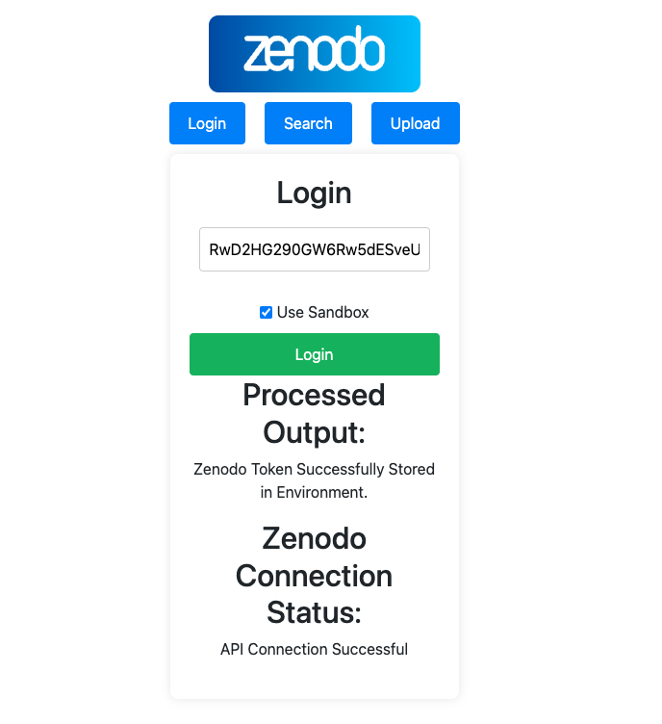
Major Components
Logging in to Extension
Takes in API Access Token
Validates via deposit query status code
Stores in env var for use throughout JupyterLab instance
      Securely only accessible to user within session
Sandbox functionality (stored for use in uploading)
  Searching is exclusively non-sandbox
Note: This is simply a draft of the application; cosmetic details, such as spacing, will be addressed in the future.

Slide 9
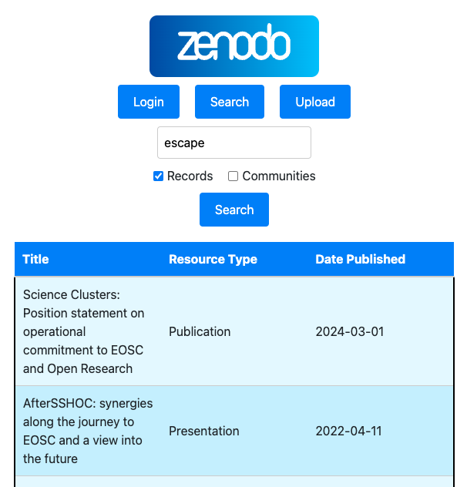
Major Components
Searching
Uses built in Elasticsearch query string syntax from REST API
      Searches for DOI, Title, Description, Creators, Communities
Returns Title, Resource Type, Date Published
Sorted by Most Recently changed (same as REST API)

Slide 10
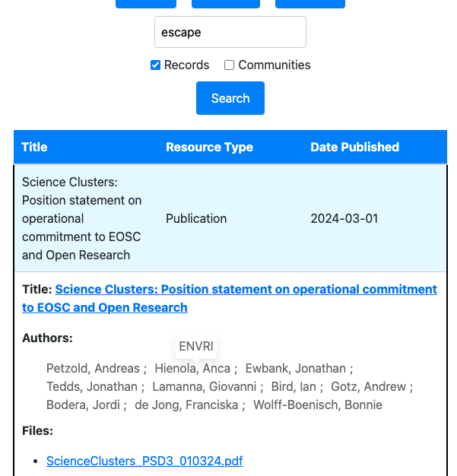
Major Components
Searching
Uses built in Elasticsearch query string syntax from REST API
Returns Title, Resource Type, Date Published
Sorted by Most Recently changed (same as REST API)
Clicking a Record gives more information
  Title with link to Zenodo record
  Authors (with affiliations upon hover)
  Download links on listed files (WIP)
        Now on the PC
        Future: $HOME directory in Jupyter

Slide 11
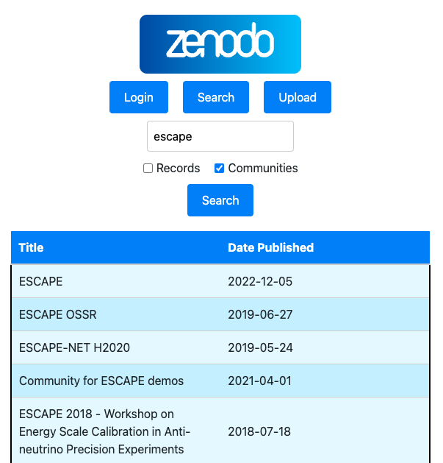
Major Components
Searching
Searchable Communities (same Elasticsearch query)
Returns title and date published sorted by most recently changed

Slide 12
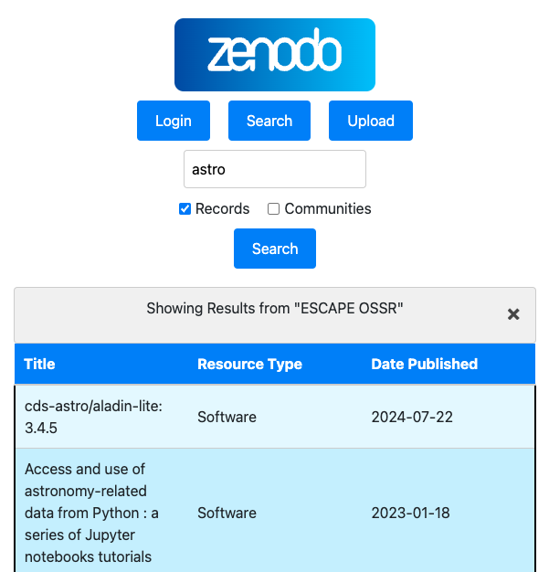
Major Components
Searching
Searchable Communities (same Elasticsearch query)
Returns title and date published sorted by most recently changed
When clicked:
  Allows for searching of records within that community
    Possible future goal: More advanced search settings

Slide 13
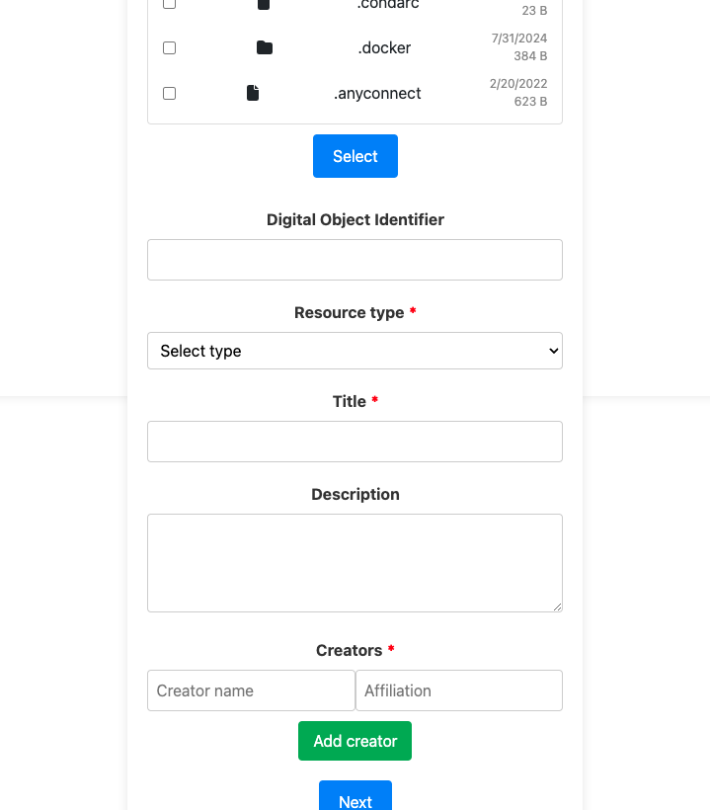
Major Components
Uploading
Takes in basic required info
  Files to upload (from $HOME directory), Resource Type, Title, Creator
  Optional: DOI (otherwise automatic), Description, Creator affiliation, multiple Creators

Slide 14
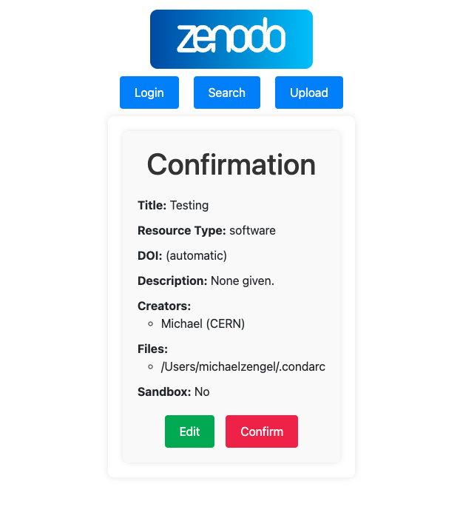
Major Components
Uploading
Takes in basic required info
  Files to upload (from $HOME directory), Resource Type, Title, Creator
  Optional: DOI (otherwise automatic), Description, Creator affiliation, multiple Creators
Confirmation Page of Info to Upload
”Confirm” does the following:
  Creates deposit
  Sets metadata (WIP)
  Adds files to deposit (WIP)

Slide 15
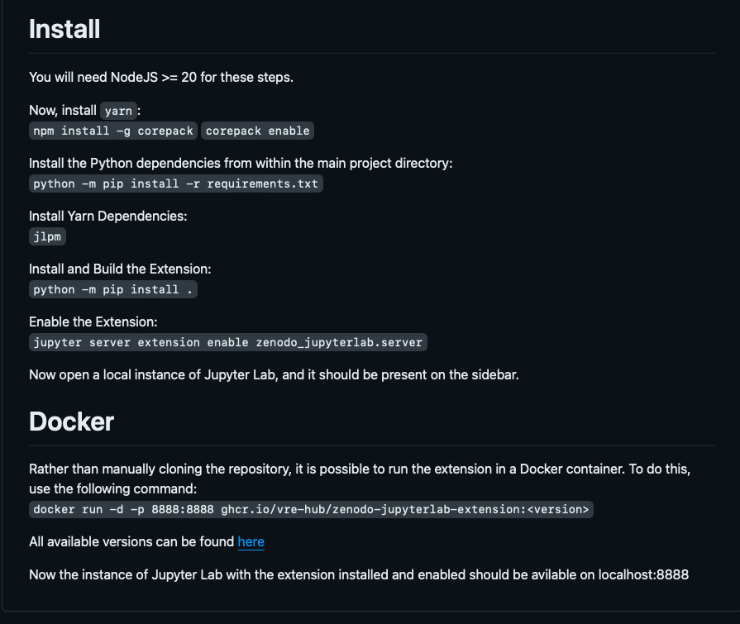
Usage
Downloadable and Installable via git repository
For Developers:
  Easy installation in development mode (-ve after install command)
  Simple building of front-end via jlpm
Up to date docker image available for download
  Automatically downloads dependencies, software, installs, and runs Jupyter Lab with extension active
  Can easily be added to Jupyter Hub distributions

Slide 16
Future Steps
Continued Development of software
  Implementation of downloads to the Jupyter $HOME directory
  Ability to upload files to Zenodo Records
  Advanced search settings
  Improved cosmetic design
Presentation of results at ADASS
  Astronomical Data Analysis Software & Systems
+

Slide 17
Conclusions
The Software:
Jupyter Lab Extension
Provides Visual interface between users
and the Zenodo Service
Easily integrated into existing VRE
Why it’s useful:
Capability for fully cloud-based interaction (downloading and uploading) with Zenodo
Adds another step into the VRE based
analysis workflow
Allows for more seamless downloading and uploading of results and software
Applicable to any Jupyter-based environment
+

Slide 18
Questions and Demo

Slide 19
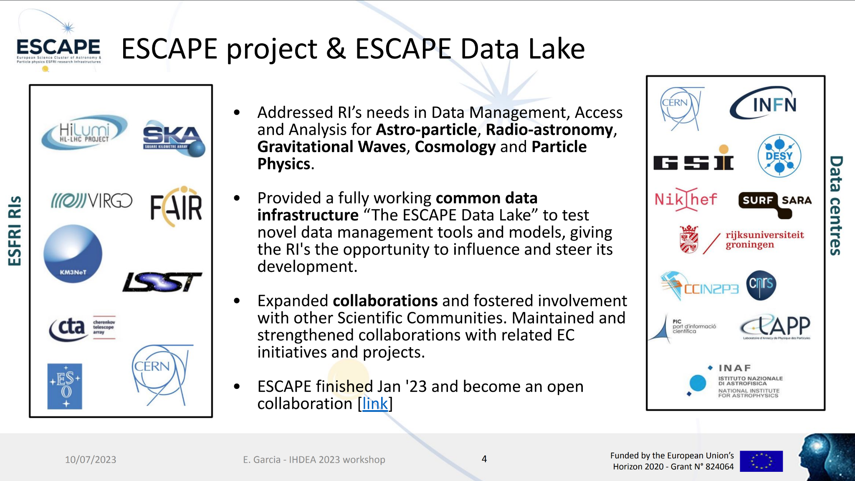
-> link

Slide 20
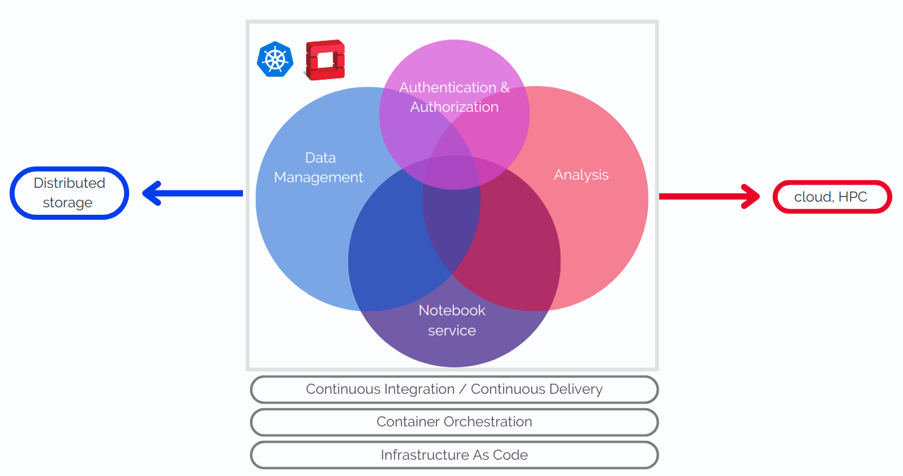
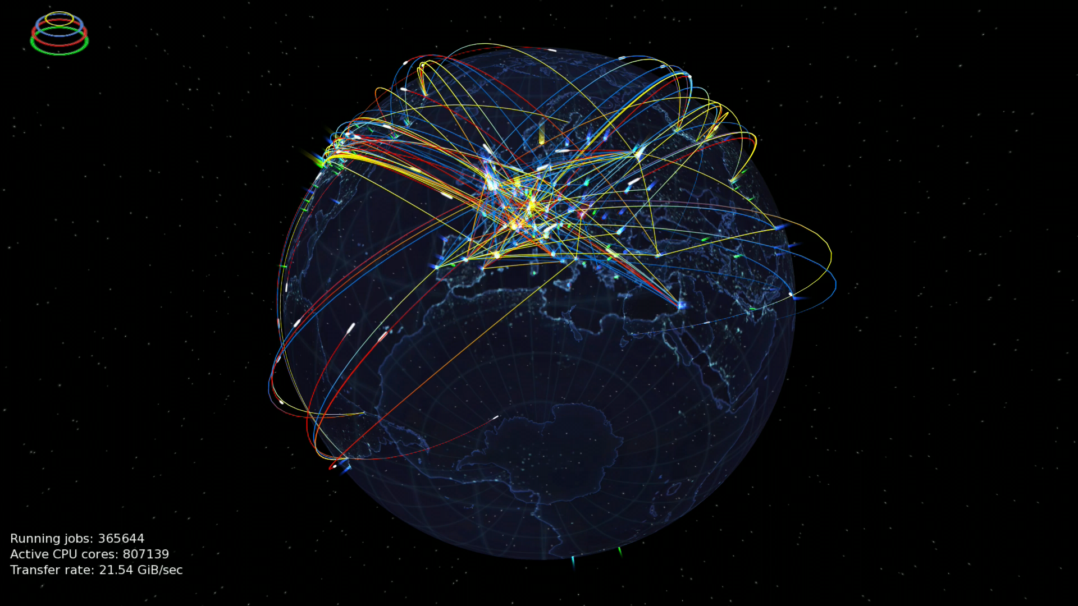
Motivation
Grand Purpose of VRE
  Virtual Research Environment (VRE): simplify life for physicists by combining software and infrastructure in one place
VRE
Initiative that started during the ESCAPE project —> Develop an analysis facility to allow users to perform an end-to-end scientific analysis
VRE is a PoC, place in where to incorporate all the dev of the ESCAPE collaboration
  1st version → rucio jupyterlab extension to ease and reduce complexity of a rucio instance (a data lake)
  End-to-end analysis (a pic would be nice) is composed of data access and discoverability (rucio extension) + preliminary analysis (notebooks) + perform (re)analyses (reana extension) + share and preserve results (zenodo)

