Slide 1

Combining Deep learning & Raman Spectroscopy for Rapid pesticide screening
Esther Kiguru
The University of Nairobi
ASP2024 Alumni Online Presentation

Slide 2
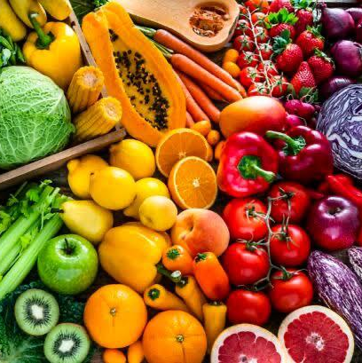
How safe is the food we consume?
Fruits & Vegetables accounts for 25% and > 80% of diets in rural & urban areas in Kenya.
The large population creates high demand for fresh produce daily.
To satiate the high demand,farmers use pesticides to protect crops from pest & diseases to increase yields;This contaminates the foods.
Repeated exposure to pesticide residue can result in a cumulative effect on the body overtime

Slide 3
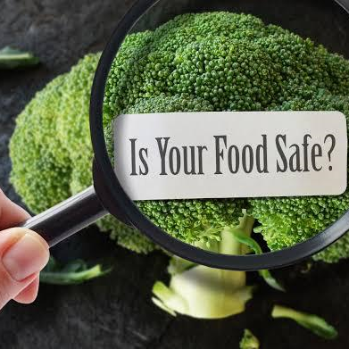
Should we be concerned?
There is a need for assessment to ensure Maximum Residue Limits are not exceeded

Slide 4
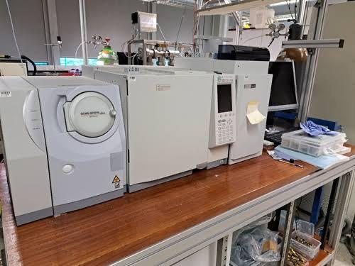
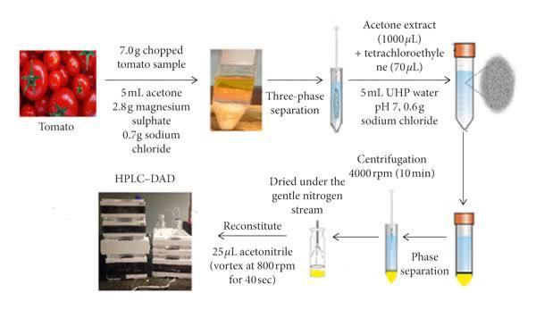
Residue Detection Methods
Standard detection methods e.g GC-MS,LC

Slide 5
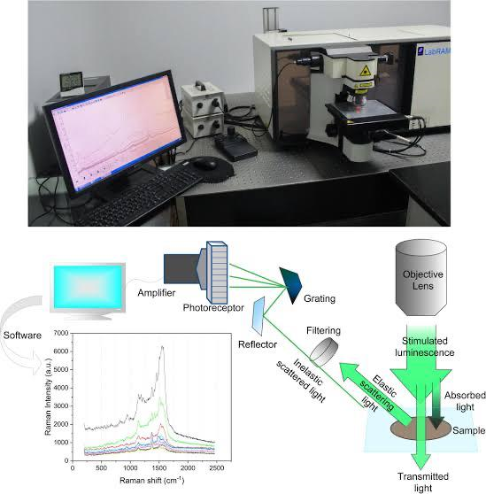
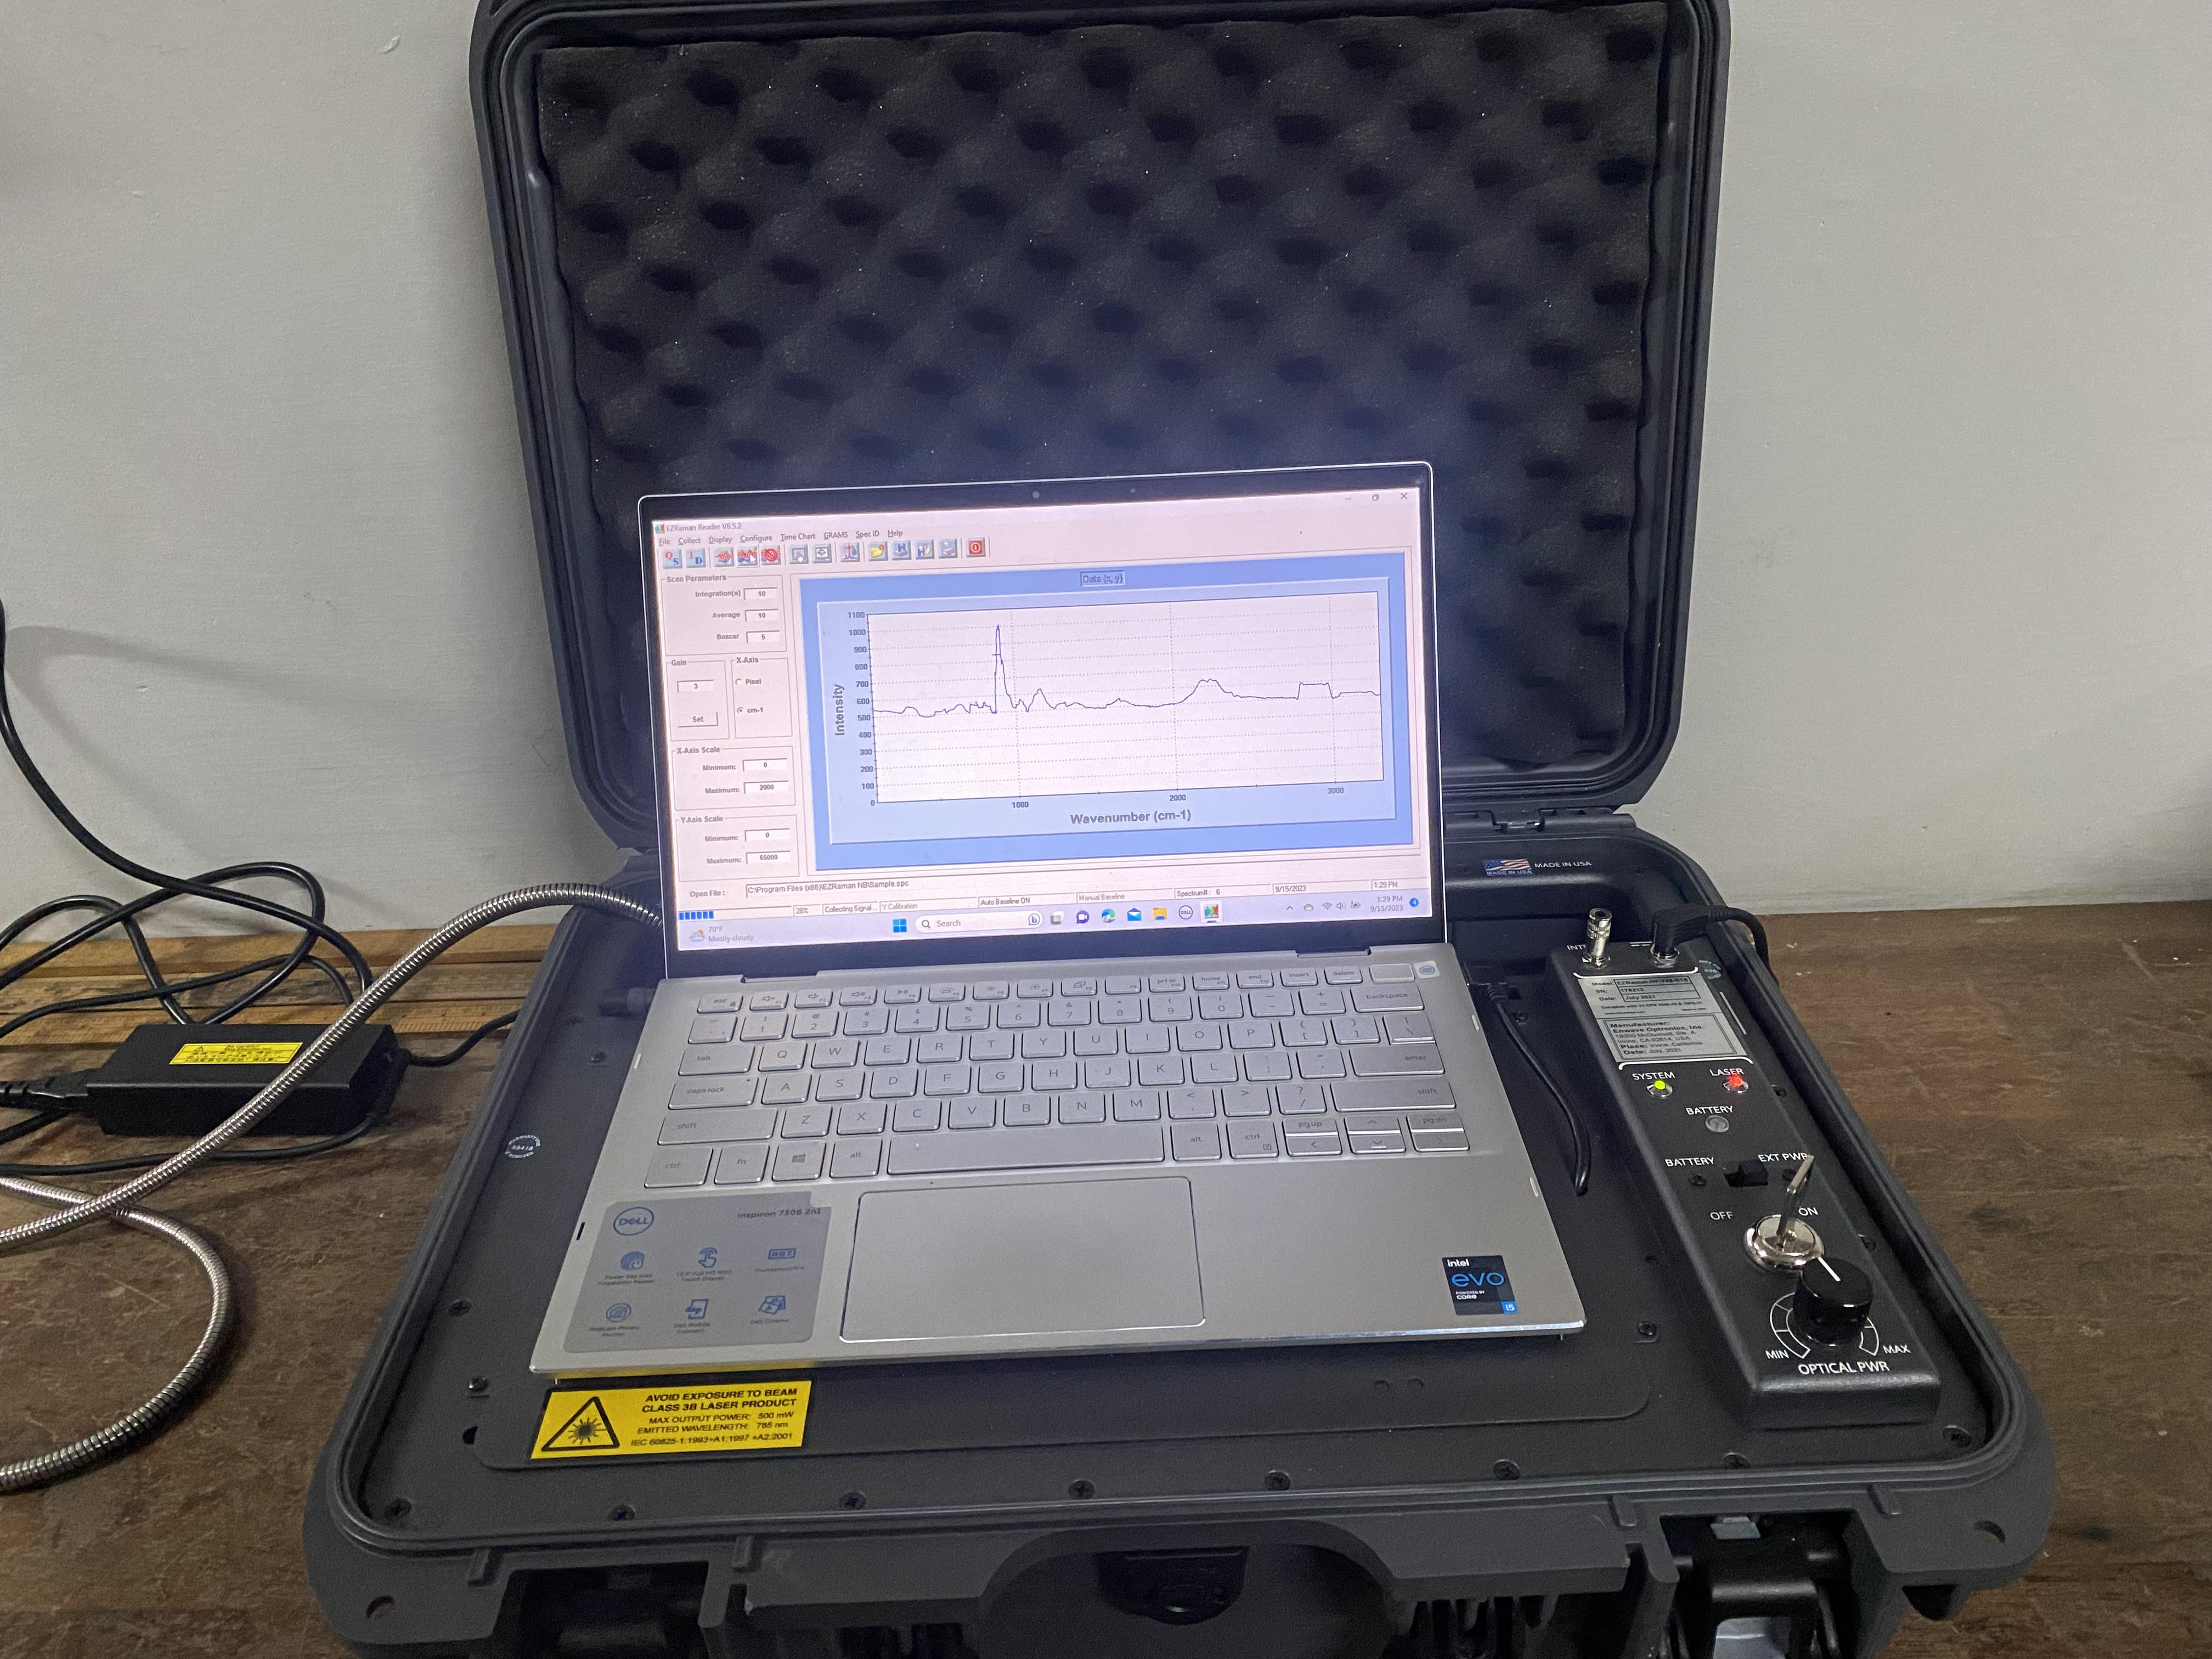
Spectroscopy based techniques

Slide 6
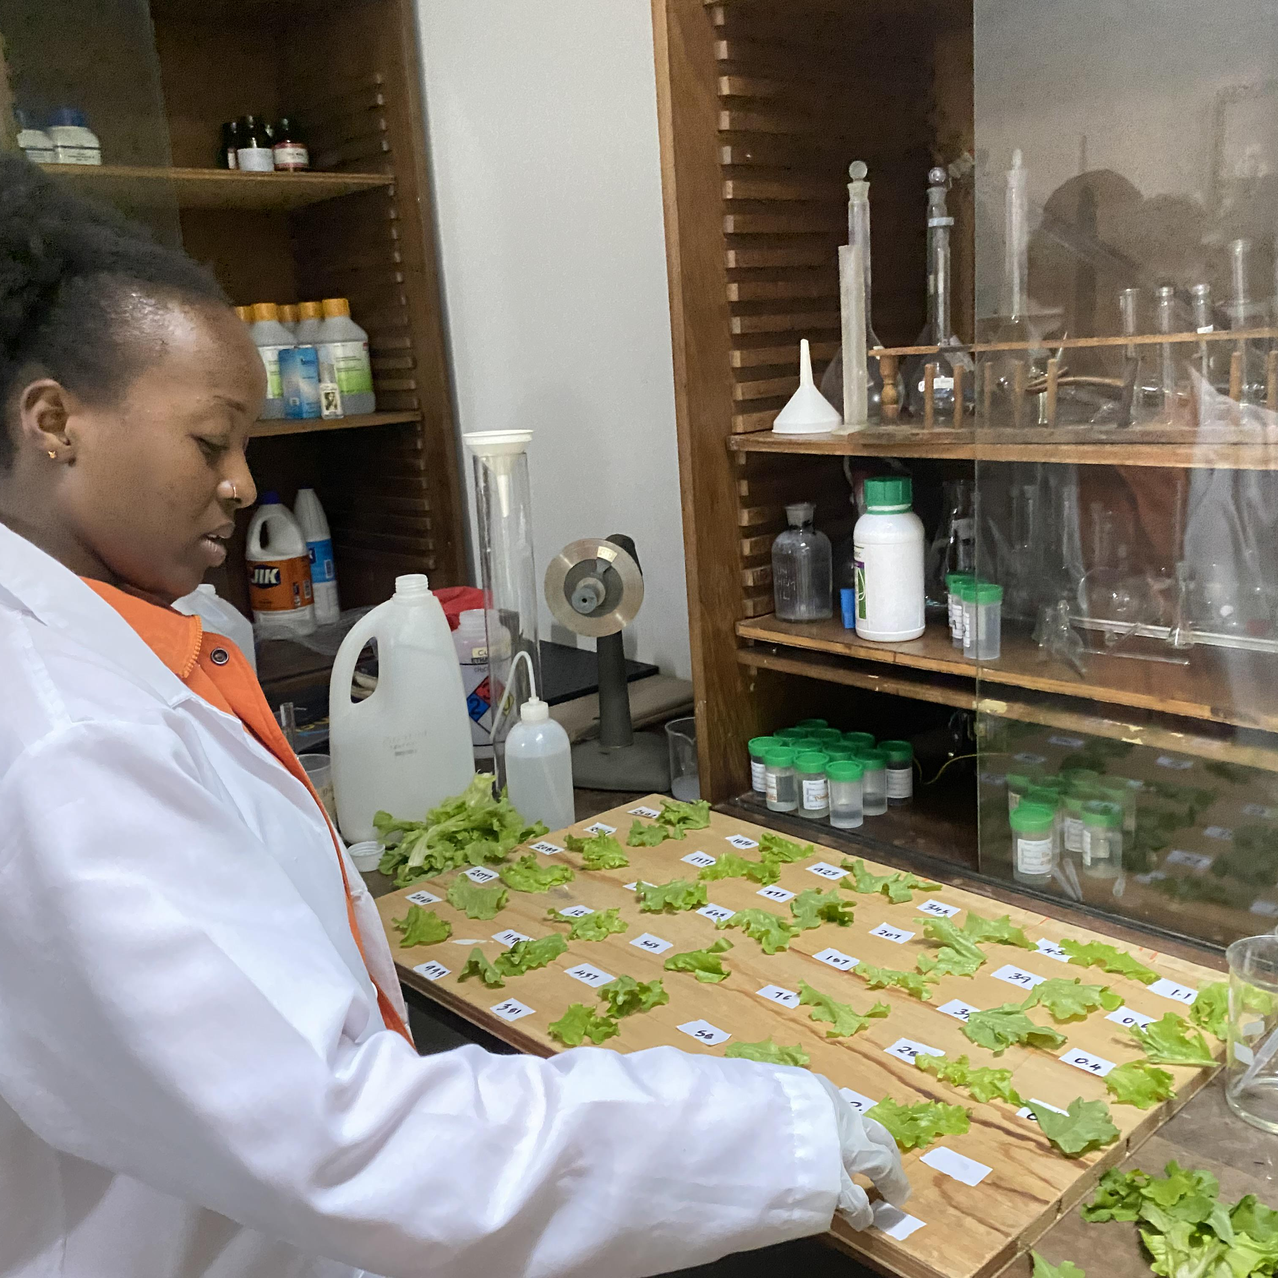
Methodology

Slide 7
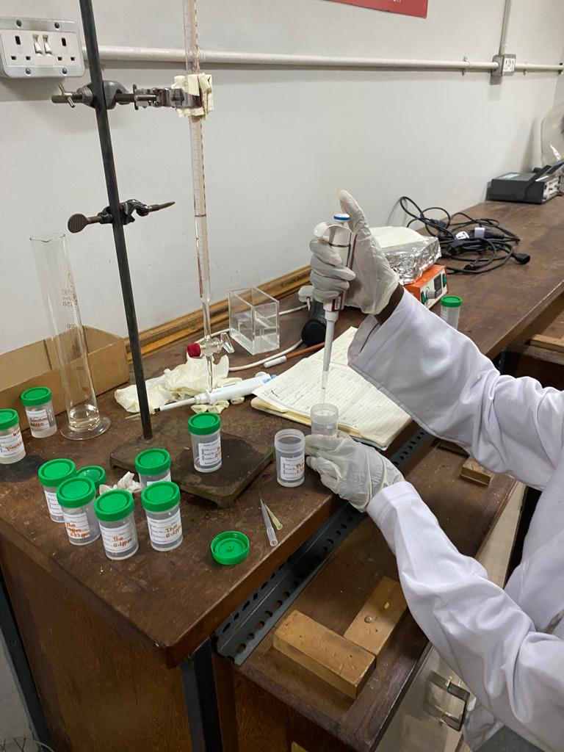
Pesticide Concentration Preparation
Pesticide concentrations of Chlorothalonil (CTL) were prepared using serial dilution techniques.
According to the Pest Control Products Board,the Maximum Residue Limit(MRL) of Chlorothalonil was 2.0 parts per million (ppm)
Different concentrations above ,within and below the MRLs were prepared for the pesticide

Slide 8
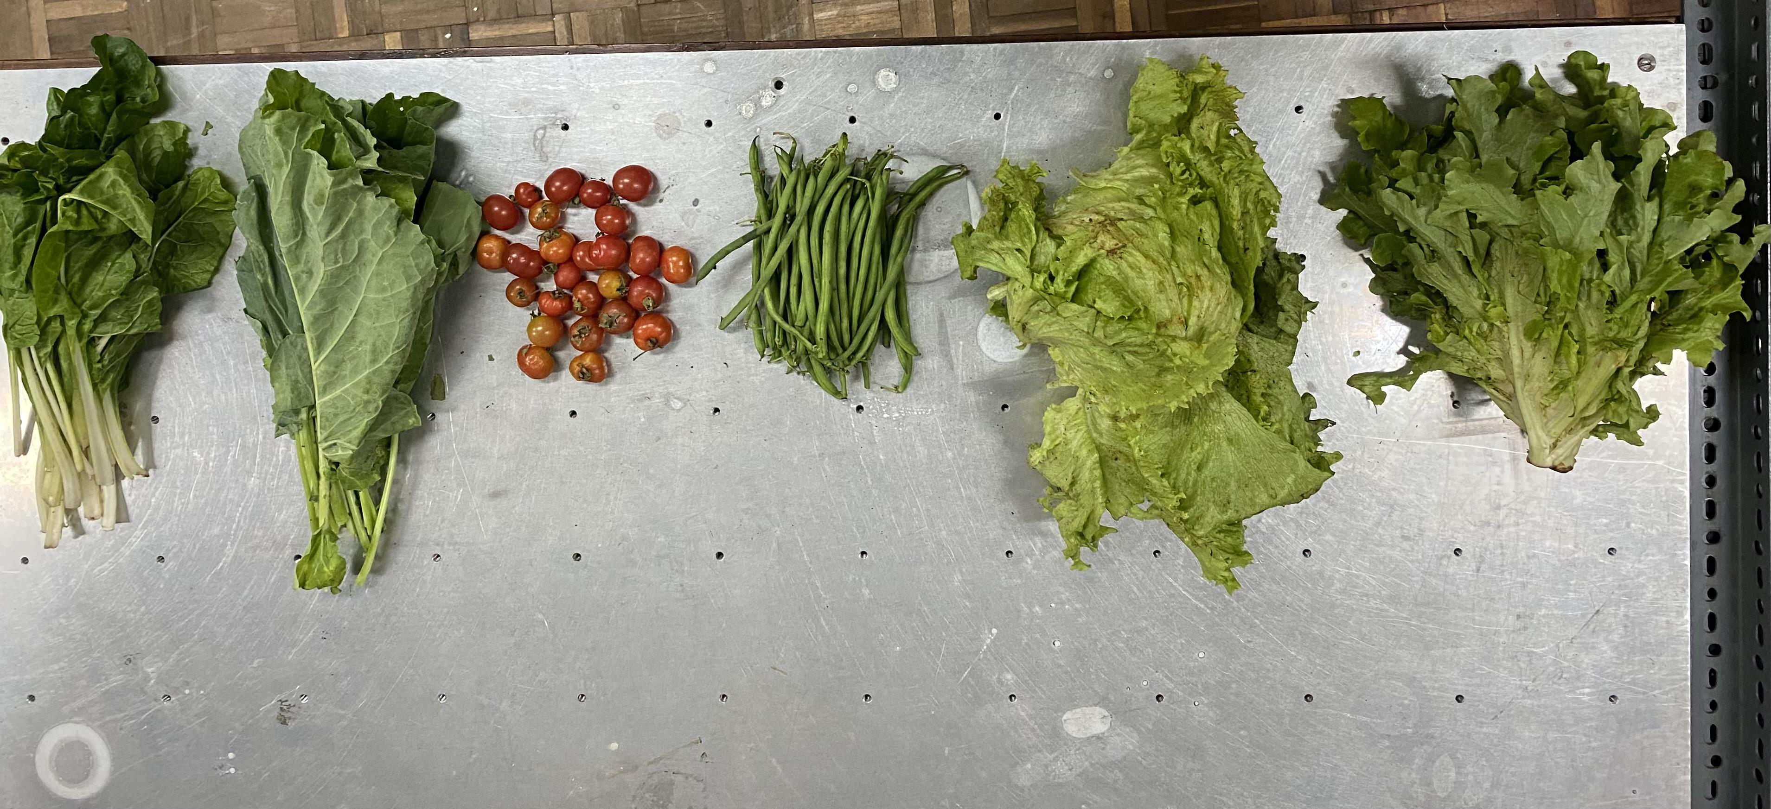
Selection of suitable vegetables
Vegetable samples of Tomatoes,Kales,spinach and lettuce were collected from a nearby farm
The vegetable samples were washed,cut into small pieces and labelled according to the different concentration levels.

Slide 9
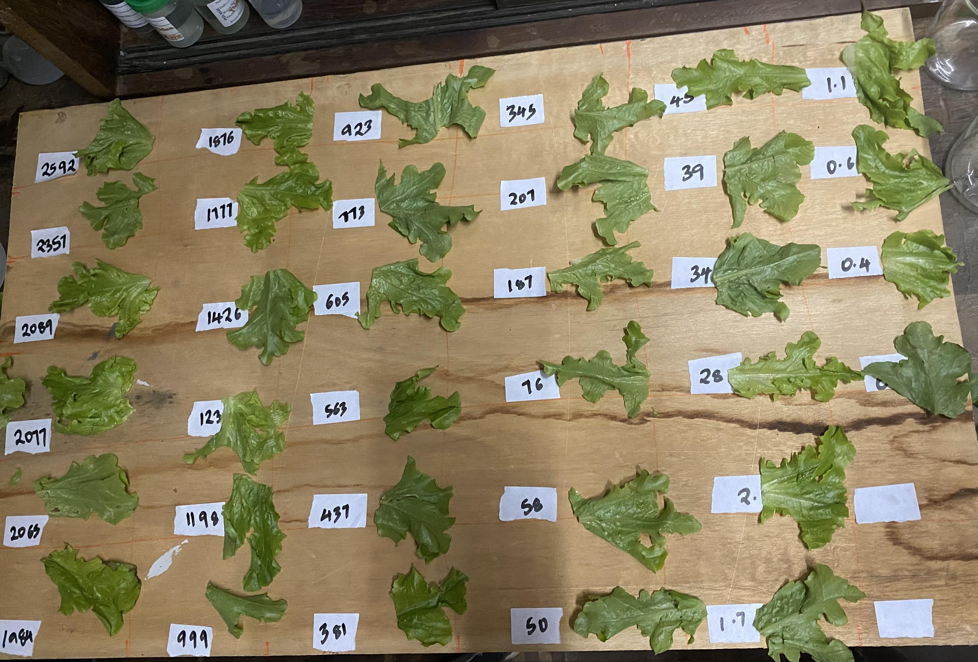
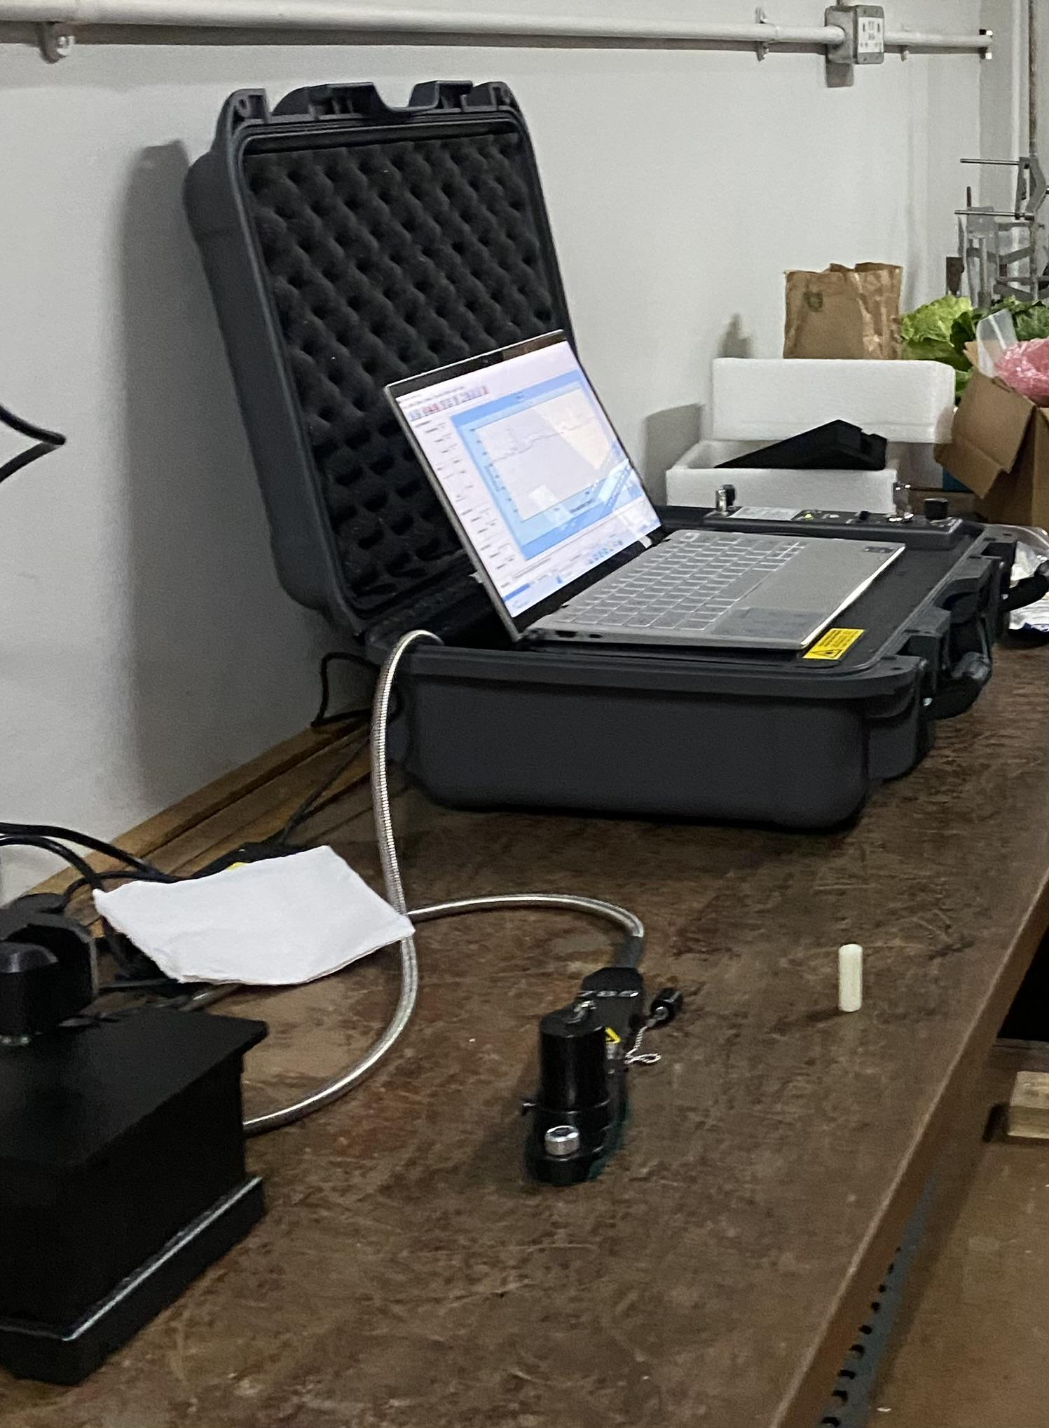
The prepared samples were then sprayed with the different CTL concentrations and left to dry for a few hours before taking spectral measurements.

Slide 10
Data Preprocessing & Augmentation
Data Cleaning
Noise removal
Augmentation
Examining the data for any potential missing values, gaps and
removal of unwanted features
Minimized background noise interference
Applied Outlier Detection to enhance data
quality.
Generative Adversarial Networks(GANs)
GANs
offer a powerful means to augment limited datasets, reducing the dependency on extensive
and time-consuming laboratory efforts

Slide 11
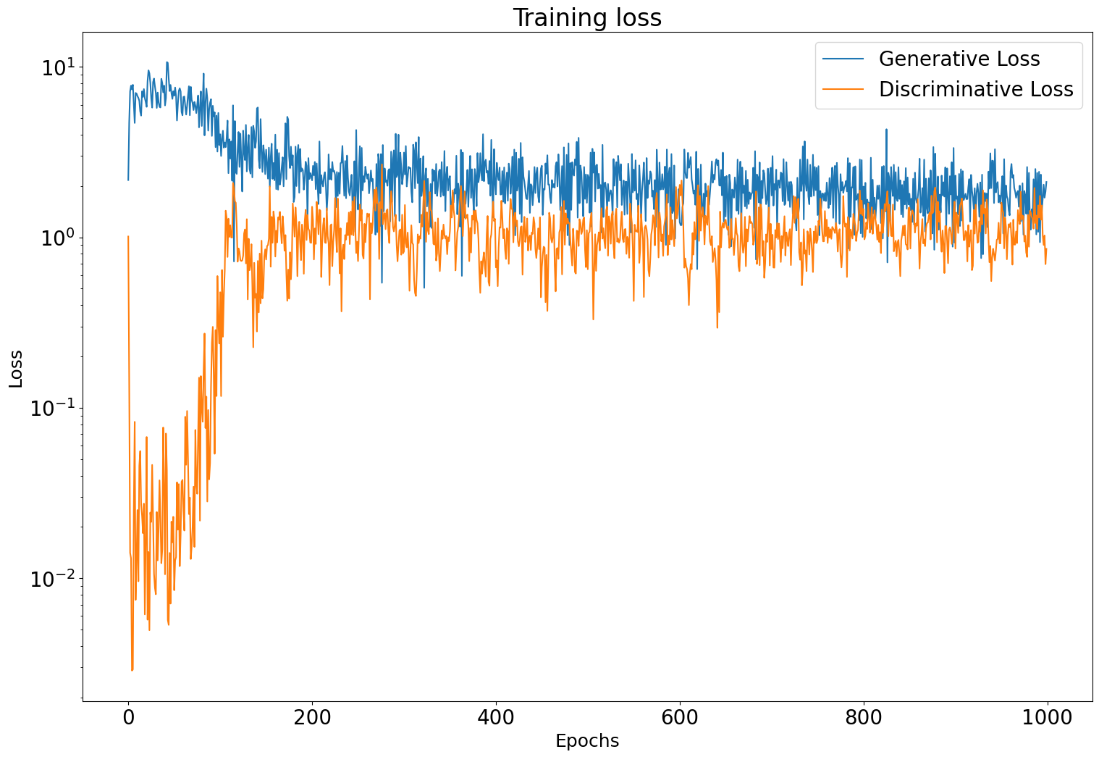
GANs model
As training progresses, the generator loss should decrease implicating that the generator is getting better at generating data that is more difficult for the discriminator to distinguish from real data.
Convergence is reached when the generator loss stabilizes not necesarily reaching zero, but it should remain relatively constant.
A decreasing discriminator loss means that the discriminator is getting better at distinguishing between real and generated data.
when the discriminator loss stabilizes at this point, the discriminator is no longer able to easily differentiate between real and generated data.

Slide 12
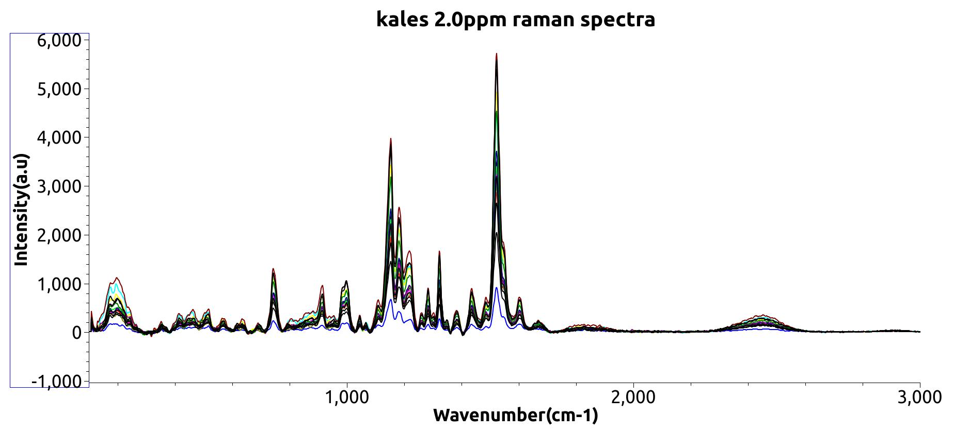
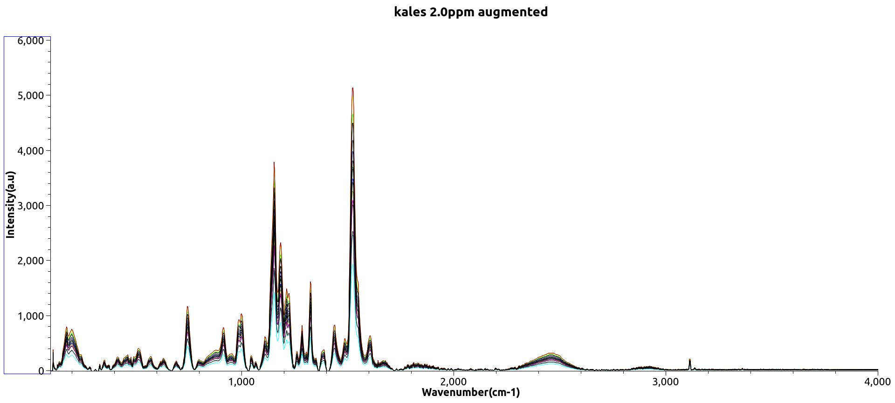
Original spectra
Augmented spectra

Slide 13
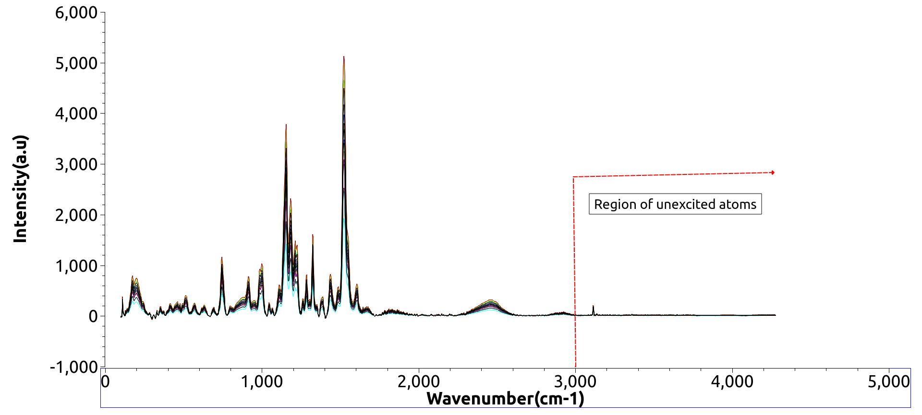
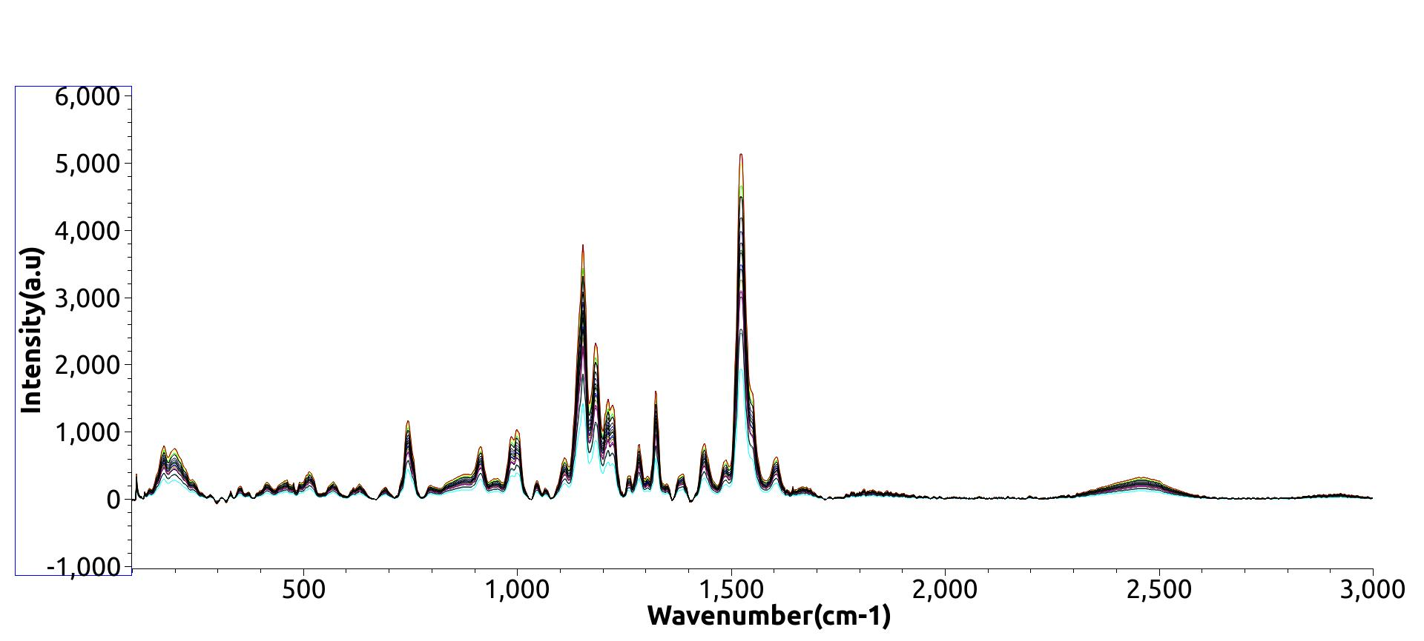
Red laser with wavelength of 785 nm is limited to excite atoms at a raman
shift of 3000 hence no significant spectra observed pass the
region

Slide 14
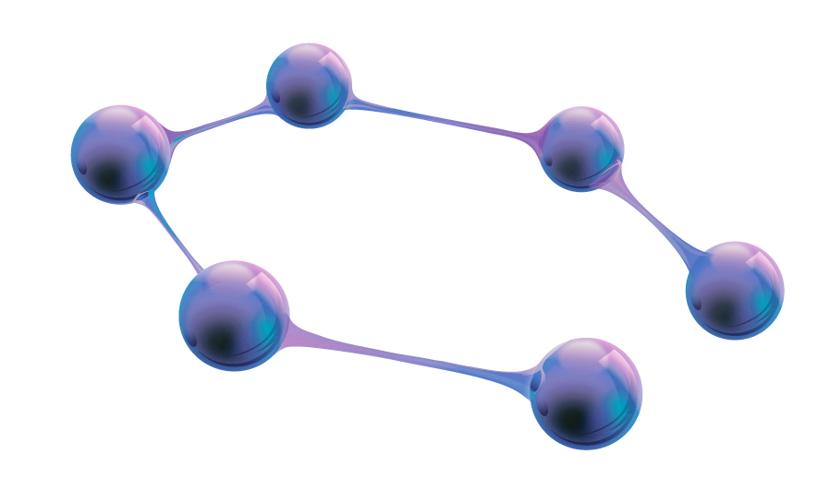
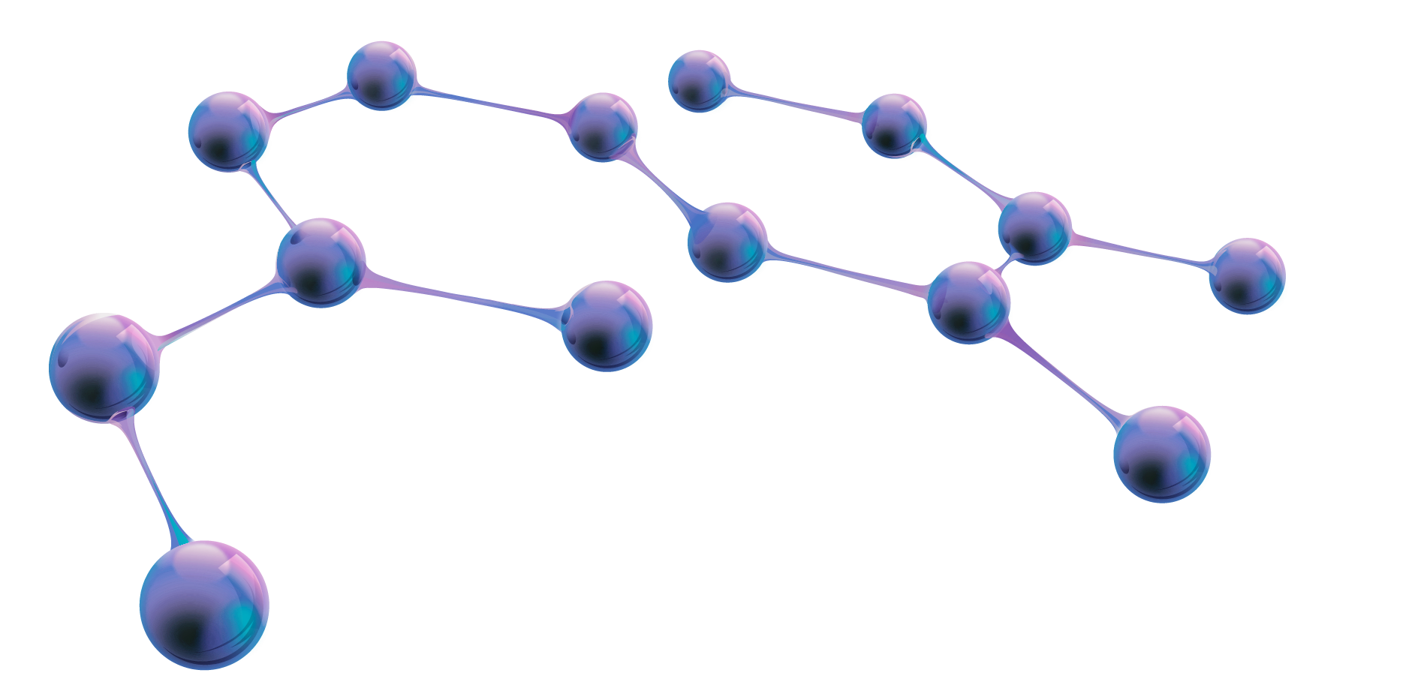
Model Development

Slide 15
Classification Model
Regression Model
qualitative analysis of pesticide presence in spectral data.
predicts a continuous numerical output based on input features

Slide 16
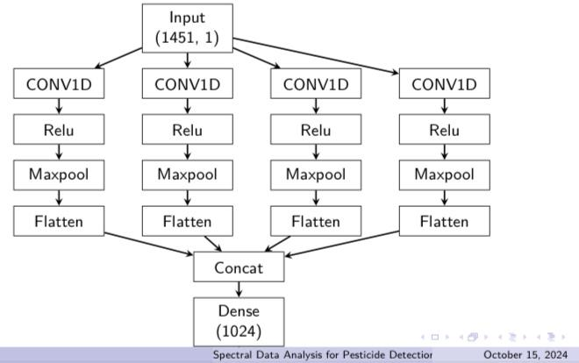
Classification Model
The model architecture is a stacked ResNet-type 1D-CNN for spectral data classification
Layers:
Convolutional layers for spatial feature extraction.
Relu activation layer for introducing non-linearity
Flatten layer for one-dimensional data representation.
Dense layer establishes the relationship patterns in the features
Max pooling for downsampling.
Output layer that represents the predicted classes
Optimizer: AdamW optimizer for gradient descent.
Evaluation Metrics:
Accuracy: Percentage of correctly classified samples.
Loss: Error between predictions and true labels.
Precision: Proportion of true positive predictions among all positive predictions.
Recall: Proportion of true positive predictions among all actual positive instances.
F1 Score: Harmonic mean of precision and recall. Support: The number of actual occurrences of each class in the specified datase

Slide 17
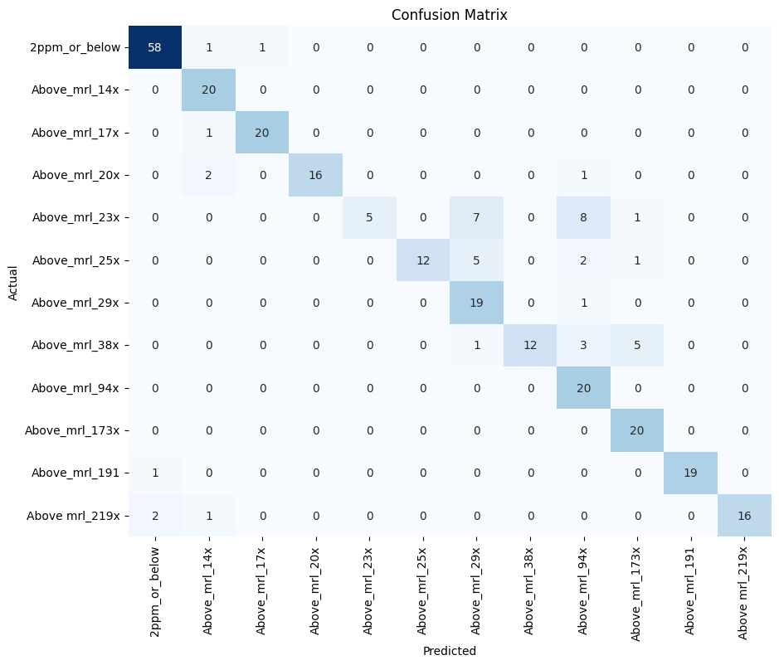

Slide 18
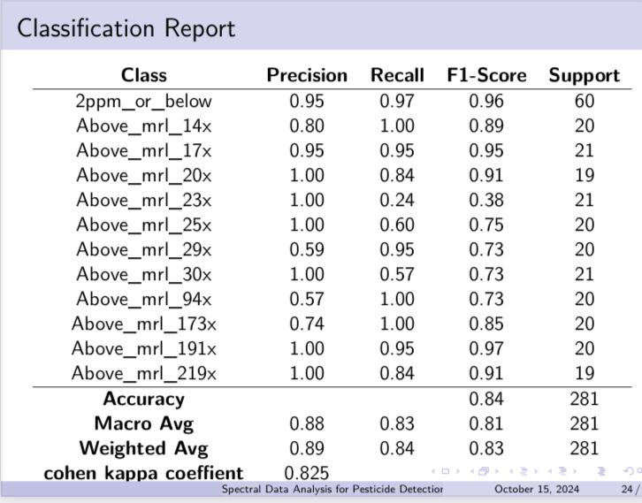

Slide 19
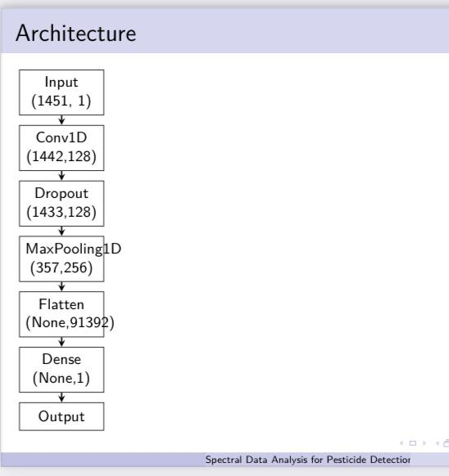
Regression Model
1D Convolutional Neural Network (CNN) followed by dense layers.
Convolutional Layers:
1D Convolutional layers capture hierarchical features in the input data.
Dropout layers and MaxPooling1D layers are employed for regularization.
Dense Layers: combine features for final regression prediction.
Evaluation Metrics:
Mean Absolute Error (MAE) is used as the loss function.
R2SCORE, Mean Squared Error (MSE), and Mean Absolute Error (MAE) are used as evaluation metrics.

Slide 20
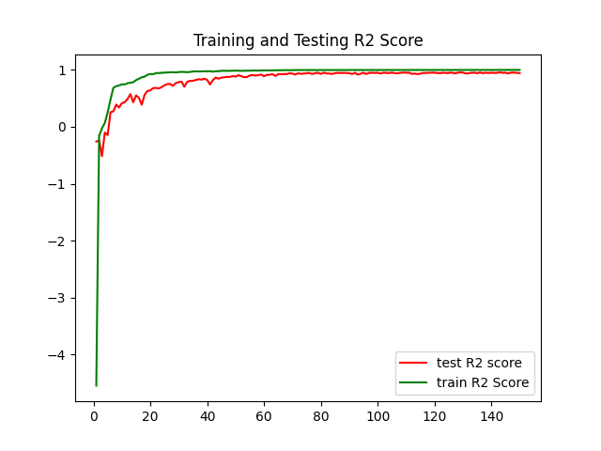
Indicates the proportion of the variance in the dependent variable predictable from the independent variable(s).
Ranges from -∞ to 1, with 1 being a perfect fit
R2 Score Trend Over Training Epochs

Slide 21
Application Programming Interface

Slide 22

User authentication Interface

Slide 23
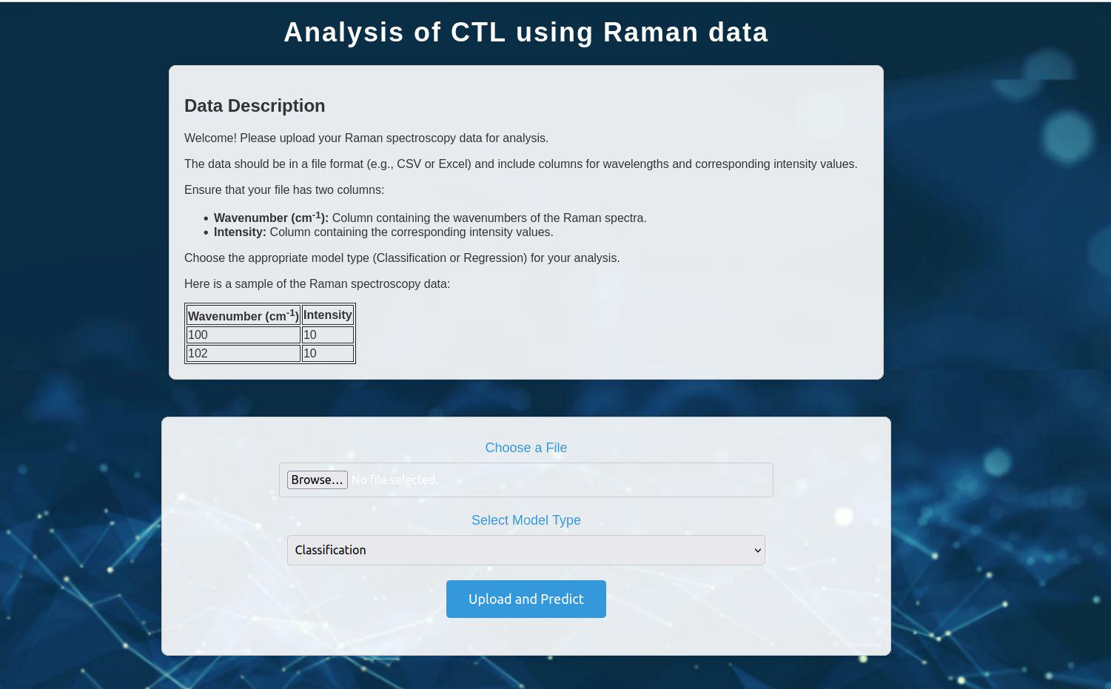

Slide 24
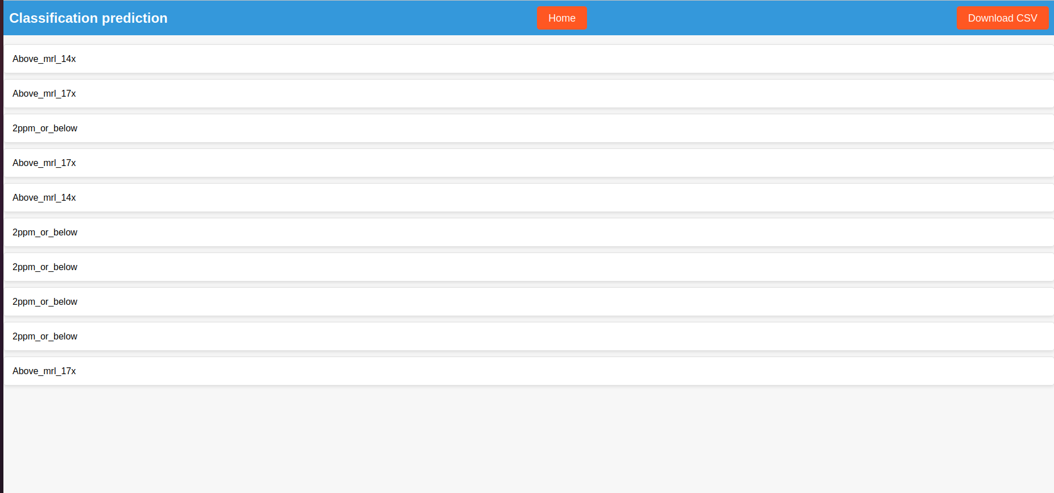

Slide 25
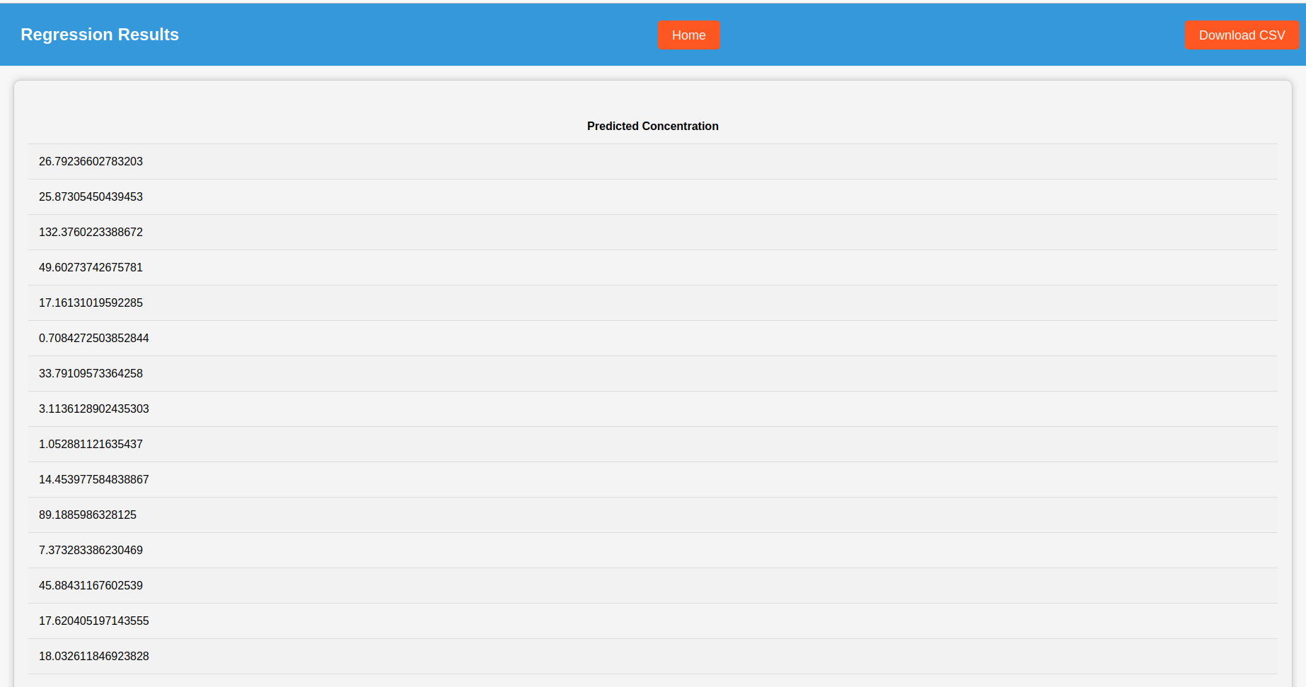

Slide 26


Thanks!

