Slide 1
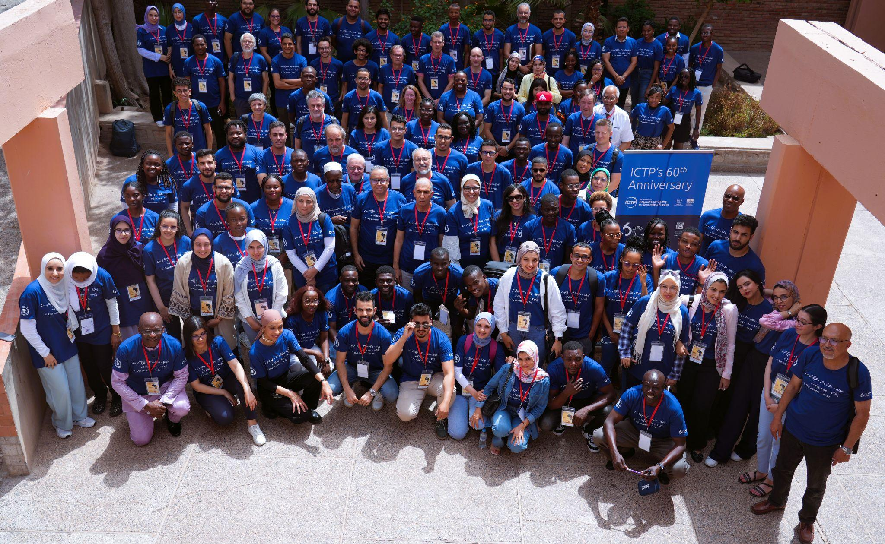
ASP Online Conference 2024
15th October, 2024

Slide 2

Development and Implementation of Physics-informed Neural Network for Nuclear Magnetic Resonance-guided Clinical Hyperthermia
Presentation by: ENENCHE Oche Solomon

Slide 3
Introduction
The concept of using heat as a treatment method dates back to ancient civilizations. The Edwin Smith Papyrus, an Egyptian medical text from 1700 BC, describes the use of heat in the treatment of breast cancer.
What is clinical hyperthermia?
This is a form of treatment that involves heating the body tissue to a certain temperature (usually between 42°C–48°C) for about an hour to destroy tumours and cancer cells. It is usually administered as an adjutant to radiation therapy.

Slide 4
Challenges associated with clinical hyperthermia.
Real-time monitoring of the process of administering this therapy and the delivery of precise heat to target areas of tissues has been a lingering challenge. This leads to the destruction of living cells around the tissue being treated in the process.

Slide 5
Aim
The purpose of this research is to address these challenges by integrating the principles of magnetic resonance relaxation with the bioheat transfer phenomena using Physics-Informed Neural Network (PINN) in the context of NMR-guided clinical hyperthermia.

Slide 6
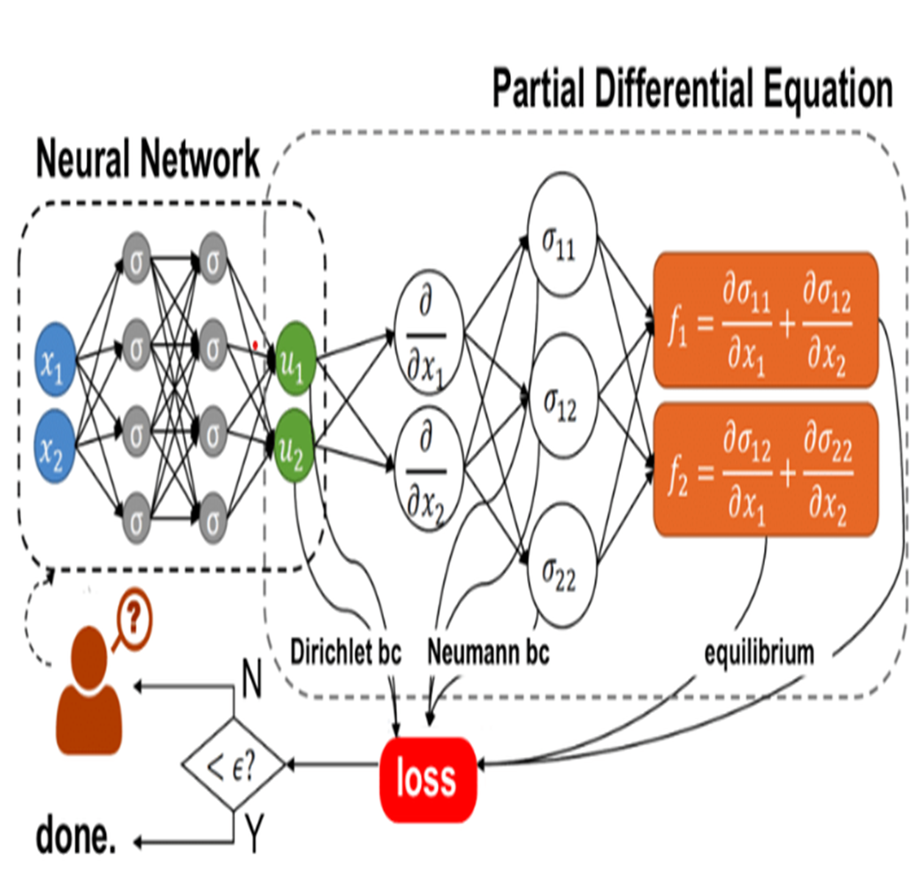
Physics-Informed Neural Network (PINN)
PINN is a deep learning model that integrates physical laws into the learning process of a neural network model. It is particularly useful where there is noisy or limited data available and the underlying principle of physics associated with the system to be modelled is well understood.

Slide 7
1D Pennes Bioheat Equation
The equation used in training the PINN model is the Pennes Bioheat equation expressed as:
ρ_{t}c_{t}(∂T/∂t) = k∂²T/∂x² + ρSAR + w_{b}ρ_{b}c_{b}(T − T_{b})
The SAR term in the Pennes' Bioheat Equation is a critical component that quantifies the rate at which electromagnetic energy is converted into heat within biological tissues, contributing to the overall temperature change in the tissue.

Slide 8
Methods
Relevant data and parameters for the selected tissues were obtained from previous research on hyperthermia, and the validity of these parameters was confirmed. A Python code was developed to integrate the bioheat equation into the neural network's learning process. This was implemented on Google Colab using a 64-bit computer with an 8GB RAM and a Core i7 processor. The model was trained for 5000 epochs and employed for the simulation and prediction of biothermal profiles of the selected tissues.

Slide 9
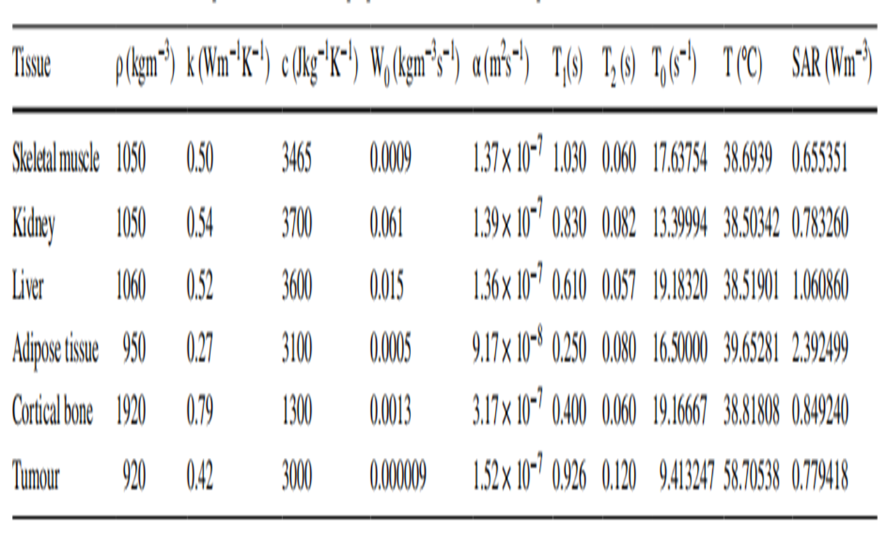
Table of values

Slide 10
Results
During training, the model loss decreased from 9860 to 2003, showing convergence after 2000 epochs. The residual term from the PDE decreased from 9093 to 67.09 by the final iteration. These are indications of learning and a good accuracy of the prediction.
Visualization of the predicted biothermal profile correlates with the known profile of the tissues. The simulation demonstrated the real-time diffusion of heat on the tissues.

Slide 11
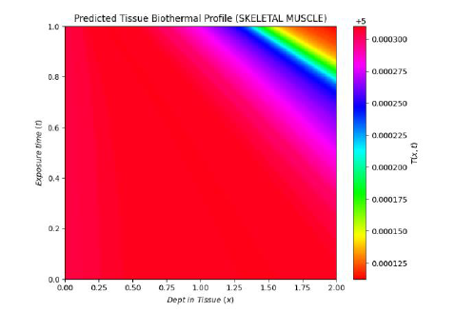
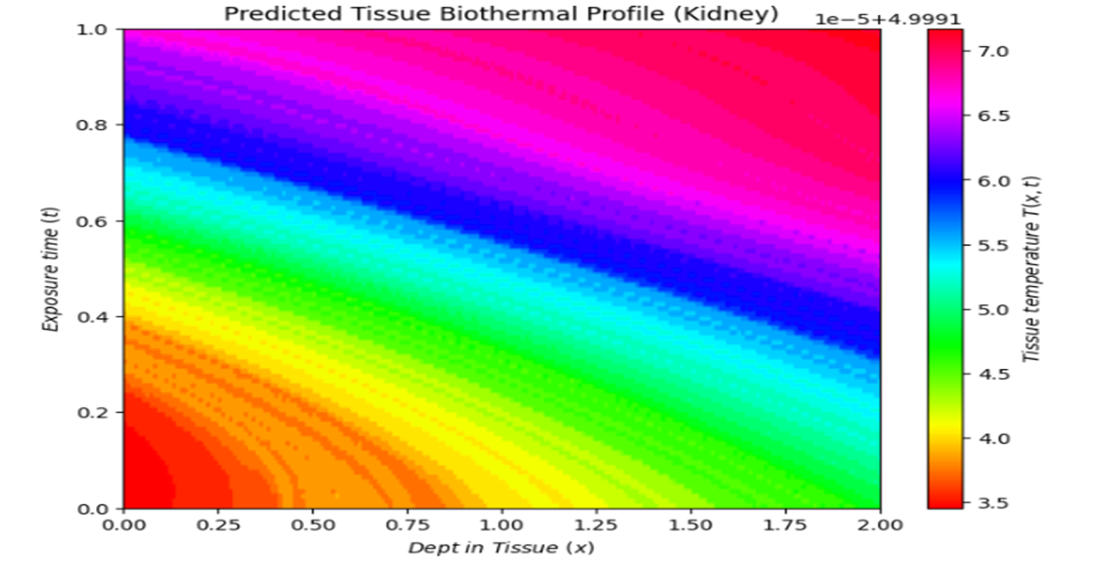
Figures
Notes:
Red areas indicating regions of higher temperatures near the tissue surface and decreasing temperatures as depth increases. This suggests that during thermal therapy, the kidney tissue absorbs heat more near the surface.

Slide 12
Conclusion
The development and implementation of the PINN effectively tackled the difficulties related to precise and customized hyperthermia treatments. The performance benefit of this technique are demonstrated through simulations. The new theranostics approach can provide real-time monitoring of tissues during hyperthermia treatment of tumors so that the surrounding tissues are not overheated in the process. Additionally, the effectiveness of the model with limited data addresses the common issue of data scarcity in medical research, which often arises due to the strict privacy regulations surrounding clinical data.

Slide 13
Acknowledgement
I would like to express my heartfelt gratitude to my undergraduate thesis advisor, Dr. Michael Dada, for his invaluable guidance, unwavering support, and mentorship. My sincere appreciation also goes to the ASP leadership, Dr. Ketevi Assamagan and Mounia Laassiri, for providing me with this remarkable opportunity. Lastly, I extend my thanks to all the friends who supported and encouraged me throughout the course of this research and presentation.

Slide 14
References
Awojoyogbe, B. O., & Dada, M. O. (2018). Computational Design of an RF Controlled Theranostic Model for Evaluation of Tissue Biothermal Response. Journal of Medical and Biological Engineering, 38(6), 993–1013. https://doi.org/10.1007/s40846-018-0386-x
Raissi, M., Perdikaris, P., & Karniadakis, G. (2019). Physics-informed neural networks: A deep learning framework for solving forward and inverse problems involving nonlinear partial differential equations. Journal of Computational Physics, 378, 686–707. https://doi.org/10.1016/j.jcp.2018.10.045
Mahmood, J., Alexander, A. A., Samanta, S., Kamlapurkar, S., Singh, P., Saeed, A., Carrier, F., Cao, X., Shukla, H. D., & Vujaskovic, Z. (2020). A Combination of Radiotherapy, Hyperthermia, and Immunotherapy Inhibits
Pancreatic Tumor Growth and Prolongs the Survival of Mice. Cancers, 12(4), 1015.
https://doi.org/10.3390/cancers12041015

Slide 15

THANK YOU.

