Slide 1
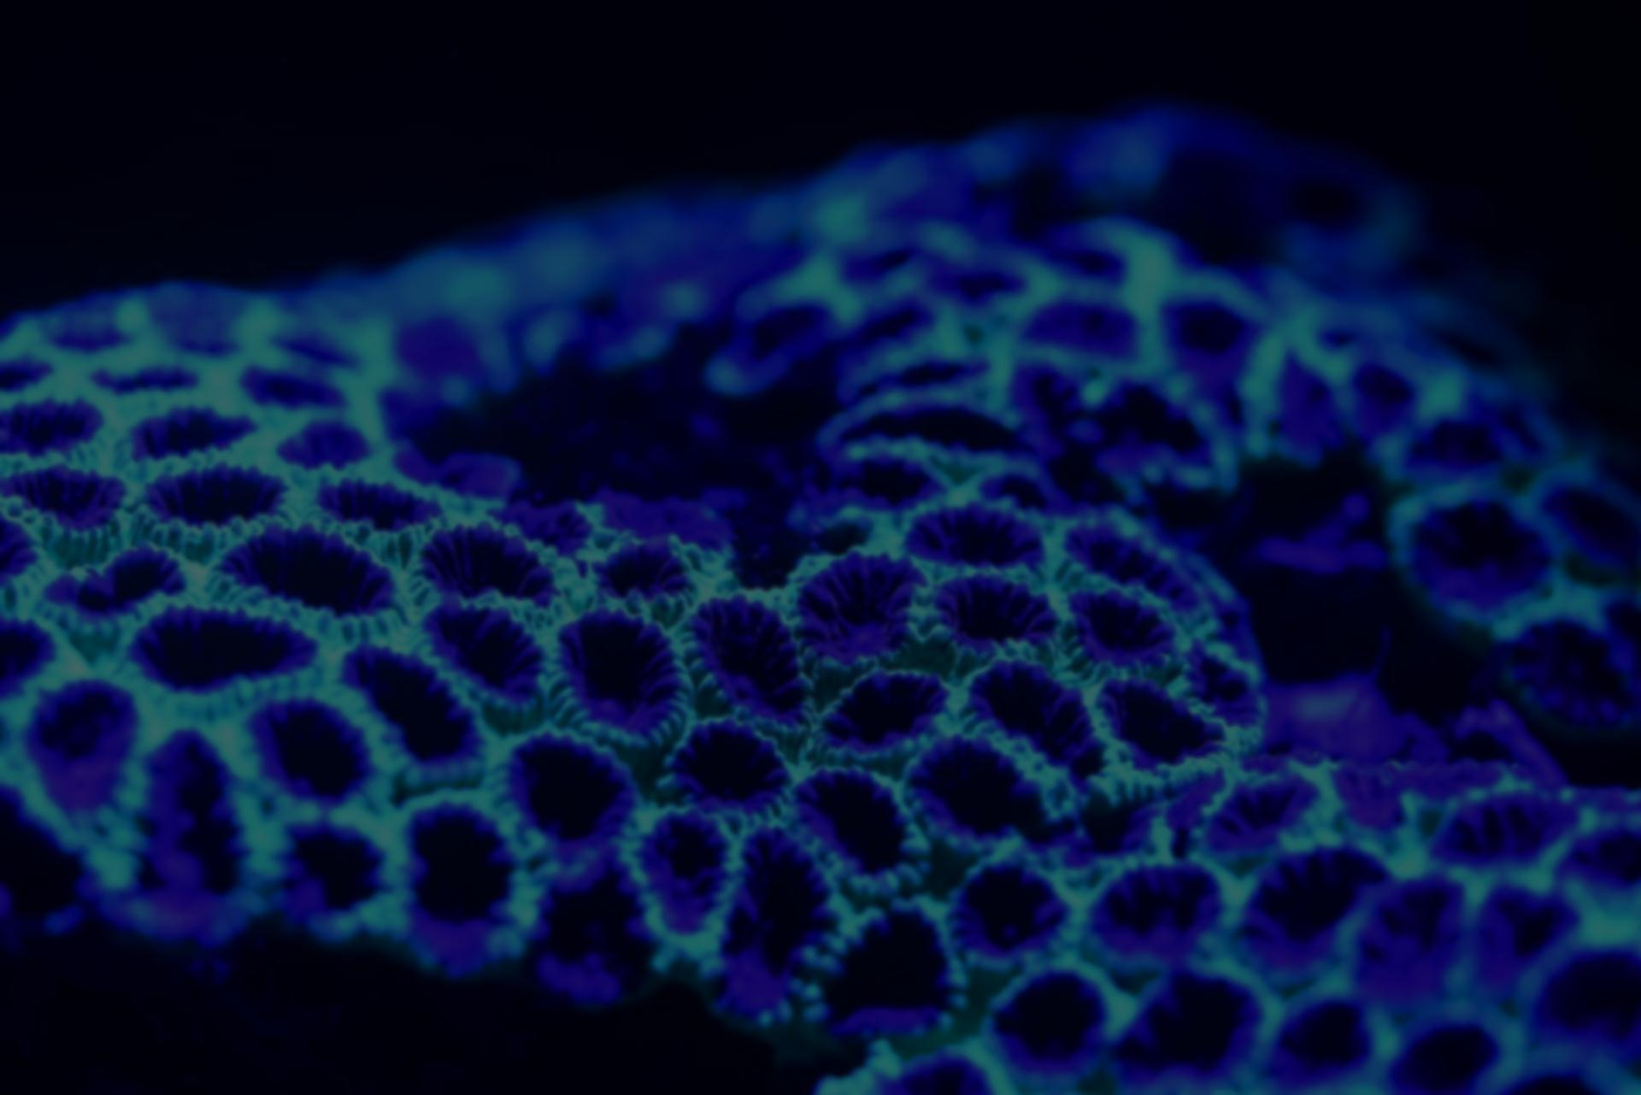


Welcome
Ceph New Users Workshop

Slide 2
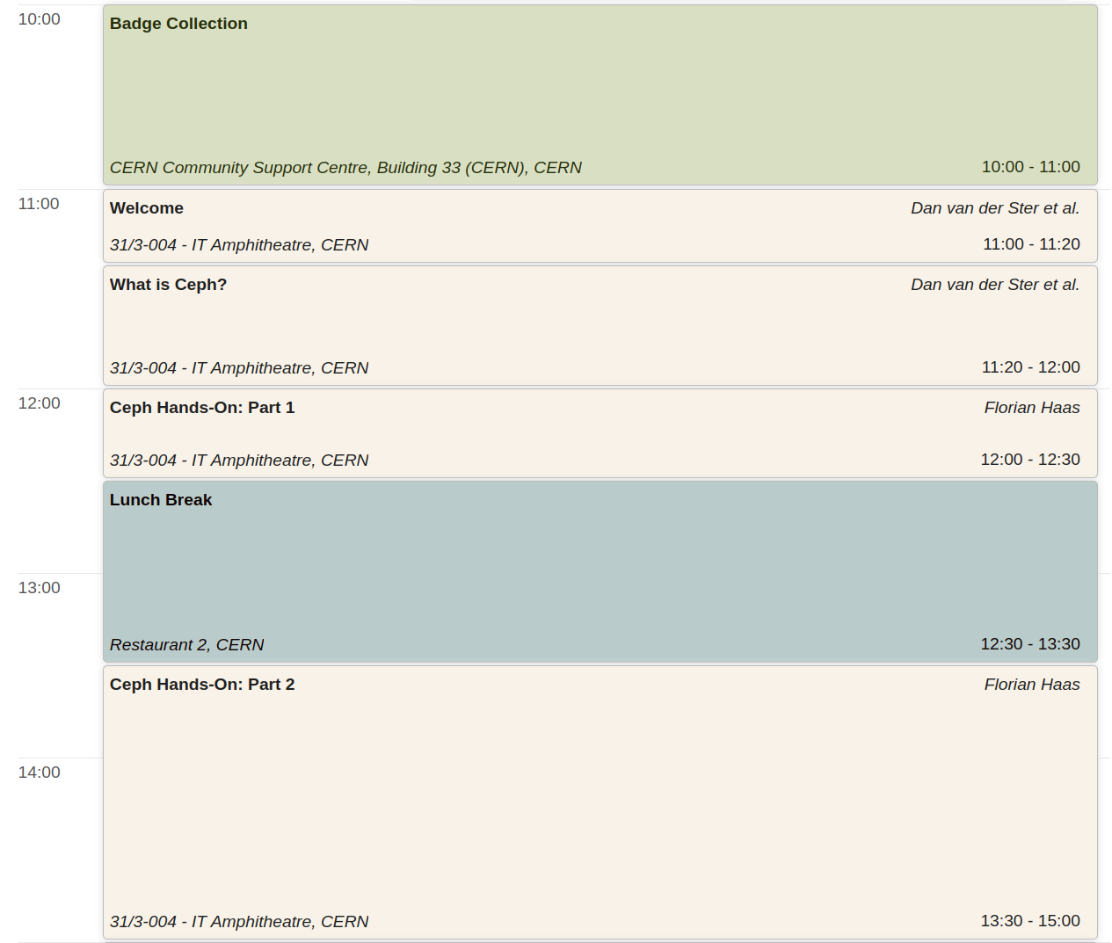
Agenda

Slide 3
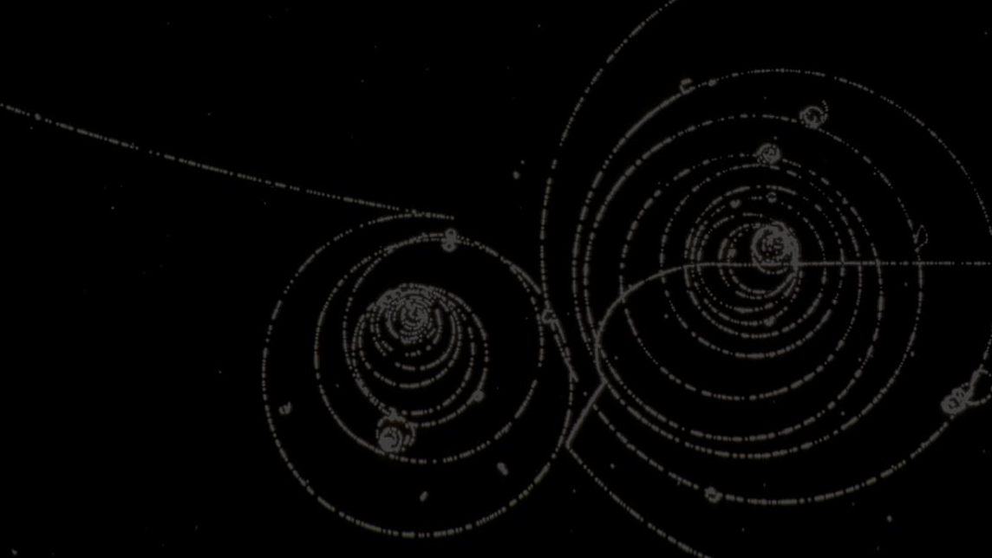
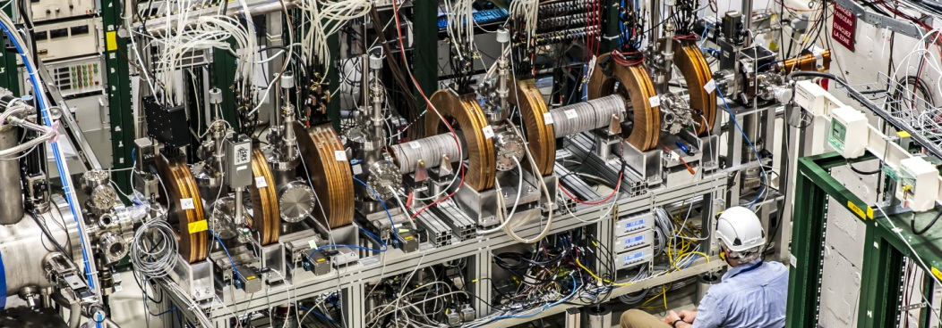
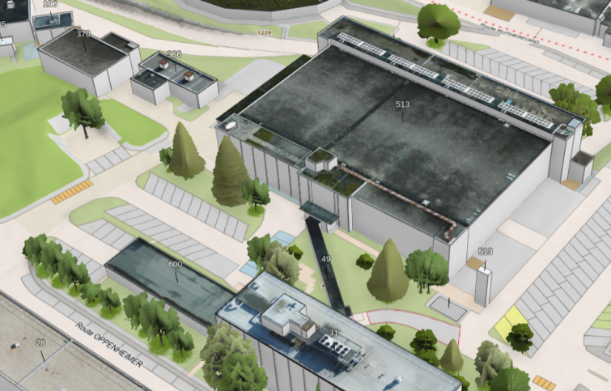
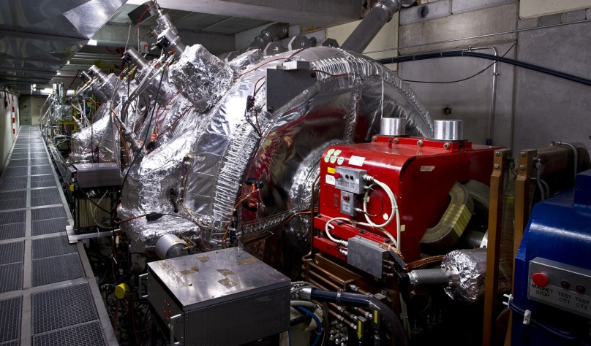

Visits: Antimatter Factory – 12:30
Meeting Point
With Guides
We are here

Slide 4
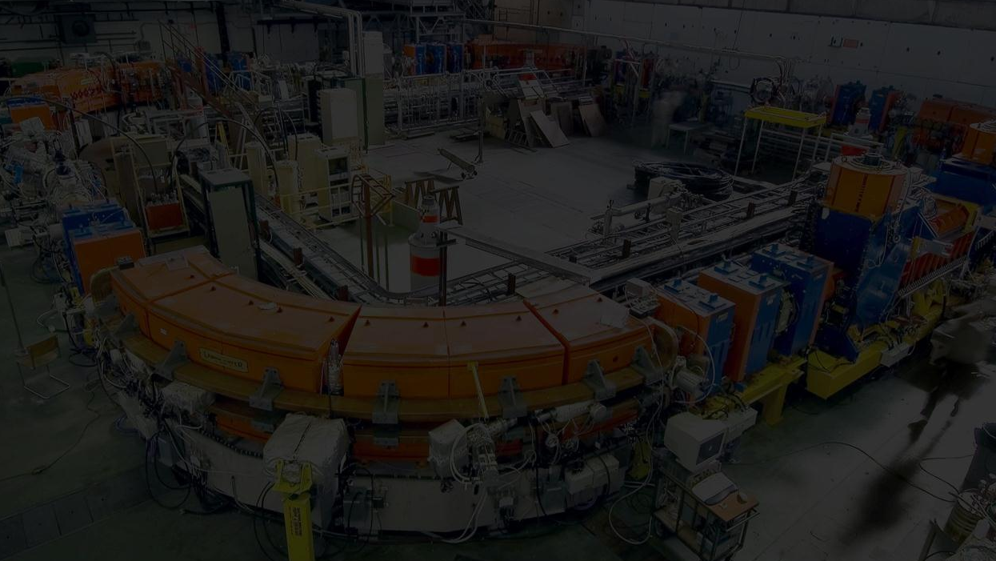
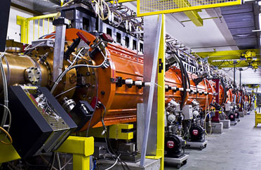
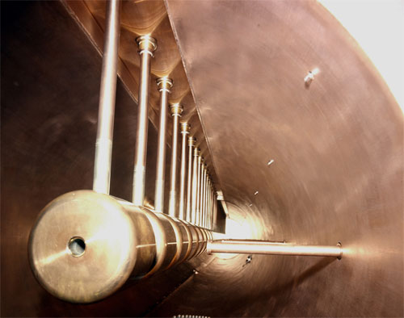
Visits: LINAC/LEIR – 12:30
Meeting Point
With Guides
We are here

Slide 5
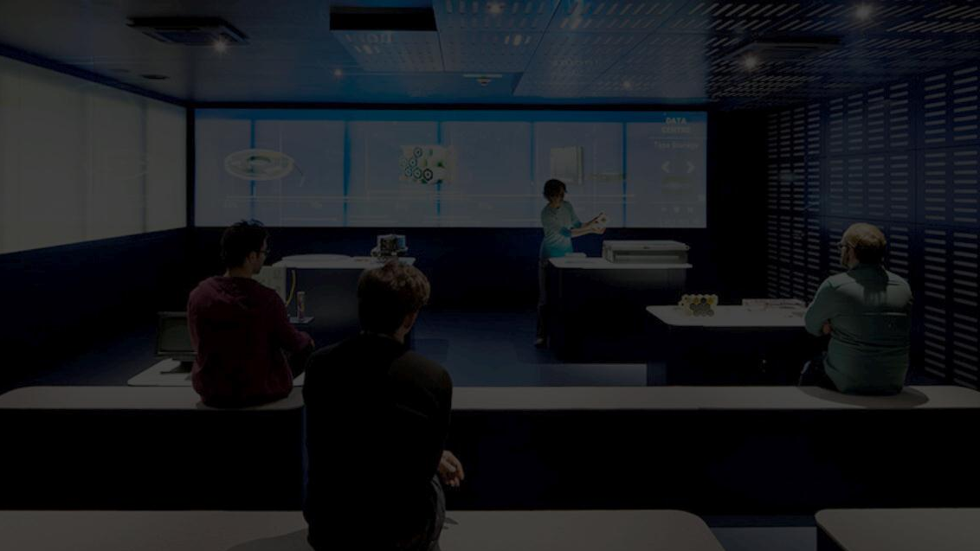
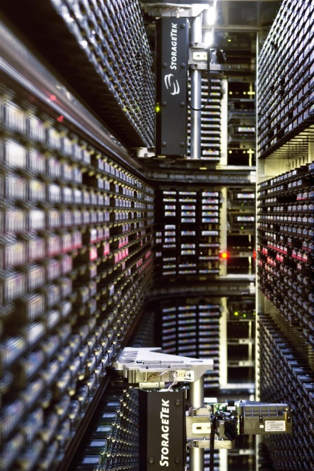
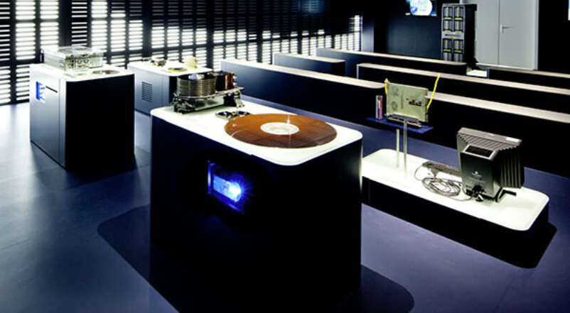
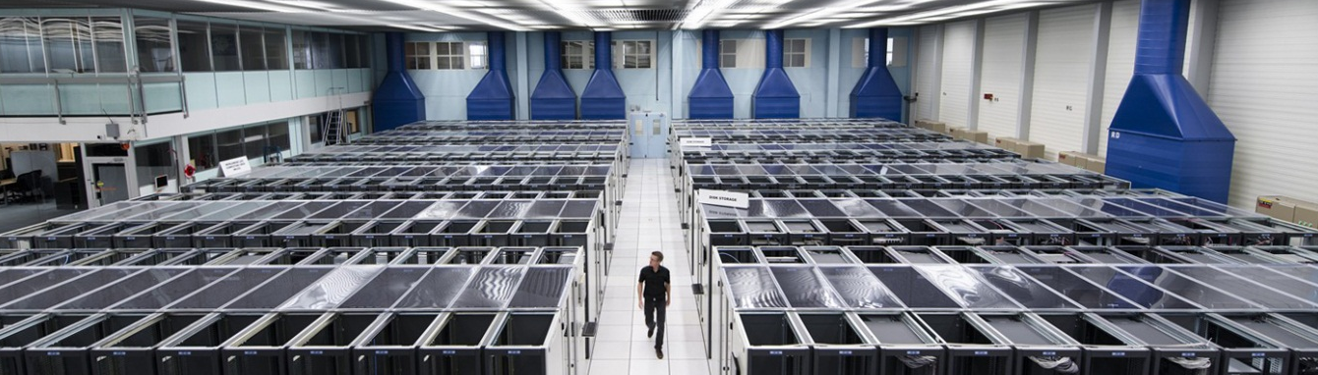
Visits: Data Centre Visit Point – 12:30
Meeting Point
This building, 1st floor
We are here

Slide 6
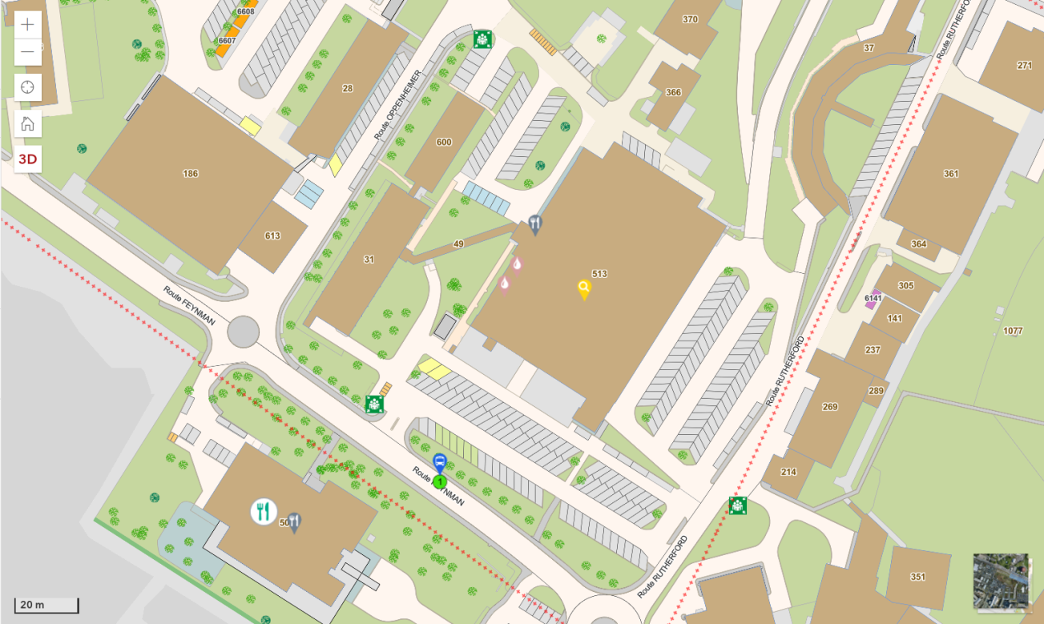
Lunch Break
CERN Restaurant 2
Self-service restaurant
Cash (CHF) and credit cards
Table reserved at ground floor
Several menus available 1st floor,
plus pizza, salads on ground floor
Coffee/tea + snacks until 17:00
If you are going to a visit
Lunch bag has been prepared with your chosen sandwich / salad
Pick up after the visit
IT Amphitheatre
Restaurant 2

Slide 7
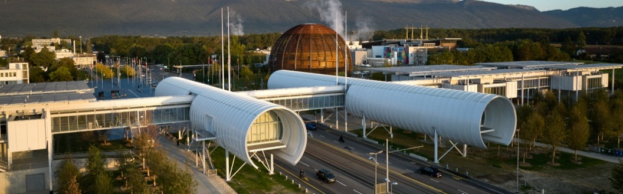
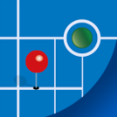

Useful Links
Developer Summit Homepage
https://indico.cern.ch/e/ceph-new-users-workshop
Science Gateway Exhibitions
  http://visit.cern
  Open Tue-Sun 09:00 - 17:00
  Privatized for Cephalocon Attendees, tomorrow (Wed 04/12) @17:30
CERN Maps
  Web: maps.web.cern.ch
  Android App || iOS App
Transports Publics Genevois
  Web: www.tpg.ch/en
  Android App || iOS App

