Slide 1
KPIs for Open Science Monitoring
Iris Kyranou
18 September 2024

Slide 2
Agenda
1 Motivation
Existing monitors
KPIs examples
What’s next?

Slide 3
Motivation
From CERN Open Science Policy: Implementation Plan V1.0
“Monitoring
The OSWG is charged with creating a biennial Open Science (OS) report. The report will be sent for feedback and approval to the Director for Research and Computing at CERN. Once approved, it will be made openly accessible on the CERN Document Server (CDS). The report comprises specific Key Performance Indicators (KPIs) and their analysis for each section of the policy as well as concrete Open Science success stories. Appropriate KPIs will be developed and suggested by the OSWG in the next 12 months.”
From United Nations Educational, Scientific and Cultural Organization(UNESCO)
“Call for inputs: Global Consultation on the Draft Principles of Open Science Monitoring” - Deadline for inputs: 30.11.2024

Slide 4
Existing monitors & Projects
CERN Publications annual report – Superset
French Open Science Monitor
  Lorraine University Open Science
  Agence Nationale de la Recherche (ANR)
Charité Dashboard on Responsible Research
Curtin Open Knowledge Initiative (Open Access)
OpenAIRE monitor(s)
PLOS + DataSeer
CHAOSS (Open Software)
PathOS project
+++

Slide 5
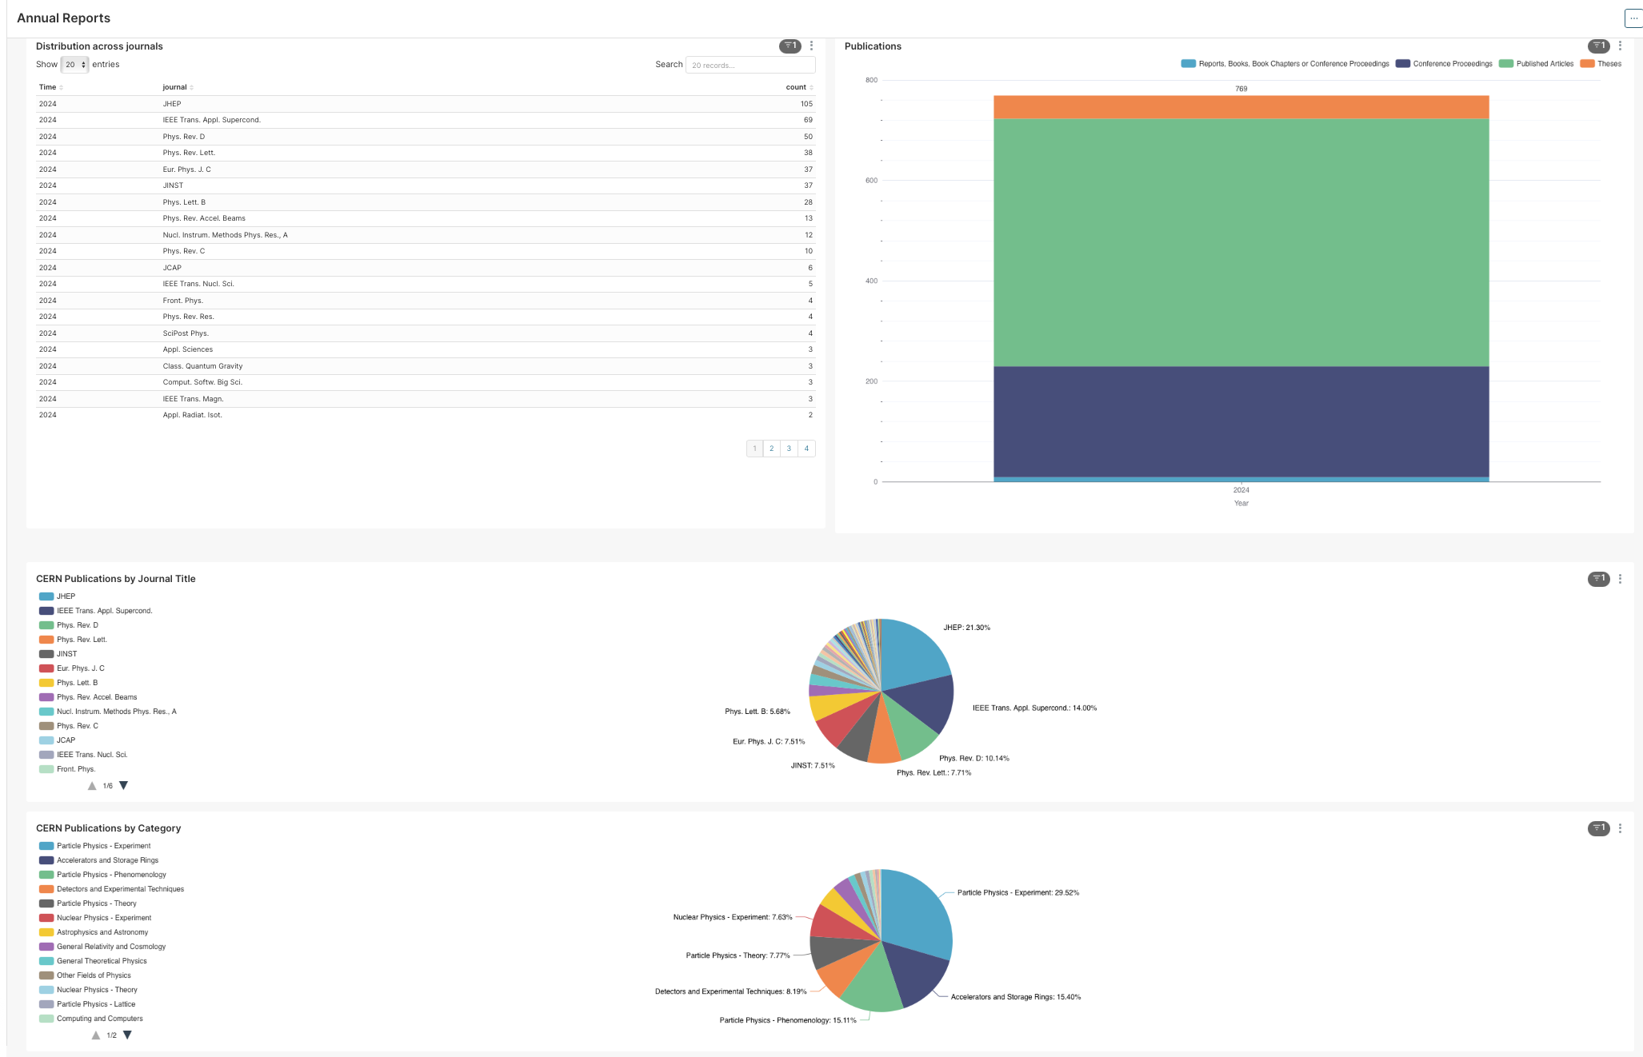
CERN Publications Annual Reports - Superset
https://bi.siscern.org/superset/dashboard/6

Slide 6
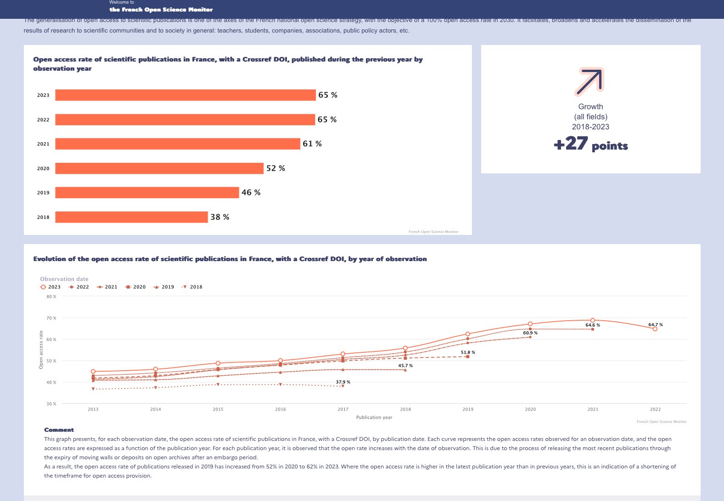
French Science Monitor
https://frenchopensciencemonitor.esr.gouv.fr/

Slide 7
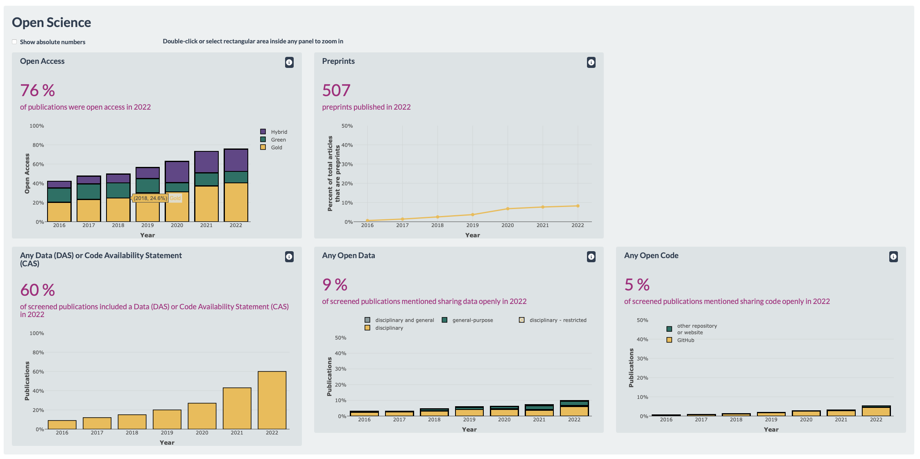
Charité Metrics Dashboard
https://s-quest.bihealth.org/charite-dashboard/#tabStart

Slide 8
Existing monitors & Projects
CERN Publications annual report – Superset
French Open Science Monitor
  Lorraine University Open Science
  Agence Nationale de la Recherche (ANR)
Charité Dashboard on Responsible Research
Curtin Open Knowledge Initiative (Open Access)
OpenAIRE monitor(s)
PLOS + DataSeer
CHAOSS (Open Software)
PathOS project
+++

Slide 9
KPIs examples
Open Software
Open Access
# of publications mentioned use/creation/sharing of code and software
Projects created by CERN
CERN Open Source Software Catalogue
Community Activity
Project viability
% of publications that were open access
Open access status statistics
Open access route
Open access mechanism (SCOAP3, CERN OA agreements, other agreements, etc)
Open Data
Open Hardware
#/% of publications mentioned use/produce/sharing of data New items in HEP data (CERN authors) / CERN open data repositories
CERN Open Data Portal statistics
FAIR: Datasets with PiD, by PiD type, with a license
Usage of the CERN Open Hardware License in Open Hardware repository/github
% of PCB designs which are open-sourced
% of those which are done in KiCad
Other
# of researchers with ORCID
OS Train and support on research data management, OA practices, data management tools

Slide 10
Thank you!
iris.kyranou@cern.ch
Questions

Slide 11

What’s next?
attainable
How do we continue?
Different research outcomes need different KPIs
How would you monitor your research?
What is meaningful and easily attainable?
more
meaningful
hard
easy
less

