Slide 1
CERN Archives & Library
Presentation of the AL section
Lydia Pieper
17 September 2024

Slide 2
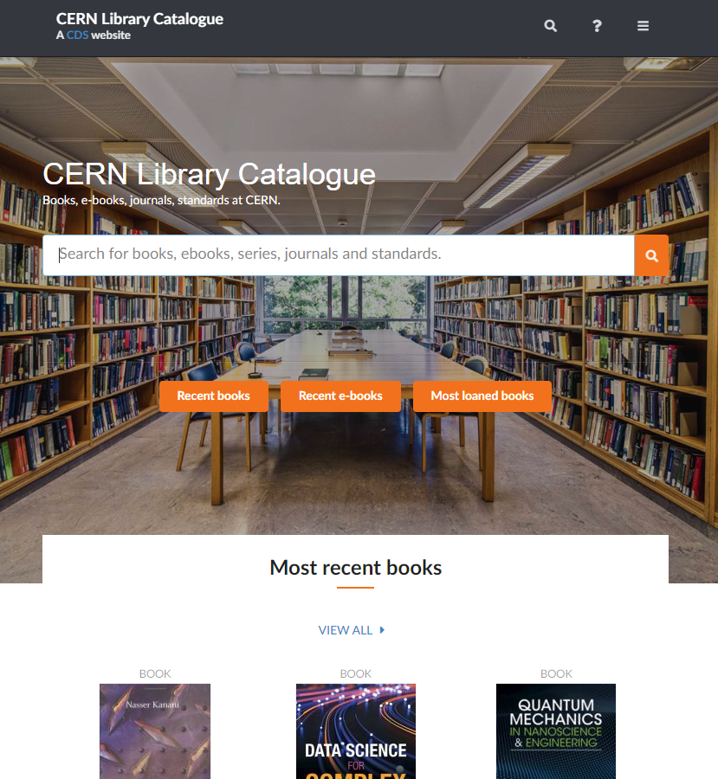
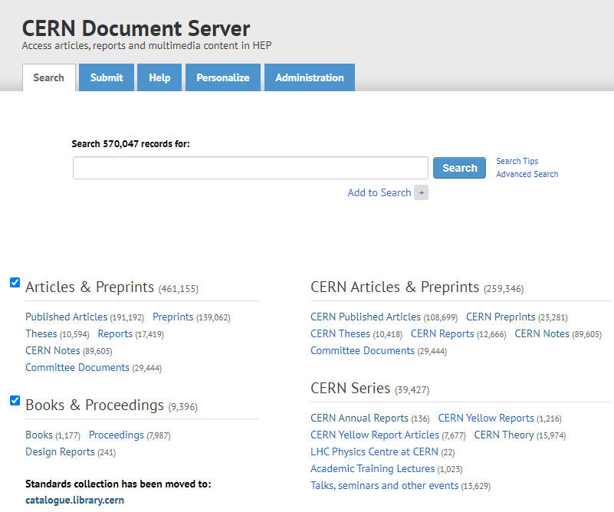
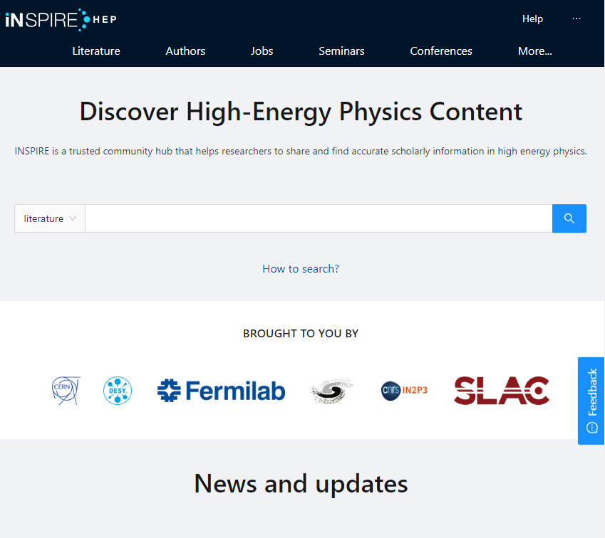
Where to find information?
Library catalogue: https://catalogue.library.cern/
Books, proceedings, journals, standards, in all fields of relevance to the Organisation
CERN Document Server (CDS):
http://cds.cern.ch/
CERN institutional repository which stores documents written by CERN authors and collaborations: CERN articles, reports, Yellow Reports, theses, photos, lectures, Archive collections… and much more!
INSPIRE:
https://inspirehep.net/​
High energy physics (HEP) content: interlinked database on literature, conferences, institutions, seminars, researchers, experiments, job

Slide 3
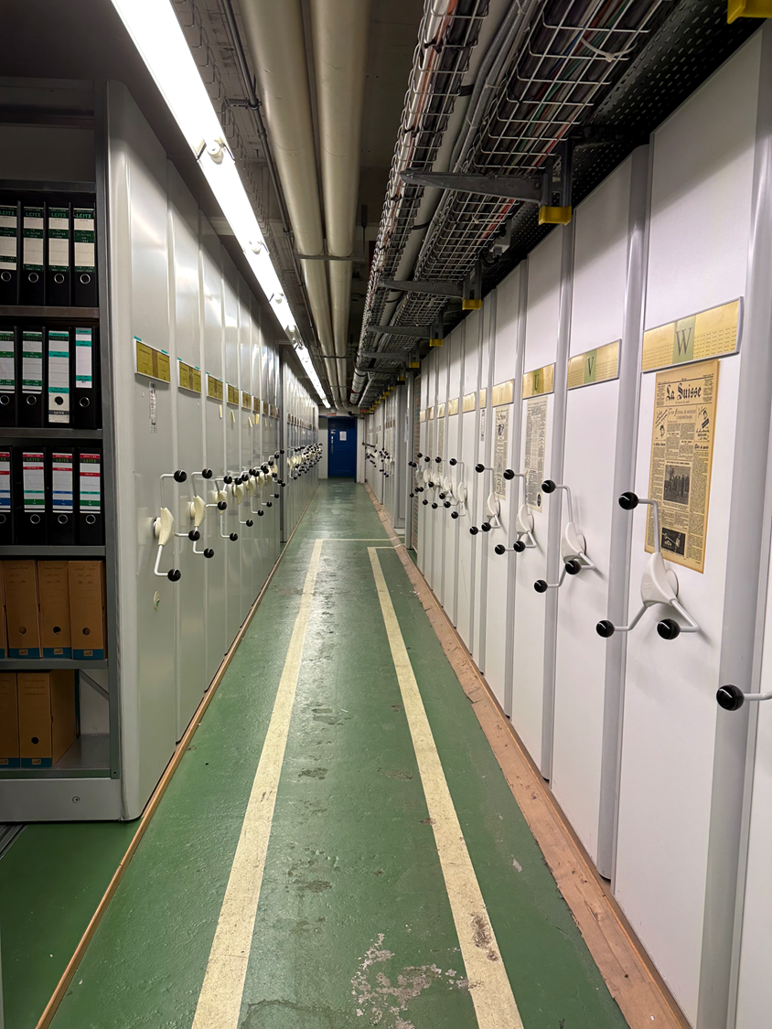
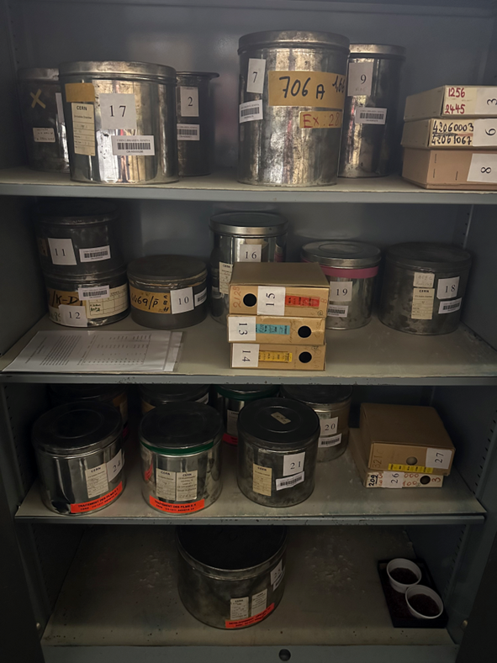
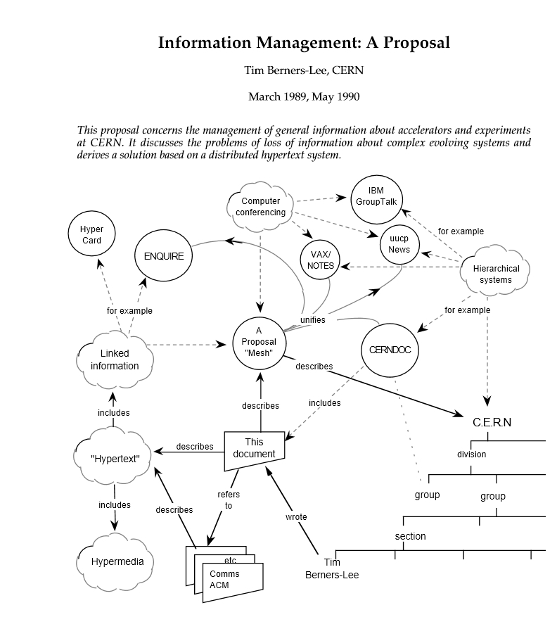
CERN Archives
The Archives holds over 2 linear kilometres (or 16’000 document boxes) of original historical documents, photographs, film reels, audio recordings, and objects. CDS contains 38,000 archival bibliographic records and some digitized documents.
You can request access to documents by emailing archive.enquiries@cern.ch
https://scientific-info.cern/archives
Notes:
The CERN Archives was originally conceived as a support for writing the history of CERN, as part of CERN’s 25th Anniversary celebrations. The projects were launched in April 1979 by the Committee of Council, and in November the DG requested division leaders to make source material available to the CERN Historical Archives and to appoint Divisional Records Officers to ensure ongoing collection of historical records.

Slide 4
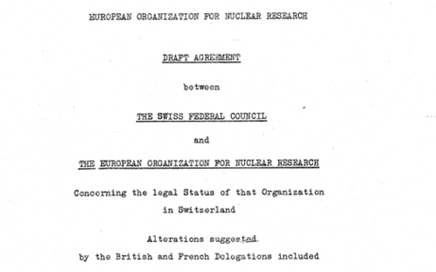
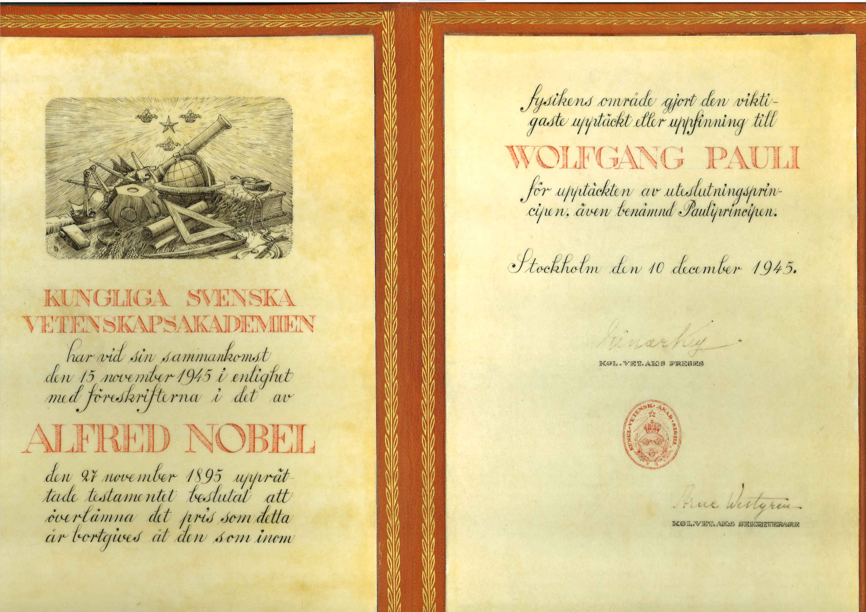
CERN Archives
We also have custody of the Wolfgang Pauli records, a private collection of scientific books, correspondence, and manuscripts from the Austrian Nobel Prize winner.
Our materials document all aspects of CERN’s history, including the CERN Council, administration & management, the experiments, theoretical and experi-mental physics, and technology, including a collection related to the creation of the World Wide Web.

Slide 5

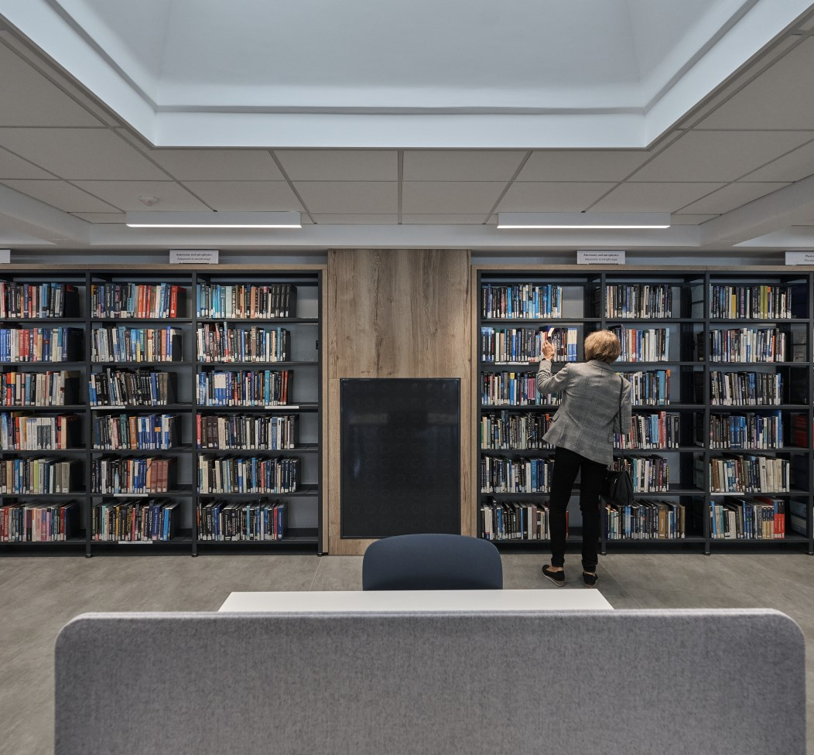
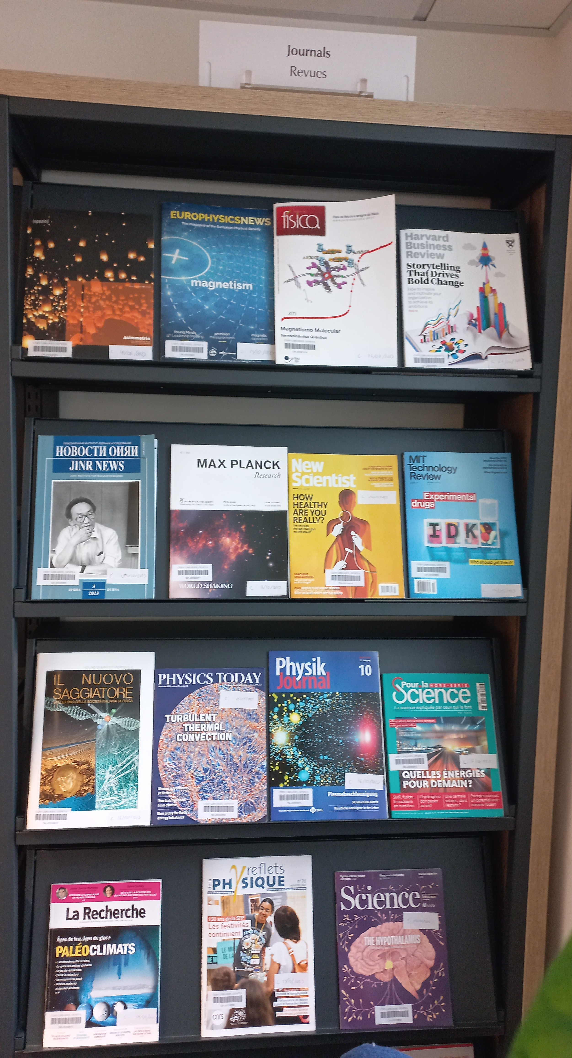
CERN Library collection
16’000 paper books freely available, 40’000 paper books in total
More than 110’000 e-books
20’000 proceedings
45’000 standards
2’300 journals

Slide 6
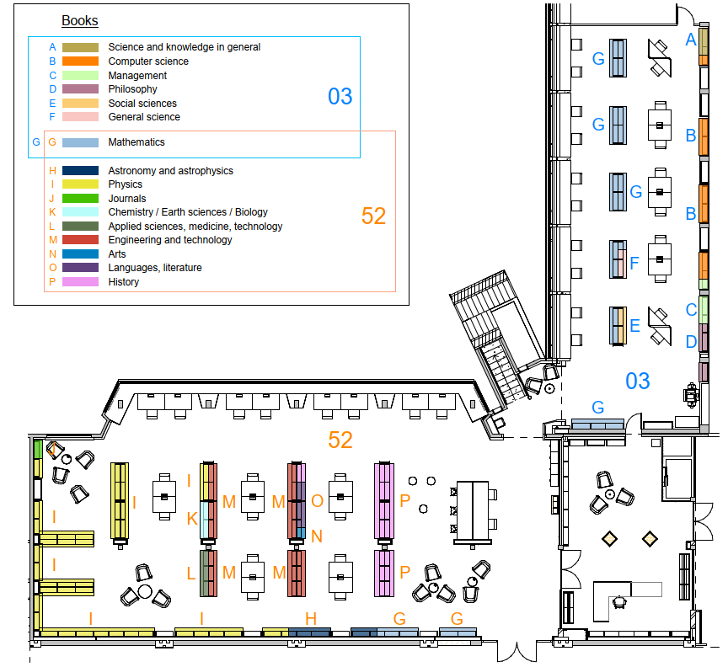
CERN Library catalogue:
Which subjects are covered?
Physics and Mathematics are our biggest subject groups, but we also offer books in other fields:
Engineering
Computer Science
Chemistry & Biology
Astronomy
Applied Sciences
Languages
History
Arts
Philosophy
Management
General Science
Social Sciences
etc.

Slide 7
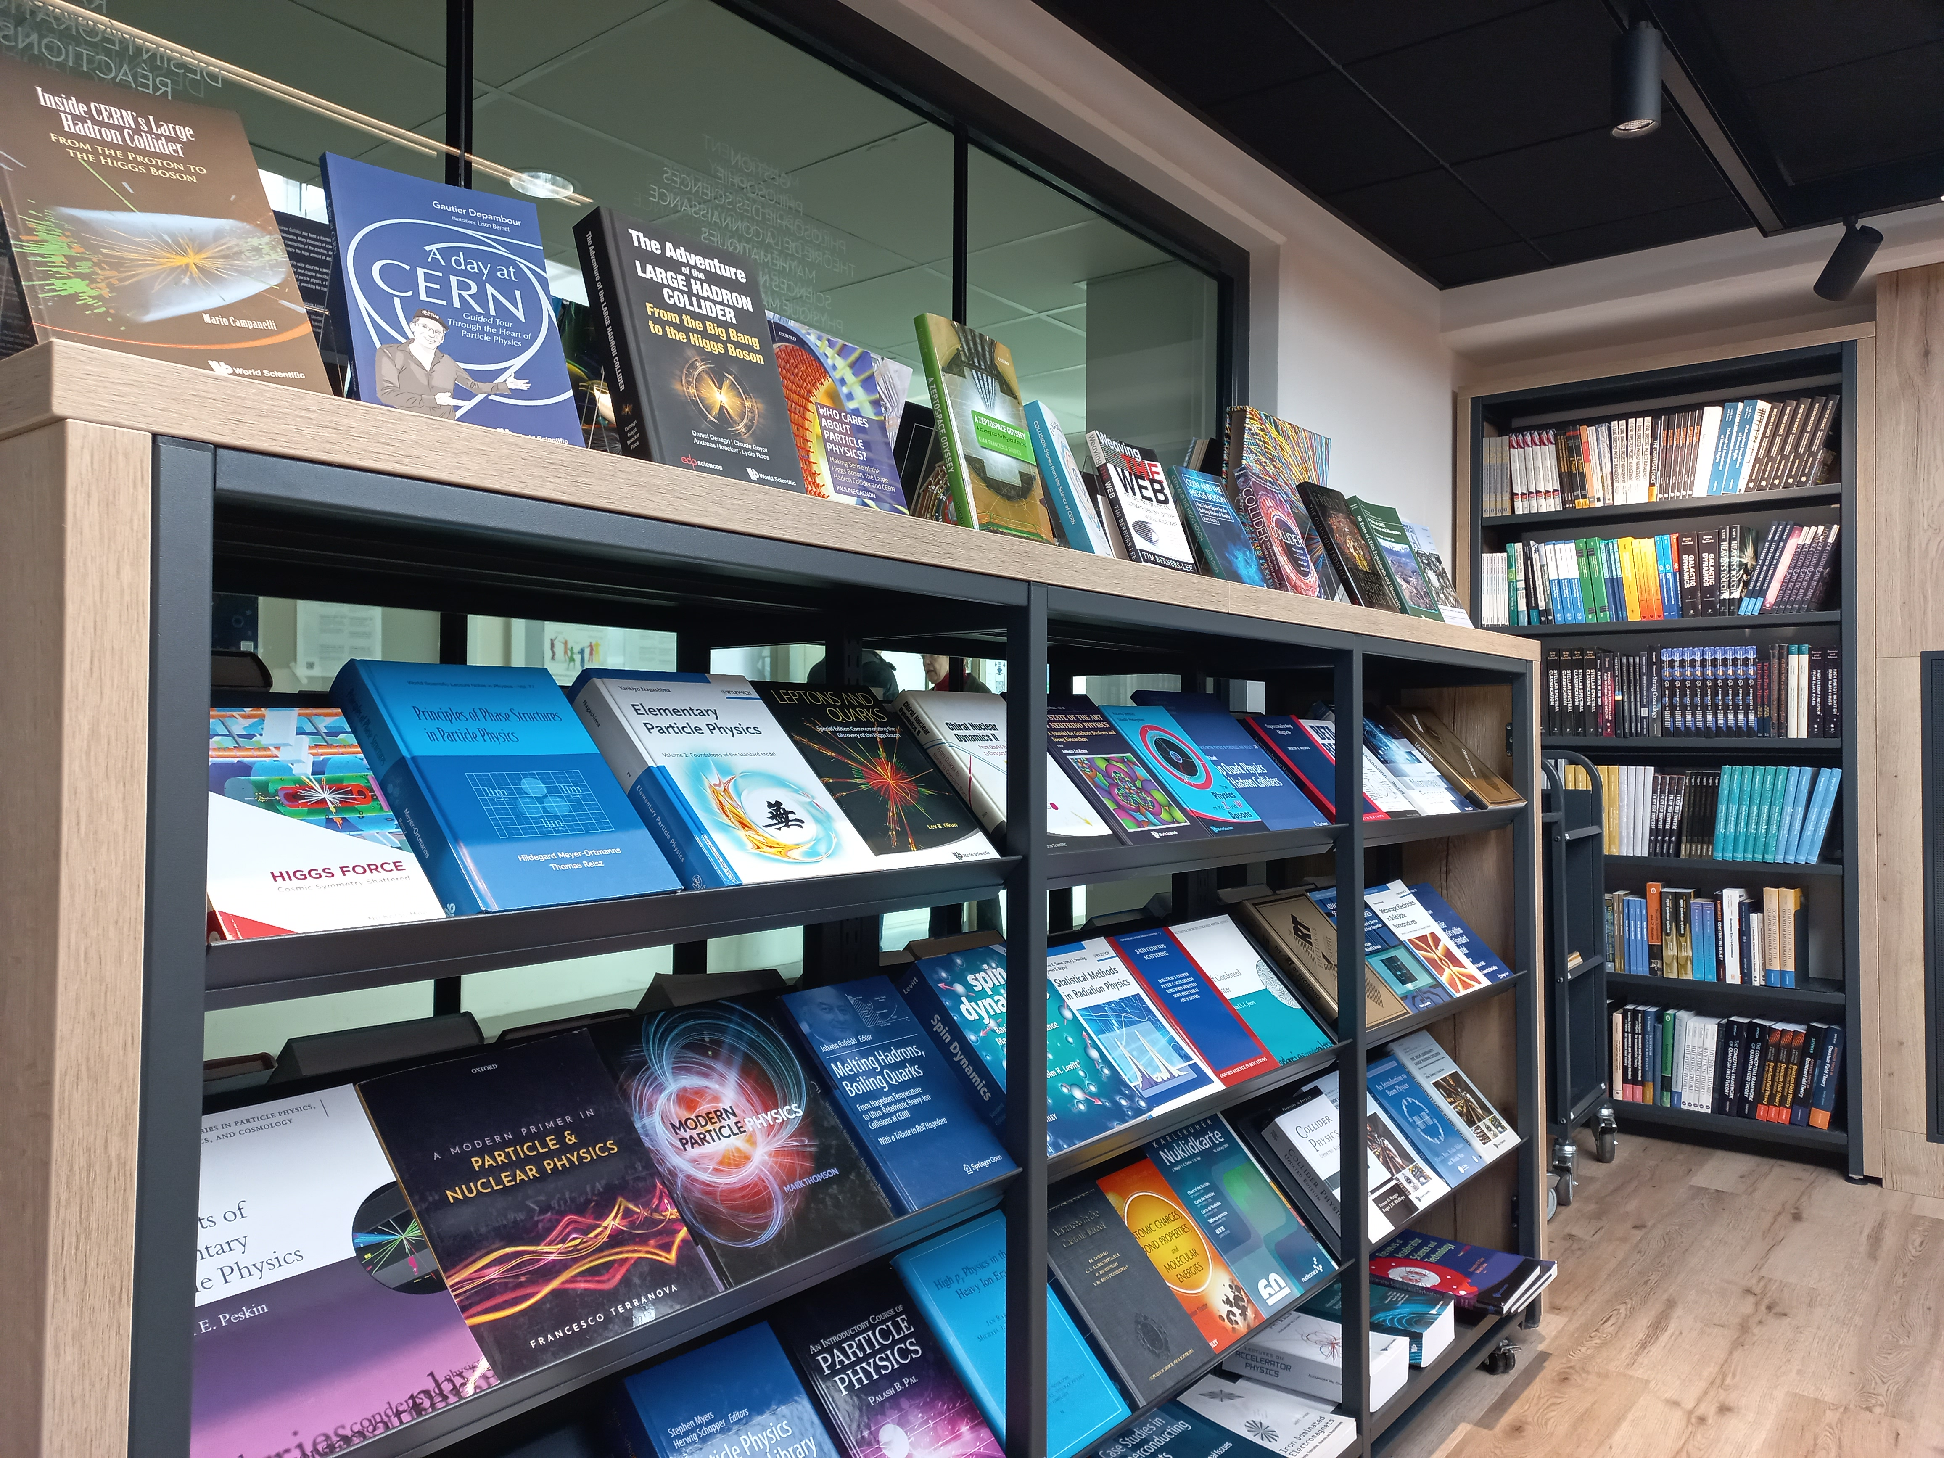
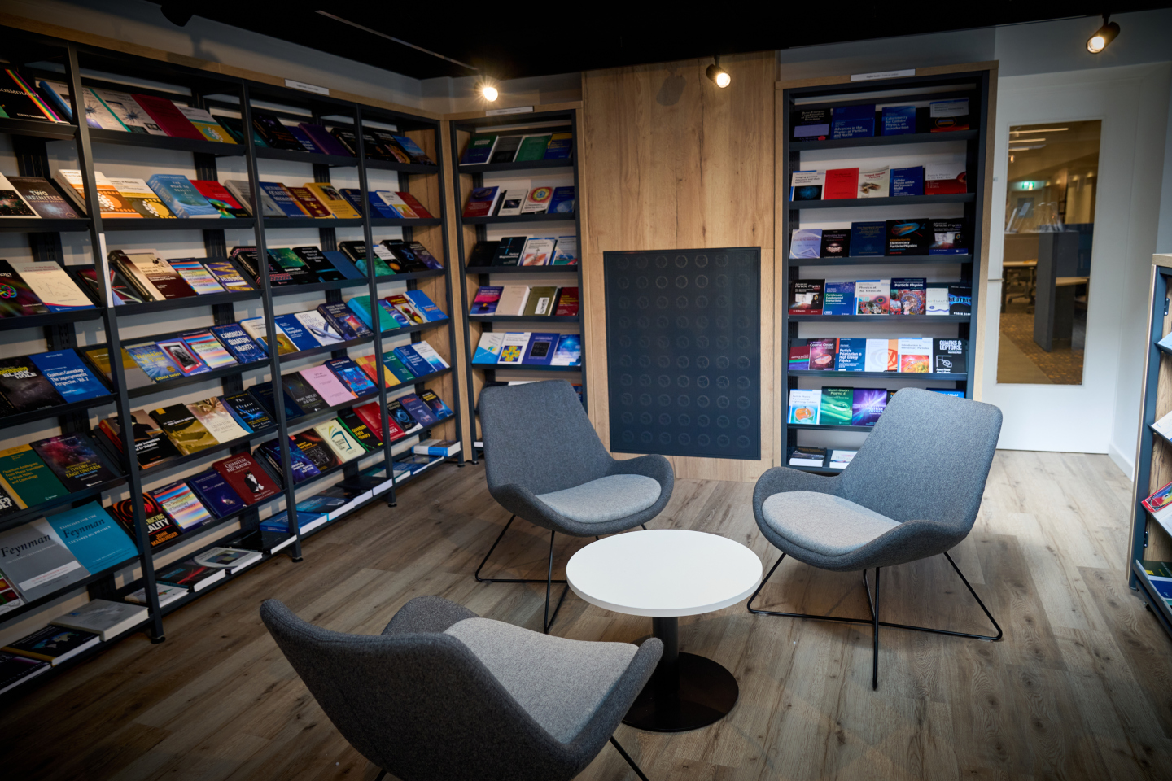
CERN Bookshop – part of the CERN Library!
Bookshop catalogue
We offer not only physics and mathematics books but also popular science, children’s books, CERN photo books, as well as books in different languages (English, French, Italian, German)
Location and opening hours are the same as the Library Welcome Desk:
Monday-Friday: 09:00 – 18:00
Payment: cash/card or CERN budget code

Slide 8
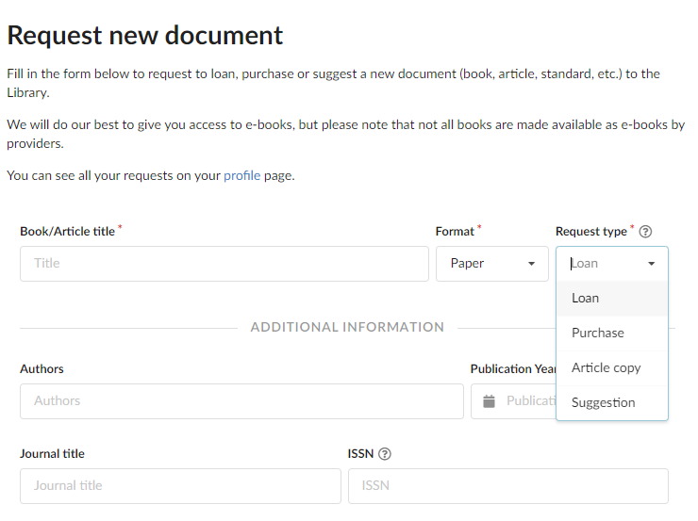
Library and bookshop services
Request for a document by submitting this form https://catalogue.library.cern/request:
    Loan: We can get books that we do not have in our catalogue – Usually delivered in 2-5 days
    Purchase: We can order books for you with payment by cash/card or budget code
    Article copy: If you cannot access an article you would like to read online, we can deliver it within 24h
    Suggestion: Let us know if an important document or book is missing in our collections – We can purchase it for the library

Slide 9
Online resources external to the Library catalogue
Beside e-books and e-journals available in the catalogue, CERN SIS provides a wide range of online resources in various disciplines:
Dictionaries and reference books (e.g. Oxford English Dictionary, Oxford References, Grand Robert)
Online databases (e.g. Total Materia, Nucleonica)
Scientific writing references (e.g. Chicago Manual of Style, Oxford Style guide)
Online trainings and videos (O’Reilly learning platform)
Online standards (SNV Connect): more than 45’000 standards accessible for CERN
All resources available here: https://sis.web.cern.ch/search-and-read/online-resources

Slide 10
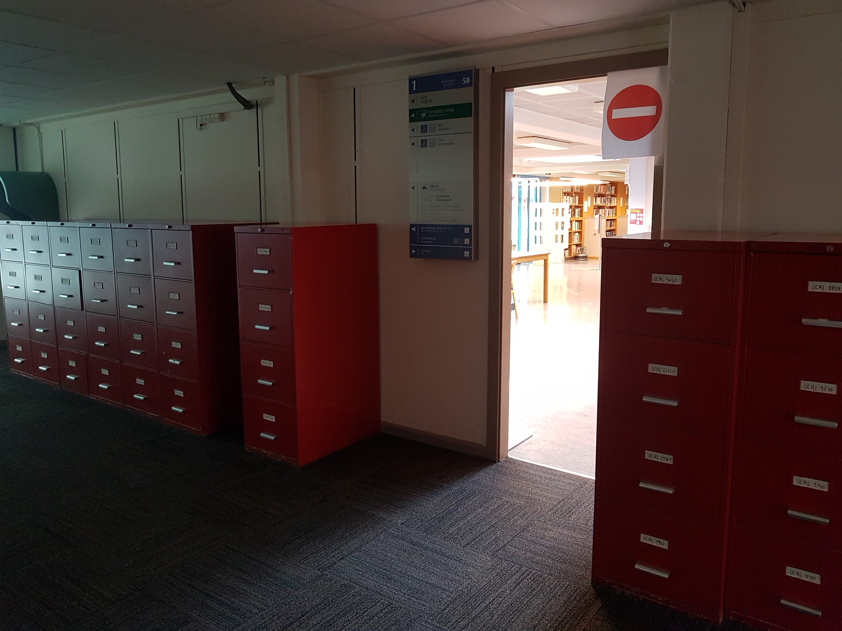
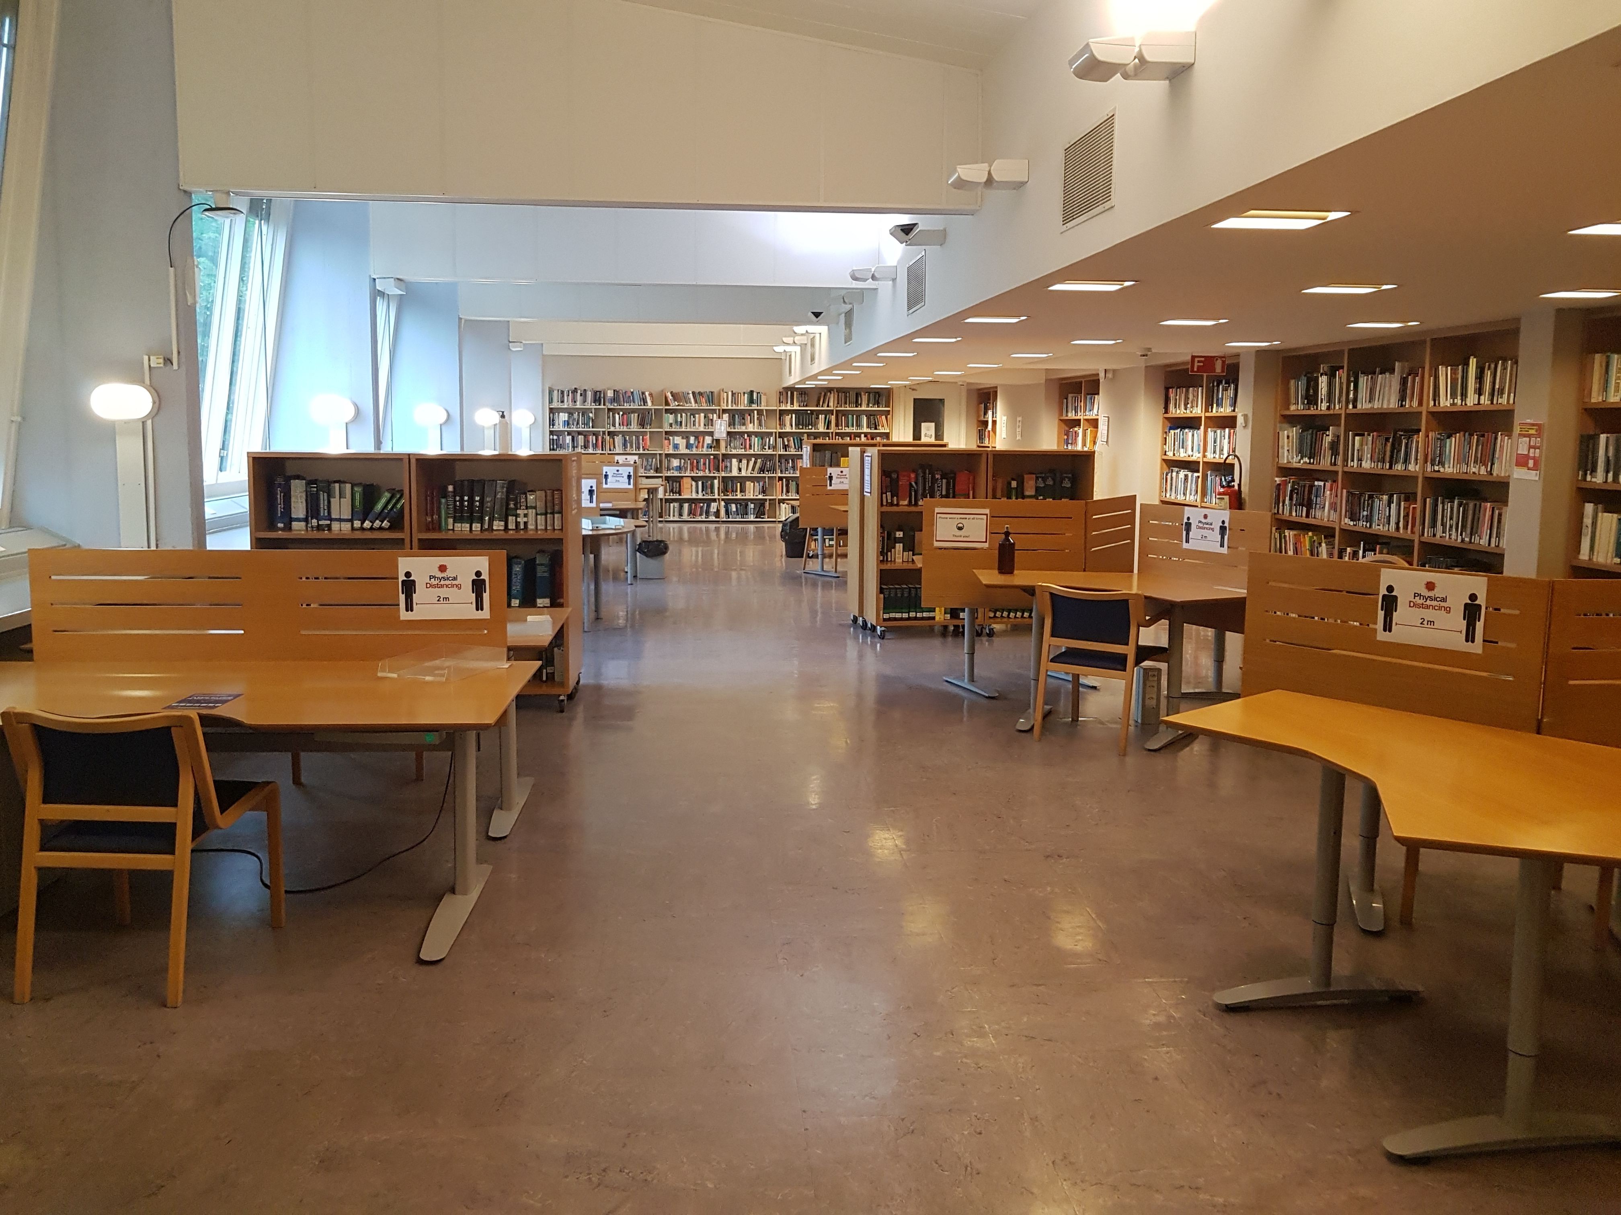
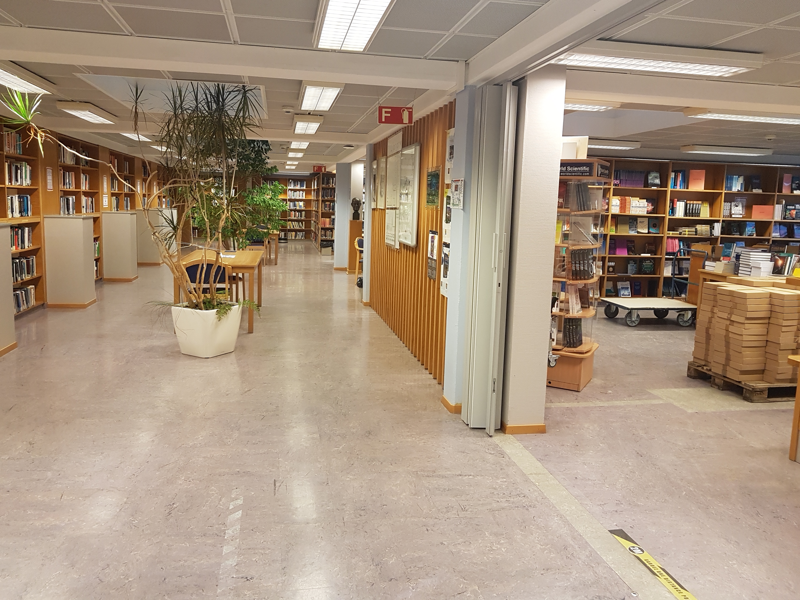
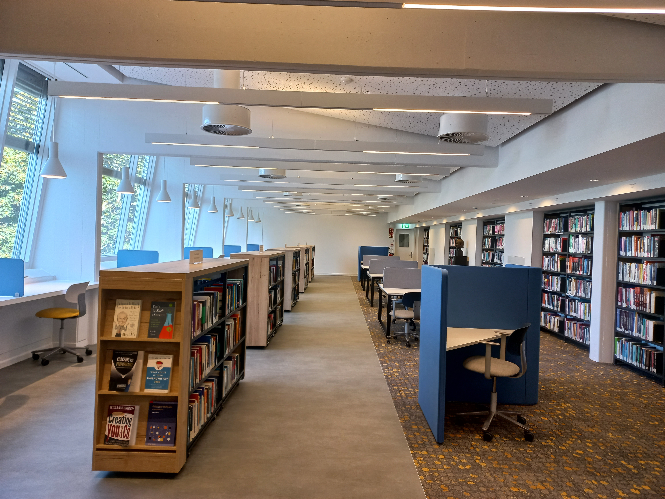
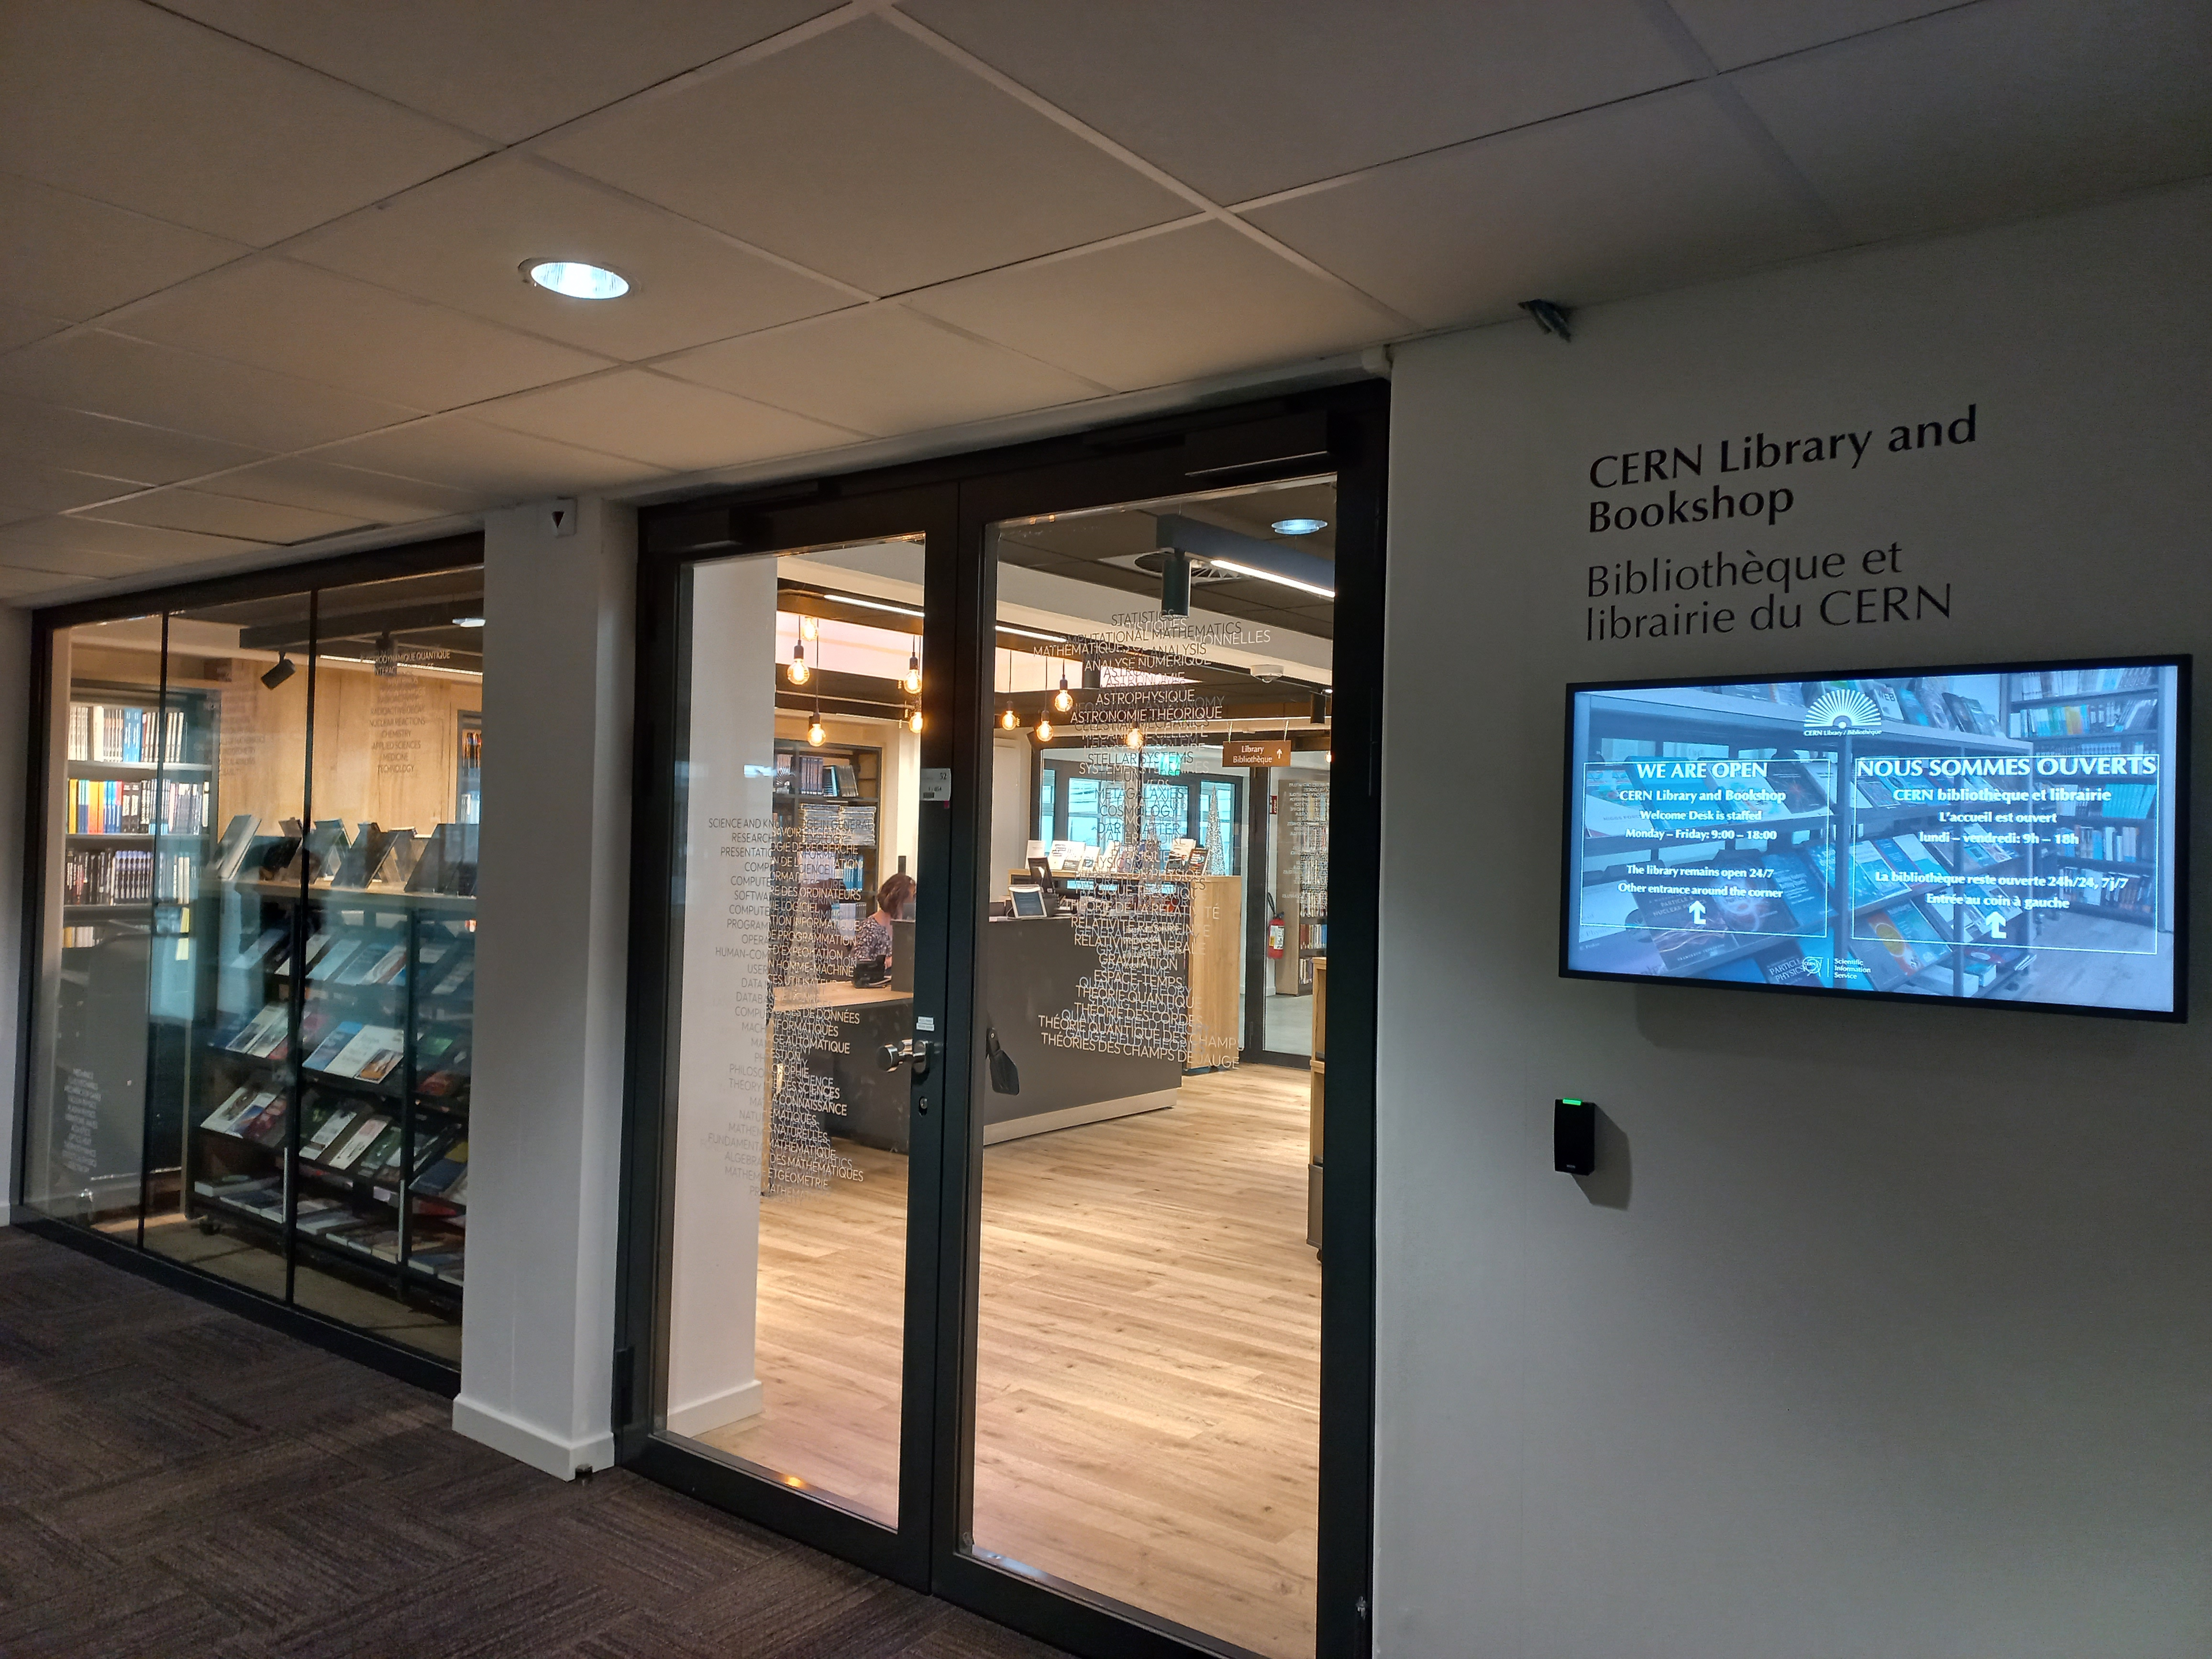
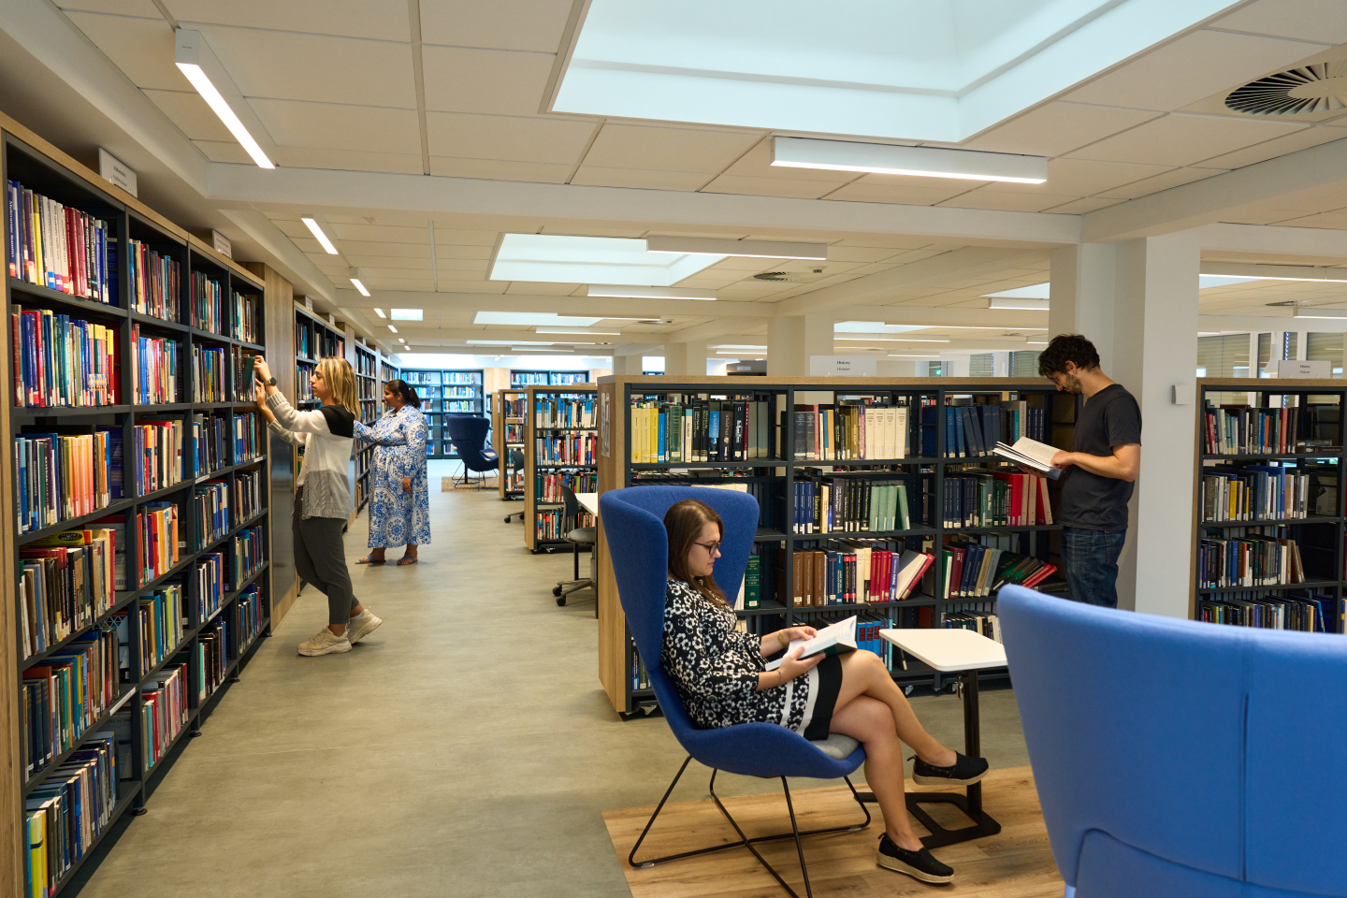
Library facilities – renovated last year!

Slide 11
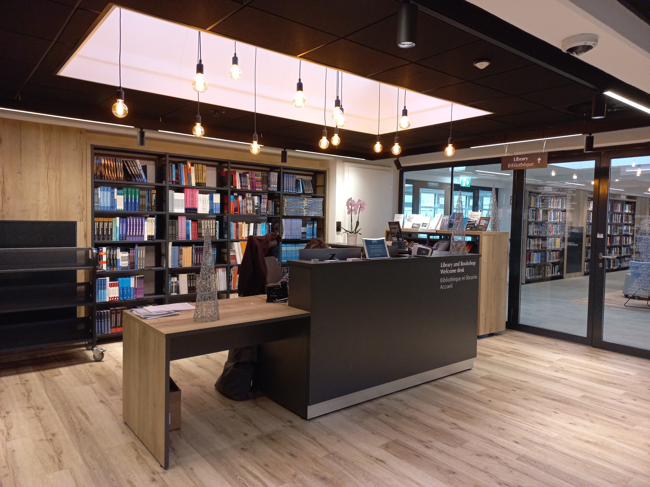
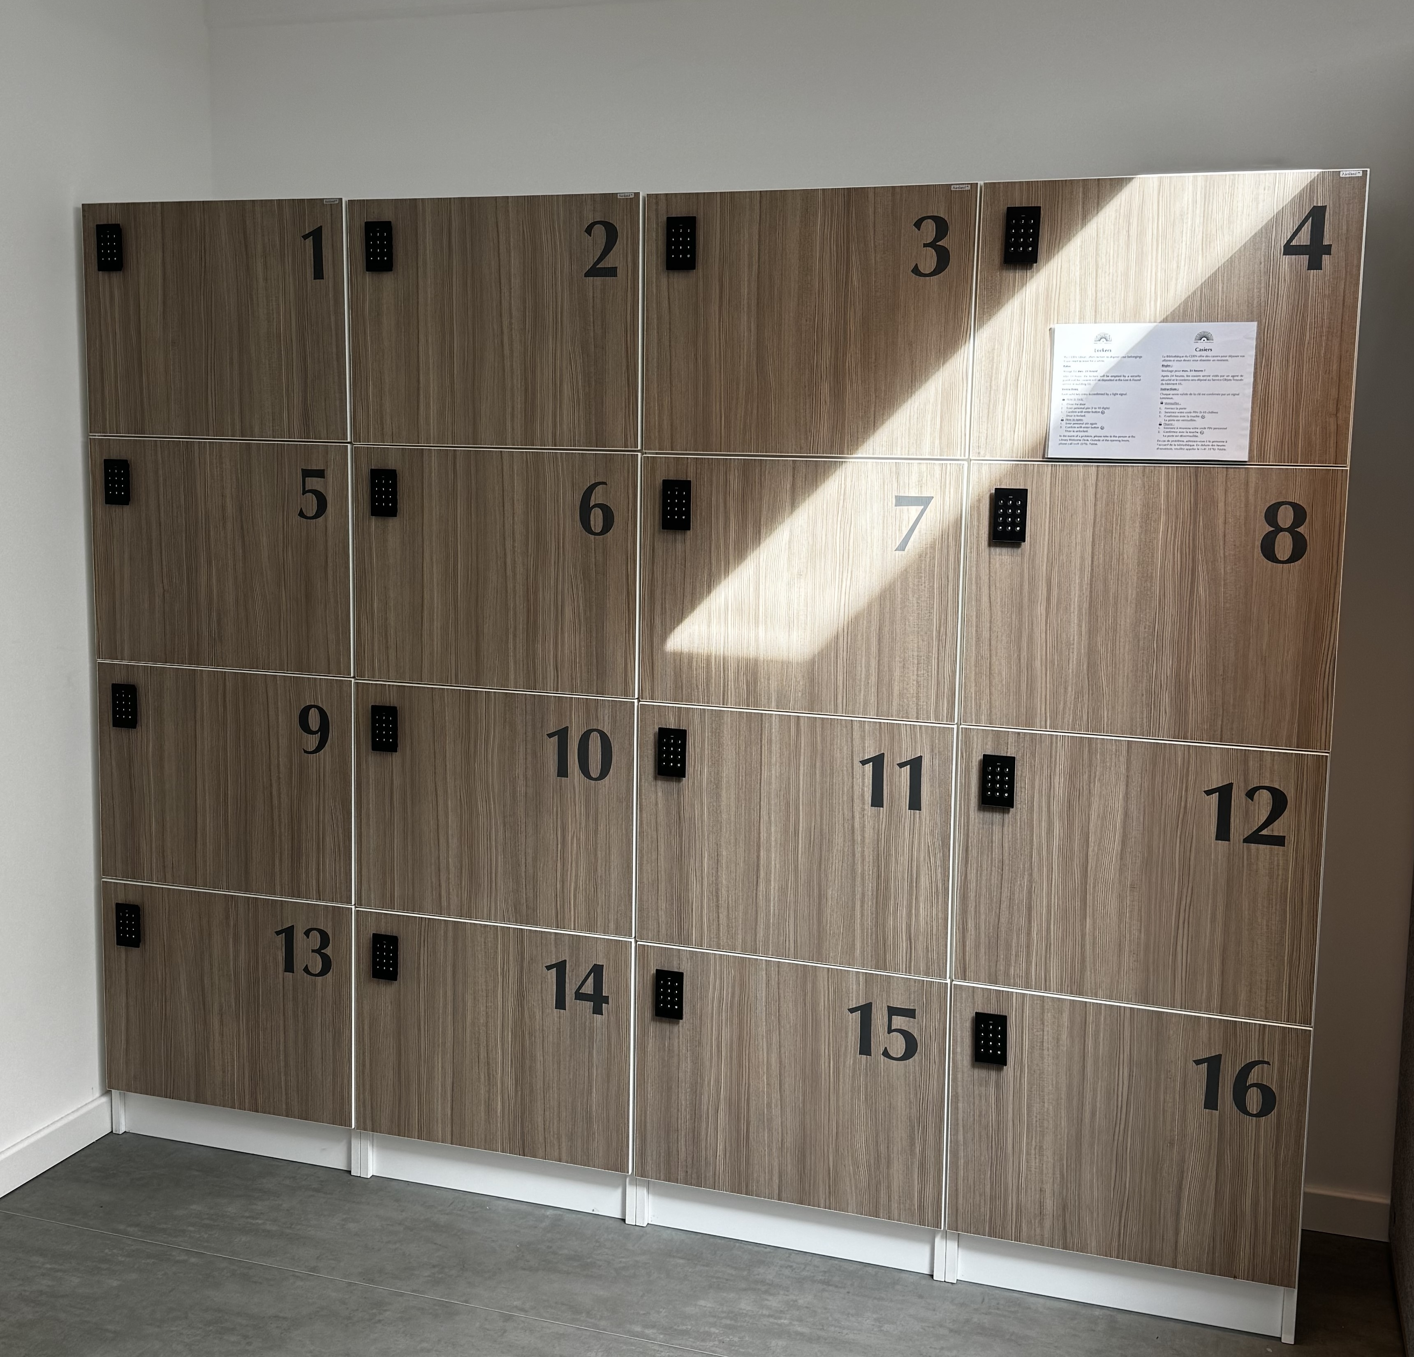
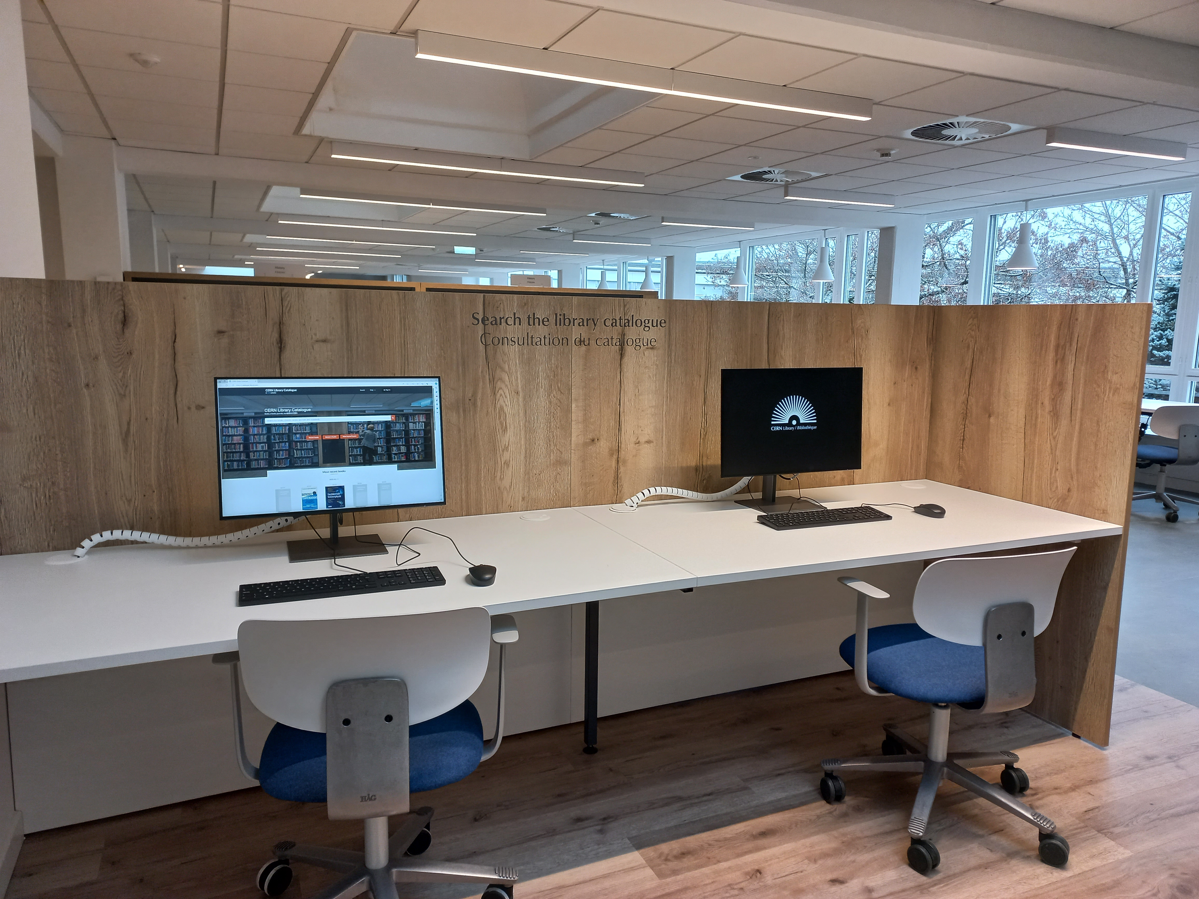
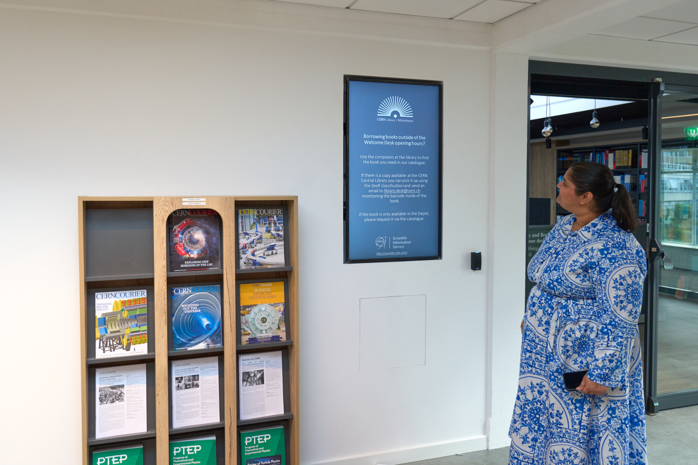
Library facilities
Public PCs to search the
library catalogue; four screens for connecting laptops
The library is open 24/7! Desk is open from Monday-Friday 9:00 – 18:00
Library lockers and a water fountain
Recent CERN publications display
Location: Building 52/1-052

Slide 12
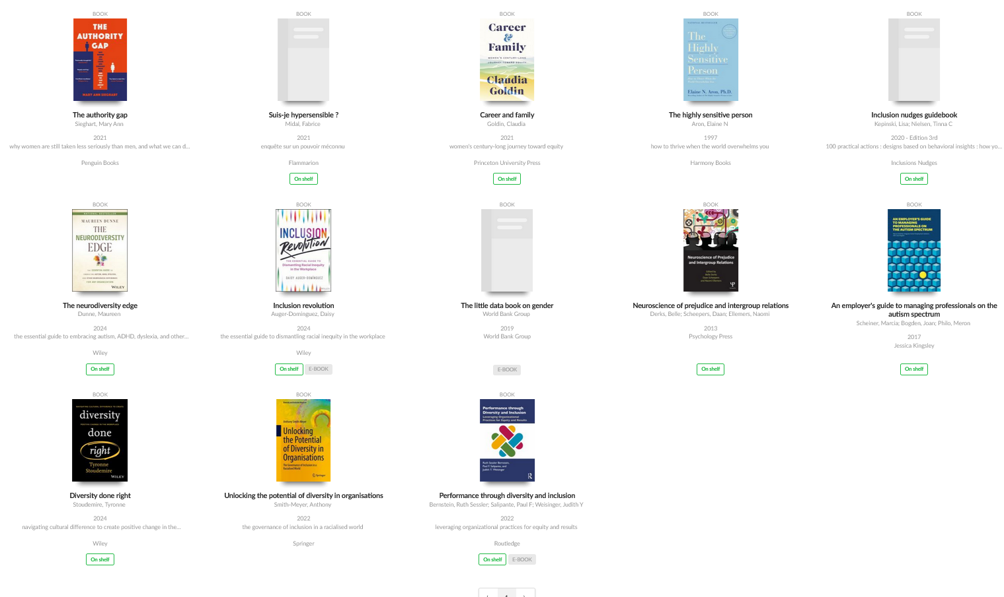
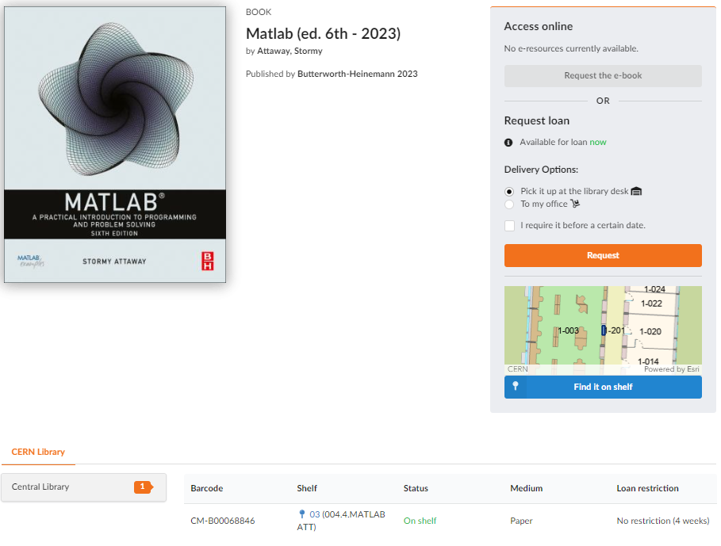

The library is becoming more accessible (1)
Reading corner with books about Diversity & Inclusion: selection made with Diversity & Inclusion Office and dedicated tag
Location of the book on the shelf in the catalogue. Implemented with MapCERN

Slide 13
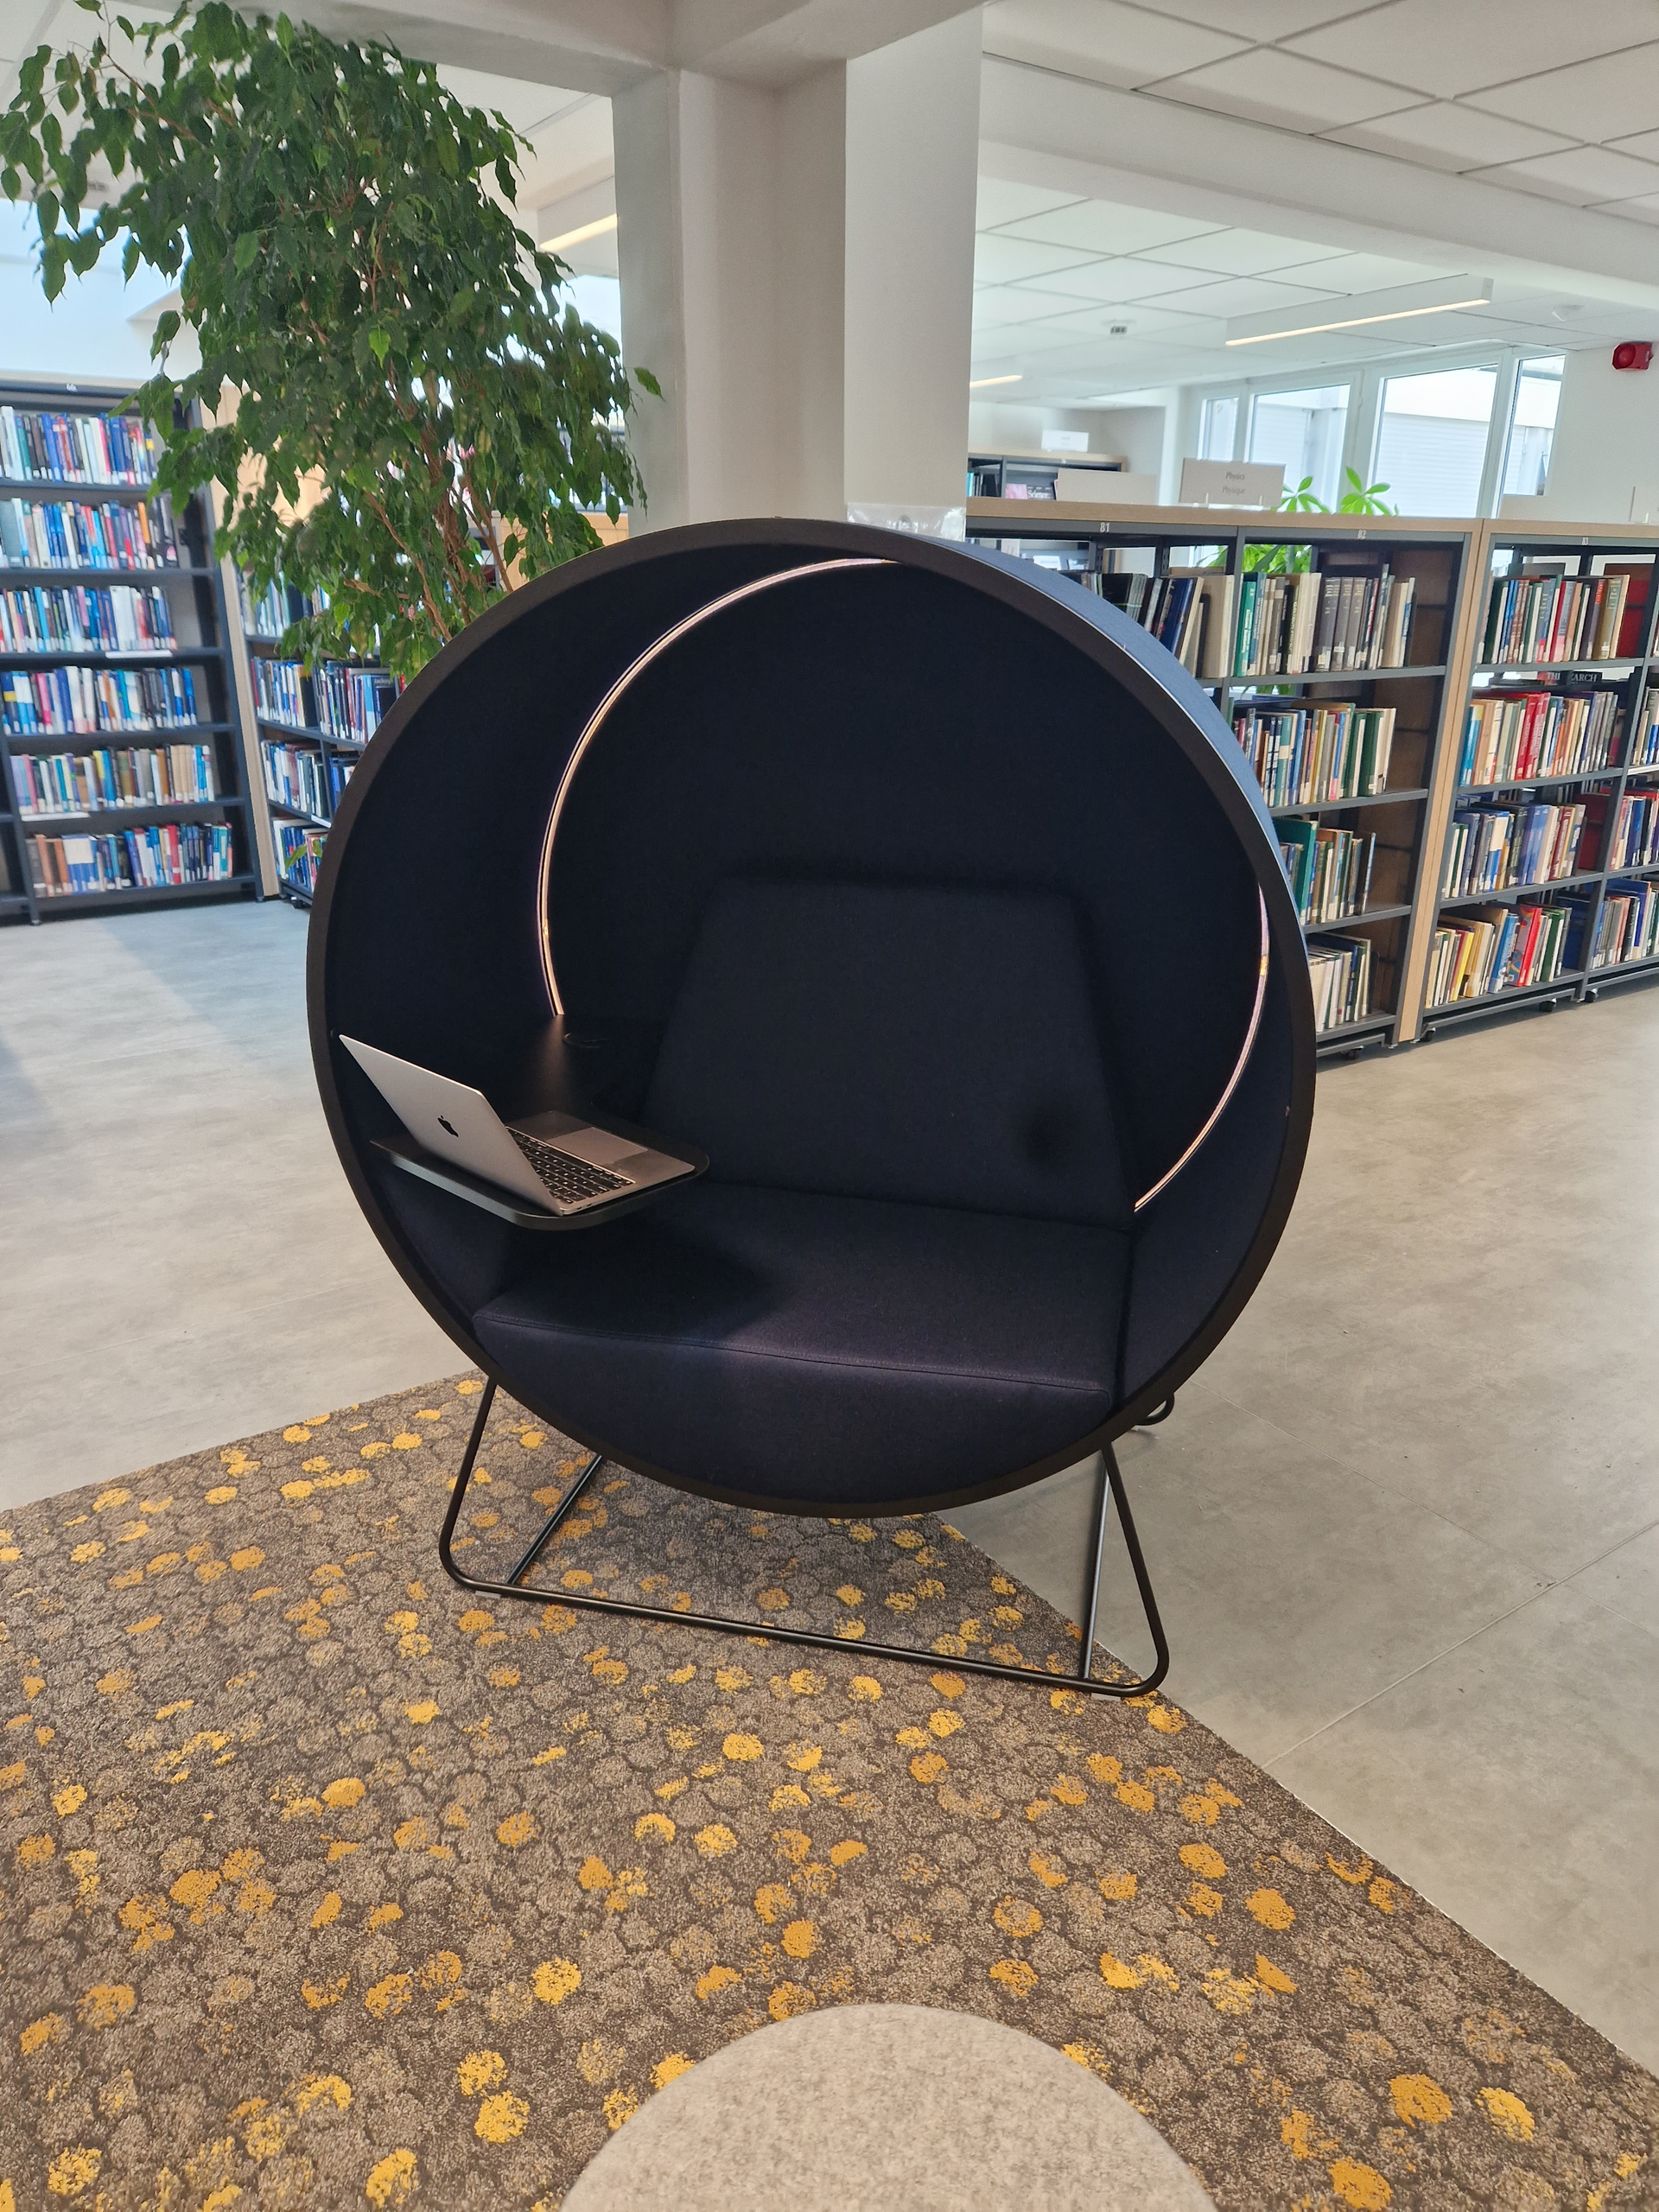
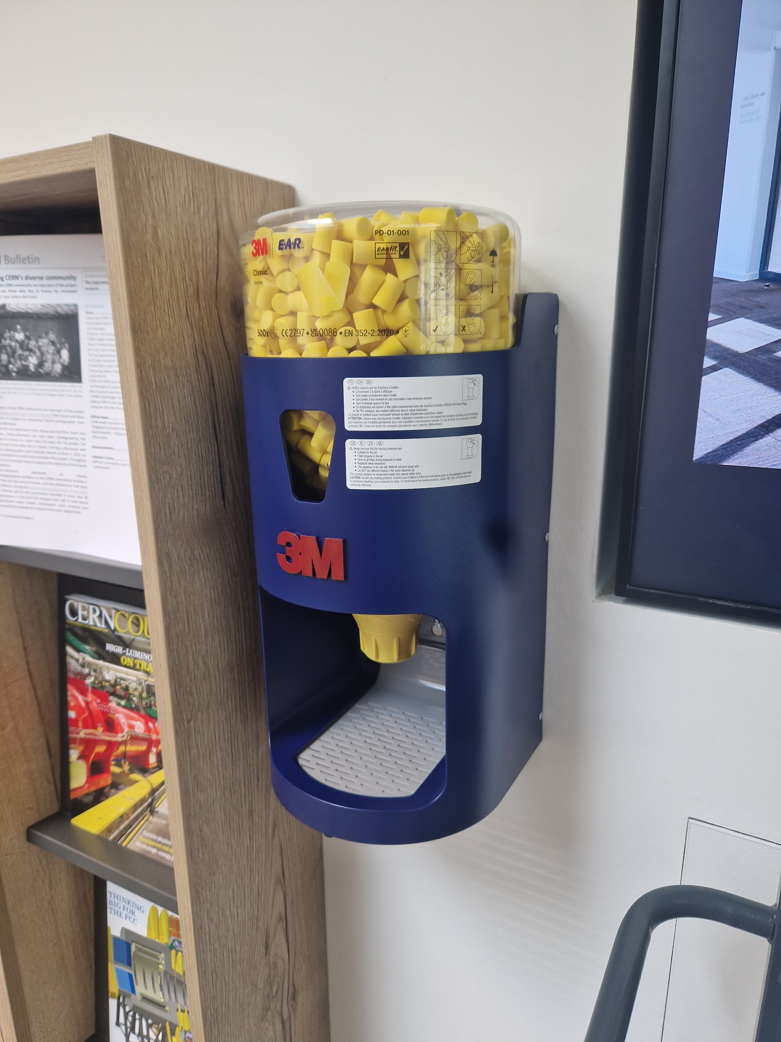
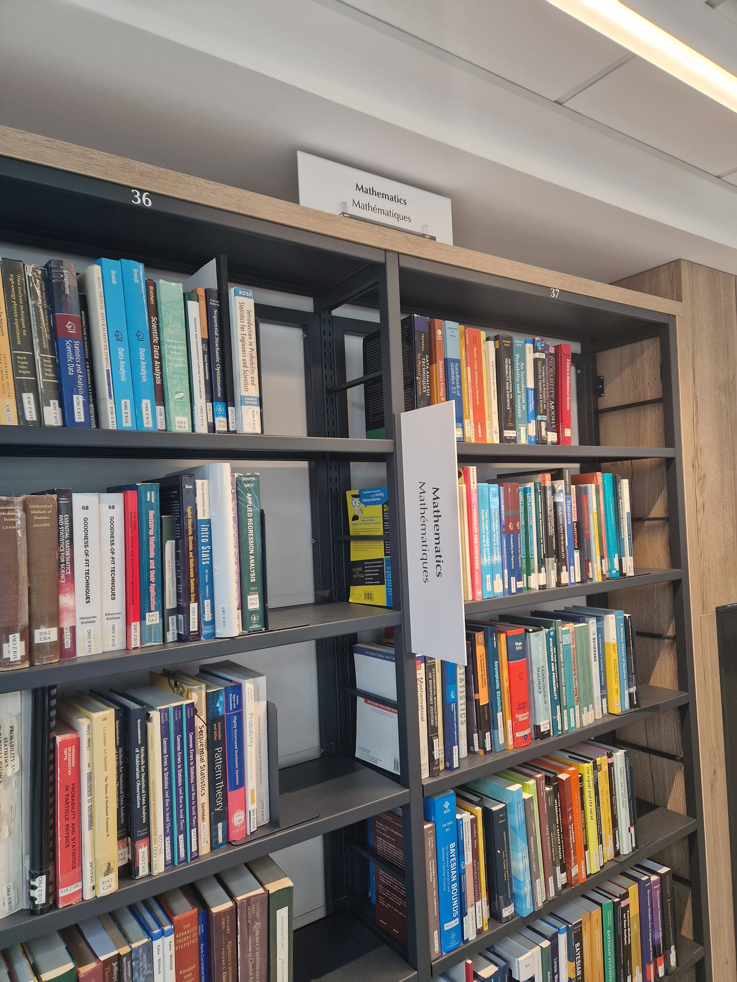

The library is becoming more accessible (2)
“Kuppel” chair: reduces surrounding noise and soft light.
2nd one will arrive by the end of the year
Ear plug dispenser, noise cancelling headphones and magnifying glasses can be borrowed
Better visible signs in the library
Audiobooks and videos are available since July in the catalogue
and more planned…
Notes:
Next steps:
Motorized doors
Accessibility of SIS Drupal website, ok → accessibility of CERN Library Catalogue to be done

Slide 14
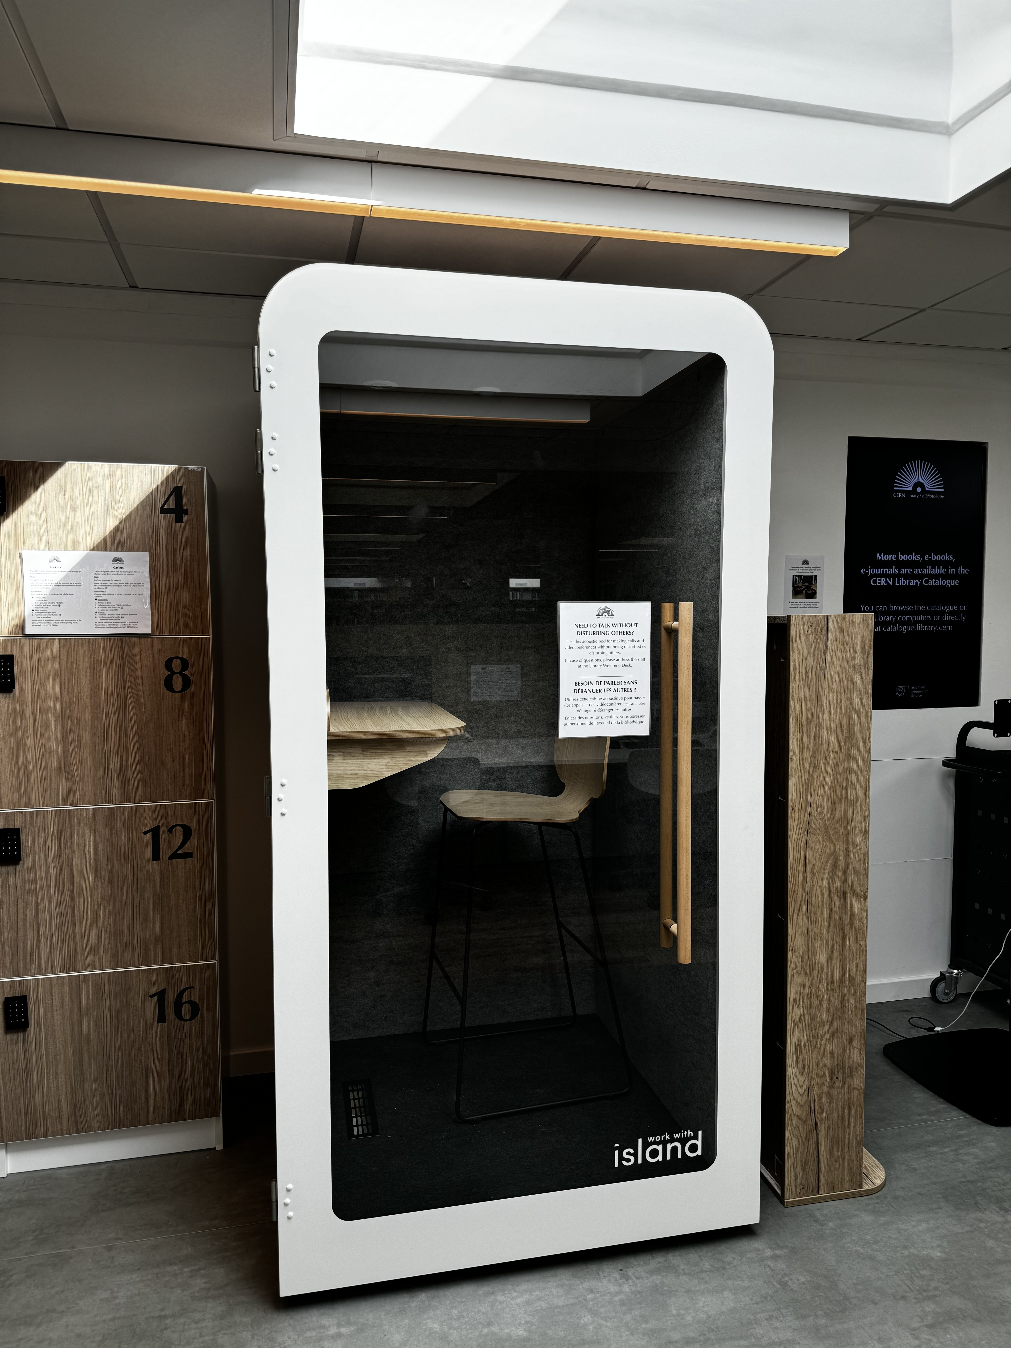
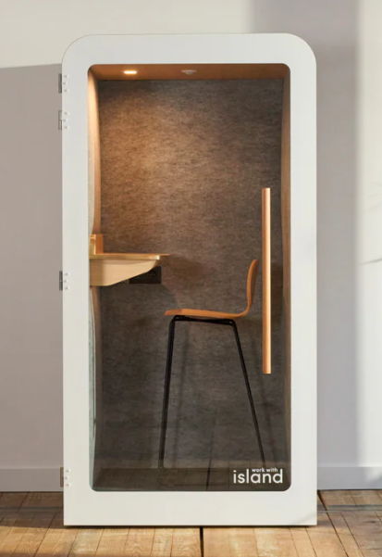
New: Island SOLO booth
Island SOLO is an acoustic booth for calls and video conferences without being disturbed or disturbing others.
It is located next to the lockers in the CERN Library.

Slide 15
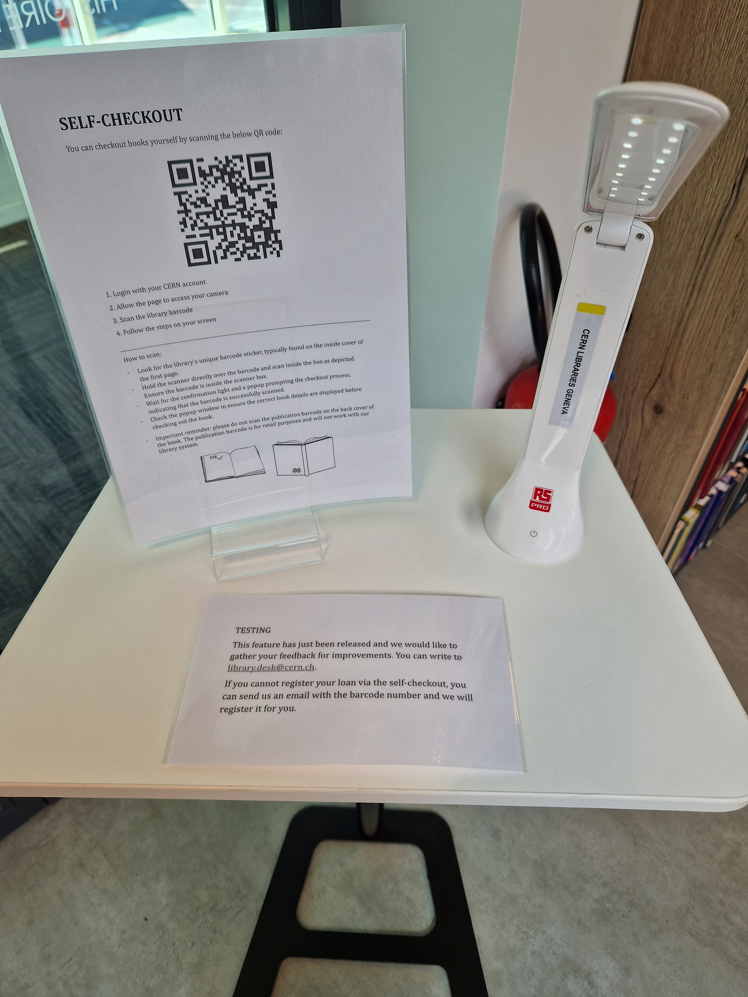
New: Test phase for self-checkout
Scan the QR code
Login with CERN SSO
Scan the barcode inside the book
Register the loan

Slide 16
Thanks for your attention!
Any questions?

