Slide 1
10 years of SCOAP³:
Achieving the transition to OA for an entire discipline
All slides © 2024 SCOAP3 Collaboration, shared under CC-BY 4.0 license.
Alexander Kohls
Head of CERN Scientific Information Service & Member of SCOAP³ Executive Committee
European Organization for Nuclear Research (CERN)

Slide 2
SCOAP³ in a nutshell
Sponsoring Consortium for Open Access Publishing in Particle Physics
Mission:
  SCOAP³ enables open access publishing in the field of high-energy physics, helping to remove financial and administrative barriers to science
International collaboration launched in 2014
Partnership consisting of 3000+ libraries, research institutions and international research organizations from 47 countries (and growing)
11 of the leading journals in the discipline of high energy physics

Slide 3
2007: The Origins of SCOAP³
Authors want the widest possible audience for their scientific publications. To enable this, a global transition of the scholarly publishing model was needed and CERN was the only institution in our field to initiate such a change.
Robert Aymar, August 2022
Robert Aymar described his vision of a transition towards open access in 2007 during an interview with BMC available on YouTube (https://youtu.be/qkBRPJsmVXQ)

Slide 4
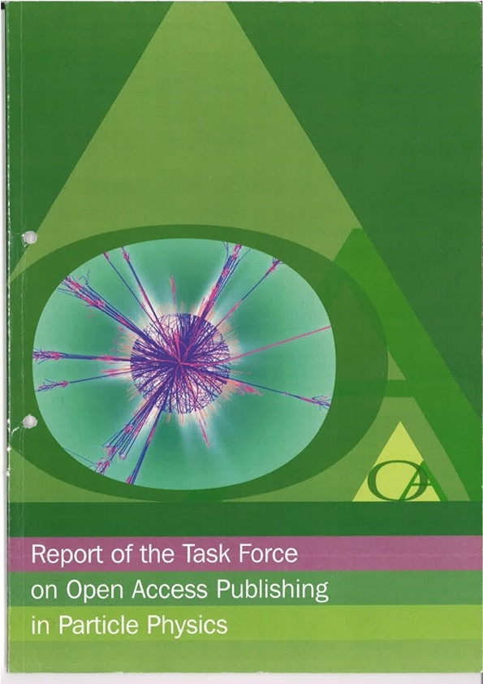
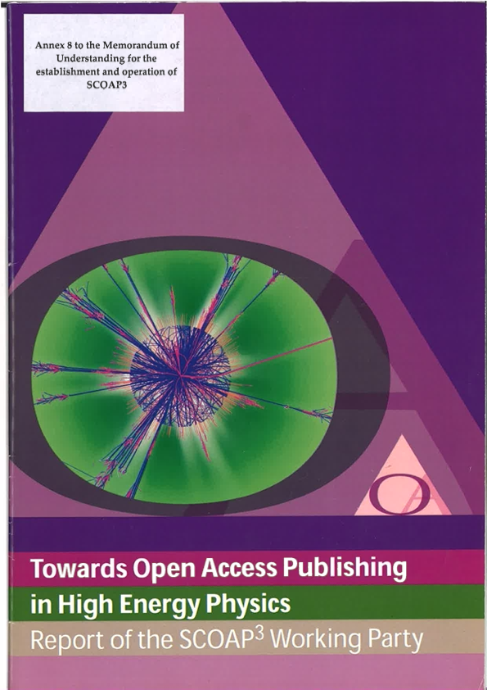
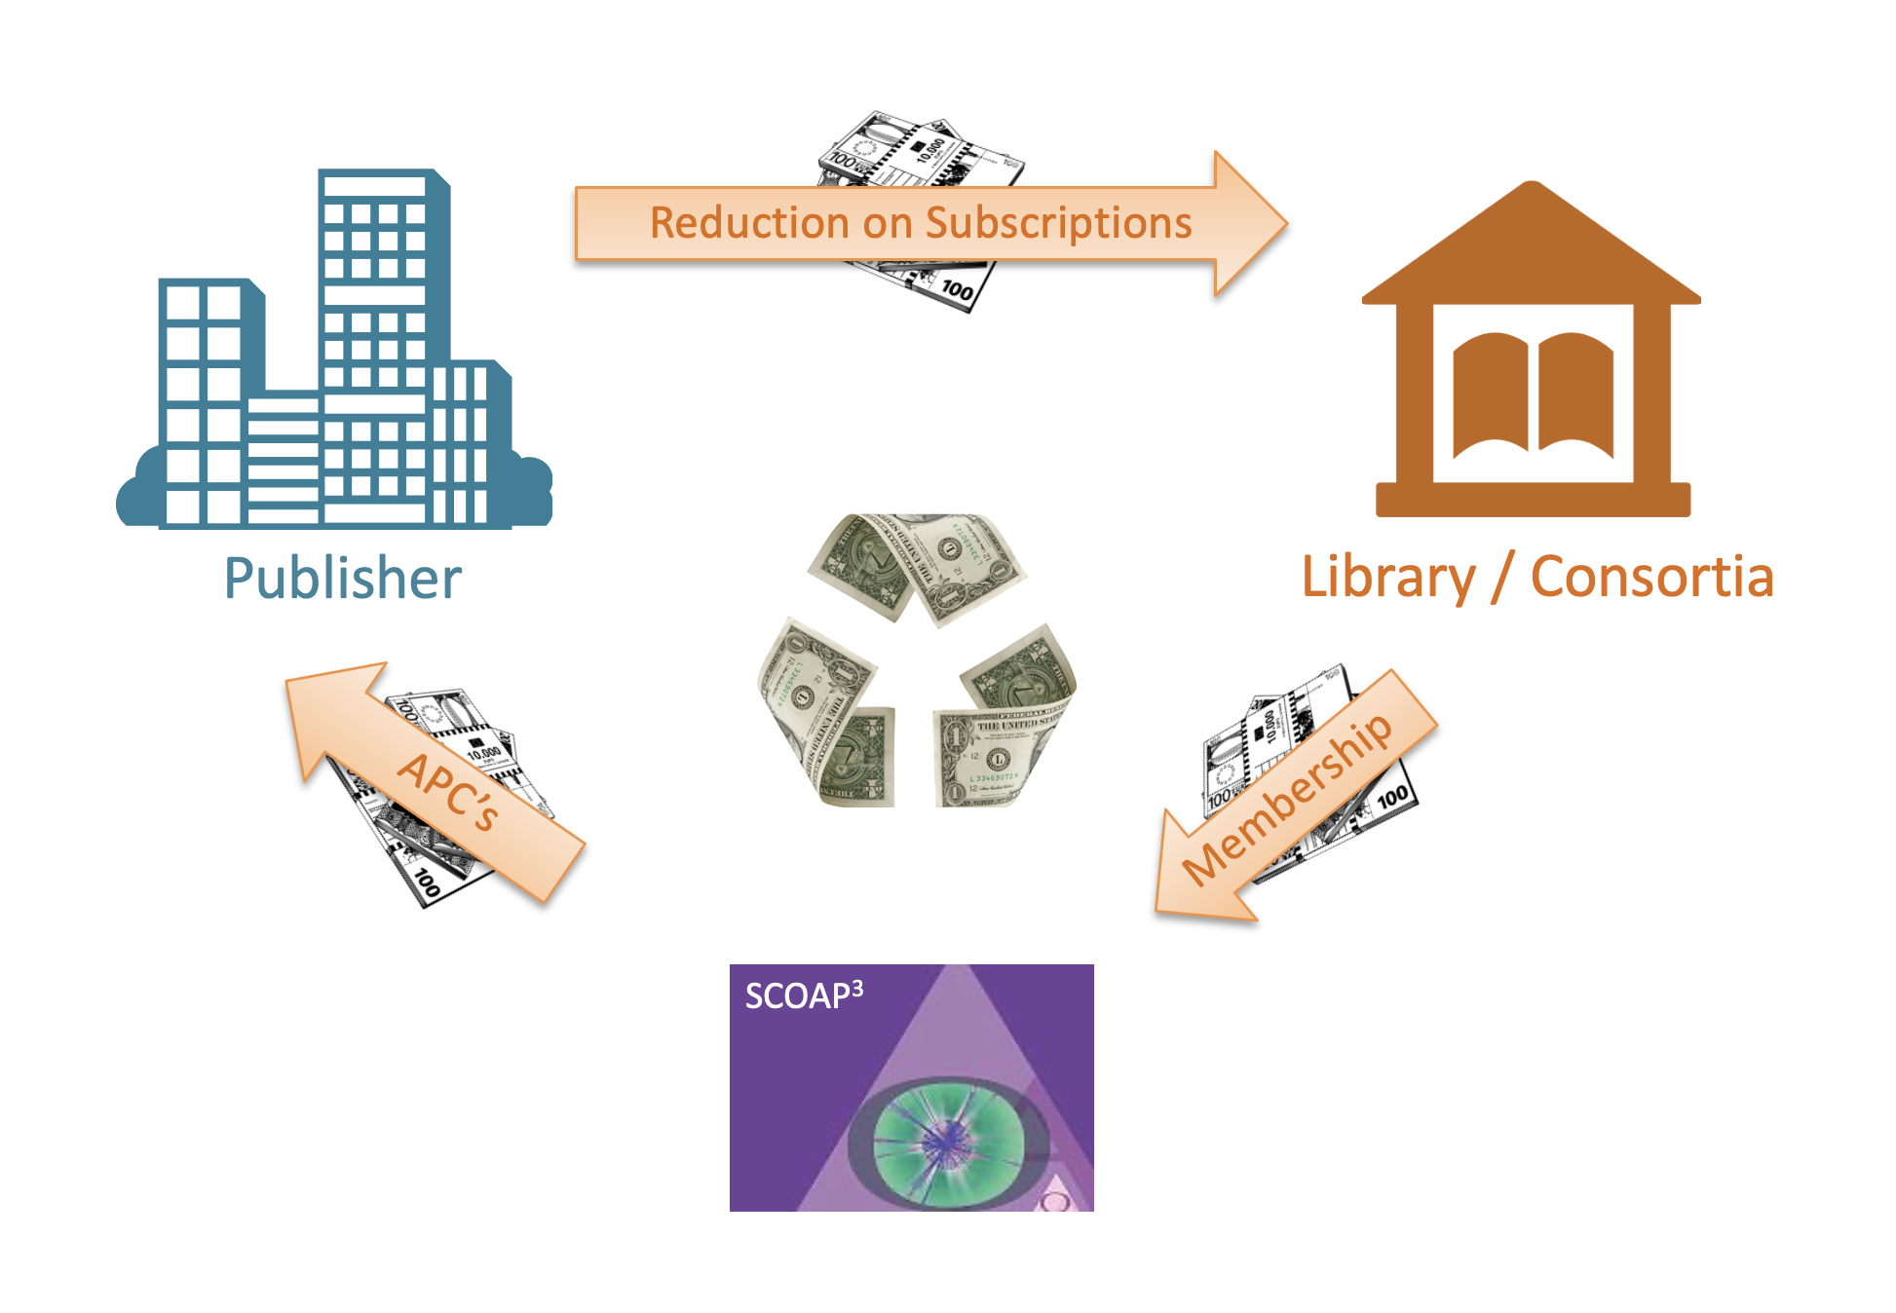
2007–2008: Developing the operational model of SCOAP³
…reuse funds previously spent by libraries to subscribe to HEP journals… to pay centrally for OA publishing
SCOAP³

Slide 5
SCOAP³ Timeline
2006
2012
2014
First Partners signing Memorandum of Understanding
Report of the SCOAP³ Working Party
Consensus building process
and establishing of future international partnership
Task Force to assess feasibility of wide-scale Open Access in HEP
Market Survey and Competitive Tender
Start of SCOAP³ Operation
2007
2013

Slide 6
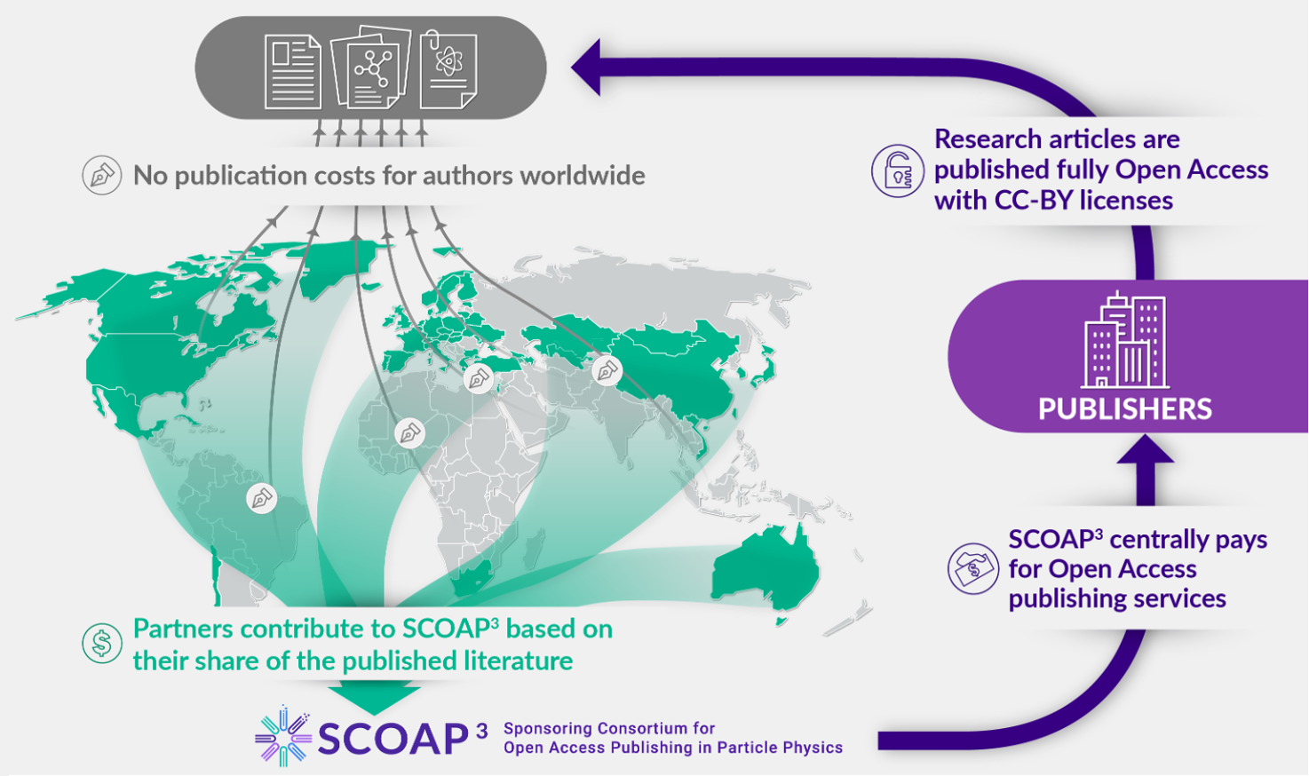
SCOAP³ – How does it work?

Slide 7
Calculating equitable partner contributions, i.e. “Fair Share”
Principles
Relative fraction of authorship of HEP articles
Special case: 10% of authors affiliated with two or more institutions in different countries
Additional allowance
of 10% of the SCOAP³ budget for countries that cannot be reasonably expected to contribute
If article has more than one author
pro-rata share
If one of multiple author affiliations
is CERN
CERN
Total number of signatures of the country
Total number of signatures globally
If one of multiple author affiliations is
a HEP laboratory
Host country of laboratory
Countries of remaining multiple-affiliation cases
Highest
GDP PPP
E.g.: L. Pavarotti (IT), W.A. Mozart (GR, AT), G. Gershwin (USA, CERN) → 1/3 IT; 1/3 AT; 1/3 CERN

Slide 8
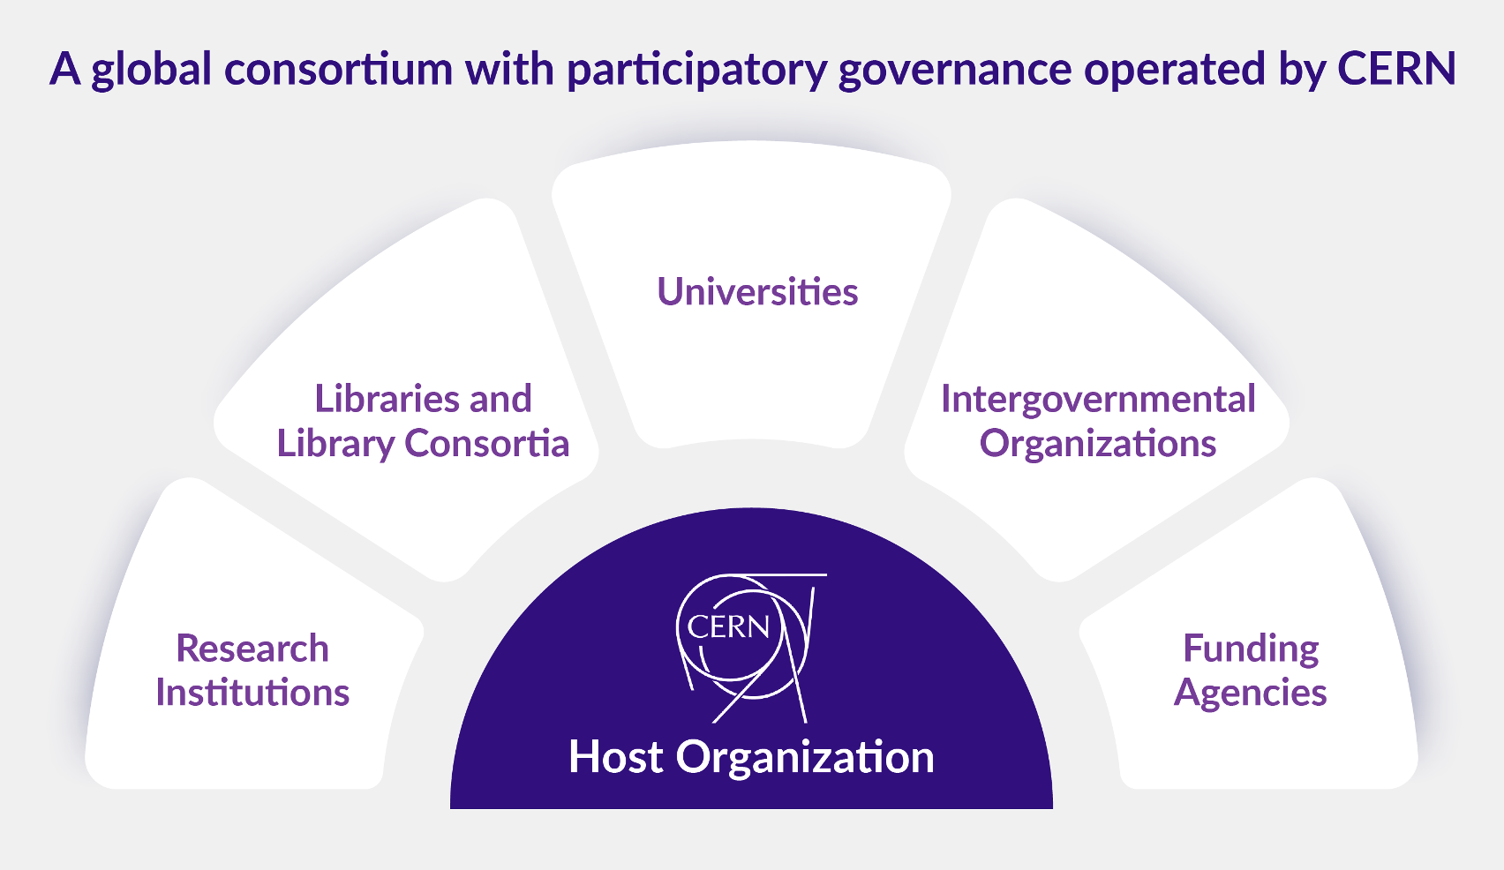
SCOAP³ Governance

Slide 9
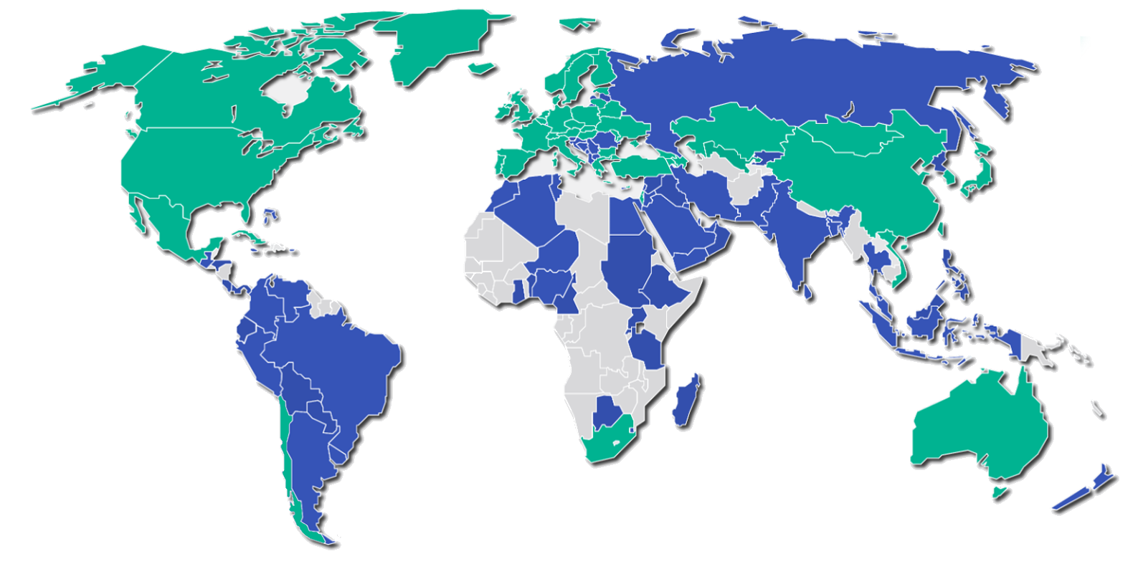
Achieving research communication in HEP as a global public good

Slide 10
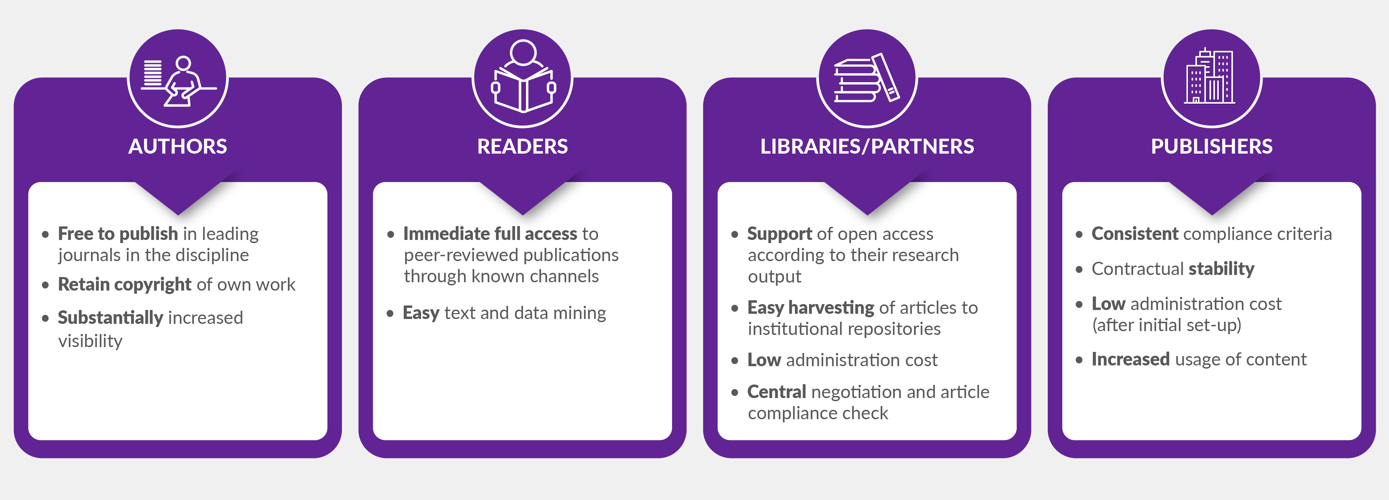
Who benefits from SCOAP³?

Slide 11
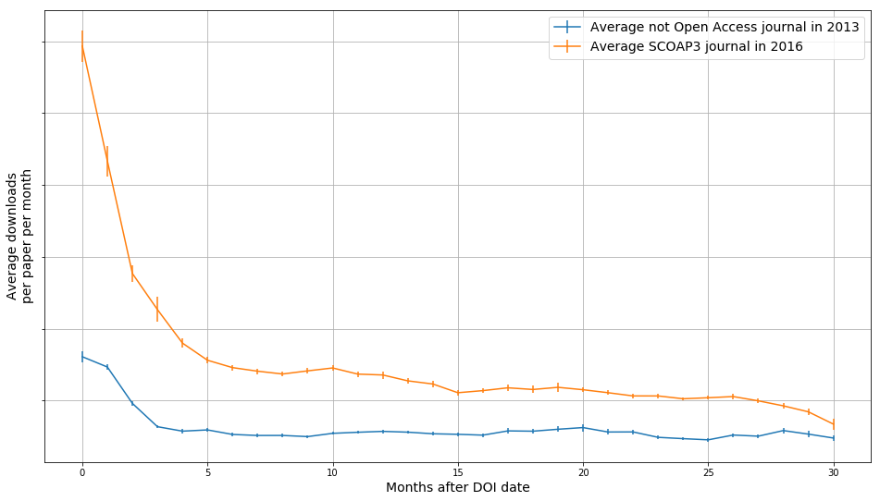
SCOAP³ demonstrating positive effect of Open Access
2013: journals before SCOAP³
2016: journals after SCOAP³
Average downloads/paper/month
After SCOAP³
Before SCOAP³
Months after DOI minting
Downloads 3Q13, 4Q13, 1Q16, 2Q16 on publishers’ platforms, 50k non-Open Access articles and 8k Open Access articles, Elsevier: Phys.Lett.B, Nucl.Phys.B; Springer: Eur. Phys. J. C, JHEP

Slide 12
Proven collaborative OA approach paved the way for many other Diamond OA initiatives
“I have always been very impressed by the pioneer work of CERN in the field of Open Access. SCOAP³ served as a major source of inspiration when I developed Plan S and I am extremely grateful to Salvatore, Eckhard and Alex for their input and advice.
Plan S which is all about accelerating the transition to full and immediate Open Access to scientific publications, prescribes that the author should retain the copyright, a CC-BY type license should apply and that in case of an APC, the costs will be borne by the Funder. Publication in hybrid journals is not allowed under the plan. By respecting these conditions, SCOAP³ and its repository function in line with Plan S.”
Robert-Jan Smits (former OA Envoy of the European Commission)

Slide 13










First 10 years (2014-2023): 62,560 articles funded…
Publisher | Journal | Articles
 | Physical Review C | 516
 | Physical Review D | 13,076
 | Physical Review Letters | 8,263
 | Nuclear Physics B | 3,060
 | Physics Letters B | 8,263
 | Advances in High Energy Physics | 1,120
 | Chinese Physics C | 740
 | New Journal of Physics | 25
 | J. Cosm. and Astroparticle Physics | 654
 | Acta Physica Polonica B | 165
 | Progress of Theor. and Exp. Physics | 841
 | European Physical Journal C | 9,500
 | J. High Energy Physics | 22,949
Joined in
2018
until
2017

Slide 14
…at stable prices for SCOAP³ partners
+54%
+38%
+24%
+7%

Slide 15
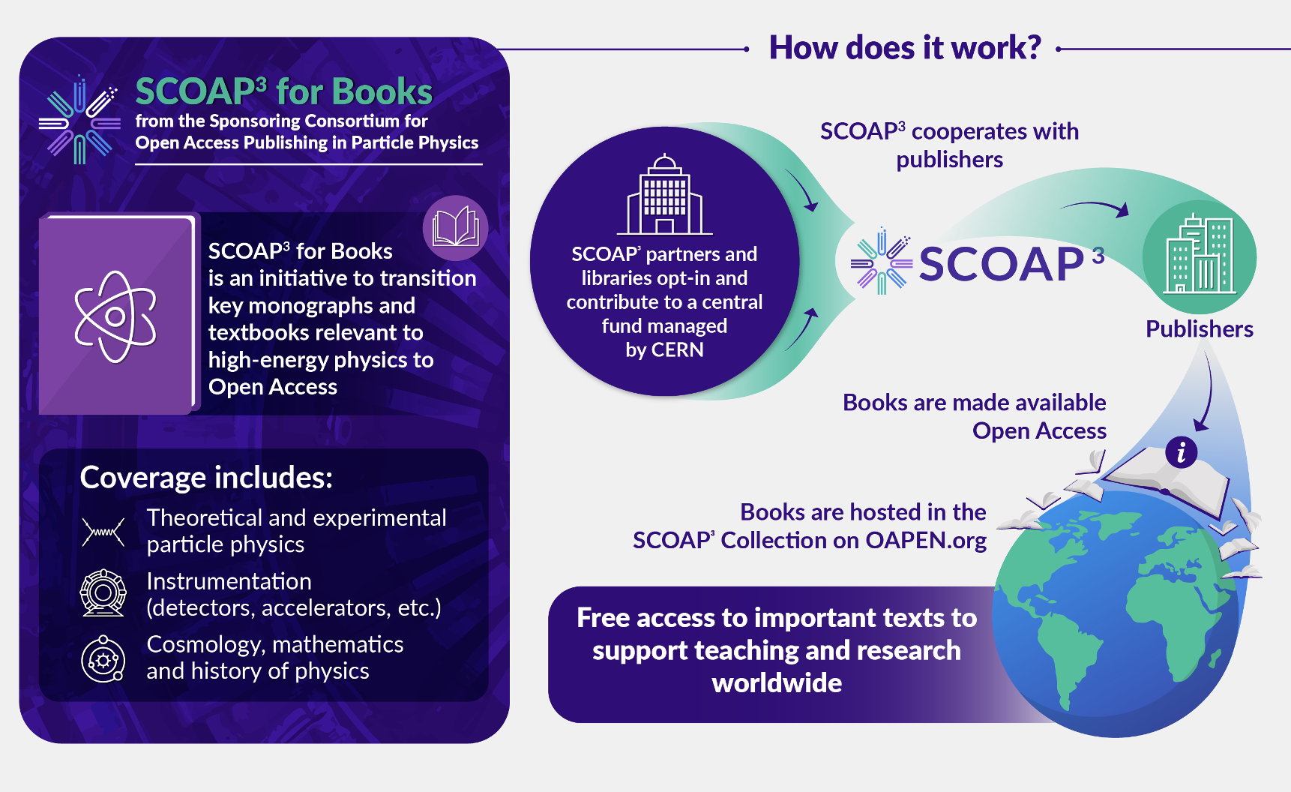
SCOAP³ for Books – going beyond journal articles

Slide 16
Huge impact on the usage (downloads)

Slide 17
Huge impact on geographic distribution
Converted to OA

Slide 18
THANK YOU
Any Questions or Comments?
alexander.kohls@cern.ch
https://scoap3.org

